Slide 1
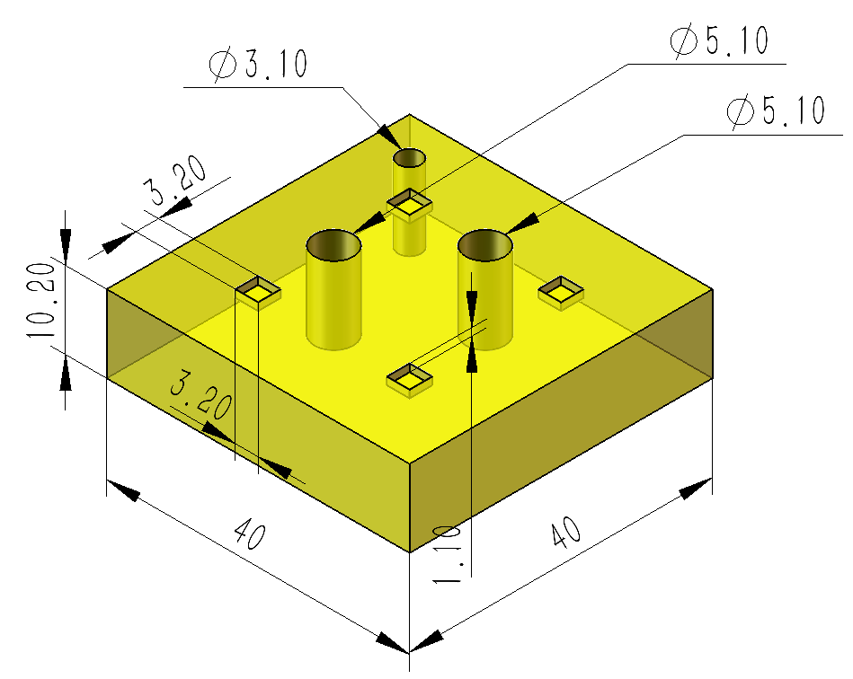
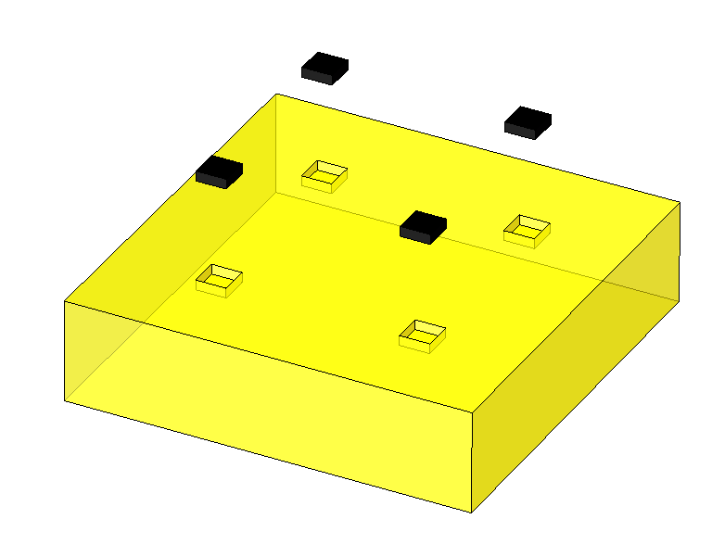
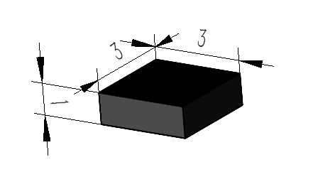
One cell
Cell:
One cell consists of 4 SiPMs and one glass scintillator
Corner glass scintillator: there are four pyramid-shaped holes to locate SiPMs
SiPM

Slide 2
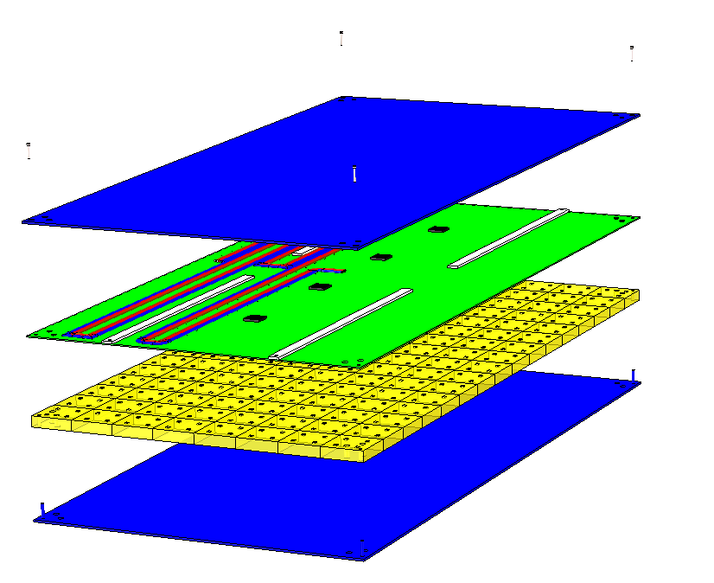
One box
4-M1.6 bolts: Connecting the components of each box
Upper cover plate
2.2mm gasket: Playing a role of buffer layer to prevent ASIC chip from being compressed by upper cover plate
ASIC chip：One chip corresponds to 32 or 28 channels.
One channel corresponds to one glass scintillator.
PCB plate: gasket is glued on it
Cell：128/112/96 cells in one box, SiPM is welded on PCB plate
Bottom cover plate

Slide 3
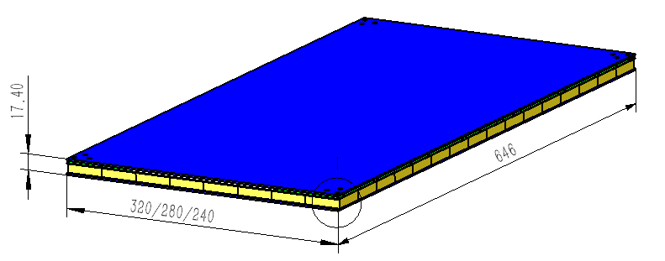
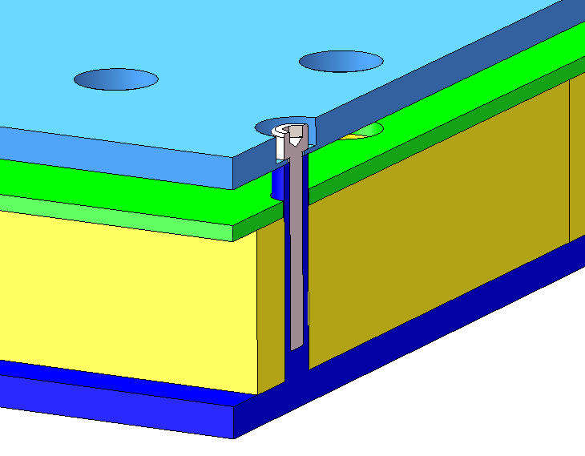
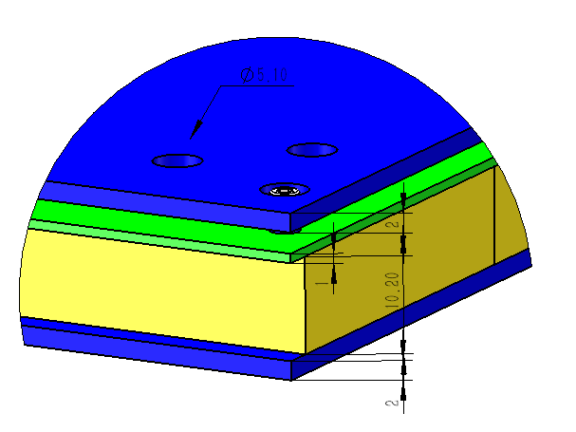
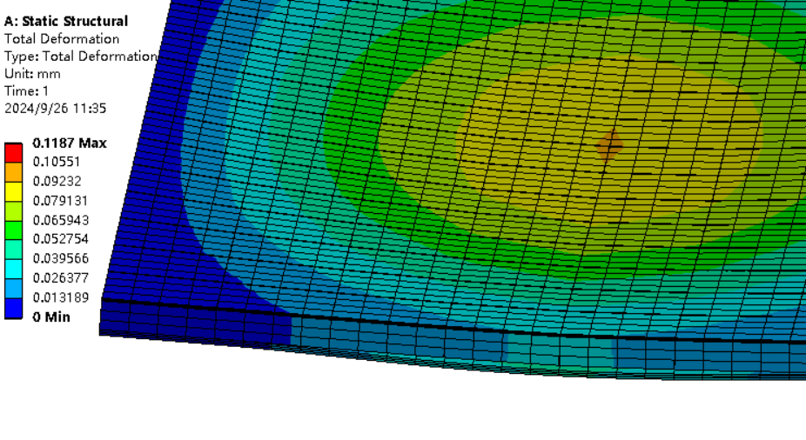
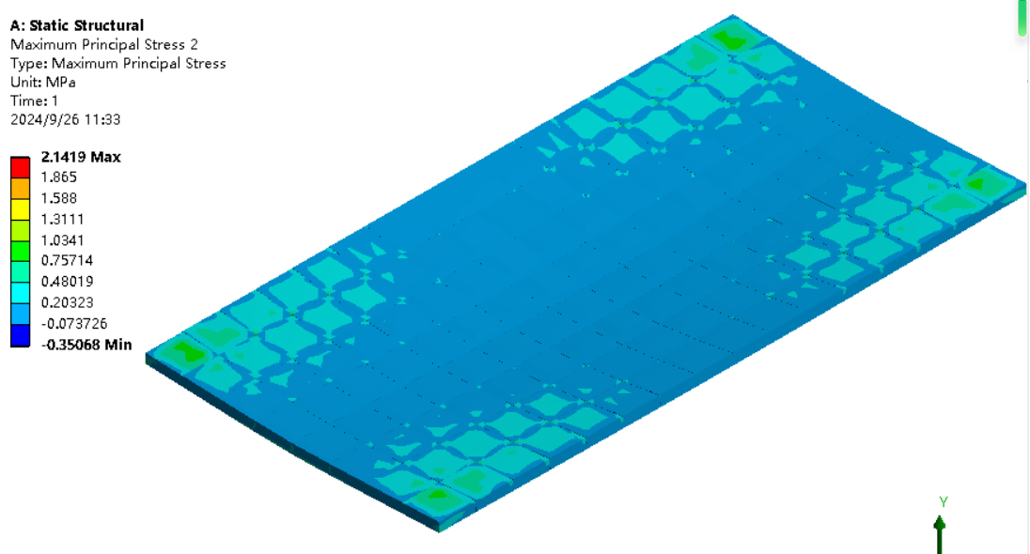
One box
counterbore
M1.6 bolts
Two φ5.1 holes：
Connecting absorber layer
Inside thread pin
Maximum principal stress 2.1MPa of GS
Maximum deformation
0.11mm
Gravity condition during moving

Slide 4
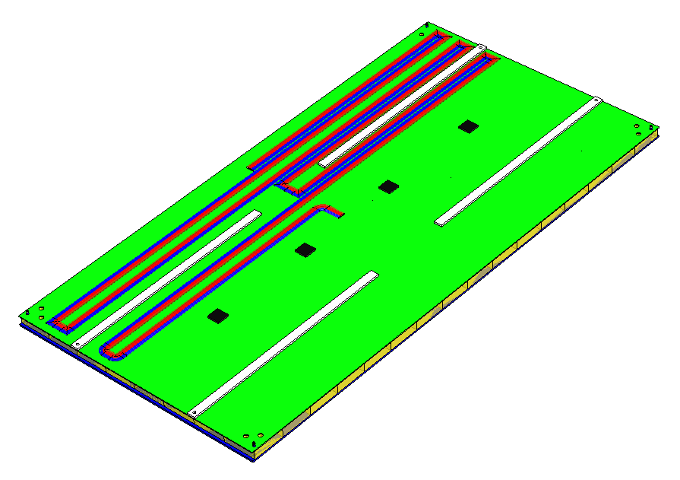
Cable of one box
5 cables of each box
Each of them is 2mm in diameter
Five cables needs to be at the same side of box
Cables are located between upper cover plate and PCB plate

Slide 5
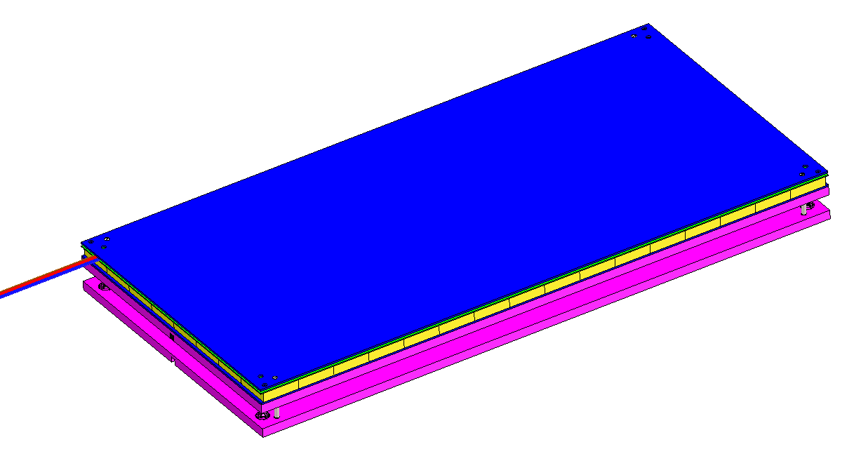
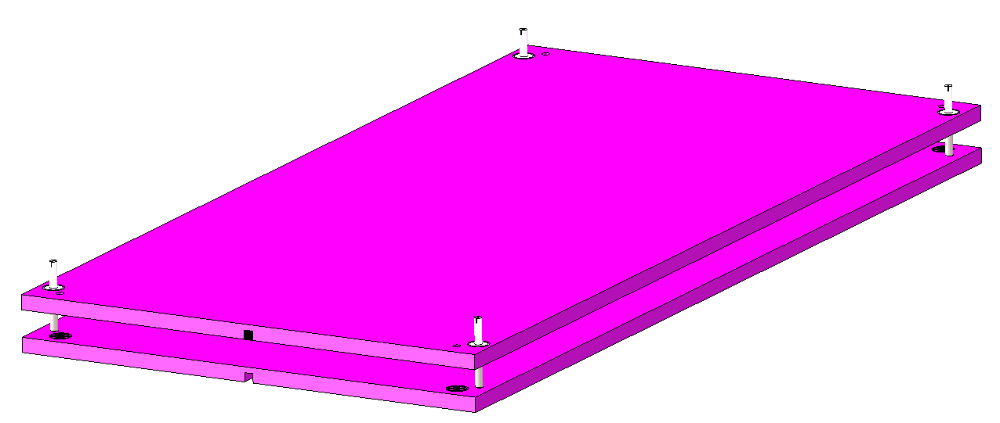
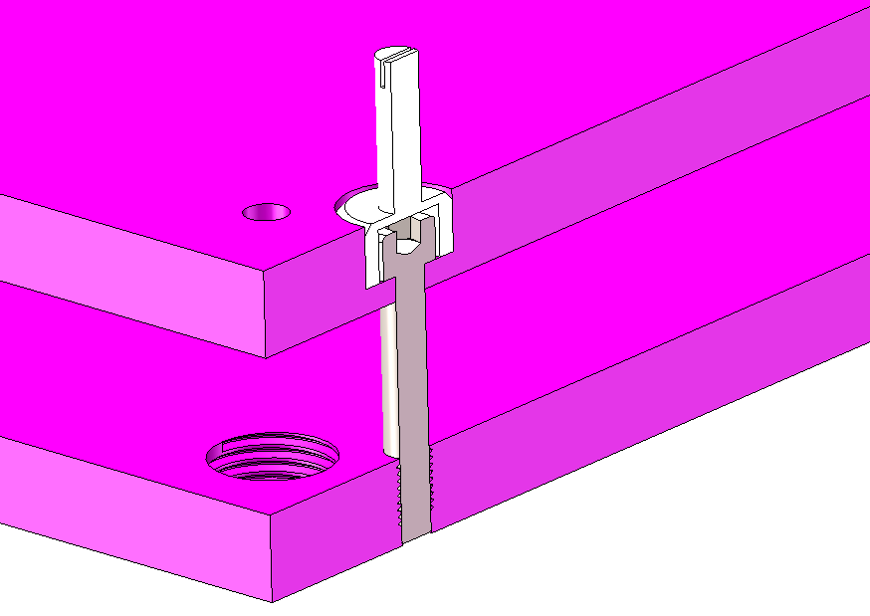
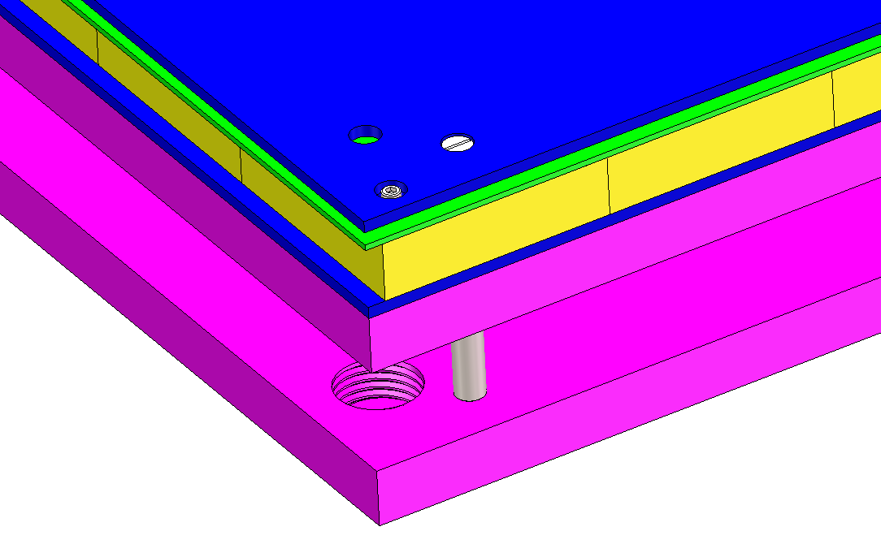
How to install one box
4 locating pins
Φ5 bar
pin
M14 thread
4-M5 bolts used to fix two neighbor absorber layer
Positioning the box

Slide 6
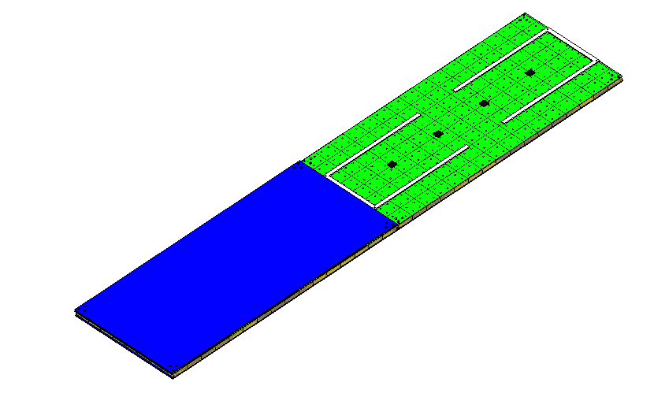
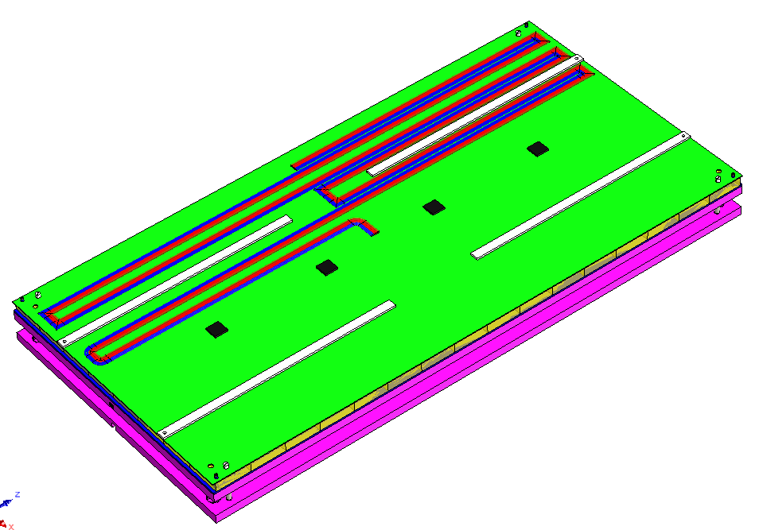
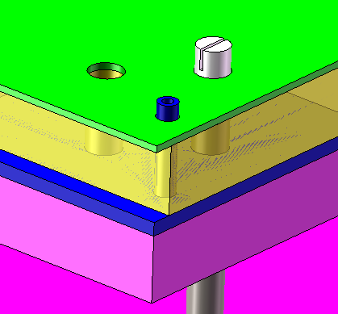
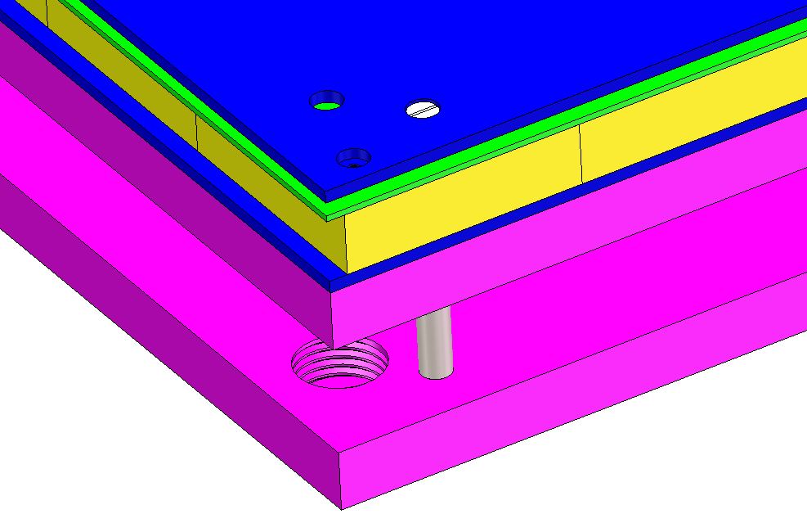
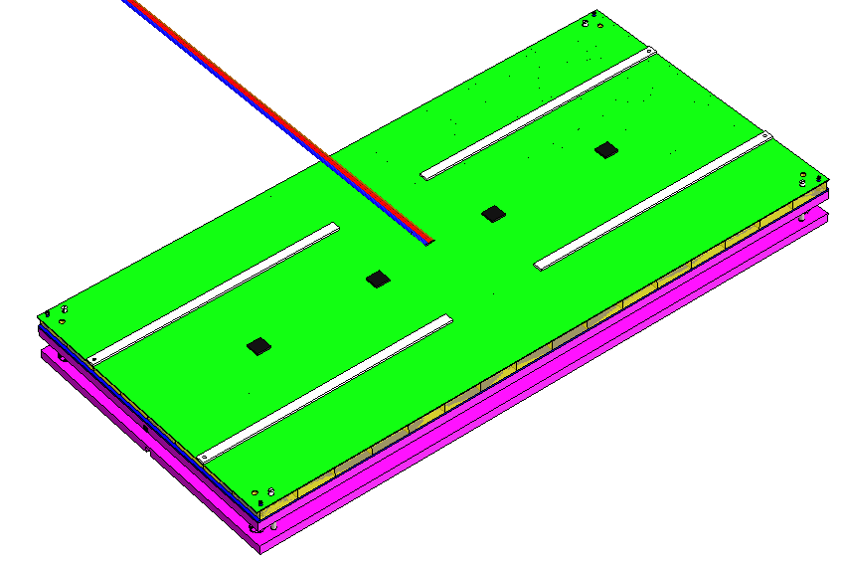
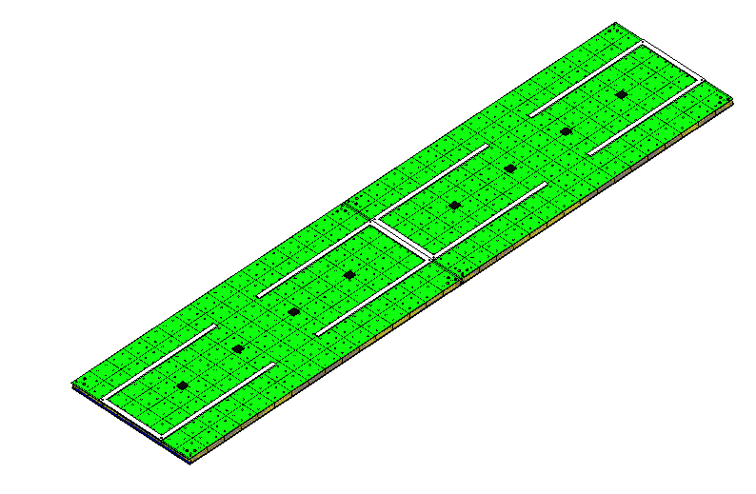
How to install next box
Positioning with pins
Removing four
M1.6 bolts
Removing the upper cover plate and make the cables straight
Removing the upper cover plate and make the cables straight

Slide 7
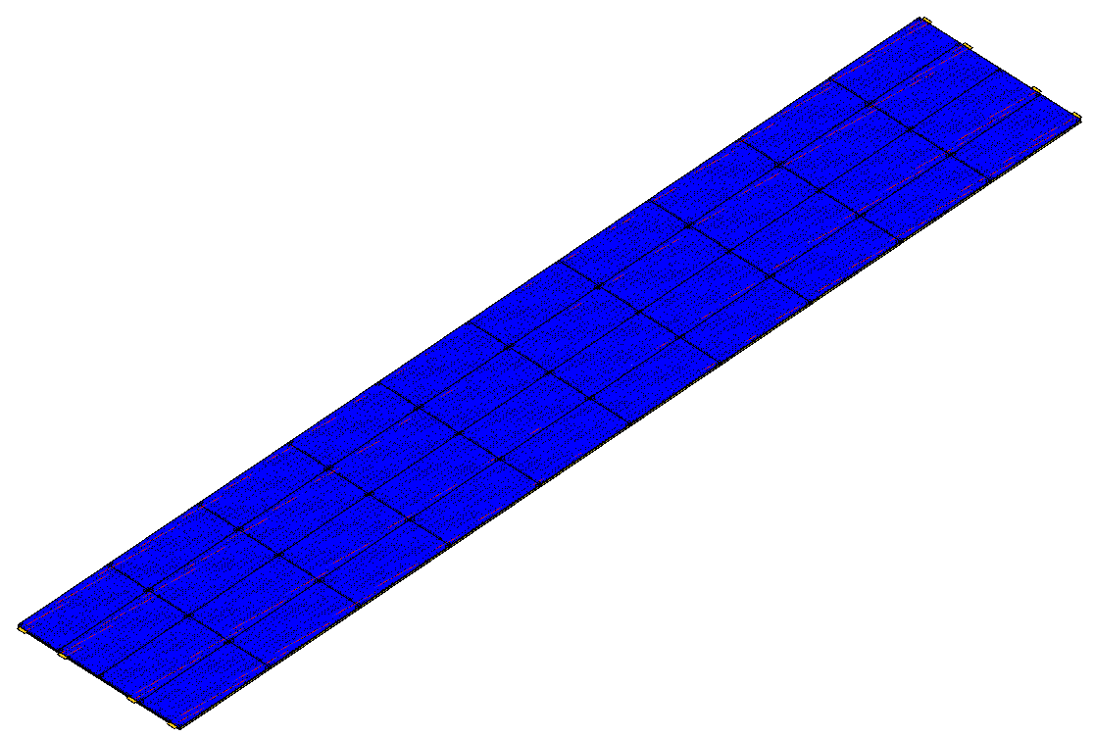
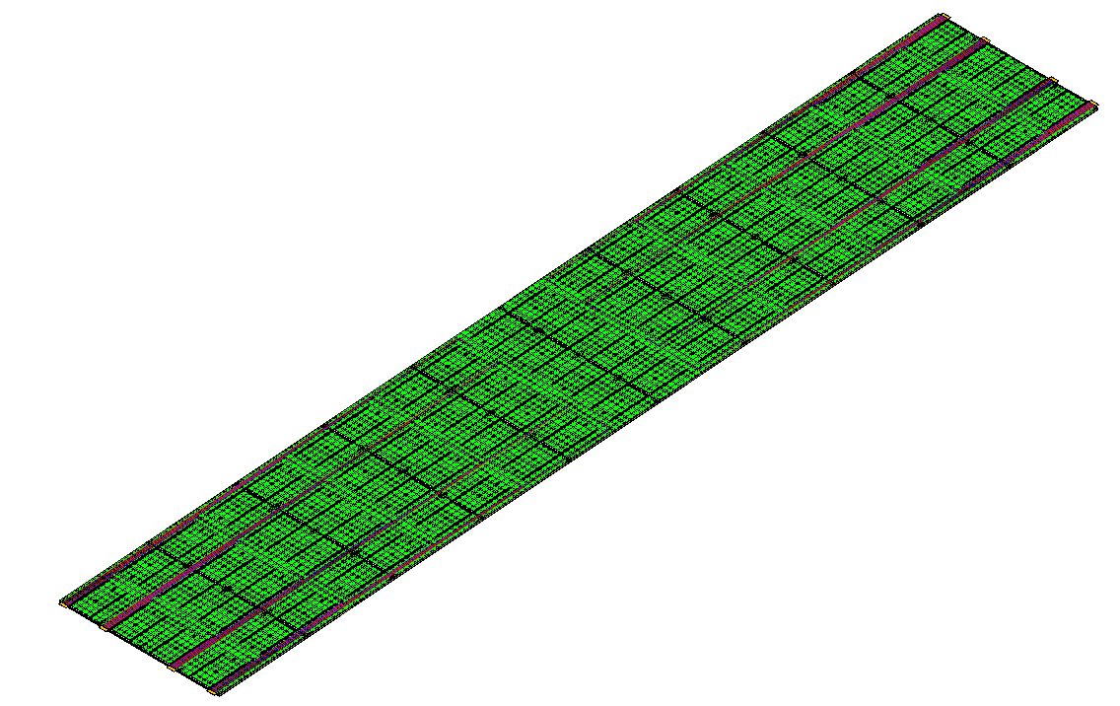
How to install one layer
1-10
1-9
1-5
1-8
1-4
1-3
1-7
②
1-6
1-2
1-1
③
④
48th layer as an example
Final situation of one layer
Step continuing:
After finishing installation of 1-1 to 1-5 cables need to be bended and arranged first time
After finishing installation of 1-6 to 1-10 cables need to be bended and arranged second time
The installation sequence for each region is like this picture
Boxes can be installed in parallel for all 4 regions

Slide 8
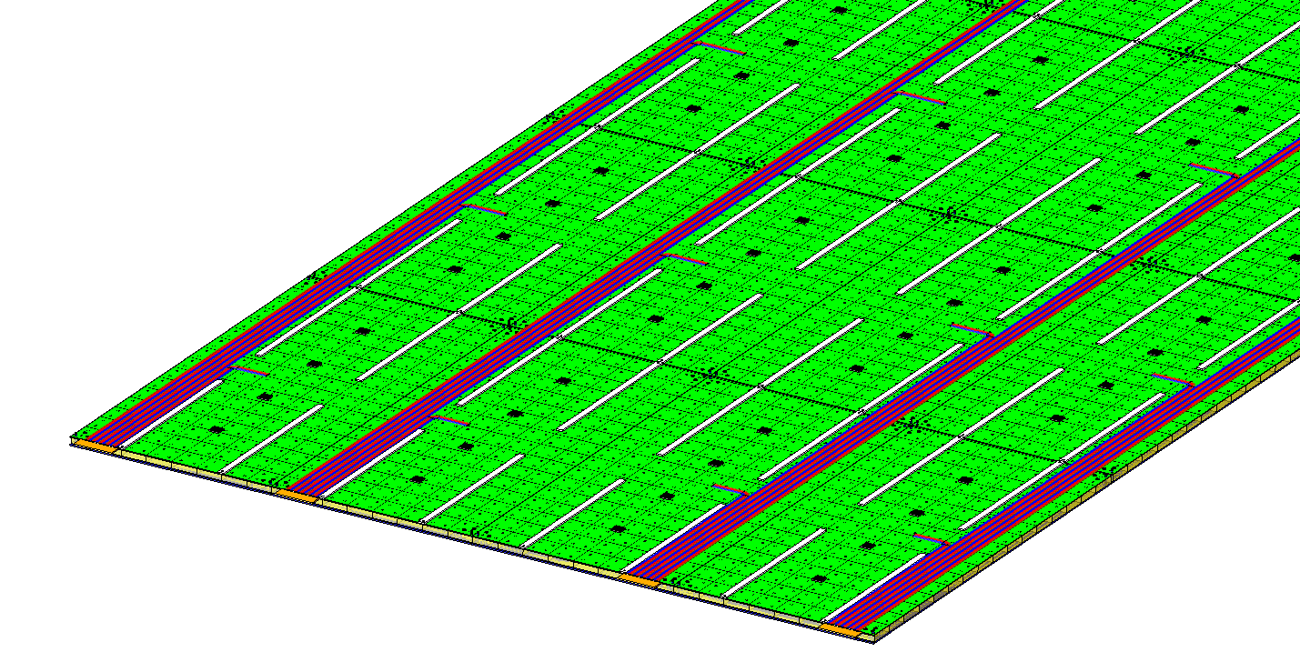
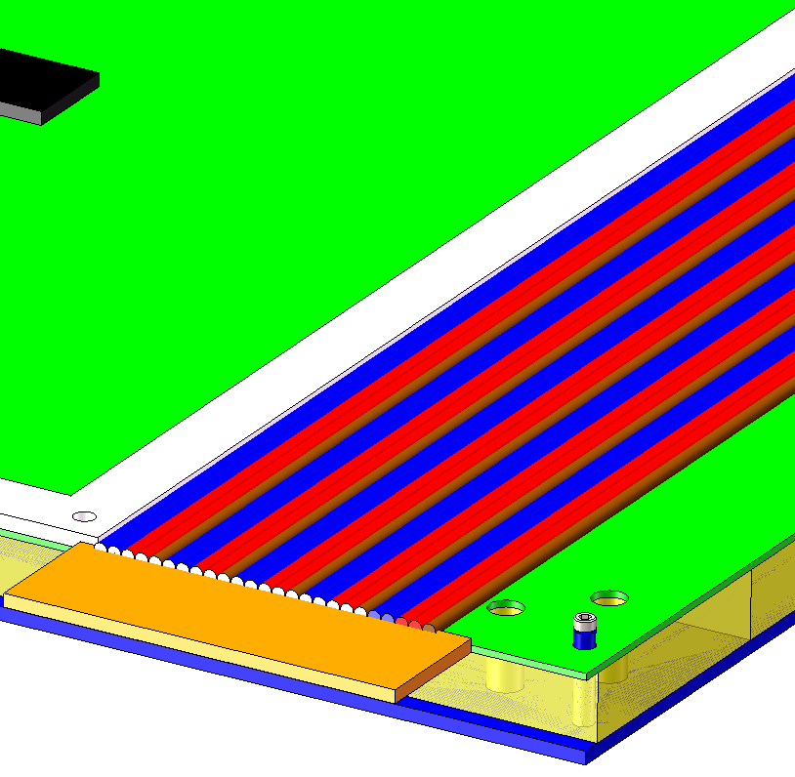
How to install one layer
1-10
1-9
1-5
1-8
1-4
1-3
1-7
1-6
1-2
1-1
③
Administration board
There are 8 or 6 administration boards for each layer, each boards is 20mm*60mm
The input of one board is 25 cables and output of one board is 2 cables and one fiber

Slide 9
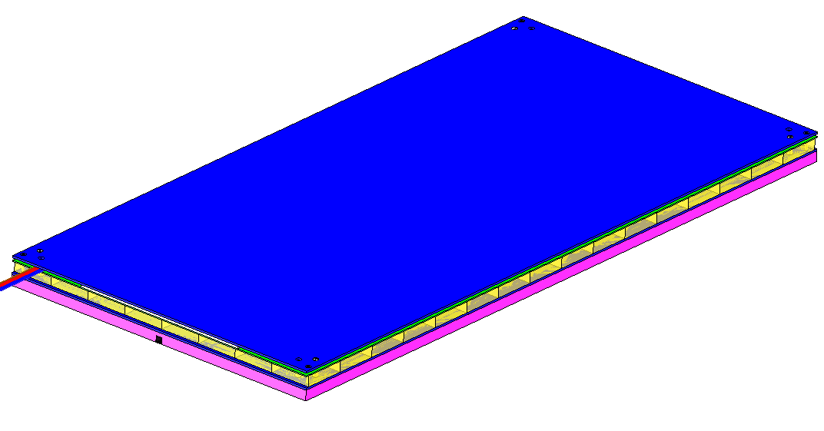
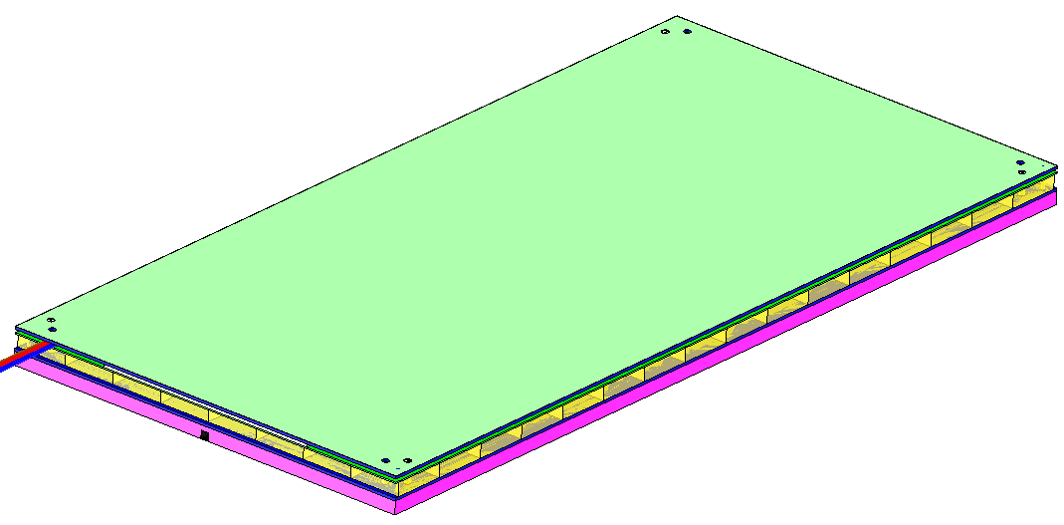
How to install the next layer
One box with lower absorber
Installing all the upper cover plate and M1.6 bolts
Add 0.2mm thermal conductive silicone on the top surface

Slide 10
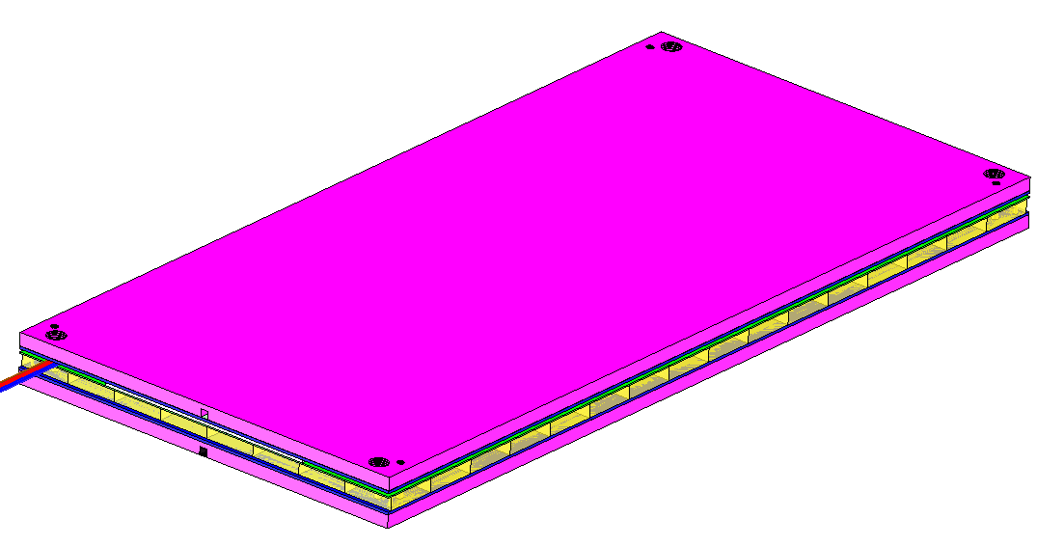
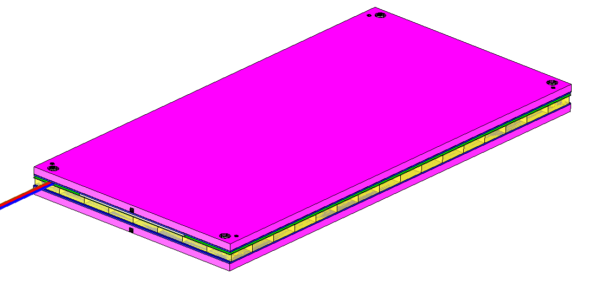
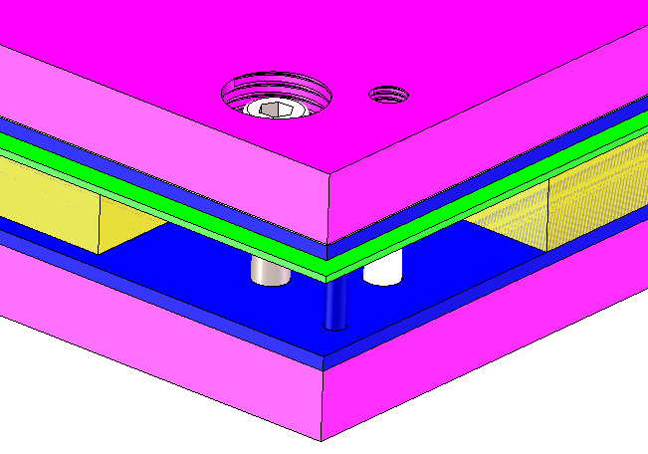
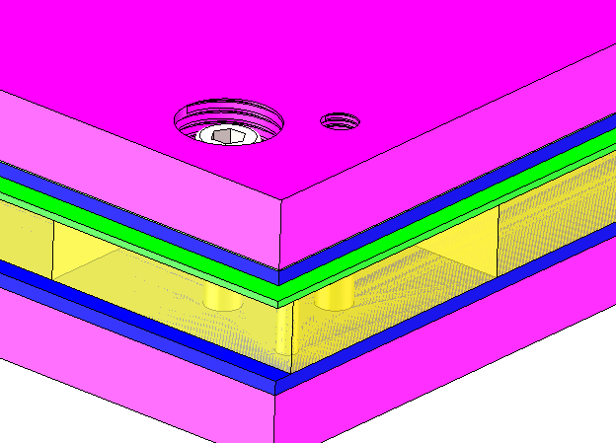
How to install the next layer
Using four M5 bolts to connect the two neighbor absorber layer through the box
Installing the upper absorber layer
Hide the corner
Glass scintillator
M5 bolts
Pin

Slide 11
Statistic
 | Box quantities/wedge | Glass quantities/ wedge
1st ~3rd layer | 30/layer | 3200/layer
4th ~7th layer | 30/layer | 3360/layer
8th~10th layer | 30/layer | 3520/layer
11th~14th layer | 30/layer | 3680/layer
15th~18th layer | 30/layer | 3840/layer
19th~22nd layer | 40/layer | 4000/layer
23rd~25th layer | 40/layer | 4160/layer
 | Box quantities/wedge | Glass quantities/ wedge
26th ~29th layer | 40/layer | 4320/layer
30th ~33rd layer | 40/layer | 4480/layer
34th~36th layer | 40/layer | 4640/layer
37th~40th layer | 40/layer | 4800/layer
41st~44th layer | 40/layer | 4960/layer
45th~48th layer | 40/layer | 5120/layer
Total | 1740 | 200800

Slide 12
Statistic
 | Cable quantities in layer/wedge | Cable quantities at end/ wedge
1st ~3rd layer | 150/layer | 18/layer
4th ~7th layer | 150/layer | 18/layer
8th~10th layer | 150/layer | 18/layer
11th~14th layer | 150/layer | 18/layer
15th~18th layer | 150/layer | 18/layer
19th~22nd layer | 200/layer | 24/layer
23rd~25th layer | 200/layer | 24/layer
 | Box quantities/wedge | Cable quantities at end/ wedge
26th ~29th layer | 200/layer | 24/layer
30th ~33rd layer | 200/layer | 24/layer
34th~36th layer | 200/layer | 24/layer
37th~40th layer | 200/layer | 24/layer
41st~44th layer | 200/layer | 24/layer
45th~48th layer | 200/layer | 24/layer
Total | 8700 | 1044
There are 27840 boxes in total, 3212800 glass scintillator
There are 139200 cables in the layer in total, 16704 cables at end in total

Slide 13
加两页，一页box安装，一页外部走线

