Slide 1

Serendipitous Syzygies of
Scattering Amplitudes
David A. Kosower
Institut de Physique Théorique, CEA–Saclay
work with Sebastian Pögel (PSI, Switzerland)
[2505.14857]
NOPP, IHEP, Beijing
July 19, 2025

Slide 2

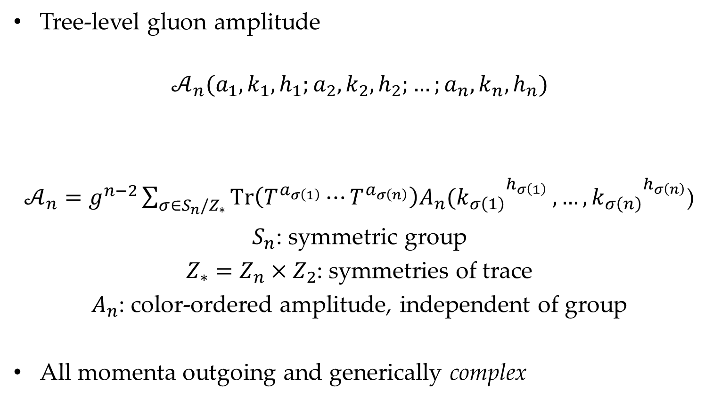
Scattering Amplitudes in Yang–Mills
Tree-level gluon amplitude
$$𝒜_{n}(a_{1},k_{1},h_{1};a_{2},k_{2},h_{2};…;a_{n},k_{n},h_{n})$$
$𝒜_{n}=g^{n−2}\sum_{σ∈S_{n}/Z_{∗}}{Tr\left(T^{a_{σ\left(1\right)}}⋯T^{a_{σ\left(n\right)}}\right)A_{n}({k_{σ\left(1\right)}}_{}^{h_{σ\left(1\right)}}},…,{k_{σ\left(n\right)}}_{}^{h_{σ\left(n\right)}}$)
$S_{n}$: symmetric group
$Z_{∗}=Z_{n}×Z_{2}$: symmetries of trace
$A_{n}$: color-ordered amplitude, independent of group
All momenta outgoing and generically complex
Color index
Momentum
Helicity: $±$

Slide 3
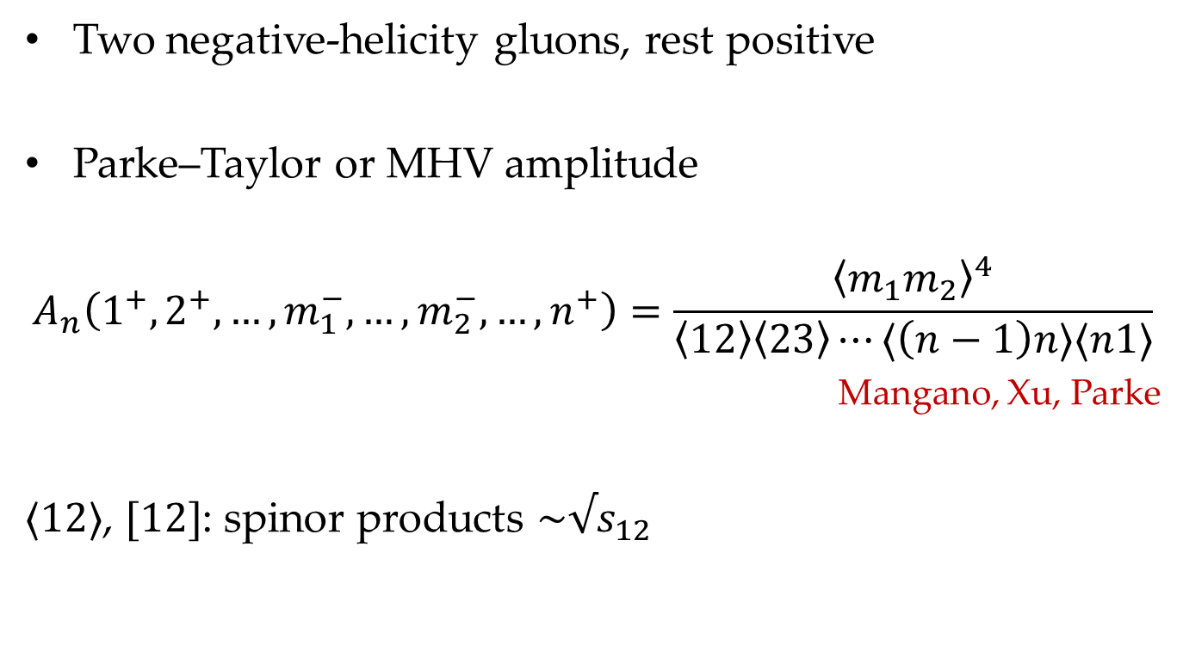
Example
Two negative-helicity gluons, rest positive
Parke–Taylor or MHV amplitude
$$A_{n}\left(1^{+},2^{+},…,m_{1}^{−},…,m_{2}^{−},…,n^{+}\right)=\frac{{\left\langle m_{1}m_{2}\right\rangle }^{4}}{\left\langle 12\right\rangle \left\langle 23\right\rangle ⋯⟨\left(n−1\right)n⟩⟨n1⟩}$$
Mangano, Xu, Parke
$⟨12⟩$, $[12]$: spinor products $\sim √s_{12}$

Slide 4
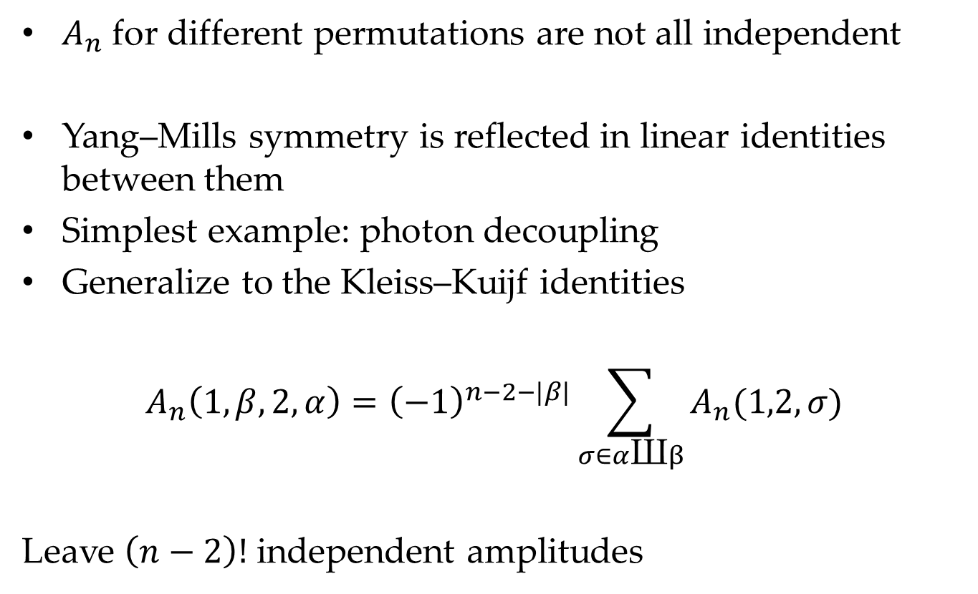
Symmetries of Scattering Amplitudes
$A_{n}$ for different permutations are not all independent
Yang–Mills symmetry is reflected in linear identities between them
Simplest example: photon decoupling
Generalize to the Kleiss–Kuijf identities
$$A_{n}\left(1,β,2,α\right)={\left(−1\right)}^{n−2−|β|}\sum_{σ∈α\text{Ш}β}{A_{n}(1,2,σ)}$$
Leave $\left(n−2\right)!$ independent amplitudes

Slide 5
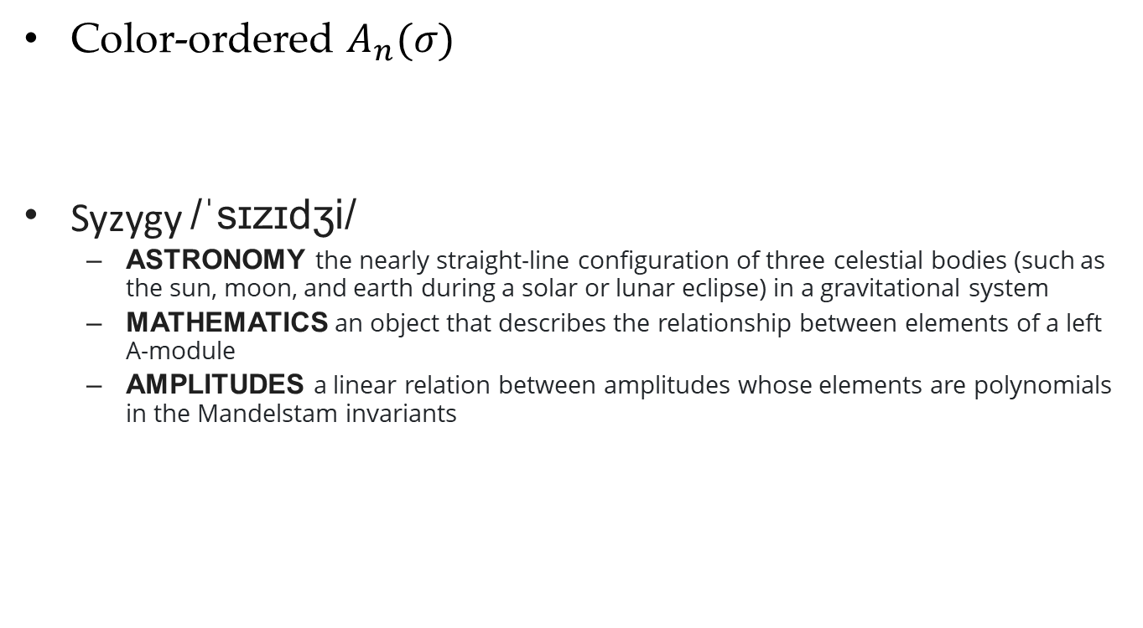
Syzygies of Scattering Amplitudes
Color-ordered $A_{n}(σ)$
Syzygy /ˈsɪzɪdʒi/
  Astronomy the nearly straight-line configuration of three celestial bodies (such as the sun, moon, and earth during a solar or lunar eclipse) in a gravitational system
  MATHEMATICS an object that describes the relationship between elements of a left A-module
  AMPLITUDES a linear relation between amplitudes whose elements are polynomials in the Mandelstam invariants

Slide 6
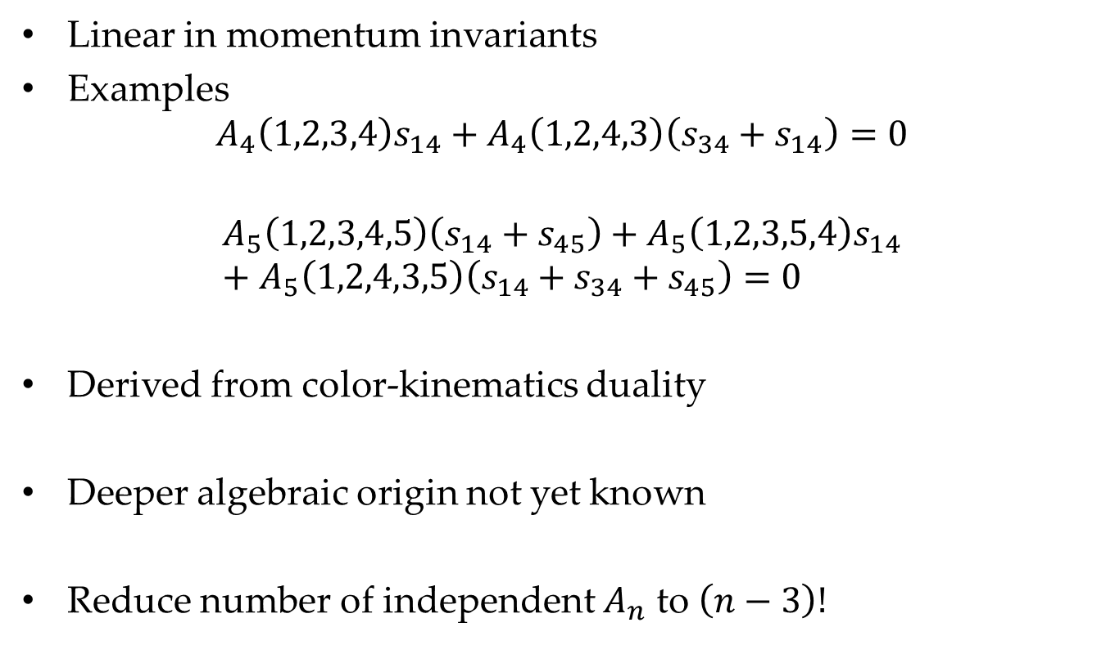
Bern–Carrasco–Johansson Identities
Linear in momentum invariants
Examples
$$A_{4}\left(1,2,3,4\right)s_{14}+A_{4}\left(1,2,4,3\right)\left(s_{34}+s_{14}\right)=0$$
$$A_{5}\left(1,2,3,4,5\right)\left(s_{14}+s_{45}\right)+A_{5}\left(1,2,3,5,4\right)s_{14}+A_{5}\left(1,2,4,3,5\right)\left(s_{14}+s_{34}+s_{45}\right)=0$$
Derived from color-kinematics duality
Deeper algebraic origin not yet known
Reduce number of independent $A_{n}$ to $\left(n−3\right)!$

Slide 7
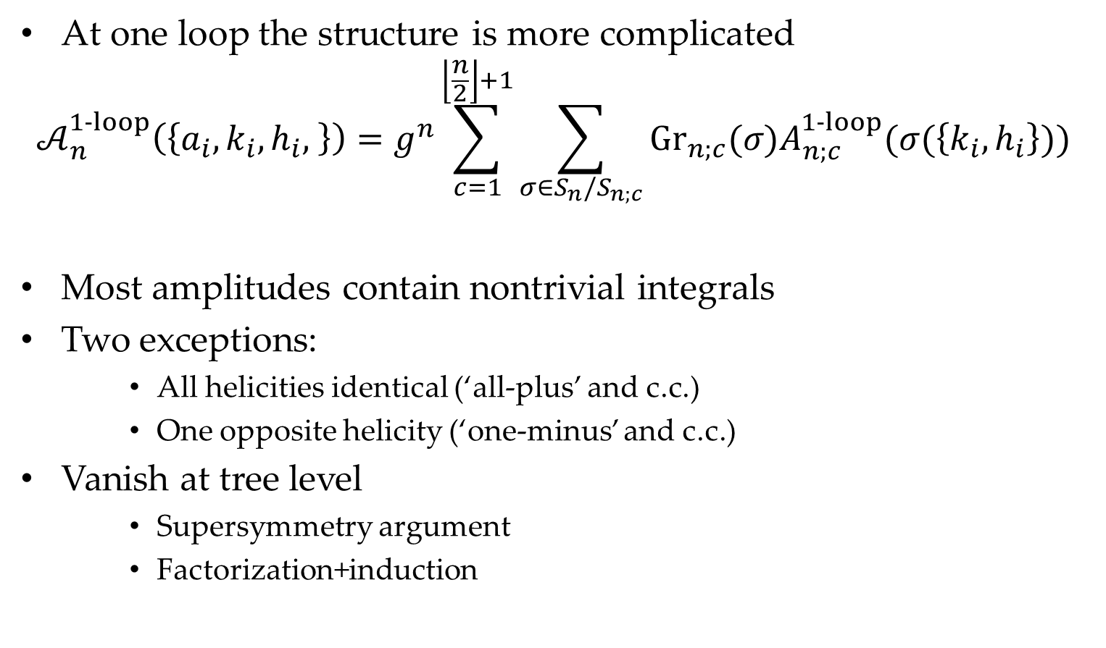
Syzygies of One-Loop Amplitudes
At one loop the structure is more complicated
$$𝒜_{n}^{1‑loop}\left(\left\{{a_{i},k}_{i},h_{i}, \right\}\right)=g^{n}\sum_{c=1}^{\left\lfloor \frac{n}{2}\right\rfloor +1}{\sum_{σ∈S_{n}/S_{n;c}}{{Gr}_{n;c}(σ)A_{n;c}^{1‑loop}(σ(\left\{k_{i},h_{i}\right\}))}}$$
Most amplitudes contain nontrivial integrals
Two exceptions:
    All helicities identical (‘all-plus’ and c.c.)
    One opposite helicity (‘one-minus’ and c.c.)
Vanish at tree level
    Supersymmetry argument
    Factorization+induction

Slide 8
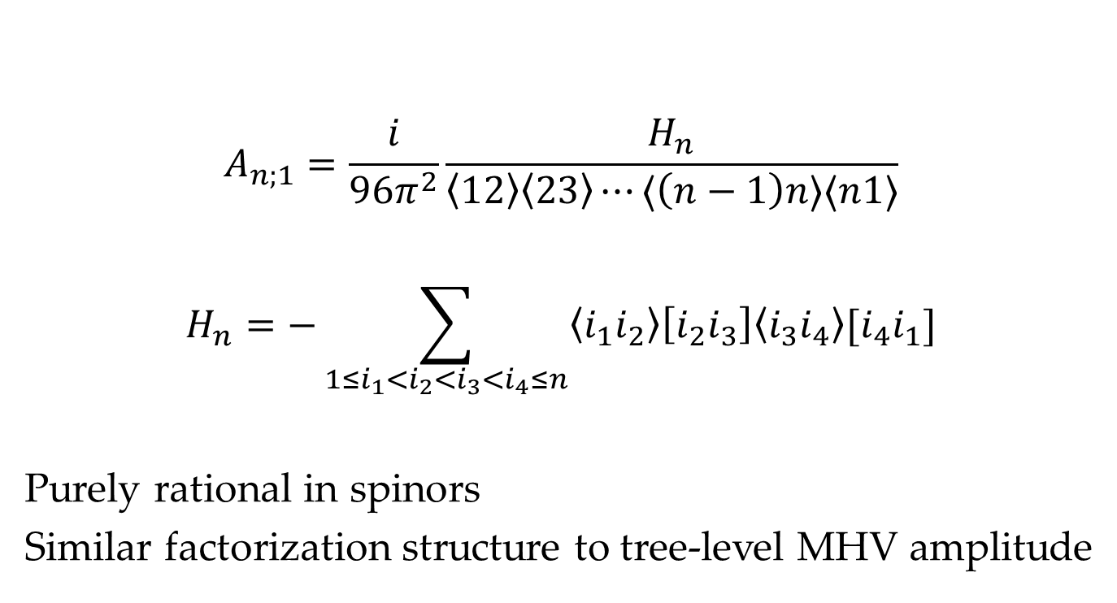
One-Loop All-Plus
$$A_{n;1}=\frac{i}{96π^{2}}\frac{H_{n}}{\left\langle 12\right\rangle \left\langle 23\right\rangle ⋯⟨\left(n−1\right)n⟩⟨n1⟩}$$
$$H_{n}=−\sum_{1≤i_{1}<i_{2}<i_{3}<i_{4}≤n}{\left\langle i_{1}i_{2}\right\rangle \left[i_{2}i_{3}\right]\left\langle i_{3}i_{4}\right\rangle [i_{4}i_{1}]}$$
Purely rational in spinors
Similar factorization structure to tree-level MHV amplitude

Slide 9


Syzygies of One-Loop Amplitudes
  Identities relate all $A_{n;c}$ to $A_{n;1}$: helicity-independent
  At first glance, no identities between different $A_{n;1}$

Slide 10
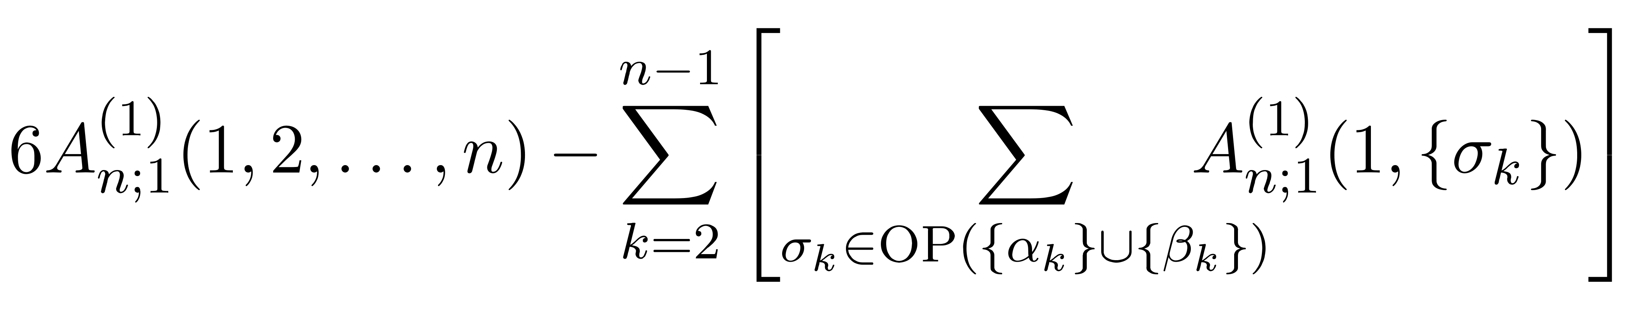
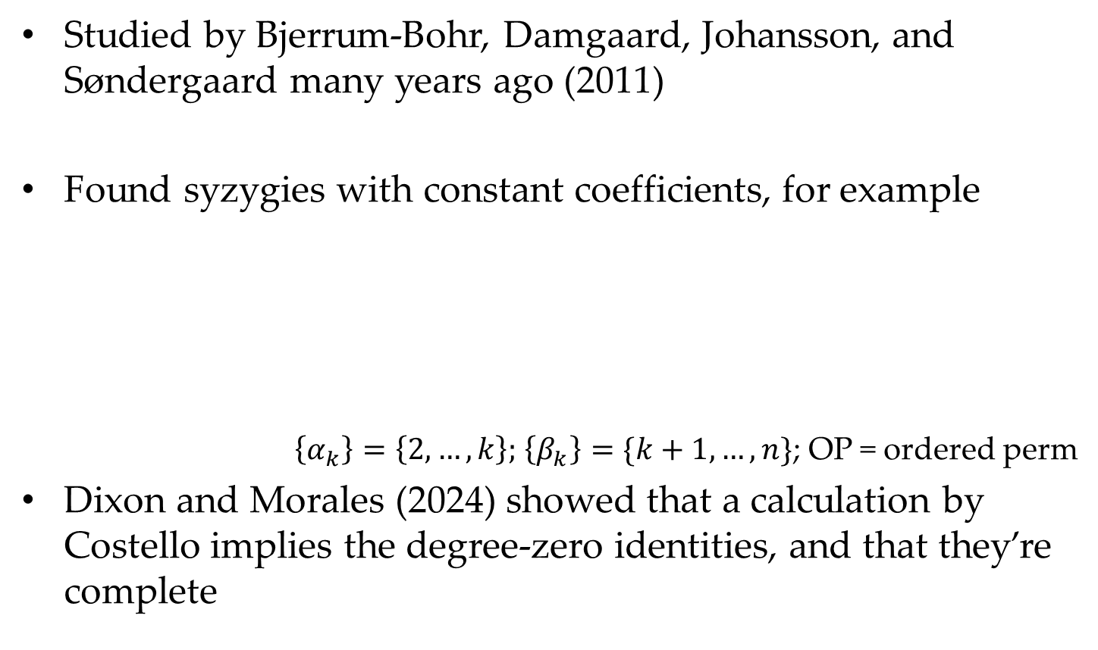
Syzygies of All-Plus Amplitudes
Studied by Bjerrum-Bohr, Damgaard, Johansson, and Søndergaard many years ago (2011)
Found syzygies with constant coefficients, for example
$\left\{α_{k}\right\}=\left\{2,…,k\right\};$ $\left\{β_{k}\right\}=\{k+1,…,n\}$; OP = ordered perm
Dixon and Morales (2024) showed that a calculation by Costello implies the degree-zero identities, and that they’re complete
0 =

Slide 11

Syzygies of All-Plus Amplitudes
How many identities did they find?
$\frac{\left(n−1\right)!}{2}−\left[\begin{matrix}n−1 \\ 3\end{matrix}\right]$
$n=5$: 6
$n=6$: 25
$n=7$: 135
Unsigned Stirling number of the first kind

Slide 12
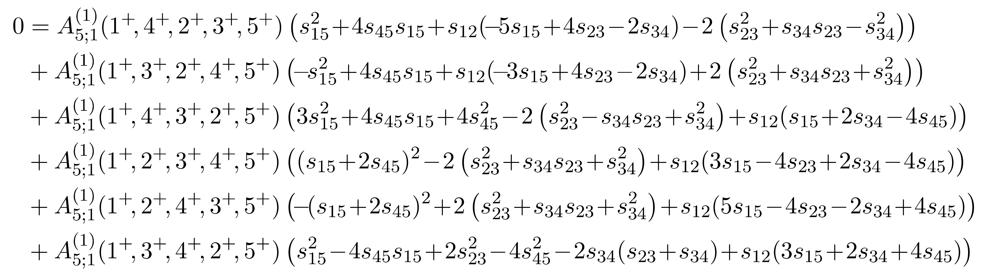

Syzygies of All-Plus Amplitudes
No syzygies of degree one here
Examples of syzygies of degree two from BBDJS
Four independent ones, reducing to two independent $A$s
32 independent ones at six points, leaving three independent $A$s
Is there more to the story?

Slide 13
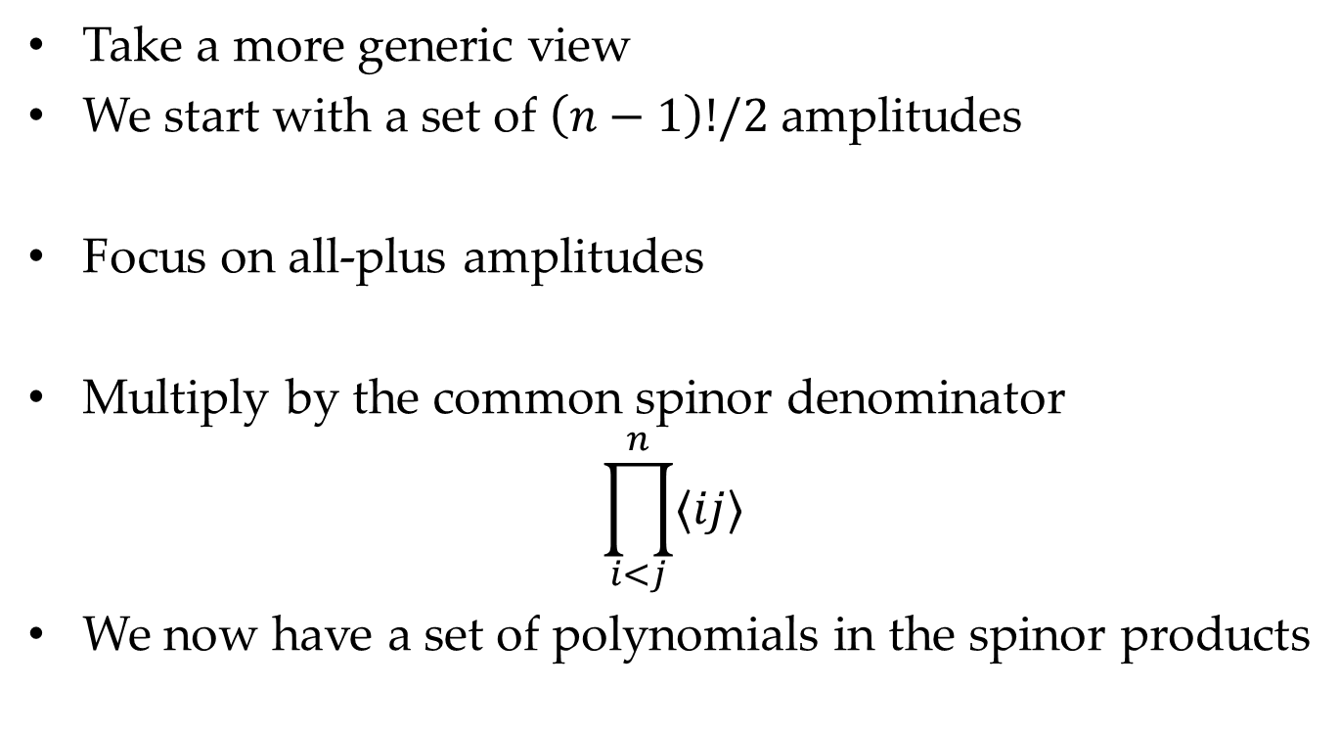
Syzygies Are Ubiquitous
Take a more generic view
We start with a set of $\left(n−1\right)!/2$ amplitudes
Focus on all-plus amplitudes
Multiply by the common spinor denominator
$$\prod_{i<j}^{n}{⟨ij⟩}$$
We now have a set of polynomials in the spinor products

Slide 14
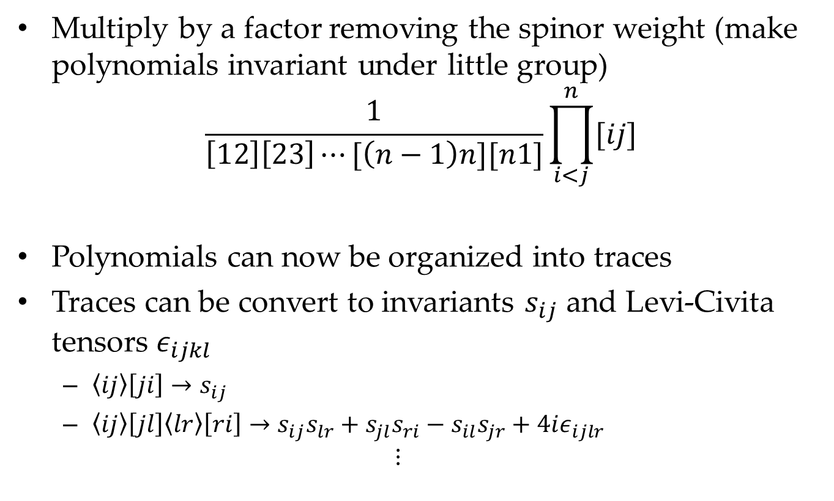
Syzygies Are Ubiquitous
Multiply by a factor removing the spinor weight (make polynomials invariant under little group)
$$\frac{1}{\left[12\right]\left[23\right]⋯[\left(n−1\right)n][n1]}\prod_{i<j}^{n}{[ij]}$$
Polynomials can now be organized into traces
Traces can be convert to invariants $s_{ij}$ and Levi-Civita tensors $ε_{ijkl}$
  $\left\langle ij\right\rangle \left[ji\right]→s_{ij}$
  $\left\langle ij\right\rangle \left[jl\right]\left\langle lr\right\rangle \left[ri\right]→s_{ij}s_{lr}+s_{jl}s_{ri}−s_{il}s_{jr}+4iε_{ijlr}$
  $$⋮$$

Slide 15
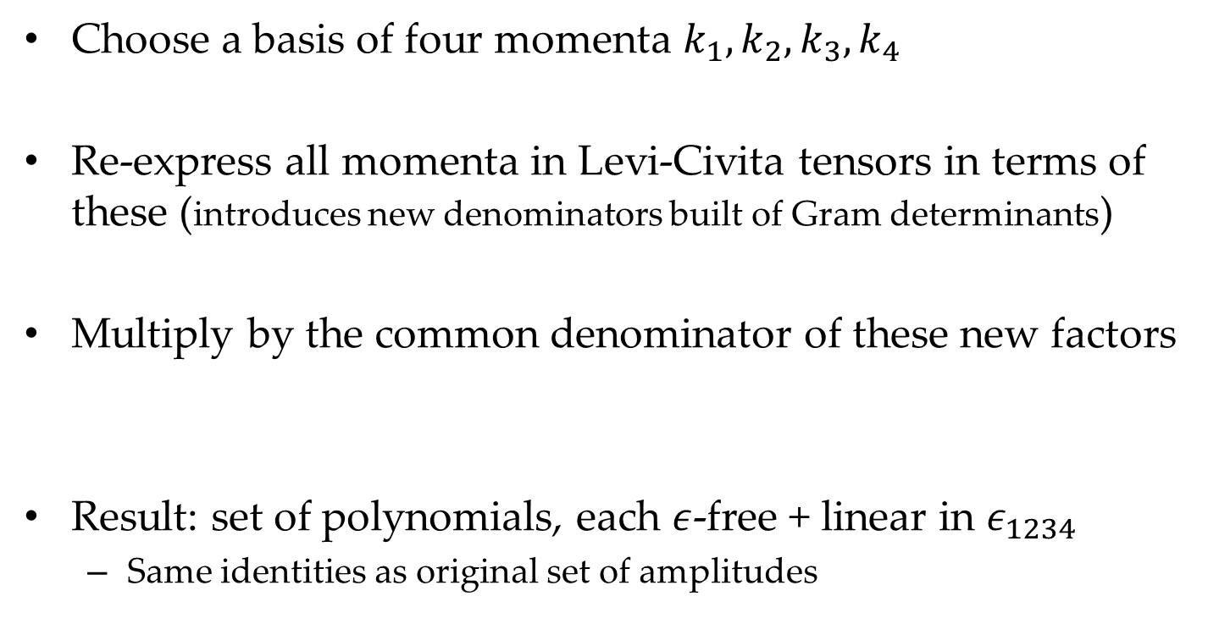
Syzygies Are Ubiquitous
Choose a basis of four momenta $k_{1}, k_{2}, k_{3}, k_{4}$
Re-express all momenta in Levi-Civita tensors in terms of these (introduces new denominators built of Gram determinants)
Multiply by the common denominator of these new factors
Result: set of polynomials, each $ε$-free + linear in $ε_{1234}$
  Same identities as original set of amplitudes

Slide 16
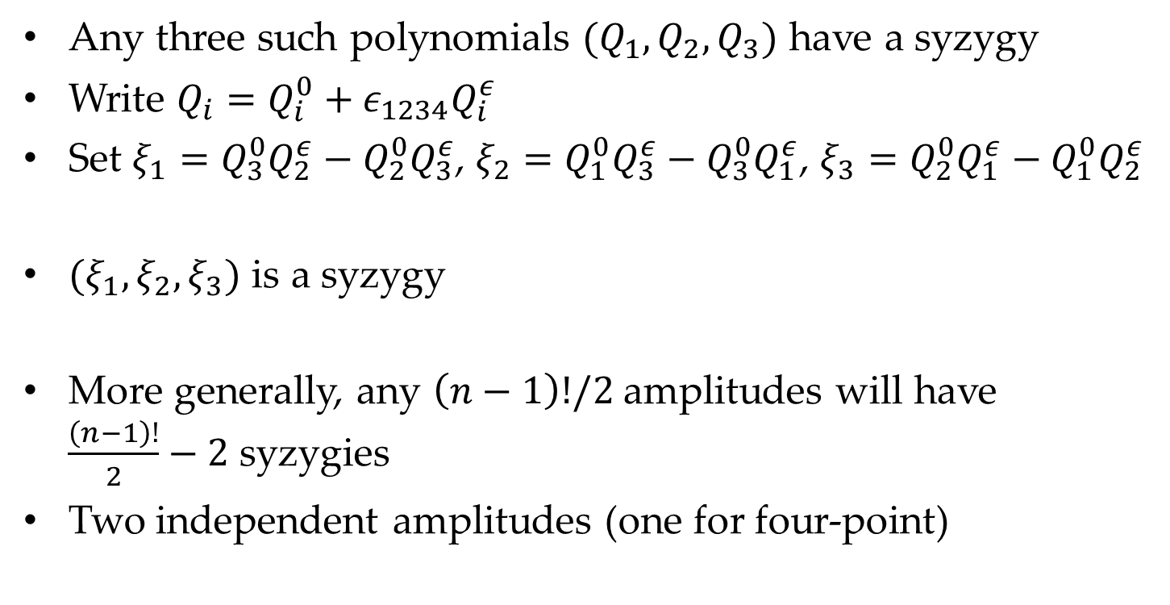
Syzygies Are Ubiquitous
Any three such polynomials $(Q_{1},Q_{2},Q_{3})$ have a syzygy
Write $Q_{i}=Q_{i}^{0}+ε_{1234}Q_{i}^{ε}$
Set $ξ_{1}=Q_{3}^{0}Q_{2}^{ε}−Q_{2}^{0}Q_{3}^{ε}$, $ξ_{2}=Q_{1}^{0}Q_{3}^{ε}−Q_{3}^{0}Q_{1}^{ε}$, $ξ_{3}=Q_{2}^{0}Q_{1}^{ε}−Q_{1}^{0}Q_{2}^{ε}$
$(ξ_{1},ξ_{2},ξ_{3})$ is a syzygy
More generally, any $\left(n−1\right)!/2$ amplitudes will have
$\frac{\left(n−1\right)!}{2}−2$ syzygies
Two independent amplitudes (one for four-point)

Slide 17
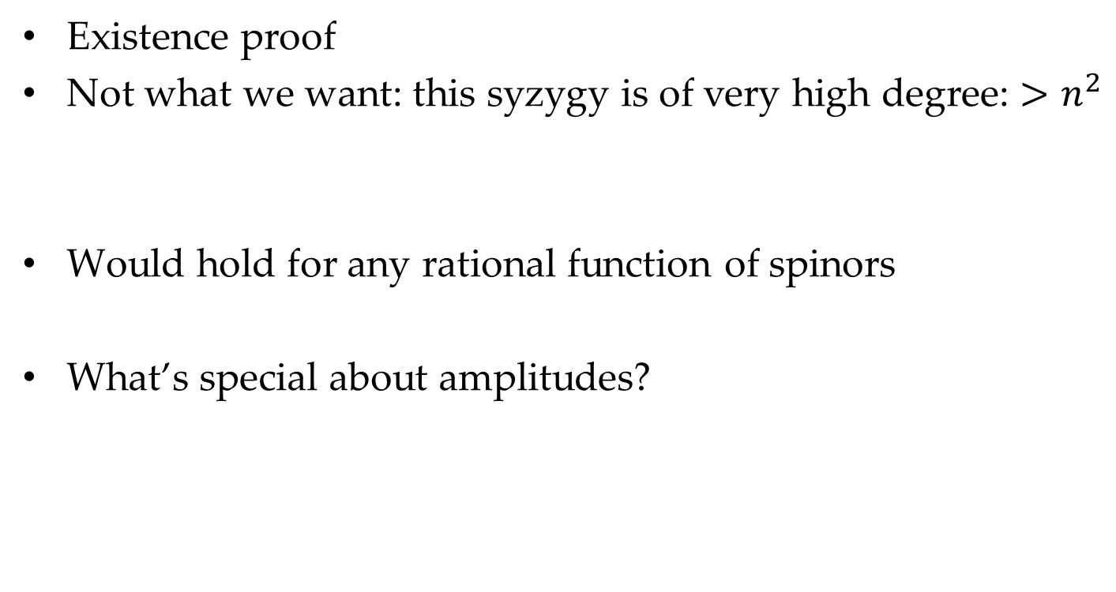
Syzygies Are Ubiquitous
Existence proof
Not what we want: this syzygy is of very high degree: $>n^{2}$
Would hold for any rational function of spinors
What’s special about amplitudes?

Slide 18
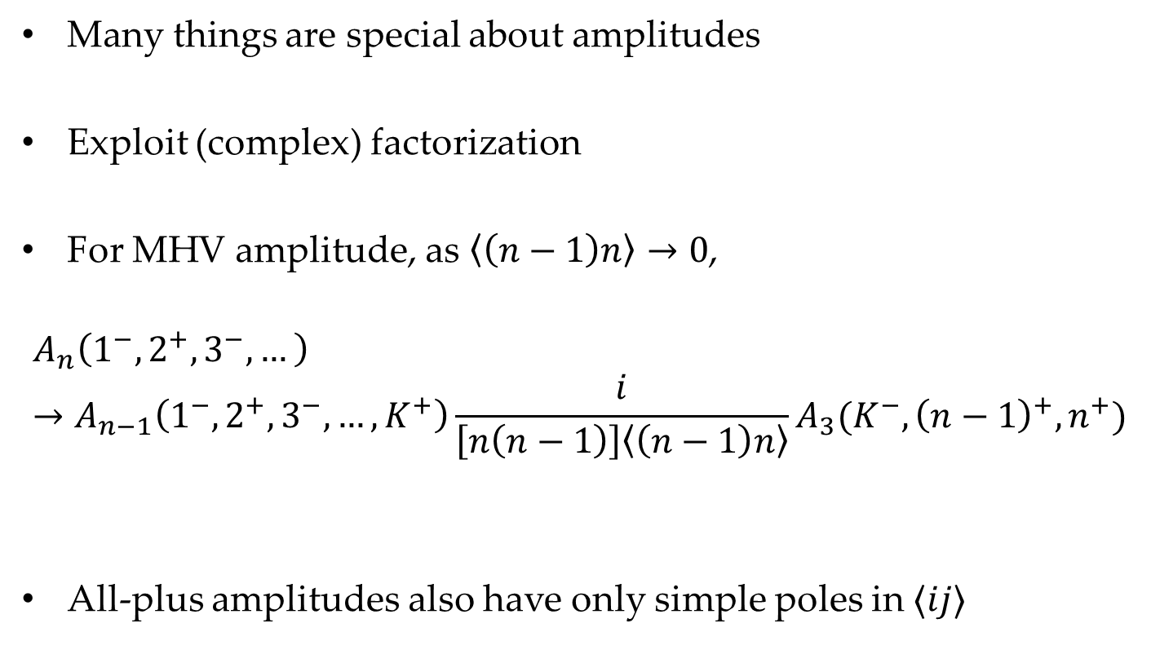
Amplitudes
Many things are special about amplitudes
Exploit (complex) factorization
For MHV amplitude, as $\left\langle \left(n−1\right)n\right\rangle →0$,
$$A_{n}\left(1^{−},2^{+},3^{−},…\right)→A_{n−1}\left(1^{−},2^{+},3^{−},…,K^{+}\right)\frac{i}{\left[n\left(n−1\right)\right]\left\langle \left(n−1\right)n\right\rangle }A_{3}(K^{−},{\left(n−1\right)}^{+},n^{+})$$
All-plus amplitudes also have only simple poles in $⟨ij⟩$

Slide 19
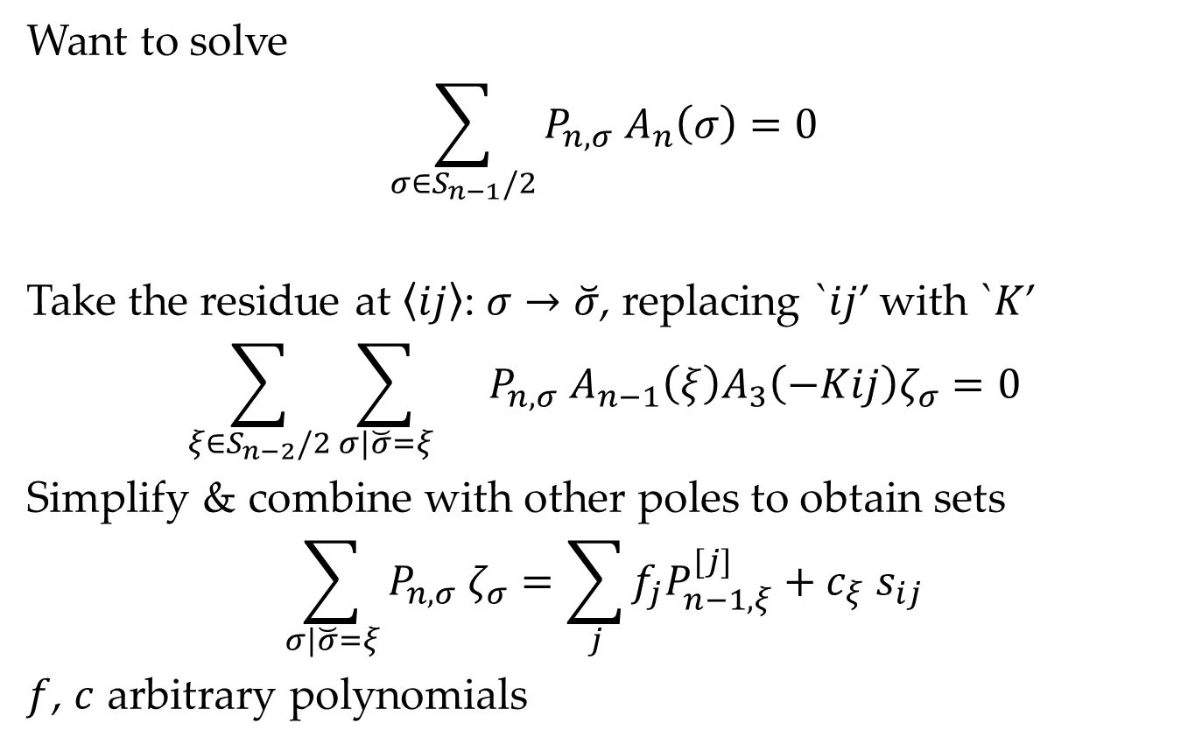
Factorization
Want to solve
$$\sum_{σ∈S_{n−1}/2}{P_{n,σ} A_{n}\left(σ\right)=0}$$
Take the residue at $⟨ij〉$: $σ→\breve{σ}$, replacing `$ij$’ with `$K$’
$$\sum_{ξ∈S_{n−2}/2}{\sum_{σ|\breve{σ}=ξ}{}P_{n,σ} A_{n−1}\left(ξ\right)A_{3}\left(−Kij\right)ζ_{σ}=0}$$
Simplify & combine with other poles to obtain sets
$$\sum_{σ|\breve{σ}=ξ}{P_{n,σ}{ ζ}_{σ}}=\sum_{j}{f_{j}P_{n−1,ξ}^{[j]}}+c_{ξ} s_{ij}$$
$f$, $c$ arbitrary polynomials

Slide 20
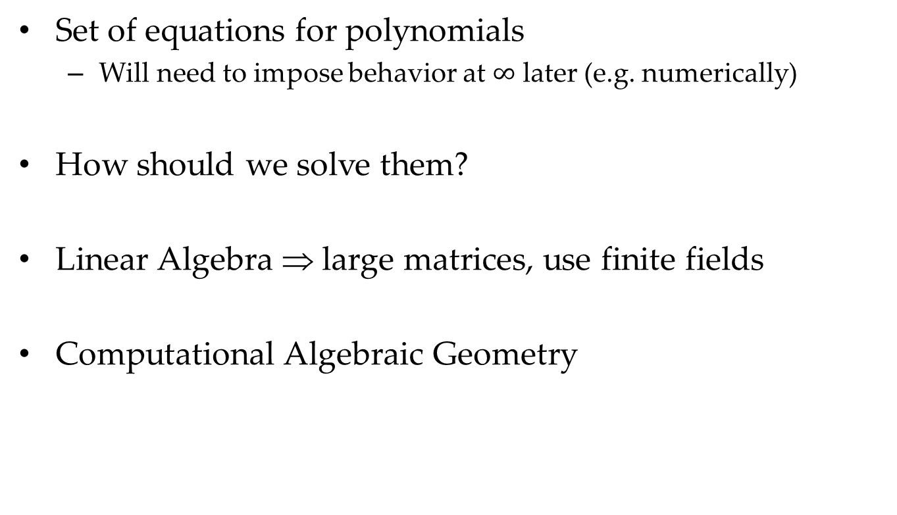
Factorization
Set of equations for polynomials
  Will need to impose behavior at $∞$ later (e.g. numerically)
How should we solve them?
Linear Algebra ⇒ large matrices, use finite fields
Computational Algebraic Geometry

Slide 21
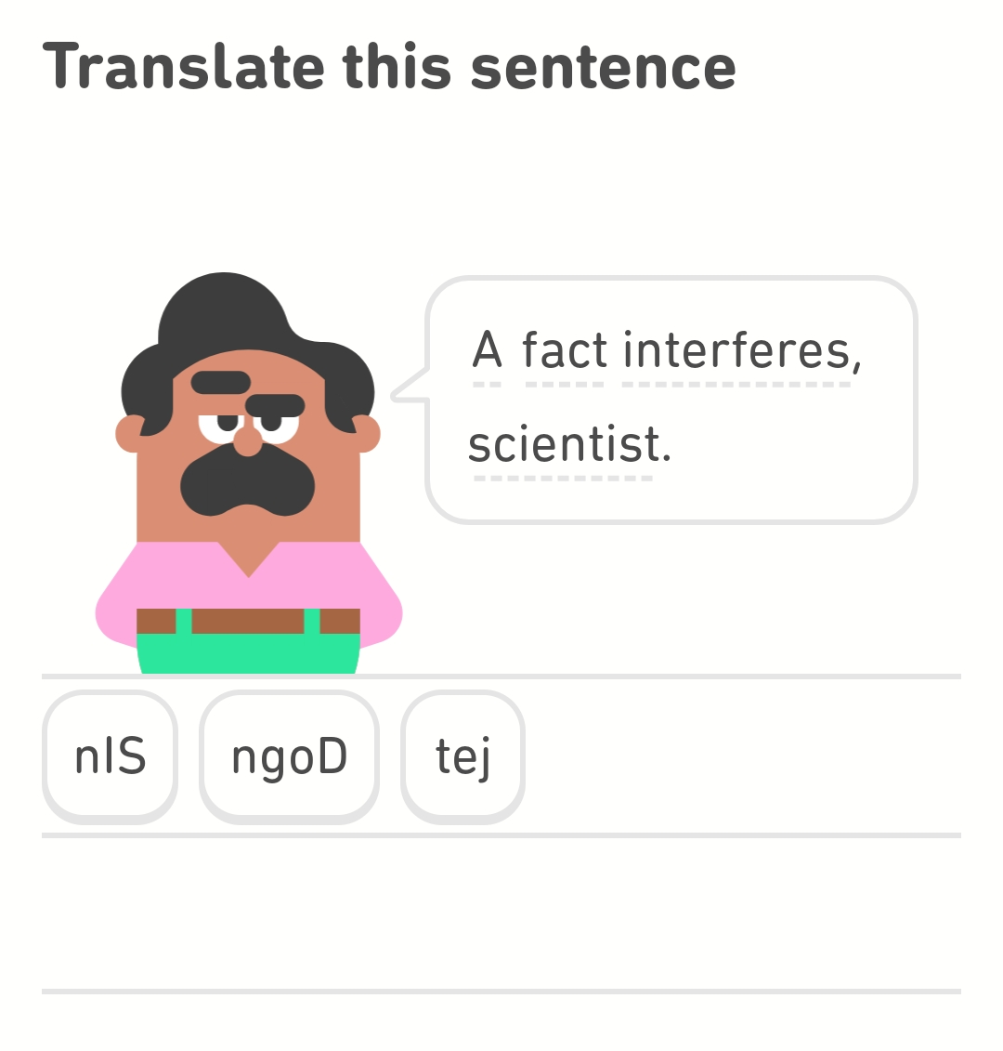
A Foreign-Language Lesson

Slide 22
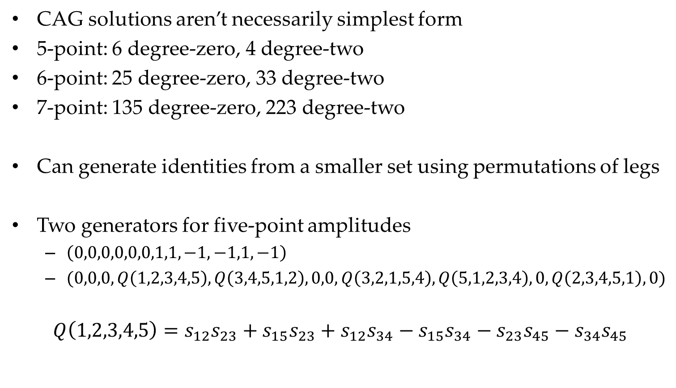
All-Plus Identities
CAG solutions aren’t necessarily simplest form
5-point: 6 degree-zero, 4 degree-two
6-point: 25 degree-zero, 33 degree-two
7-point: 135 degree-zero, 223 degree-two
Can generate identities from a smaller set using permutations of legs
Two generators for five-point amplitudes
  $\left(0,0,0,0,0,0,1,1,−1,−1,1,−1\right)$
  $(0,0,0, Q\left(1,2,3,4,5\right), Q\left(3,4,5,1,2\right), 0,0, Q\left(3,2,1,5,4\right), Q\left(5,1,2,3,4\right),0, Q\left(2,3,4,5,1\right),0)$
$$Q\left(1,2,3,4,5\right)=s_{12}s_{23}+s_{15}s_{23}+s_{12}s_{34}−s_{15}s_{34}−s_{23}s_{45}−s_{34}s_{45}$$

Slide 23
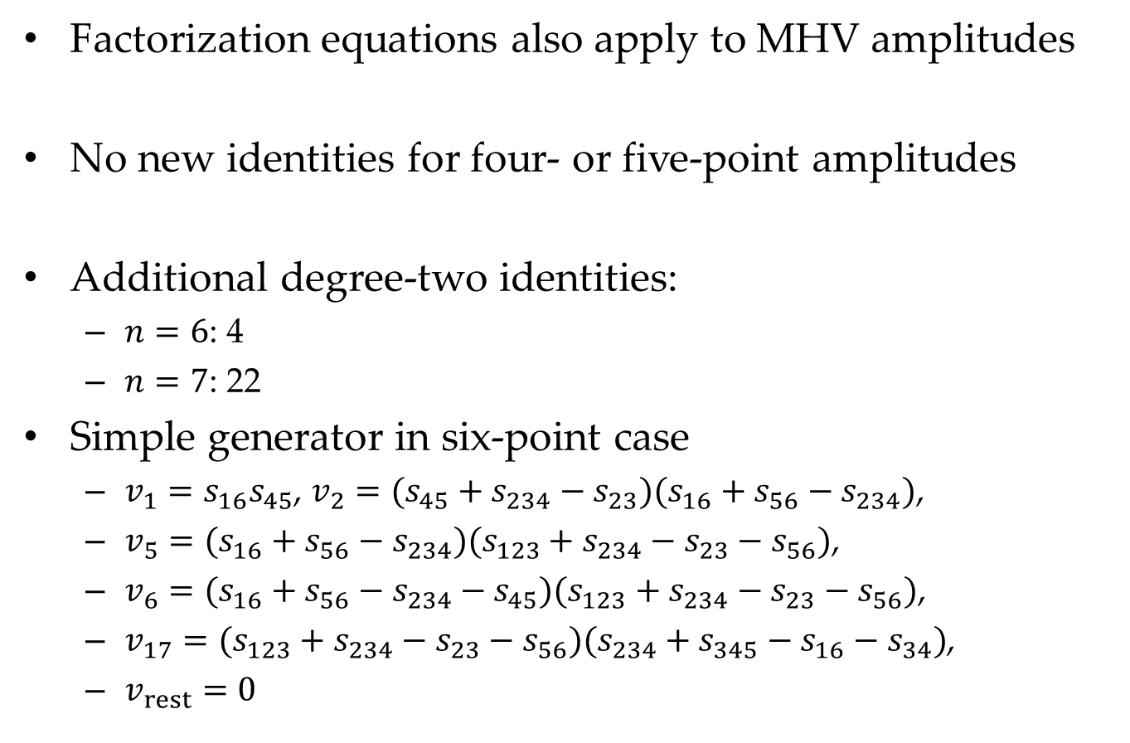
More Identities for MHV Amplitudes
Factorization equations also apply to MHV amplitudes
No new identities for four- or five-point amplitudes
Additional degree-two identities:
  $n=6$: 4
  $n=7$: 22
Simple generator in six-point case
  $v_{1}=s_{16}s_{45}$, $v_{2}=(s_{45}+s_{234}−s_{23})(s_{16}+s_{56}−s_{234})$,
  $v_{5}=(s_{16}+s_{56}−s_{234})(s_{123}+s_{234}−s_{23}−s_{56})$,
  $v_{6}=(s_{16}+s_{56}−s_{234}−s_{45})(s_{123}+s_{234}−s_{23}−s_{56})$,
  $v_{17}=(s_{123}+s_{234}−s_{23}−s_{56})(s_{234}+s_{345}−s_{16}−s_{34})$,
  $v_{rest}=0$

Slide 24
Summary
Scattering amplitudes have lots of new identities
In the all-plus amplitude at one loop, these are simple
Similar identities will likely hold for
  coefficients of integral functions
  rational terms in higher-loop amplitudes

