Slide 1
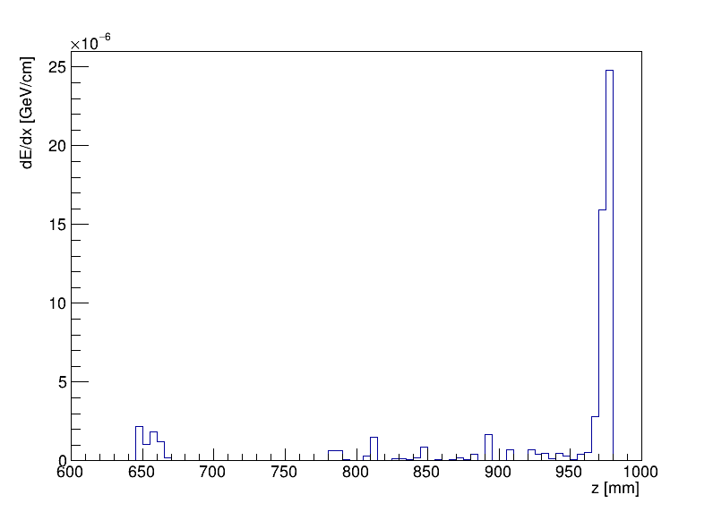
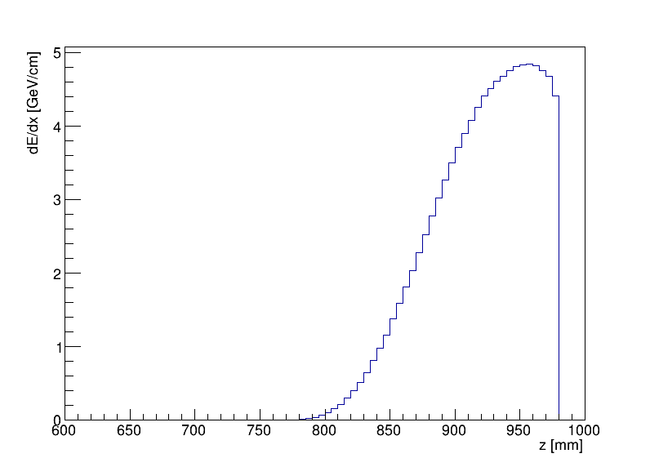
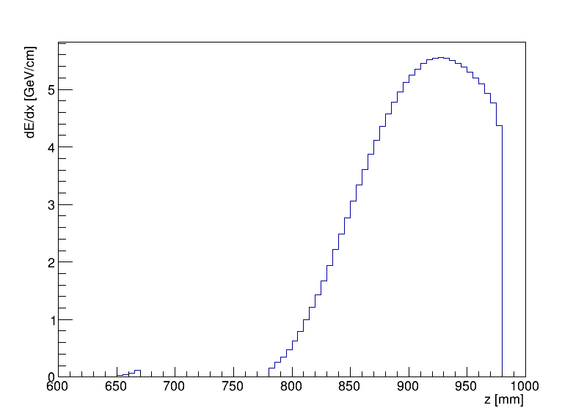
Without Flange/Bellow
Theta
0.7 deg
12.2 mrad
Theta
0.9 deg
15.7 mrad
Theta
0.7 deg
19.2 mrad
Theta
1.3 deg
22.6 mrad

Slide 2
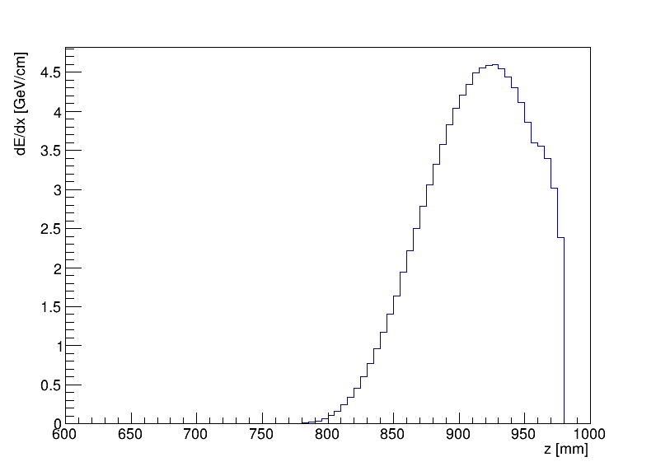
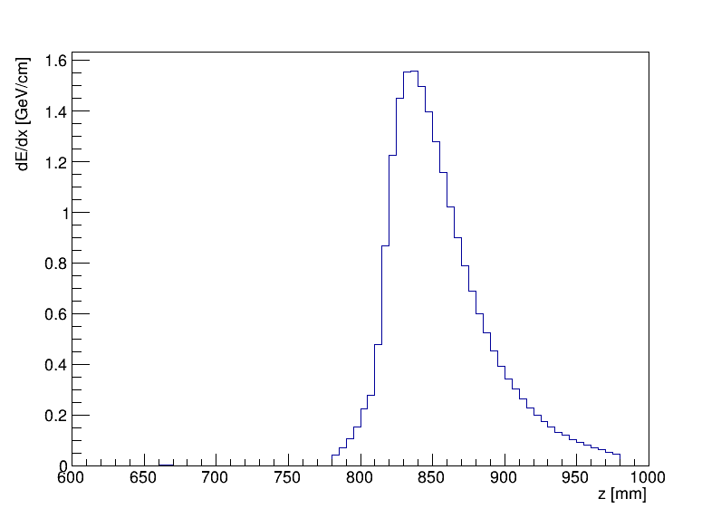
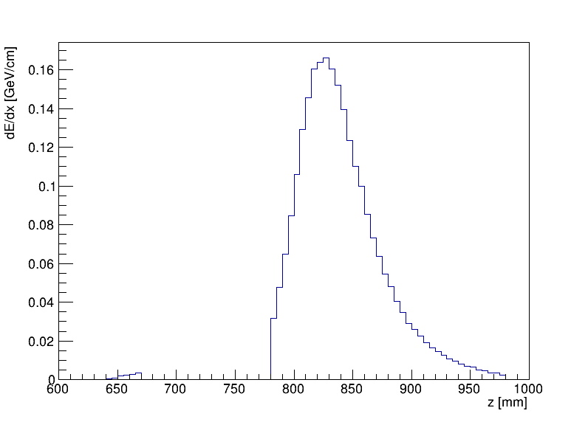
Without Flange/Bellow
Theta
1.8 deg
31.4 mrad
Theta
1.9 deg
33.1 mrad
Theta
2.0 deg
34.9 mrad
Theta
2.1 deg
36.6 mrad

Slide 3
TwoGam (BesTwoGam)
$$e^{+}+e^{−}→e^{+}+e^{−}+e^{+}+e^{−}$$
$\sqrt{s}=240 GeV$ w2min = 0.01 DOUCUT FALSE
No tag
$$σ=8860±132 nb$$
Single tag
T1MIN = 1.228 deg
T1MAX = 178.872 deg
$$σ=0.6959±0.0609 nb$$
Double tag
T1MIN = T2MIN = 1.228 deg
T1MAX = T2MAX = 178.872 deg
$$σ=(3.836±0. 115)×{10}^{−3} nb$$
(y = 12 mm at z = 560 mm)

Slide 4
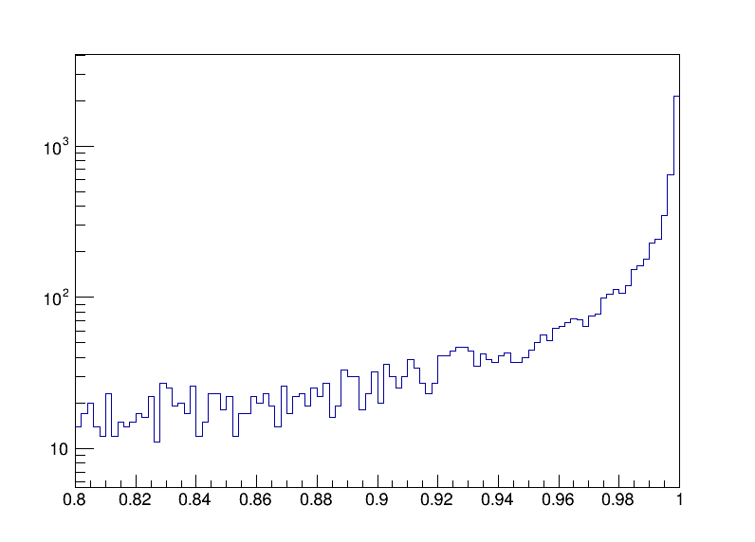
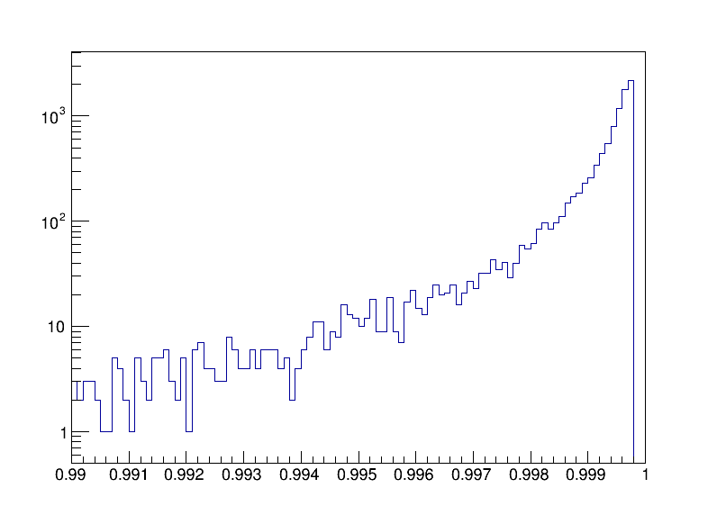
TwoGam (BesTwoGam)
$$e^{+}+e^{−}→e^{+}+e^{−}+e^{+}+e^{−}$$
Events
Events
CosTheta
CosTheta
T1MIN = T2MIN = 1.228 deg
T1MAX = T2MAX = 178.872 deg

Slide 5
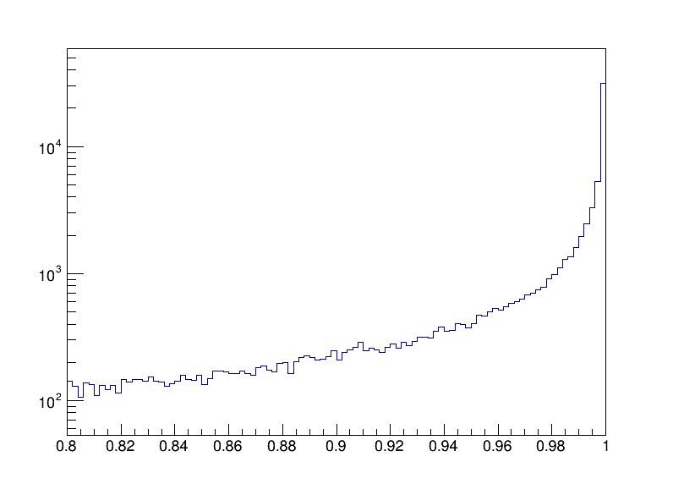
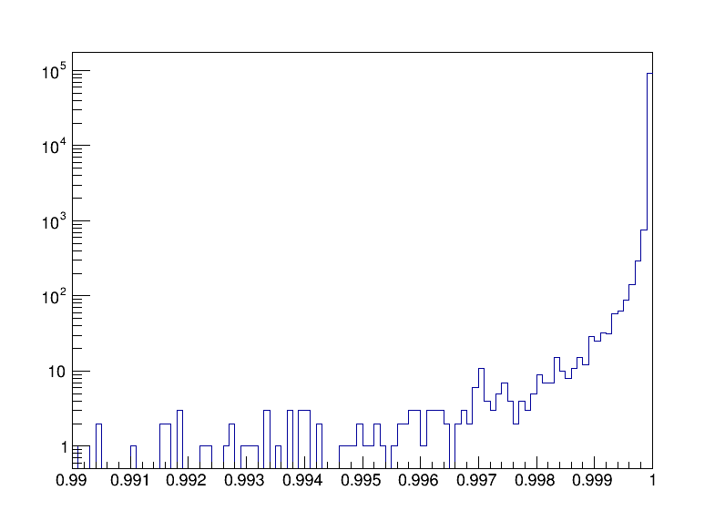
TwoGam (BesTwoGam)
$$e^{+}+e^{−}→e^{+}+e^{−}+e^{+}+e^{−}$$
Events
Events
CosTheta
CosTheta
No Theta Cut
$$σ=8860±132 nb$$

Slide 6
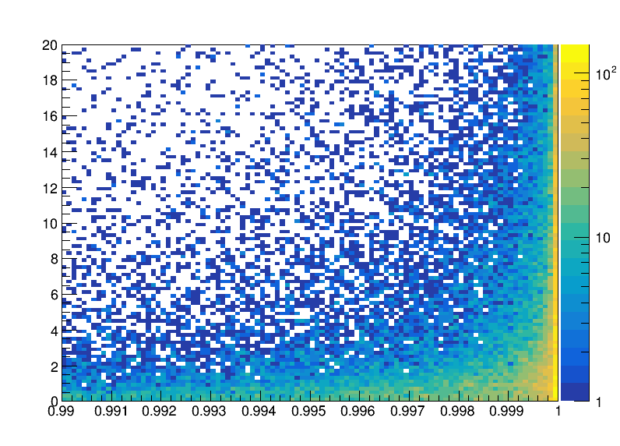
TwoGam (BesTwoGam)
$$e^{+}+e^{−}→e^{+}+e^{−}+e^{+}+e^{−}$$
Energy [GeV]
Events
CosTheta
$$Arctan\left(12/560\right)≈21.4 mrad$$
$$Arctan(12/1000)≈12 mrad$$
$$\cos{22 mrad}≈0.99976$$
$$\cos{12 mrad}≈0.99992$$
LumiCal at :

Slide 7
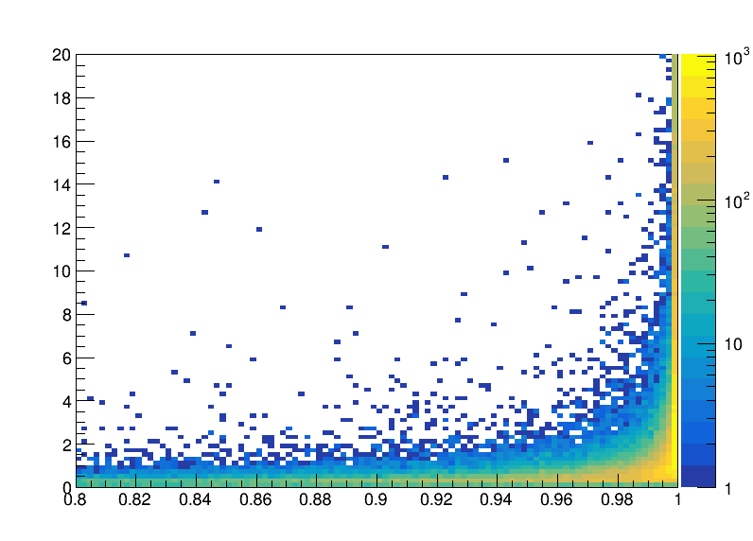
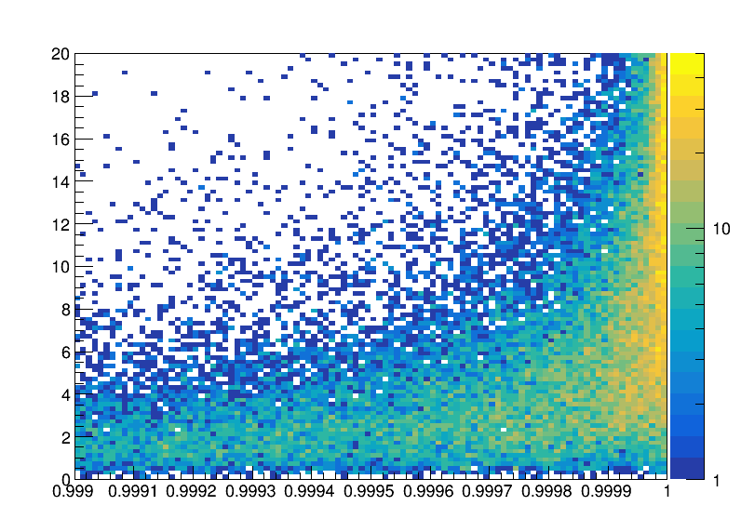
DIAG 36
$$e^{+}+e^{−}→e^{+}+e^{−}+μ^{+}+μ^{−}$$
Energy [GeV]
Events
Energy [GeV]
Events
CosTheta
CosTheta
$$Arctan\left(12/560\right)≈21.4 mrad$$
$$Arctan(12/1000)≈12 mrad$$
$$\cos{22 mrad}≈0.99976$$
$$\cos{12 mrad}≈0.99992$$
LumiCal at :

Slide 8
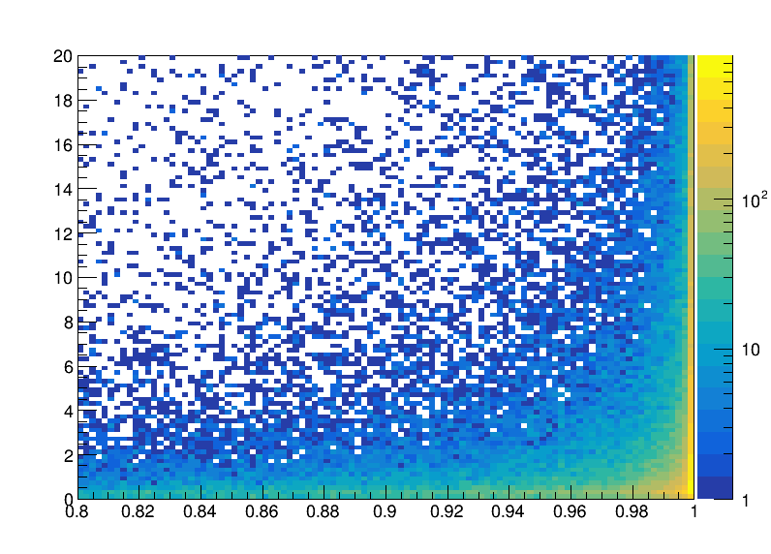
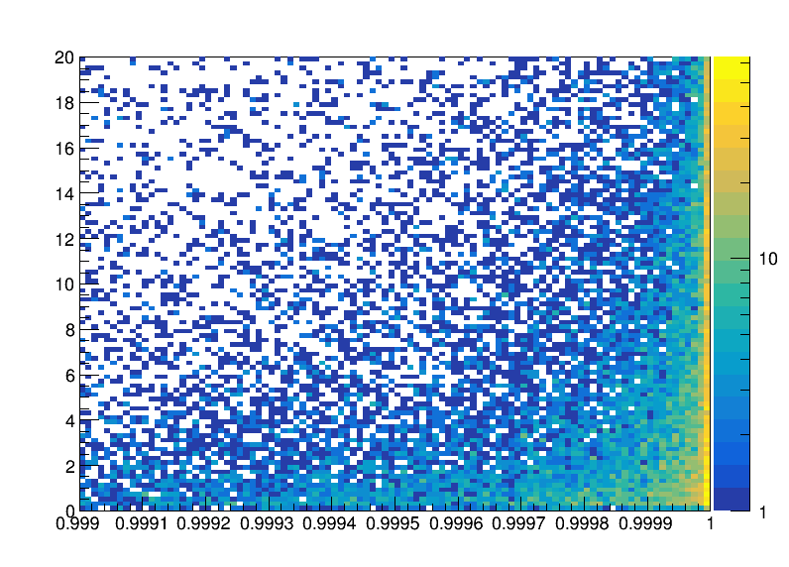
TwoGam (BesTwoGam)
$$e^{+}+e^{−}→e^{+}+e^{−}+μ^{+}+μ^{−}$$
Energy [GeV]
Events
Energy [GeV]
Events
CosTheta
CosTheta
$$Arctan\left(12/560\right)≈21.4 mrad$$
$$Arctan(12/1000)≈12 mrad$$
$$\cos{22 mrad}≈0.99976$$
$$\cos{12 mrad}≈0.99992$$
LumiCal at :

Slide 9
TwoGam (BesTwoGam)
$$e^{+}+e^{−}→e^{+}+e^{−}+μ^{+}+μ^{−}$$
$$\cos{θ}∈\left[0.99, 0.99976\right] \sim 31.0 \%$$
$$\cos{θ}∈\left[0.99, 0.99992\right] \sim 38.2 \%$$
$$Total : 277.8 nb$$
$$\cos{θ}∈\left[0.99, 0.99976\right] \sim 86.12 nb$$
$$\cos{θ}∈\left[0.99, 0.99992\right] \sim 106.12 nb$$

