Slide 1
Simulation of pixel TPC

Slide 2
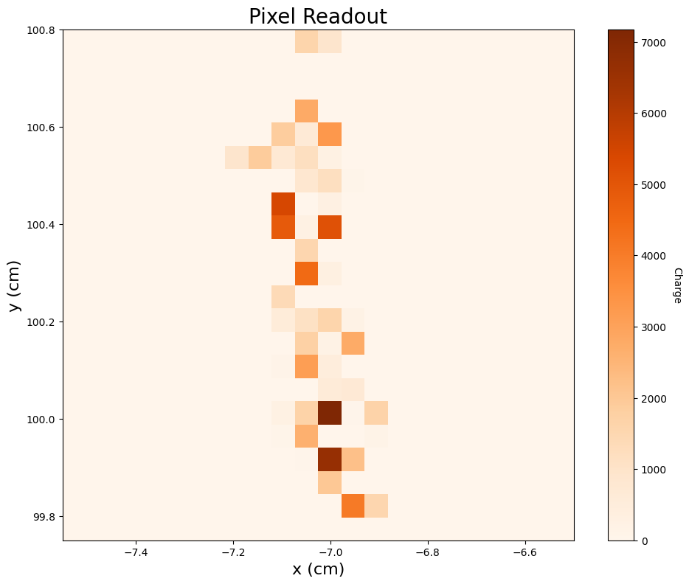
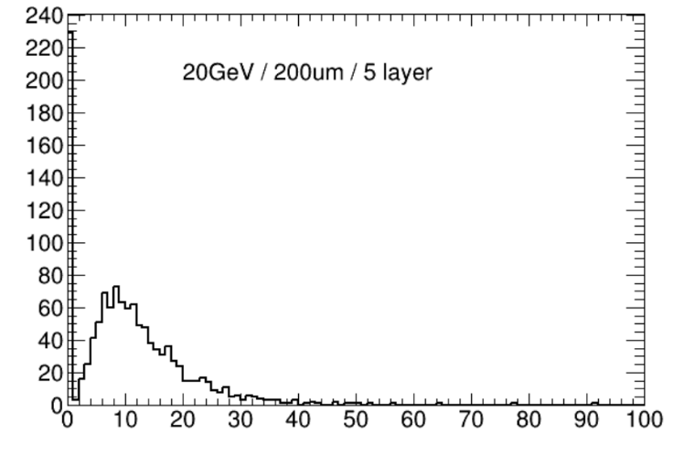
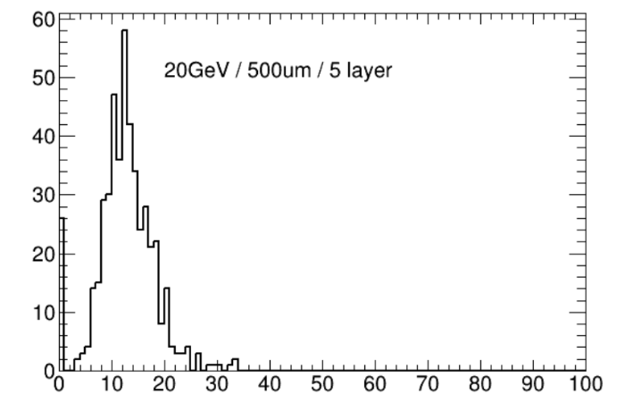
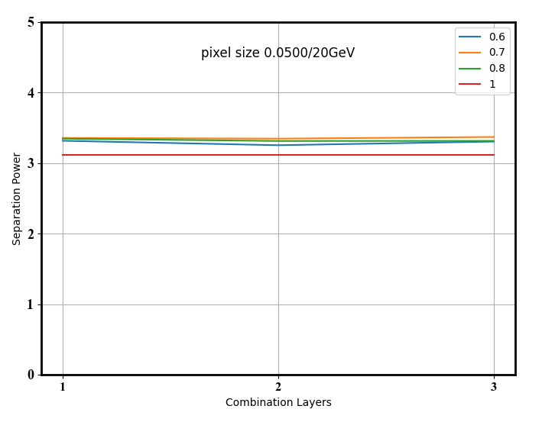
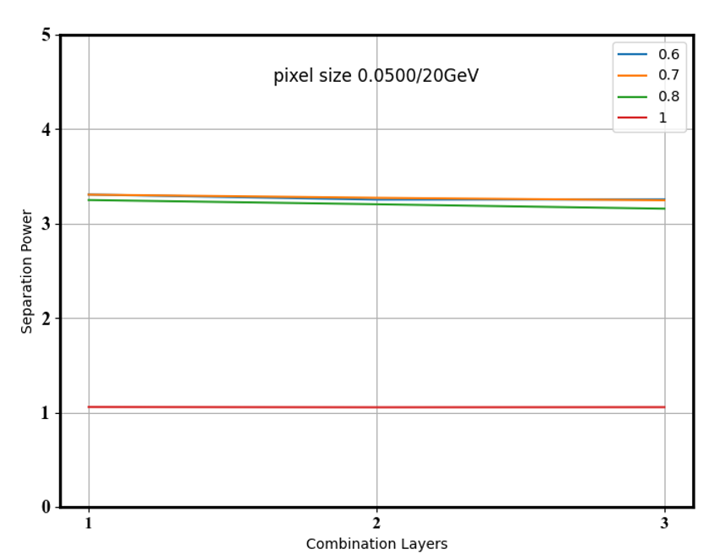
Reconstruction Algorithm
dE/dx & dN/dx
The smaller the pixel, the more it is affected by secondary ionization.
dN/dx
dE/dx
Pixel size | Electronic Noise | Sigma_amp
55um | 100e⁻ | ^{15 um}
110um | 100e⁻ | 15 um
220um | 100e⁻ | 15 um
330um | 100e⁻ | 15 um
500um | 100e⁻ | 15 um

Slide 3
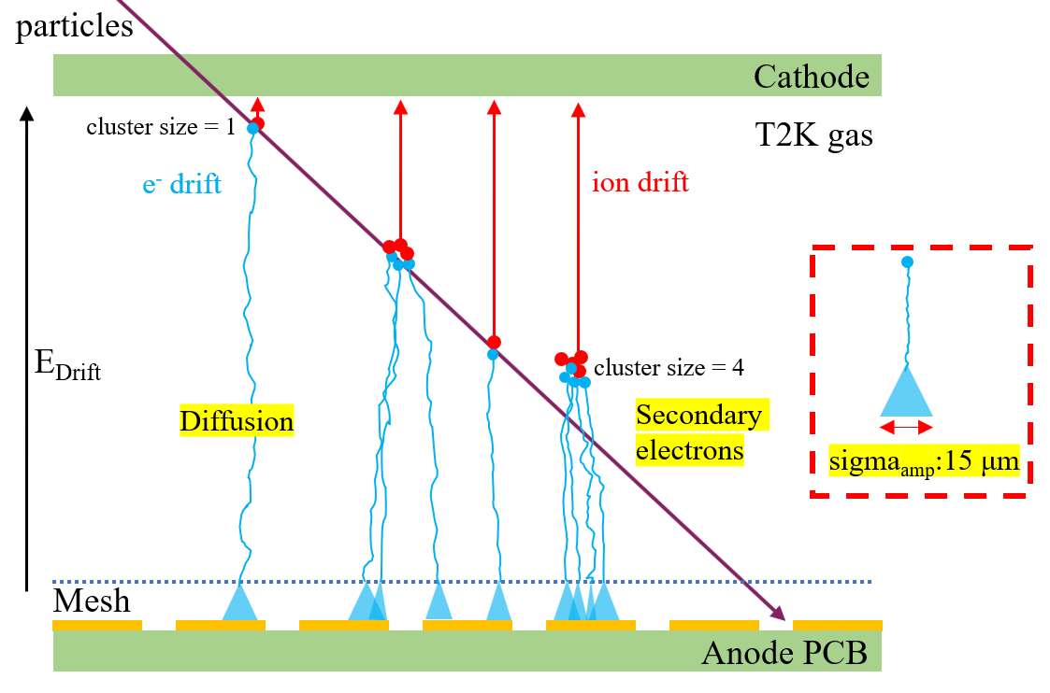
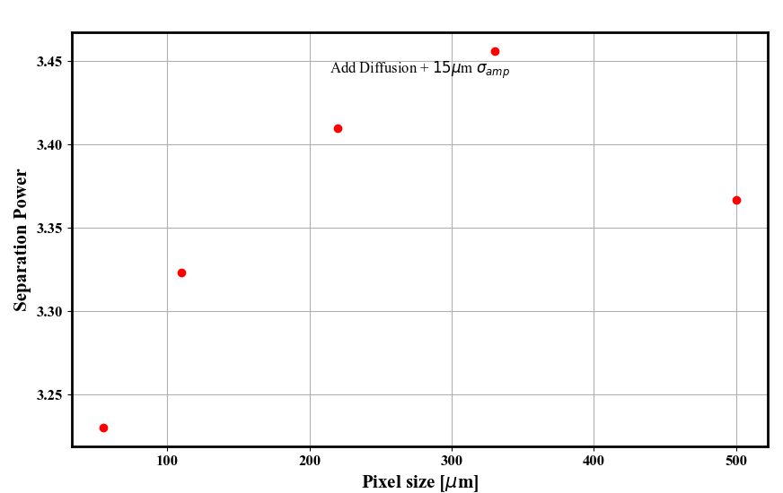
Optimization of pixel size
_{为什么像素变小，性能会变差？}

Slide 4
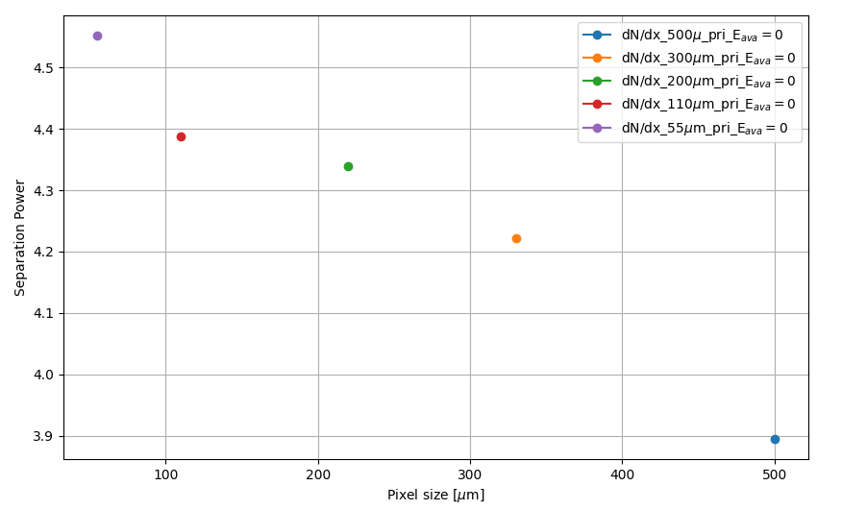
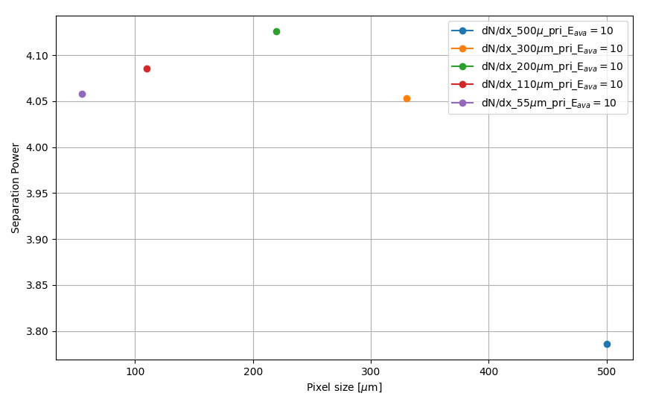
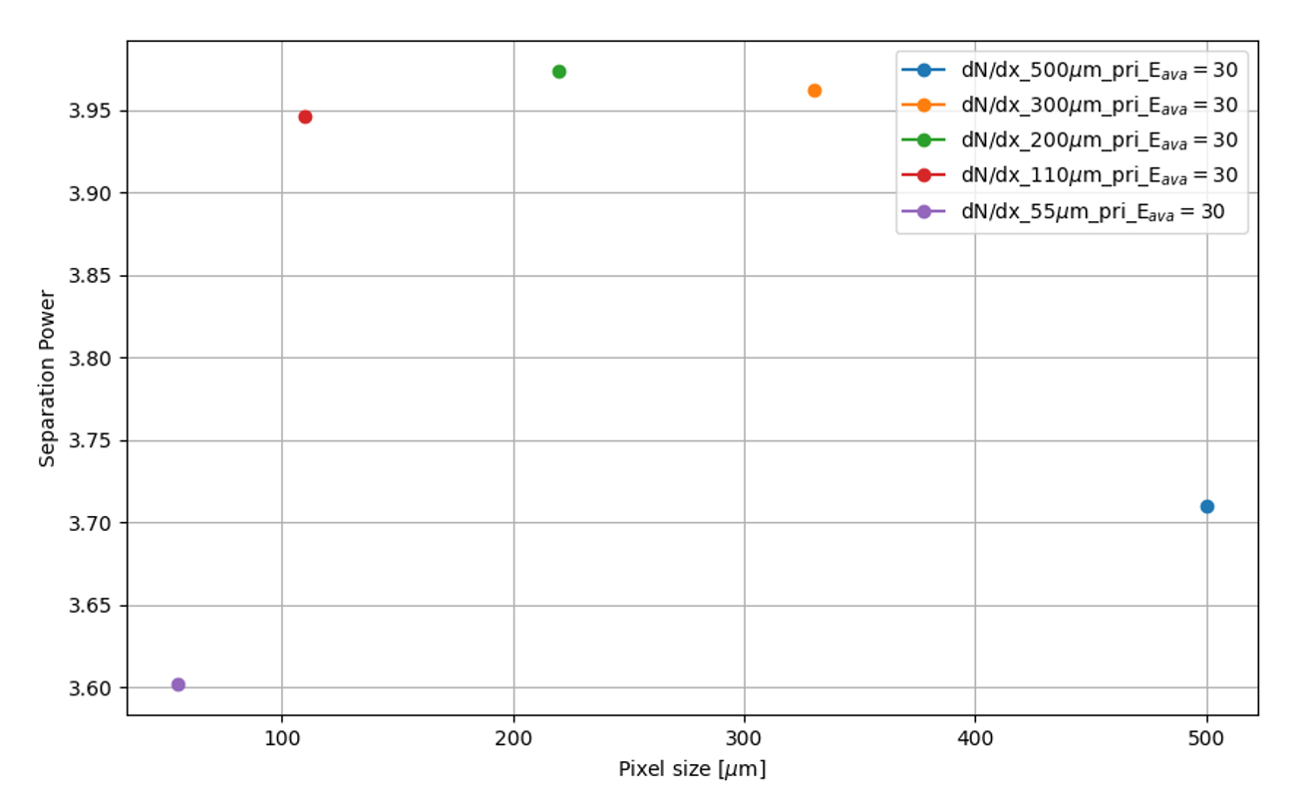
σ_{amp} Effect on Reconstruction
primary electrons + 0 σ_{amp}
primary electrons + 10 um σ_{amp}
primary electrons + 30 um σ_{amp}
σ_{amp} = 0 ，确实像素越小，性能越好
σ_{amp} > 0 ，结果就会变差，一个电子在经过倍增后会引起多个像素着火，Sp的最优像素在200um附近
σ_{amp} >继续变大，Sp的最优像素会继续右移，约在300um附近

Slide 5
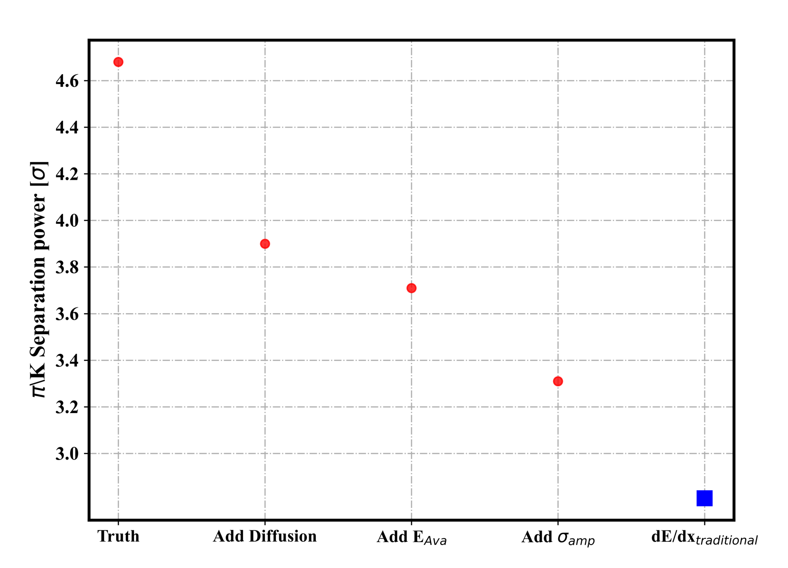
TPC Operating Principle
Key determinants of TPC performance
Secondary electrons
Diffusion
signal width after amplification
Electronic noise

Slide 6
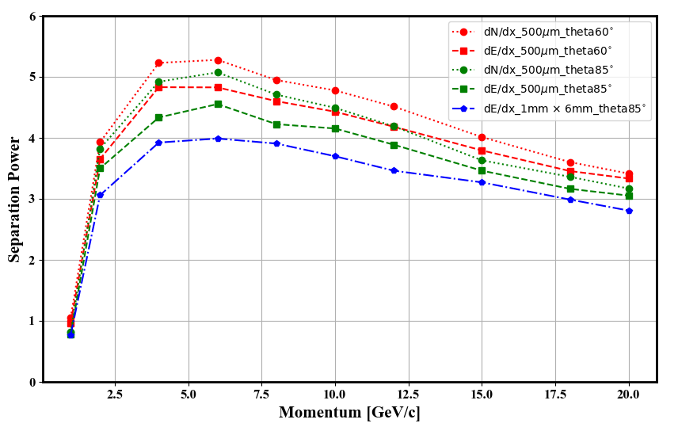
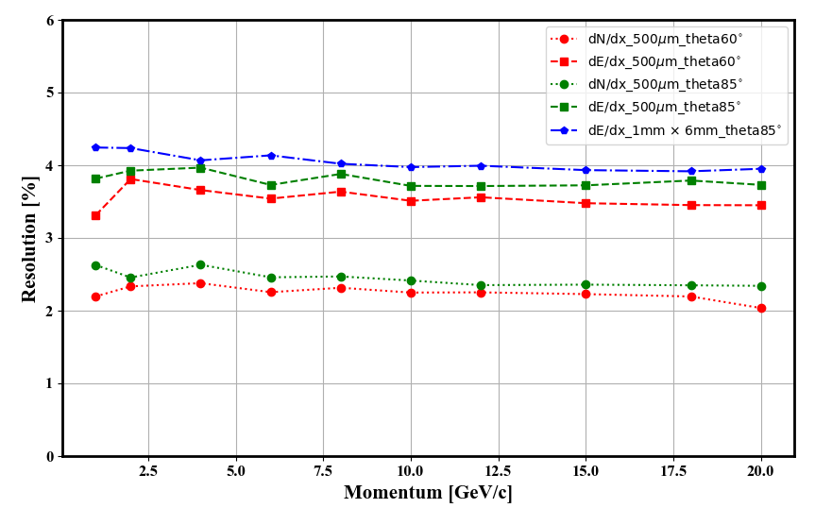
PID Performance

Slide 7
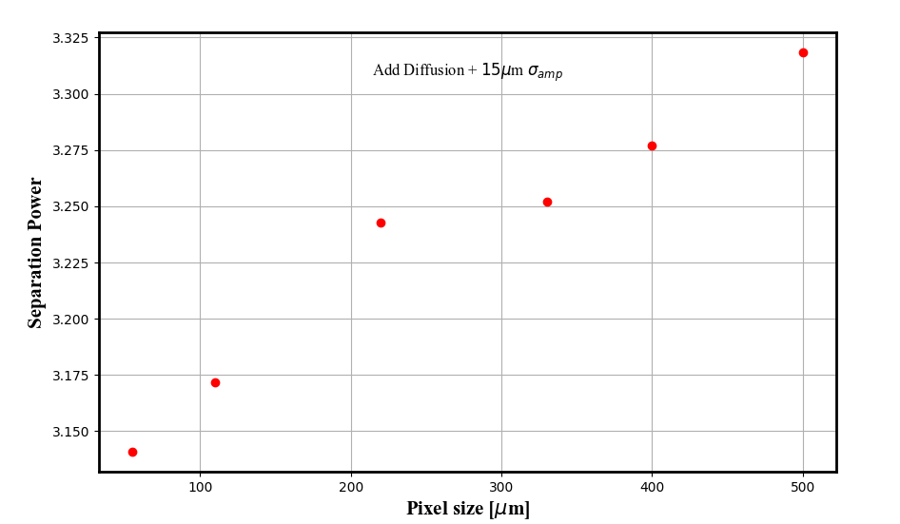
dE/dx Reconstruction
下一步：去掉电子学噪声，研究dE/dx 性能变差是否是由于小像素的信噪比变差造成的？

Slide 8
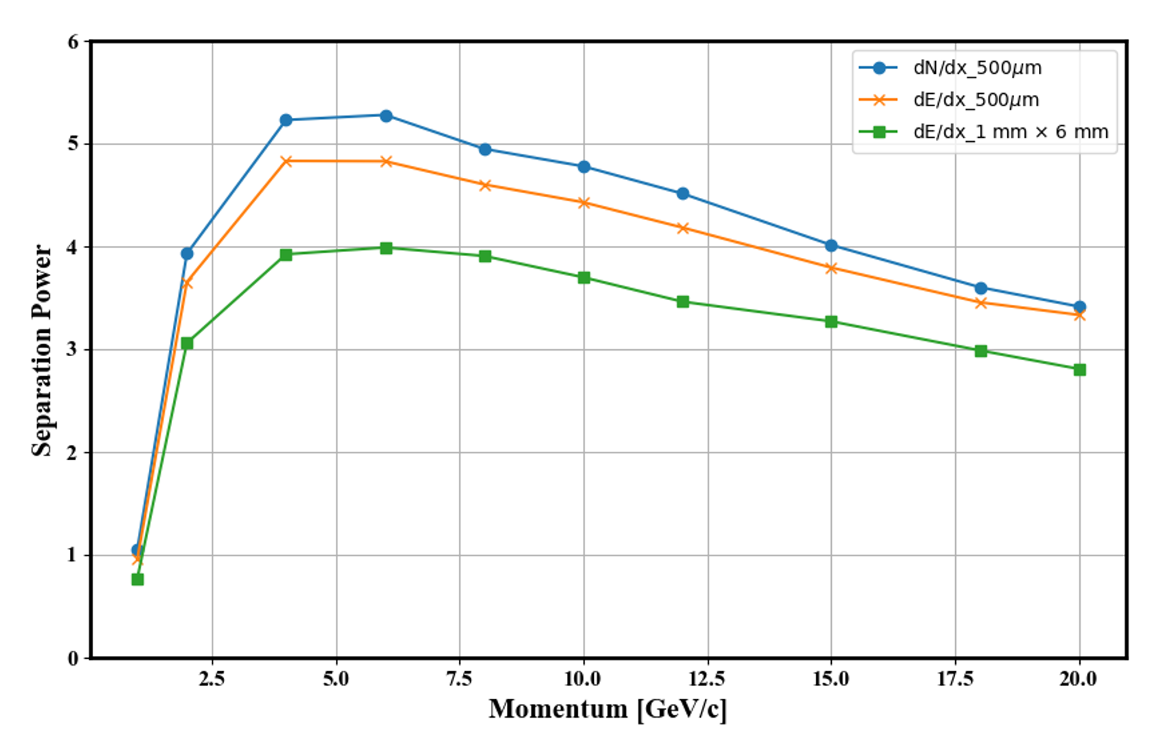
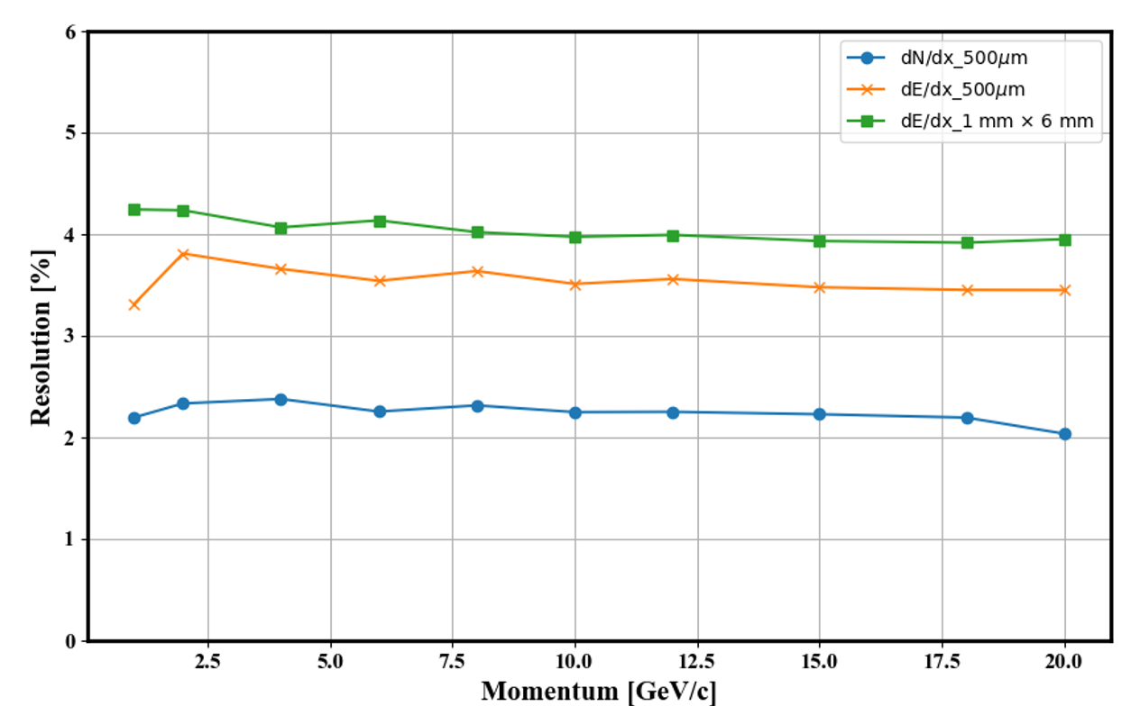
Resolution Performance

Slide 9
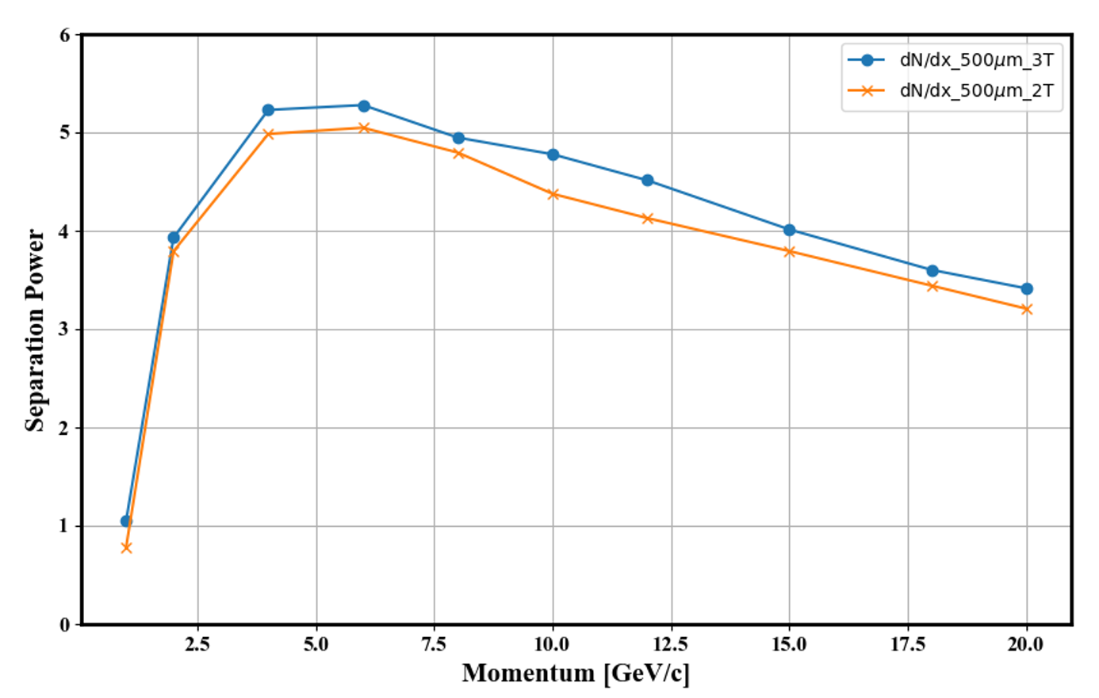
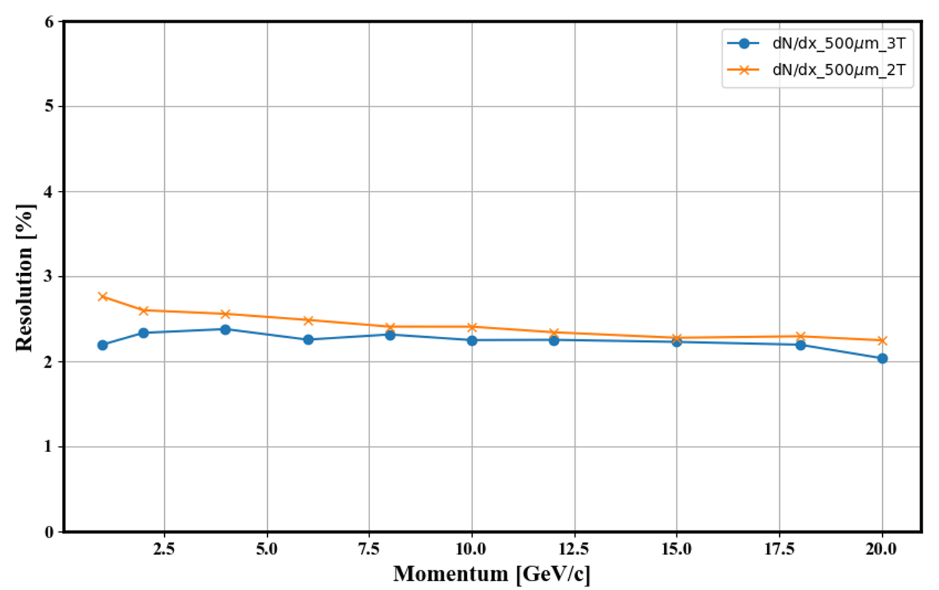
Performance @ 2T/ 3T

Slide 10
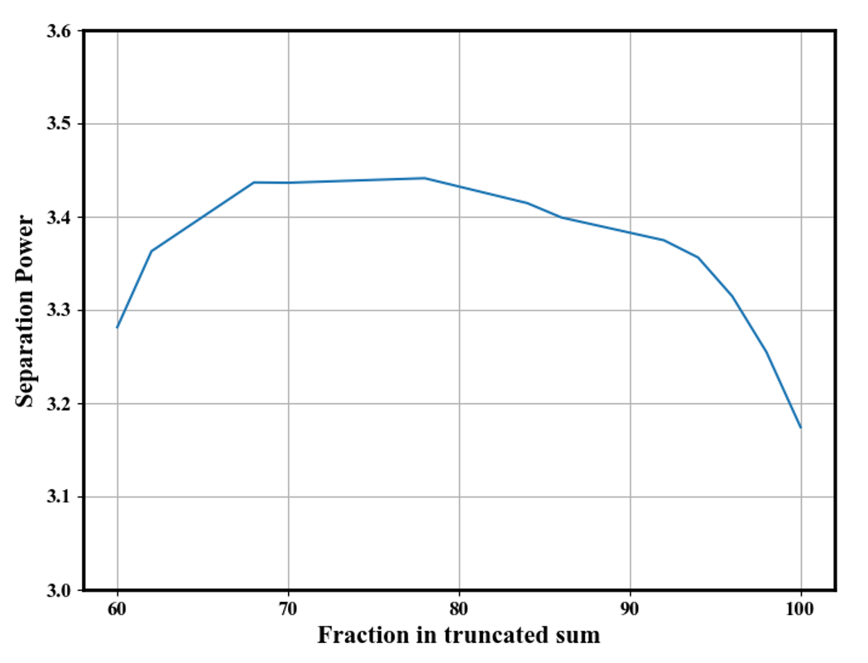
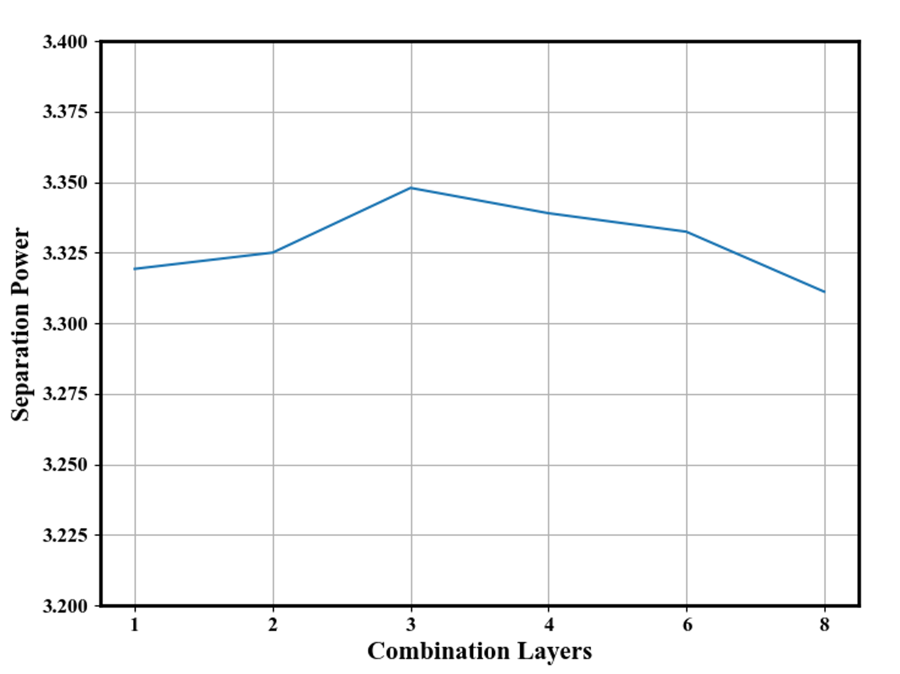

Slide 12
Parameters vs. pixel size
Digitization Parameters | Pixel size ($μm$)
 | 55 | 110 | 220 | 330 | 500 | 600 | 800 | 1000 | 2000
Amplification factor $f_{amp}$ | 2000 | 2000 | 2000 | 2000 | 2000
Signal width $σ_{amp}$ ($μm$) | 15 | 15 | 15 | 15 | 15
Noise ($e^{−}$) | 100 | 100 | 100 | 100 | 100
The numbers in red show the current parameters in simulation. Are they reasonable?
It is very important and appreciated to have RECOMMENT VALUES for the parameters.

Slide 13
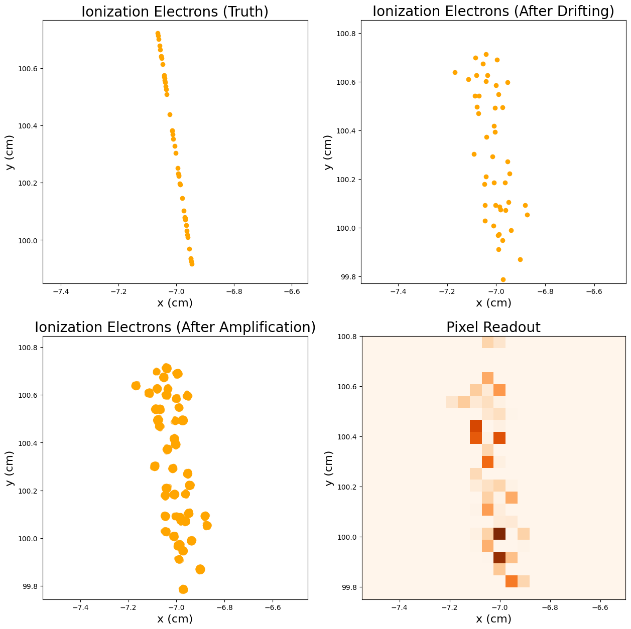
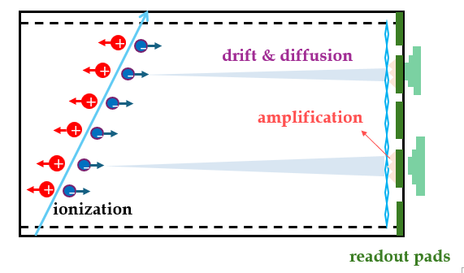
Full Simulation Framework of Pixel TPC
A
B
A
B
C
D
C
D
Garfield++-Based Simulation / Digitization Framework
Ionization
Transport
Amplification
Signal Generation

Slide 14
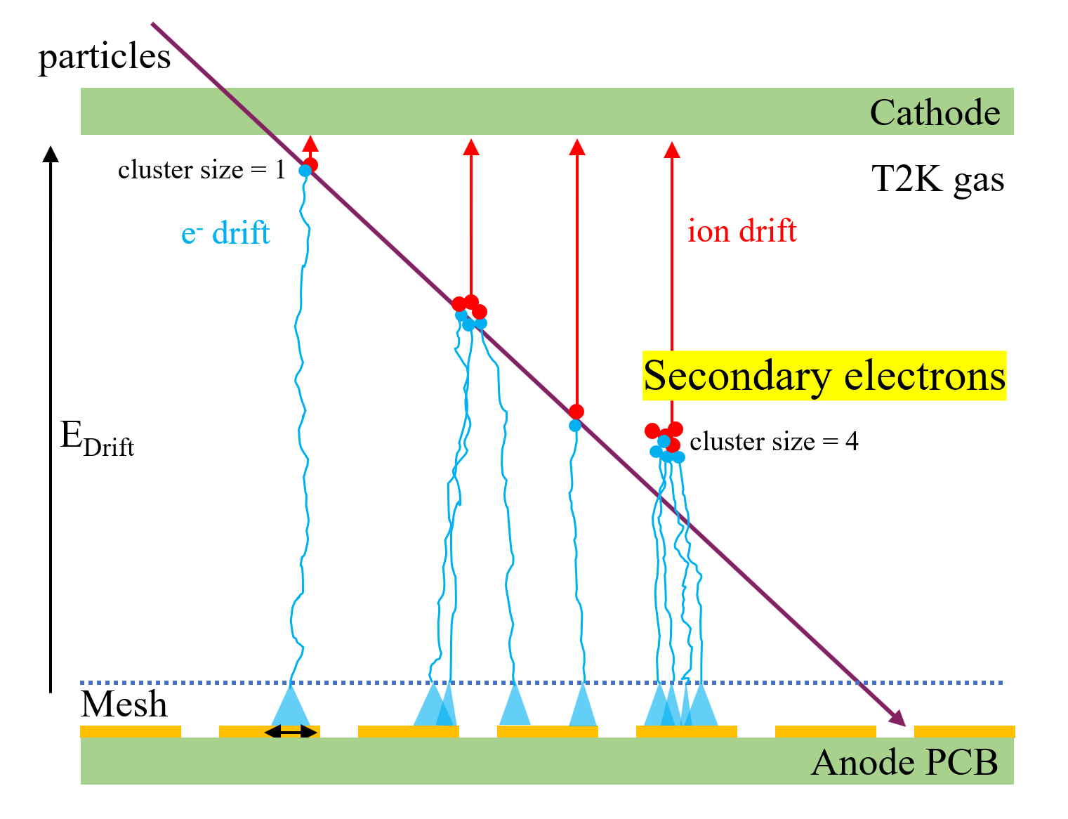
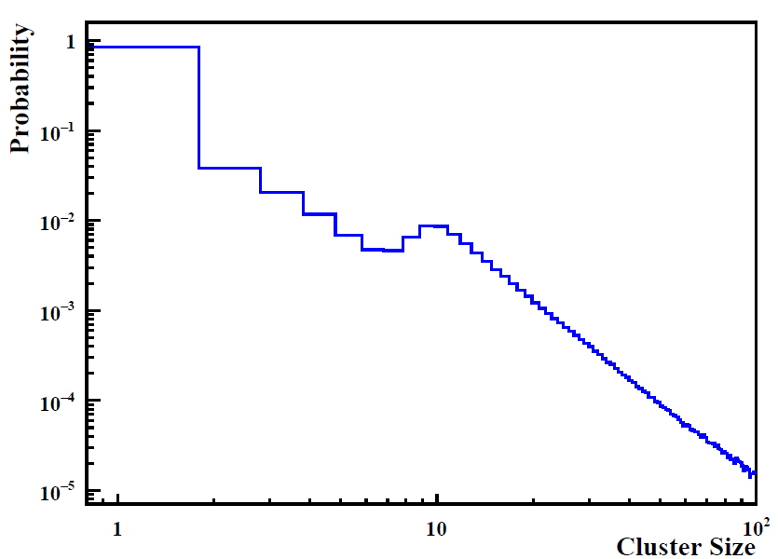
TPC Readout
A
B
Cluster size
Remarks:
The ionizations are defined by the gas mixture
The current gas mixture is T2K: Ar/CF₄/iC₄H₁₀ (95/3/2)
Secondary electrons have a significant impact on reconstruction.
C
D

Slide 15
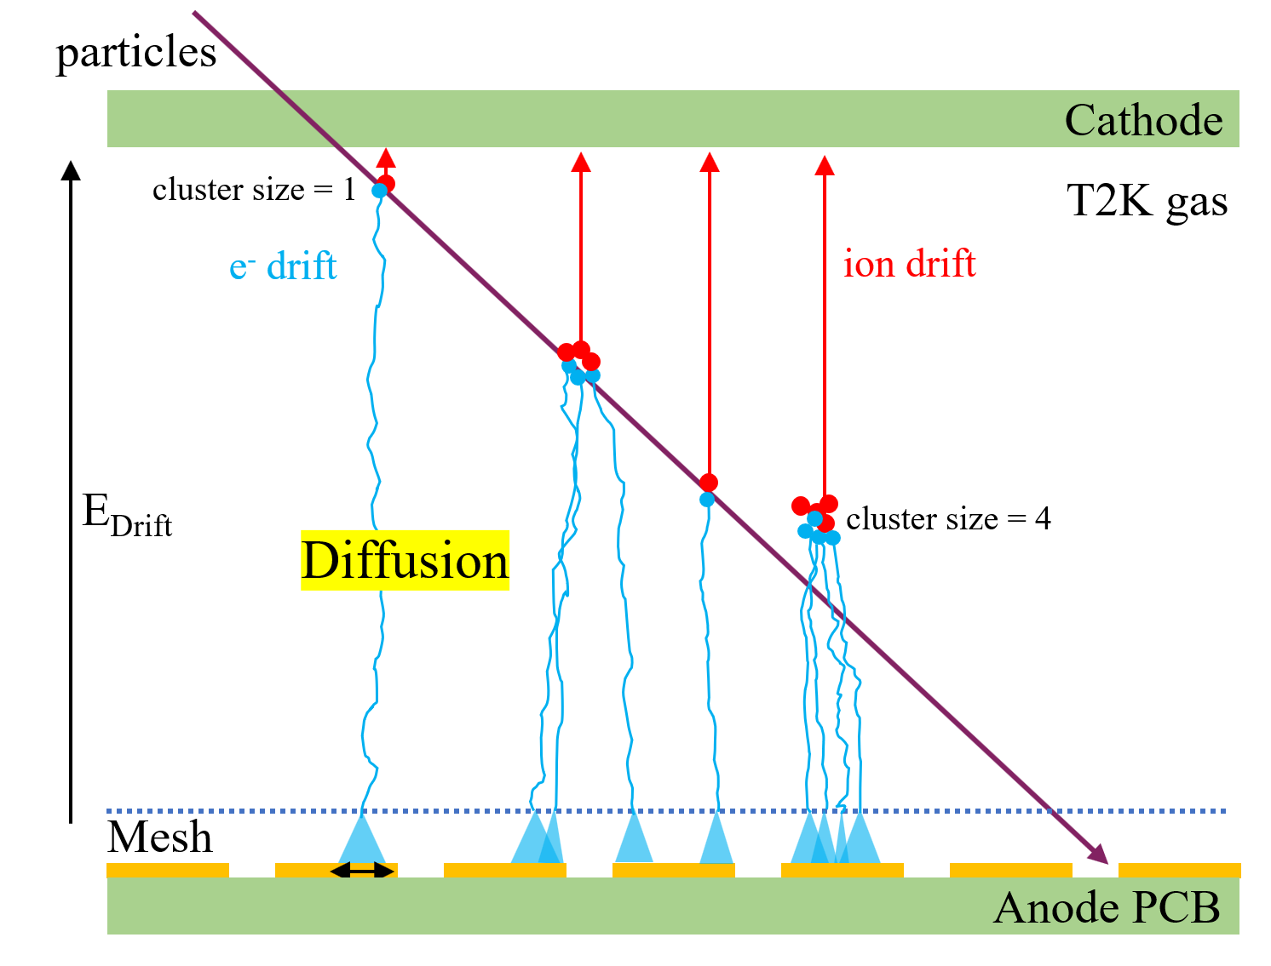
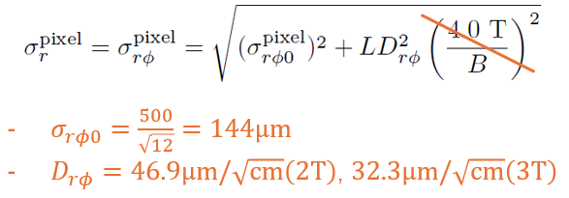
TPC Readout
A
B
Remarks:
From A to B, the electron positions are fluctuated by diffusion
For 3T field, the fluctuation can up to 550um
C
D

Slide 16
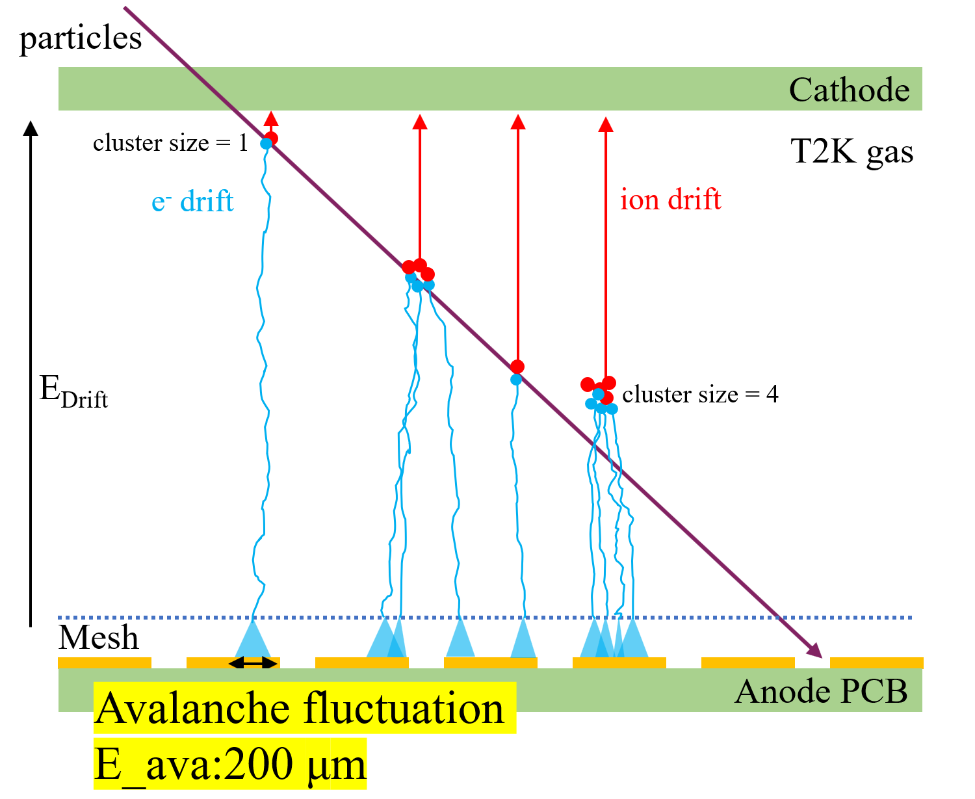
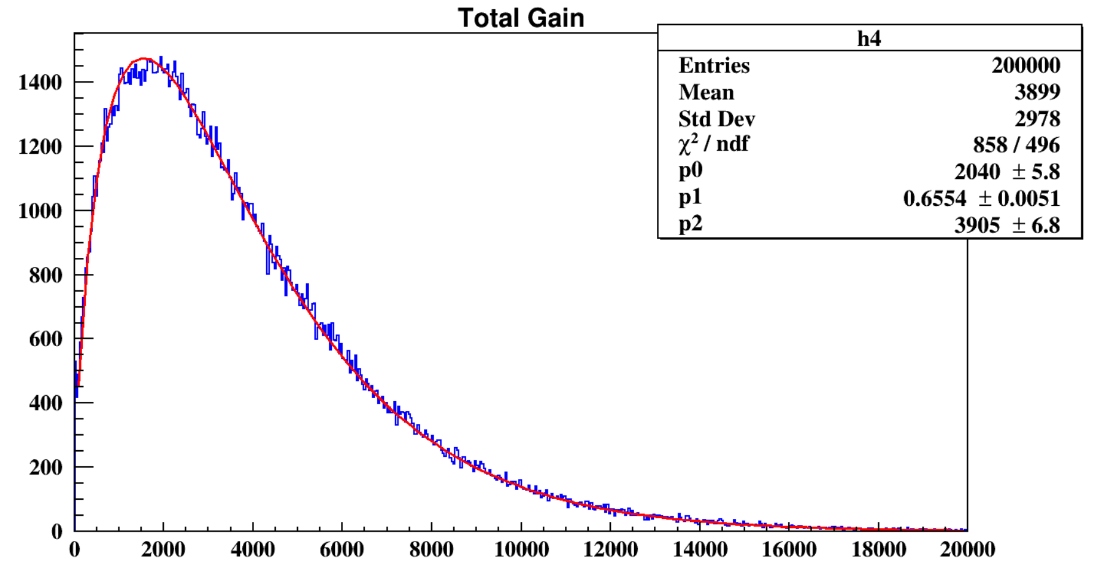
TPC Readout
A
B
Remarks:
From B to C, the single electron is amplified, which end up with a 200um spread in space
C
D
200um

Slide 17
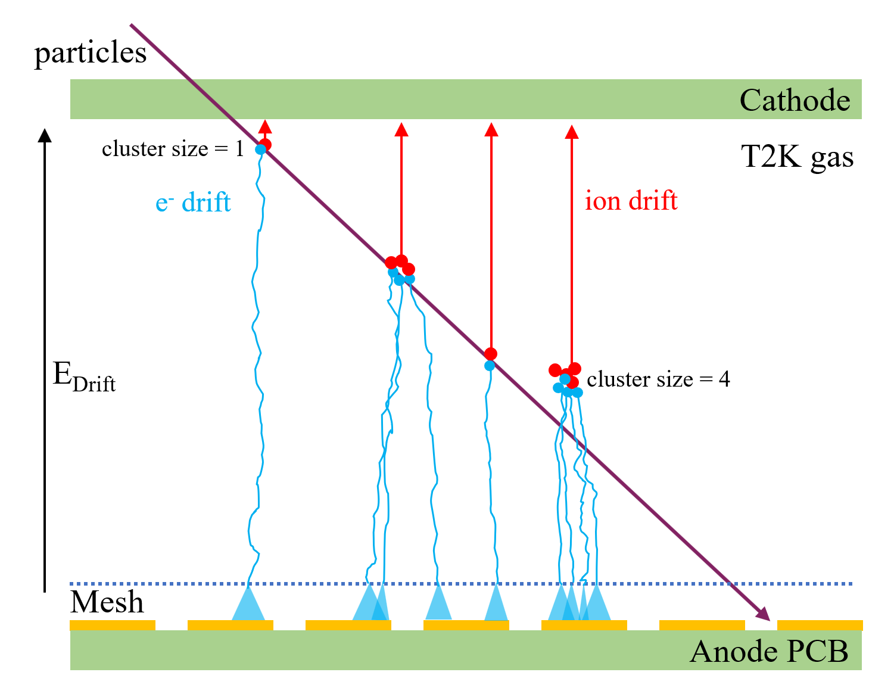
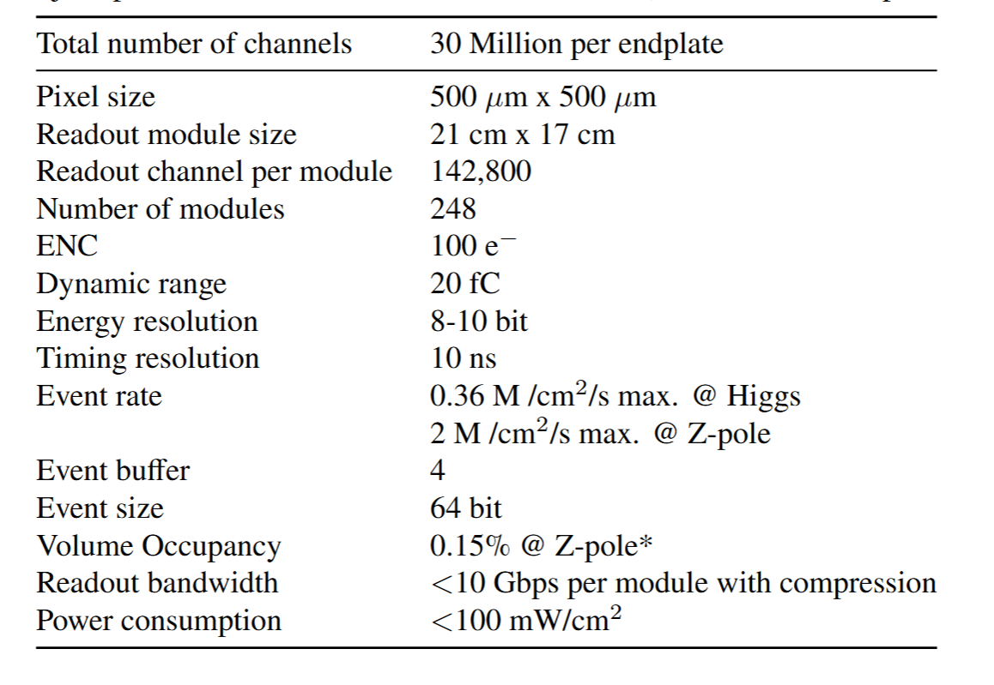
TPC Readout
A
B
v
1~2 Clusters per pixel
Remarks:
From C to D, the detector granularity defines the readout pattern
The current pixel size is 500x500 um²
Electronics noise is 100 e⁻
C
D
500um

Slide 18
Reconstruction Algorithm: dN/dx
Intuition:
Ionization is proportional to the number of fired pixels
Algorithm:
Count the number of hits whose energies are above a threshold
Discard the top 30% of layers with the highest hits and take sum
Output:
$N$ [n/cm⁻¹]
Sum the pixel number over a layer/ muti-layer
The smaller the pixel, the more it is affected by secondary ionization.
Distribution of hit numbers merged from 5 layers of pixels(200um & 500um)

Slide 19
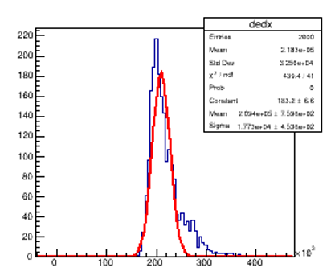
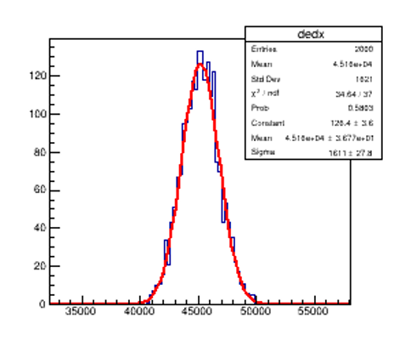
Reconstruction Algorithm: dE/dx
Intuition:
Ionization is proportional to the energy deposition
Algorithm:
Combine hits into layers (row-wise or column wise)
Calculate the sum of the energy deposition within each layer
Discard the top 30% of layers with the highest energy and take sum
Output:
$E$ [charge/cm⁻¹]
Sum the energies over a layer /muti-layer
Distribution of Energy before and after truncation.

Slide 20
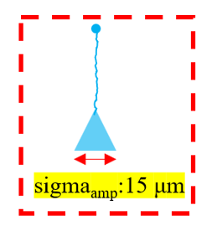
Digitization Parameters
Single ionization electron
Avalanche electrons
Signal width:
Double Gaussian $σ_{amp}$
Amplification: Single electron → Avalanche electrons
Amplification factor $f_{amp}$ (# of electrons): x 2000
Signal width $σ_{amp}$: 15 $μm$
Electronics noise:
Single channel noise: 100 e⁻

