Slide 1


Holographic applications, from quantum realms to the big bang
UCAS Beijing, Jul 11-19, 2025
Resurgence and $T\overline{T}$-deformed Torus Partition function
based on 2410.19633 (PRL accepted); 2503.19350, Jie Gu, Yunfeng Jiang, Huajia Wang
Huajia Wang
Kavli Institute for Theoretical Sciences (KITS)
University of Chinese Academy of Sciences (UCAS)

Slide 2
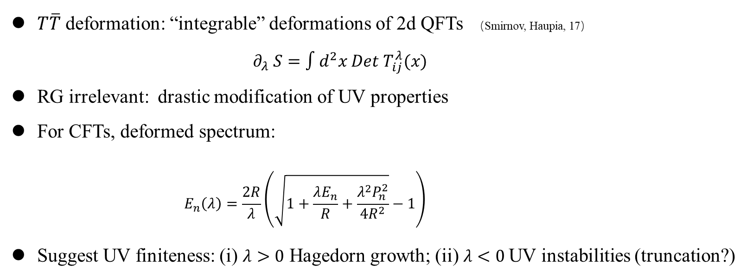
Introduction and Motivation
$T\overline{T}$ deformation: “integrable” deformations of 2d QFTs （Smirnov, Haupia, 17）
    $$∂_{λ} S=∫d^{2}x Det T_{ij}^{λ}(x)$$
RG irrelevant: drastic modification of UV properties
For CFTs, deformed spectrum:
        $$E_{n}\left(λ\right)=\frac{2R}{λ}\left(\sqrt{1+\frac{λE_{n}}{R}+\frac{λ^{2}P_{n}^{2}}{{4R}^{2}}}−1\right)$$
Suggest UV finiteness: (i) $λ>0$ Hagedorn growth; (ii) $λ<0$UV instabilities (truncation?)
1.

Slide 3
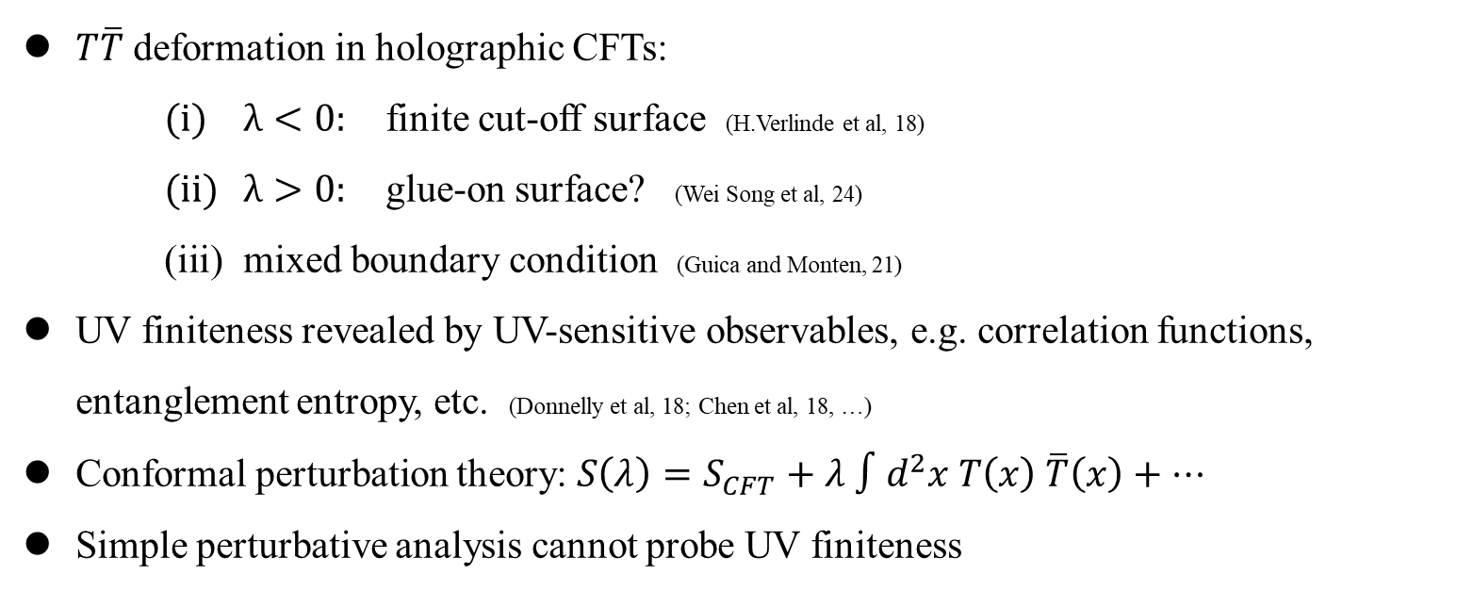
Introduction and Motivation
$T\overline{T}$ deformation in holographic CFTs:
    $λ<0:$ finite cut-off surface (H.Verlinde et al, 18)
    $λ>0:$ glue-on surface? (Wei Song et al, 24)
    mixed boundary condition (Guica and Monten, 21)
UV finiteness revealed by UV-sensitive observables, e.g. correlation functions, entanglement entropy, etc. (Donnelly et al, 18; Chen et al, 18, …)
Conformal perturbation theory: $S\left(λ\right)=S_{CFT}+λ ∫d^{2}x T\left(x\right) \overline{T}\left(x\right)+…$
Simple perturbative analysis cannot probe UV finiteness
2.

Slide 4
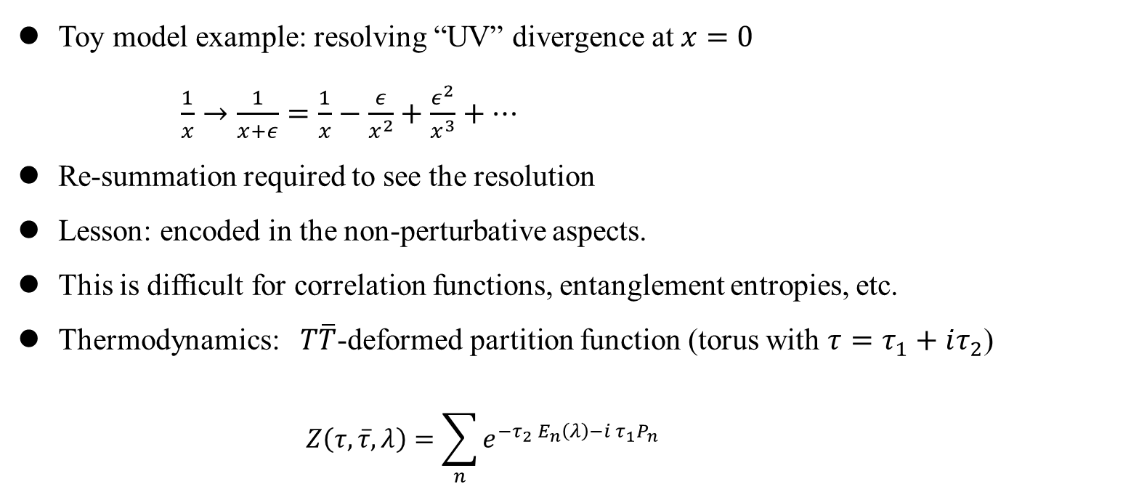
Introduction and Motivation
Toy model example: resolving “UV” divergence at $x=0$
      $\frac{1}{x}→\frac{1}{x+ε}=\frac{1}{x}−\frac{ε}{x^{2}}+\frac{ε^{2}}{x^{3}}+…$
Re-summation required to see the resolution
Lesson: encoded in the non-perturbative aspects.
This is difficult for correlation functions, entanglement entropies, etc.
Thermodynamics: $T\overline{T}$-deformed partition function (torus with $τ=τ_{1}+iτ_{2}$)
      $$Z\left(τ,\overline{τ},λ\right)=\sum_{n}{e^{−τ_{2} E_{n}\left(λ\right)−i τ_{1}P_{n}}}$$
3.

Slide 5
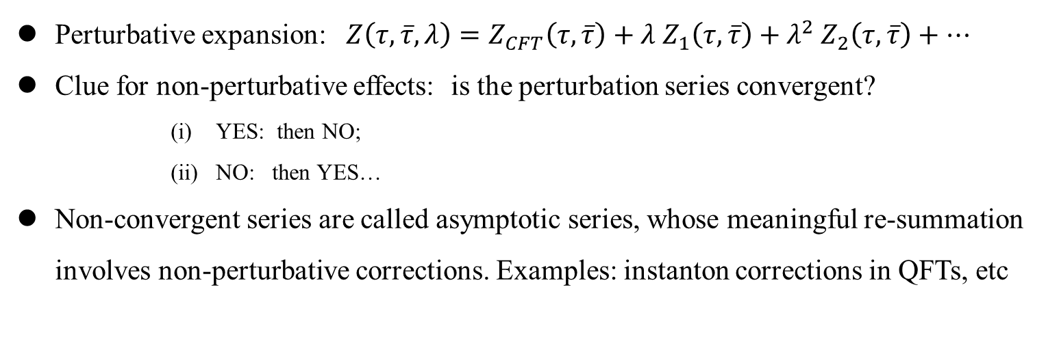
Introduction and Motivation
Perturbative expansion: $Z\left(τ,\overline{τ},λ\right)=Z_{CFT}\left(τ,\overline{τ}\right)+λ Z_{1}\left(τ,\overline{τ}\right)+λ^{2} Z_{2}\left(τ,\overline{τ}\right)+…$
Clue for non-perturbative effects: is the perturbation series convergent?
      YES: then NO;
      NO: then YES…
Non-convergent series are called asymptotic series, whose meaningful re-summation involves non-perturbative corrections. Examples: instanton corrections in QFTs, etc
4.

Slide 6
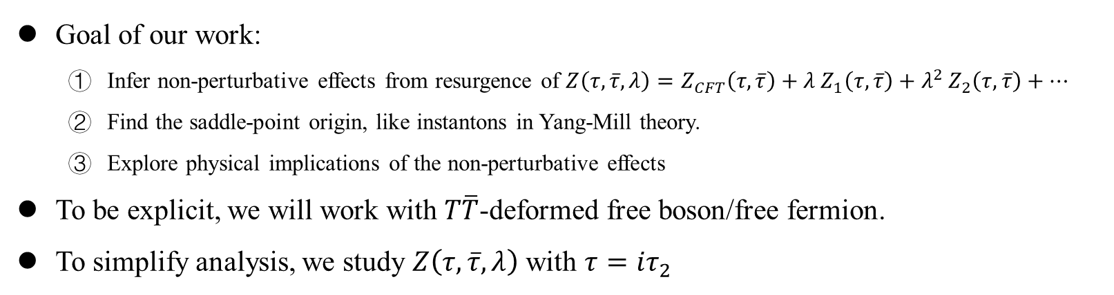
Introduction and Motivation
Goal of our work:
  Infer non-perturbative effects from resurgence of $Z\left(τ,\overline{τ},λ\right)=Z_{CFT}\left(τ,\overline{τ}\right)+λ Z_{1}\left(τ,\overline{τ}\right)+λ^{2} Z_{2}\left(τ,\overline{τ}\right)+…$
  Find the saddle-point origin, like instantons in Yang-Mill theory.
  Explore physical implications of the non-perturbative effects
To be explicit, we will work with $T\overline{T}$-deformed free boson/free fermion.
To simplify analysis, we study $Z\left(τ, \overline{τ}, λ\right)$ with $τ=iτ_{2}$
5.

Slide 7
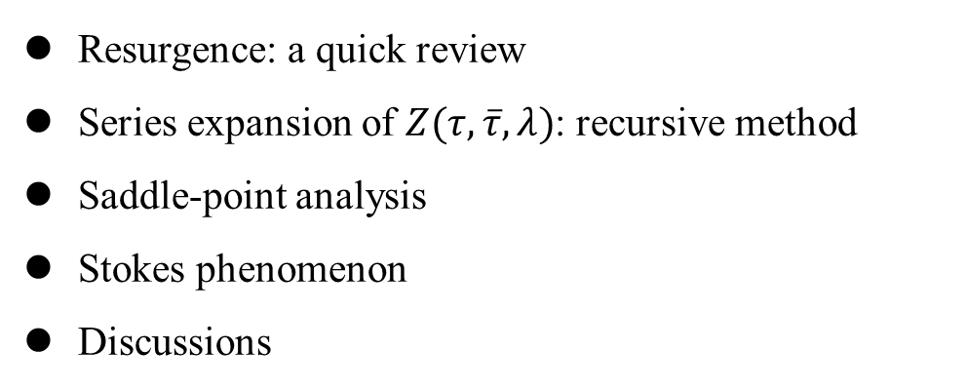
Outline
Resurgence: a quick review
Series expansion of $Z(τ,\overline{τ},λ)$: recursive method
Saddle-point analysis
Stokes phenomenon
Discussions
6.

Slide 8
Outline
Resurgence: a quick review
Series expansion of $Z(τ,\overline{τ},λ)$: recursive method
Saddle-point analysis
Stokes phenomenon
Discussions
6.

Slide 9
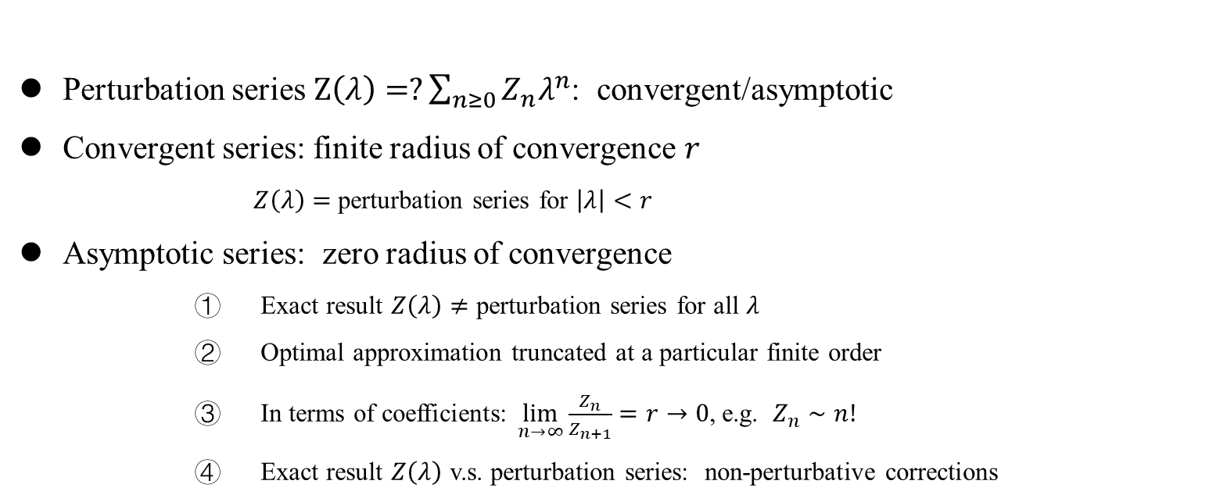
Resurgence: a quick review
Perturbation series $Z\left(λ\right)=?\sum_{n≥0}{Z_{n}λ^{n}}$: convergent/asymptotic
Convergent series: finite radius of convergence $r$
        $Z\left(λ\right)=$ perturbation series for $\left|λ\right|<r$
Asymptotic series: zero radius of convergence
      Exact result $Z\left(λ\right)≠$ perturbation series for all $λ$
      Optimal approximation truncated at a particular finite order
      In terms of coefficients: $\lim_{n→∞}\frac{Z_{n}}{Z_{n+1}}=r→0$, e.g. $Z_{n}∼n!$
      Exact result $Z\left(λ\right)$ v.s. perturbation series: non-perturbative corrections
7.

Slide 10
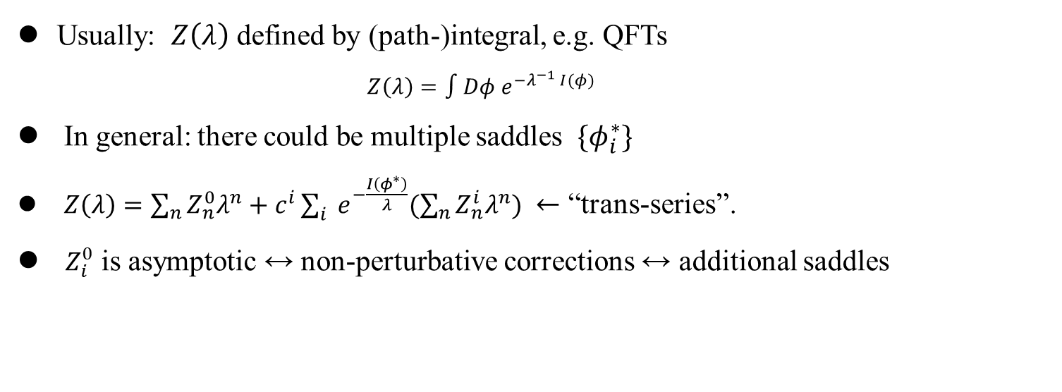
Resurgence: a quick review
Usually: $Z\left(λ\right)$ defined by (path-)integral, e.g. QFTs
    $$Z\left(λ\right)=∫Dφ e^{−λ^{−1} I(φ)}$$
In general: there could be multiple saddles $\{φ_{i}^{∗}\}$
$Z\left(λ\right)=\sum_{n}{Z_{n}^{0}λ^{n}}+c^{i}\sum_{i}{ e^{−\frac{I\left(φ^{∗}\right)}{λ}}(\sum_{n}{Z_{n}^{i}λ^{n}}) }$ $←$ “trans-series”.
$Z_{i}^{0}$ is asymptotic $↔$ non-perturbative corrections $↔$ additional saddles
8.

Slide 11
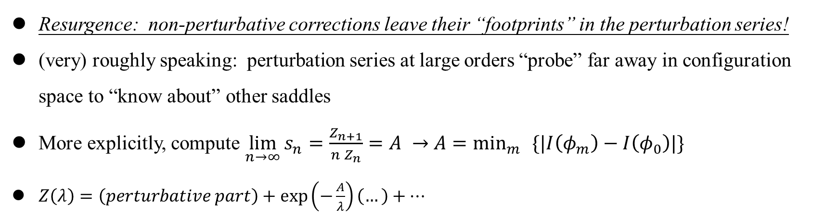
Resurgence: a quick review
Resurgence: non-perturbative corrections leave their “footprints” in the perturbation series!
(very) roughly speaking: perturbation series at large orders “probe” far away in configuration space to “know about” other saddles
More explicitly, compute $\lim_{n→∞}{s_{n}=\frac{Z_{n+1}}{n Z_{n}}=A}$ $→$ $A=\min_{m}{ }\{|I\left(φ_{m}\right)−I\left(φ_{0}\right)|\}$
$Z\left(λ\right)=\left(perturbative part\right)+\exp\left(−\frac{A}{λ}\right)\left(…\right)+…$
9.

Slide 12
Introduction and Motivation
Resurgence: a quick review
Series expansion of $Z(τ,\overline{τ},λ)$: recursive method
Saddle-point analysis
Stokes phenomenon
Discussions

Slide 13

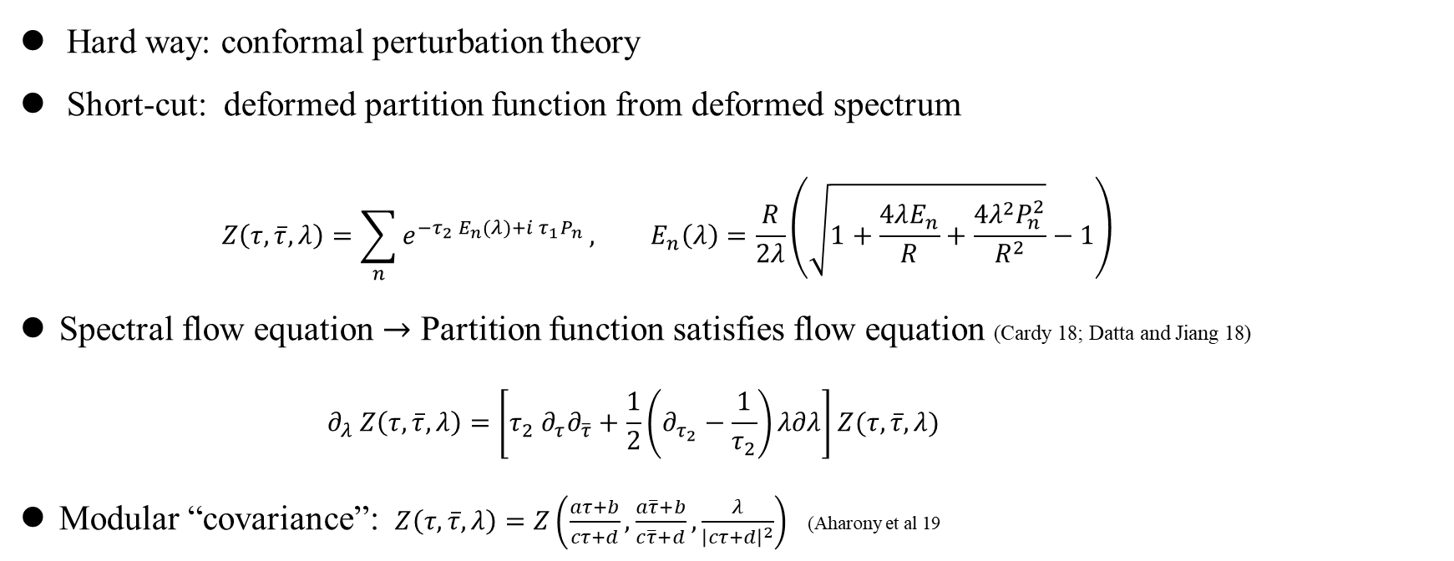
Series expansion of $Z(τ,\overline{τ},λ)$: recursive method
Hard way: conformal perturbation theory
Short-cut: deformed partition function from deformed spectrum
    $$Z\left(τ,\overline{τ},λ\right)=\sum_{n}{e^{−τ_{2} E_{n}(λ)+i τ_{1}P_{n}}}, E_{n}\left(λ\right)=\frac{R}{2λ}\left(\sqrt{1+\frac{4λE_{n}}{R}+\frac{4λ^{2}P_{n}^{2}}{R^{2}}}−1\right)$$
Spectral flow equation $→$ Partition function satisfies flow equation (Cardy 18; Datta and Jiang 18)
      $$∂_{λ} Z\left(τ,\overline{τ},λ\right)=\left[τ_{2} ∂_{τ}∂_{\overline{τ}}+\frac{1}{2}\left(∂_{τ_{2}}−\frac{1}{τ_{2}}\right)λ∂λ\right]Z(τ,\overline{τ},λ)$$
Modular “covariance”: $Z\left(τ,\overline{τ},λ\right)=Z\left(\frac{aτ+b}{cτ+d},\frac{a\overline{τ}+b}{c\overline{τ}+d},\frac{λ}{{\left|cτ+d\right|}^{2}}\right)$ (Aharony et al 19
10.

Slide 14
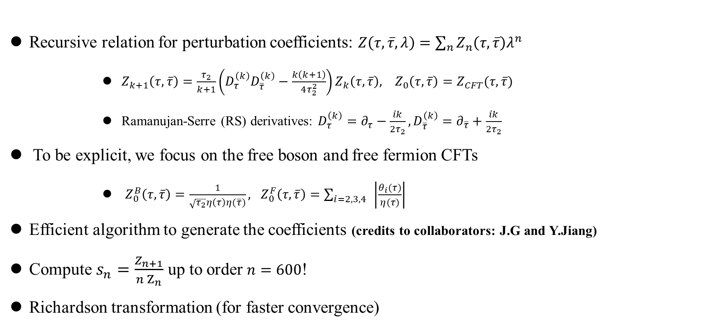
Series expansion of $Z(τ,\overline{τ},λ)$: recursive method
Recursive relation for perturbation coefficients: $Z\left(τ,\overline{τ},λ\right)=\sum_{n}{Z_{n}\left(τ,\overline{τ}\right)λ^{n}}$
      $Z_{k+1}\left(τ,\overline{τ}\right)=\frac{τ_{2}}{k+1}\left(D_{τ}^{\left(k\right)}D_{\overline{τ}}^{\left(k\right)}−\frac{k\left(k+1\right)}{4τ_{2}^{2}}\right)Z_{k}\left(τ,\overline{τ}\right), Z_{0}\left(τ,\overline{τ}\right)=Z_{CFT}(τ,\overline{τ})$
      Ramanujan-Serre (RS) derivatives: $D_{τ}^{\left(k\right)}=∂_{τ}−\frac{ik}{2τ_{2}}, D_{\overline{τ}}^{\left(k\right)}=∂_{\overline{τ}}+\frac{ik}{2τ_{2}}$
To be explicit, we focus on the free boson and free fermion CFTs
      $Z_{0}^{B}\left(τ,\overline{τ}\right)=\frac{1}{\sqrt{τ_{2}}η\left(τ\right)η(\overline{τ})}, Z_{0}^{F}\left(τ,\overline{τ}\right)=\sum_{i=2,3,4}{ }\left|\frac{θ_{i}(τ)}{η(τ)}\right|$
Efficient algorithm to generate the coefficients (credits to collaborators: J.G and Y.Jiang)
Compute $s_{n}=\frac{Z_{n+1}}{n Z_{n}}$ up to order $n=600$!
Richardson transformation (for faster convergence)
11.

Slide 15
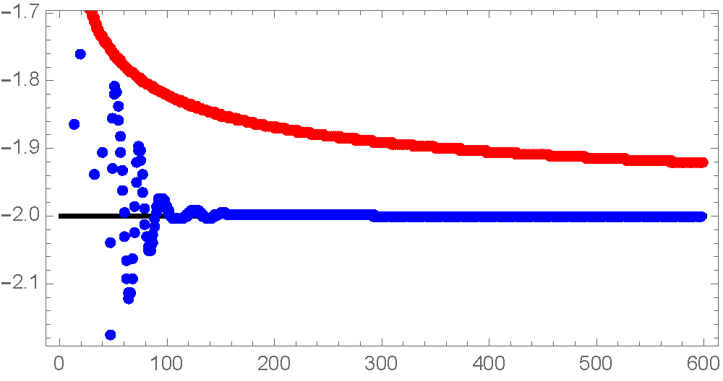
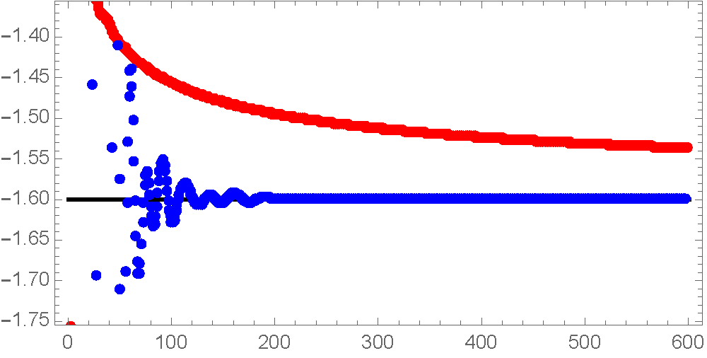
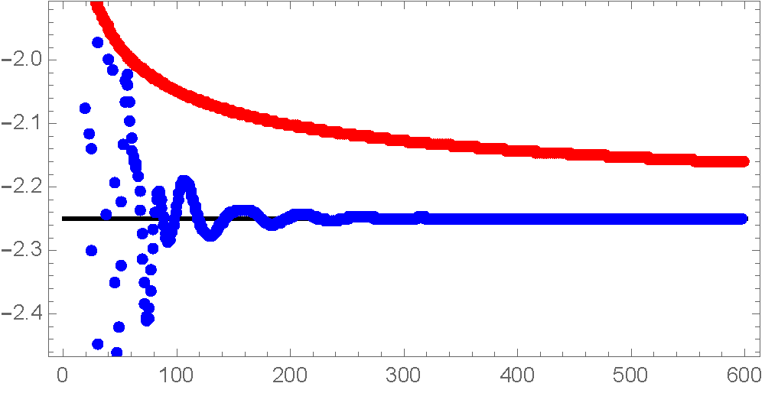
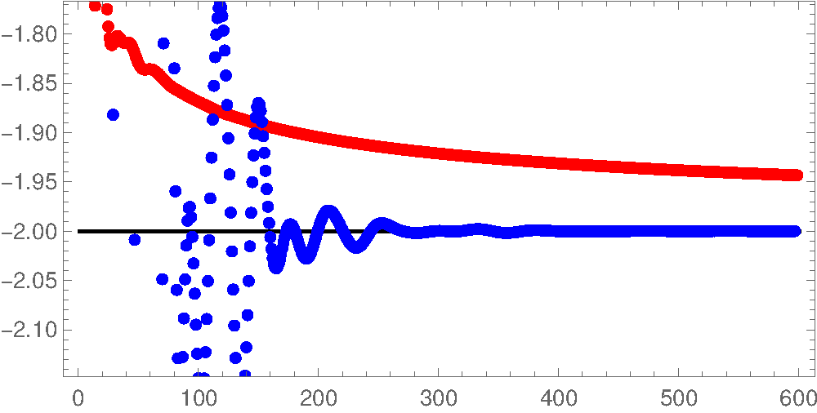
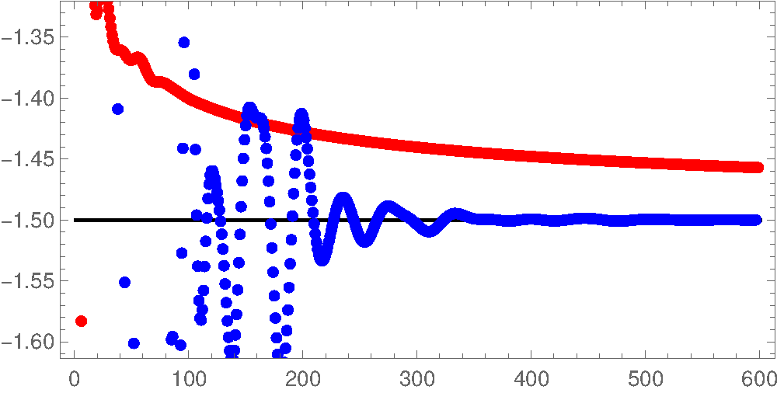
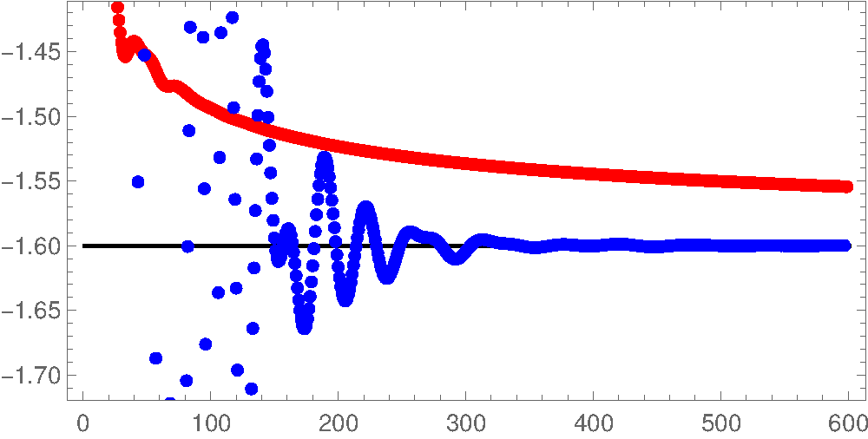






Series expansion of $Z(τ,\overline{τ},λ)$: recursive method
$$τ_{2}=1$$
$τ_{2}=4/$5
$$τ_{2}=9/8$$
Free boson
$$τ_{2}=1$$
$τ_{2}=3$/4
$τ_{2}=4$/5
Free fermion
$N$umerical observation in both free boson/fermion: $\lim_{n→∞}{s_{n}=−2τ_{2} }$
12.

Slide 16
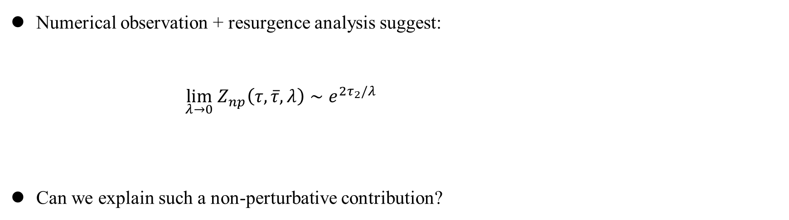
Series expansion of $Z(τ,\overline{τ},λ)$: recursive method
Numerical observation + resurgence analysis suggest:
$\lim_{λ→0} Z_{np}\left(τ,\overline{τ},λ\right)∼e^{2τ_{2}/λ}$
Can we explain such a non-perturbative contribution?
13.

Slide 17
Outline
Resurgence: a quick review
Series expansion of $Z(τ,\overline{τ},λ)$: recursive method
Saddle-point analysis
Stokes phenomenon
Discussions

Slide 18
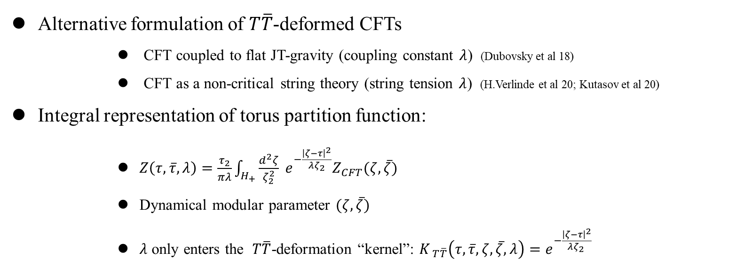
Saddle-point analysis:
Alternative formulation of $T\overline{T}$-deformed CFTs
      CFT coupled to flat JT-gravity (coupling constant $λ$) (Dubovsky et al 18)
      CFT as a non-critical string theory (string tension $λ$) (H.Verlinde et al 20; Kutasov et al 20)
Integral representation of torus partition function:
      $Z\left(τ,\overline{τ},λ\right)=\frac{τ_{2}}{πλ}\int_{H_{+}}{\frac{d^{2}ζ}{ζ_{2}^{2}}} e^{−\frac{{\left|ζ−τ\right|}^{2}}{λζ_{2}}}Z_{CFT}(ζ,\overline{ζ})$
      Dynamical modular parameter $(ζ,\overline{ζ})$
      $λ$ only enters the $T\overline{T}$-deformation “kernel”: $K_{ T\overline{T}}\left(τ,\overline{τ}, ζ,\overline{ζ},λ\right)=e^{−\frac{{\left|ζ−τ\right|}^{2}}{{λζ}_{2} }}$
14.

Slide 19
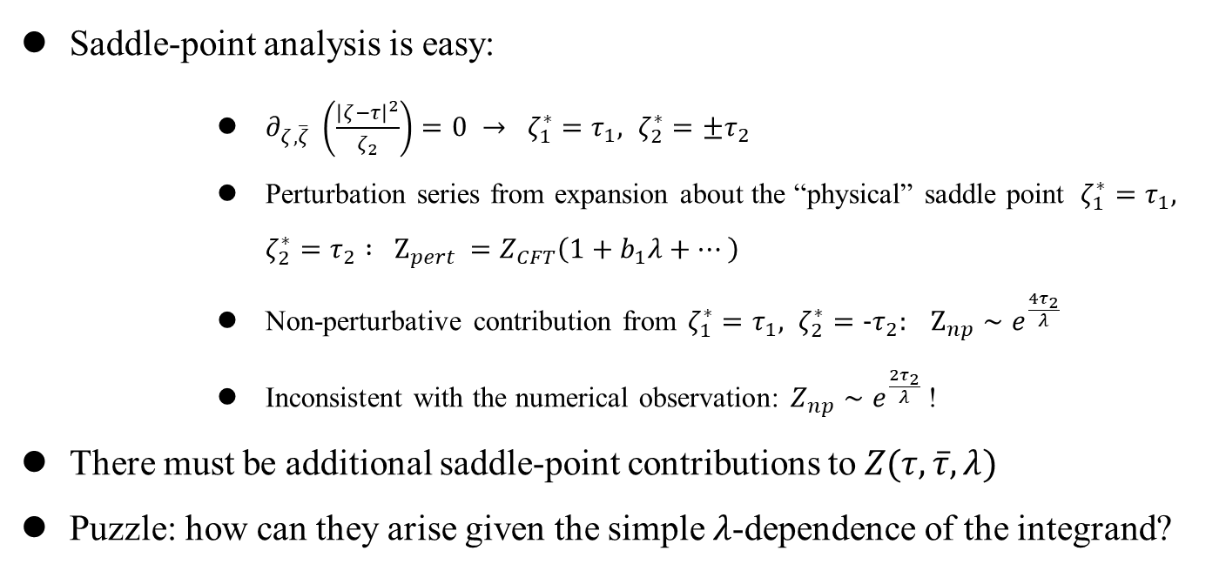
Saddle-point analysis:
Saddle-point analysis is easy:
      $∂_{ζ,\overline{ζ}} \left(\frac{{\left|ζ−τ\right|}^{2}}{ζ_{2}}\right)=0 → ζ_{1}^{∗}=τ_{1}, ζ_{2}^{∗}=±τ_{2}$
      Perturbation series from expansion about the “physical” saddle point $ζ_{1}^{∗}=τ_{1}, ζ_{2}^{∗}=τ_{2}$ $: Z_{pert }=Z_{CFT}\left(1+b_{1}λ+…\right)$
      Non-perturbative contribution from $ζ_{1}^{∗}=τ_{1}, ζ_{2}^{∗}=−τ_{2}: Z_{np}∼e^{\frac{4τ_{2}}{λ}}$
      Inconsistent with the numerical observation: $Z_{np}∼e^{\frac{2τ_{2}}{λ}}$ !
There must be additional saddle-point contributions to $Z(τ,\overline{τ},λ)$
Puzzle: how can they arise given the simple $λ$-dependence of the integrand?
15.

Slide 20
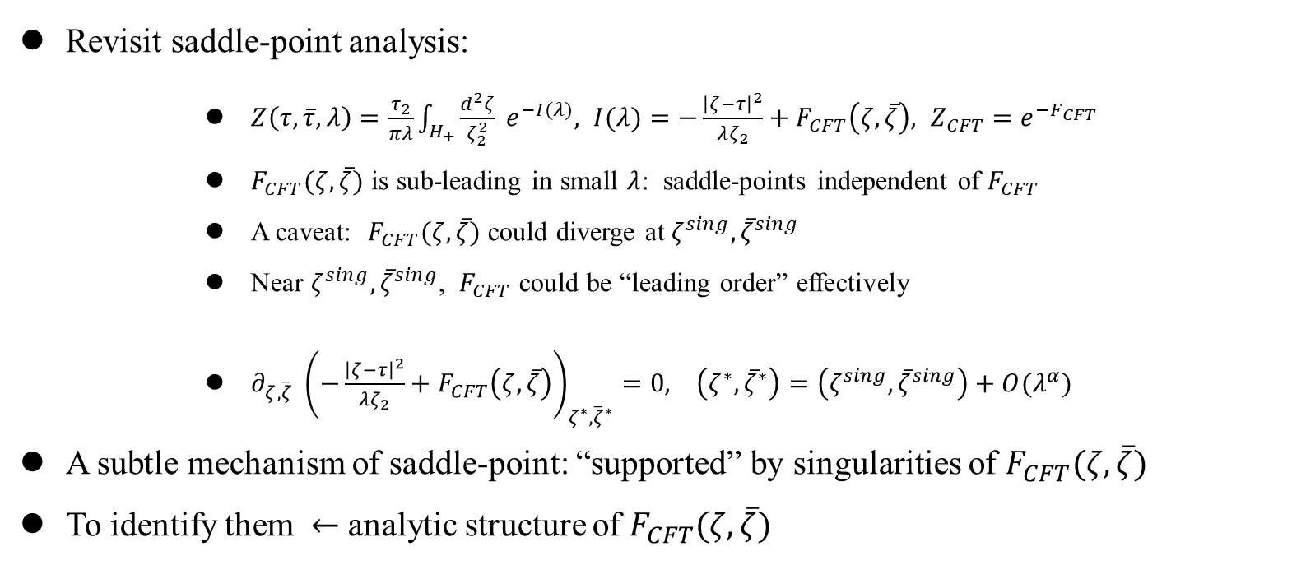
Saddle-point analysis:
Revisit saddle-point analysis:
      $Z\left(τ,\overline{τ},λ\right)=\frac{τ_{2}}{πλ}\int_{H_{+}}{\frac{d^{2}ζ}{ζ_{2}^{2}}} e^{−I(λ)}, I(λ)=−\frac{{\left|ζ−τ\right|}^{2}}{λζ_{2}}+F_{CFT}\left(ζ,\overline{ζ}\right), Z_{CFT}=e^{−F_{CFT}}$
      $F_{CFT}(ζ,\overline{ζ})$ is sub-leading in small $λ$: saddle-points independent of $F_{CFT}$
      A caveat: $F_{CFT}(ζ,\overline{ζ})$ could diverge at $ζ^{sing}, {\overline{ζ}}^{sing}$
      Near $ζ^{sing}, {\overline{ζ}}^{sing}$, $F_{CFT}$ could be “leading order” effectively
      $∂_{ζ,\overline{ζ}} {\left(−\frac{{\left|ζ−τ\right|}^{2}}{λζ_{2}}+F_{CFT}\left(ζ,\overline{ζ}\right)\right)}_{ζ^{∗},{\overline{ζ}}^{∗}}=0, \left(ζ^{∗},{\overline{ζ}}^{∗}\right)=\left(ζ^{sing},{\overline{ζ}}^{sing}\right)+O(λ^{α})$
A subtle mechanism of saddle-point: “supported” by singularities of $F_{CFT}(ζ, \overline{ζ})$
To identify them $←$ analytic structure of $F_{CFT}(ζ,\overline{ζ})$
16.

Slide 21
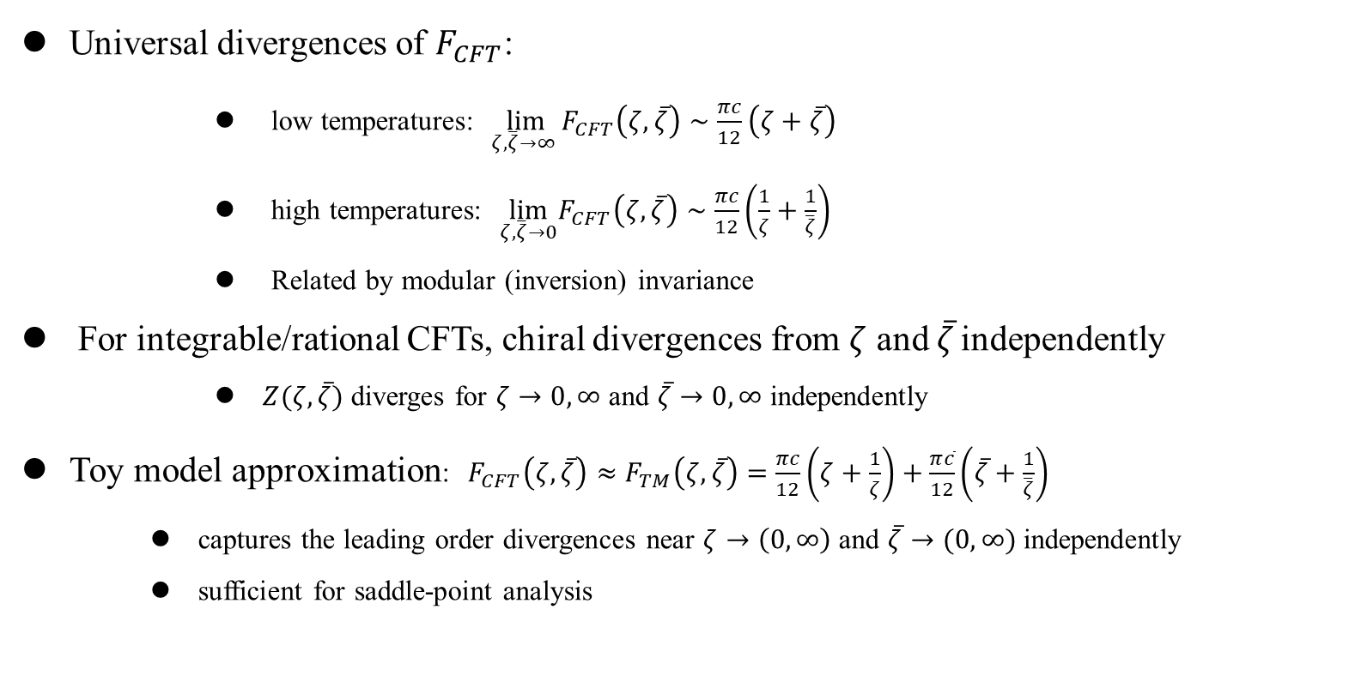
Saddle-point analysis:
Universal divergences of $F_{CFT}$:
      low temperatures: $\lim_{ζ,\overline{ζ}→∞ }F_{CFT}\left(ζ,\overline{ζ}\right)∼\frac{πc}{12}\left(ζ+\overline{ζ}\right)$
      high temperatures: $\lim_{ζ,\overline{ζ}→0}F_{CFT}\left(ζ,\overline{ζ}\right)∼\frac{πc}{12}\left(\frac{1}{ζ}+\frac{1}{\overline{ζ}}\right)$
      Related by modular (inversion) invariance
For integrable/rational CFTs, chiral divergences from $ζ$ and $\overline{ζ}$ independently
      $Z(ζ,\overline{ζ})$ diverges for $ζ→0, ∞$ and $\overline{ζ}→0,∞$ independently
Toy model approximation: $F_{CFT}\left(ζ,\overline{ζ}\right)≈F_{TM}\left(ζ,\overline{ζ}\right)=\frac{πc}{12}\left(ζ+\frac{1}{ζ}\right)+\frac{π\overline{c}}{12}\left(\overline{ζ}+\frac{1}{\overline{ζ}}\right)$
    captures the leading order divergences near $ζ→\left(0, ∞\right)$ and $\overline{ζ}→(0,∞)$ independently
    sufficient for saddle-point analysis
17.

Slide 22
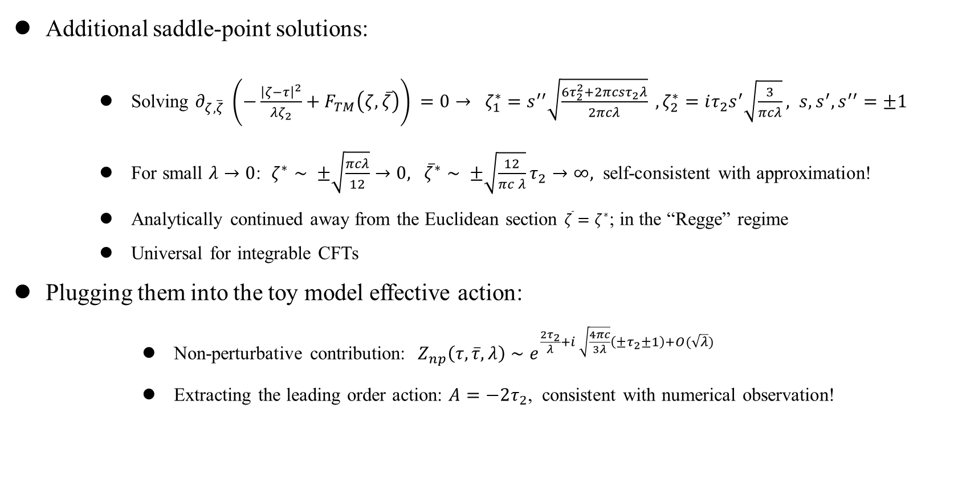
Saddle-point analysis:
Additional saddle-point solutions:
    Solving $∂_{ζ,\overline{ζ}} {\left(−\frac{{\left|ζ−τ\right|}^{2}}{λζ_{2}}+F_{TM}\left(ζ,\overline{ζ}\right)\right)}_{ }=0→ ζ_{1}^{∗}=s^{′′}\sqrt{\frac{6τ_{2}^{2}+2πcsτ_{2}λ}{2πcλ}} , ζ_{2}^{∗}=iτ_{2}s^{′}\sqrt{\frac{3}{πcλ}}, s,s^{′},s^{′′}=±1$
    For small $λ→0$: $ζ^{∗}∼ ±\sqrt{\frac{πcλ}{12}}→0, {\overline{ζ}}^{∗}∼ ±\sqrt{\frac{12}{πc λ}}τ_{2}→∞,$ self-consistent with approximation!
    Analytically continued away from the Euclidean section $\overline{ζ}=ζ^{∗}$; in the “Regge” regime
    Universal for integrable CFTs
Plugging them into the toy model effective action:
      Non-perturbative contribution: $Z_{np}\left(τ,\overline{τ},λ\right)∼e^{\frac{2τ_{2}}{λ}+i \sqrt{\frac{4πc}{3λ}}\left(±τ_{2}±1\right)+O(\sqrt{λ})}$
      Extracting the leading order action: $A=−2τ_{2}$, consistent with numerical observation!
18.

Slide 23
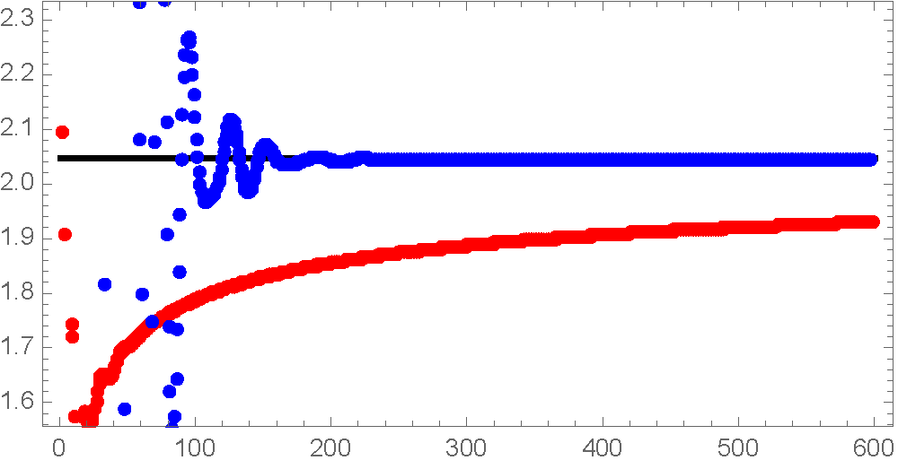
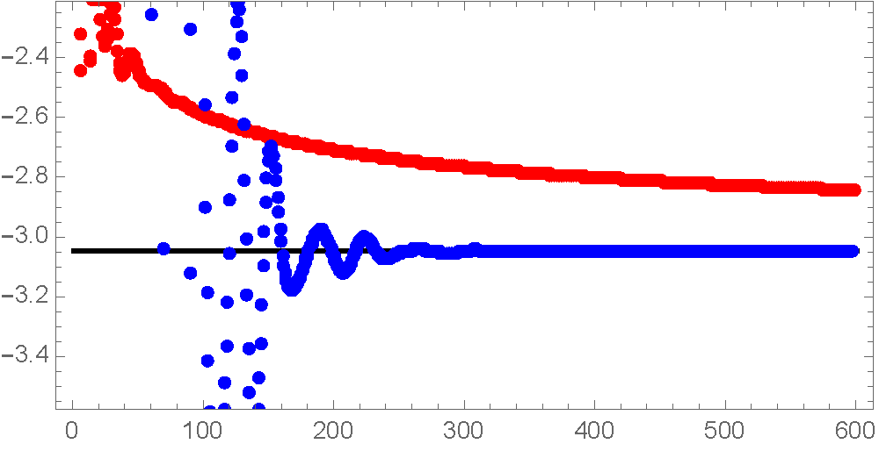
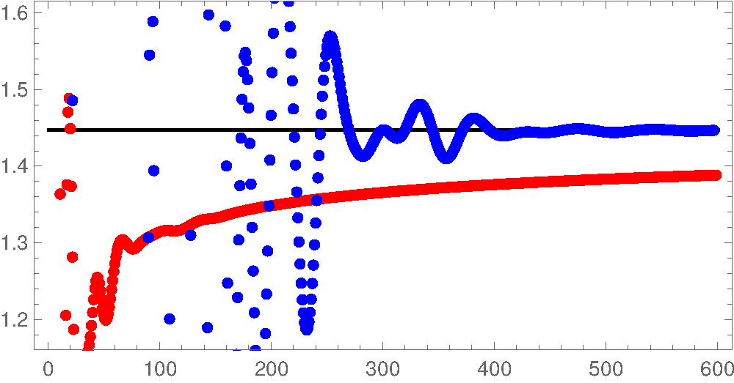
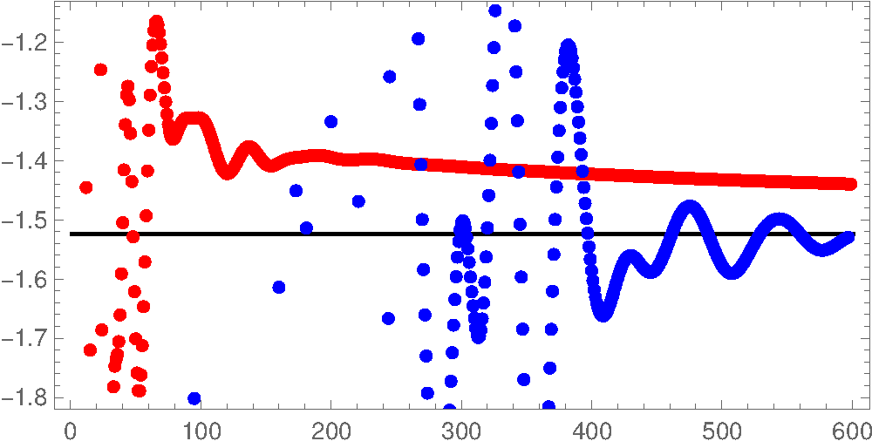





Can check higher order in $1/n$ corrections to $s_{n}$:
$$O(1)$$
$$O(n^{−1/2 })$$
$$O(n^{−1 })$$
Free boson
$$τ_{2}=1$$
Free fermion
$$τ_{2}=1$$
19.

Slide 24
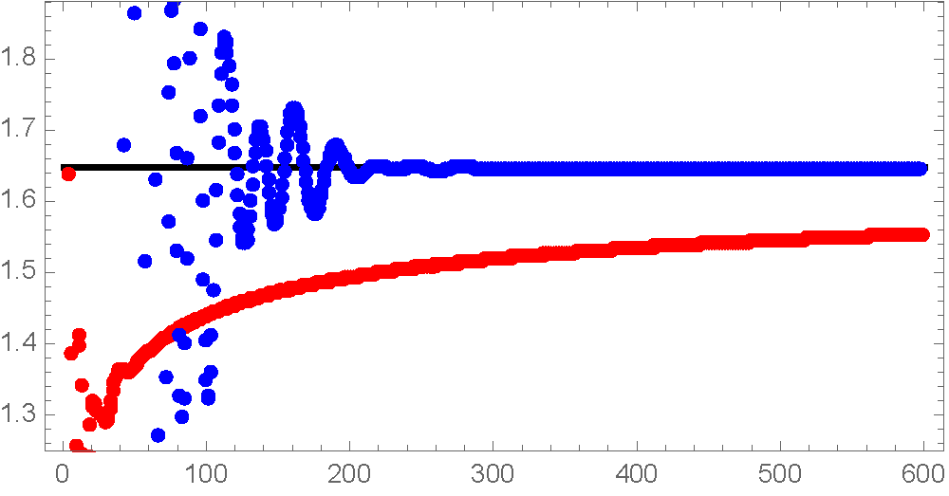
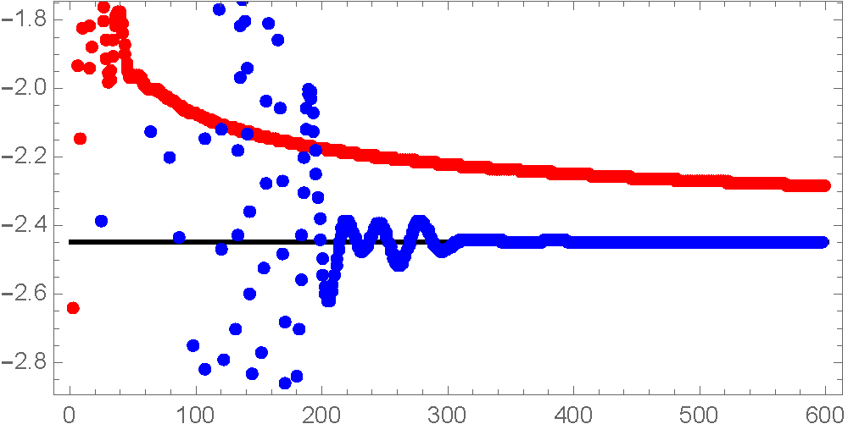
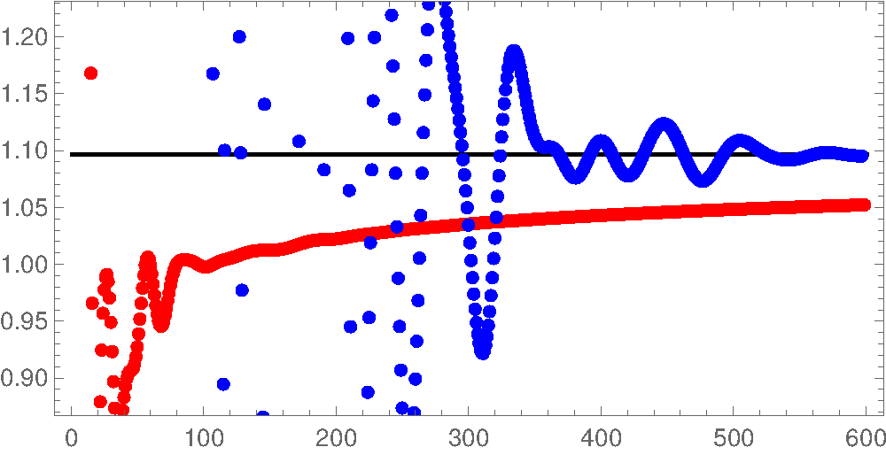
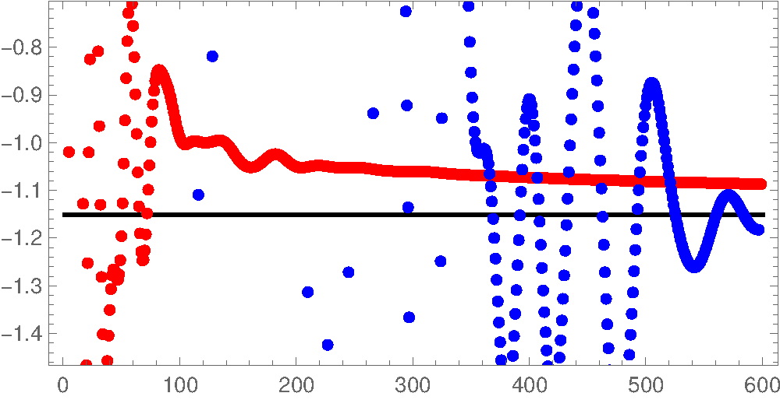


Can check higher order in $1/n$ corrections to $s_{n}$:
$$O(1)$$
$$O(n^{−1/2 })$$
$$O(n^{−1 })$$
Free boson
$$τ_{2}=4/5$$
Free fermion
$$τ_{2}=3/4$$
Great match -- we found the correct saddle-point origin!
20.

Slide 25
Outline
Resurgence: a quick review
Series expansion of $Z(τ,\overline{τ},λ)$: recursive method
Saddle-point analysis
Stokes phenomenon
Discussions

Slide 26
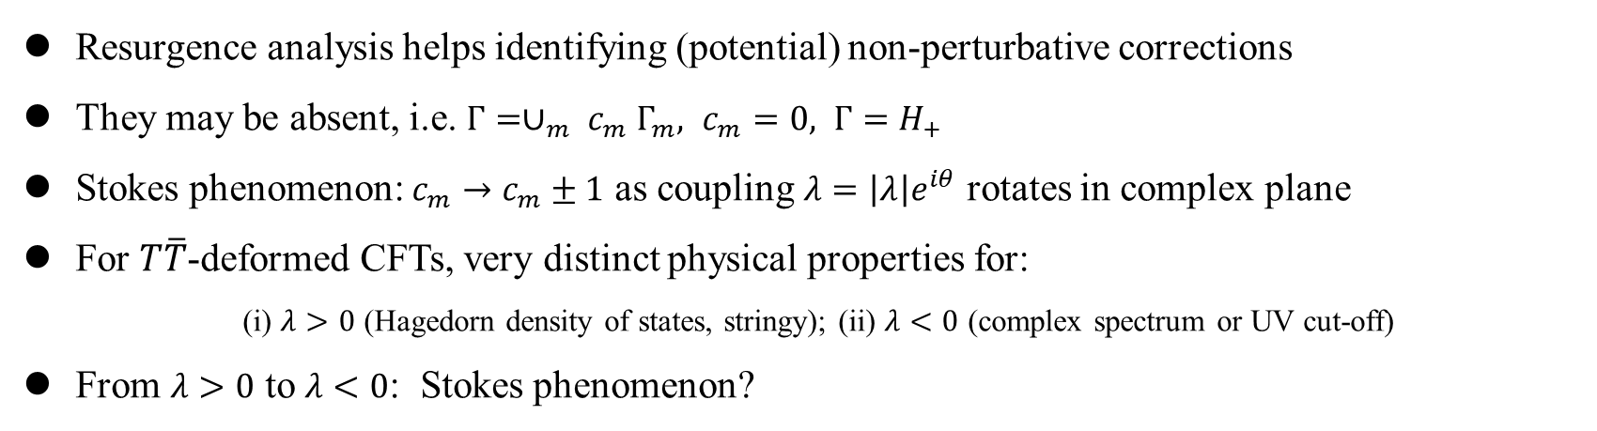
Stokes phenomenon
Resurgence analysis helps identifying (potential) non-perturbative corrections
They may be absent, i.e. $Γ=∪_{m} c_{m} Γ_{m}, c_{m}=0, Γ=H_{+}$
Stokes phenomenon: $c_{m}→c_{m}±1$ as coupling $λ=\left|λ\right|e^{iθ}$ rotates in complex plane
For $T\overline{T}$-deformed CFTs, very distinct physical properties for:
      (i) $λ>0$ (Hagedorn density of states, stringy); (ii) $λ<0$ (complex spectrum or UV cut-off)
From $λ>0$ to $λ<0$: Stokes phenomenon?
21.

Slide 27





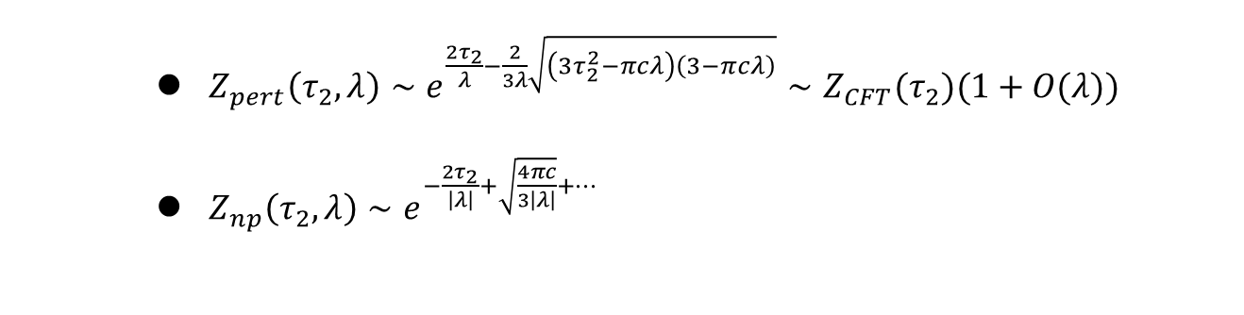
Stokes phenomenon
    $Z_{pert}\left(τ_{2},λ\right)∼e^{\frac{2τ_{2}}{λ}−\frac{2}{3λ}\sqrt{\left(3τ_{2}^{2}−πcλ\right)\left(3−πcλ\right)}}∼Z_{CFT}(τ_{2})(1+O(λ))$
    $Z_{np}\left(τ_{2},λ\right)∼e^{−\frac{2τ_{2}}{\left|λ\right|}+\sqrt{\frac{4πc}{3\left|λ\right|}}+…}$
$$λ$$
$$λ<0$$
$$λ>0$$
$$Z_{pert}\left(τ_{2},−|λ|\right)+Z_{np}(τ_{2},λ)$$
$$Z_{pert}\left(τ_{2},\left|λ\right|\right)$$
22.

Slide 28
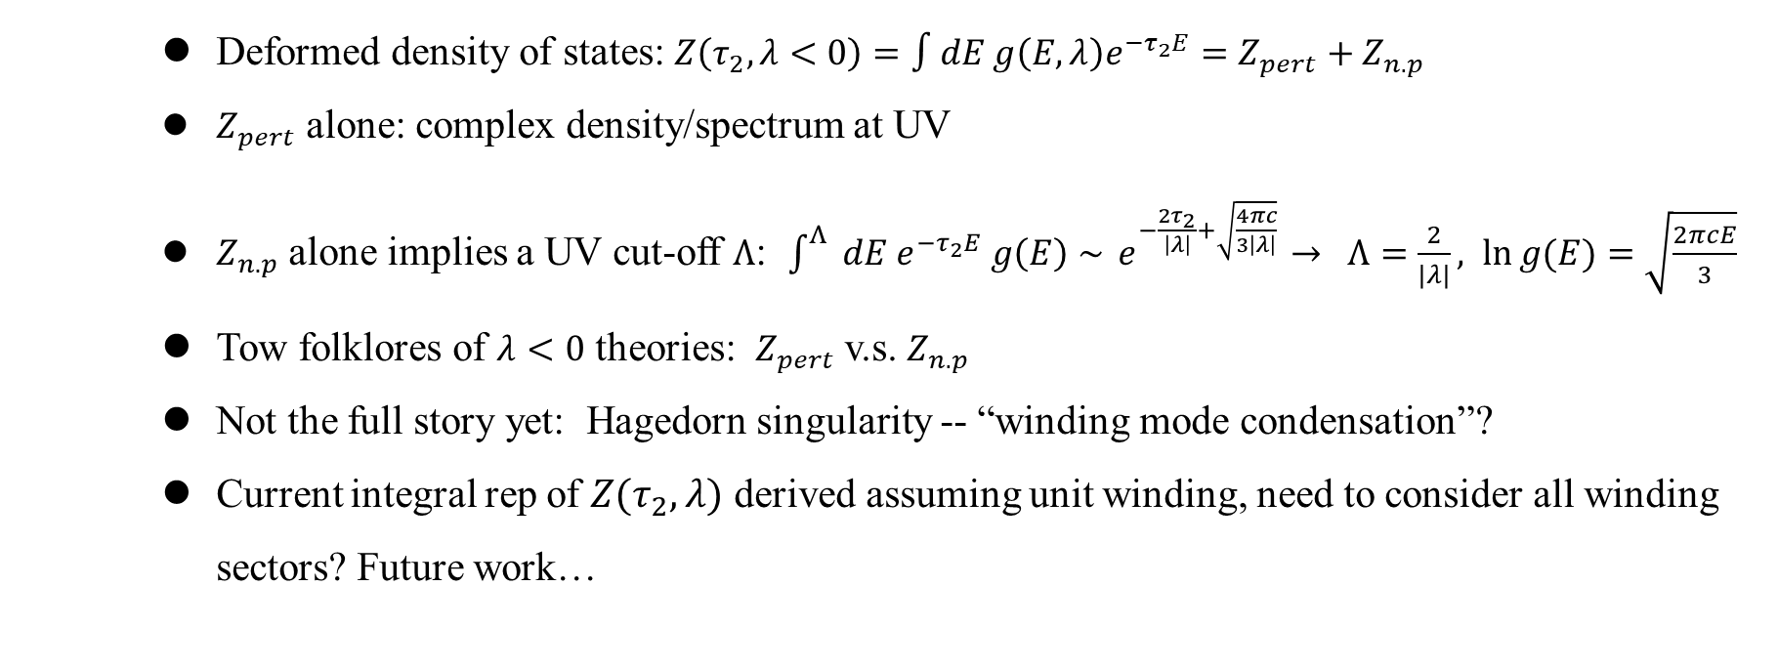
Stokes phenomenon
    Deformed density of states: $Z\left(τ_{2},λ<0\right)=∫dE g\left(E,λ\right)e^{−τ_{2}E}=Z_{pert}+Z_{n.p}$
    $Z_{pert}$ alone: complex density/spectrum at UV
    $Z_{n.p}$ alone implies a UV cut-off $Λ$: $\int_{ }^{Λ}{ dE e^{−τ_{2}E} g\left(E\right)∼}{ e}^{−\frac{2τ_{2}}{\left|λ\right|}+\sqrt{\frac{4πc}{3\left|λ\right|}}} → Λ=\frac{2}{|λ|}, \ln{g(E)}=\sqrt{\frac{2πcE}{3}}$
    Tow folklores of $λ<0$ theories: $Z_{pert}$ v.s. $Z_{n.p}$
    Not the full story yet: Hagedorn singularity -- “winding mode condensation”?
    Current integral rep of $Z(τ_{2},λ)$ derived assuming unit winding, need to consider all winding sectors? Future work…
23.

Slide 29
Outline
Resurgence: a quick review
Series expansion of $Z(τ,\overline{τ},λ)$: recursive method
Saddle-point analysis
Stokes phenomenon
Discussions

Slide 30
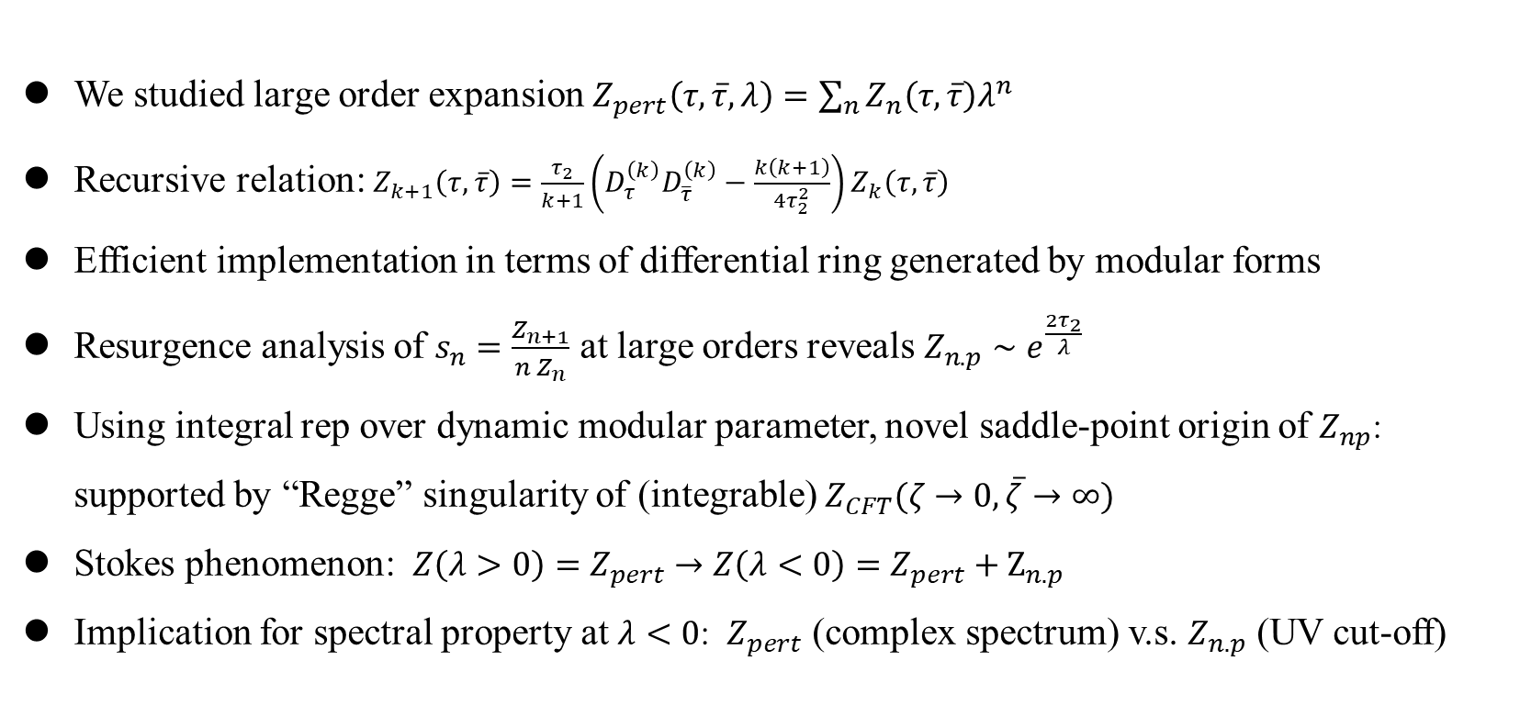
Summary
We studied large order expansion $Z_{pert}\left(τ,\overline{τ},λ\right)=\sum_{n}{Z_{n}\left(τ,\overline{τ}\right)λ^{n}}$
Recursive relation: $Z_{k+1}\left(τ,\overline{τ}\right)=\frac{τ_{2}}{k+1}\left(D_{τ}^{\left(k\right)}D_{\overline{τ}}^{\left(k\right)}−\frac{k\left(k+1\right)}{4τ_{2}^{2}}\right)Z_{k}\left(τ,\overline{τ}\right)$
Efficient implementation in terms of differential ring generated by modular forms
Resurgence analysis of $s_{n}=\frac{Z_{n+1}}{n Z_{n}}$ at large orders reveals $Z_{n.p}∼e^{\frac{2τ_{2}}{λ}}$
Using integral rep over dynamic modular parameter, novel saddle-point origin of $Z_{np}$: supported by “Regge” singularity of (integrable) $Z_{CFT}(ζ→0, \overline{ζ}→∞)$
Stokes phenomenon: $Z\left(λ>0\right)=Z_{pert}→Z\left(λ<0\right)=Z_{pert}+Z_{n.p}$
Implication for spectral property at $λ<0$: $Z_{pert}$ (complex spectrum) v.s. $Z_{n.p}$ (UV cut-off)
24.

Slide 31
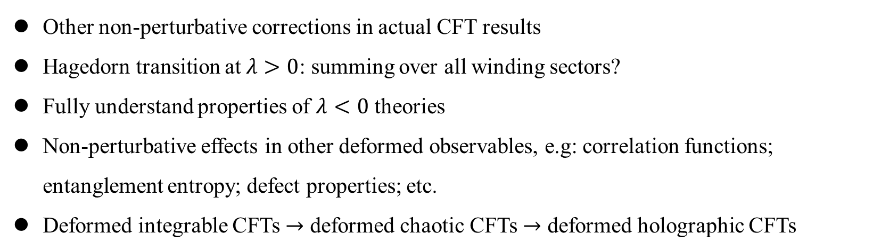
Outlook
Other non-perturbative corrections in actual CFT results
Hagedorn transition at $λ>0$: summing over all winding sectors?
Fully understand properties of $λ<0$ theories
Non-perturbative effects in other deformed observables, e.g: correlation functions; entanglement entropy; defect properties; etc.
Deformed integrable CFTs $→$ deformed chaotic CFTs $→$ deformed holographic CFTs
25.

Slide 32
Thank you!

Slide 33
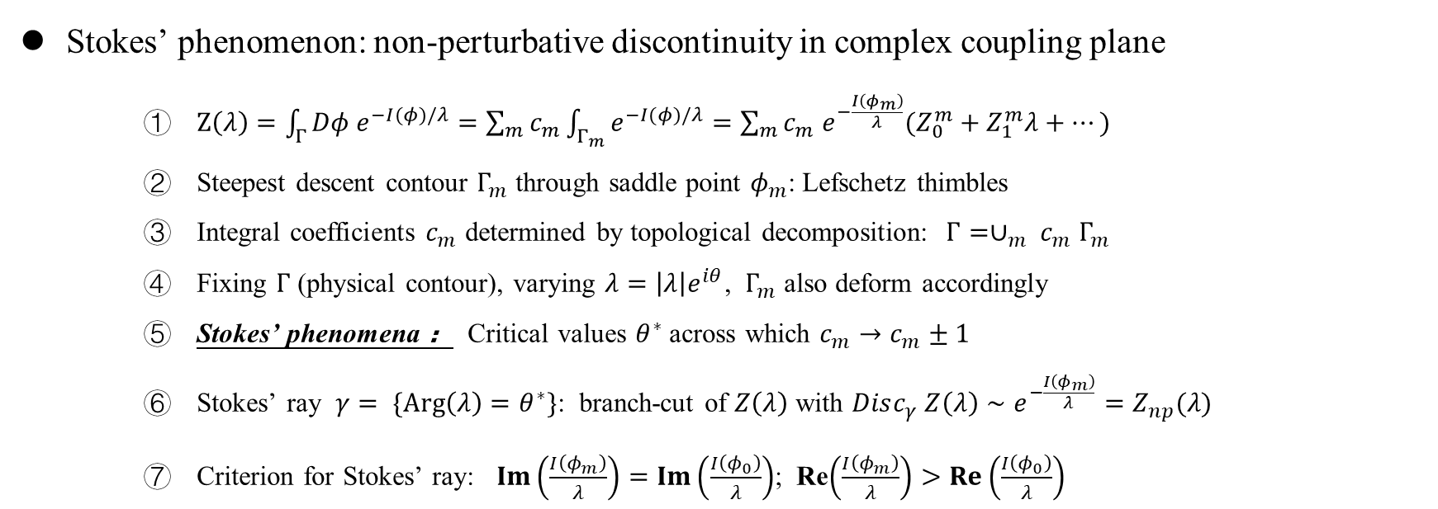
Resurgence: a quick review
Stokes’ phenomenon: non-perturbative discontinuity in complex coupling plane
    $Z\left(λ\right)=\int_{Γ}{Dφ e^{−I(φ)/λ}=\sum_{m}{c_{m}}\int_{Γ_{m}}{e^{−I(φ)/λ}}}=\sum_{m}{c_{m} e^{−\frac{I\left(φ_{m}\right)}{λ}}(Z_{0}^{m}+Z_{1}^{m}λ+…)}$
    Steepest descent contour $Γ_{m}$ through saddle point $φ_{m}$: Lefschetz thimbles
    Integral coefficients $c_{m}$ determined by topological decomposition: $Γ=∪_{m} c_{m} Γ_{m}$
    Fixing $Γ$ (physical contour), varying $λ=\left|λ\right|e^{iθ}$, $Γ_{m}$ also deform accordingly
    Stokes’ phenomena ： Critical values $θ^{∗}$ across which $c_{m}→c_{m}±1$
    Stokes’ ray $γ= \{Arg\left(λ\right)=θ^{∗}\}$: branch-cut of $Z\left(λ\right)$ with $Disc_{γ} Z\left(λ\right)∼e^{−\frac{I\left(φ_{m}\right)}{λ}}=Z_{np}(λ)$
    Criterion for Stokes’ ray: $Im\left(\frac{I\left(φ_{m}\right)}{λ}\right)=Im\left(\frac{I\left(φ_{0}\right)}{λ}\right)$; Re$\left(\frac{I\left(φ_{m}\right)}{λ}\right)>Re\left(\frac{I\left(φ_{0}\right)}{λ}\right)$

Slide 34
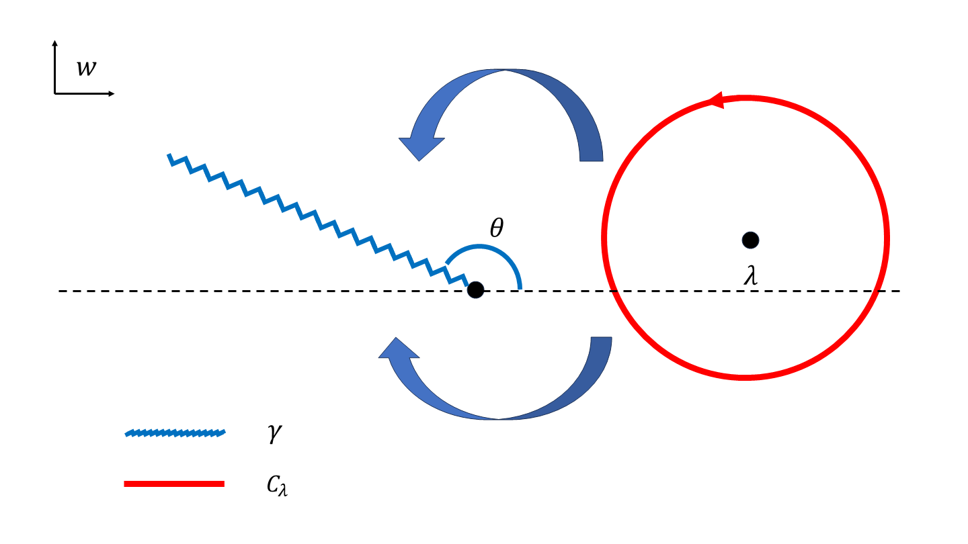
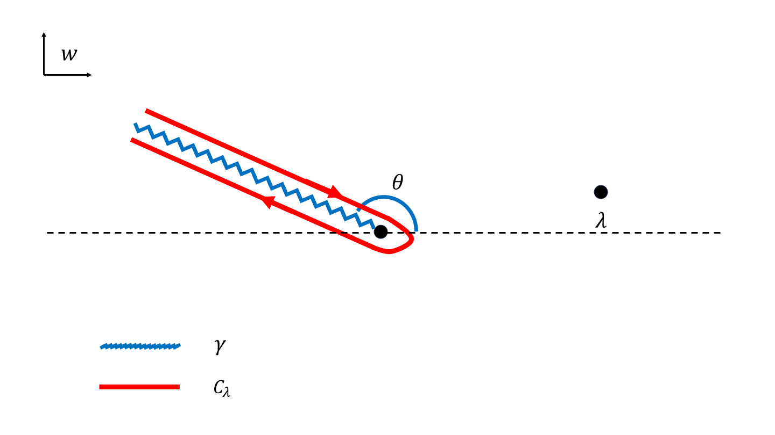
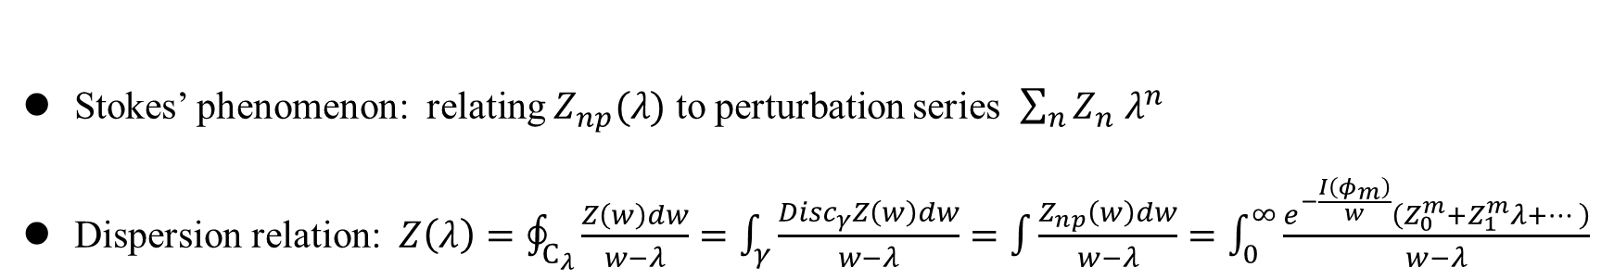
Resurgence: a quick review
Stokes’ phenomenon: relating $Z_{np}(λ)$ to perturbation series $\sum_{n}{Z_{n} λ^{n}}$
Dispersion relation: $Z\left(λ\right)=\oint_{C_{λ}}{\frac{Z\left(w\right)dw}{w−λ}}=\int_{γ}{\frac{Disc_{γ}Z\left(w\right)dw}{w−λ}}=\int{\frac{Z_{np}\left(w\right)dw}{w−λ}=\int_{0}^{∞}{\frac{e^{−\frac{I\left(φ_{m}\right)}{w}}\left(Z_{0}^{m}+Z_{1}^{m}λ+…\right)}{w−λ}}}$

Slide 35
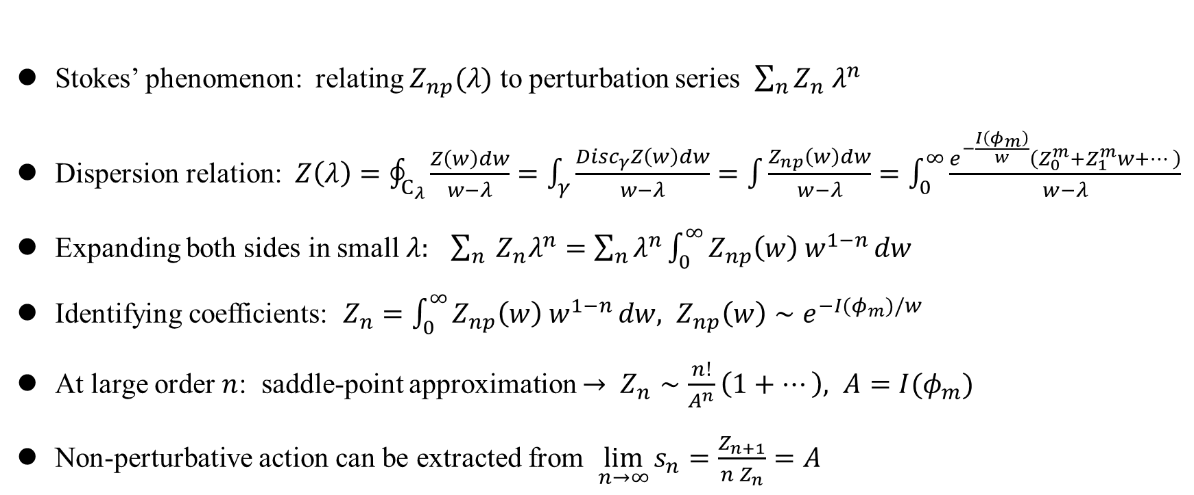
Resurgence: a quick review
Stokes’ phenomenon: relating $Z_{np}(λ)$ to perturbation series $\sum_{n}{Z_{n} λ^{n}}$
Dispersion relation: $Z\left(λ\right)=\oint_{C_{λ}}{\frac{Z\left(w\right)dw}{w−λ}}=\int_{γ}{\frac{Disc_{γ}Z\left(w\right)dw}{w−λ}}=\int{\frac{Z_{np}\left(w\right)dw}{w−λ}=\int_{0}^{∞}{\frac{e^{−\frac{I\left(φ_{m}\right)}{w}}\left(Z_{0}^{m}+Z_{1}^{m}w+…\right)}{w−λ}}}$
Expanding both sides in small $λ:$ $\sum_{n}{ Z_{n}λ^{n}}=\sum_{n}{λ^{n}}\int_{0}^{∞}{Z_{np}\left(w\right) w^{1−n}}dw$
Identifying coefficients: $Z_{n}=\int_{0}^{∞}{Z_{np}\left(w\right) w^{1−n}}dw, Z_{np}\left(w\right)∼e^{−I(φ_{m})/w}$
At large order $n$: saddle-point approximation $→$ $Z_{n}∼\frac{n!}{A^{n}}\left(1+…\right), A=I(φ_{m})$
Non-perturbative action can be extracted from $\lim_{n→∞}{s_{n}=\frac{Z_{n+1}}{n Z_{n}}=A}$

Slide 36
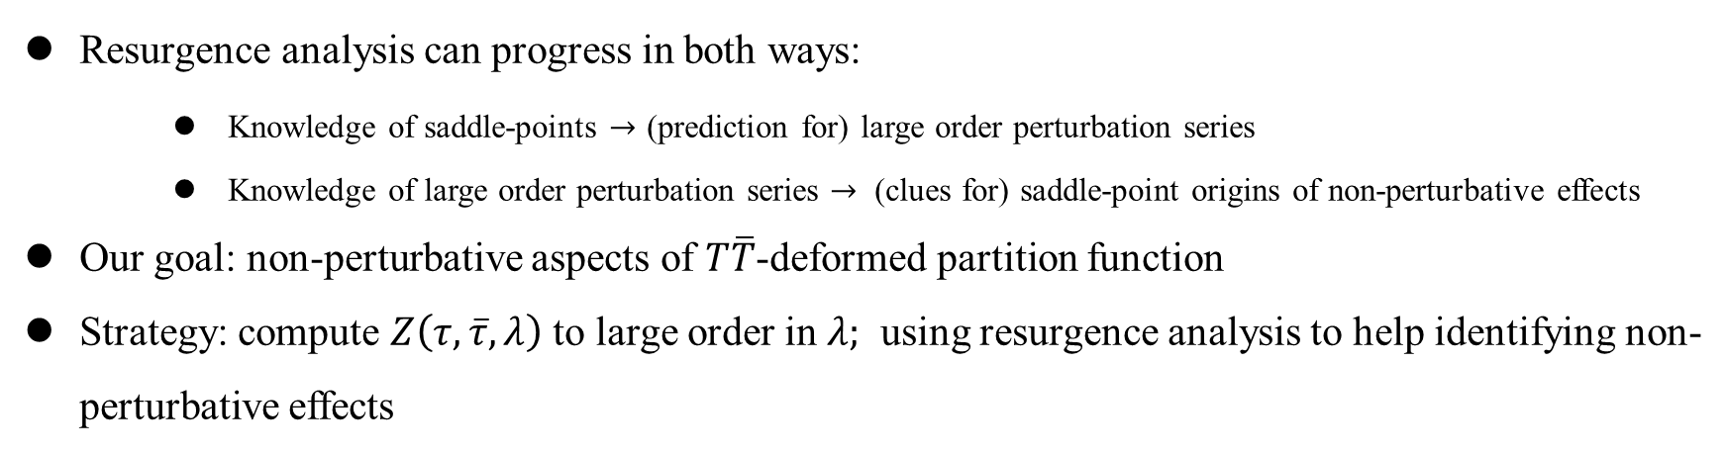
Resurgence: a quick review
Resurgence analysis can progress in both ways:
    Knowledge of saddle-points $→$ (prediction for) large order perturbation series
    Knowledge of large order perturbation series $→$ (clues for) saddle-point origins of non-perturbative effects
Our goal: non-perturbative aspects of $T\overline{T}$-deformed partition function
Strategy: compute $Z\left(τ,\overline{τ},λ\right)$ to large order in $λ;$ using resurgence analysis to help identifying non-perturbative effects

Slide 37
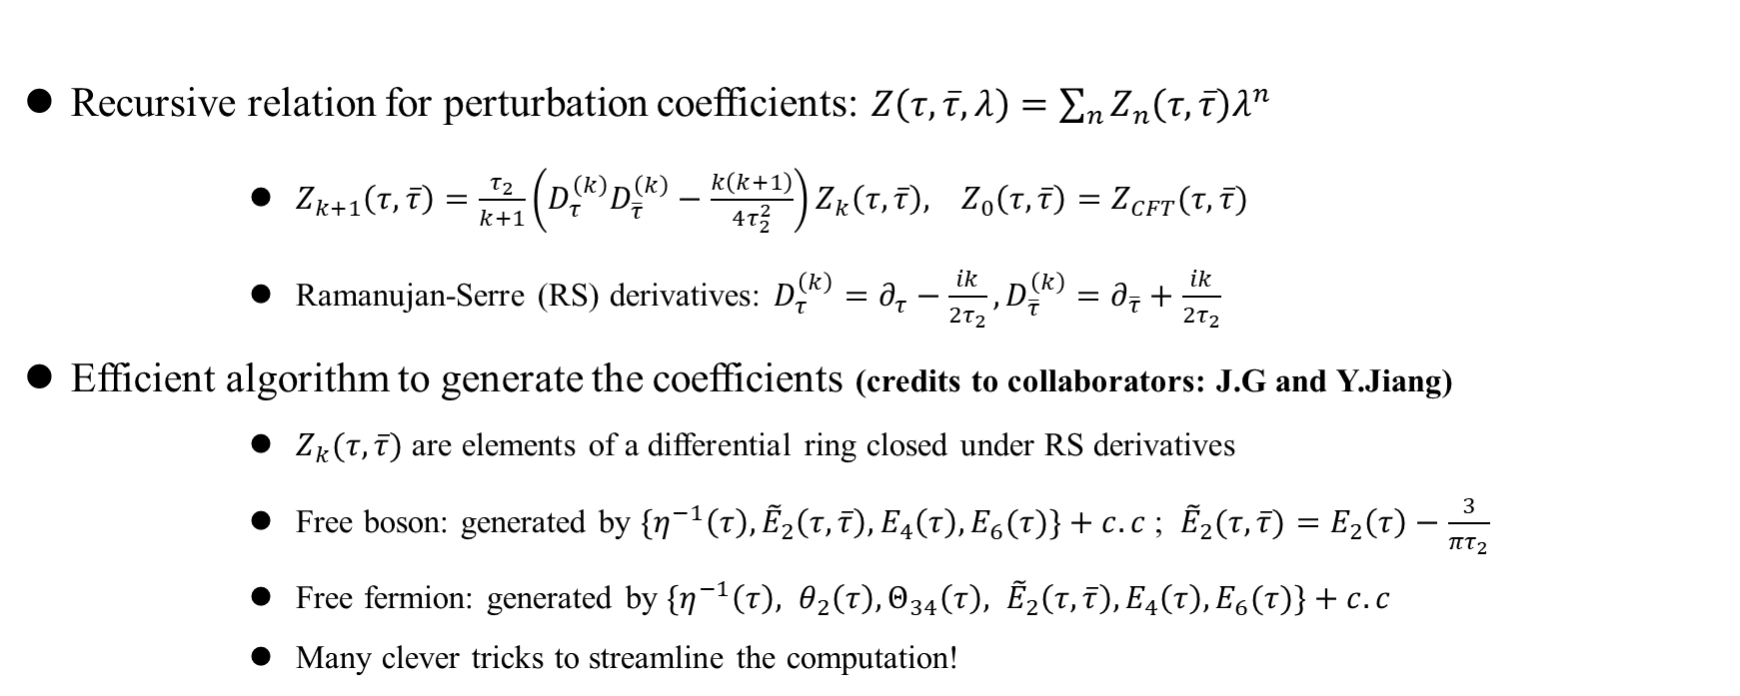
Series expansion of $Z(τ,\overline{τ},λ)$: recursive method
Recursive relation for perturbation coefficients: $Z\left(τ,\overline{τ},λ\right)=\sum_{n}{Z_{n}\left(τ,\overline{τ}\right)λ^{n}}$
      $Z_{k+1}\left(τ,\overline{τ}\right)=\frac{τ_{2}}{k+1}\left(D_{τ}^{\left(k\right)}D_{\overline{τ}}^{\left(k\right)}−\frac{k\left(k+1\right)}{4τ_{2}^{2}}\right)Z_{k}\left(τ,\overline{τ}\right), Z_{0}\left(τ,\overline{τ}\right)=Z_{CFT}(τ,\overline{τ})$
      Ramanujan-Serre (RS) derivatives: $D_{τ}^{\left(k\right)}=∂_{τ}−\frac{ik}{2τ_{2}}, D_{\overline{τ}}^{\left(k\right)}=∂_{\overline{τ}}+\frac{ik}{2τ_{2}}$
Efficient algorithm to generate the coefficients (credits to collaborators: J.G and Y.Jiang)
      $Z_{k}(τ,\overline{τ})$ are elements of a differential ring closed under RS derivatives
      Free boson: generated by $\{η^{−1}\left(τ\right), {\tilde{E}}_{2}\left(τ,\overline{τ}\right), E_{4}\left(τ\right), E_{6}(τ)\}+c.c$; ${\tilde{E}}_{2}(τ,\overline{τ})=E_{2}\left(τ\right)−\frac{3}{πτ_{2}}$
      Free fermion: generated by $\{η^{−1}\left(τ\right), θ_{2}\left(τ\right), Θ_{34}\left(τ\right), {\tilde{E}}_{2}\left(τ,\overline{τ}\right), E_{4}\left(τ\right), E_{6}(τ)\}+c.c$
      Many clever tricks to streamline the computation!

Slide 38
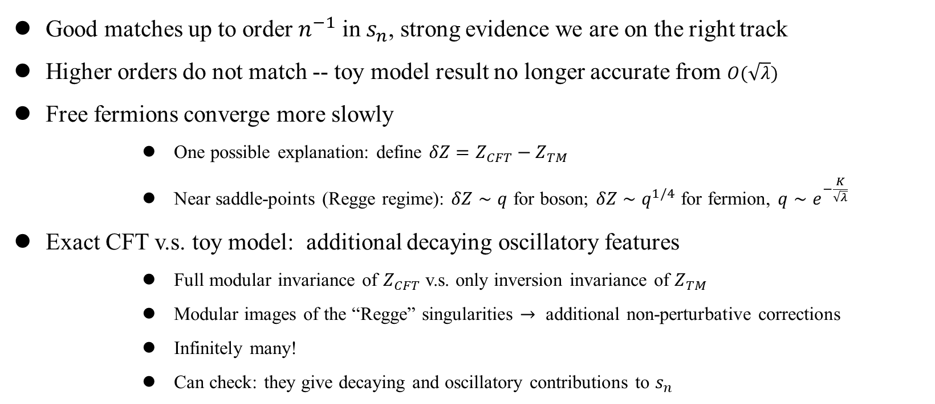
Saddle-point analysis:
Good matches up to order $n^{−1}$ in $s_{n}$, strong evidence we are on the right track
Higher orders do not match -- toy model result no longer accurate from $O(\sqrt{λ})$
Free fermions converge more slowly
      One possible explanation: define ${δZ=Z}_{CFT}−Z_{TM}$
      Near saddle-points (Regge regime): $δZ∼q$ for boson; $δZ∼q^{1/4}$ for fermion, $q∼e^{−\frac{K}{\sqrt{λ}}}$
Exact CFT v.s. toy model: additional decaying oscillatory features
      Full modular invariance of $Z_{CFT}$ v.s. only inversion invariance of $Z_{TM}$
      Modular images of the “Regge” singularities $→$ additional non-perturbative corrections
      Infinitely many!
      Can check: they give decaying and oscillatory contributions to $s_{n}$

Slide 39
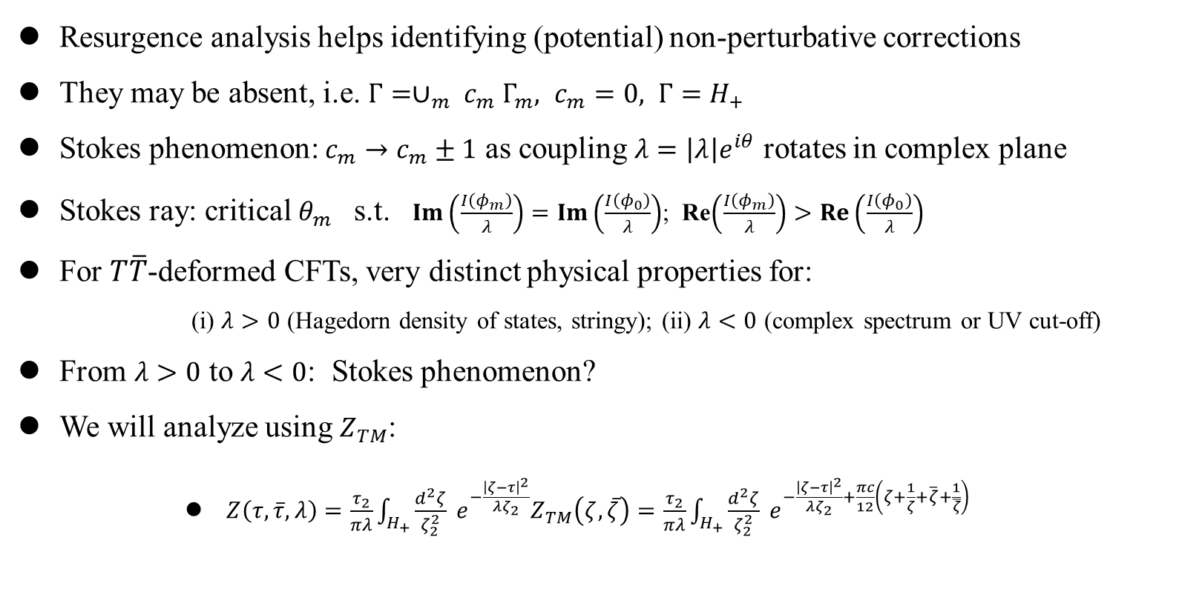
Stokes phenomenon
Resurgence analysis helps identifying (potential) non-perturbative corrections
They may be absent, i.e. $Γ=∪_{m} c_{m} Γ_{m}, c_{m}=0, Γ=H_{+}$
Stokes phenomenon: $c_{m}→c_{m}±1$ as coupling $λ=\left|λ\right|e^{iθ}$ rotates in complex plane
Stokes ray: critical $θ_{m}$ s.t. $Im\left(\frac{I\left(φ_{m}\right)}{λ}\right)=Im\left(\frac{I\left(φ_{0}\right)}{λ}\right)$; Re$\left(\frac{I\left(φ_{m}\right)}{λ}\right)>Re\left(\frac{I\left(φ_{0}\right)}{λ}\right)$
For $T\overline{T}$-deformed CFTs, very distinct physical properties for:
      (i) $λ>0$ (Hagedorn density of states, stringy); (ii) $λ<0$ (complex spectrum or UV cut-off)
From $λ>0$ to $λ<0$: Stokes phenomenon?
We will analyze using $Z_{TM}$:
      $Z\left(τ,\overline{τ},λ\right)=\frac{τ_{2}}{πλ}\int_{H_{+}}{\frac{d^{2}ζ}{ζ_{2}^{2}}} e^{−\frac{{\left|ζ−τ\right|}^{2}}{λζ_{2}}}Z_{TM}\left(ζ,\overline{ζ}\right)=\frac{τ_{2}}{πλ}\int_{H_{+}}{\frac{d^{2}ζ}{ζ_{2}^{2}}} e^{−\frac{{\left|ζ−τ\right|}^{2}}{λζ_{2}}+\frac{πc}{12}\left(ζ+\frac{1}{ζ}+\overline{ζ}+\frac{1}{\overline{ζ}}\right)}$

Slide 40
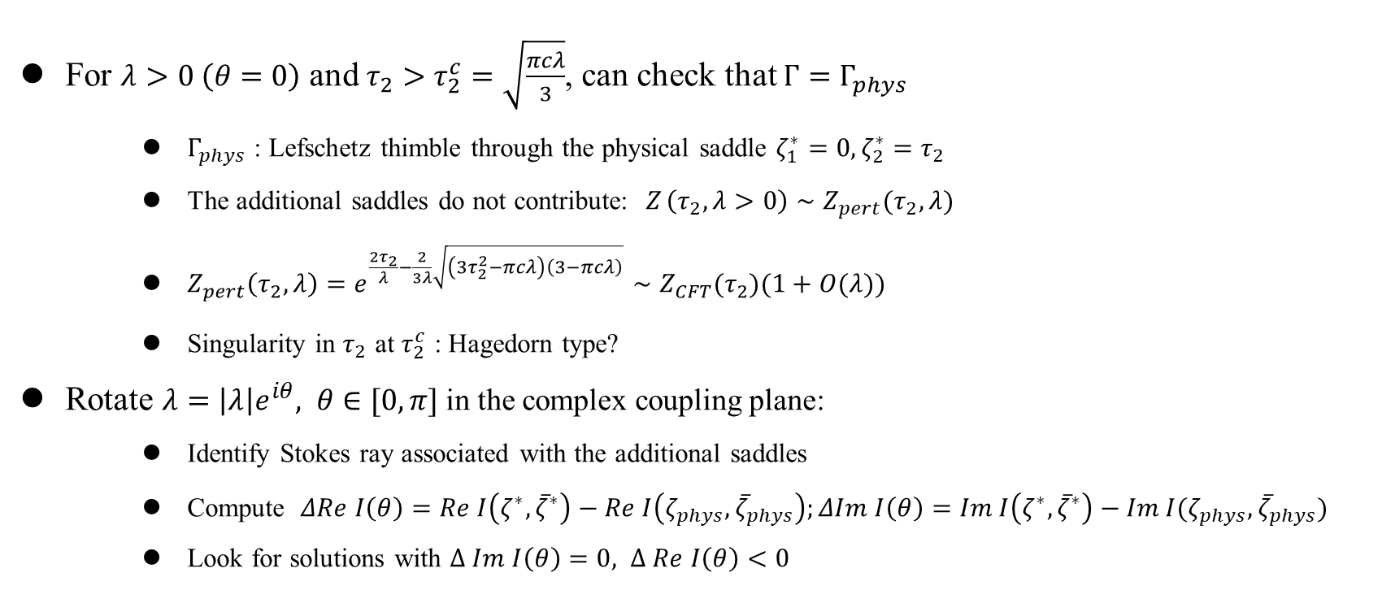
Stokes phenomenon
For $λ>0 \left(θ=0\right)$ and $τ_{2}>τ_{2}^{c}=\sqrt{\frac{πcλ}{3}}$, can check that $Γ=Γ_{phys}$
    $Γ_{phys}$ : Lefschetz thimble through the physical saddle $ζ_{1}^{∗}=0, ζ_{2}^{∗}=τ_{2}$
    The additional saddles do not contribute: $Z_{ }\left(τ_{2}, λ>0\right)∼Z_{pert}(τ_{2},λ)$
    $Z_{pert}\left(τ_{2},λ\right)=e^{\frac{2τ_{2}}{λ}−\frac{2}{3λ}\sqrt{\left(3τ_{2}^{2}−πcλ\right)\left(3−πcλ\right)}}∼Z_{CFT}(τ_{2})(1+O(λ))$
    Singularity in $τ_{2}$ at $τ_{2}^{c}$ : Hagedorn type?
Rotate $λ=\left|λ\right|e^{iθ}, θ∈[0,π]$ in the complex coupling plane:
    Identify Stokes ray associated with the additional saddles
    Compute $ΔRe I\left(θ\right)=Re I\left(ζ^{∗},{\overline{ζ}}^{∗}\right)−Re I\left(ζ_{phys},{\overline{ζ}}_{phys}\right);ΔIm I\left(θ\right)=Im I\left(ζ^{∗},{\overline{ζ}}^{∗}\right)−Im I(ζ_{phys},{\overline{ζ}}_{phys})$
    Look for solutions with $Δ Im I\left(θ\right)=0, Δ Re I\left(θ\right)<0$

Slide 41
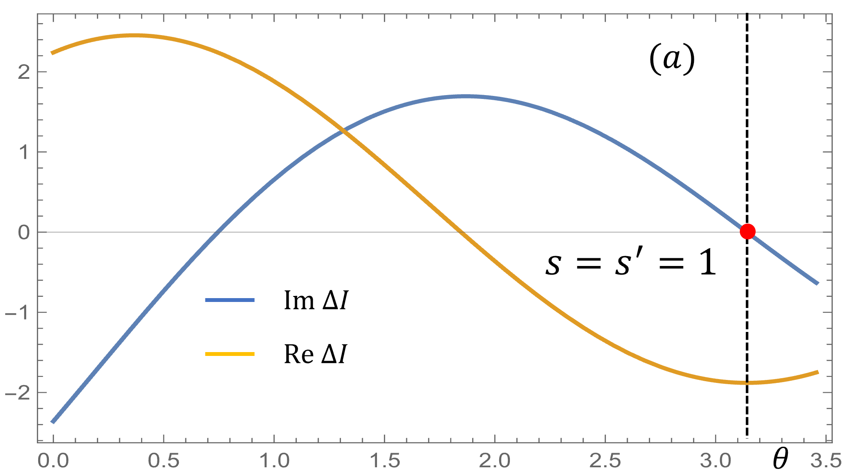
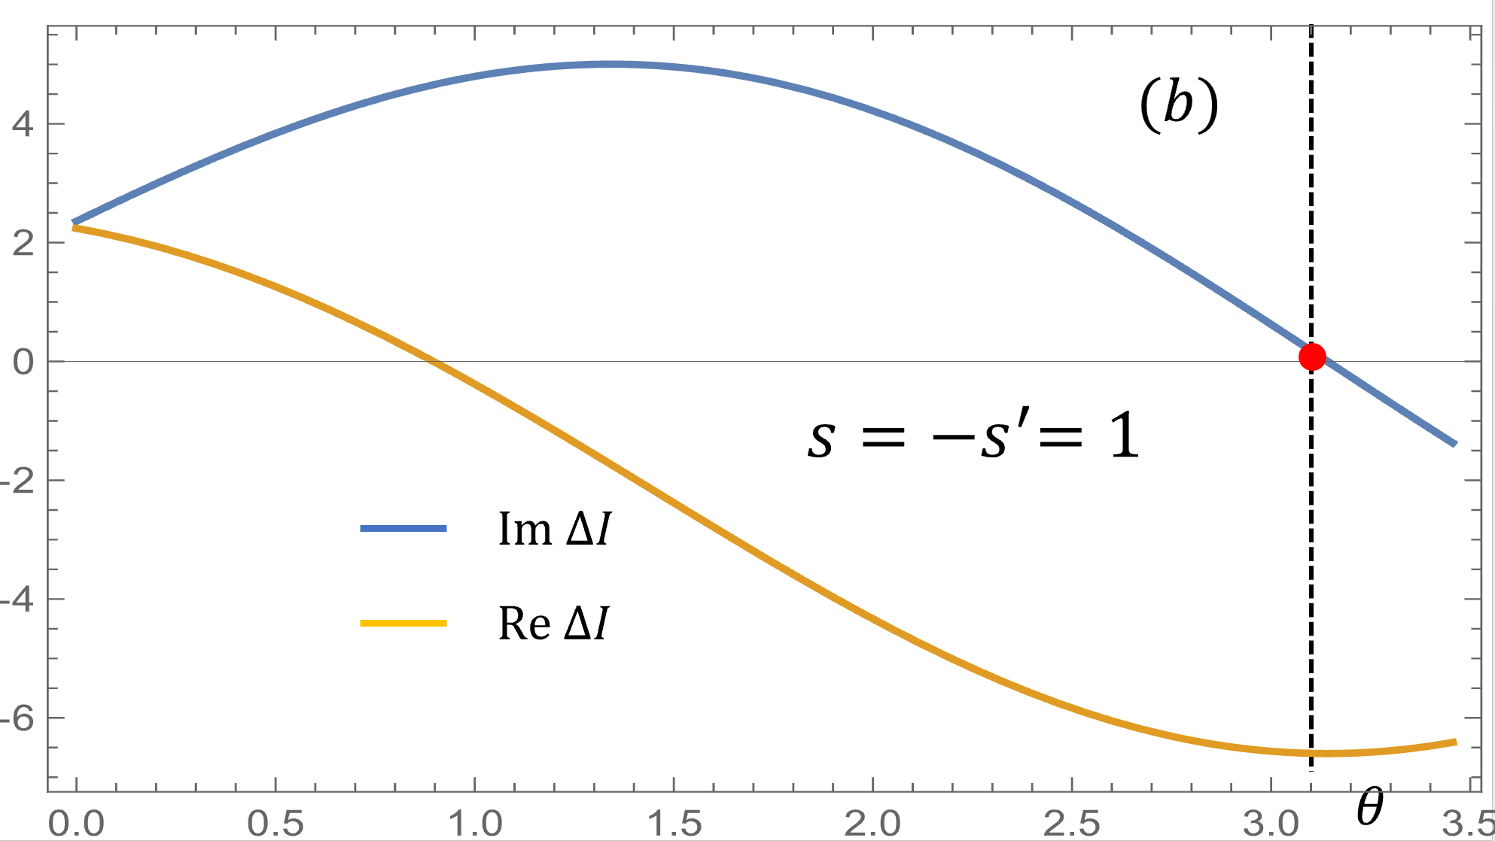
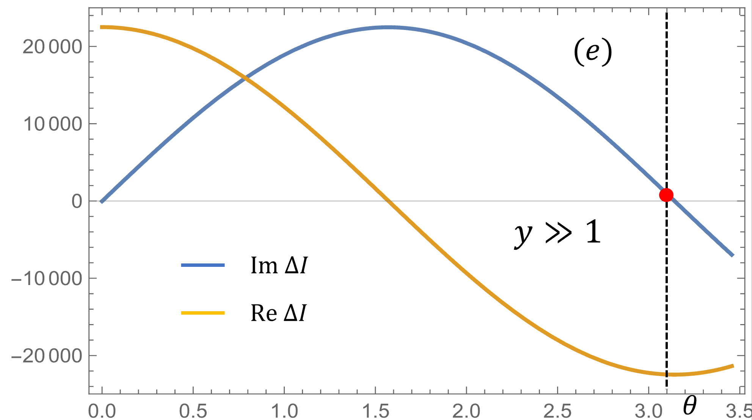
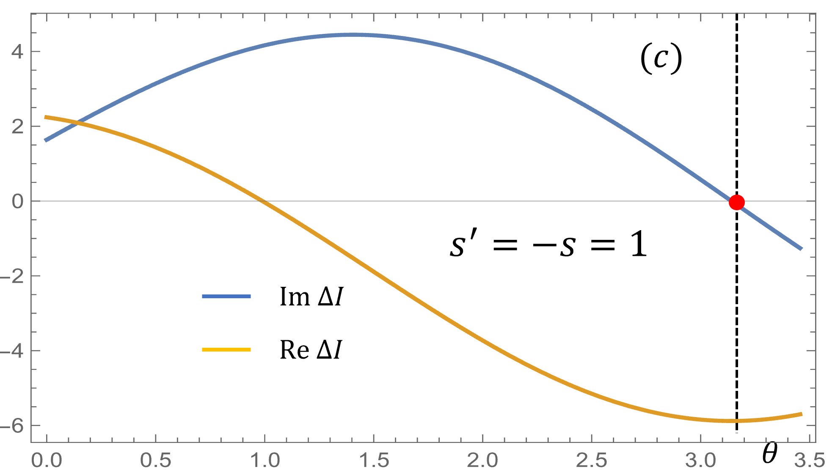



Stokes phenomenon
$$τ_{2}∼τ_{2}^{c}$$
$$τ_{2}≫τ_{2}^{c}$$

Slide 42


Stokes phenomenon
For any $τ_{2}>τ_{2}^{c}$, Stokes phenomenon at $θ=π (λ<0)$ for all additional saddles
    Receives non-perturbative corrections at $λ<0$
    $Z\left(τ_{2},λ<0\right)=Z_{pert}\left(τ_{2},−\left|λ\right|\right)+Z_{n.p}\left(τ_{2},λ\right)∼e^{−\frac{2τ_{2}}{\left|λ\right|}+\frac{2}{3\left|λ\right|}\sqrt{\left(3τ_{2}^{2}+πc\left|λ\right|\right)\left(3+πc\left|λ\right|\right)}}+e^{−\frac{2τ_{2}}{\left|λ\right|}+\sqrt{\frac{4πc}{3\left|λ\right|}}+…}$
    Partition function non-singular and well-defined for all $τ_{2}>0$
$$λ$$
$$λ<0$$
$$λ>0$$
$$Z_{pert}\left(τ_{2},−|λ|\right)+Z_{np}(τ_{2},λ)$$
$$Z_{pert}\left(τ_{2},\left|λ\right|\right)$$

Slide 43

Stokes phenomenon
    Deformed density of states: $Z\left(τ_{2},λ<0\right)=∫dE g\left(E,λ\right)e^{−τ_{2}E}=Z_{pert}+Z_{n.p}$
    $Z_{pert}$ alone: complex density/spectrum at UV
    Consistent with $λ→−|λ|$ of flow equation solution: $E_{n}\left(λ<0\right)=\frac{2}{|λ|}\left(1−\sqrt{1−|λ|E_{n}+\frac{λ^{2}P_{n}^{2}}{4}}\right)$
    $Z_{n.p}$ alone implies a UV cut-off $Λ$: $\int_{ }^{Λ}{ dE e^{−τ_{2}E} g\left(E\right)∼}{ e}^{−\frac{2τ_{2}}{\left|λ\right|}+\sqrt{\frac{4πc}{3\left|λ\right|}}} → Λ=\frac{2}{|λ|}, \ln{g(E)}=\sqrt{\frac{2πcE}{3}}$
    Tow folklores of $λ<0$ theories: $Z_{pert}$ v.s. $Z_{n.p}$

Slide 44

Stokes phenomenon
However, this can’t be the whole story
$Z_{pert}$ v.s $Z_{n.p}$: mutually incompatible picture
$Z\left(τ_{2},λ<0\right)$ for $τ_{2}<τ_{2}^{c}$: order of (i) $λ→−λ$; (ii) $τ_{2}→τ_{2}^{c^{−}}$
Possibly requires resolving the Hagedorn transition at $λ>0$, “winding mode condensation”
Current integral rep of $Z(τ_{2},λ)$ derived assuming unit winding, need to consider all winding sectors? Future work…
Exact CFT v.s. toy model: modular symmetry $→$ infinitely many other non-perturbative corrections
32.

