Slide 1
Bubble dynamics in holographic superfluids with first order phase transition
Holographic Applications: From Quantum Realms to the Big Bang
Beijing, July 15, 2025
Zhen-han Jin(金振翰)
Institute of Theoretical Physics
Chinese Academy of Sciences
Based on work in progress with
Yu-ping An, Li Li
Notes:
In collaboration with:
in progress
坐标轴 字号

Slide 2
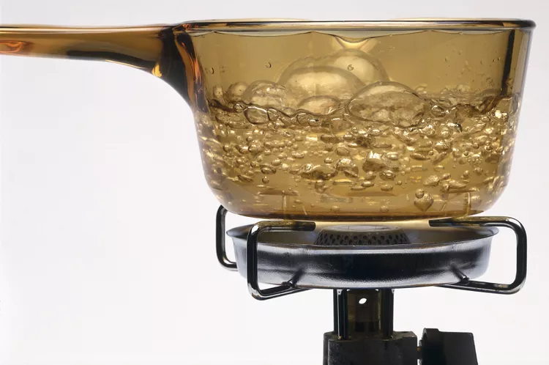
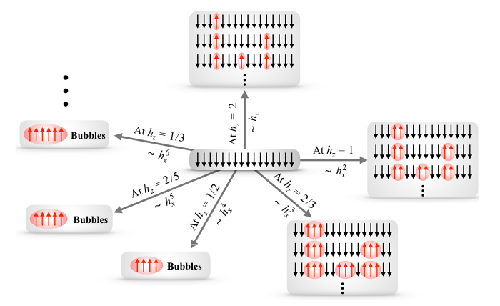
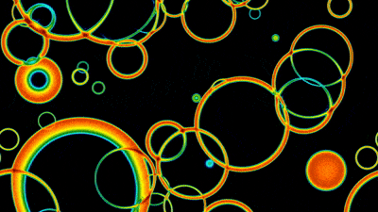
Background
Liquid-gas
quantum material
cosmology
https://www.thoughtco.com/what-are-the-bubbles-in-boiling-water-4109061
arXiv.2103.04762
https://wallgo.readthedocs.io/en/latest/
(Bubble) nucleation
Meta-stable state
Stable-stable state
Notes:
First order phase transition is characterized by the existence of metastable state and the discontinuous change of order parameter. The process during which the state jumps from metastable state to stable state is known as bubble nucleation. This process has been studied comprehensively in many area, such as liquid-gas phase transition, quantum material, cosmology during which plentiful observable phenomena will be found.
So as we can see in the picture, bubble dynamics is a pretty out-of-equilibrium, which is very complex. And holographic just give us an ideal platform to study the system which is out-of-equilibrium and strong-coupled
As for holographic model, recently the work mainly focused on criticl dynamics of first-order phase transition where Z2 symmetry is broken, where domain wall will be formed during.
The dynamics of bubble is very complex and highly out of equilibrium process.
Holographic sytem is good plarform to inverstage the bubble dynamics, which narturally introduce finite temperatue and dissipation. Strongcoupling and out of equilibrium.

Slide 3
Background
Critical dynamics of first order phase transition where Z2 symmetry is broken (Arxiv:2209.12789 )
Phase decomposition during first order phase transition(Arxiv:2311.08277)
Stability analysis of stable state, meta-stable state, unstable state (Arxiv:2211.14762)
……
What’s the bubble dynamics in the first order phase transition where the U(1) symmetry is broken?
Notes:
As for holographic model, recently the work mainly focused on the critical dynamics in the first-order phase transition during which the Z2 symmetry is broken and domain wall is formed.
There is also some study about… and …….
How does the bubble nucleate, expand and interact with each other. This is the main motivation for us to investigate this this.

Slide 4
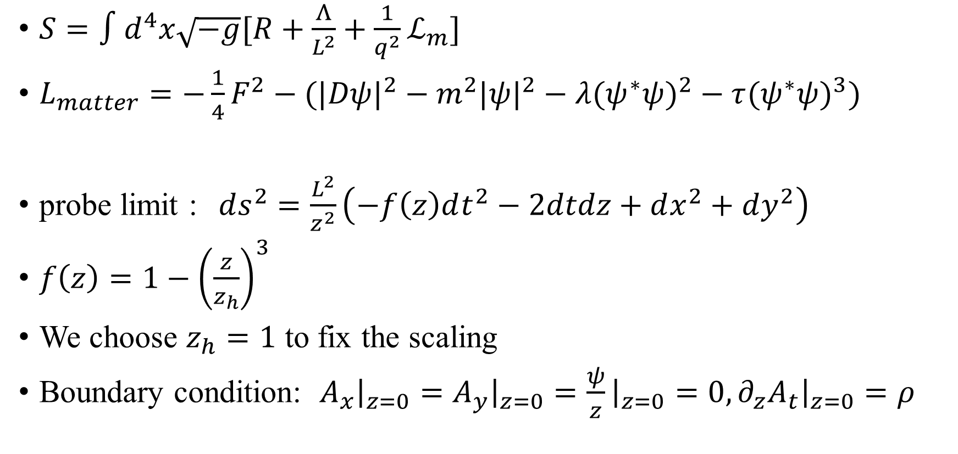
Background
$S=∫d^{4}x\sqrt{−g}[R+\frac{Λ}{L^{2}}+\frac{1}{q^{2}}ℒ_{m}]$
$L_{matter}=−\frac{1}{4}F^{2}−(|Dψ|^{2}−m^{2}|ψ|^{2}−λ(ψ^{∗}ψ)^{2}−τ(ψ^{∗}ψ)^{3})$
probe limit :$ds^{2}=\frac{L^{2}}{z^{2}}\left(−f\left(z\right)dt^{2}−2dtdz+dx^{2}+dy^{2}\right)$
$f\left(z\right)=1−{\left(\frac{z}{z_{h}}\right)}^{3}$
We choose $z_{h}=1$ to fix the scaling
Boundary condition: $A_{x}{\left.​\right|}_{z=0}=A_{y}{\left.​\right|}_{z=0}=\frac{ψ}{z}{\left.​\right|}_{z=0}=0,{∂_{z}A}_{t}{\left.​\right|}_{z=0}=ρ$
Notes:
In our study, we investigate the model which contains self interaction and will calculate in the probe limit, which ignore the backreaction from the matter. And in our study ,we will start with the state where the complex scalar was set to zero ,and when we lower the temperature, scalar will increase gradually, thus spontaneously break the U(1) symmetry.
And due to the scaling symmetry of the system ,we fix the position of the horizon equal to 1,which mean that we fix the temperature of the system. This enable us to adjut the charge density to trigger the phase transition.
Due to the extience of scaling symmetry in the system, we fix the position of the horizon equal to 1.So we can vary the charge density to trigger the first order phase transition.
varying the charge density, this is equililenvt to adjeu t the temperature to trigger the 1st.
We start for a state where the scalar was set to zero ,and when we lower the temperature, we will scalar will increase gradually, thus spontaneous break the U(1) symmetry.

Slide 5
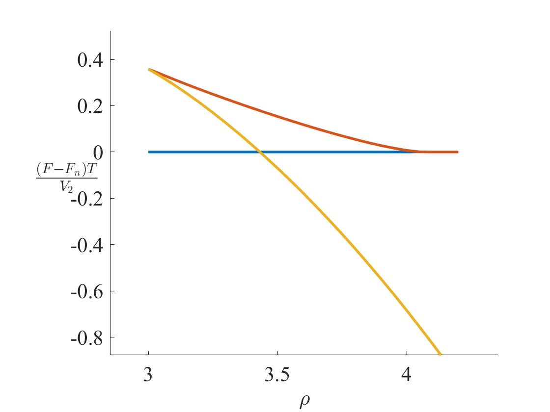



Background
Supercritical evolution
superfluid state
$$h$$
Critical state
$$φ=he^{\frac{−r^{2}}{2σ^{2}}}$$
$$h_{c}$$
Subcritical evolution
Normal state
Notes:
To be specific, during first order phase transition, the free energy, which is calculated from Euclidean on–shell action has this kind of form. Due to the existence of meta-stable state, A nuleai is needed to trigger the phase transition. In our work ,we put Gaussion wave perturbation in the condensate to trigger it. There is a lot of parameter in the wave packet, but in our study, we will just consider the influence of the amplitude. An interesting thing when we change the initial parameter. there is a critical value. When the parameter is lager than this value the system will evolve into a superfluid state……. But if we can really choose the parameter equal to critical parameter, the system will evolve in to a critical state. We use

Slide 6
Background
The dynamics of single bubble
Supercritical evolution
$$h$$
dynamics of many bubble
collision
Critical state
The scaling phenomena near critical point
$$h_{c}$$
Subcritical evolution
Notes:
Our main work is about three apects of the dynamical system. First ,our work is maingly about the dynamcis near the critical .and we found some scaling phenomena near the critical point. We will investigate the dynamics of single bubble expaenion. Following this, the dynamcis of manubbubel collision will be investigate

Slide 7
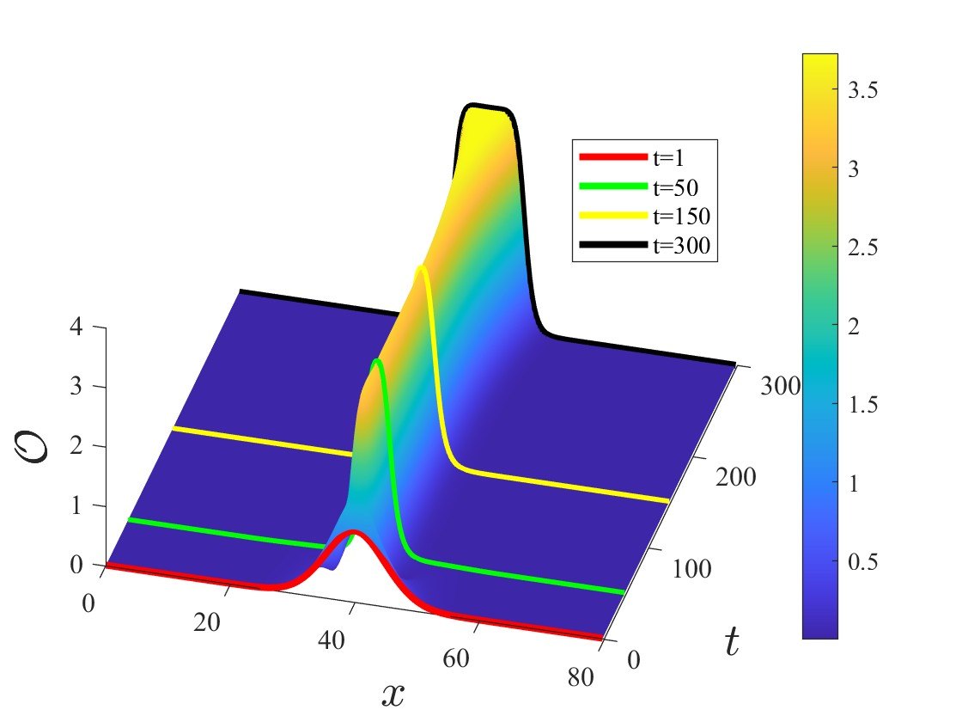
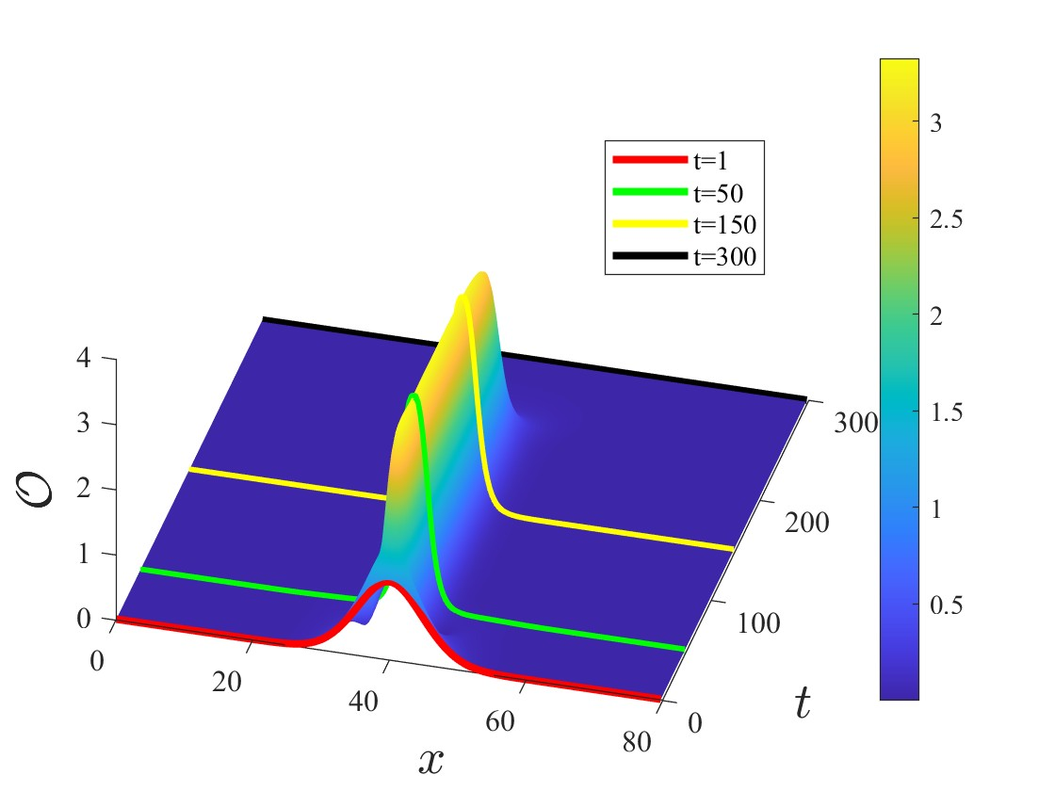

Scaling phenomena of nucleation
Supercritical evolution
$$\left|h−h_{c}\right|\sim 6×{10}^{−6}$$
Subcritical evolution
Notes:
As the system has rotation symmetry, we can choose one slice to see the phenomena. The right hand side is the time evolution of this slice. The height or the color in this picture indicate the value of the condensate. And the picture in the left is the characterized time I chose. The process ccan be divided into three stage. FIrst ,the stage Gaussion bubble will quickly evolve into a sharper configuration. Which is drawn in the green line,And then if the parameter isnear the critical value enough, it will remain near the critical value for a long time for both case. This is the second stage. and then after the non-lincear effect grows.it will either become a bubble or be dissipated. This process of evolution is very typical
This is the evolution with the parameter near the crticical .

Slide 8
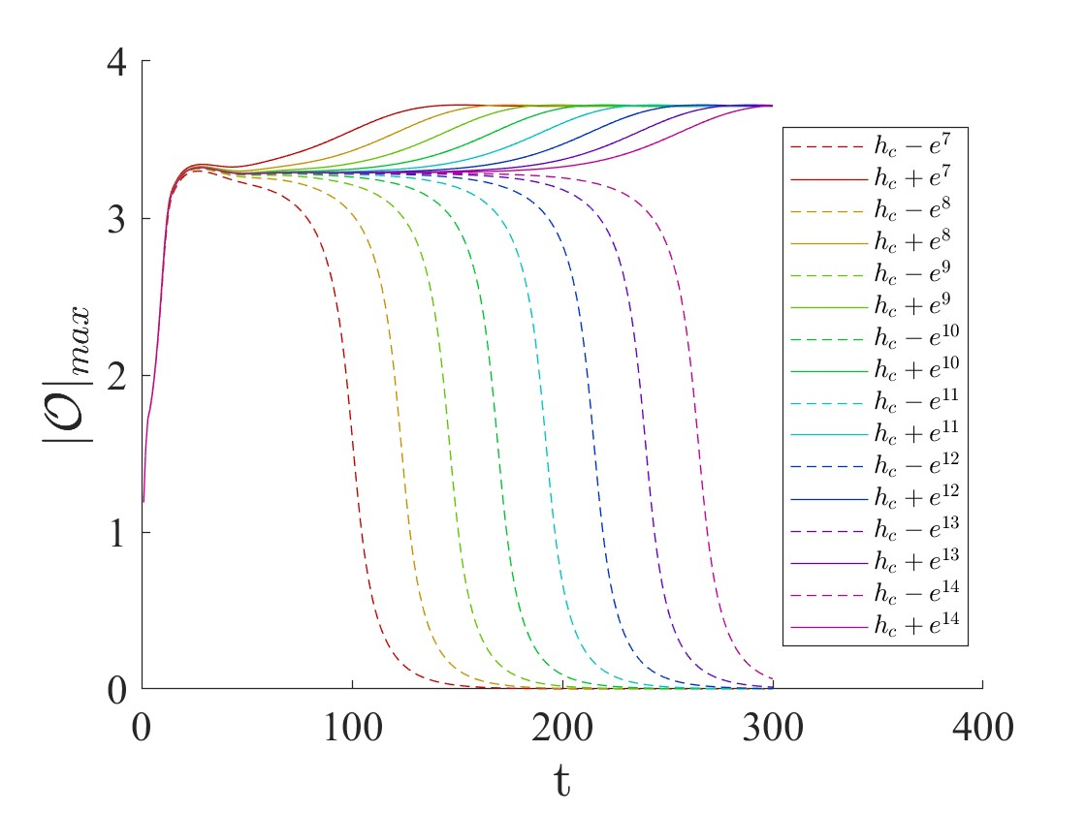

Scaling phenomena of nucleation
$$φ=he^{\frac{−r^{2}}{2σ^{2}}}, h=h_{c}±e^{−m},m∈[7,14]$$
Notes:
So next ,let us change the initial parameter in a very small scale. and see what will happen. This picture just shows the time evolution the max value of the condensate under different parameter. The dotted line indicate the subcritical and supercritical evolution.
And whenwe adjust the phenomena,We can also see the phenomena in a more clear way, the dotted line indicate a subcritical case, and the solid line is the corresponding supercritical case. We have tune the parameter , and nearer the parater is to the critical value ,the longer tiam it will remain in platform. And it to is natural to assume that the critical solution is a static, thus enable us to use perturbation to quantify this phenoman.

Slide 9
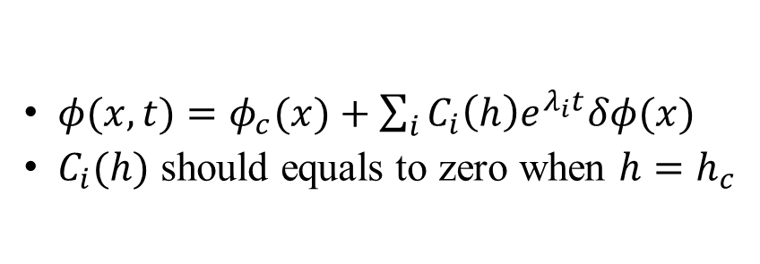
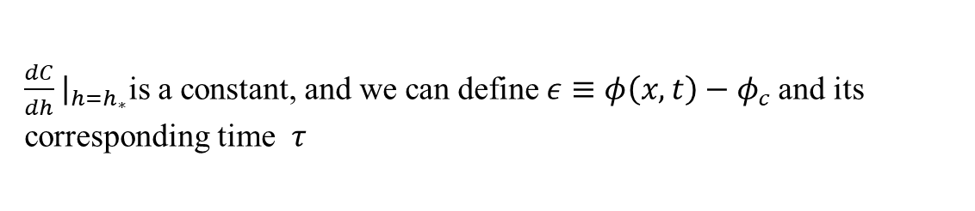
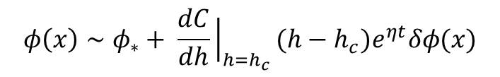
Scaling phenomena of nucleation
$φ(x,t)=φ_{c}(x)+\sum_{i}{C_{i}\left(h\right)e^{λ_{i}t}δφ(x)}$
$C_{i}(h)$ should equals to zero when $h=h_{c}$
We assume there should be only one dominant unstable mode
$$φ\left(x\right)∼φ_{∗}+C_{0}{(h)e}^{ηt}δφ(x)$$
Expand $C_{0}\left(h\right)$ around critical parameter $h_{c}$, where $C_{0}\left(h_{c}\right)=0$
$$φ\left(x\right)∼φ_{∗}+ \frac{dC}{dh}{\left.​\right|}_{h=h_{c}}(h−h_{c})e^{ηt}δφ(x)$$
$\frac{dC}{dh}{\left.​\right|}_{h=h_{∗}}$is a constant, and we can define $ε≡φ\left(x,t\right)−φ_{c}$and its corresponding time $τ$
$$ε∼ (h−h_{c})e^{ητ}δφ(x)$$
the time $τ∝−\frac{1}{η}\ln{(h−h_{c})}$
Notes:
The existence of the static solution enables us to do perturbation analysis around it. In the long period during which the configuration is near the critical solution, we write the perturtion in this kind of form. The coefficient is associated with the intial data. By assuming that there is only one unstable mode, this relation can be written as this form
So is we fix the \epsilon which measure the difference between critical value and the real value, the period during which different initial parameter
Between the actucal condensate value and critical value. And we can define a corresponding tau, which measure the . The \tau means that after pierod of tau , the aactually value will
Measure the deviation from the crtication. Derfine the tau, during which the deviation will reach \epsilon. This is theoretical prediction.
Epsilon
will have same different value comparaed to critical solution will show a scaling law

Slide 10
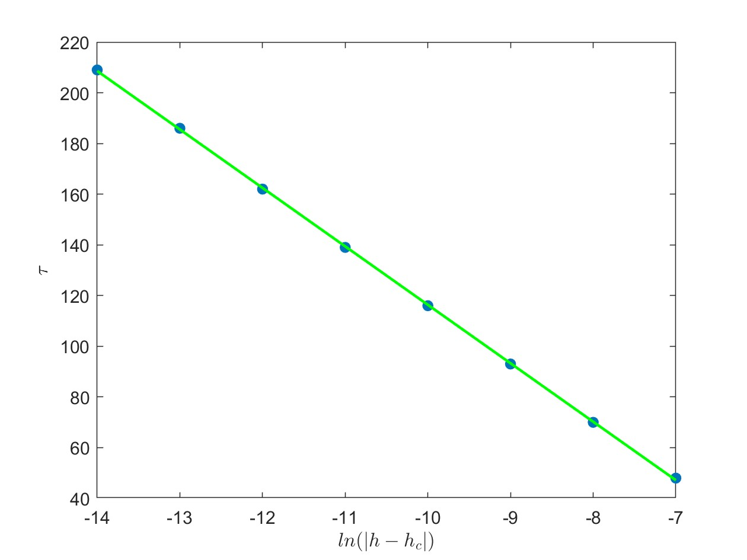
Scaling phenomena of nucleation
$−\frac{1}{η}≈−23.1071$
Notes:
which verify our assumption that their only one

Slide 11
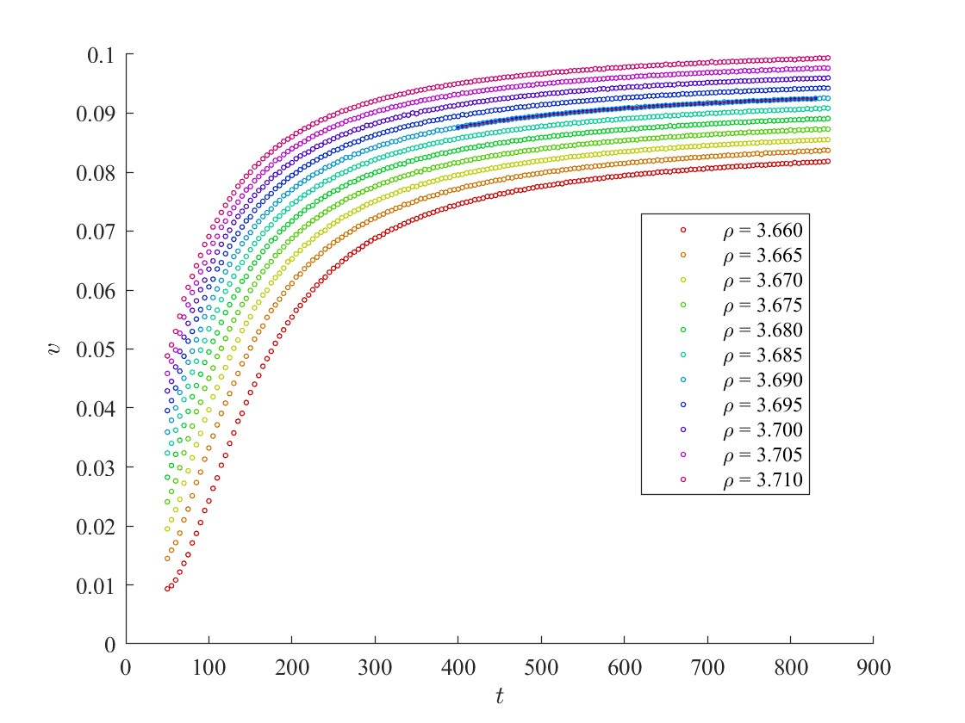
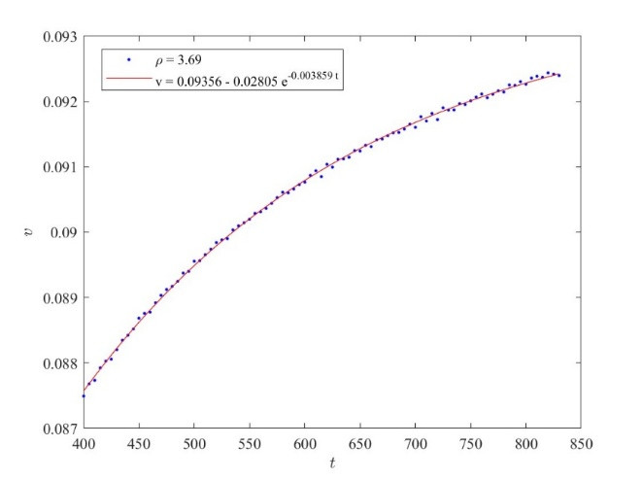

Single bubble expansion dynamics
Supercritical evolution
$$h$$
Critical state
$$h_{c}$$
$$v=a−be^{−ct}$$
Subcritical evolution
Notes:
After study the bubble nucleation, then let’s move to the dynamics of bubble expansion.
This plot
And we find the later. We can use this equation to determine the terminal velocity. evolution of the single evolution can be well fiteed by this equation
The second part of our work is the dynamics of single bubble far from critical value . This have simulate the bubble dynamics in different charge temperate. We find that in our model, the bubble velocity of bubble will not reach a constant value. But will increase in a exponent from. We havefittef the data, nad find the teminal velocity will have a linear relation

Slide 12
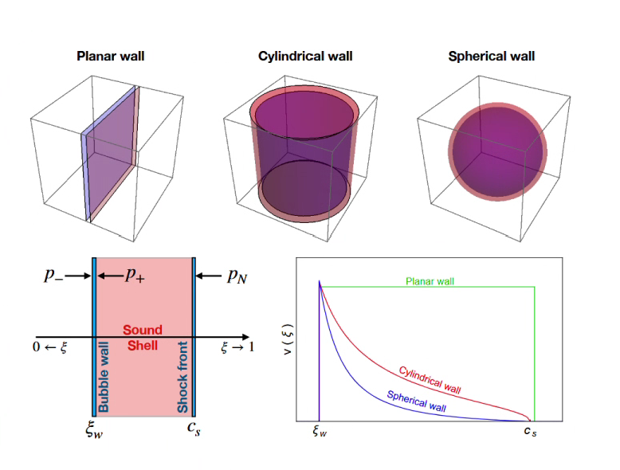
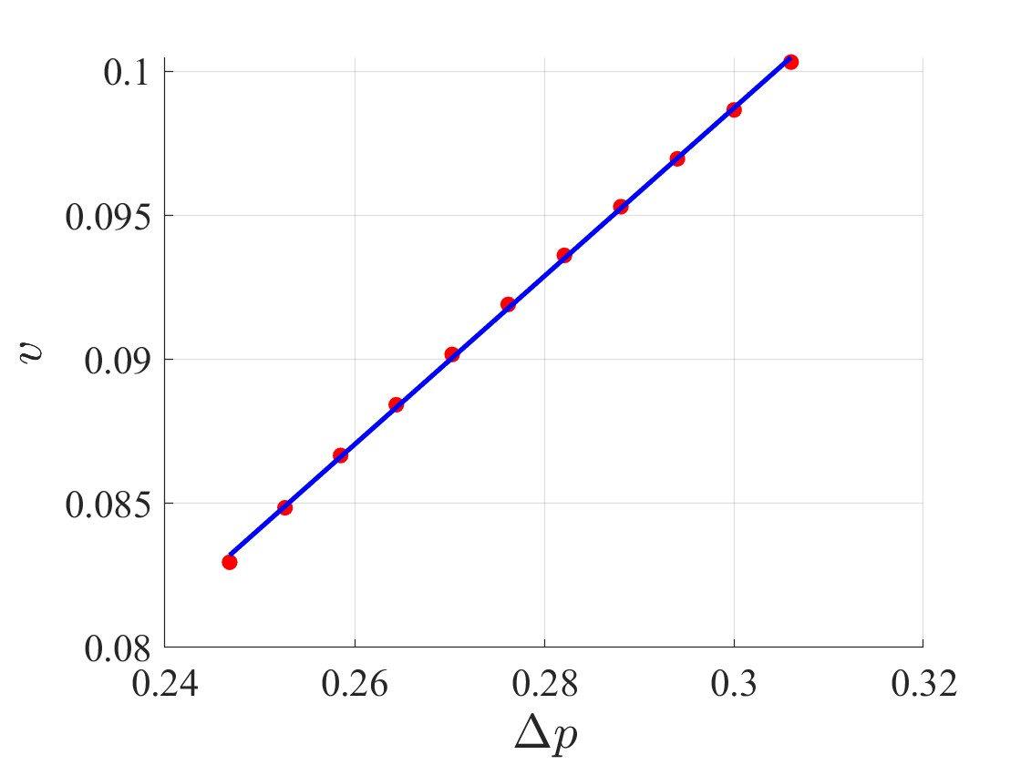

Single bubble dynamics
arXiv:2302.10042
$$Δp$$
Notes:
Actually, the expansion velocity of bubble is a very important quantity. There are a lot of refence discussing this quantity. For example in this reference, they discuss the relation between pressure difference and terminal velocity. So in holographic case, we also calculate the relation between this two quantity, and we get a linear result. But due to the limitation of probe limit. Its difficult to do more analysis of the velocity. So we just show this reulst, which may give us some qutitatively insight
可以用于估计不同bubble的速度
So its important to discuss the v between , here we get this result. We find that the v is linear with p difference.

Slide 13
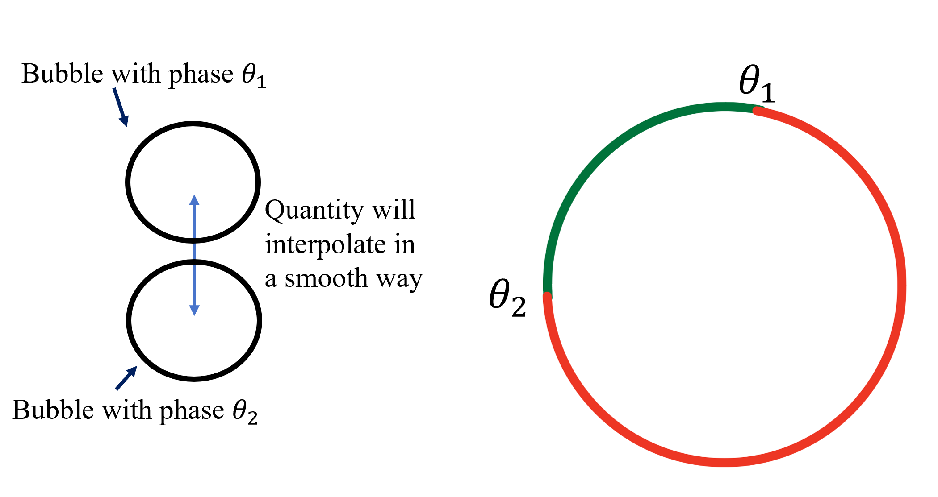
Multiple bubbles dynamics
  Geodesic rule: when domains emerge, the order parameter will interpolate in a way that minimizes the free energy.
  important application in Kibble-Zurek mechanism
Notes:
Having explored the property of single bubble, Now let’s move on to the multiple bubble dynamics. We will foucs on the defects formed in h this process by using the geodesic rule.
Assume that we have two bubbles. One with phase set as theta1, one with phase set as theta2. This circle in the right is the phase manifold.We can find corresponding point of theta1 and theta2 in the circle. As we know the physical quanti in real world or numerical simulation should change in a smooth. So in this circle, there are two probable wasy for theta to interpolate. but as we know the graidnet of phase will contribute to the free energy. So according to geodesic, the phase will interpolate along the green path. In other other word, the phase will interpolate along the small arc
放一个能产生涡旋图
As for the third part, I would like to first introduce the Kilbble Zurek hanism. We have put three two dimension bubble in the boundary. The circle in the right is just the phase manifold, and the red point indicate the phase of the bubble. This gives the result that the phase will interpolate in a small arc and thus once the difference between three phase is smaller than pi, a defect will form because of the emergence of the winding number.

Slide 14
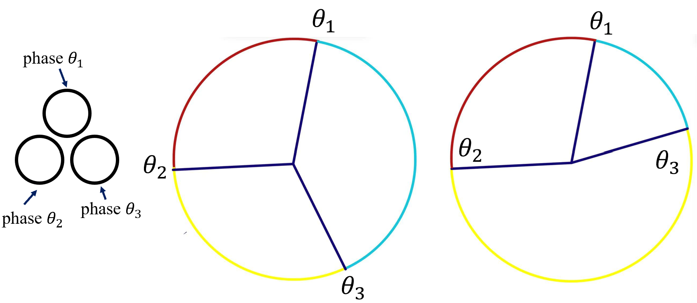
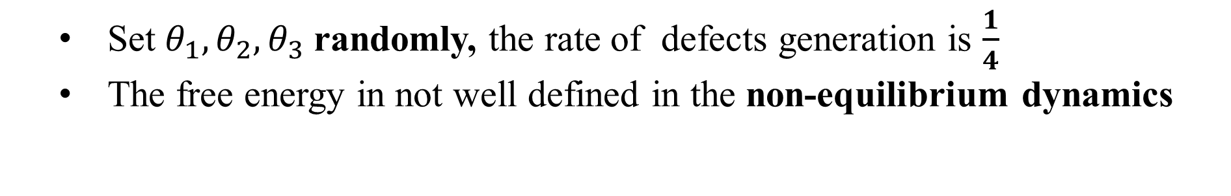
Multiple bubbles dynamics
  Set $θ_{1},θ_{2},θ_{3}$randomly, the rate of defects generation is $\frac{1}{4}$
  The free energy in not well defined in the non-equilibrium dynamics
Winding number formed
No Winding number
Notes:
Things will get more interesting when we consider three bubble collision. Just as before, we can find the corresponding position of these phase in this circle, and we just consider two condtion. Let’s see the first condition.And according the geodesic rule , the phase will interpolate along the small arc, so a winding number will form in this case. And in another case, if the points corresponding to the phase, are in the same semi-circle, then theta_2 will not interpolate with theta3 along the yellow path. So a winding number will not form in this case.
So in conclusion ,it will give the prediction that if these three point on the same circle, the the wind number will not form in this case. this will give an interesting predition that if we set the phase of this three bubble randomly, the rate of the defects generation is ¼.

Slide 15
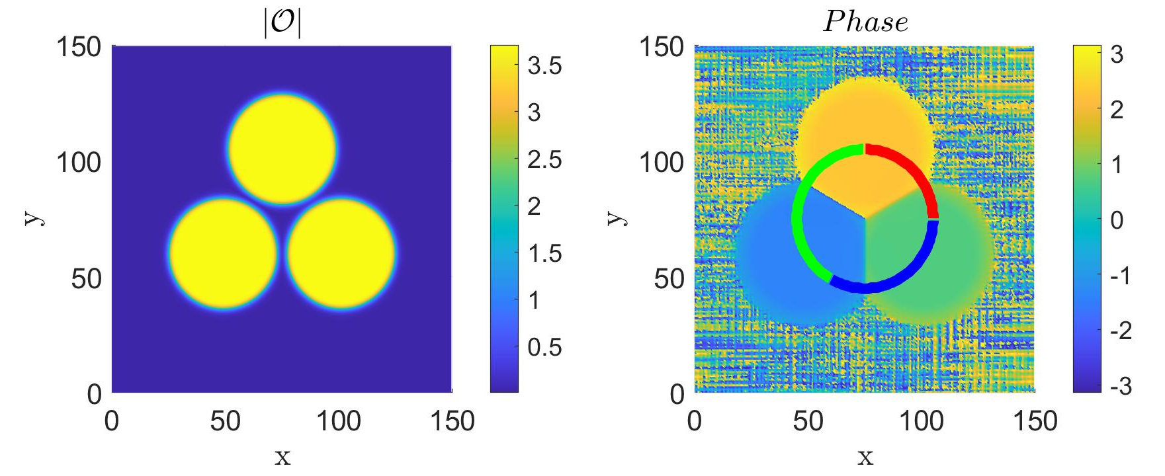
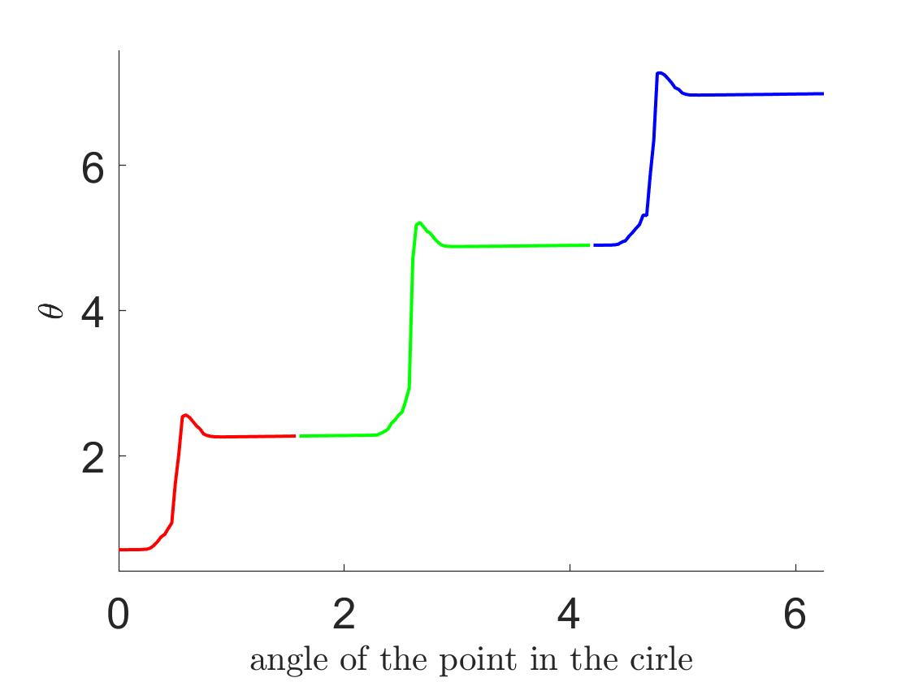
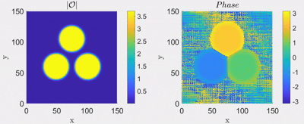



Multiple bubbles dynamics
$$\frac{2}{3}π+0.5$$
$$\frac{4}{3}π+0.5$$
$$0$$
Notes:
OK , and then let’s see the verification of geodesic rule in holographic model. The left picture is the condensate, and its corredspong phase distribution. We set the initial phase of the bubble as this. Which according to geodesic rule , a defects will form . We have extracted the pahse data alogn this ring and draw these data in the right picture. Each colored section in the right-hand image matches the data of the same-colored part of the ring.
And we will find that different phase will interpolate in the small arc in the phase space and thus form a wind number. This will finally lead to the formation of
We set the initial phase as this, and according to the geodesic rule, a vortex will form in the end。 To be more specific, we have extract the phase along this ring, and show the change of the phase in the right picture. Different color in this right picture indicate different part in this ring, respectively. And we can see that the phase of the different bubble just interpolate in a way small arc.

Slide 16
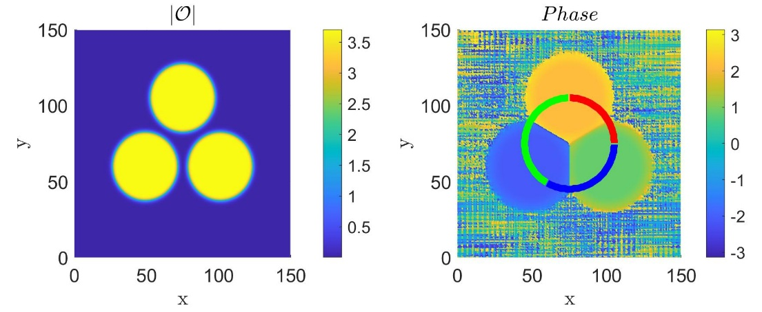
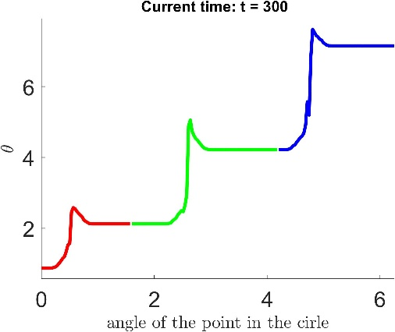
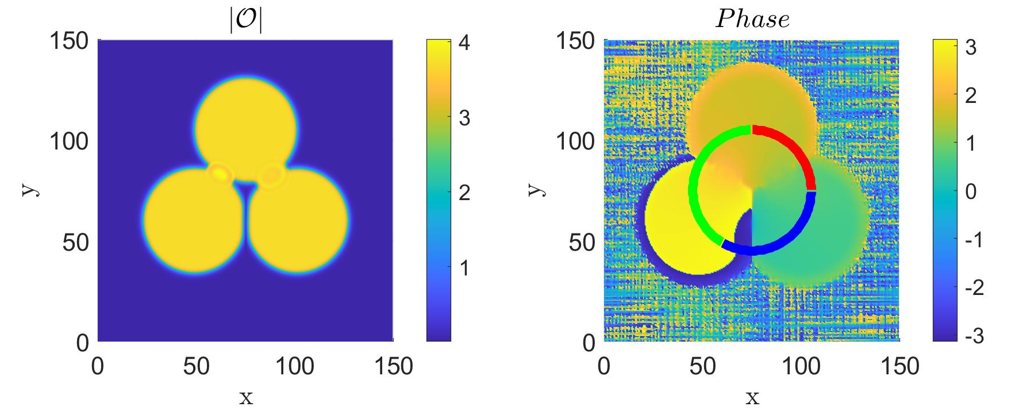
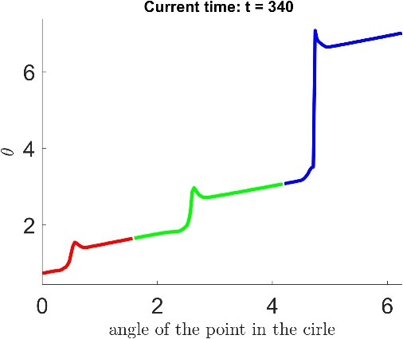
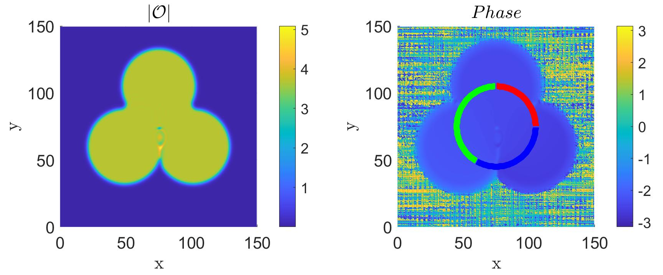
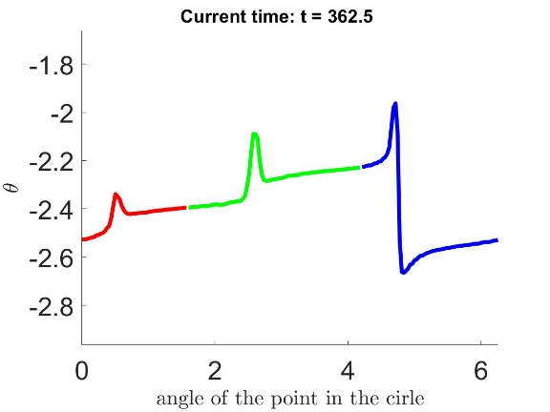
Multiple bubbles dynamics
Notes:
But the geosic rule also will also give the prediction that if we set the phase of the bubble randomly , we will get the defects generation rate of about ¼. However in our case, this rate will be greatly suppressed.
We have iniail phase, which according to geodesic rule ,a defects will form. During the simulation, we find that phase difference of the three bubble will merely change, until the bubble wall start to connect. Once the wall connect , the phase will start to relax, and the phenomena we find is that the smaller phase difference will become smaller, while the largest phase difference will become larger.This is due to the bubble with smaller phase difference is easier to reach equilibrium, and thus will increase the phase difference between this two bubble in the bottom .And once the larget phase difference is larger the pi. This interpolation will quickly decay. And will interpolate along the small arc, in the phase space ,so the defects will not form in the last.
We have see the phenoma in a large range of parameter, we conclude taht the generation rate made by the geodesic rule
And the process of this violation is almost the same under different parameter that violates the geodesic rule. So we just choose one example to explain. Just as before, we extract the phase from this ring in. and different color in the right picture indicate the the phase in the ring. At the first stage , the phase difference of the three bubble will merely change. Only when their wall connected, will their phase difference start to change. At the time 300hunded seconds, their phases were interplated in this way. This is also the time ,their bubble wall ,start to connect, and the phase strat to relax. The phenomena we find is that, the smaller phase difference will become smaller, while the larget phase difference will become larger.
The phenomena we find is that the smaller phase difference will become smaller., which is just shown in the red and green part of the line.
And once the one the the phase difference between the bubble is larger than \pi, the defects will not form. This connection through large arc will quikly decay ,the phase connection will quickly change into small arc.
And this phenomena will greatly supprese the production of defects.
We have extracted the data from the black ring. So we have give some time slices of the phase in the black ring. As the bubble expand and connected with each other, the phase relaxation will happen between them. But as we can see from the picture, the initial phase diffence between the two bubbles will greatly influence the later evolution of the phase difference. 相位差最小与次小的两个bubble的相位差会在后续的演化中变得更小，and thus the most large phase difference will become larger， once the phase difference is larger than the pi, this kind of connection will quickly decay and connect in the other arc.

Slide 17
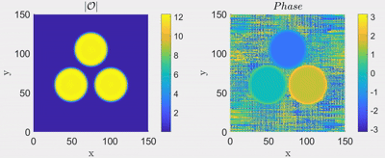
Multiple bubbles dynamics
Notes:
Despite of this, we also find some example that will lead over production of vortex. But the mechanism under this is to be explore later.
Also ,we find some phenomena that will lead to the over production of vortex. In this case, a small production will be formed during
wzufme)

Slide 18
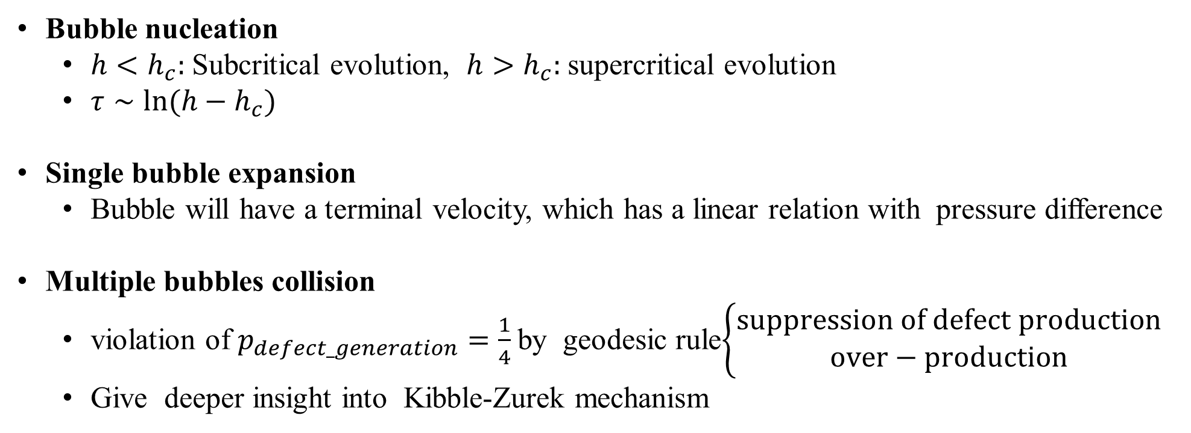
Summary
Bubble nucleation
  $h<h_{c}:$Subcritical evolution, $h>h_{c}:$supercritical evolution
  $τ∼\ln{(h−h_{c})}$
Single bubble expansion
  Bubble will have a terminal velocity, which has a linear relation with pressure difference
Multiple bubbles collision
  violation of $p_{defect_generation}=\frac{1}{4}$by geodesic rule$\left\{\begin{aligned}suppression of defect production \\ over−production\end{aligned}\right.$
  Give deeper insight into Kibble-Zurek mechanism
Notes:
There is also other phenomena

Slide 19
Thanks！
Notes:
There is also other phenomena

