Slide 1

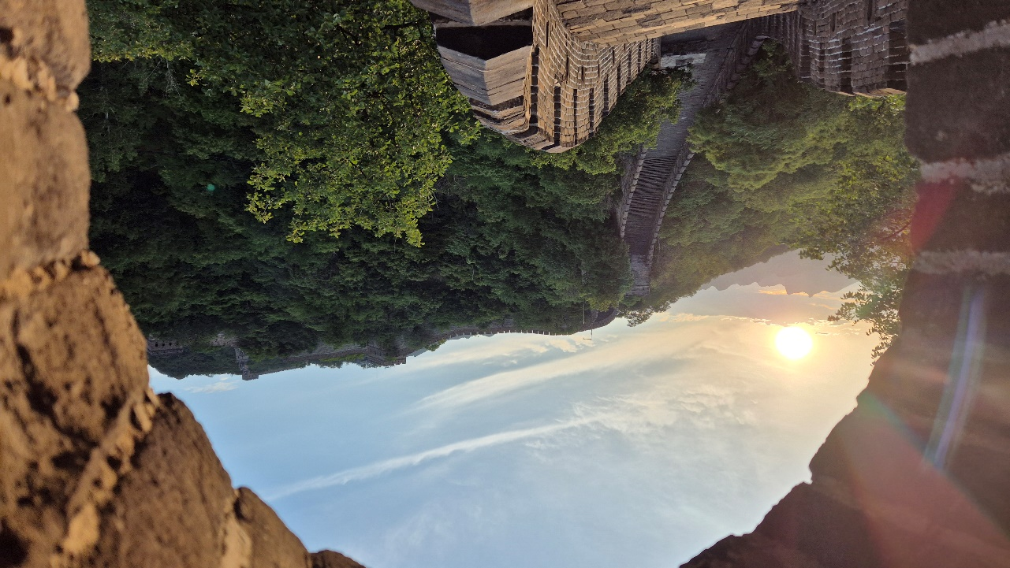

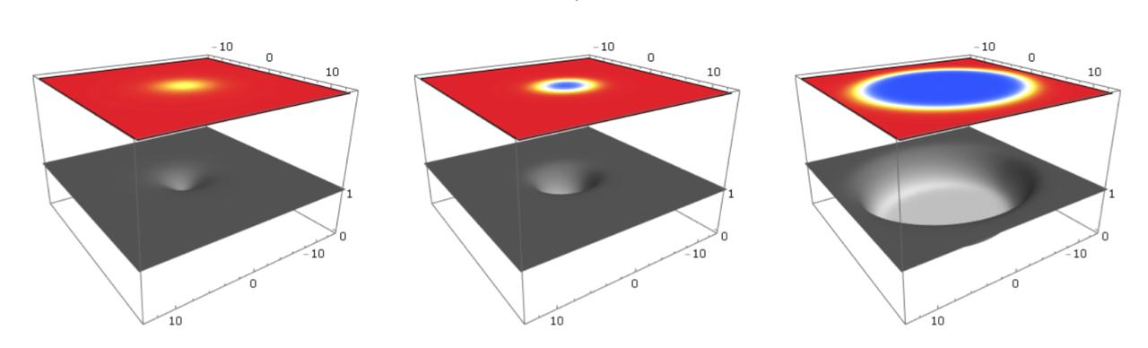
Holographic bubble nucleation in astrophysics or the early universe
First order phase transitions in a cooling environment
With Javier Subils and David Mateos
Reference: 2508.xxxxx
Wilke van der Schee
Holographic applications:
from Quantum Realms to the Big Bang
11 – 19 July 2025, UCAS Beijing

Slide 2
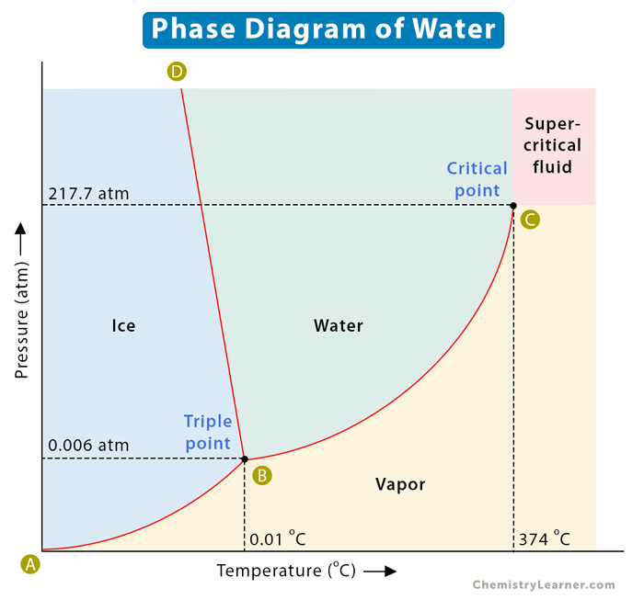
outline
Wilke van der Schee, CERN/Utrecht
First order phase transitions
  Sources: early universe, astrophysics
  Signature: gravitational waves (mHz, MHz)
  A window into the Planck scale?
Dynamics
  Bubble nucleation and false vacua
    Bubble velocities and shapes
Critical bubbles
  Determines the minimal size for relaxation to true vacuum
    Technical: de Turck trick at constant temperature
    Action, tunneling and the nucleation rate
    Comparison with effective field theory
Notes:
Many states + linearized

Slide 3
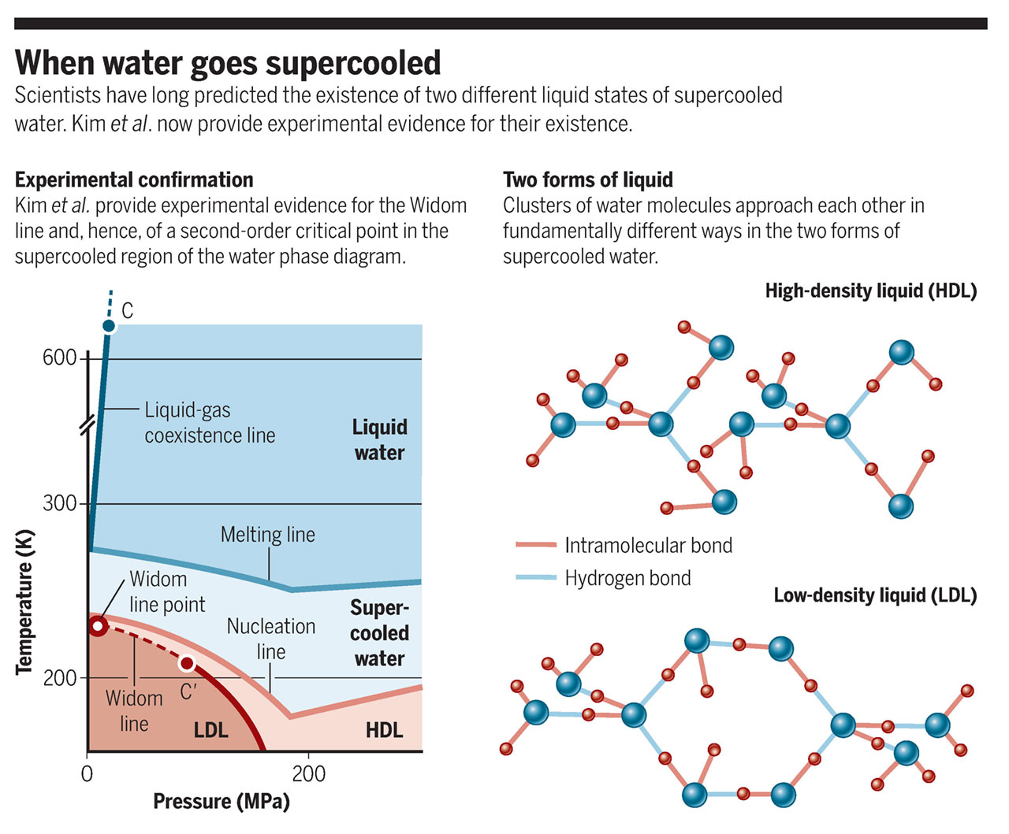
supercooled
Wilke van der Schee, CERN/Utrecht
Fun fact
  Supercooled water at –44 degrees, one micrometer
  X-ray femtoscopy identifies
  high and low density liquids
  A second critical point in the supercooled region ☺
More seriously
  If the Standard Model* has a first order phase transition (FOPT):
    Universe cools down fast, but extremely homogeneous
    Universe will supercool beyond critical temperature
    Bubbles will nucleate, but at what rate? How?
    *technically this is then beyond standard model (quite some examples)
      Really unique opportunity to probe extremely high energy scales
  If QCD has a critical point:
    FOPT potentially present during neutron star mergers
Paola Gallo and H. Eugene Stanley, Supercooled water reveals its secrets (2017)
Notes:
Many states + linearized

Slide 4
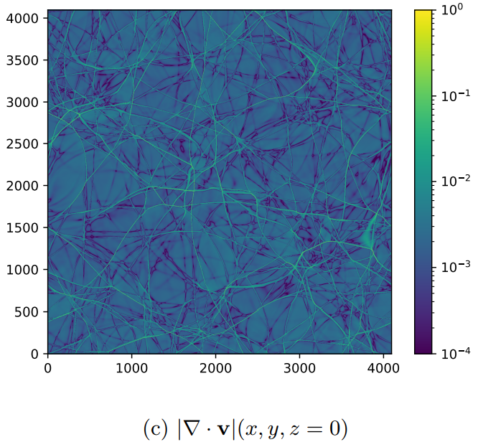
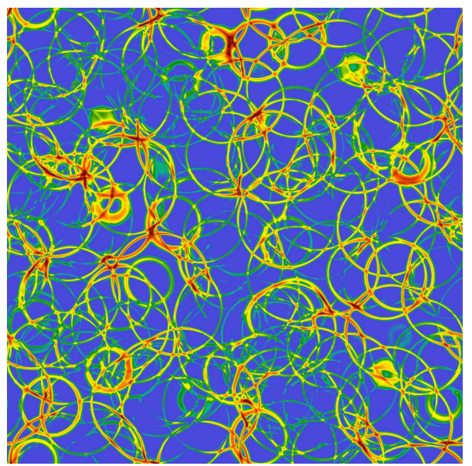
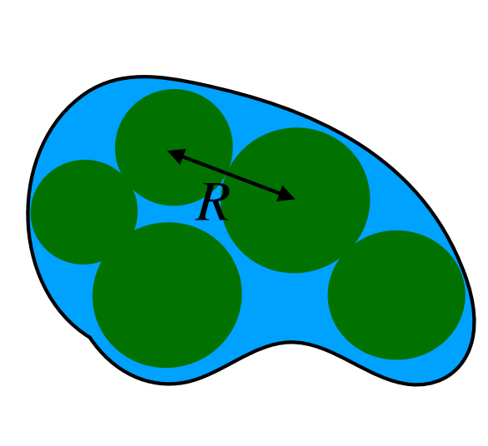
Bubble collisions
Wilke van der Schee, CERN/Utrecht
Bubble collisions in the Early Universe or in Astrophysics
  If the Standard Model has a first order phase transition (FOPT):
    Universe cools down fast, but extremely homogeneous
    Universe will supercool beyond critical temperature
    Bubbles will nucleate, but at what rate? How?
  FOPT potentially present during neutron star mergers
    Merger could cause both superheating and supercooling (subcooling?)
  Collisions of bubbles: unique signature in gravitational waves (!)
    LISA can potentially measure these (mHz)
Andreas Ekstedt, Oliver Gould, Joonas Hirvonen, Benoit Laurentd, Lauri Niemic, Philipp Schichoe and Jorinde van de Vis,
How fast does the WallGo? A package for computing wall velocities in first-order phase transitions (2024)
Mark Hindmarsh, Stephan J. Huber, Kari Rummukainen and David J. Weir, Numerical simulations of acoustically generated gravitational waves at a first order phase transition (2015)
Jorge Casalderrey-Solana, David Mateos, Mikel Sanchez-Garitaonandia, Mega-Hertz Gravitational Waves from Neutron Star Mergers (2022)
Notes:
Many states + linearized

Slide 5
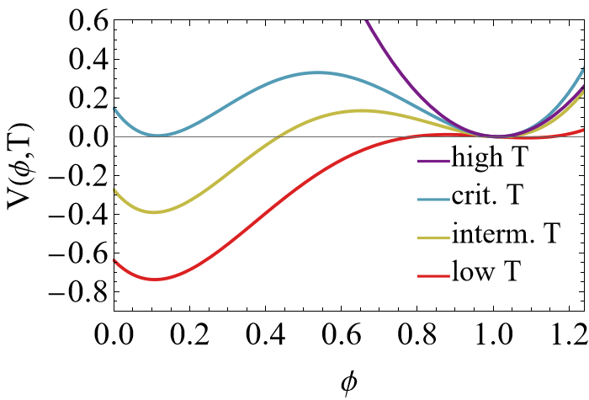


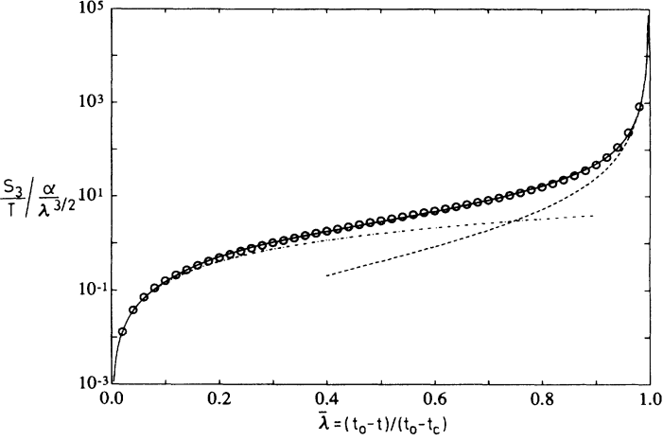
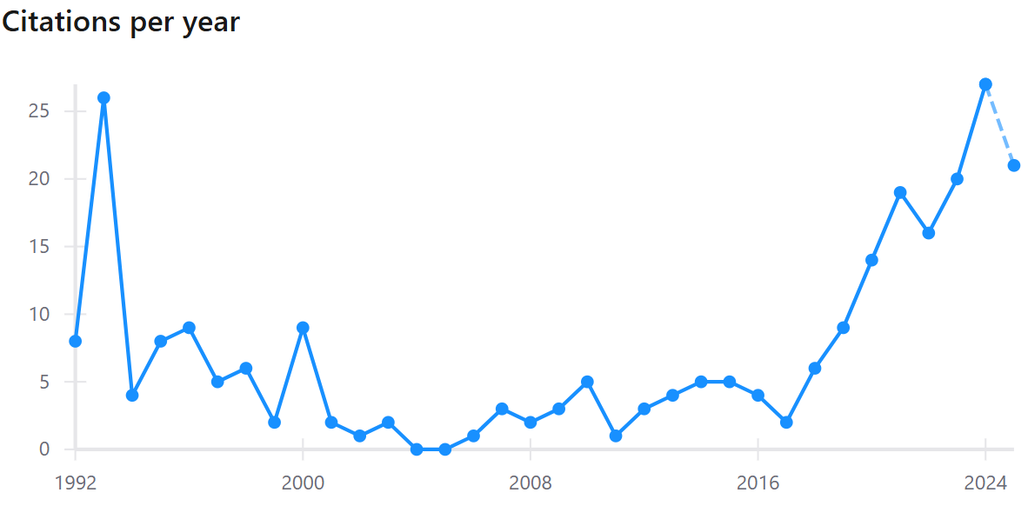
Nucleation in effective field theory
Wilke van der Schee, CERN/Utrecht
An effective potential at constant temperature:
Three regimes
  High temperature: one stable hot phase
  Intermediate (T₀<T<T_{c}): two (meta)stable phases
  Low temperature: one stable cold phase
Cooling the system:
  Below T_{c} and above T₀ the system can tunnel
  to the true minimum (supercooled)
K. Enqvist, J. Ignatius, K. Kajantie and K. Rummukainen, Nucleation and bubble growth in a first-order cosmological electroweak phase transition (1992)
Notes:
Many states + linearized

Slide 6
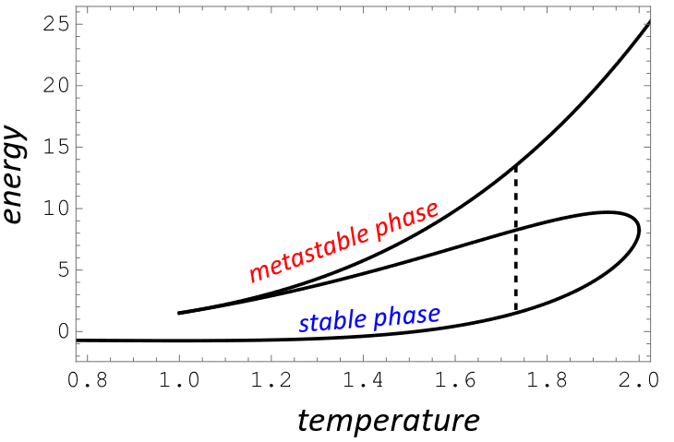
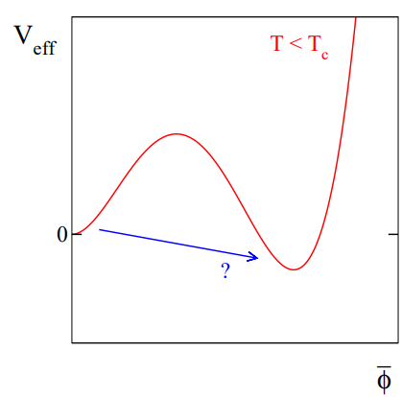
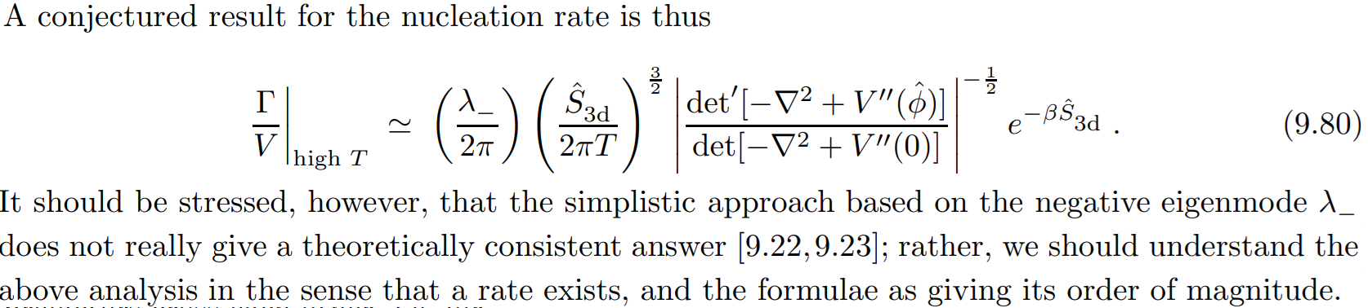
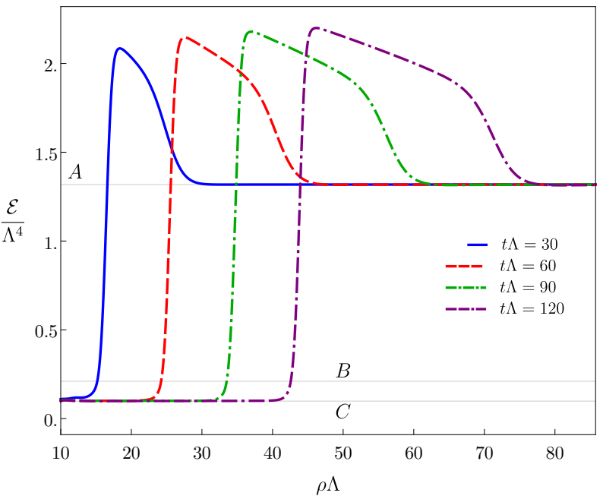
Bubble nucleation and growth
See also talk by Zhenhan Jin, Tue 18:20
See also talk by Hao-Tian Sun, Mon 17:55
Wilke van der Schee, CERN/Utrecht
Vacuum-like decay
  Wall velocity can accelerate to the speed of light
Thermal-like decay
  Deflagration: subsonic detonation
  Friction from the remaining plasma
  Energy density (typically) needs to be balanced
  This means a wall that becomes wider with time:
Mikko Laine and Aleksi Vuorinen, Basics of Thermal Field Theory, A Tutorial on Perturbative Computations (2017)
Yago Bea, Jorge Casalderrey-Solana, Thanasis Giannakopoulos, Aron Jansen, David Mateos, Mikel Sanchez-Garitaonandia and Miguel Zilhão, Holographic Bubbles with Jecco: Expanding, Collapsing and Critical (2022)
Notes:
Many states + linearized

Slide 7

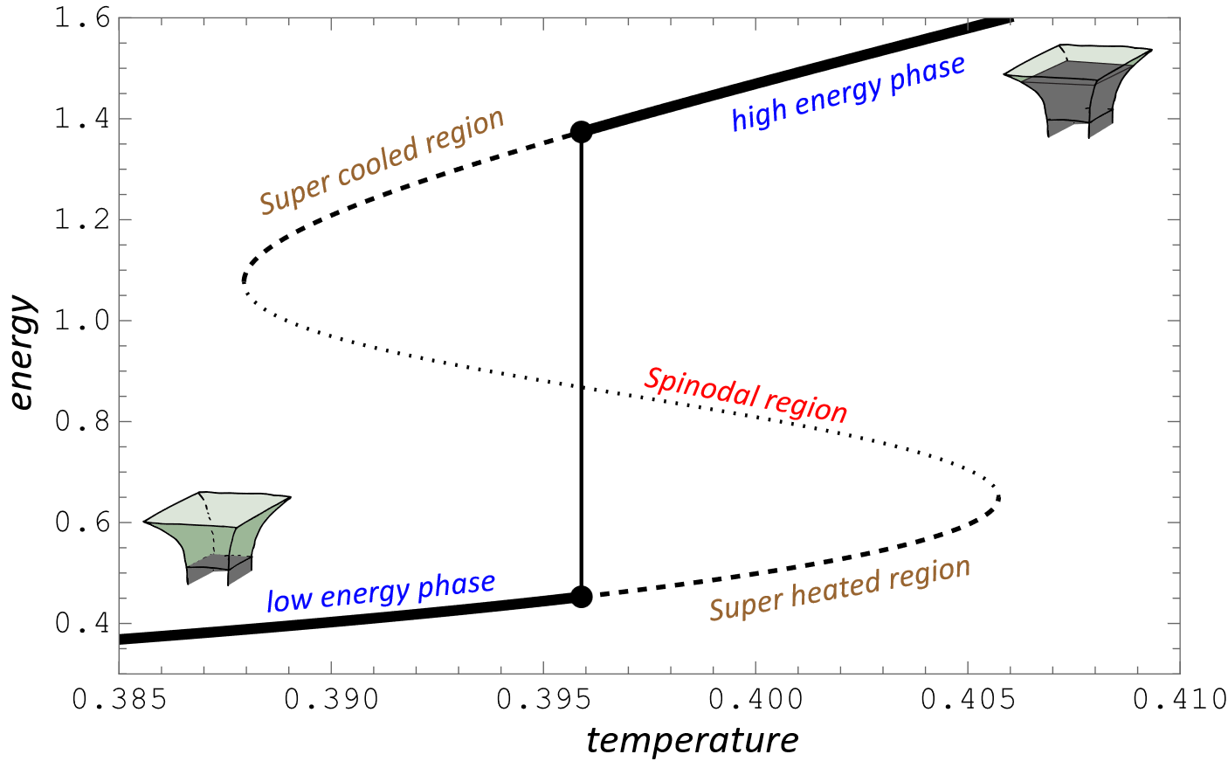

Supercool holography
See also talk by Andrei Starinets, Mon 17:00
Wilke van der Schee, CERN/Utrecht
A non-conformal holographic toy model
  Source for scalar provides extra scale (j = 1)
The universe cools; what happens?
  First it becomes supercooled (metastable)
  If no bubbles form: it enters spinodal branch
    Negative specific heat, imaginary speed of sound
    Gubser-Mitra: unstable (Gregory-Laflamme)
    System phase separates
  If bubbles form:
    They keep on colliding (gravitational waves!)
    If given enough time only solution is phase separated at critical temperature (unlike water)
  Finally enters low energy phase
Yago Bea and David Mateos, Heating up Exotic RG Flows with Holography
Notes:
Many states + linearized

Slide 8
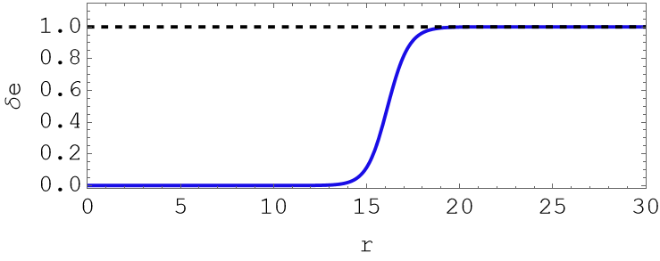
Supercooled and critical holography
Wilke van der Schee, CERN/Utrecht
Bubble nucleation
  Small bubbles disappear (surface tension is too expensive)
  Large bubbles can expand
    Somewhat non-trivial, but Gubser-Mitra implies that the end state
    is the phase separated state at the critical temperature
    Interesting question if this is possible in an expanding
    universe (but for now we’re in a box ☺)
A critical bubble
  An unstable time-independent solution of the EOM
  At T_{c} the phase separated phase satisfies this:
    The limit of a large bubble
  For smaller bubbles this would not be stable: the bubble would collapse
Yago Bea and David Mateos, Heating up Exotic RG Flows with Holography
Notes:
Many states + linearized

Slide 9

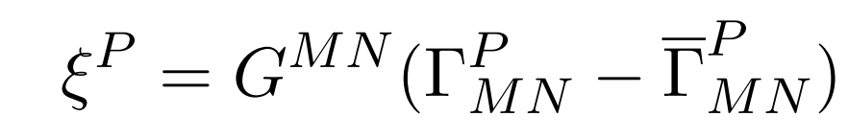
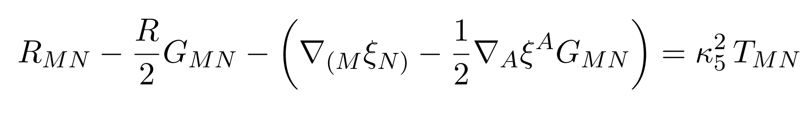
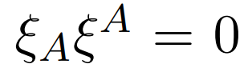
Some technicalities: DeTurck
Wilke van der Schee, CERN/Utrecht
Solve a slightly modified problem
  Take a reference metric (the homogeneous solution, ) and define
  Solve the modified Einstein equations:
  Check that:
  This helps imposing boundary conditions and to make the PDEs elliptic
    Since we know the solution exists there should not be any `soliton’ with ξ non-zero
  Technically we work at large but finite N_{c}, otherwise the nucleation rate vanishes
    Spherical symmetry
    Fully backreacted AdS₅ solutions though ☺
Óscar J. C. Dias, Jorge E. Santos and Benson Way, Numerical Methods for Finding Stationary Gravitational Solutions (2015)
Notes:
Many states + linearized

Slide 10
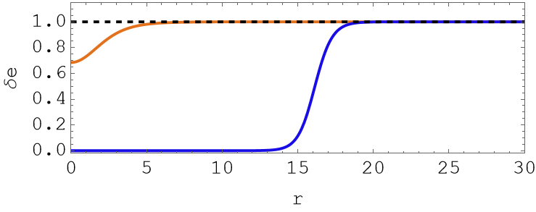
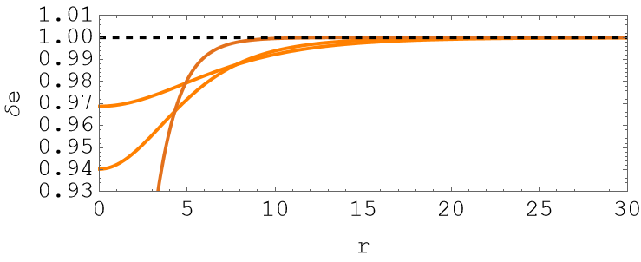
Supercooled and critical holography
Wilke van der Schee, CERN/Utrecht
A critical bubble
  An unstable time-independent solution of the EOM
  For smaller bubbles this would not be stable: the bubble would collapse
    Stable if wall is less steep
    Stable if more pressure at the centre of the bubble
  Even smaller bubbles (regarding slope, closer to T₀):
    The size starts growing again (!):
Notes:
Many states + linearized

Slide 11
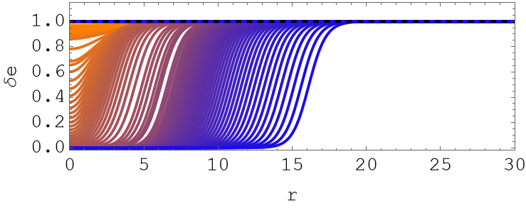
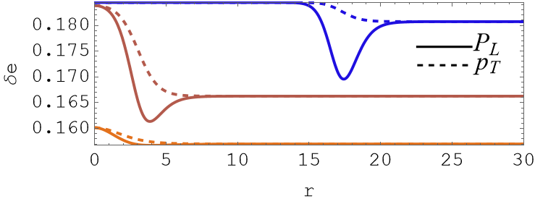
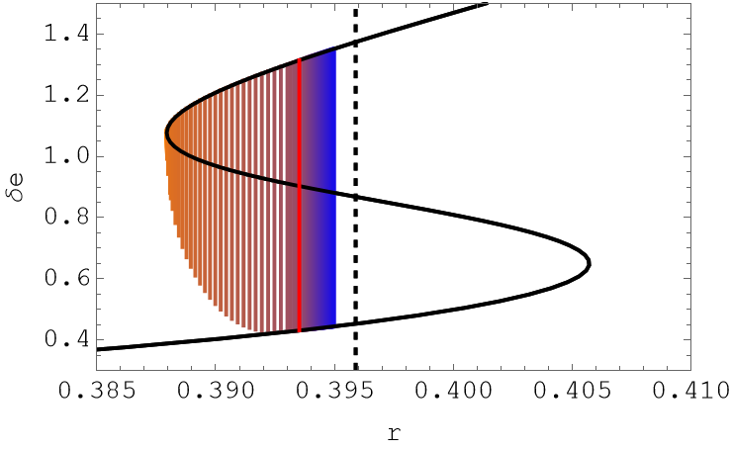
Supercooled and critical holography
Wilke van der Schee, CERN/Utrecht
A few more details: pressures
  Pressure inside is higher than outside (but energy density is lower)
    Remember: at T_{c} pressures of both phases are equal
  Transverse pressure is always smaller than longitudinal pressure
  Transverse pressure can be non-monotonic (always?)
  Longitudinal pressure is always monotonic
Notes:
Many states + linearized

Slide 12
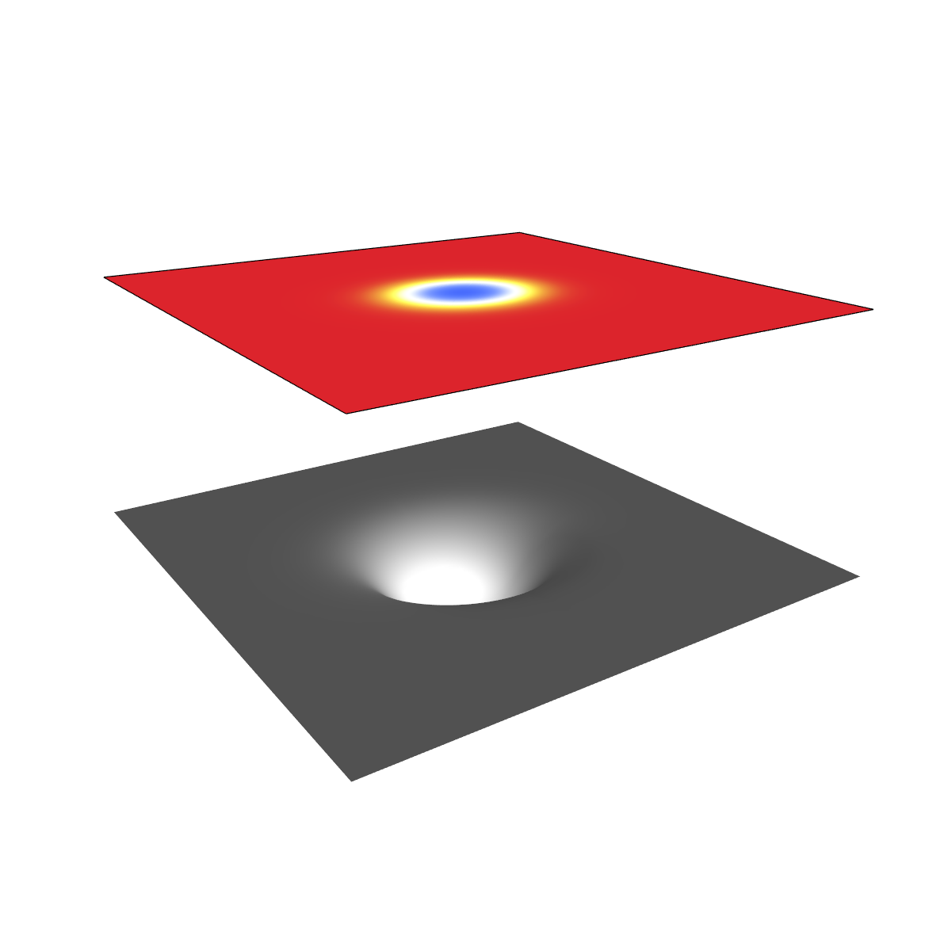
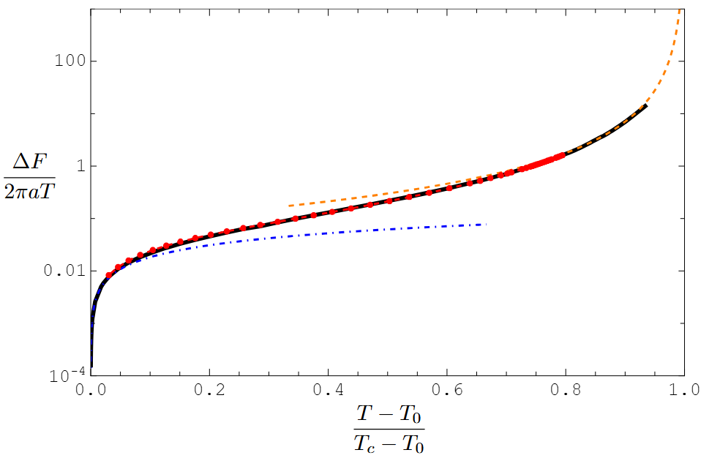
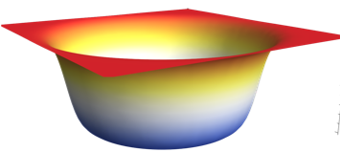


What kind of bubbles will nucleate?
Wilke van der Schee, CERN/Utrecht
We compute the action:
  Larger bubbles are (much) harder to nucleate
  No final answer, but quiet some supercooling can be expected
  Effective field theory approach can work well (red, after fitting (!))
  Thin wall works for large bubbles (orange, (T-T_{c})⁻²)
  Small bubble effective description not as good (blue, (T-T₀)^{4/3})
Notes:
Many states + linearized

Slide 13
Discussion
See also talk by Zhenhan Jin, Tue 18:20
Wilke van der Schee, CERN/Utrecht
Bubble nucleation in holography
  Full microscopic construction of critical bubbles
    Backreacted AdS₅, limiting behaviour fits effective potential
  No final answer, but quiet some supercooling can be expected
  Applications to neutron stars and early universe
    Really not much certain both for nucleation and dynamics
    Great help to have (toy!) models where microscopics is under full control
  Dynamics is clearly the next step
    Velocities are interesting, wall profiles
    Competition with cooling due to expansion
Notes:
Many states + linearized

