Slide 1
Pole dynamics in holographic thermal correlators
Jie Ren
Sun Yat-sen University
Based on 2412.02608 (with Zhe Yu) and an upcoming work
Beijing
2025-07-16

Slide 2
Introduction & Motivation
Analyticity properties (poles, branch cuts) in correlation functions play an important role in charactering a quantum system. Analyzing these poles helps explain how systems like the quark-gluon plasma (QGP) or quantum fluids dissipation disturbances and approach equilibrium.
Poles in holographic correlators (quasinormal modes of AdS black holes) can move in highly nontrivial ways as a parameter changes.
States in N=4 super-Yang-Mills theory (or its subsectors) can exhibit significantly more nontrivial behaviors than the particular state of the RN-AdS black hole.
The holographic method enables us to study more general states by constructing numerical solutions to Einstein’s equations with less symmetries. [Other nonperturbative methods in QFT usually require higher symmetries, such as the localization method.]

Slide 3
Pole motion
Single pole: hydrodynamic modes, fundamental tone, overtones, zero mode, etc
Pole structure: symmetric, in pairs, isospectrality, spectral duality, etc
Pole skipping
Pole motion:
Pole collisions
Merging and splitting
Accumulating to form a branch cut
Avoided crossings (level repulsions)
Cascade repulsions

Slide 4
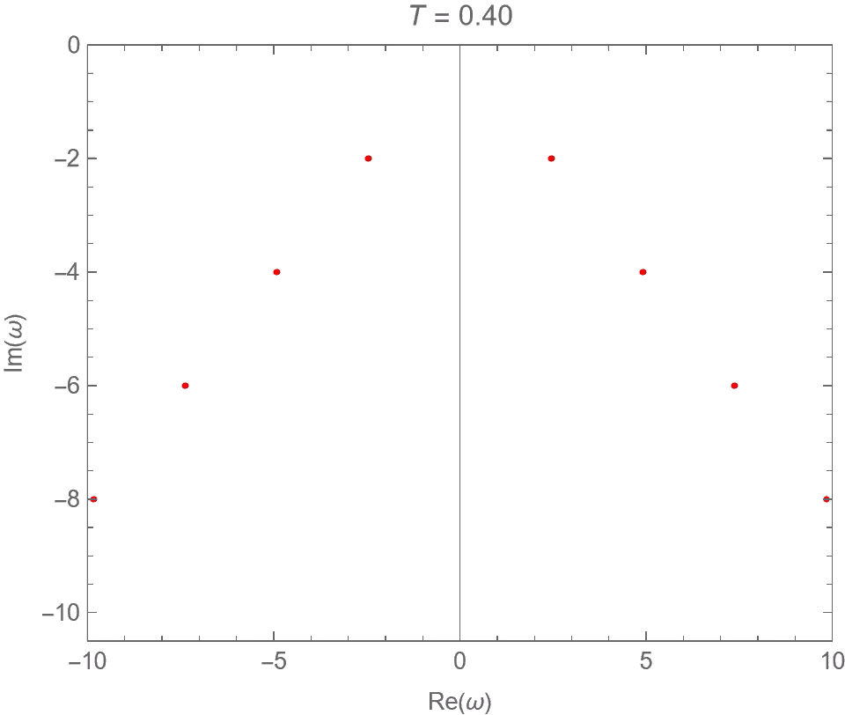
Quasinormal modes of the Schwarzschild-AdS₅ black hole with momentum dissipation
Current-current correlator
JR & Wenni Zheng, 2109.07481

Slide 5
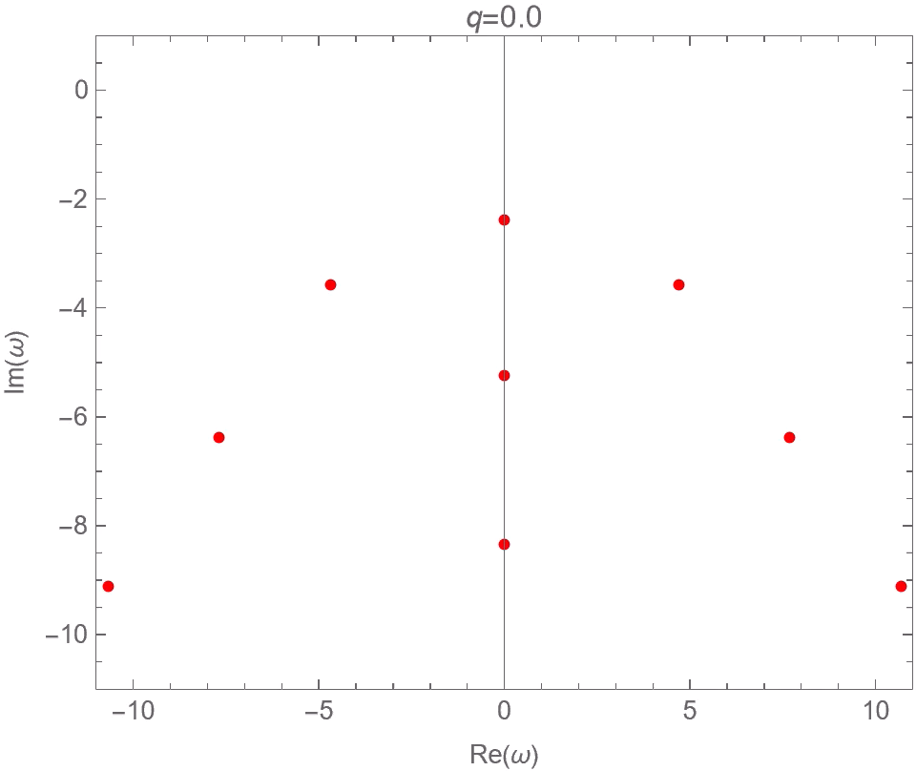
Quasinormal modes of the RN-AdS₅ black hole perturbed by a charged scalar field
JR & Zhe Yu, 2412.02608

Slide 6
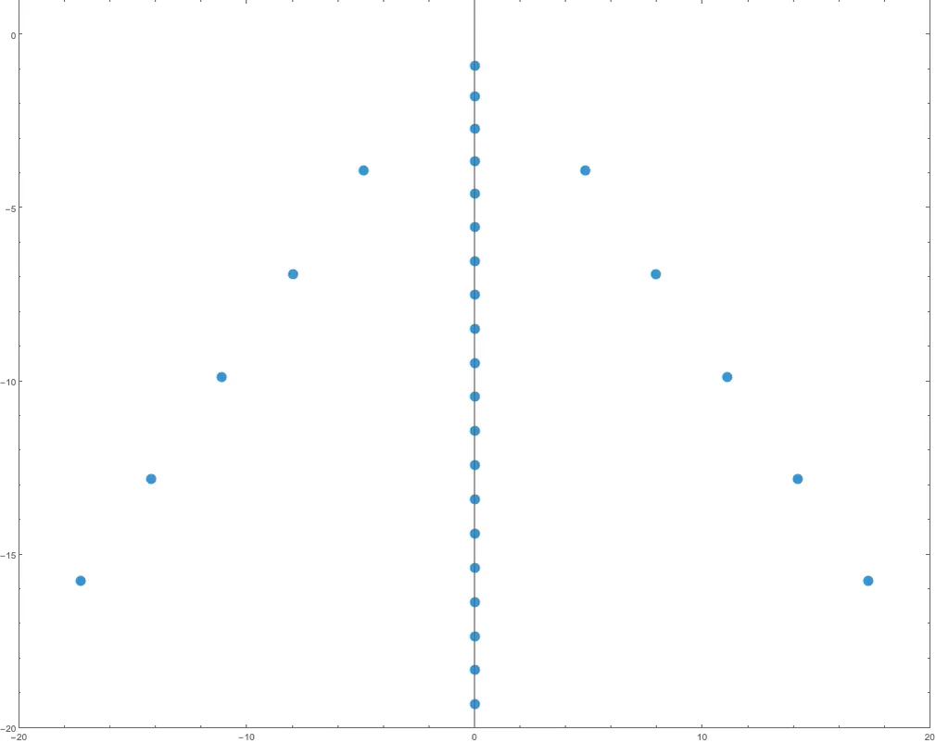
Quasinormal modes of the RN-AdS₅ black hole perturbed by a charged scalar field

Slide 7
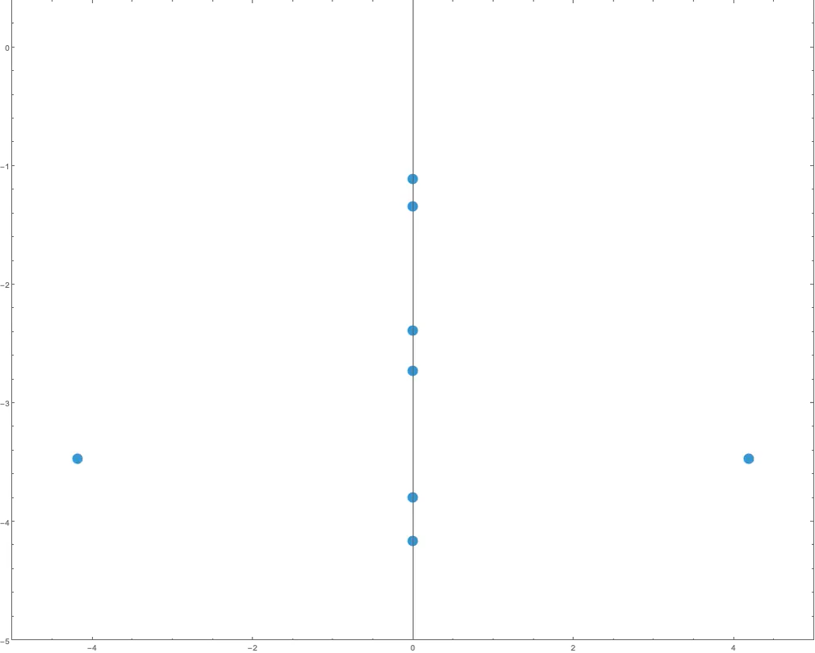
Quasinormal modes of the 2-charge black hole in AdS₅ (Gubser-Rocha model) perturbed by a charged scalar field
Upcoming work

Slide 8
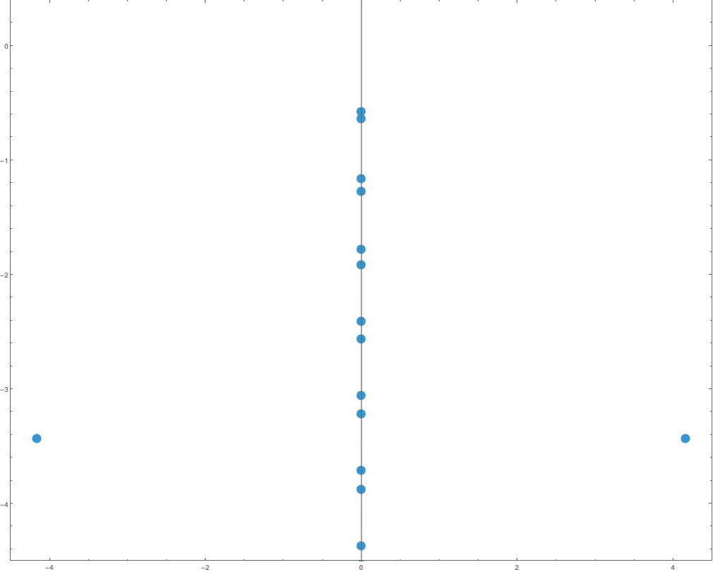
Quasinormal modes of the 2-charge black hole in AdS₅ (Gubser-Rocha model) perturbed by a charged scalar field
Upcoming work

Slide 9
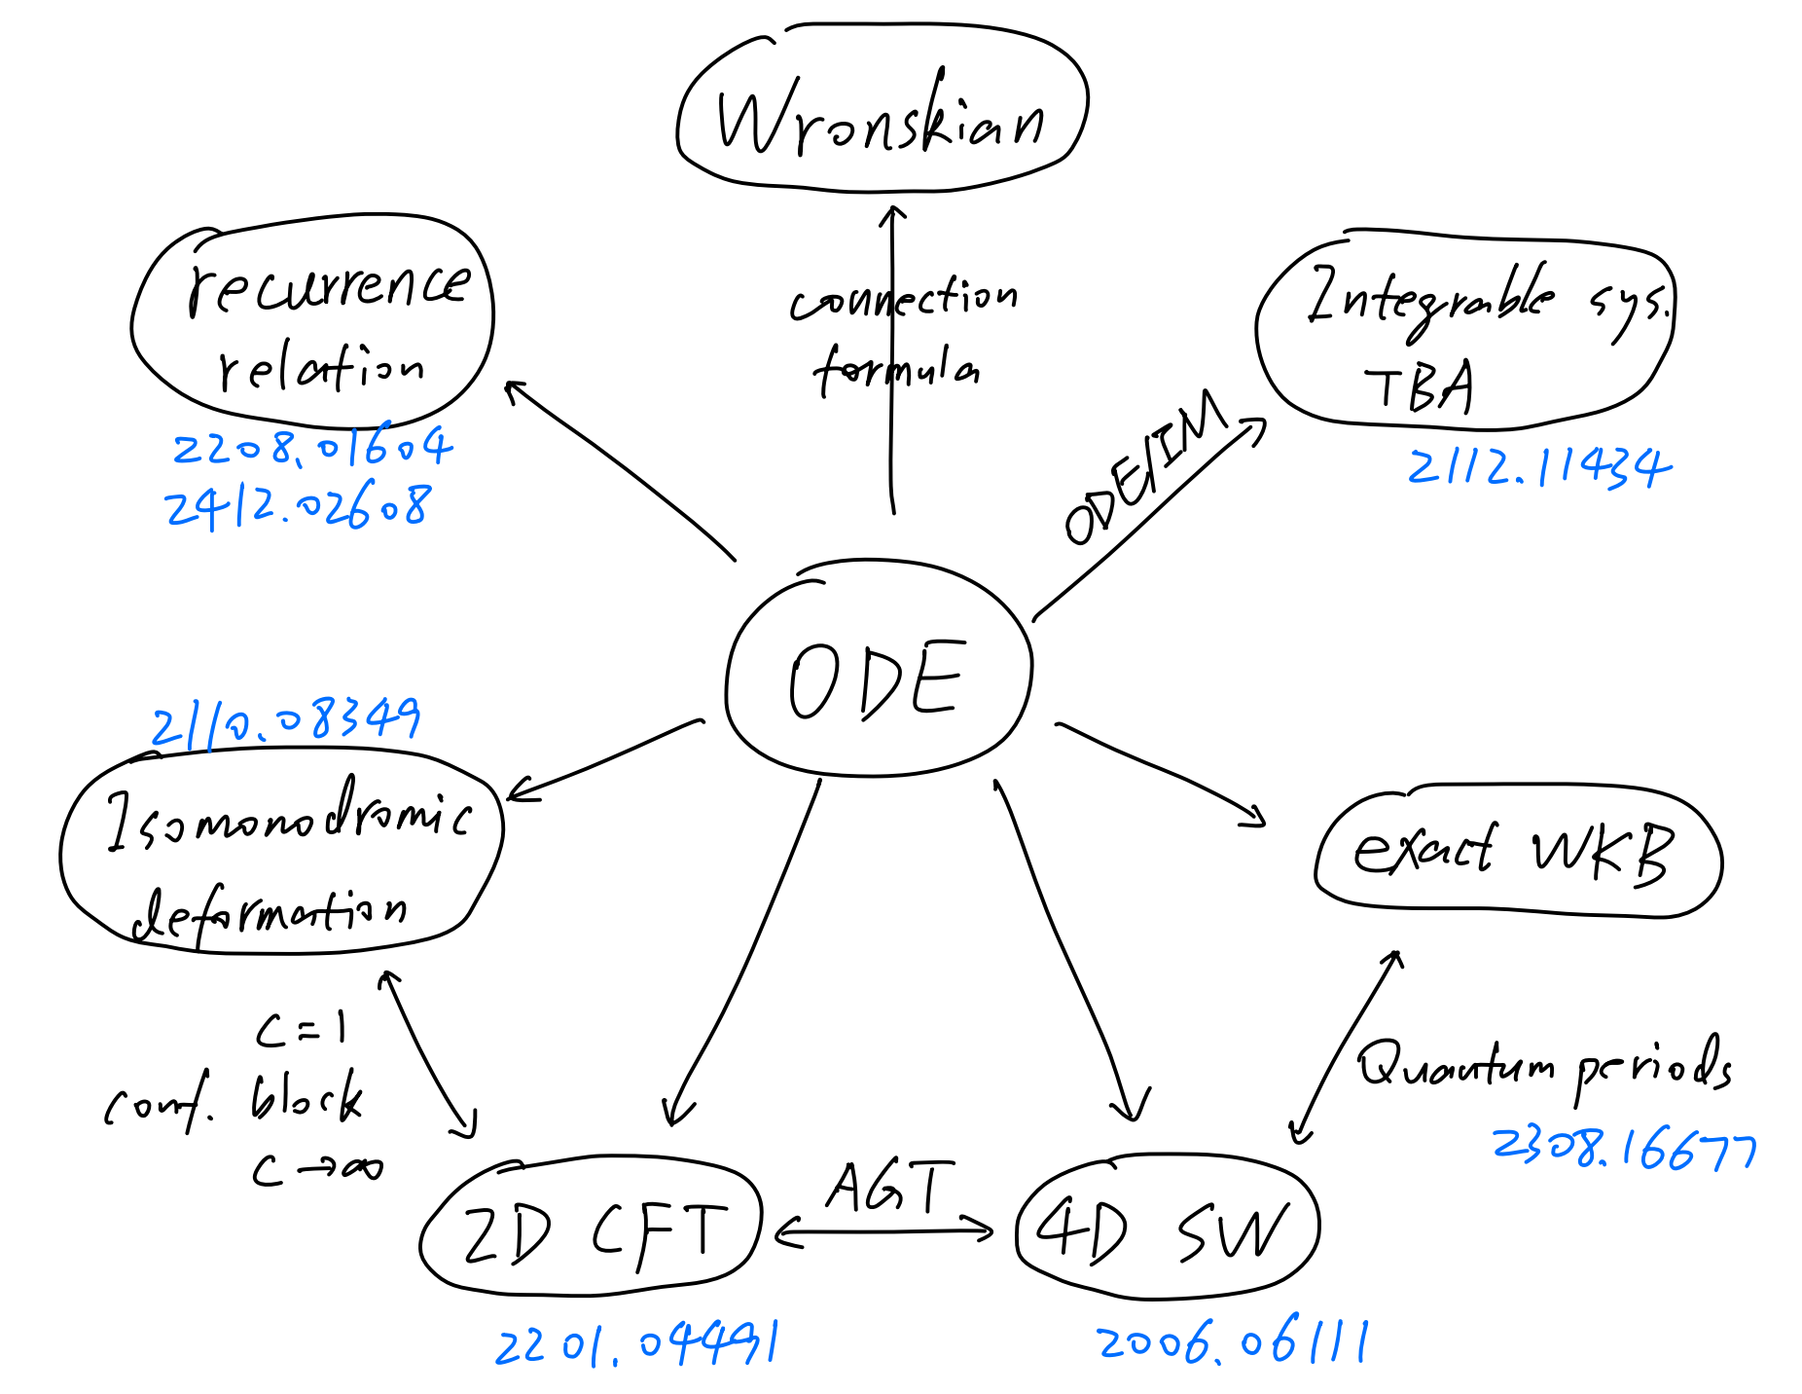

Slide 10
Outline
Introduce the models (RN-AdS black hole and Gubser-Rocha model)
Methods for calculating quasinormal modes
(Not in the review paper: R.A. Konoplya & A. Zhidenko, Quasinormal modes of black holes: From astrophysics to string theory, 1102.4014)
What analytic results can be obtained by the above methods?
How do we explain these pole structure and motion mathematically and physically?
Future perspectives: construct more general solutions (numerical relativity). Classify the patterns of pole motion.

Slide 11
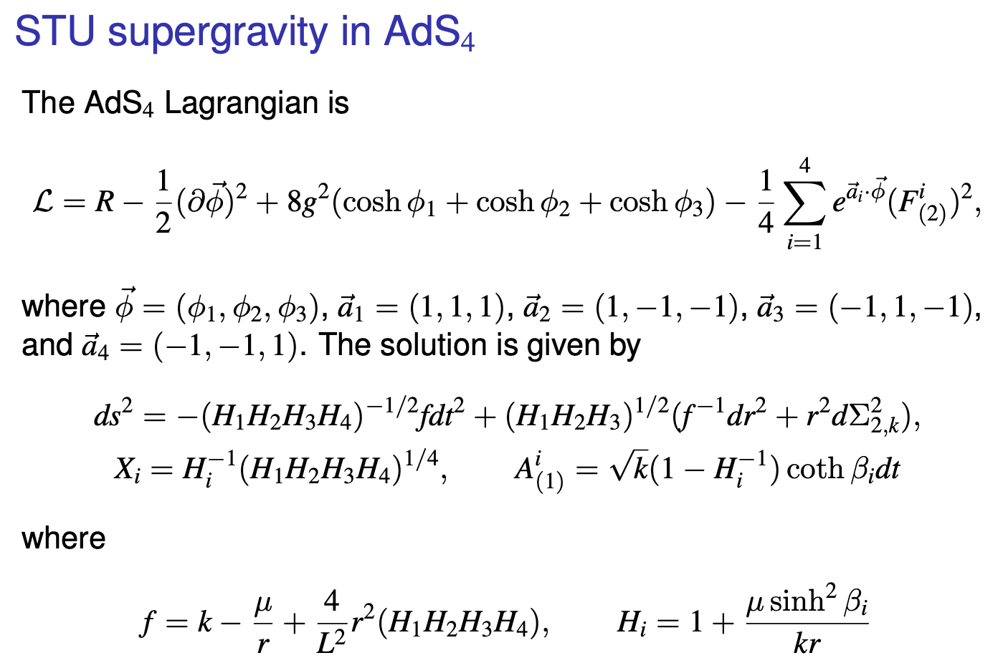

Slide 12
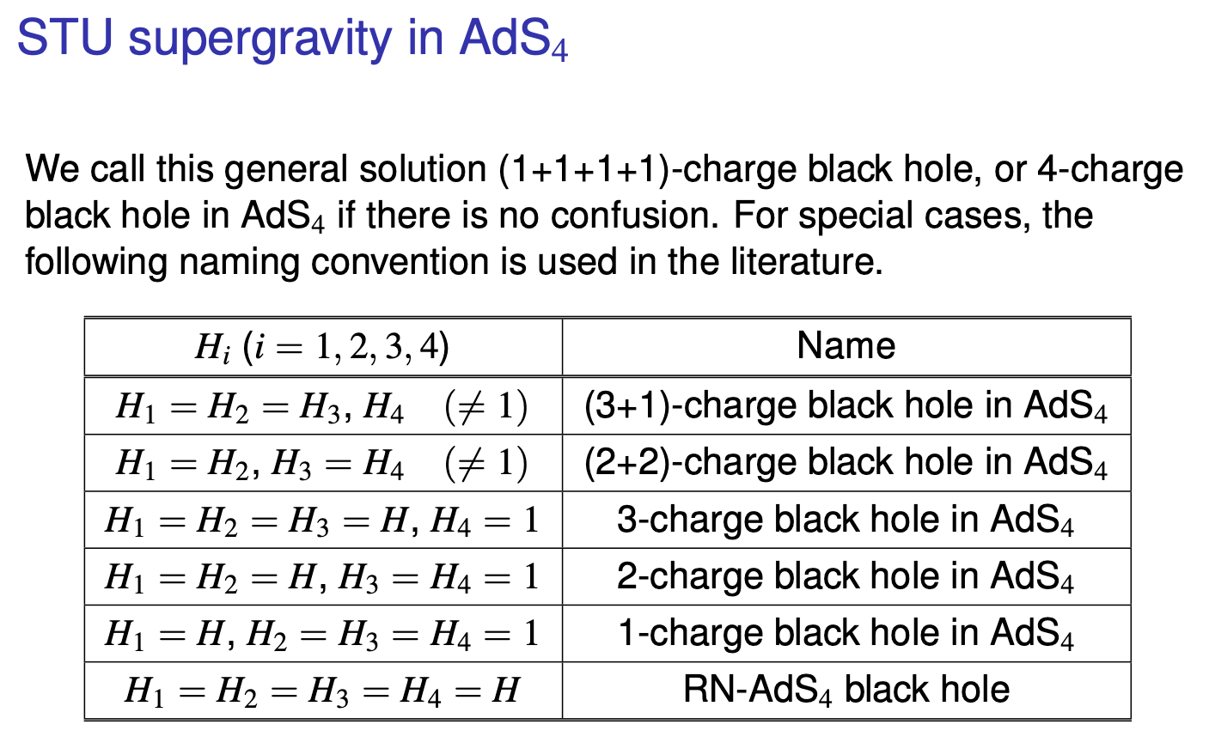

Slide 13
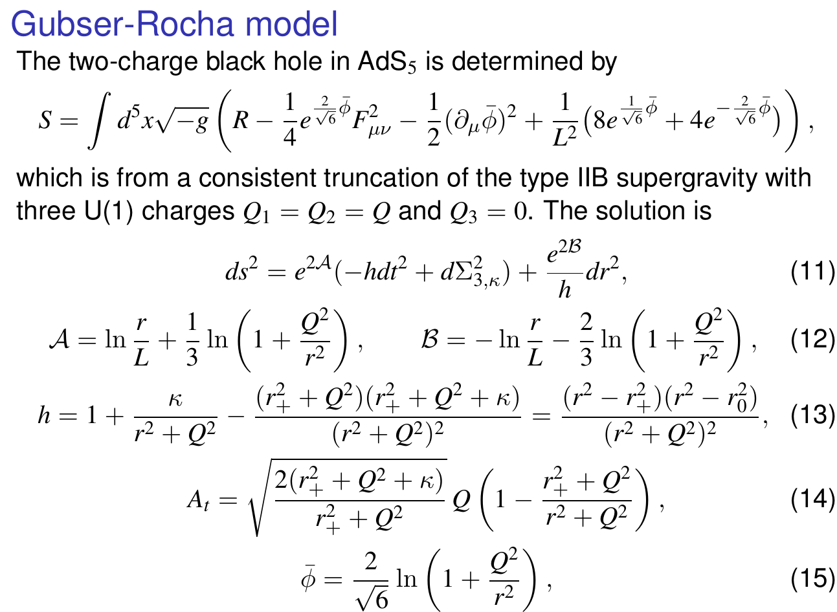

Slide 14
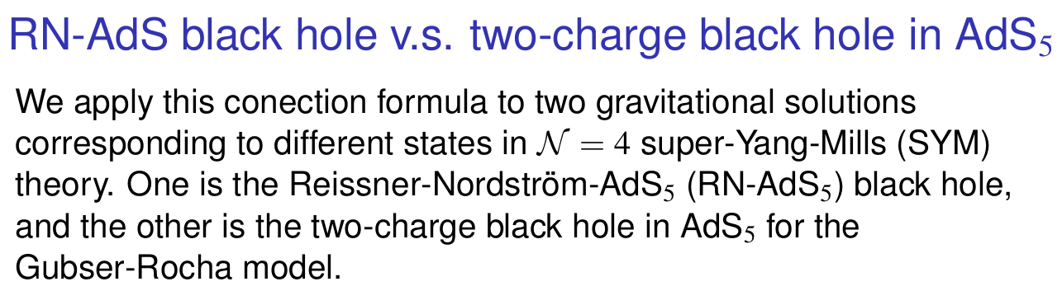
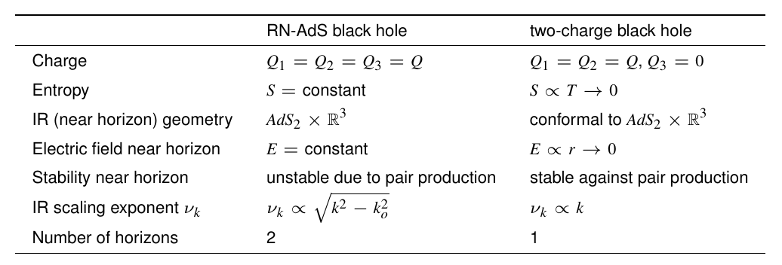

Slide 15
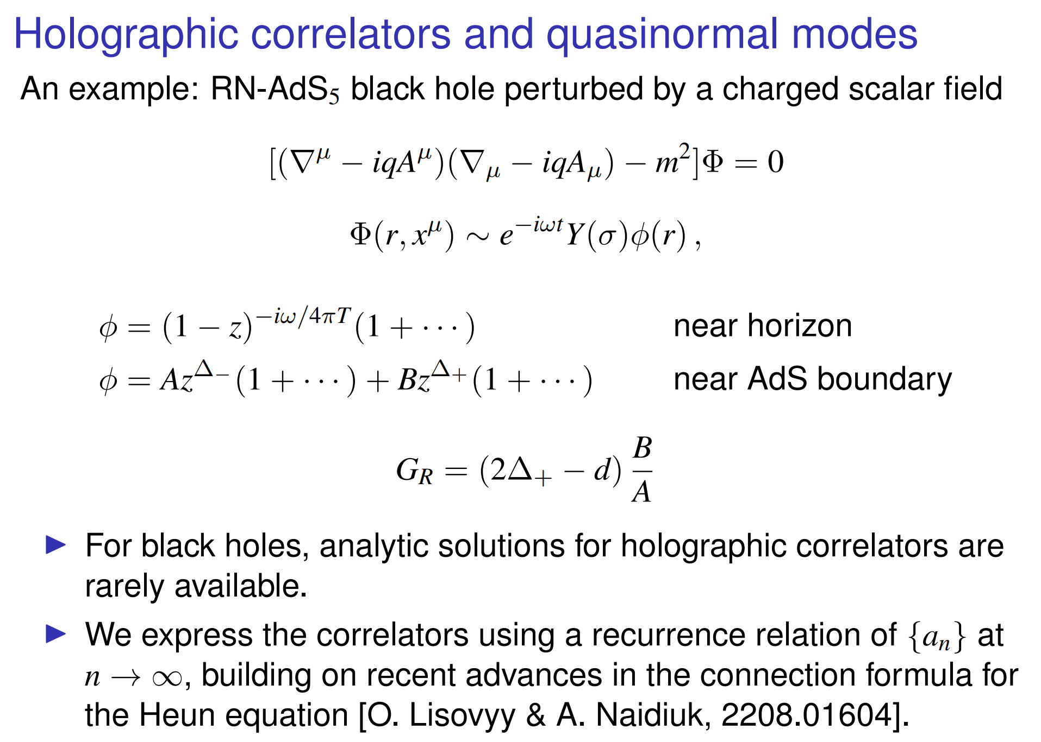

Slide 16
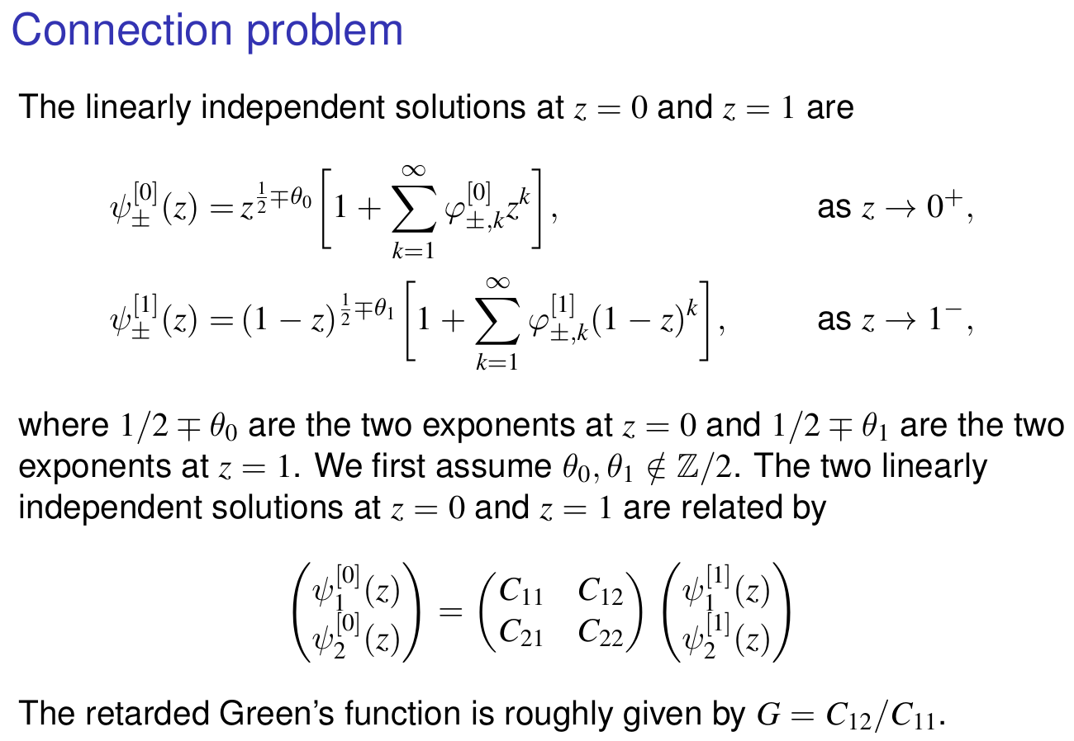

Slide 17
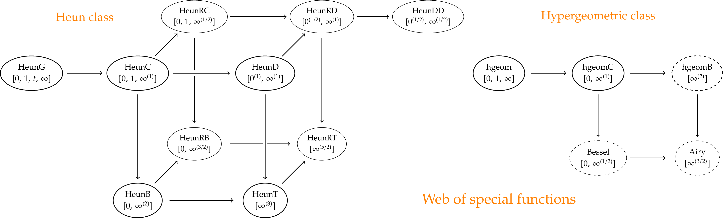
Heun function and confluent cases

Slide 18
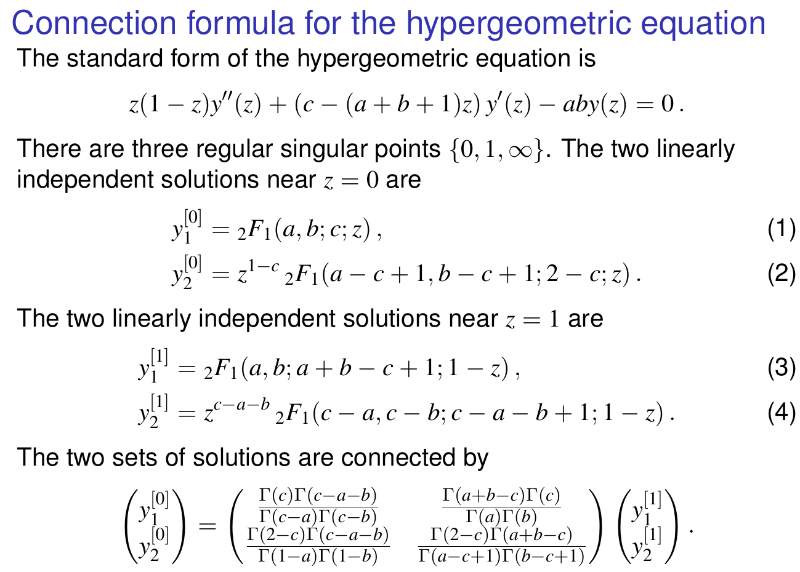

Slide 19
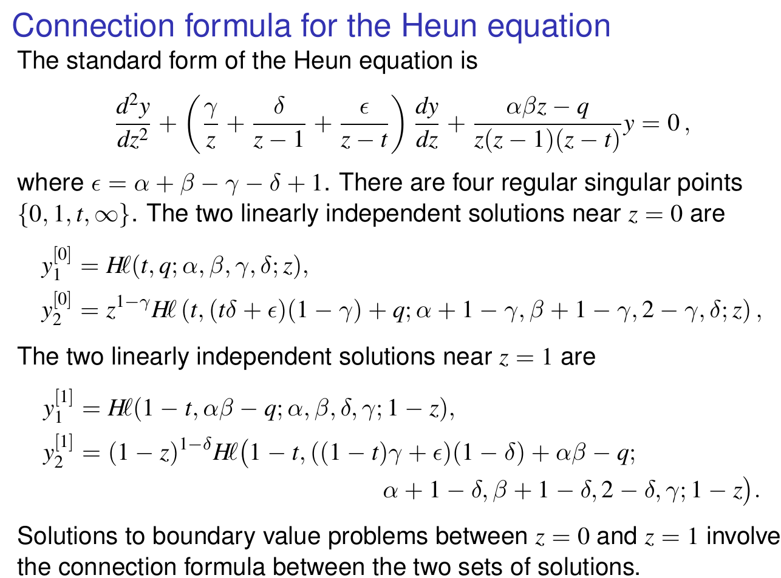

Slide 20
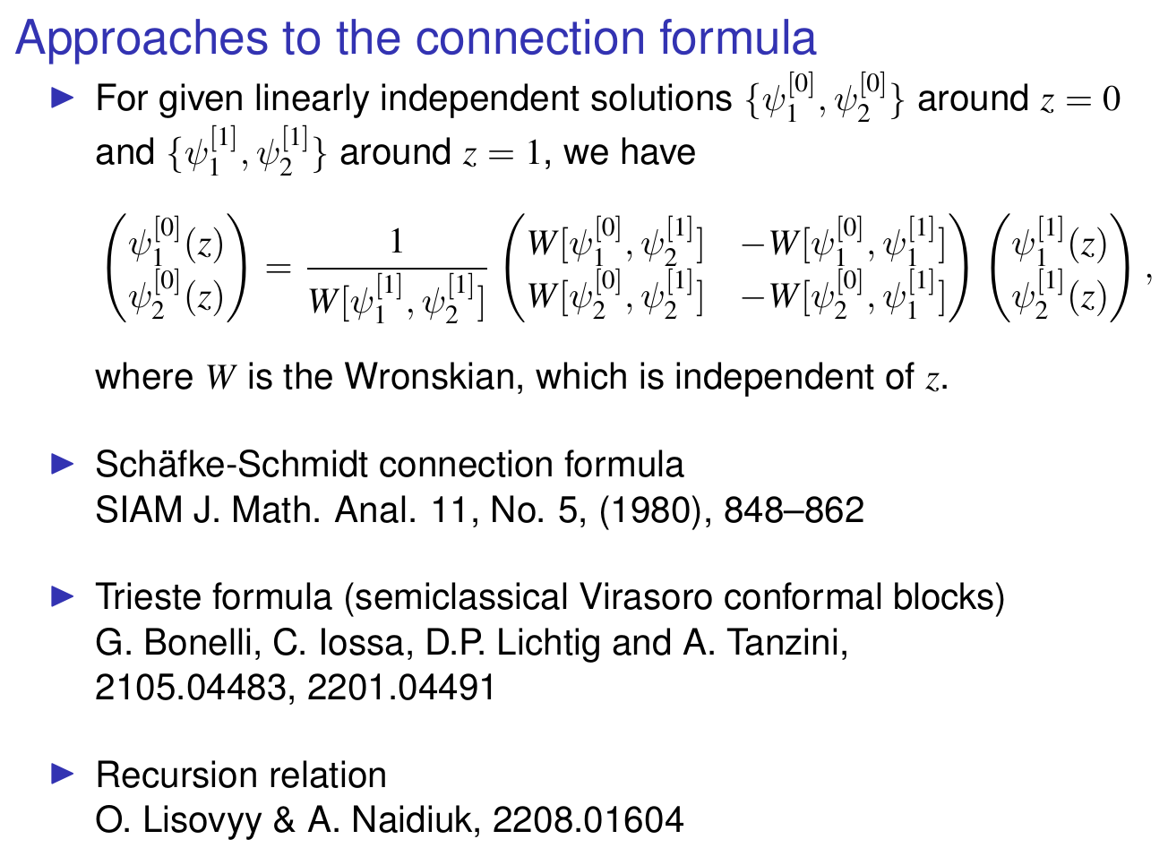
SW-QNM correspondence,
2006.06111

Slide 21
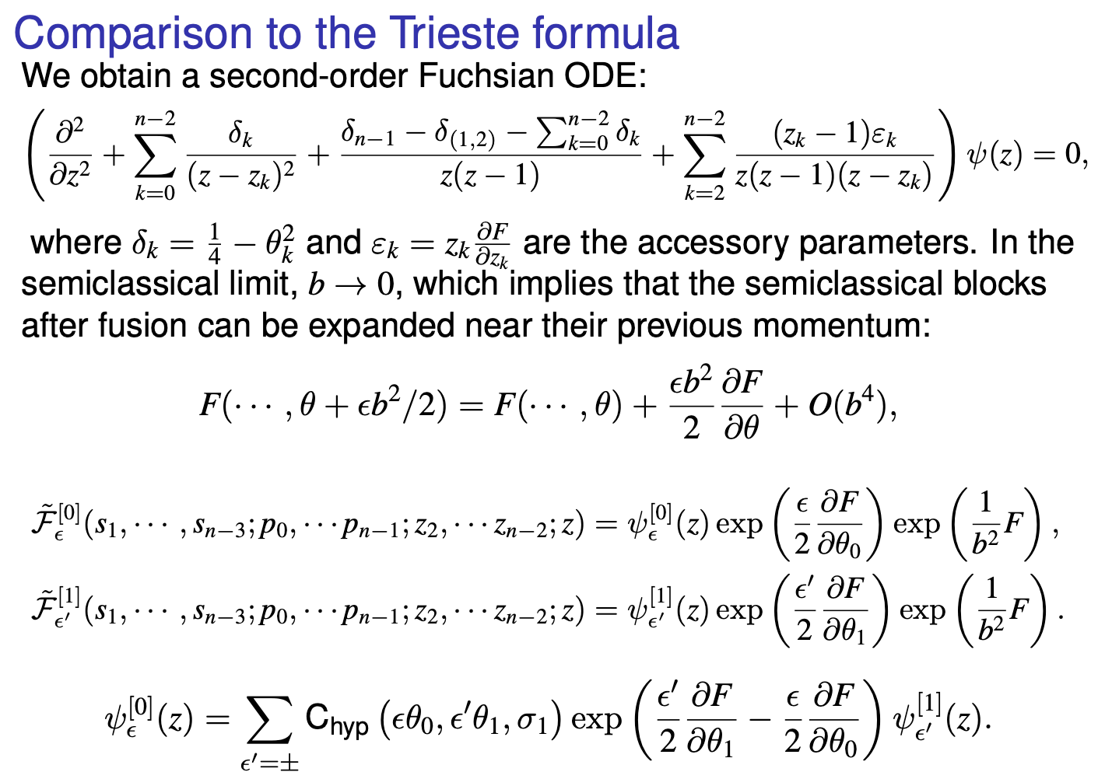

Slide 22
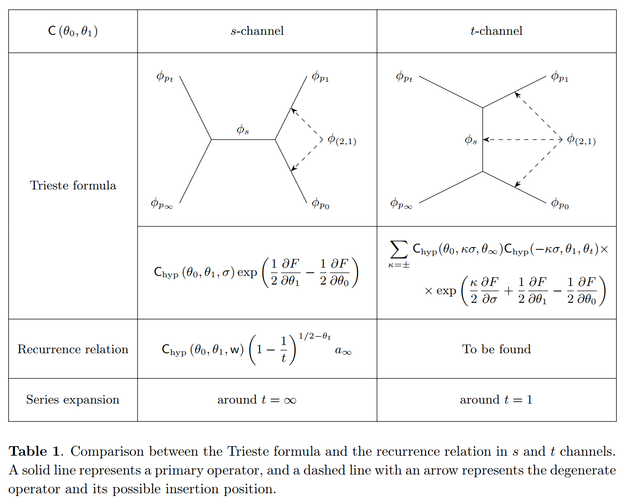

Slide 24
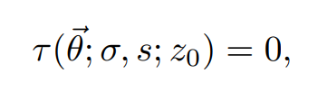
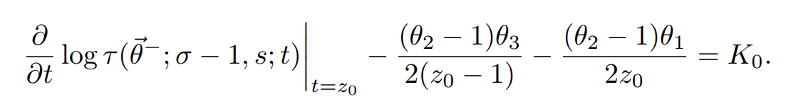
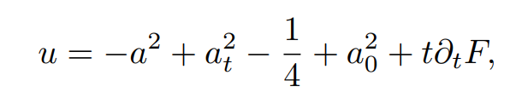
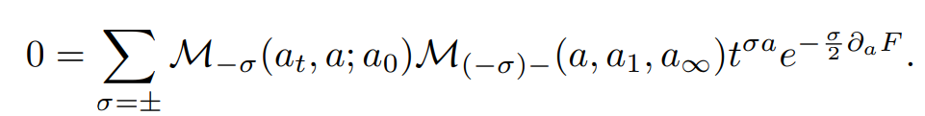

Slide 25
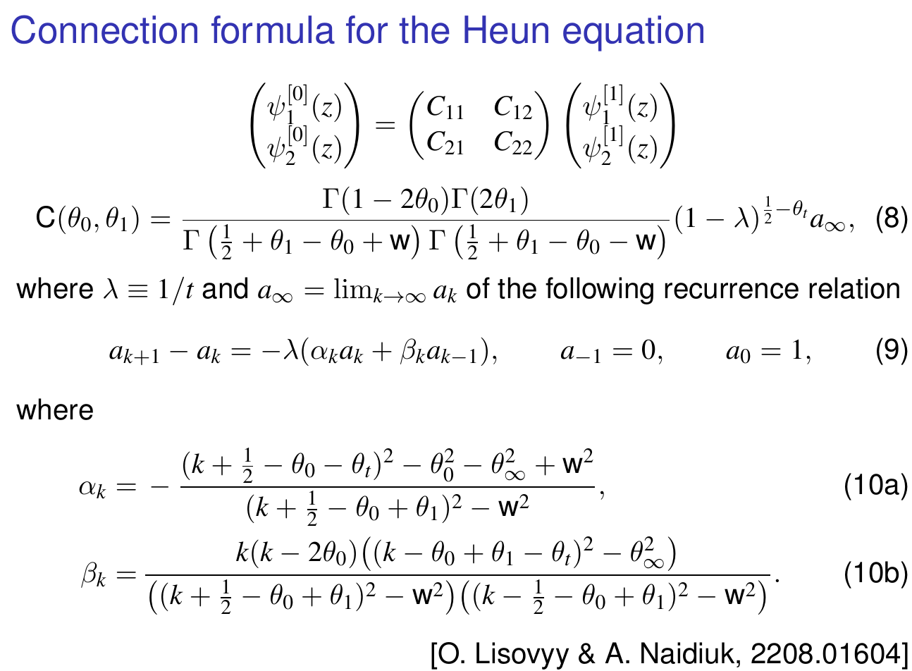

Slide 26
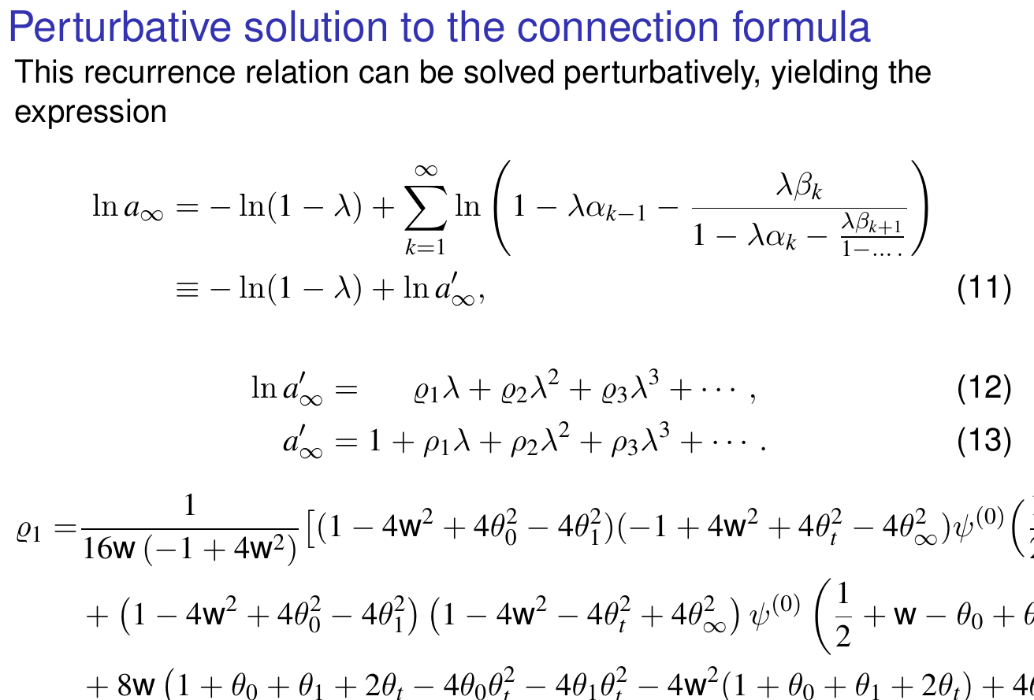

Slide 27
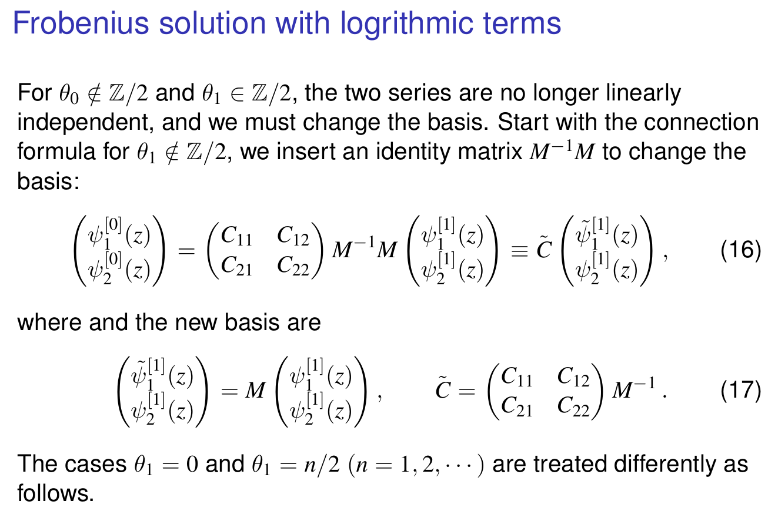
JR & Zhe Yu, 2412.02608

Slide 28
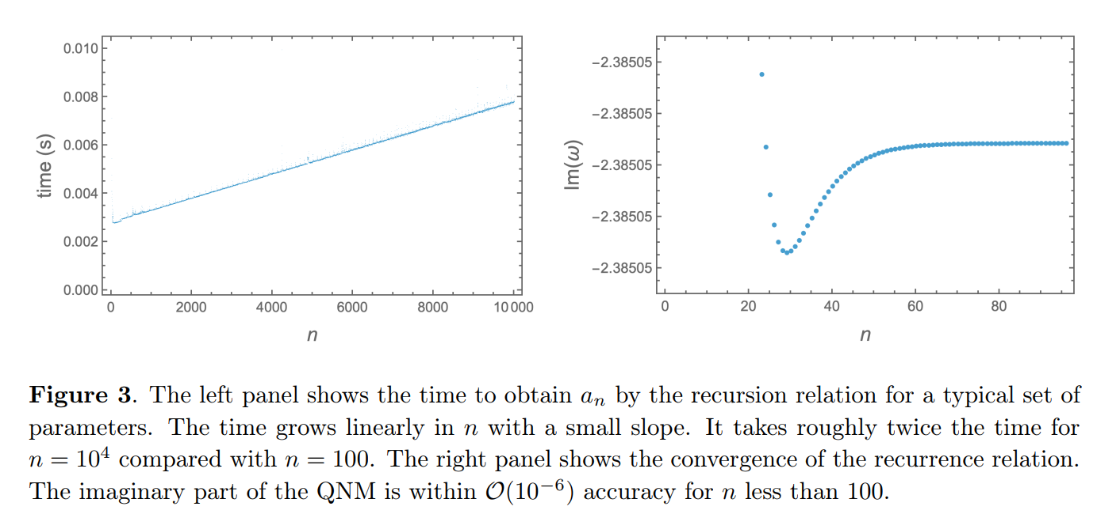
Convergence, stability, accuracy, and effectiveness of the recurrence relation

Slide 29
Quasinormal modes of the RN-AdS₅ black hole perturbed by a charged scalar field
JR & Zhe Yu, 2412.02608

Slide 30
Quasinormal modes of the RN-AdS₅ black hole perturbed by a charged scalar field

Slide 31
Quasinormal modes of the 2-charge black hole in AdS₅ (Gubser-Rocha model) perturbed by a charged scalar field
Upcoming work

Slide 32
Quasinormal modes of the 2-charge black hole in AdS₅ (Gubser-Rocha model) perturbed by a charged scalar field
Upcoming work

Slide 33
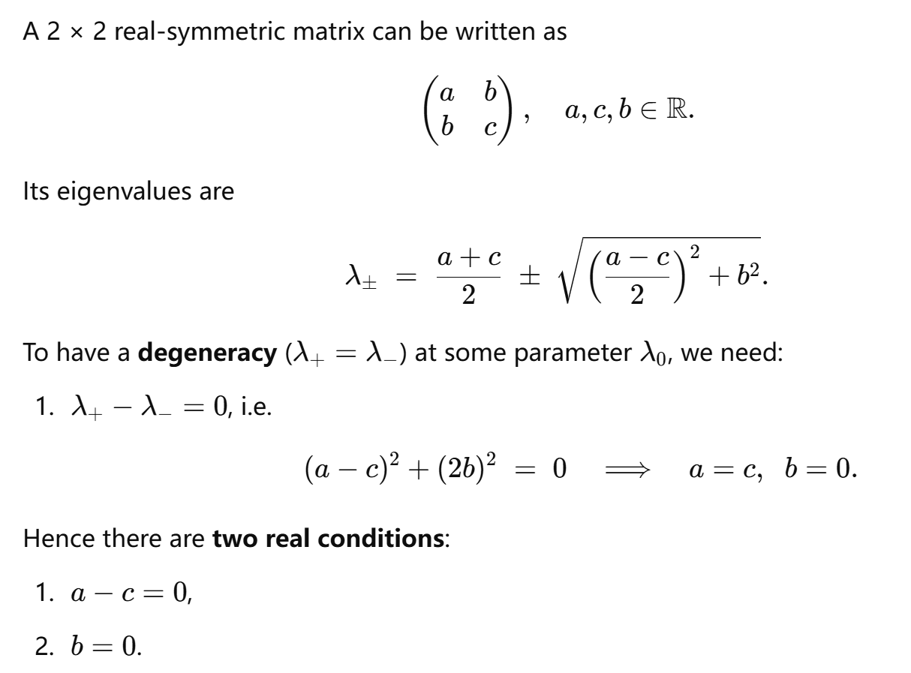
Two-level crossing and avoided-crossing

Slide 34
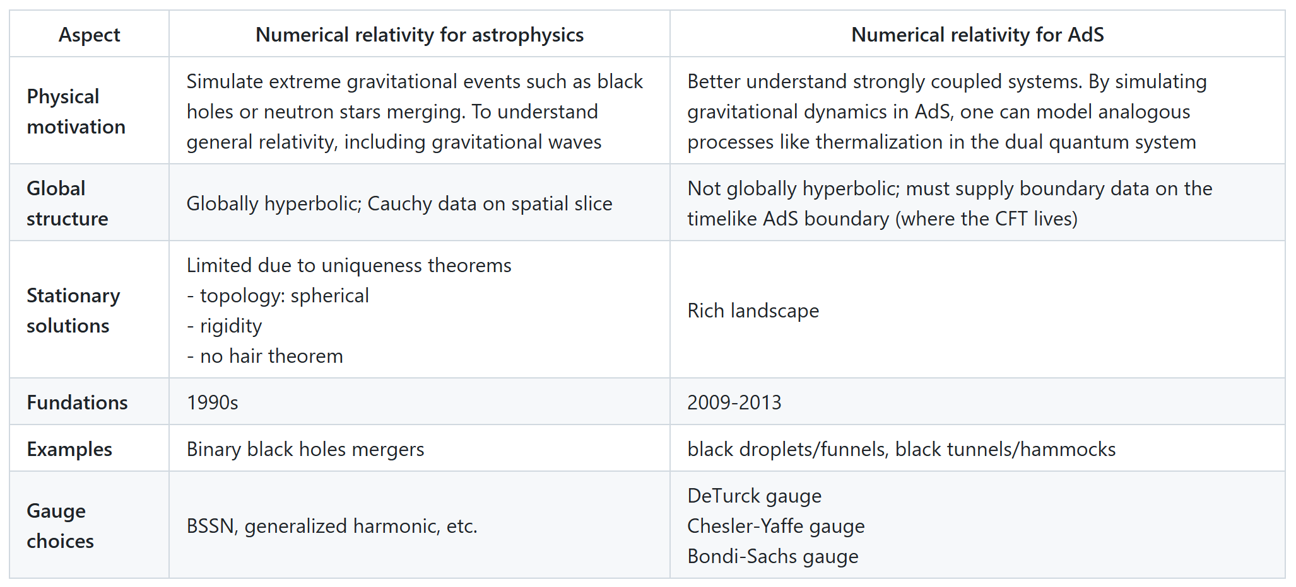
Future perspectives – numerical relativity

Slide 35
Future perspectives – numerical relativity
Stationary spacetimes -- DeTurck method
Pseudospectral method
For solving QNMs, we do not need an initial guess; need to increase precision when the grid size is large
QNMspectral: solving linear ODEs
GRSpectral: solving nonlinear PDEs (and linear ODEs)
https://github.com/renphysics/GRSpectral
For QNMs of the RN-AdS_5 black hole, a Mathematica notebook is given by an ancillary file of JR & Zhe Yu, https://arxiv.org/abs/2412.02608
Time evolution (Yu Tian’s talk on Friday)

Slide 36
Conclusion
Quasinormal modes of AdS black holes (poles in holographic correlators) can move in highly nontrivial ways as a parameter changes.
States in N=4 super-Yang-Mills theory can exhibit significantly more nontrivial behaviors than the particular state of the RN-AdS black hole
Zero modes, level repulsion, merging and splitting, accumulating to form a branch cut, cascade repulsion
Future perspectives: numerical relativity, non-modal effect, pseudospectrum

Slide 37
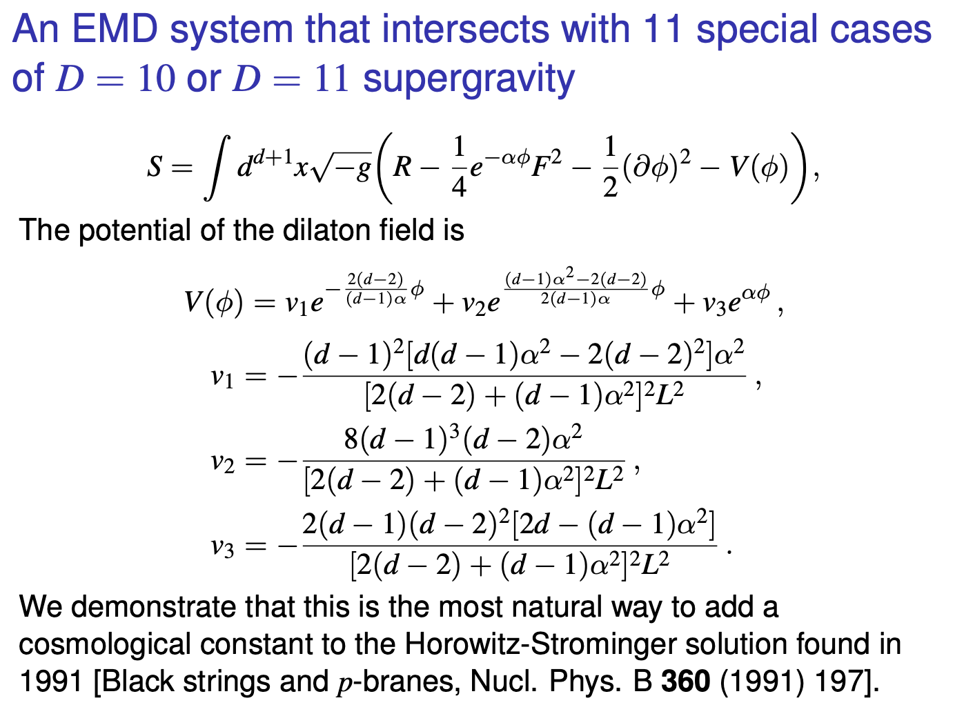

Slide 38
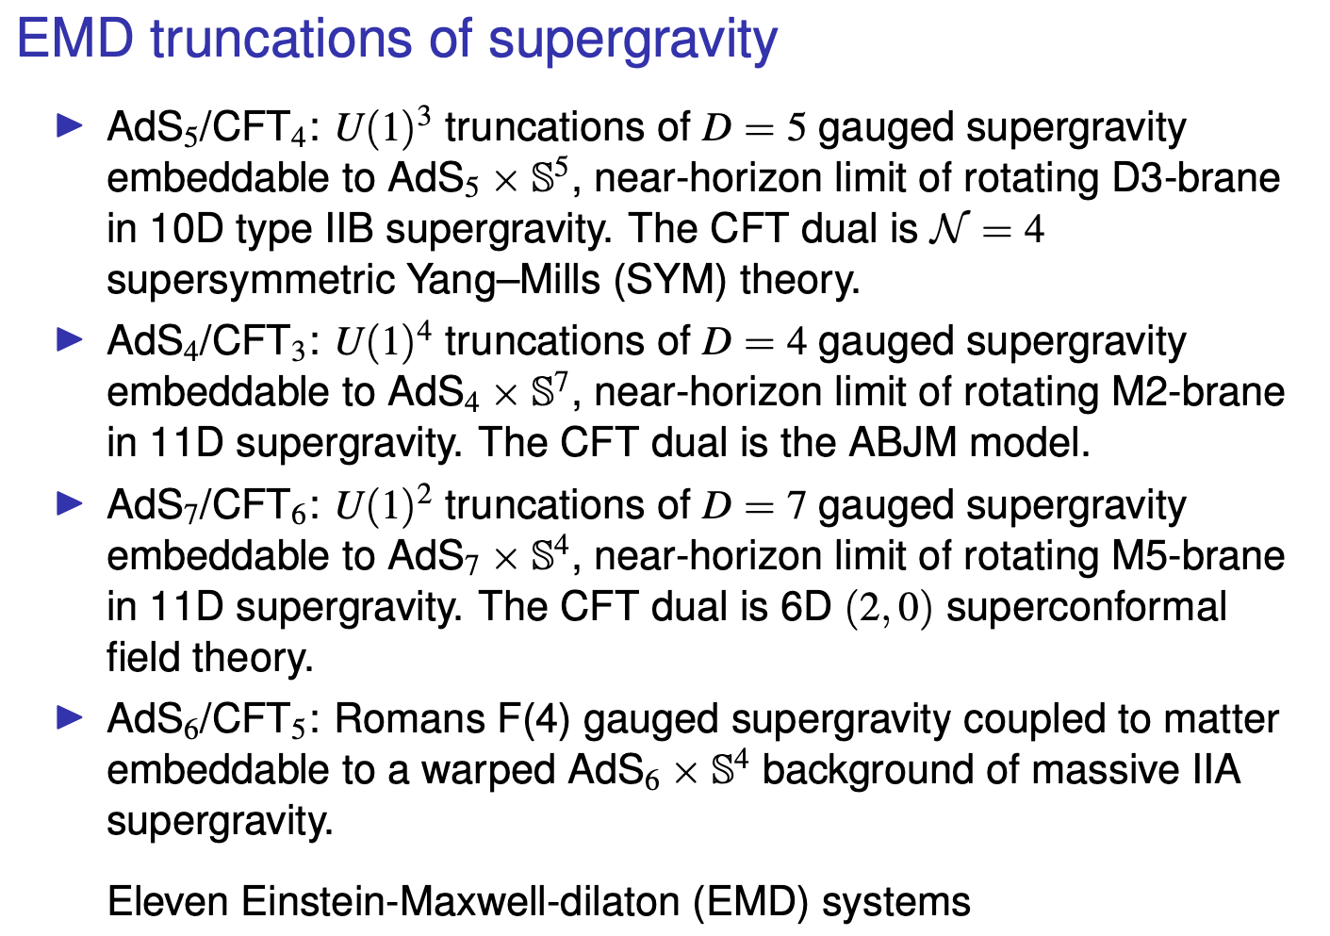

Slide 39
EMD truncations of supergravity
When the parameters α and d take the values in the table (next slide), this EMD system is consistent truncations of D = 10 and D = 11 supergravities. In these cases, the EMD system is a top-down model.​
For AdS₄, the system belongs to supergravity for all α. The EMD system is obtained by turning off one of two U(1) gauge fields in an FI-gauged supergravity.
For AdS₅ and higher dimensions, the system may belong to the so-called fake supergravity.

Slide 40
