Slide 1
Holographic Entanglement Entropy Inequalities in Multipartite Systems
Yi Yang@ShanghaiTech
Holographic applications: from Quantum Realms to the Big Bang
July 11-19, 2025, UCAS

Slide 2
Motivations
Entanglement entropy inequality (HEI)
Strong subadditivity for black hole information paradox
Quantum information, quantum transportations…
It is a challenge to prove multipartite HEIs in QFT
Holography offers a geometric approach

Slide 3
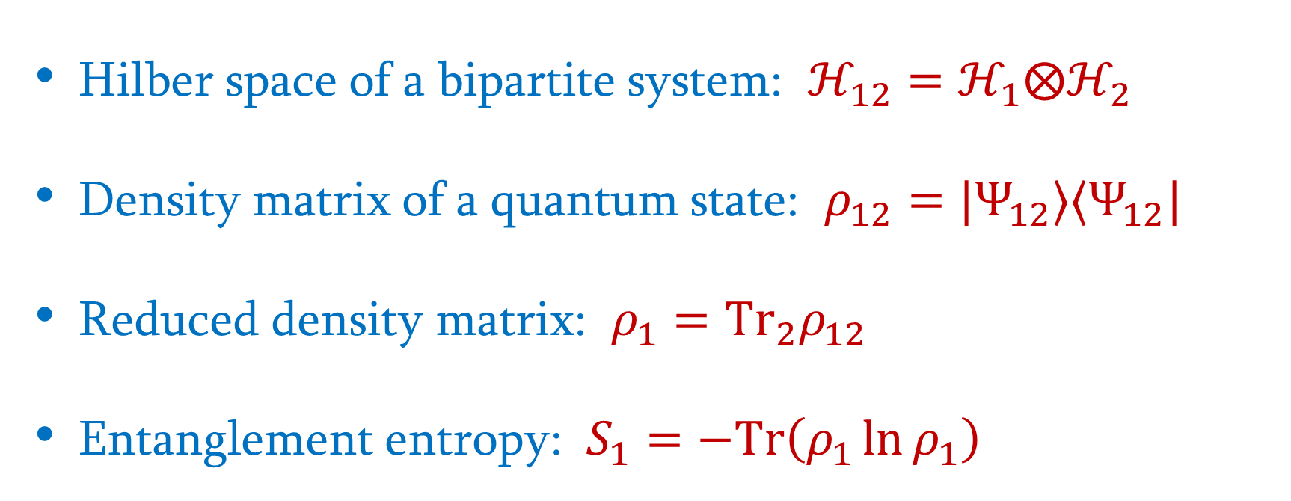
Entanglement Entropy
Hilber space of a bipartite system: $ℋ_{12}=ℋ_{1}⨂ℋ_{2}$
Density matrix of a quantum state: $ρ_{12}=|Ψ_{12}⟩⟨Ψ_{12}|$
Reduced density matrix: $ρ_{1}={Tr}_{2}ρ_{12}$
Entanglement entropy: $S_{1}=−Tr\left(ρ_{1}\ln{ρ_{1}}\right)$

Slide 4







Subadditivity (SA)
$$S_{1}+S_{2}≥S_{12}$$
$$1$$
$$1$$
$$1$$
$$2$$
$$2$$
$$2$$

Slide 5


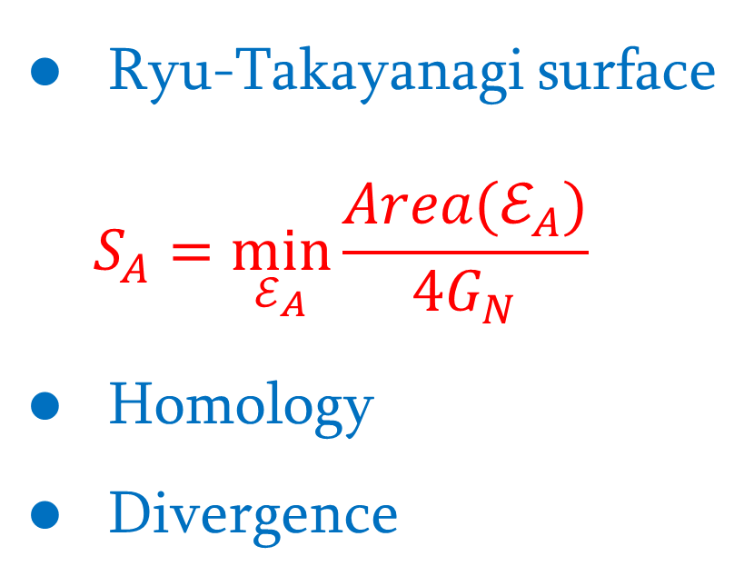
Holographic Entanglement Entropy
Ryu-Takayanagi surface
$$S_{A}=\min_{ℰ_{A}}{\frac{Area(ℰ_{A})}{4G_{N}}}$$
Homology
Divergence
$$ℰ_{A}$$
$$A$$

Slide 6
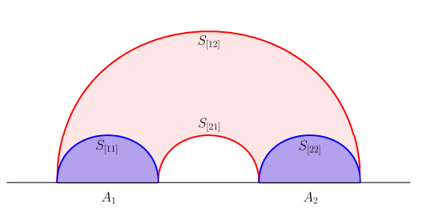
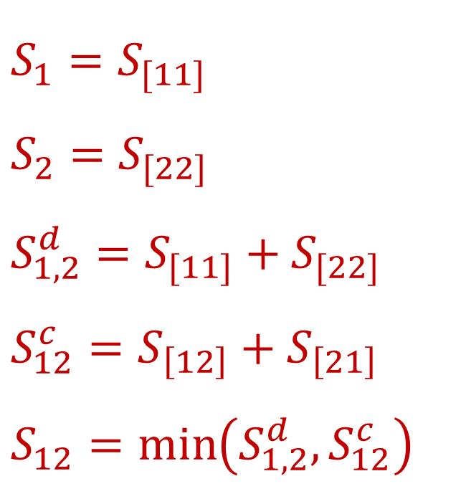

Holographic SA
$$S_{1}=S_{[11]}$$
$$S_{2}=S_{[22]}$$
$$S_{1,2}^{d}=S_{[11]}+S_{[22]}$$
$$S_{12}^{c}=S_{\left[12\right]}+S_{\left[21\right]}$$
$$S_{12}=\min\left(S_{1,2}^{d}, S_{12}^{c}\right)$$
$$S_{1}+S_{2}≥S_{12}$$

Slide 7
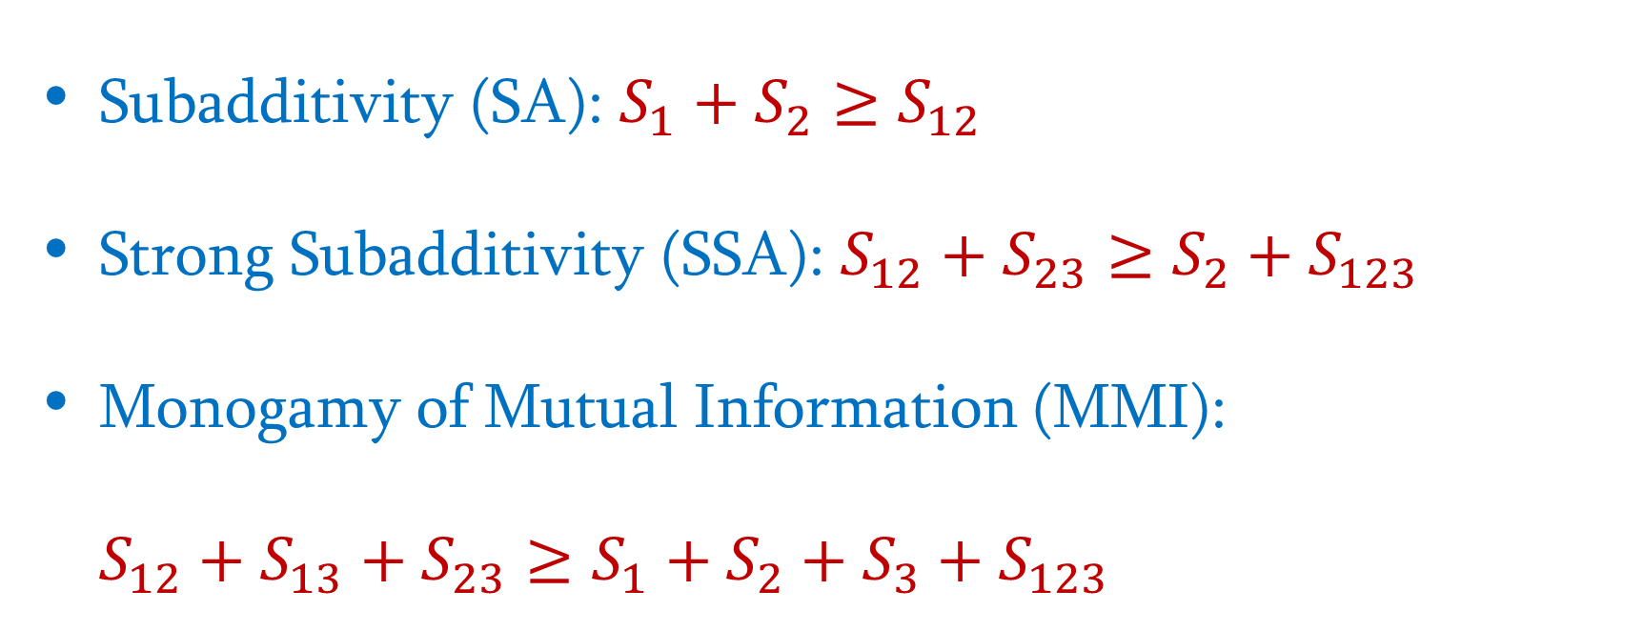
Entanglement Entropy Inequality
Subadditivity (SA): $S_{1}+S_{2}≥S_{12}$
Strong Subadditivity (SSA): $S_{12}+S_{23}≥S_{2}+S_{123}$
Monogamy of Mutual Information (MMI):
$$S_{12}+S_{13}+S_{23}≥S_{1}+S_{2}+S_{3}+S_{123}$$

Slide 8
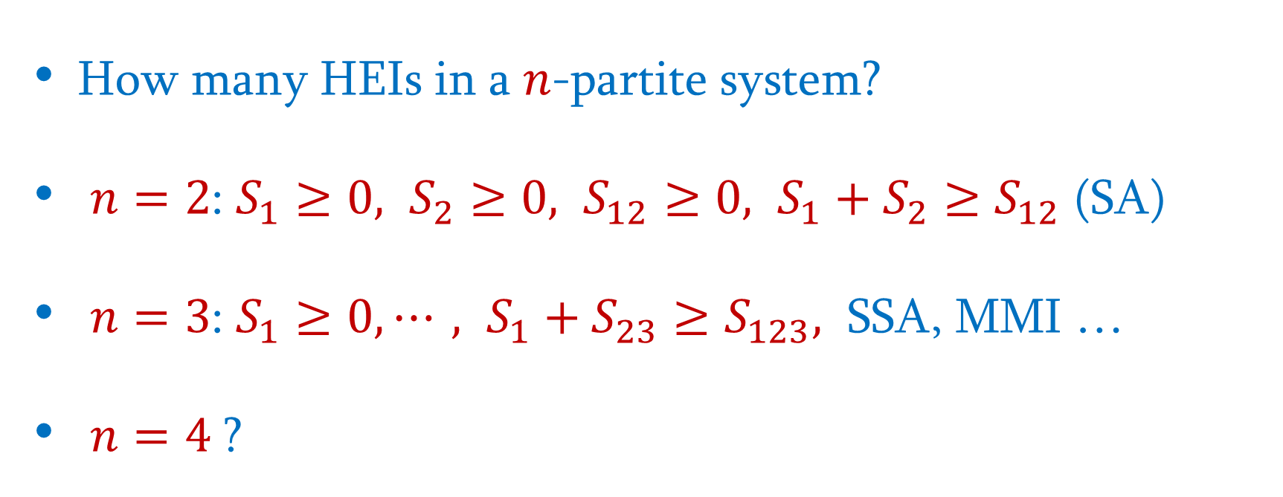
Independent HEI
How many HEIs in a $n$-partite system?
$n=2$: $S_{1}≥0, S_{2}≥0, S_{12}≥0, S_{1}+S_{2}≥S_{12}$ (SA)
$n=3$: $S_{1}≥0, ⋯, S_{1}+S_{23}≥S_{123},$ SSA, MMI …
$n=4$ ?

Slide 9
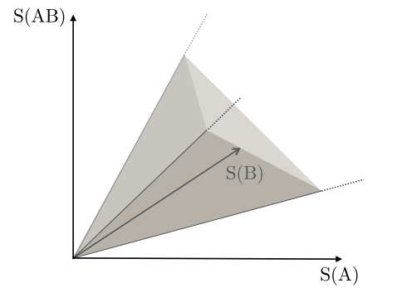
Entanglement Entropy Cone
Extremal rays
A balanced HEI is finite
A superbalanced HEI is Independent

Slide 10
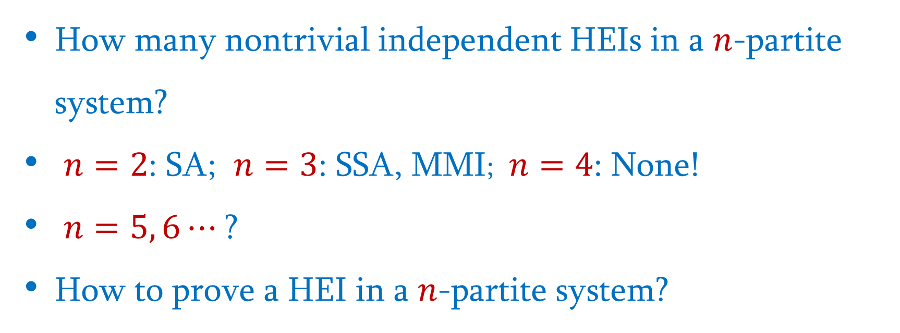
Questions
How many nontrivial independent HEIs in a $n$-partite system?
$n=2$: SA; $n=3$: SSA, MMI; $n=4$: None!
$n=5, 6⋯$ ?
How to prove a HEI in a $n$-partite system?

Slide 11
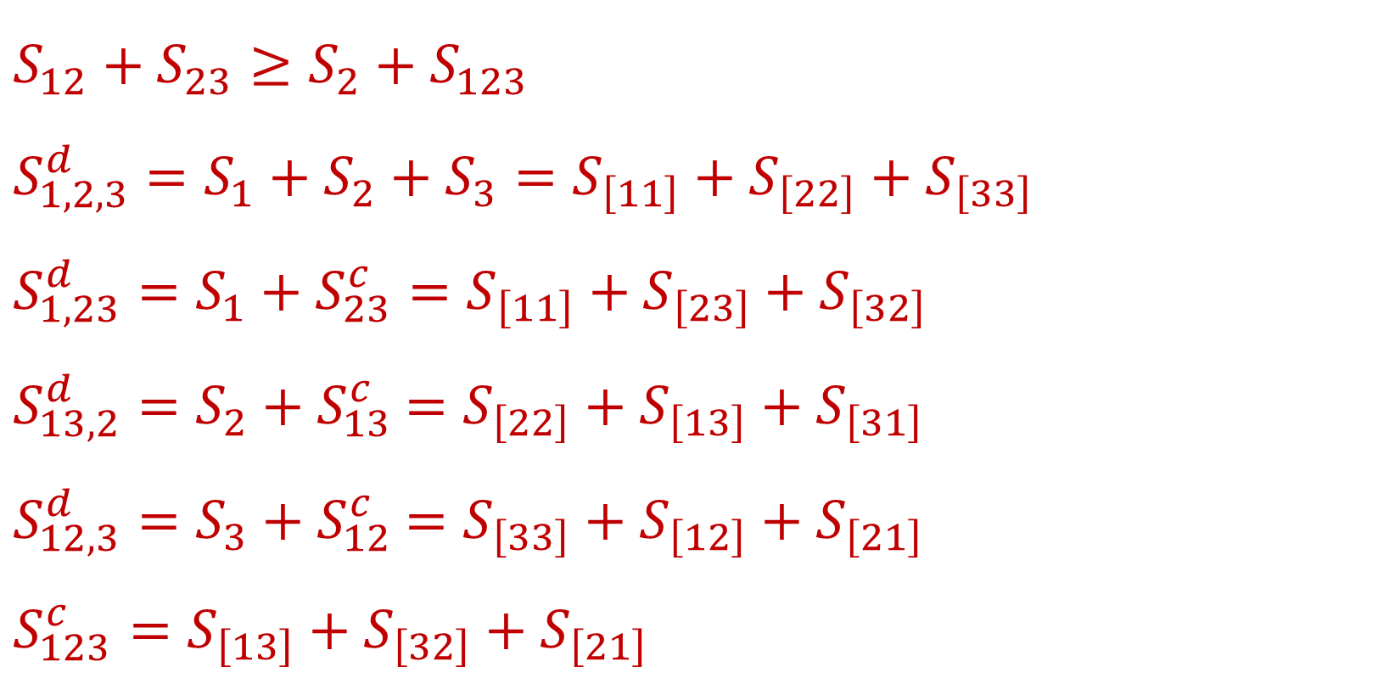
Tripartite System: Configurations
$$S_{12}+S_{23}≥S_{2}+S_{123}$$
$$S_{1,2,3}^{d}=S_{1}+S_{2}+S_{3}=S_{\left[11\right]}+S_{\left[22\right]}+S_{\left[33\right]}$$
$$S_{1,23}^{d}=S_{1}+S_{23}^{c}=S_{\left[11\right]}+S_{\left[23\right]}+S_{\left[32\right]}$$
$S_{13,2}^{d}=S_{2}+S_{13}^{c}$ $=S_{\left[22\right]}+$ $S_{\left[13\right]}+S_{\left[31\right]}$
$S_{12,3}^{d}=S_{3}+S_{12}^{c}$ $=S_{\left[33\right]}+S_{\left[12\right]}+S_{\left[21\right]}$
$$S_{123}^{c}=S_{\left[13\right]}+S_{\left[32\right]}+S_{\left[21\right]}$$

Slide 12
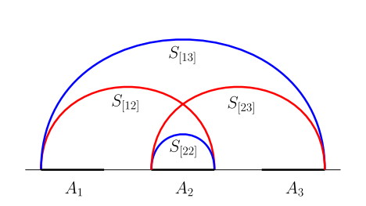
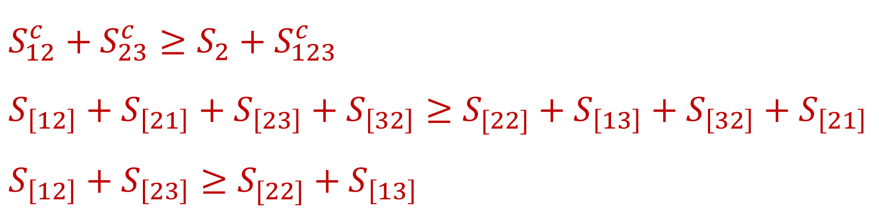
Tripartite System: Completed Connected
$$S_{12}^{c}+S_{23}^{c}≥S_{2}+S_{123}^{c}$$
$$S_{\left[12\right]}+S_{\left[21\right]}+S_{\left[23\right]}+S_{\left[32\right]}≥S_{[22]}+S_{\left[13\right]}+S_{\left[32\right]}+S_{\left[21\right]}$$
$$S_{\left[12\right]}+S_{\left[23\right]}≥S_{[22]}+S_{\left[13\right]}$$

Slide 13
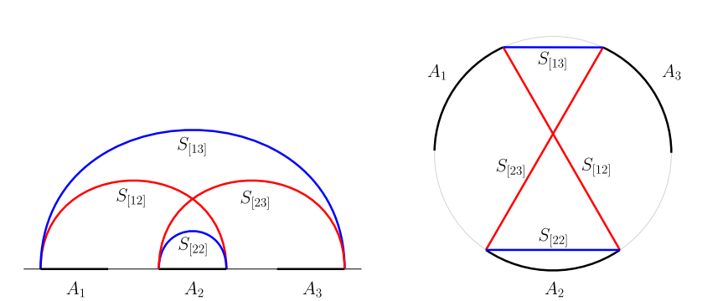
Circular Graph

Slide 14
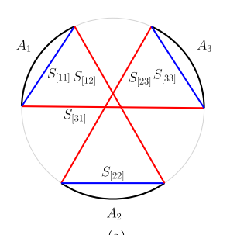
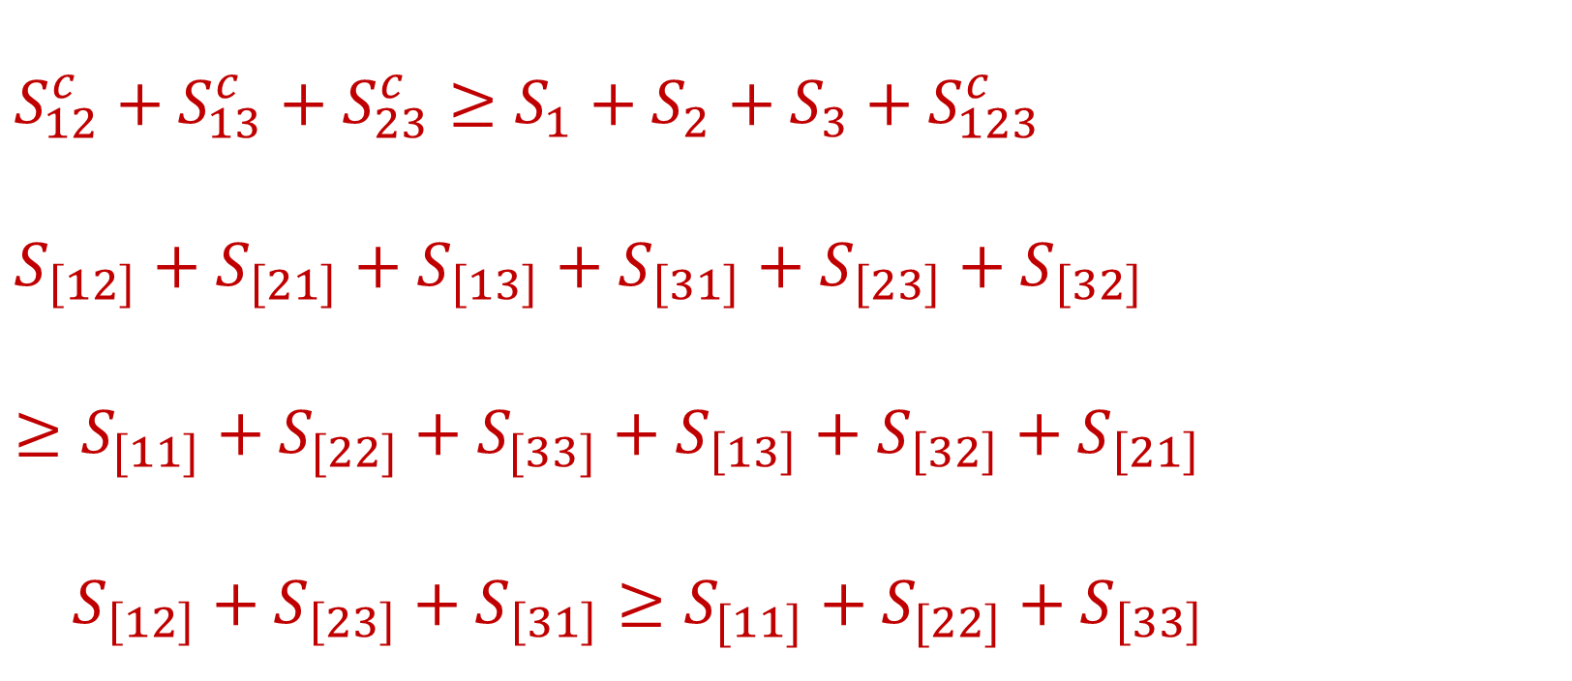
Tripartite System: MMI
$$S_{12}^{c}+S_{13}^{c}+S_{23}^{c}≥S_{1}+S_{2}+S_{3}+S_{123}^{c}$$
$$S_{\left[12\right]}+S_{\left[21\right]}+S_{\left[13\right]}+S_{\left[31\right]}+S_{\left[23\right]}+S_{\left[32\right]}≥S_{[11]}+S_{[22]}+S_{[33]}+S_{\left[13\right]}+S_{\left[32\right]}+S_{\left[21\right]}$$
$S_{\left[12\right]}+S_{\left[23\right]}+S_{\left[31\right]}≥S_{[11]}+S_{[22]}+S_{\left[33\right]}$

Slide 15
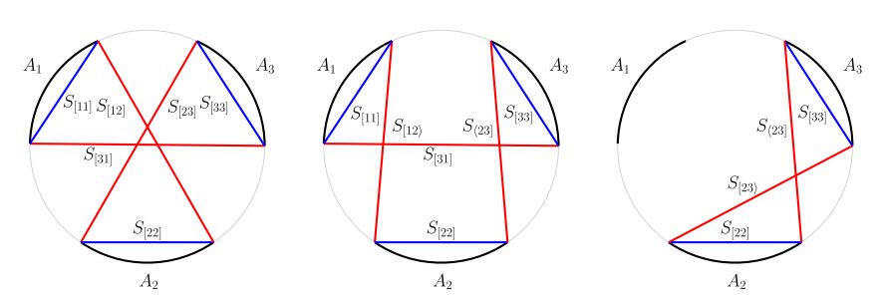



Tripartite System: “Clean gaps”
$$≥$$
$$≥$$
$$≥0$$

Slide 16
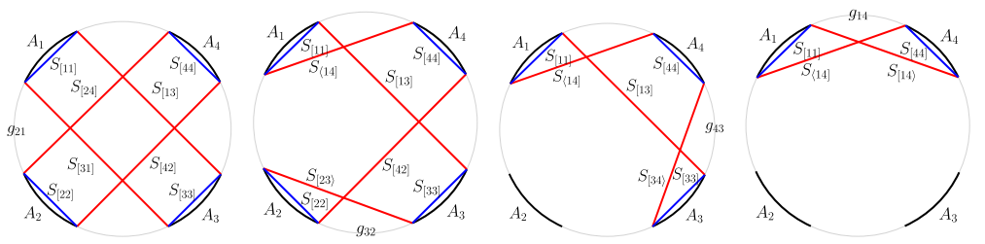
4-partite System: Compatible
$$S_{13}^{c}⇒S_{1}+S_{3}≥S_{\left[13\right]}+S_{\left[31\right]}, S_{24}^{c}⇒S_{2}+S_{4}≥S_{\left[24\right]}+S_{\left[24\right]}$$

Slide 17
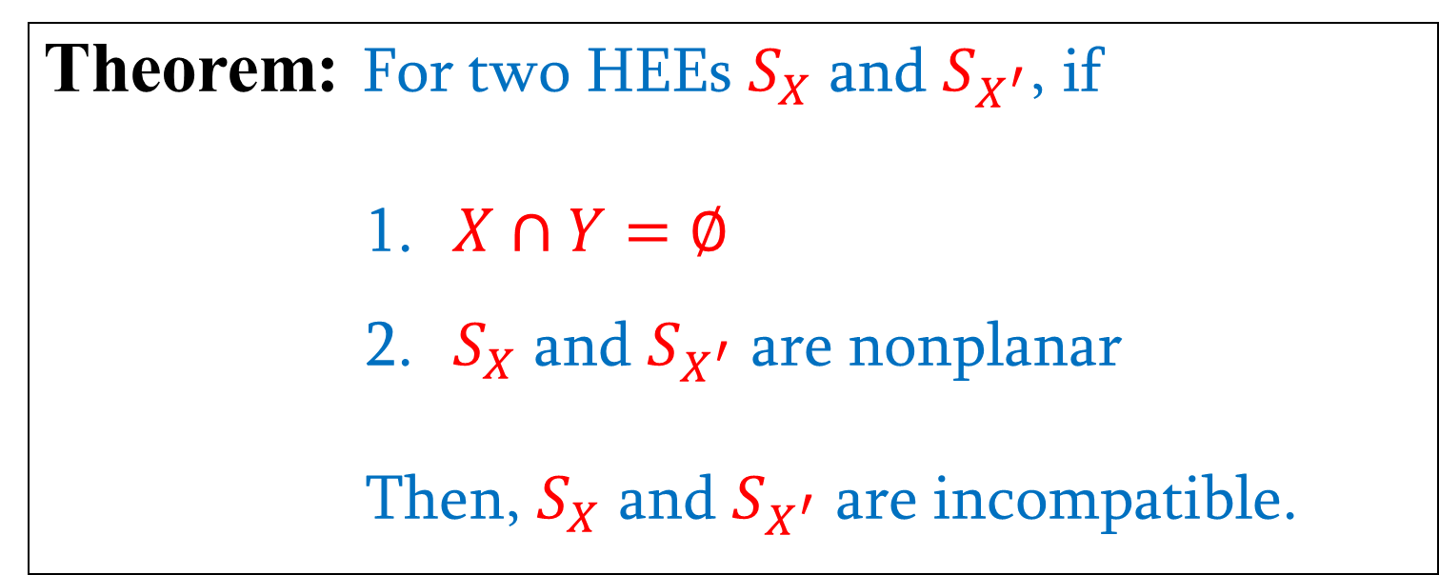
Compatible Theorem
Theorem: For two HEEs $S_{X}$ and $S_{X^{′}}$, if
$X∩Y=∅$
$S_{X}$ and $S_{X^{′}}$ are nonplanar
Then, $S_{X}$ and $S_{X^{′}}$ are incompatible.

Slide 18
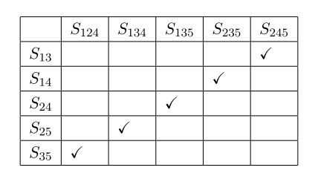
Allowed Configurations
Incompatible pairs in a 5-partite system
Compatible Completed Connected (CCC) configurations

Slide 19
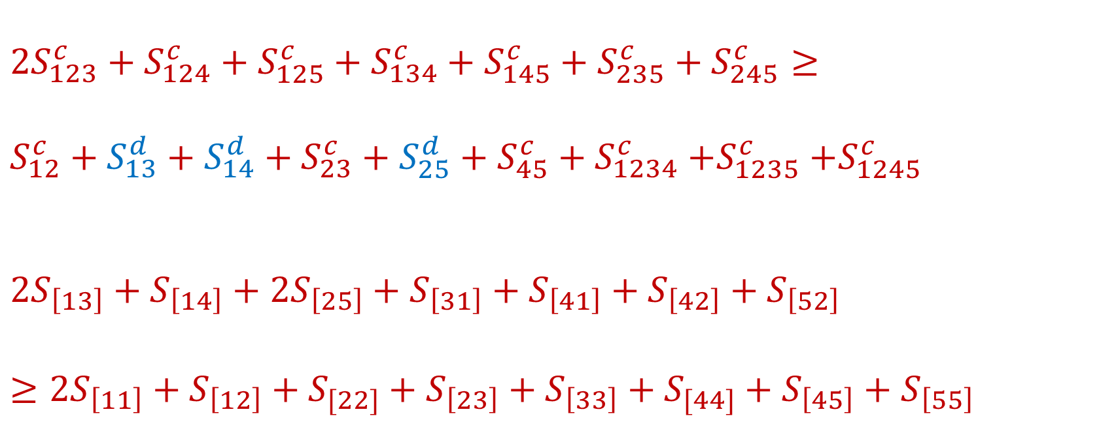
A HEI in the 5-partite System
$$2S_{123}^{c}+S_{124}^{c}+S_{125}^{c}+S_{134}^{c}+S_{145}^{c}+S_{235}^{c}+S_{245}^{c}≥$$
$S_{12}^{c}+S_{13}^{d}+S_{14}^{d}+S_{23}^{c}+S_{25}^{d}+S_{45}^{c}+S_{1234}^{c}$ $+S_{1235}^{c}$ $+S_{1245}^{c}$
$$2S_{\left[13\right]}+S_{\left[14\right]}+2S_{\left[25\right]}+S_{\left[31\right]}+S_{\left[41\right]}+S_{\left[42\right]}+S_{\left[52\right]}≥2S_{\left[11\right]}+S_{\left[12\right]}+S_{[22]}+S_{\left[23\right]}+S_{\left[33\right]}+S_{[44]}+S_{\left[45\right]}+S_{\left[55\right]}$$

Slide 20
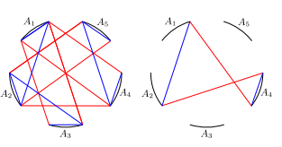

A HEI in the 5-partite System
$$≥$$

Slide 21
Prove a HEI in CCC configurations
Write the HEI in a CCC configuration
Draw its circular graph
Balanced condition: the same # of red/blue lines
Superbalanced condition: gapless
Reduce the circular graph by “Clean gaps”

Slide 22
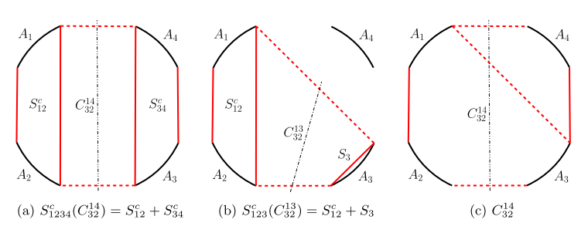
Non CCC configurations: Cuts

Slide 23
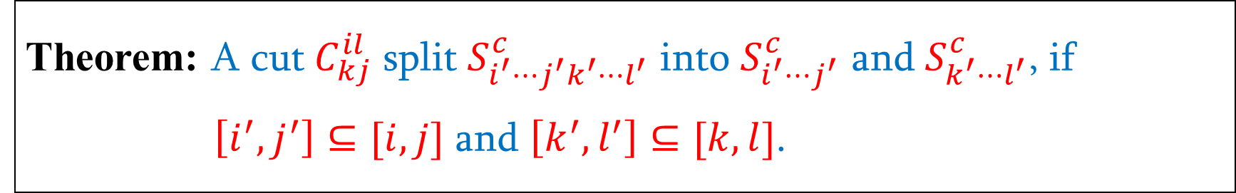
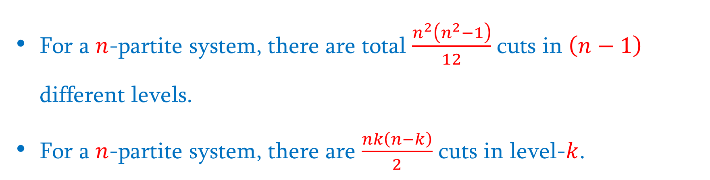
Cut Theorem
Theorem: A cut$C_{kj}^{il}$ split $S_{i^{′}⋯j^{′}k^{′}⋯l^{′}}^{c}$ into $S_{i^{′}⋯j^{′}}^{c}$ and $S_{k^{′}⋯l^{′}}^{c}$, if $\left[i^{′}, j^{′}\right]⊆[i, j]$ and $\left[k^{′}, l^{′}\right]⊆[k, l]$.
For a $n$-partite system, there are total $\frac{n^{2}\left(n^{2}−1\right)}{12}$ cuts in $\left(n−1\right)$ different levels.
For a $n$-partite system, there are $\frac{nk\left(n−k\right)}{2}$ cuts in level-$k$.

Slide 24
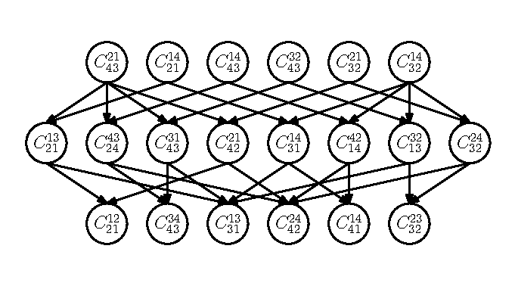
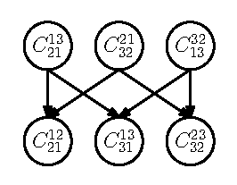
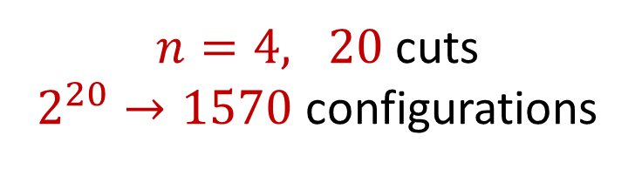
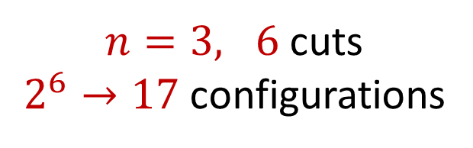
Dependency Acyclic Graph of Cuts
$n=3, 6$ cuts
$2^{6}→17$ configurations
$n=4, 20$ cuts
$2^{20}→1570$ configurations

Slide 25
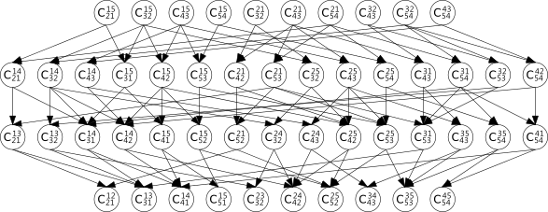
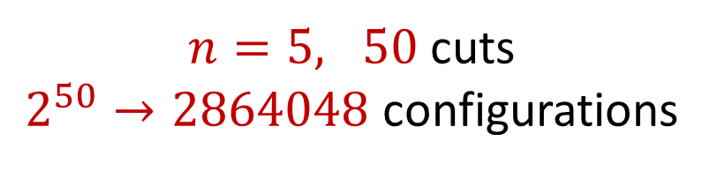
Dependency Acyclic Graph of Cuts
$n=5, 50$ cuts
$2^{50}→2864048$ configurations

Slide 26
Configuration Theorem
Theorem: If a balanced HEI is valid in CCC configurations, then it is valid in all configurations.

Slide 27
Summary
Show the HEI is superbalance (independent)
Write the HEI in a CCC configuration
Draw its circular graph and prove it by “clean gaps”
All other configurations are valid by the configuration theorem
Thank you!

