Slide 1

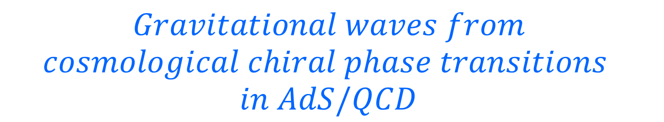
$Gravitational waves from$
$$cosmological chiral phase transitions \\ in AdS/QCD$$
Yidian Chen(陈亦点)
School of Physics, Hangzhou Normal University
Collaborators: Pu Chen, Danning Li, Mei Huang
Based on JHEP 07 (2023) 225[arXiv: 2212.06591], 2507.xxxxx
Holographic applications: from Quantum Realms to the Big Bang, Beijing,
Jul. 16, 2025

Slide 2
Introduction
II. Holographic Nucleation
III. Gravitational Waves
VI. Summary

Slide 3
I. Introduction

Slide 4
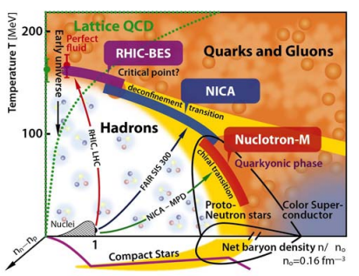
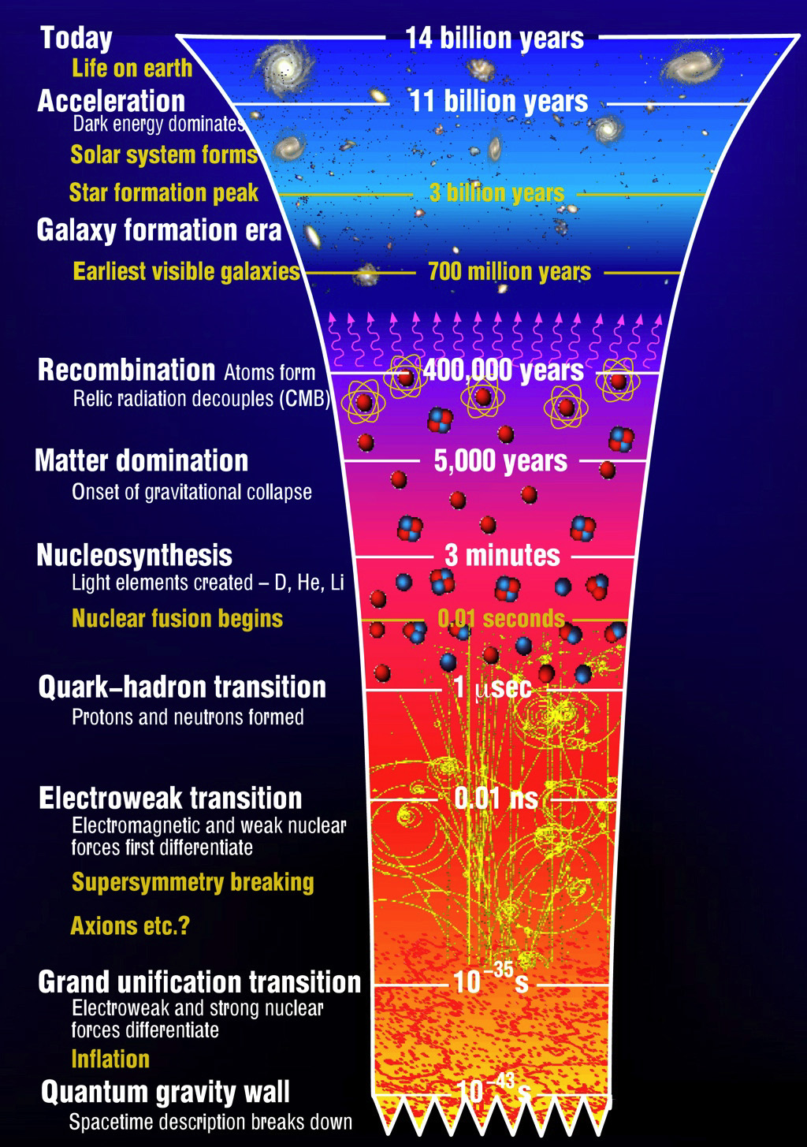
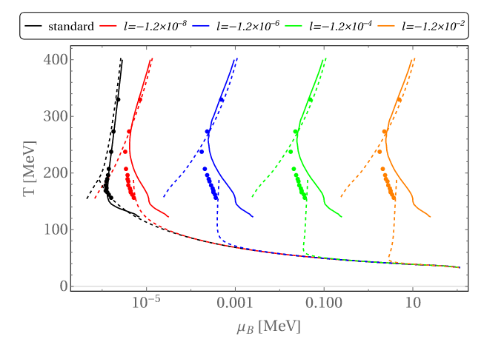
Cosmic QCD phase transition
Gao et al., PRL(2022)

Slide 5
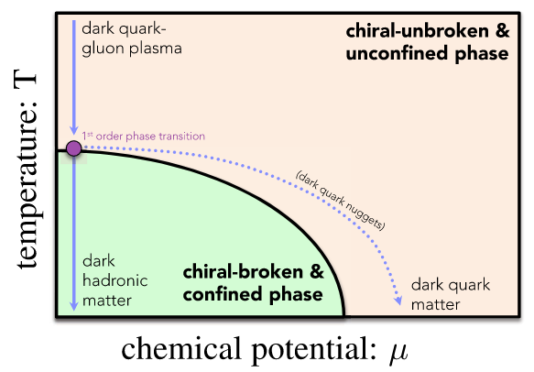
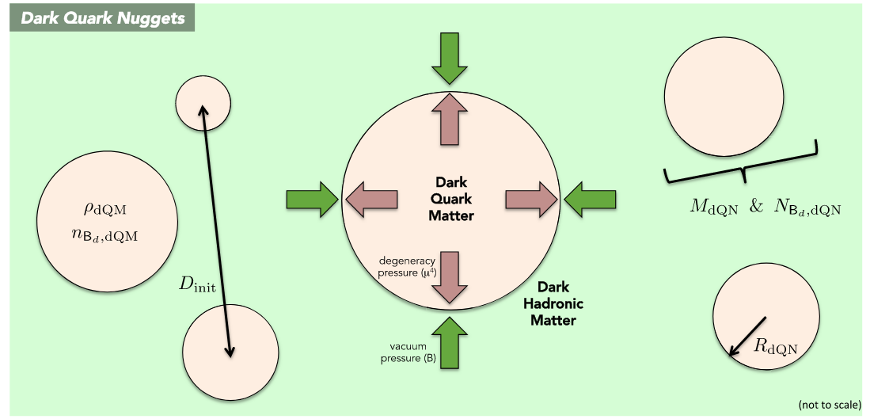
Dark QCD phase transition?
Bai et al., PRD(2019)

Slide 6

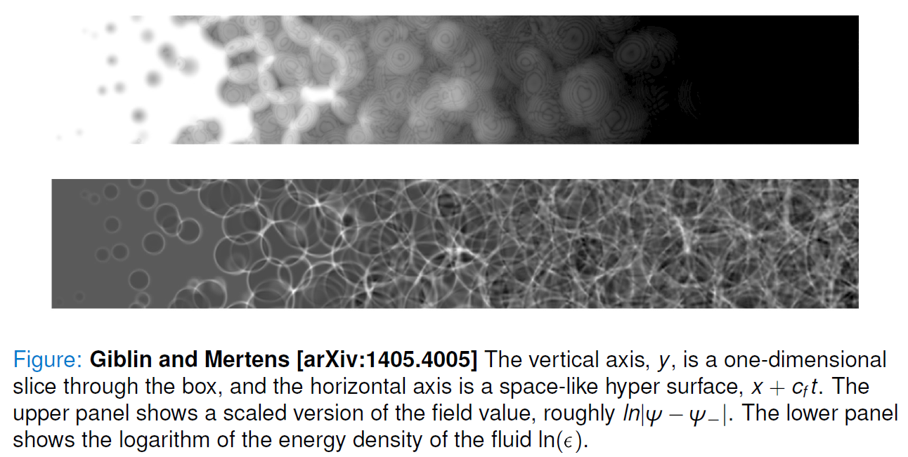
Stochastic gravitational waves

Slide 7
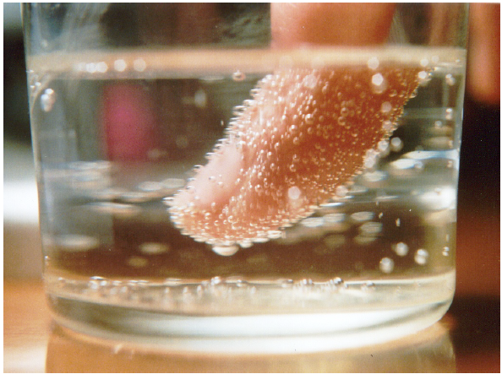
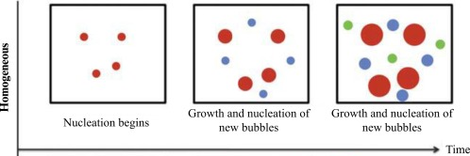
Nonequilibrium first-order transition
Classical Nucleation Theory

Slide 8
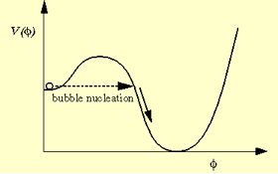

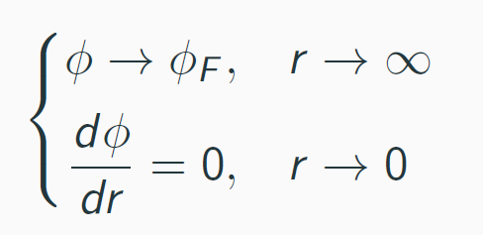
Nonequilibrium first-order transition
S. Coleman, Phys. Rev. D 15, 2929 (1977); (𝑻=𝟎)
A. D. Linde, Nucl. Phys. B216, 421 (1983). (𝑻≠𝟎)
Quantum Nucleation Theory
Bounce Solution
At sufficiently high temperatures, the least-action solution has O(3) symmetry [Linde, 1983]. The O(3)-symmetric bubble is governed by
with boundary conditions

Slide 9
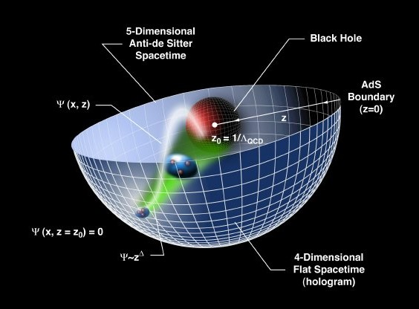
Holographic Dictionary: d-QFT/d+1-Gravity
AdS/CFT: original discovery of duality
relates gravity theories on anti-de Sitter spacetimes to conformal field theories
General Gauge/Gravity duality

Slide 10
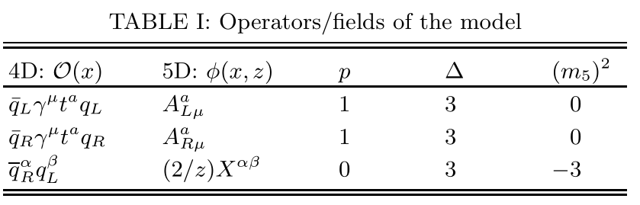
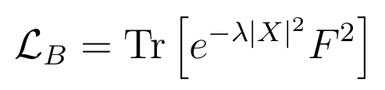


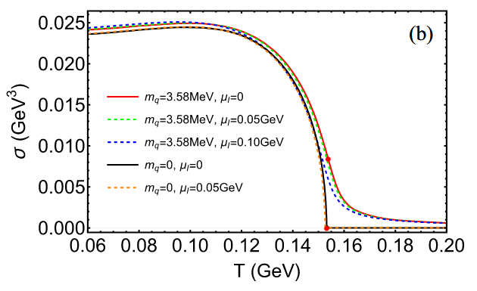
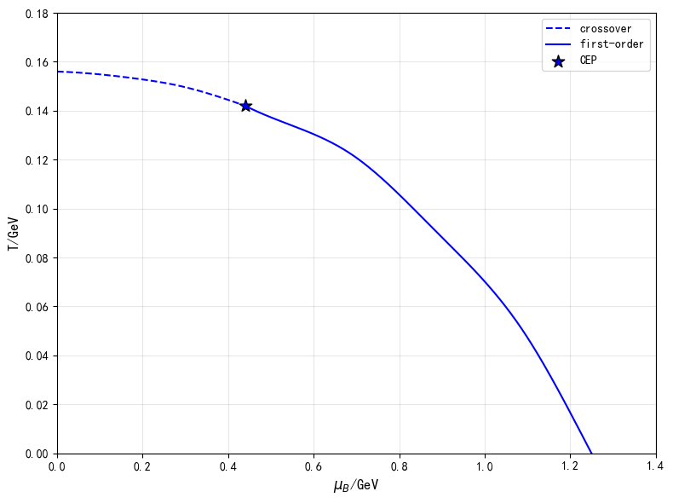
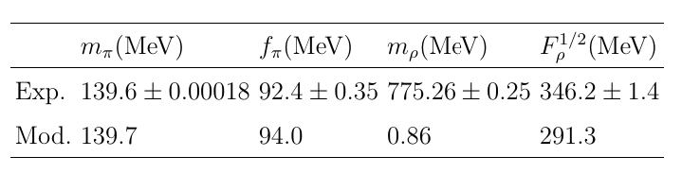
Soft-wall model
Karch et al., PRD(2006)
Chelabi et al., PRD(2016)
Chelabi et al., JHEP(2016)
Liang et al., PRD(2023)
5D action
chemical potential effects on chiral transition
Dilaton profile
AdS₅
Meson spectra

Slide 11
II. Holographic Nucleation

Slide 12

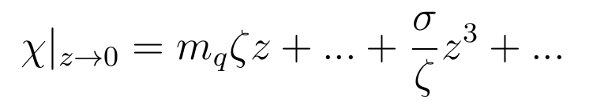
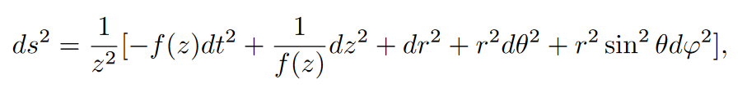
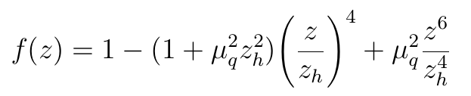

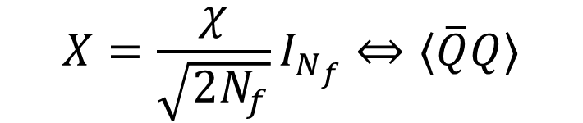
5D Model
Y. Chen, Danning Li and M. Huang, JHEP 07 (2023) 225
Φ denotes the dilaton field and the complex scalar field X corresponds to the quark condensation or fermionic condensate of BSMs.
$$X=\frac{χ}{\sqrt{2N_{f}}}I_{N_{f}}⇔⟨\overline{Q}Q⟩$$
5D action
Metric
Potential

Slide 13
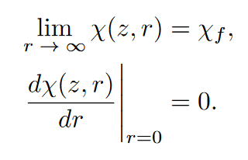

Bounce Solution
Y. Chen, Danning Li and M. Huang, JHEP 07 (2023) 225
the equations of motion of the scalar field X can be obtained from action
The solution requires the following boundary conditions

Slide 14
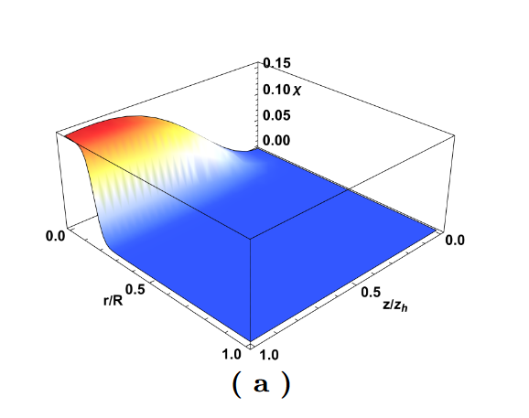
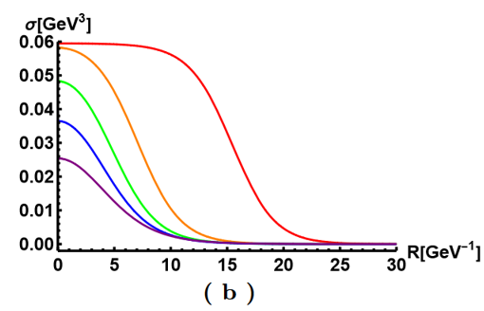
Bounce Solution
Y. Chen, Danning Li and M. Huang, JHEP 07 (2023) 225
the condensate σ as a function of the radial coordinate r at different temperatures.
the bounce solution of the scalar field χ as a function of the fifth dimensional coordinate z and the radial coordinate r

Slide 15
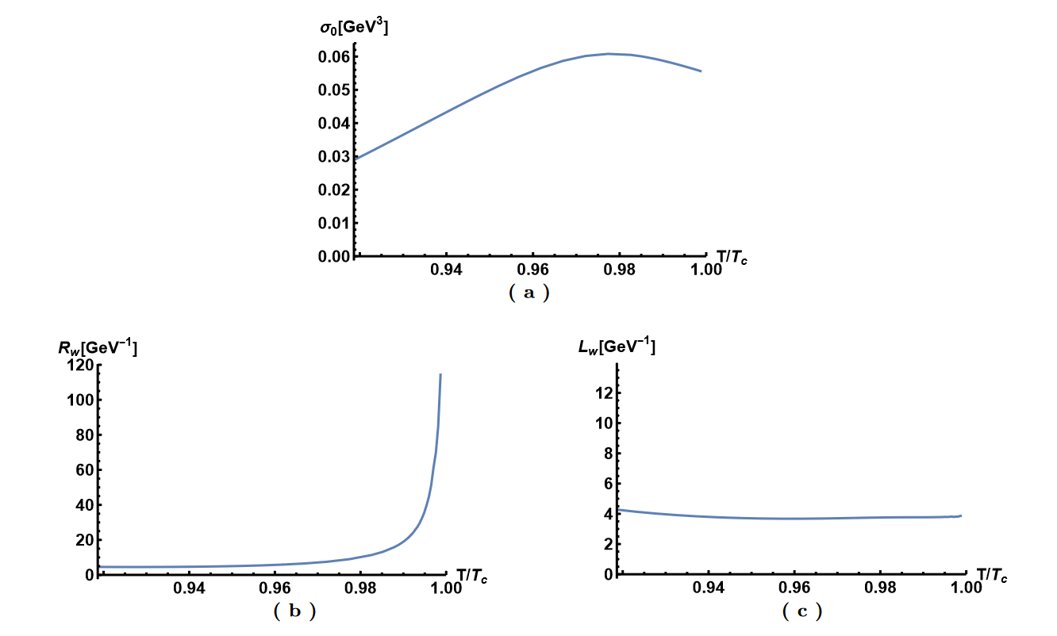

Thin-Wall Approximation
Y. Chen, Danning Li and M. Huang, JHEP 07 (2023) 225
we use hyperbolic tangent function interpolation condensation as a function of the radial r, shown following
where σ0 is the condensation value at the center, Rw denotes the radius of the bubble, and Lw represents the thickness of the bubble wall.

Slide 16

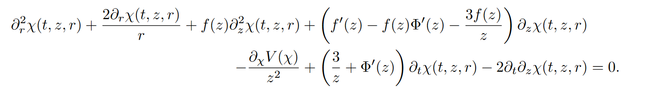


Real-time evolution
Y. Chen, Danning Li and M. Huang, JHEP 07 (2023) 225
To investigate the real-time evolution, we transform the framework to the ingoing Eddington-Finkelstein coordinate, then the metric becomes
Under the coordinate transformation, the scalar field χ is invariant, and its equation of motion becomes as follows
We choose the following boundary conditions

Slide 17

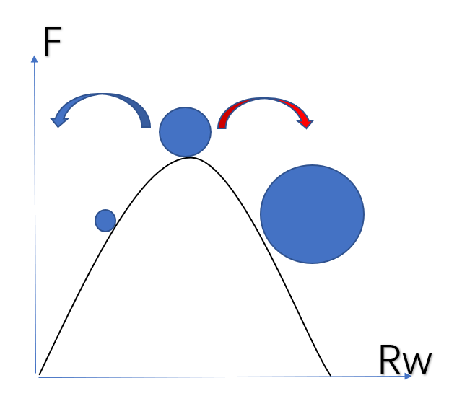


Bubble velocity
Y. Chen, Danning Li and M. Huang, JHEP 07 (2023) 225
bounce solution=critical bubble solution

Slide 18
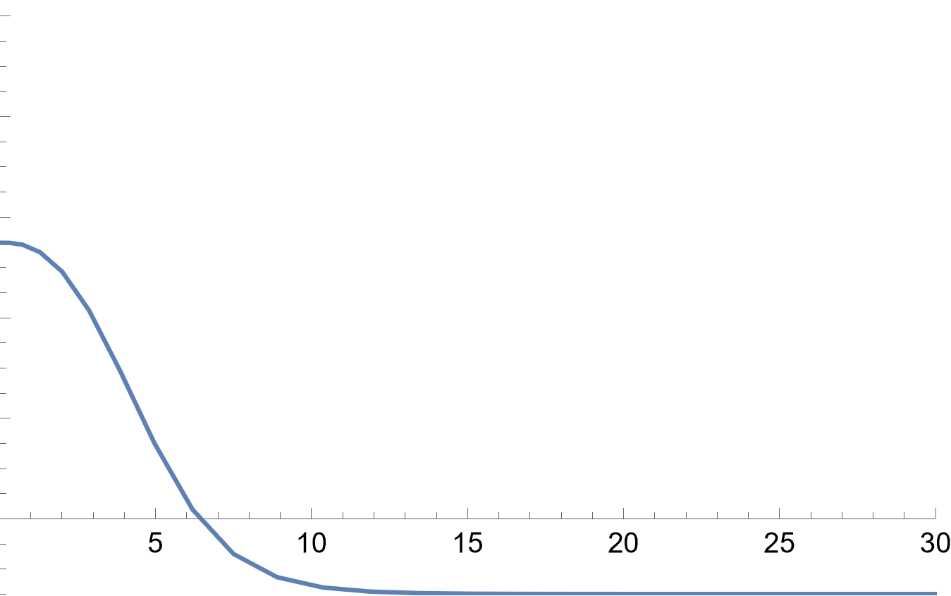
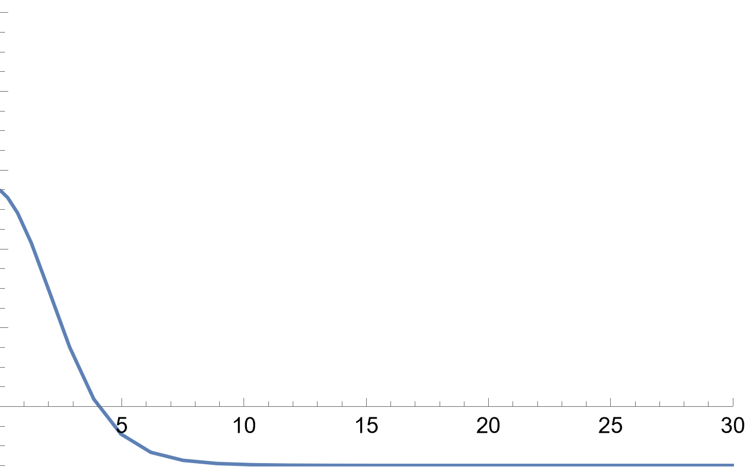
Bubble velocity
Y. Chen, Danning Li and M. Huang, JHEP 07 (2023) 225

Slide 19


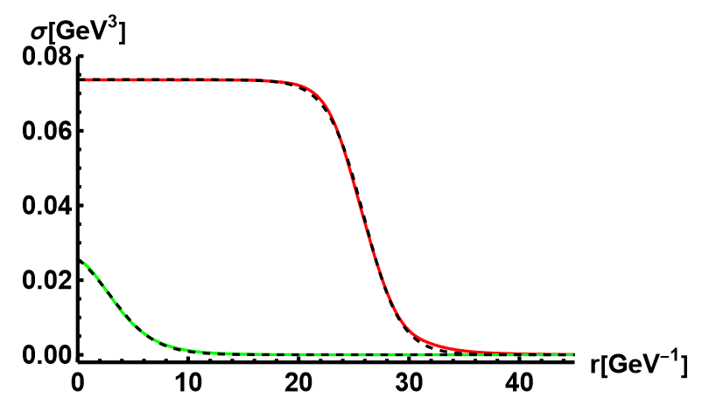
Bubble velocity
Y. Chen, Danning Li and M. Huang, JHEP 07 (2023) 225
To obtain the bubble wall velocity, we used the function
we can define the velocity of the bubble wall by
the solid line is the numerical solution and the dashed line represents the fitting results of the hyperbolic tangent function.

Slide 20
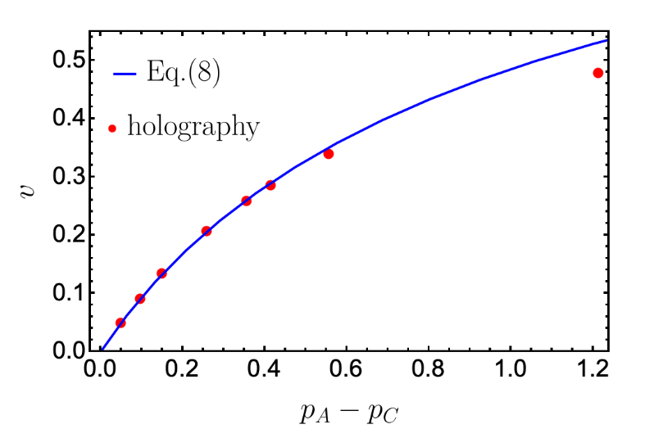
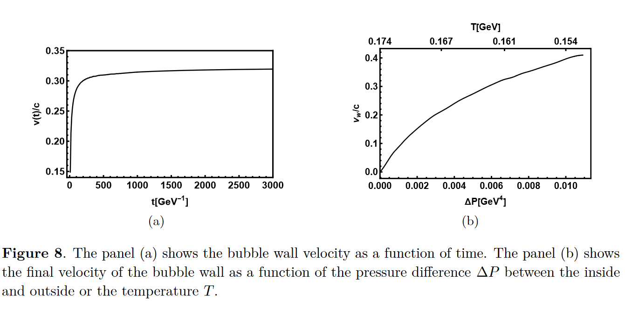

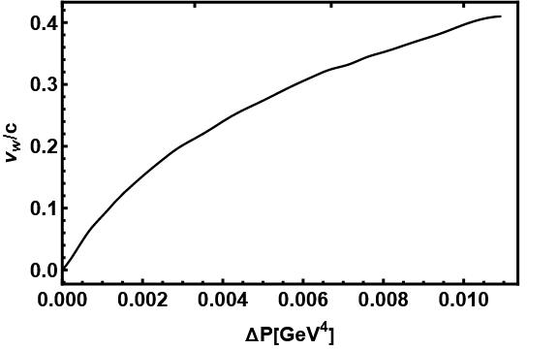

Bubble velocity
Y. Chen, Danning Li and M. Huang, JHEP 07 (2023) 225
The final velocity of the bubble wall $v_{w}$ is defined as
$$c_{s}=\frac{1}{\sqrt{3}}$$
R. A. Janik et al., Phys Rev Lett(2022)

Slide 21
III. Gravitational Waves

Slide 22

GW power spectra
Y. Chen, Danning Li and M. Huang, JHEP 07 (2023) 225
Within the linear approximation, the total GW power spectra can be written as
we have found that for the holographic model, the final velocity of the bubble wall is less than the speed of sound, i.e., the non-runaway case. According to Ref. [C. Caprini et al., JCAP(2016)], the GWs generated by collisions in the non-runaway case can be neglected with respect to acoustic waves and magnetohydrodynamic turbulence. Therefore, the total power spectrum is approximated to
Due to the complexity of turbulence, the contribution from the turbulence is dropped in this paper to make a conservative estimate.

Slide 23
GW power spectra
Y. Chen, Danning Li and M. Huang, JHEP 07 (2023) 225
The key quantities which determine these power spectra are the following:
The percolation temperature Tp is defined as the temperature at which the probability to have the false vacuum is about 0.7.
The phase transition strength parameter α, which is related to the scalar potential energy released during the phase transition
The bubble wall speed vw
The transition rate parameter β/H, which can be thought of as the inverse phase transition duration

Slide 24


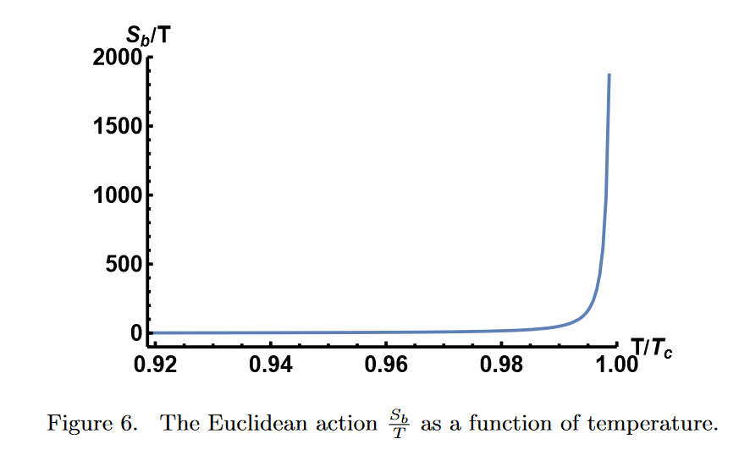

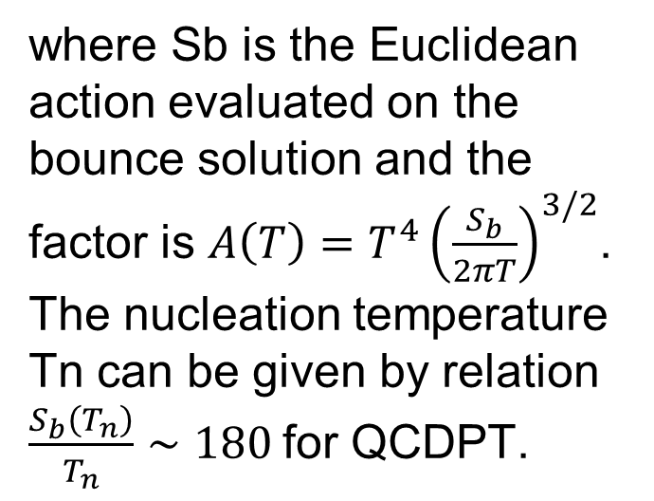
GW power spectra
Y. Chen, Danning Li and M. Huang, JHEP 07 (2023) 225
the tunneling rate of the stochastically generated bubbles is
where Sb is the Euclidean action evaluated on the bounce solution and the factor is $A\left(T\right)=T^{4}{\left(\frac{S_{b}}{2πT}\right)}^{3/2}$. The nucleation temperature Tn can be given by relation $\frac{S_{b}\left(T_{n}\right)}{T_{n}}∼180$for QCDPT.
$$T_{p}≃T_{c}$$

Slide 25



GW power spectra
Y. Chen, Danning Li and M. Huang, JHEP 07 (2023) 225
The nucleation temperature is defined as one bubble per unit Hubble volume and is written as
the probability of a false vacuum is defined as
The percolation temperature is defined as $I\left(T_{p}\right)≃1$, which is the temperature when the probability of false vacuum is about $P\left(T_{p}\right)≃1/e$.

Slide 26

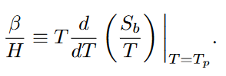
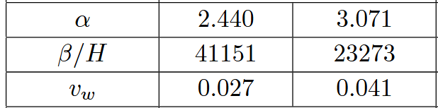
GW power spectra
Y. Chen, Danning Li and M. Huang, JHEP 07 (2023) 225
The parameter α is defined as
Near-conformal model α~O(1)
The inverse of the duration time is defined as
Strongly coupled theory β~10000 ?
F.R. Ares et al., Phys.Rev.Lett.(2022);
J. Shao, Mei Huang, Phys.Rev.D(2023)

Slide 27
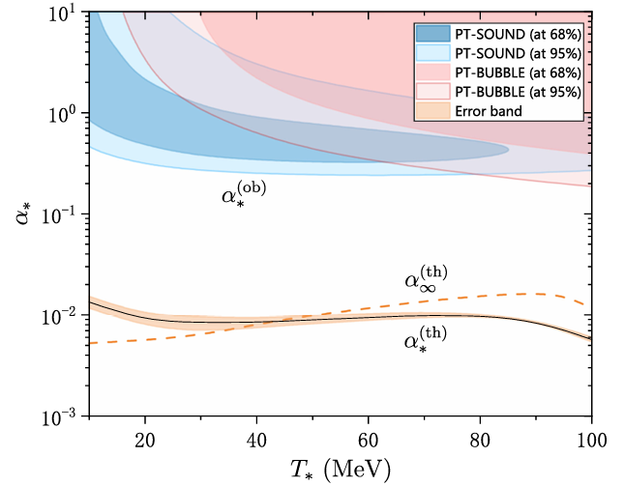
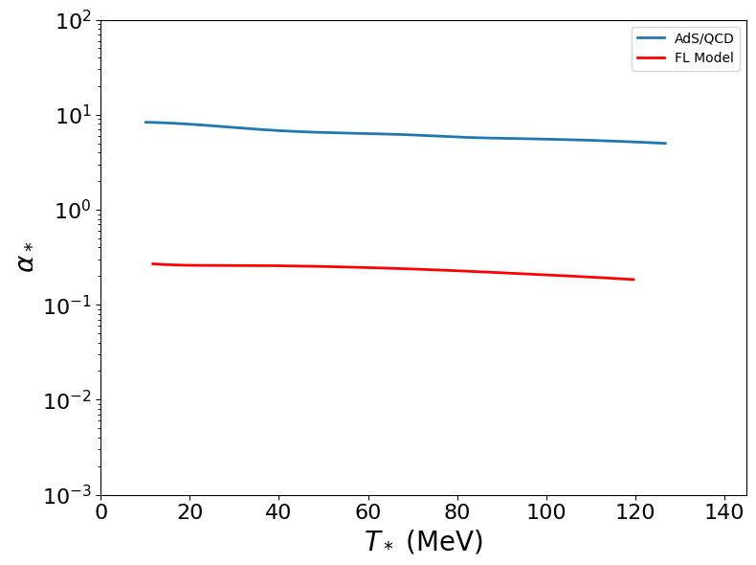
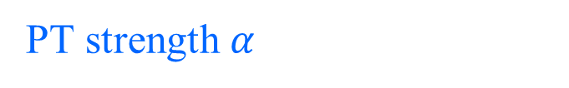
PT strength $α$
Data for the FL model is from
J. Shao, H. Mao, M. Huang, PRD(2025)
Zheng et al., PRD(2025)

Slide 28
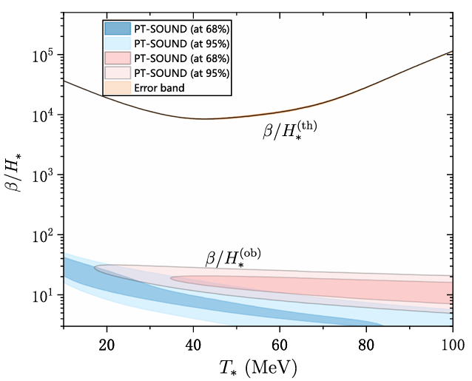
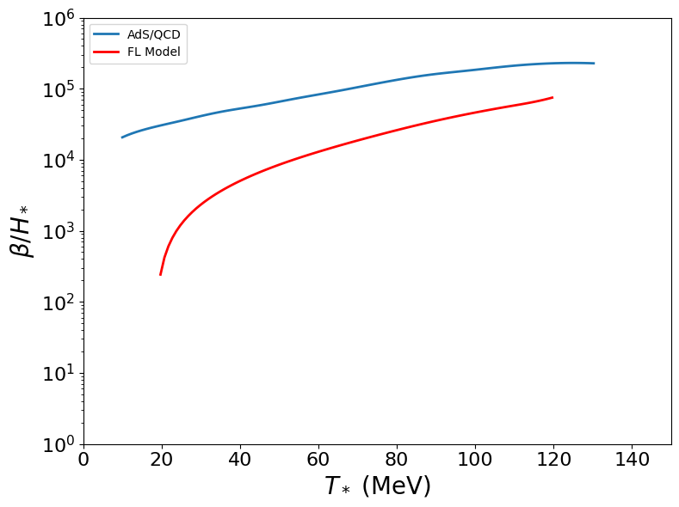
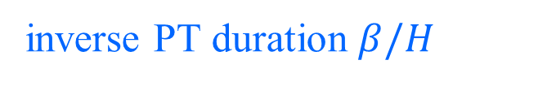
inverse PT duration $β/H$
Data for the FL model is from
J. Shao, H. Mao, M. Huang, PRD(2025)
Zheng et al., PRD(2025)

Slide 29
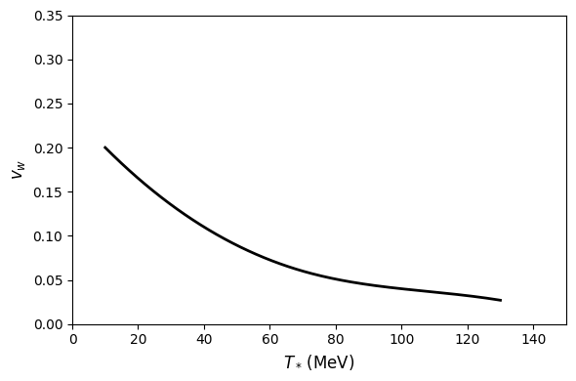
Bubble wall velocity

Slide 30
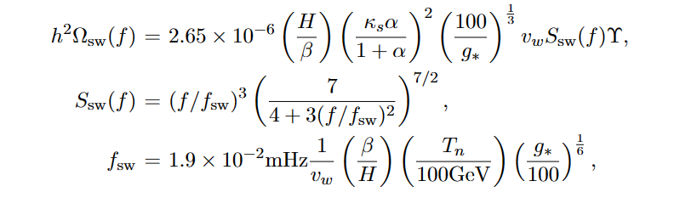
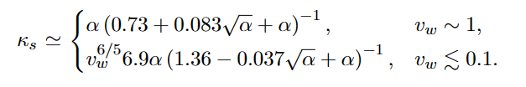
GW power spectra
Y. Chen, Danning Li and M. Huang arXiv: 2212.06591
From numerical simulations, the power spectrum from sound waves has the form of
The specific form of the factor κv depends on the bubble wall velocity and has the following form in the limits of large and small velocities

Slide 31
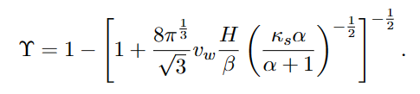
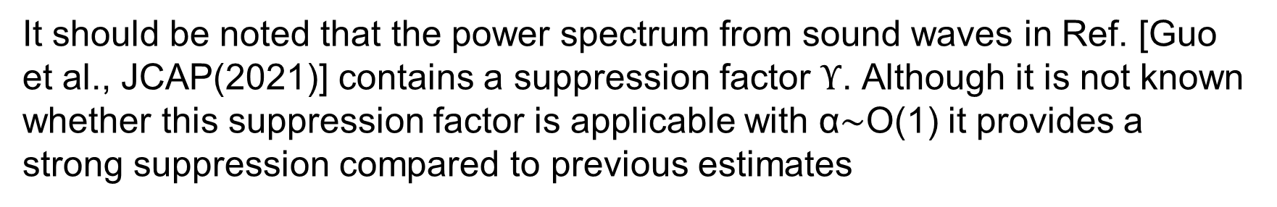
GW power spectra
Y. Chen, Danning Li and M. Huang arXiv: 2212.06591
the suppression factor is
It should be noted that the power spectrum from sound waves in Ref. [Guo et al., JCAP(2021)] contains a suppression factor $Υ$. Although it is not known whether this suppression factor is applicable with α∼O(1) it provides a strong suppression compared to previous estimates
The GW signal can be suppressed by a factor of ${10}^{−3}$ if the kinetic suppression effect from Ref. [Cutting et al. PRL(2020)] is also included.

Slide 32
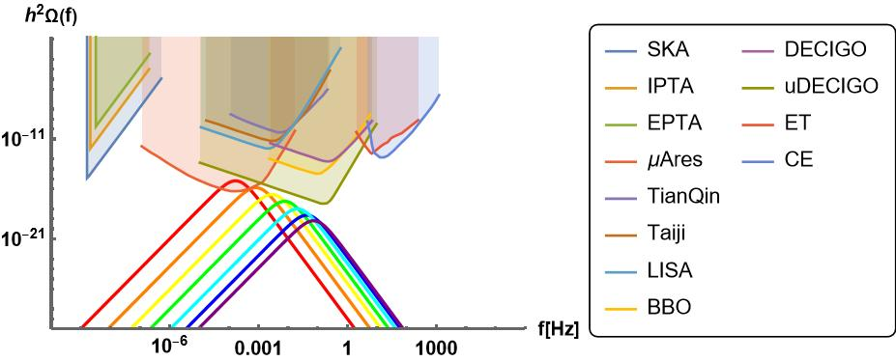
GW power spectra
NANOGrav
In the holographic QCD model, gravitational waves from chiral phase transitions cannot explain the NANOGrav observations.

Slide 33
V. Summary

Slide 34

Summary
We investigate the bounce solution in the holographic QCD model with first-order phase transition. The strength parameter α, inverse duration time β/H and bubble wall velocity vw are calculated by holographic bounce solution.
We find the parameter $α$ is about O(1) and $β/H$ is about 10000-100000. The velocity $v_{w}$ is found to be less than the sound speed. Along the phase transition line in the QCD phase diagram, we find that the bubble velocity $v_{w}$ increases as the temperature decreases, while the inverse duration time $β/H$ decreases and the strength parameter $α$ grows.
The GW signal is strongly suppressed due to the presence of the factor 𝚼, making it difficult to be detected by the experiment.

Slide 35
Thanks！

