Slide 1
Study of $B^{+}→h^{+}π^{0}(h=π or K)$at Belle and BelleII
Update log:
Perform 3D fit instead of 2D fit.
Measurement of branch ratio and CP asymmetry of $B^{+}→π^{+}π^{0}$will be added to this research.
Workflow:
Traversing PID selections from 0.1 to 0.9 with a step of 0.05.
If CSMVA selection is set too loose, it will take more time to complete mu_transformation.
Check the correlation between fitting variables of each component
Perform a fit considering correlation(RooNDkeysPdf)
If we use RooNDkeysPdf to consider the correlation between two/three variables, it is takes too long to draw the canvas.
If we use TH2F/TH3F to consider the correlation between two/three variables, the fitting is easy to fail.

Slide 2
$$Analysis of B2BII$$

Slide 3
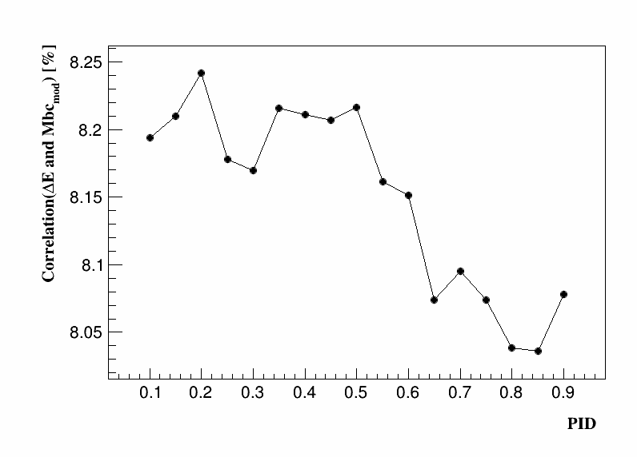
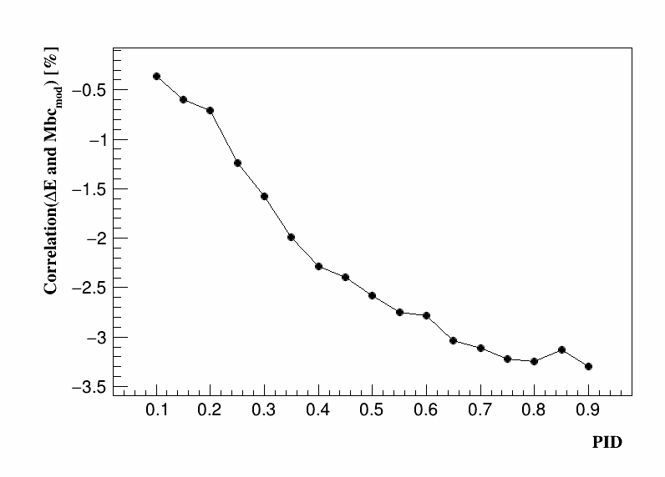
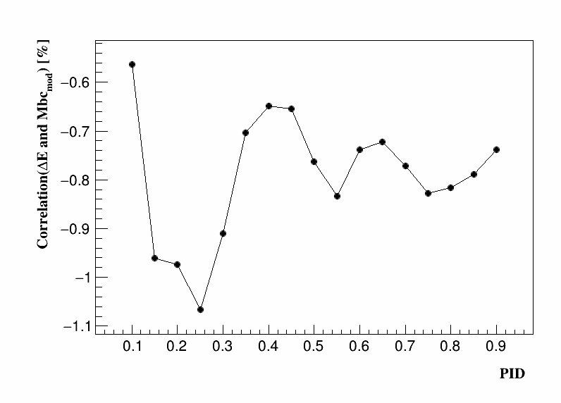
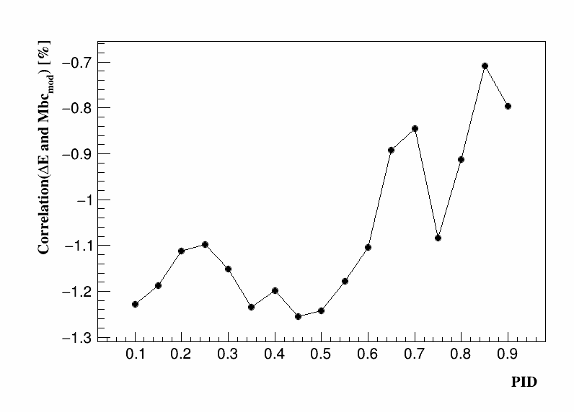
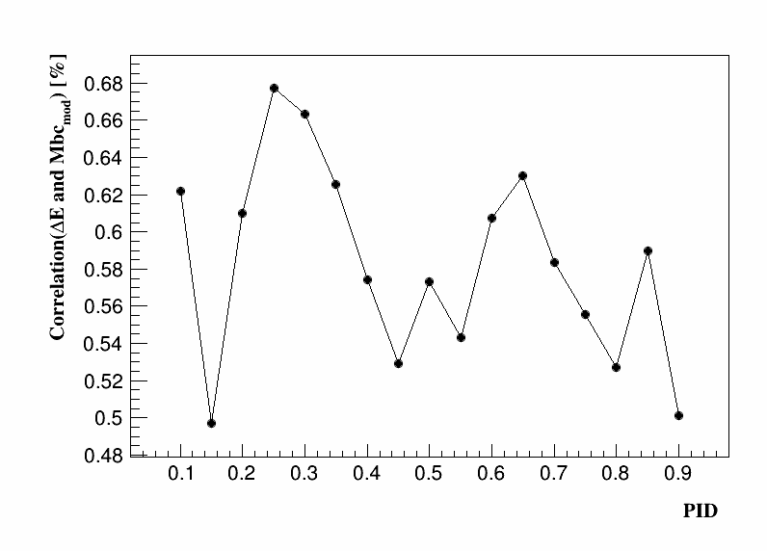
Check correlation between variables of each components
$∆E↔M_{bc} (B^{+}→π^{+}π^{0})$:
BB background
$$B^{+}→K^{+}π^{0}$$
$$mis_{rec} of B^{+}→π^{+}π^{0}$$
$$B^{+}→π^{+}π^{0}$$
qq background

Slide 4
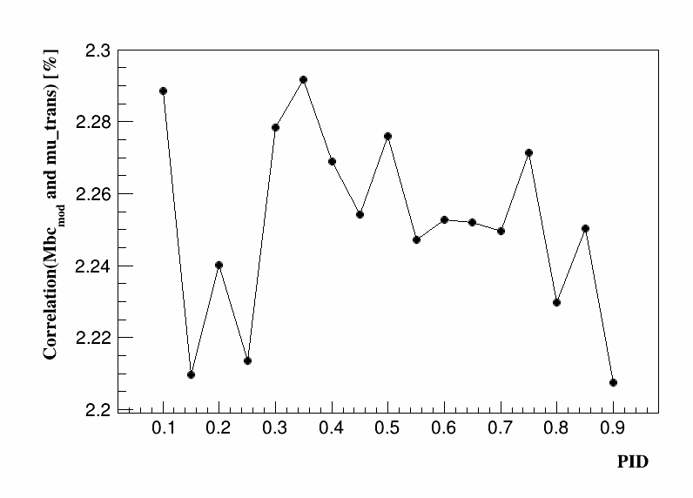
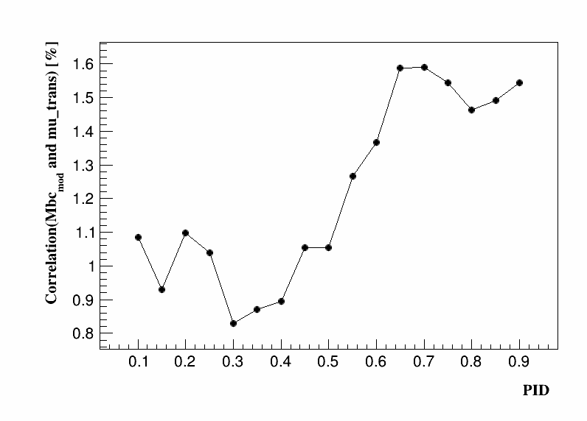
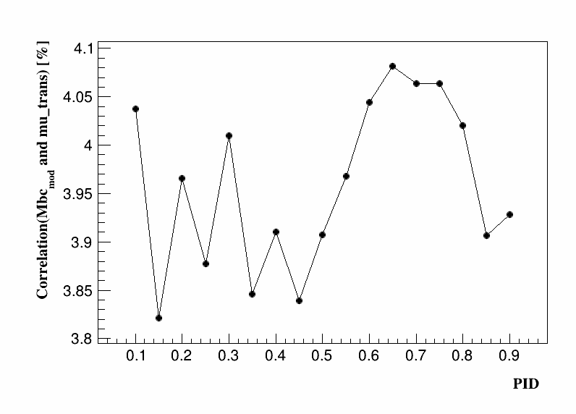
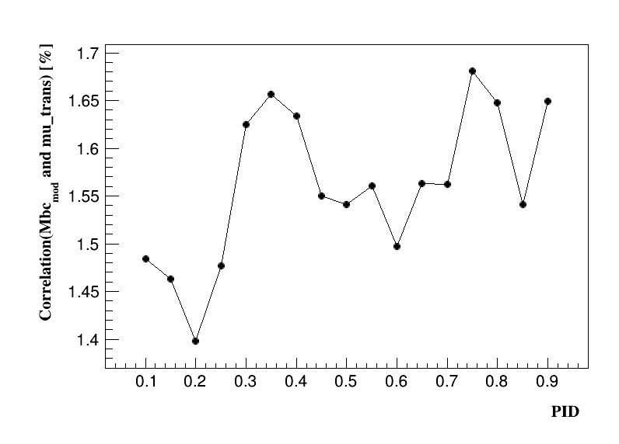
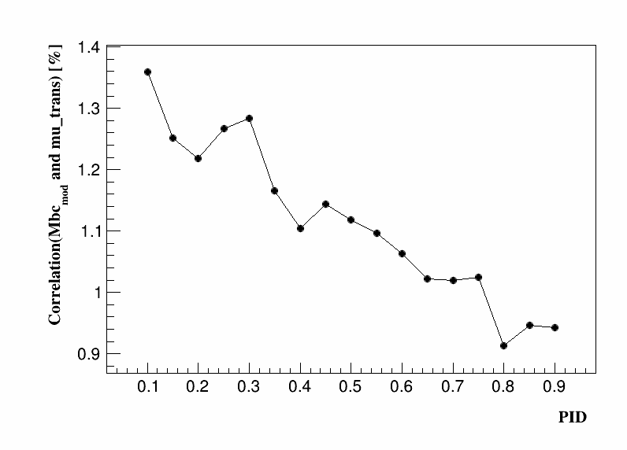
Check correlation between variables of each components
$M_{bc}↔mu_trans (B^{+}→π^{+}π^{0})$:
$$B^{+}→K^{+}π^{0}$$
BB background
$$mis_{rec} of B^{+}→π^{+}π^{0}$$
$$B^{+}→π^{+}π^{0}$$
qq background

Slide 5
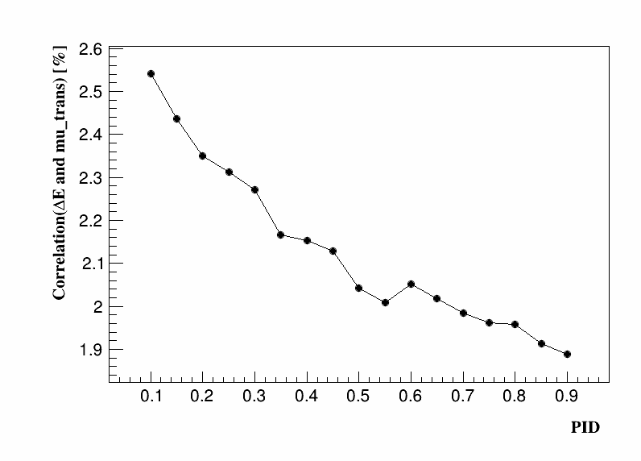
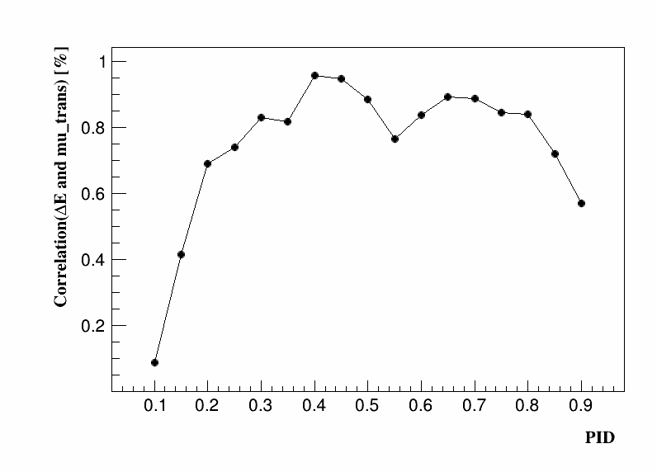
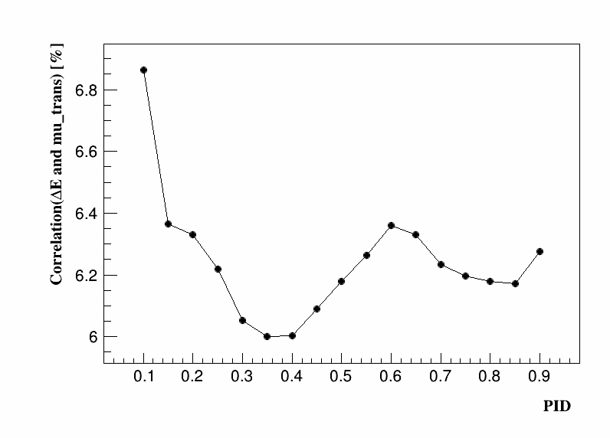
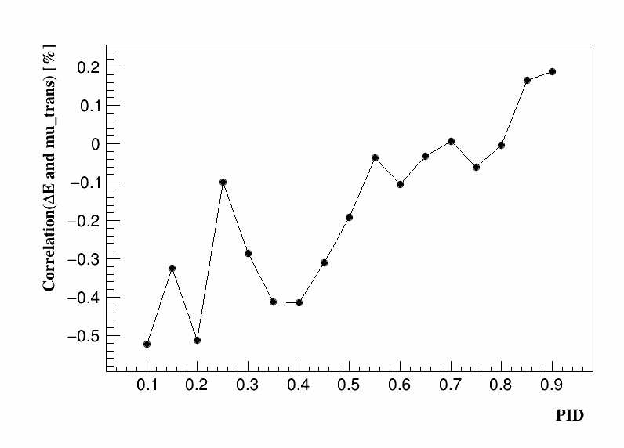
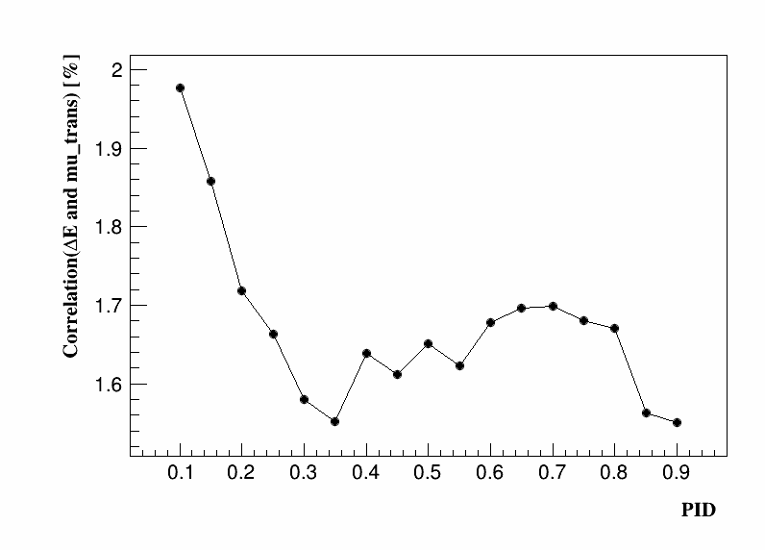
Check correlation between variables of each components
$∆E↔mu_trans (B^{+}→π^{+}π^{0})$:
BB background
$$mis_{rec} of B^{+}→π^{+}π^{0}$$
$$B^{+}→K^{+}π^{0}$$
Summary:
Using Roo3DkeysPdf to describe BB background
Using Roo3DkeysPdf to describe mis_rec. $B^{+}→π^{+}π^{0}$.
Using Roo2DkeysPdf to describe $B^{+}→K^{+}π^{0}$.
$$B^{+}→π^{+}π^{0}$$
qq background

Slide 6
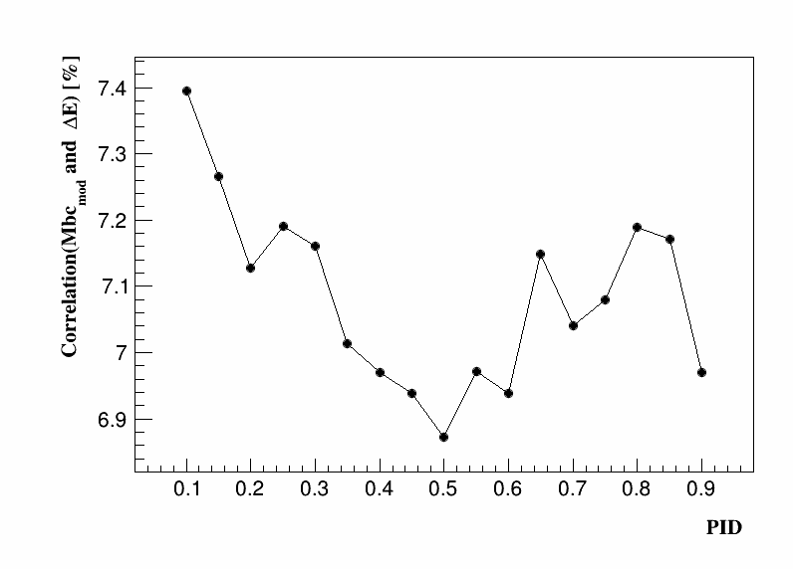
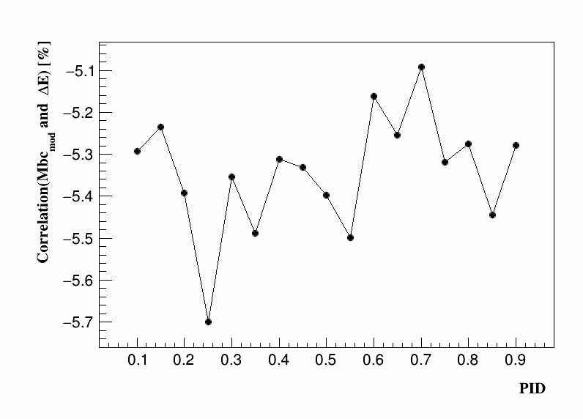
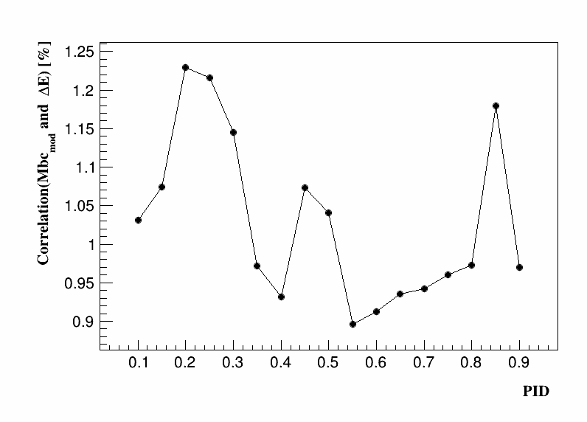
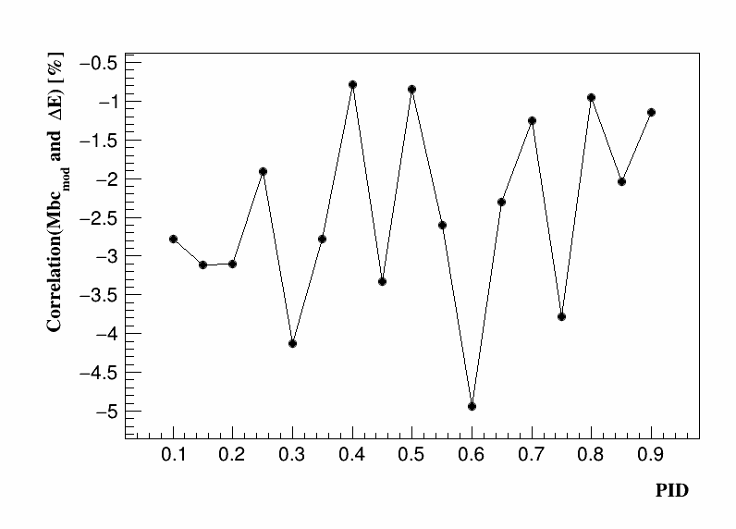
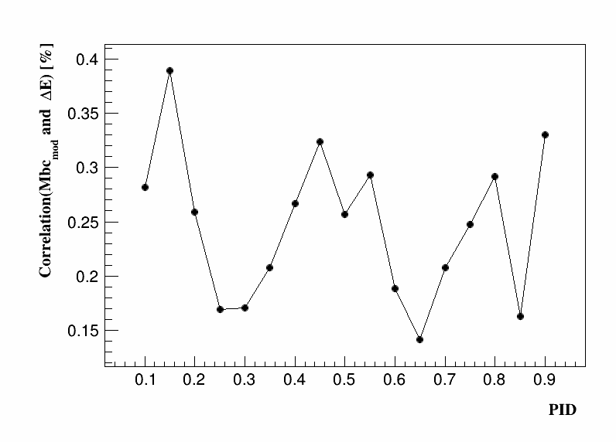
Check correlation between variables of each components
$∆E↔M_{bc} (B^{+}→K^{+}π^{0})$:
BB background
$$B^{+}→K^{+}π^{0}$$
$$mis_{rec} of B^{+}→K^{+}π^{0}$$
$$B^{+}→π^{+}π^{0}$$
qq background

Slide 7
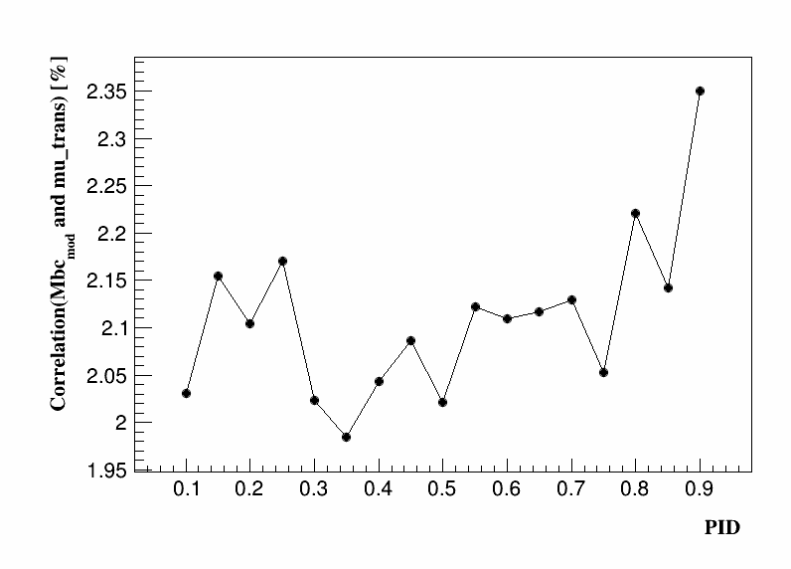
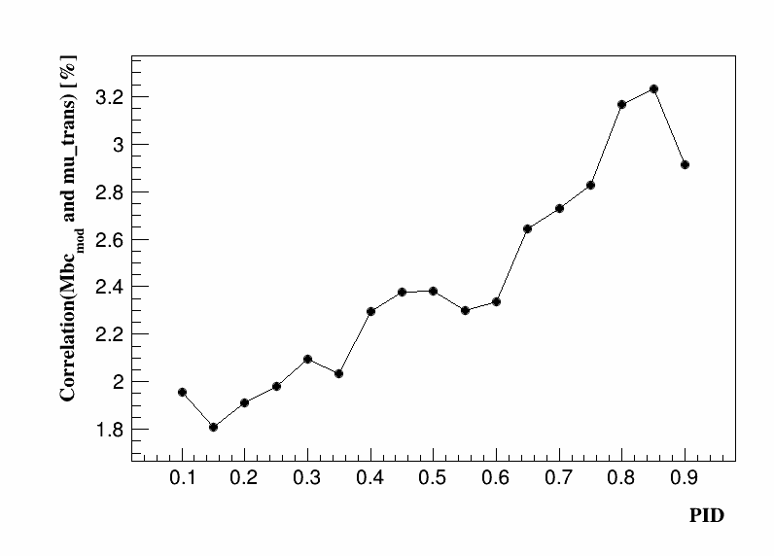
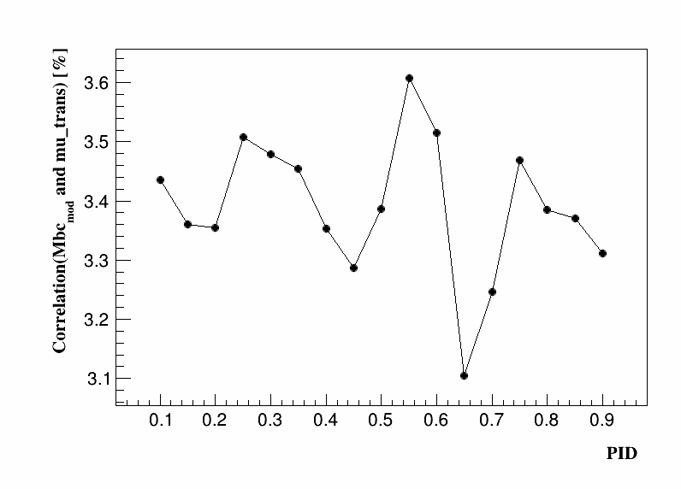
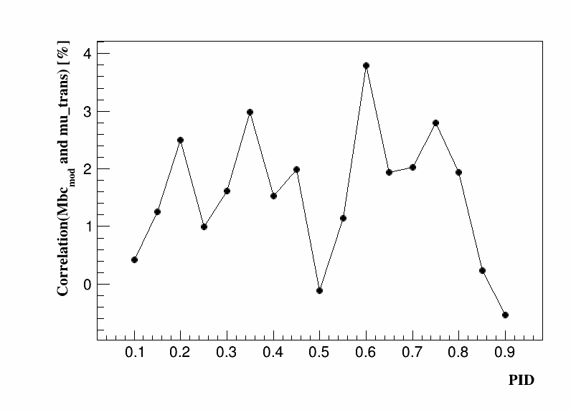
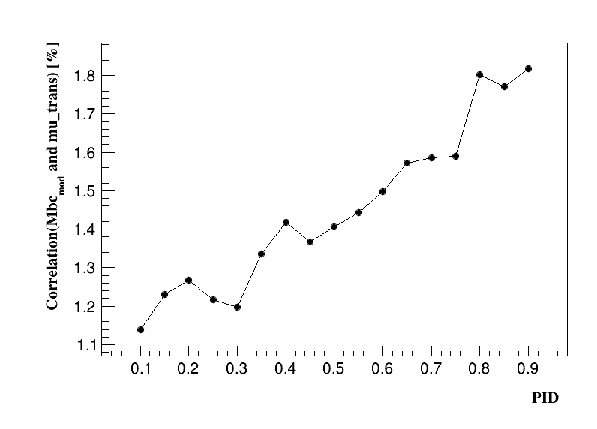
Check correlation between variables of each components
$M_{bc}↔mu_trans (B^{+}→K^{+}π^{0})$:
BB background
$$B^{+}→K^{+}π^{0}$$
$$mis_{rec} of B^{+}→K^{+}π^{0}$$
$$B^{+}→π^{+}π^{0}$$
qq background

Slide 8
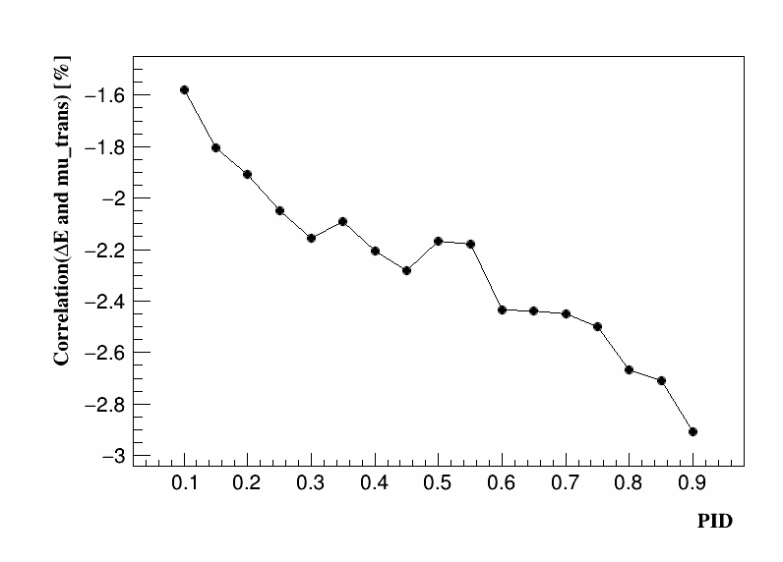
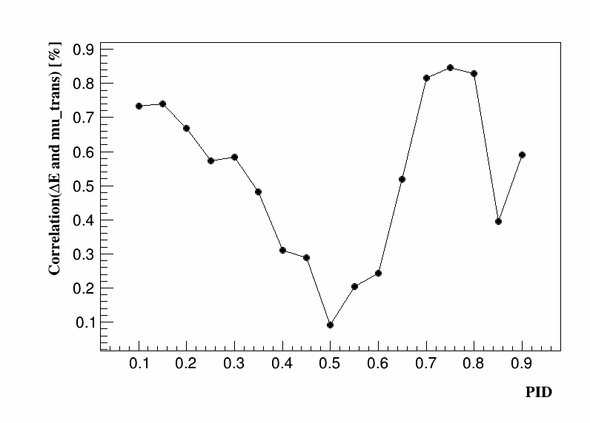
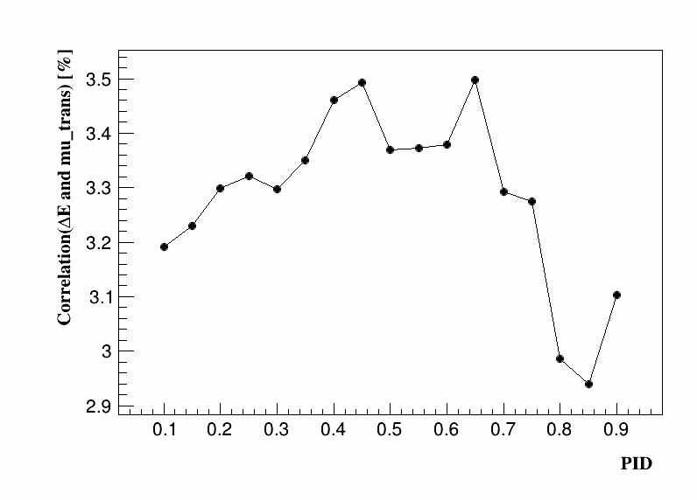
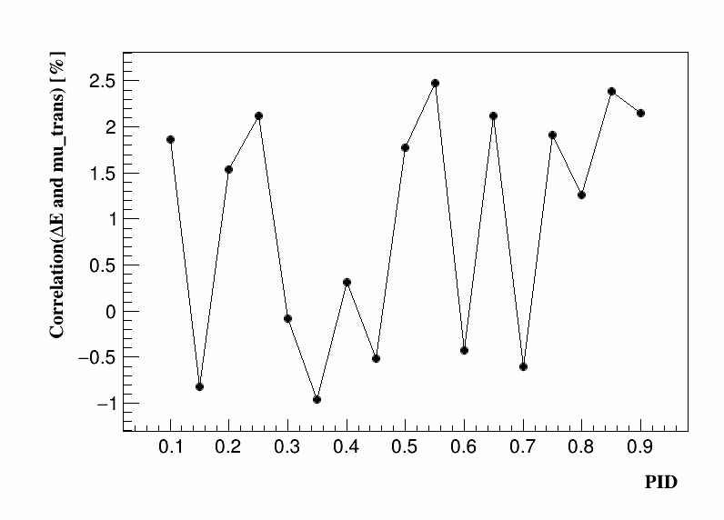
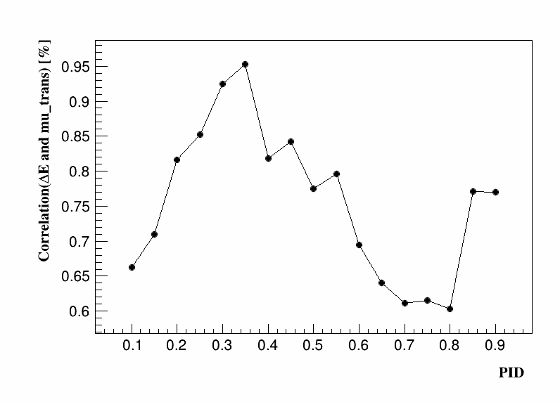
Check correlation between variables of each components
$∆E↔mu_trans (B^{+}→K^{+}π^{0})$:
BB background
$$B^{+}→K^{+}π^{0}$$
$$mis_{rec} of B^{+}→K^{+}π^{0}$$
Summary:
Using Roo3DkeysPdf to describe BB background
Using Roo3DkeysPdf to describe mis_rec. $B^{+}→K^{+}π^{0}$.
Using Roo2DkeysPdf to describe $B^{+}→K^{+}π^{0}$.
$$B^{+}→π^{+}π^{0}$$
qq background

Slide 9
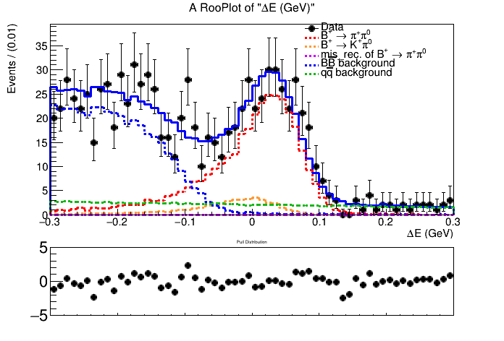
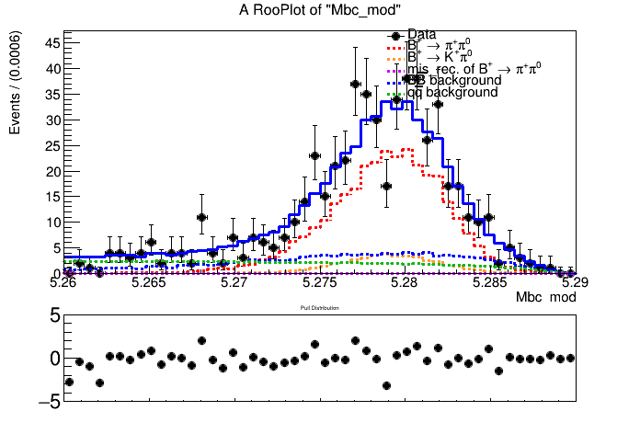
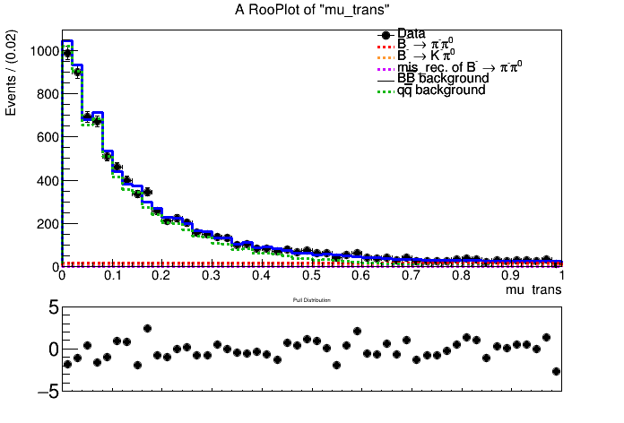
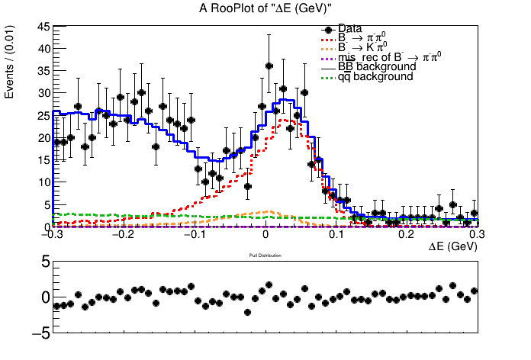
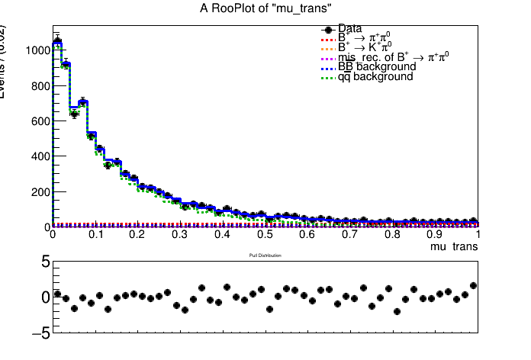
Fitting plots of $B^{+}→π^{+}π^{0}$ （not considering corr.）
$signal−enhanced region:5.26<{Mbc}_{mod}<5.29,−0.15<∆E<0.10,mu_{trans}>0.65$

Slide 10
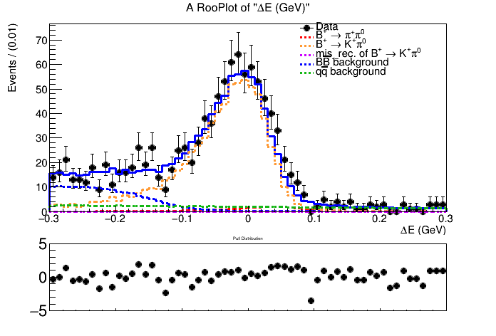
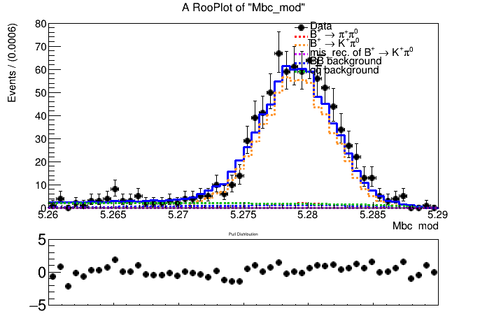
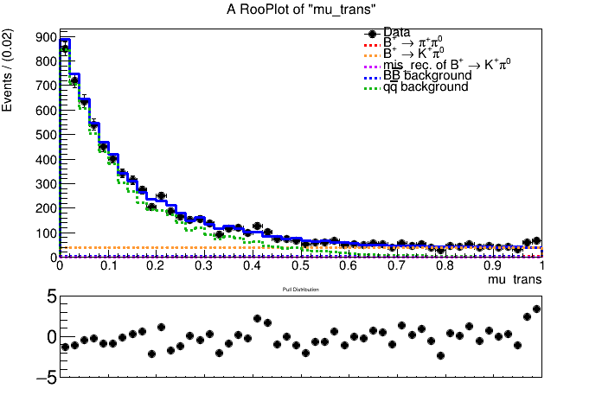
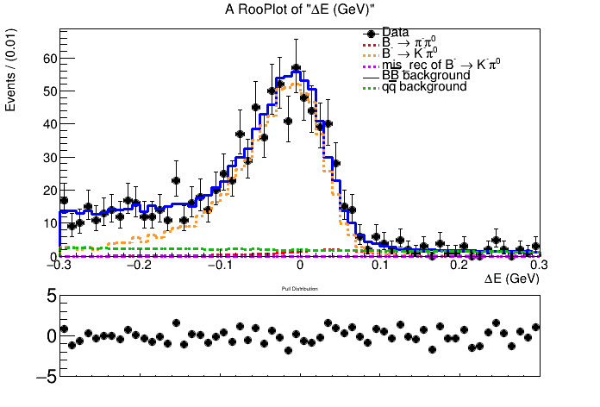
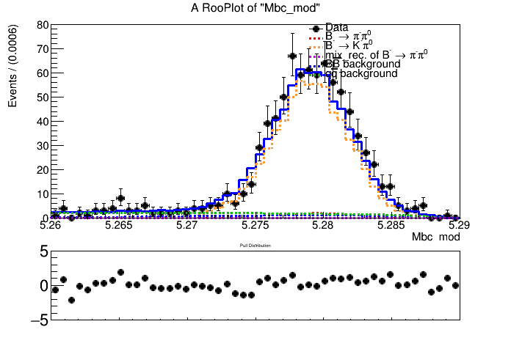
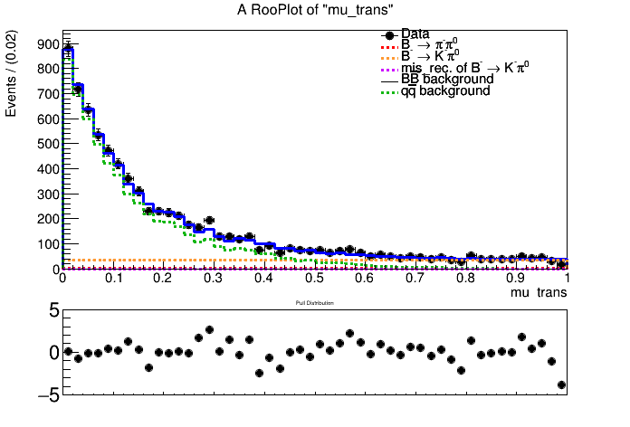
Fitting plots of $B^{+}→K^{+}π^{0}$ （not considering corr.）
$signal−enhanced region:5.26<{Mbc}_{mod}<5.29,−0.15<∆E<0.10,mu_{trans}>0.65$

Slide 11
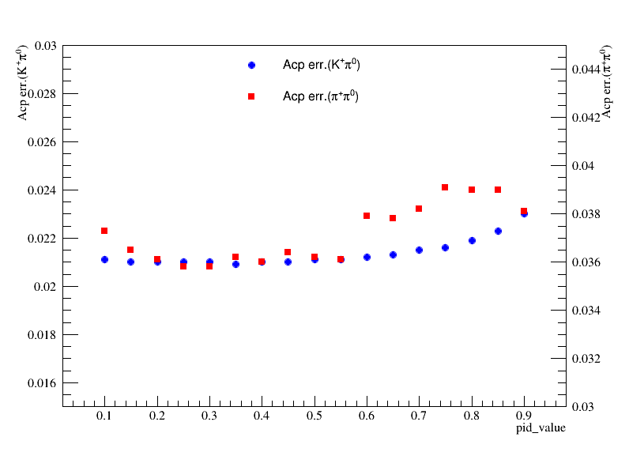
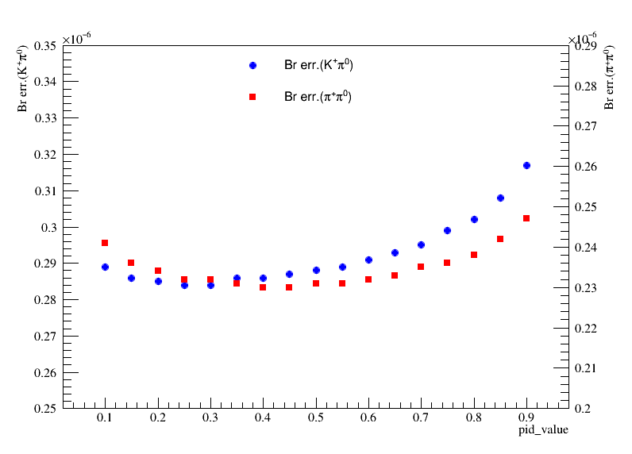
Fitting to $B^{+}→K^{+}π^{0}$ and $B^{+}→π^{+}π^{0}$ separately（considering corr.）
 | $$luminosity$$ | $$A_{CP}(B^{+}→K^{+}π^{0})$$ | $$Br(B^{+}→K^{+}π^{0})$$ | $$A_{CP}(B^{+}→π^{+}π^{0})$$ | $$Br(B^{+}→π^{+}π^{0})$$
$$my measurement$$ $$(MC samples)$$ | $$771/fb$$ | $$−0.017±0.021$$ | $$(13.40±0.28)×{10}^{−6}$$ | $$−0.022±0.036$$ | $$(6.23±0.23)×{10}^{−6}$$
$$previous results$$ $$(data samples)$$ | $$771/fb$$ | $$0.043±0.024$$ | $$(12.62±0.31)×{10}^{−6}$$ | $$0.025±0.043$$ | $$(5.86±0.26)×{10}^{−6}$$

Slide 12
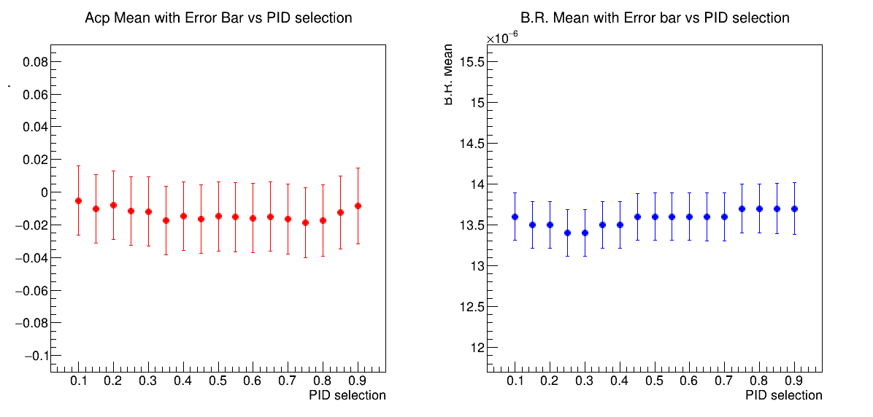
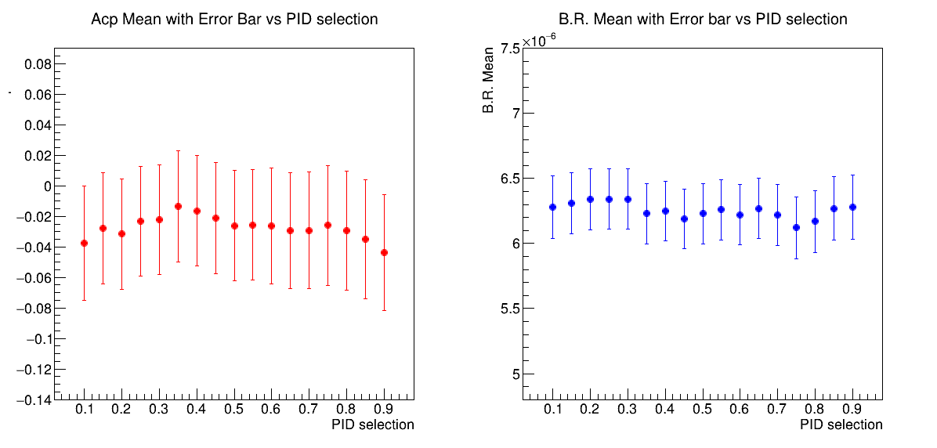
Fitting to $B^{+}→K^{+}π^{0}$ and $B^{+}→π^{+}π^{0}$ separately（considering corr.）
mean values of Acp(left) and B.R(right) corresponding to different $B^{+}→K^{+}π^{0}$
mean values of Acp(left) and B.R(right) corresponding to different $B^{+}→π^{+}π^{0}$

Slide 13
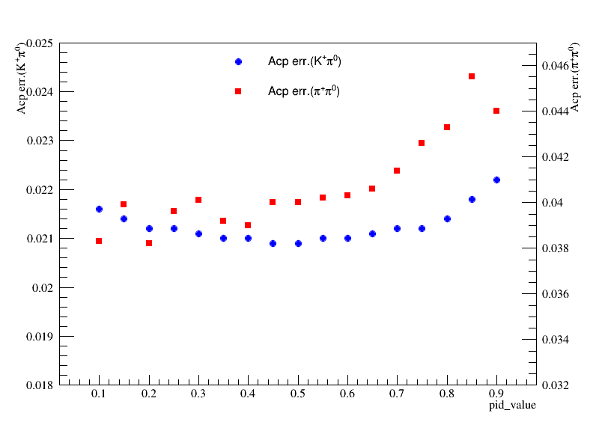
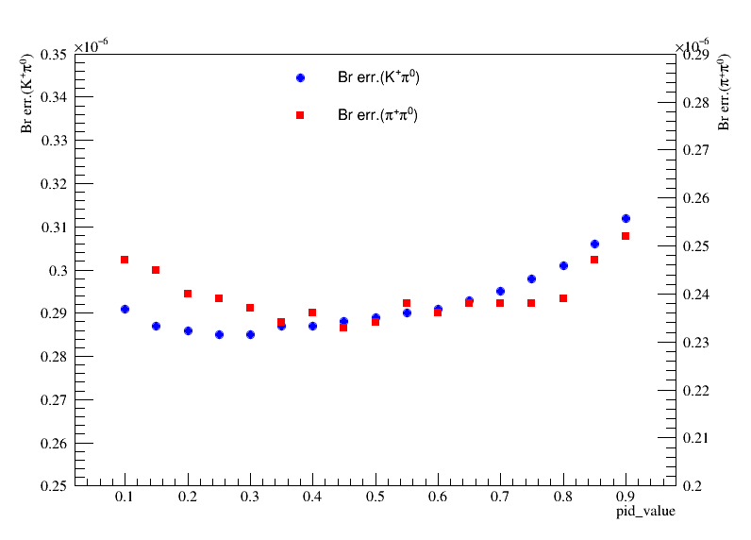
Fitting to $B^{+}→K^{+}π^{0}$ and $B^{+}→π^{+}π^{0}$ simultaneously（not considering corr.）
 | $$luminosity$$ | $$A_{CP}(B^{+}→K^{+}π^{0})$$ | $$Br(B^{+}→K^{+}π^{0})$$ | $$A_{CP}(B^{+}→π^{+}π^{0})$$ | $$Br(B^{+}→π^{+}π^{0})$$
$$my measurement$$ $$(MC samples)$$ | $$771/fb$$ | $$−0.019±0.021$$ | $$(13.60±0.29)×{10}^{−6}$$ | $$−0.005±0.039$$ | $$(5.89±0.24)×{10}^{−6}$$
$$previous results$$ $$(data samples)$$ | $$771/fb$$ | $$0.043±0.024$$ | $$(12.62±0.31)×{10}^{−6}$$ | $$0.025±0.043$$ | $$(5.86±0.26)×{10}^{−6}$$

Slide 14
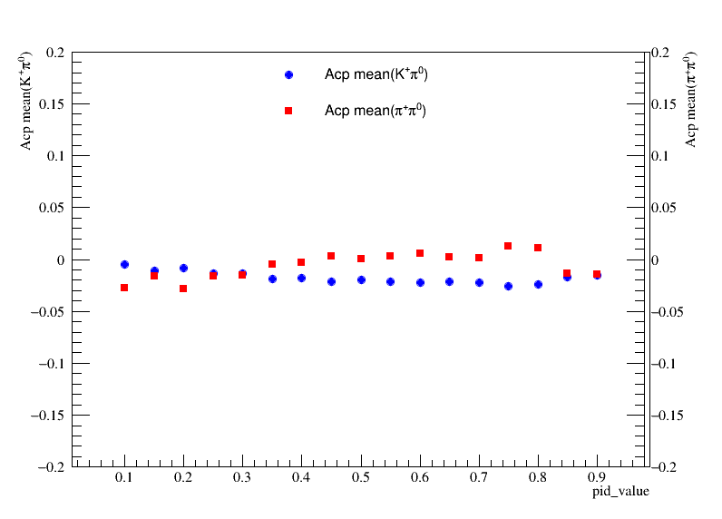
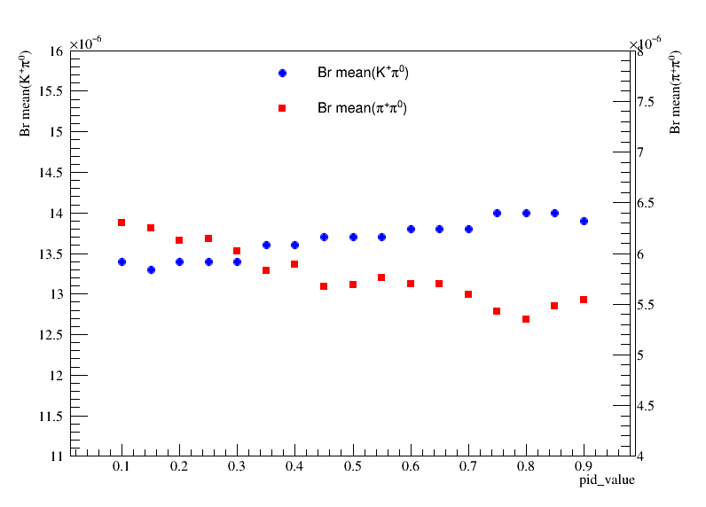
Fitting to $B^{+}→K^{+}π^{0}$ and $B^{+}→π^{+}π^{0}$ simultaneously（not considering corr.）
mean values of Acp corresponding to different $B^{+}→h^{+}π^{0} (h=K or π)$
mean values of B.R corresponding to different $B^{+}→h^{+}π^{0} (h=K or π)$

Slide 15
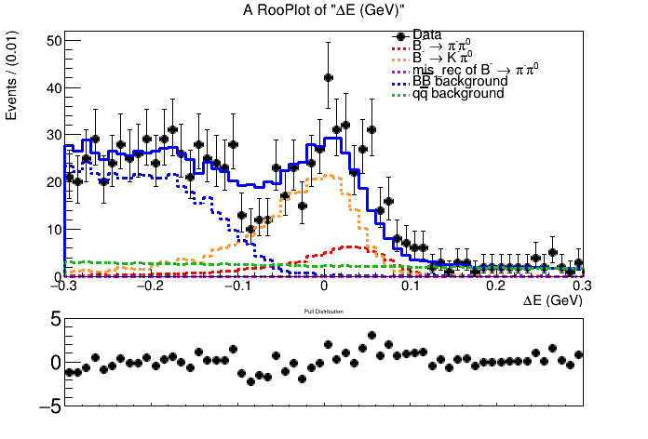
Fitting plots of $B^{+}→π^{+}π^{0}$ simutaneously（not considering corr.）

Slide 16
Fitting plots of $B^{+}→K^{+}π^{0}$ simutaneously（not considering corr.）

