Slide 1
Group meeting
邹世明
2024/12/12

Slide 2
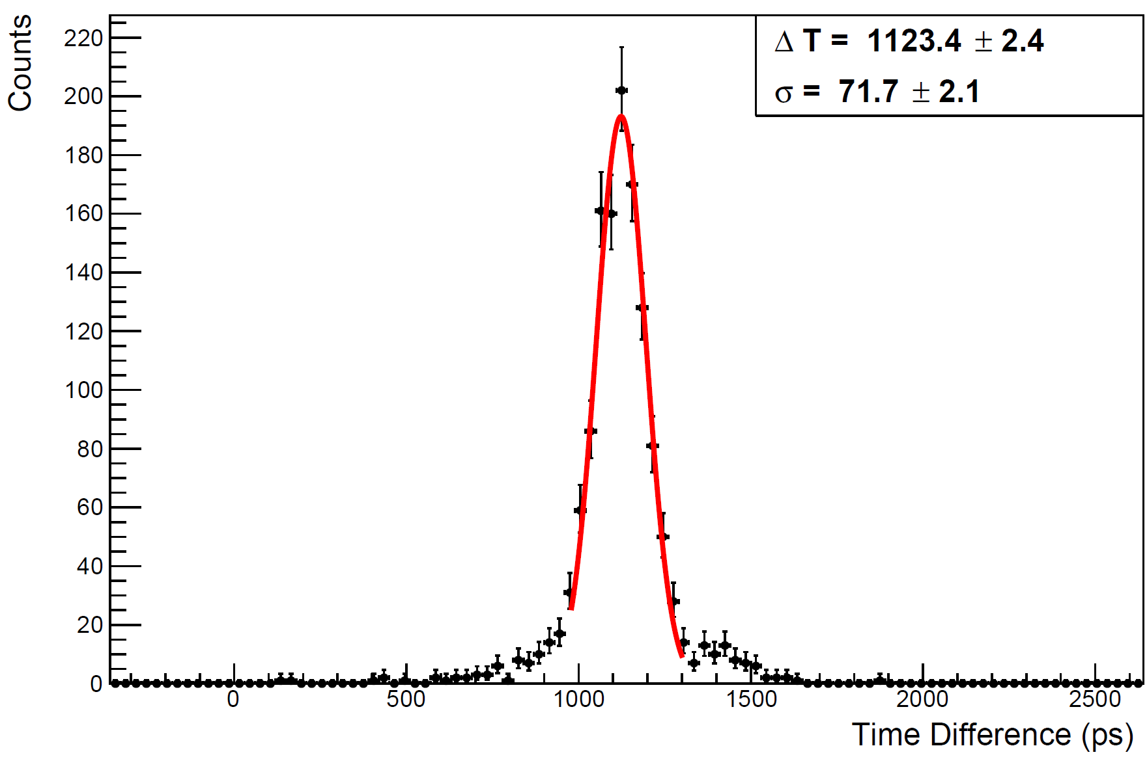
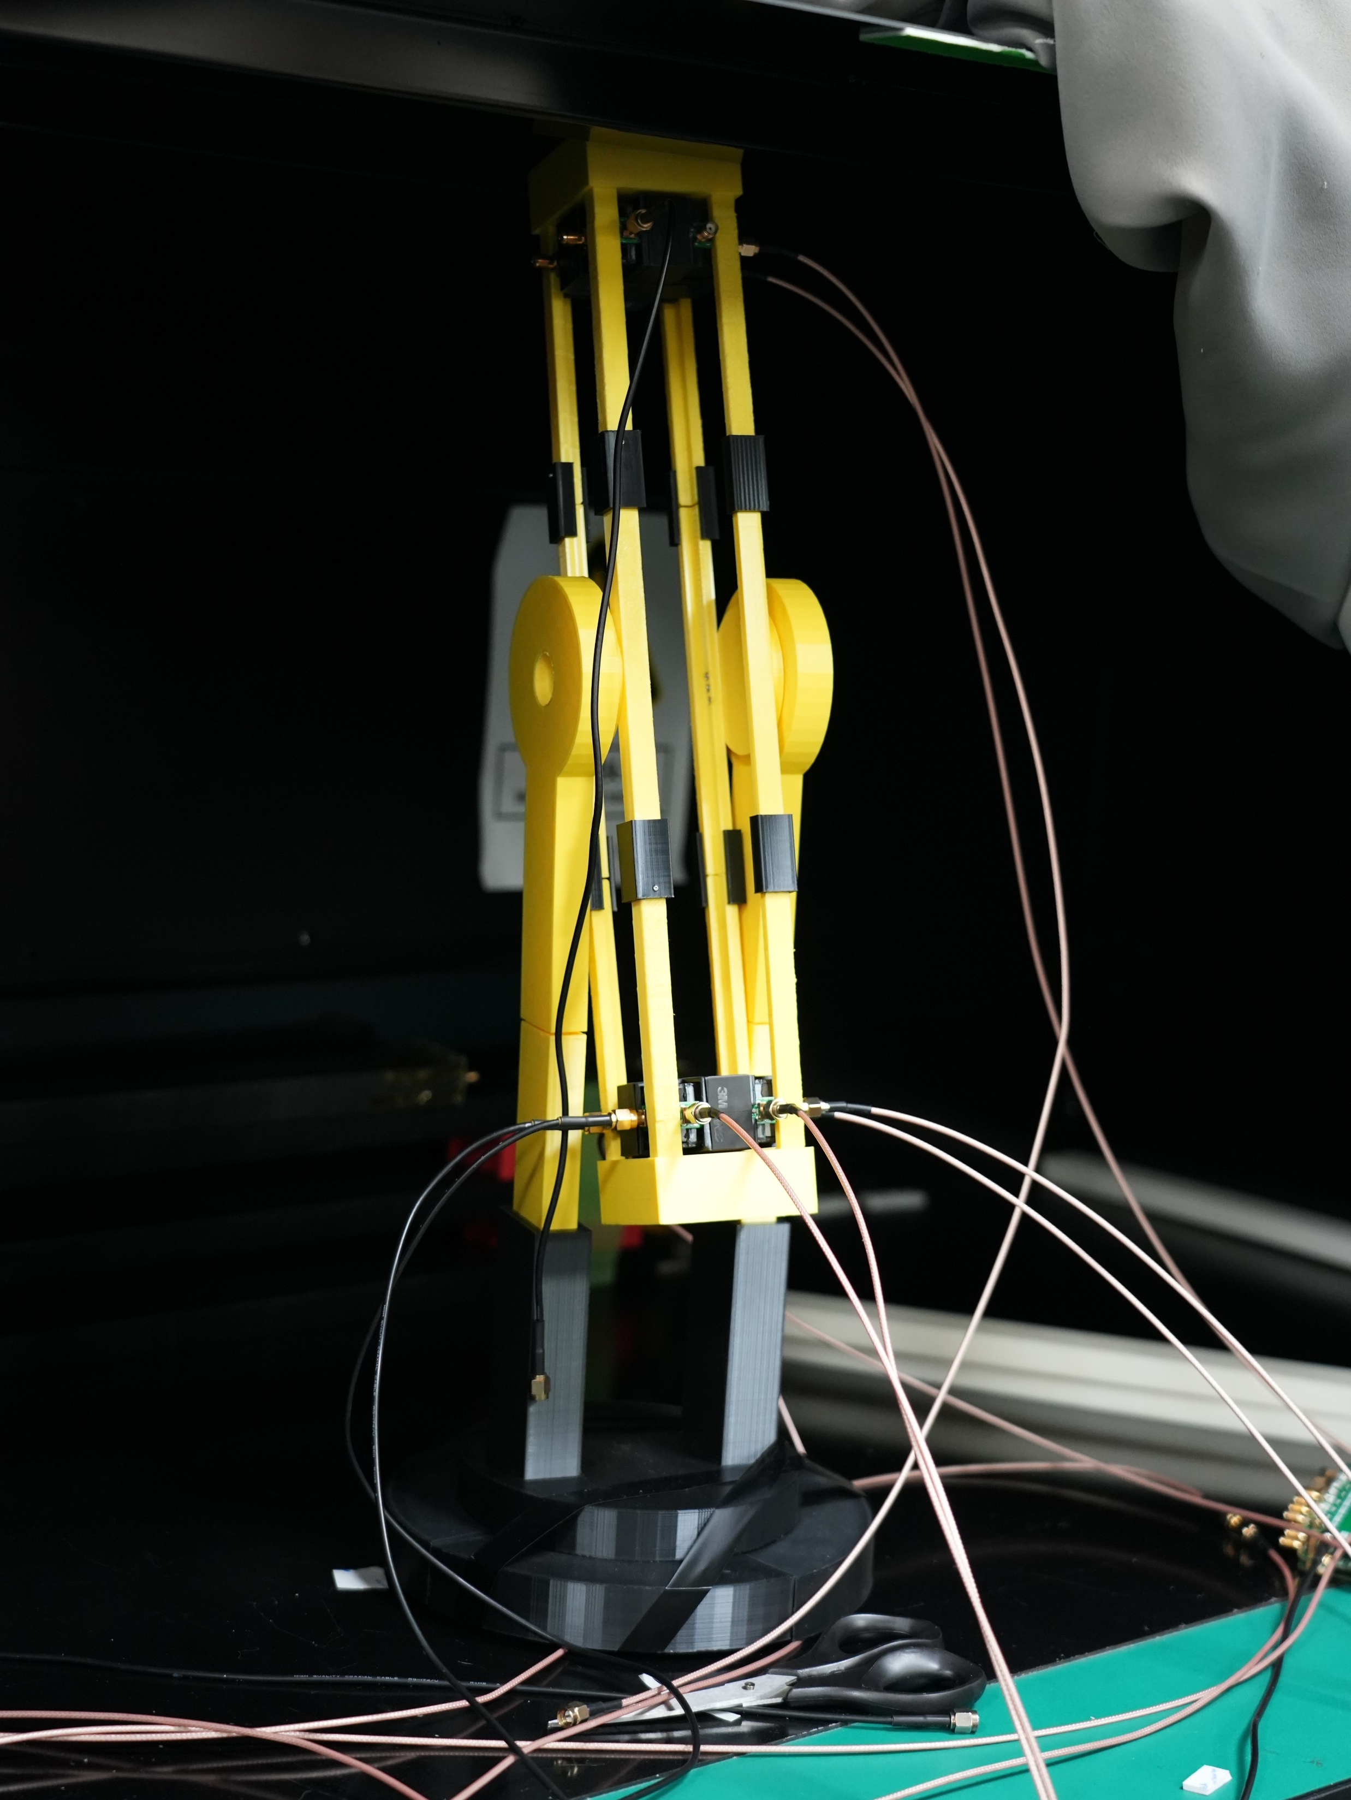
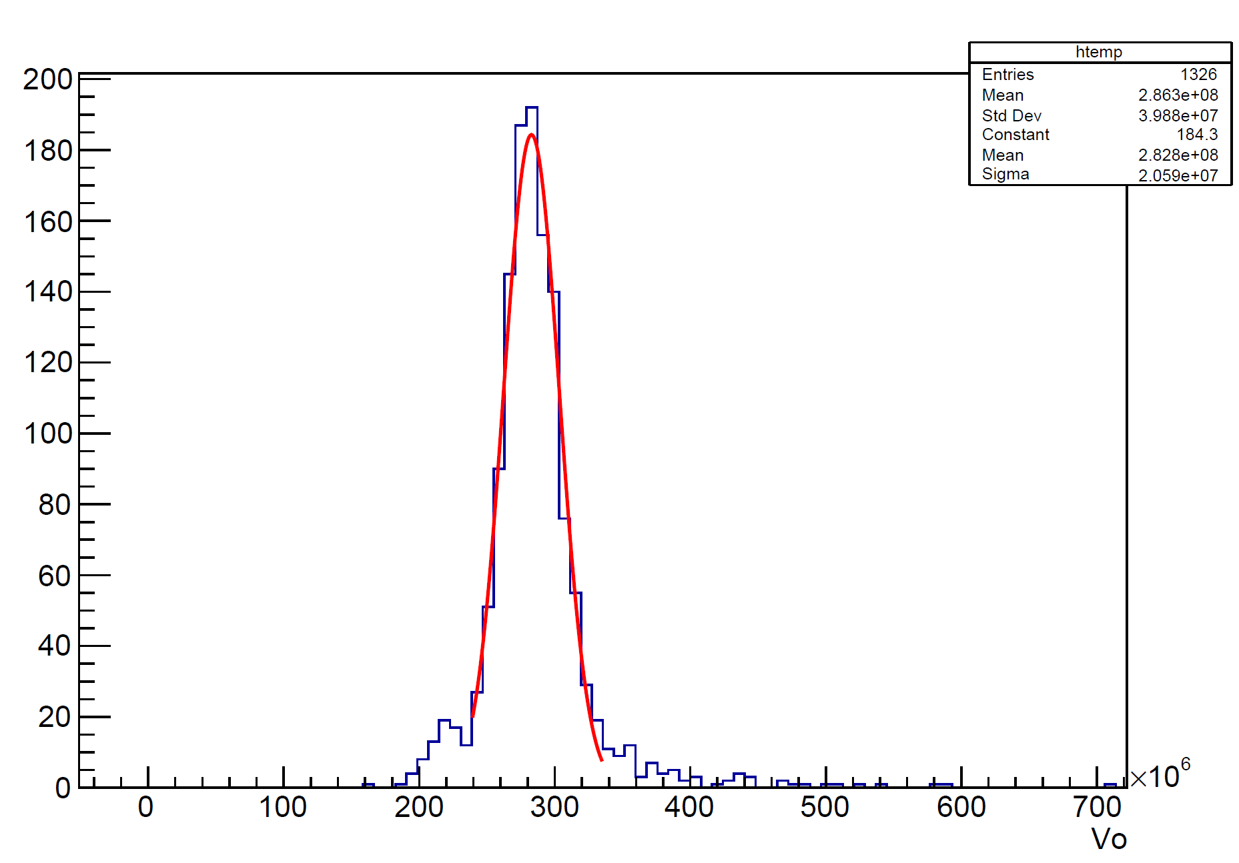
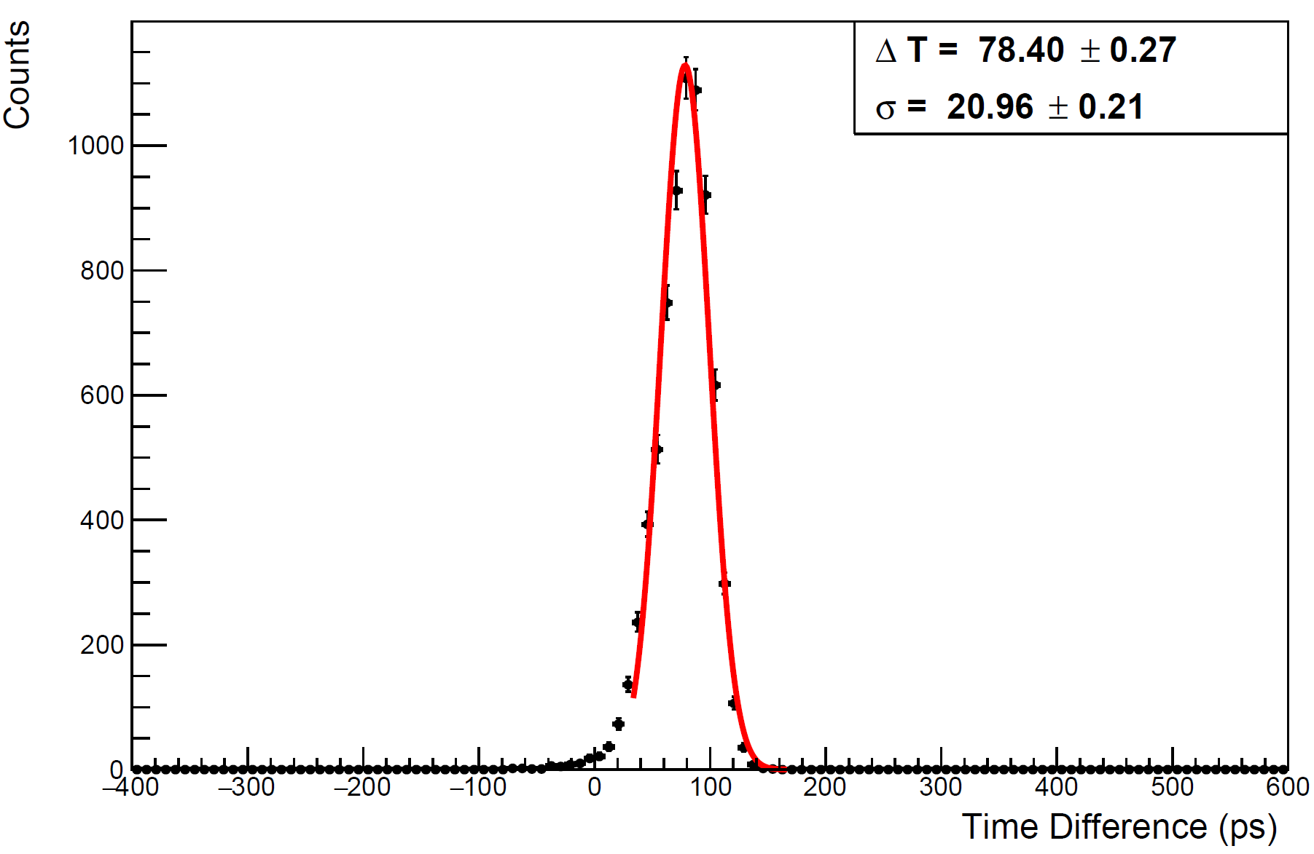
The velocity of muon in cosmic ray
Cosmic ray
Time resolution result
Velocity distribution
Mean = $2.828×{10}^{8} m/s$
Calibration result

Slide 3
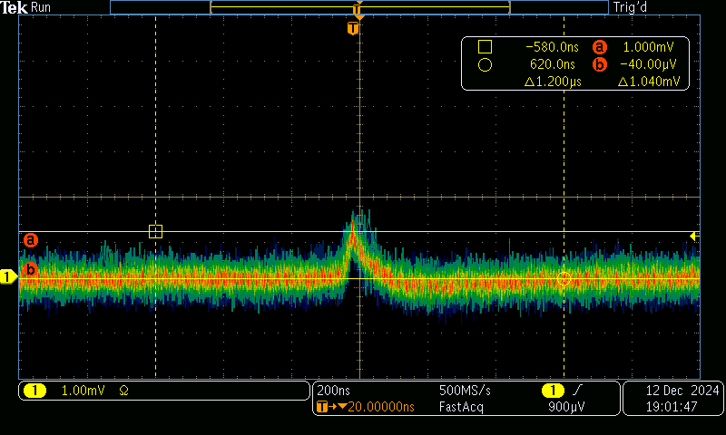
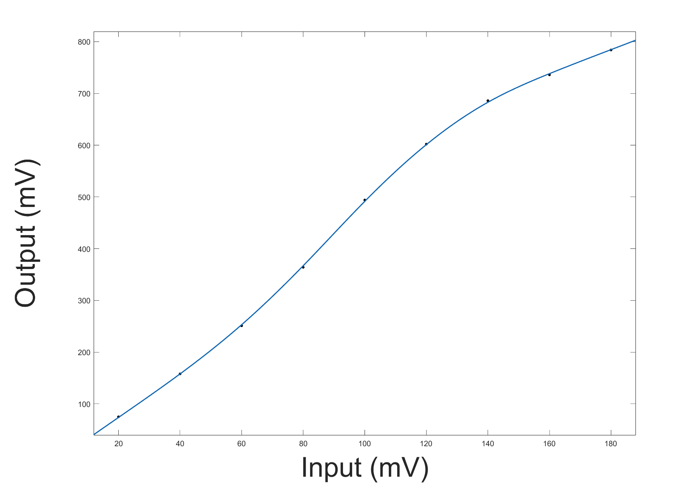
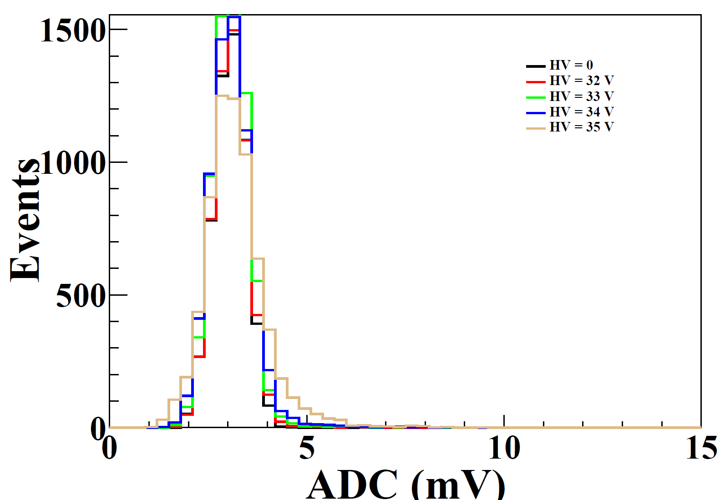
Test of Ashiph
SiPM 信号
Test 接口用于信号发生器测试
DT5742暗噪声测试结果

Slide 4
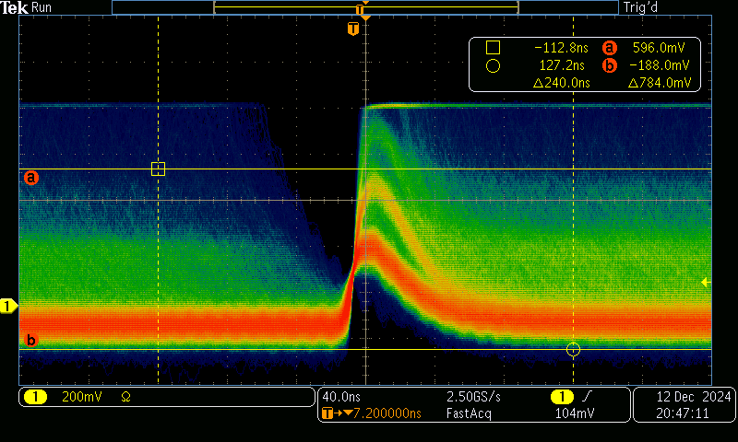
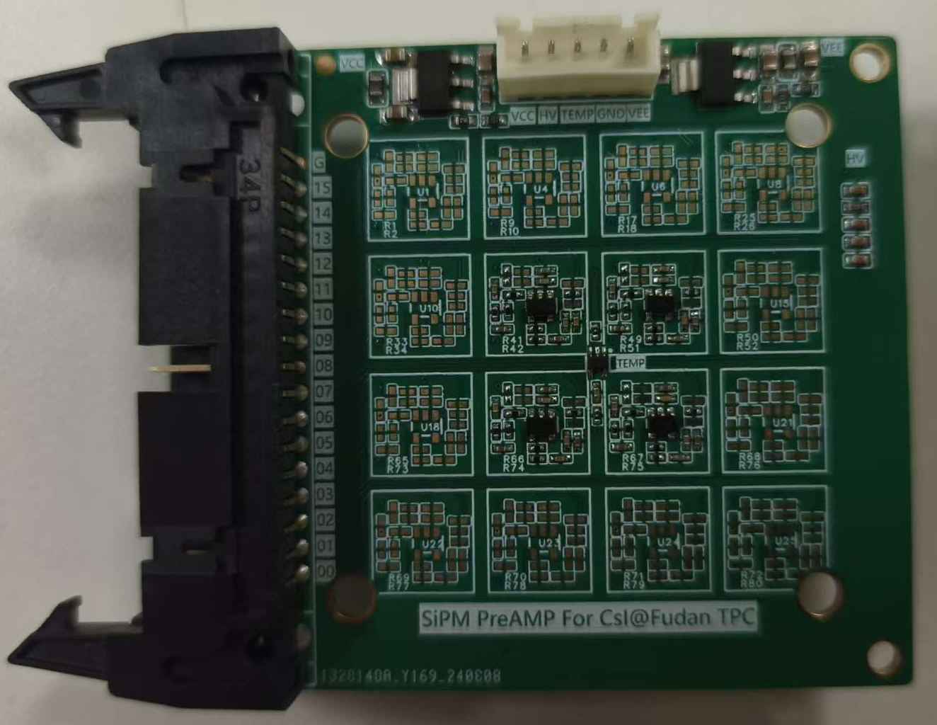
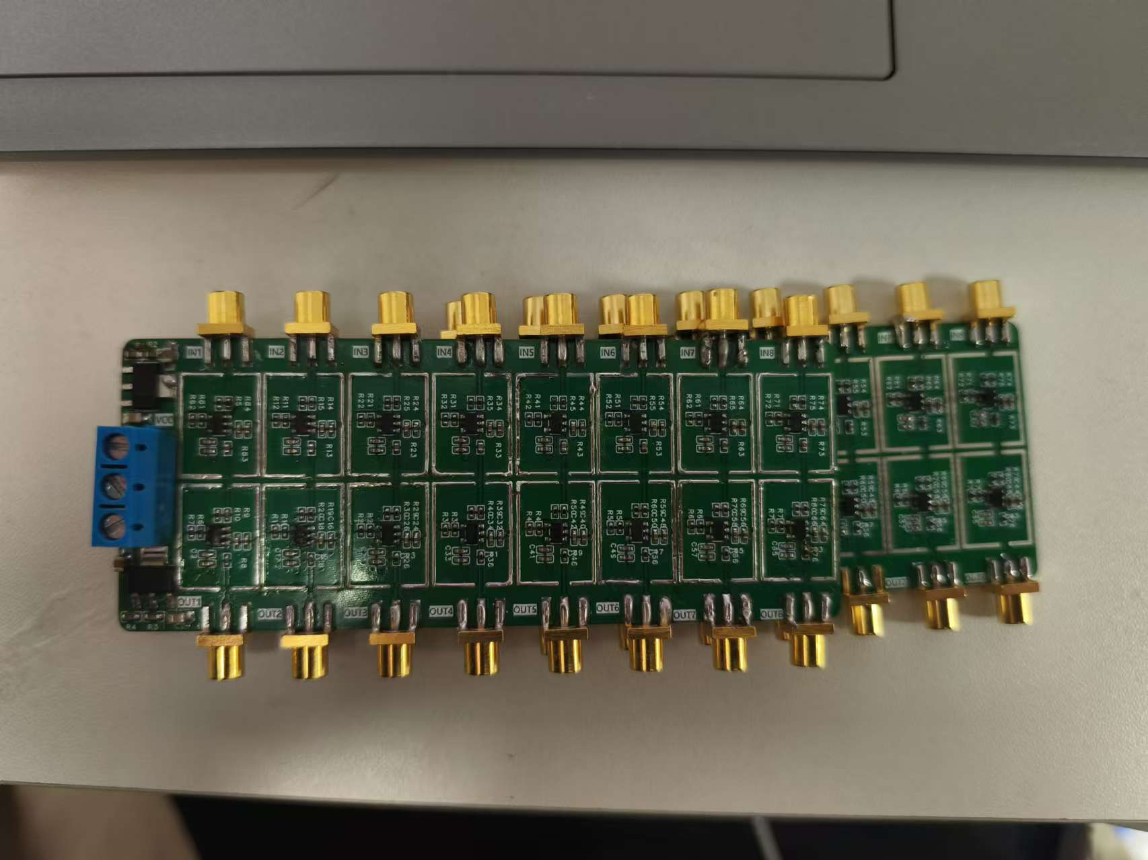
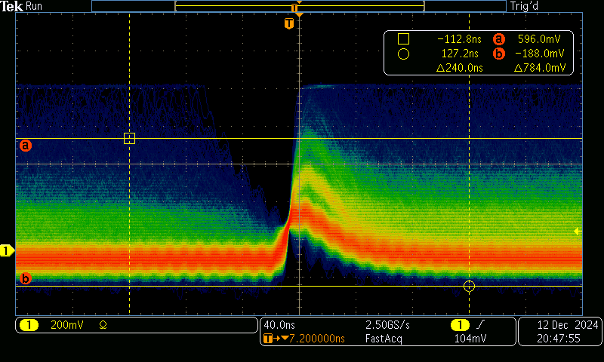
Test of 16*NDL board
偏压33V
偏压33V
三级快放大电路

Slide 5
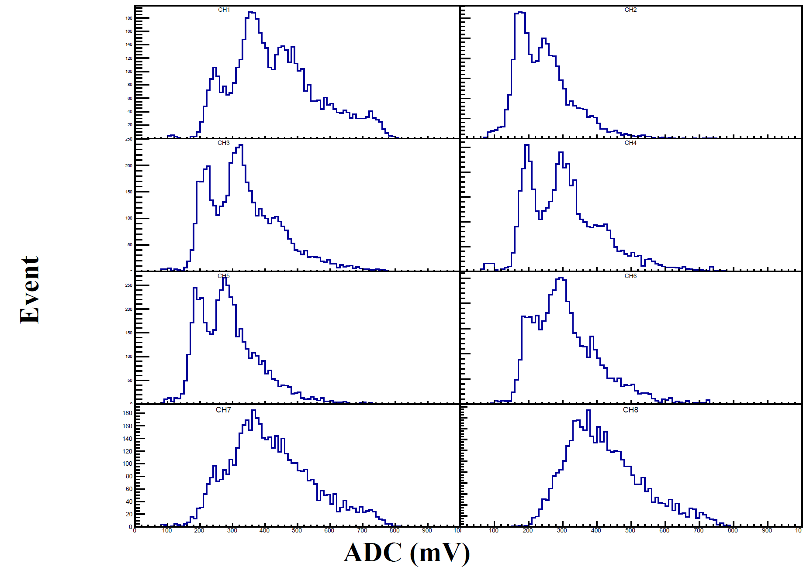
Test of 16*NDL board
三级快放大电路

Slide 6
$$B^{0}→K_{s}π^{0}$$

Slide 7
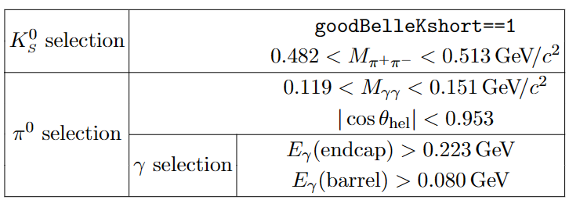
Selection Criteria, MC simulation and data samples
$K_{s}^{0}$:
$0.482GeV/c^{2}<M\left(π^{+}π^{−}\right)<0.513$ $GeV/c^{2}$
$π^{0}$:
$E_{γ}$(endcap)>223 $MeV/c^{2}$
$E_{γ}$(Barrel)>90 $MeV/c^{2}$
$0.119 GeV/c^{2}<M(γγ)<0.151$ $GeV/c^{2}$
$$\left|cosθ_{hel}\right|<0.95$$
$B^{0}$:
$Mbc>5.274 GeV/c^{2}$
$−0.2<ΔE<0.1 GeV/c^{2}$
FBDT_output>0.6
MC simulation and data sample:
Signal MC :
MC15rd_b_Signal_1110022100 (20M)
Generic MC (Run-dependent MC - proc13 - 4S exp 7-18)
uubar: MC15rd_uubar_exp7-18_4S_v3 (744.764 $fb^{−1}$)
ssbar: MC15rd_ddbar_exp7-18_4S_v3 (744.764 $fb^{−1}$)
ddbar: MC15rd_ssbar_exp7-18_4S_v3 (744.764 $fb^{−1}$)
ccbar: MC15rd_ccbar_exp7-18_4S_v3 (744.764 $fb^{−1}$)
charged: MC15rd_charged_exp7-18_4S_v3 (744.764 $fb^{−1}$)
mixed: MC15rd_charged_exp7-18_4S_v3 (744.764 $fb^{−1}$)
Data:
Moriond 2022 dataset with hadron type (189.273 $fb^{−1}$)
reslease08-01-10
Cuts from BELLE2-NOTE-PH-2021-053_v3

Slide 8
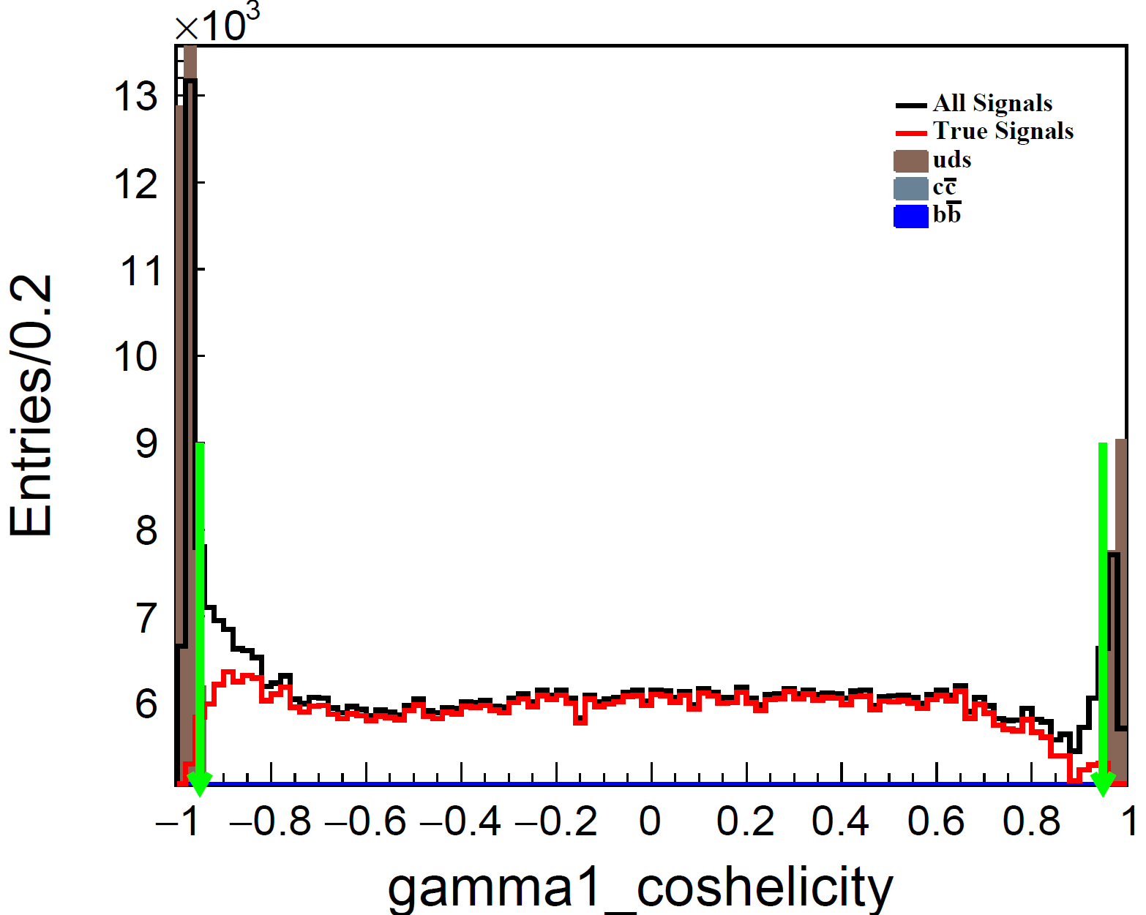
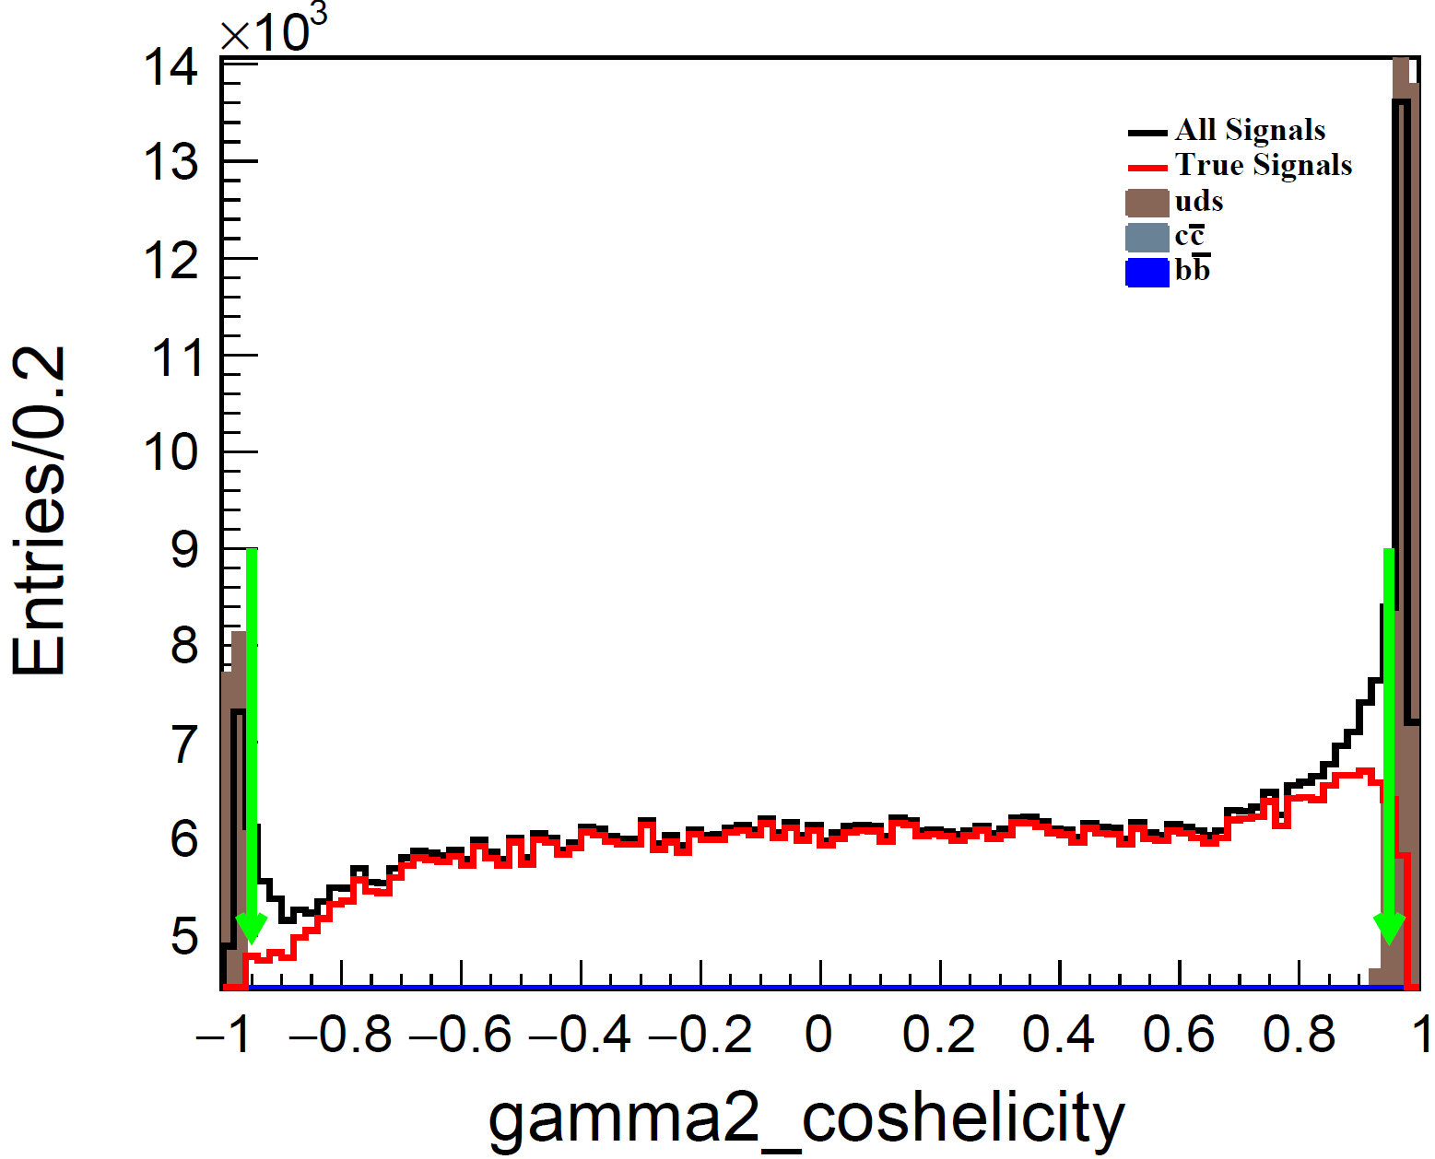
Helicity angle
$$\left|cosθ_{hel}\right|<0.95$$

Slide 9
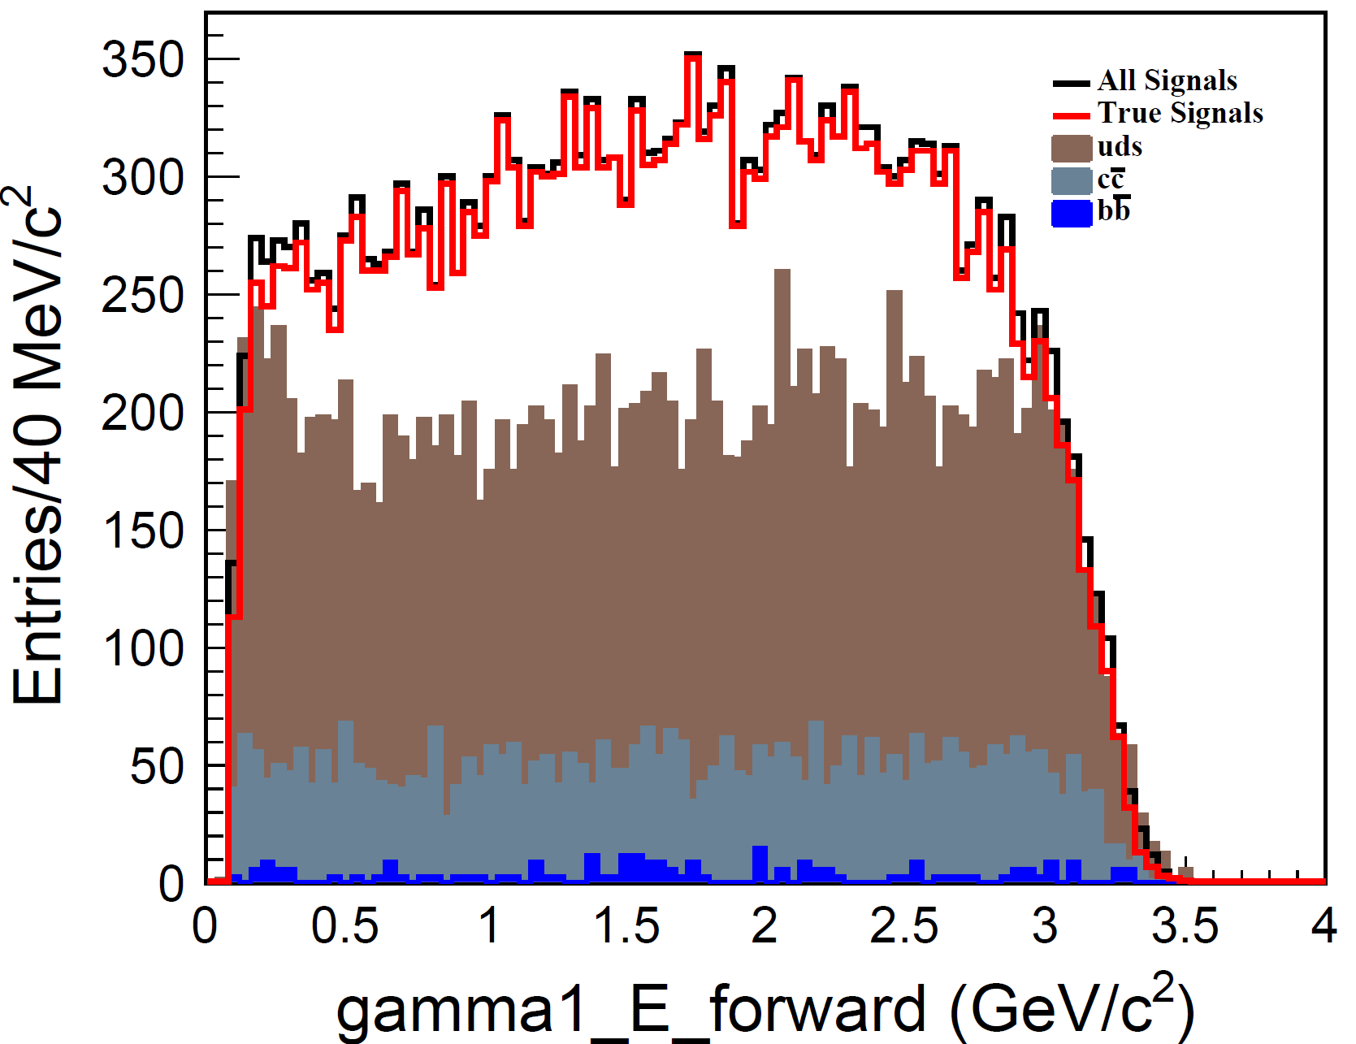
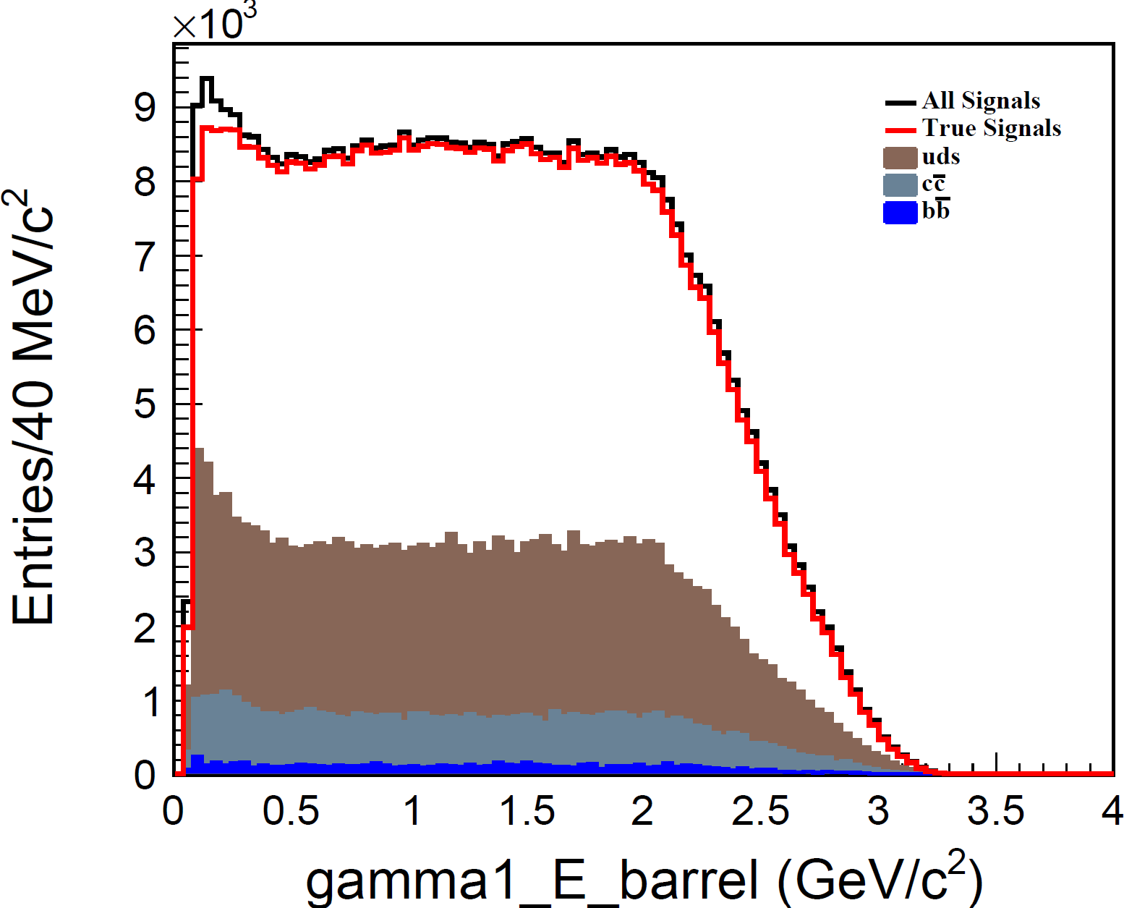
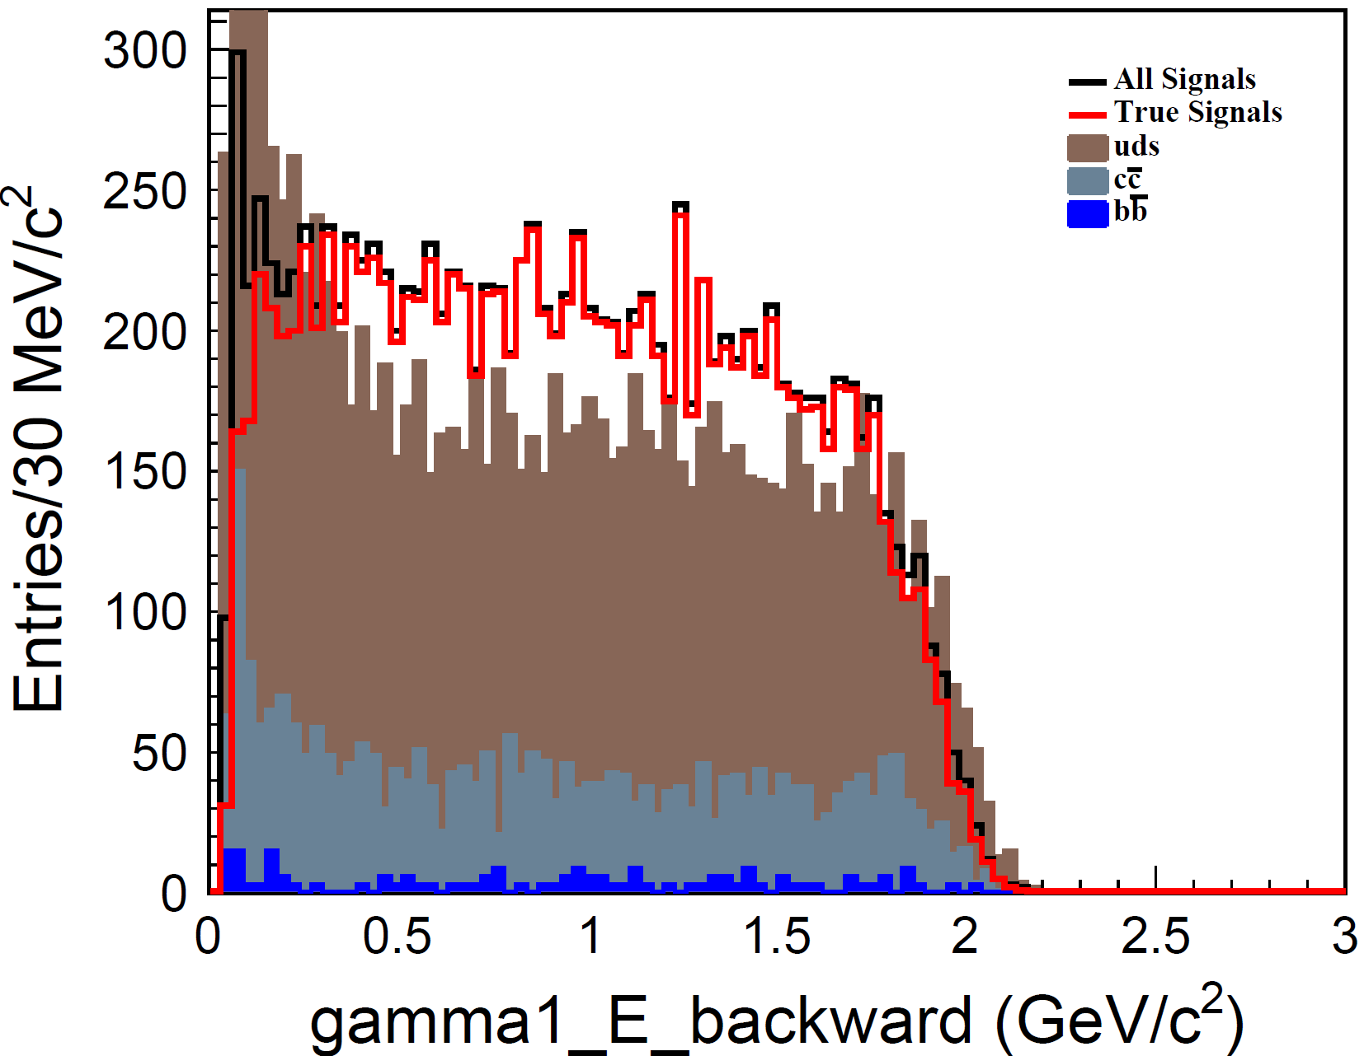
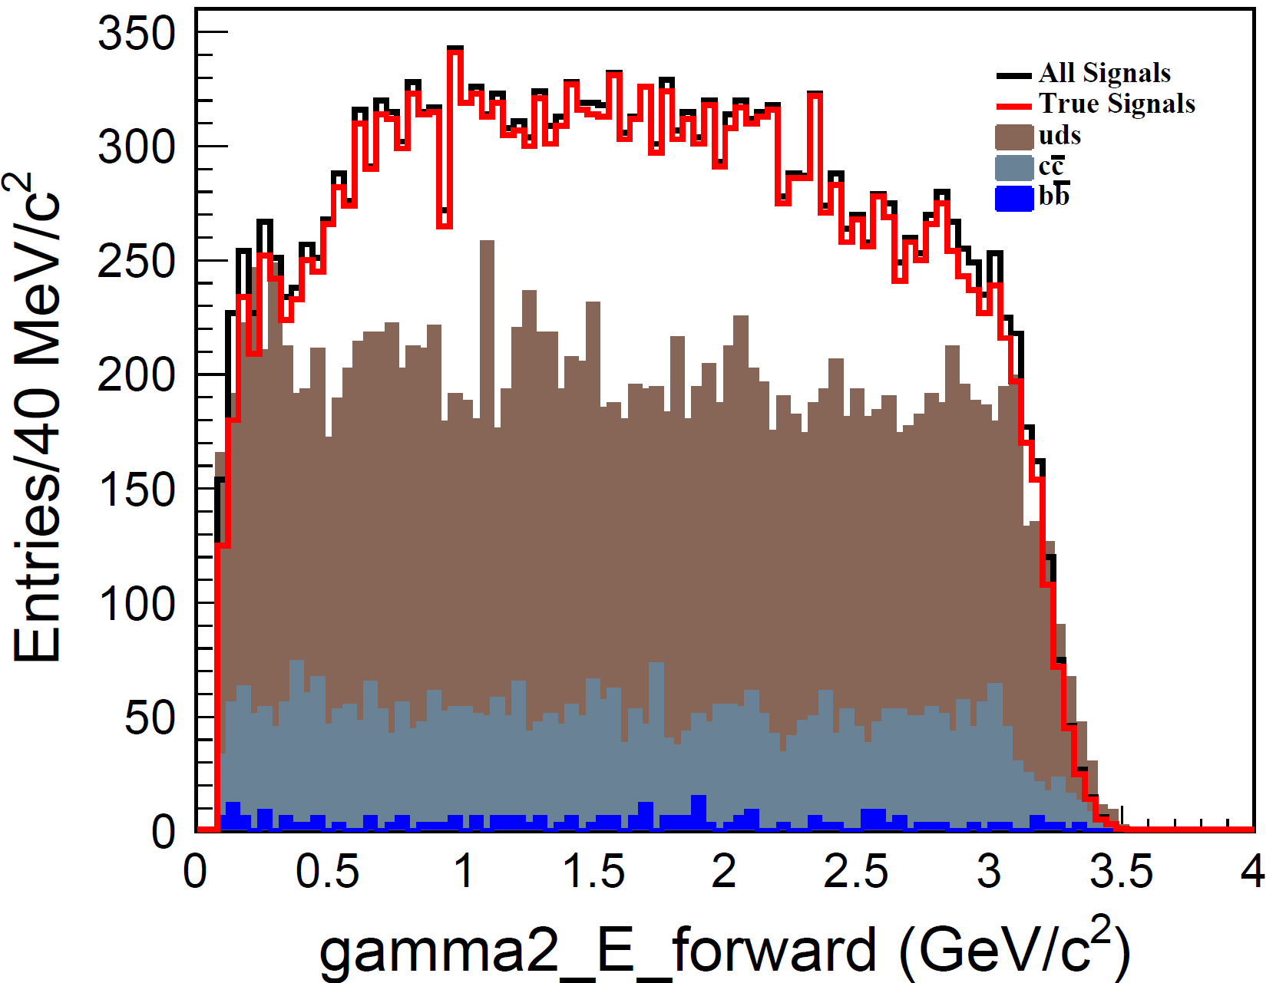
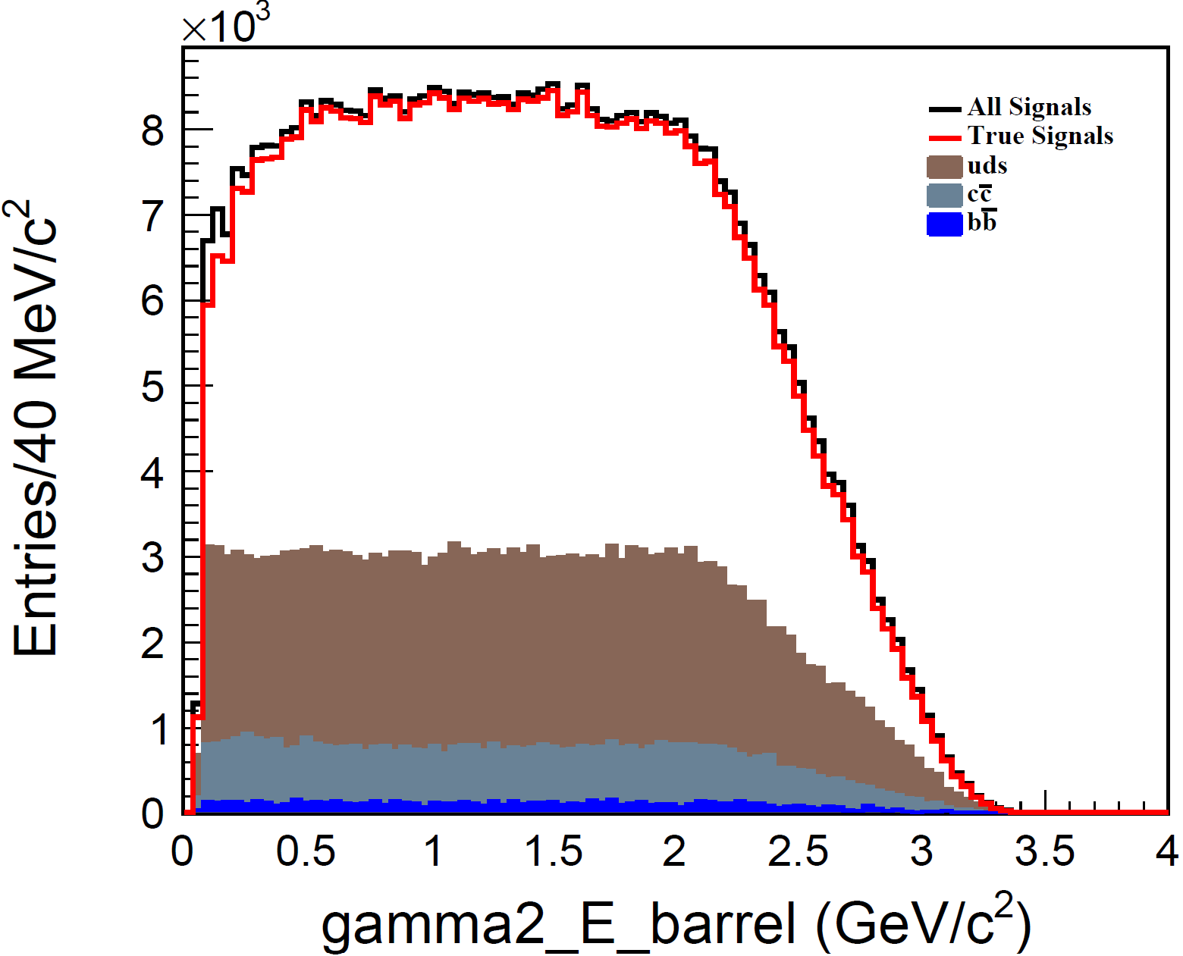
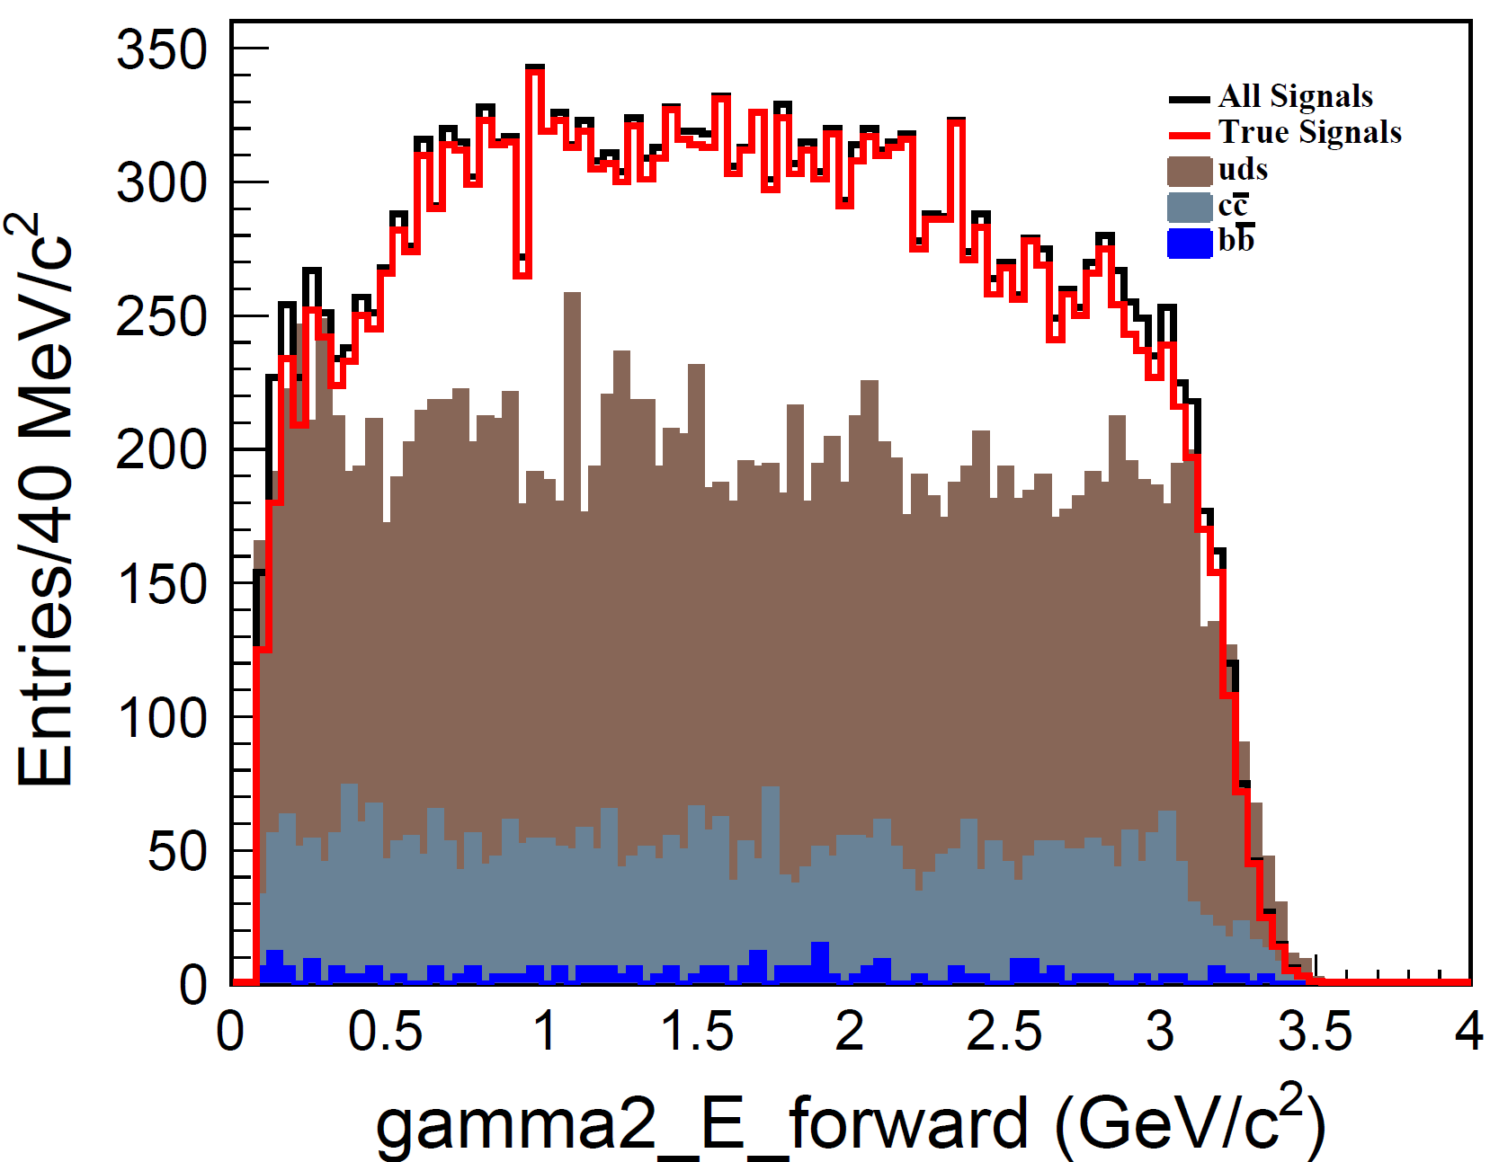
Energy of Gamma candidates
$E_{γ}$(endcap)>223 $MeV/c^{2}$ ${ E}_{γ}$(Barrel)>90 $MeV/c^{2}$

Slide 10
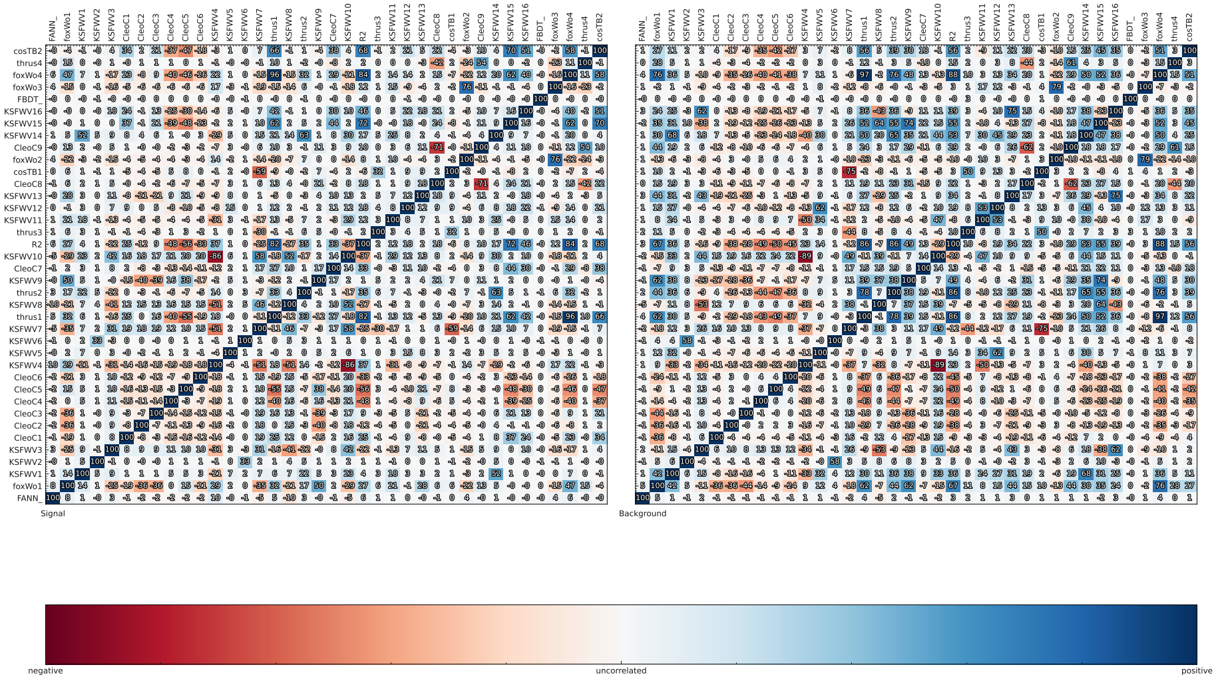
Continuum Suppression

Slide 11
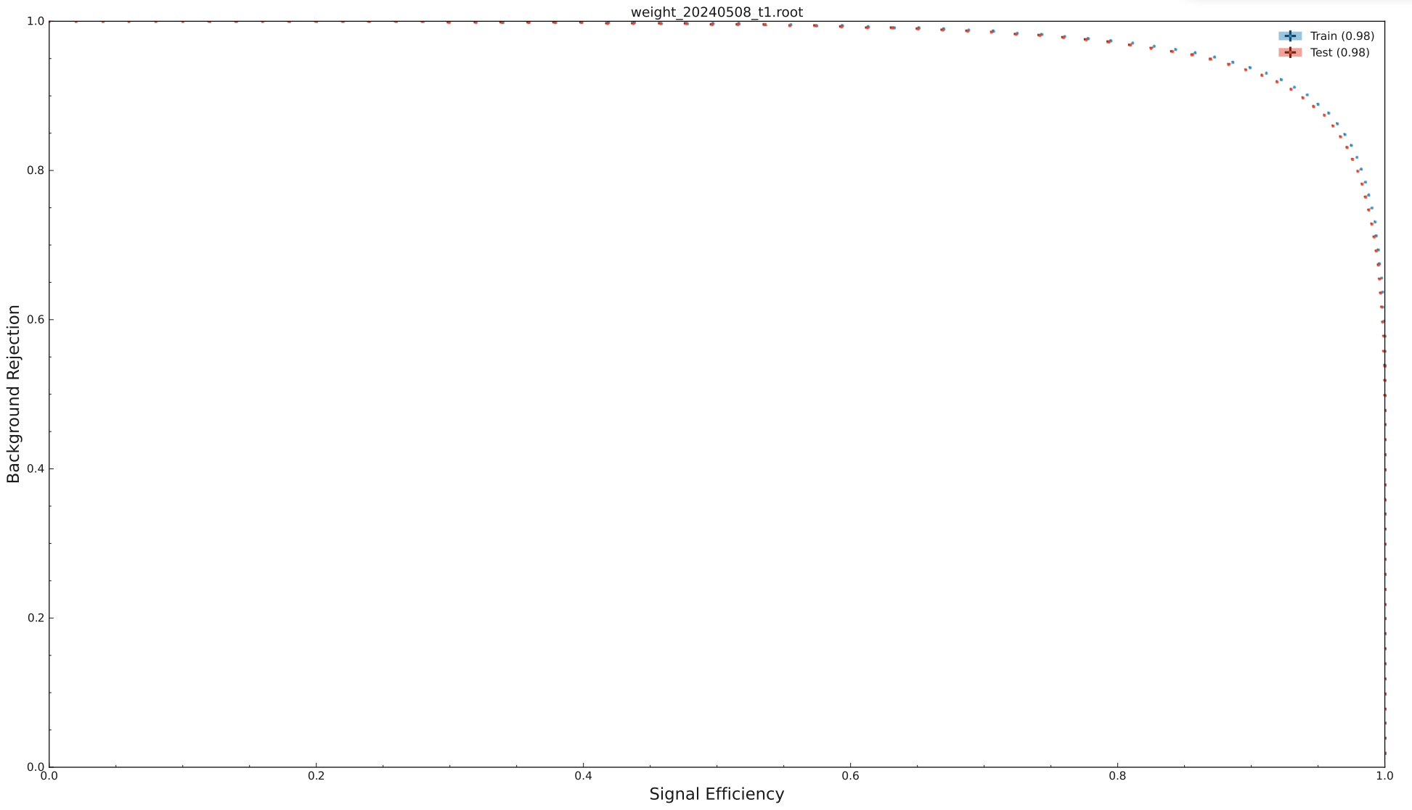
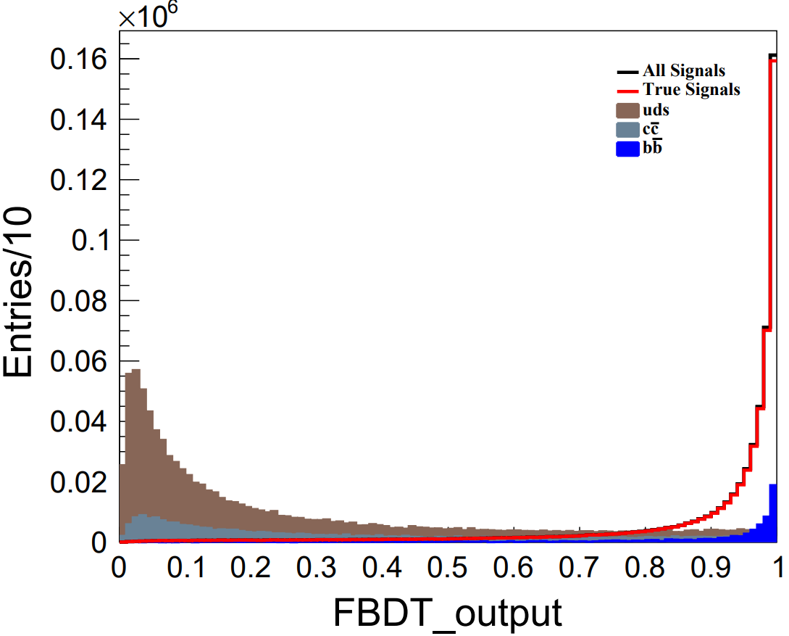
Continuum Suppression
$$FBDT_{output}>0.6$$
78.3% continuum background rejection with 8.8% efficiency loss

Slide 12
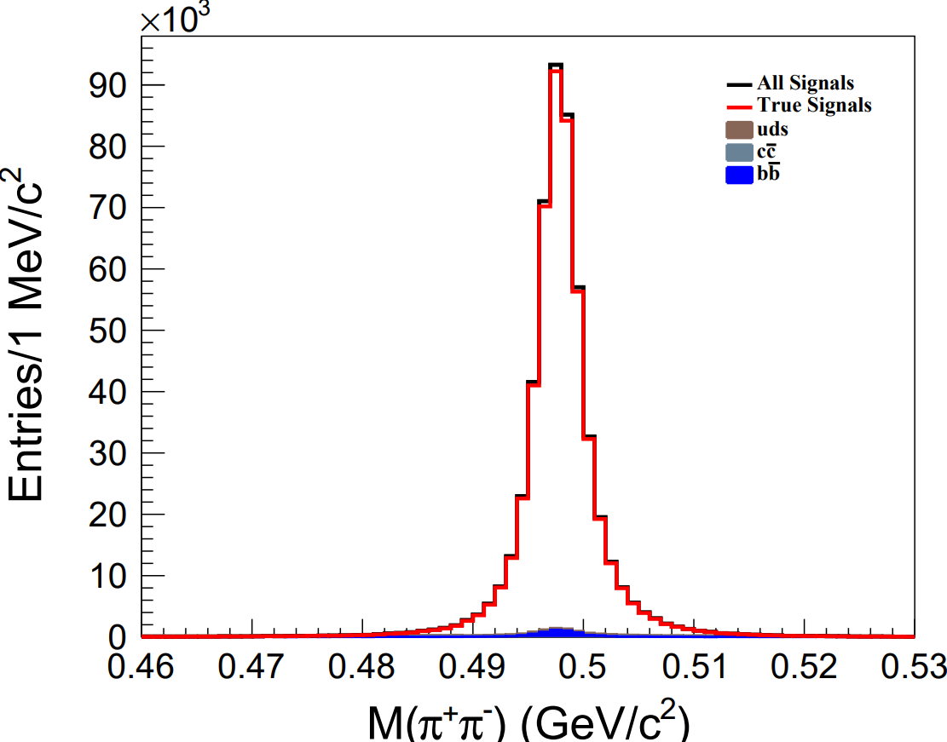
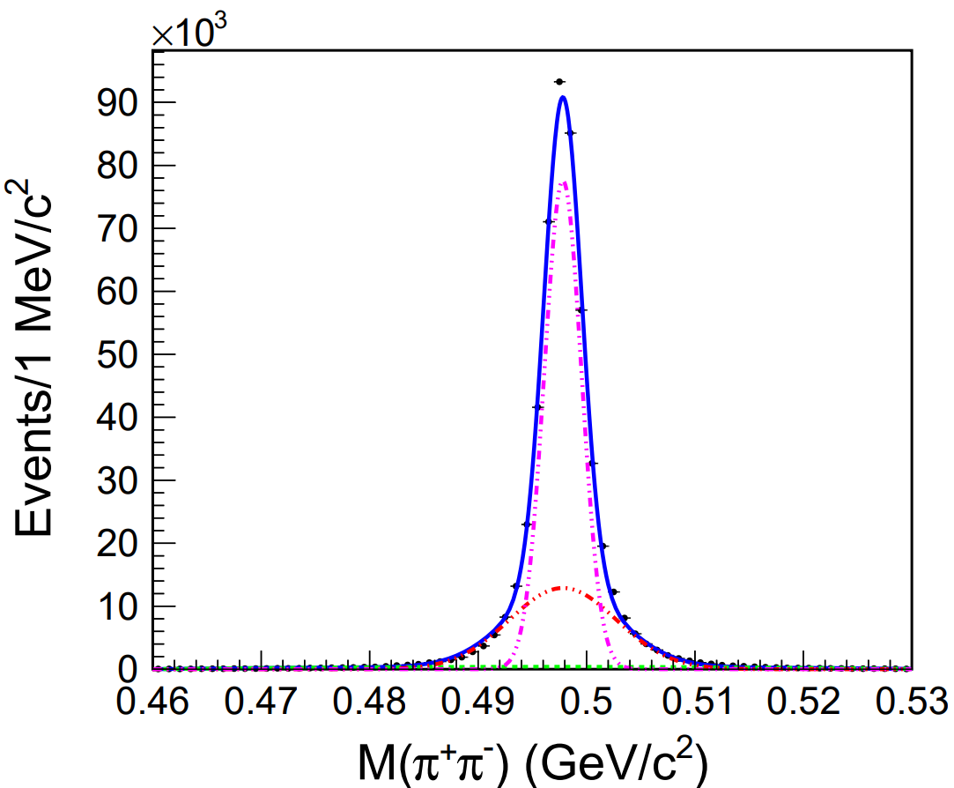
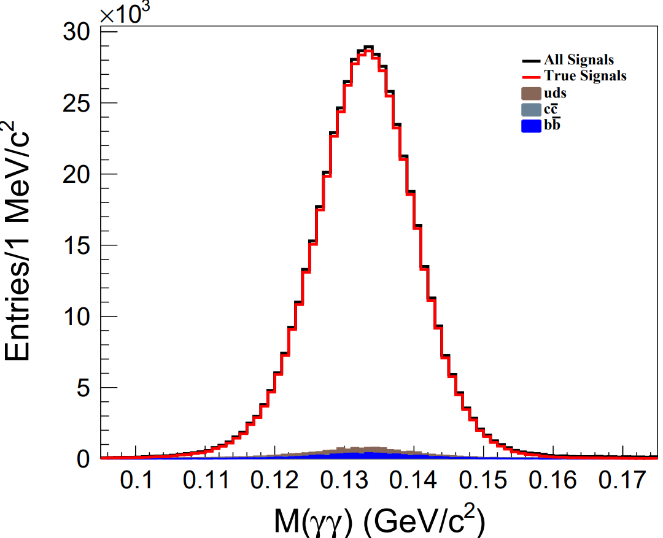
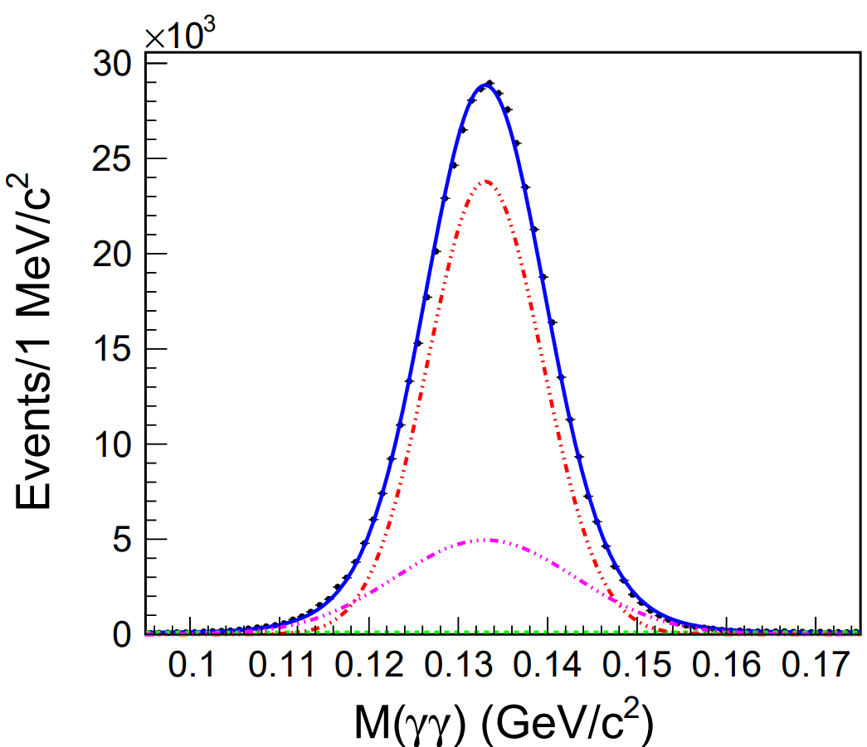
Invariant mass of $K_{s}$ and $π^{0}$
$$Mean = 497.8 MeV/c^{2}$$
$$σ=2. 2MeV/c^{2}$$
$0.482GeV/c^{2}<M\left(π^{+}π^{−}\right)<0.513$ $GeV/c^{2}$
$$Mean = 133.0 MeV/c^{2}$$
$$σ=7.0 MeV/c^{2}$$
$0.119 GeV/c^{2}<M(γγ)<0.151$ $GeV/c^{2}$

Slide 13
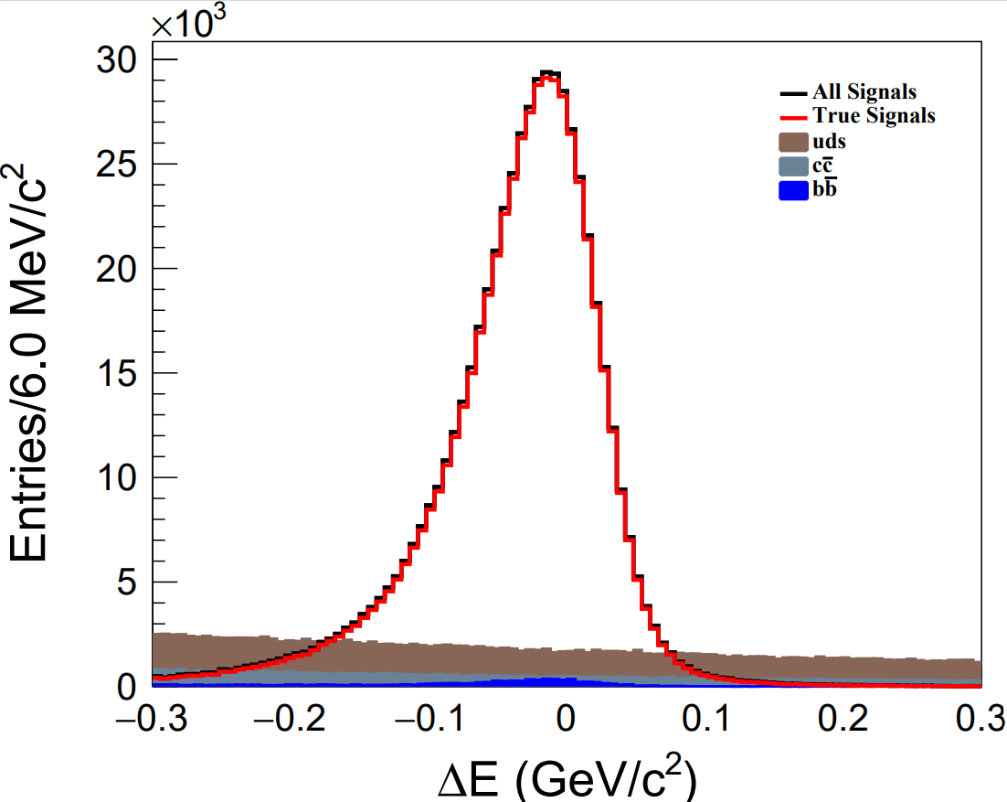
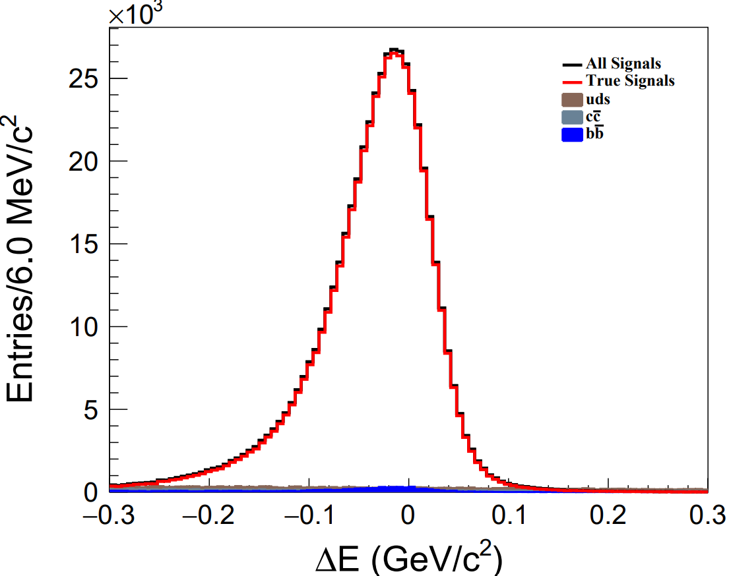
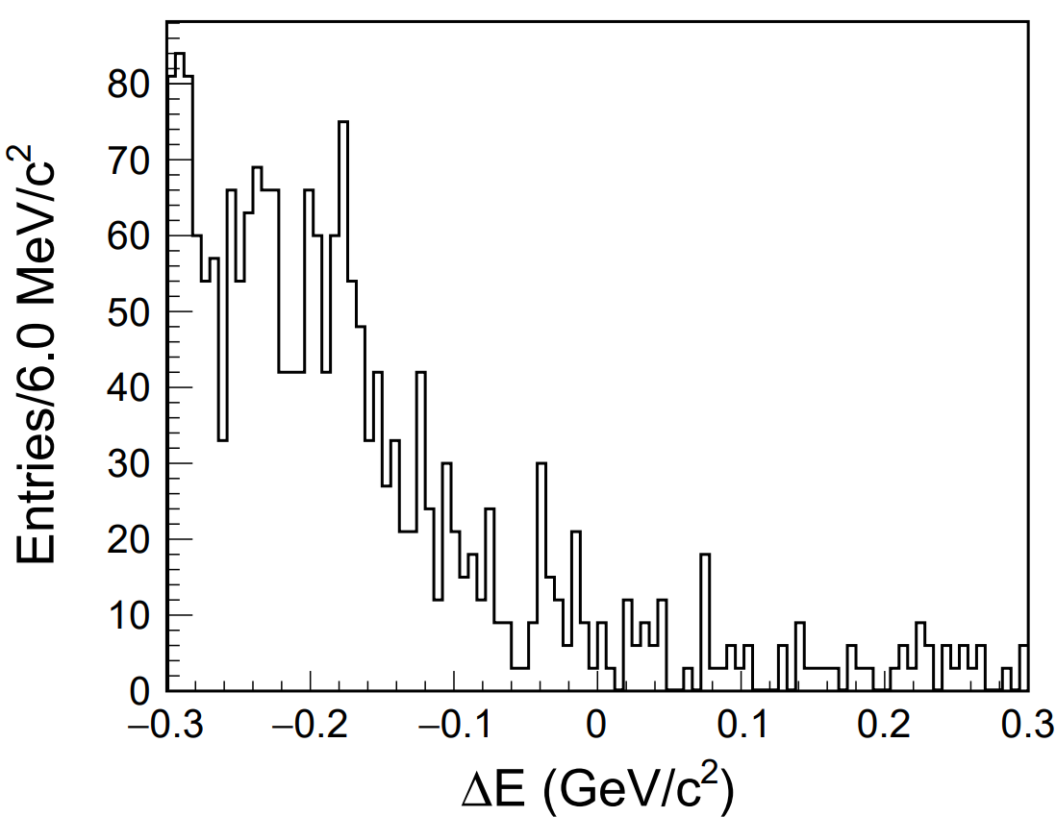
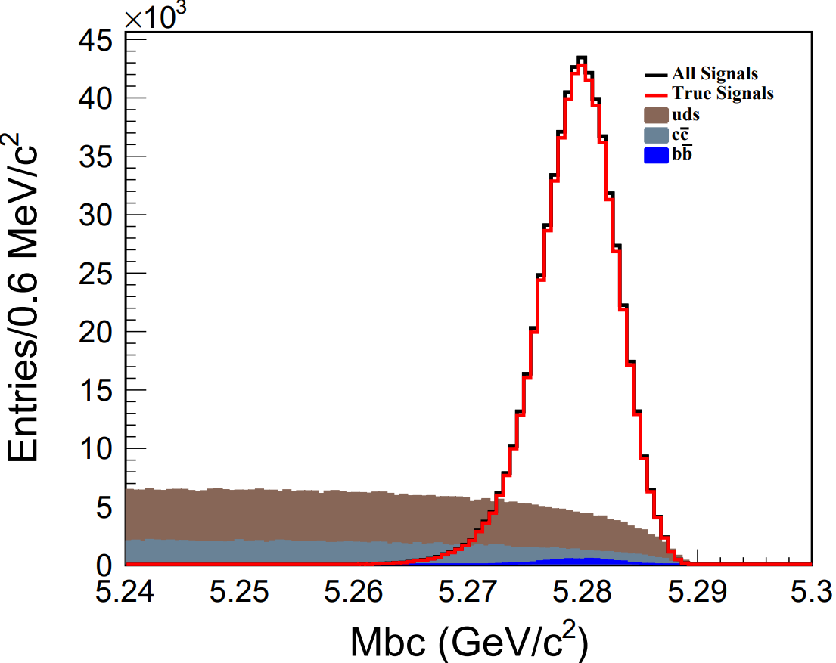
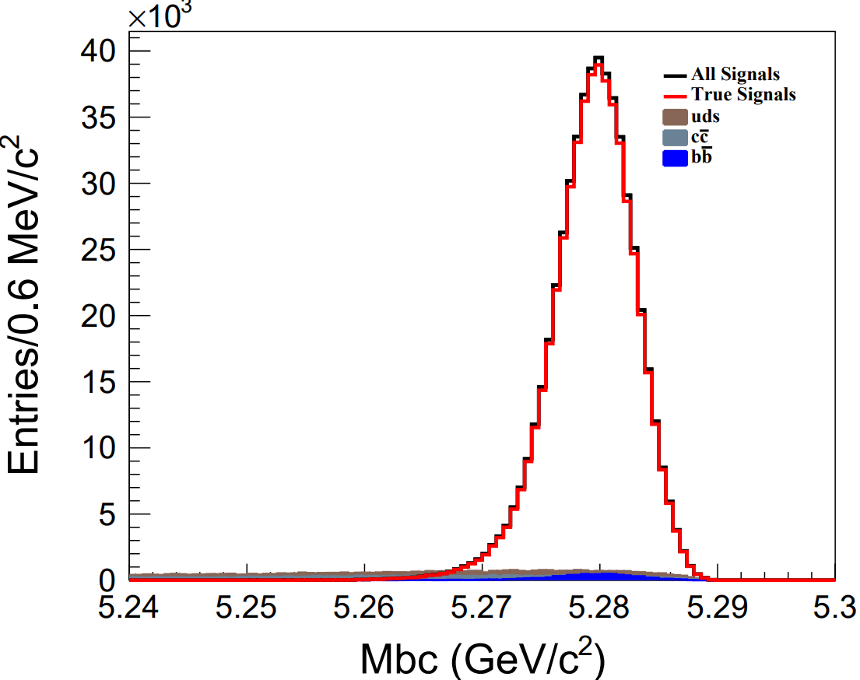
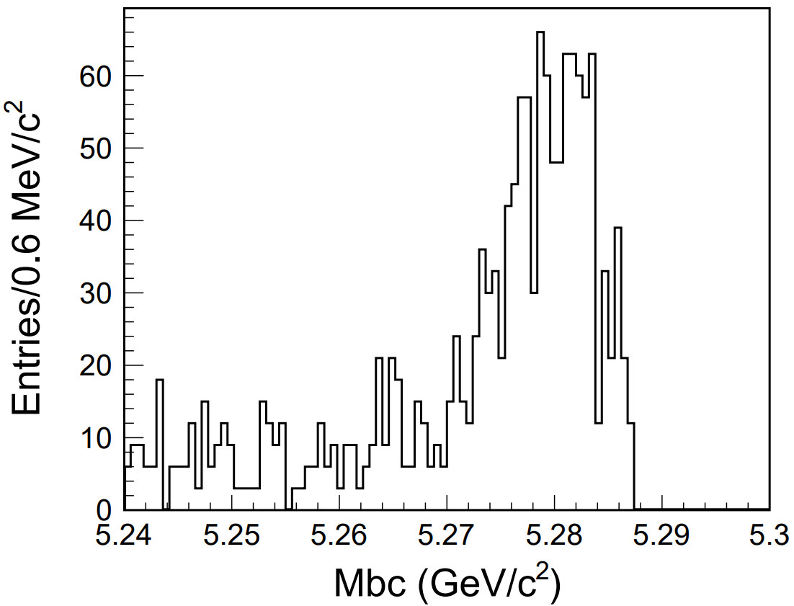
Mbc and $ΔE$
Efficiency = 23.2%, SCF =1.5%
After CS
$$b\overline{b} background$$
After CS
$$b\overline{b} background$$

Slide 14
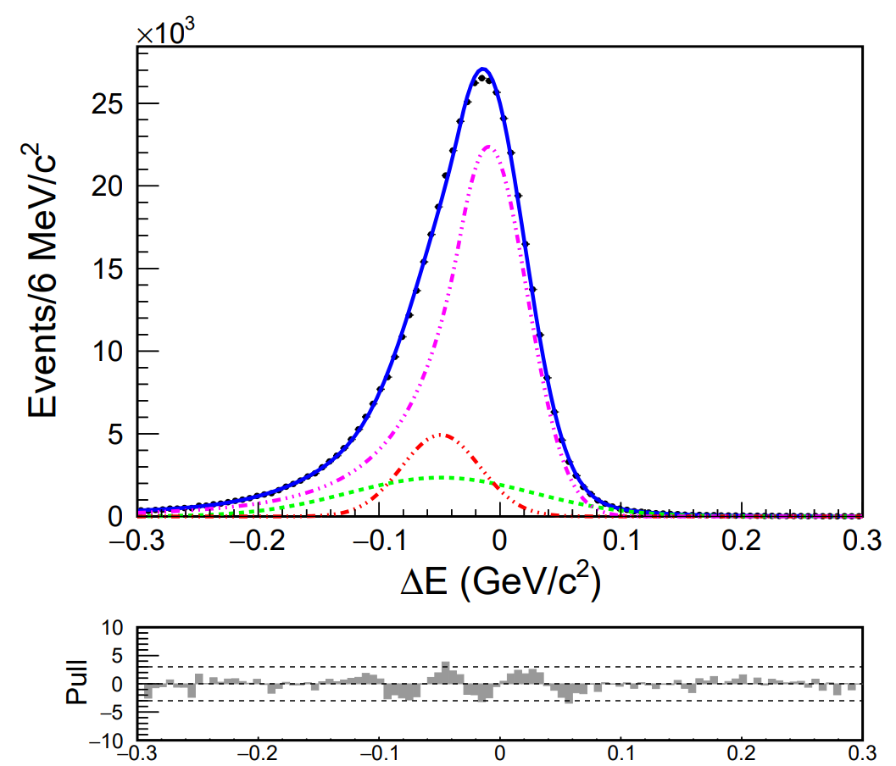
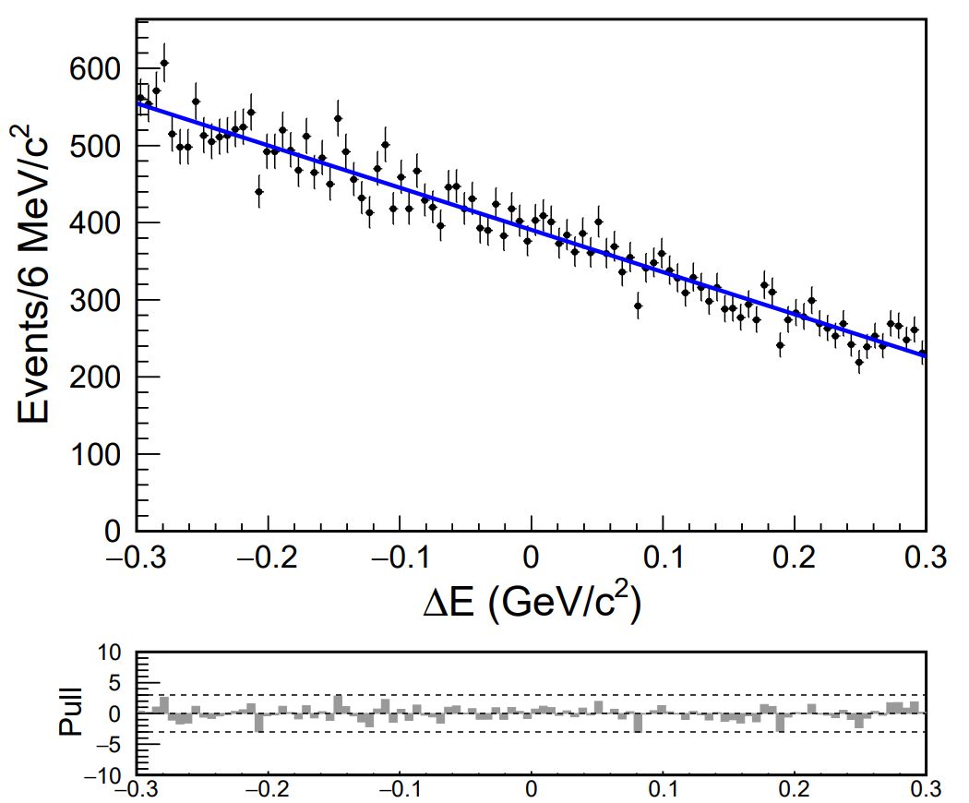
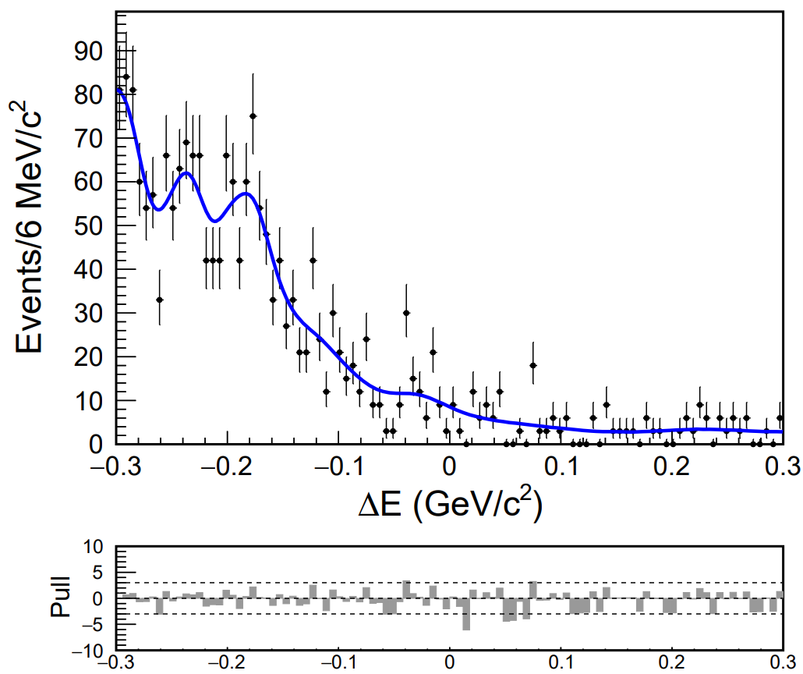
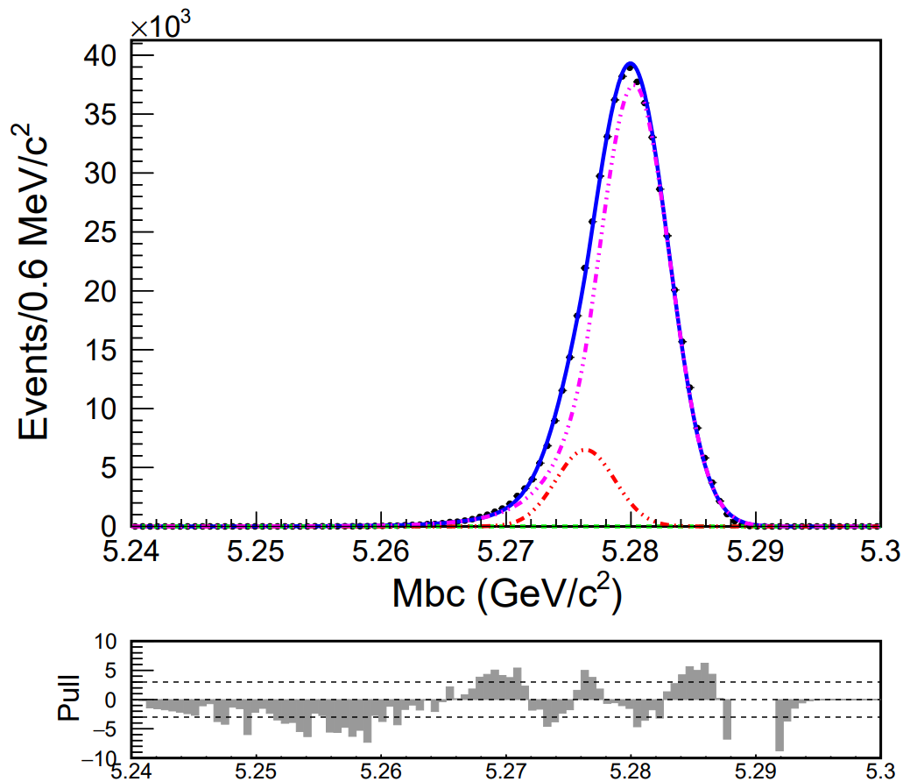
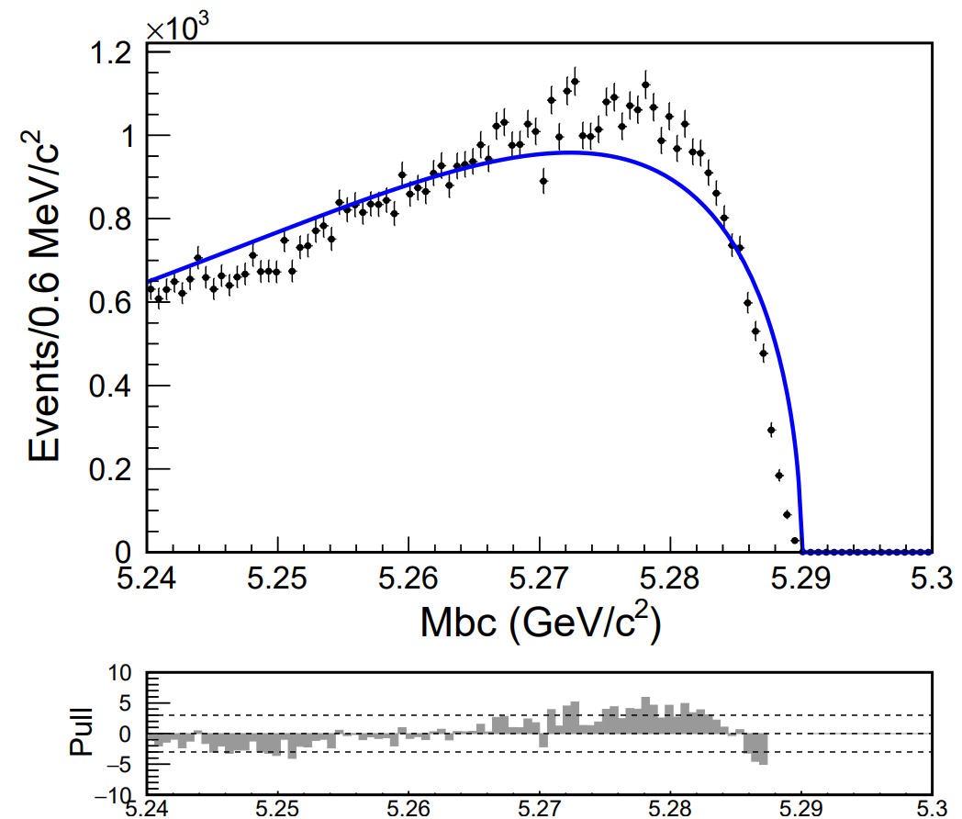
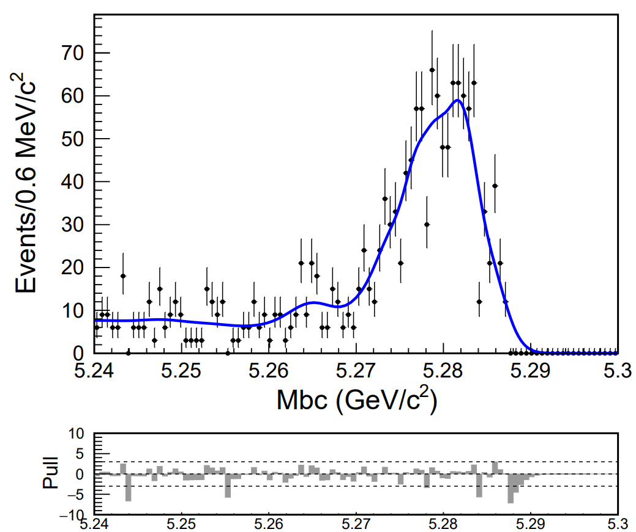
Fit for different components
2 Gaussian + 1 CB
Kernel PDF
1D poly
1 Gaussian + 1 CB
Kernel PDF
argusBG

