Slide 1
Femtotesla science and technology
& Exotic interaction searches
Yuanhong Wang（王元泓）
Univ. of Sci. & Tech. of China (USTC)
CAS Key Laboratory of Microscale Magnetic Resonance
E-mail: blood@mail.ustc.edu.cn

Slide 2
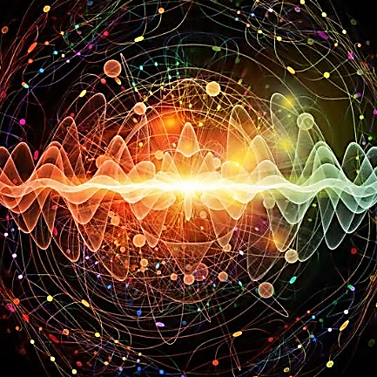
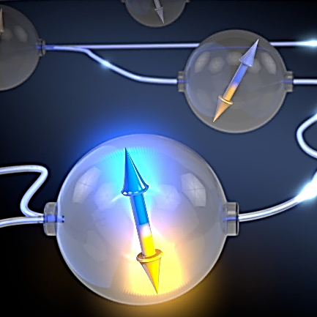

Outline
Precision measurement
Femtotesla technology
Femtotesla science
From classical to quantum sensors
Spin-based quantum sensing:
Hybrid alkali-noble atomic gas
Searches for exotic spin-dependent interactions
2

Slide 3
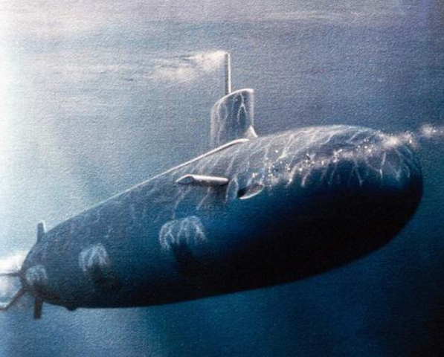
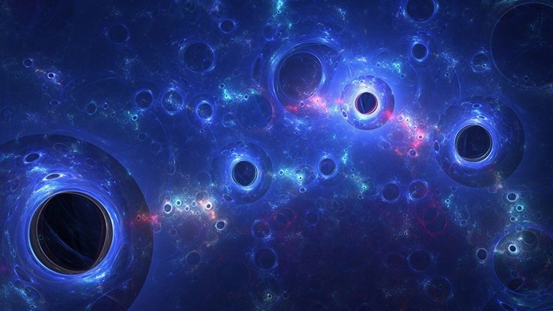
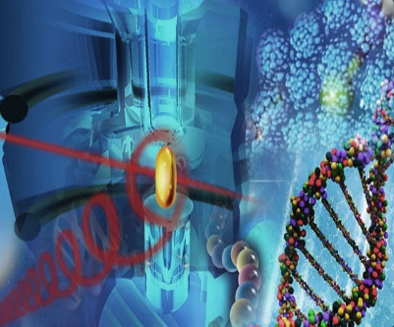
Precision measurement
Each increase in precision by one digit would promote the development of related science and the way of human life
National security
Dark energy/matter
NMR/MRI
Facing the Major Needs of the Country
Facing the Frontiers of World Science and Technology
Facing People's Lives and Health
Notes:
我的研究重点是磁场传感。
它在前沿科学中有着重要的应用。
例如，在世界前沿科学、暗物质、暗能量和磁单极子搜索中。
磁场感应还可用于测量人脑和心脏的磁场，这是一项新开发的技术。
近年来，随着量子技术的飞速发展，磁场灵敏度得到了极大的提升，从经典测量方法到量子方法。
提高基本物理量的测量精度将促进相关科学的发展

Slide 4
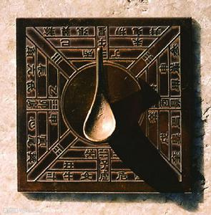
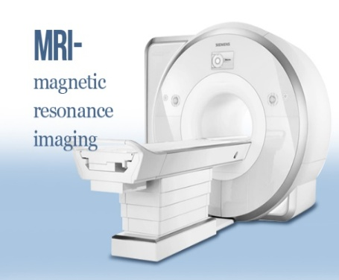
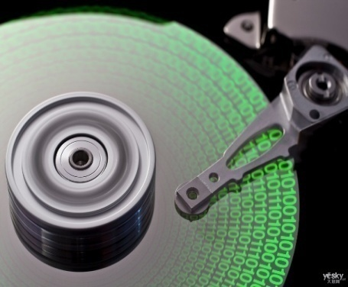
Magnetic field sensing
With rapid developments of magnetic field sensing, it plays important roles in changing the way of the life of human beings
Earth’s magnetic field
Biology’s magnetic field
Material’s magnetic field
Compass:
sailing age
MRI：
medical health
Spintronics：
Information age
10⁻²
10⁻³
10⁻⁴
10⁻⁵
10⁻⁶
10⁻⁷
Notes:
每次测量精度极限的突破，都伴随着新思路、新方法和新技术的涌现，不仅推动了原有学科的发展，还催生出了一批新兴学科，革命性的改变人类认识和改造物质世界的方式和能力，从而成为推动人类文明进步的重要引擎之一。

Slide 5
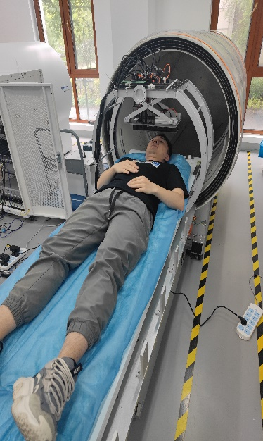

Biology magnetic diagnostics
Quantum magnetometer provides a novel approach for magnetocardiography and magnetoencephalography diagnostics
10 ⁰ T
MRI
10 ⁻³ T
Magnet
10 ⁻⁵ T
Earth
10 ⁻⁹ T
Space
10 ⁻¹¹ T
Heart
Biomagnetism
10 ⁻¹² T
Brain
10 ⁻¹⁵ T
Neuron

Slide 6
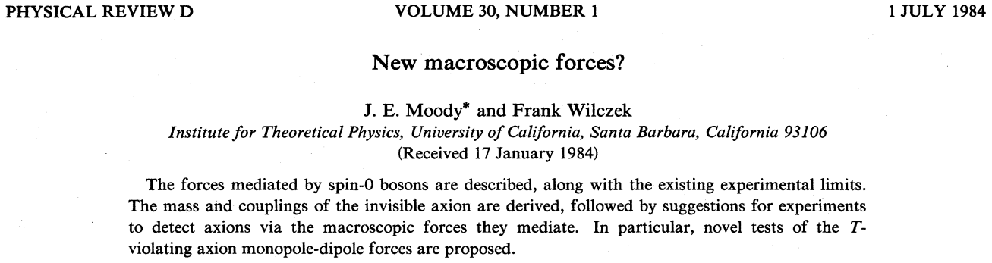
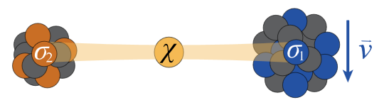
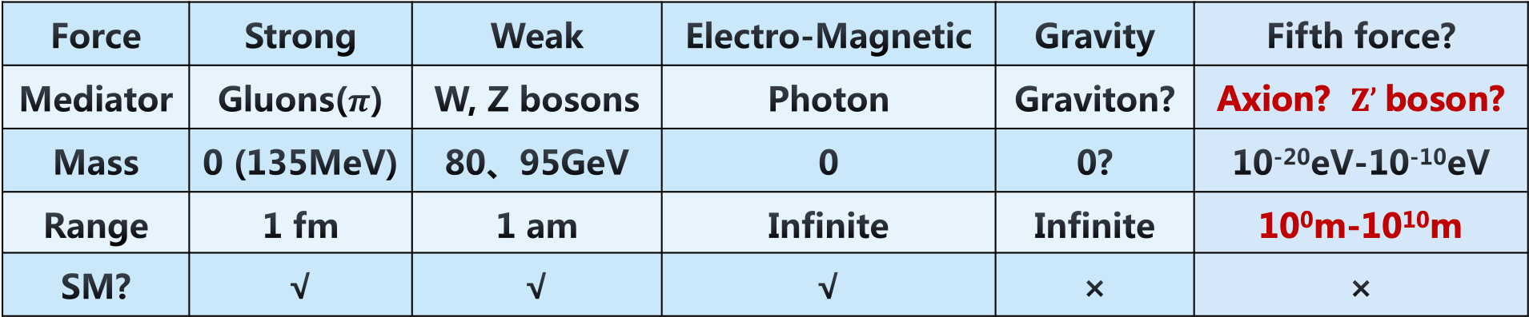
Exotic spin-dependent interactions
Spin-dependent interaction
Exchange
New boson
Force | Strong | Weak | Electro-Magnetic | Gravity | Fifth force?
Mediator | Gluons($π$) | W, Z bosons | Photon | Graviton? | Axion? $Z’$boson?
Mass | 0 (135MeV) | 80、95GeV | 0 | 0? | 10⁻²⁰eV-10⁻¹⁰eV
Range | 1 fm | 1 am | Infinite | Infinite | 10⁰m-10¹⁰m
SM? | √ | √ | √ | × | ×
6

Slide 7
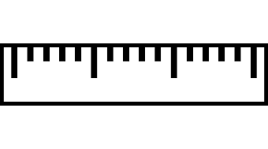
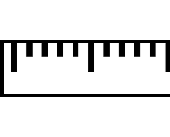
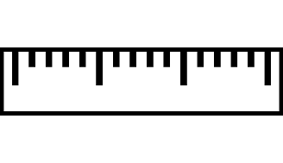
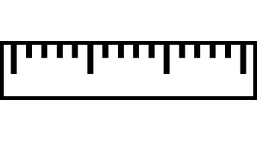
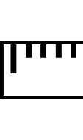
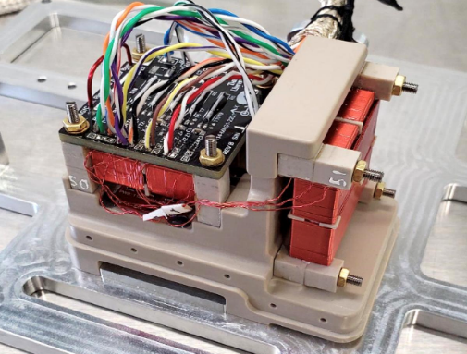
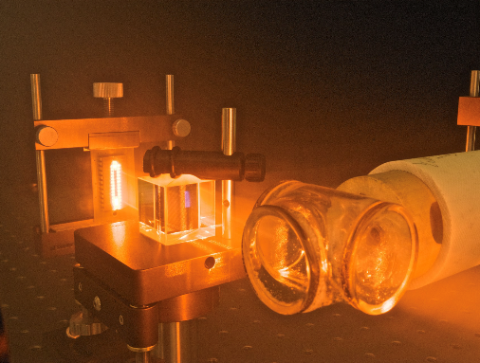
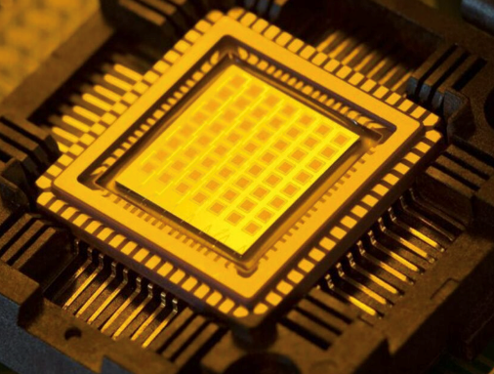
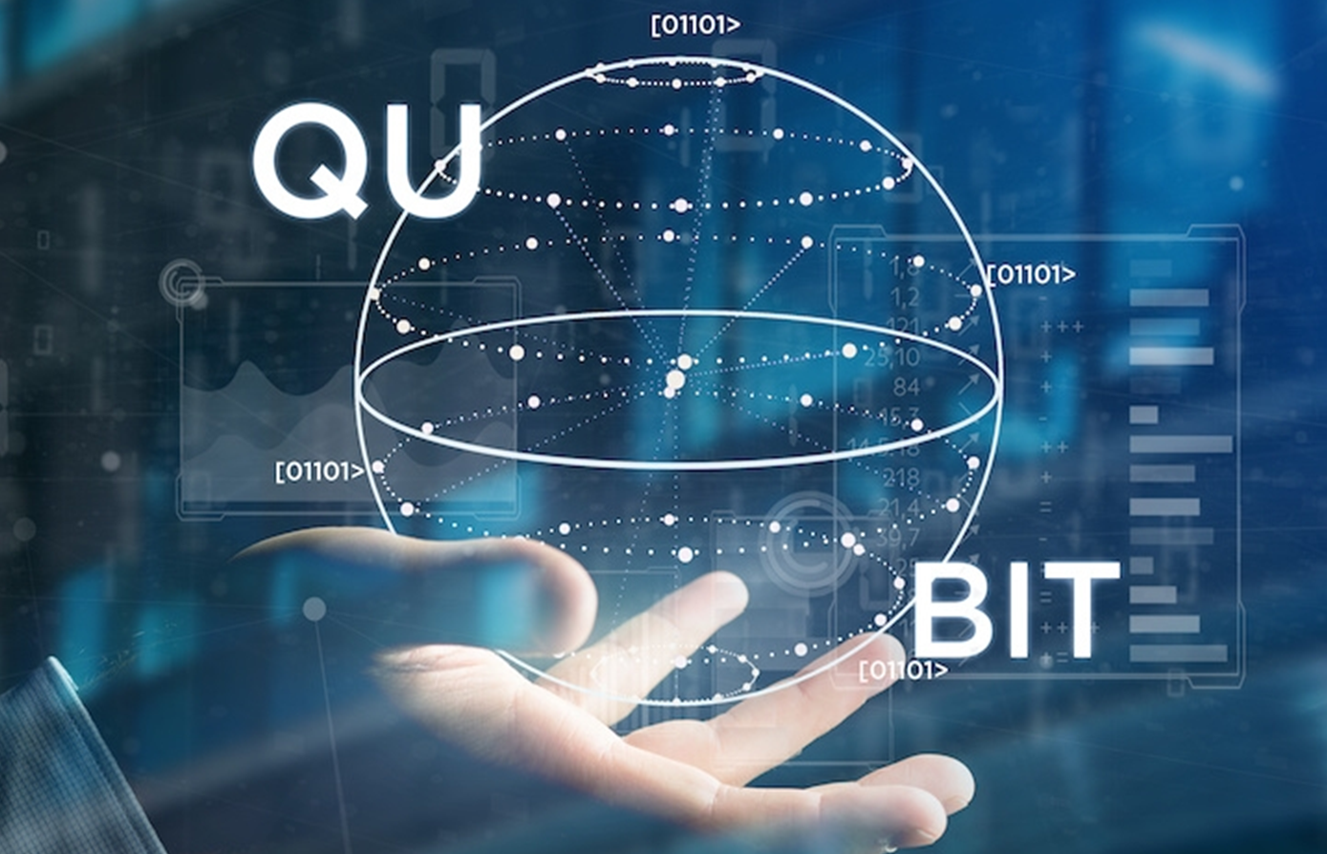
Tools for magnetic field sensing
Electron charge and spin can be used as magnetic-sensitive sensor, in particular, spin-based sensors step into su-fT regime
nT
pT
fT
aT
Fluxgate magnetometer
SQUID devices
Atomic vapor or NV centers
Electron charge:
classical electromagnetic
Room temperature
Electron charge:
Quantum tunneling
Low temperature
Electron spin+Photon:
Quantum mechanics
(Near) Room temperature
Notes:
经典电磁学：
高斯计，磁通门，感应线圈
SQUID，TMS
proton
原子光泵
NV center
压缩态

Slide 8
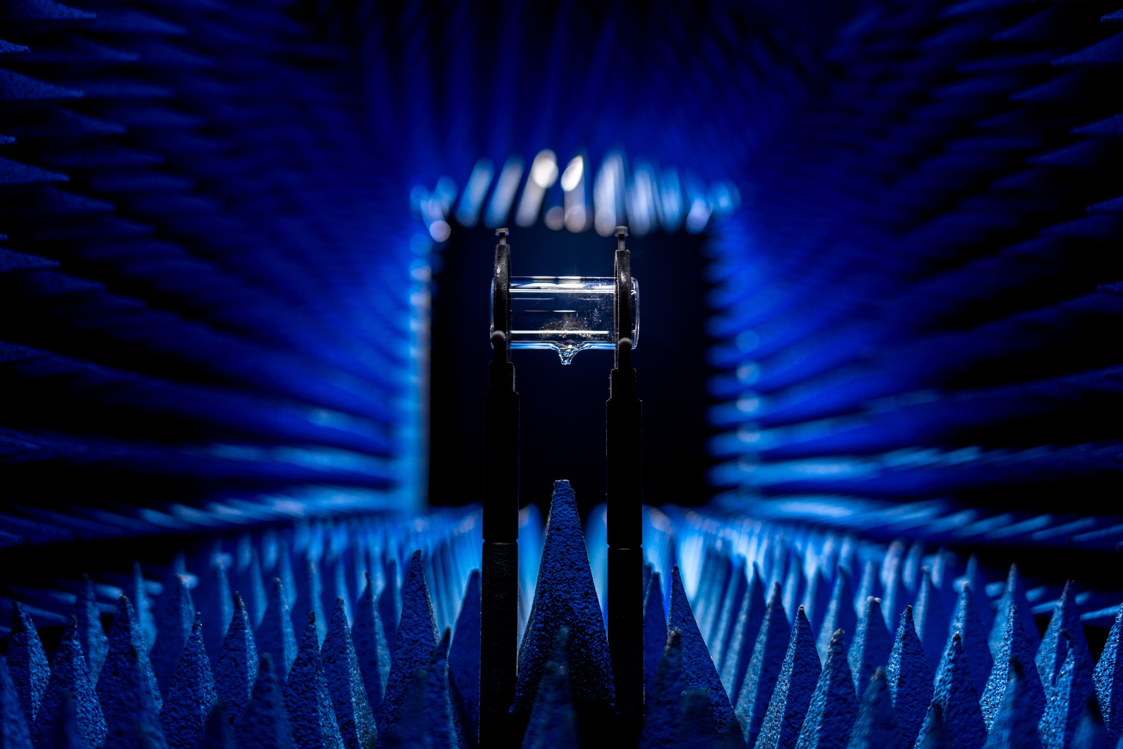
Alkali metal (K, Rb, Cs)
Adv.: Large magnetic moment,
well-developed laser technology
Disadv.: Low density (10¹⁴cm⁻³),
short coherence time (~10ms)

Slide 9
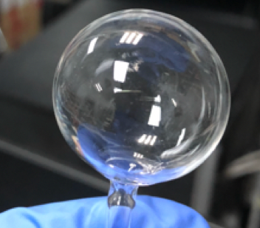
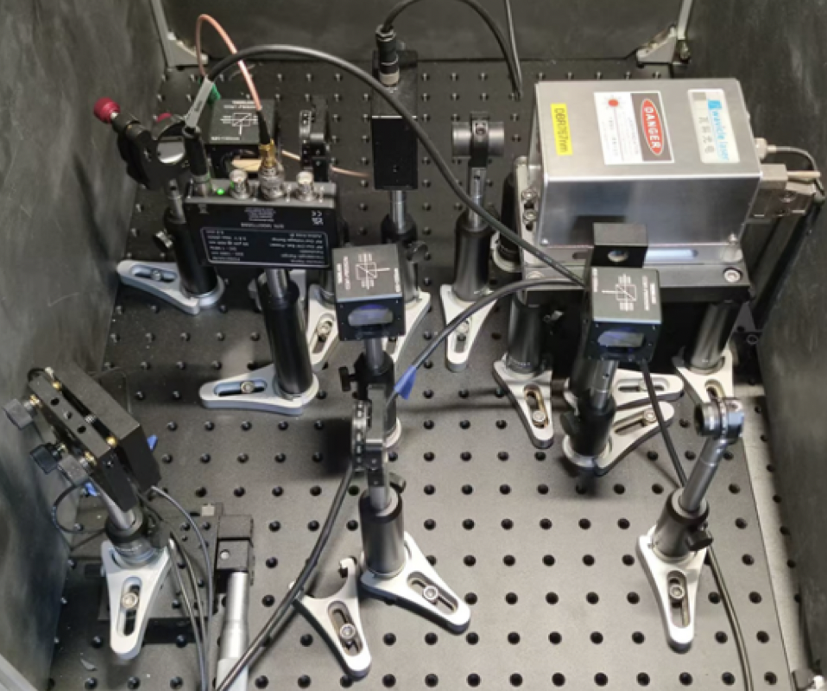
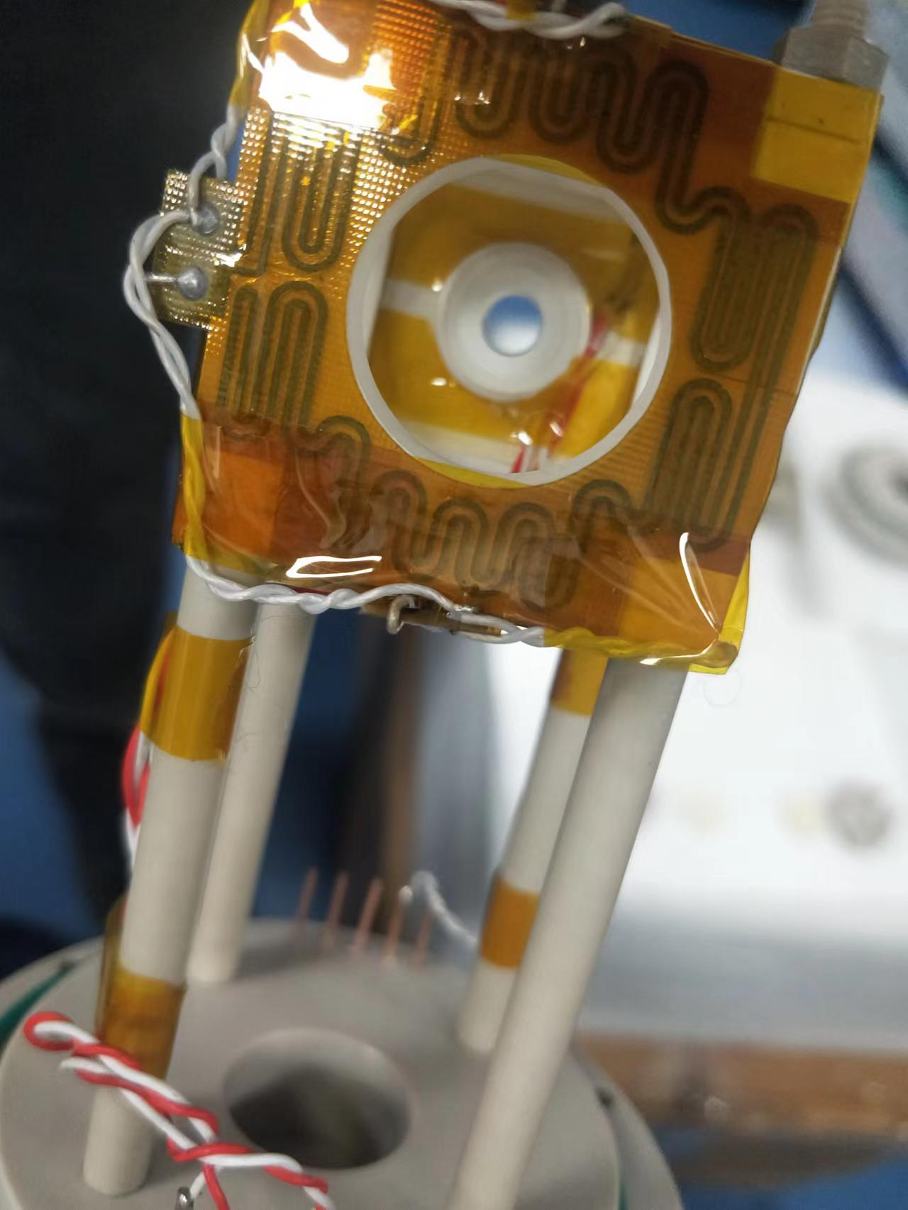
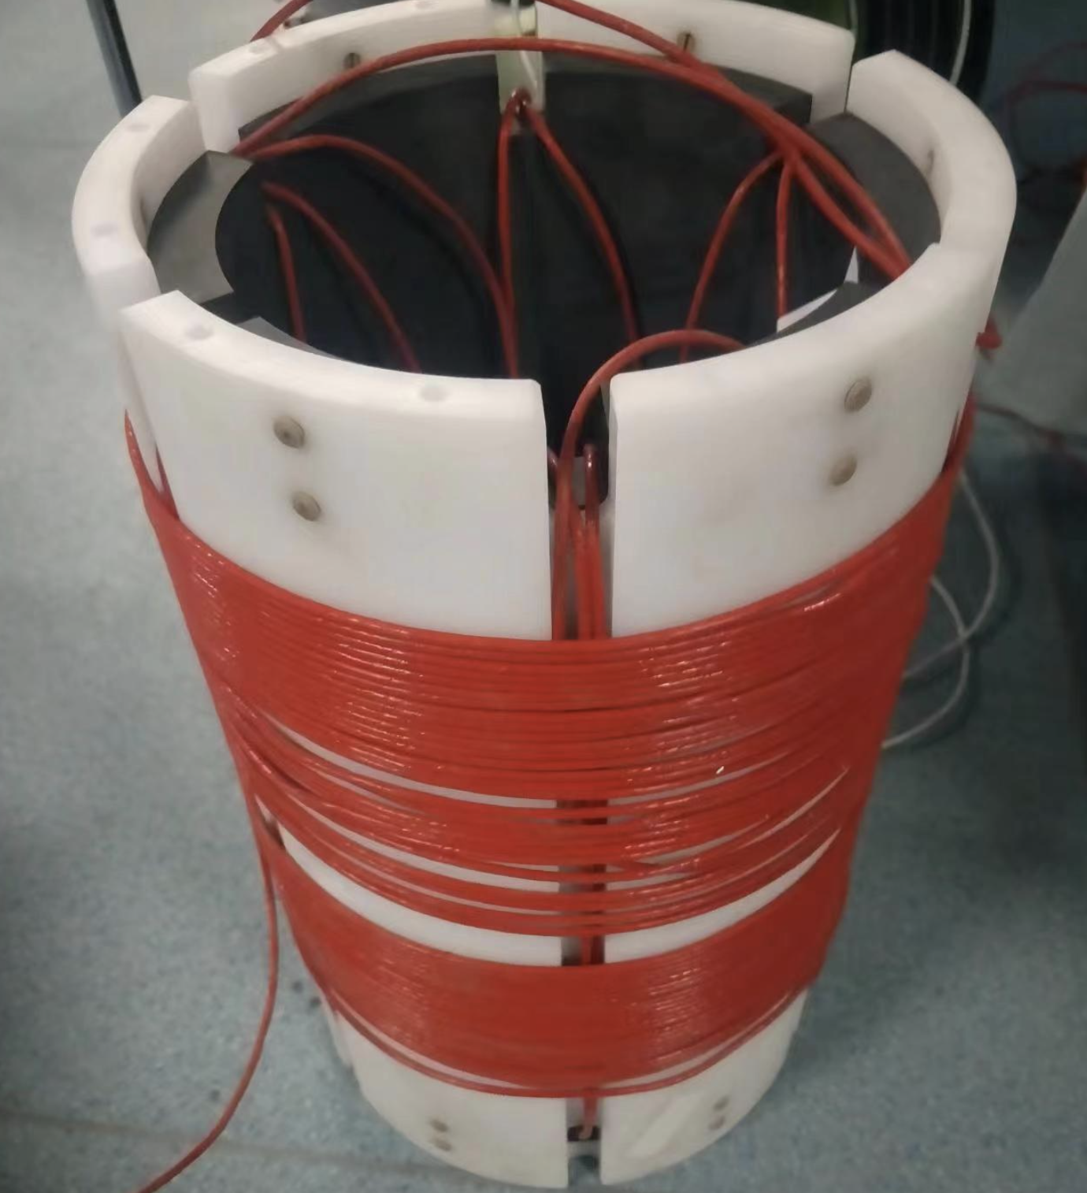
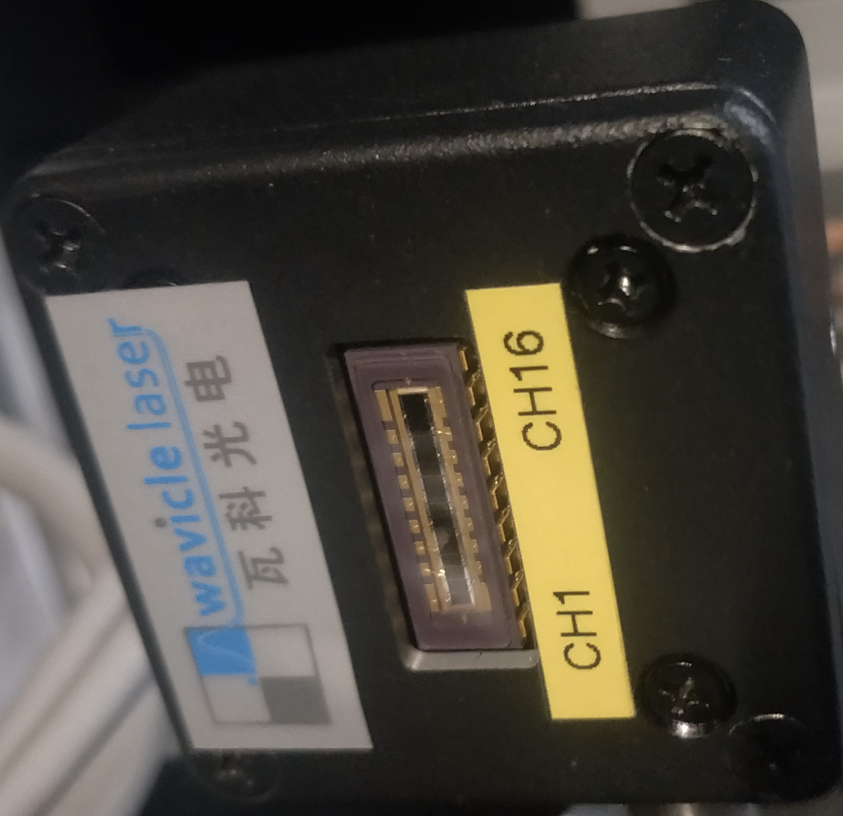
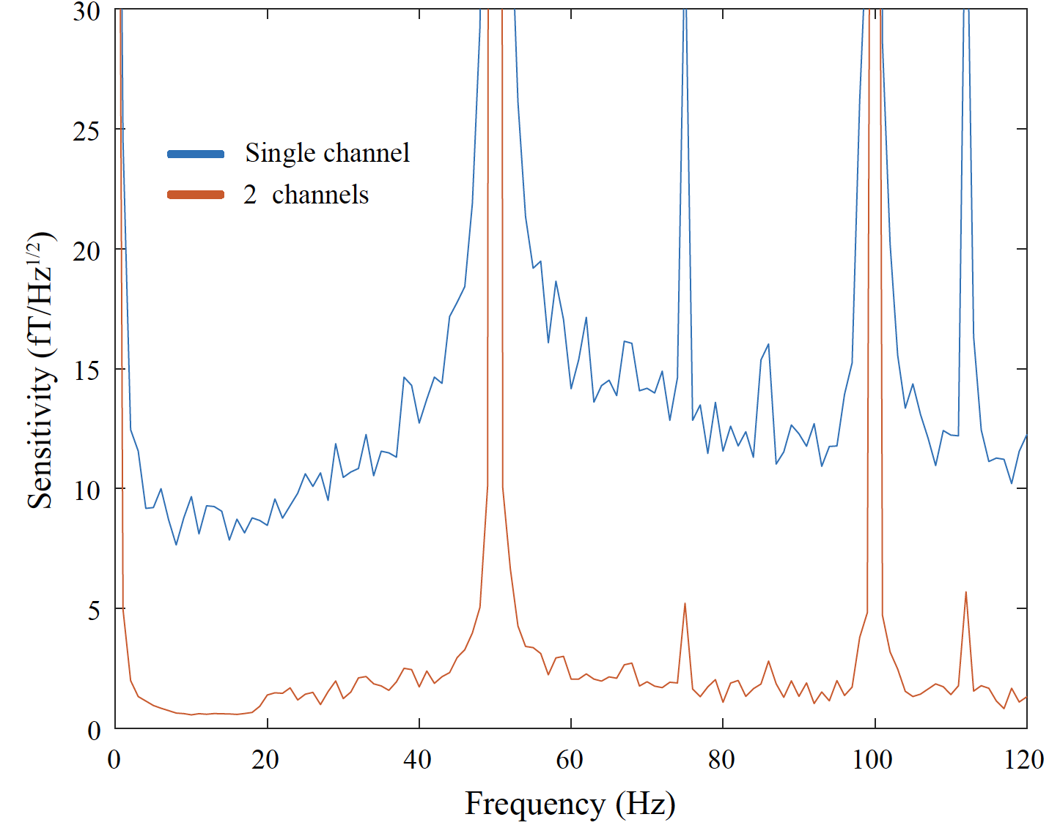
Alkali-metal magnetometers in USTC
Sub-femtotesla sensitivity has been realized via improving signal response and reducing technical noise
Improving signal response
Reducing technical noise
Atomic vapor
Optical system
Low-noise oven
Magnetic shields
Multichannel
Sensitivity (fT/Hz^{1/2})
0.5fT/Hz^{1/2}
Frequency (Hz)

Slide 10
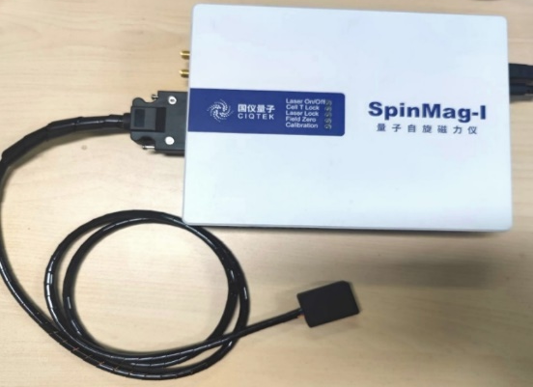
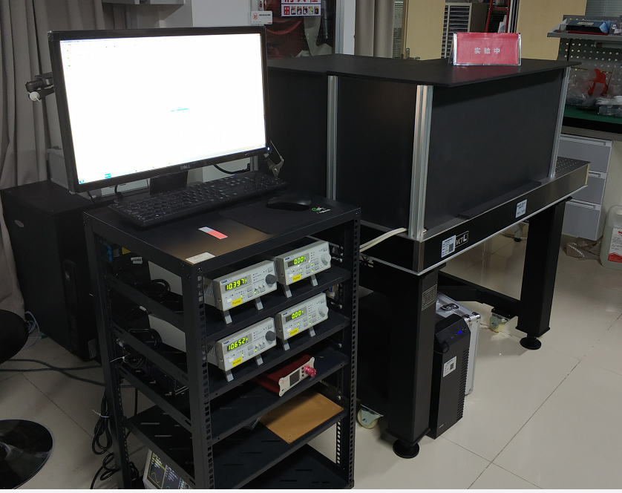
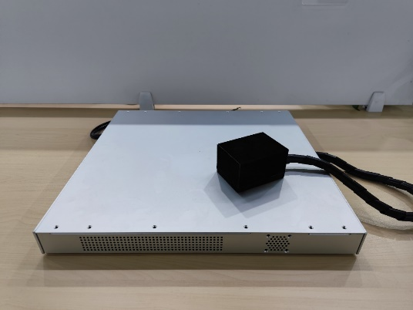
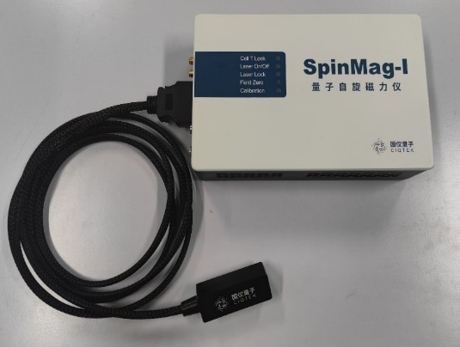
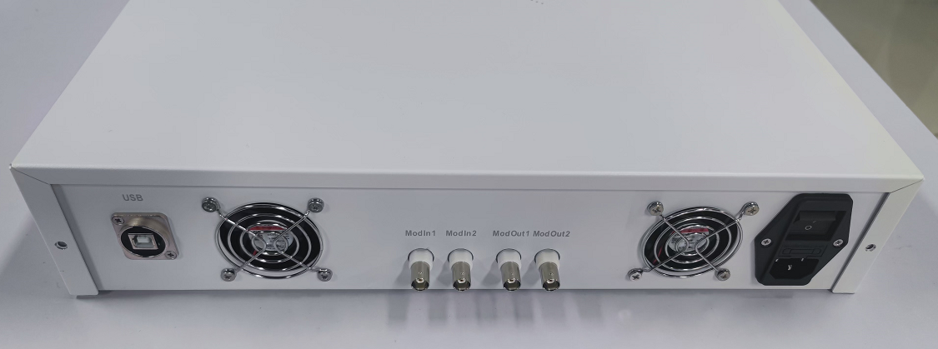
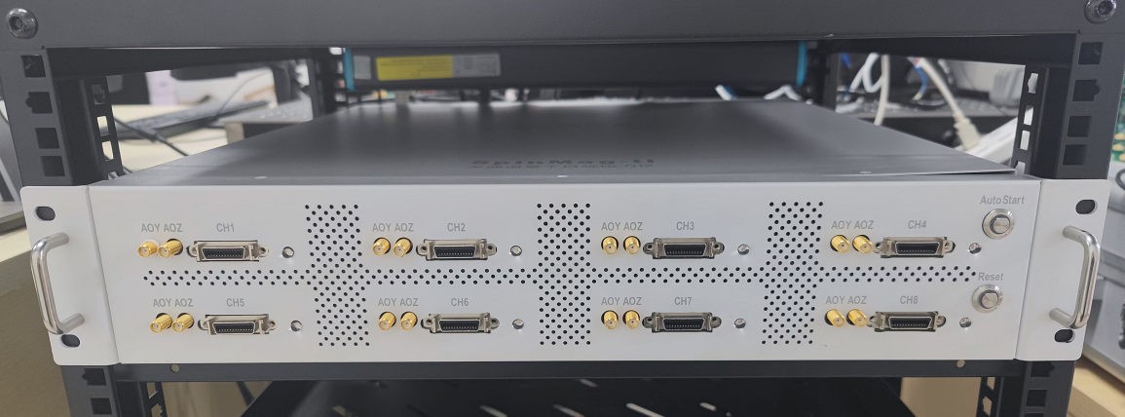
Miniaturized atomic magnetometers
Develop multiple generations of miniaturized atomic magnetometers collaborating with Guoyi quantum (国仪量子)
proof of concept
Miniaturize
V1.0
Multi
channel
Miniaturize
V2.0
Miniaturize
V3.0
2020.04
2021.09
2022.05
2023.01
2023.12
Setup：1.2×0.8×0.9 m³
Sensor： 9.5×7.0×5.5 cm³
Driver： 45×43×4.5 cm³
Sensor： 3.3×2.4×1.2 cm³
Driver： 20×15×4.5 cm³
Sensor： 5×2×2 cm³
Driver： 18×11.5×4.2 cm³
Sensor： 5×2×2 cm³
Driver： standard 2U chassis
Notes:
王

Slide 11
Alkali metal (K, Rb, Cs)
Adv.: Large magnetic moment,
well-developed laser technology
Disadv.: Low density (10¹⁴cm⁻³),
short coherence time (~10ms)
Noble gas（³He, ¹²⁹Xe）
Disadv.：small magnetic moment、lacking suitable optical transition
Adv.：High density（10¹⁹cm⁻³）、
long coherence (hours)

Slide 12
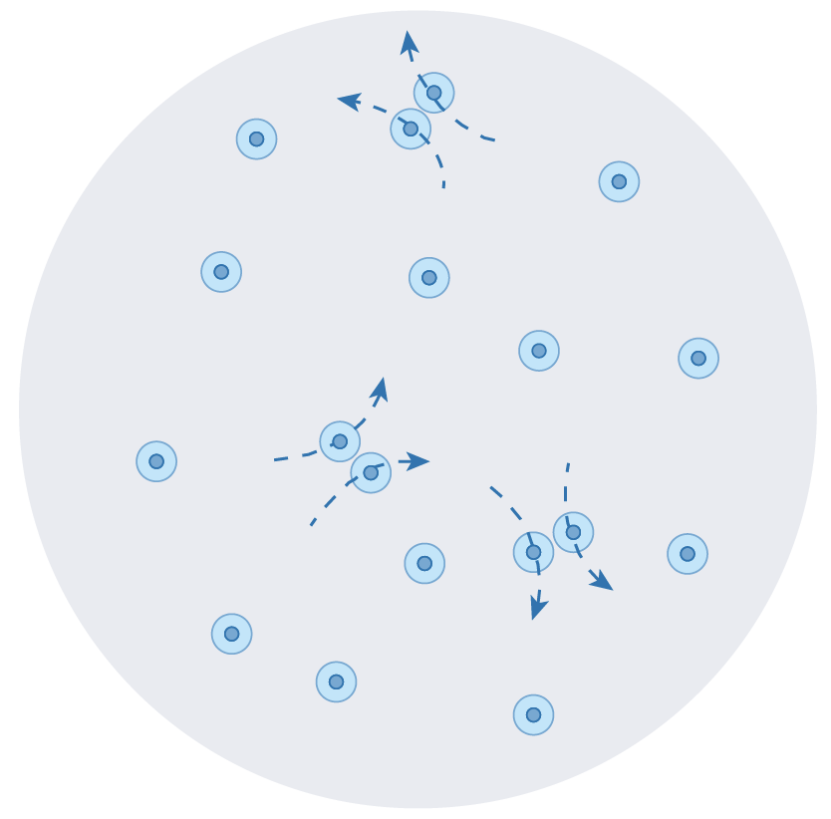
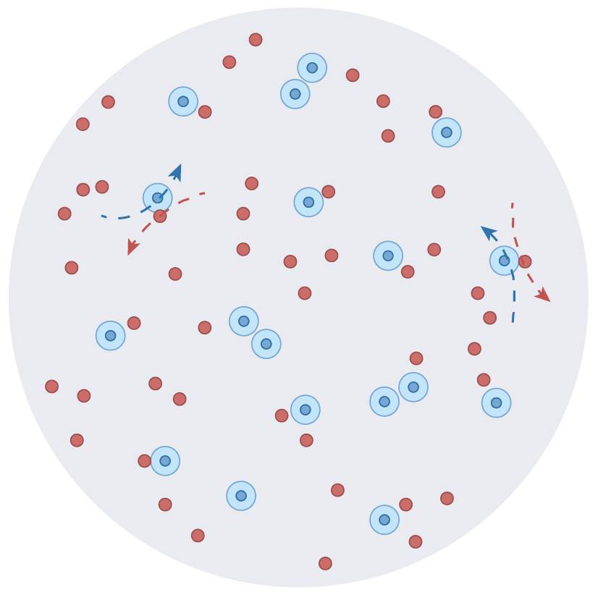
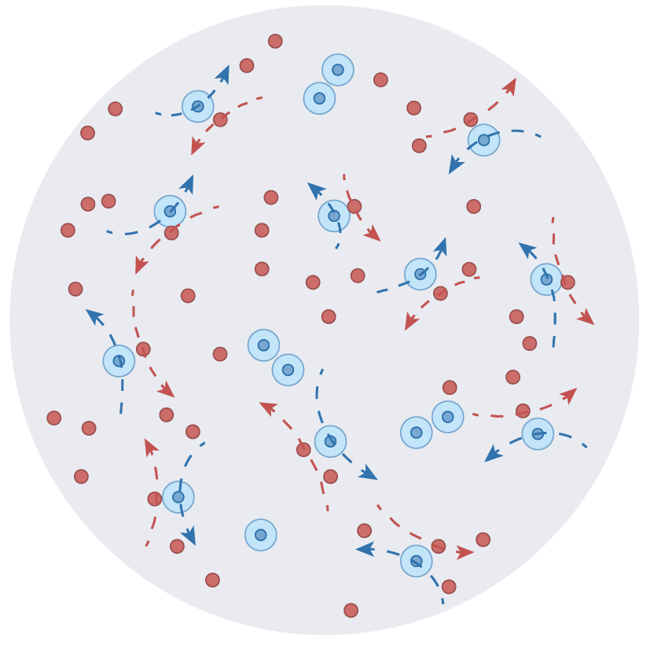
New approach: Interacting atomic gas
Multiple spins overlap in one vapor cell and interact with each other,
and consequently introduce richful “quantum resource” for sensing
Noble
gas
Entanglement
Alkali-metal
spin gas
Correlated alkali-noble gas
Entangled spin gases
NMOR effect
SERF effect
Nuclear spin amplification
Fano resonance effect
Nuclear spin squeezing
Memory-based sensing
Notes:
多个自旋在一个蒸汽池中重叠并相互作用， 从而为传感引入了丰富的“量子资源

Slide 13
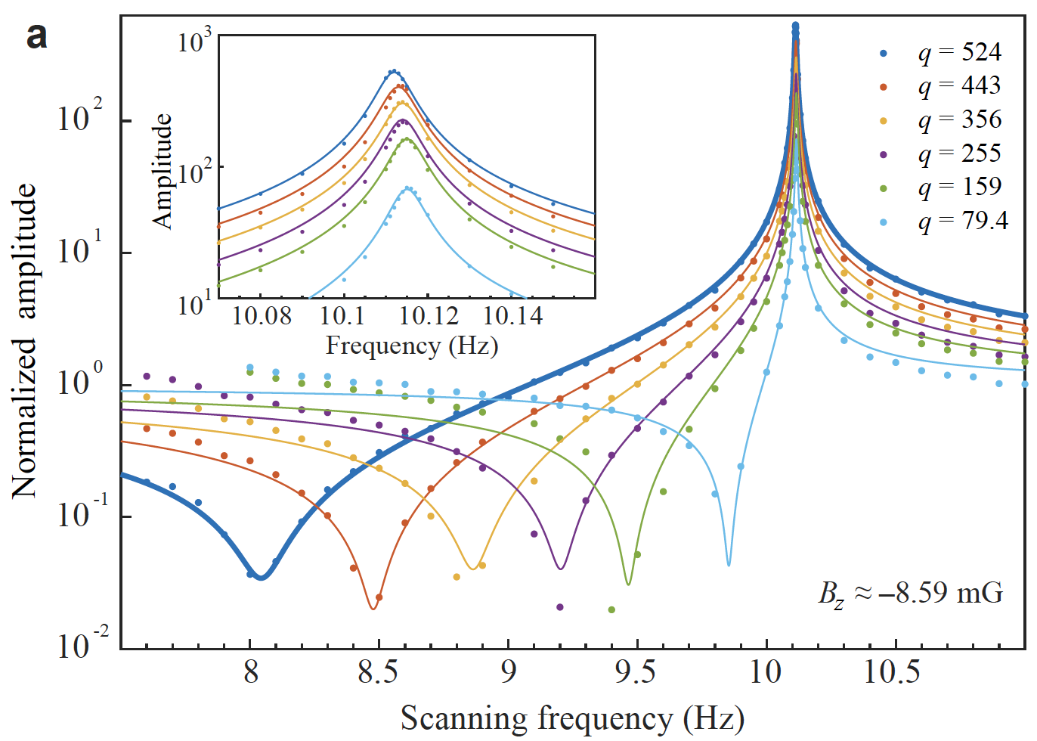
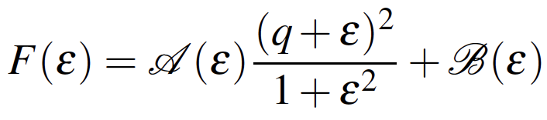

New approach: Interacting atomic gas
Interference enhancement：
Quantum amplification
Interference destructive:
Quantum Suppression
$$G= λPγMT_{2}$$
Notes:
有干涉相消的区间也有干涉放大的区间；在相消区间可以实现对外部磁场的抑制，放大区间可以实现对外部磁场或赝磁场的放大。
NP: amplification
PRL2024: Deamplification
PRL2022: Floquet amplification
PNAS2024: Dark spin amplification
PRL2024: Cooperative amplifcation

Slide 14
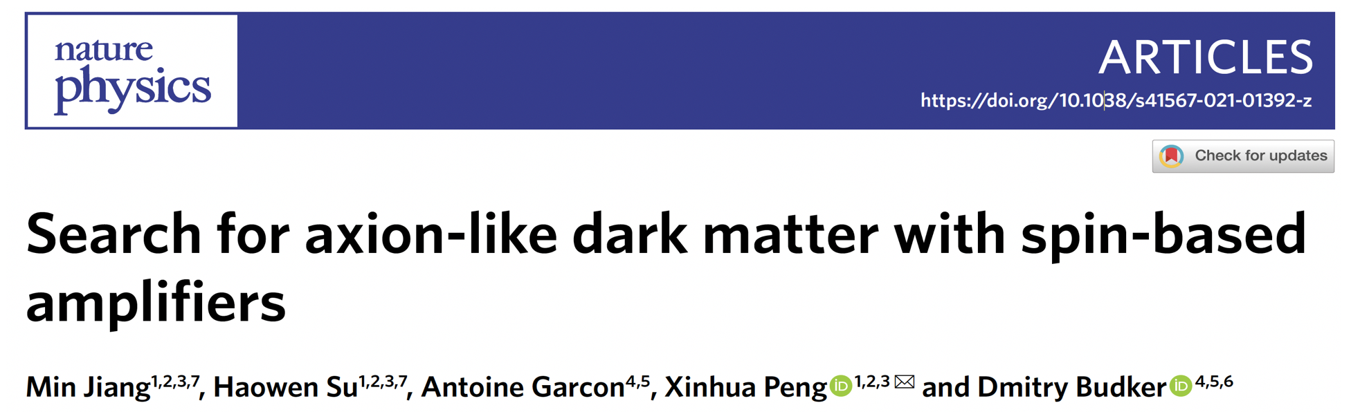
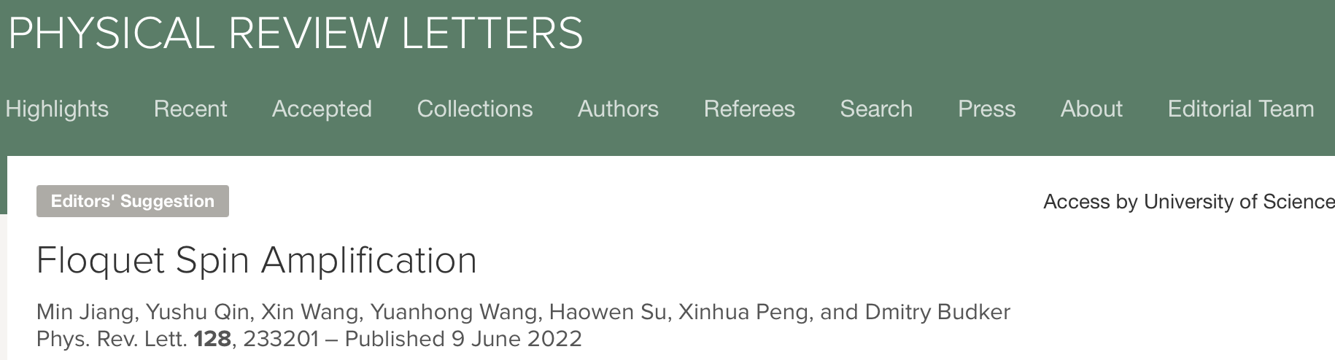

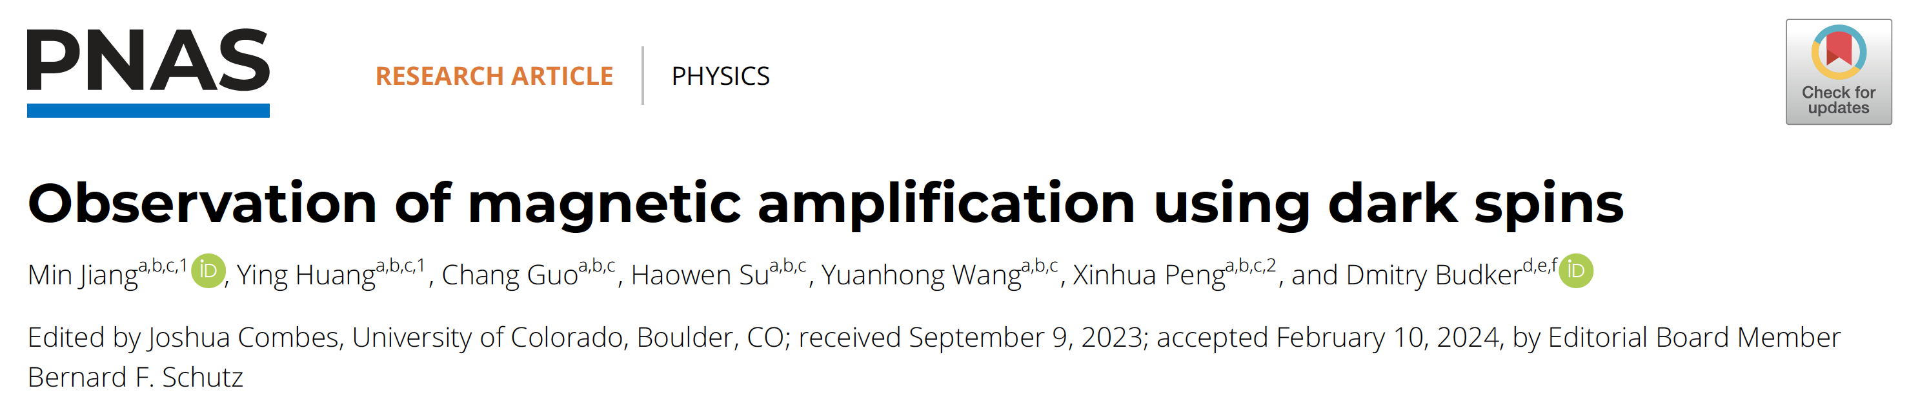
Noble-gas amplification
Amp. Fact
128
First realization
2021
500
Floquet Amp.
2022
1000
Cooperative spins
2022
5400
Dark spins
2024
14
Notes:
在惰性气体放大方面，放大倍数从128，经过引入floquet技术、反馈协同技术与暗态放大技术，到现在的5400倍

Slide 15
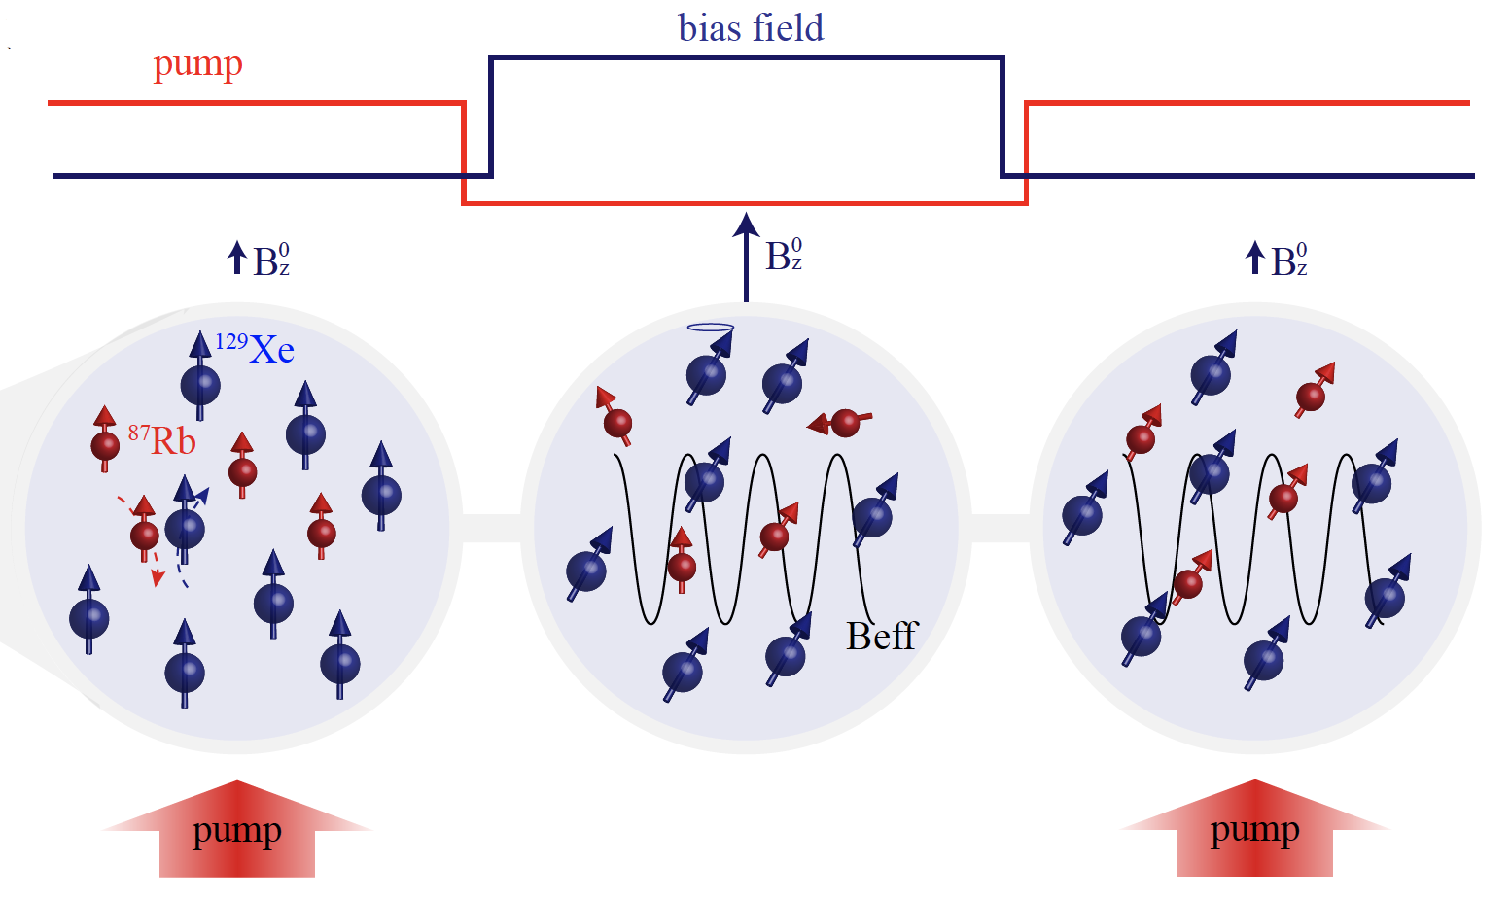
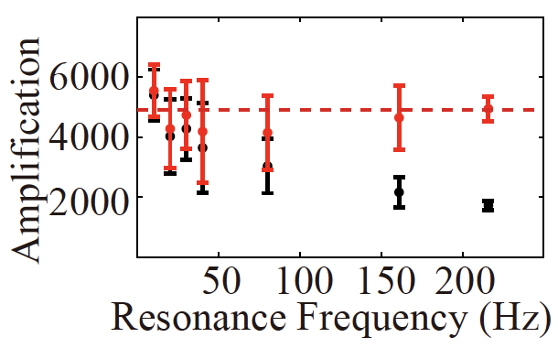
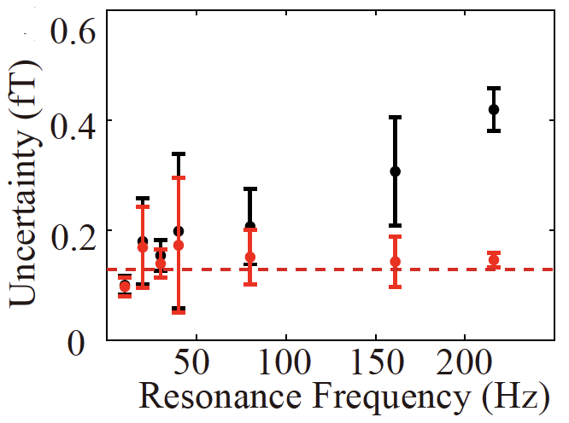

Significant amplification using dark spins
Amp. Factor:
$$Σ=λ Υ M P{ T}_{2}$$
Dark noble-gas nuclear spins without pump light
T2~6 minutes
“Dark spin
amplification”
Amp. factor: ~ 5400
~0.1 fT @10Hz
Measurement time: 500s
Notes:
暗态放大技术：一段时间极化，然后使惰性气体工作在暗态自由演化的工作段内，大概持续T2越300s，之后再开光进行探测，单次测量灵敏度达到0.1fT。

Slide 16
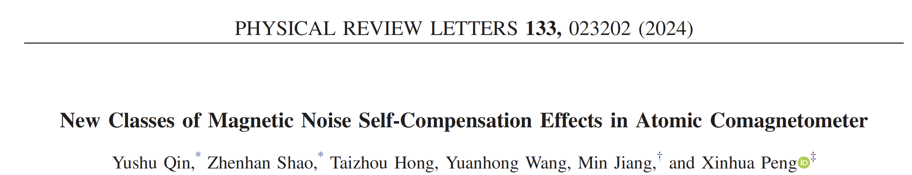
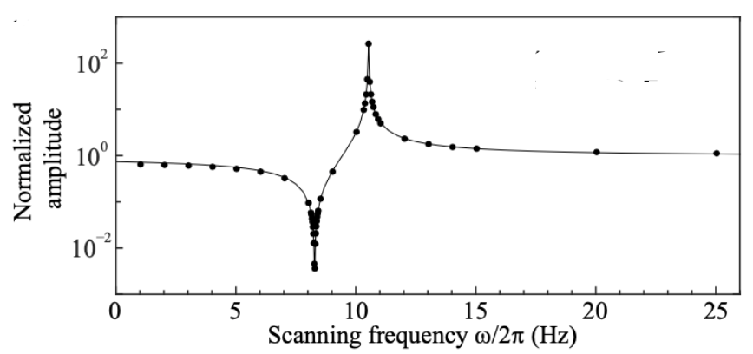
Magnetic noise suppression
Magnetic interference effect of hybrid atoms is uncovered, using this physical effect to reduce magnetic noise interference by at least two orders of magnitude
Reducing magnetic noise by at least two orders of magnitude
Notes:
揭示了混合原子的磁干扰效应，利用这种物理效应将磁噪声干扰降低至少两个数量级

Slide 17
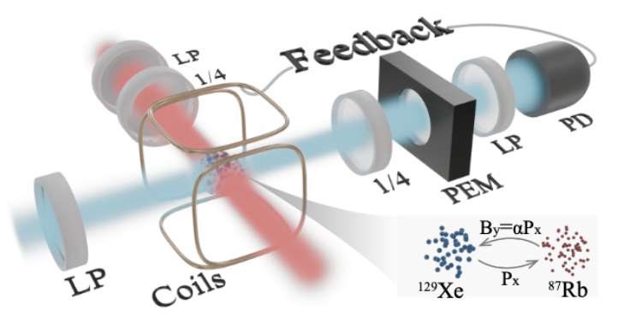
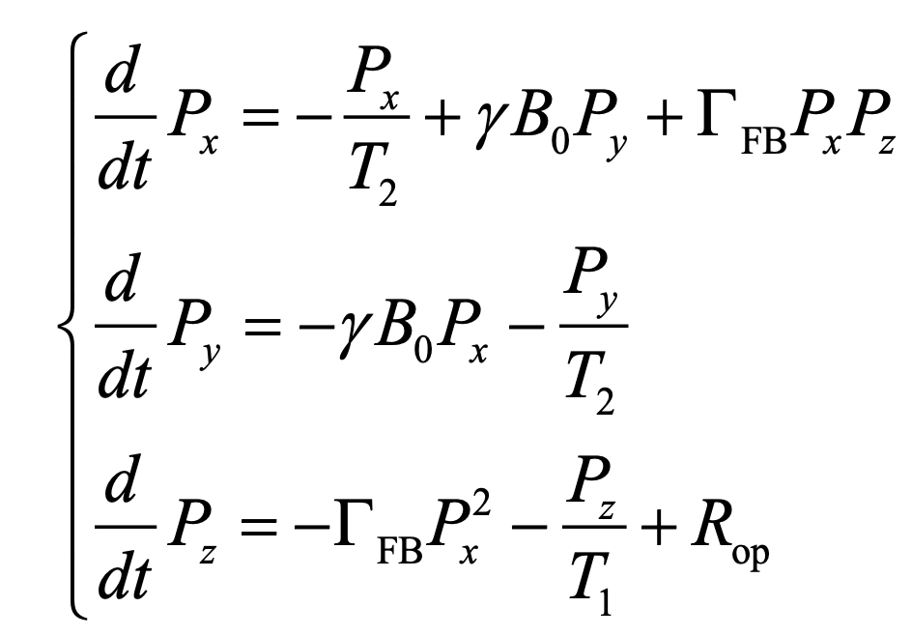
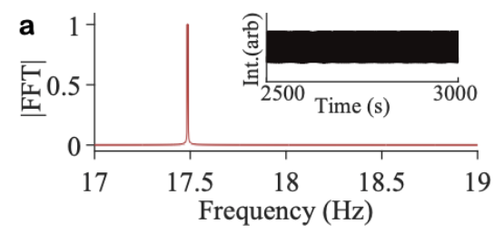


New: Nonlinear noble gas
Observation of continuous time crystal signatures in noble-gas nuclear spins that nonlinearly interact with each other through feedback mechanisms
Feedback induces
nonlinear dynamics
Limit cycle (single peak)
Quasi-periodic
(Multi peaks)
Chaotic
(Unstable)
pup
Under reviewing, 2025
17
17
Notes:
通过反馈引入非线性相互作用，使惰性气体核自旋可以观察到连续时间晶体的特征。
反馈引入非线性项，当这样的非线性项小时惰性气体会处于协同工作状态，再强就是maser状态，再再强就是时间晶体甚至混沌状态。
Nonlinear
Weak: PRL cooperative
Strong: SA Maser and Floquet maser
Even strong: Time crystal, and chaos

Slide 18




Science perspective
18
Notes:
我们的工作受到Science的专文报道，称“研发了全新的量子放大器…克服了度量学中的低频噪声难题”

Slide 19


Exotic spin-dependent interactions searches
Detection principle: exotic interactions induce spin energy shift
Axion
Hamiltonian =
Axion-photon
Axion-spin
Frequency measurement, energy shift
Axion-gluon
Oscillation frequency：Compton frequency
19

Slide 20
Spins as exotic interaction detector
Spin, with its high detection precision, holds great potential detection for exotic spin-dependent interactions and is a key research focus in fundamental physics
Spin detection strategies for axions
10⁻⁶ Hz
10⁻³ Hz
10⁰ Hz
10³ Hz
10⁶ Hz
CASPEr
NV center
SAPPHIRE
Our work
Atomic comagnetometer
NASDUCK
nEDM
OPM
Fifth force
PSI HgM
ChangE
GNOME
AMAILS
Our work
10⁻²¹ eV
10⁻¹⁸ eV
10⁻¹⁵ eV
10⁻¹² eV
10⁻⁹ eV
10⁻⁶ eV
Axion mass（eV）or Compton frequency（Hz）
Notes:
例如针对暗物质重要候选粒子—轴子，部署了大量的自旋探测计划

Slide 21



Ultralight axion dark matter searches
¹²⁹Xe
Axion
Spin-amplification: 128
Sensitivity: 18fT/Hz^{1/2}
5 hours average: 130aT
Axion-nucleon interaction: $≤$10⁻⁹GeV⁻¹ (feV-peV)
Astrophysical limits
Astrophysical limits
Establish the most stringent limits on axion-nucleon coupling beyond astrophysical limits
21

Slide 22

Ultralight axion dark matter searches
Noble gas becomes important systems to perform dark matter searches
Jiang et al. Rep. Prog. Phys. 88 016401 (2025)
Noble-gas Experiments | Sapphire (Our work) | NASDUCK （Weizmann Institute） | K-³He Comag. (Princeton) | ChangE (Beihang)
Noble gas | Rb-¹²⁹Xe | Rb-¹²⁹Xe | K-³He | Rb-²¹Ne
Published | Nat. Phys., 2021 | Sci. Adv. 2022 | PRX, 2023 | arXiv 2023

Slide 23


Exotic spin-dependent forces
New bosons (e.g. axions) act as force mediator and then induce exotic spin interactions between two spin ensembles (here we use atomic gas)
New bosons
Notes:
除了直接搜索宇宙中的暗物质粒子外，我们还将传感器应用于暗物质候选粒子诱导的自旋依赖新相互作用上。
让我介绍一些细节。这是我们的典型设置：有自旋源细胞和自旋传感器细胞，它们可以通过交换Z’玻色子相互作用。自旋源可以在自旋传感器或自旋放大器上产生磁场。然后利用自旋放大器进行搜索。
Let me introduce some details. Here is our typical setp: there are spin source cell and spin sensor cell, they could interact with each other through exchanging Z’ bosons.
The spin source could produce a magnetic field on the spin sensor, or spin amplifier.
Then We can use spin amplifier to search from them.

Slide 24




Axion-mediated spin-dependent forces
Two types of experiments are performed to search for axion-mediated electron-neutron and neutron-neutron interactions
feV
Search setup
(Spin amplifier+shield)
Exp#1: Rb cell-Xe cell
Exp#2: Xe cell-Xe cell
peV
Pseudomagnetic fields are limited below 0.1 fT
neV
Axion Mass
ueV
meV
-0.2
-0.1
0
0.1
0.2
Axion-mediated pseudo field (fT)
Wang…Jiang* et al., Phys. Rev. Lett. 129, 051801 (2022)
Su…Jiang* et al., Phys. Rev. Lett. 133, 191801 (2024)
Notes:
Axion: Axion window

Slide 25



Z’ boson-mediated spin-dependent forces
Two types of experiments are performed to search for Z’ boson-mediated neutron-nucleon and neutron-electron interactions
Search setup
(Spin amplifier+shield)
Exp#1: Xe cell-BGO crystal
Exp#2: Xe cell-Rb cell
Modulating spin-dependent force
Su…Jiang* et al., Sci. Adv. 7, eabi9535 (2021)
Wang…Jiang* et al., Sci. Adv. 9, eade0353 (2023)
Notes:
Axion: Axion window

Slide 26










APS Viewpoint，Physics world
26
Notes:
评价我们的sapphire研究计划是暗物质探测领域的一个瑰宝

Slide 27



Correlation sensing via multiple-sensor network
Single sensor
N-sensor network
Localized noise is hard to suppress
Can’t tell the orientation of DMs
Suppress the false alarm rate $∝ pN$
Enhance sensitivity $∝1/\sqrt{N}$
Network contains DM orientation inf.
Ultralight dark matter with long de Broglie wavelength enables the network detection
1feV de Broglie wavelength $≈$
$$\text{100 }\text{times} \text{the} \text{Earth} \text{diamete}\text{r}$$

Slide 28


Long-baseline dark matter search (AMAILS)
New limits on dark photon dark matter

Slide 29


Space-based new physics searches

Slide 30


Invitation review
Introduction to the Progress of Spin Sensors in exotic spin-dependent interactions detection
30
Notes:
我们团队受邀，我作为第一作者，在国际著名期刊《Reports on Progress in Physics》上撰写综述，系统介绍自旋量子传感器在暗物质探测方面的进展

Slide 31

Long-baseline dark matter search (AMAILS)
Our two projects have been included by the AxionLimits
SAPPHIRE：Our work
AMAILS：Our work
31
Notes:
我们的两项暗物质研究结果被国际权威AxionLimits学术机构收录

Slide 32



Summary
Magnetic field sensing is widespread from particle to universe
NMR & MRI
Heart & brain
DNA
Mars' magnetic field
Geological exploration

Slide 33
Thanks
Yuanhong Wang（王元泓）
Univ. of Sci. & Tech. of China (USTC)
CAS Key Laboratory of Microscale Magnetic Resonance
E-mail: blood@mail.ustc.edu.cn

