Slide 1
Melting of heavy vector mesons and quasinormal
modes in a finite density plasma from holography
arXiv:2204.08068v1 [hep-ph]
Hiwa A. Ahmed (何瓦)
School of Nuclear Science And Technology, UCAS
Weekly Group Meeting
December 13th, 2024

Slide 2
Introduction
Heavy-ion collisions allow us to investigate quantum chromodynamics (QCD) in the laboratory.
It is believed that one can use heavy mesons as probes in order to extract relevant information of the medium in such extreme conditions.
The idea is that, in contrast to hadrons made of the light quarks: u (up), d (down), and s (strange), that dissociate at the critical temperature when the plasma is formed, heavy mesons, made of c (charm) or b (bottom) quarks survive at higher temperatures.
That is the motivation for understanding how the properties of the QGP, like temperature and density, affect the dissociation of charmonium.

Slide 3
Holographic model
The five-dimensional action describing the finite density medium in the dual field theory is given by

Slide 4
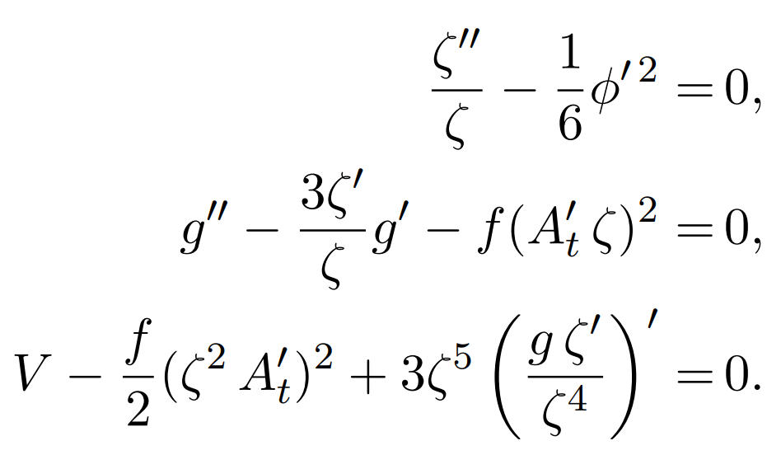
Holographic model

Slide 5
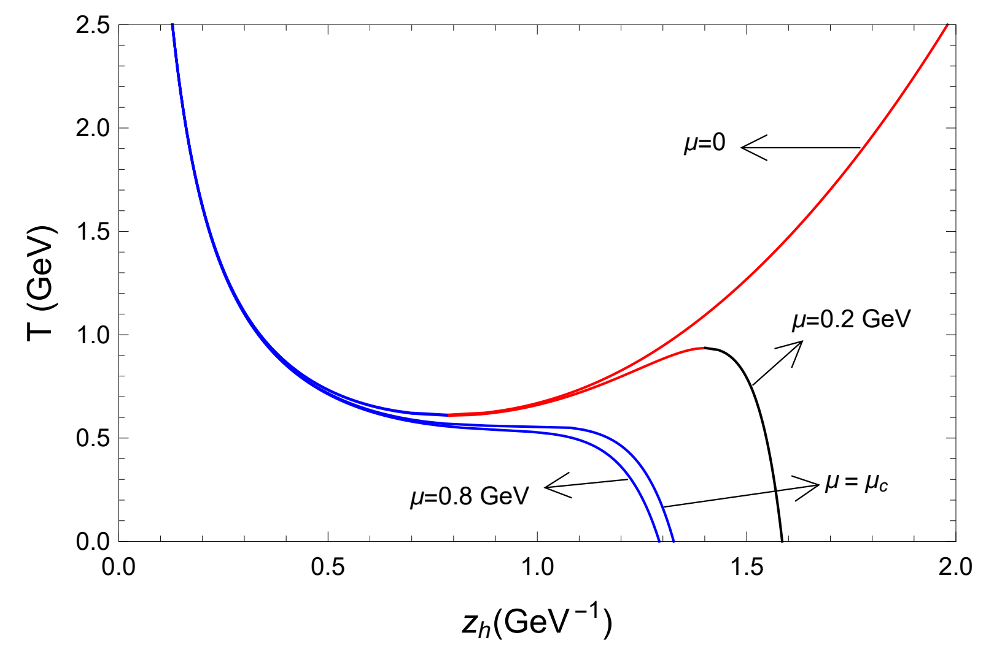
Holographic model

Slide 6
Heavy vector mesons
The heavy-vector mesons in the dual field theory are described by five-dimensional gauge field whose action is given by

Slide 7
Heavy vector mesons
The way this holographic model was built allows us to get an analytic solution for the mass spectrum, which is given by

Slide 8
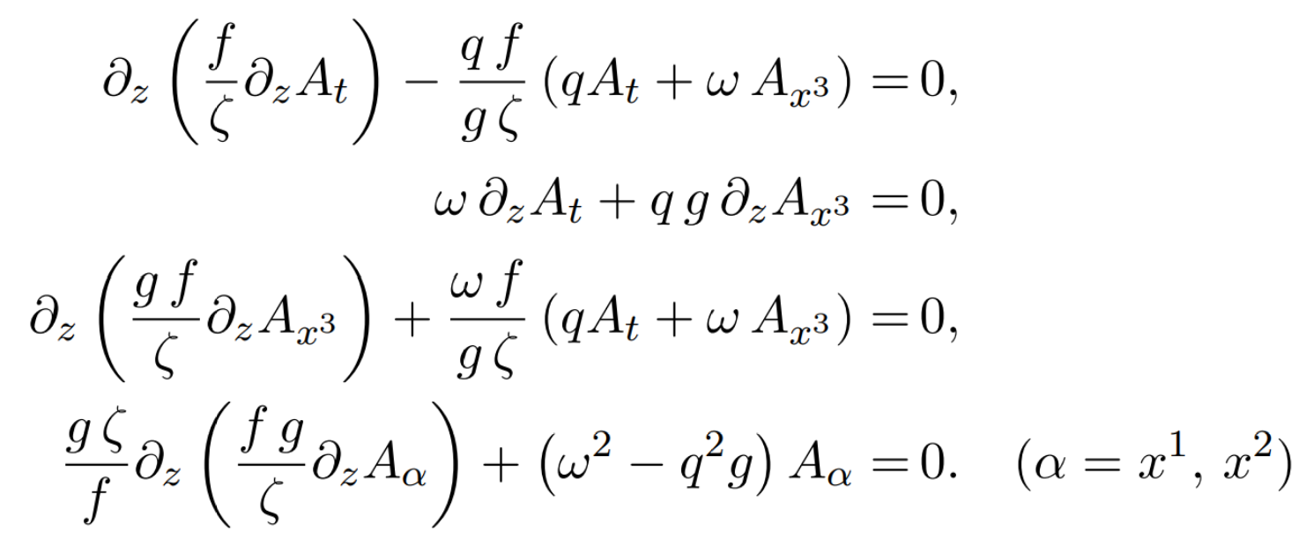
Finite temperature
For the black hole embedded in the geometry will change the eigenvalues into complex. These states shall be interpreted as quasiparticles characterized by the complex frequencies whose real part is interpreted as the thermal mass, while their imaginary part related to the decay rate of these states.

Slide 9
Finite temperature

Slide 10
Finite temperature
The Schrodinger-like form of the differential equations can be solved close to the horizon where $g(z_{h}) = 0$. Thus, there is the following solutions for both sector

Slide 11
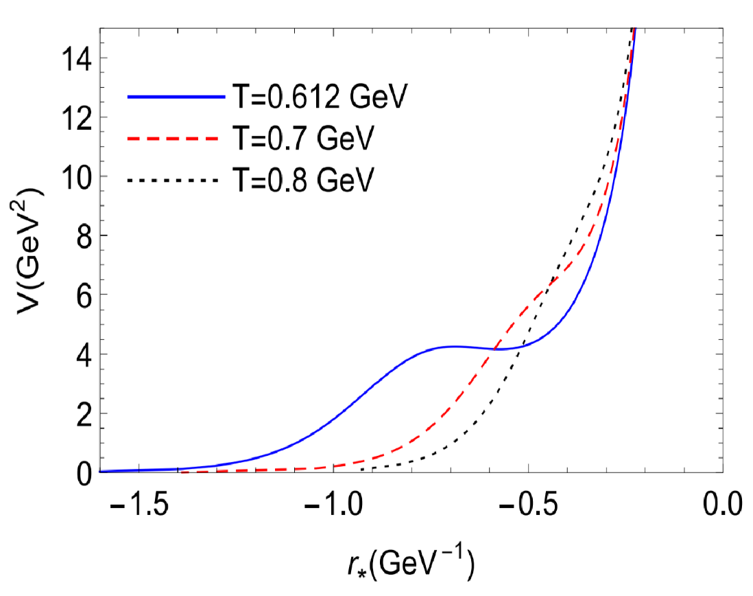
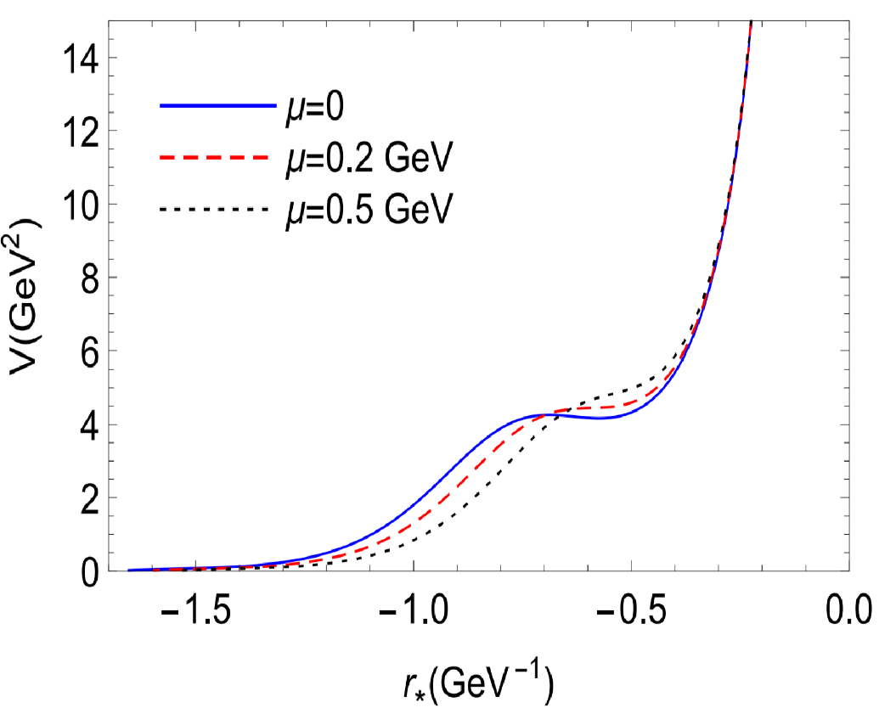
The effective potential
The potential as a function of the tortoise coordinate for selected values of the temperature setting $q = 0$.

Slide 12
Spectral Functions
To calculate the correlation functions we need to determine the on-shell action,

Slide 13
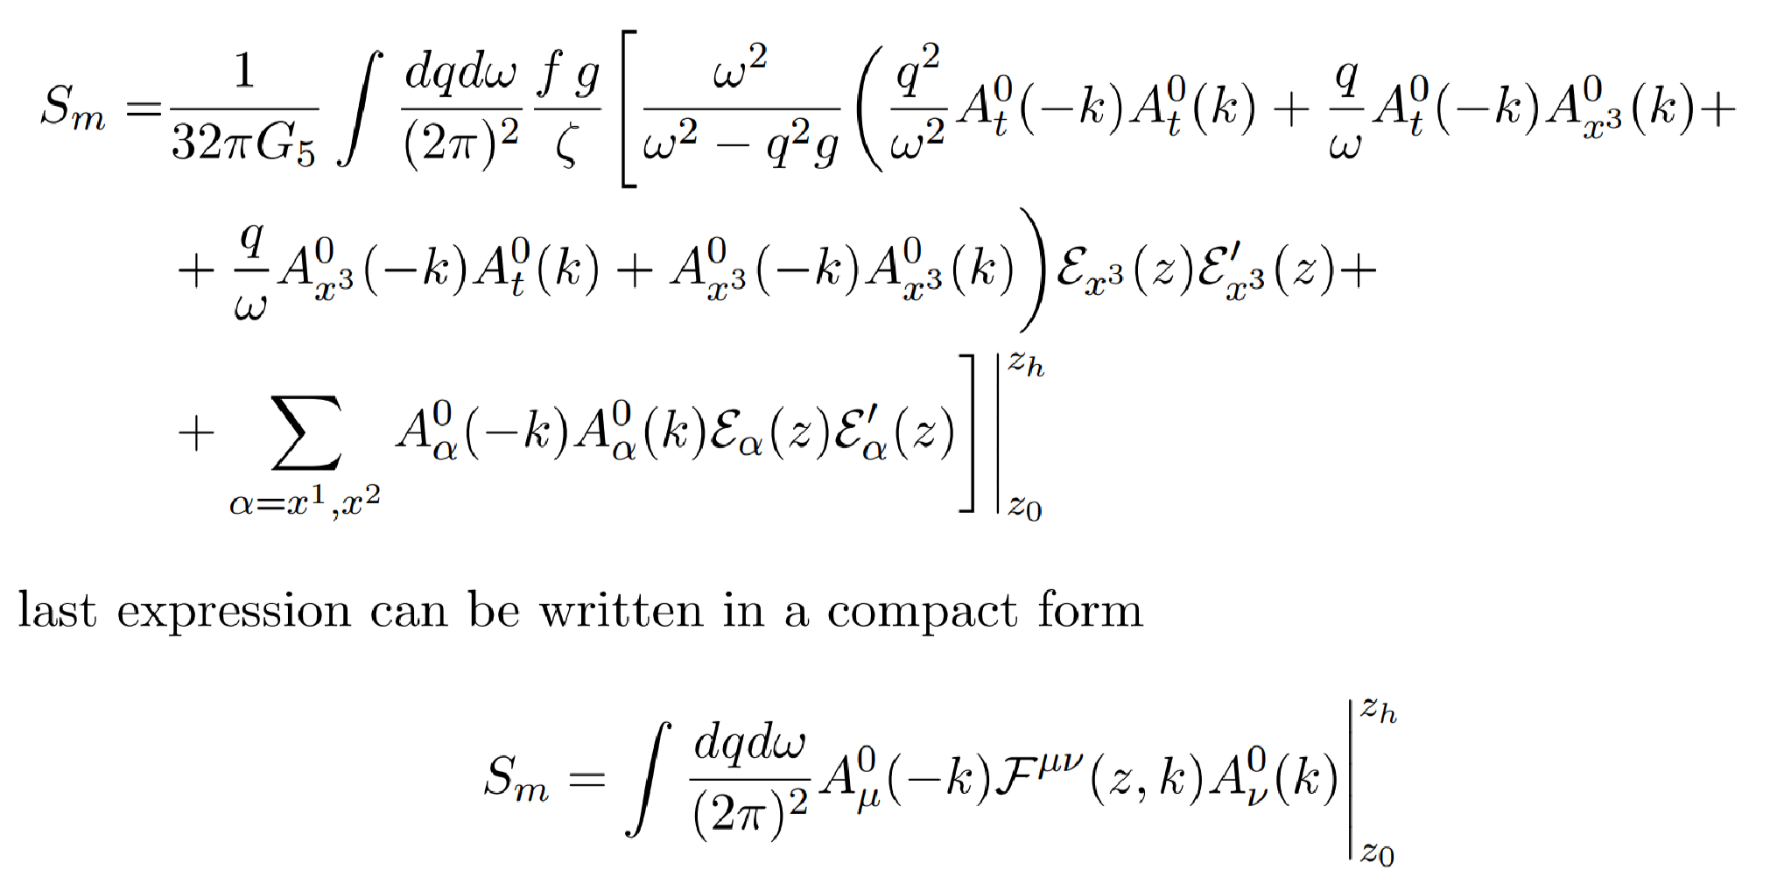
Spectral Functions
Consider the ingoing solution at the horizon such that the retarded Green’s function computed.
Get the current-current correlators using the Son-Starinets prescription :

Slide 14
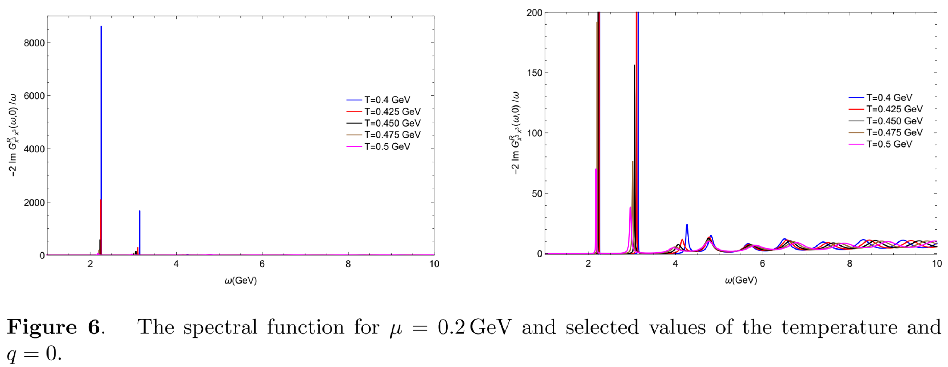
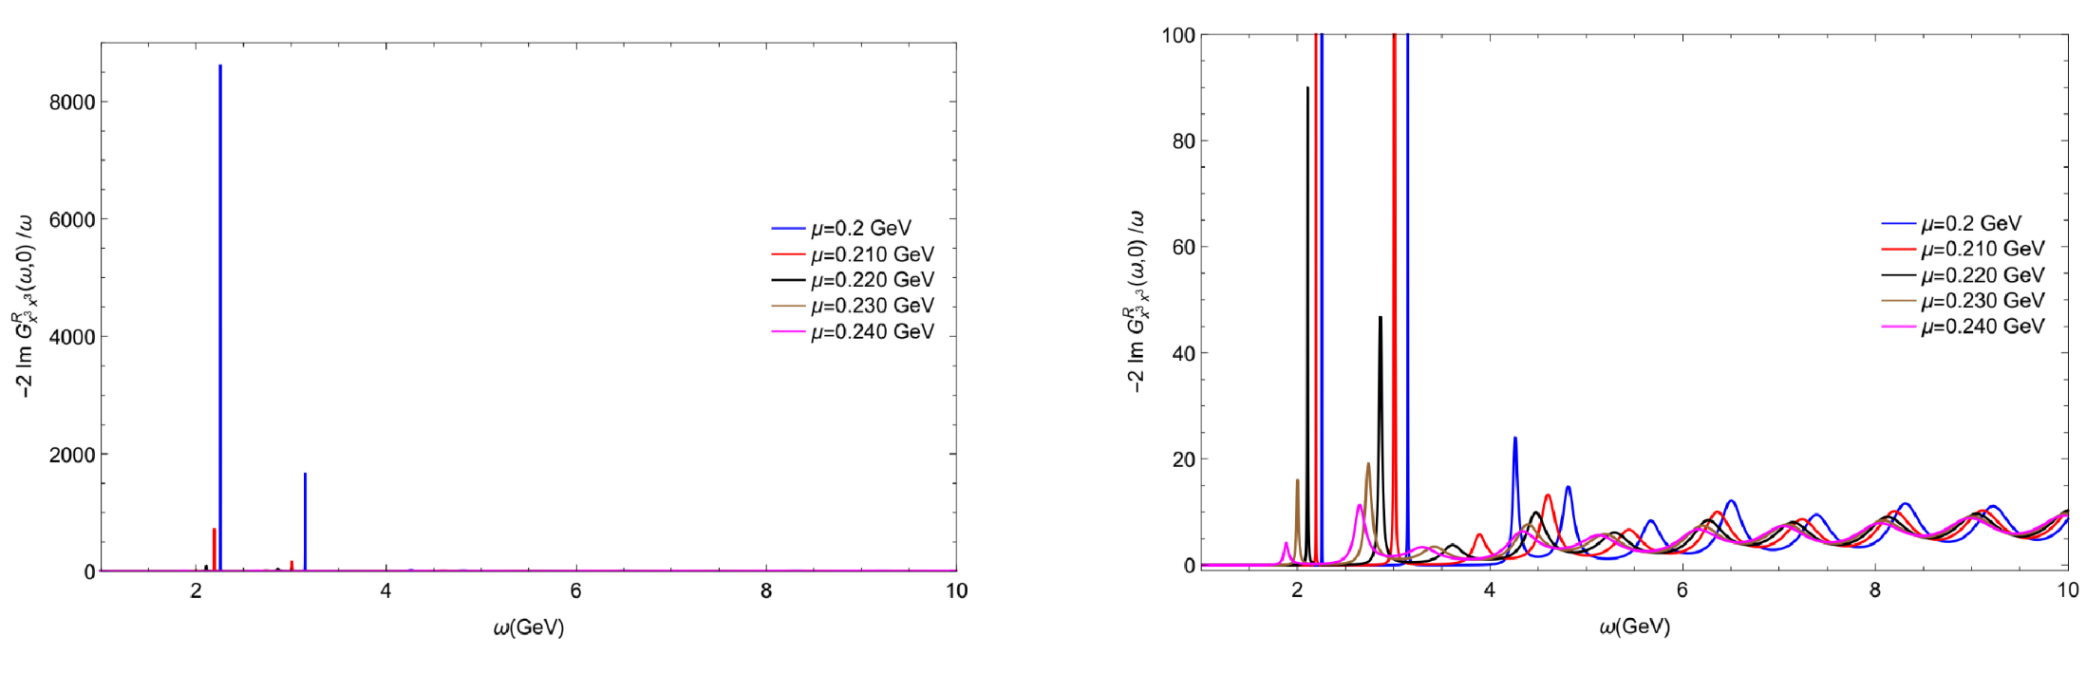
Spectral Functions

