Slide 1
Chiral Enhancement Induced by Rotating Gluon
Hopefully
KunXu@UCAS
2024.12.13

Slide 2
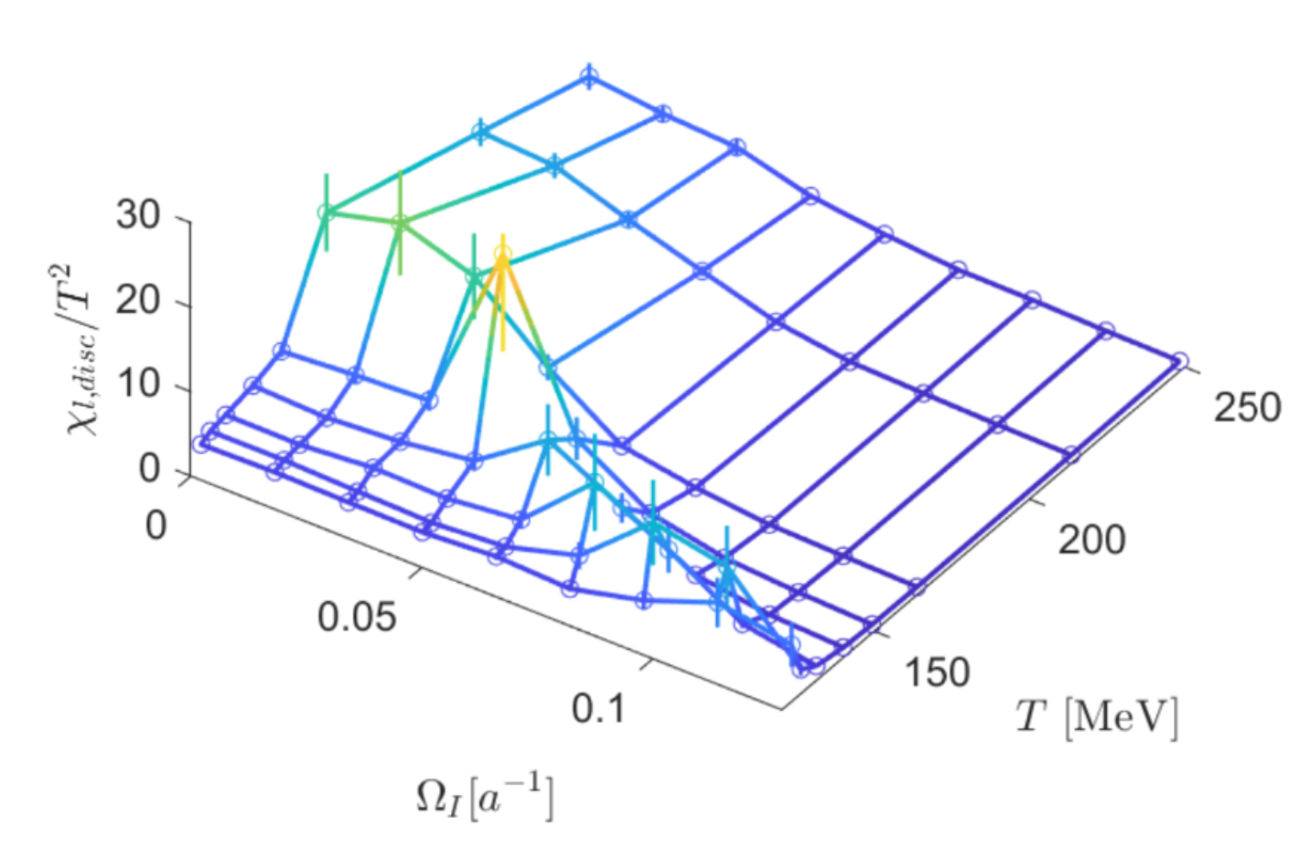
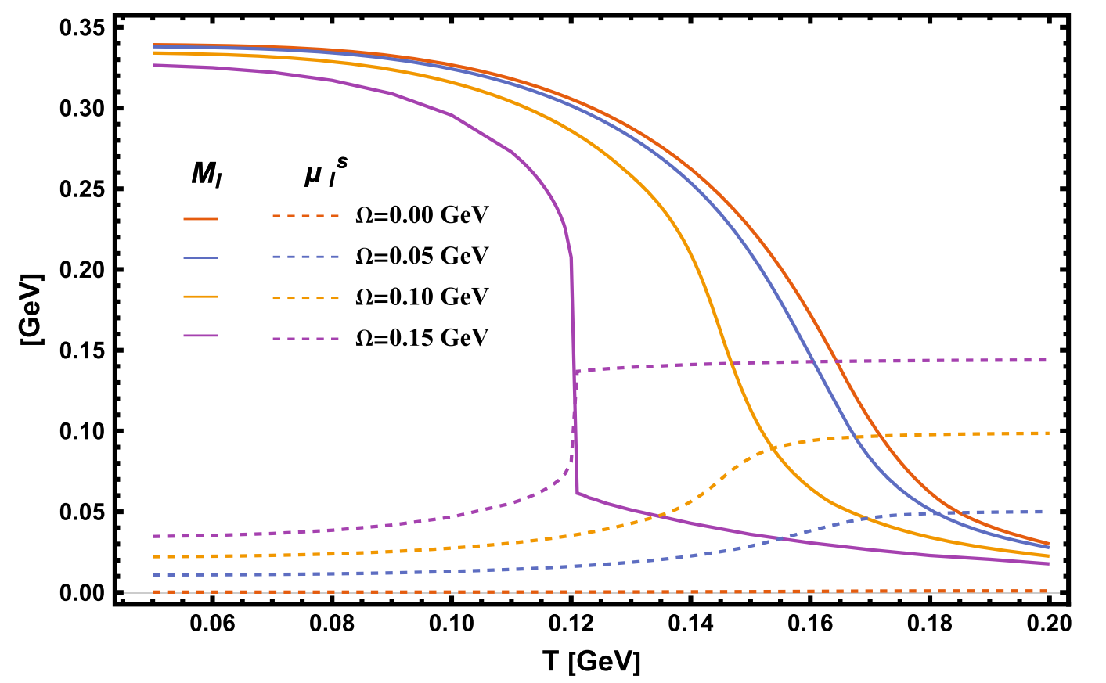
Rotation & magnetic field
Spin polarization
Spin alignment
IMC&MC
Magnetic susceptibility
Meson property（mass, decay constant…）
EoS
CEP(chiral phase transition…)
CME
NJL: rotation reduce chiral condensate
LQCD: rotation enhances chiral condensate
Gluon!

Slide 3
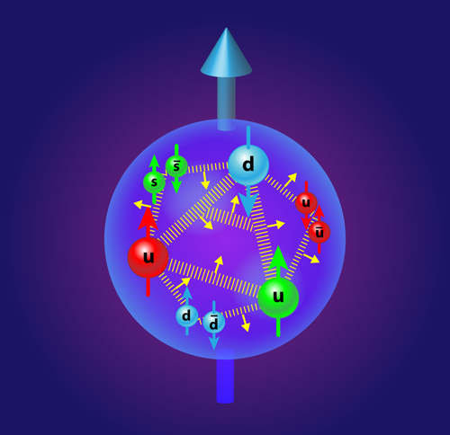
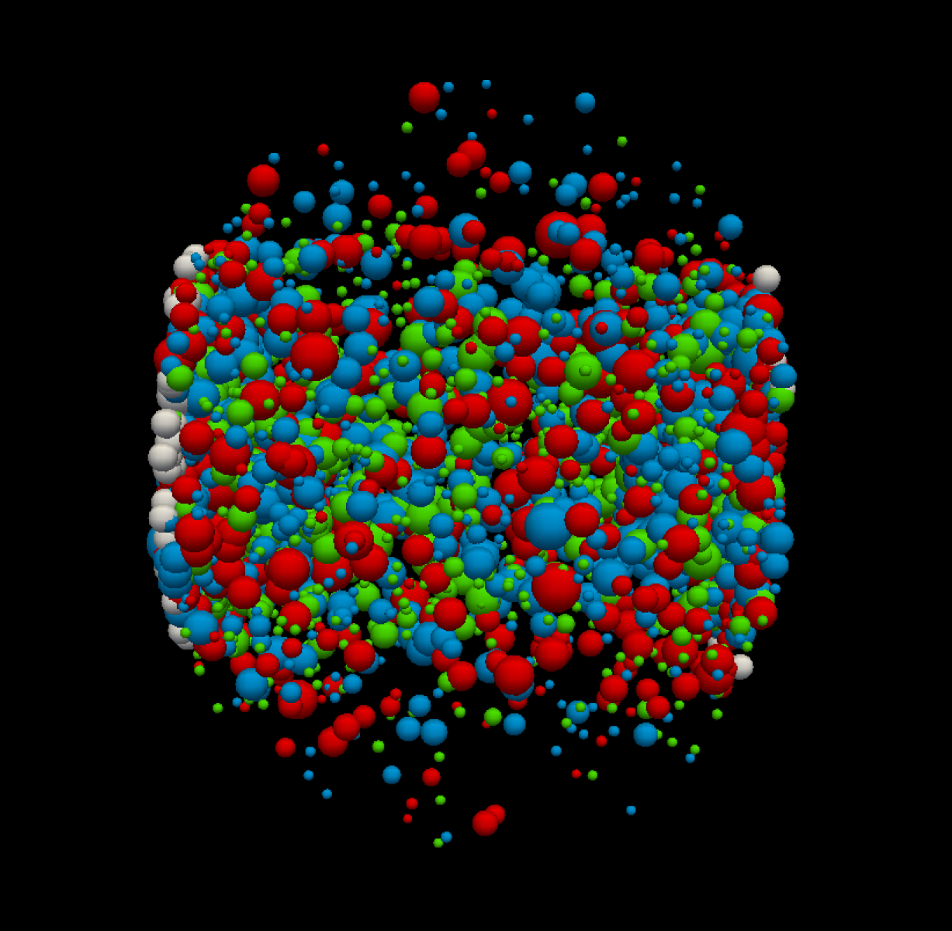
Proton spin crisis
Quark gluon plasma
Glue Spin and Helicity in the Proton from Lattice QCD
Yi-Bo Yang, Raza Sabbir Sufian, Andrei Alexandru, Terrence Draper, Michael J. Glatzmaier, Keh-Fei Liu, and Yong Zhao (χQCD Collaboration).
Phys. Rev. Lett. 118, 102001 (2017)
Same order of mass, larger spin…
Gluon is important!
LQCD: 50% of proton spin comes from gluon!

Slide 4
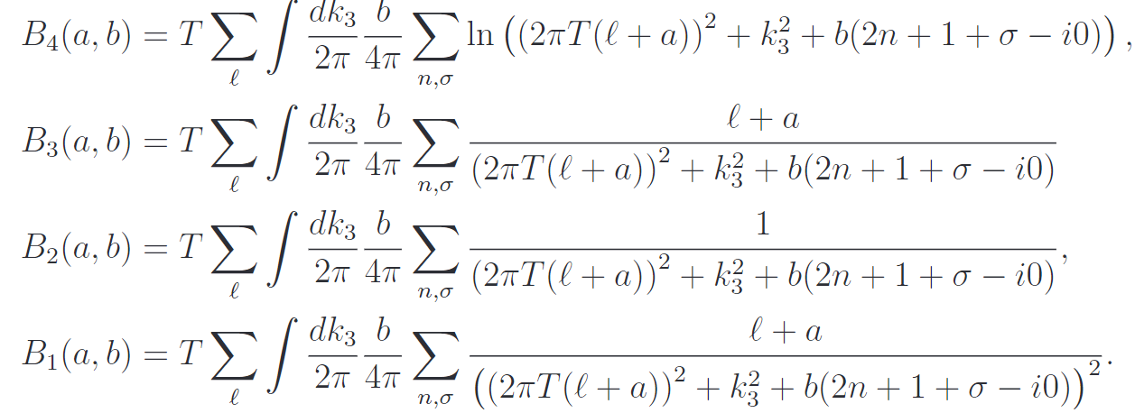
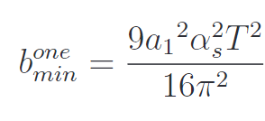
2305.00757
Chromo-magnetic field generated spontaneously
Background field method
the effective potential
Related to Polyakov-loop
Chromomagnetic field
(1) The magnetic field at high temperature:
(2) For pure A0:

Slide 5
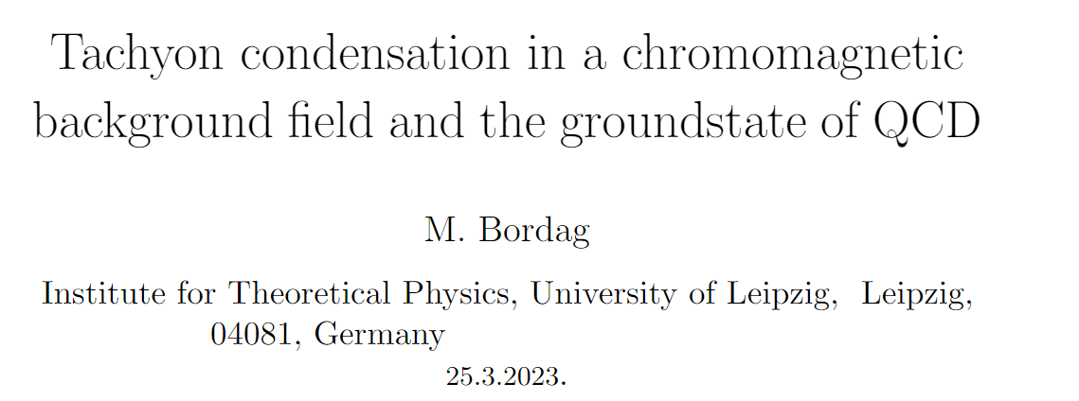
2305.00757
1910.00654
/hep-ph/0110280
2207.08711

Slide 6
Firstly, physical picture
Why chromo-magnetic field spontaneously generated
Magnetic susceptibility: paramagnetism v.s. diamagnetism
Scalar, spinor, vector particle
Orbital v.s. Spin angular momentum

Slide 7
SU(2)
Kinetic term,
Interaction with background field
Gluon interaction(ignore in this work)

Slide 8
Free charged gluon under chromo-magnetic field:
Good!
Equation of motion:
Opposite “color charge”
Define:
Then:
Take W+ as an example:
Opposite spin
LLL Unstable!

Slide 9
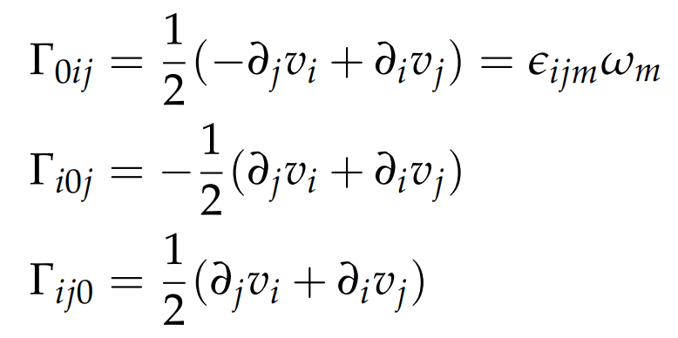
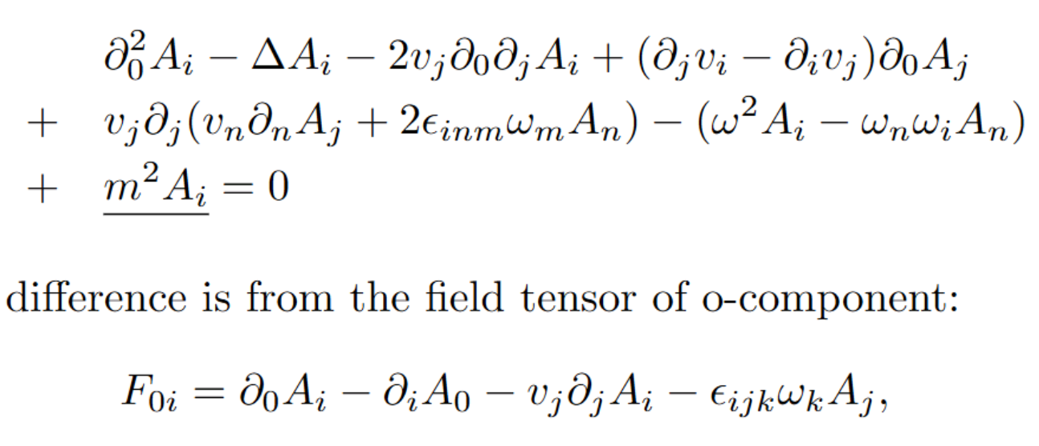
Vector particle under rotation
Reference:
Chernodub:1807.10705
Yin Jiang:2106.04851
XG Huang:2006.03591
define
EoM
Bessel function
Spin-up and spin-down
The only effect of Rotation on spin-1 particle
In cylindrical coordinate

Slide 10
Both chromo-magnetic field and rotation
Magnetic field
rotation
EoM
Dispersion relation: Landau energy level
Now I am here…

Slide 11
Next, thermodynamic potential
Find the minimum with respect to H: $\frac{∂Ω}{∂H}=0$
And obtain chromo-magnetic field as a function of rotation( and T…) $H(ω)$
Expectation: chromo-magnetic field increases with rotation.
Then, NJL with rotation + $H(ω)$
Expectation: chiral rotation catalysis.

Slide 12
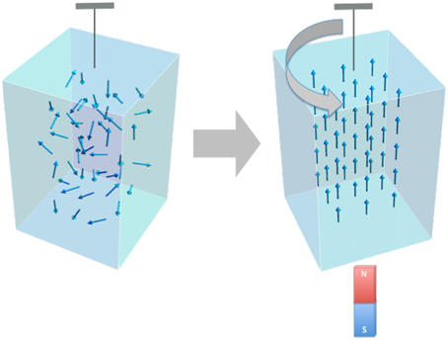
Rotation enhances magnetic field
Barnett effect
Magnetization by Rotation

Slide 13
Future improvements
SU(3)
Gluon mass.
Gluon interaction and two-loops
Quark loop to gluon
Quark induces chromo-magnetic field
Dyson-Schwinger equation
Polyakov loop
…

Slide 14
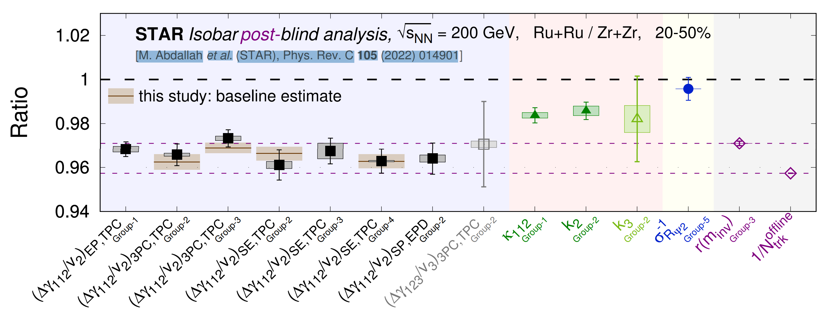
Magnetic field: QCD v.s. QED
color charge electric charge
u1 quark + +
u2 quark - +
Chromo-magnetic field weakens electro-magnetic field (effectively)
Competition! Could induce non-monotonic behavior
SU(3), more complicated…
May explain the different
background in isobar collision

Slide 15
Possible implications
To spin alignment: a chromo-magnetic field is present in HIC, which could lead to $ρ_{00}>\frac{1}{3}$. Also spin polarization.
IMC: electro-magnetic field induce chromo-magnetic field via quark loop.
CME
Meson mass, with both quark and gluon under considered.
……

