Slide 1
Progress and Plan
Mingyi Dong
2024.12.16

Slide 2
Progress in the experimental hall last week
 | Planned tasks last week | date | person in charge | Status
1 | Removing the patch cards of CGEM on both sides | Dec.6-8 | Italy team | done
2 | Manufacturing of the shielding box for MDC | Arrived on Dec. 12 | Jinyu Fu, Stefano | The samples arrived on Dec. 10, and after modification, all boxes arrived on Dec.12
3 | Manufacturing of the shielding box for CGEM | Arrived on Dec. 12 | Jinyu Fu, Stefano | done
4 | Installation of the shielding box for MDC | Dec. 13-14 | Italy team, IHEP team | done
5 | Testing | Dec. 14-16 | Italy team, IHEP team | done
6 | Connecting the cooling system of CGEM to BESIII water cooling pipes | Dec. 9-15 | Italy team | done

Slide 3
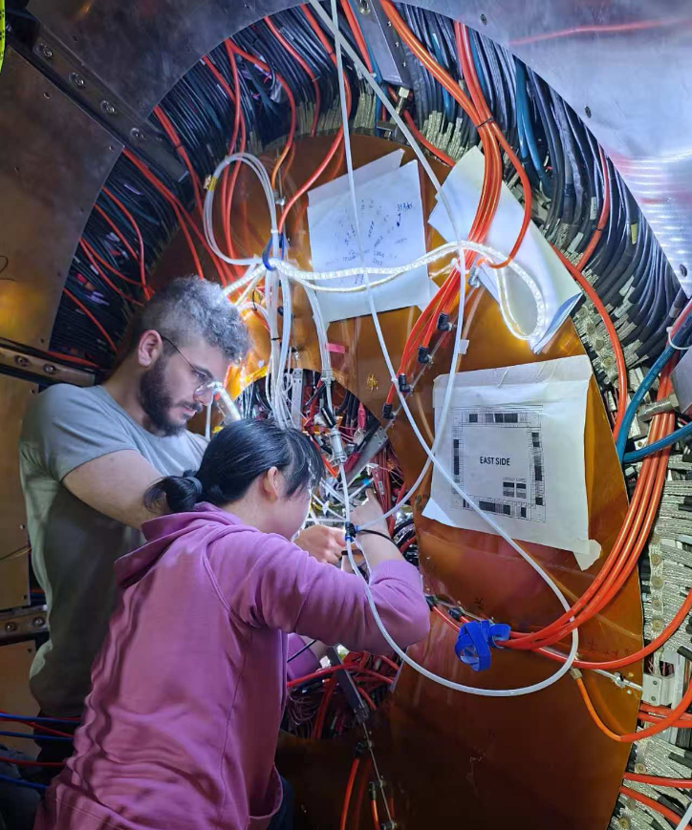
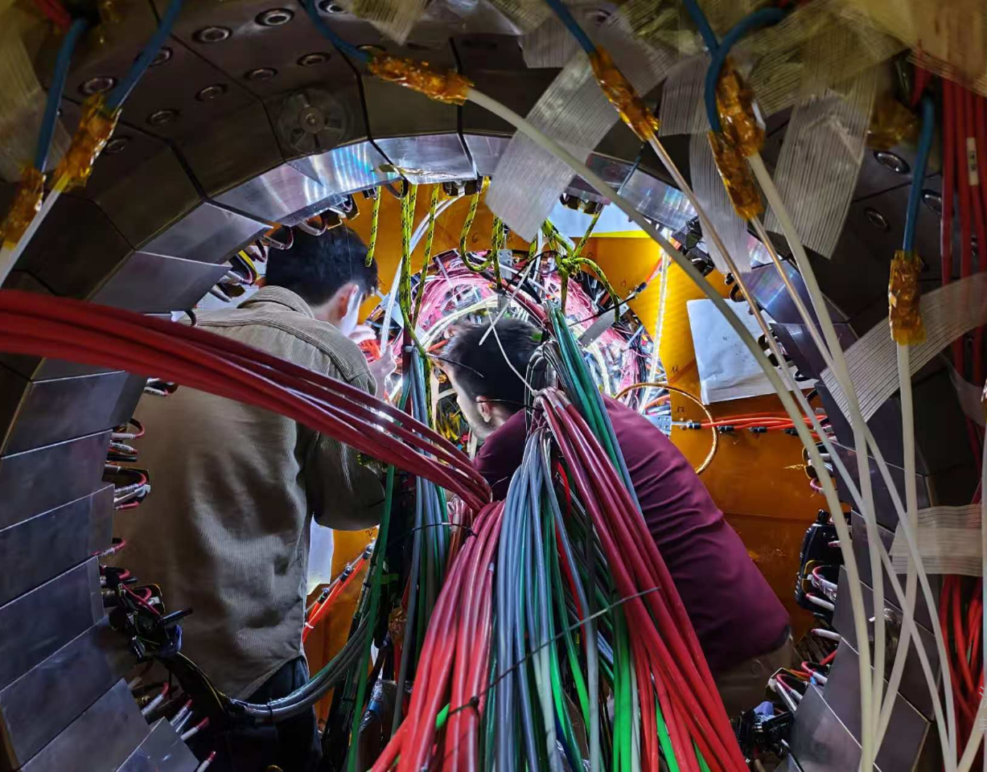
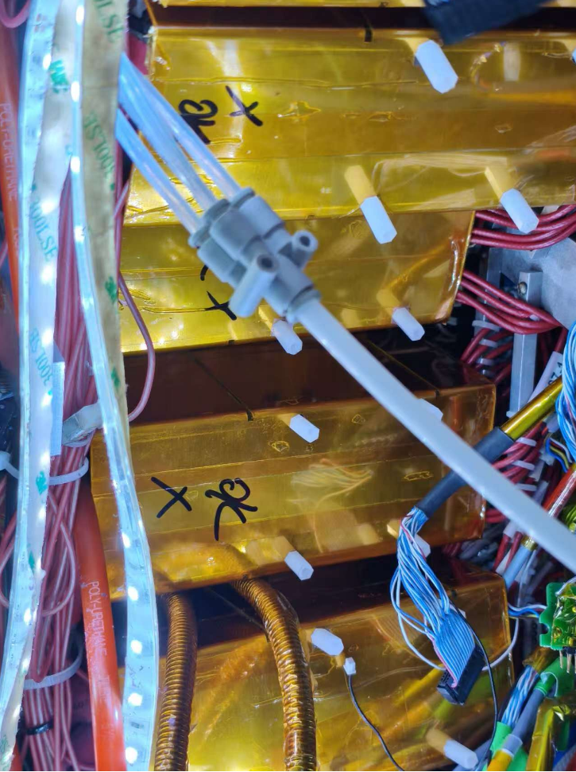
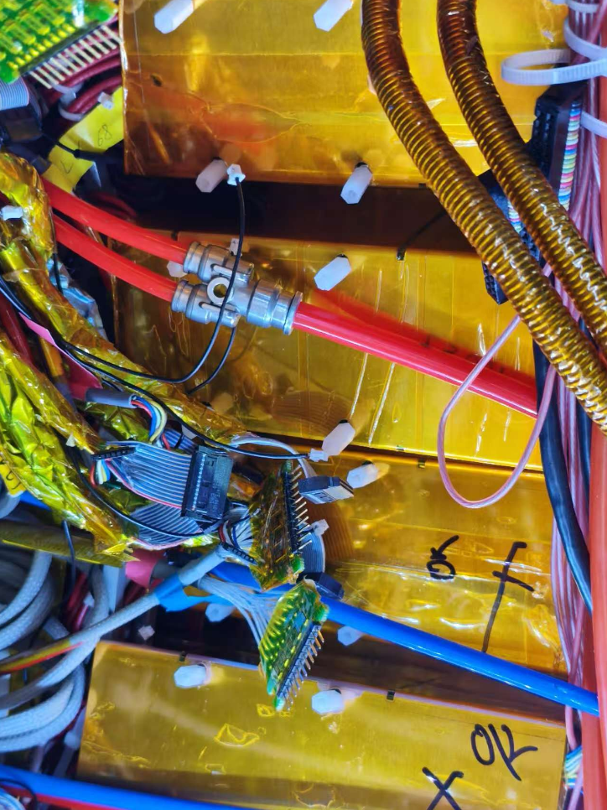
Installation of shielding boxes for MDC preamplifiers
On Dec.13, 14
Installed shielding boxes for MDC preamplifiers

Slide 4
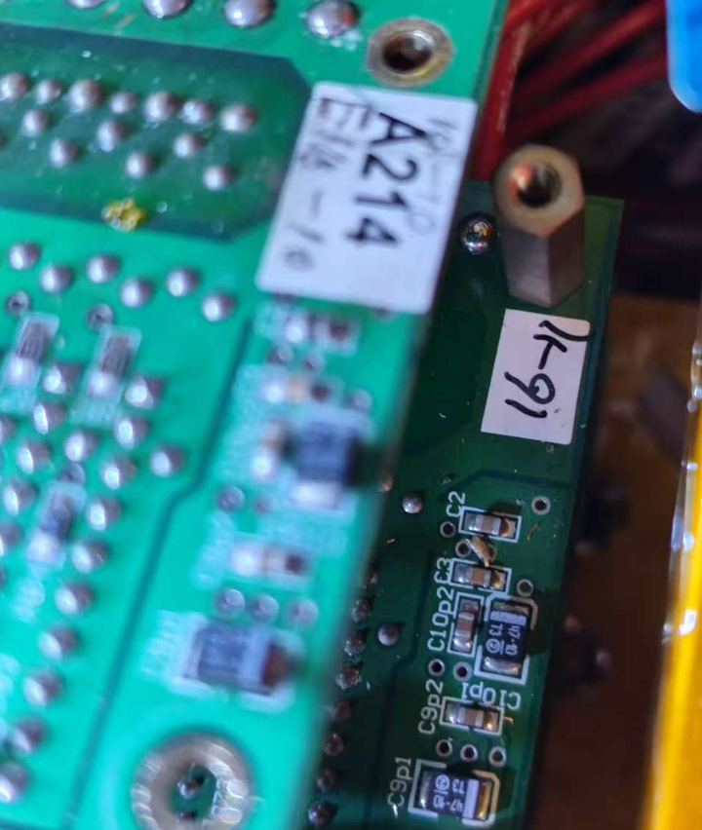
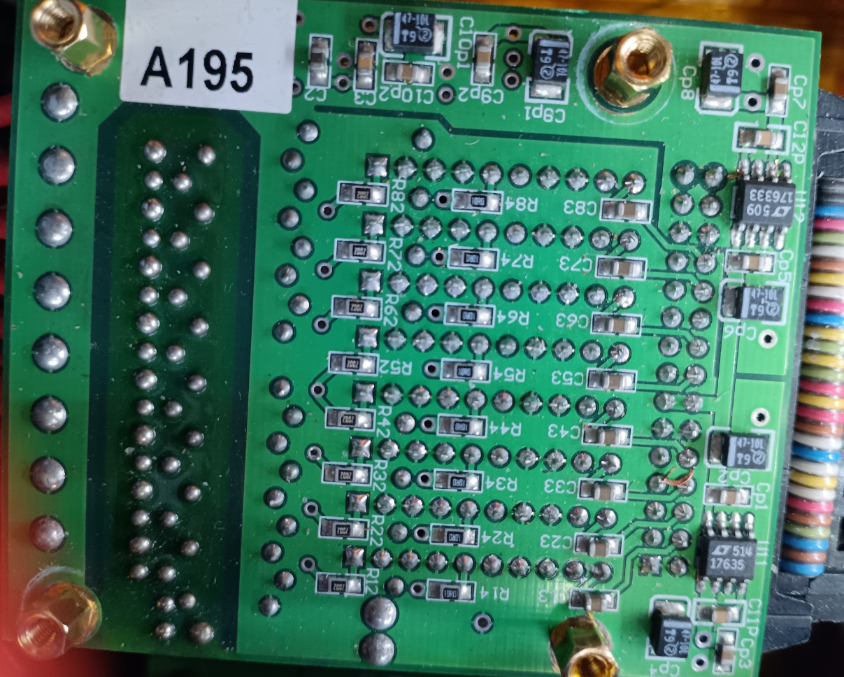
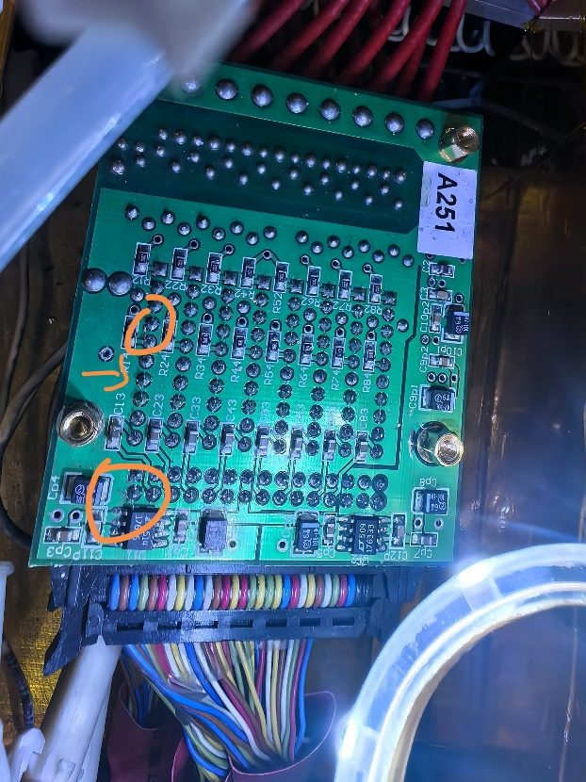
Installation of shielding boxes for MDC preamplifiers
On Dec.13, 14
Copper fragments or small cables were found on MDC preamplifier boards, causing a short circuit between the pins
Removed the conductive fragments and clean the preamplifier boards, fixed the problematic preamplifier boards

Slide 5
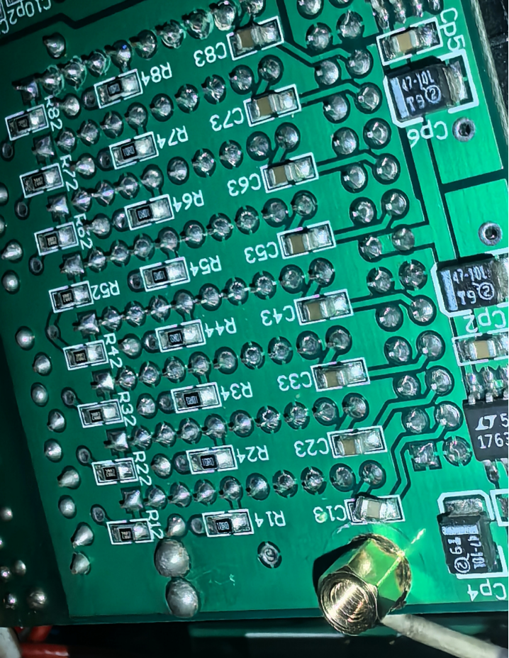
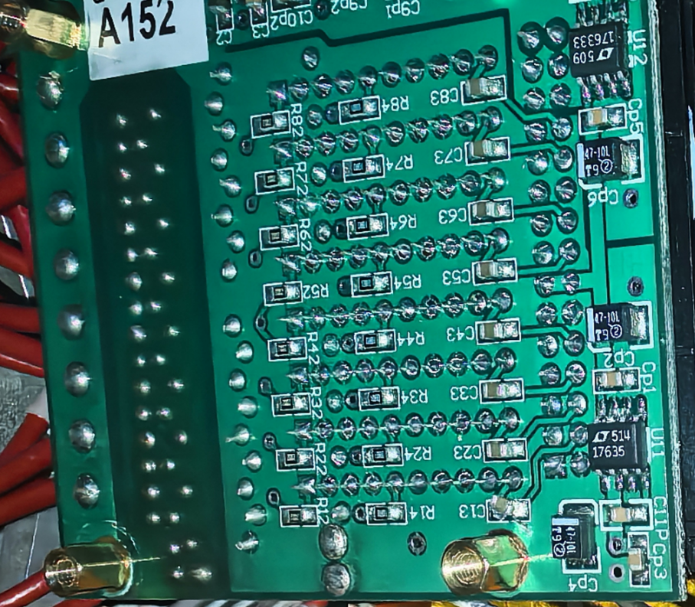
Installation of shielding boxes for MDC preamplifiers
On Dec.13, 14
Found that one capacitor on several boards was almost detached, re soldered it and fixed the boards

Slide 6
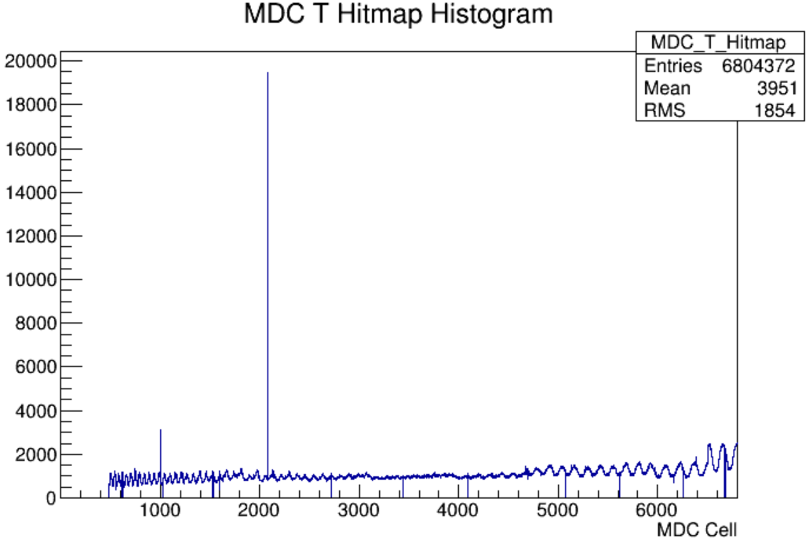
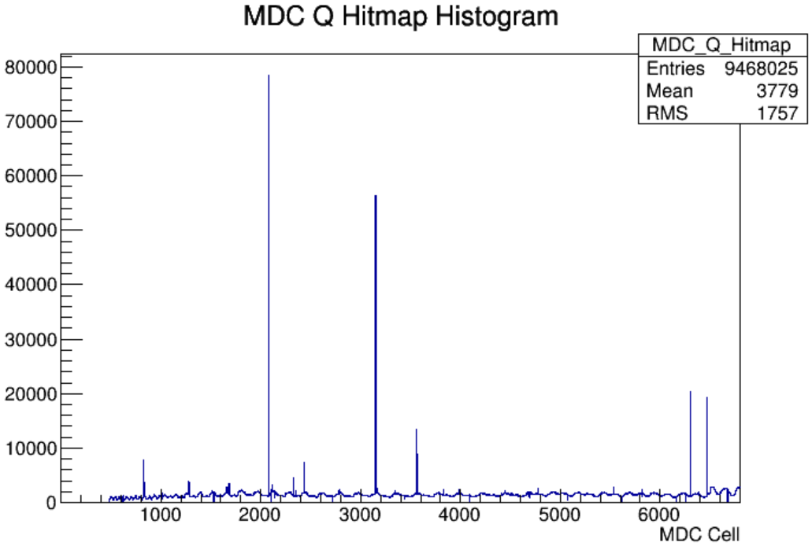
Cosmic-ray tests
After the installation of the preamplifier shielding box, cosmic-ray testing was conducted
Without connecting the CGEM card, almost no noise was found in MDC
Run 83736
Dec.15
Run 83736
Dec.15

Slide 7
Plan for next week
 | Tasks | Time needed (day) | person in charge
1 | Mount patch cards of CGEM | Dec.16-20 | Italy team
2 | Installation of shielding boxes for CGEM | Dec.16-20 | Italy team
3 | Testing | Dec.21-22 | Italy team, IHEP
4 | Installation of final shielding plates | Dec.23 | Italy team, IHEP

