Slide 1
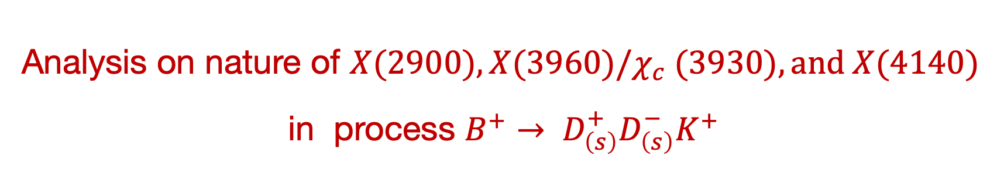
Analysis on nature of $X(2900), X(3960)/χ_{c} (3930), and X(4140)$ in process $B^{+}→ D_{\left(s\right)}^{+}D_{\left(s\right)}^{−}K^{+}$
何军
南京师范大学
Zuo-Ming Ding, Qi Huang, Jun He, Eur. Phys. J. C 84 (2024) 822
Zuo-Ming Ding, Jun He, Eur. Phys. J. C 83 (2023) 806
Zuo-Ming Ding, Han-Yu Jiang, Dan Song, Jun He, Eur. Phys. J. C 81 (2021)732
S. Y. Kong, J. T. Zhu, D. Song and J. He, Phys. Rev. D 104 (2021) 094012
2025中高能核物理和强子物理前沿研讨会 2025年1月17-19日

Slide 2
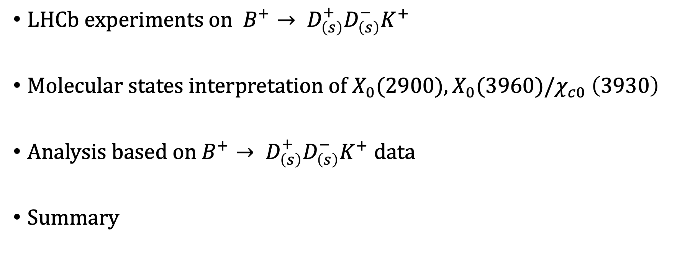
Outline
$LHCb experiments on B^{+}→ D_{\left(s\right)}^{+}D_{\left(s\right)}^{−}K^{+}$
$Molecular states interpretation of X_{0}(2900), X_{0}(3960)/χ_{c0} \left(3930\right)$
$Analysis based on B^{+}→ D_{\left(s\right)}^{+}D_{\left(s\right)}^{−}K^{+} data$
Summary

Slide 3
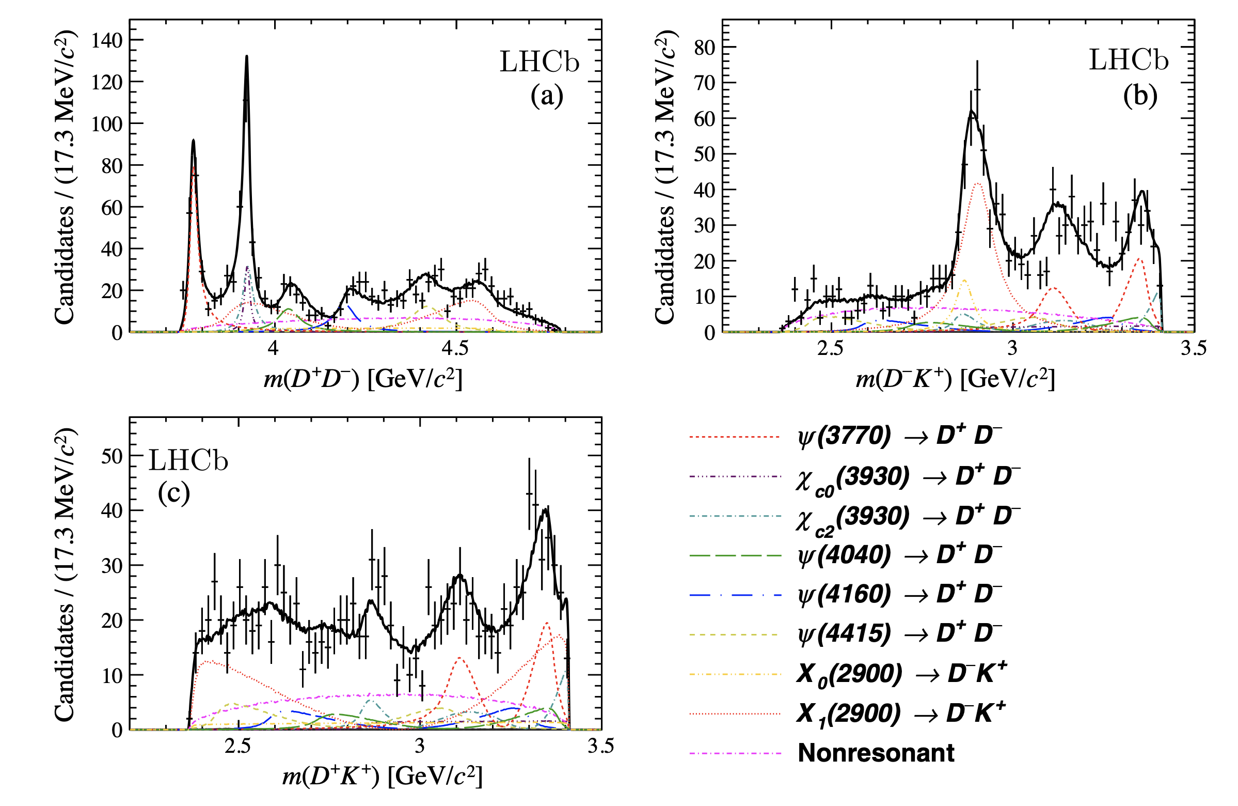
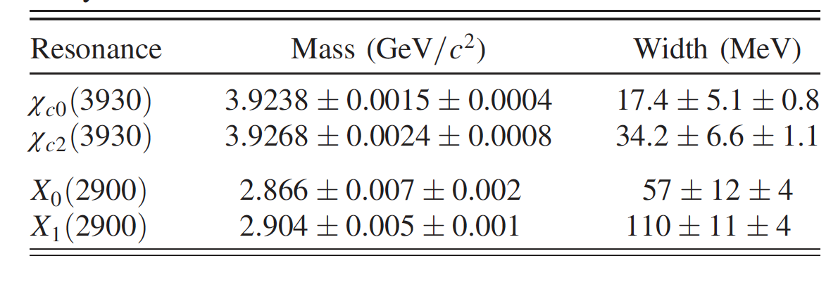
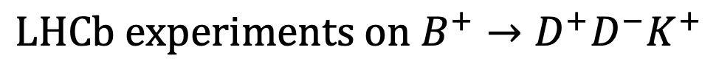
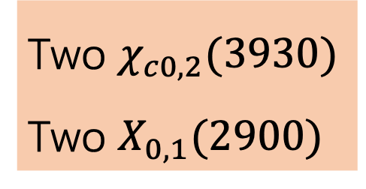
$$LHCb experiments on B^{+}→D^{+}D^{−}K^{+}$$
Two $χ_{c0,2}(3930)$
Two $X_{0,1}(2900)$
PRL 125, 242001 (2020),PRD 102, 112003 (2020)

Slide 4
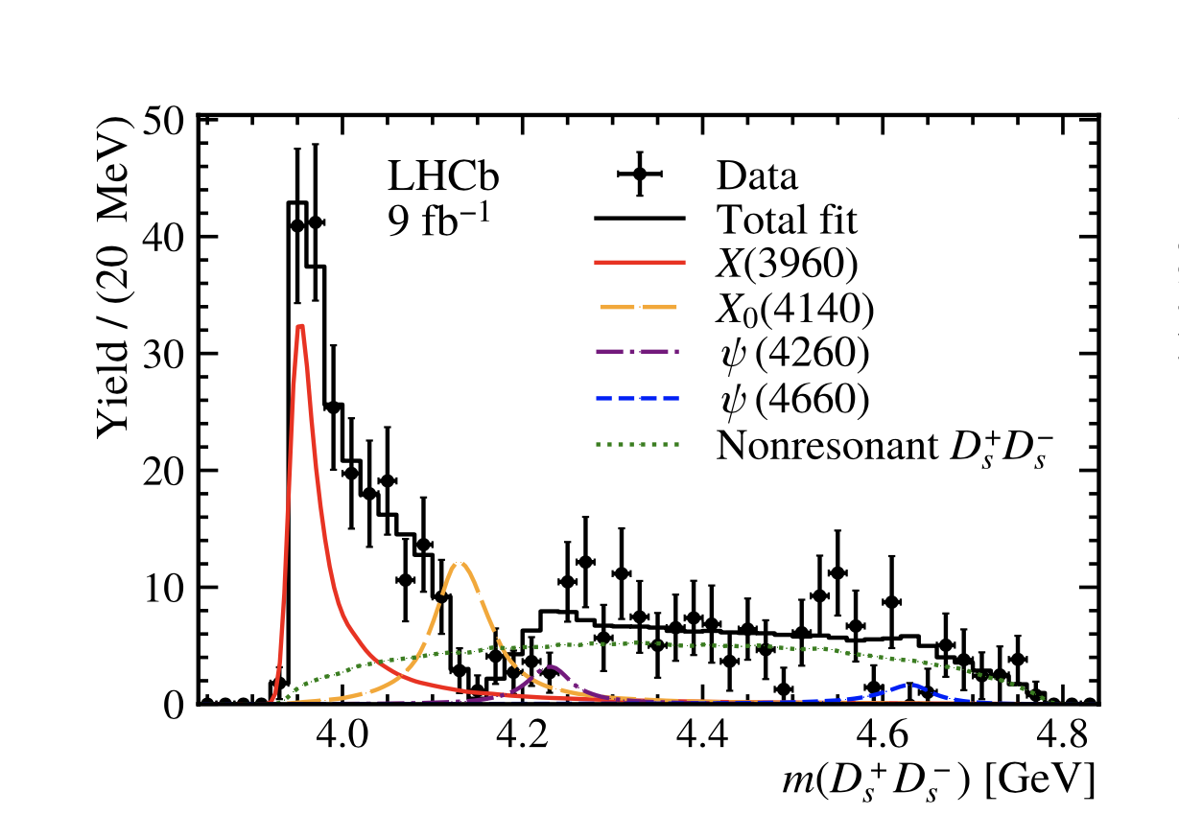
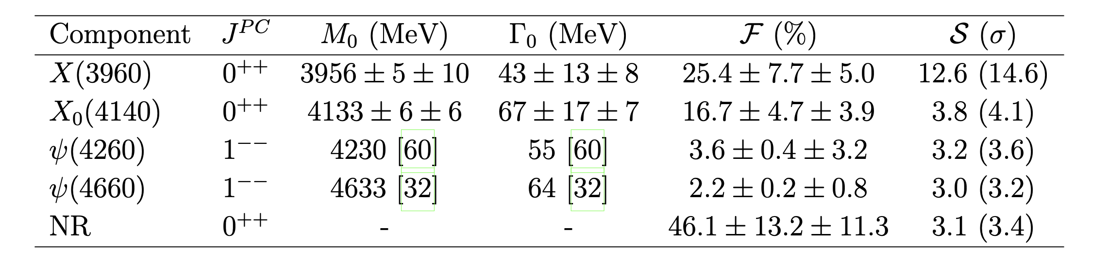
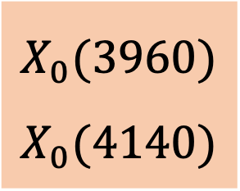
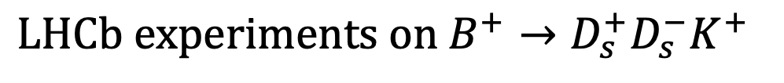
$$LHCb experiments on B^{+}→D_{s}^{+}D_{s}^{−}K^{+}$$
$$X_{0}(3960)$$
$$X_{0}(4140)$$
PRL 131, 071901 (2023)

Slide 5

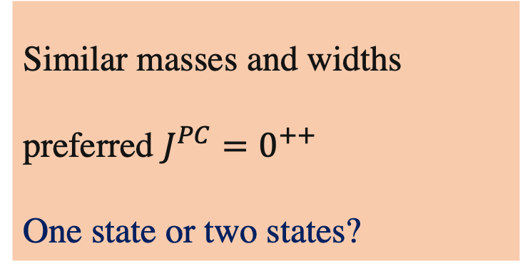

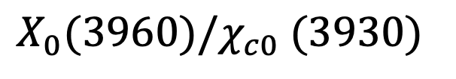


$$X_{0}(3960)/χ_{c0} (3930)$$
$$B^{+}→D^{+}D^{−}K^{+}$$
$X_{0}(3960)/χ_{c0} (3930)$as $D_{s}^{+}D_{s}^{−}$molecule
$$B^{+}→D_{s}^{+}D_{s}^{−}K^{+}$$
$${\overline{D}}_{s}D_{s}$$
H. Mutuk, Eur. Phys. J. C 82(12), 1142 (2022)
Q. Xin, Z.G.Wang, X.S.Yang, AAPPS Bull. 32(1), 37 (2022)
M. Bayar, A. Feijoo, E. Oset, Phys. Rev. D 107(3), 034007 (2023)
T. Ji, X.K. Dong, M. Albaladejo, M.L. Du, F.K. Guo, J. Nieves,Phys. Rev. D 106,094002 (2022)
J.M. Xie, M.Z. Liu, L.S. Geng, Phys. Rev. D 107(1), 016003 (2023)
Similar masses and widths
preferred $J^{PC}=0^{++}$
One state or two states?
Tetraquark
Bing-Dong Wan,Interpretation of X(3960) as the hidden charm-strange tetraquark states via QCD sum rules,Nuclear Physics B,1004,2024,116538,
S. Y. Li, Y. R. Liu, Z. L. Man, Z. G. Si and J. Wu, Chin. Phys. C 48, 063109 (2024)
S. S. Agaev, K. Azizi and H. Sundu, Phys. Rev. D 107, 054017 (2023)
$c\overline{c}$core with $D_{s}^{+} D_{s}^{−}$coupling
Y. Chen, H. Chen, C. Meng, H.R. Qi, H.Q. Zheng, Eur. Phys. J. C 83(5), 381 (2023)

Slide 6
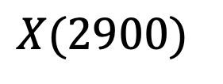

$$X(2900)$$
$$X\left(2900\right) as {\overline{D}}^{∗}K^{∗} molecular state$$
QCD sum rule
H.X. Chen, W. Chen, R.R. Dong, N. Su, Chin. Phys. Lett. 37(10), 101201 (2020)
S.S. Agaev, K. Azizi, H. Sundu, J. Phys. G 48(8), 085012 (2021)
H. Mutuk, J. Phys. G 48(5), 055007 (2021)
Chiral unitary approach
R. Molina, E. Oset, Phys. Lett. B 811, 135870(2020)
OBE model
M.Z. Liu, J.J. Xie, L.S. Geng, Phys. Rev. D 102(9), 091502 (2020)
Compact tetraquark
Triangle singularity
J.R. Zhang, Phys. Rev. D 103(5), 054019 (2021)
Z.G.Wang, Int. J. Mod. Phys. A 35(30), 2050187 (2020)
X.G. He, W. Wang, R. Zhu, Eur. Phys. J. C 80(11), 1026 (2020)
G.J.Wang, L. Meng, L.Y. Xiao,M. Oka, S.L. Zhu, Eur. Phys. J. C 81(2),188 (2021)
X.H. Liu, M.J. Yan, H.W. Ke, G. Li, J.J. Xie, Eur. Phys. J. C 80(12), 1178 (2020)
T.J. Burns, E.S. Swanson, Phys. Lett. B 813, 136057 (2021)

Slide 7
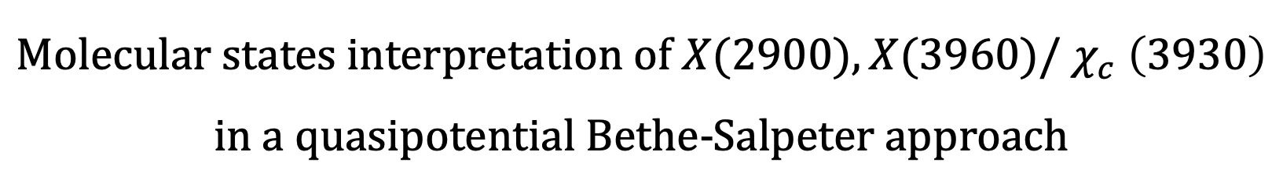
$$Molecular states interpretation of X(2900), X(3960)/ χ_{c} \left(3930\right)$$
in a quasipotential Bethe-Salpeter approach

Slide 8
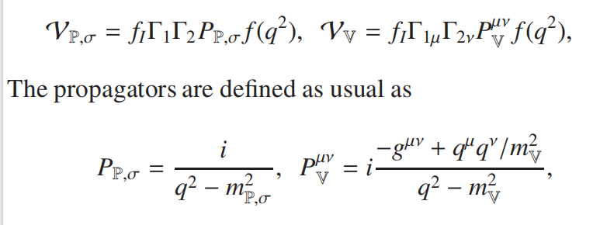
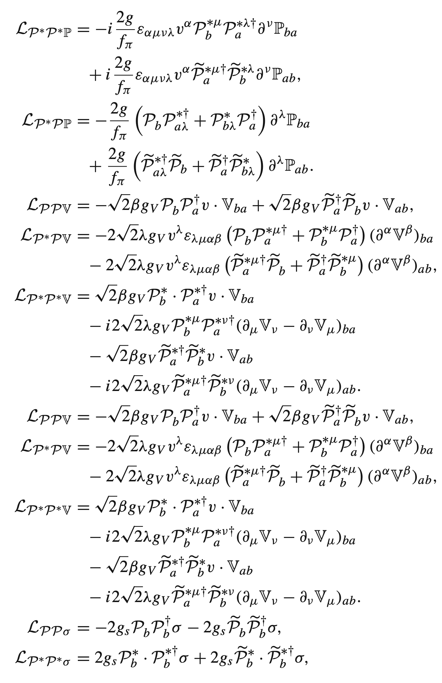
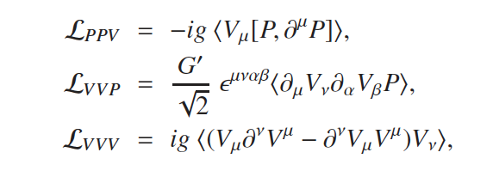
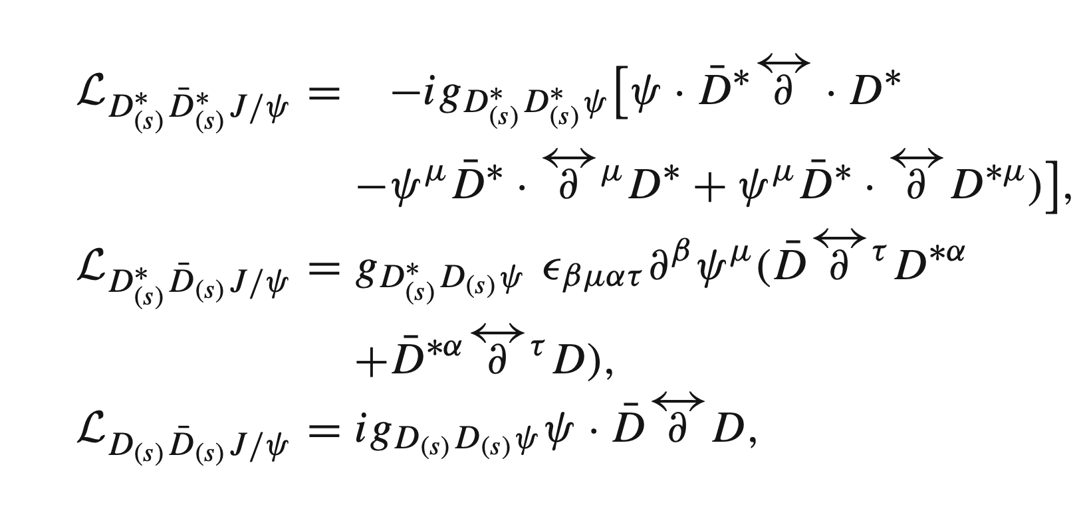
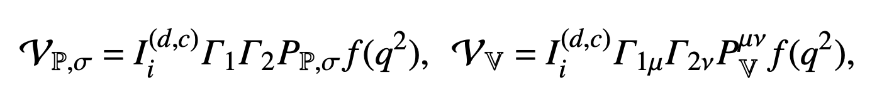



















One boson exchange model
$X_{0}(3960)/χ_{c0} (3930)$as $D_{s}^{+}D_{s}^{−}$molecule
$$X\left(2900\right) as {\overline{D}}^{∗}K^{∗} molecular state$$
$$𝒫^{\left(∗\right)}$$
$$Γ_{1}$$
$$𝒫^{\left(∗\right)}$$
$$K^{\left(∗\right)}$$
$$Γ_{1}$$
$$K^{\left(∗\right)}$$
$$π, η, ρ,φ……$$
$$π, η, ρ,ω……$$
$$f\left(q^{2}\right)=\frac{Λ_{e}^{2}}{q^{2}−Λ_{e}^{2}}$$
$$f\left(q^{2}\right)=\frac{Λ_{e}^{2}}{q^{2}−Λ_{e}^{2}}$$
$𝒫^{\left(∗\right)}/$ ${\overline{𝒫}}^{\left(∗\right)}$
$$Γ_{2}$$
$𝒫^{\left(∗\right)}/$ ${\overline{𝒫}}^{\left(∗\right)}$
$𝒫^{\left(∗\right)}/$ ${\overline{𝒫}}^{\left(∗\right)}$
$$Γ_{2}$$
$𝒫^{\left(∗\right)}/$ ${\overline{𝒫}}^{\left(∗\right)}$
$$Γ_{1,2}$$
$$Γ_{1,2}$$
M. Bando, T. Kugo, S. Uehara, K. Yamawaki, T. Yanagida, Phys.Rev. Lett. 54, 1215 (1985), M. Bando, T. Kugo, K. Yamawaki, Phys. Rep. 164, 217–314 (1988), H. Nagahiro, L.Roca, A. Hosaka, E.Oset, Phys. Rev. D 79,014015 (2009)
Chen et al. PRD47(1993)1030; Yan et al.PRD46(1992)1148; Wise, PRD45(1992)2188; Casalbuoni et al. Phys. Rept. 281(1997)145
Notes:
To get the interaction of two charmed mesons, we adopt the one-boson-exchange model, that is, two charmed meson interacts by exchanging light mesons, such as $π, η, ρ,……$
To obtain the interaction for a certain state, we need construct the wave functions with fixed isospin. Here, we list the wave functions for different systems.

Slide 9
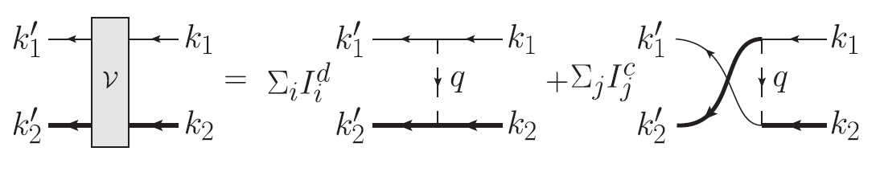
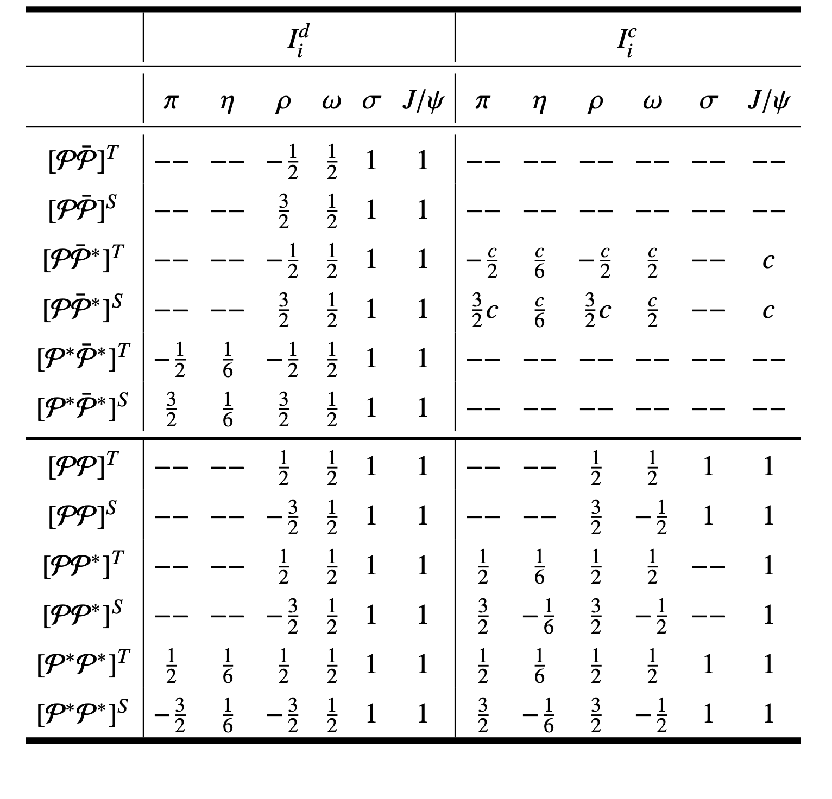
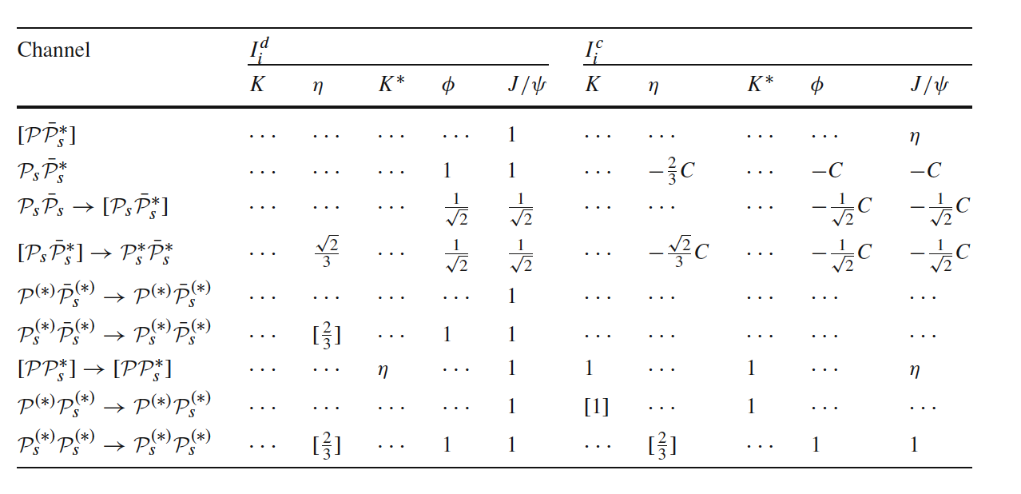
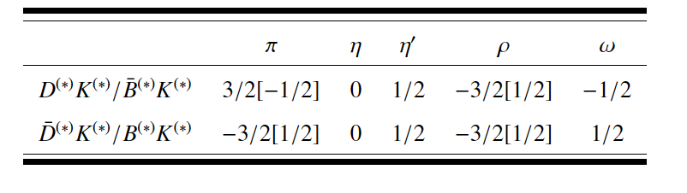
Potential
Notes:
The potential can be obtained with above wave functions and Lagrangians. We have two types of diagrams, direct diagram and cross diagram. For different exchanges, we have isospin factors. In this work, we consider exchanges of pi eta, rho, omega, sigma and Jpsi meson. The potential can be obtained by the standard Feynman rules with upper and lower vertices, and propagator of the exchanged light meson. A form factor is also introduced to the exchanged meson. Here, we adopt a form factor of such form.

Slide 10
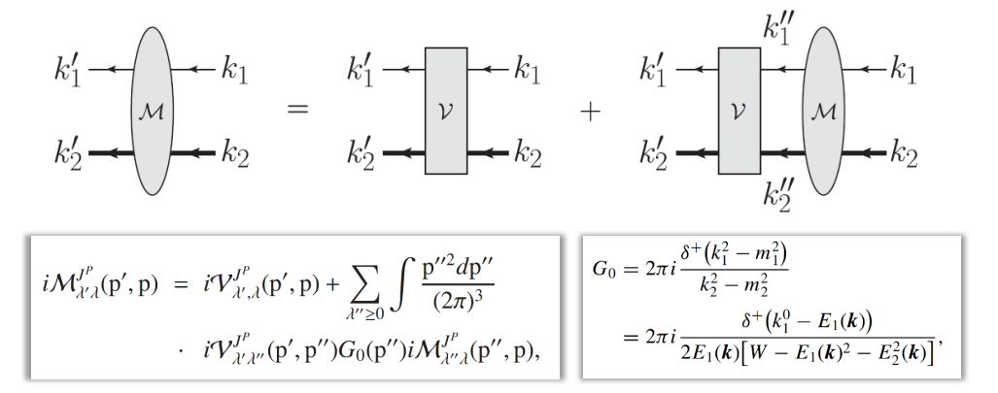
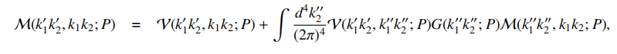
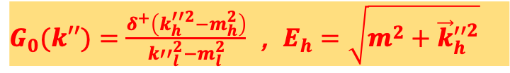
Quasipotential Bethe-Salpeter Equation
$G_{0}(k′′)=\frac{δ^{+}\left(k_{h}^{′′2}−m_{h}^{2}\right)}{k′′_{l}^{2}−m_{l}^{2}}$ , $E_{h}=\sqrt{m^{2}+{\vec{k}}_{h}^{′′2}}$
The 4-dimensional BSE
Quasipotential approximation
The 3-dimensional equation
Notes:
To find the bound state from the interaction. We adopt quasipotential Bethe-Salpeter Equation approach. The Bethe-Salpeter Equation is widely used to study the bound state problems. It is a four dimensional integral equation in Minkowski space. It is a hard work to solve such equation directly. Professor Roberts and Chang are experts to solve such equations. However, in the study of exotic states, we need not to make so exact calculation. As done in the study of the deuteron and nucleon-nucleon scattering, we make an quasipitential approximation to reduce the 4-dimensional BSE to a 3-dimensional equation by introducing a delta function.

Slide 11
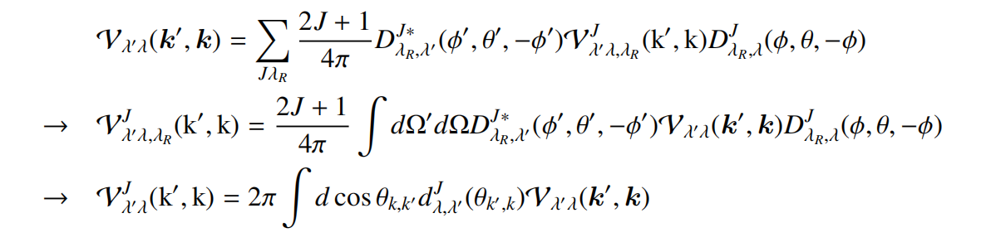
Partial wave decomposition
The 3-dimensional equation
Partial wave decomposition
The 1-dimensional equation
Notes:
Then we can make a Partial wave decomposition on the 3-dimensional equation obtained. Finally, we reach a 1-dimensional equation

Slide 12

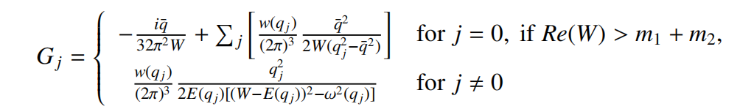


Transformation to matrix equation
Transformed as a
matrix equation by
Gauss discretization
Search for the pole
$$M={(1−VG)}^{−1}V$$
$$\left|1−VG\right|=0$$
Notes:
Then, we transform the 1-dimensional integral equation to a matrix equation by Gauss discretization. The pole can be found at a position with determinant of 1-VG being 0.

Slide 13
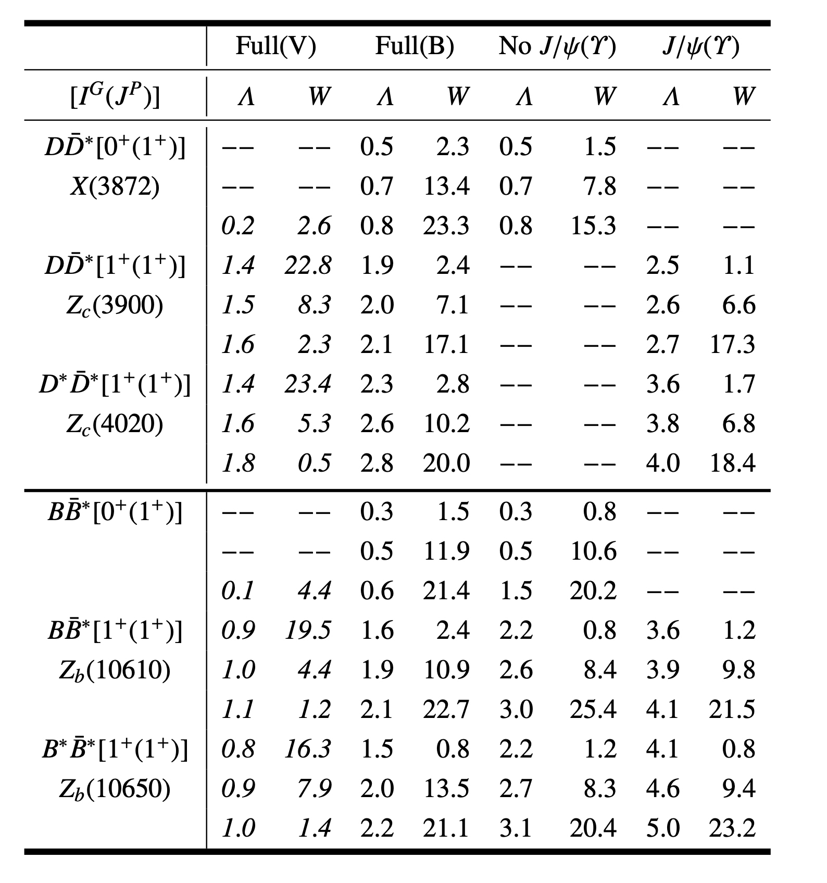
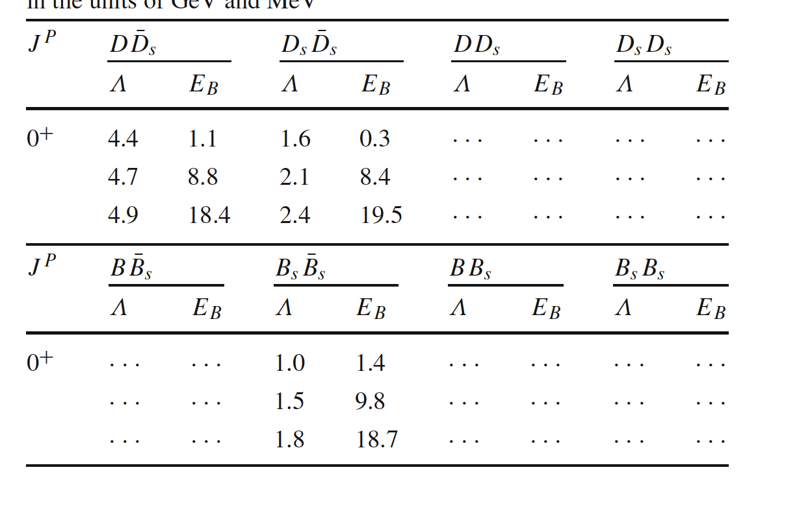
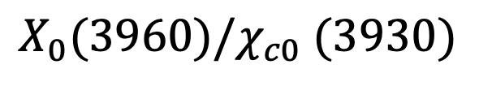
$$X_{0}(3960)/χ_{c0} (3930)$$
Zuo-Ming Ding, Han-Yu Jiang, Dan Song, Jun He, Eur. Phys. J. C 81 (2021)732
Notes:
First, we give the results for observed states. The X(3872), Z_c(3900), Zc(4020), and Zb states can be reproduced.
However, cutoffs for $D{\overline{D}}^{∗}$and $D^{∗}{\overline{D}}^{∗}$states with $1^{+}(1^{+})$are about 2 GeV, larger than those to produce $0^{+}(1^{+})$ state. In the literature, the Zc(3900) has been suggested to be virtual state. If we assume that the $Z_{c}(3900)$and $Z_{c}(4020)$are virtual states , the gap of the cutoff will reduce.
We consider the heavy meson exchange. Without the $J/ψ$ exchange, the two hidden-charm states with $1^{+}(1^{+})$ can not be produced while without the $Υ$ exchange the two hidden-bottom states are still found with a little larger cutoff. Only with the $J/ψ(Υ)$ exchange, the bound state can be found in both cases while the hidden-bottom states requires larger cutoffs. The $J/ψ$ exchange in the charm sector is more important than the $Υ$exchange in the bottom sector.

Slide 14
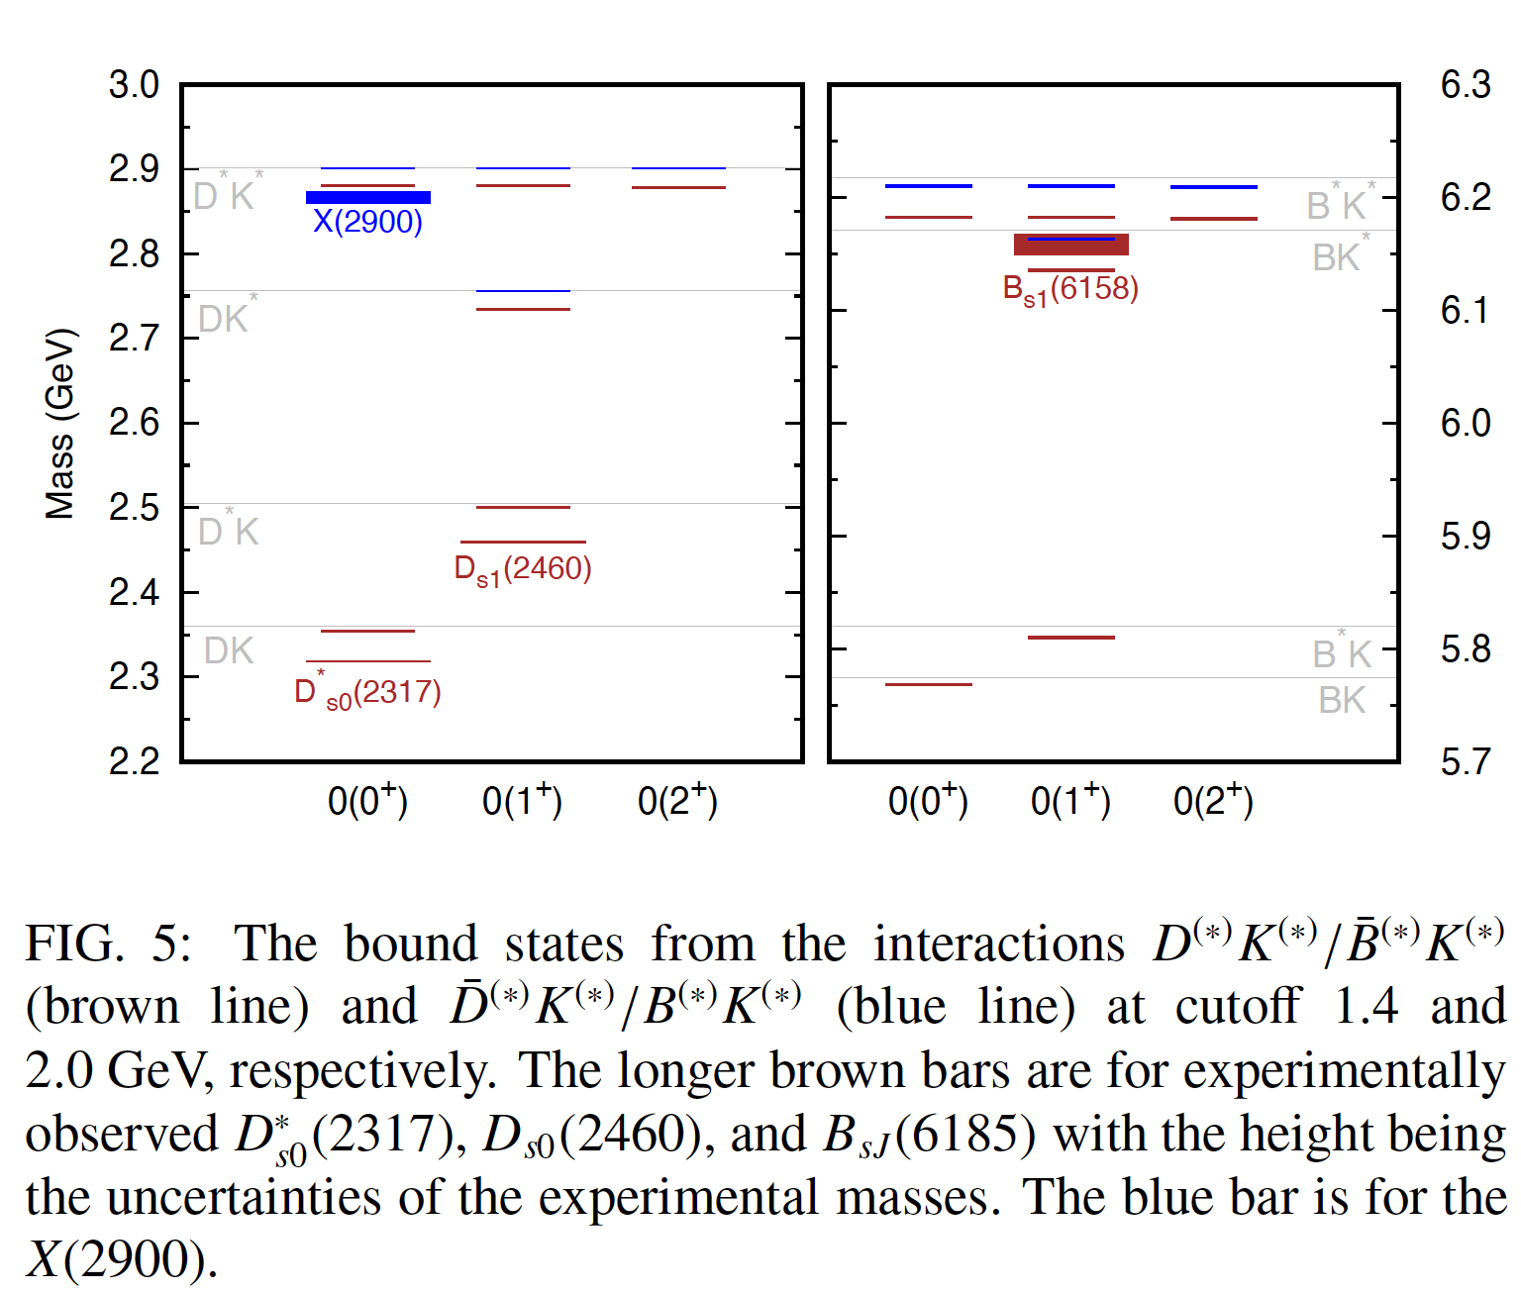
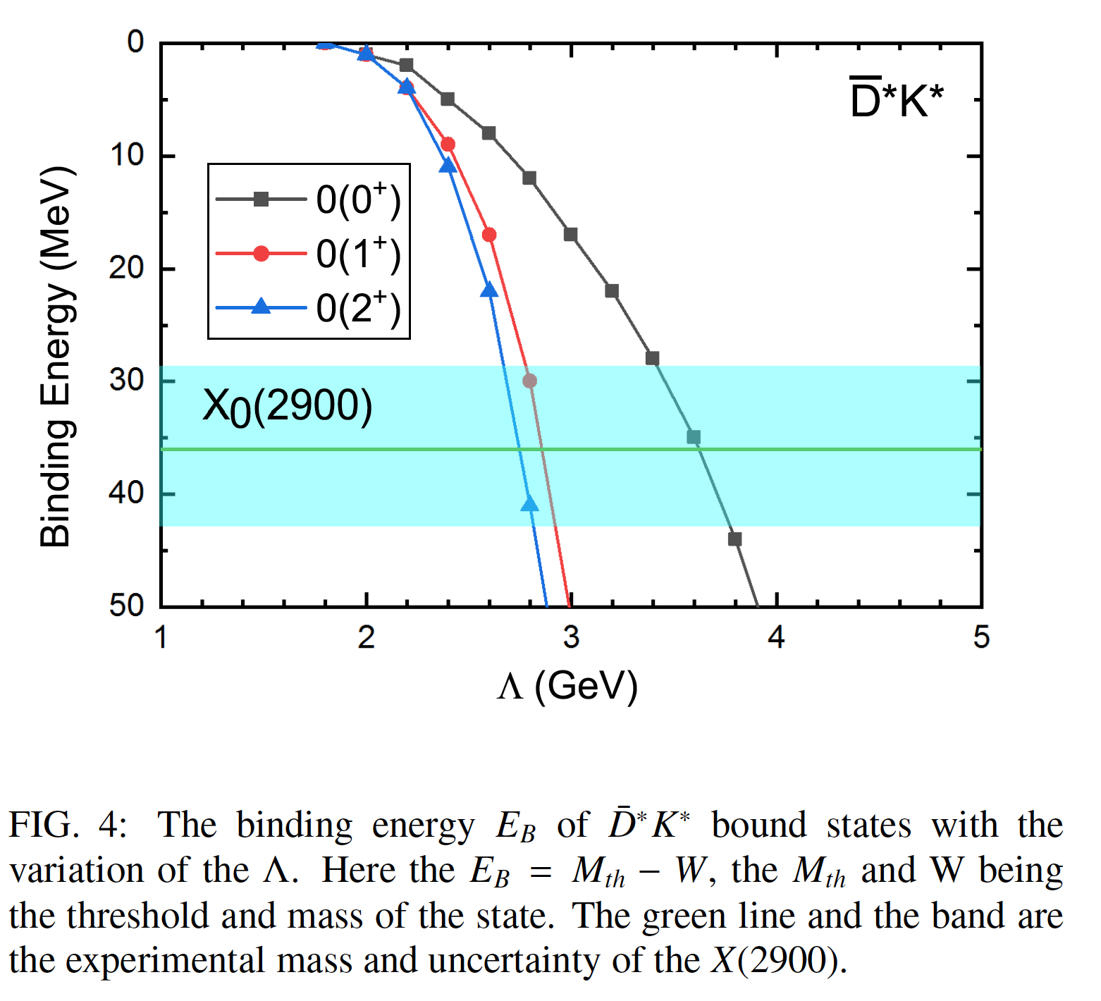
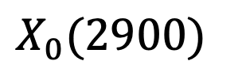
$$X_{0}(2900)$$
S. Y. Kong, J. T. Zhu, D. Song and J. He, Phys. Rev. D 104 (2021) 094012

Slide 15
$$Analysis based on B^{+}→ D_{\left(s\right)}^{+}D_{\left(s\right)}^{−}K^{+} data$$

Slide 16
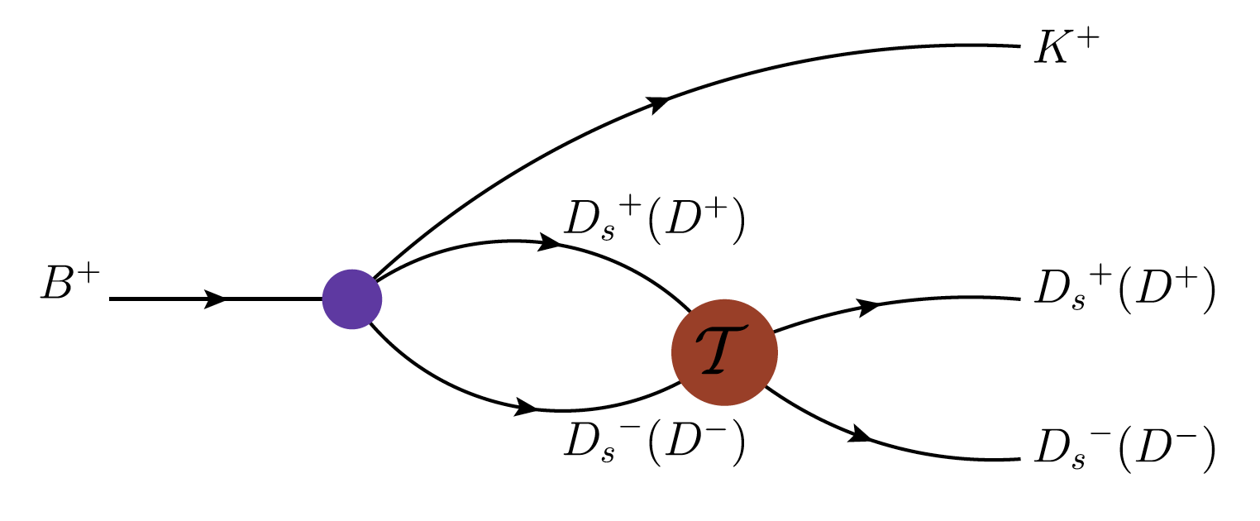
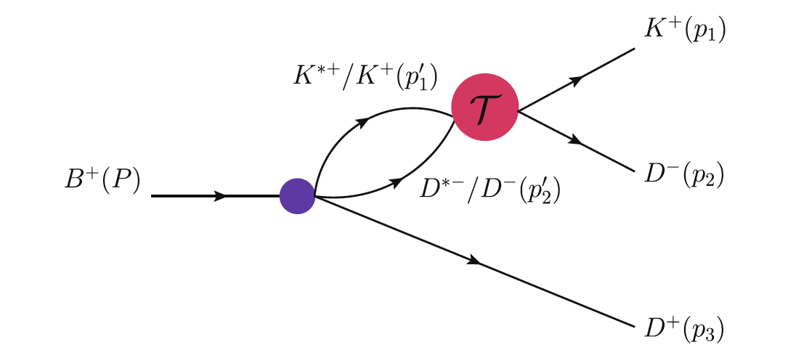
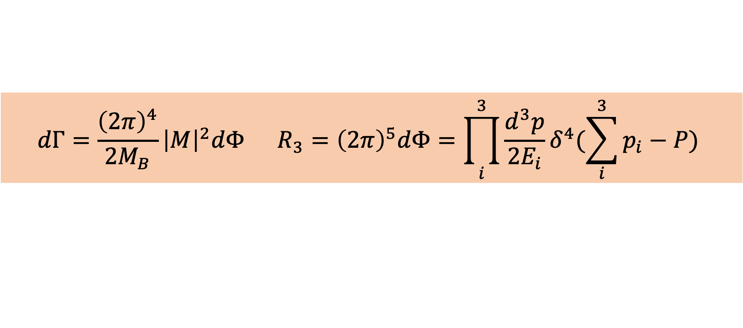


Three-body decay
$$T={(1−VG)}^{−1}V$$
$$M=TGA$$
$$dΓ=\frac{{\left(2π\right)}^{4}}{2M_{B}}{\left|M\right|}^{2}dΦ R_{3}={\left(2π\right)}^{5}dΦ=\prod_{i}^{3}{\frac{d^{3}p}{2E_{i}}δ^{4}(\sum_{i}^{3}{p_{i}}−P)}$$
GENEV code in FAWL

Slide 17
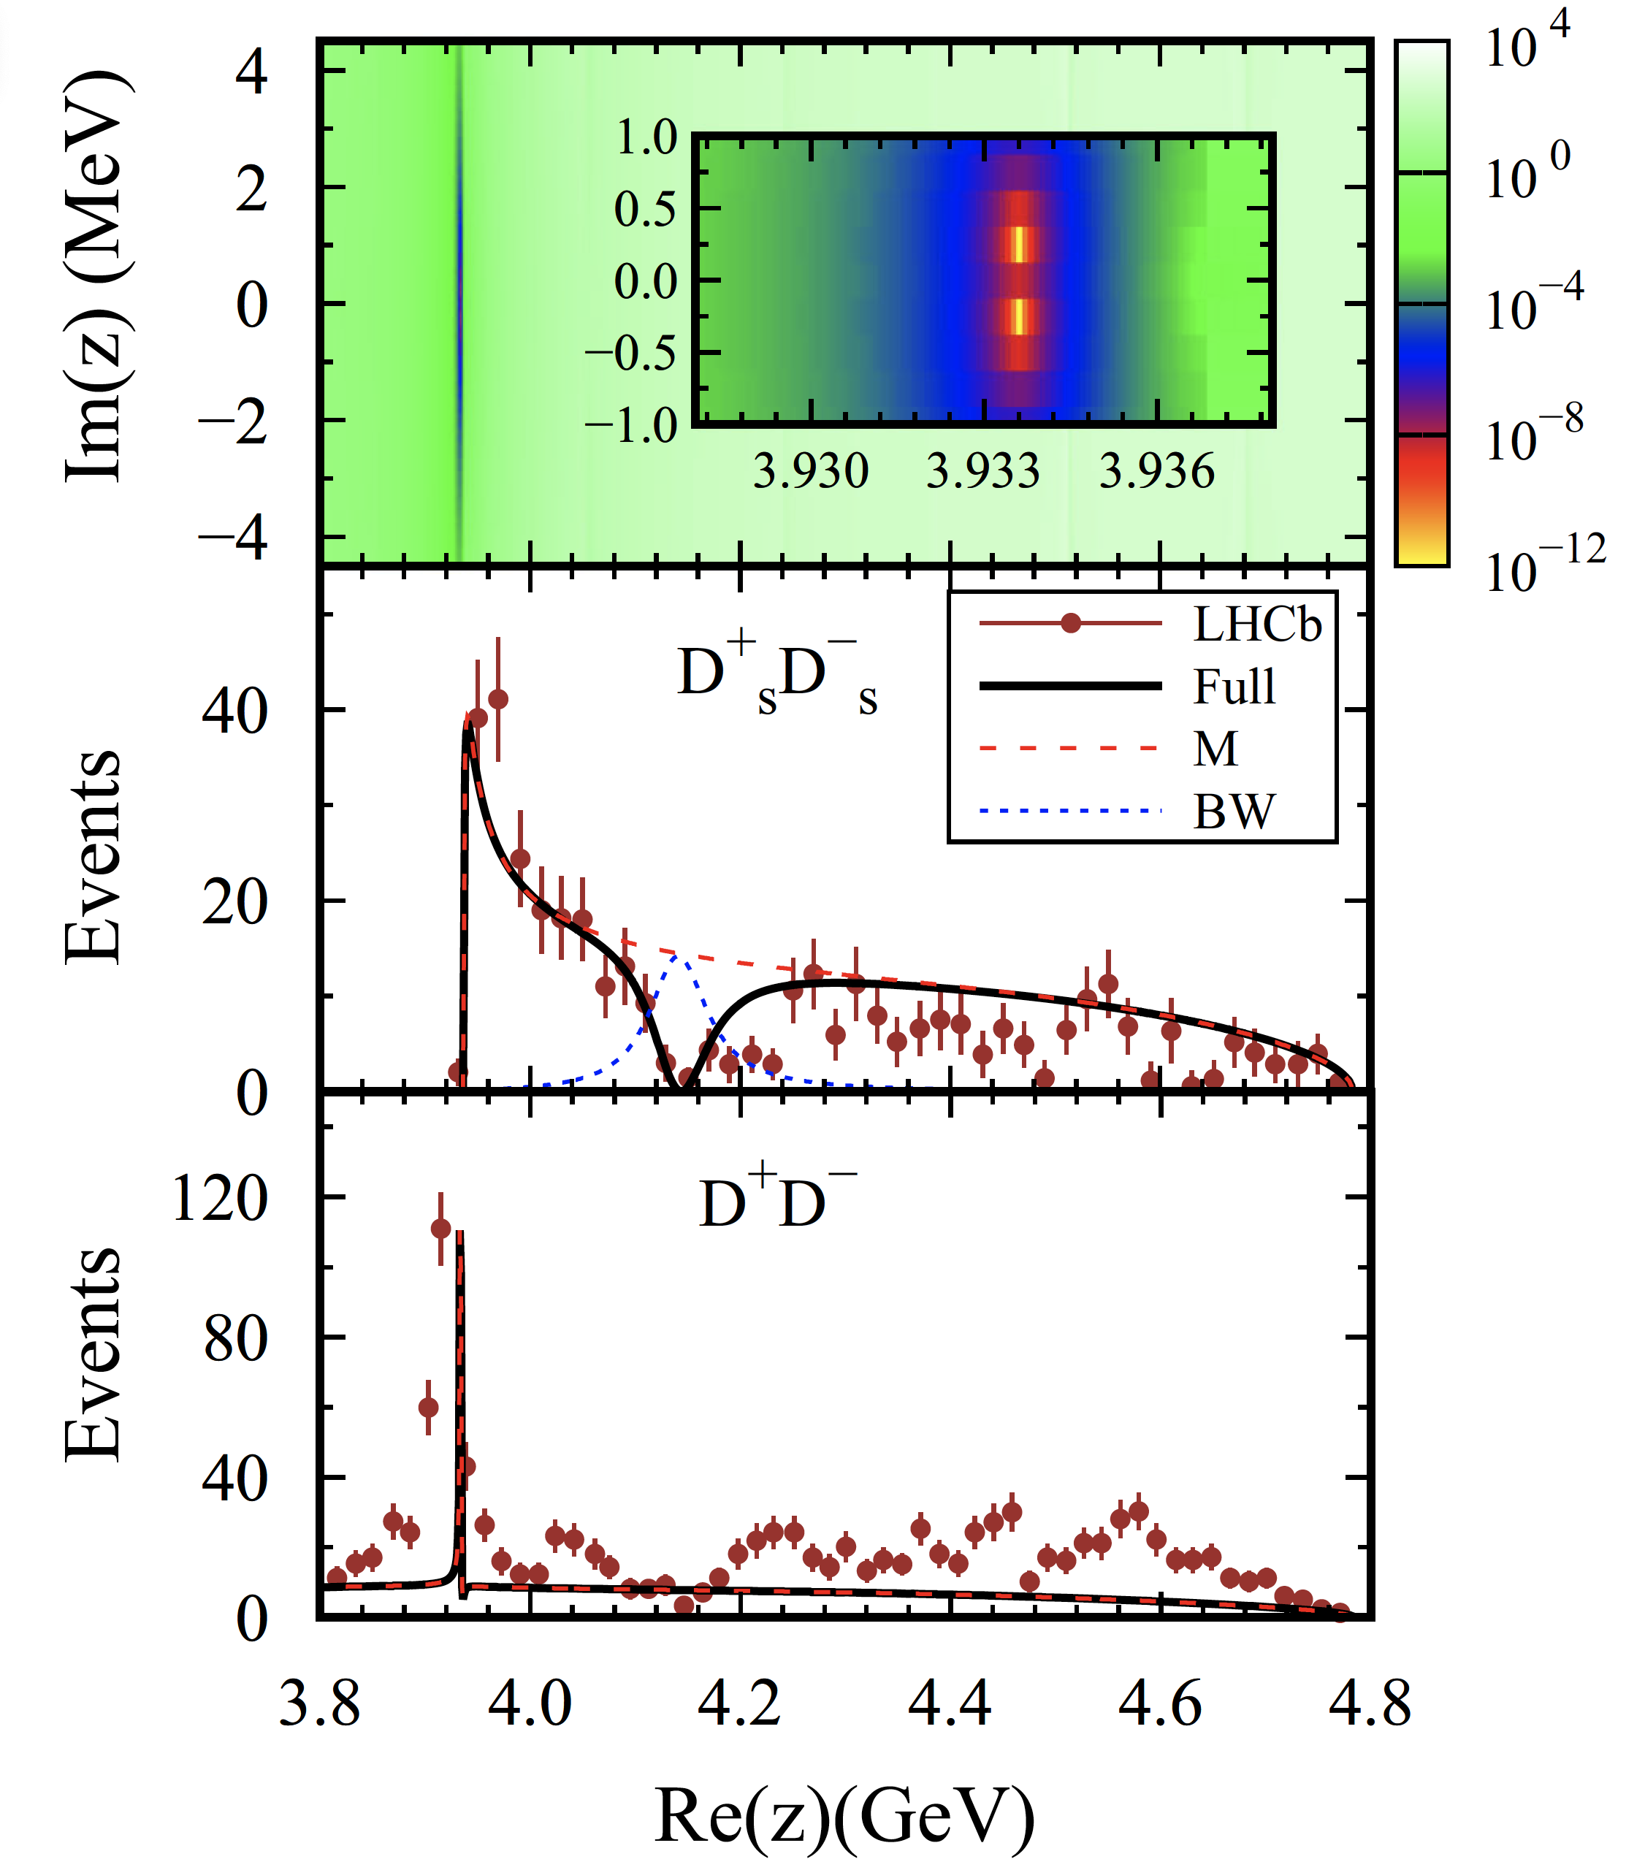
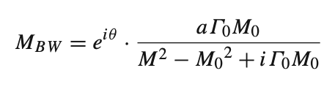

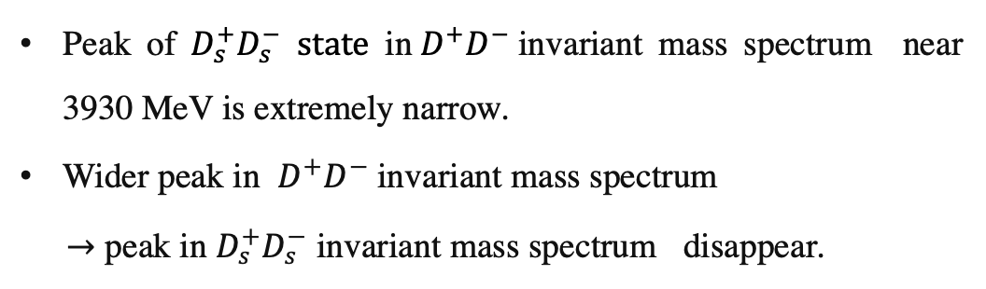
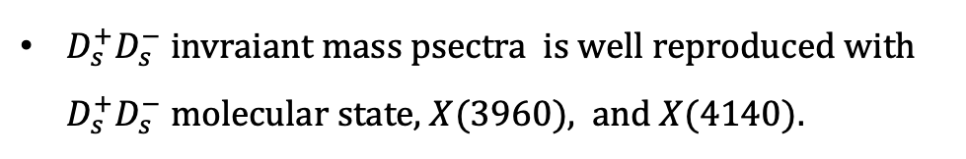
$D_{s}^{+}D_{s}^{−} and D^{+}D^{−} invariant mass spectra (only with D_{s}^{+}D_{s}^{−}$- $D^{+}D^{−} rescattering)$
Two conjugate poles located at 3933.6±0.25i MeV.
$X(4140)$
$D_{s}^{+}D_{s}^{−} invraiant mass psectra$ is well reproduced with $D_{s}^{+}D_{s}^{−}$ molecular state, $X(3960)$, and $X(4140)$.
Peak of $D_{s}^{+}D_{s}^{−}$ state in$D^{+}D^{−}$invariant mass spectrum near 3930 MeV is extremely narrow.
Wider peak in $D^{+}D^{−} \text{invariant} \text{mass} \text{spectrum}$
$→$ peak in $D_{s}^{+}D_{s}^{−} \text{invariant} \text{mass} \text{spectrum}$disappear.
Zuo-Ming Ding, Jun He, Eur. Phys. J. C 83 (2023) 806

Slide 18
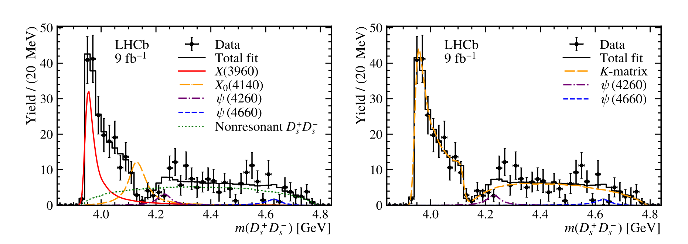
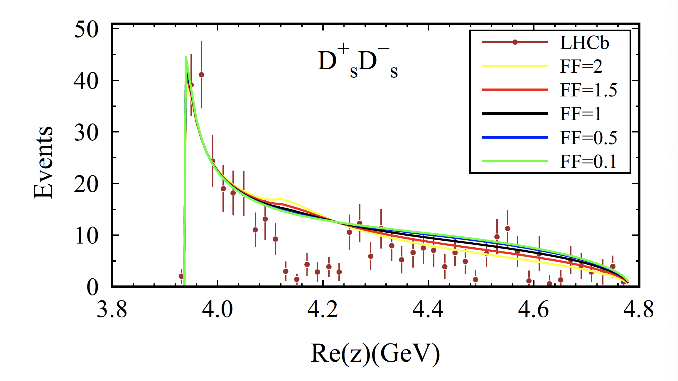
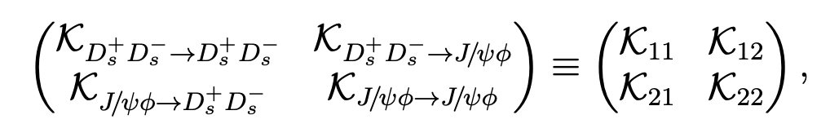
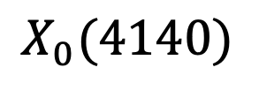
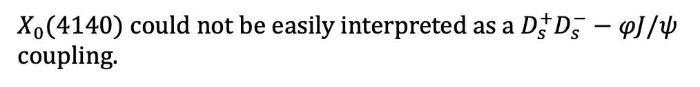
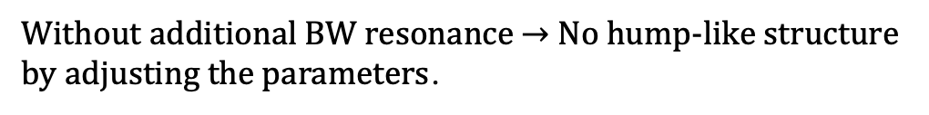

$$X_{0}(4140)$$
LHCb
This work
Introducing an additional BW resonance
Without $X(4140)$，$with D_{s}^{+}D_{s}^{−}−φJ/ψ$ coupling
$Including D_{s}^{+}D_{s}^{−} −φJ/ψ$ coupling
Without additional BW resonance $→$No hump-like structure
by adjusting the parameters.
$X_{0}(4140)$could not be easily interpreted as a $D_{s}^{+}D_{s}^{−}−φJ/ψ$ coupling.
Our results do not conflict with experimental analysis, but are obtained with more theoretical constraint.
Zuo-Ming Ding, Jun He, Eur. Phys. J. C 83 (2023) 806

Slide 19
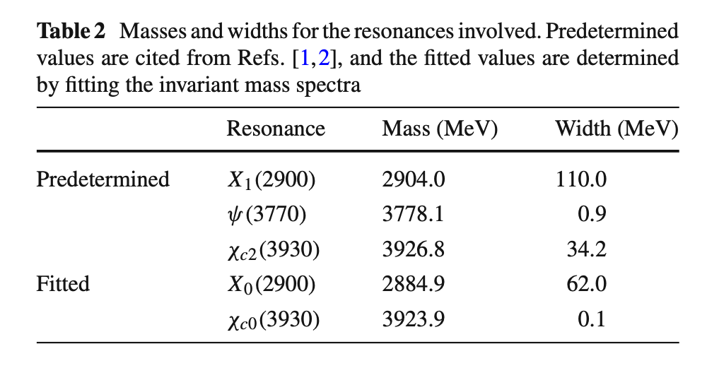
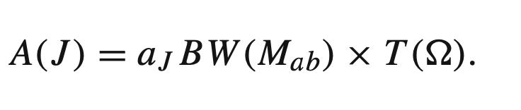
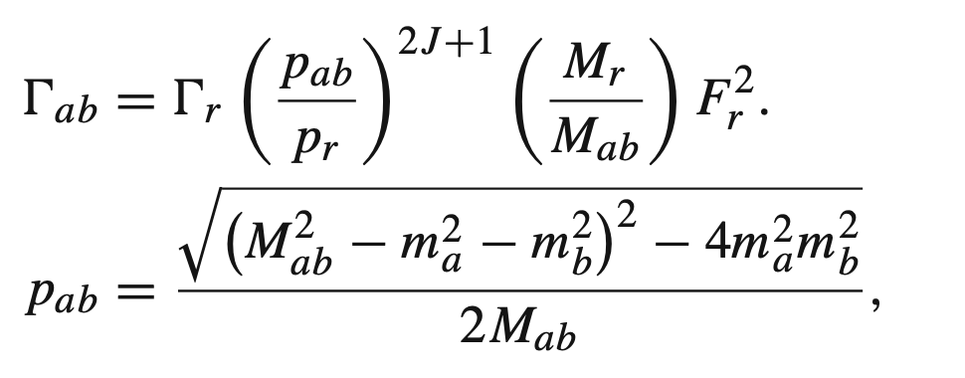





$$With both D_{s}^{+}D_{s}^{−}−D^{+}D^{−} and D^{−}K^{+}rescattering$$
$$Rescattering$$
$Res$onance
Zuo-Ming Ding, Qi Huang, Jun He, Eur. Phys. J. C 84 (2024) 822

Slide 20





$$D^{+}D^{−} invariant mass spectrum$$
$χ_{c0}(3930)$peak is too narrow to fully explain the experimental structure around 3930 MeV
$Wider χ_{c2}(3930)$plays a crucial role in forming the resonance near 3930 MeV
Distinct structure around 3770 MeV from $ψ(3770）$
For structures in the higher energy region, experimental analysis suggests that additional states, such as $ψ(4040), ψ(4160), and ψ(4415),$should be included.
Zuo-Ming Ding, Qi Huang, Jun He, Eur. Phys. J. C 84 (2024) 822

Slide 21




$$D^{−}K^{+} invariant mass psectrum$$
An obvious peak produced near 2885 MeV
Satisfactory fit of the LHCb’s data cannot be obtained if the $X_{1}(2900)$ is not included,
Two bumps can be observed around 3.0 to 3.5 GeV: $ψ(3770)$and $χ_{c2}(3930)$states
Zuo-Ming Ding, Qi Huang, Jun He, Eur. Phys. J. C 84 (2024) 822

Slide 22
Summary

Slide 23

Summary
The process $B^{+}→ D_{\left(s\right)}^{+}D_{\left(s\right)}^{−}K^{+}$is studied based on the LHCb data.
$X(3960)$can be interpreted as a $D_{s}^{+}{ D}_{s}^{−}$ molecular state, and reproduce the peak in $D_{s}^{+}{ D}_{s}^{−}$ invariant mass spectrum.
The $D_{s}^{+}{ D}_{s}^{−}$ molecular state provide a too narrow peak in $D^{+}D^{−}$ invariant mass spectrum. Only with a BW form $χ_{c2}$, the experimental peak can be reproduced.
$X_{0}(2900)$ can be interpreted as a ${\overline{D}}^{∗}K^{∗}$ molecular state, but a BW $X_{2}(2900)$ is required to reproduce the peaks in $D^{−} K^{+}$ invariant mass spectrum.
In our model, the $X_{0}(4140)$ could not be easily interpreted as a $D_{s}{\overline{D}}_{s} −φJ/ψ$ coupling.

Slide 24
THANK YOU!

