Slide 1
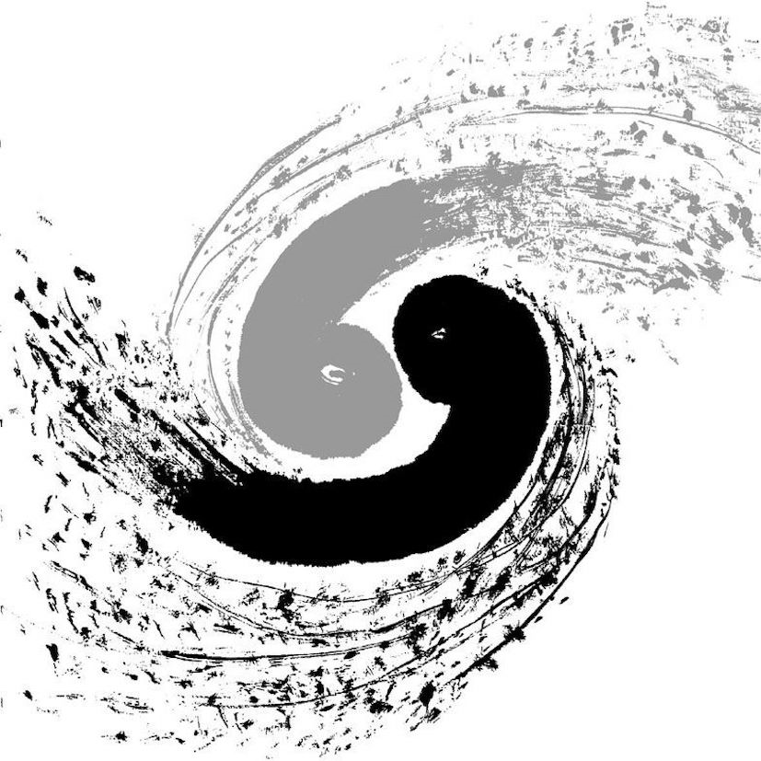
$$Study of B^{+}→h^{+}π^{0}(h=K,π) at Belle and BelleII$$
Wanyi Zhuang¹, Kairui Huang¹, Xiaolong Wang¹, Mikihiko Nakao²
¹Fudan University
²KEK(High Energy Accelerator Research Organization)
23110200038@m.fudan.edu.cn
2024.12.18

Slide 2
$$Analysis of B2BII$$
Signal region:
$5.26<{Mbc}_{mod}<5.29$
$−0.30<∆E<0.20$
$0<mu_trans<1$(CSMVA>0.60)
Correlation:
Using Roo3DkeysPdf to describe BB background
Using Roo3DkeysPdf to describe mis_rec. $B^{+}→π^{+}π^{0}$.
Using Roo2DkeysPdf to describe $B^{+}→K^{+}π^{0}$.

Slide 3
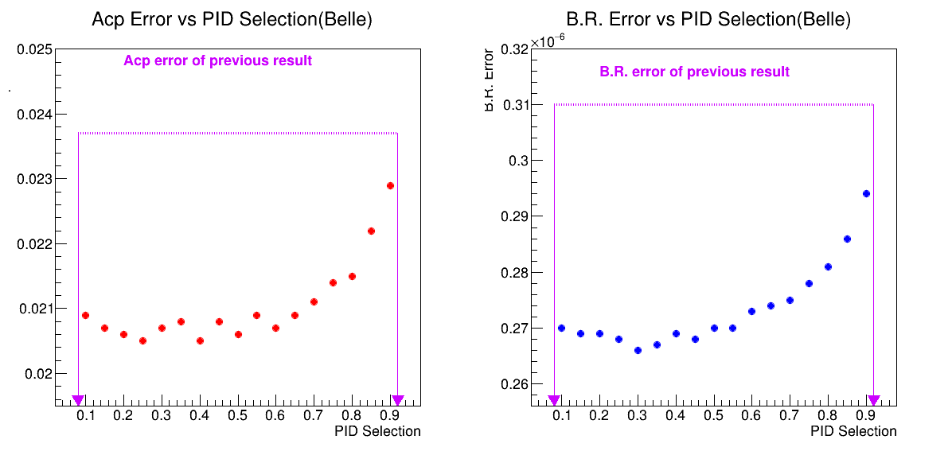
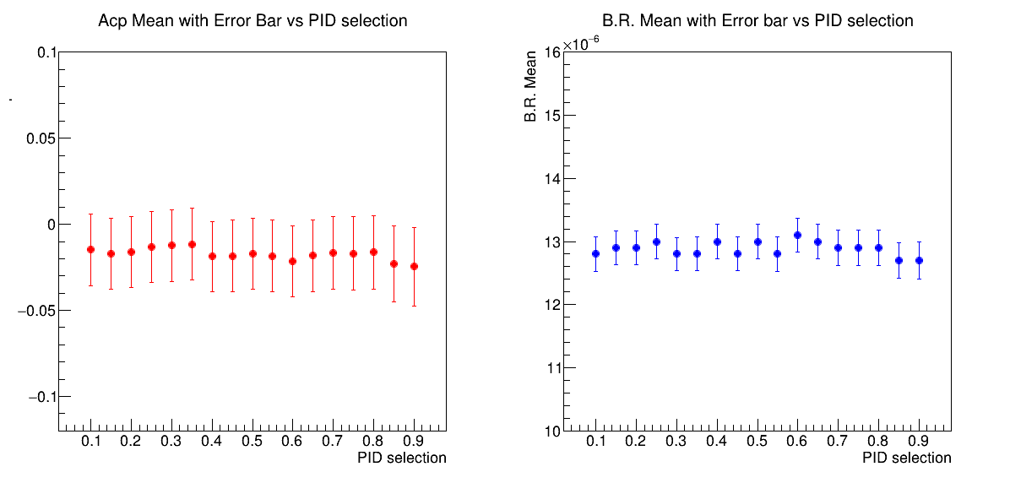
Fitting to $B^{+}→K^{+}π^{0}$ （considering corr.）
Set binaryKID > 0.4
 | $$A_{CP}(B^{+}→K^{+}π^{0})$$ | $$Br(B^{+}→K^{+}π^{0})$$
$$my measurement$$ $$(MC samples)$$ | $$−0.019±0.021$$ | $$(13.00±0.27)×{10}^{−6}$$
$$previous results$$ $$(data samples)$$ | $$0.043±0.024$$ | $$(12.62±0.31)×{10}^{−6}$$

Slide 4
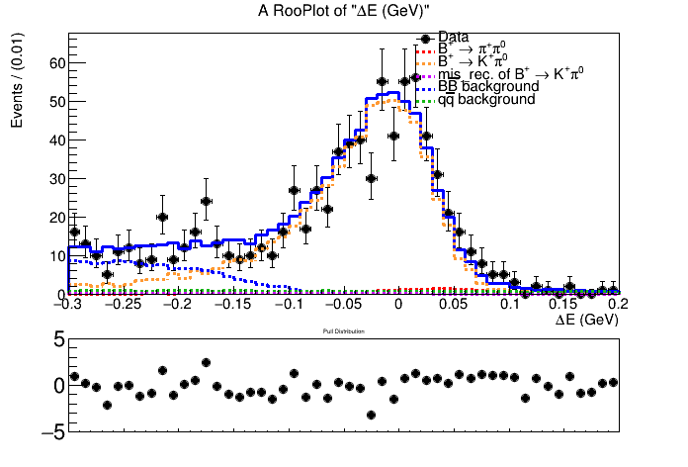
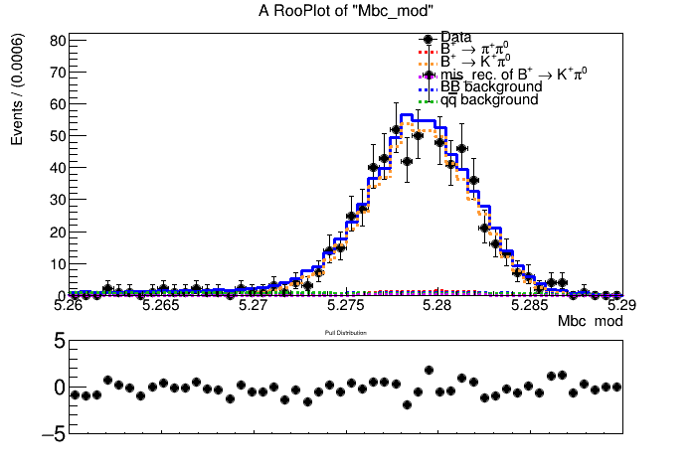
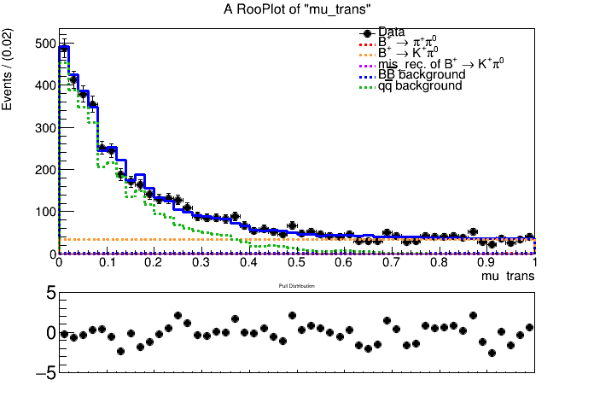
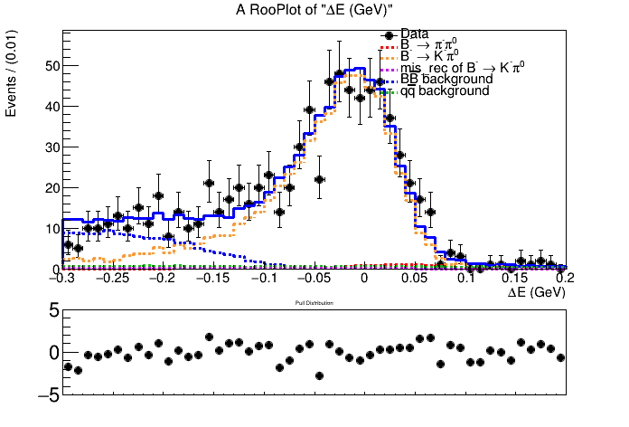
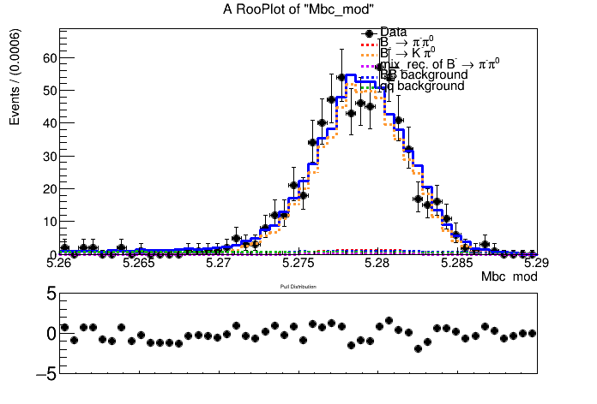
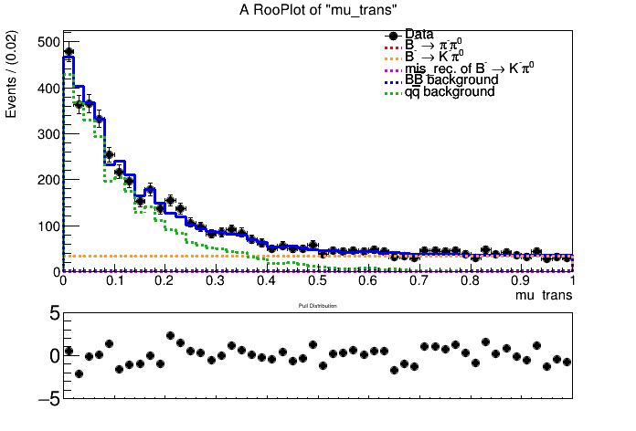
Fitting plots of $B^{+}→K^{+}π^{0}$ （not considering corr.）
Set binaryKID > 0.4
$signal−enhanced region:5.26<{Mbc}_{mod}<5.29,−0.15<∆E<0.10,mu_{trans}>0.65$

Slide 5
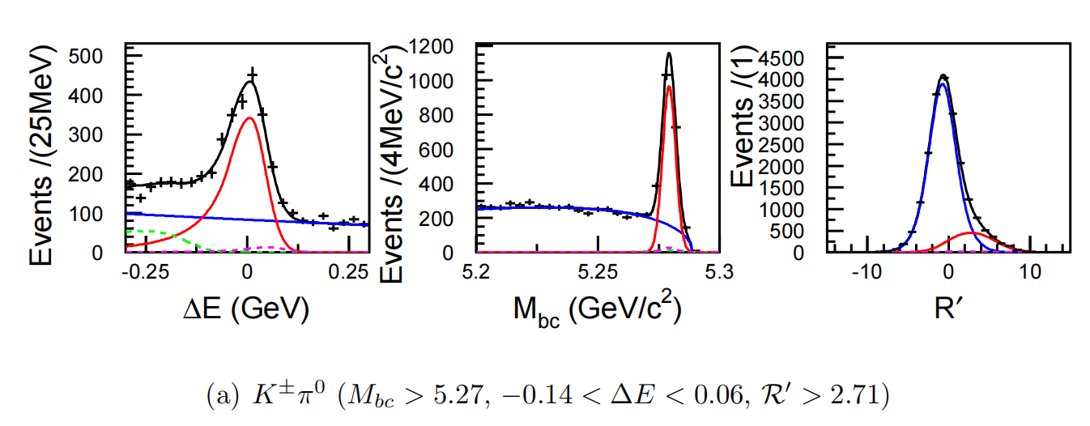
Fitting plots of $B^{+}→K^{+}π^{0}$ （belle previous results）

Slide 6
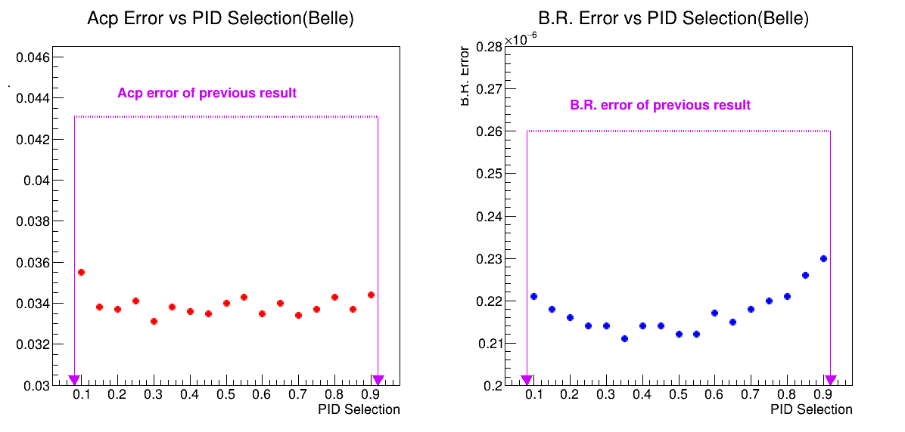
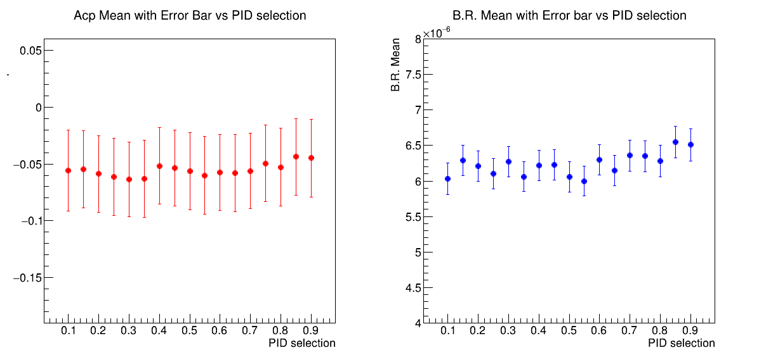
Fitting to $B^{+}→π^{+}π^{0}$ （considering corr.）
Set binaryKID < 0.3
 | $$A_{CP}(B^{+}→π^{+}π^{0})$$ | $$Br(B^{+}→π^{+}π^{0})$$
$$my measurement$$ $$(MC samples)$$ | $$−0.062±0.033$$ | $$(6.37±0.21)×{10}^{−6}$$
$$previous results$$ $$(data samples)$$ | $$0.025±0.043$$ | $$(5.86±0.26)×{10}^{−6}$$

Slide 7
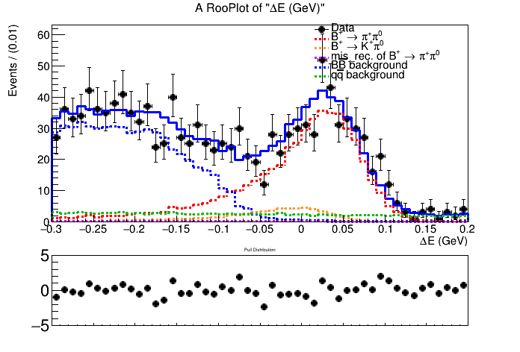
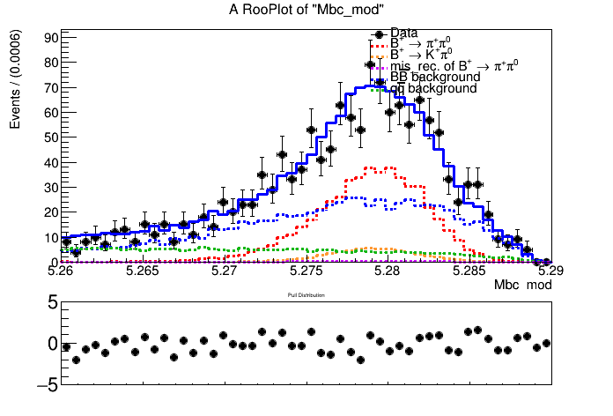
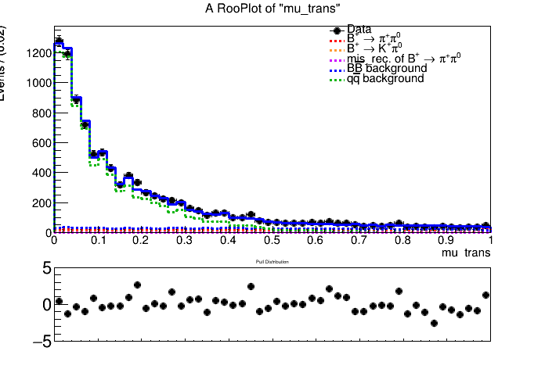
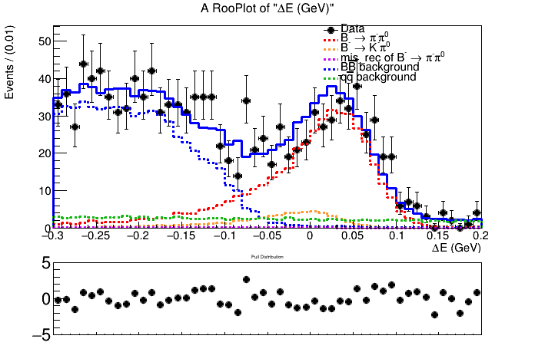
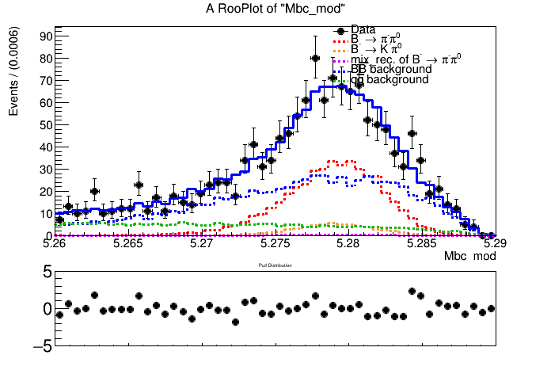
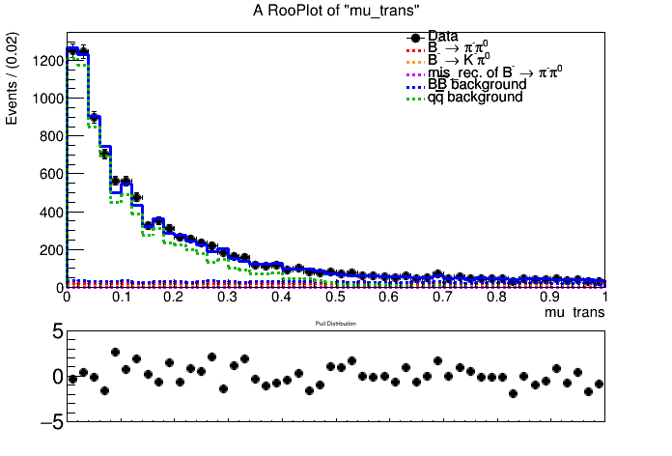
Fitting plots of $B^{+}→π^{+}π^{0}$ （not considering corr.）
Set binaryKID < 0.3
$signal−enhanced region:5.26<{Mbc}_{mod}<5.29,−0.15<∆E<0.10,mu_{trans}>0.65$

Slide 8
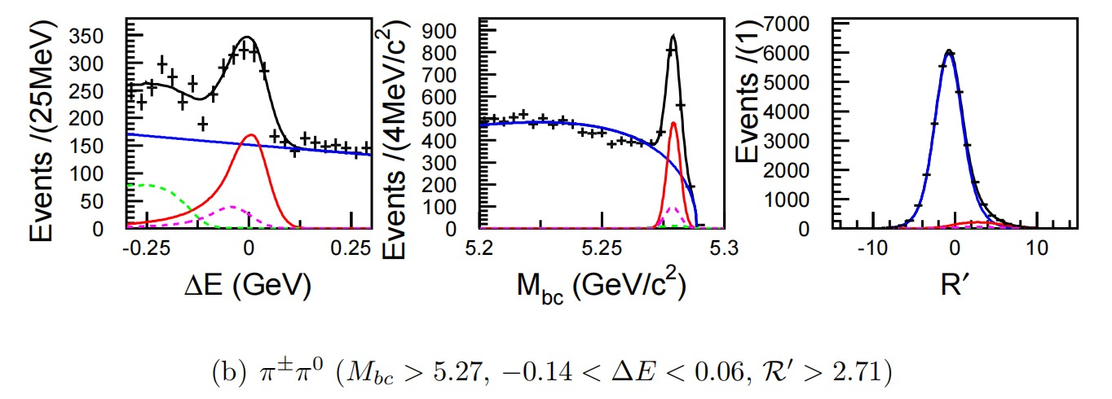
Fitting plots of $B^{+}→π^{+}π^{0}$ （belle previous results）

Slide 9
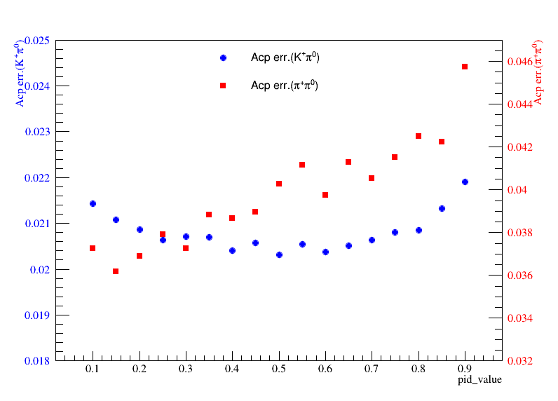
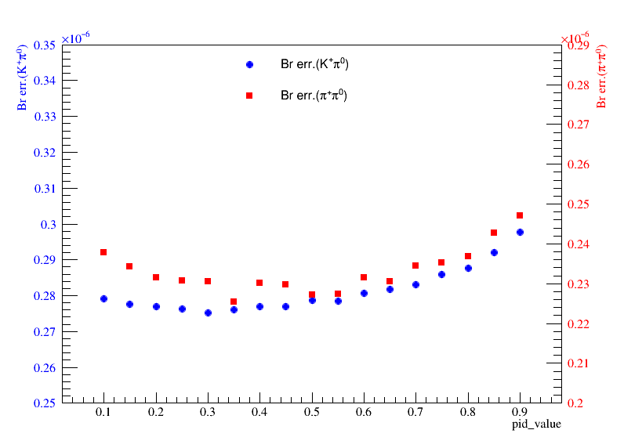
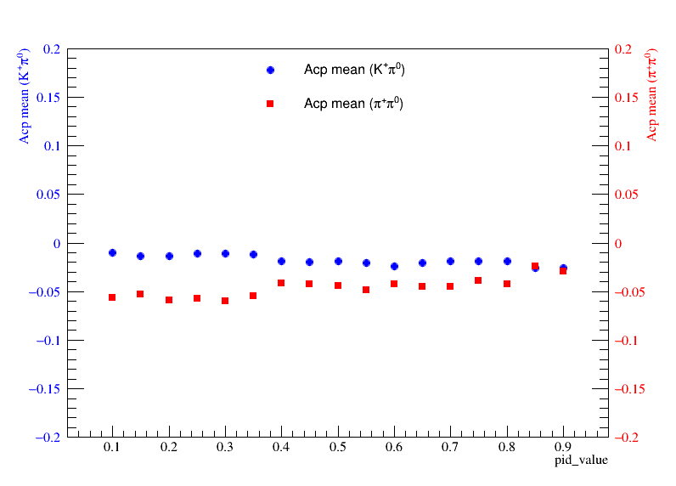
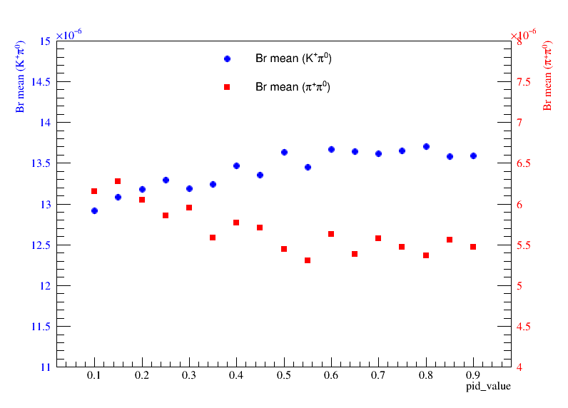
Fitting to $B^{+}→K^{+}π^{0}$ and $B^{+}→π^{+}π^{0}$ simultaneously（considering corr.）

Slide 10
Fitting to $B^{+}→K^{+}π^{0}$ and $B^{+}→π^{+}π^{0}$ simultaneously
For $B^{+}→K^{+}π^{0}$,Set binaryKID > 0.4
For $B^{+}→π^{+}π^{0}$,Set binaryKID < 0.3
 | $$luminosity$$ | $$A_{CP}(B^{+}→K^{+}π^{0})$$ | $$Br(B^{+}→K^{+}π^{0})$$ | $$A_{CP}(B^{+}→π^{+}π^{0})$$ | $$Br(B^{+}→π^{+}π^{0})$$
$$my measurement$$ $$(MC samples)$$ | $$771/fb$$ | $$−0.018±0.020$$ | $$(13.40±0.28)×{10}^{−6}$$ | $$−0.058±0.037$$ | $$(5.91±0.23)×{10}^{−6}$$
$$previous results$$ $$(data samples)$$ | $$771/fb$$ | $$0.043±0.024$$ | $$(12.62±0.31)×{10}^{−6}$$ | $$0.025±0.043$$ | $$(5.86±0.26)×{10}^{−6}$$
 | $$luminosity$$ | $$A_{CP}(B^{+}→K^{+}π^{0})$$ | $$Br(B^{+}→K^{+}π^{0})$$ | $$A_{CP}(B^{+}→π^{+}π^{0})$$ | $$Br(B^{+}→π^{+}π^{0})$$
$$my measurement$$ $$(MC samples)$$ | $$771/fb$$ | $$−0.018±0.020$$ | $$(13.27±0.27)×{10}^{−6}$$ | $$−0.052±0.037$$ | $$(5.90±0.23)×{10}^{−6}$$
$$previous results$$ $$(data samples)$$ | $$771/fb$$ | $$0.043±0.024$$ | $$(12.62±0.31)×{10}^{−6}$$ | $$0.025±0.043$$ | $$(5.86±0.26)×{10}^{−6}$$

Slide 11
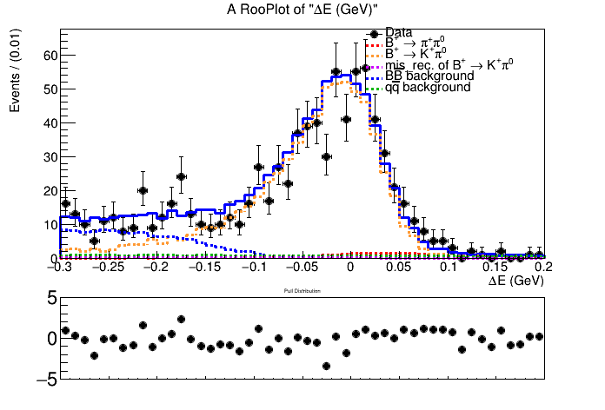
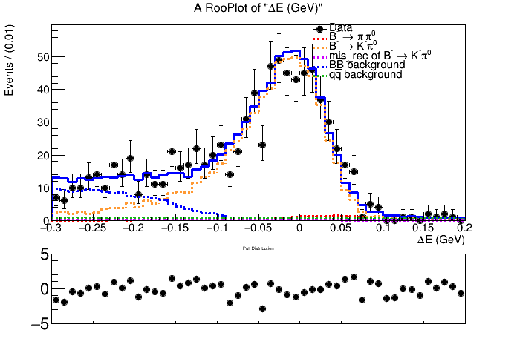
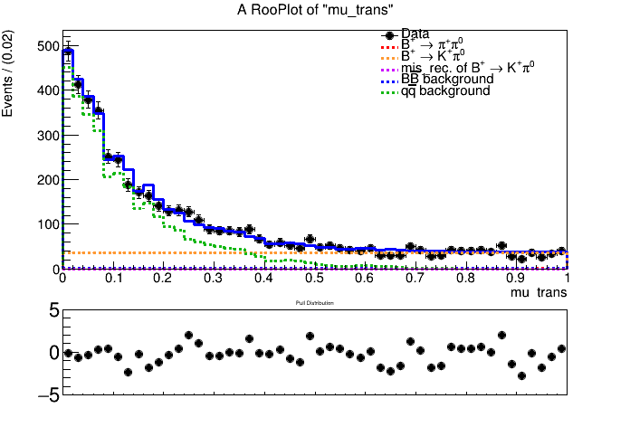
Fitting to $B^{+}→K^{+}π^{0}$ and $B^{+}→π^{+}π^{0}$ simultaneously（not considering corr.）
$signal−enhanced region:5.26<{Mbc}_{mod}<5.29,−0.15<∆E<0.10,mu_{trans}>0.65$

Slide 12
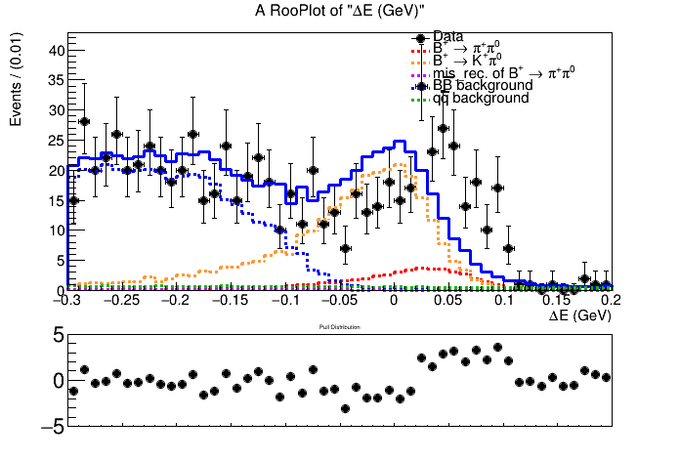
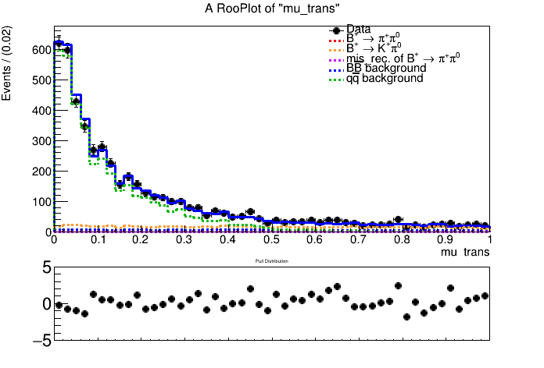
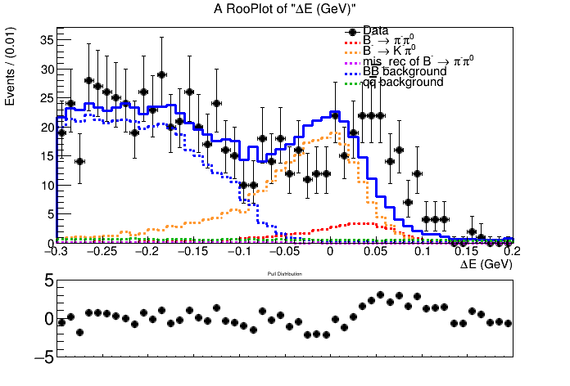
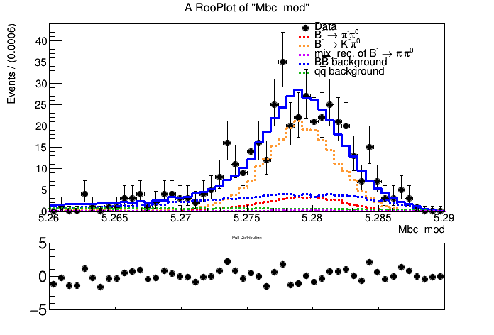
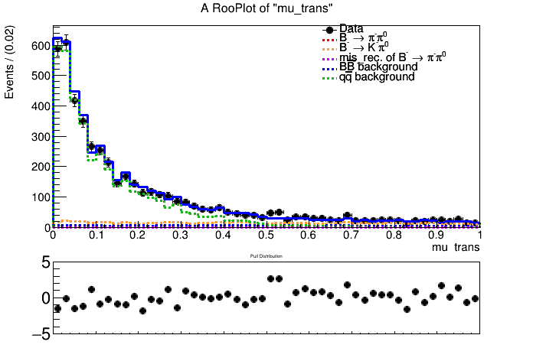
Fitting to $B^{+}→K^{+}π^{0}$ and $B^{+}→π^{+}π^{0}$ simultaneously（not considering corr.）
$signal−enhanced region:5.26<{Mbc}_{mod}<5.29,−0.15<∆E<0.10,mu_{trans}>0.65$

Slide 13
$$Analysis of Belle2$$
Signal region:
$5.26<{Mbc}_{mod}<5.29$
$−0.30<∆E<0.20$
$0<mu_trans<1\text{(}\text{CSMVA}\text{>0.60)}$
Correlation:
Using Roo3DkeysPdf to describe BB background
Using Roo3DkeysPdf to describe mis_rec. $B^{+}→π^{+}π^{0}$.
Using Roo2DkeysPdf to describe $B^{+}→K^{+}π^{0}$.

Slide 14
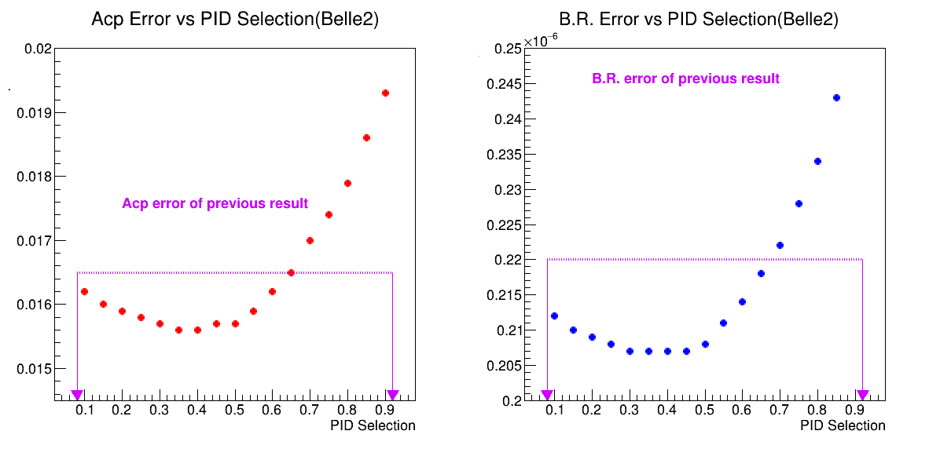
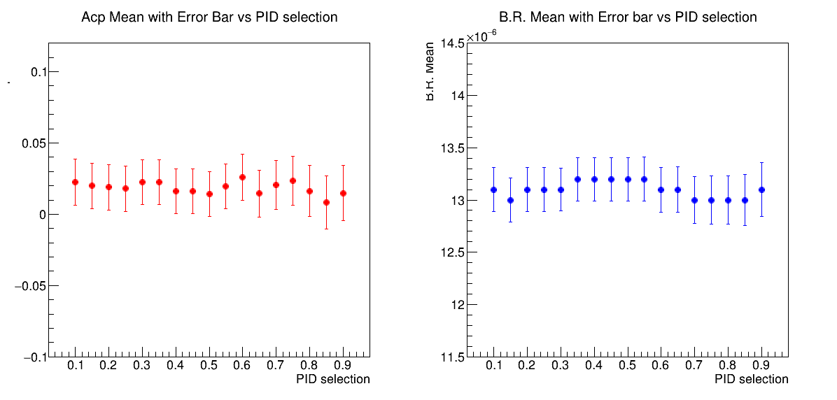
Fitting to $B^{+}→K^{+}π^{0}$ （considering corr.）
Set KaonIDNN > 0.5
 | $$A_{CP}(B^{+}→K^{+}π^{0})$$ | $$Br(B^{+}→K^{+}π^{0})$$
$$my measurement$$ $$(MC samples)$$ | $$0.018±0.016$$ | $$(13.30±0.21)×{10}^{−6}$$
$$previous results$$ $$(MC samples)$$ | $$−0.020±0.016$$ | $$(12.85±0.22)×{10}^{−6}$$

Slide 15
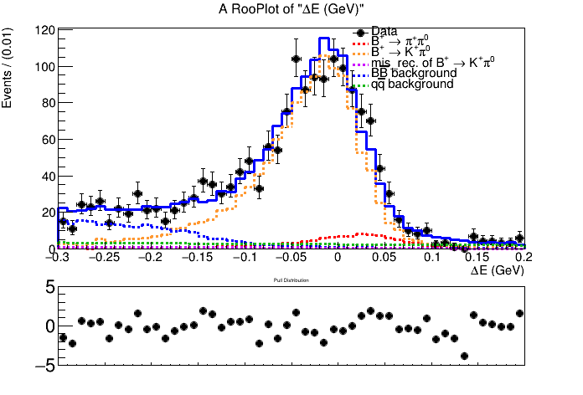
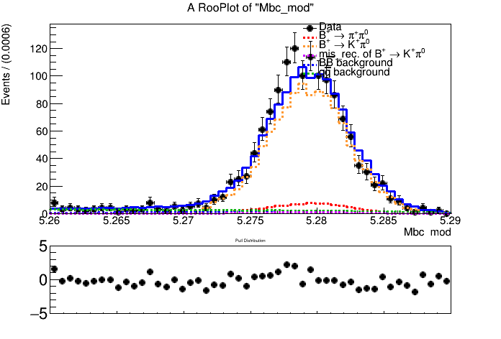
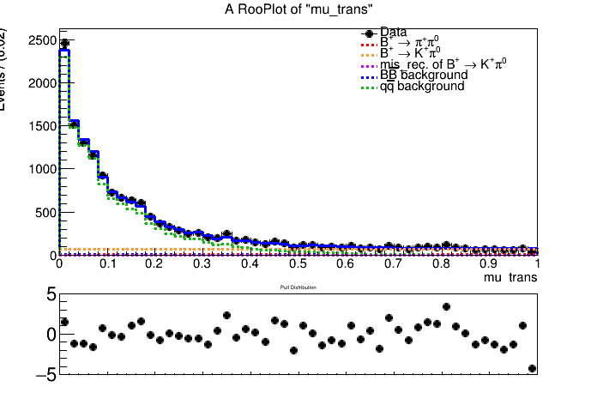
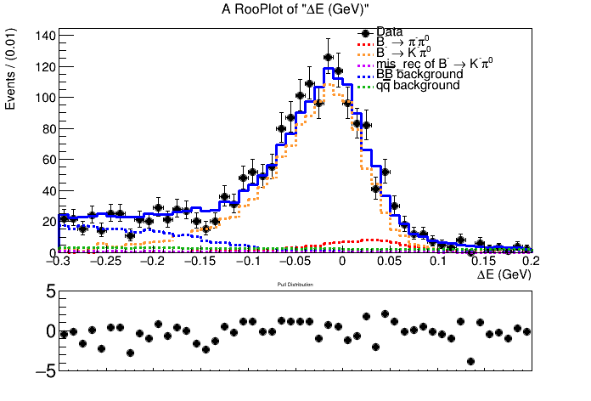
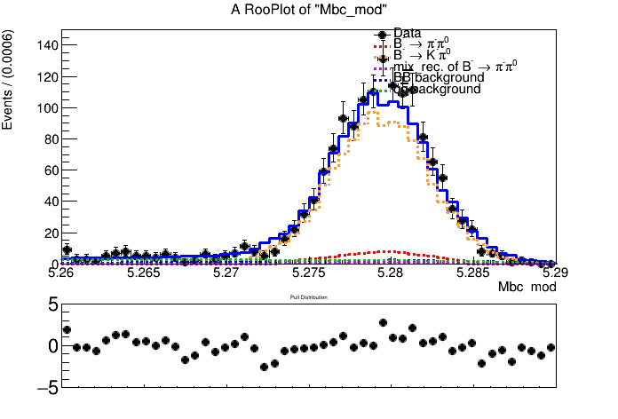
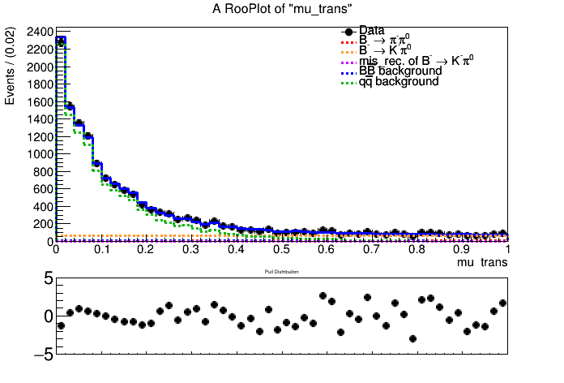
Fitting plots of $B^{+}→K^{+}π^{0}$ （not considering corr.）
Set KaonIDNN > 0.4
$signal−enhanced region:5.26<{Mbc}_{mod}<5.29,−0.15<∆E<0.10,mu_{trans}>0.65$

Slide 16
Fitting plots of $B^{+}→K^{+}π^{0}$ （belle2 previous results）

Slide 17
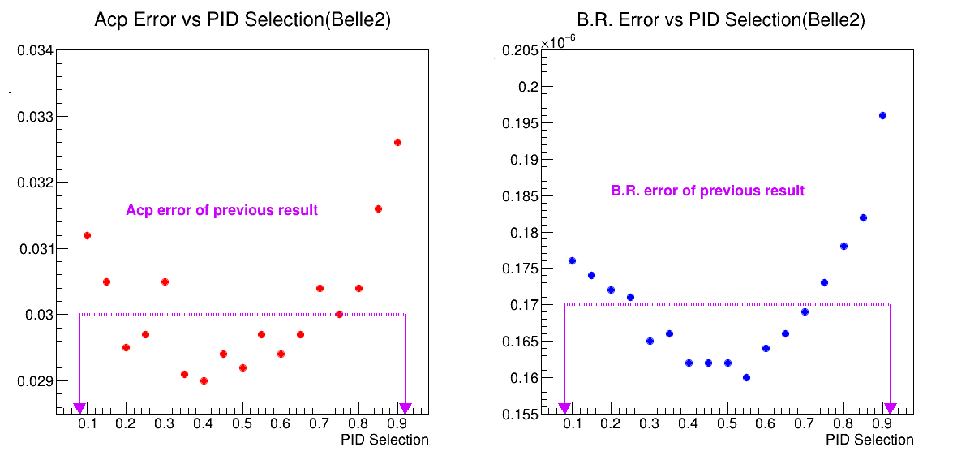
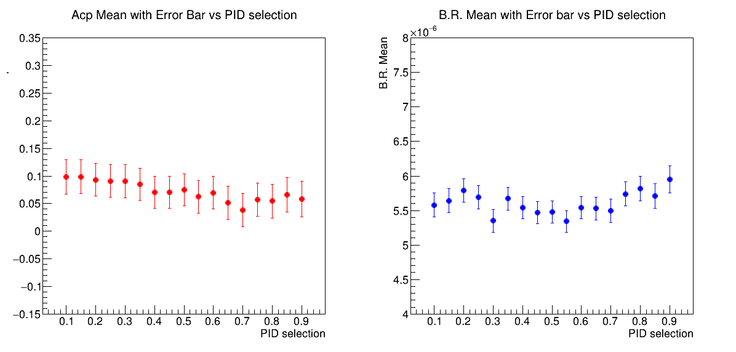
Fitting to $B^{+}→π^{+}π^{0}$ （considering corr.）
Set pionIDNN > 0.6
 | $$A_{CP}(B^{+}→π^{+}π^{0})$$ | $$Br(B^{+}→π^{+}π^{0})$$
$$my measurement$$ $$(MC samples)$$ | $$0.070±0.029$$ | $$(5.54±0.16)×{10}^{−6}$$
$$previous results$$ $$(data samples)$$ | $$0.016±0.030$$ | $$(5.34±0.17)×{10}^{−6}$$

Slide 18
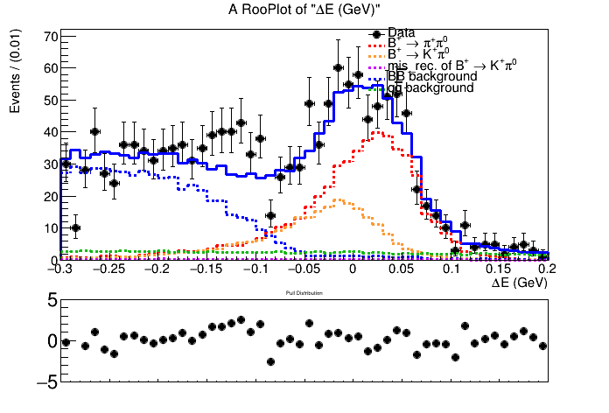
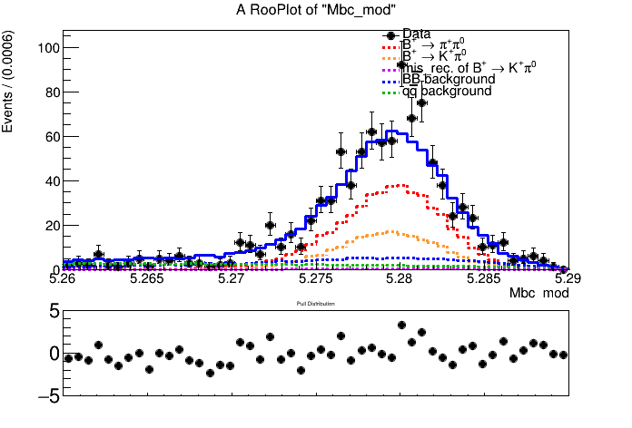
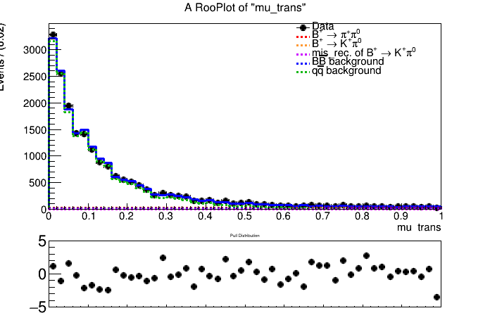
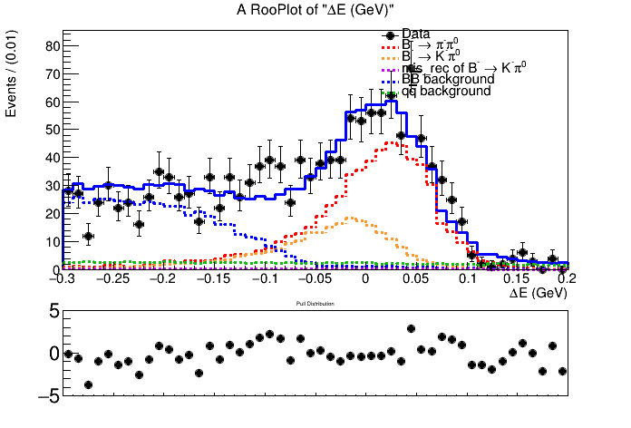
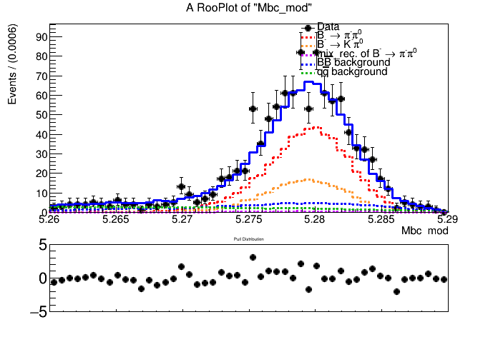
Set pionIDNN > 0.4
Fitting plots of $B^{+}→π^{+}π^{0}$ （not considering corr.）
$signal−enhanced region:5.26<{Mbc}_{mod}<5.29,−0.15<∆E<0.10,mu_{trans}>0.65$

Slide 19
Fitting plots of $B^{+}→π^{+}π^{0}$ （belle2 previous results）

Slide 20
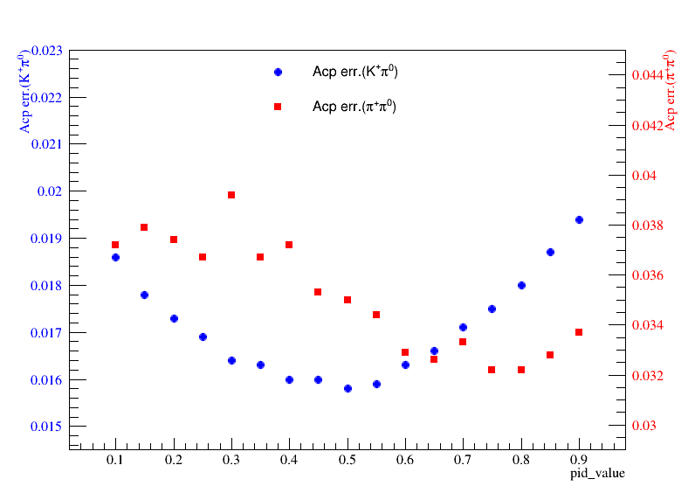
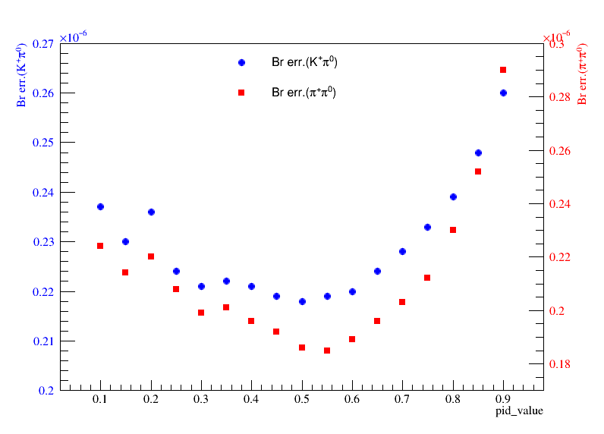
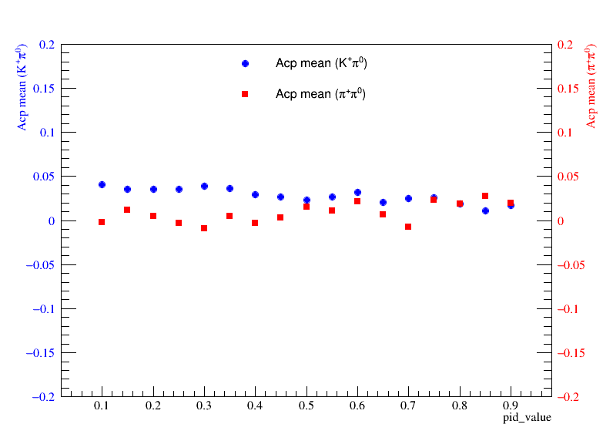
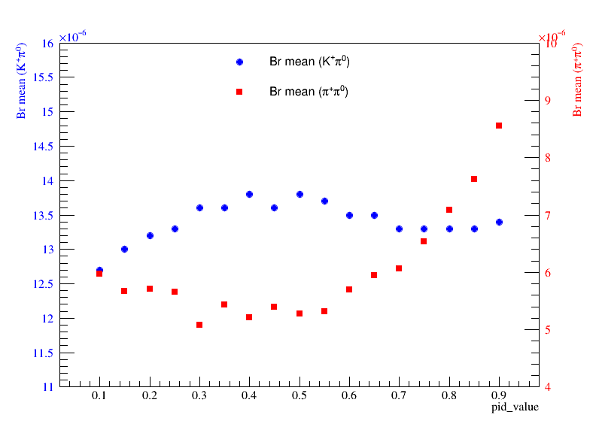
Fitting to $B^{+}→K^{+}π^{0}$ and $B^{+}→π^{+}π^{0}$ simultaneously（considering corr.）

Slide 21
Fitting plots of $B^{+}→π^{+}π^{0}$ and $B^{+}→K^{+}π^{0}$（not considering corr.）
For $B^{+}→K^{+}π^{0}$,Set KaonIDNN > 0.5
For $B^{+}→π^{+}π^{0}$,Set pionIDNN > 0.6
 | $$luminosity$$ | $$A_{CP}(B^{+}→K^{+}π^{0})$$ | $$Br(B^{+}→K^{+}π^{0})$$ | $$A_{CP}(B^{+}→π^{+}π^{0})$$ | $$Br(B^{+}→π^{+}π^{0})$$
$$my measurement$$ $$(MC samples)$$ | $$1/ab$$ | $$0.019±0.016$$ | $$(13.51±0.21)×{10}^{−6}$$ | $$0.017±0.033$$ | $$(5.76±0.19)×{10}^{−6}$$
$$previous results$$ $$(MC samples)$$ | $$1/ab$$ | $$−0.020±0.016$$ | $$(12.85±0.22)×{10}^{−6}$$ | $$0.016±0.030$$ | $$(5.34±0.17)×{10}^{−6}$$
 | $$luminosity$$ | $$A_{CP}(B^{+}→K^{+}π^{0})$$ | $$Br(B^{+}→K^{+}π^{0})$$ | $$A_{CP}(B^{+}→π^{+}π^{0})$$ | $$Br(B^{+}→π^{+}π^{0})$$
$$my measurement$$ $$(MC samples)$$ | $$1/ab$$ | $$0.020±0.016$$ | $$(13.60±0.22)×{10}^{−6}$$ | $$0.021±0.033$$ | $$(5.68±0.19)×{10}^{−6}$$
$$previous results$$ $$(MC samples)$$ | $$1/ab$$ | $$−0.020±0.016$$ | $$(12.85±0.22)×{10}^{−6}$$ | $$0.016±0.030$$ | $$(5.34±0.17)×{10}^{−6}$$

Slide 22
Fitting plots of $B^{+}→π^{+}π^{0}$ and $B^{+}→K^{+}π^{0}$（not considering corr.）
$signal−enhanced region:5.26<{Mbc}_{mod}<5.29,−0.15<∆E<0.10,mu_{trans}>0.65$

Slide 23
Fitting plots of $B^{+}→π^{+}π^{0}$ and $B^{+}→K^{+}π^{0}$（not considering corr.）
$signal−enhanced region:5.26<{Mbc}_{mod}<5.29,−0.15<∆E<0.10,mu_{trans}>0.65$

Slide 24
Back up
1.deltaE distribution
2.belle2 pid should be binaryPID?
3.Reduce the signal region?
4.Data taking, our analysis

