Slide 1
Group Meeting
邹世明
2024.12.20

Slide 2
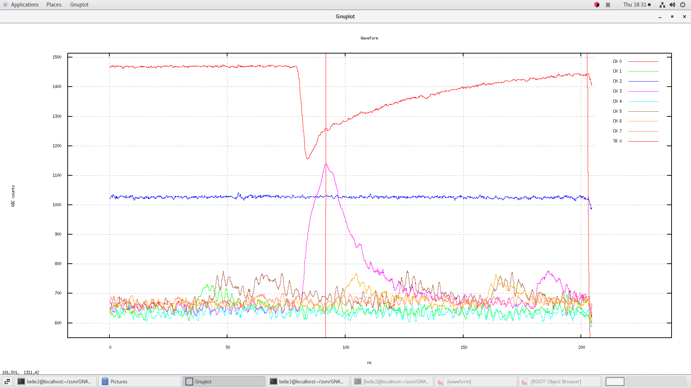
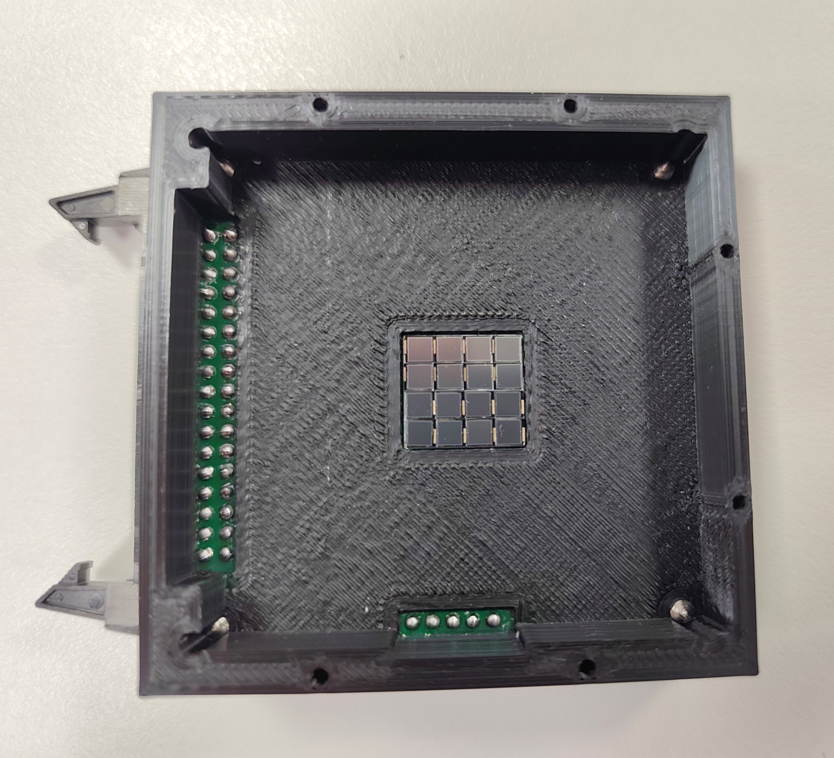
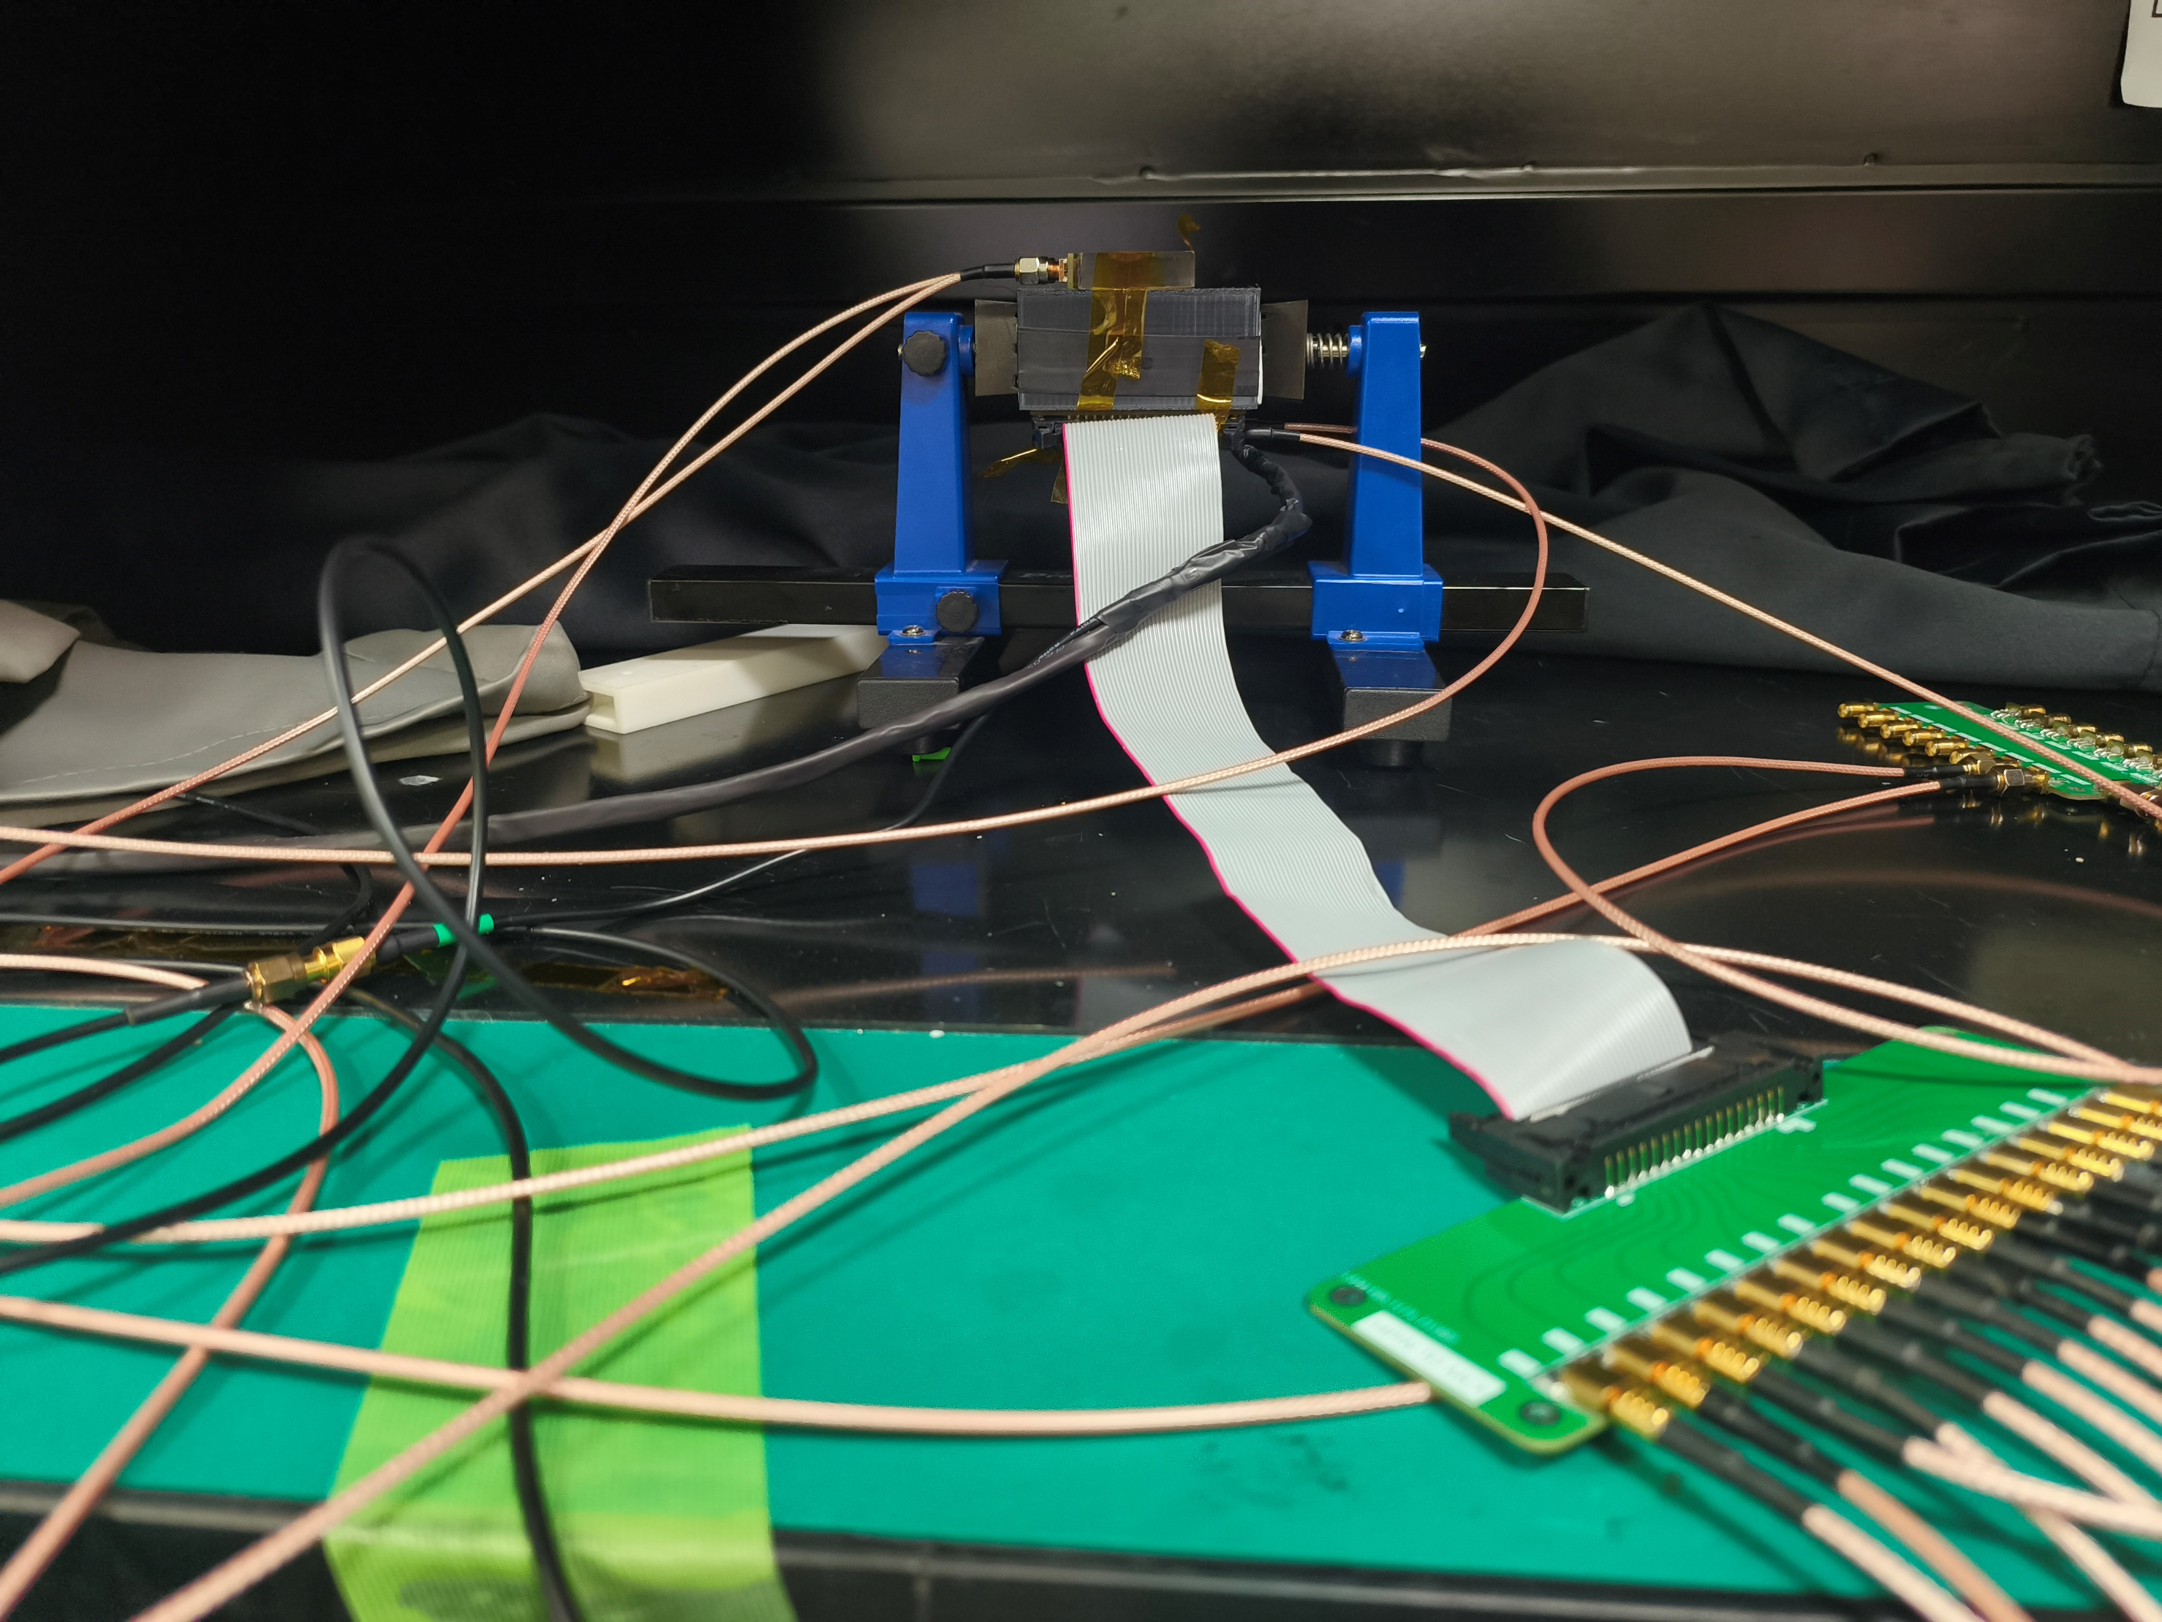
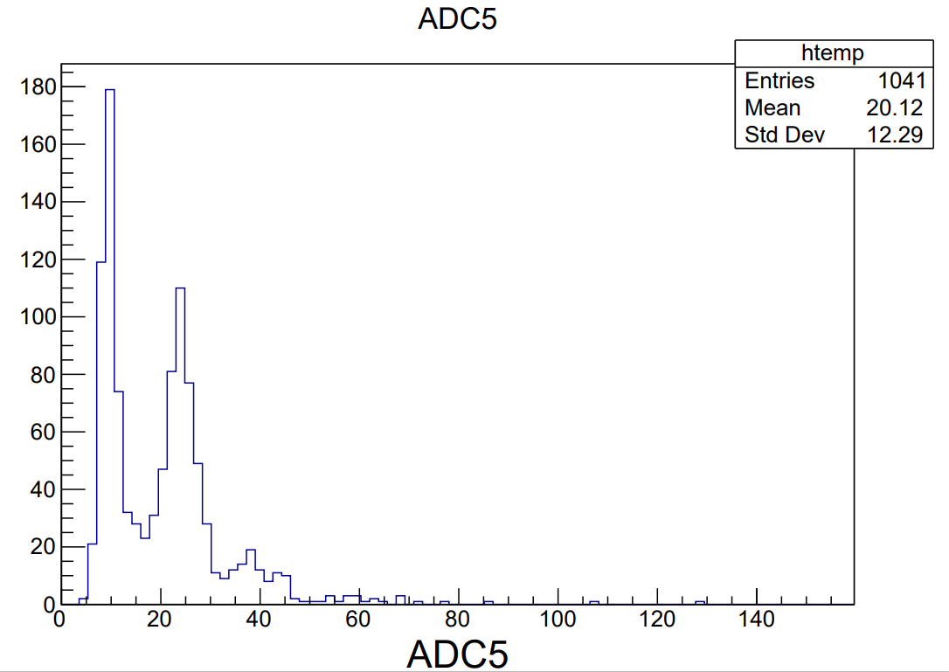
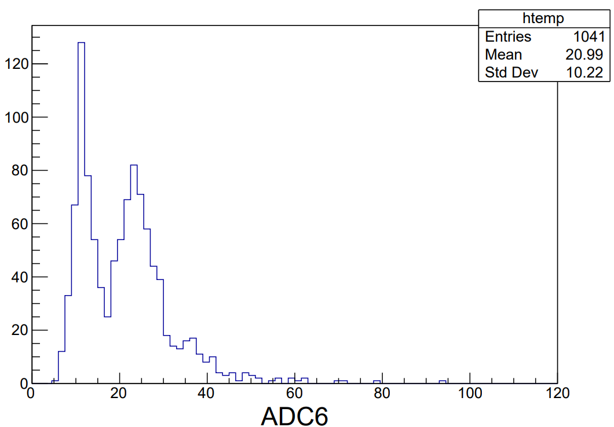
Test for 16NDL board

Slide 3
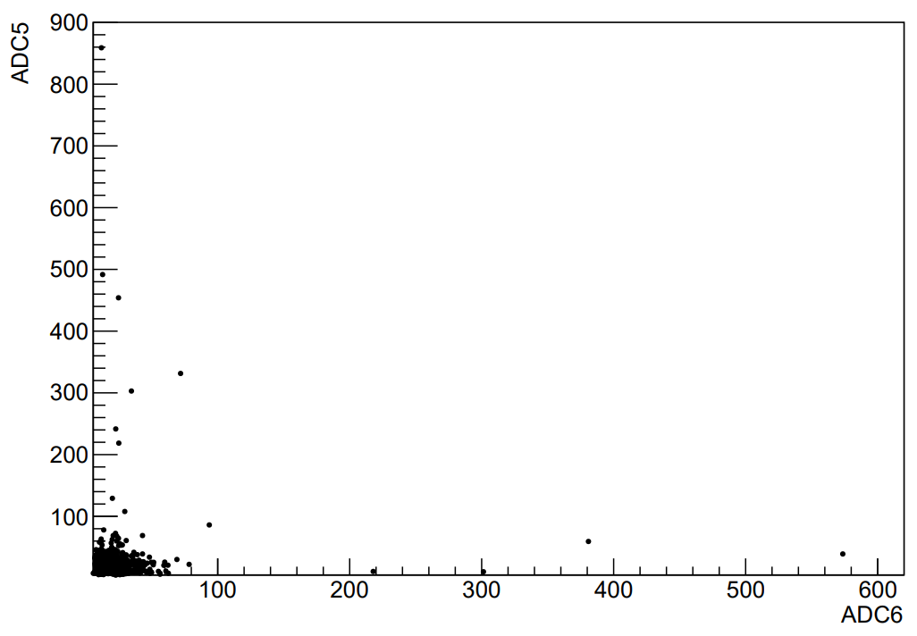
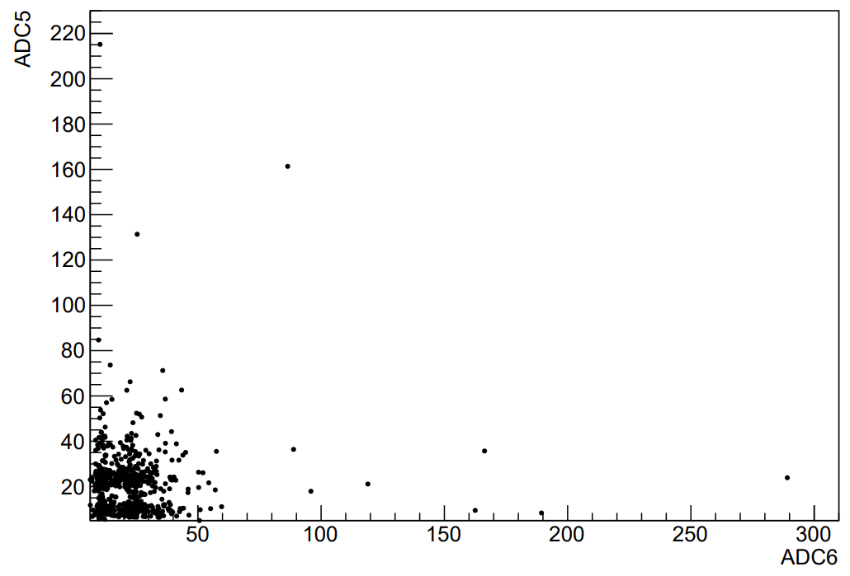
Test for 16NDL board
Trigger1
Aerogel
SiPM array
Trigger2
Trigger1
SiPM array
Aerogel
Trigger2

Slide 4
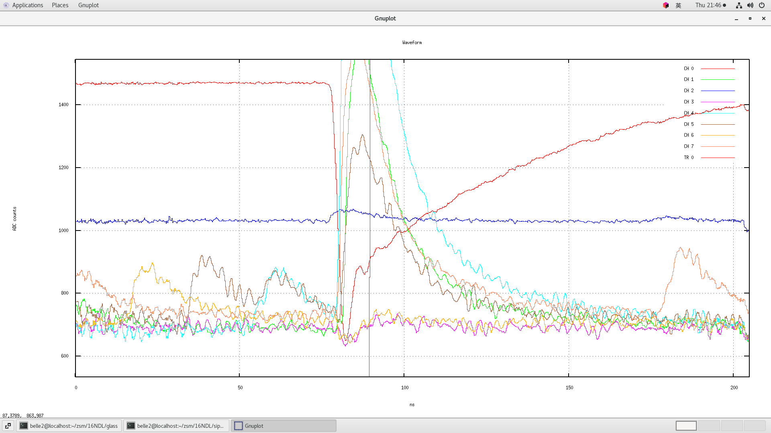
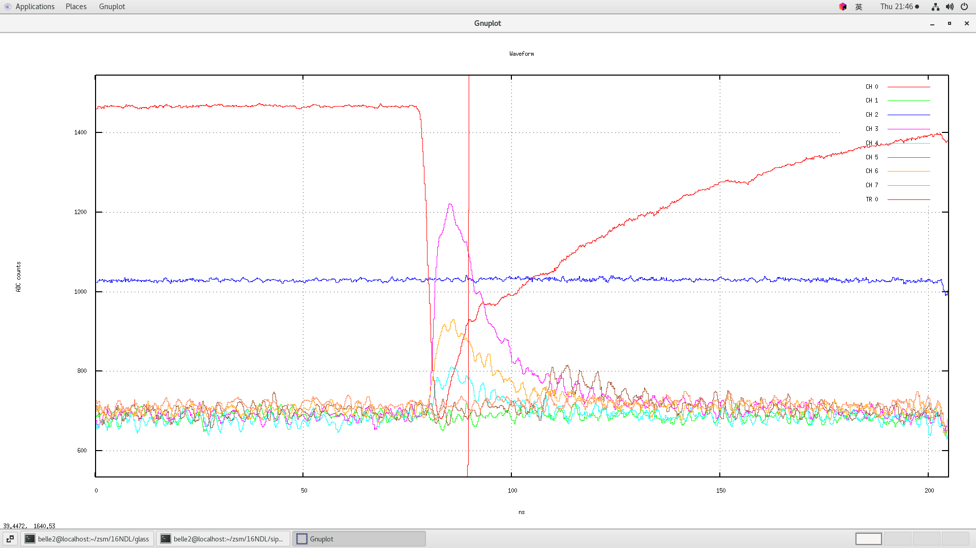
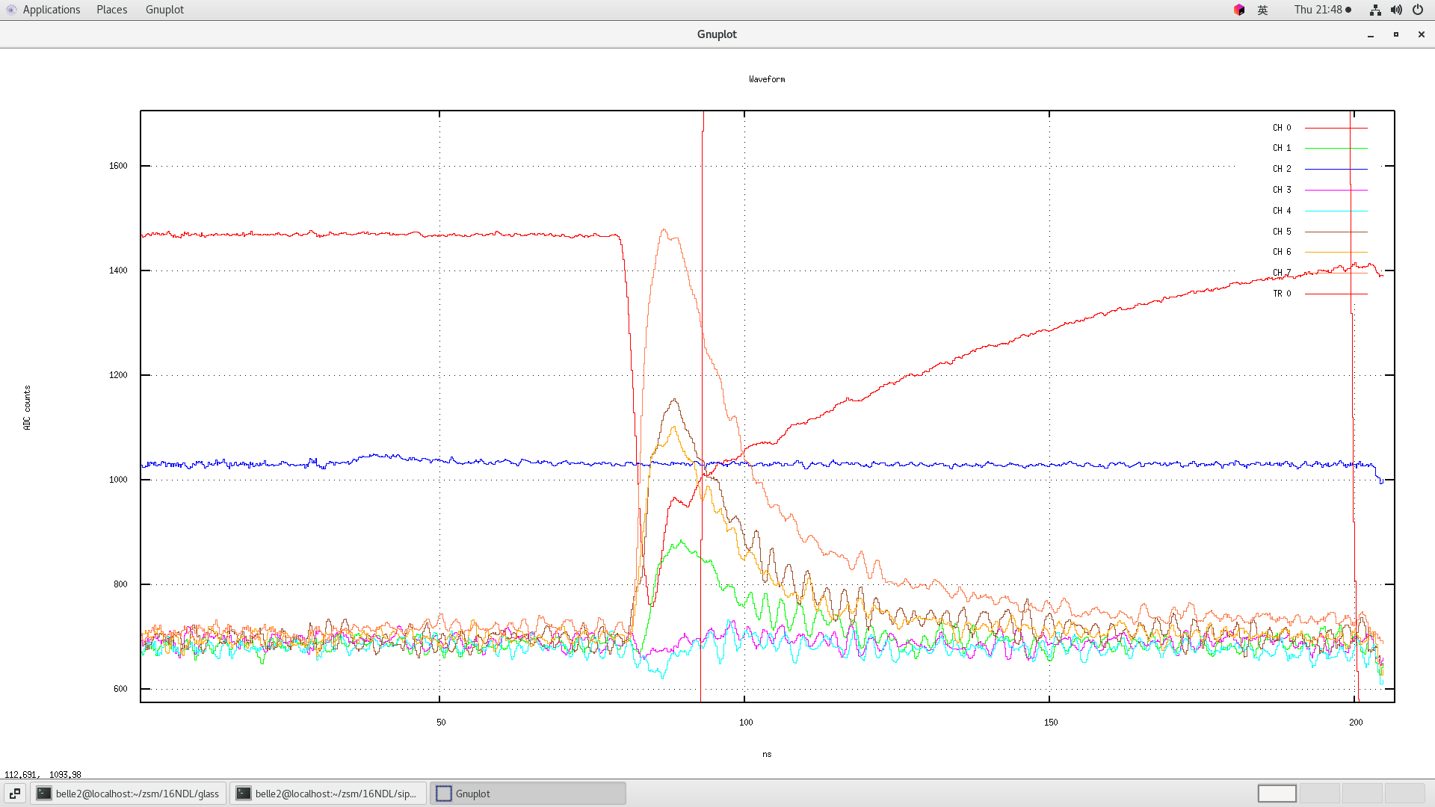
Test for 16NDL board (glass)

Slide 5
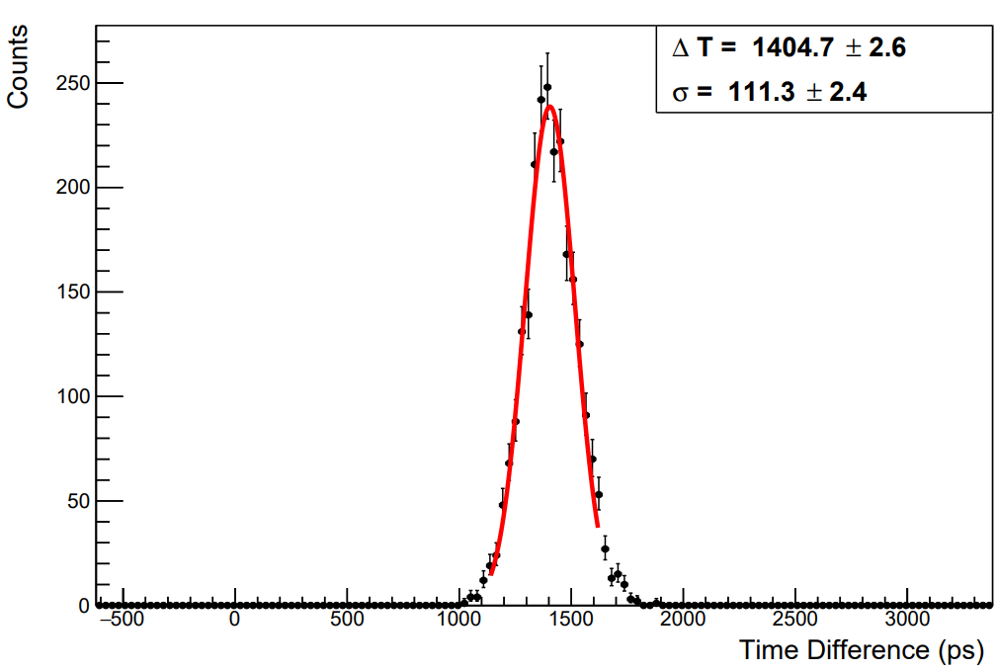
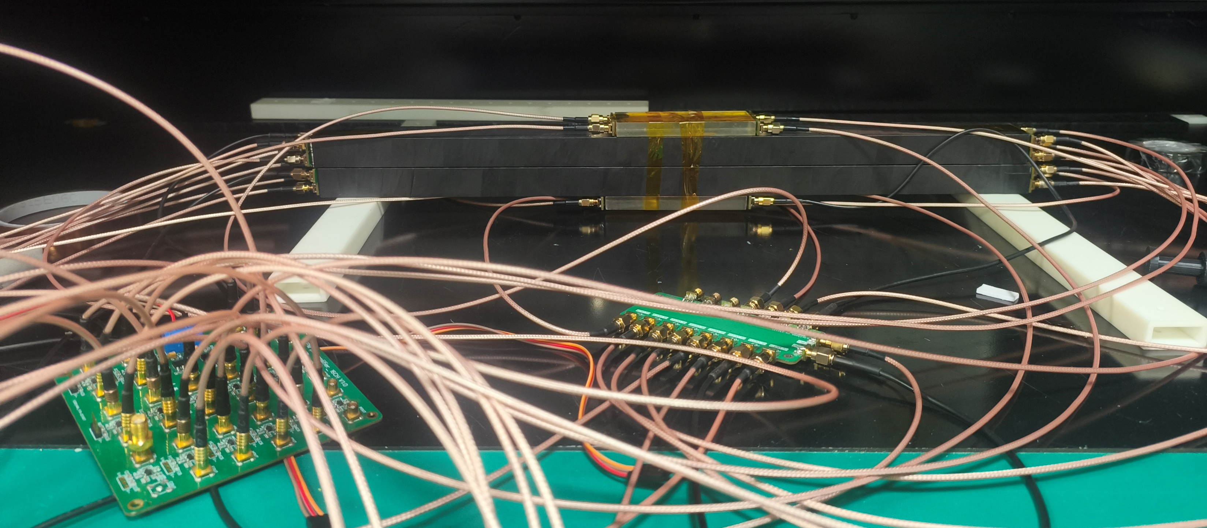
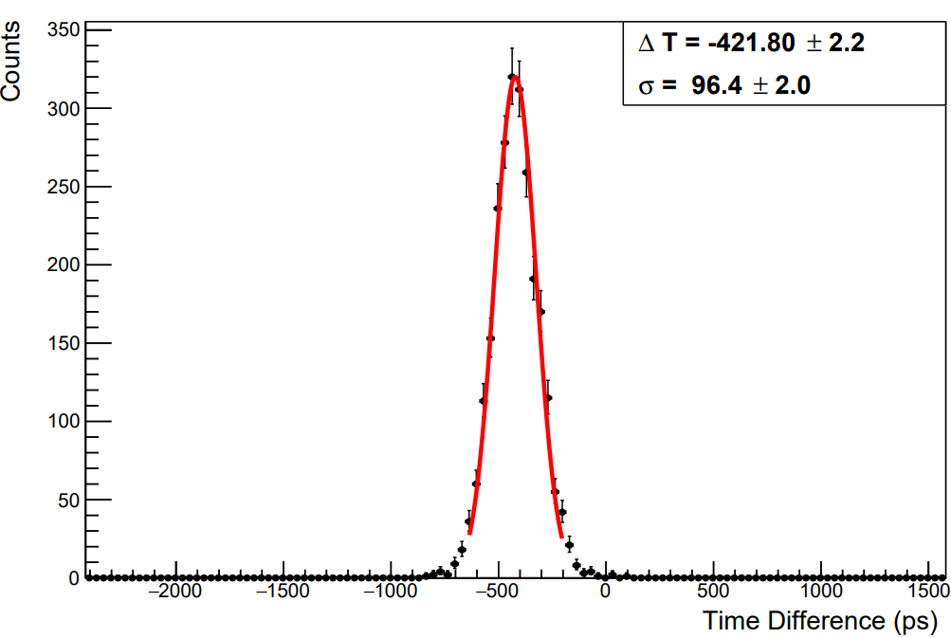
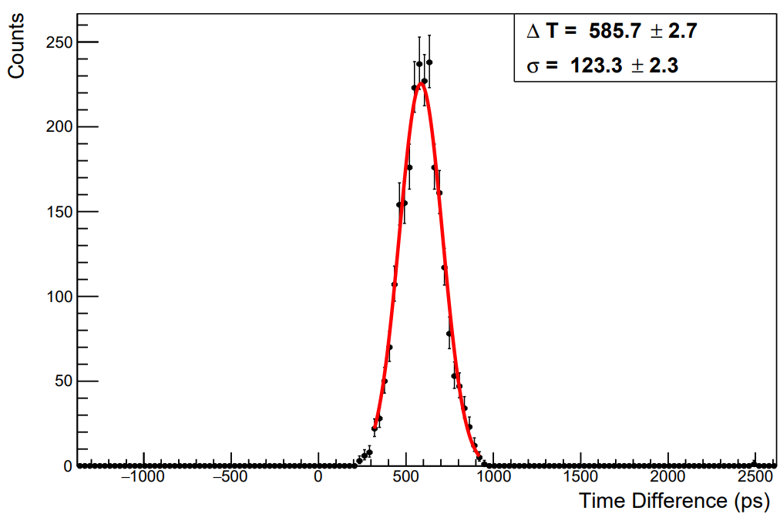
Test for 50 cm long GNKD
SCN. 1
$$σ=100.3 ps$$
SCN. 1
TRG
$$σ=113.4 ps$$

Slide 6
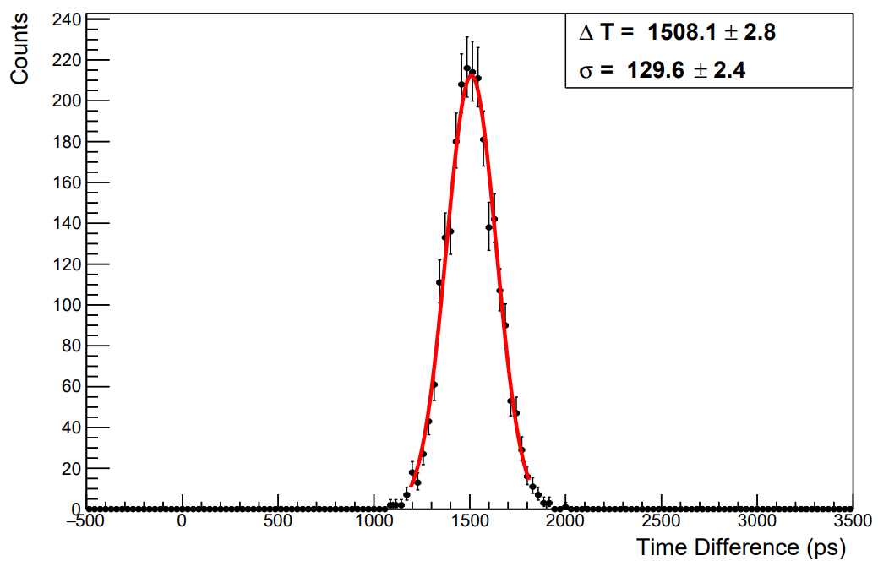
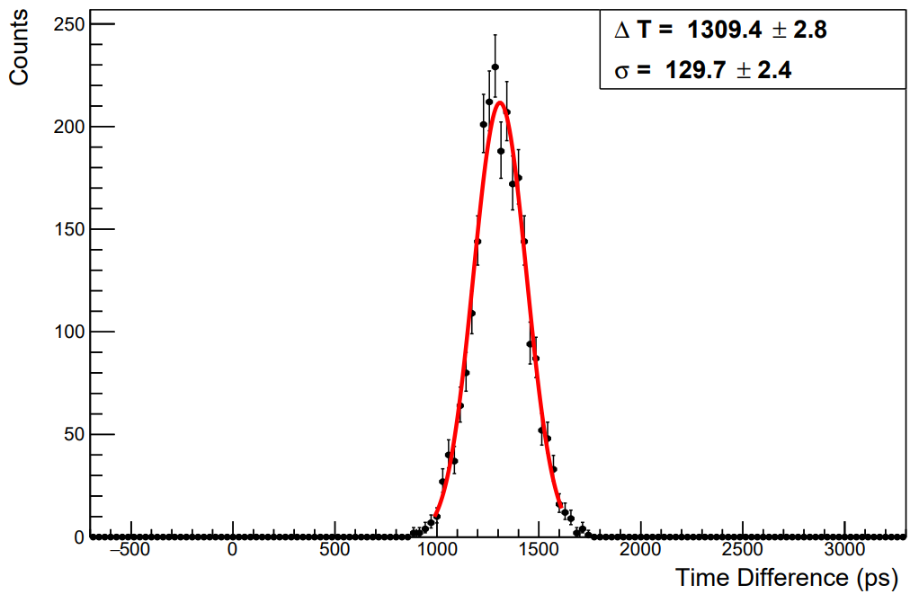
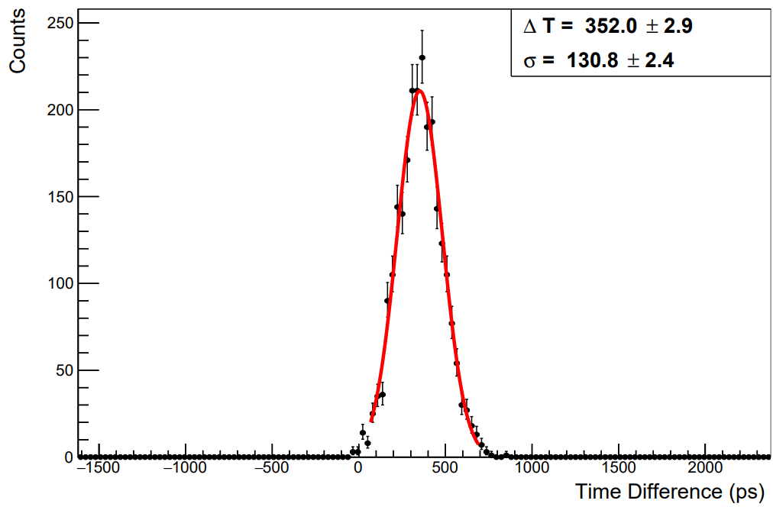
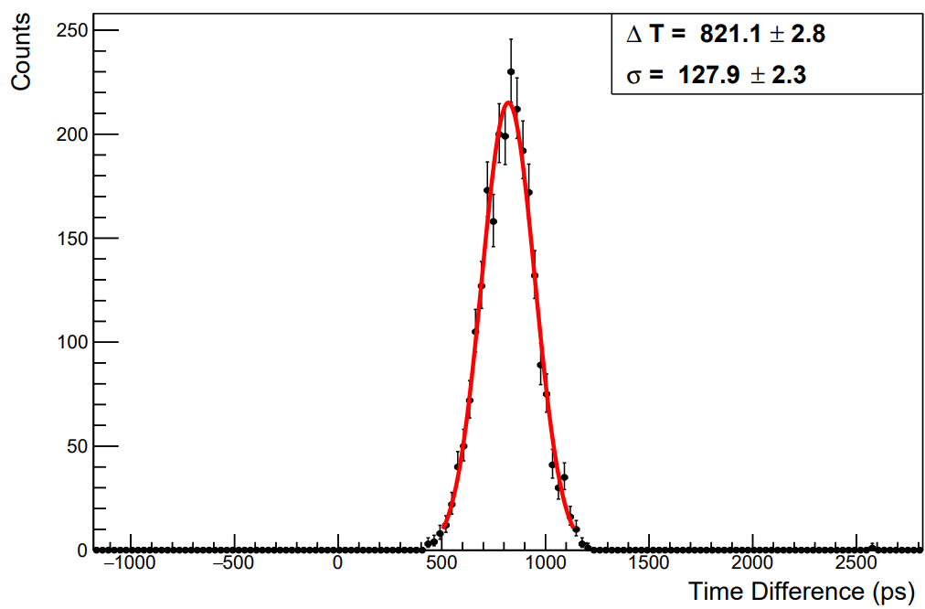
Test for 50 cm long GNKD
$$σ=120.3± 2.6ps$$
$$σ=120.4±2.6 ps$$
TRG
$$σ=121.6±2.6 ps$$
$$σ=118.5±2.6 ps$$

Slide 7
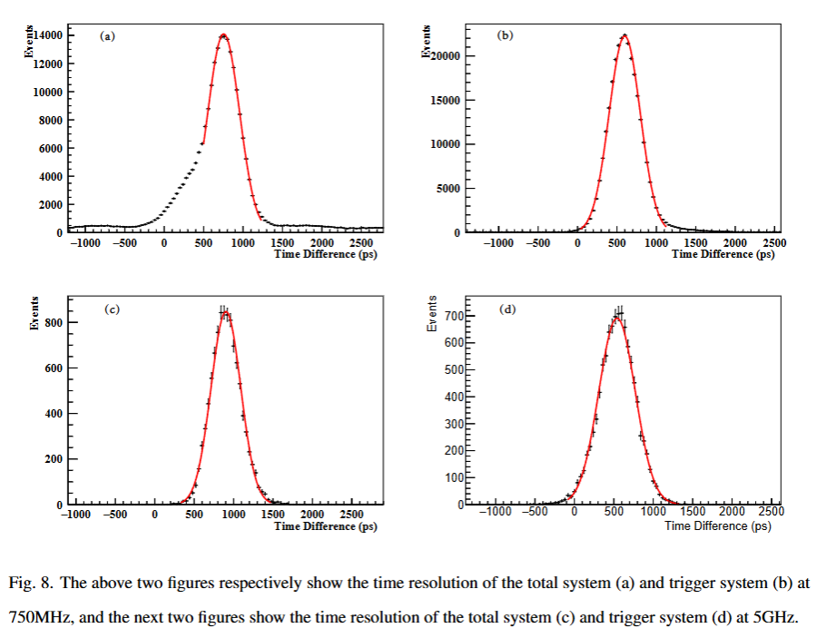
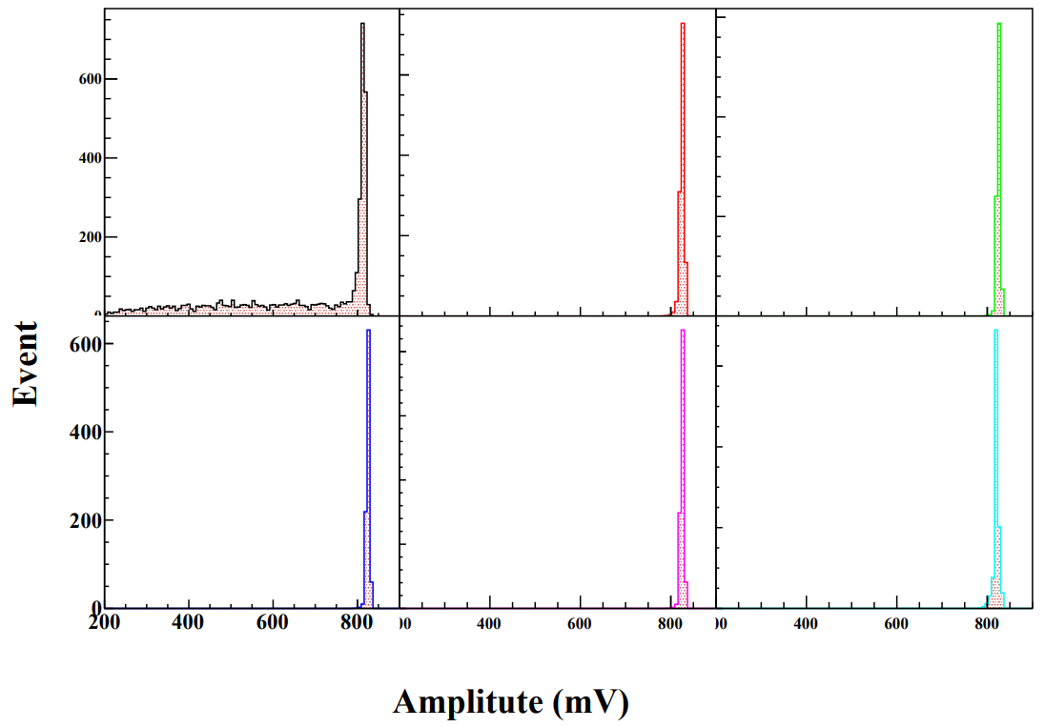
BaF2 issues
ADC in beam test

