Slide 1
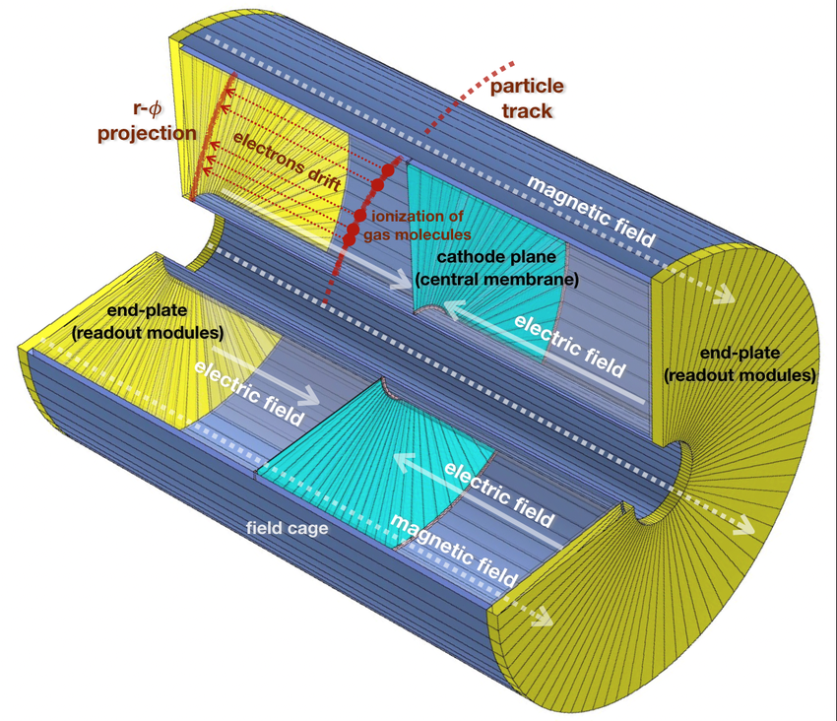
Detector and event visualization software for CEPC
Yujie Zeng (曾宇杰), Tianzi Song (宋天资), Zhaoyang Yuan (袁朝阳),
Yumei Zhang (张玉美), Zhengyun You (尤郑昀)
Sun Yat-sen University (中山大学)

Slide 2
Contents
Introduction
Software structure
Visualization in Phoenix
Detector visualization
Event display
Visualization in Unity
FBX format
Detector visualization
Event display
Detector geometry
Event data model
Visualization software
GUI
Visualization logic

Slide 3
Structure of a visualization software
An event display software should provide visualization functions of the detector geometry, display of different views of detectors, event hits distribution, and interactive control between the display and the users.
The display software should be composed of four parts:
Detector geometry
Event data model
Visualization
GUI
Visualization platform
Detector geometry
CEPC detector display
Event and data information
Event data model
Event display
GUI

Slide 4
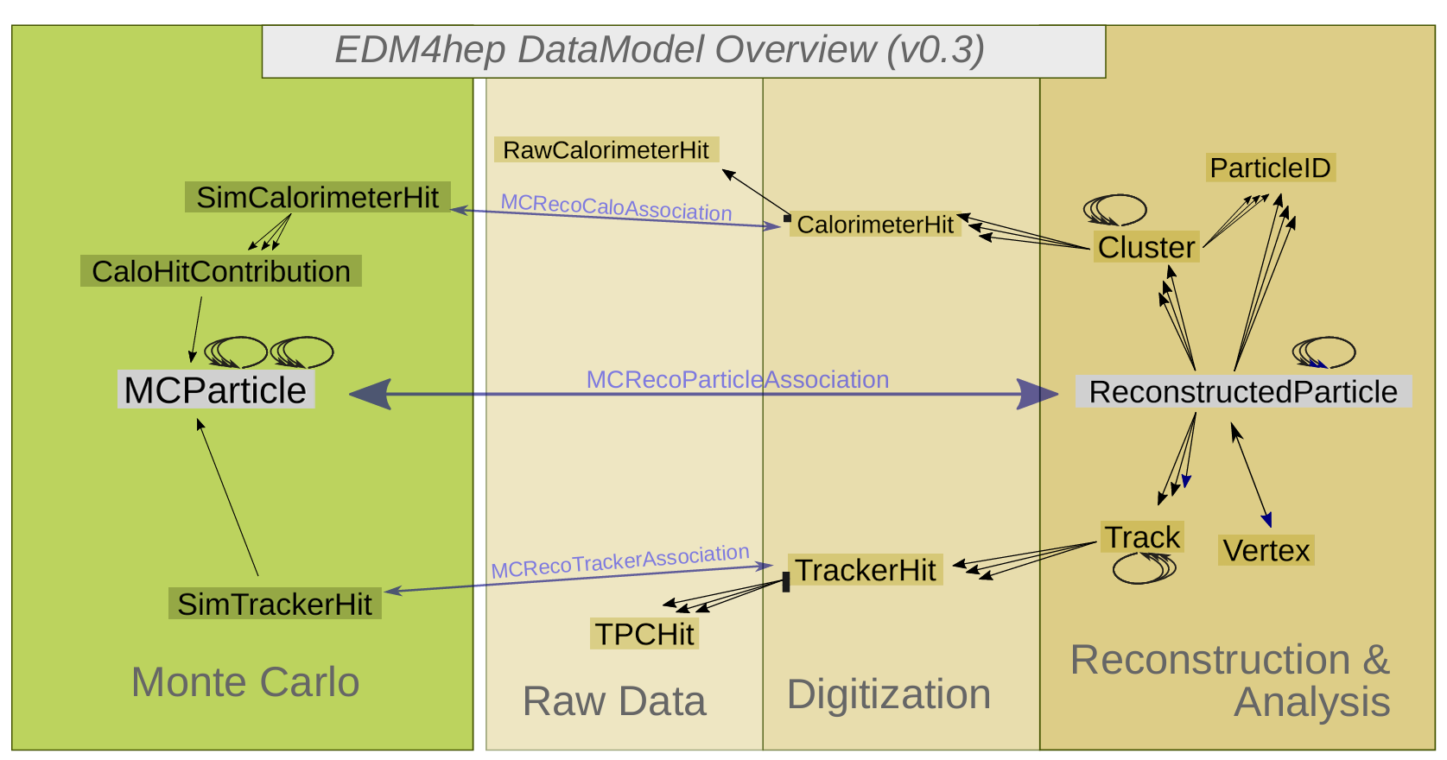
Event data model
The event data model contains three types of information: simulation, calibration, and reconstruction, which is generated by CEPC offline software.
The EDM information is then read by the event manager and displayed together with detector geometry.
EDM4hep is the common EDM that can be used by all communities in the Key4Hep project such as ILC, CLIC, FCC-ee & FCC-hh, CEPC, ...

Slide 5
CEPCSW introduction
CEPCSW is the CEPC offline software prototype based on Key4hep, it widely reused existing components (e.g. edm4hep, dd4hep, ROOT…)
It provides a ready-to-work environment to algorithm developers and physicists
Installation:
git clone git@code.ihep.ac.cn:cepc/CEPCSW.git
cd CEPCSW
git checkout master
source setup.sh
./build.sh
Generating a small MC data sample:
./run.sh RecPFACyber/script/sim.py
./run.sh RecPFACyber/script/digi.py
./run.sh RecPFACyber/script/tracking.py
./run.sh RecPFACyber/script/rec.py

Slide 6
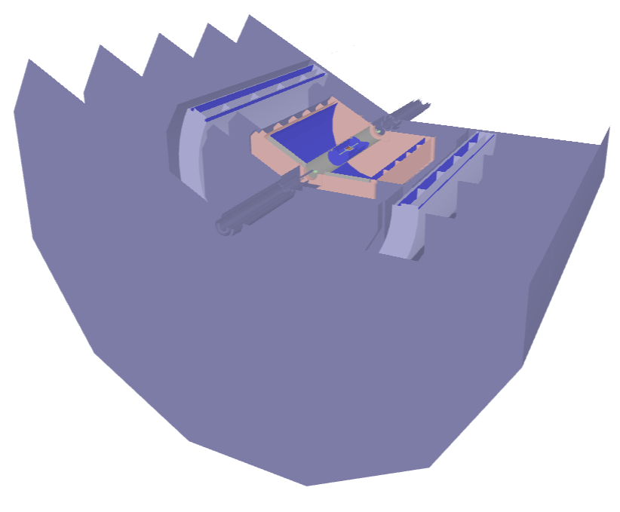
Contents
Introduction
Software structure
Visualization in Phoenix
Detector visualization
Event display
Visualization in Unity
FBX format
Detector visualization
Event display

Slide 7
Phoenix, an web-based event display system
Phoenix is an extensible, experiment-agnostic framework for event and geometry visualization.
Can be used to visualize detector geometry in ROOT format, and uploaded events in JSON.
TypeScript-based, which is an extended version of JavaScript.
Use the popular three.js library for 3D support, can easily run the application in a web browser or in a web server through Node.js.

Slide 8
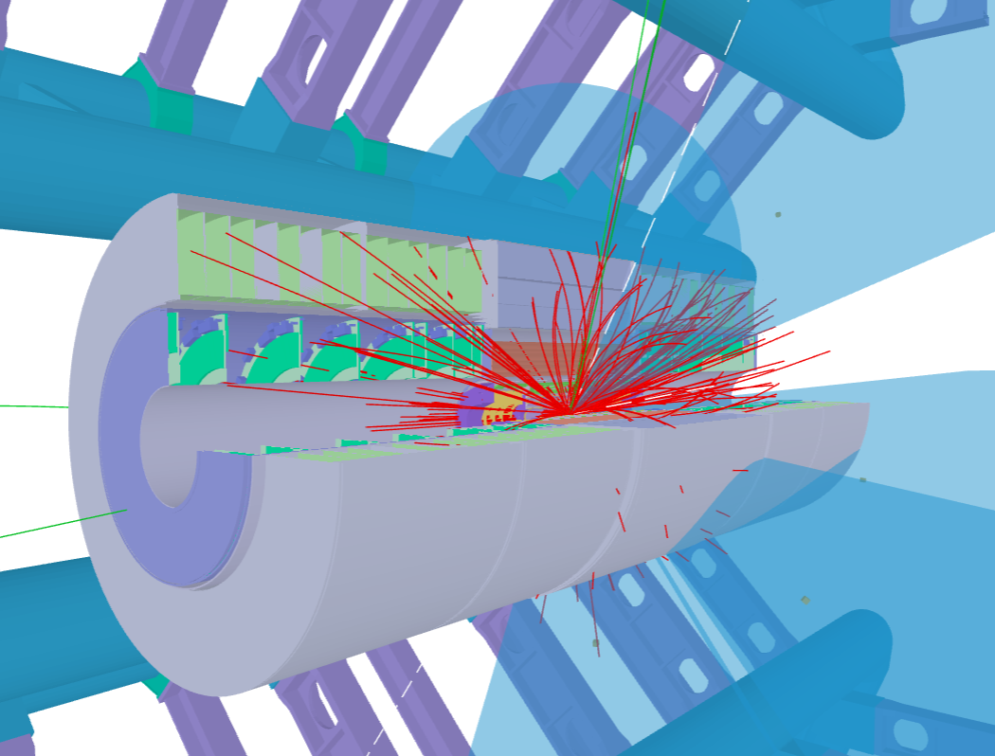
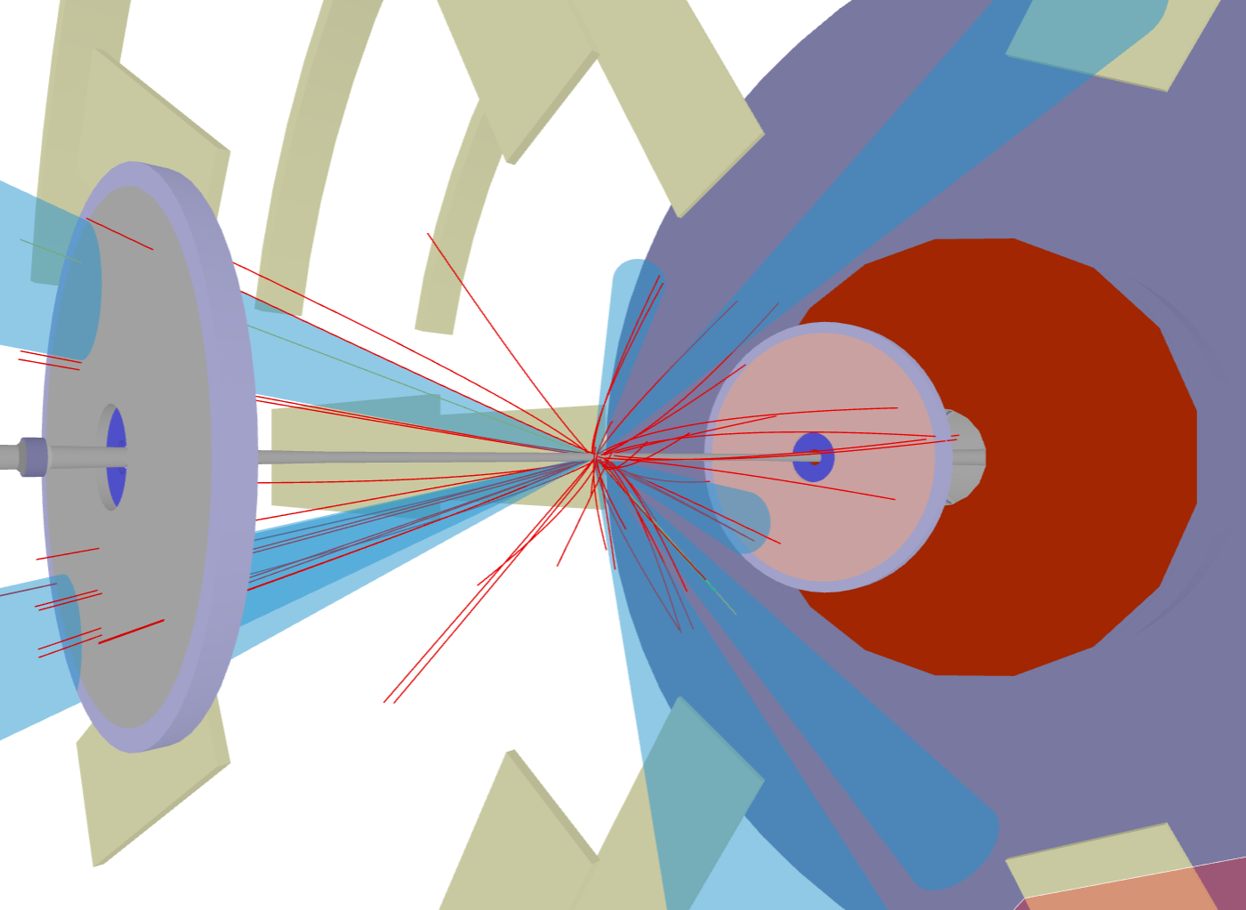
Application of Phoenix in LHC experiments
ATLAS detector and events in Phoenix.
CMS detector and events in Phoenix.
Phoenix has been the official web event display of the ATLAS experiment. It can be used to visualize different versions of ATLAS geometry, and uploaded events.
Also used in web event display of LHCb experiment.

Slide 9
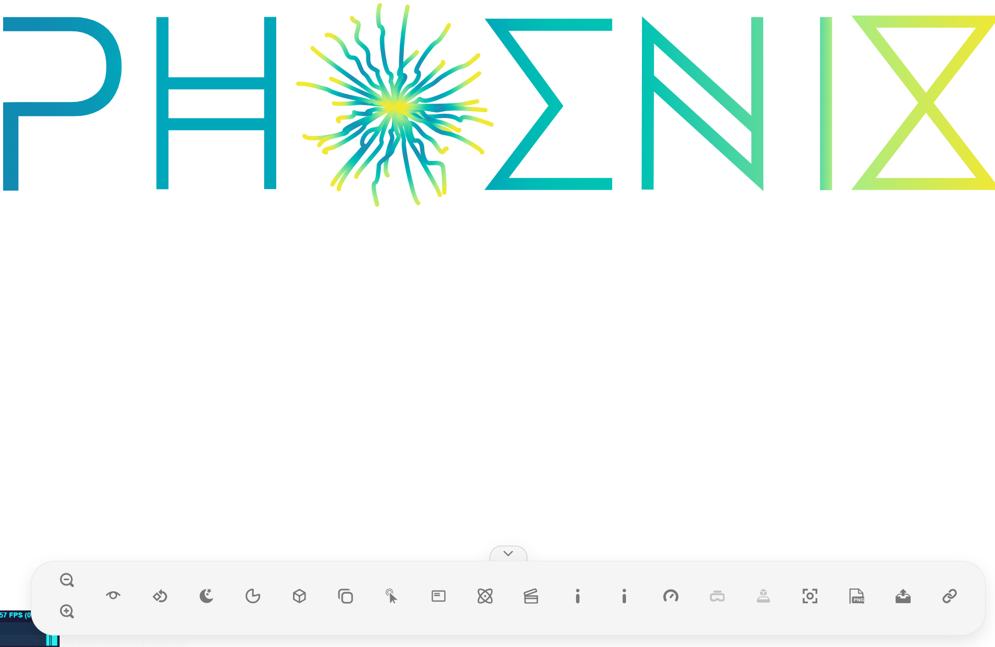
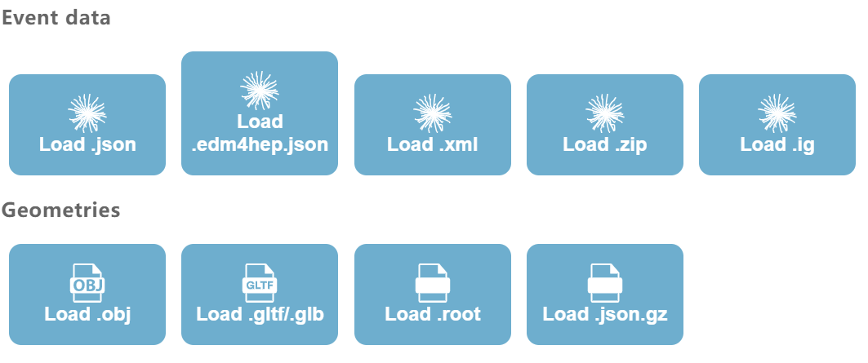
Phoenix UI
Phoenix official website: https://hepsoftwarefoundation.org/phoenix/#/
The official Phoenix web page is shown on the right
To visualize detector and events, press Upload button in the memu tool bar.
To visualize events, use upload buttons on the event data list. To visualize detector, press the “Load .root” button to upload detector geometry file

Slide 10
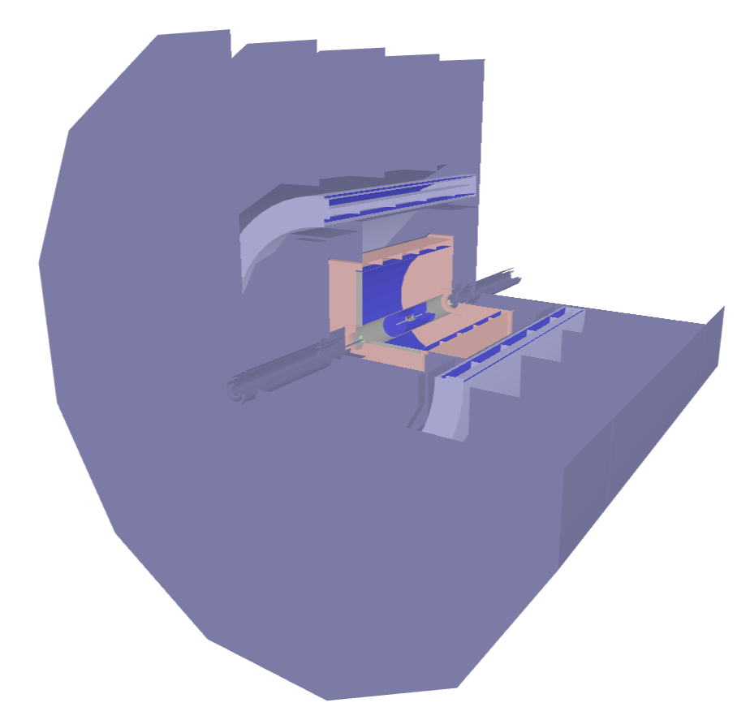
File formats supported by Phoenix
Phoenix supports ROOT geometry file for detector visualization. With CEPCSW and ROOT software one can convert the detector geometry description to .root format.
Phoenix makes use of a JSON format to represent event data.
A JSON file for event visualization should contain multiple visual components, i.e. tracks, jets, hits, clusters
Phoenix also supports using .edm4hep.json format to load event data.

Slide 11
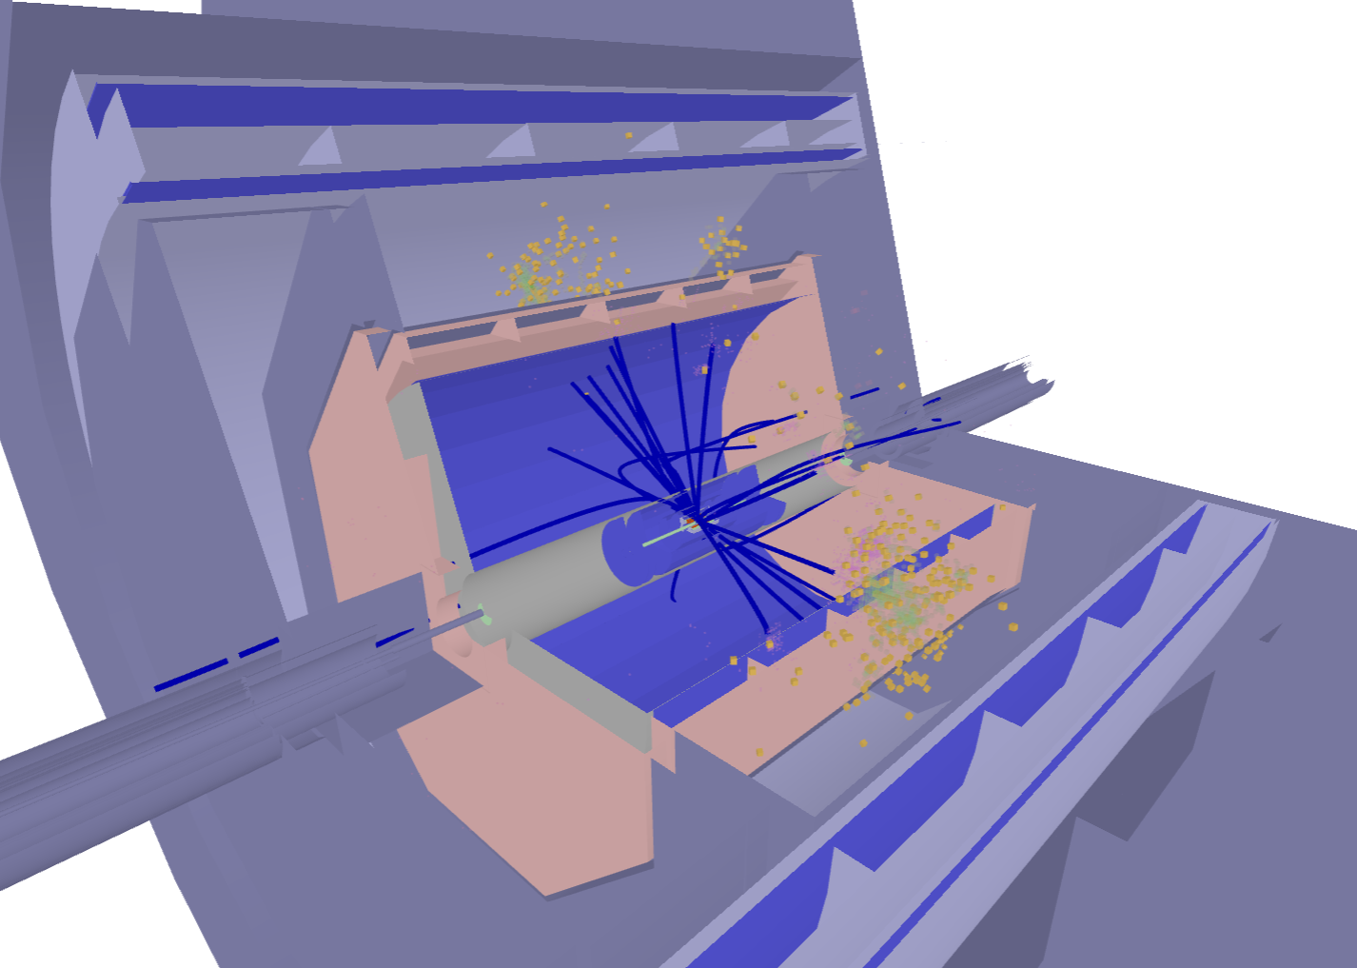
Procedure to dump event data to JSON
edm4hep2json is a toolkit that dumps the contents of an EMD4hep file in JSON format.
Usage $edm4hep2json –e 0,1 Rec_TDR_o1_v01.root
-e option is used to specify the events will be dumped to JSON
Phoenix can only use reconstructed event files for visualization. The visualized detector and event are shown in the right
However the algorithm for loading .edm4hep.json files in Phoenix is flawed.
To successfully load the json file, you may need to change the file name, the file name should not contain multiple “.” characters. (i.e. Rec_TDR_o1_v01.edm4hep.json is a invalid file name, but Rec_TDR_o1_v01_edm4hep.json can be uploaded)
The edm4hep .json file may contain invalid objects for event display. Need to remove these objects by writing programs.
edm4hep2json
.edm4hep.json file

Slide 12
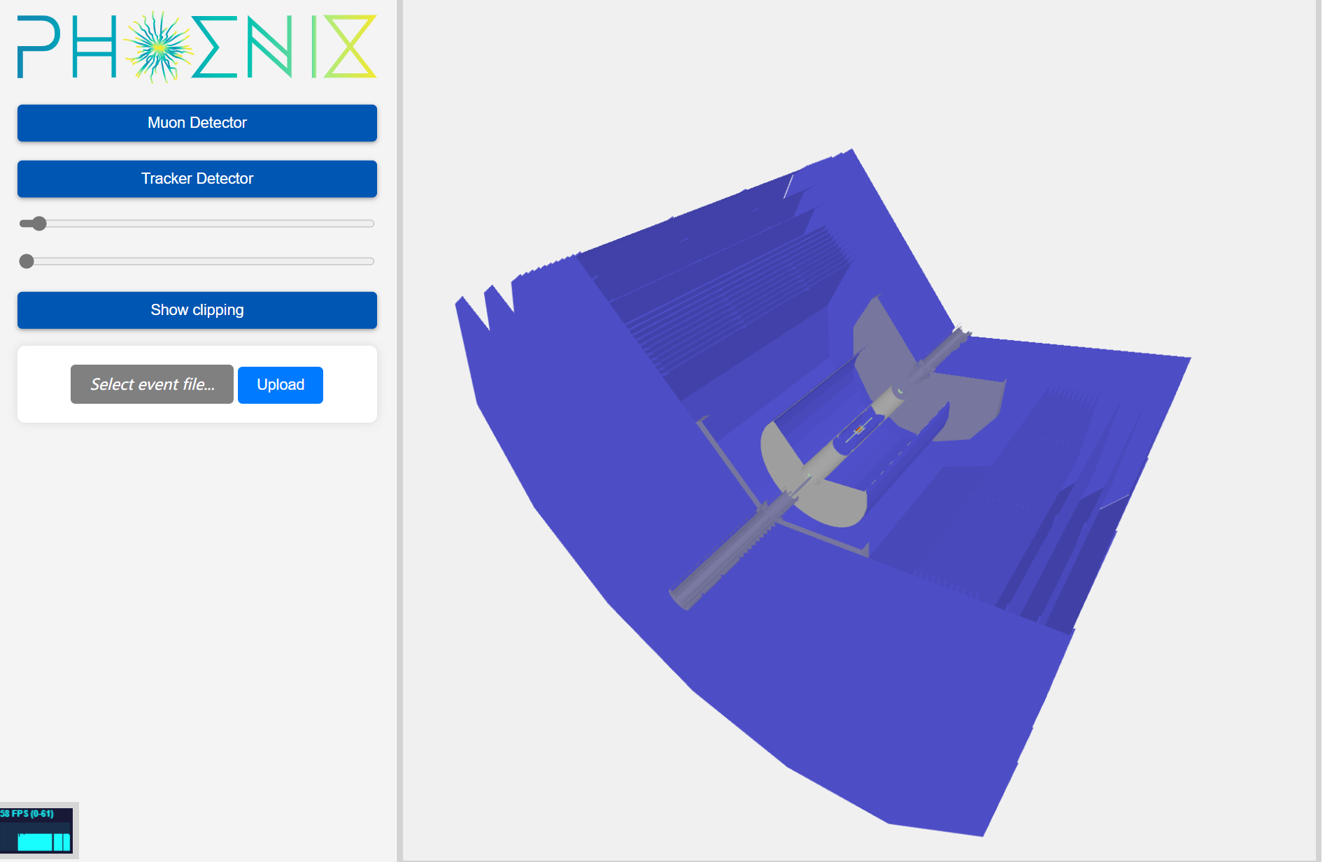
Run & Customize phoenix locally
To develop our own phoenix application, one can download essential packages and run the applications locally.
Essential packages:
Node.js: provides Runtime environment for Javascript
express: a simple package to start a web server
Phoenix.js & Three.js: Phoenix library
After installing the packages, one can create a simple web application and edit the webpage to realize more features.

Slide 13
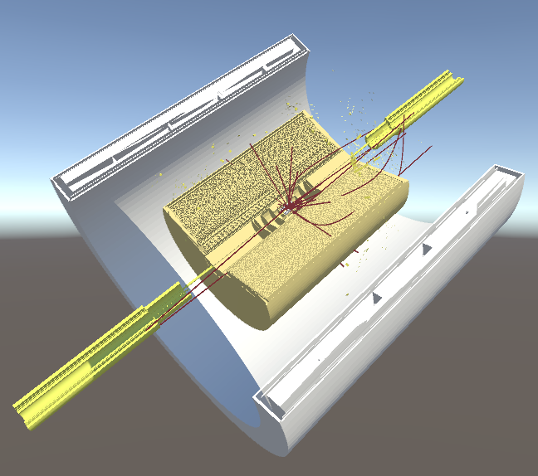
Contents
Introduction
Software structure
Visualization in Phoenix
Detector visualization
Event display
Visualization in Unity
FBX format
Detector visualization
Event display

Slide 14
Unity engine
Unity is the world’s most popular development platform for creating multiplatform games and interactive experiences.
Unity has the following advantages:
Easy to use: Unity engine has a intuitive interface for beginners to get started quickly. Additionally, it provides comprehensive documentation for users.
High-Quality Graphics: Unity supports advanced graphics technologies like physically-based rendering.
Cross Platform: With Unity, we can develop once and deploy the application across multiple platforms (Windows, Android, Linux, MacOS, …)
…
Platforms that Unity supports

Slide 15
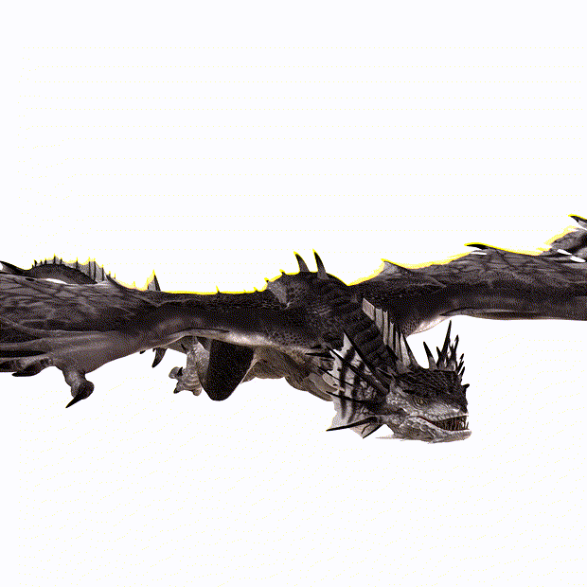
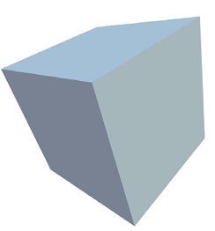
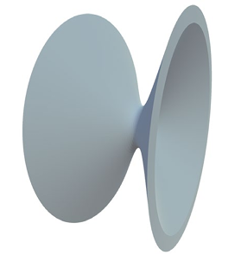
FBX format
FBX (Filmbox) is a 3D mesh file format used for exchanging 3D models and animation data.
Contain geometry, materials, skeletons, animations, and others, making it a powerful file format.
In Unity, FBX files can be directly imported for building game scenes, character models, animations, and more.
(1)Cube
(2)Cone
(3)Sphere
(4)Hyperboloid
Some basic shapes in FBX format and shown in Unity
Animations in FBX
To convert detector geometry to FBX format, we developed DD4hep2FBX converter that could convert DD4hep geometry description to FBX format.
DD4hep2FBX directly converts detector geometry description to FBX format, while preserving Shapes, Materials, transformations, Geometry hierarchy properties

Slide 16
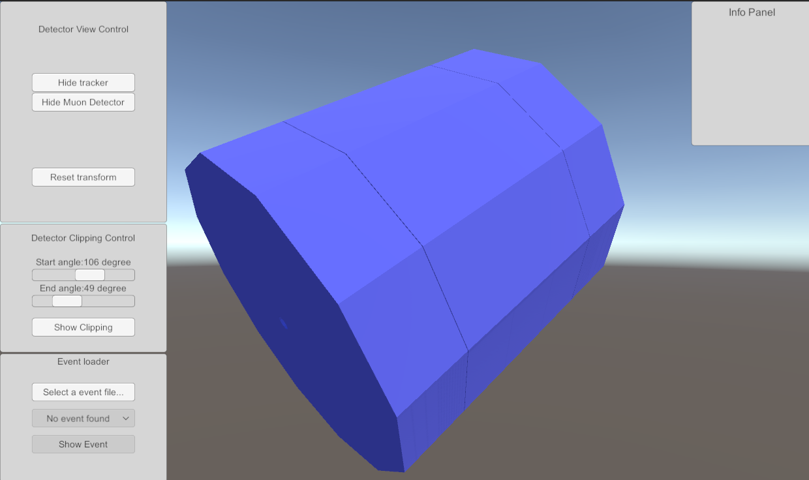
CEPC Visualization in Unity
Currently we realized a few simple features for visualization. The GUI of the software is shown on the right:
You can drag the mouse to change the angle the viewing angle. Slide the mouse wheel to zoom in and zoom out:

Slide 17
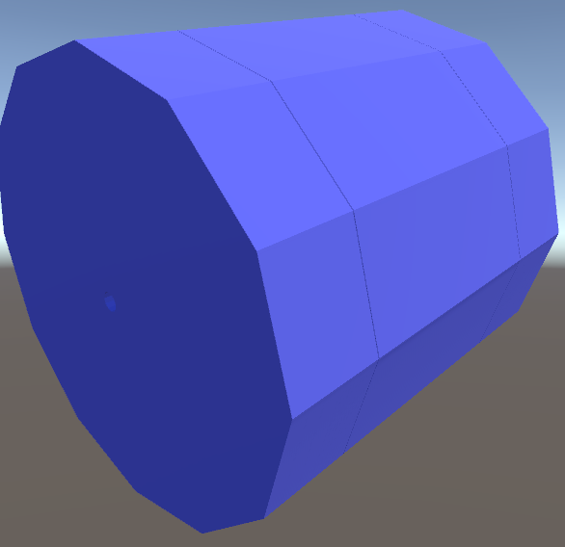
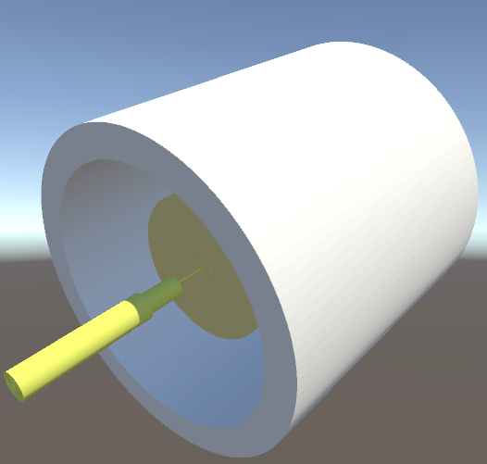
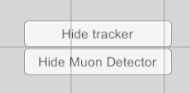
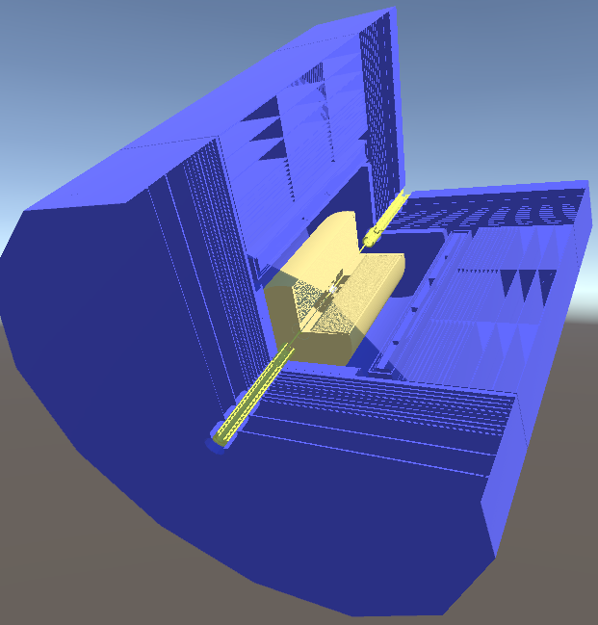
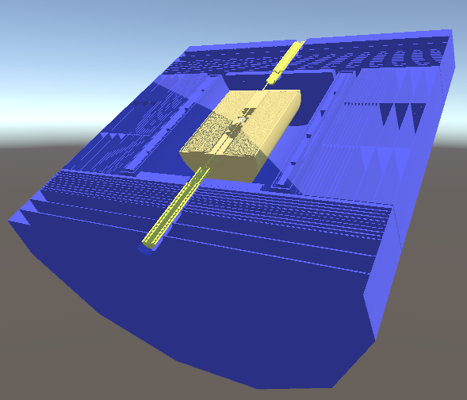
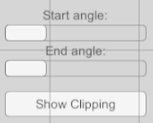
CEPC Visualization in Unity
You can press button in the “Detector View” panel to show and hide subdetector of CEPC:
Use the scrollbars and button to obtain a clipping view of the detector from different angles:

Slide 18
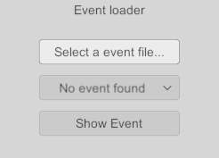
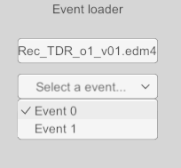
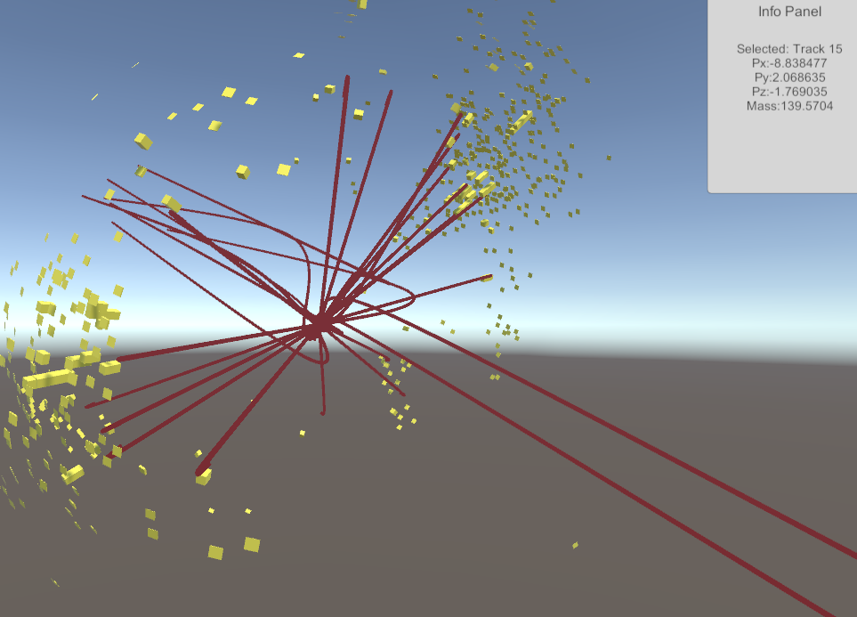
Event Visualization in Unity
Temporarily this application only supports .edm4hep.json file for event visualization.
Select event file by clicking the button. Select the event to be visualized in the dropdown
Press “show event button” to visualize the event. The visual components like tracks, clusters can be selected, and their information are shown in the info panel

Slide 19
Summary
Phoenix:
Pros:
future official web display platform of HEP experiments
Highly cross platform. Can open in any web browser
Already has comprehensive functions
Cons:
Lacked documentation support
Flawed functionality. Inflexible
Unity:
Pros:
Support many platforms
Comprehensive community and documentation support
Highly flexible and customizable. Supports high-level 3D display effects.
Cons:
Generated executables can only run locally. Not cross platform
Ongoing Work:
Add more functions to current visualization software. i.e. Add event animation, add menu to change the rendering effect…
Improve existing functions of the software
Port the software to a VR platform such as Oculus Quest or Apple Vision Pro.
Thank you for listening!

