Slide 1
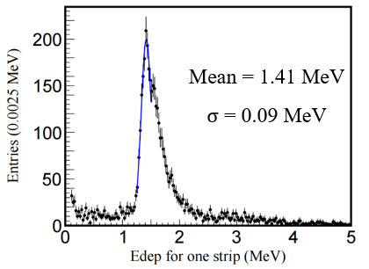
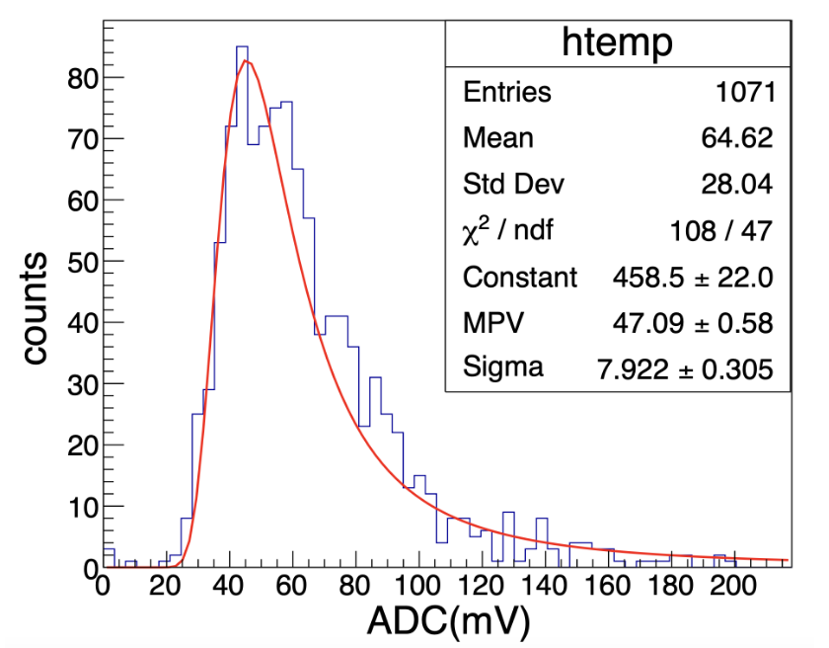
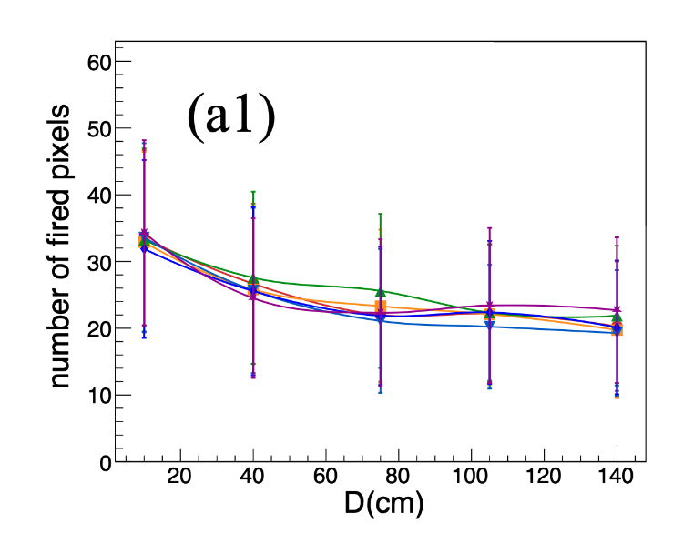
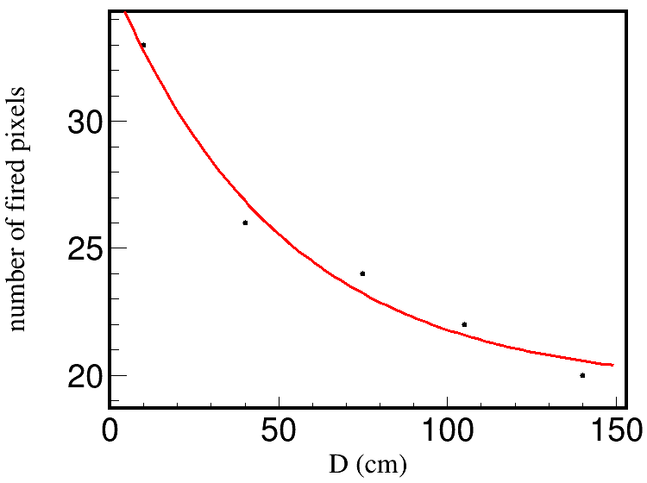
Digitization
$1 keV<EDep_{hit}<100 MeV EDep_{strip} > 0.1 MeV$
$Eff_{fudge} =1.00$
$mean=\left(16.0813×e^{−D/50.8147}+19.5474\right)×\frac{E_{dep}}{1.41 MeV}×\frac{47.09 mV}{23}$
$σ=7.922 mV$
$ADC=Random.Landau(mean,σ)$
$$mip=1.41 MeV$$
$$1 mip→ADC=47.09$$
$$p. e.=23 σ=7.922$$
Zhang H, Wang X, Ma W, et al. Journal of Instrumentation, 2024, 19(06): P06020.
$$N=16.0813×e^{−x/50.8147}+19.5474$$

Slide 2
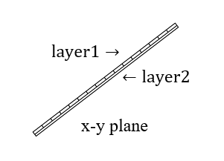
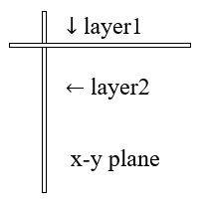
Reconstruction
Find the point with the smallest $x^{2}+y^{2}$ in each section as the starting point, then search for the point closest to the previous point layer by layer.
Use RANSAC to select the points, and use linear fitting to fit the track of these points, and select the one with the smallest $χ^{2}$.
In a superlayer of Barrel, layer1 gives pos.x and pos.y, layer2 gives pos.z.
In a superlayer of Endcap, layer1 gives pos.y, layer2 gives pos.x, both can give pos.z.

Slide 3
$Eff_{fudge} =1 (μ)$
 | 5 GeV Barrel | 5 GeV Endcap | 10 GeV Barrel | 10 GeV Endcap | $$h→μ^{+}μ^{−}$$
$$N_{events}$$ | 1k | 1k | 1k | 1k | 1k
$$N_{muonid}$$ | 967 | 963 | 965 | 977 | 927
$$N_{muonrec}$$ | 957 | 952 | 957 | 970 | 902
$Eff_{fudge} =1 (π)$
 | 10 GeV Barrel | 10 GeV Endcap
$$N_{events}$$ | 1k | 1k
$$N_{muonid}$$ | 25 | 26
$$N_{muonrec}$$ | 15 | 8

Slide 4
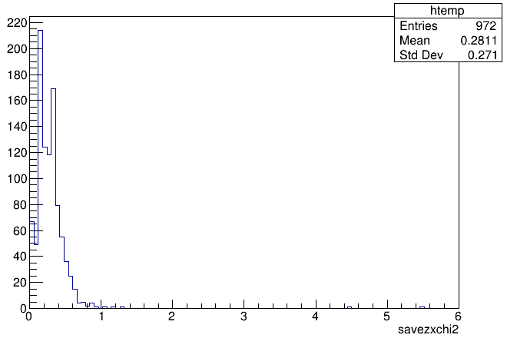
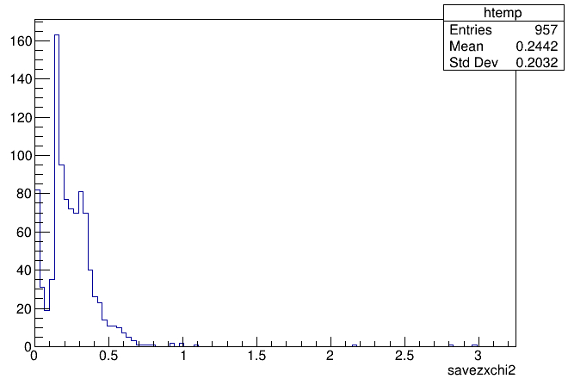
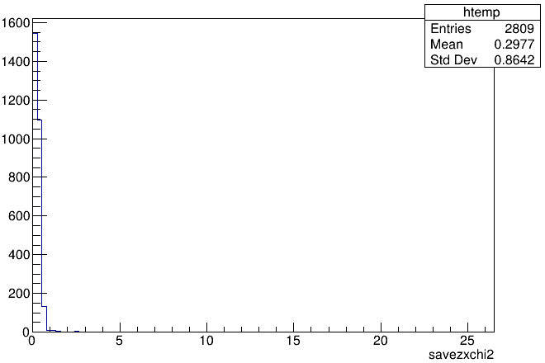
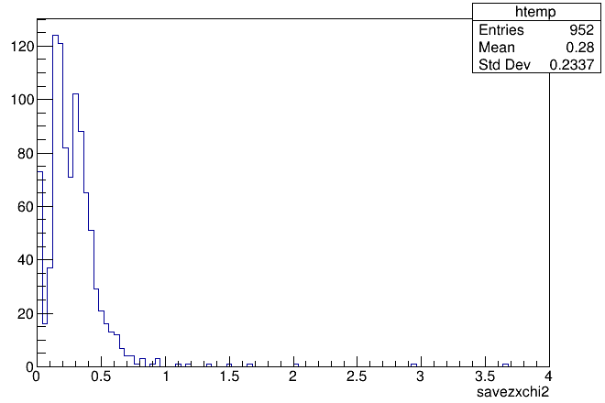
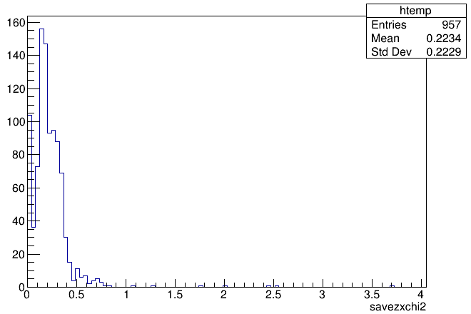
10 GeV Endcap
10 GeV Barrel
$$h→μ^{+}μ^{−}$$
5 GeV Endcap
5 GeV Barrel

Slide 5
$$Num_{layer}≥3$$
$$Eff_{fudge} =1$$
 | 5 GeV Barrel | 5 GeV Endcap | 10 GeV Barrel | 10 GeV Endcap | $$h→μ^{+}μ^{−}$$
$$N_{events}$$ | 9959 | 9977 | 9998 | 9952 | 1k
$$N_{muonid}$$ | 9953 | 9863 | 9998 | 9823 | 927
$$N_{muonrec}$$ | 9950 | 9744 | 9998 | 9782 | 902
$Eff_{fudge} =$ 0.95
 | 5 GeV Barrel | 5 GeV Endcap | 10 GeV Barrel | 10 GeV Endcap | $$h→μ^{+}μ^{−}$$
$$N_{events}$$ | 1k | 1k | 1k | 1k | 1k
$$N_{muonid}$$ | 964 | 961 | 965 | 976 | 926
$$N_{muonrec}$$ | 908 | 923 | 924 | 948 | 859
$$Num_{layer}≥4$$
$$Eff_{fudge} =1$$
 | 5 GeV Barrel | 5 GeV Endcap | 10 GeV Barrel | 10 GeV Endcap | $$h→μ^{+}μ^{−}$$
$$N_{events}$$ | 1k | 1k | 1k | 1k | 1k
$$N_{muonid}$$ | 828 | 879 | 923 | 921 | 845
$$N_{muonrec}$$ | 809 | 858 | 891 | 906 | 809

Slide 6
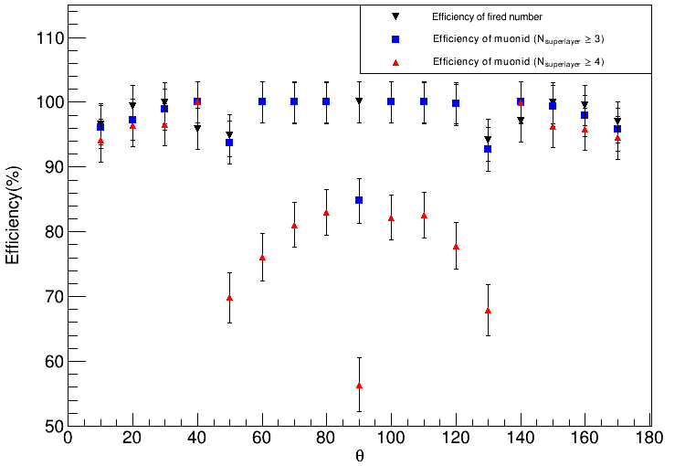
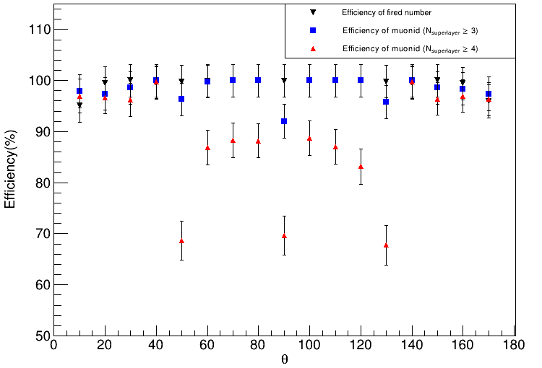
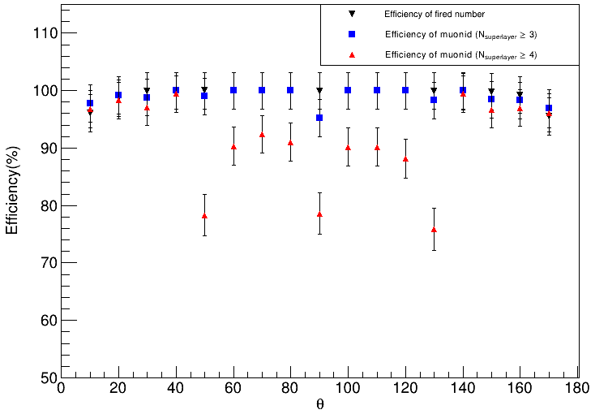
$$5 GeV μ$$
$$6 GeV μ$$
$$7 GeV μ$$

Slide 7
$Num_{layer}≥3$ $Eff_{fudge} =1$
$$5 GeV μ$$ | $$10°$$ | $$20°$$ | $$30°$$ | $$40°$$ | $$50°$$ | $$60°$$ | $$70°$$ | $$80°$$ | $$90°$$
$$N_{events}$$ | 966 | 994 | 999 | 959 | 948 | 1000 | 999 | 999 | 1000
$$N_{superlayer}≥3$$ | 929 (%) | 967 (%) | 988 (%) | 959 (%) | 889 (%) | 1000 (%) | 999 (%) | 999 (%) | 848 (%)
$$N_{superlayer}≥4$$ | 909 (%) | 958 (%) | 964 (%) | 959 (%) | 662 (%) | 761 (%) | 810 (%) | 829 (%) | 564 (%)
$$5 GeV μ$$ | $$100°$$ | $$110°$$ | $$120°$$ | $$130°$$ | $$140°$$ | $$150°$$ | $$160°$$ | $$170°$$
$$N_{events}$$ | 1000 | 999 | 996 | 941 | 971 | 999 | 995 | 969
$$N_{superlayer}≥3$$ | 1000 (%) | 999 (%) | 994 (%) | 873 (%) | 971 (%) | 993 (%) | 974 (%) | 928 (%)
$$N_{superlayer}≥4$$ | 822 (%) | 825 (%) | 775 (%) | 639 (%) | 970 (%) | 962 (%) | 954 (%) | 916 (%)

Slide 8
$Num_{layer}≥3$ $Eff_{fudge} =1$
$$5.5 GeV μ$$ | $$10°$$ | $$20°$$ | $$30°$$ | $$40°$$ | $$50°$$ | $$60°$$ | $$70°$$ | $$80°$$ | $$90°$$
$$N_{events}$$ | 970 | 991 | 998 | 993 | 995 | 996 |  | 999 | 999
$$N_{superlayer}≥3$$ | 945 (%) | 973 (%) | 985 (%) | 993 (%) | 940 (%) | 995 (%) | (%) | 999 (%) | 905 (%)
$$N_{superlayer}≥4$$ | 935 (%) | 967 (%) | 972 (%) | 992 (%) | 658 (%) | 813 (%) | (%) | 847 (%) | 639 (%)
$$5.5 GeV μ$$ | $$100°$$ | $$110°$$ | $$120°$$ | $$130°$$ | $$140°$$ | $$150°$$ | $$160°$$ | $$170°$$
$$N_{events}$$ | 997 | 1000 | 999 | 988 | 992 | 997 | 986 | 964
$$N_{superlayer}≥3$$ | 997 (%) | 1000 (%) | 999 (%) | 939 (%) | 992 (%) | 979 (%) | 967 (%) | 943 (%)
$$N_{superlayer}≥4$$ | 857 (%) | 844 (%) | 811 (%) | 685 (%) | 992 (%) | 959 (%) | 954 (%) | 929 (%)

Slide 9
$Num_{layer}≥3$ $Eff_{fudge} =1$
$$6 GeV μ$$ | $$10°$$ | $$20°$$ | $$30°$$ | $$40°$$ | $$50°$$ | $$60°$$ | $$70°$$ | $$80°$$ | $$90°$$
$$N_{events}$$ | 951 | 995 | 1000 | 995 | 998 | 999 | 1000 | 1000 | 999
$$N_{superlayer}≥3$$ | 931 (%) | 969 (%) | 986 (%) | 995 (%) | 961 (%) | 997 (%) | 1000 (%) | 1000 (%) | 919 (%)
$$N_{superlayer}≥4$$ | 922 (%) | 962 (%) | 962 (%) | 992 (%) | 685 (%) | 868 (%) | 883 (%) | 882 (%) | 696 (%)
$$6 GeV μ$$ | $$100°$$ | $$110°$$ | $$120°$$ | $$130°$$ | $$140°$$ | $$150°$$ | $$160°$$ | $$170°$$
$$N_{events}$$ | 1000 | 999 | 999 | 998 | 995 | 1000 | 994 | 959
$$N_{superlayer}≥3$$ | 1000 (%) | 999 (%) | 999 (%) | 956 (%) | 995 (%) | 986 (%) | 978 (%) | 934 (%)
$$N_{superlayer}≥4$$ | 887 (%) | 870 (%) | 831 (%) | 676 (%) | 992 (%) | 964 (%) | 964 (%) | 924 (%)

Slide 10
$Num_{layer}≥3$ $Eff_{fudge} =1$
$$7 GeV μ$$ | $$10°$$ | $$20°$$ | $$30°$$ | $$40°$$ | $$50°$$ | $$60°$$ | $$70°$$ | $$80°$$ | $$90°$$
$$N_{events}$$ | 961 | 987 |  | 999 | 1000 | 1000 | 999 | 1000 | 999
$$N_{superlayer}≥3$$ | 940 (%) | 979 (%) | (%) | 999 (%) | 990 (%) | 1000 (%) | 999 (%) | 1000 (%) | 951 (%)
$$N_{superlayer}≥4$$ | 930 (%) | 970 (%) | (%) | 993 (%) | 783 (%) | 903 (%) | 923 (%) | 910 (%) | 785 (%)
$$7 GeV μ$$ | $$100°$$ | $$110°$$ | $$120°$$ | $$130°$$ | $$140°$$ | $$150°$$ | $$160°$$ | $$170°$$
$$N_{events}$$ | 1000 | 999 | 999 | 999 | 998 | 998 | 992 | 955
$$N_{superlayer}≥3$$ | 1000 (%) | 999 (%) | 999 (%) | 982 (%) | 998 (%) | 982 (%) | 975 (%) | 925 (%)
$$N_{superlayer}≥4$$ | 902 (%) | 901 (%) | 881 (%) | 758 (%) | 992 (%) | 965 (%) | 962 (%) | 918 (%)

Slide 11
$Num_{layer}≥3$ $Eff_{fudge} =1$
$$7.5 GeV μ$$ | $$10°$$ | $$20°$$ | $$30°$$ | $$40°$$ | $$50°$$ | $$60°$$ | $$70°$$ | $$80°$$ | $$90°$$
$$N_{events}$$ | 959 | 988 |  | 999 | 999 | 998 | 999 | 1000 | 1000
$$N_{superlayer}≥3$$ | (%) | (%) | (%) | (%) | (%) | (%) | (%) | (%) | (%)
$$N_{superlayer}≥4$$ | (%) | (%) | (%) | (%) | (%) | (%) | (%) | (%) | (%)
$$7.5 GeV μ$$ | $$100°$$ | $$110°$$ | $$120°$$ | $$130°$$ | $$140°$$ | $$150°$$ | $$160°$$ | $$170°$$
$$N_{events}$$ | 1000 | 999 | 998 | 995 | 998 | 998 | 991 | 942
$$N_{superlayer}≥3$$ | (%) | (%) | (%) | (%) | (%) | (%) | (%) | (%)
$$N_{superlayer}≥4$$ | (%) | (%) | (%) | (%) | (%) | (%) | (%) | (%)

Slide 12
$Num_{layer}≥3$ $Eff_{fudge} =1$
$$8 GeV μ$$ | $$10°$$ | $$20°$$ | $$30°$$ | $$40°$$ | $$50°$$ | $$60°$$ | $$70°$$ | $$80°$$ | $$90°$$
$$N_{events}$$ | 952 | 988 | 998 | 998 | 1000 | 1000 | 1000 | 1000 | 998
$$N_{superlayer}≥3$$ | (%) | (%) | (%) | (%) | (%) | (%) | (%) | (%) | (%)
$$N_{superlayer}≥4$$ | (%) | (%) | (%) | (%) | (%) | (%) | (%) | (%) | (%)
$$8 GeV μ$$ | $$100°$$ | $$110°$$ | $$120°$$ | $$130°$$ | $$140°$$ | $$150°$$ | $$160°$$ | $$170°$$
$$N_{events}$$ | 999 | 998 | 1000 | 1000 | 1000 |  | 991 | 948
$$N_{superlayer}≥3$$ | (%) | (%) | (%) | (%) | (%) | (%) | (%) | (%)
$$N_{superlayer}≥4$$ | (%) | (%) | (%) | (%) | (%) | (%) | (%) | (%)

Slide 13
$Num_{layer}≥3$ $Eff_{fudge} =1$
$$8.5 GeV μ$$ | $$10°$$ | $$20°$$ | $$30°$$ | $$40°$$ | $$50°$$ | $$60°$$ | $$70°$$ | $$80°$$ | $$90°$$
$$N_{events}$$ | 964 | 983 | 998 | 998 | 998 | 998 | 998 | 999 | 999
$$N_{superlayer}≥3$$ | (%) | (%) | (%) | (%) | (%) | (%) | (%) | (%) | (%)
$$N_{superlayer}≥4$$ | (%) | (%) | (%) | (%) | (%) | (%) | (%) | (%) | (%)
$$8.5 GeV μ$$ | $$100°$$ | $$110°$$ | $$120°$$ | $$130°$$ | $$140°$$ | $$150°$$ | $$160°$$ | $$170°$$
$$N_{events}$$ | 997 | 1000 | 999 | 988 | 992 |  | 986 | 964
$$N_{superlayer}≥3$$ | (%) | (%) | (%) | (%) | (%) | (%) | (%) | (%)
$$N_{superlayer}≥4$$ | (%) | (%) | (%) | (%) | (%) | (%) | (%) | (%)

Slide 14
$Num_{layer}≥3$ $Eff_{fudge} =1$
$$5 GeV μ$$ | $$10°$$ | $$20°$$ | $$30°$$ | $$40°$$ | $$50°$$ | $$60°$$ | $$70°$$ | $$80°$$ | $$90°$$
$$N_{events}$$
$$N_{superlayer}≥3$$ | (%) | (%) | (%) | (%) | (%) | (%) | (%) | (%) | (%)
$$N_{superlayer}≥4$$ | (%) | (%) | (%) | (%) | (%) | (%) | (%) | (%) | (%)
$$5 GeV μ$$ | $$100°$$ | $$110°$$ | $$120°$$ | $$130°$$ | $$140°$$ | $$150°$$ | $$160°$$ | $$170°$$
$$N_{events}$$
$$N_{superlayer}≥3$$ | (%) | (%) | (%) | (%) | (%) | (%) | (%) | (%)
$$N_{superlayer}≥4$$ | (%) | (%) | (%) | (%) | (%) | (%) | (%) | (%)

Slide 15
$Num_{layer}≥3$ $Eff_{fudge} =1$
$$5 GeV μ$$ | $$10°$$ | $$20°$$ | $$30°$$ | $$40°$$ | $$50°$$ | $$60°$$ | $$70°$$ | $$80°$$ | $$90°$$
$$N_{events}$$
$$N_{superlayer}≥3$$ | (%) | (%) | (%) | (%) | (%) | (%) | (%) | (%) | (%)
$$N_{superlayer}≥4$$ | (%) | (%) | (%) | (%) | (%) | (%) | (%) | (%) | (%)
$$5 GeV μ$$ | $$100°$$ | $$110°$$ | $$120°$$ | $$130°$$ | $$140°$$ | $$150°$$ | $$160°$$ | $$170°$$
$$N_{events}$$
$$N_{superlayer}≥3$$ | (%) | (%) | (%) | (%) | (%) | (%) | (%) | (%)
$$N_{superlayer}≥4$$ | (%) | (%) | (%) | (%) | (%) | (%) | (%) | (%)

Slide 16
$Num_{layer}≥3$ $Eff_{fudge} =1$
$$5 GeV μ$$ | $$10°$$ | $$20°$$ | $$30°$$ | $$40°$$ | $$50°$$ | $$60°$$ | $$70°$$ | $$80°$$ | $$90°$$
$$N_{events}$$
$$N_{superlayer}≥3$$ | (%) | (%) | (%) | (%) | (%) | (%) | (%) | (%) | (%)
$$N_{superlayer}≥4$$ | (%) | (%) | (%) | (%) | (%) | (%) | (%) | (%) | (%)
$$5 GeV μ$$ | $$100°$$ | $$110°$$ | $$120°$$ | $$130°$$ | $$140°$$ | $$150°$$ | $$160°$$ | $$170°$$
$$N_{events}$$
$$N_{superlayer}≥3$$ | (%) | (%) | (%) | (%) | (%) | (%) | (%) | (%)
$$N_{superlayer}≥4$$ | (%) | (%) | (%) | (%) | (%) | (%) | (%) | (%)

Slide 17
$Num_{layer}≥3$ $Eff_{fudge} =1$
$$5 GeV μ$$ | $$10°$$ | $$20°$$ | $$30°$$ | $$40°$$ | $$50°$$ | $$60°$$ | $$70°$$ | $$80°$$ | $$90°$$
$$N_{events}$$
$$N_{superlayer}≥3$$ | (%) | (%) | (%) | (%) | (%) | (%) | (%) | (%) | (%)
$$N_{superlayer}≥4$$ | (%) | (%) | (%) | (%) | (%) | (%) | (%) | (%) | (%)
$$5 GeV μ$$ | $$100°$$ | $$110°$$ | $$120°$$ | $$130°$$ | $$140°$$ | $$150°$$ | $$160°$$ | $$170°$$
$$N_{events}$$
$$N_{superlayer}≥3$$ | (%) | (%) | (%) | (%) | (%) | (%) | (%) | (%)
$$N_{superlayer}≥4$$ | (%) | (%) | (%) | (%) | (%) | (%) | (%) | (%)

Slide 18
$Num_{layer}≥3$ $Eff_{fudge} =1$
$$5 GeV μ$$ | $$10°$$ | $$20°$$ | $$30°$$ | $$40°$$ | $$50°$$ | $$60°$$ | $$70°$$ | $$80°$$ | $$90°$$
$$N_{events}$$
$$N_{superlayer}≥3$$ | (%) | (%) | (%) | (%) | (%) | (%) | (%) | (%) | (%)
$$N_{superlayer}≥4$$ | (%) | (%) | (%) | (%) | (%) | (%) | (%) | (%) | (%)
$$5 GeV μ$$ | $$100°$$ | $$110°$$ | $$120°$$ | $$130°$$ | $$140°$$ | $$150°$$ | $$160°$$ | $$170°$$
$$N_{events}$$
$$N_{superlayer}≥3$$ | (%) | (%) | (%) | (%) | (%) | (%) | (%) | (%)
$$N_{superlayer}≥4$$ | (%) | (%) | (%) | (%) | (%) | (%) | (%) | (%)

Slide 19
$Num_{layer}≥3$ $Eff_{fudge} =1$
$$5 GeV μ$$ | $$10°$$ | $$20°$$ | $$30°$$ | $$40°$$ | $$50°$$ | $$60°$$ | $$70°$$ | $$80°$$ | $$90°$$
$$N_{events}$$
$$N_{superlayer}≥3$$ | (%) | (%) | (%) | (%) | (%) | (%) | (%) | (%) | (%)
$$N_{superlayer}≥4$$ | (%) | (%) | (%) | (%) | (%) | (%) | (%) | (%) | (%)
$$5 GeV μ$$ | $$100°$$ | $$110°$$ | $$120°$$ | $$130°$$ | $$140°$$ | $$150°$$ | $$160°$$ | $$170°$$
$$N_{events}$$
$$N_{superlayer}≥3$$ | (%) | (%) | (%) | (%) | (%) | (%) | (%) | (%)
$$N_{superlayer}≥4$$ | (%) | (%) | (%) | (%) | (%) | (%) | (%) | (%)

Slide 20
$Num_{layer}≥3$ $Eff_{fudge} =1$
$$5 GeV μ$$ | $$10°$$ | $$20°$$ | $$30°$$ | $$40°$$ | $$50°$$ | $$60°$$ | $$70°$$ | $$80°$$ | $$90°$$
$$N_{events}$$
$$N_{superlayer}≥3$$ | (%) | (%) | (%) | (%) | (%) | (%) | (%) | (%) | (%)
$$N_{superlayer}≥4$$ | (%) | (%) | (%) | (%) | (%) | (%) | (%) | (%) | (%)
$$5 GeV μ$$ | $$100°$$ | $$110°$$ | $$120°$$ | $$130°$$ | $$140°$$ | $$150°$$ | $$160°$$ | $$170°$$
$$N_{events}$$
$$N_{superlayer}≥3$$ | (%) | (%) | (%) | (%) | (%) | (%) | (%) | (%)
$$N_{superlayer}≥4$$ | (%) | (%) | (%) | (%) | (%) | (%) | (%) | (%)

