Slide 1
Progress and Plan
Mingyi Dong
2024.12.23

Slide 2
Progress
 | Tasks | Time needed (day) | person in charge | Stauts
1 | Mount patch cards of CGEM | Dec.16-20 | Italy team | done
2 | Installation of shielding boxes for CGEM | Dec.16-20 | Italy team | done
3 | Testing | Dec.21-22 | Italy team, IHEP | Done/ more tests after installation of beam pipe
4 | Installation of final shielding plates | Dec.23 | Italy team, IHEP | Not yet， will be finished today or tomorrow

Slide 3
Plan for next week
Will start the recovery work of IP area on Dec.24
1 | Deal with CGEM cables to ensure they do not interfere with pushing the east EEMC | Dec. 23/24
2 | (1) Remove current operation platform on east side (2) Push the east EEMC back to its original position (3) Disconnect the east EEMC from the support structure | Dec. 24-25
3 | Fix CGEM cables on EEMC support structure to ensure they do not interfere with installation of beam pipe | Dec.26
4 | Install the support tools for beam pipe installation | Dec.27
5 | Install beam pipe | Dec.28-29
6 | Remove the support tools for beam pipe installation | Dec.29
7 | Laser measurement and alignment of beam pipe | Dec.30

Slide 4
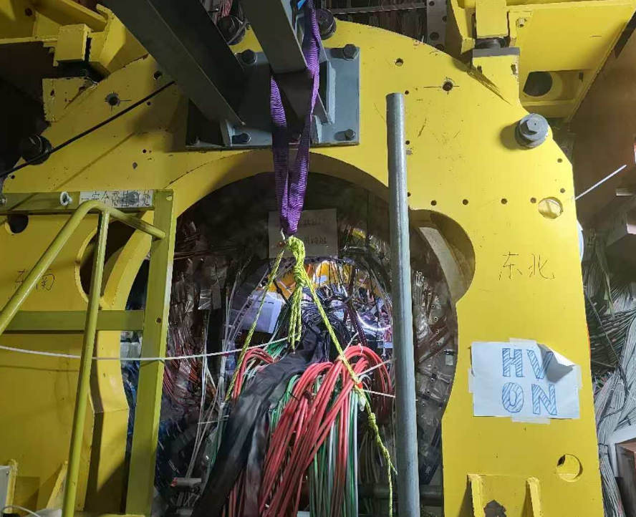
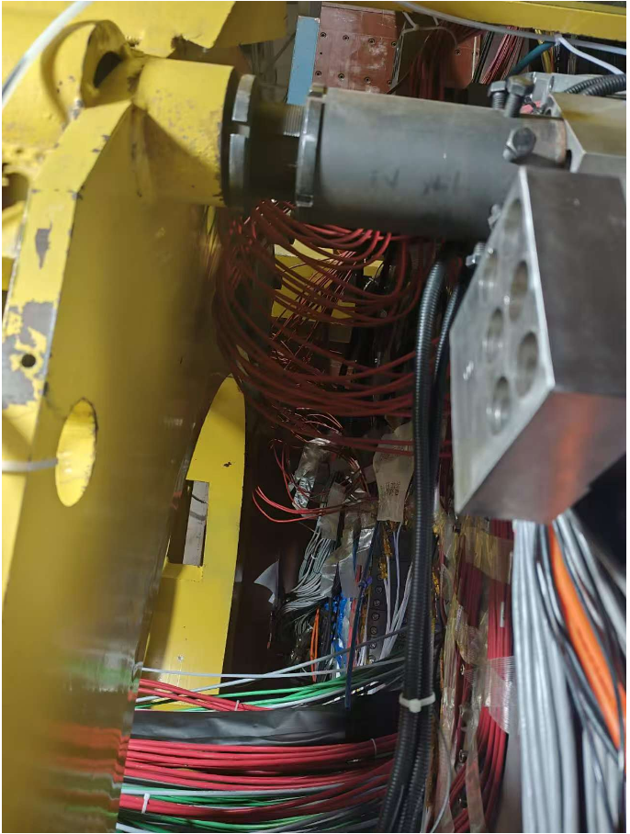
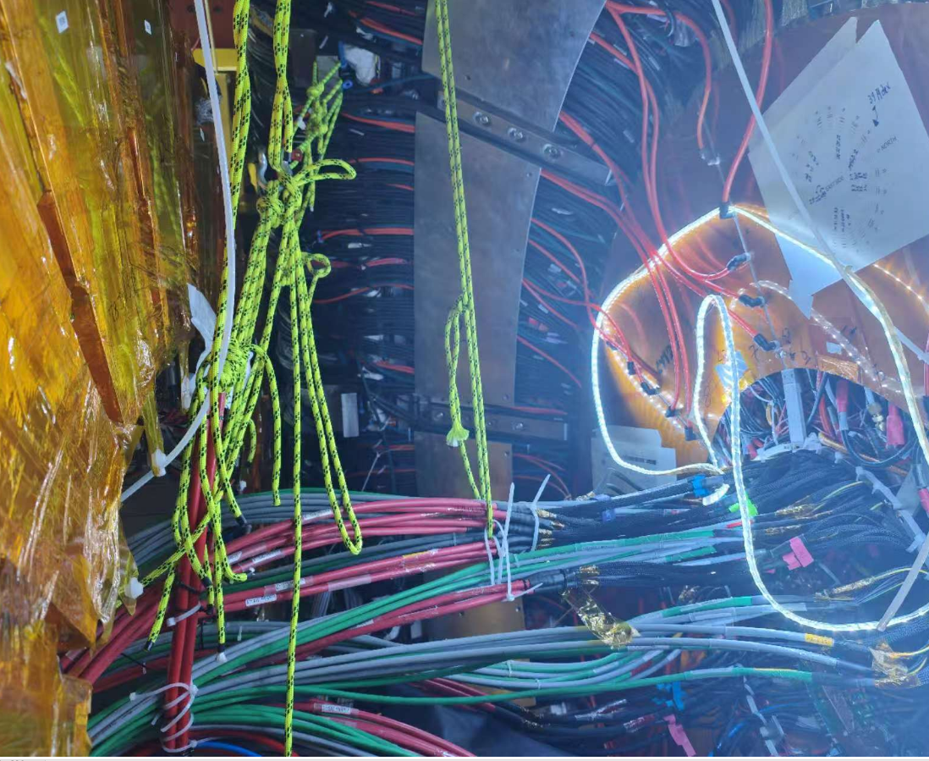
Fixing CGEM cables during pushing EEMC

