Slide 1
Status of Cgem gas slow control system
20241223 Meeting
Xiaolan Luo , Yinhong Zhang

Slide 2
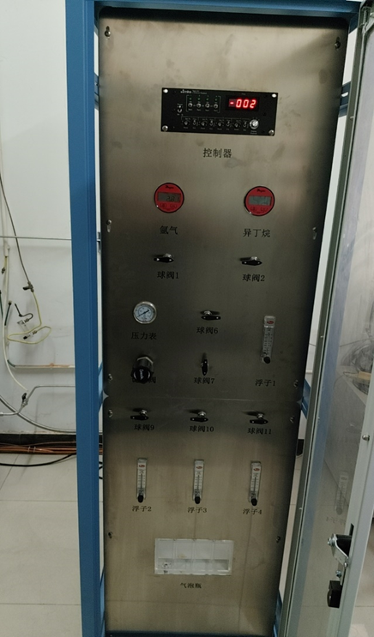
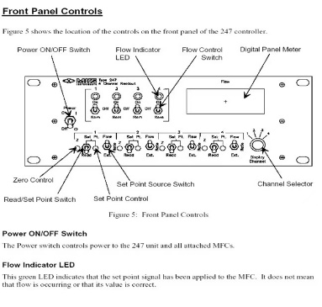
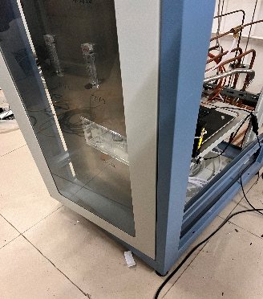
Gas slow control installation and commissioning
Design and installation of the slow control system according to the schematic diagram of the gas system.
Local data logging and slow control with Siemens Plc system
Completed wiring of all modules to local sensors.
Waiting to switch existing system to slow control operation.
Slow control system commissioning- needs 1-2days

Slide 3
Slow control parameters
Number 编号 | Name 名称 |  | Quantity 数量 | Signal output 两线制 | Range 量程 | Value and Alarm lines 实际值及报警线 | 备注Note 接口Sensor interfaces
1 | 单元气压力 Pressure | 氩气Ar | 1*2 | 4-20mA | 0-4bar | 1.3-3.0 bar | 1/4NPT/External thread
2 |  | 异丁烷C4H10 | 1*2 | 4-20 mA | 0-4bar | 1.3-3.0 bar | 1/4NPT/External thread
3 | 质量流流量 Flow rate | 氩气Ar | 1 | 0-5V | 0-10000sccm | 1450±1% Sccm | Totol value 1600Sccm Must be closed at the same time
4 |  | 异丁烷I-Butane | 1 | 0-5V | 0-10000sccm | 150±1% Sccm
5 | 质量流流量计开关量 Remote switching of flow meters | 氩气Ar | 1 |  |  |  | Must be closed at the same time
6 |  | 异丁烷I-butane | 1
7 | 缓冲罐压力 Pressure of buffer tank |  | 1*2 | 4-20 mA | 0-4bar | 0.5-0.9 bar | 1/4NPT/External thread
8 | 缓冲罐温度 Temperature of buffer tank |  | 1*2 | 4-20 mA | 0-28°C | 20-28°C | 1/4NPT/External thread
9 | 总进气压力 Mixture inlet pressure |  | 1*2 | 4-20 mA | 0-1bar | 0.3-0.5 bar | 1/4NPT/External thread
10 | 总进气流量 Mixture inlet pressure |  | 1 | 4-20 mA | 0-2500sccm | 1600 Sccm? | Set a float flow meter into full release.
11 | 室1进气流量 Flow rate of Chamber 1 |  | 1 | 4-20 mA | 0-1000sccm | 500 Sccm | A bubbler with water
12 | 室2进气流量 Flow rate of Chamber 2 |  | 1 | 4-20 mA | 0-1000sccm | 300 Sccm | A bubbler with water
13 | 室3进气流量 Flow rate of Chamber 3 |  | 1 | 4-20 mA | 0-1000sccm | 800 Sccm | A bubbler with water
14 | 室1压力 Pressure of Chamber 1 |  | 1*2 | 4-20 mA | 0-0.03bar | ＜10 mbar | 1/4NPT/External thread
15 | 室2压力 Pressure of Chamber 2 |  | 1*2 | 4-20 mA | 0-0.03bar | ＜10 mbar | 1/4NPT/External thread
16 | 室3压力 Pressure of Chamber 3 |  | 1*2 | 4-20 mA | 0-0.03bar | ＜10 mbar | 1/4NPT/External thread

Slide 4
Gas slow control installation and commissioning
Slow control system commissioning- needs 1-2days
Adjustment of all pressure and flow rate parameters
Testing the feasibility of remote switching of mass flow, etc.

