Slide 1



Next-to-next-to-leading order threshold soft function for $tW$ production
[Jia-Le Ding, Hai Tao Li, Jian Wang arXiv: 2502.18648]
丁家乐
山东大学
2025粒子物理标准模型及新物理精细计算研讨会
2025年3月28日至31日，保定

Slide 2
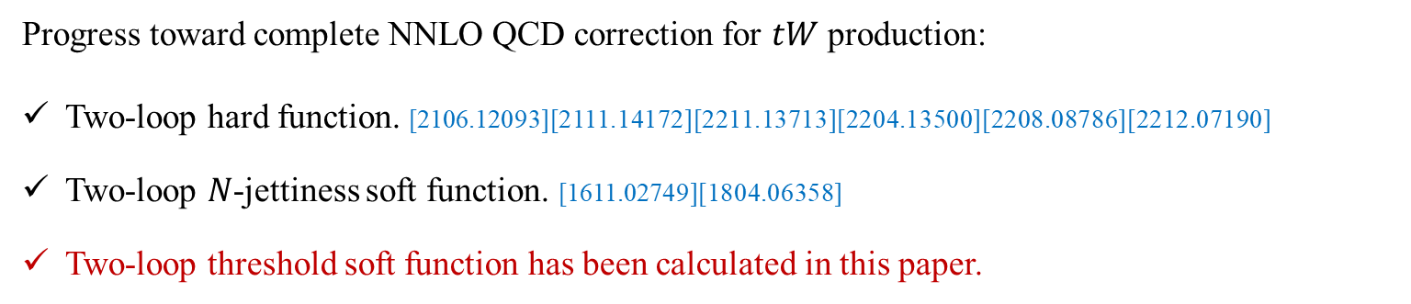
Introduction
Among the various production modes of a single top quark, the associated production of a top quark with a $W$ boson has the second-largest cross section at Large Hadron Collider (LHC).
The cross section is directly proportional to the square of the Cabibbo-Kobayashi-Maskawa (CKM) matrix element $V_{tb}$.
Inclusive and differential cross sections for $tW$ production have been measured extensively.
Progress toward complete NNLO QCD correction for $tW$ production:
Two-loop hard function. [2106.12093][2111.14172][2211.13713][2204.13500][2208.08786][2212.07190]
Two-loop $N$-jettiness soft function. [1611.02749][1804.06358]
Two-loop threshold soft function has been calculated in this paper.

Slide 3

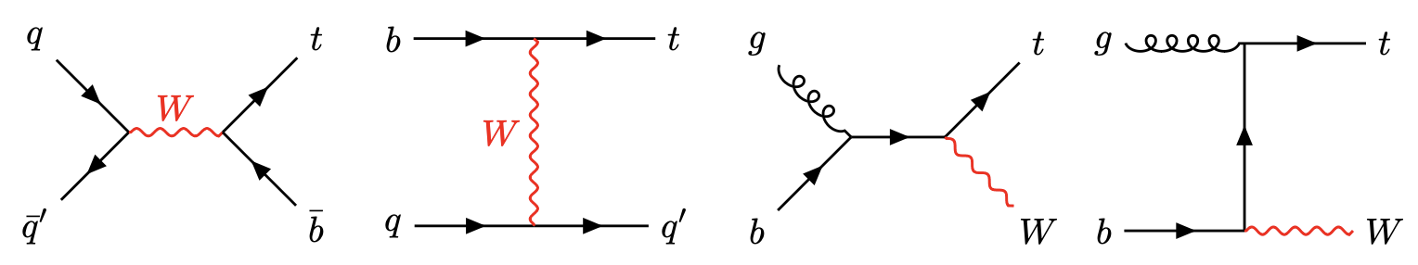
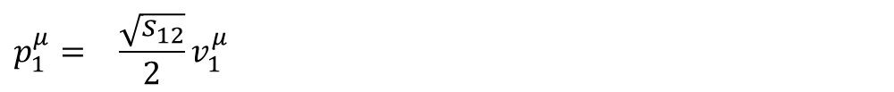

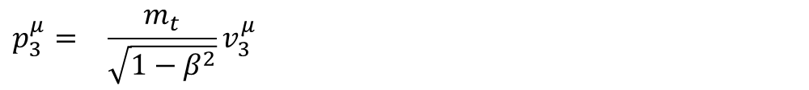

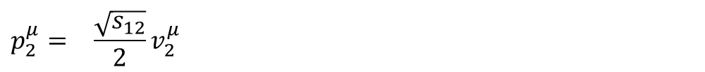

Process
Associated production of a top quark and a $W$ boson:
$$b/\overset{‾}{b}\left(p_{1}\right)+g\left(p_{2}\right)→t/\overset{‾}{t}\left(p_{3}\right)+W^{−}/W^{+}\left(p_{4}\right)$$
$$b/\overset{‾}{b}\left(p_{1}\right)+g\left(p_{2}\right)→t/\overset{‾}{t}\left(p_{3}\right)+W^{−}/W^{+}\left(p_{4}\right)$$
$$\begin{matrix}p_{1}^{μ}= & \frac{\sqrt{s_{12}}}{2}v_{1}^{μ}\end{matrix}$$
$$\begin{matrix}v_{1}^{μ}= & \left(1,0,0,1\right)\end{matrix}$$
$$\begin{matrix}p_{2}^{μ}= & \frac{\sqrt{s_{12}}}{2}v_{2}^{μ}\end{matrix}$$
$$\begin{matrix}v_{2}^{μ}= & \left(1,0,0,−1\right)\end{matrix}$$
$$\begin{matrix}p_{3}^{μ}= & \frac{m_{t}}{\sqrt{1−β^{2}}}v_{3}^{μ}\end{matrix}$$
$$\begin{matrix}v_{3}^{μ}= & \left(1,0,βsinθ,βcosθ\right)\end{matrix}$$
$$\begin{matrix}v_{0}^{μ}= & v_{1}^{μ}+v_{2}^{μ}= \left(1,0,0,1\right)\end{matrix}$$
$\begin{matrix}\end{matrix}S:$ hadronic energy of the collider
$\begin{matrix}s_{12}\end{matrix}:$ partonic invariance mass
$\begin{matrix}\end{matrix}β:$ the velocity of the top quark
$\begin{matrix}\end{matrix}θ:$ the polar angle of the momentum of the top quark

Slide 4



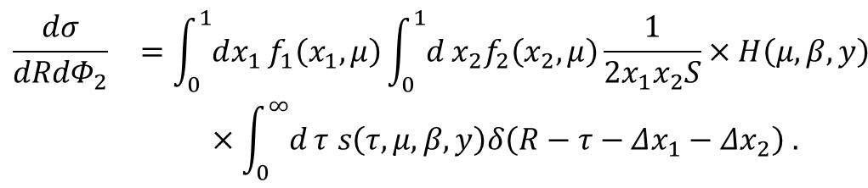




Cross Section
In the hadronic threshold limit, the cross section takes a factorization form:
$$\begin{matrix}\frac{dσ}{dRdΦ_{2}} & =\int_{0}^{1}{dx_{1}}f_{1}\left(x_{1},μ\right)\int_{0}^{1}{d}x_{2}f_{2}\left(x_{2},μ\right)\frac{1}{2x_{1}x_{2}S}×H\left(μ,β,y\right) \\ & ×\int_{0}^{∞}{d}τ s\left(τ,μ,β,y\right)δ\left(R−τ−Δx_{1}−Δx_{2}\right) .\end{matrix}$$
$H:$ hard function
$\begin{matrix}R=1−\frac{Q^{2}}{S}:\end{matrix}$ hadronic threshold variable
$s:$ soft function
$\begin{matrix}τ=1−\frac{Q^{2}}{s_{12}}≡\frac{ω}{\sqrt{s_{12}}}:\end{matrix}$ partonic threshold variable
$f_{i}:$ parton distribution functions
$$y=cosθ$$
$\frac{ω}{2}:$ soft radiation energy in the partonic CMS

Slide 5
Soft Function
In momentum space the soft function is defined as the vacuum matrix element:
,
the soft Wilson lines defined by
.

Slide 6

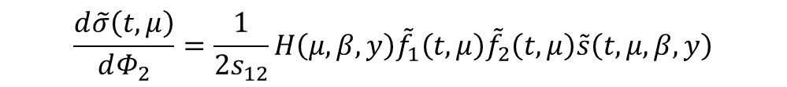

Renormalization
Performing the Laplace transformation, which converts the cross section to a product of the PDFs, hard function and soft function:
$$\begin{matrix}\frac{d\tilde{σ}\left(t,μ\right)}{dΦ_{2}}=\frac{1}{2s_{12}}H\left(μ,β,y\right){\tilde{f}}_{1}\left(t,μ\right){\tilde{f}}_{2}\left(t,μ\right)\tilde{s}\left(t,μ,β,y\right)\end{matrix}$$
,
the soft anomalous dimension can be derived from the independence of the cross section on the renormalization scale $μ$
$$\begin{matrix}γ_{s}=\frac{dln\tilde{s}}{dlnμ}=−\frac{dlnH}{dlnμ}−\frac{dln{\tilde{f}}_{1}}{dlnμ}−\frac{dln{\tilde{f}}_{2}}{dlnμ}\end{matrix}$$
.
Then the renormalized soft function reads
$$\tilde{s}\left(t,μ,β,y\right)=Z_{s}^{−1}{\tilde{s}}_{ bare}\left(t,μ,β,y\right)$$
,
the renormalized NNLO soft functions in Laplace space are given by
$$\begin{matrix}{\tilde{s}}^{\left(2\right)}={\tilde{s}}_{bare}^{\left(2\right)}−Z_{s}^{\left(2\right)}−{\tilde{s}}_{bare}^{\left(1\right)}Z_{s}^{\left(1\right)}+Z_{s}^{\left(1\right)2}−\frac{β_{0}}{ε}{\tilde{s}}_{bare}^{\left(1\right)}\end{matrix}$$
.

Slide 7
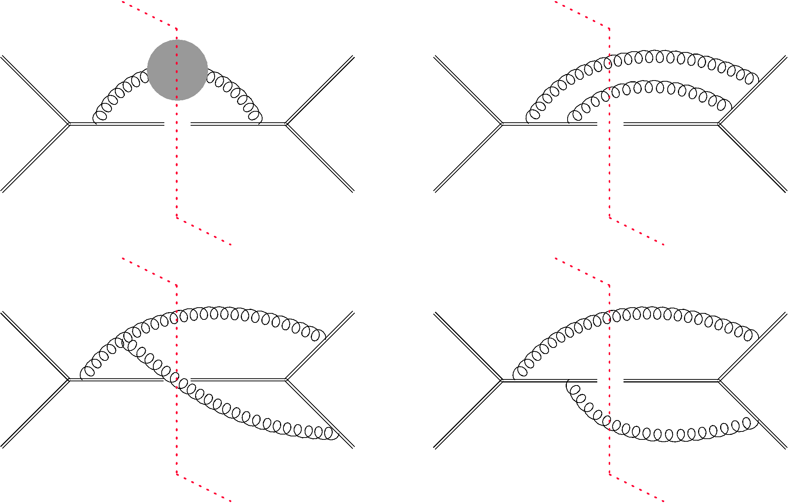
Double-real Corrections
The NNLO bare soft function consists of two parts, the double-real and virtual-real corrections, and thus can be expressed as
$$s_{bare}^{\left(2\right)}\left(τ,μ,β,y\right)=s_{DR}^{\left(2\right)}\left(τ,μ,β,y\right)+s_{VR}^{\left(2\right)}\left(τ,μ,β,y\right)\begin{matrix}\end{matrix}$$
.
The selected Feynman diagrams for the double-real corrections are shown as

Slide 8
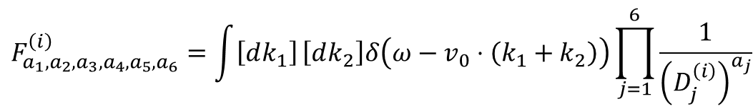
Double-real Corrections
The scalar integrals needed in the calculation of double-real corrections can be written as
$$\begin{matrix}F_{a_{1},a_{2},a_{3},a_{4},a_{5},a_{6}}^{\left(i\right)}=\int{\left[dk_{1}\right]}\left[dk_{2}\right]δ\left(ω−v_{0}⋅\left(k_{1}+k_{2}\right)\right)\prod_{j=1}^{6}{\frac{1}{{\left(D_{j}^{\left(i\right)}\right)}^{a_{j}}}}\end{matrix}$$
.
We find two integral families with the following denominators:
$$\begin{matrix}D_{j}^{\left(1\right)}: v_{1}⋅k_{2}, v_{1}⋅\left(k_{1}+k_{2}\right), v_{2}⋅k_{1}, v_{3}⋅k_{1}, v_{3}⋅\left(k_{1}+k_{2}\right), {\left(k_{1}+k_{2}\right)}^{2}\end{matrix}$$
,
$$\begin{matrix}D_{j}^{\left(2\right)}: v_{1}⋅k_{1}, v_{1}⋅k_{2}, v_{2}⋅k_{1}, v_{3}⋅k_{1}, v_{3}⋅k_{2}, {\left(k_{1}+k_{2}\right)}^{2}\end{matrix}$$
.
After performing reduction by integration-by-part (IBP) using FIRE6 [1901.07808], there are 13 and 12 master integrals for the first and second families, respectively, which can be chosen as
,
.

Slide 9
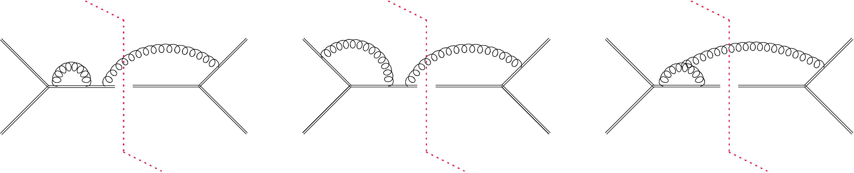
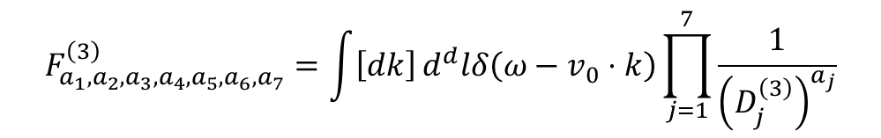
Virtual-real Corrections
The selected Feynman diagrams for the virtual-real corrections are shown as
The scalar integrals needed in the calculation of virtual-real corrections can be written as
$$\begin{matrix}F_{a_{1},a_{2},a_{3},a_{4},a_{5},a_{6},a_{7}}^{\left(3\right)}=\int{\left[dk\right]}d^{d}lδ\left(ω−v_{0}⋅k\right)\prod_{j=1}^{7}{\frac{1}{{\left(D_{j}^{\left(3\right)}\right)}^{a_{j}}}}\end{matrix}$$
,
$$\begin{matrix}D_{j}^{\left(3\right)}: v_{1}⋅k, v_{1}⋅l, v_{2}⋅\left(k−l\right), v_{3}⋅k, v_{3}⋅\left(k−l\right), l^{2}, {\left(k−l\right)}^{2}\end{matrix}$$
.
After performing reduction by integration-by-part (IBP), we find there are 9 master integrals for the third family, which can be chosen as
.

Slide 10
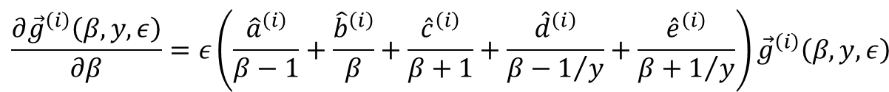
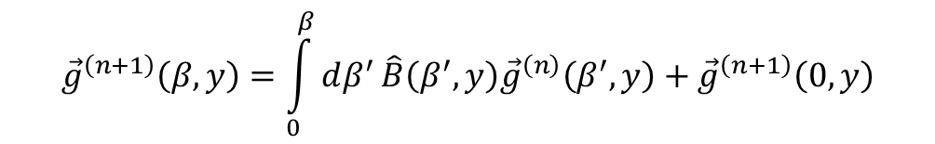



Differential Equation
$$\frac{∂{\vec{f}}^{\left(i\right)}\left(ε,β,y,ω\right)}{∂β}={\hat{A}}^{\left(i\right)}\left(ε,β,y,ω\right){\vec{f}}^{\left(i\right)}\left(ε,β,y,ω\right)$$
.
Performing a liner transformation using Libra [2012.00279]
$$\begin{matrix}{\vec{g}}^{\left(i\right)}\left(ε,β,y\right)={\hat{T}}^{\left(i\right)}\left(ε,β,y,ω\right){\vec{f}}^{\left(i\right)}\left(ε,β,y,ω\right)\end{matrix}$$
,
to obtain the canonical basis, which satisfy differential equation:
$$\begin{matrix}\frac{∂{\vec{g}}^{\left(i\right)}\left(β,y,ε\right)}{∂β}=ε\left(\frac{{\hat{a}}^{\left(i\right)}}{β−1}+\frac{{\hat{b}}^{\left(i\right)}}{β}+\frac{{\hat{c}}^{\left(i\right)}}{β+1}+\frac{{\hat{d}}^{\left(i\right)}}{β−1/y}+\frac{{\hat{e}}^{\left(i\right)}}{β+1/y}\right){\vec{g}}^{\left(i\right)}\left(β,y,ε\right)\end{matrix}$$
.
Expanding the canonical basis expand in a series of $ε$
$$\begin{matrix}\vec{g}\left(β,y,ε\right)=\sum_{n=0}^{∞}{{\vec{g}}^{\left(n\right)}\left(β,y\right)ε^{n}}\end{matrix}$$
.
This differential equation can be solved order-by-order in $ε:$
$$\begin{matrix}{\vec{g}}^{\left(n+1\right)}\left(β,y\right)=\int_{0}^{β}{dβ^{′}}\hat{B}\left(β^{′},y\right){\vec{g}}^{\left(n\right)}\left(β^{′},y\right)+{\vec{g}}^{\left(n+1\right)}\left(0,y\right)\end{matrix}$$
.

Slide 11
Differential Equation
There are two advantages when the boundary point is chosen at $β=0$:
Given that the transformation matrix $T$ is also regular, canonical basis satisfy the following regularity condition
$$\begin{matrix}\lim_{β→0}β∂_{β}{\vec{g}}^{\left(i\right)}\left(β,y,ε\right)=0\end{matrix}$$
.
The master integrals at $β=0$ do not depend on $y.$ As a result, we do not have to construct and solve the differential equation with respect to $y$.
After applying the regularity condition, canonical basis are reduced at $β=0$:
,
,
.

Slide 12
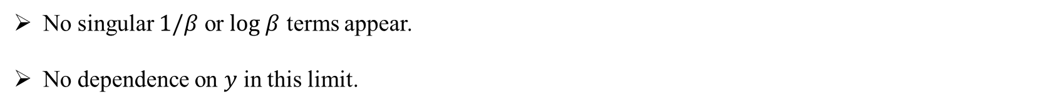
Result
No singular $1/β$ or $log β$ terms appear.
No dependence on $y$ in this limit.

Slide 13
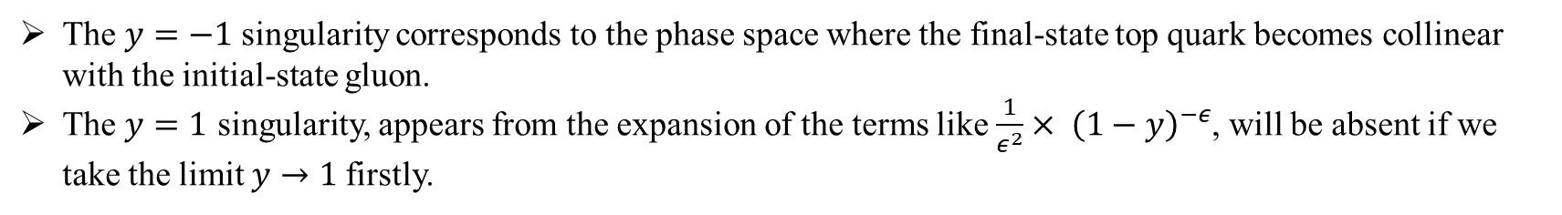
Result
The $y=−1$singularity corresponds to the phase space where the final-state top quark becomes collinear with the initial-state gluon.
The $y=1$ singularity, appears from the expansion of the terms like $\frac{1}{ε^{2}}× {\left(1−y\right)}^{−ε}$, will be absent if we take the limit $y→1$firstly.

Slide 14
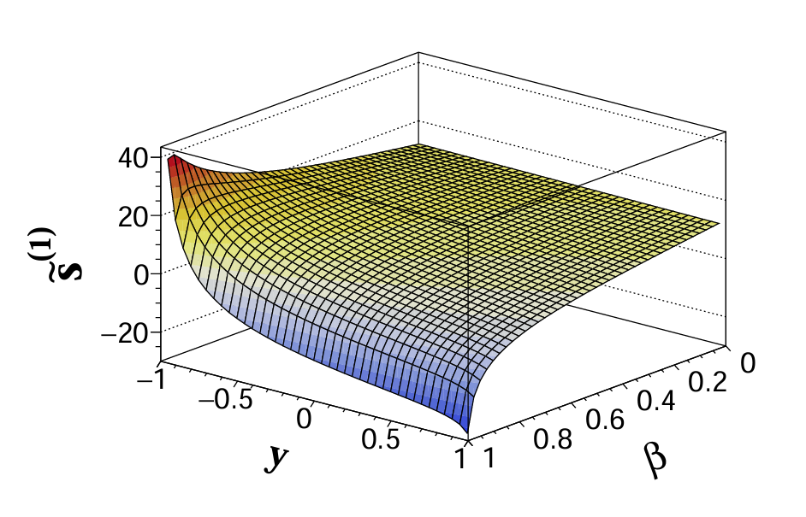
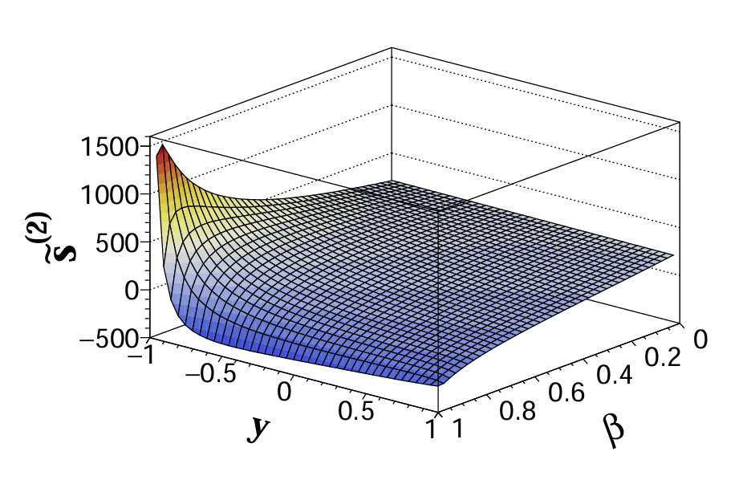
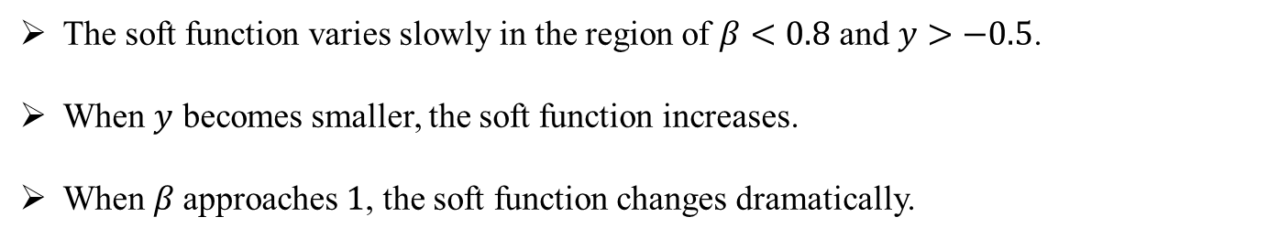
Result
The soft function varies slowly in the region of $β<0.8$ and $y>−0.5$.
When $y$ becomes smaller, the soft function increases.
When $β$approaches $1$, the soft function changes dramatically.

Slide 15
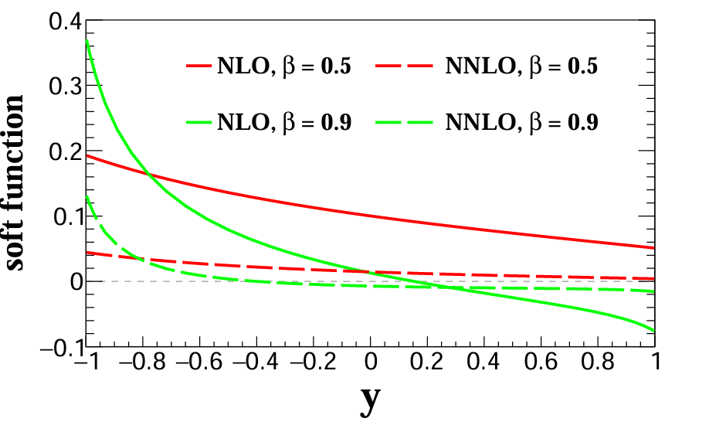
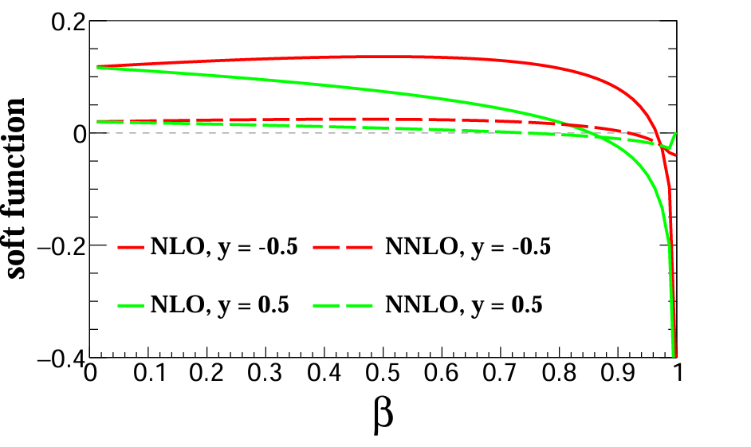
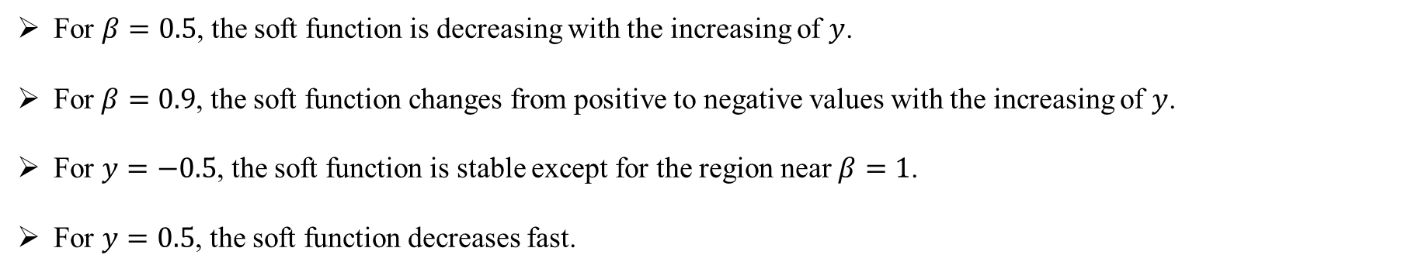
Result
For $β=0.5$, the soft function is decreasing with the increasing of $y$.
For $β=0.9$, the soft function changes from positive to negative values with the increasing of $y$.
For $y=−0.5$, the soft function is stable except for the region near $β=1$.
For $y=0.5$, the soft function decreases fast.

Slide 16
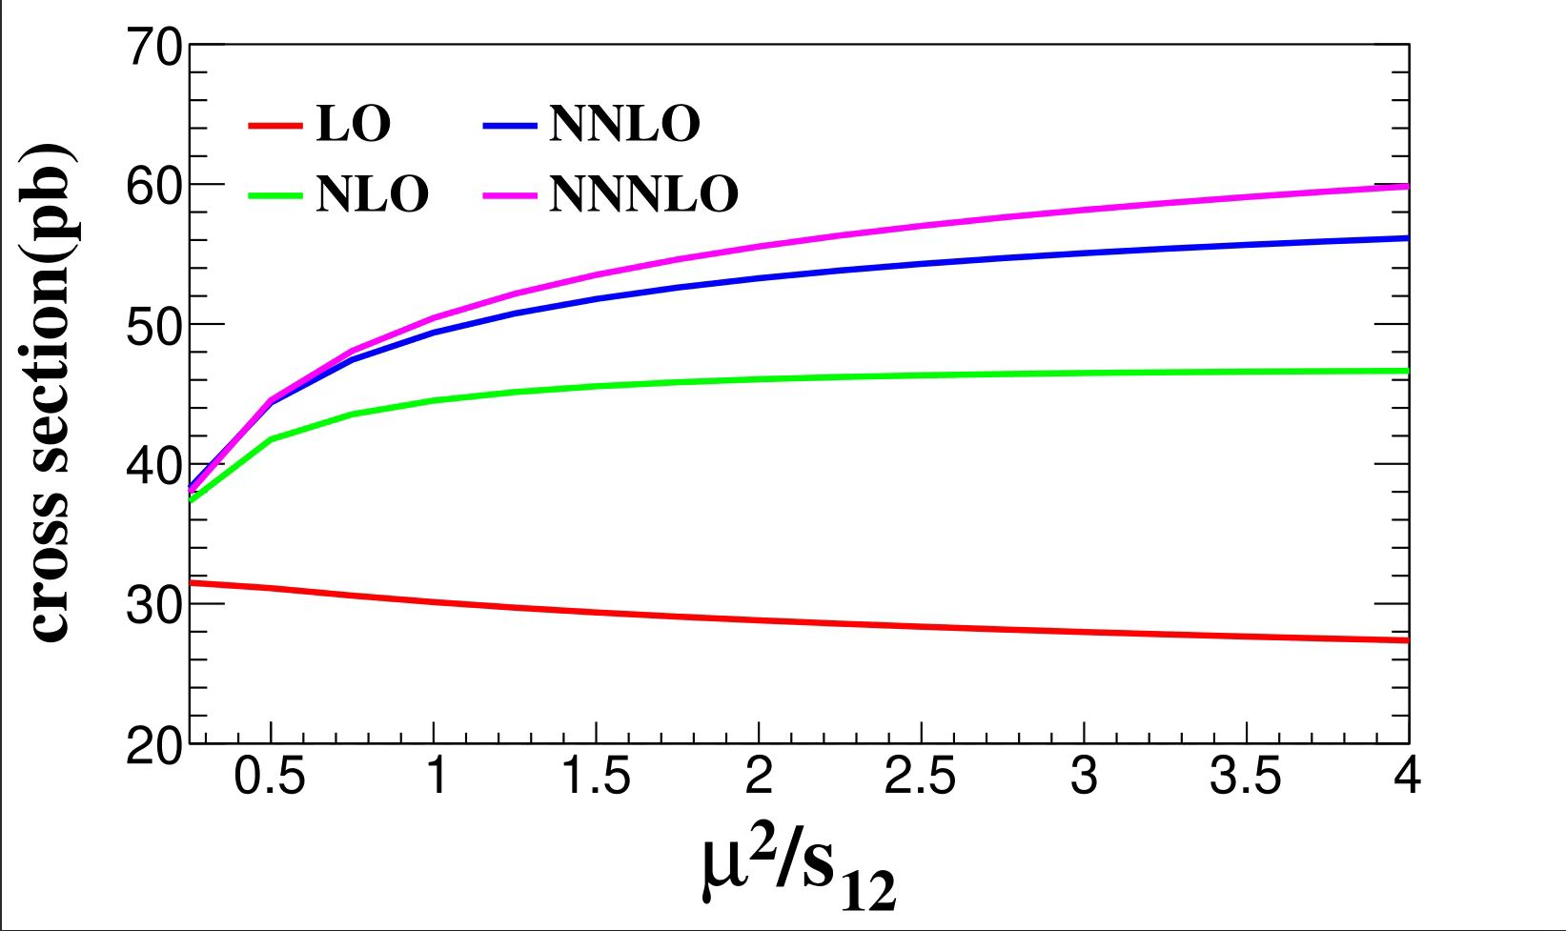
Work in Progress

Slide 17
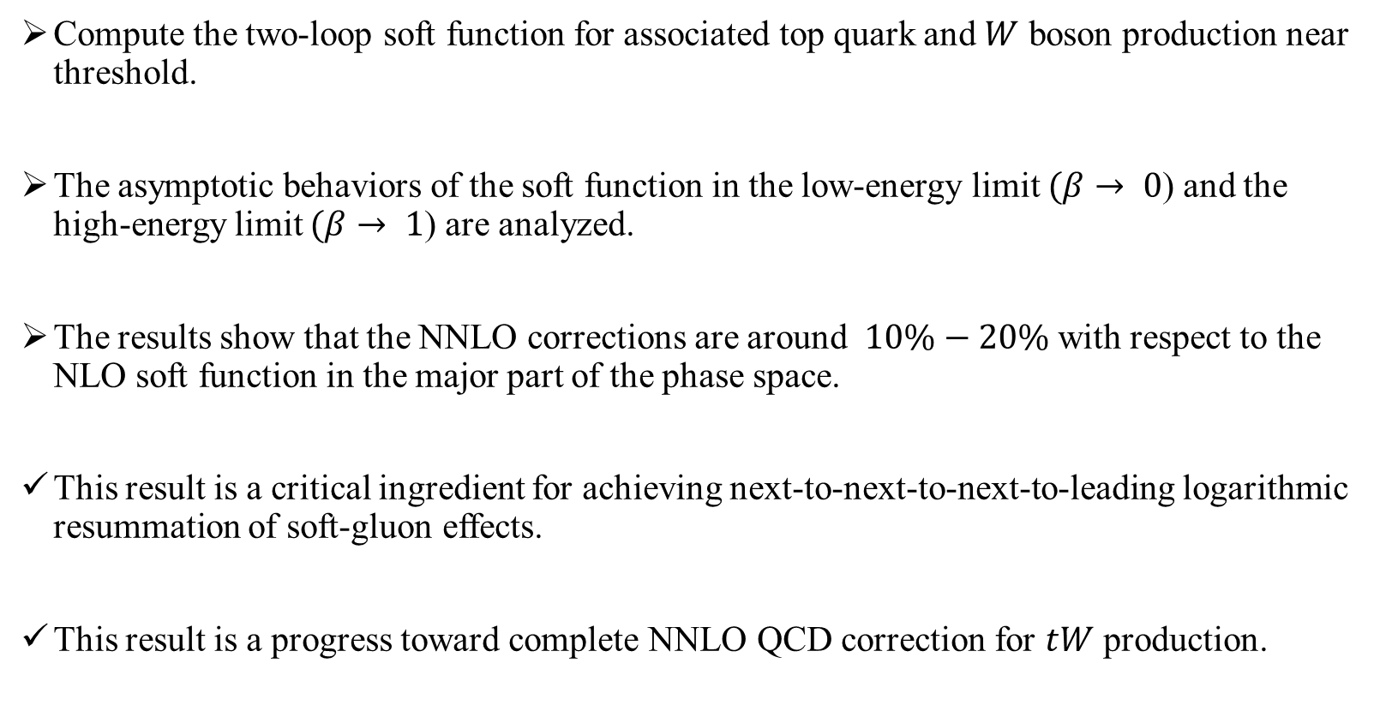
Summary and outlook
Compute the two-loop soft function for associated top quark and $W$ boson production near threshold.
The asymptotic behaviors of the soft function in the low-energy limit $(β→ 0$) and the high-energy limit $(β→ 1$) are analyzed.
The results show that the NNLO corrections are around $10\%−20\%$ with respect to the NLO soft function in the major part of the phase space.
This result is a critical ingredient for achieving next-to-next-to-next-to-leading logarithmic resummation of soft-gluon effects.
This result is a progress toward complete NNLO QCD correction for $tW$ production.

Slide 18
Thanks for your attention!

