Slide 1


Heavy meson LCDAs from lattice QCD
Lattice Parton
Collaboration
高浩飞 上海交通大学
924700270@sjtu.edu.cn
in collaboration with:韩雪莹(IHEP),王伟(SJTU), 张其安(BUAA), et al.
2025粒子物理标准模型及新物理精细计算研讨会
2025.03.27.2025

Slide 2
Outline
Motivation
Theoretical framework
Lattice verification
Summary and prospect

Slide 3
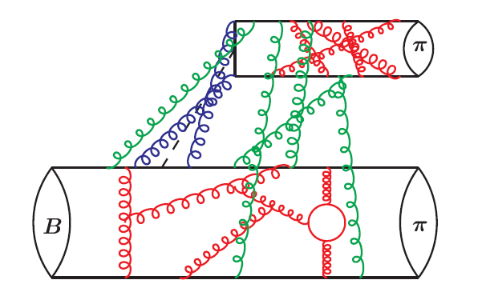
Motivation: Why heavy meson LCDAs
LCDAs: Light-Cone Distribution Amplitudes
Weak decays of heavy mesons play a crucial role in
Precise tests of Standard Model
Searching for New Physics in the rare decay
  $B→ππ$: Beneke, Buchalla, Neubert, Sachrajda, 1999; 1422 citations
Hard kernel ⊗ LCDA
Heavy meson LCDA
Hard kernel: Perturbative
Meson LCDAs: Nonperturbative

Slide 4
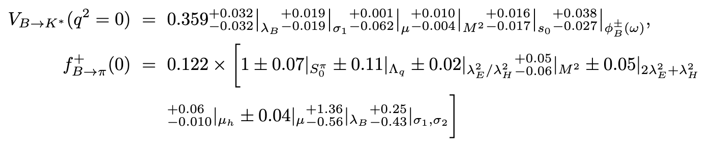
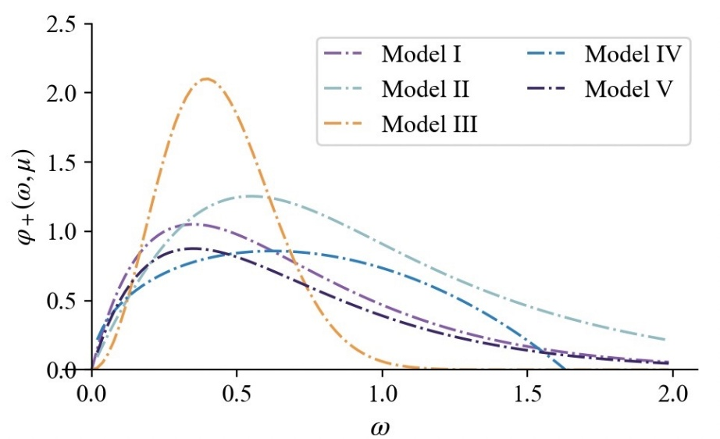
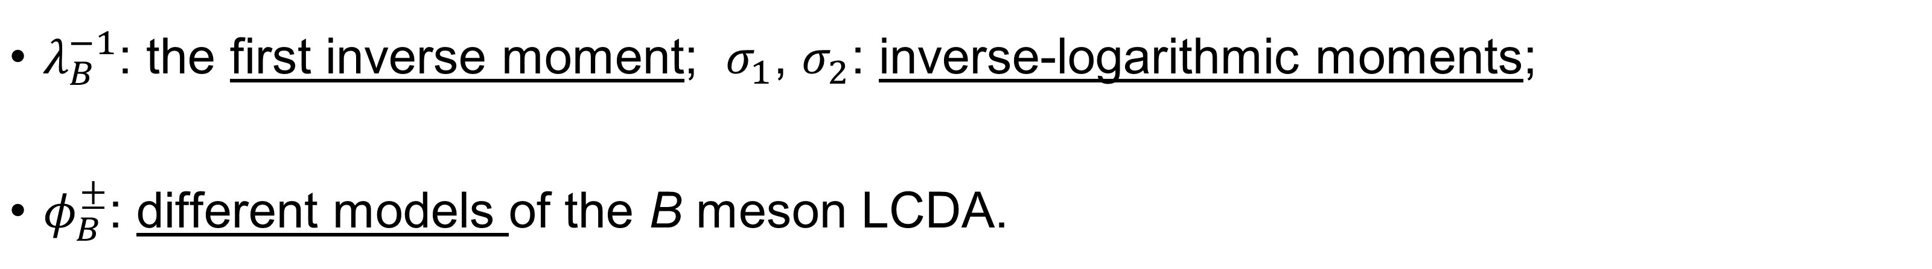
Motivation: Why LQCD
In current theoretical predictions, the uncertainty of heavy meson LCDA plays a dominant role:
[Gao, Lu, Shen, Wang, Wei, 2020; Cui, Huang, Shen, Wang, 2023]
$λ_{B}^{−1}$: the first inverse moment; $σ_{1}$, $σ_{2}$: inverse-logarithmic moments;
$φ_{B}^{±}$: different models of the B meson LCDA.
Without reliable 𝐵 LCDA, it is impossible to discuss precision calculation!

Slide 5
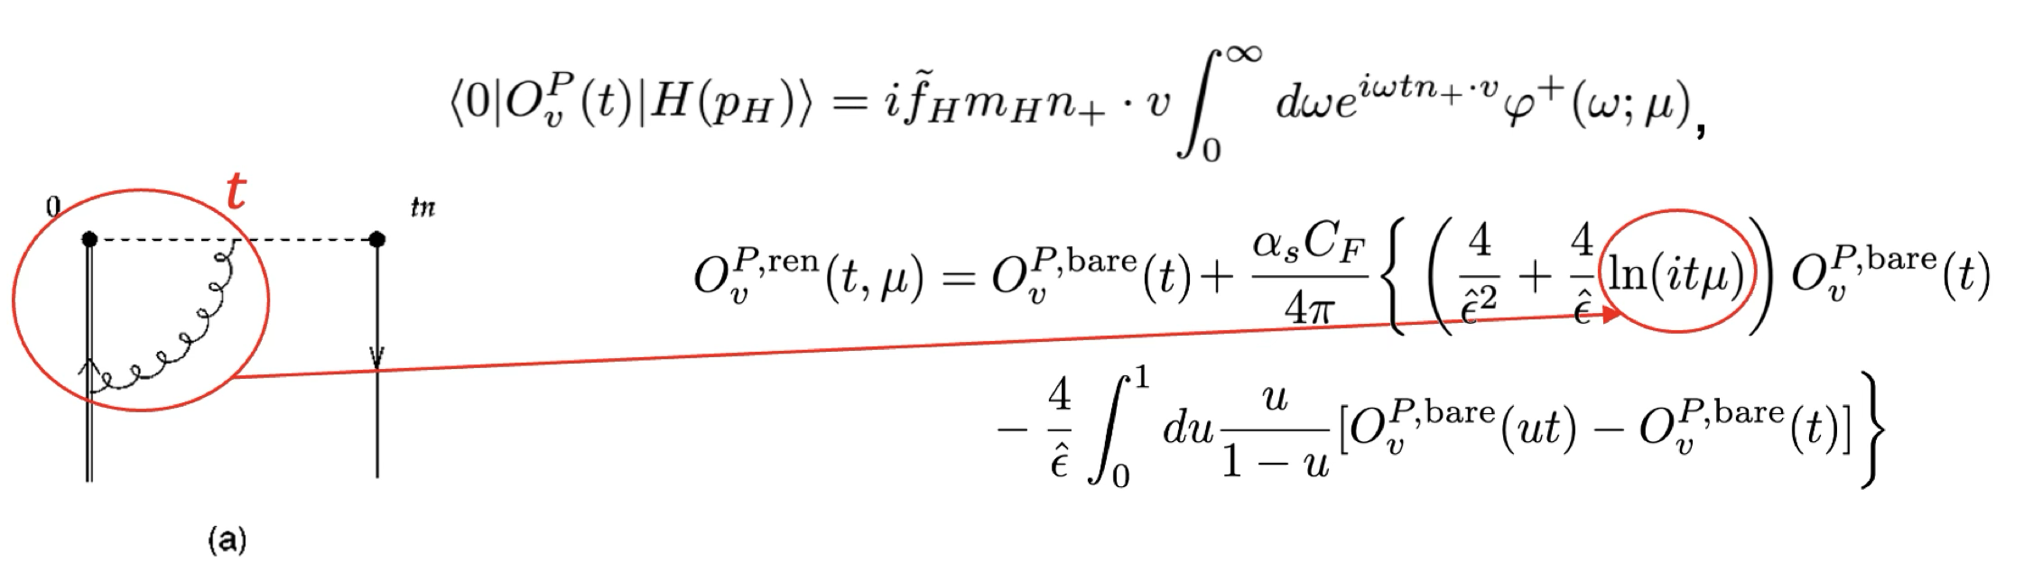
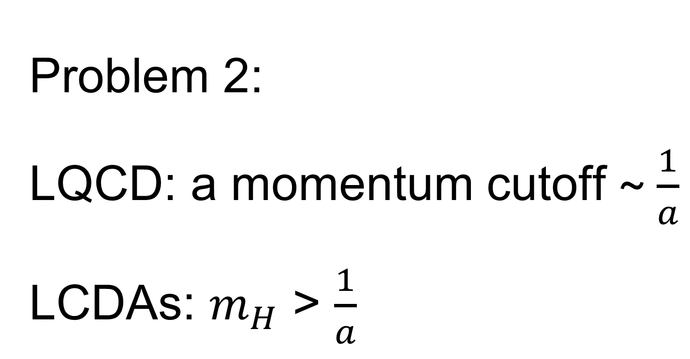
Theoretical framework
Problem 1:
LCDAs: defined on the light cone.
LQCD: defined in Euclidean spacetime.
Definition of HQET LCDA
Problem 2:
LQCD: a momentum cutoff ~ $\frac{1}{a}$
LCDAs: $m_{H}$ > $\frac{1}{a}$
[Braun, Ivanov, Korchemsky, 2004]

Slide 6
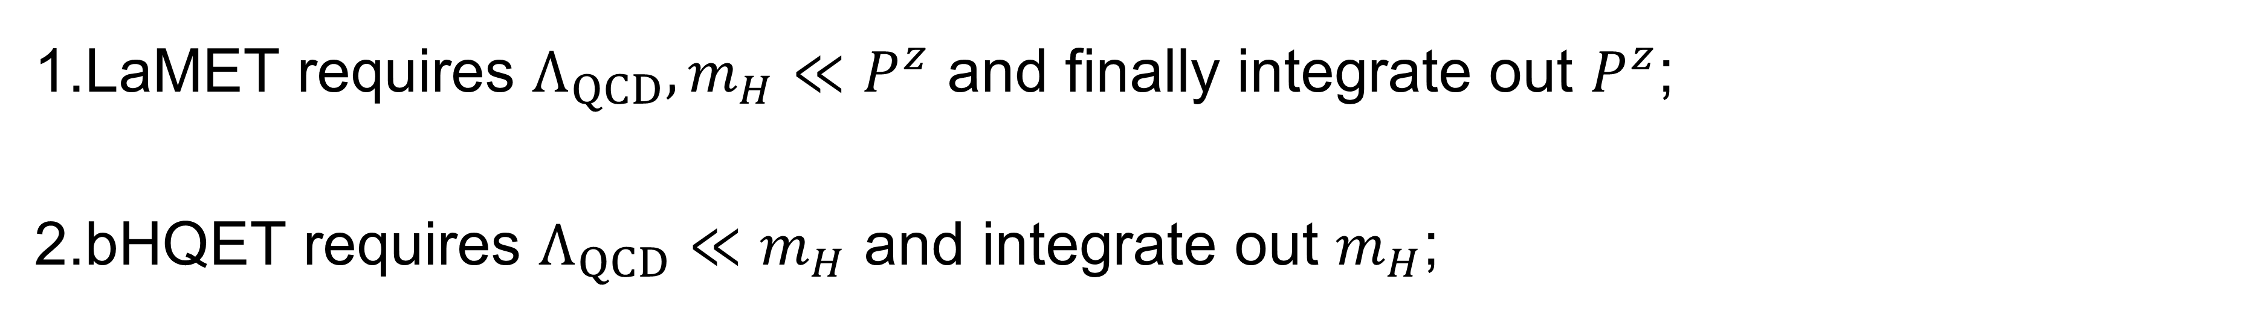
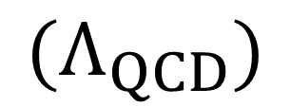
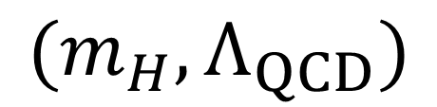
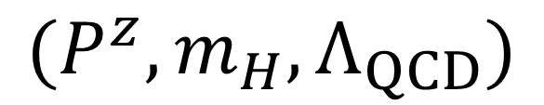
Theoretical framework
Start from quasi DA, calculable from LQCD
Quasi
DA
QCD
LCDA
HQET
LCDA
LaMET
bHQET
$$(P^{z}, m_{H}, Λ_{QCD})$$
$$(m_{H}, Λ_{QCD})$$
$$(Λ_{QCD})$$
A multi-scale process:
LaMET requires $Λ_{QCD}, m_{H}≪P^{z}$ and finally integrate out $P^{z}$;
bHQET requires $Λ_{QCD}≪m_{H}$ and integrate out $m_{H}$;
$⇒$ Hierarchy $Λ_{QCD}≪m_{H}≪P^{z}$.

Slide 7
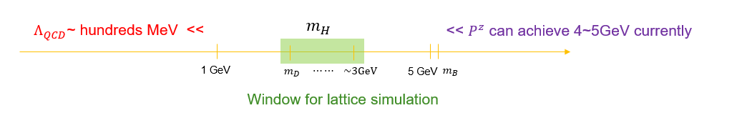
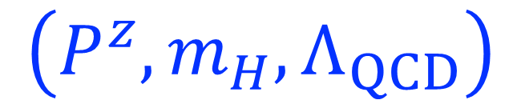

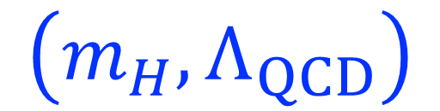
Theoretical framework
$$\left(P^{z},m_{H},Λ_{QCD}\right)$$
$$\left(m_{H},Λ_{QCD}\right)$$
$$\left(Λ_{QCD}\right)$$
Quasi DA
LCDA in QCD
LCDA in HQET
LaMET
bHQET
⇒ Hierarchy 𝜦_𝐐𝐂𝐃≪𝒎_𝑯≪𝑷^𝒛: A big challenge for lattice simulation
At this stage, the heavy meson could be 𝐷, but by no means be the 𝐵 meson!

Slide 8
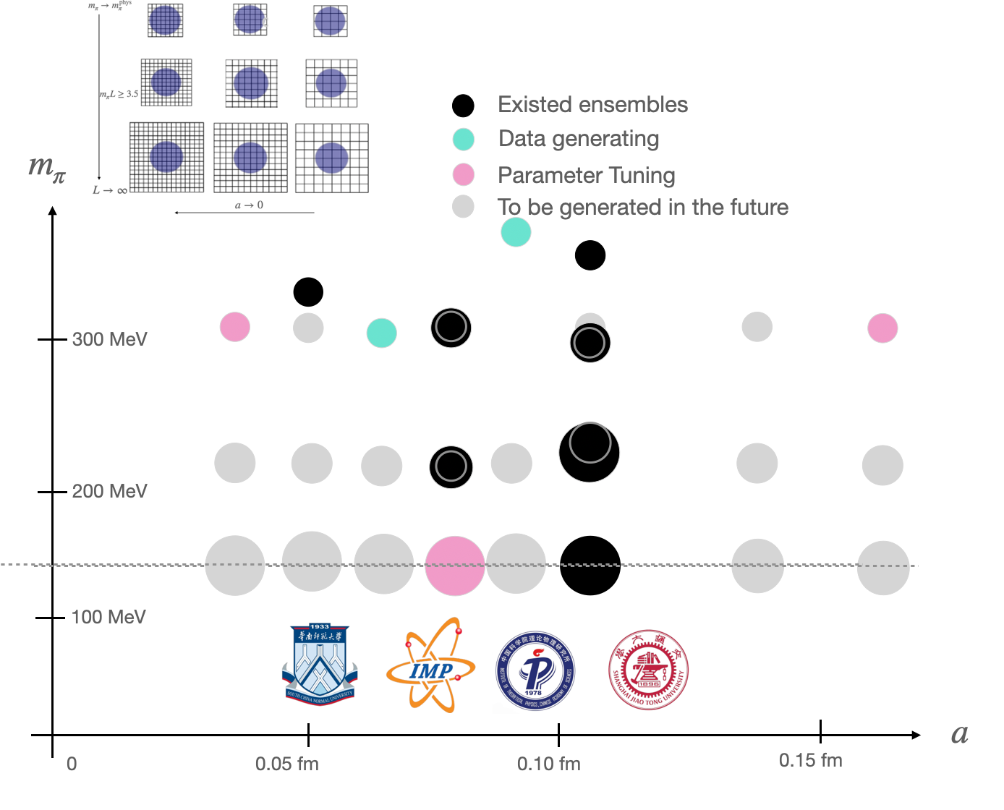

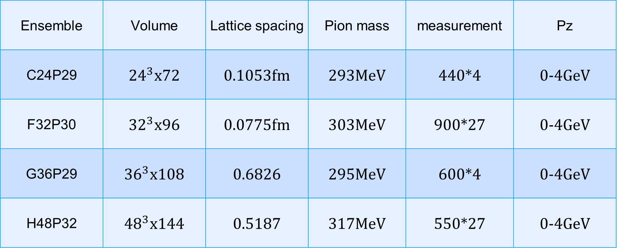
Lattice verification: lattice setup
CLQCD Ensembles
Ensemble | Volume | Lattice spacing | Pion mass | measurement | Pz
C24P29 | ${24}^{3}$x72 | 0.1053fm | 293MeV | 440*4 | 0-4GeV
F32P30 | ${32}^{3}$x96 | 0.0775fm | 303MeV | 900*27 | 0-4GeV
G36P29 | ${36}^{3}$x108 | 0.6826 | 295MeV | 600*4 | 0-4GeV
H48P32 | ${48}^{3}$x144 | 0.5187 | 317MeV | 550*27 | 0-4GeV

Slide 9

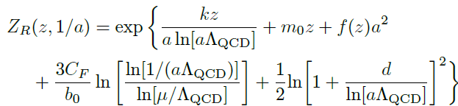
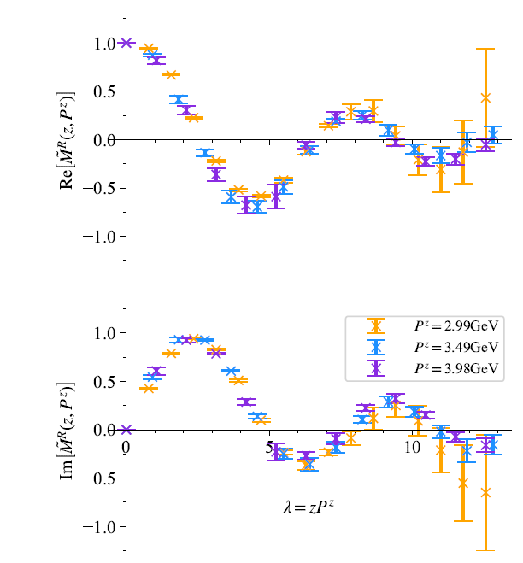
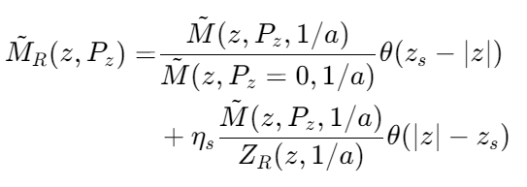
Lattice verification: self renormalization
Bare matrix element:
Self renormalization factor:
[Huo, Su, Ji, Wang, 2004]
Renormalized MEs:
2410.18654

Slide 10
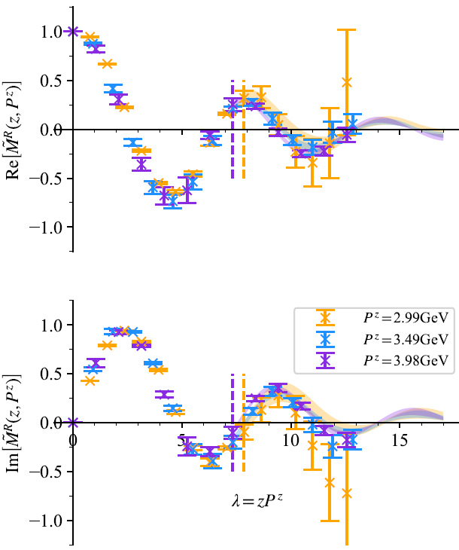
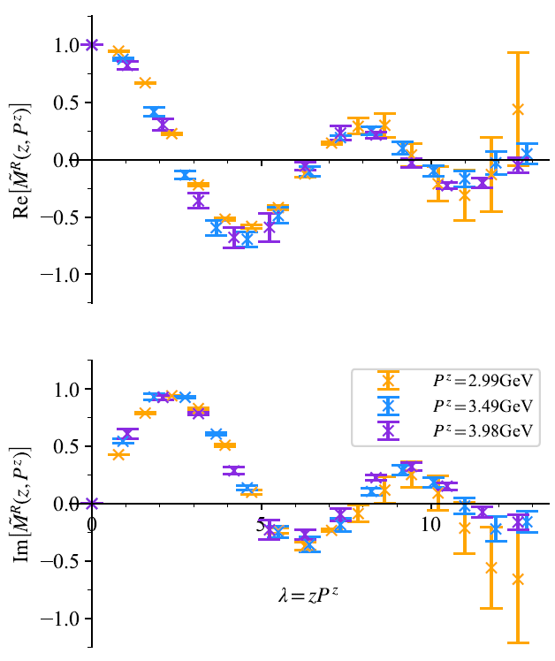
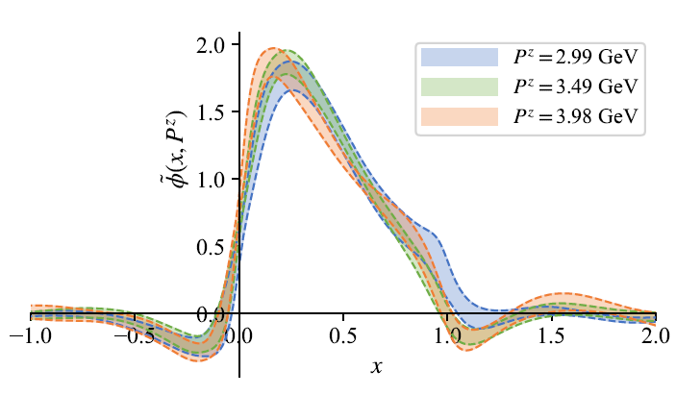


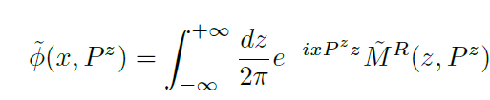
Lattice verification: quasi-DA
quasi-DA
2008.03886

Slide 11
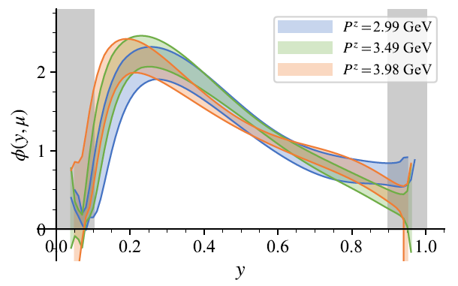
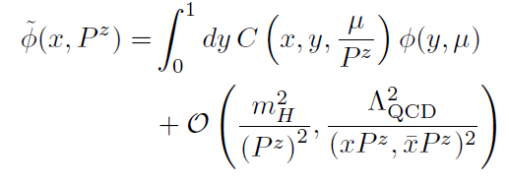

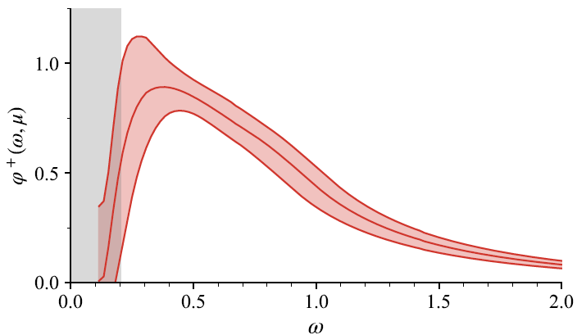
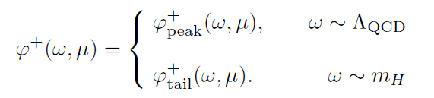
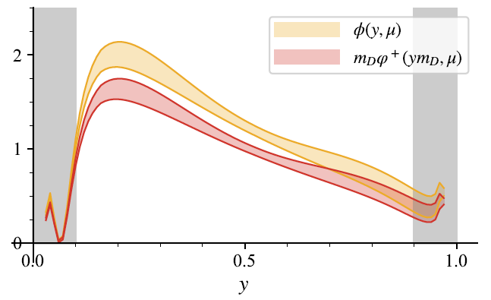

Lattice verification: 2-step matching
Liu, Wang, Xu, Zhang, Zhao, 2019;
han, Hua, Ji, Lu, Wang, Xu, Zhang, Zhao, 2024
Grey band: the matching in LaMET failed
2305.06401
bHQET

Slide 12
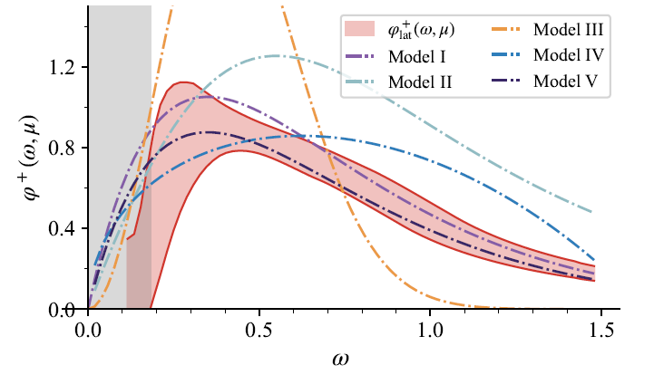
Phenomenological discussions： comparison with models
Some models of heavy meson LCDAs
Our results are consistent with the model estimates. Especially agree with model V, which constrained by the RG evolution of HQET LCDA.
Result from ﬁrst-principles of QCD will help to remove the uncertainty arising from the model parametrizations.

Slide 13
Summary and prospect
We present a lattice-implementable method to extract heavy meson LCDAs, and implement it on a CLQCD ensemble.
From one lattice spacing (a=0.05187 fm) to many lattice spacings (a=0.1053 fm, 0.0775 fm, 0.6826 fm) ,we expect to achieve improved results.
More importantly, improving the reliability of our results for the next stage:
How to properly control the power corrections within two step match?
How to better estimate systematic error
Thanks For Your Attention ！

