Slide 1

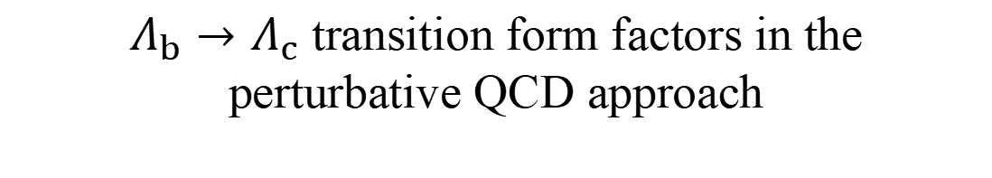
$Λ_{b}→Λ_{c}$ transition form factors in the
perturbative QCD approach
汇报人：邹芝田
合作者：李营、王亚鑫

Slide 2
Motivation
01
Outline
Baryon decay in PQCD
02
Recent progress
03
Summary
04

Slide 3
Motivation
01

Slide 4


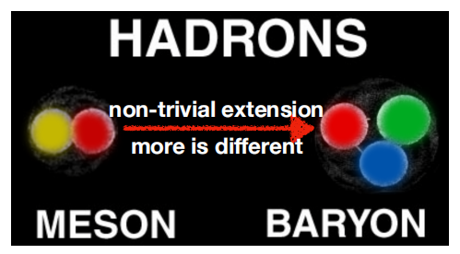
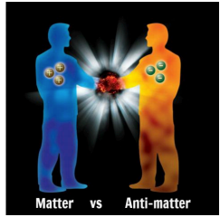
Heavy flavor physics and CPV
heavy flavor physics has achieved great progress in heavy meson systems,
CKM mechanism has been established for CPV in B meson decays,
however, studies on heavy flavor baryon are limited.
CPV is one of the necessary conditions for baryogenesis decays;
CPV is well established in meson decays
no significant deviation from SM prediction
not strong enough to account for the baryogenesis
Unlike mesons, only direct CPV occurs in baryon decays due to baryon number conservation
However, no CPV has been observed in baryon sector yet

Slide 5
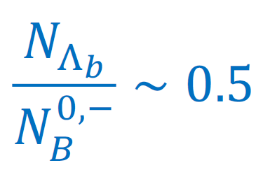

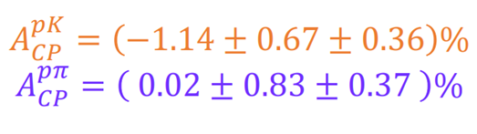

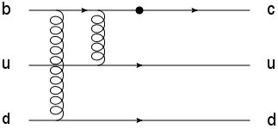
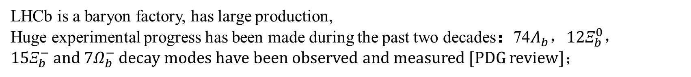
Opportunities and Challenges
LHCb is a baryon factory, has large production,
Huge experimental progress has been made during the past two decades：74$Λ_{b}$，12$Ξ_{b}^{0}$，15$Ξ_{b}^{−}$and 7$Ω_{b}^{−}$ decay modes have been observed and measured [PDG review]；
Precision of b-baryon CPV measurement reached of order 1%
non-zero polarization, more observables
However, baryons are more challenging for theory than Mesons!
1>
More Complex dynamics
Baryons are made of three quarks. Compared to meson decays, one more quark requires one more gluon.
2>
Baryon LCDAs are not well determined
A major source of theoretical uncertainties.
3>
Factorization assumption may not work well
References: Phys. Rev. D 105 (7) (2022) 073005.
Large nonfactorizable effects exist in the color-suppressed and penguin-dominated decays.
• power counting of baryon is different from meson

Slide 6
Baryon decay in PQCD
02

Slide 7
QCD studies on baryon are limited
• GFA (Hsiao,Yao,Geng,2017; Liu,Geng,2021)
• QCDF (Zhu,Ke,Wei,2016,2018)
• PQCD (Lü,Wang,Zou,Ali,Kramer,2009; Zhou, zou,li,et.al.,2022~2023)
• quark model(Geng,Liu,Tsai,et.al.,2019~2022)
• Light-cone Sum rule (Jiang,Cheng,Khodjamirian,Yu, in progress)

Slide 8

Why $Λ_{b}→Λ_{c}$in PQCD
In 2000, H.n. Li Applicability of Perturbative QCD to $Λ_{b}→Λ_{c}$ decay [Phy. Rev. D 61,114002(2000)]
In 2009: Cai-Dian Lv, Yu-Ming Wang, $Λ_{b}^{0}→pπ,pK$ [Phys. Rev. D 80 (2009) 034011]
the form factors are two orders of magnitude smaller than Lattice QCD/experiments, considering only the leading twist of LCDAs of baryons.
$$A_{cp}\left(Λ_{b}→pπ^{−}\right)−A_{cp}\left(Λ_{b}→pK^{−}\right)≈−0.26$$
In 2022, when consider contributions of high-twist LCDAs, they are consistent with LatticeQCD. [Y.Li, Y.L.Shen, FSY,]

Slide 9
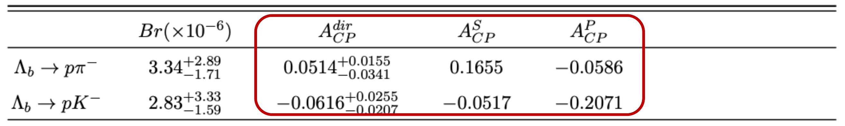

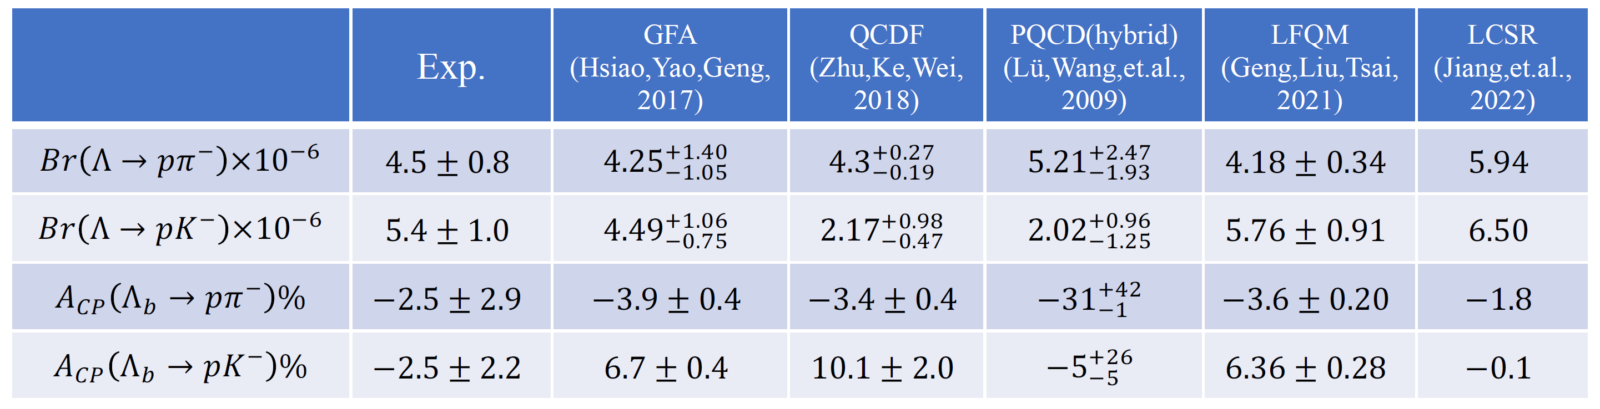
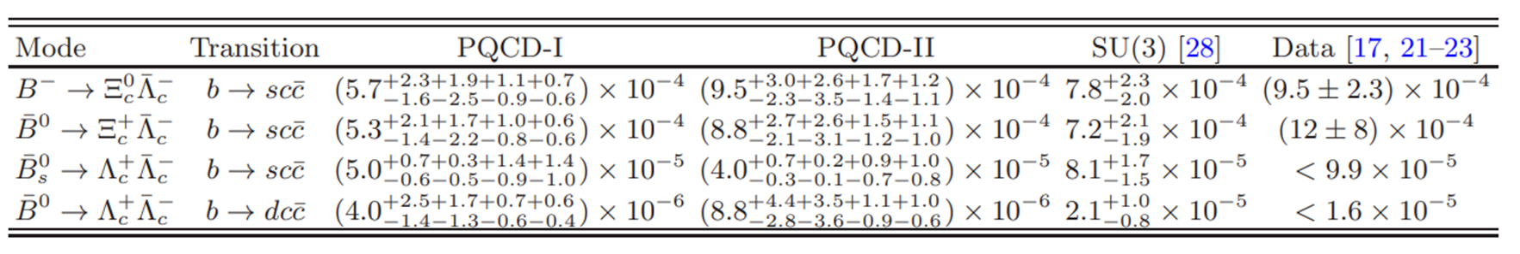
韩佳杰，于福升等
周锐，邹芝田，李营：

Slide 10
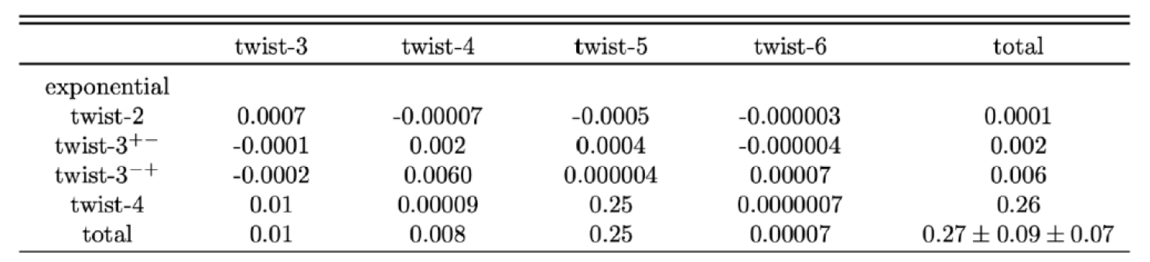

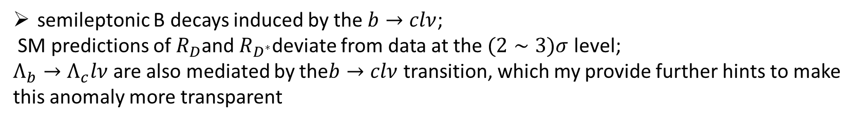

$$Λ_{b}→Λ_{c}$$
$$Λ_{b}→p$$
semileptonic B decays induced by the $b→clν$;
SM predictions of $R_{D}$and $R_{D^{∗}}$deviate from data at the $(2∼3)σ$ level;
$Λ_{b}→Λ_{c}lν$are also mediated by the$b→clν$ transition, which my provide further hints to make this anomaly more transparent
Phys.Rev.D 100 (2019) 11, 113004
In 2000, H.n. Li Applicability of Perturbative QCD to $Λ_{b}→Λ_{c}$ decay [Phy. Rev. D 61,114002(2000)]
In the heavy to heavy transition form factor, the power correction effect is much greater in the baryon transition process than in the meson transition process
Phys. Rev. D 94 (2016) 7, 073008
To reduce model dependence ,it is useful to calculate the from factor in the large recoil region directly.

Slide 11
Recent progress
03

Slide 12
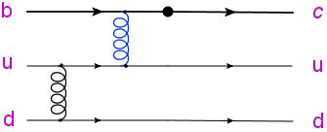
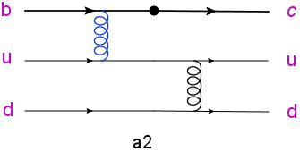
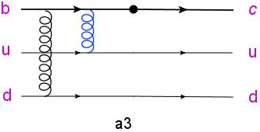
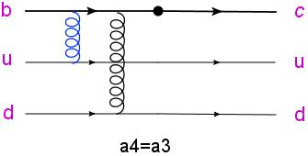
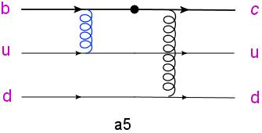
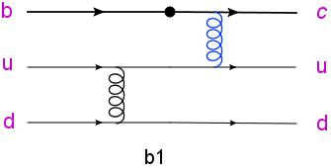
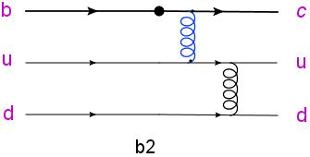
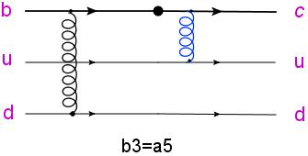
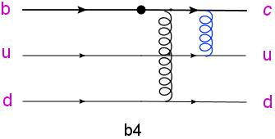
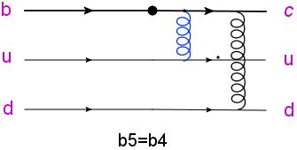
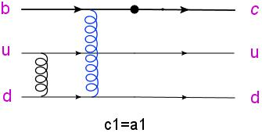
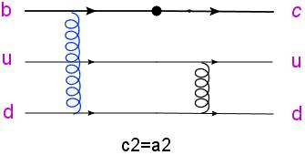
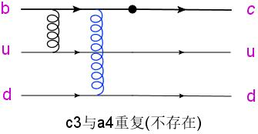
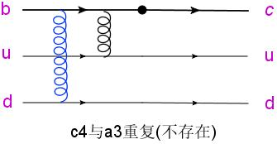
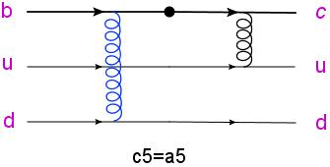
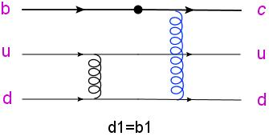
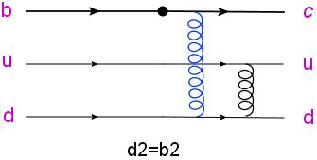
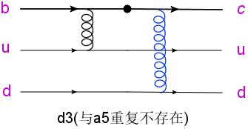
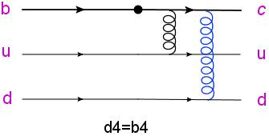
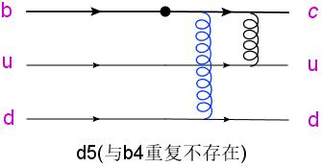

$Λ_{b}→Λ_{c}$ FEYNMAN DIAGRAMS
a1

Slide 13
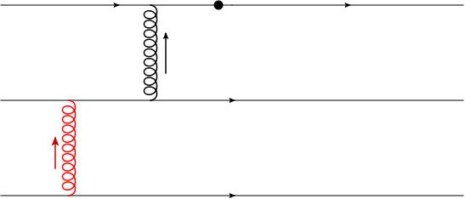
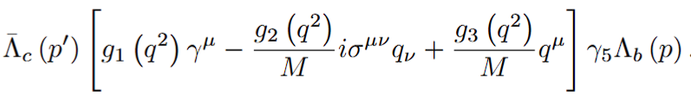











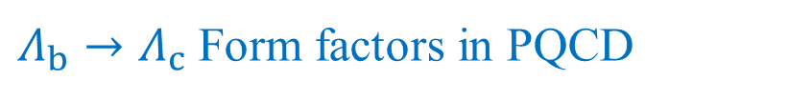



















$Λ_{b}→Λ_{c}$ Form factors in PQCD
$$σ$$
$$γ^{μ}(1−γ_{5})$$
n
$$c$$
$$k_{1}$$
$$α$$
$$i$$
$$b$$
$$q_{b}$$
$$i^{’}$$
$$α^{’}$$
$$k_{1}^{’}$$
$$l_{b}$$
$$Λ_{b}(P)$$
$$u$$
$$ρ$$
$$m$$
$$u$$
$$Λ_{c}(P^{’})$$
$$k_{2}$$
$$β$$
$$j$$
$$q_{a}$$
$$j^{’}$$
$$β^{’}$$
$$k_{2}^{’}$$
$$σ$$
$$l_{a}$$
$$k_{3}$$
$$γ$$
$$k$$
$$d$$
$$d$$
$$k^{’}$$
$$γ^{’}$$
$$k_{3}^{’}$$
$$ρ$$
The $Λ_{b}→Λ_{c}$ transition matrix elements can be parameterized in the following form :
vector
axial-vector

Slide 14
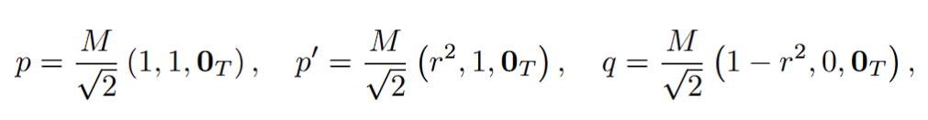
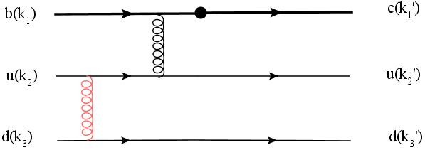
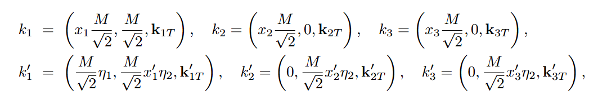
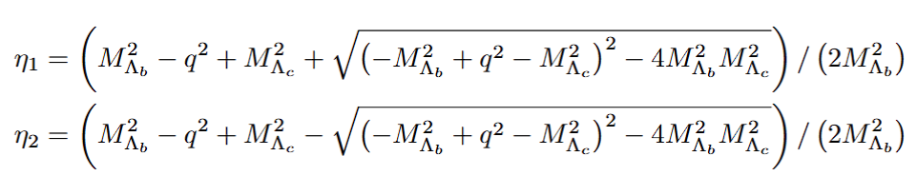

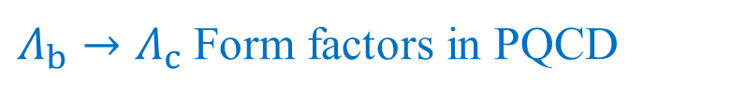

$Λ_{b}→Λ_{c}$ Form factors in PQCD
They obey the conservation laws
PQCD formula for two-body decays
$$F_{i}(q^{2})$$

Slide 15
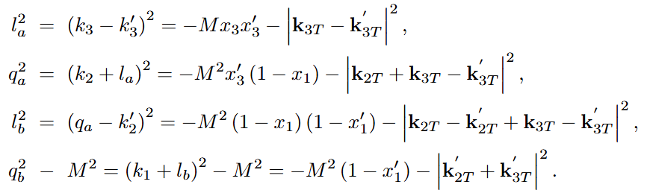

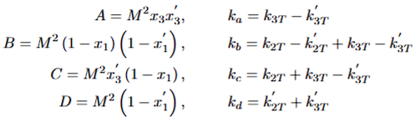

$$×$$

Slide 16
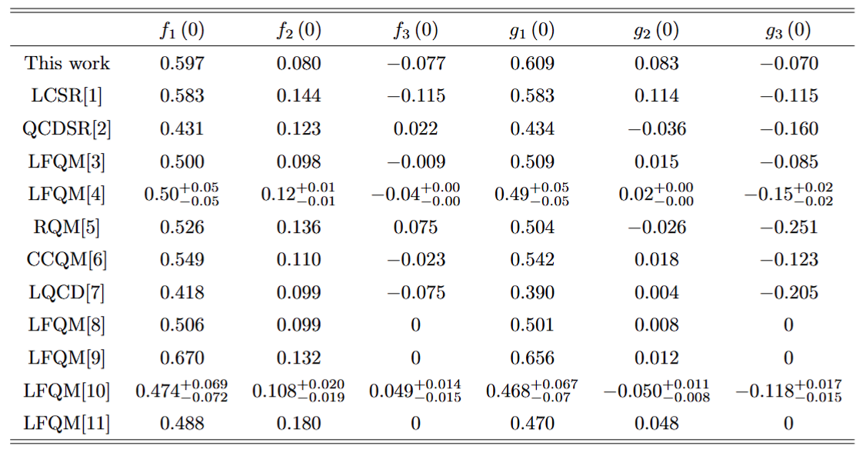
[1]
Yan Miao et al 2022 Chinese Phys.C 46 113107
[6]
T.Gutsche,M.A.Ivanov,J.G.K$\ddot{o}$rner et al,Phys.Rev.D 91(7),074001(2015)
[2]
Z.X.Zhao,R.H.Li,Y.L.Shen et al,arXiv:2010.07150[hep-ph]
[7]
W.Detmold,C.Lehner,and S.Meinel,Phys.Rev.D 92(3),034503(2015)
[3]
J,Zhu,Z.T.Wei,and H.W.Ke,Phys.Rev.D 99(5),054020(2019)
[8]
H.W.Ke,X.Q.Li,and Z.T.Wei,Diquarks and$Λ_{b}→Λ_{c}$ weak decays,Phys. Rev.D 77,014020(2008)
[4]
Y.S.Li,X.Liu,and F.S.Yu,Phys.Rev.D 104(1),013005(2021)
[9]
Z.X.Zhao,Weak decays of heavy barons in the light-front approach,Chin.Phys.C 42,093101(2018)
C.K.Chua,Color-allowed bottom baryon to s-wave and p-wave charmed baryon nonleptonic decays,Phys.Rev.D 100,034025(2019)
[10]
[5]
R. N. Faustov and V.O.Galkin,Phys.Rev.D 94(7) 073008(2016)

Slide 17

$q^{2}$ dependencies of the form factors.

Slide 18
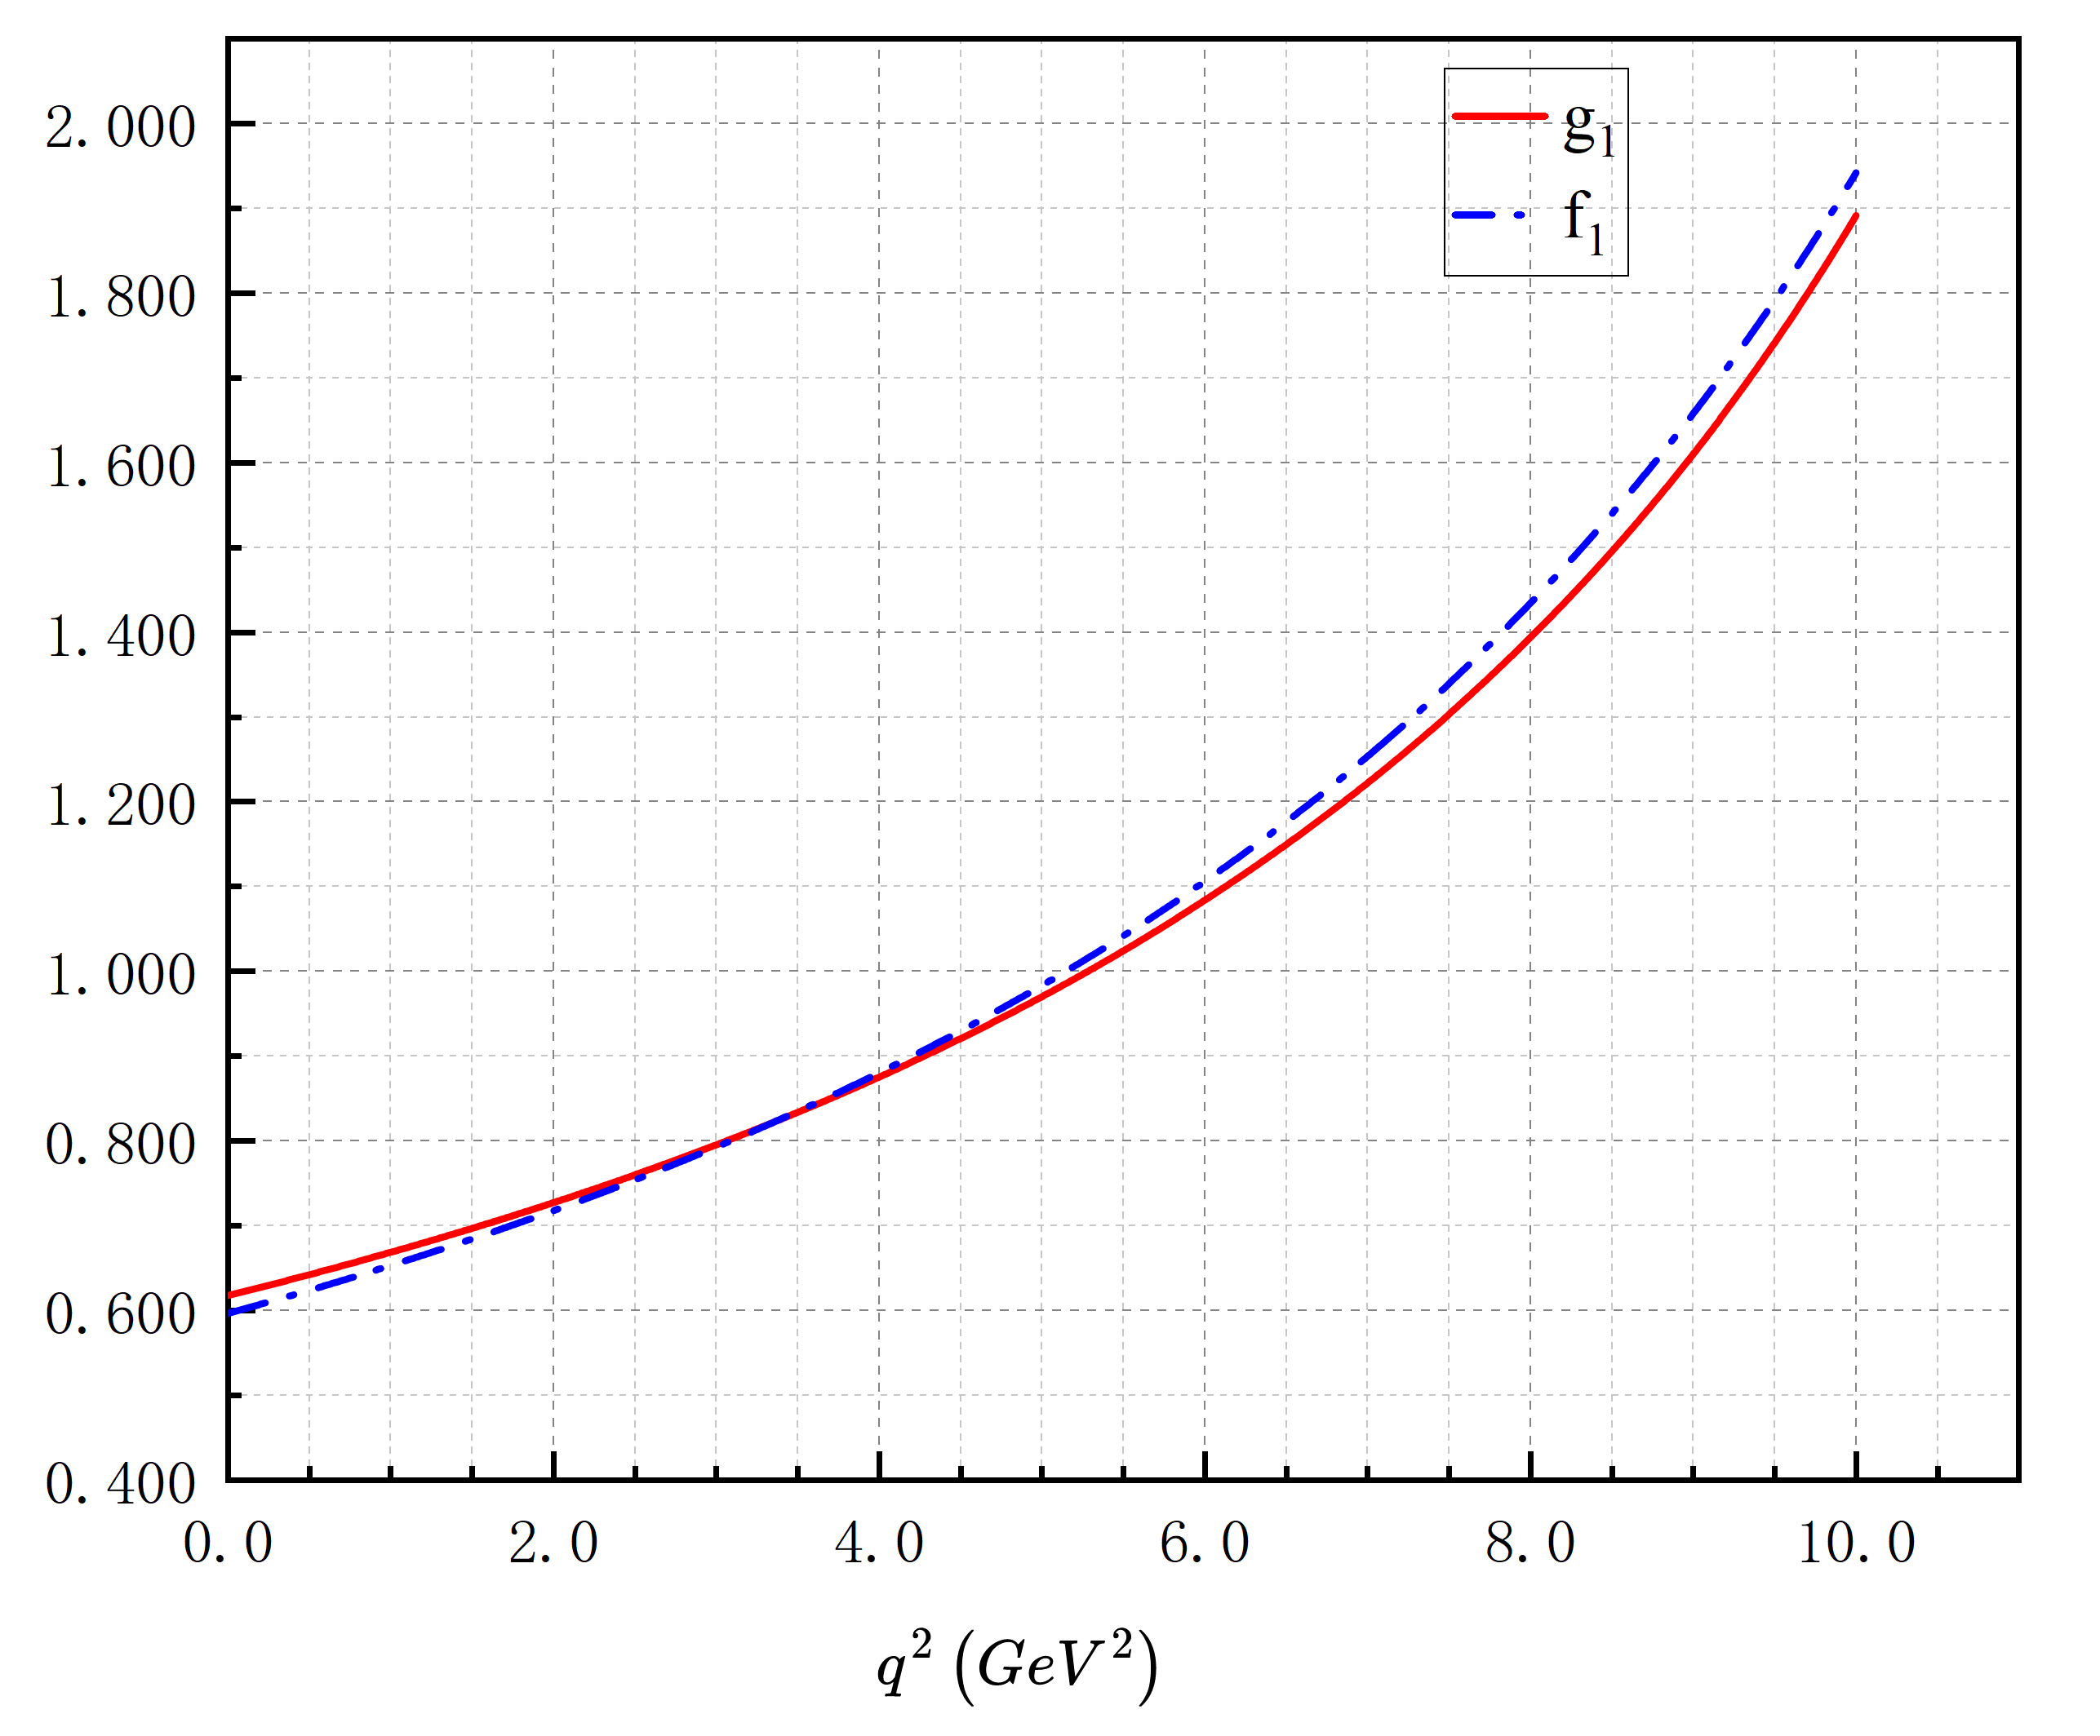

Slide 19

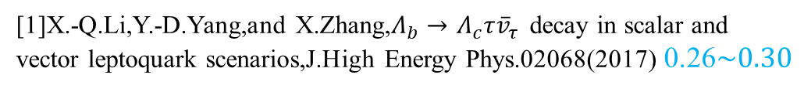
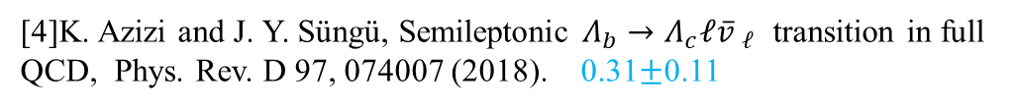
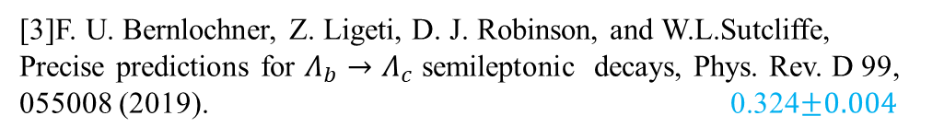

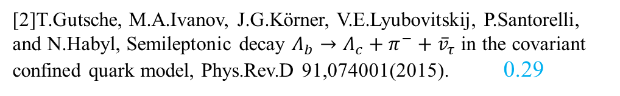
Experimental observables of the semileptonic $Λ_{b}→Λ_{c}ℓ{\overline{v}}_{ℓ}$ decay
The ratio of the branching ratio $R_{Λ_{c}}$
[1]X.-Q.Li,Y.-D.Yang,and X.Zhang,$Λ_{b}→Λ_{c}τ{\overline{v}}_{τ}$ decay in scalar and vector leptoquark scenarios,J.High Energy Phys.02068(2017) 0.26$\sim 0.30$
[2]T.Gutsche, M.A.Ivanov, J.G.Körner, V.E.Lyubovitskij, P.Santorelli, and N.Habyl, Semileptonic decay $Λ_{b}→Λ_{c}+π^{−}+{\overline{v}}_{τ}$ in the covariant confined quark model, Phys.Rev.D 91,074001(2015). 0.29
[3]F. U. Bernlochner, Z. Ligeti, D. J. Robinson, and W.L.Sutcliffe, Precise predictions for $Λ_{b}→Λ_{c}$ semileptonic decays, Phys. Rev. D 99, 055008 (2019). 0.324$±0.004$
[4]K. Azizi and J. Y. Süngü, Semileptonic $Λ_{b}→Λ_{c}ℓ{\overline{v} }_{ℓ}$ transition in full QCD, Phys. Rev. D 97, 074007 (2018). 0.31$±$0.11

Slide 20
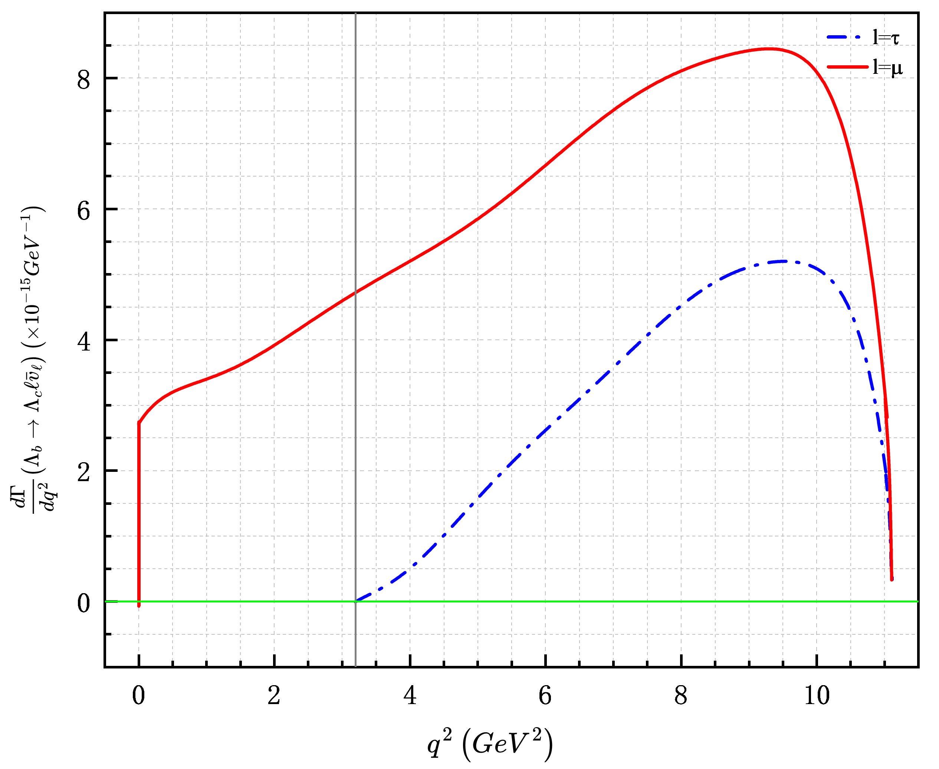
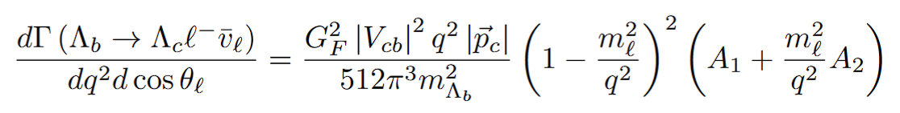


differential decay widths
由于电子和谬子的质量都远远小于两个重子的质量，所以在标准模型下的预期结果应该二者几乎相同

Slide 21




hadron polarization $P_{z}^{h}$ of ${ Λ}_{c}$
At zero recoil
$H_{1/2,1}^{2}−H_{−1/2,−1}^{2}=H_{1/2,0}^{2}−H_{−1/2,0}^{2}=H_{1/2,t}^{2}−H_{−1/2,t}^{2}=0$

Slide 22



leptonic forward-backward asymmetry($A_{FB}$)
At zero recoil,one finds $H_{1/2,1}^{2}$=$H_{−1/2,−1}^{2}$

Slide 23




lepton polarization $P_{z}^{l}$
$$P_{z}^{μ}=−1$$

Slide 24

Summary and outlook
We calculate the form factors of the $Λ_{b}→Λ_{c}$ transition within the framework of PQCD with the DAs of the $Λ_{b}$-baryon and further investigate experimental observables.
PQCD is a powerful tool to analyze the heavy baryon decays. The applications of the PQCD formalism extension to other b-baryon decays are in progress.
But we still have a long way to realize.
How to reliably compute the non-factorizable contribution in particular the W-exchange one?

Slide 25
THANKS

Slide 26
Backup Slides

Slide 27








$Λ_{b}(Λ_{c})$ Baryon wave functions

Slide 28




Slide 29





Experimental observables of the semileptonic $Λ_{b}→Λ_{c}ℓ{\overline{v}}_{ℓ}$ decay
$$λ_{Λ_{b}}=−λ_{Λ_{c}}+λ_{W^{−}}$$

Slide 30


The form factors in the space-like region can be parameterized in a three-parameter form as

Slide 31


Slide 32



Gegenbauer-1 model
Exponential model

Slide 33


Gegenbauer-2 model
Free-parton approximation

Slide 34

In the standard model, low-energy effective Hamiltonian is given:
Fermi coupling constant
Local four-quark operators
CKM matrix elements
Wilson coefficient
For two-body nonleptonic B meson decays, the key step is to calculate the hadronic matrix elements

Slide 35


研究成果与进展
Research achievements and progress
两体非轻衰变$B→M_{2}M_{3}$的衰变振幅
Fourier transform

