Slide 1
Probing the couplings of axion-like particle with leptons at future $e^{+}e^{−}$ and $e^{−}p$ colliders
Xin-Yang Li（李欣洋）
Liaoning Normal University
2025.03.30
Based on Eur.Phys.J.C 84 (2024) 10, 1033 with C.-X. Yue and X.-C. Sun
arxiv:2503.03179 with C.-X. Yue, M.-S.-Y. Wang and Y.-Y. Bu

Slide 2
1
Introduction
2
The theory framework
Outline
3
Prospects for detecting the couplings of axion-like particle with neutrinos at the CEPC
CONTEXT
4
Probing the couplings of axion-like particle with leptons via three-lepton final state processes at future $e^{−}p$ colliders
5
Conclusions
1

Slide 3
1. Introduction
1.1 Axion-Like Particles (ALPs)
the effective theory
The Standard Model （SM）
Beyond the Standard Model （BSM）
ultimate theory of nature
Axion-Like Particles (ALPs) appear in many extensions of the SM
generalizations of QCD axions
CP-odd neutral pseudoscalars
low- and high-energy experiments
ALP
the masses
independent parameters
couplings to the SM particles
2

Slide 4
1. Introduction
1.2 The constraints or projected constraints on the ALP- lepton couplings
Exploring the four-point couplings (W-ℓ-ν-a) for leptophilic ALPs at future high-energy colliders
X.-H.Jiang and C.-T.Lu, Phys.Rev.D111, 035035(2025), 2412.19195
Exploring the three-point couplings (aℓℓ) at future high-energy colliders
Exploring the possibility of detecting the aℓℓ couplings from their loop-level impact on the ALP couplings to EW gauge bosons at current colliders
3

Slide 5
2. The theory framework
The effective interactions of ALP with the SM particles:
: the ALP field
the mass of ALP
: the field strength tensors of
: the respective coupling constants
: the decay constant of ALP
: Hermitian matrices in flavor space
4

Slide 6
2. The theory framework
The purely leptonic ALP couplings:
In the flavor-diagonal scenario, the ALP-lepton effective couplings:
5

Slide 7
2. The theory framework
After electroweak symmetry breaking:
: the gluon, photon, Z boson and W boson field strength tensors
The coupling coefficients
:
6

Slide 8
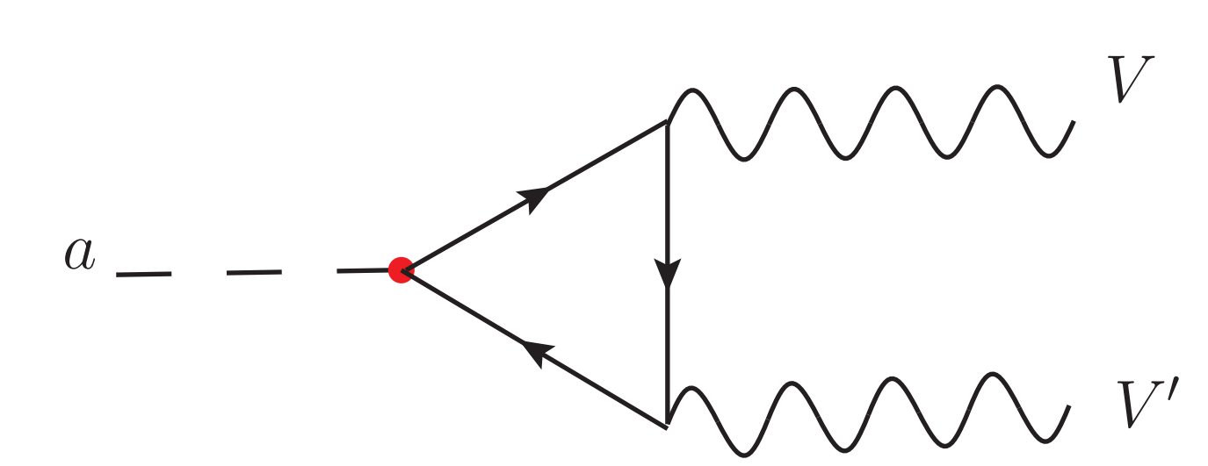
2. The theory framework
The ALP-lepton couplings give rise to the ALP-EW gauge boson effective couplings at one-loop:
: the EW gauge bosons
the scalar 3-point Passarino-Veltman function
7

Slide 9
2. The theory framework
8

Slide 10
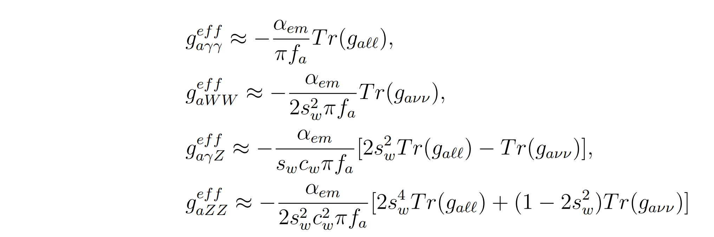
2. The theory framework
If m_{a} > $m_{ℓ} ,the$ALP-EW gauge boson effective couplings can be approximated as:
9

Slide 11
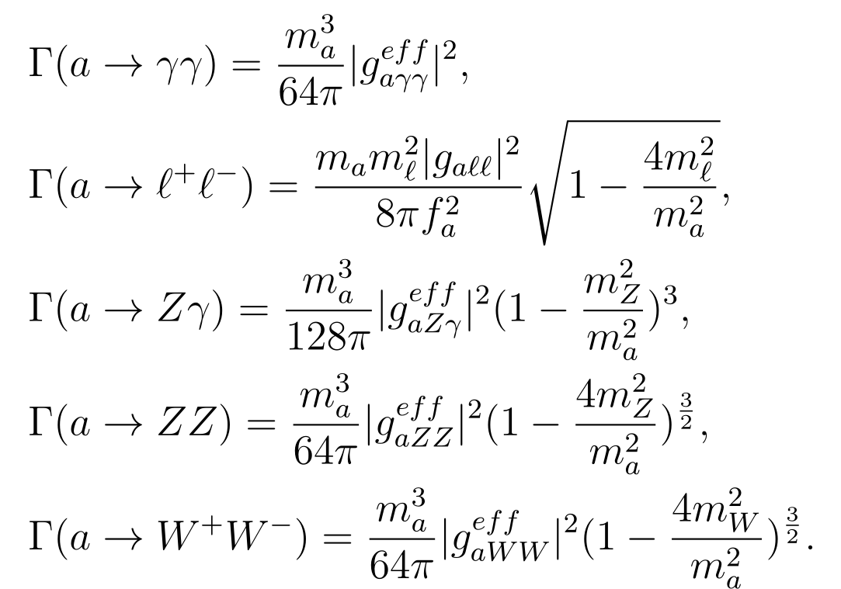
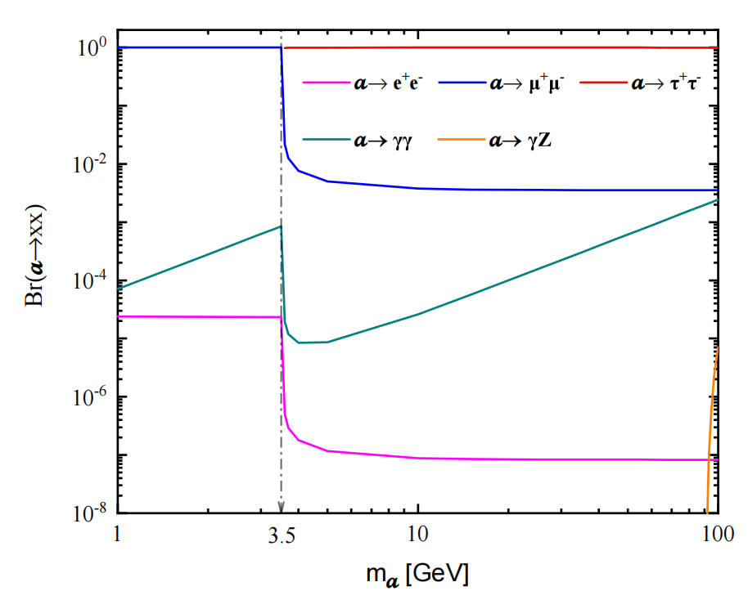
2. The theory framework
The relevant decay widths of ALP into charged leptons and EW gauge bosons：
The specific branching ratios for these decay modes：
10

Slide 12
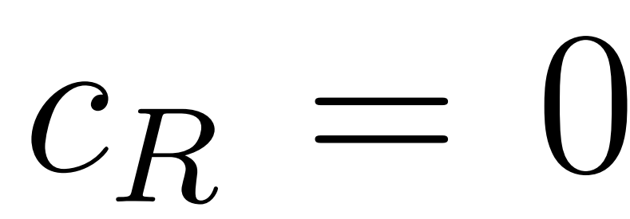
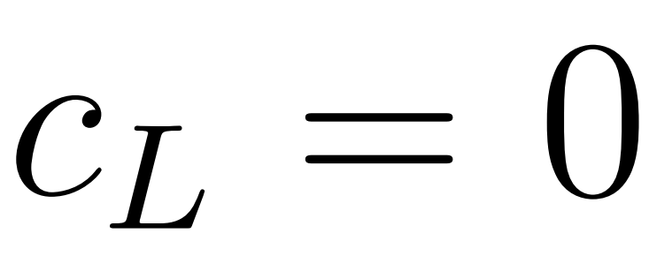
3. Prospects for detecting the couplings of axion-like particle with neutrinos at the CEPC
Chong-Xing Yue, Xin-Yang Li* and Xiao-Chen Sun
Eur.Phys.J.C 84 (2024) 10, 1033
CEPC
GeV
The Feynman diagrams for the signal process induced by ALPs.
：
：
：
11

Slide 13
3. Prospects for detecting the couplings of axion-like particle with neutrinos at the CEPC
The typical Feynman diagrams for the SM background of the process
12

Slide 14
3. Prospects for detecting the couplings of axion-like particle with neutrinos at the CEPC
CEPC
GeV
FeynRules generate the model file for the effective Lagrangian
Madgraph5-aMC@NLO generate signal and background events and calculate the production cross sections of both the signal and background
Pythia 8 the parton shower
Delphes the detector simulation
Madanalysis5 the signal and background analysis
Basic cuts:
The SM background: 0.067 (1.311×10⁻⁴) pb 240 (91) GeV CEPC
13

Slide 15
3. Prospects for detecting the couplings of axion-like particle with neutrinos at the CEPC
3.1 In the case
14

Slide 16
3. Prospects for detecting the couplings of axion-like particle with neutrinos at the CEPC
15

Slide 17
3. Prospects for detecting the couplings of axion-like particle with neutrinos at the CEPC
The improved cuts
16

Slide 18
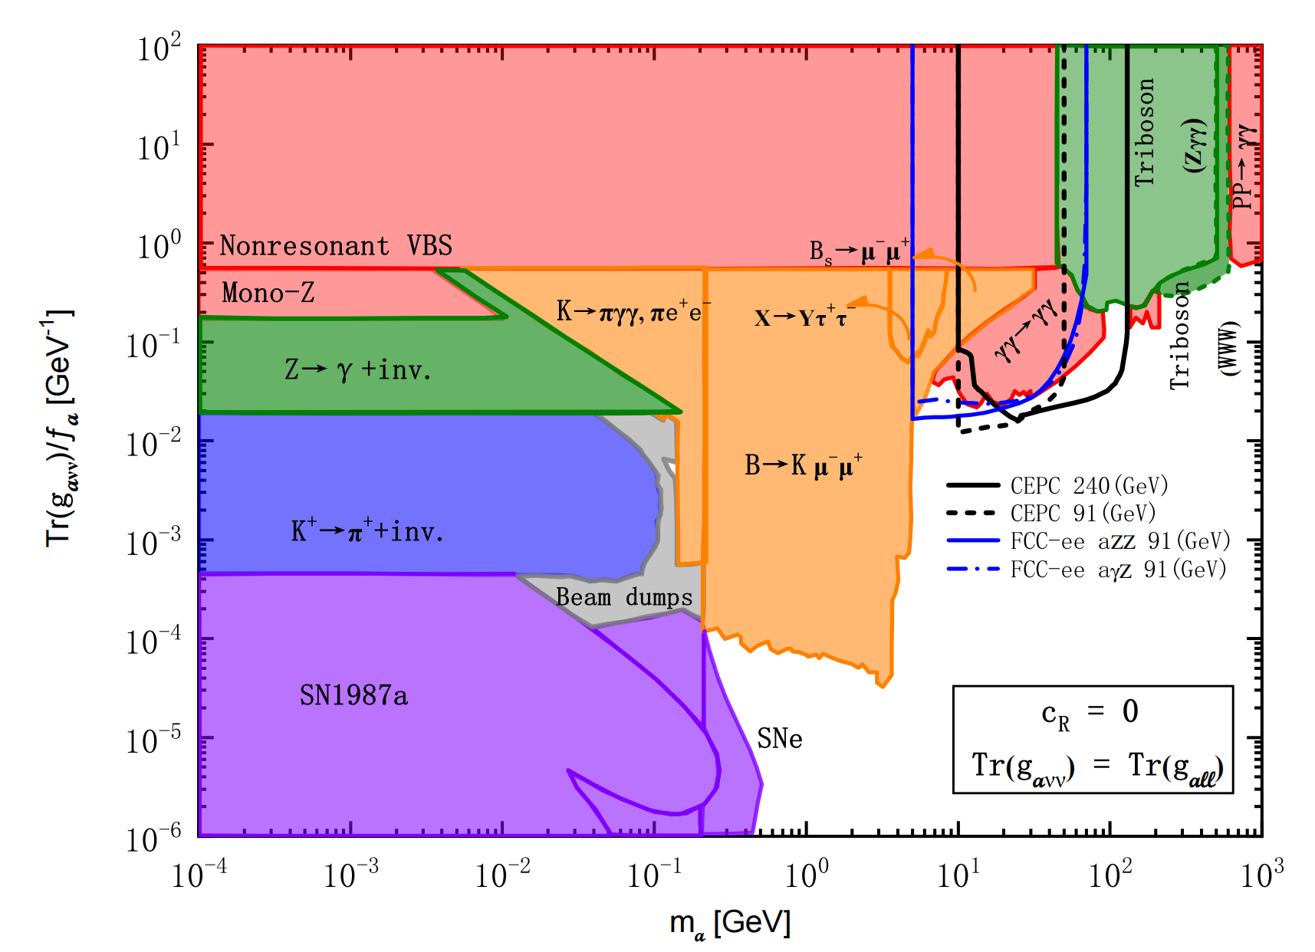
3. Prospects for detecting the couplings of axion-like particle with neutrinos at the CEPC
The projected 2σ sensitivities of the 240 (91) GeV CEPC to the ALP-neutrino couplings：
91 GeV CEPC
240 GeV CEPC
17

Slide 19
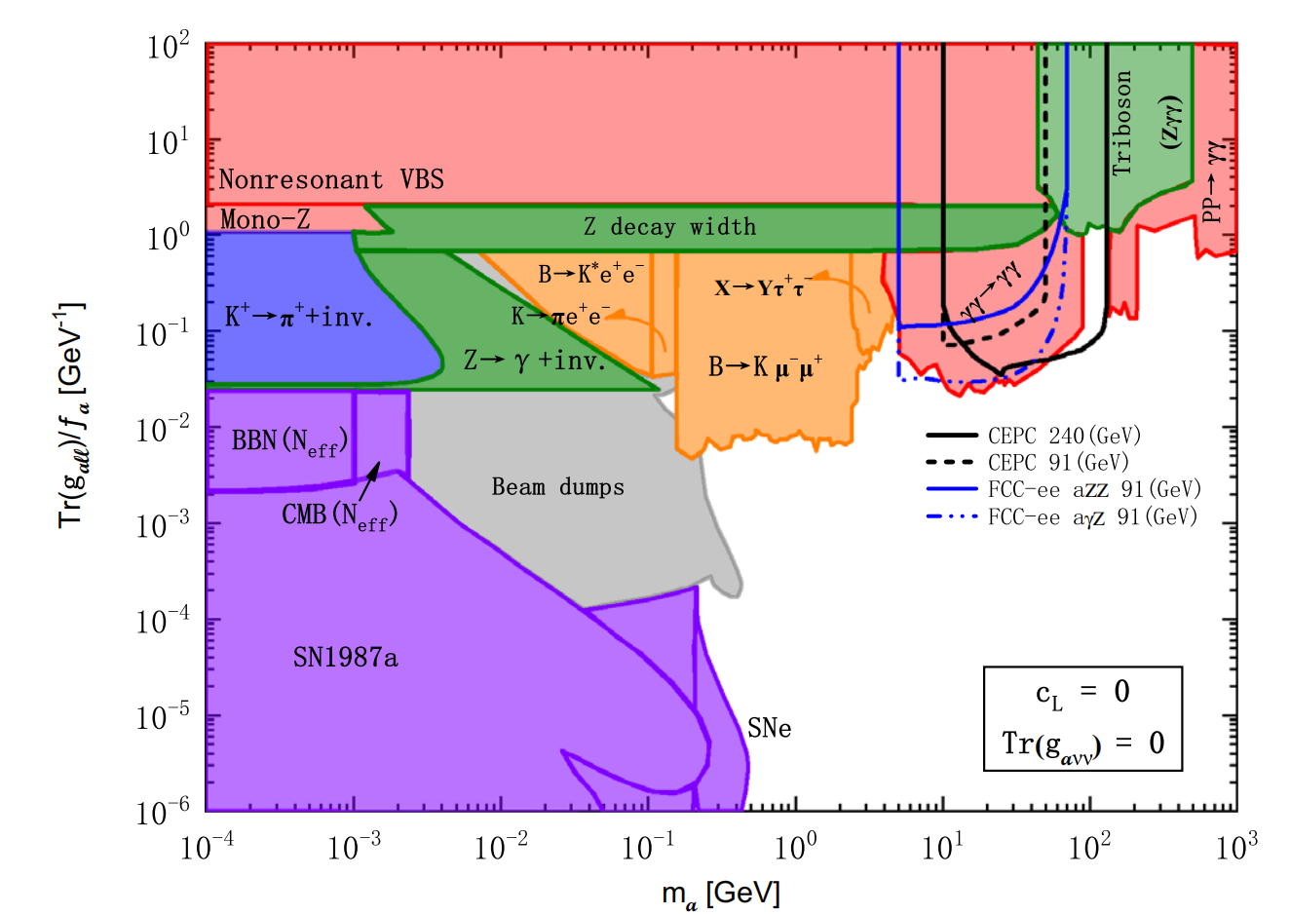
3. Prospects for detecting the couplings of axion-like particle with neutrinos at the CEPC
3.2 In the case
The projected 2σ sensitivities of the 240 (91) GeV CEPC to the ALP-lepton couplings
240 GeV CEPC
18

Slide 20
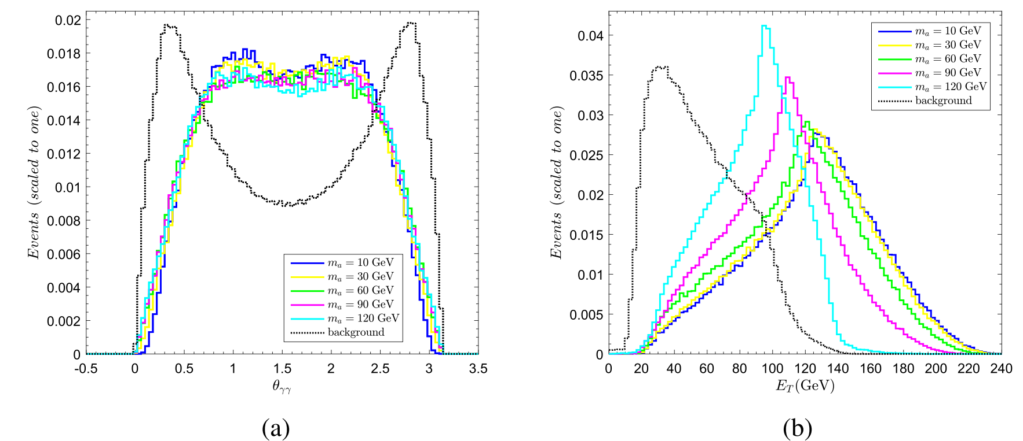
3. Prospects for detecting the couplings of axion-like particle with neutrinos at the CEPC
3.3 In the case
The improved cuts
19

Slide 21
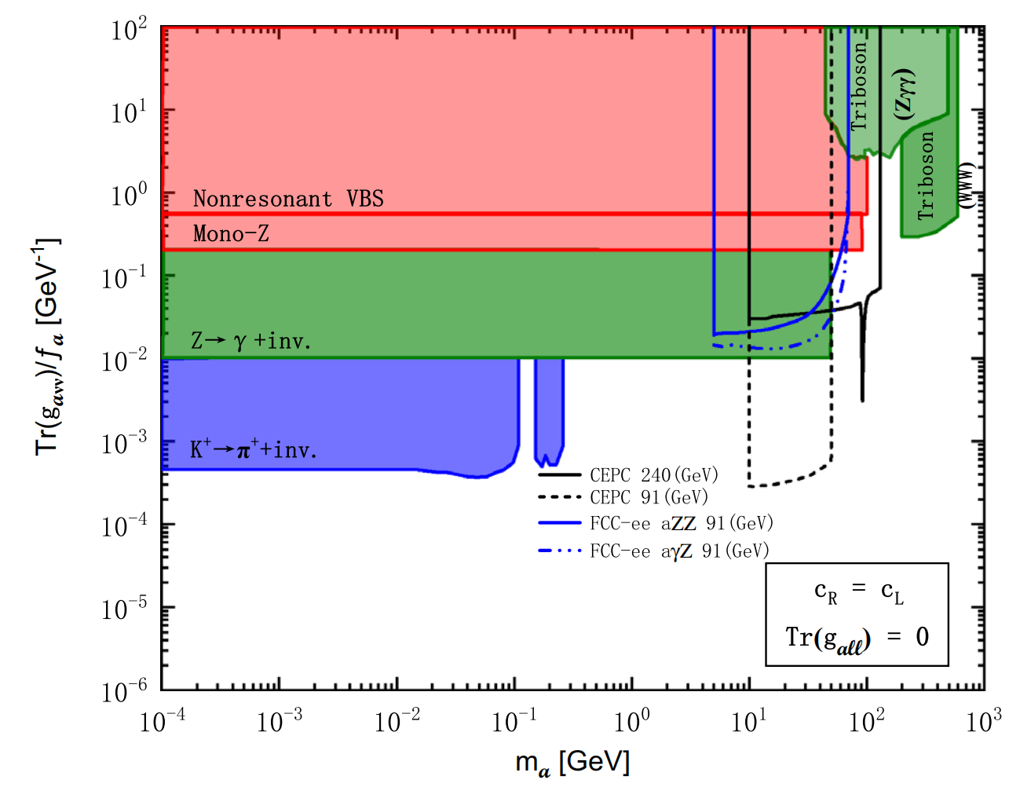
3. Prospects for detecting the couplings of axion-like particle with neutrinos at the CEPC
The projected 2σ sensitivities of the 240 (91) GeV CEPC to the ALP-neutrino couplings
91 GeV CEPC
240 GeV CEPC
20

Slide 22
4. Probing the couplings of axion-like particle with leptons via
three-lepton final state processes at future $e^{−}p$ colliders
arxiv:2503.03179
accepted by Physical Review D
Chong-Xing Yue, Xin-Yang Li*,
Mei-Shu-Yu Wang and Yang-Yang Bu
LHeC
:
:
FCC-eh
:
:
The leptonic decays of taus
21

Slide 23
4. Probing the couplings of axion-like particle with leptons via
three-lepton final state processes at future $e^{−}p$ colliders
Probing the ALP-lepton couplings via
Probing the ALP-lepton couplings via
22

Slide 24
4. Probing the couplings of axion-like particle with leptons via
three-lepton final state processes at future $e^{−}p$ colliders
LHeC
:
FCC-eh
:
Basic cuts:
NN23LO1 Parton Distribution Functions (PDFs)
Factorization and renormalization scales for the signal and background simulations
are set to the default dynamic scales provided by MadGraph5
23

Slide 25
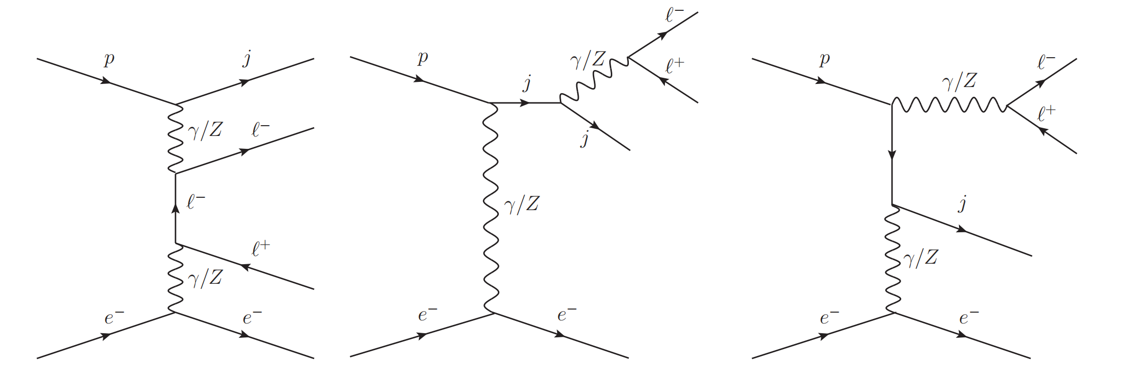
4. Probing the couplings of axion-like particle with leptons via
three-lepton final state processes at future $e^{−}p$ colliders
4.1 Searching for the ALP-lepton couplings via three-lepton final state processes for
4.1.1 The process
The typical Feynman diagrams for the SM background of the process
1.3 (3.5)TeV LHeC (FCC-eh) 0.041 (0.095) pb
24

Slide 26
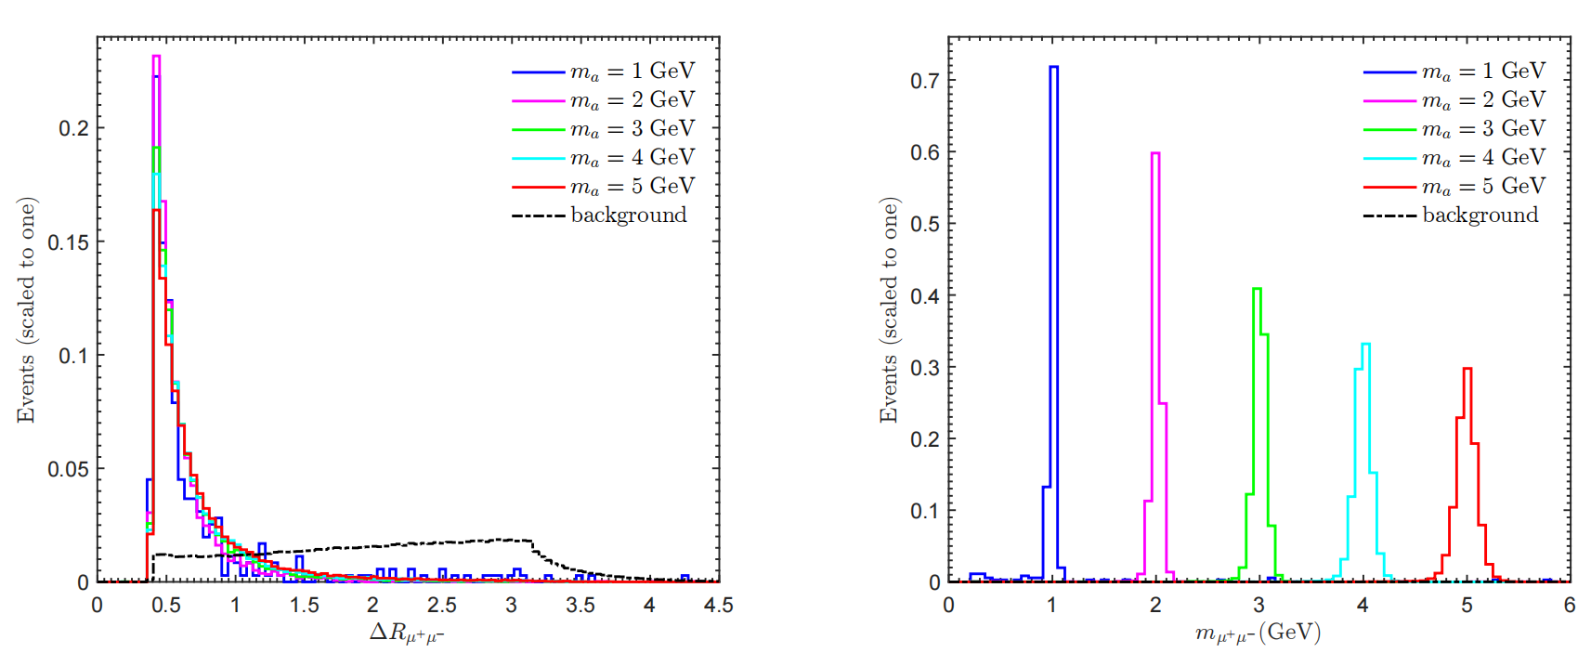
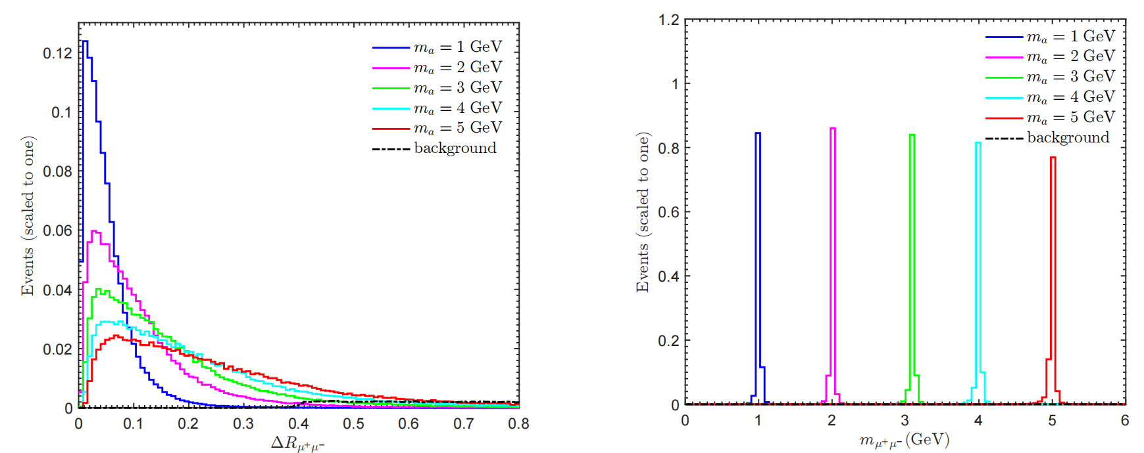
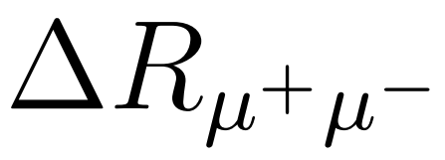
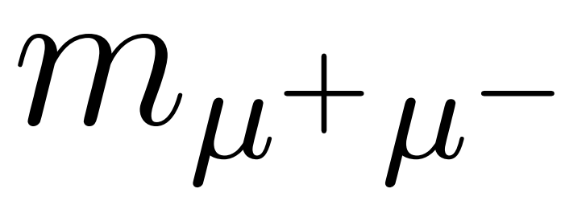
4. Probing the couplings of axion-like particle with leptons via
three-lepton final state processes at future $e^{−}p$ colliders
1.3 TeV LHeC with
3.5 TeV FCC-eh with
25

Slide 27
4. Probing the couplings of axion-like particle with leptons via
three-lepton final state processes at future $e^{−}p$ colliders
The improved cuts
26

Slide 28
4. Probing the couplings of axion-like particle with leptons via
three-lepton final state processes at future $e^{−}p$ colliders
4.1.2 The process
The typical Feynman diagrams for the SM background：
1.3 (3.5)TeV LHeC (FCC-eh) 0.011 (0.037) pb
27

Slide 29
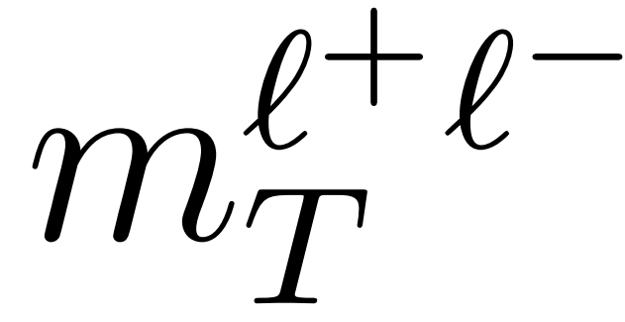
4. Probing the couplings of axion-like particle with leptons via
three-lepton final state processes at future $e^{−}p$ colliders
1.3 (3.5)TeV LHeC (FCC-eh) with
28

Slide 30
4. Probing the couplings of axion-like particle with leptons via
three-lepton final state processes at future $e^{−}p$ colliders
The improved cuts
29

Slide 31
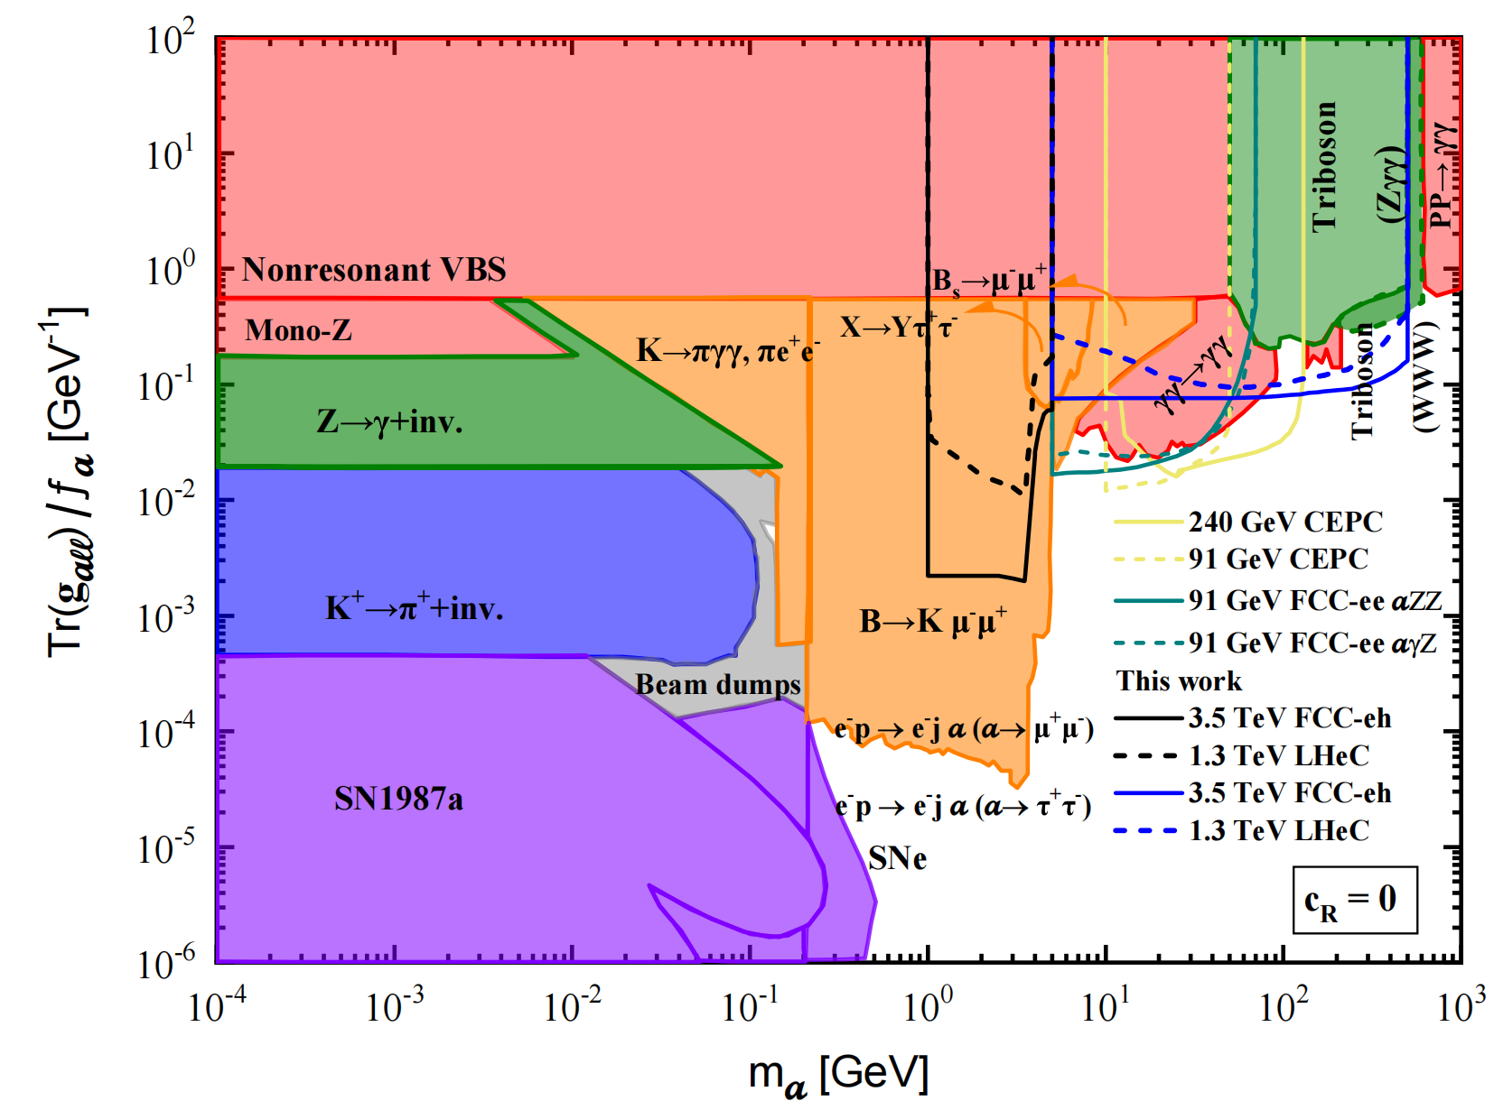
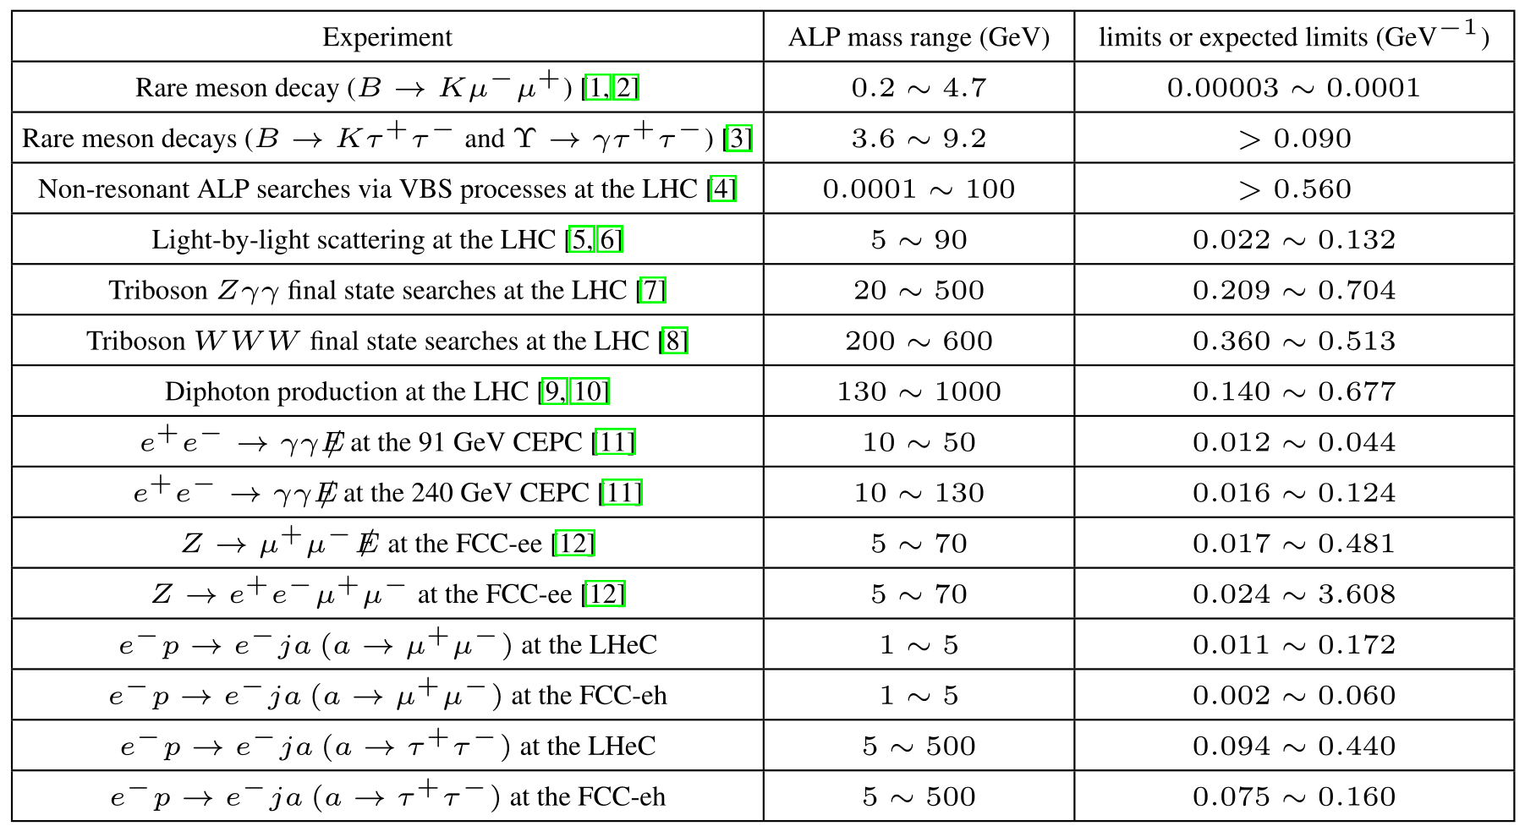
4. Probing the couplings of axion-like particle with leptons via
three-lepton final state processes at future $e^{−}p$ colliders
The projected 2σ sensitivities to the ALP-lepton coupling and other results
LHeC (FCC-eh)
30

Slide 32
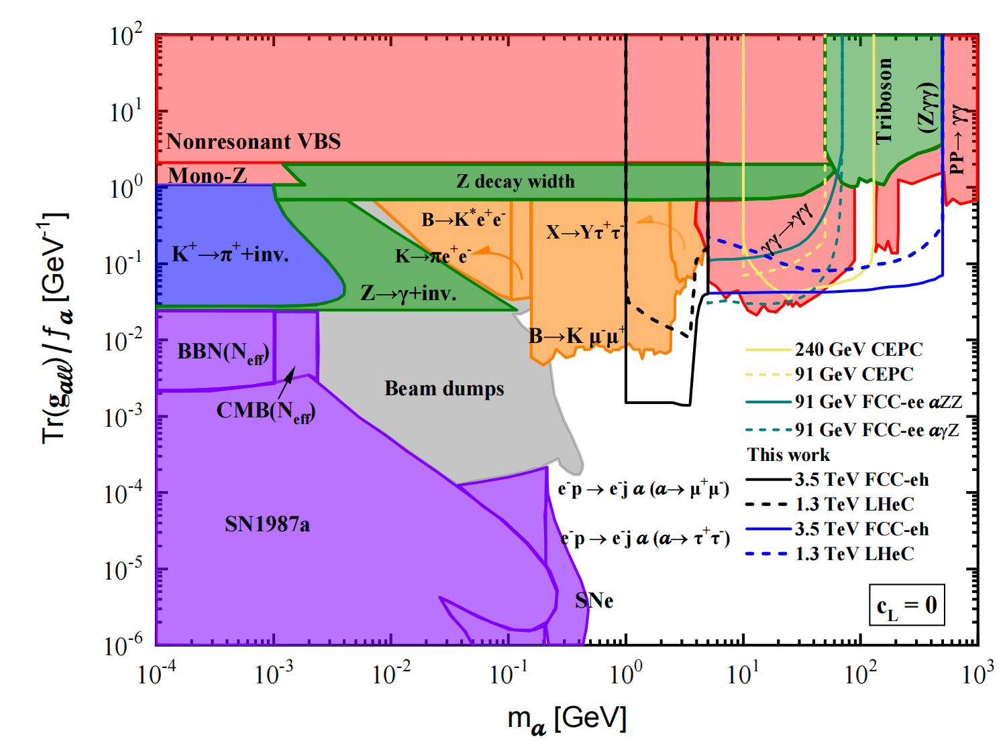
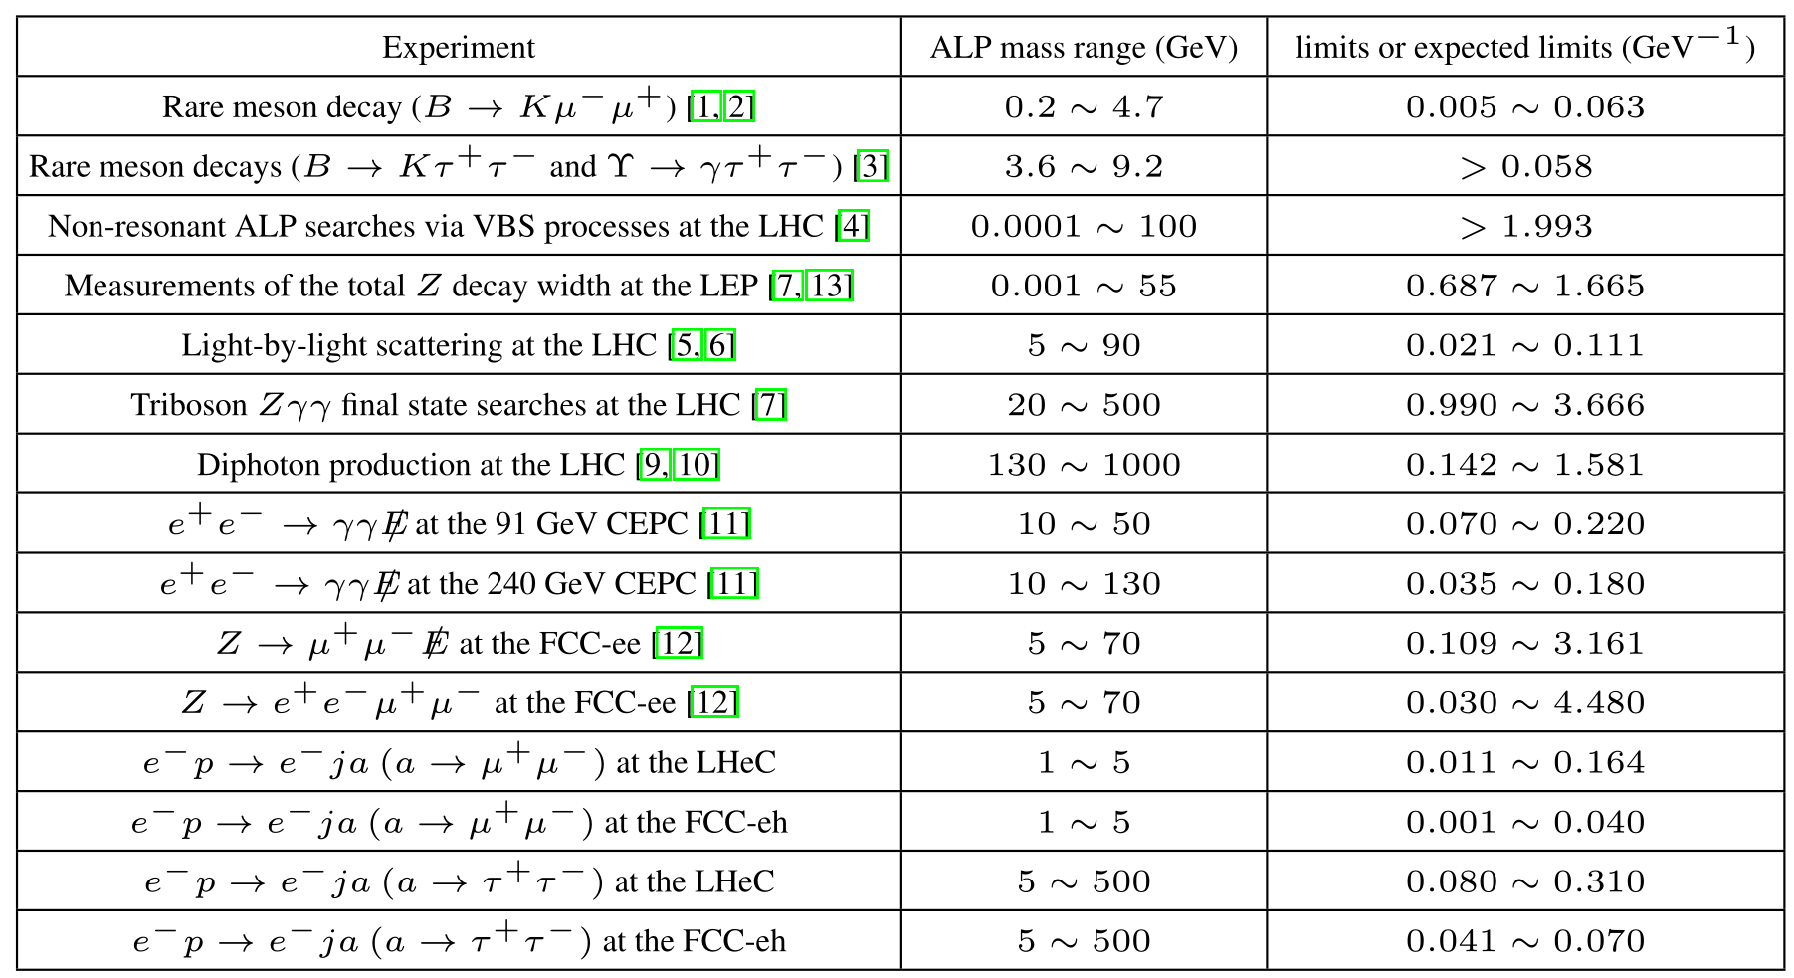
4. Probing the couplings of axion-like particle with leptons via
three-lepton final state processes at future $e^{−}p$ colliders
The projected 2σ sensitivities to the ALP-lepton coupling and other results
LHeC (FCC-eh)
31

Slide 33
5. Conclusions
high energy experiments
future $e^{+}e^{−}$colliders
ALP
future $e^{−}p$ colliders
240 (91) GeV CEPC: induced by ALP
(LHC and meson decay)
(1) For c_{R} = 0 and ,
(2) For c_{L} = c_{R} and ,
(3) For c_{L} = 0 and , (LHC and LEP)
(LHC and LEP)
1.3 (3.5) TeV LHeC (FCC-eh):
(LHC and meson decay)
(1) For c_{L} = 0 and ,
(2) For c_{R} = 0 and ,
(3) For c_{L} = 0 and ,
(future $e^{+}e^{−}$colliders and LHC)
(future $e^{+}e^{−}$colliders,LHC and LEP)
Our results are not only stronger than some existing bounds of the LHC and LEP but also complementary to the expected bounds of the future $e^{+}e^{−}$colliders.
32
53

Slide 34
THANKS FOR YOUR LISTENING!
Xin-Yang Li （李欣洋）

Slide 35
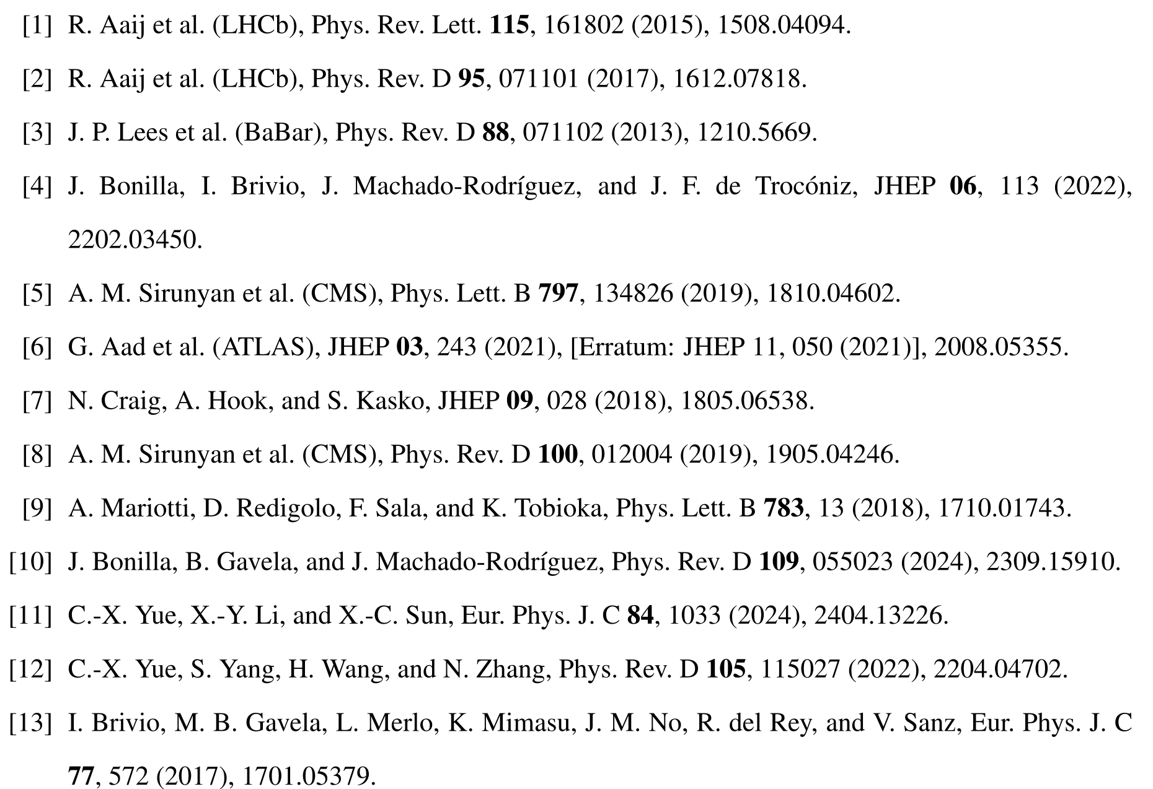
4. Probing the couplings of axion-like particle with leptons via
three-lepton final state processes at future $e^{−}p$ colliders
32

