Slide 1
Frontiers in Nuclear Lattice EFT: From Ab Initio Nuclear Structure to Reactions
March 1-3, 2025, Beijing
Nuclear charge radii from the
partial pinhole algorithm
Zhengxue Ren
Forschungszentrum Jülich & Universität Bonn
Collaborators: Serdar Elhatisari, Ulf-G. Meißner

Slide 2
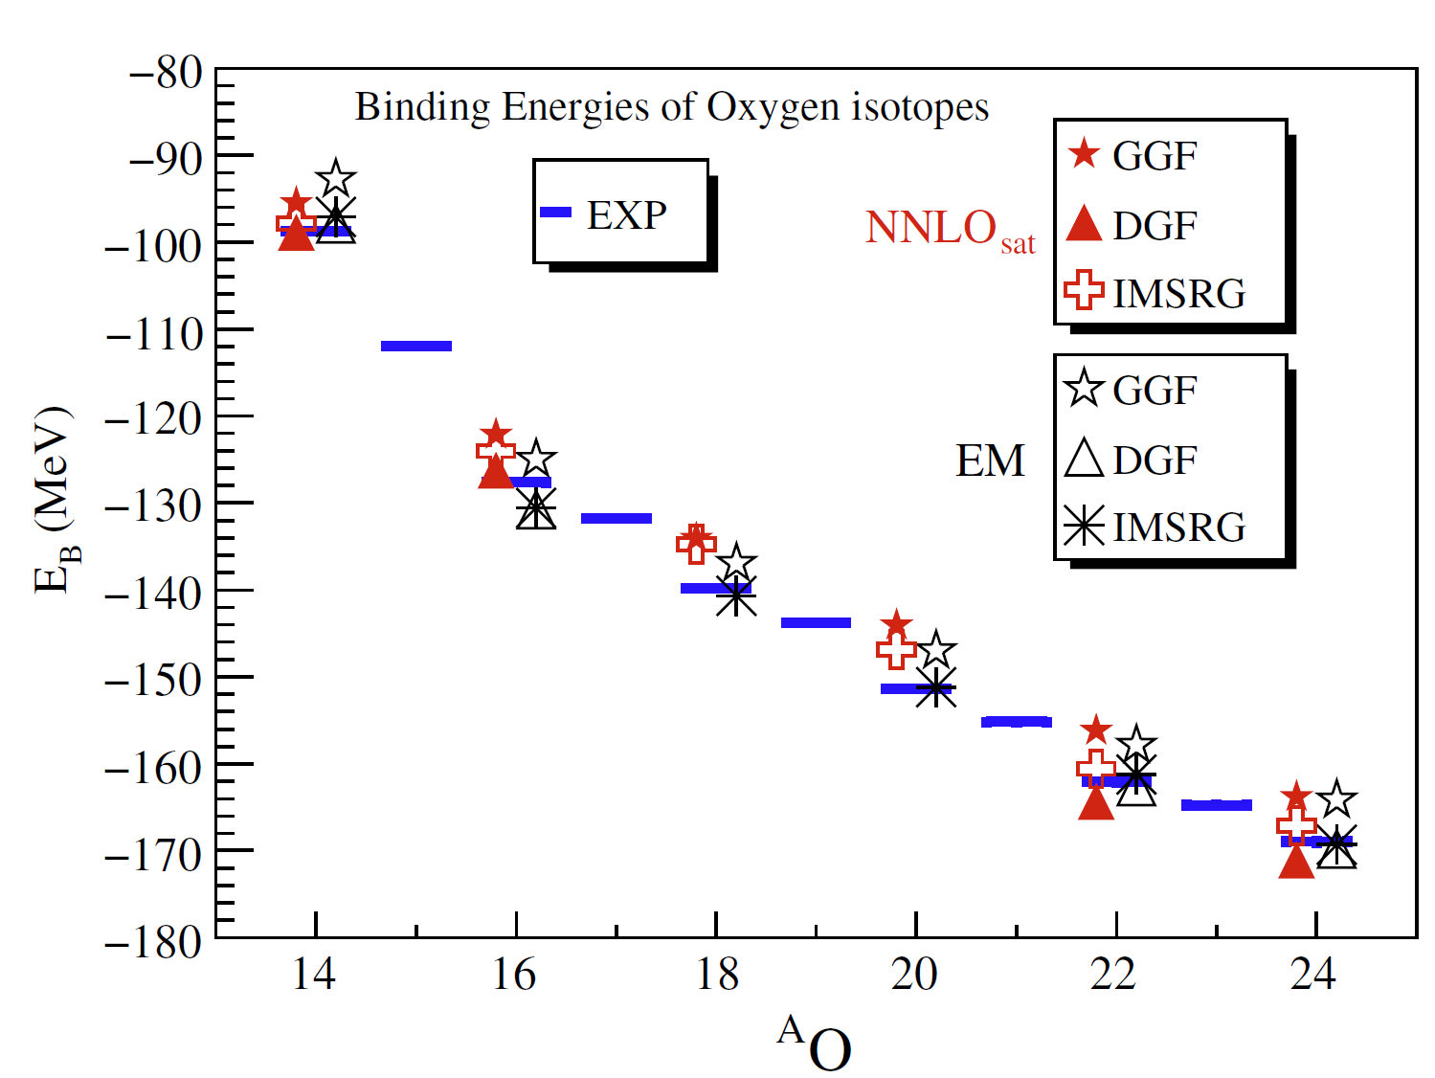
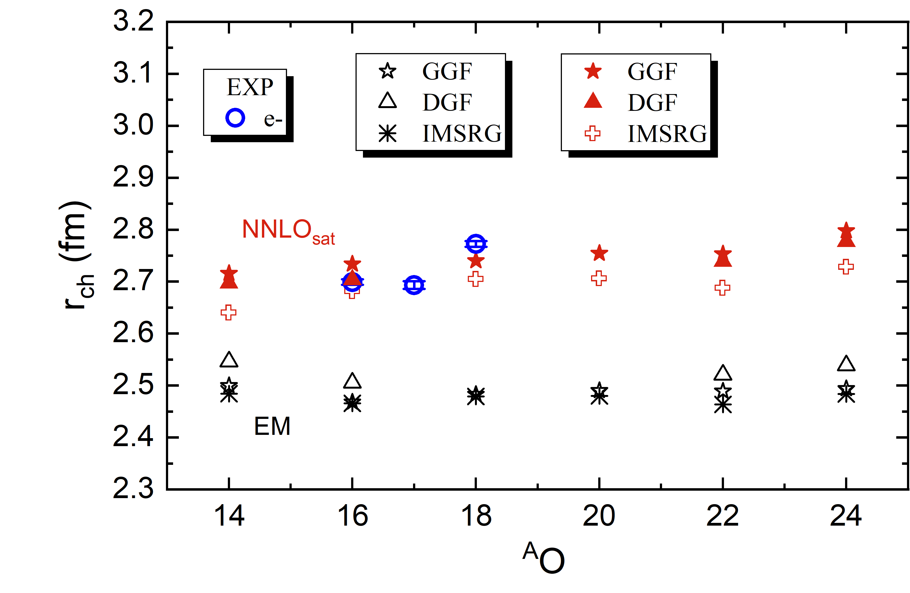
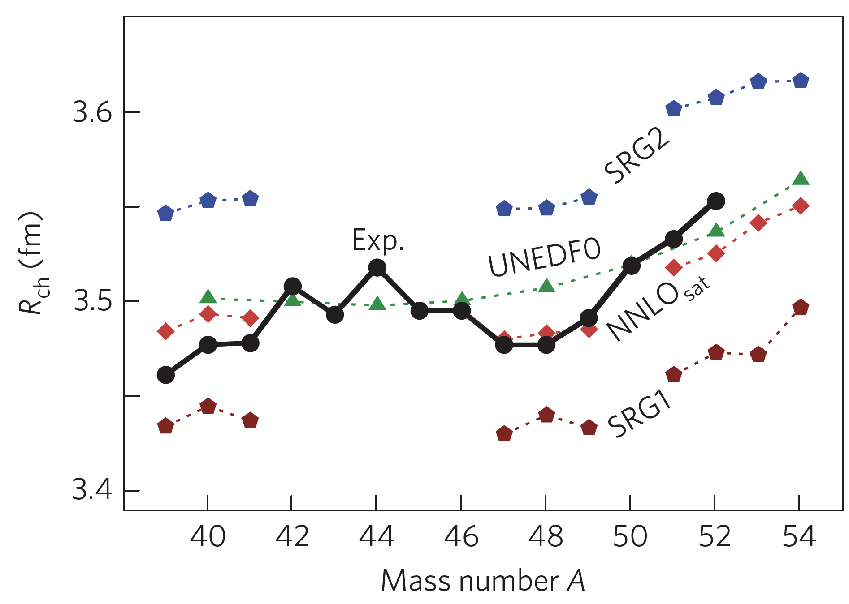
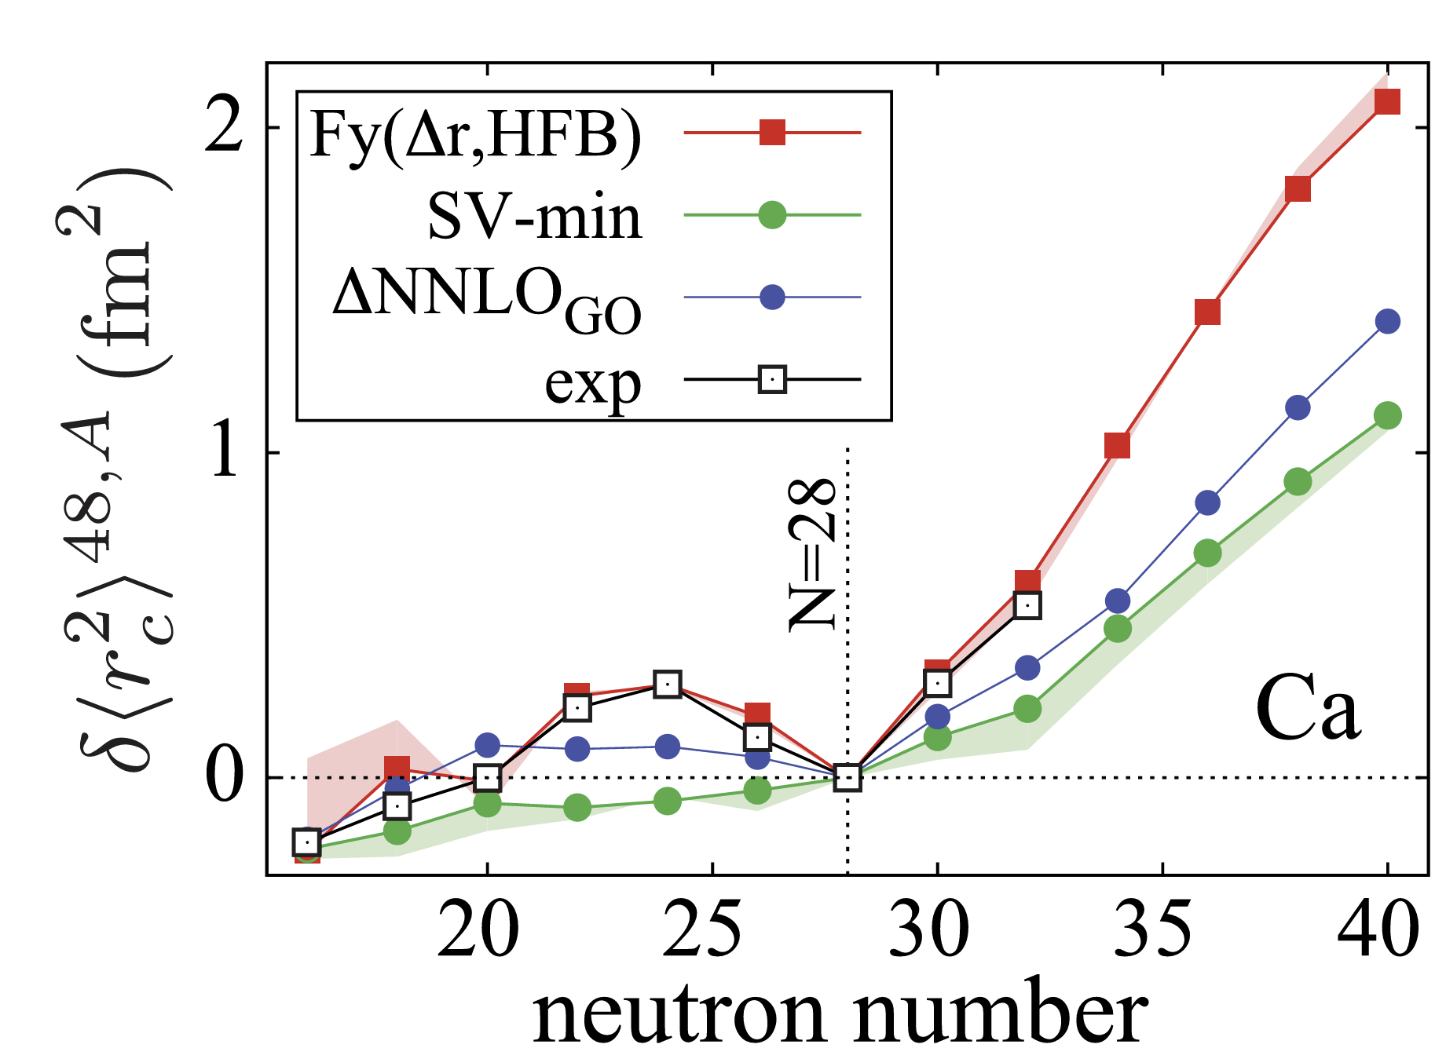
Nuclear radii: challenge for nuclear theory
Oxygen isotopes
Lapoux et al., PRL 117, 052501 (2016)
Calcium isotopes
Garcia Ruiz et al., NP 117, 052501 (2016); Kortelainen et al., PRC 105,L021303(2022)
Possible sources for the discrepancy: nuclear forces, or many-body correlations?

Slide 3
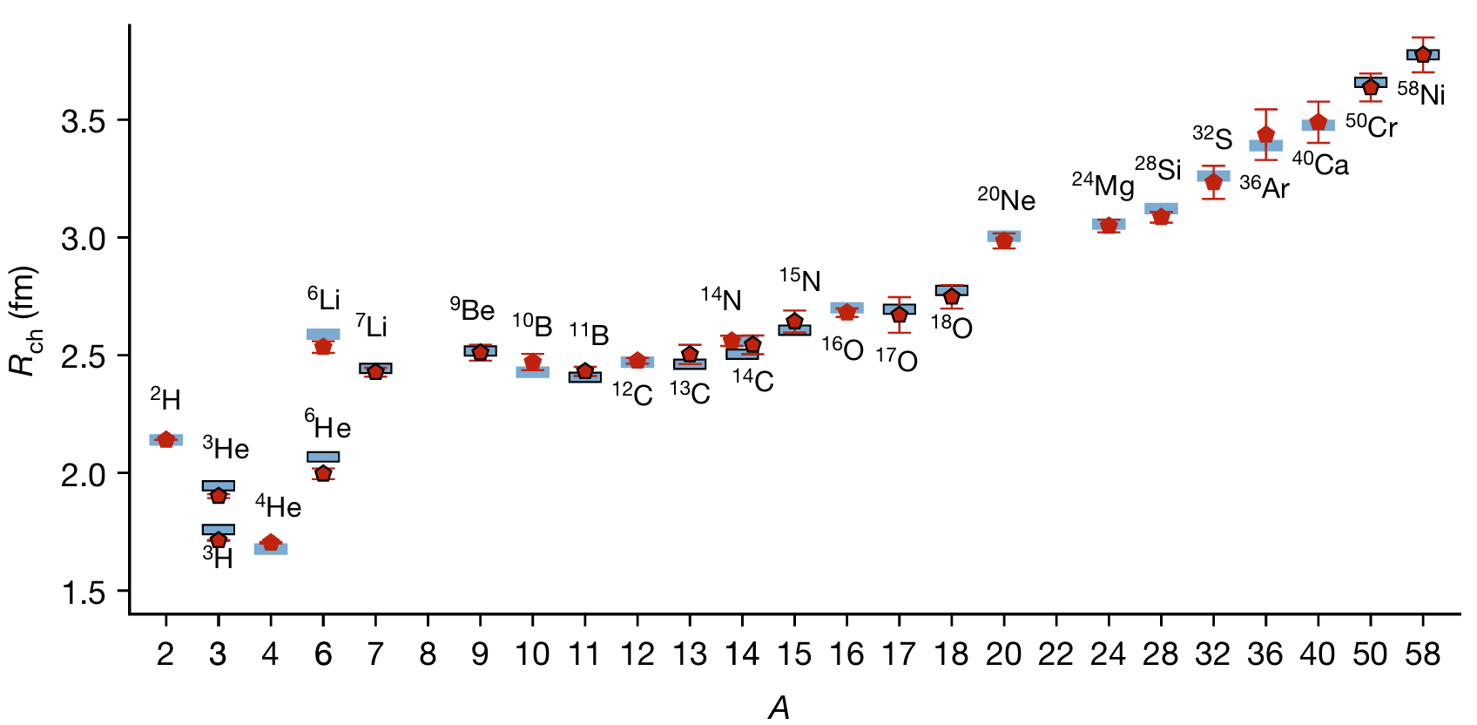
Nuclear radii from nuclear lattice EFT
Nuclear lattice EFT combines Chiral EFT, Lattice method, Monte-Carlo algorithm.
Lähde, Meißner, “Nuclear Lattice Effective Field Theory”, Springer (2019)
As an exact method, it includes all many-body correlations.
With the recently developed wavefunction matching method, nuclear lattice EFT achieves good descriptions on nuclear binding energies and charge radii.
Taken from Elhatisari et al., Nature 630, 59 (2024)
The nuclear charge radii for odd mass and heavy nuclei show large error bars.
In this work, we proposes a novel partial pinhole algorithm for calculating charge radii with significantly reducing the errors, and apply it to oxygen isotopes.

Slide 4
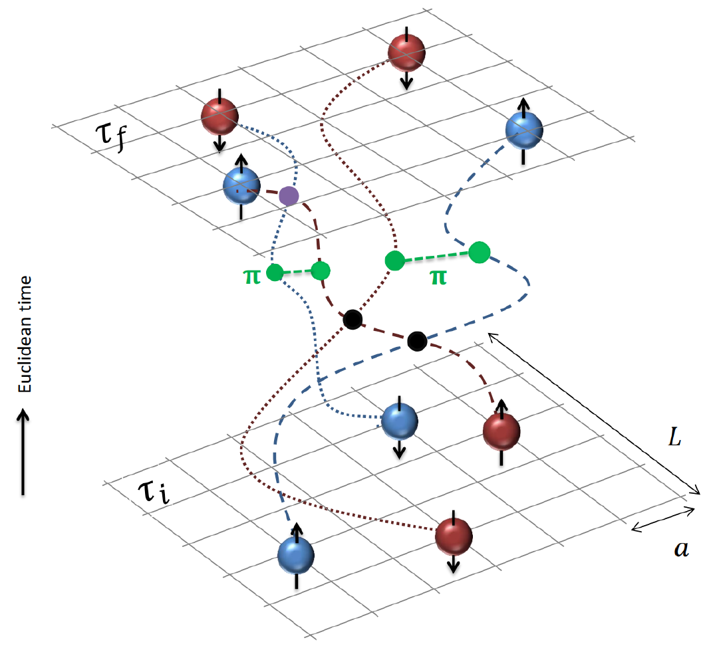
Nuclear lattice EFT: an Introduction
The ground state can be obtained via an imaginary time evolution
with $|Ψ_{A}⟩$ being a Slater determinant.
Expectation of any operator 𝒪 reads,
Space-time is discretized into a ${L^{3}×L}_{t}$ lattice space:
Nucleon-nucleon interactions
Nucleon wavefunctions
Evolution operators
Remark: $:e^{−a_{t}H}:|Ψ_{A}⟩$ is superposition of many Slater determinants.

Slide 5
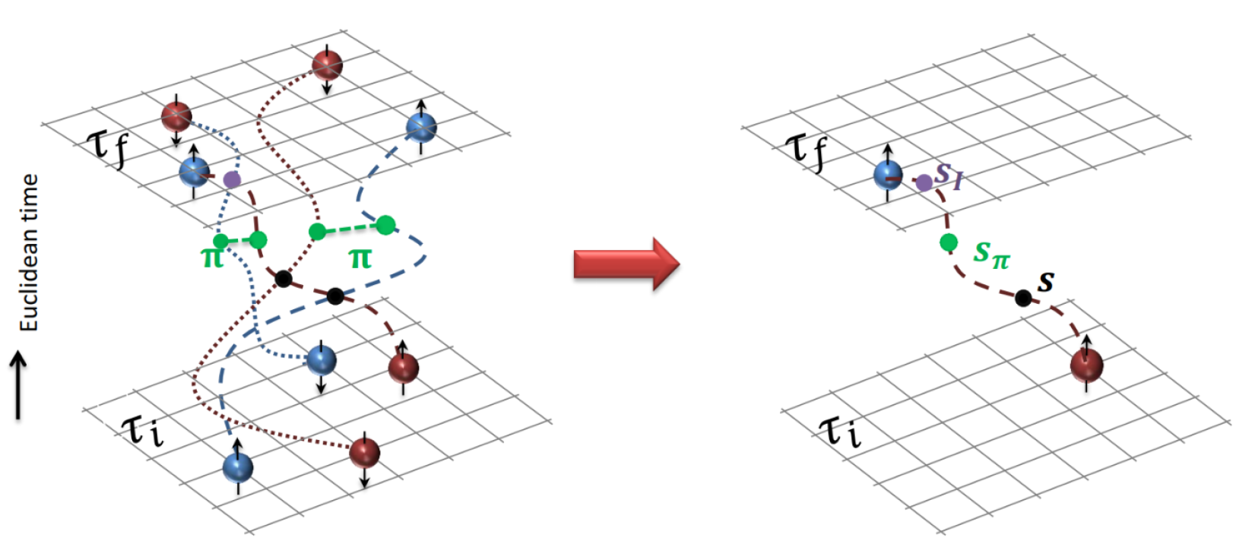
Auxiliary Field Monte Carlo method
Exponentials of the interaction can be rewritten using a Gaussian integral identity
The interactions between nucleons are transferred into the interactions between nucleon and auxiliary fields.
For a fixed auxiliary field, wavefunction will keep as a Slater determinant,

Slide 6
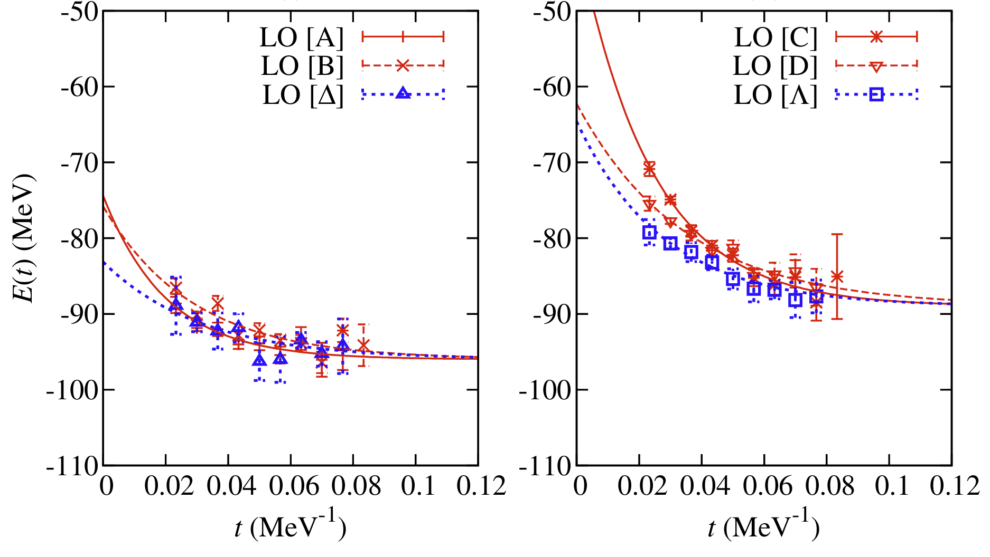
Auxiliary Field Monte-Carlo method
For a given $τ$, the expectation of any operator 𝒪 could be expressed as a summation over all configurations of auxiliary fields (path integral)
The auxiliary fields are generated by Monte-Carlo method
Probability distribution:
Phase factor:
In most cases, $\left\langle e^{iθ\left[s\right]}\right\rangle ≈0$ as $τ→∞$.
Epelbaum et al., PRL 109, 252501 (2012)

Slide 7
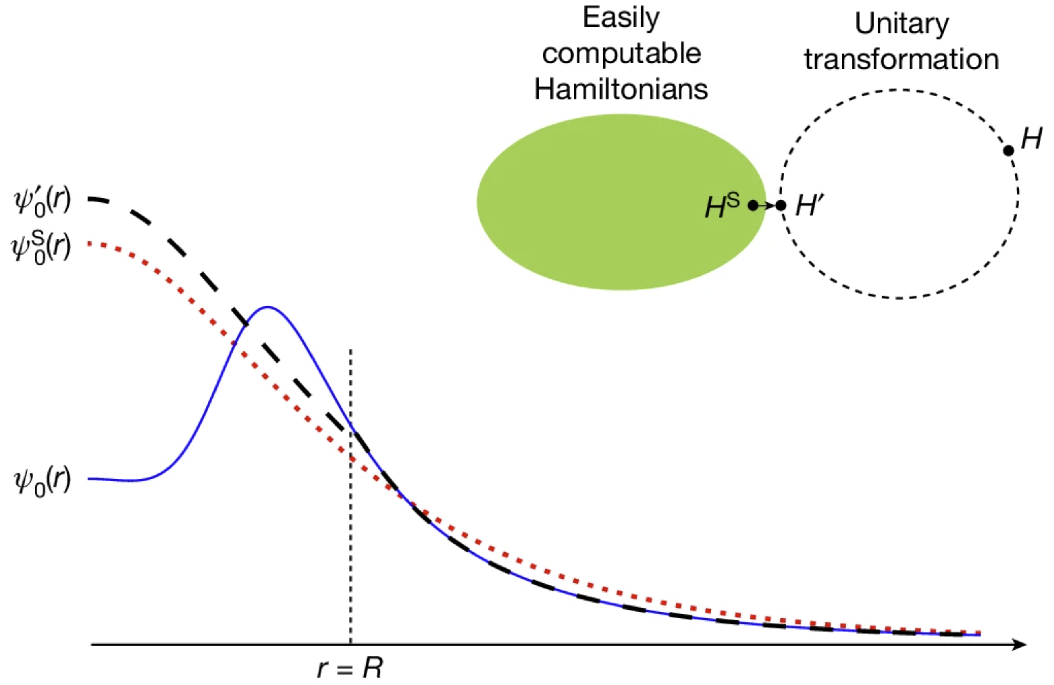
Wavefunction matching
The Hamiltonian with SU(4) symmetry is free from sign problem, and can well describe nuclear binding energies and densities.
It could serve as zeroth order Hamiltonian, and higher order interactions are taken into perturbatively,
Perturbative quantum Monte Carlo method
Wavefunction matching
Lu et al., PLB 797, 134863 (2019)
Lu et al., PRL 128, 242501 (2022)
Elhatisari et al., Nature 630, 59 (2024)
$H:$ HiFi chiral EFT interactions
$H^{S}:$ SU(4)-like Hamiltonian
$H′:$ transformed Hamiltonian
$$H^{′}=U^{−1}HU$$
Decomposition of $H′$
$$H^{′}=H^{S}+(H^{′}−H^{S})$$

Slide 8
Pinhole algorithm
The $A$-body density operator is introduced
where $ρ_{ij}\left(n\right)=a_{ij}^{+}\left(n\right)a_{ij}(n)$ with the position $n$, spin $i$, and isospin $j$.
Remark: $ρ_{A}$ is a projection operator in $A$-particle space
Completeness: $\sum_{\{n,i,j\}}{ρ_{A}}=1$
Projection: $ρ_{A}\left|Ψ\right\rangle ∝a_{i_{1}j_{1}}^{+}\left(n_{1}\right)⋯a_{i_{2}j_{2}}^{+}\left(n_{A}\right)|0⟩$
$$n_{6}$$
$$n_{1}$$
$$n_{3}$$
$$n_{5}$$
$$n_{4}$$
$$n_{2}$$
The expectation of observable related to $ρ_{A}$ (e.g., intrinsic density) can be written as
where$\left\{\tilde{s}\right\}≡\left\{s\right\}+\{n,i,j\}$. Pinhole coordinates $\{n,i,j\}$ have similar roles as $\left\{s\right\}$.
Elhatisari et al., PRL 119, 222505 (2017)

Slide 9
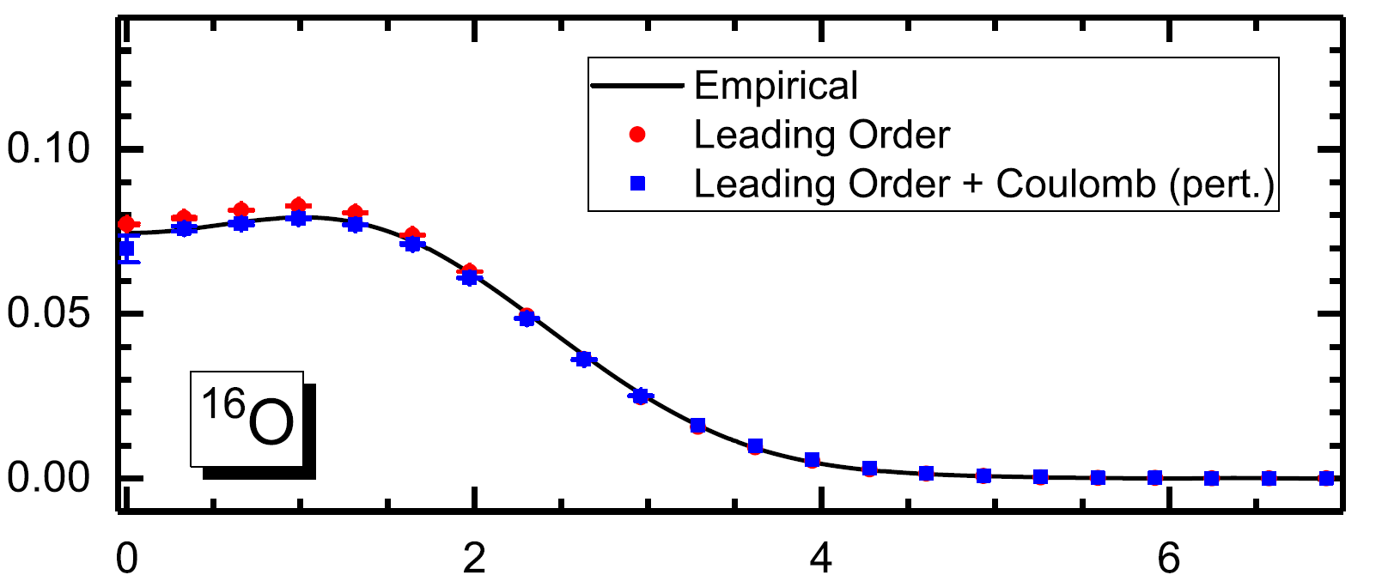
Pinhole algorithm
Intrinsic density can be measured directly, from which the radius can be derived.
$$r_{c.m.}$$
$$R_{ch}$$
However, $\{n,i,j\}$ will break SU(4) symmetry, thus introduces strong sign oscillation.
$\left\langle e^{iθ}\right\rangle$ at $τ=0.2 {MeV}^{−1}$ for $H^{S}$
 | ⁴He | ¹⁶O | ⁴⁰Ca
w/o pinhole | 1 | 1 | 1
w/ pinhole | 0.76 | 0.31 | 0.02
A more efficient way to extract charge radii is in demand.

Slide 10
Partial pinhole algorithm
Point-proton RMS radius could be written as,
It is related to two-body $pp$, $np$, $nn$ correlations,
with the correlations $G_{t_{1}t_{2}}$ defined as
It is possible to reduce the number of pinhole coordinates in calculating radii,
where the summation fulfills $\sum_{\{n,i,j\}}{ρ_{M}}=1$.
Challenge: $ρ_{M}|Ψ_{A}⟩$ is not a Slater determinant even if $|Ψ_{A}⟩$ is.

Slide 11
Partial pinhole algorithm
Since ${:ρ}_{ij}^{2}\left(n\right):=0$, rank-one operator method allows us to write $:ρ_{ij}\left(n\right):$ as,
Ma et al., PRL 132, 232502 (2024)
In$M$-body operator’s case, rank-one operator method gives us
The two-body correlations could be evaluated through partial pinhole algorithm,
where $O(n_{1},i_{1},j_{1},⋯,n_{M},i_{M},j_{M})$ is defined as,

Slide 12
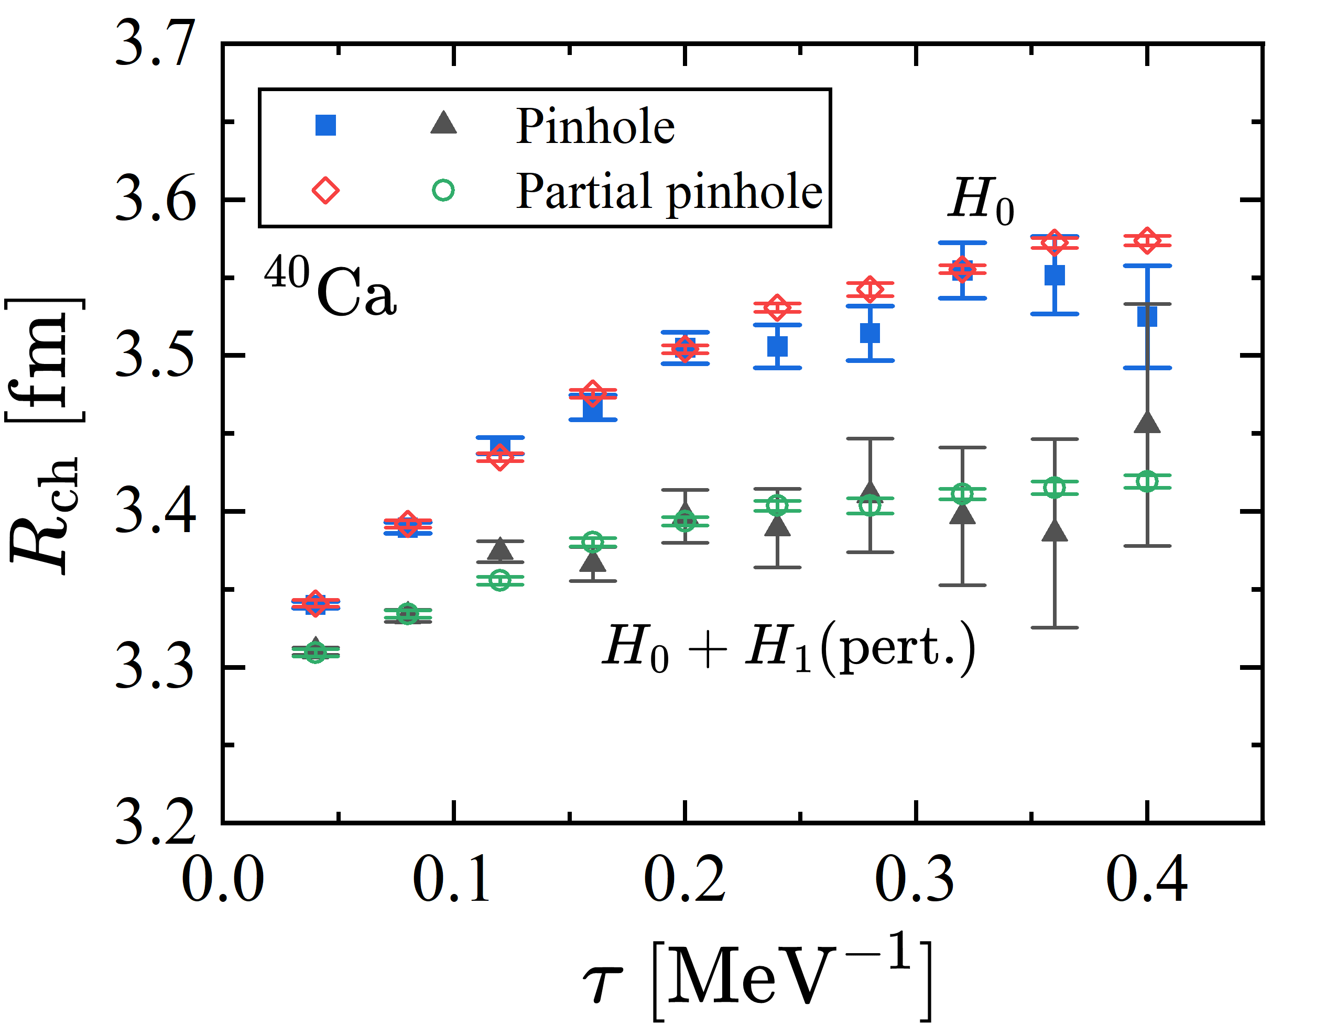
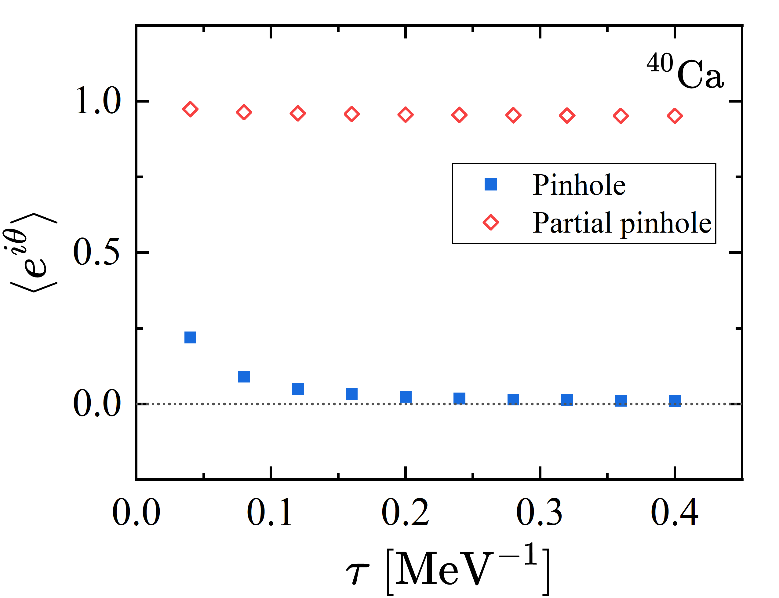
Benchmark with $H^{s}$
Non-perturbative and perturbative parts ($λ=0.1$)
The results with $M=4$

Slide 13
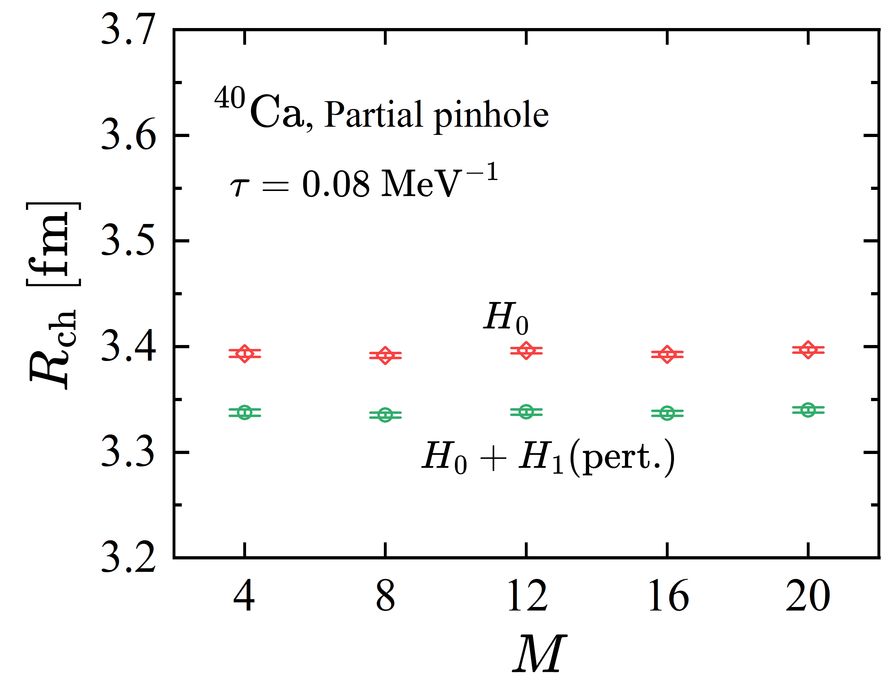
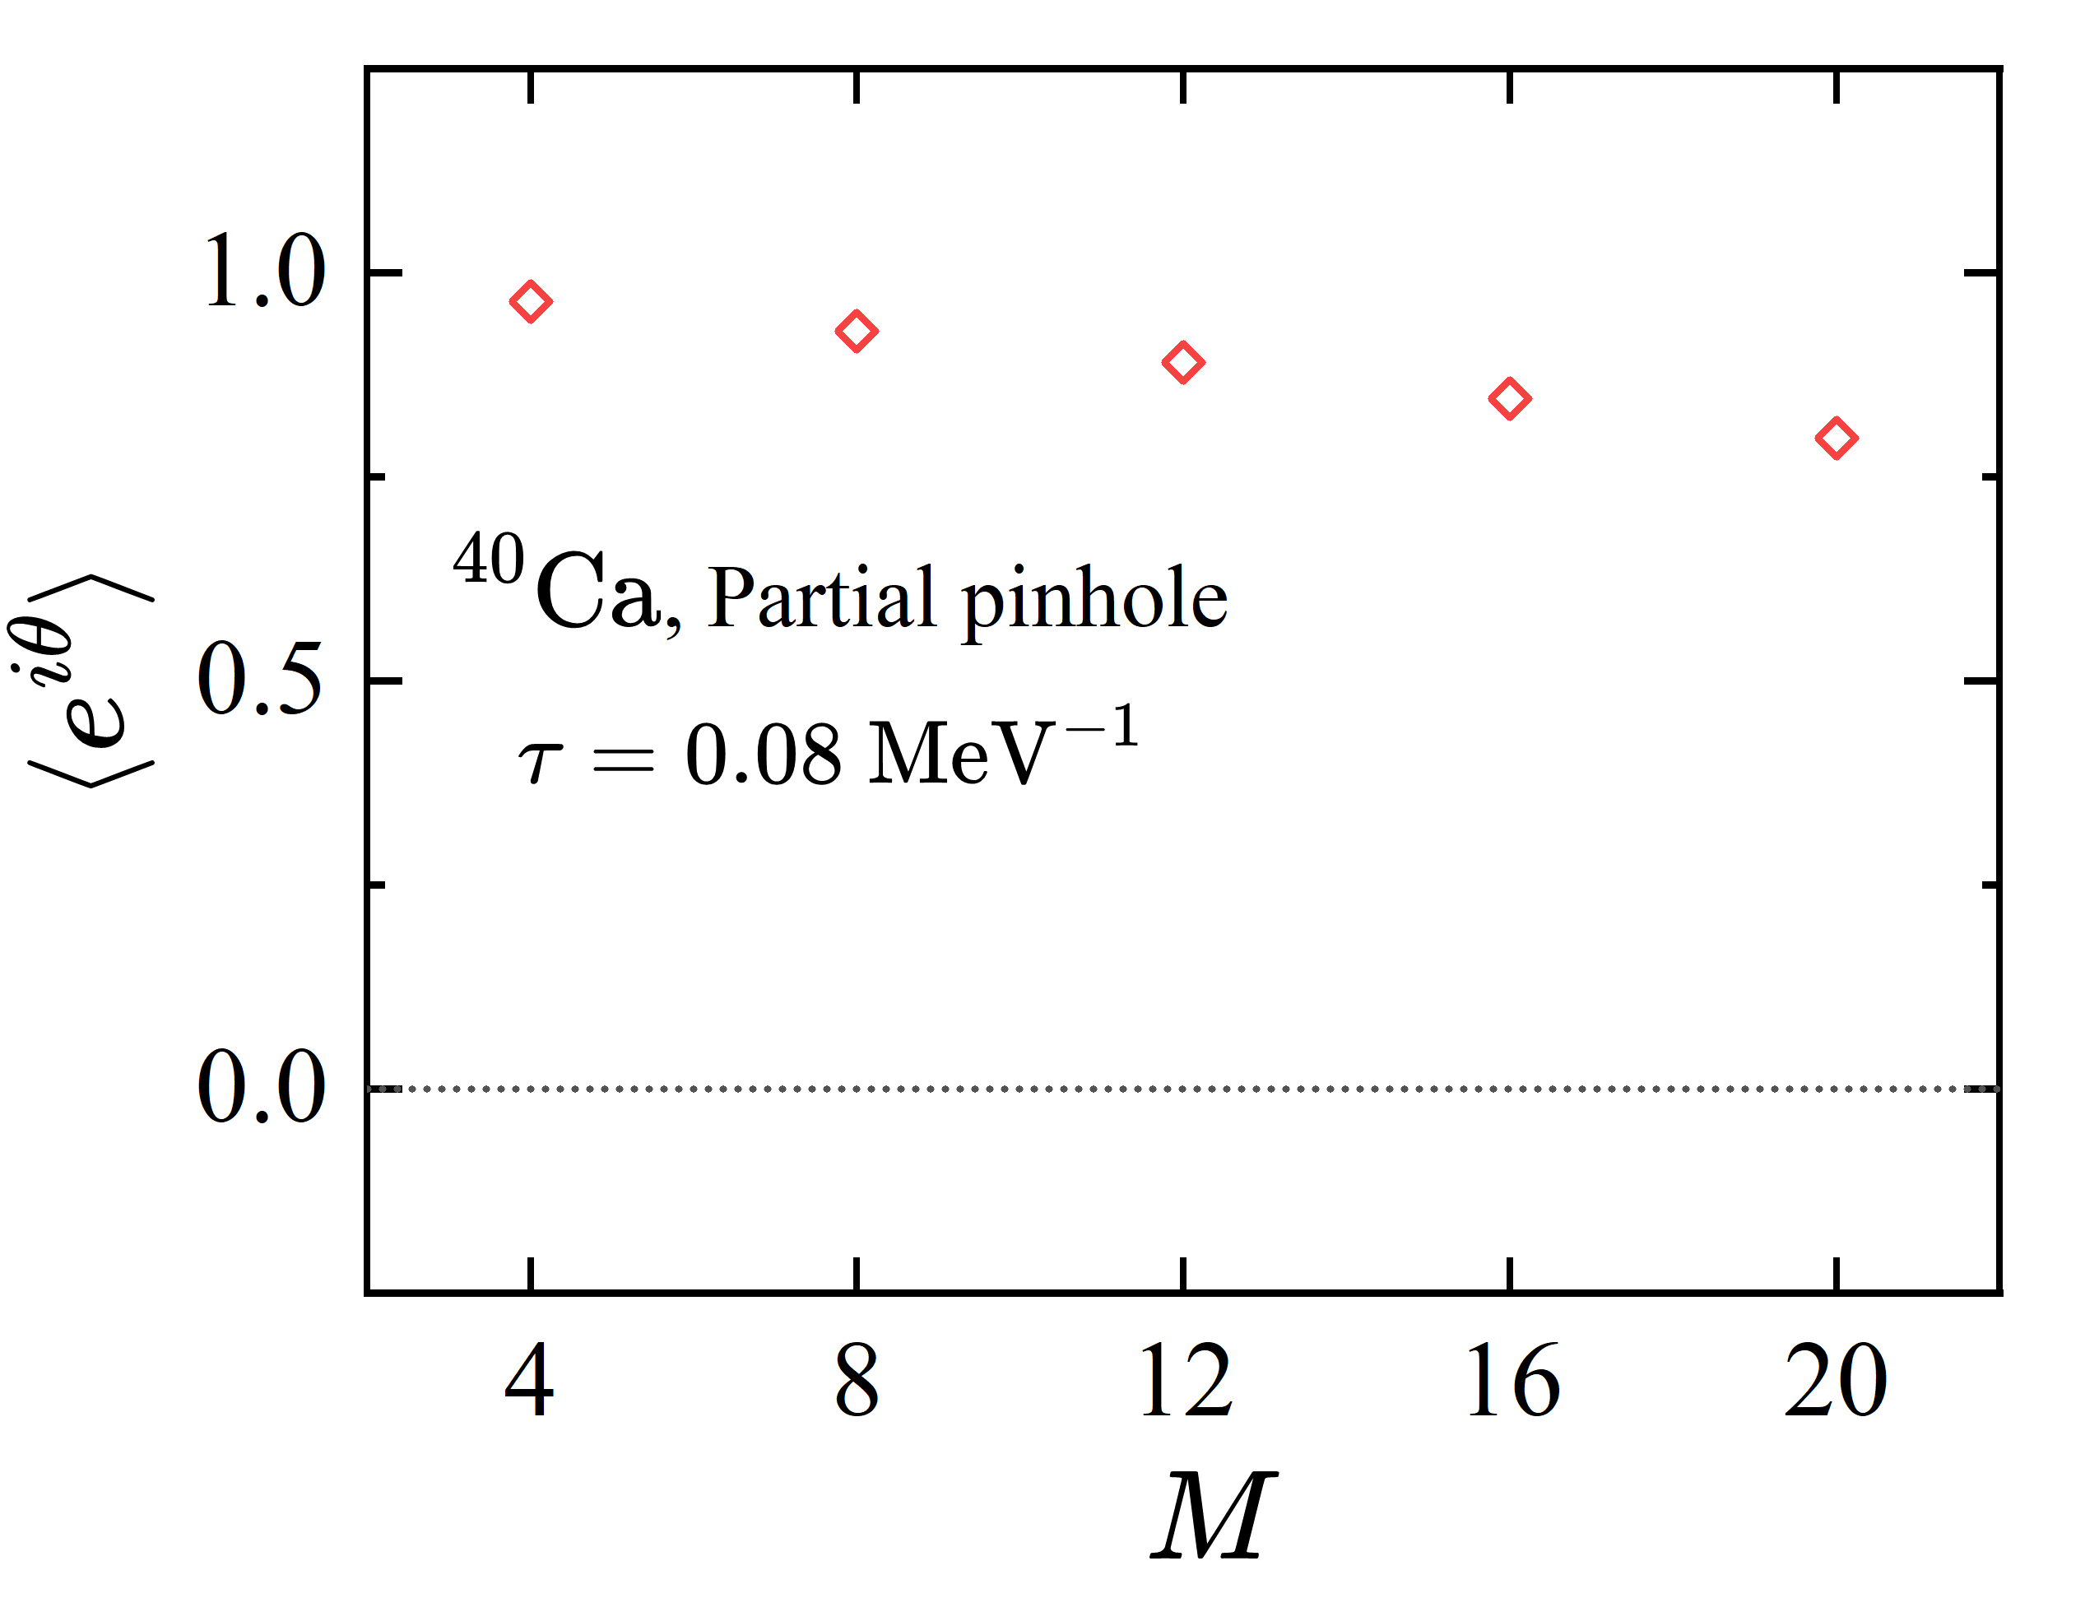
Benchmark with $H^{s}$
Non-perturbative and perturbative parts ($λ=0.1$)
Dependence on $M$

Slide 14
Combination with wavefunction matching
Combined with wavefunction matching, partial pinhole algorithm could describe nuclear $R_{ch}$ at N3LO with small statistical uncertainties.
Lattice Hamiltonian at N3LO
$V_{OPE}^{Λ_{π}}$, $V_{C_{π}}^{Λ_{π}}$, $V_{2N}^{Q^{4}}$: 2N interactions from chiral EFT at N3LO
$V_{2N,WFM}^{Q^{4} }$: 2N interactions from wavefunction matching
$W_{2N}^{Q^{4}}, W_{2N, WFM}^{Q^{4}}:$ 2N interactions from Galilean invariance restoration
Fixed by scattering data
$V_{3N}^{Q^{3}}$: 3N interactions including two-pion exchange, one-pion exchange, contact potentials.
Fixed by nuclear binding energies
Elhatisari et al., Nature 630, 59 (2024)

Slide 15
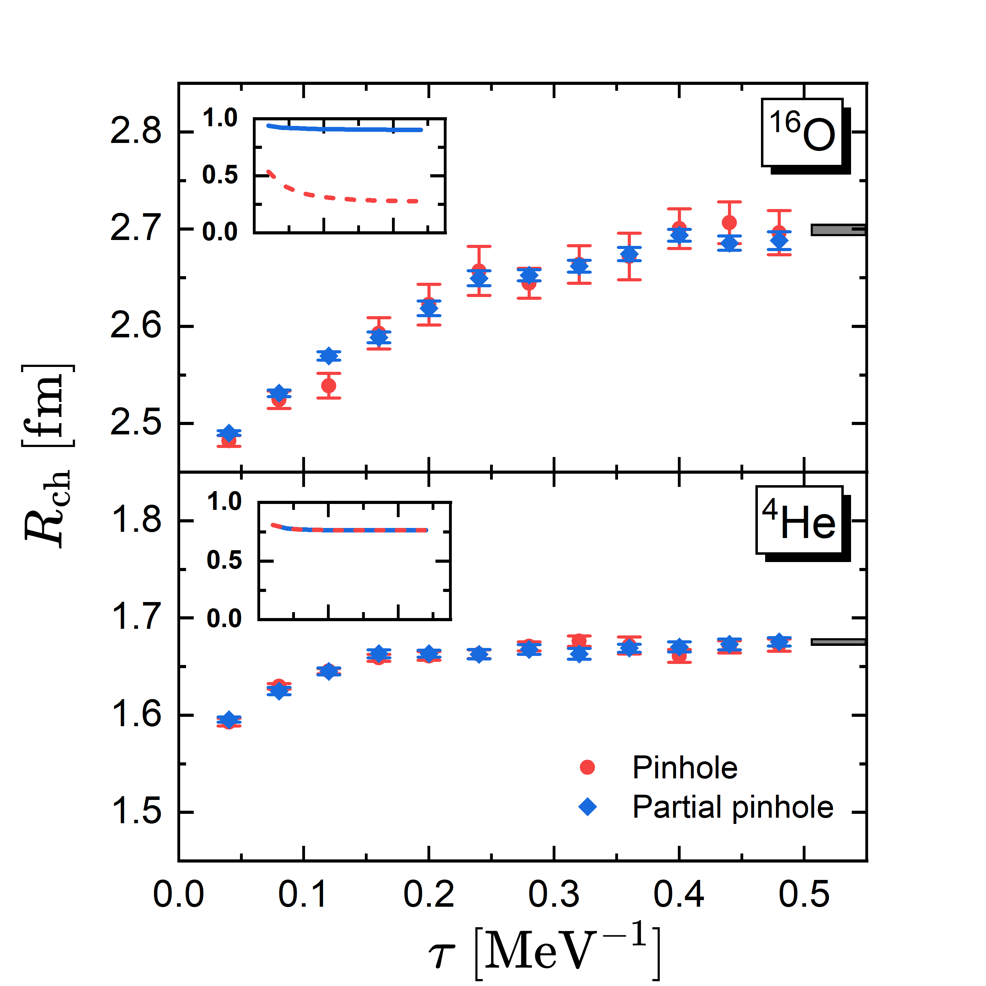
Charge radii for ⁴He and ¹⁶O
Preliminary
Both algorithms yield consistent results, and reproduce the experimental data.
Partial pinhole algorithm significantly reduces the errors for ¹⁶O.

Slide 16
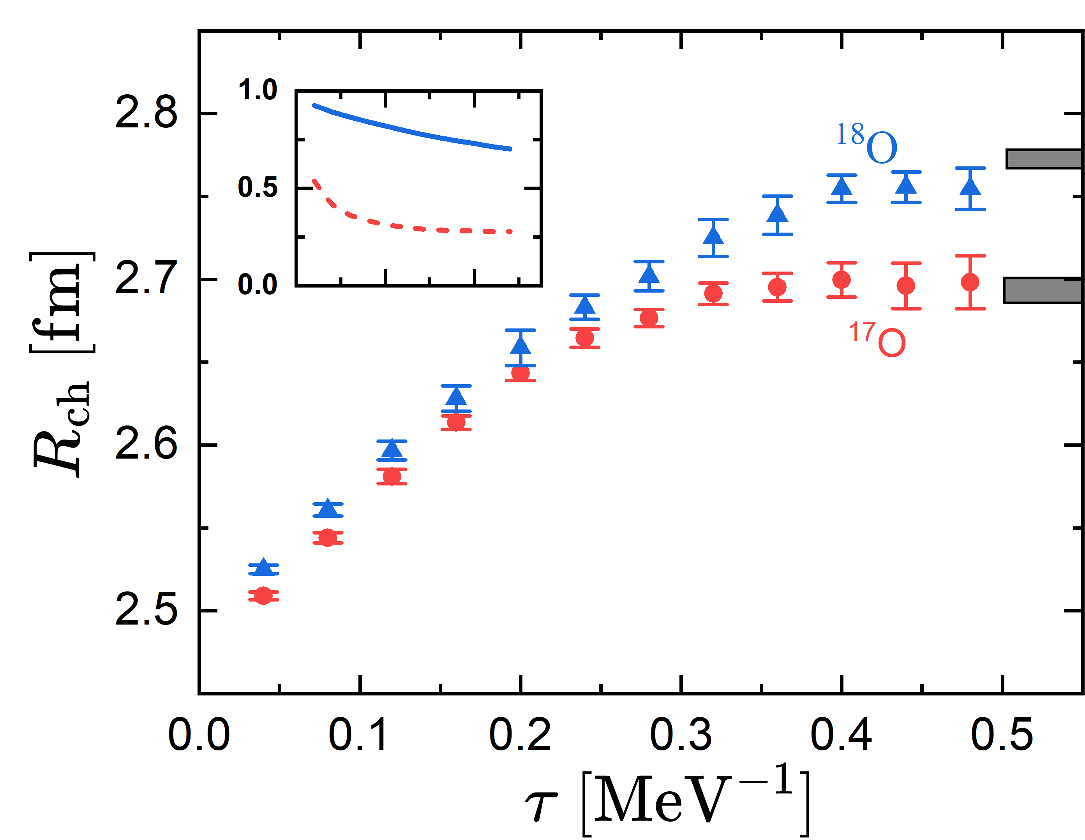
Charge radii ¹⁷O and ¹⁸O
Preliminary
The convergences are reached after $τ=0.4 {MeV}^{−1}$.
The charge radii of oxygen isotopes are well reproduced.

Slide 17
Uncertainty of 3N interactions
In wavefunction matching, the general forms of 3NFs read
Local potentials
Nonlocal potentials
where smeared densities $ρ^{(d)}$ and ${\tilde{ρ}}^{(d)}$ are introduced.
Elhatisari et al., Nature 630, 59 (2024)
To analysis the uncertainty of 3N interactions, 10 groups of 3NFs are fitted with the new technique.
Elhatisari et al., in preparation

Slide 18
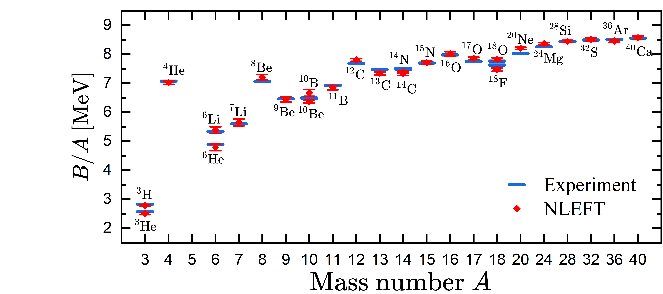
Uncertainty of 3N interactions
Group of 3NFs
$V_{c_{D}}^{(0)}$, $[V_{c_{E}}^{(0)}]_{033}$, $[V_{c_{E}}^{(0)}]_{235}$, $[V_{c_{E}}^{(0)}]_{334}$
$V_{c_{D}}^{(1)}$, $[V_{c_{E}}^{(0)}]_{022}$, $[V_{c_{E}}^{(0)}]_{235}$, $[V_{c_{E}}^{(0)}]_{334}$
$V_{c_{D}}^{(0)}$, $[V_{c_{E}}^{(1)}]_{022}$, $[V_{c_{E}}^{(0)}]_{235}$, $[V_{c_{E}}^{(0)}]_{334}$
$V_{c_{D}}^{(0)}$, $[V_{c_{E}}^{(0)}]_{022}$, $[V_{c_{E}}^{(0)}]_{235}$, $[V_{c_{E}}^{(0)}]_{334}$
$V_{c_{D}}^{(0)}$, $[V_{c_{E}}^{(1)}]_{011}$, $[V_{c_{E}}^{(0)}]_{235}$, $[V_{c_{E}}^{(0)}]_{334}$
$V_{c_{D}}^{(0)}$, $[V_{c_{E}}^{(0)}]_{011}$, $[V_{c_{E}}^{(0)}]_{235}$, $[V_{c_{E}}^{(0)}]_{334}$
$V_{c_{D}}^{(1)}$, $[V_{c_{E}}^{(0)}]_{033}$, $[V_{c_{E}}^{(0)}]_{235}$, $[V_{c_{E}}^{(0)}]_{334}$
$V_{c_{D}}^{(0)}$, $V_{c_{D}}^{(2)}$, $[V_{c_{E}}^{(0)}]_{235}$, $[V_{c_{E}}^{(0)}]_{334}$
$V_{c_{D}}^{(3)}$, $V_{c_{D}}^{(0)}$, $[V_{c_{E}}^{(0)}]_{235}$, $[V_{c_{E}}^{(0)}]_{334}$
$V_{c_{D}}^{(1)}$, $[V_{c_{E}}^{(0)}]_{022}$, $[V_{c_{E}}^{(0)}]_{235}$, $[V_{c_{E}}^{(0)}]_{334}$
Preliminary
The binding energies from ³He to ⁴⁰Ca are well reproduced by 10 groups of 3NFs.

Slide 19
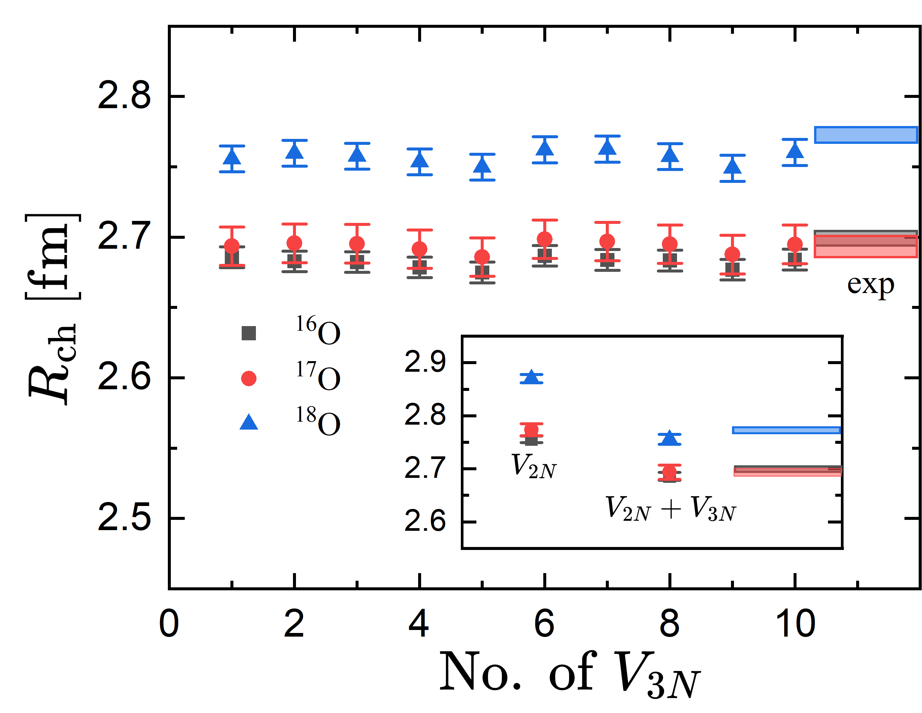
Uncertainty of 3N interactions
Preliminary
All 10 groups of 3NFs could reproduce the charge radii of oxygen isotopes, especially the remarkable increase of ¹⁸O compared to ^{16,17}O.
3NFs reduce the charge radii and make results closer to experimental data.

Slide 20
Summary and Perspectives
Summary
A novel method, partial pinhole algorithm, is proposed to calculate charge radii.
Compared to pinhole algorithm, sign oscillation is significantly reduced, especially for heavier nuclei.
Combined with wavefunction matching, the charge radii of oxygen isotopes are well reproduced at N3LO, where the uncertainties of 3NFs are found to be small.
Perspectives
Applying partial pinhole algorithm for other observables, e.g., nuclear electromagnetic transition rates.
Shen et al., arXiv:2411.14935.
Combined with perturbative quantum Monte Carlo method.
Lu et al., PRL 128, 242501 (2022)
The charge radii of oxygen isotopes beyond ¹⁸O.

Slide 21
THANK YOU!

Slide 22
Radius from partial pinhole
RMS radius
c.m.
c.m.
$$n$$
$$n’$$
$$n$$
$$n’$$

Slide 23
Reference point
To ensures that the lattices in a periodic box could be symmetric with respect to the reference point $n_{0}$, we should distinguish the parity of box size $L$:
For $L=odd$, reference point should locate on the lattice site;
For $L=even$, reference point should be in the center of a unit cell.
$$n_{0}$$
$$n_{0}$$
The reference point $n_{0}$ is then determined by minimizing the loss function,

Slide 24
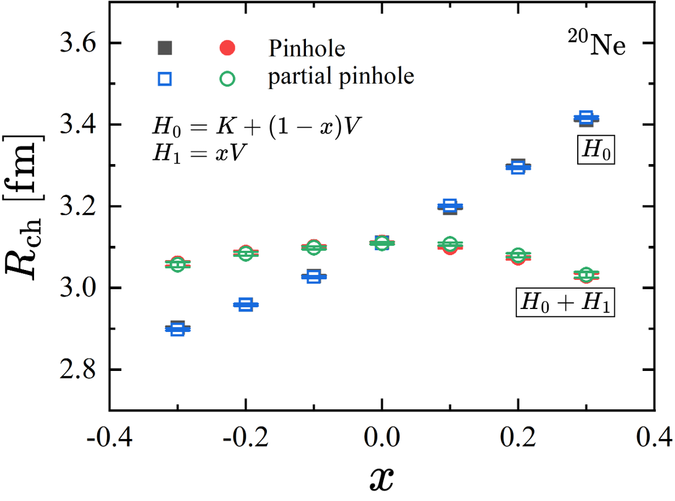
Results for ²⁰Ne: L = 9

Slide 25
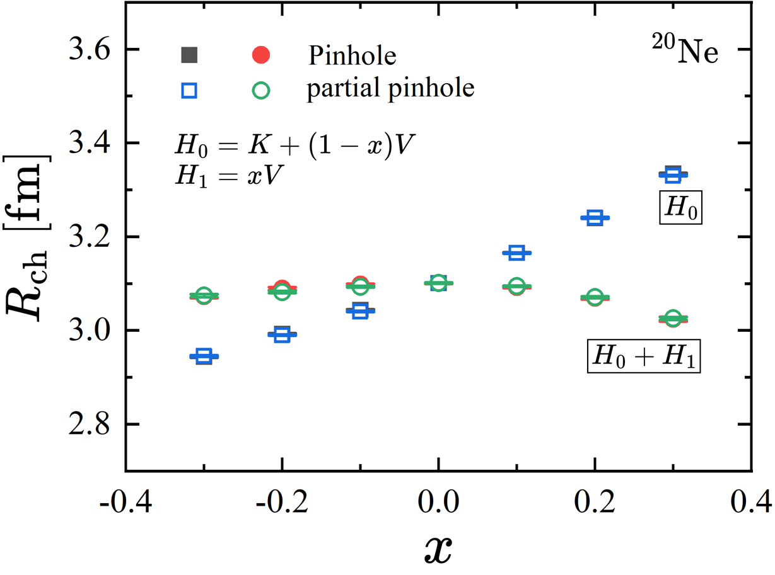
Results for ²⁰Ne: L = 8

Slide 26
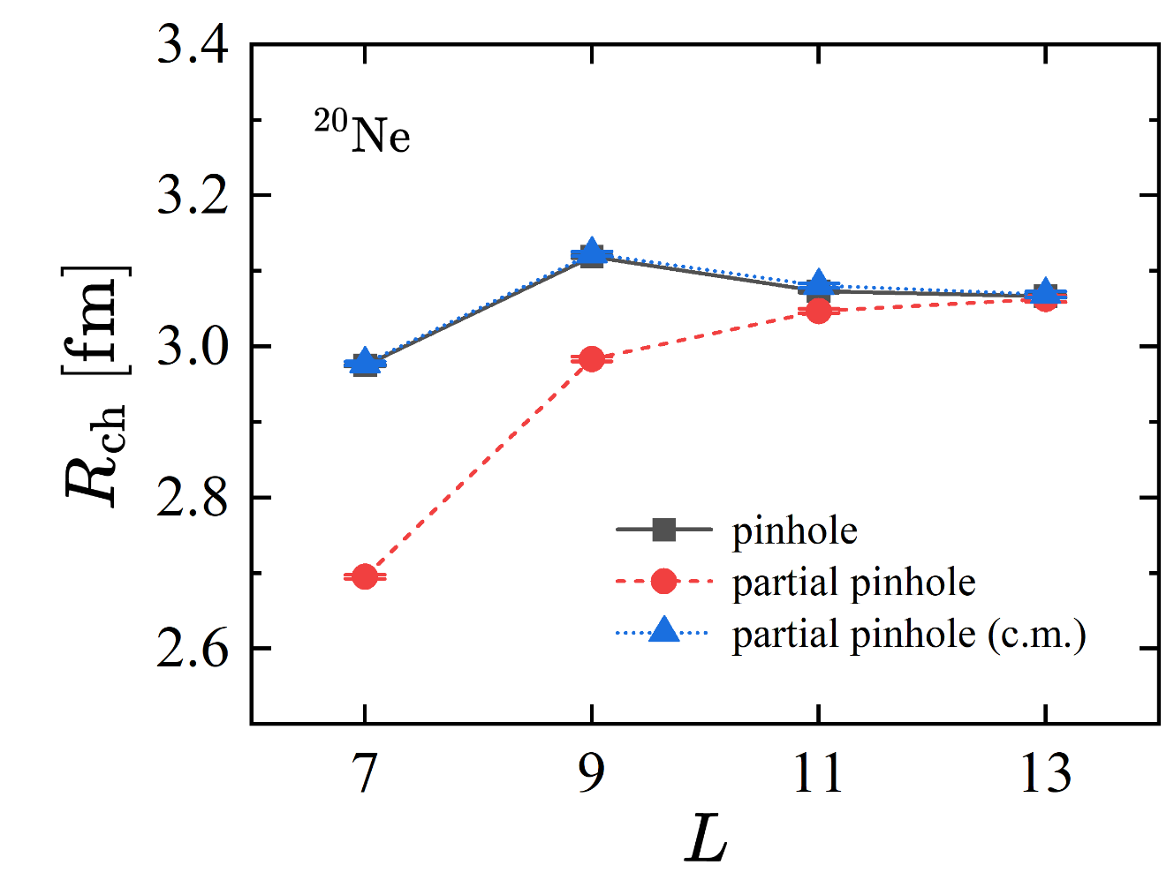
Results

