Slide 1
探测器总图进展
2025-01-06

Slide 2
机械三维总图进展
 | Detector | Detector structure | Connection structure | Arrangement of cooling pipe and cable
Barrel detector | Barrel Yoke | √ | √ | Optimization in progress
 | Magnet | √ | Optimization in progress | √
 | Barrel HCAL | √ | √ | √
 | Barrel ECAL | Optimization in progress | √ | Optimization in progress
 | Barrel OTK | √ | √ | √
 | TPC | √ | √ | Optimization in progress
 | ITK | √ | √ | √
 | Beampipe (Vertex+LumiCAL) | √ | √ | Optimization in progress (Vertex)
End detector | End Yoke | √ | √ | Optimization in progress
 | End HCAL | √ | √ | √
 | End ECAL | √ | √ | √
 | End OTK | √ | √ | Optimization in progress

Slide 3
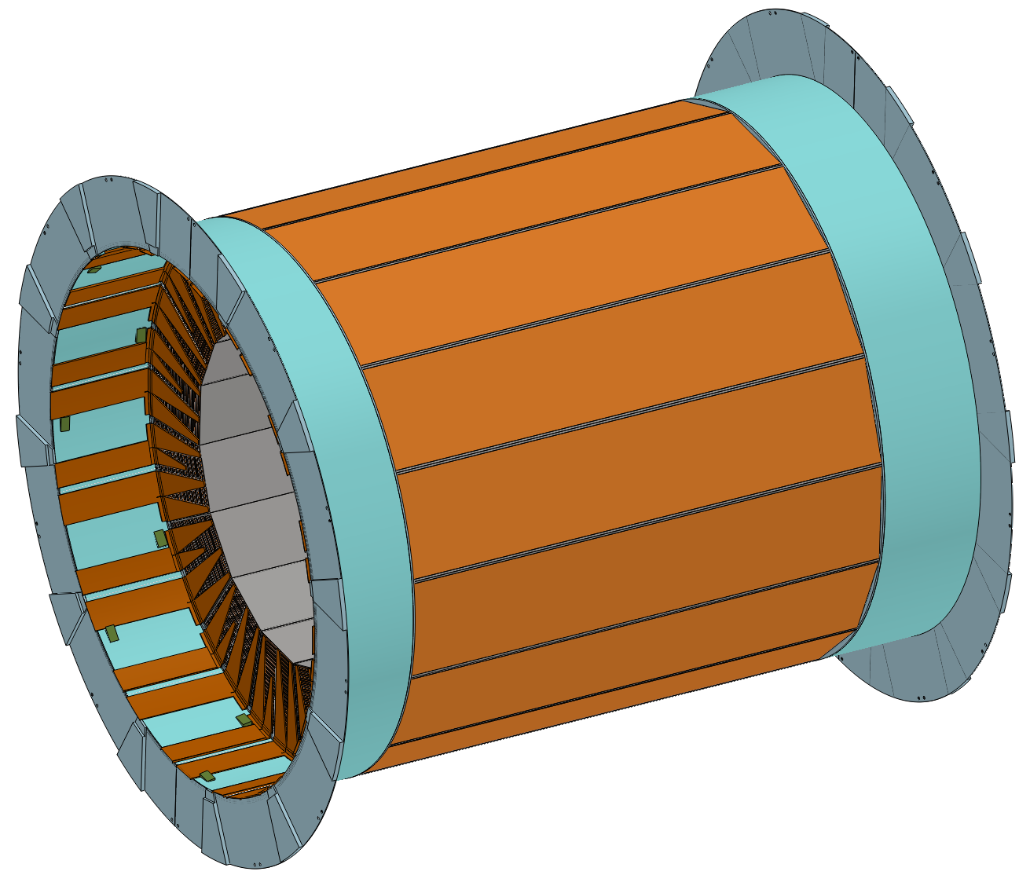
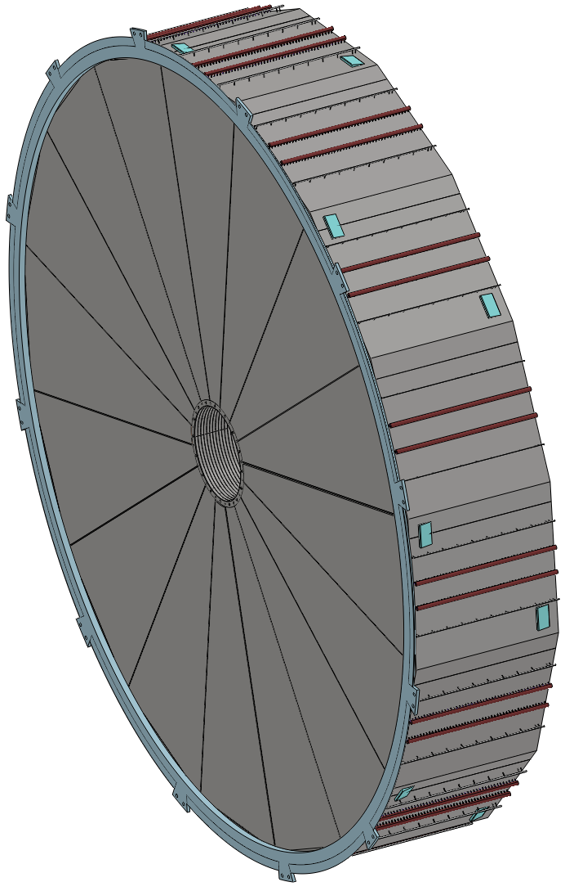
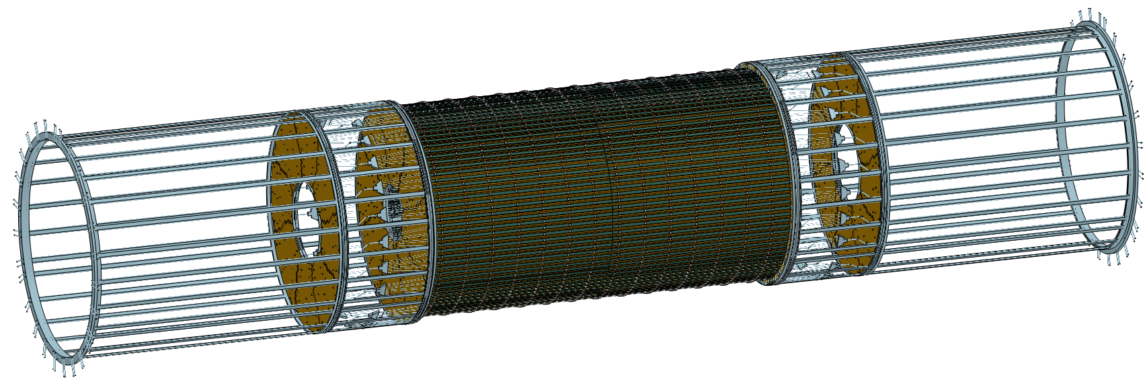
机械三维总图更新
更新
1)桶部HCAL结构简化
2)端部HCAL结构简化
3)ITK结构简化

Slide 4
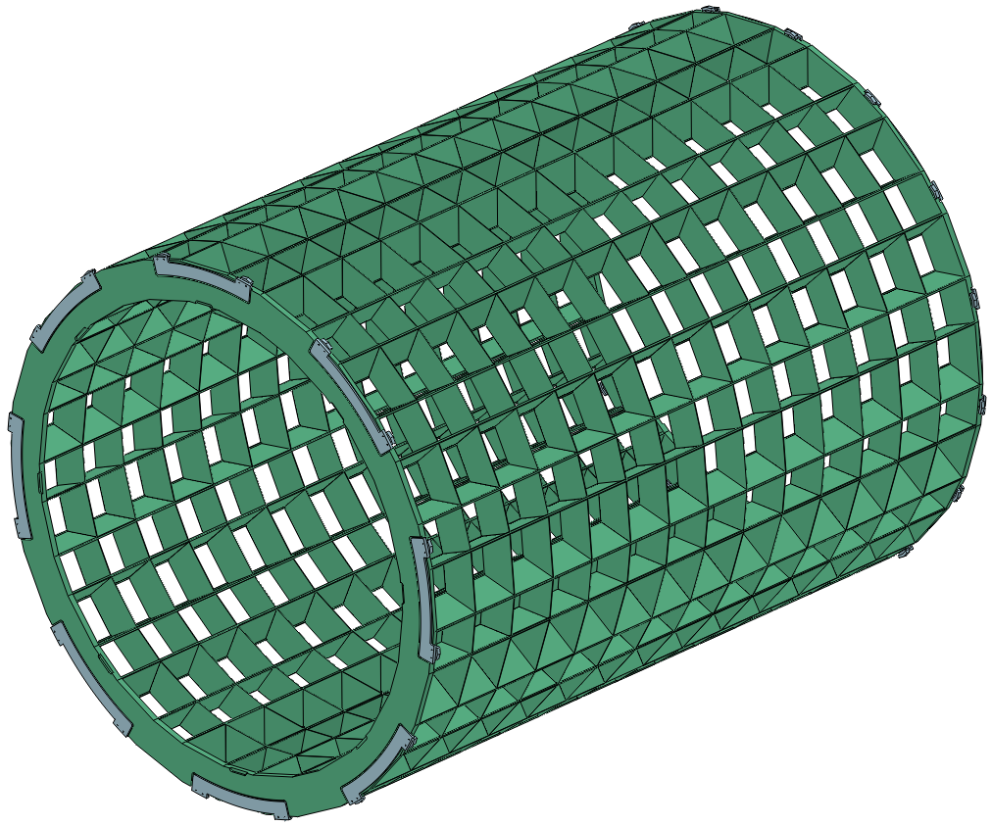
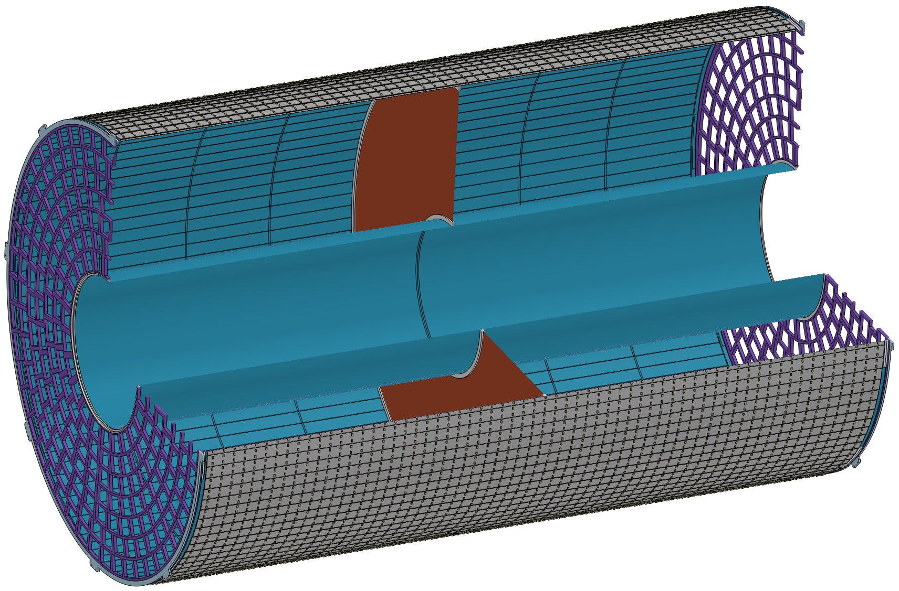
机械三维总图
缺少的部分
1)TPC端部结构与管线排布
2)桶部ECAL的结构还需优化

Slide 5
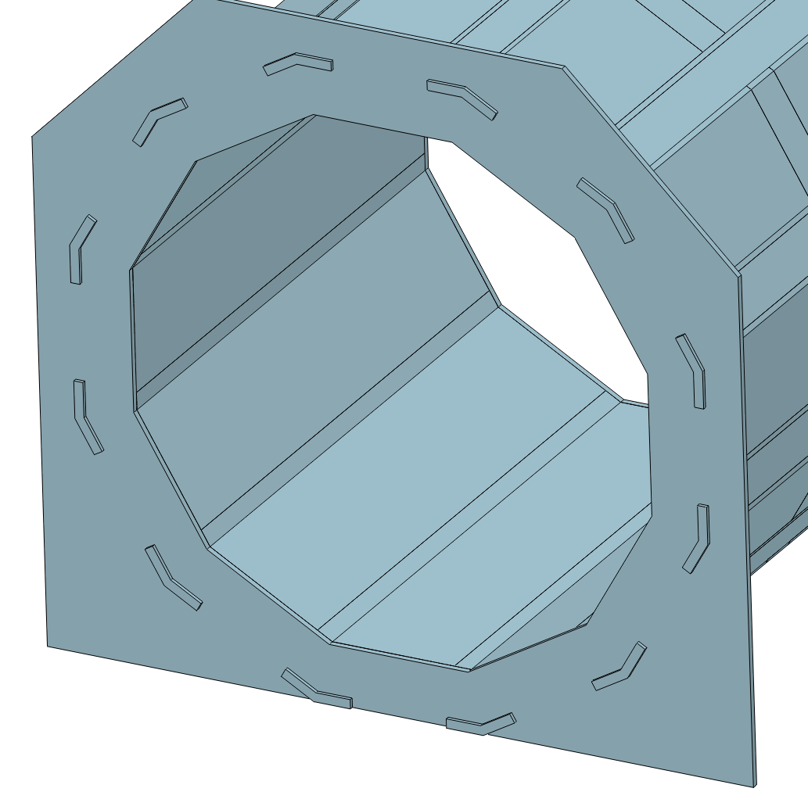
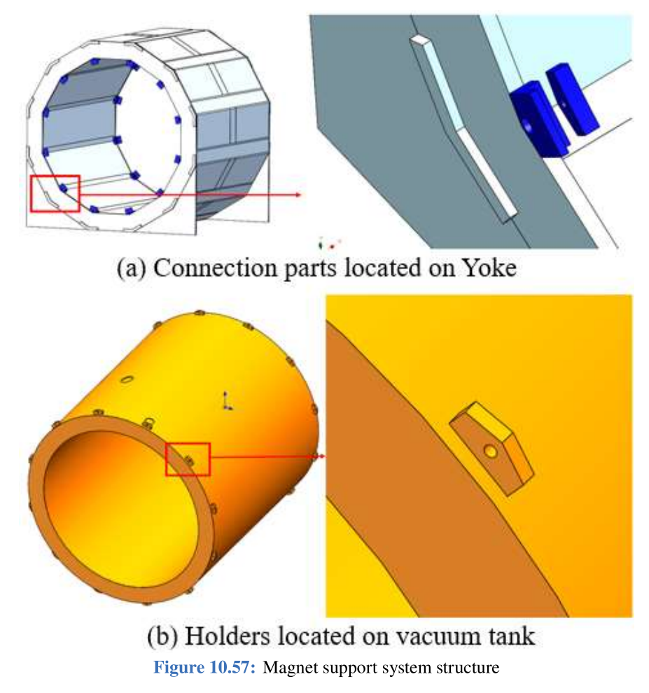
机械三维总图
存在的问题
1)超导磁体与桶轭的连接结构与轭铁的安装干涉

