Slide 1




Neutrino Interactions
LU Xianguo 卢显国
University of Warwick
2nd JUNO Neutrino Summer School
2025 August 23, Hangzhou

Slide 2
Accelerator and Atmospheric Neutrinos
Part 2: The More Interesting Part
LU Xianguo 卢显国
University of Warwick
2nd JUNO Neutrino Summer School
2025 August 23, Hangzhou

Slide 3
Outline
Experimental Techniques
  Standard-Model ν interactions
  Detectors
  MINERvA highlights
Nuclear Effects
  Structure
  Dynamics
TKI Phenomenology
  Key variables
  Current results
Quizzes and Homework are again prepared. Number of * (0-3) indicates the difficulty.

Slide 4
Great lectures on neutrinos if you want to dive into the subject
Steve Boyd, University of Warwick, Neutrino Physics Lectures, Warwick Week, 2025
Great text on nuclear, particle, and neutrino physics
Mohapatra, R. N., Pal, P. B. (2004). Massive Neutrinos in Physics and Astrophysics. India: World Scientific.
Giunti, C., Kim, C. W. (2007). Fundamentals of Neutrino Physics and Astrophysics. United Kingdom: OUP Oxford.
Povh, B., Rith, K., Scholz, C., Zetsche, F., Rodejohann, W. (2015). Particles and Nuclei: An Introduction to the Physical Concepts. Germany: Springer Berlin Heidelberg. 7th Ed.
Donnelly, T. W., Formaggio, J. A., Holstein, B. R., Milner, R. G., Surrow, B. (2017). Foundations of Nuclear and Particle Physics. United Kingdom: Cambridge University Press.
Zuber, K. (2020). Neutrino Physics. United Kingdom: CRC Press. 3rd Ed.
Rubbia, A. (2022). Phenomenology of Particle Physics. United Kingdom: Cambridge University Press.

Slide 5
Part 1: Experimental Techniques

Slide 6
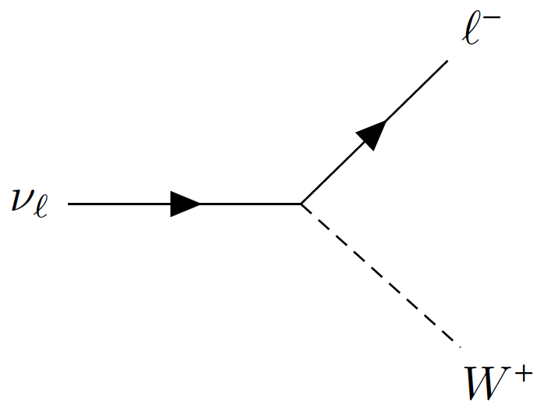

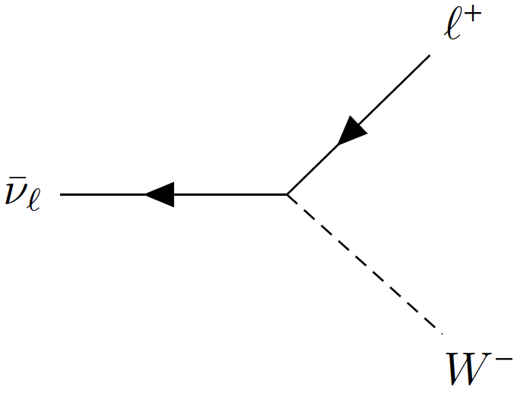
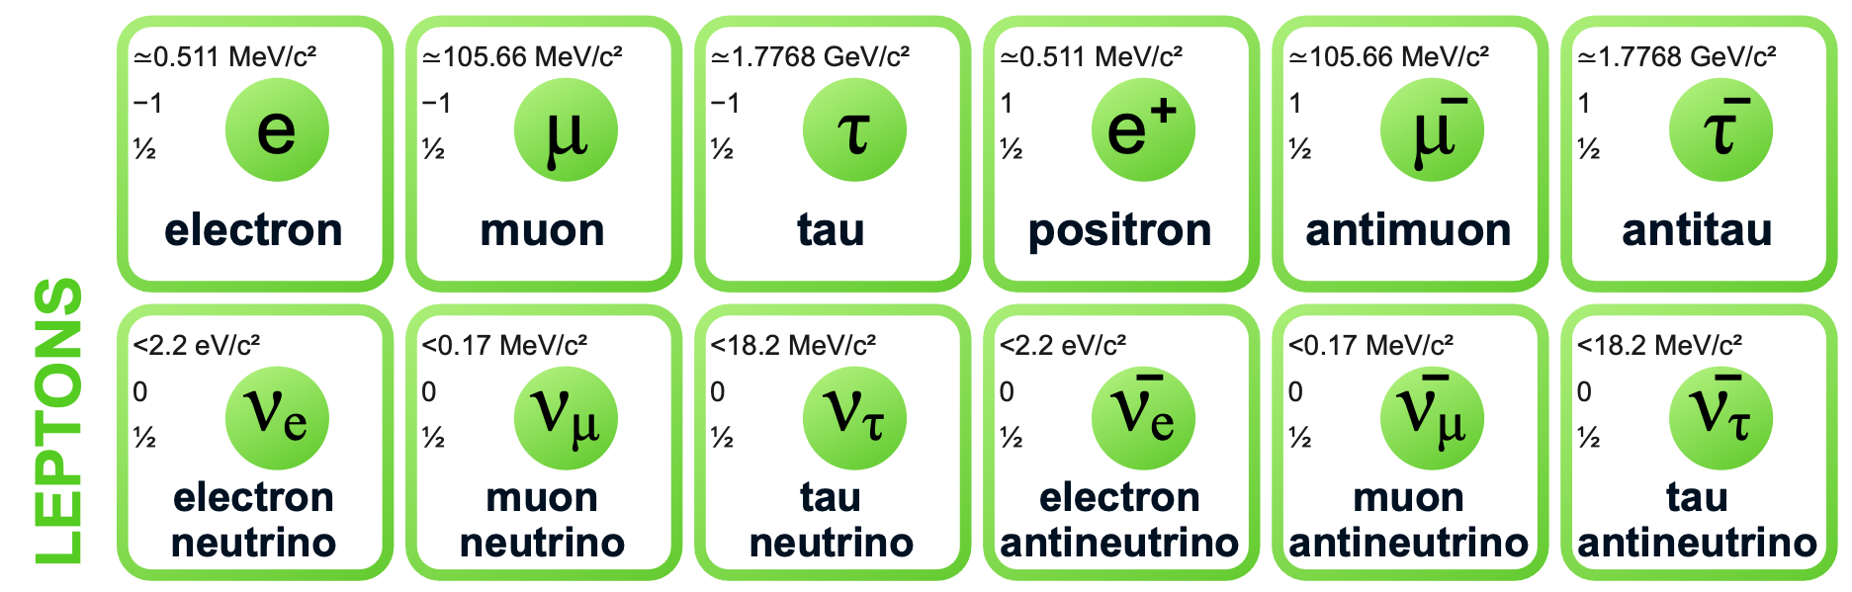
Starting point for neutrino interaction …
… done with BSM yesterday
Neutrinos and antineutrinos in Standard Model
Charge neutral
Massless
How can we tell all 6 of them apart?
Flavour, defined by charged-current interactions
0
0
0
0
0
0

Slide 7
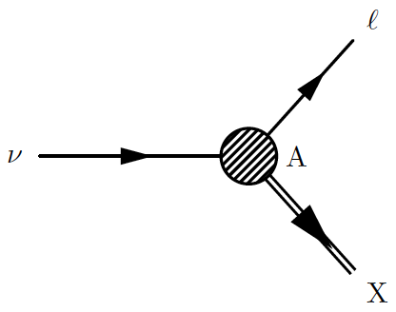
Charged lepton
— easy detection
— flavour oscillation tagging
Incoming neutrinos and antineutrinos
Target nucleus
Out-going hadrons

Slide 8
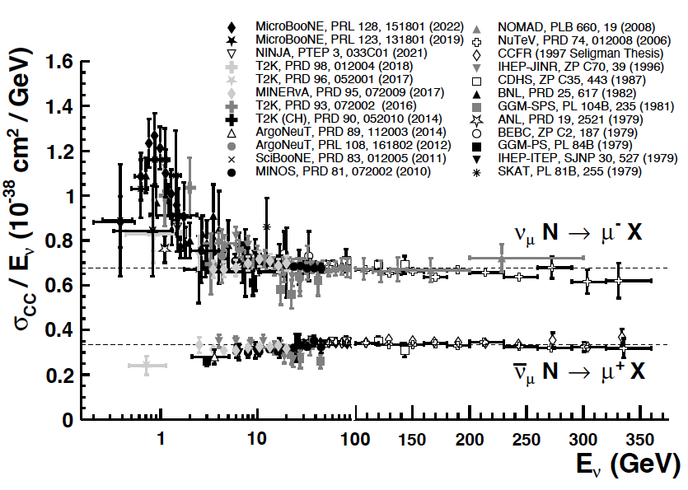
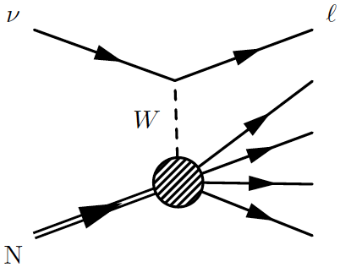
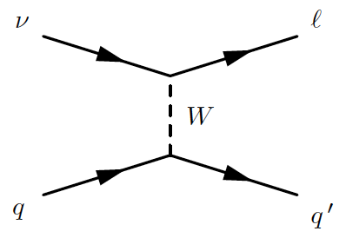
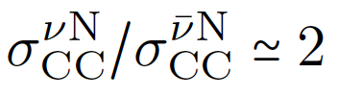
PDG, PTEP 2022, 083C01 (2022)
Deep Inelastic Scattering (DIS)
Homework**: Explain at high energy.
At high energy, ν interacting with quarks, $σ\sim E_{ν}$

Slide 9
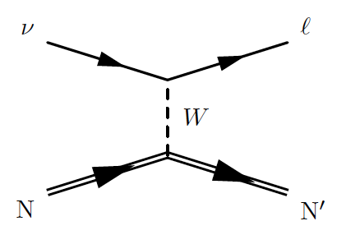
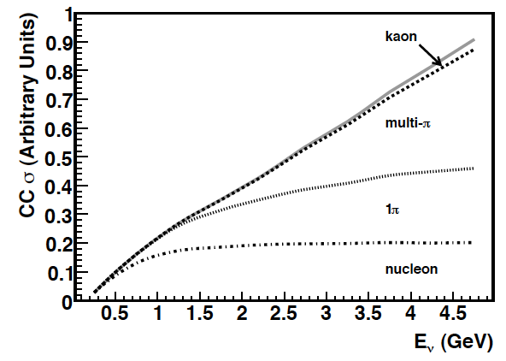
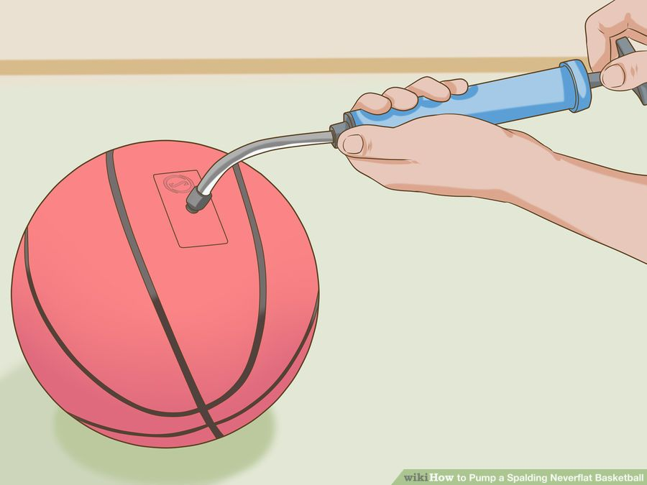
Homework: Calculate the energy threshold of ν_{e} and ν_{μ} CCQE scattering on nucleons.
Quasielastic (QE)
Formaggio & Zeller, Rev. Mod. Phys. 84, 1307 (2012)
Final-state lepton takes away energy excess
σ_{QE} starts to saturate at 1 GeV
ν
l
N
Source: http://www.wikihow.com/Pump-a-Spalding-Neverflat-Basketball

Slide 10
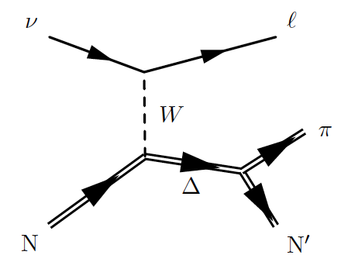
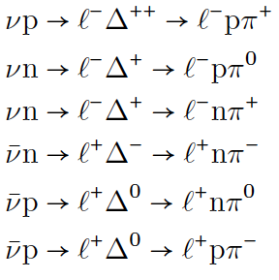
Homework*: Using isospin arguments (CG coefficients), show that the cross-section ratio between is 9:2:1 (assuming Δ dominance).
Resonant production (RES)
Formaggio & Zeller, Rev. Mod. Phys. 84, 1307 (2012)
Other resonances, e.g. N*
Non-resonant diagrams
Homework: Check the quantum numbers and quark contents of Δ and N* on PDG (Google “pdg delta resonance”; navigate https://pdg.lbl.gov/).

Slide 11
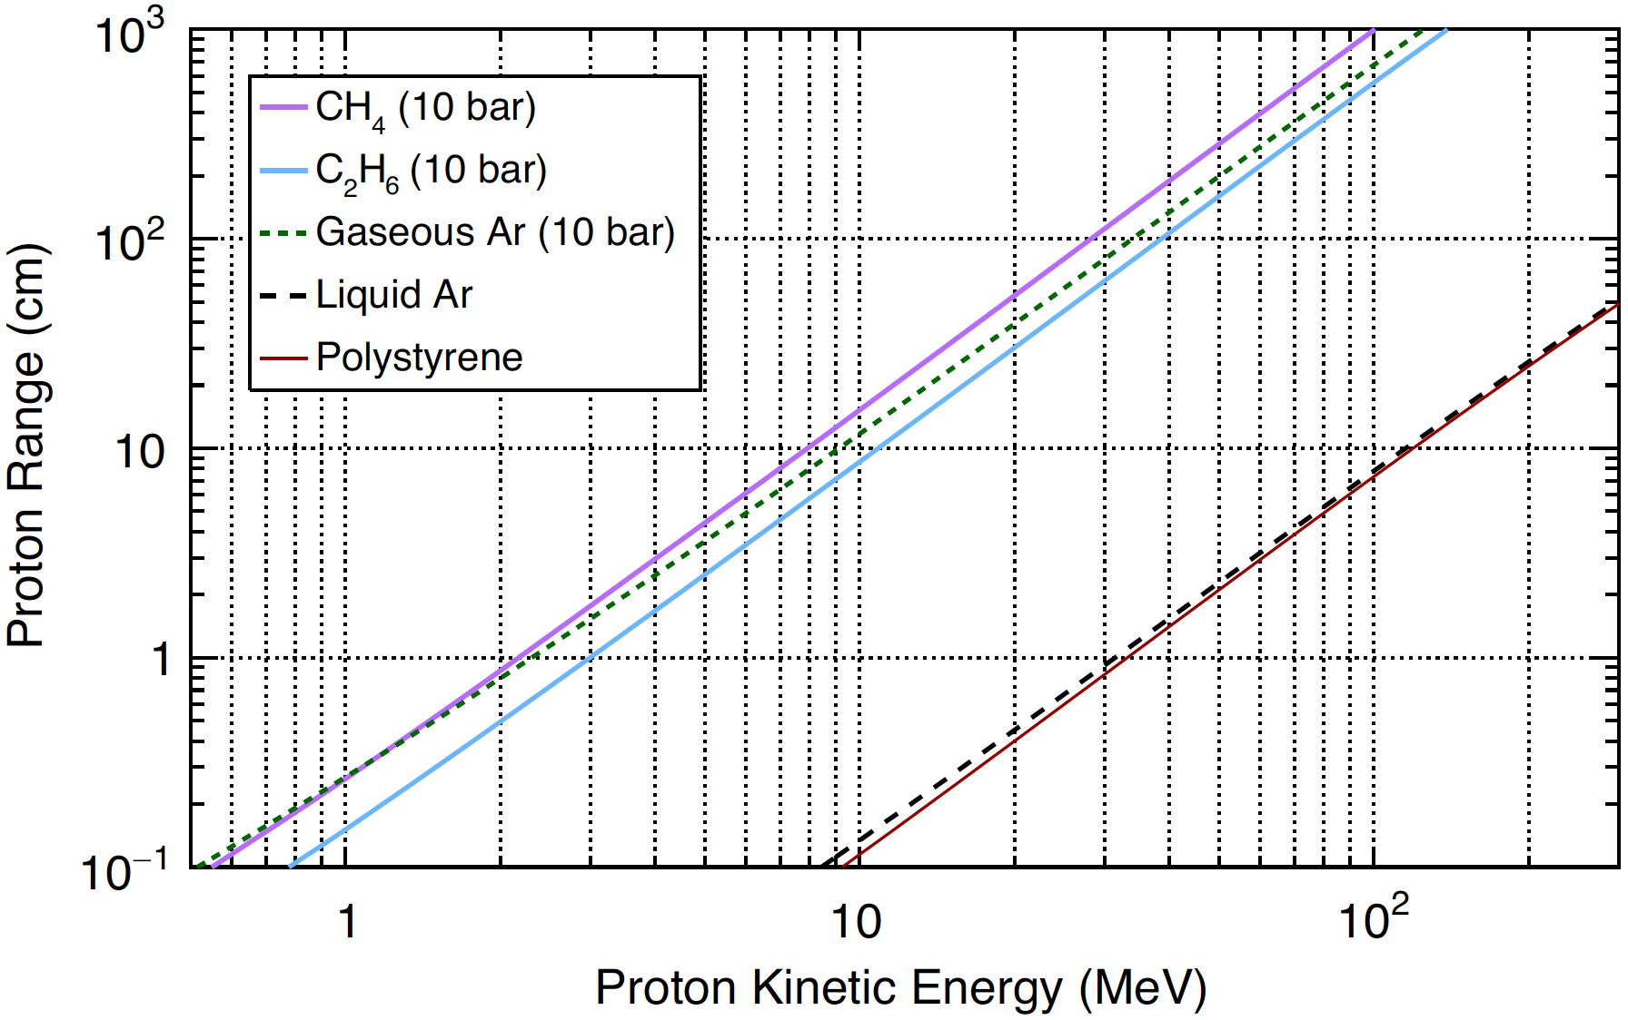

Sensing $ν$ interactions
Homework: Calculate proton momentum for 10 MeV and 100 MeV kinetic energy.
Embedded in detector, incomplete particle information
Tracking/Cherenkov threshold
Angular acceptance
Particle Identification (PID)
Neutrals
Noise
Quiz: Air density at STP in kg/m³? What about water (in its usual liquid condition)?
Proton Range (Range: how far a particle can travel in a medium)
vs
Kinetic Energy
A: 10³ B: 1 C: 10⁻³
Hamacher-Baumann, Lu, and Martín-Albo, Phys. Rev. D 102, 033005 (2020)
Quiz: Density ratio between liquid air and water (at their own conditions)? What about polystyrene (a kind of plastics) vs. water?
A: 10 B: 1 C: 0.1
Sensor granularity
~ mm-cm
10 bar gas
Tracking threshold
(no momentum measurement possible below it)
~ few MeV for 10 bar gas
~ 10s MeV for liquid/solid
liquid/solid

Slide 12
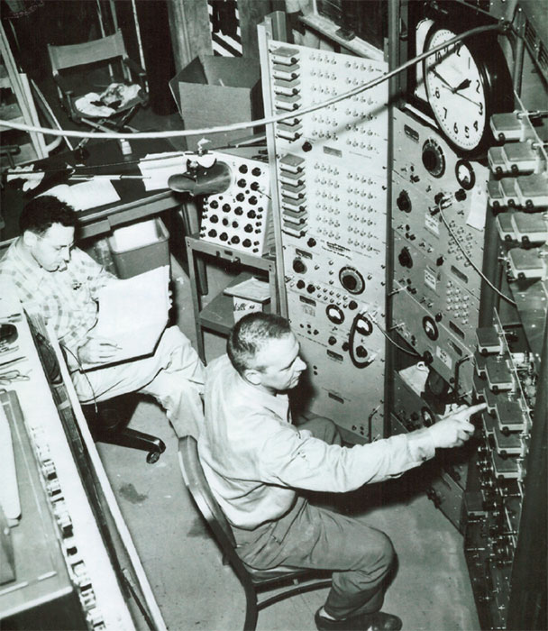
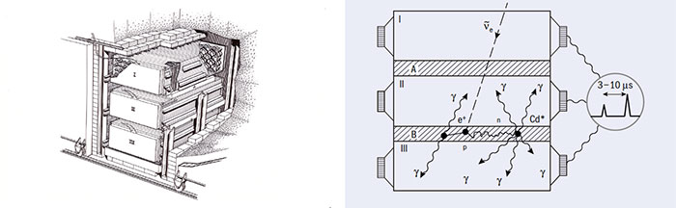
Nuclear reactor
MeV antineutrinos
Liquid scintillator
Water doped w/ cadmium
https://cerncourier.com/a/ghosts-in-the-machine/
Cowan–Reines Experiment, 1956
The first observation of neutrino interactions
Before that:
Some hand-waving and rough calculations led me to conclude that the bomb was the best source. –Reines, 1951

Slide 13
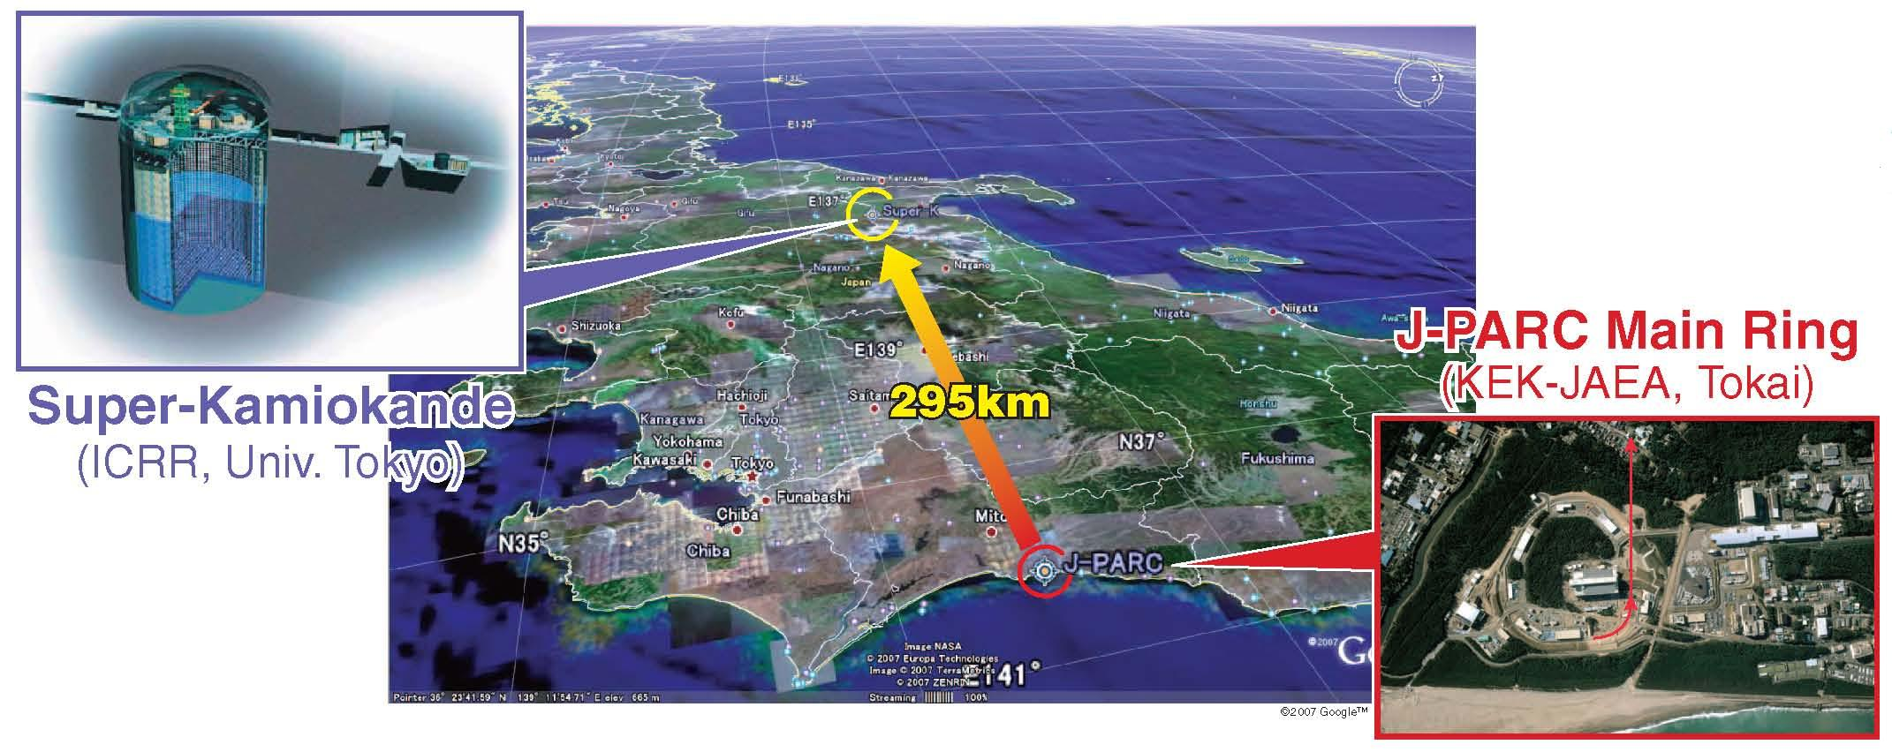
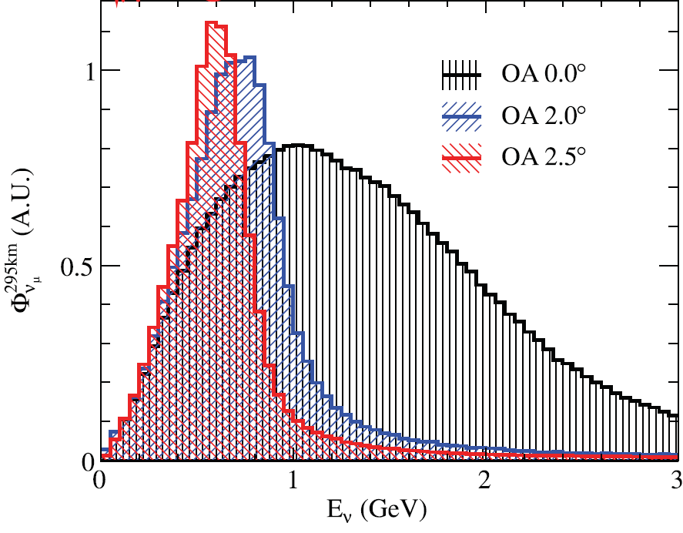
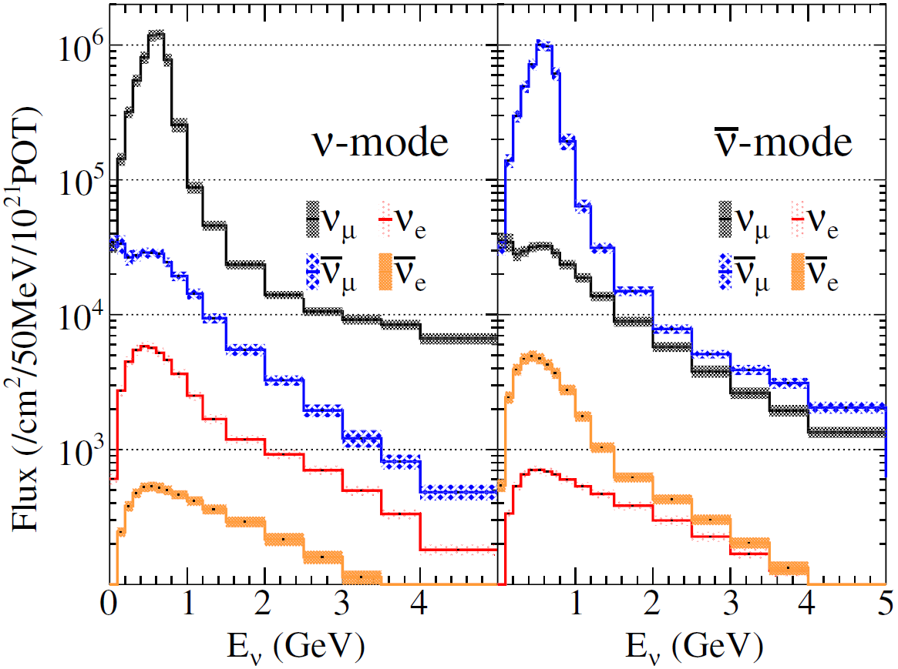
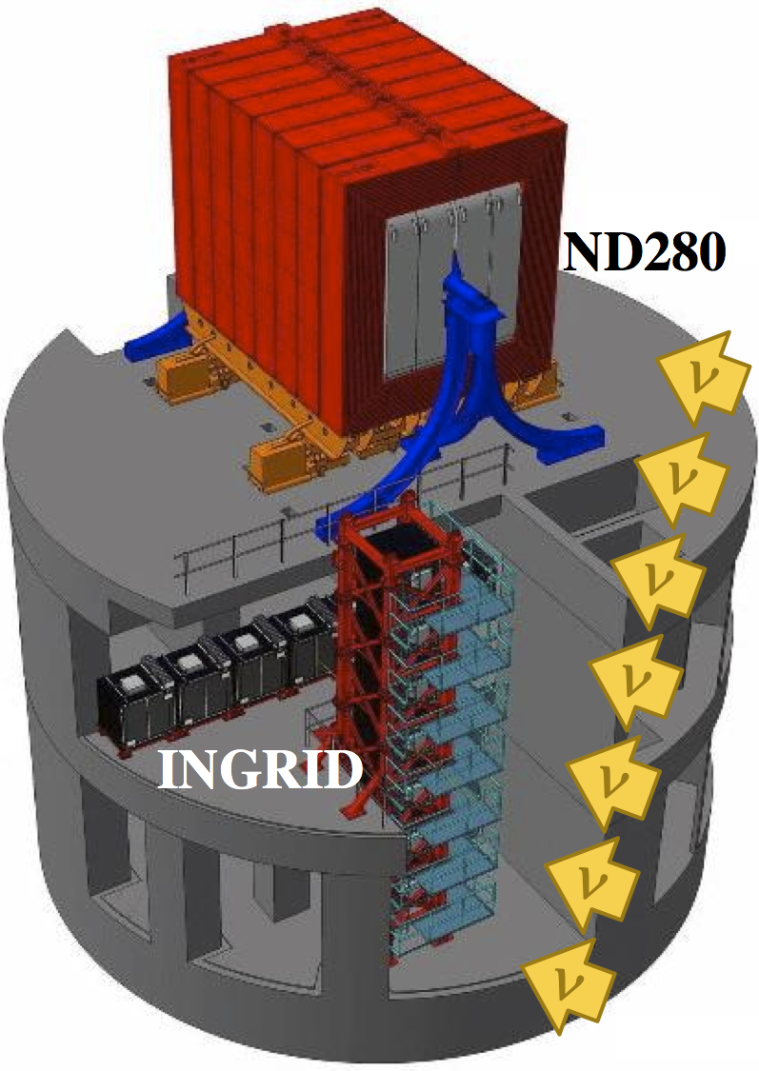
Neutrino Experiments Nowadays
T2K
T2K, Phys. Rev. D 87, 012001 (2013)
Far Detector
T2K
T2K, Phys.Rev.Lett. 116, 181801 (2016)
… we are done with the flux and oscillation measurements
Let’s look at the detectors today…
Near Detector

Slide 14
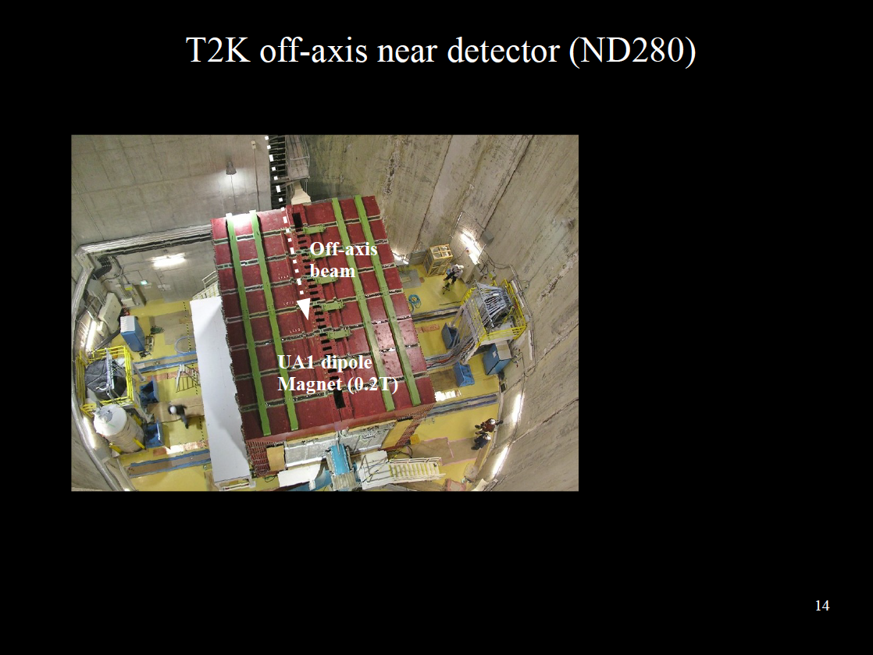
T2K

Slide 15
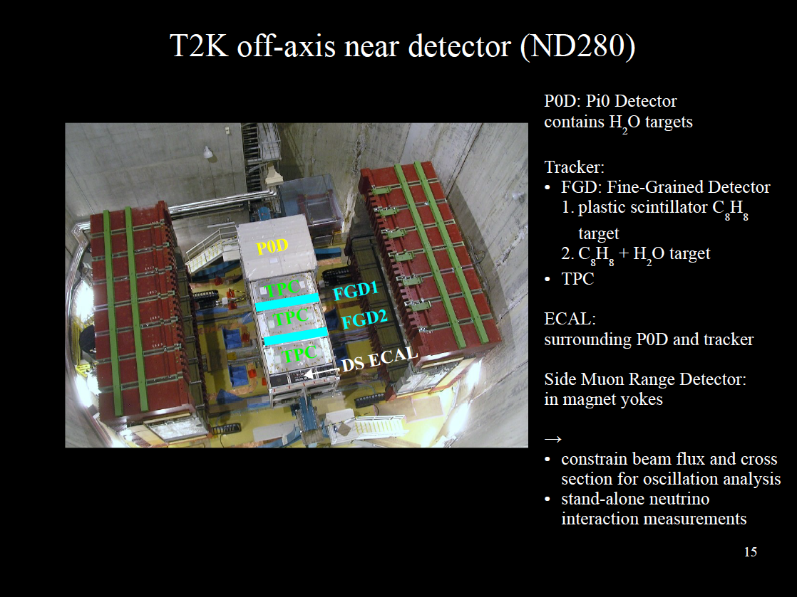
T2K

Slide 16
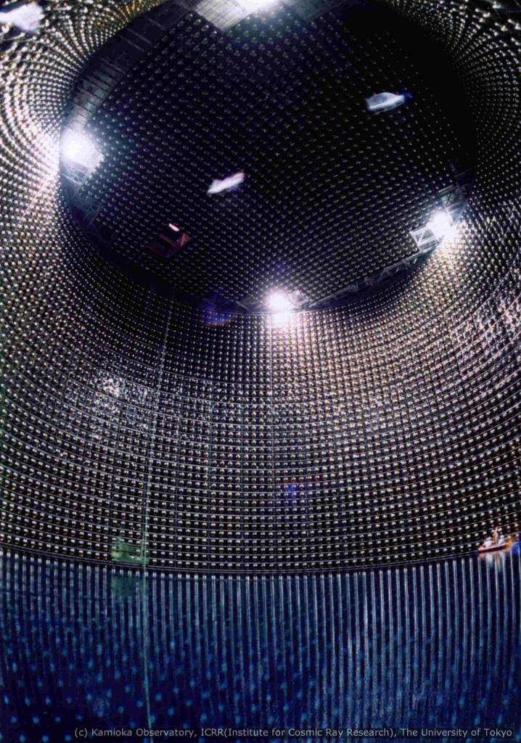
Water Cherenkov detector
T2K
50 kt water Cherenkov
11129 20-inch PMTs in inner detector; 1885 8-inch PMTs in outer veto detector
  time and amplitude of Cherenkov light
Quiz:
Assuming height=diameter, what is the diameter of the 50kt-water tank in meters?
Source: http://www-sk.icrr.u-tokyo.ac.jp/sk/detector/image-e.html

Slide 17
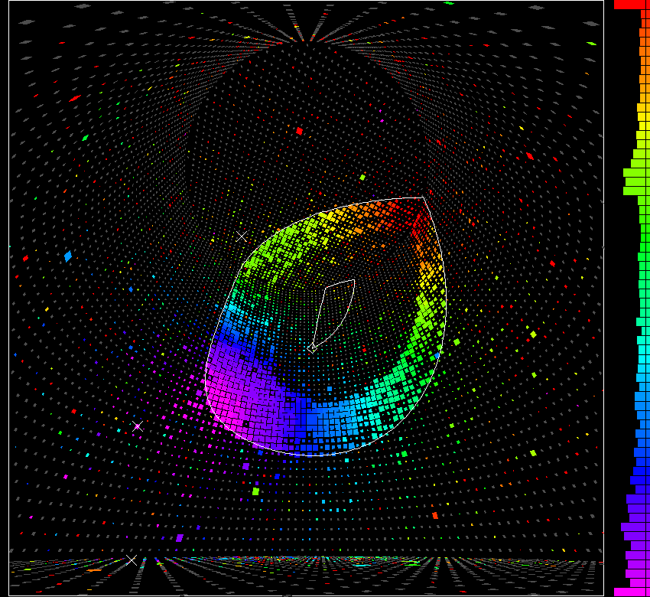
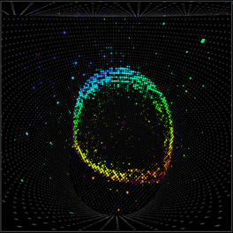
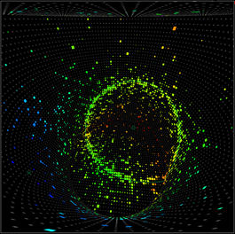
Water Cherenkov detector
T2K far detector:
Super-Kamiokande
μ±
SuperK
e±
Homework: Calculate the Cherenkov light threshold (in total energy, kinetic energy, and momentum) for e, μ, π⁺, K⁺, p, τ.
Source: http://www.ps.uci.edu/~tomba/sk/tscan/th

Slide 18
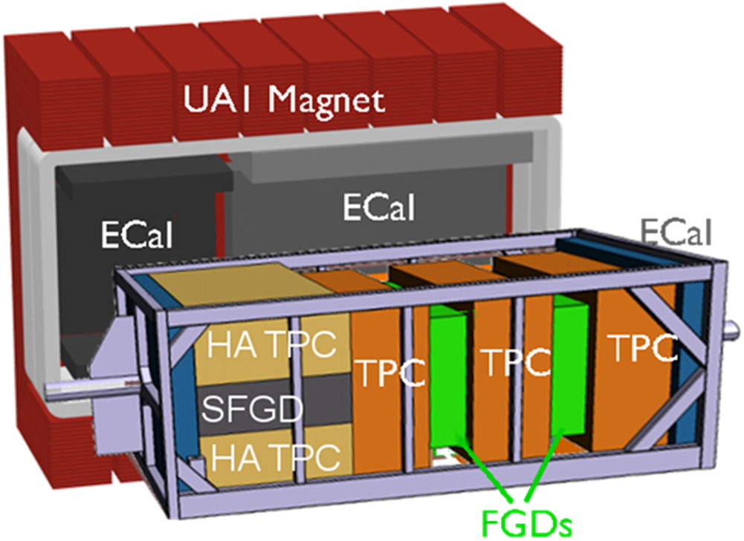
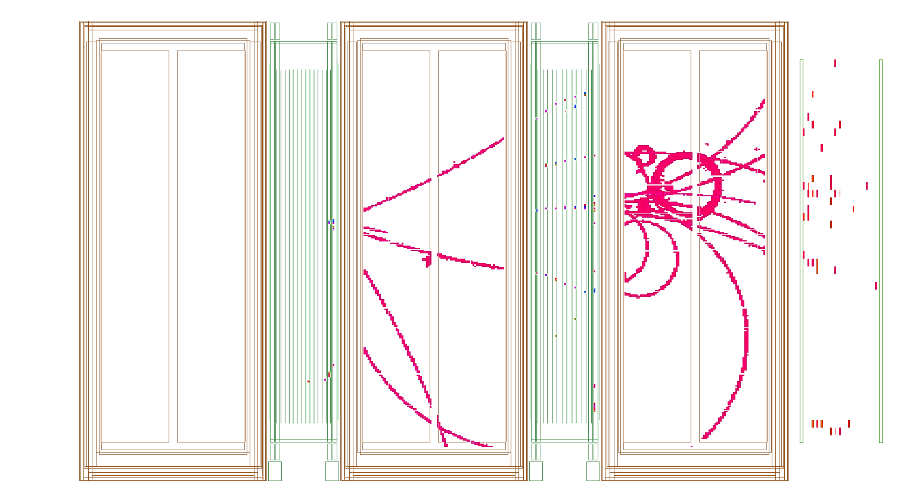
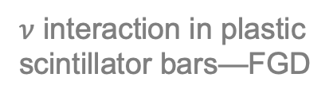
Detector
T2K Near Detector ND280
FGD (Fine-Grained Detector) planes of few-cm-thick bars
T2K
$ν$ interaction in plastic scintillator bars—FGD
T2K, arXiv:1901.03750
T2K, Nucl. Instrum. Meth. A 659, 106 (2011)

Slide 19
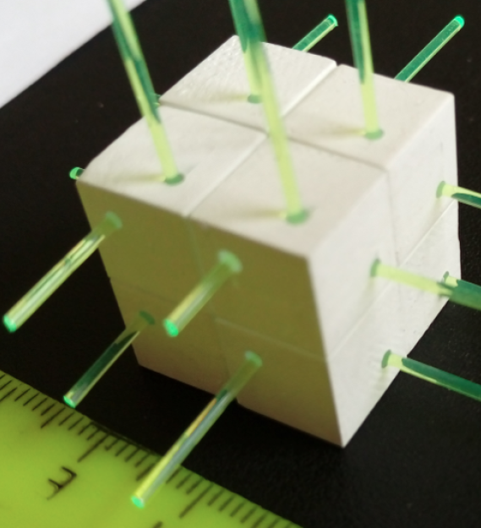

Detector
Plastic scintillator tracker
Also active target
  Tracking + calorimetry
T2K Near Detector ND280
FGD (Fine-Grained Detector) planes of few-cm-thick bars
T2K Upgrade sFGD
  Homogeneous 4$π$ acceptance
  Lower tracking threshold
  Much improved exclusivity
Exclusivity: to measure all final states (except nuclear remnant)
$ν$ interaction in plastic scintillator bars—FGD
ND280 Upgrade
sFGD (SuperFGD) 1-cm³ cube
T2K, arXiv:1901.03750
Blondel et al. JINST 13, P02006 (2018)
T2K, Nucl. Instrum. Meth. A 659, 106 (2011)

Slide 20
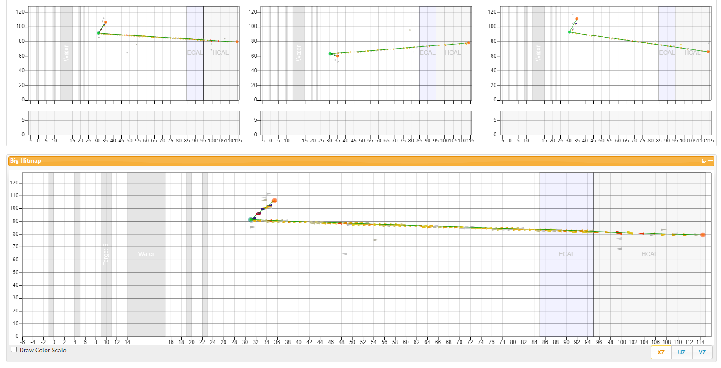
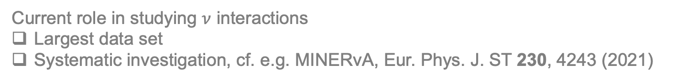



Detector
Plastic scintillator tracker
Also active target
  Tracking + calorimetry
Current role in studying $ν$ interactions
Largest data set
Systematic investigation, cf. e.g. MINERvA, Eur. Phys. J. ST 230, 4243 (2021)
Typical event display w/ plastic scintillator tracker
MINERvA
p
MINERvA
$$μ^{−}$$
$$ν {}_{}^{12}C→μ^{−}p$$
$$ν {}_{}^{12}C→μ^{−}p π^{0}$$

Slide 21
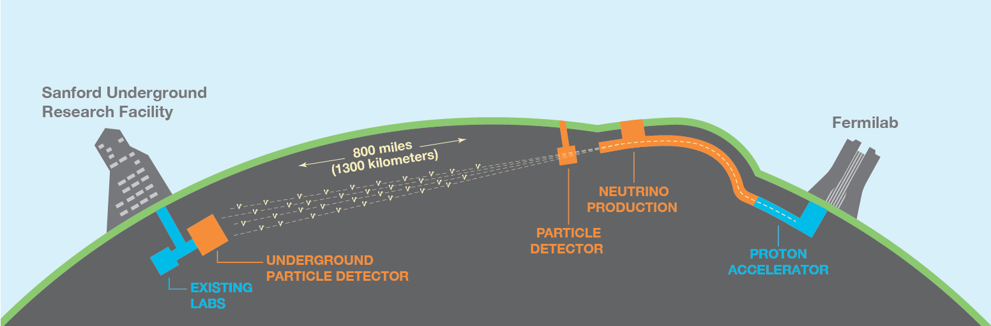
Detector
DUNE
FD (Far Detector)
  LArTPC (Liquid Argon TPC)
  Mass-scalable (~10kt) for tracking + calo
Quiz: What is Earth’s diameter in unit of DUNE’s baseline?
A: 100 B: 50 C: 10
DUNE
https://www.dunescience.org/

Slide 22
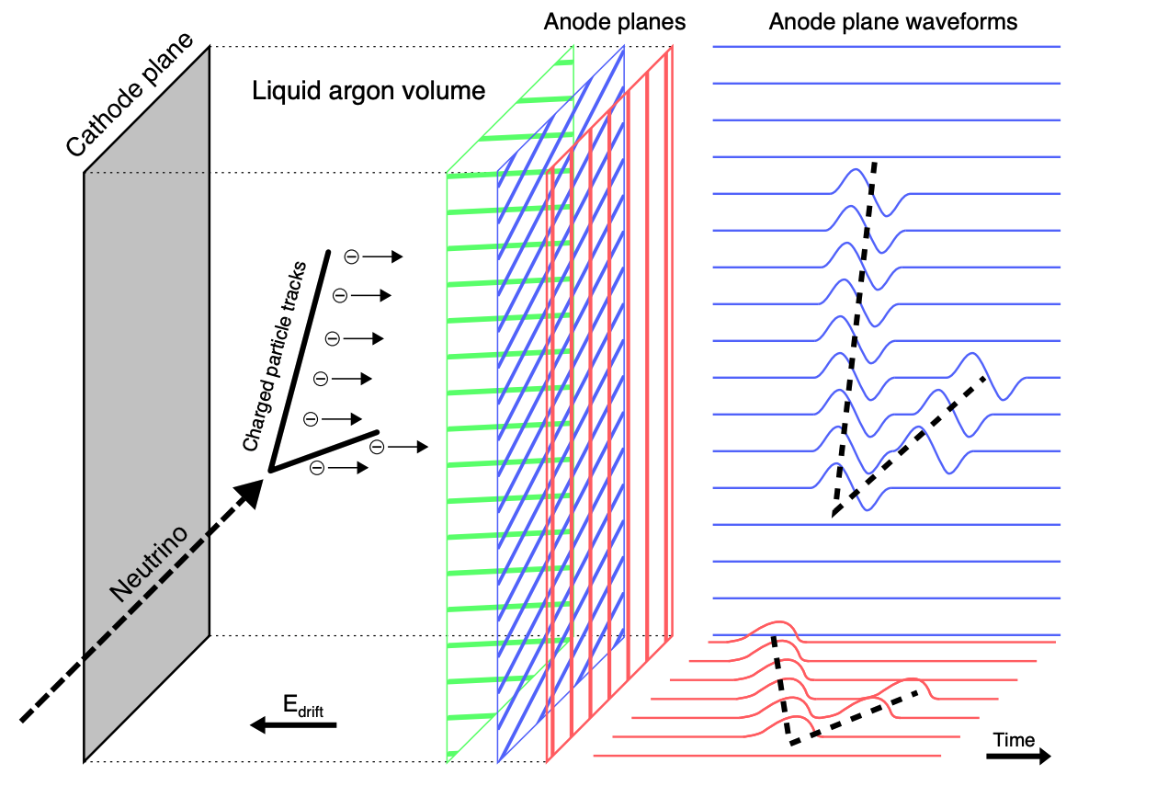
Time Projection Chamber (TPC)
Detector
Vermeulen, FERMILAB-THESIS-2021-05

Slide 23
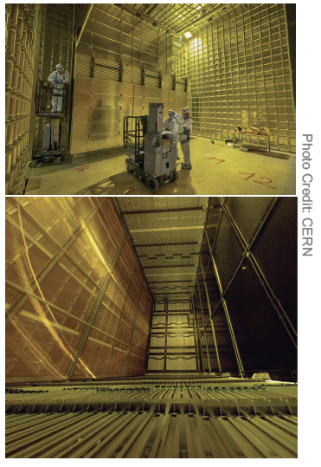
Detector
ProtoDUNE
LArTPC Demonstrator at CERN for DUNE FD
Hadron beams of 0.3-7 GeV/c
  4.7 mm wire spacing (same as FD)
  Versatile reconstruction in LAr
DUNE, JINST 15, P12004 (2020)
Preliminary
e/γ separation

Slide 24






Detector
ProtoDUNE
LArTPC Demonstrator at CERN for DUNE FD
Homework: If we need to have signals from at least 6 wires in LArTPC to reconstruct a proton track, what is the tracking threshold?
Hadron beams of 0.3-7 GeV/c
  4.7 mm wire spacing (same as FD)
  Versatile reconstruction in LAr
  Exclusivity + beam energy, can “see” inside argon nuclei
Exclusivity: to measure all final states (except nuclear remnant)
Exclusive event candidates
DUNE, JINST 15, P12004 (2020)
Quasi-elastic scattering candidate (data)
Charge-exchange scattering candidate (data)
Michel positron
$$π^{+}n \left({}_{}^{40}{Ar}\right)→π^{0}p$$
$$π^{+}$$
$$γ$$
p
beam $π^{+}$
beam $π^{+}$
$$γ$$
$$π^{+}p \left({}_{}^{40}{Ar}\right)→π^{+}p$$
p
47 cm
47 cm

Slide 25
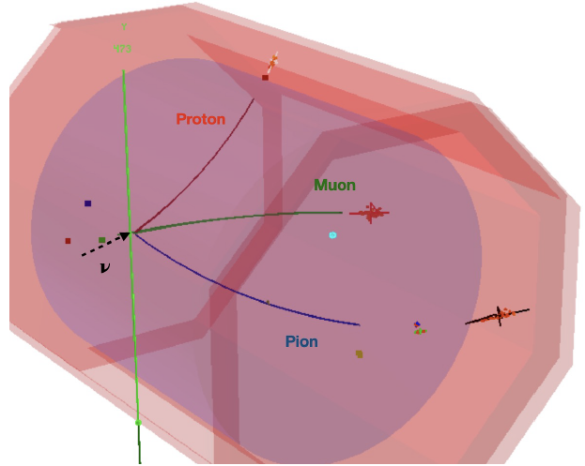
Detector
Hydrogen-rich high-pressure TPC
Why hydrogen? Why gas TPC? Why high pressure?
  Spoiler alert! No nuclear effects
  Acceptance, tracking threshold
  Target mass
Homework: Write down all (anti)neutrino-hydrogen interactions whose final-state particles are all electrically charged.
Raaf, TPC Mini Workshop
Hamacher-Baumann, Lu, Martín-Albo, Phys.Rev.D 102, 033005 (2020)

Slide 26
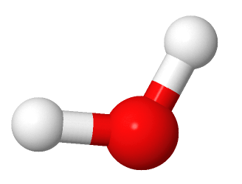
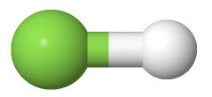
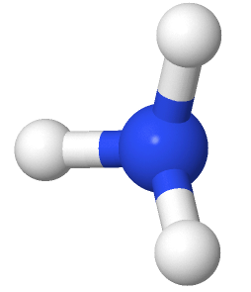
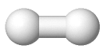
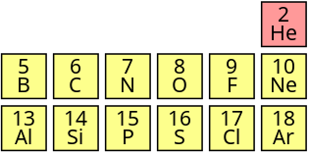
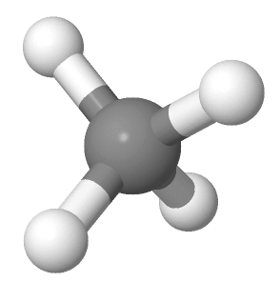
Detector
Hydrogen-rich high-pressure TPC
Why hydrogen? Why gas TPC? Why high pressure?
  Spoiler alert! No nuclear effects
  Acceptance, tracking threshold
  Target mass
Why not pure hydrogen TPC
  Bubble chamber: worse tracking
  H₂ gas: not hydrogen-rich enough
How rich is rich enough?
  Element carrying as much hydrogen as possible: Carbon base C_{x}H_{y}
HF
H₂
Hydrogen fluoride
NH₃
H₂O
Ammonia
Water
CH₄
Methane
http://www.jmol.org/
Hamacher-Baumann, Lu, Martín-Albo, Phys.Rev.D 102, 033005 (2020)

Slide 27
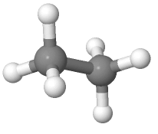
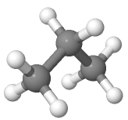
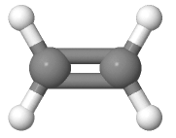
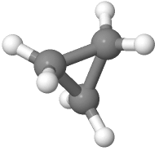
Detector
Hydrogen-rich high-pressure TPC
Why hydrogen? Why gas TPC? Why high pressure?
  Spoiler alert! No nuclear effects
  Acceptance, tracking threshold
  Target mass
Why not pure hydrogen TPC
  Bubble chamber: worse tracking
  H₂ gas: not hydrogen-rich enough
How rich is rich enough?
  Element carrying as much hydrogen as possible: Carbon base C_{x}H_{y}
    Saturated, acyclic: Alkane C_{n}H_{2n+2}
      CH₄ most efficient H-carrier, but not the largest one
HF
H₂
Hydrogen fluoride
NH₃
H₂O
Ammonia
Water
CH₄
Methane
cyclic
unsaturated
C₂H₆
Ethane
C₂H₄
Ethene
C₃H₈
Propane
C₃H₆
Cyclopropane
http://www.jmol.org/
Hamacher-Baumann, Lu, Martín-Albo, Phys.Rev.D 102, 033005 (2020)

Slide 28
Detector
Hydrogen-rich high-pressure TPC
Why hydrogen? Why gas TPC? Why high pressure?
  Spoiler alert! No nuclear effects
  Acceptance, tracking threshold
  Target mass
Why not pure hydrogen TPC
  Bubble chamber: worse tracking
  H₂ gas: not hydrogen-rich enough
How rich is rich enough?
  Element carrying as much hydrogen as possible: Carbon base C_{x}H_{y}
    Saturated, acyclic: Alkane C_{n}H_{2n+2}
      CH₄ most efficient H-carrier, but not the largest one
  Maximal partial pressure limited by vapor pressure
    Theoretically hydrogen-richest mix at 10 bar: C_{3.93}H_{9.86}
HF
H₂
Hydrogen fluoride
NH₃
H₂O
Ammonia
Water
CH₄
Methane
cyclic
unsaturated
= 17% C(CH₃)₄ (neopentane) + 35% iC₄H₁₀ (isobutane)
+ 24% C₄H₁₀ (butane) + 24% C₃H₈ (propane)
C₂H₆
Ethane
C₂H₄
Ethene
C₃H₈
Propane
C₃H₆
Cyclopropane
http://www.jmol.org/
Hamacher-Baumann, Lu, Martín-Albo, Phys.Rev.D 102, 033005 (2020)

Slide 29

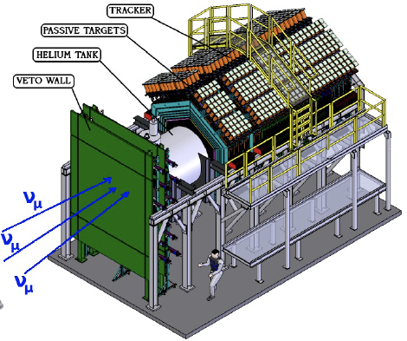
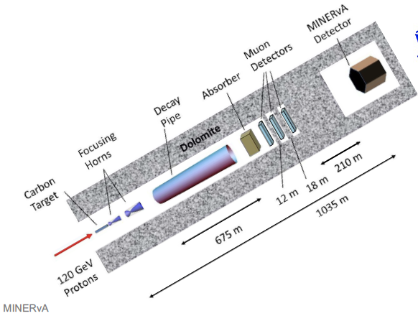
MINERvA@FNAL
A dedicated ν-interaction experiment
5.4 ton active scintillator fiducial volume
10-μs beam spill, ~ 1 event in tracker per spill

Slide 30
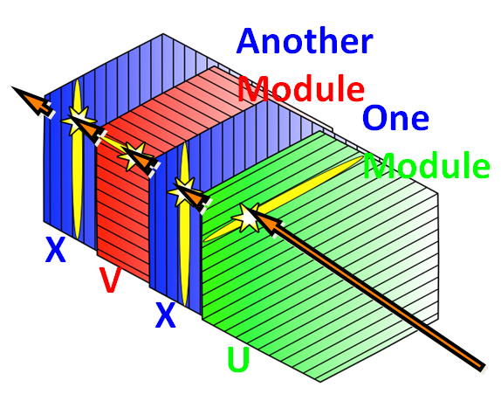
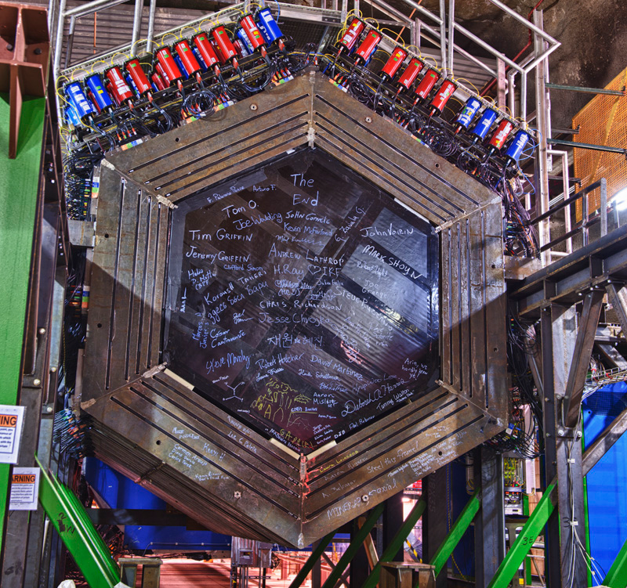

Photo Credit: R. Hahn
MINERvA
MINERvA
Scintillator bar (CH)
3.3 cm base, 1.7 cm height
3 ns timing resolution
3 views
2.7 mm position resolution per plane
Non-magnetized

Slide 31



MINERvA
$$\left\langle B\right\rangle =1.3 T$$
Muon momentum resolution (range + curvature) 8% @ 6 GeV/c
Proton threshold 100 MeV K.E., momentum (by range) resolution 2% @ 1 GeV/c
π⁰ momentum resolution ~20%
High-energy charged π energy resolution by calorimetry $18\%+8\% /\sqrt{Eπ/GeV}$
Can also detect neutrons

Slide 32



Neutrino-Electron Elastic Scattering
Well-understood SM process
$$νe⟶νe$$
MINERvA
Homework: Write down the Feynman diagram(s) for ν-e elastic scattering.
Beam flux prediction:
  GEANT4+hadron production data
in situ flux constrained by $νe$ scattering [MINERvA, Phys.Rev. D93, 112007 (2016), Phys. Rev. D 100, 092001 (2019)]
  reduced by ~ 10%
  uncertainty near the peak reduced from 8% to 4%

Slide 33




Inverse Muon Decay
(Muon decay $μ^{−}→ν_{μ}+e^{−}+\overline{ν}e$)
Another well-understood SM process
$${νμ+e^{−}→μ}^{−}+νe$$
Inverse muon decay
MINERvA
$$μ^{−}$$
New flux constraint method [MINERvA, Phys.Rev.D 104, 092010 (2021)]
Homework:
Write down the Feynman diagram(s).
What is the minimum neutrino energy for this process to happen (that is, the neutrino energy threshold)?
Can this technique constrain ${\overline{ν}}_{μ}$ flux?

Slide 34




Charged-Current Coherent π Production
Pair production
Pion decay
“Inverse pion decay”
✗ forbidden
Coherent production
à la QED pair prod.
✓ allowed
✓ IF $νμ$ is replaced by a heavy neutrino (heavy neutral lepton)
Intrinsic background to HNL search
[T2K, Phys.Rev. D100, 052006 (2019)]

Slide 35


Kaon Production
“Inverse kaon decay”
— Coherent K⁺
K⁺ decay-at-rest signature
12.4 ns lifetime, kink, energy deposit

Slide 36


Protons inside a nucleus
Bound nucleons are moving—Fermi motion
Interactions while exiting, very often breaking up the nucleus—final state interactions (FSI)
JUNO, J.Phys.G 43, 030401 (2016)
Bound-proton decay
K⁺ 20-200 MeV K.E. (not considering FSI)
✗ background from K⁺ production by atmospheric neutrinos
Proton decay at rest → K⁺ 105 MeV K.E.
Nice kinematic signature with decay chain coincidence
Or not?

Slide 37

Part 2: Nuclear Effects
—it’s all about systematics
Quiz: Here is a model
$$1 year={π×10}^{\#days of a week }seconds$$
It is wrong by a few __%.
A: 10 B: 1 C: 0.1

Slide 38


Elements
(Mendeleev, 1869)
Atom
Nucleus (Rutherford, 1911)
Electron (J. J. Thomson, 1897)
H-1
Quiz: How many neutrons does argon have?

Slide 39


Atom ~ The Sphere
Nucleus ~ 1 mm
157 m
Source: https://en.wikipedia.org/wiki/Sphere_(venue)

Slide 40





Excitation energy
Quiz: What is the momentum scale for 1 fm according to the uncertainty principle?
Homework**: What charge is seen by neutrino CC scattering?
Fermi gas
Nucleons need to “ladder up” the momentum space due to overlap of wavefunction in configuration space
Electric charge density seen by electron scattering
$$×\sim \sqrt[3]{200/4}$$
(local) density varies with r
Nucleus radius (global)
All figures from Povh, et al. Particles and Nuclei

Slide 41


Shell model (no longer non-interacting gas)
Mean field: each nucleon moving freely in a potential approximated for the sum of interactions with all other nucleons.
Confining (radial-dependent) mean-field potential leads to energy levels
Nucleus at rest
Sum of all nucleons’ Fermi motion = 0
Fermi motion
Sum of all other nucleons’ Fermi motion
Povh, et al. Particles and Nuclei
Van Cuyck, PhD Thesis, Ghent University (2017)

Slide 42




Povh, et al. Particles and Nuclei
Free-moving $≠$ free, the potential makes the nucleon off-shell
Spectral function
Probability density as a function of nucleon energy and momentum (or their equivalent)
Homework*: What would the spectral function look like if the proton is on-shell (as in Fermi gas).
²⁰⁸Pb spectral function represented by missing energy and missing momentum, using cross section data for the ²⁰⁸Pb(e, e′p)²⁰⁷Tl∗ reaction.
Quint, PhD thesis, University of Amsterdam, 1988

Slide 43

Collective effects
Fermi motion &
nuclear potential
2p2h?
Energy transfer from neutrino
Van Cuyck, PhD Thesis, Ghent University (2017)

Slide 44




Impulse approximation (IA)
1-particle-1-hole
(1p1h)
1-body current
continuum
Residual nucleus
2-particle-2-hole
(2p2h)
2-body current
continuum
Residual nucleus
All figures from Van Cuyck, PhD Thesis, Ghent University (2017)

Slide 45

Final-state interaction (FSI)
π
Van Cuyck, PhD Thesis, Ghent University (2017)
Golan, Trento, 2018

Slide 46
Final-state interaction (FSI)
Can not identify RES experimentally
π
Van Cuyck, PhD Thesis, Ghent University (2017)
Golan, Trento, 2018

Slide 47


Final-state interaction (FSI)
Credit: Wen & Lu
$†$ Proton in GiBUU final-state transport
R: radial position, M_{p}: mass
Final-state proton inside nucleus: mass evolves as it propagates out of the nucleus.

Slide 48

Final-state interaction (FSI)
Credit: Wen & Lu
$†$ Proton in GiBUU final-state transport
R: radial position, M_{p}: mass
Final-state proton inside nucleus: mass evolves as it propagates out of the nucleus.

Slide 49



Final-state interaction (FSI)
JUNO, Neutrino 2022 Poster
hN
hA
Proton spectrum from atmospheric $ν$
Credit: Wen & Lu
$†$ Proton in GiBUU final-state transport
R: radial position, p_{p}: momentum
Final-state proton in neutrino interactions: momentum evolves as it propagates out of the nucleus.

Slide 50

Final-state interaction (FSI)
JUNO, Neutrino 2022 Poster
hN
hA
Proton spectrum from atmospheric $ν$
Credit: Wen & Lu
$†$ Proton in GiBUU final-state transport
R: radial position, p_{p}: momentum
Final-state proton in neutrino interactions: momentum evolves as it propagates out of the nucleus.
Homework: In the GiBUU FSI movie:
* Calculate the physical time unit, i.e. how long is T=1 a.u.?
*** Locate the forbidden region. Explain its mechanism. What determines its boundary?

Slide 51
Why Neutrino Interactions?
How well can we measure neutrino energy?
(reminder: oscillation very sensitive to baseline and energy, L/E)
2-body reaction
precise
Fermi motion,
Final State Interaction (FSI)
spread
V. Cuyck
Martini et al., Phys.Rev. D87, 013009 (2013)
V. Cuyck
2-particle-2-hole (2p2h),
pion absorption (missing particles)
Large fraction of large bias and spread

Slide 52



Intranuclear Dynamics and Neutrino Oscillation Measurements
Coloma & Huber, Phys.Rev.Lett. 111, 221802 (2013)
Mixing between
μ and τ flavors
Mock measurement with
perfect knowledge of interactions
Parke, 1801.09643

Slide 53
Intranuclear Dynamics and Neutrino Oscillation Measurements
Coloma & Huber, Phys.Rev.Lett. 111, 221802 (2013)
Mixing between
μ and τ flavors
Mock measurement with
ignoring nuclear effects of interactions
Parke, 1801.09643

Slide 54
Part 3: TKI Phenomenology

Slide 55

©Shigeo Fukuda

Slide 56

©Shigeo Fukuda

Slide 57



Transverse Kinematic Imbalance (TKI)
[…]
[…]
TKI
Multi-dimensional observation
Momentum (magnitude)
Angle
Asymmetry
Stationary free nucleon target
Nuclear target ($A>1$)
Fermi motion
Final-state interactions (FSI)
2-particle-2-hole (2p2h)
Lu, et al., Phys.Rev.D 92, 051302 (2015)
Lu, et al., Phys.Rev.C 94, 015503 (2016)
Lu & Sobczyk, Phys.Rev.C 99, 055504 (2019)
Cai, Lu, Ruterbories, Phys.Rev.D 100, 073010 (2019)

Slide 58

Transverse Boosting Angle δα_{T}
δα_{T} is Fermi motion direction → isotropic
—total transverse momentum
—transverse momentum imbalance
—missing pT
—...
In full
FSI and missing particles

Slide 59
Transverse Boosting Angle δα_{T}
FSI and momentum sharing with extra particles
pion absorption
2p2h

Slide 60
Emulated Nucleon Momentum p_{N}
Furmanski & Sobczyk, Phys.Rev.C 95, 065501 (2017): calculation of p_{N}.
Lu & Sobczyk, Phys.Rev.C 99, 055504 (2019): p_{N} was proposed for the study of nuclear effects as a generalisation of δp_{T}

Slide 61

TKI: CC0π
p
MINERvA
$$μ^{−}$$
MINERvA, Phys.Rev.Lett. 121, 022504 (2018)
π absorption
2p2h
2p2h
π absorption
Boosting
Dragging
Abnormal acceleration?!
GENIE FSI (v2.8 hA)
Not dark energy
Identified by δα_{T} prior to measurement
Fixed after measurement
Generalisation #1
p_{N}: 3D, but mainly transverse

Slide 62

Btw, why “TKI (transverse kinematic imbalance)”?
Final-state correlations → Kinematic Imbalance
Generalized: not capturing the core of the method; can have various generalizations (see next slide)
  Transverse was chosen to represent the method, hence TKI

Slide 63

TKI: CCπ⁰
Surprising consistency!
MINERvA
p
MINERvA
$$μ^{−}$$
MINERvA, Phys. Rev. D 102, 072007 (2020)
Generalisation #2
via CC0π measurement
[Lu & Sobczyk, Phys.Rev.C 99, 055504 (2019)]

Slide 64


TKI: energy and target dependence
MINERvA, Phys.Rev.Lett. 121, 022504 (2018)
π absorption
2p2h
arXiv:2507.20539
MINERvA
At T2K energy: smaller pion production and absorption
Also sensitive to 2p2h
Boosting
Dragging

Slide 65
Neutrino Interactions
Experimental Techniques
  Standard-Model ν interactions: complex degrees of freedom
  Detectors: plastic scintillator, TPC
  MINERvA highlights: “easy” channels—ν-e elastic scattering, inverse μ decay, CC coherent production, kaon production
Nuclear Effects
  Structure: Fermi gas, shell model, spectral function
  Dynamics: currents & FSI
TKI Phenomenology
  Key variables: transverse boosting angle (δα_{T}), emulated nucleon momentum (p_{N}), generalised in correlations and topology
  Current results: MINERvA, T2K, MicroBooNE

Slide 66

Quiz
Air density at STP in kg/m³? What about water (in its usual liquid condition)? (A: 10³, B: 1, C: 10⁻³)
Density ratio between liquid air and water (at their own conditions)? What about polystyrene (a kind of plastics) vs. water? (A: 10, B: 1, C: 0.1)
Assuming height=diameter, what is the diameter of the 50kt-water tank in meters?
What is Earth’s diameter in unit of DUNE’s baseline? (A: 100, B: 50, C: 10)
Here is a model: $1 year={π×10}^{\#days of a week }seconds$. It is wrong by a few __%. (A: 10, B: 1, C: 0.1)
How many neutrons does argon have?
What is the momentum scale for 1 fm according to the uncertainty principle?

Slide 67

Homework
** Explain at high energy.
Calculate the energy threshold of ν_{e} and ν_{μ} CCQE scattering on nucleons.
Check the quantum numbers and quark contents of Δ and N* on PDG (Google “pdg delta resonance”; navigate https://pdg.lbl.gov/).
* Using isospin arguments (CG coefficients), show that the cross-section ratio between is 9:2:1 (assuming Δ dominance).
Calculate proton momentum for 10 MeV and 100 MeV kinetic energy.
Calculate the Cherenkov light threshold (in total energy, kinetic energy, and momentum) for e, μ, π⁺, K⁺, p, τ.
If we need to have signals from at least 6 wires in LArTPC to reconstruct a proton track, what is the tracking threshold?
Write down all (anti)neutrino-hydrogen interactions whose final-state particles are all electrically charged.
Write down the Feynman diagram(s) for ν-e elastic scattering.
Inverse muon decay
  Write down the Feynman diagram(s).
  What is the minimum neutrino energy for this process to happen (that is, the neutrino energy threshold)?
  Can this technique constrain ${\overline{ν}}_{μ}$ flux?
** What charge is seen by neutrino CC scattering?
* What would the spectral function look like if the proton is on-shell (as in Fermi gas).
In the GiBUU FSI movie:
  * Calculate the physical time unit, i.e. how long is T=1 a.u.?
  *** Locate the forbidden region. Explain its mechanism. What determines its boundary?

Slide 68
BACKUP

Slide 69


ME: gigantic data sets!
(all MINERvA results here are w/ LE)
LE: Low Energy, peak at 3 GeV
ME: Medium Energy, peak at 6 GeV
Neutrino flux
Anti-neutrino flux
MINERvA
MINERvA
ME 12.1 x 10²⁰ POT
LE 4.0 x 10²⁰ POT
ME 12.4 x 10²⁰ POT
LE 1.7 x 10²⁰ POT
* Data accumulation measured by
proton-on-target (POT)

