Slide 1
MPT2321 readout electronics
Ming-Kuan Yuan
Fudan University
2024.12.29
CEPC MUON RefTDR weekly report
yuanmk@mail2.sysu.edu.cn / MPT2321_readout · GitLab
2024/12/29
mkyuan23@m.fudan.edu.cn
1

Slide 2
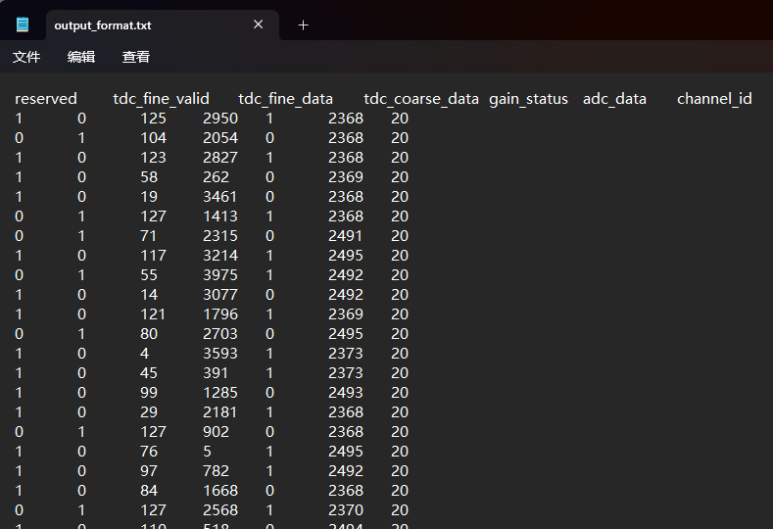
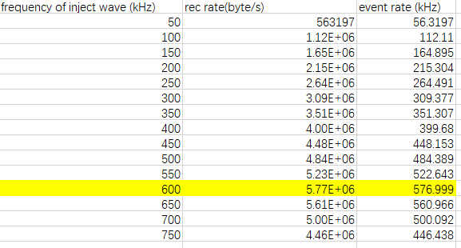
DAQ based on C++
DAQ based on C++ is ready
Single channel frequency upper limit: 500 kHz
TCP is not blocked
offline txt2root.py python script is ready
Single channel
Format of output txt file of DAQ

