Slide 1
ECAL Granularity
Shanzhen Chen, Xuhao Yuan
2024-12-16

Slide 2
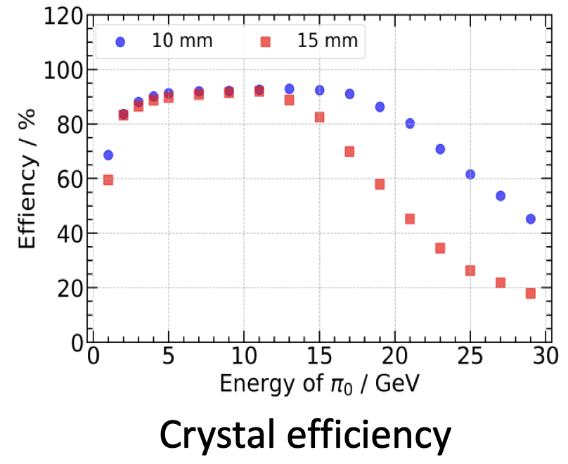
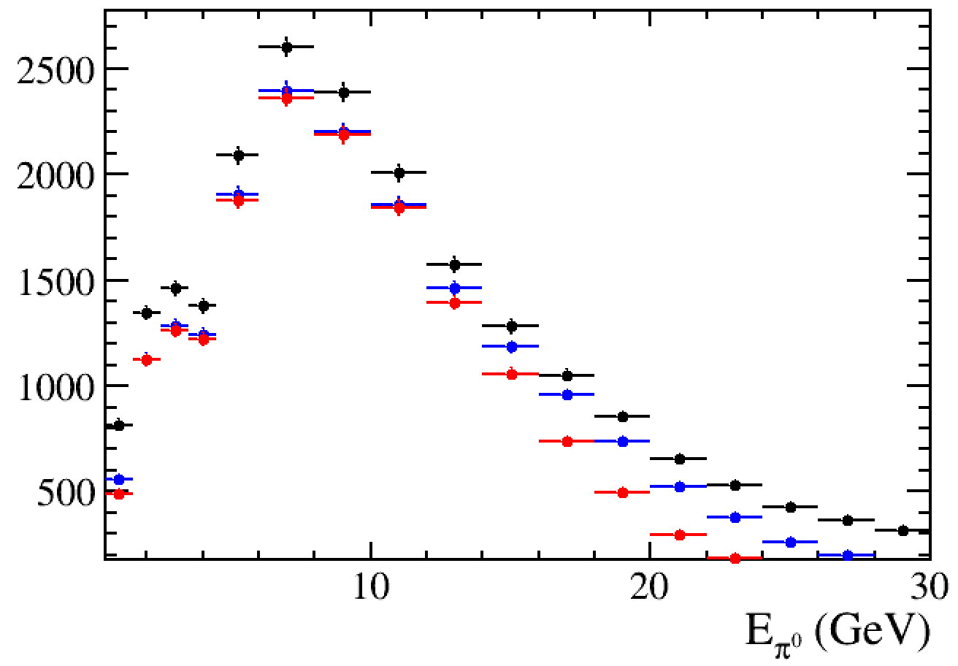
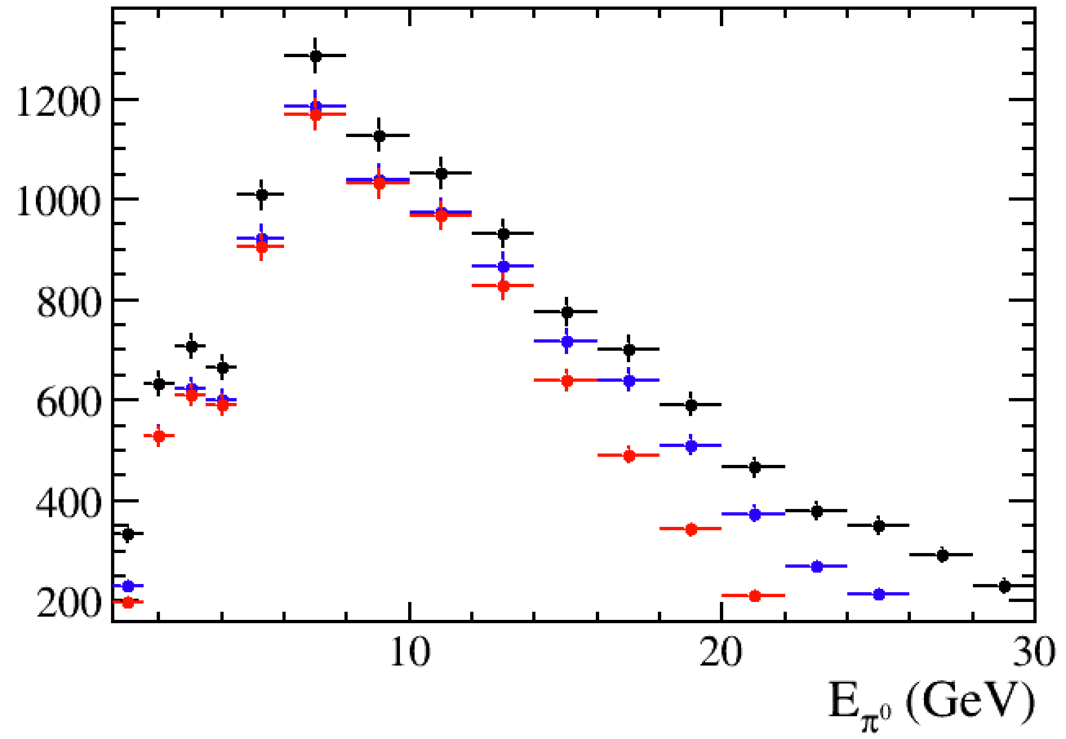
Energy distribution of $π^{0}$
Study the physics performance @10 mm OR 15 mm ECAL granularity
https://indico.ihep.ac.cn/event/24259 by Shensen Sun
Efficiency/resolution changes @ 10 or 15 mm
Comparing Z->tautau & H->tautau
$π^{0}$ from $τ^{±}$
✛ MC
✛ Corrected by efficiency @ 10 mm
✛ Corrected by efficiency @ 15 mm
15 GeV
15 GeV
Z->tautau
H->tautau
Data from E240.Pe3e3h_e3e3.e0.p0.whizard195_1000

