Slide 1
Progress and Plan
Mingyi Dong
2024.12.30

Slide 2
Progress
We started the recovery work of IP area on Dec.24
 | Tasks | Time needed (day) | person in charge | Stauts
1 | Installation of final shielding plates | Dec.23 | IHEP, Italy team | done
2 | Deal with CGEM cables to ensure they do not interfere with pushing the east EEMC | Dec. 24 | Italy team, IHEP | done
3 | (1) Remove current operation platform on east side (2) Push the east EEMC back to its original position (3) Disconnect the east EEMC from the support structure | Dec. 24-25 | IHEP | done
4 | Fix CGEM cables on EEMC support structure to ensure they do not interfere with installation of beam pipe | Dec.26 | Italy team, IHEP | done
5 | (1)Install the support tools for beam pipe installation (2) Install beam pipe | Dec.27 | IHEP | done
7 | Remove the support tools for beam pipe installation |  | IHEP | Not yet
8 | Laser measurement and alignment of beam pipe | Dec.28 | IHEP | done

Slide 3
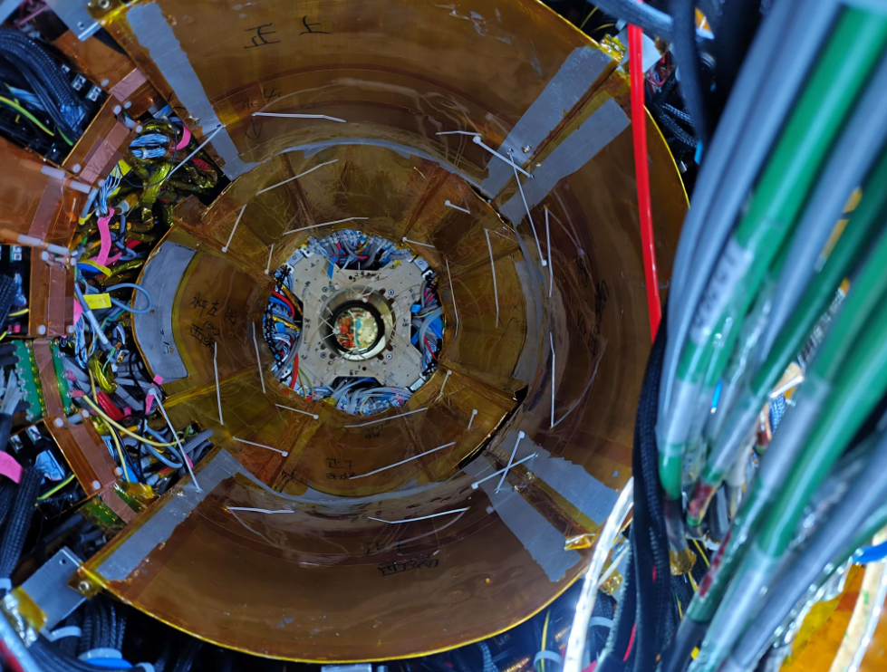
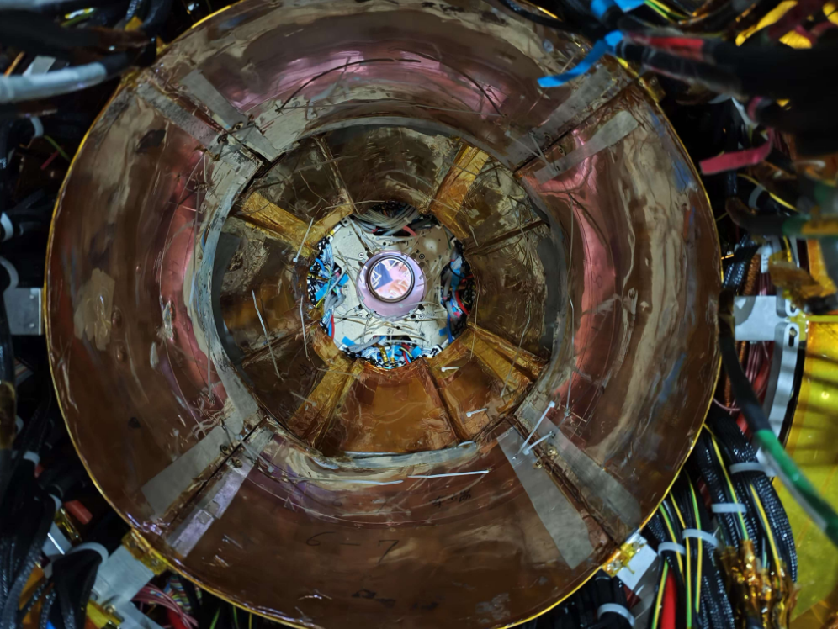
Installation of final shielding plates
Dec. 23
Installed final shielding plates. Part1 was cut by about 4-5cm to fit the space

Slide 4
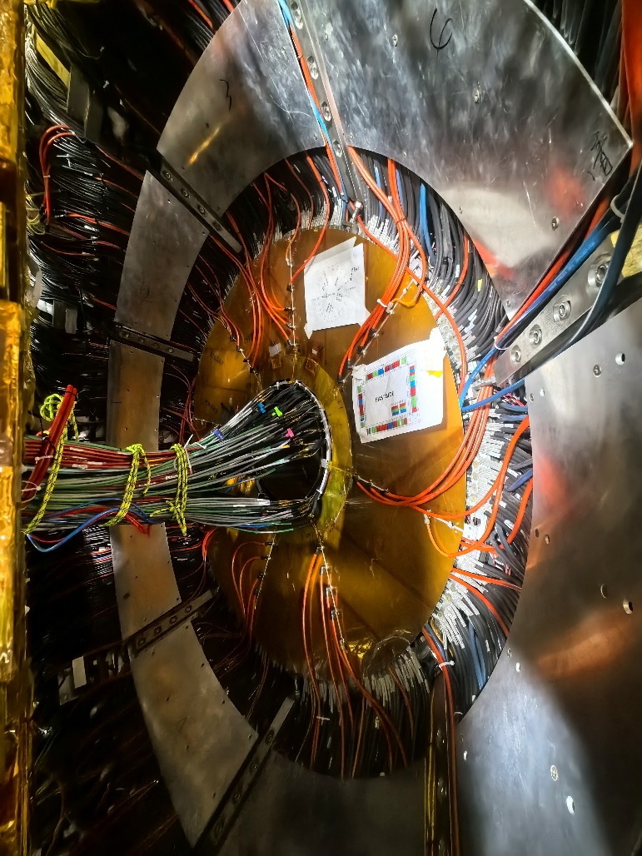
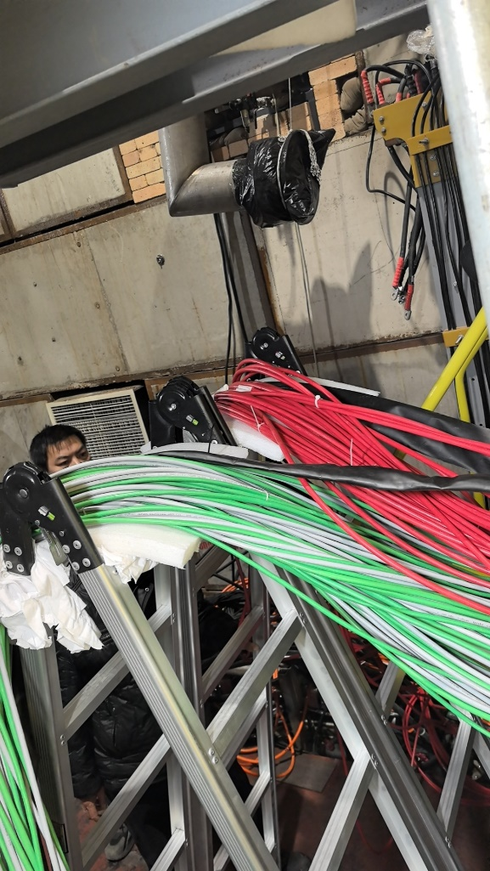
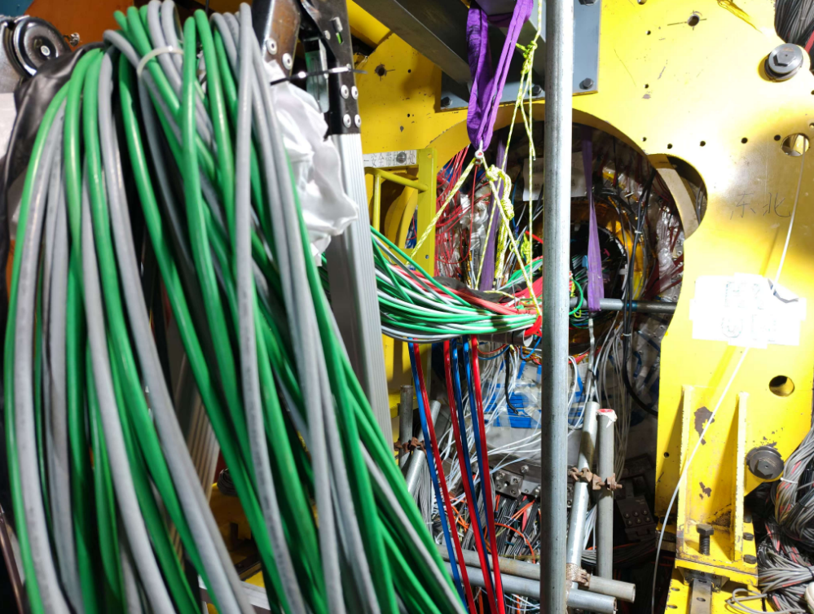
Pushing back east EEMC
Dec. 24
Handled CGEM cables to ensure they do not interfere with pushing the east EEMC
Pushing back east EMC

Slide 5
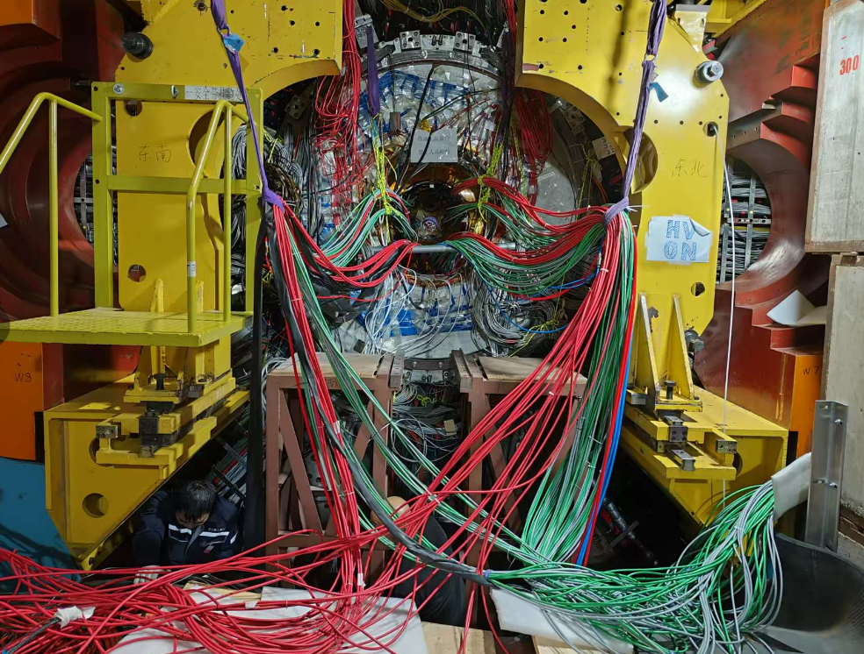
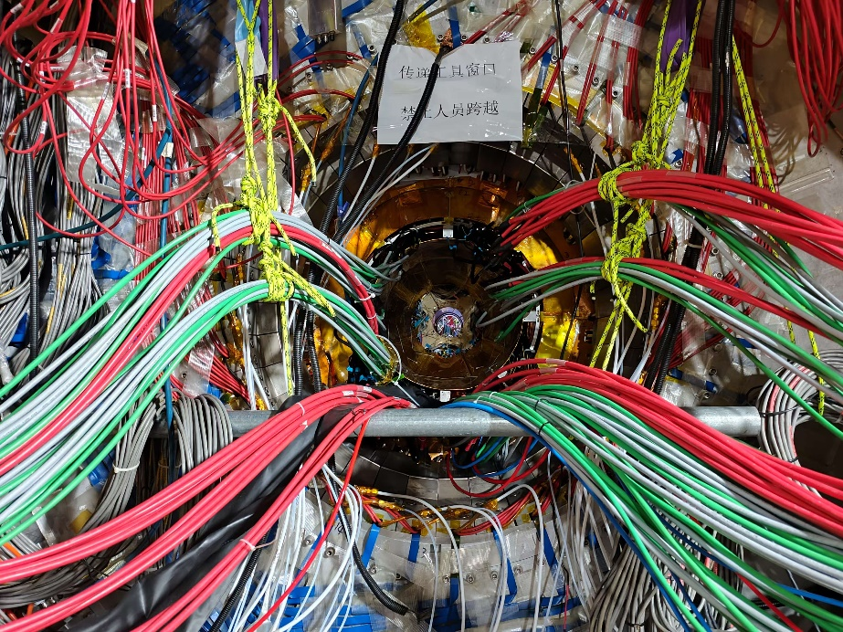
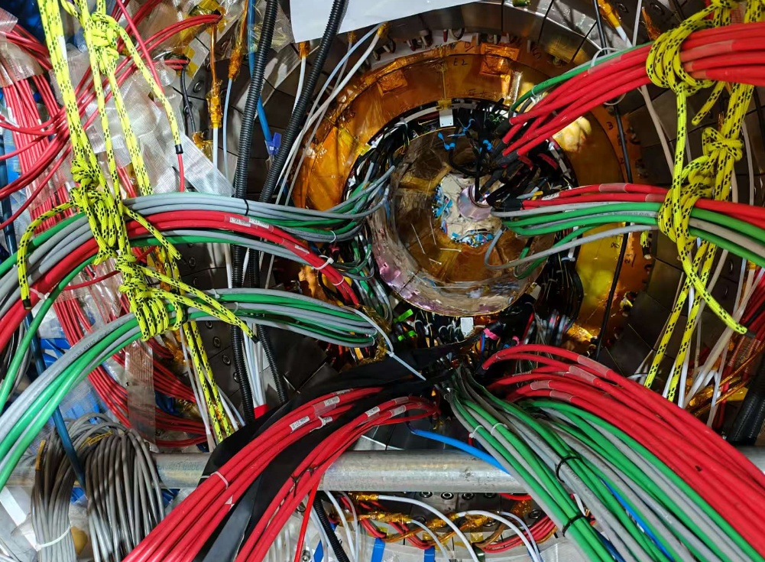
Disconnection of support structure from east EEMC
Dec. 25
Disconnected the support structure from east EEMC
Opened the east gate wider, and installed the platform for installation of beam pipe

Slide 6
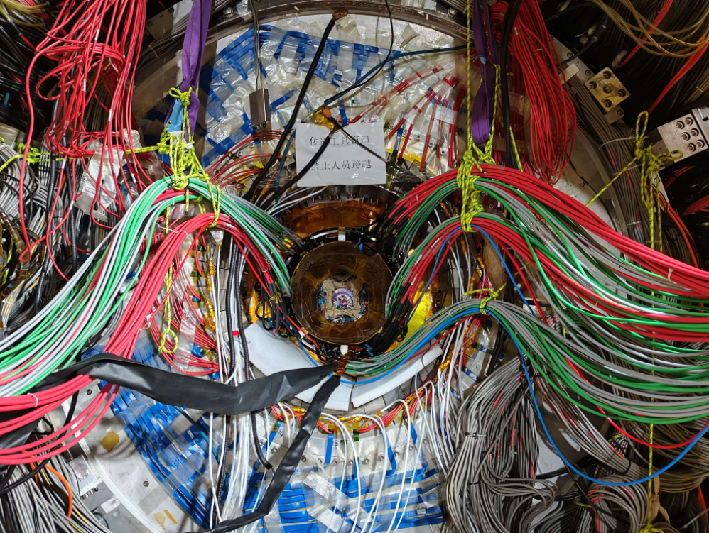
Preparation for installation of beam pipe
On Dec. 26
Protection for CGEM cables

Slide 7
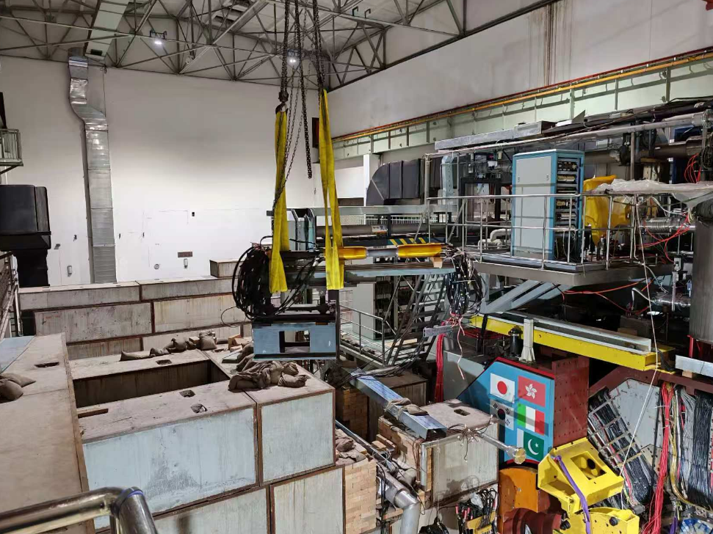
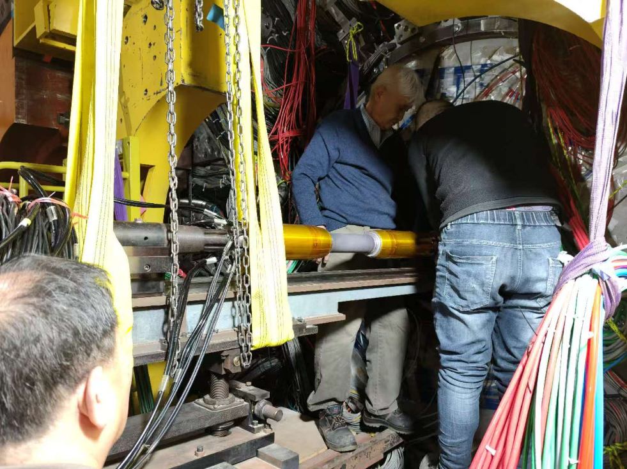
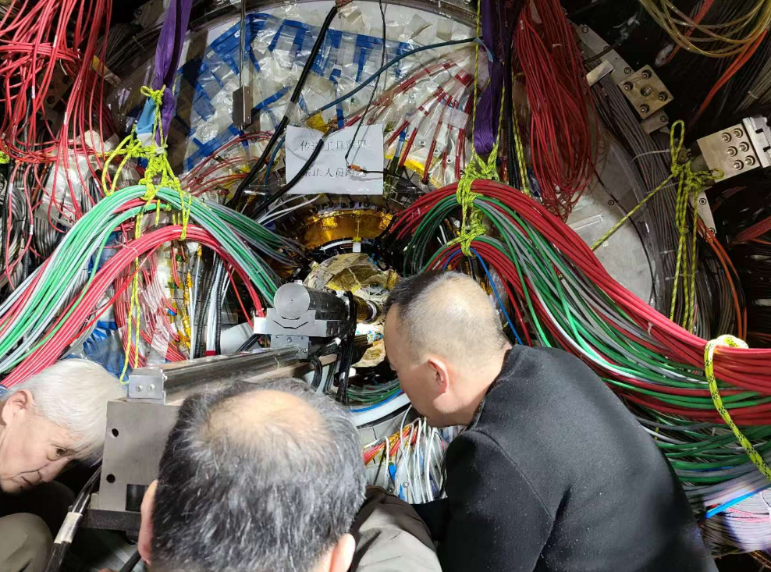
Installation of beam pipe
Dec.27
Installed beam pipe successfully

Slide 8
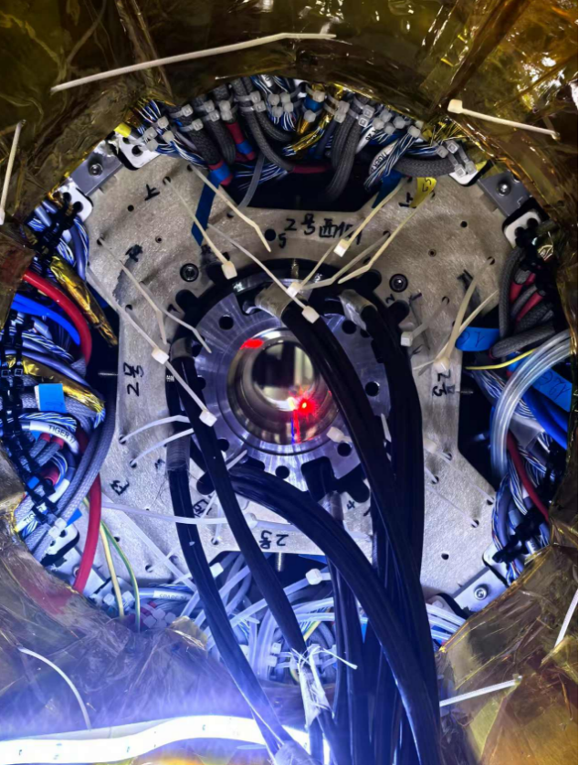
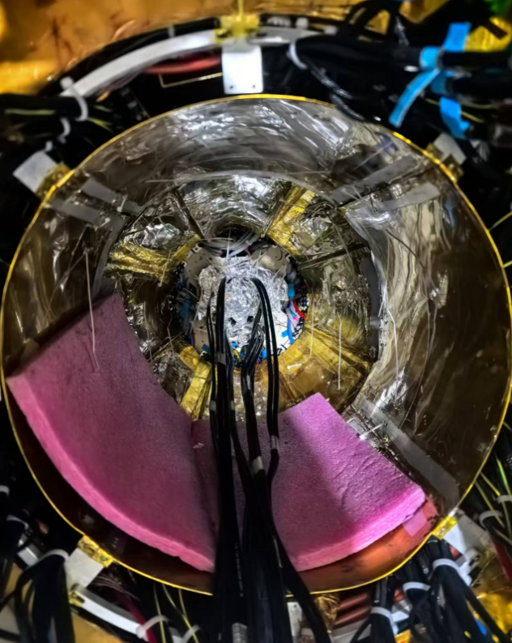
Alignment of beam pipe
Finished the alignment of beam pipe
Detector is 2.3mm higher than the vacuum pipe of machine
Beam pipe is aligned based on the vacuum pipe of machine

Slide 9
Plan for next week
 | Detailed tasks | date
1 | Install shielding plates for CGEM | Dec.31, move to the beginning of Jan.(before Jan.9)
2 | Deal with CGEM cables to ensure they do not interfere with removing big leg and pushing back EEMC on west side | Dec.31
2 | Deal with CGEM cables to ensure they do not interfere with pulling out of EEMC | Jan.2
3 | Pull out EEMC again | Jan3
4 | Deal with CGEM cables to ensure they do not interfere with installation of SCQ | Jan.4
5 | Installation of east and west SCQs and related work (some jobs are not in the IP region) SCQs will be installed in place on both sides | Jan.6- Jan.9 Jan.9
6 | Power on CGEM and MDC to check the connection | Jan.10

