Slide 1
BEAG Seminary 缪子单粒子效应研究中的蒙特卡罗
报告人：邓亦凡
日期：2025年1月3日

Slide 2
01
研究背景
缪子单粒子效应研究背景
02
实验研究简介
65-nm SRAMs Muon Accelerating Test in MLF，J-PARC
03
CONTENTS
蒙特卡罗模拟
预实验模拟，截面验证，SER预测，物理机制分析，探测器模拟
04
一些Geant4使用分享
基于辐射变色薄膜的束流定位与质量分析
05
交流
请大家批评指正
Notes:
99916d51-e60a-4a9d-bca3-f5c5f28a3080.source.default.zh-Hans

Slide 3
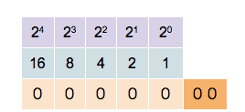
1
1. 研究背景
1.1 Soft Error and SEU
Data in the computer system were stored and processed as Binary numbers.
Each bit of the binary number corresponds to the voltage state of the memory cell in the hardware system.

Slide 4
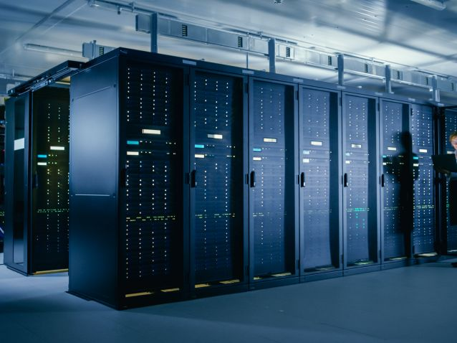
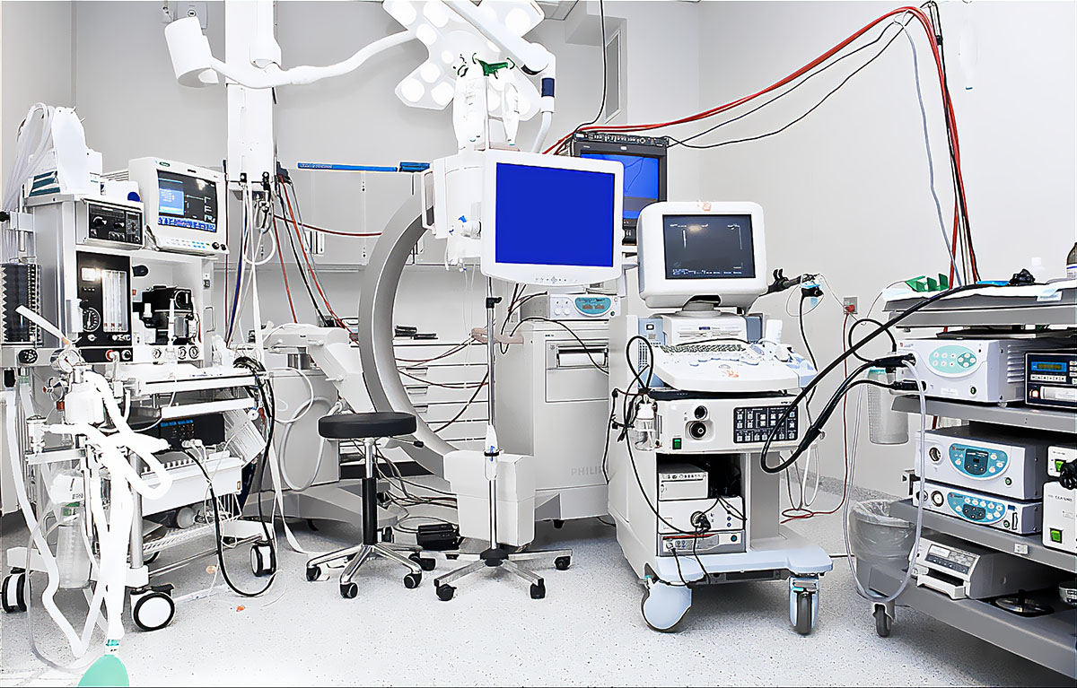
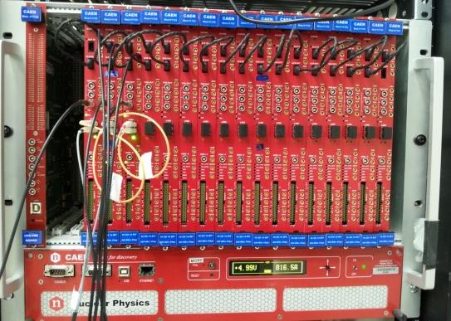
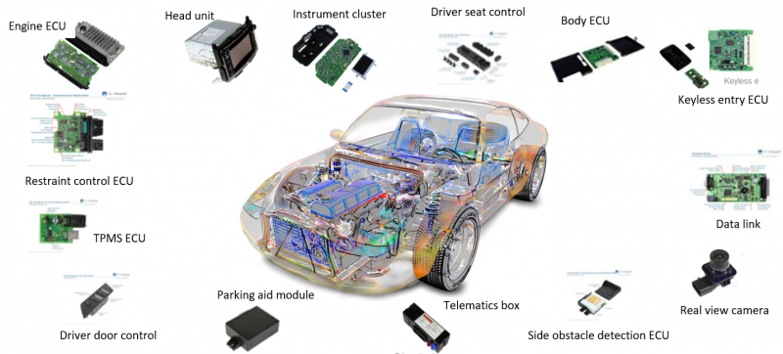
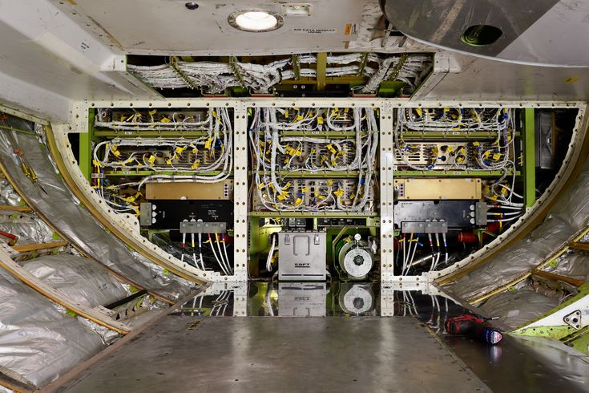
2
1. 研究背景
1.1 Soft Error and SEU
A soft error refers to a temporary malfunction occurring with a normal semiconductor
The radiation-induced soft errors in a terrestrial environment have been recognized as a major threat to electronics

Slide 5
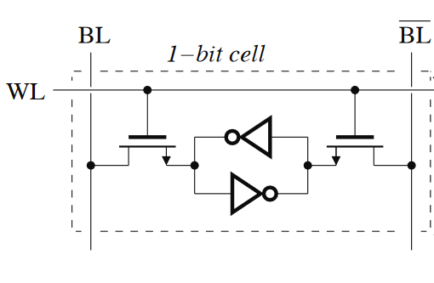
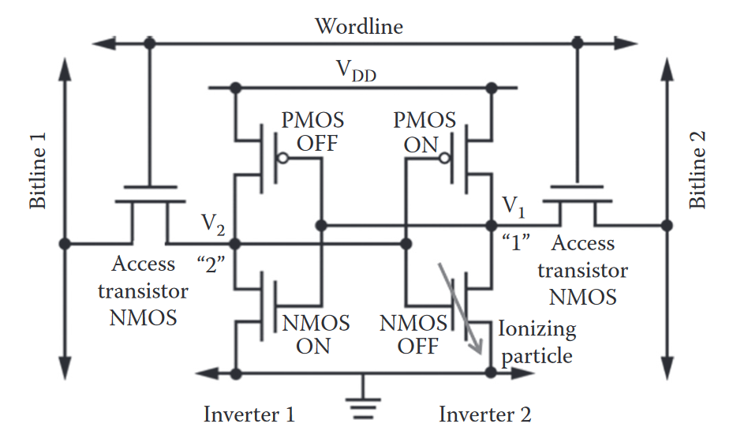
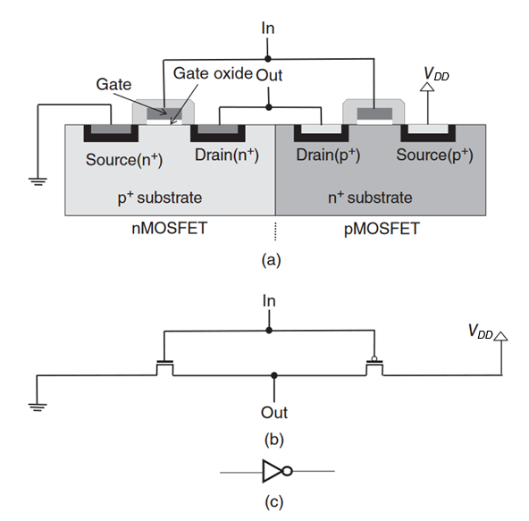
3
1. 研究背景
1.1 Soft Error and SEU
1.1 Soft Error and SEU
SRAM is subject to a representative radiation-induced soft error named Single Event Upset (SEU)
If the collected charge at the SV exceeds the critical charge (Q_{c}) an SEU will occur.
1
0
Cosmic ray ion track
off
on
Fig 1.1 Data storage mechanism of an SRAM cell
Fig 1.2 Schematic diagram of CMOS inverter

Slide 6
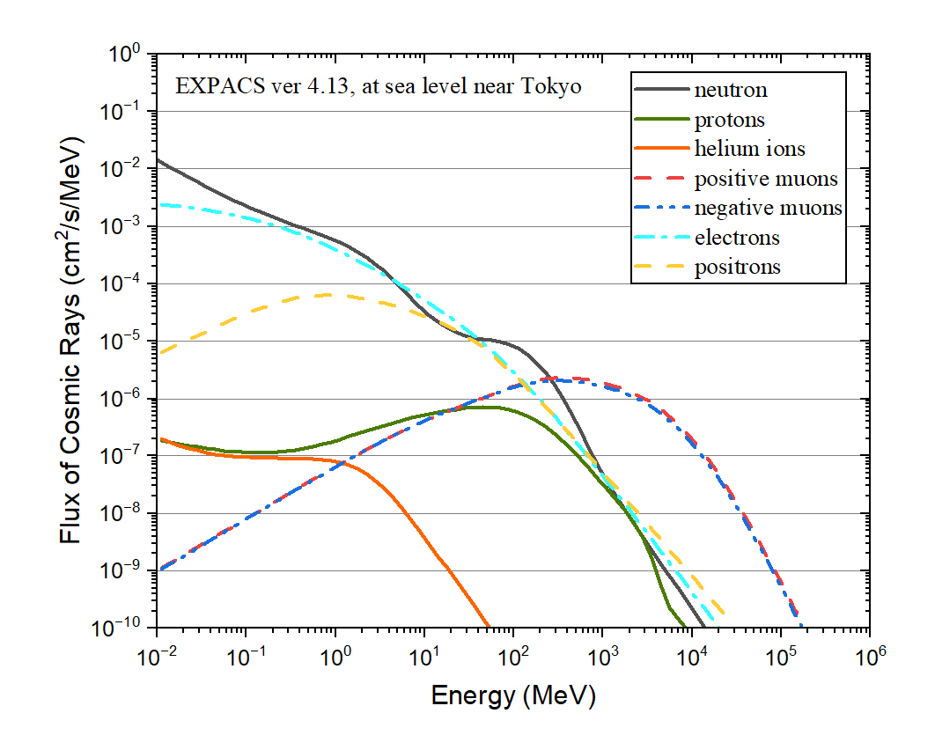
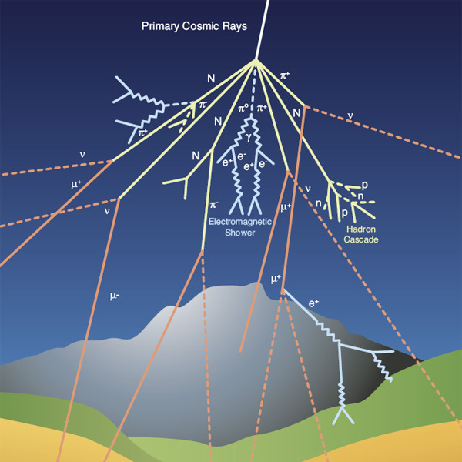
4
1. 研究背景
1.2 Cosmic Rays in Terrestrial Environment
The primary CRs are subject to strong colliding with atmospheric nuclei, resulting in secondary particles
Neutrons, muons, protons, pions, electrons, positrons, and photons, can be propagated to ground level
Figure 1.4 Energy spectra of the secondary cosmic rays at ground level, calculated with EXPACS
Fig 1.3 Schematic of the cosmic rays reaching the ground

Slide 7
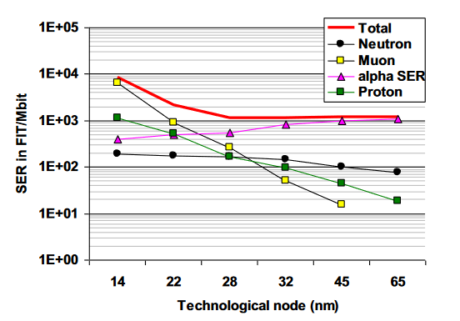
5
1. 研究背景
1.2 Cosmic Rays in Terrestrial Environment
Neutrons have always been considered a main radiation source for SEUs
With the miniaturization of semiconductor device and the decrease in operating voltage, the critical charge decrease, making the device more vulnerable to more types of particles
Muons : direct ionization & negative muon capture
Protons: direct ionization (LEP) & nuclear reaction (HEP)
Fig 1.5 Contribution of various particles to the Soft Error Rate (SER) in bulk devices

Slide 8
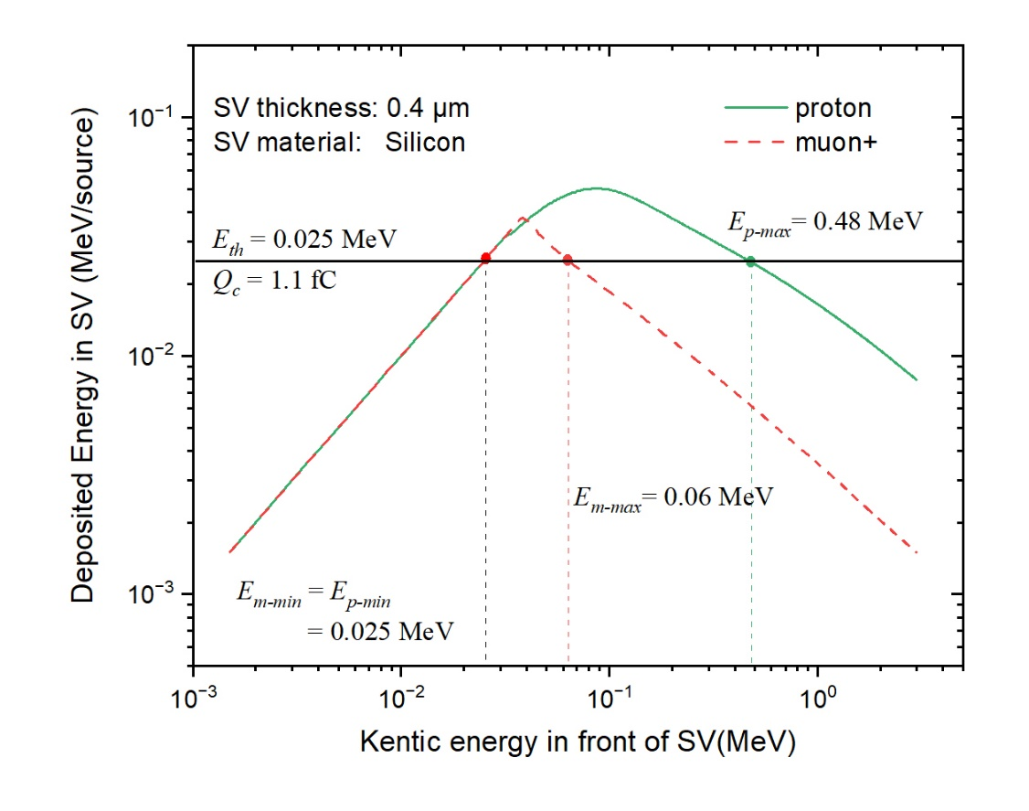
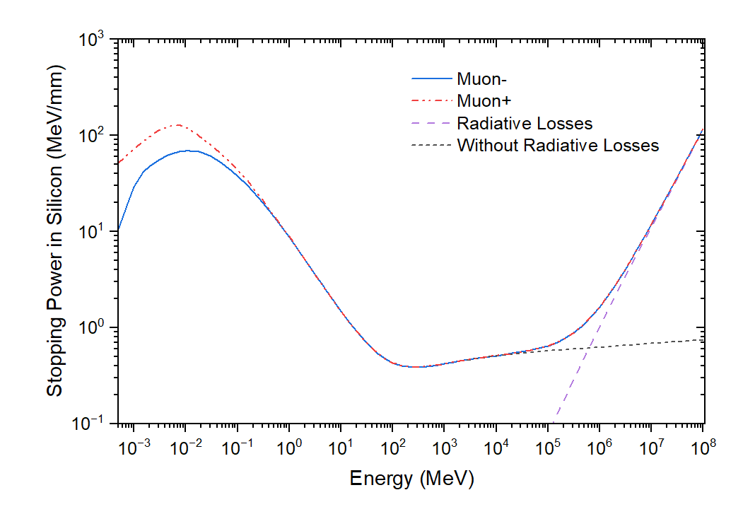
6
1. 研究背景
1.3 Characteristics of Muons
Stopping Power
Fig 1.7 The deposition energy E_{d} as a function of incident particle kinetic energy E_{k} just before entering SV. The green curve represents the case of proton, while the red one represents the case of positive muons.
Fig 1.6 Stopping power of negative and positive muons for silicon, by Geant4

Slide 9
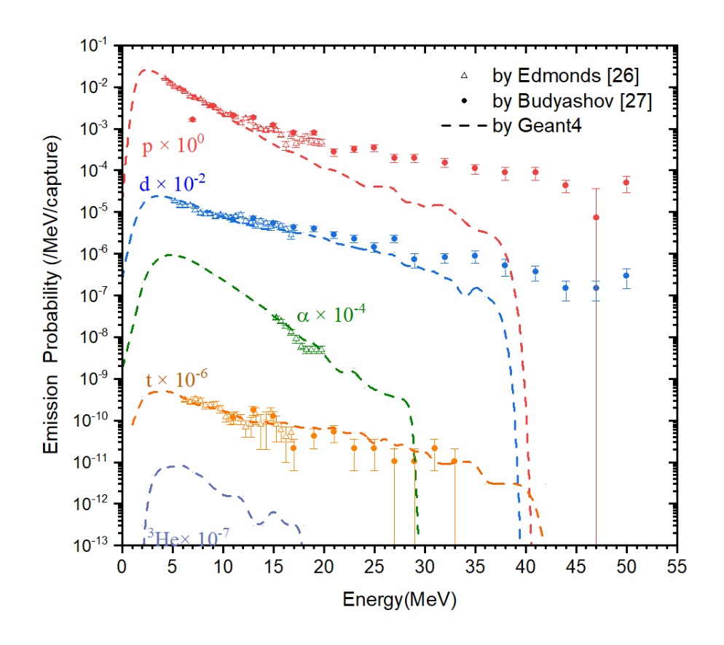
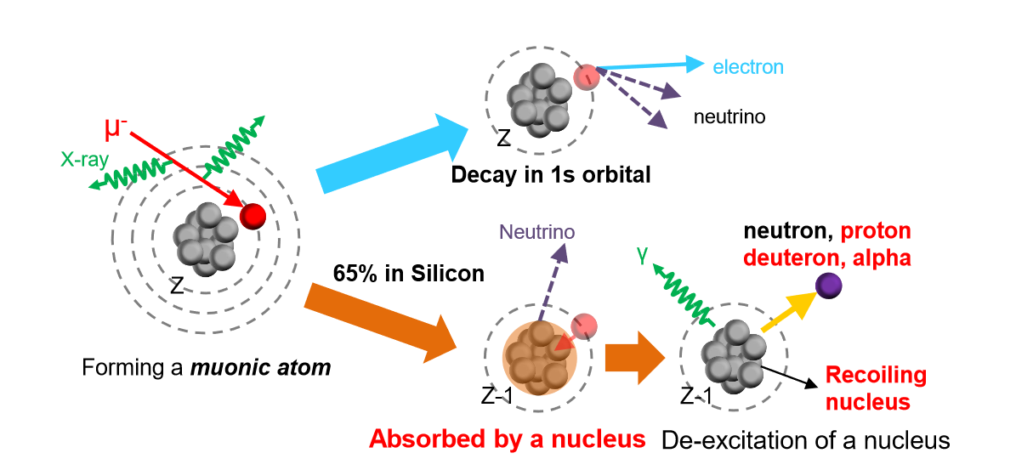
7
1. 研究背景
1.3 Characteristics of Muons
Negative Muon Capture
De-excites by releasing charged particles, neutrons, or gamma
Fig 1.9 Measured and simulated energy spectra of protons, deuterons, tritons, and alpha particles from the muon capture reaction on silicon
Fig 1.8 Schematic illustration of the negative muon capture

Slide 10
8
1. 研究背景
1.5 Previous Works

Slide 11
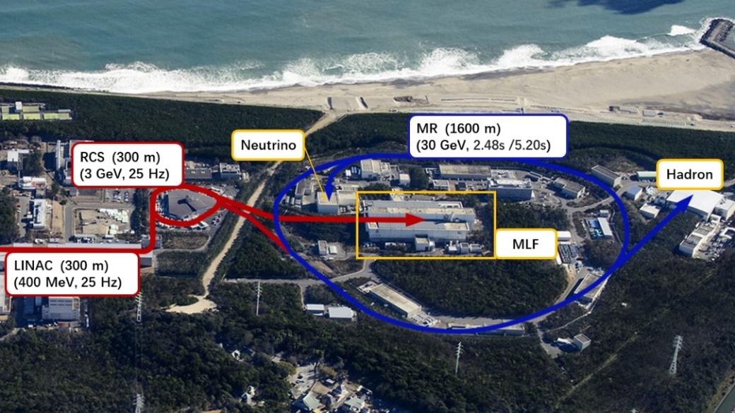
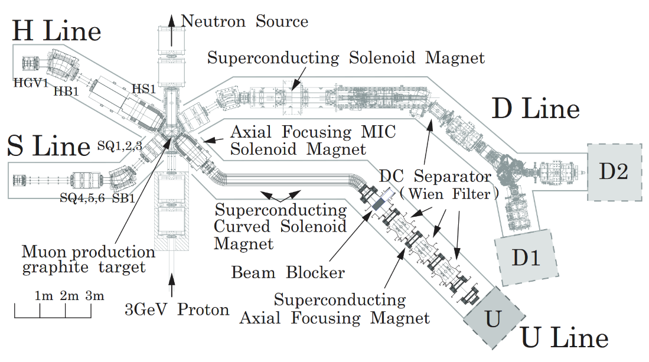
9
2. 实验研究
2.1 Muon Science Facility
D1 / D2 Line | Decay muon (μ±)
Beam Energy Range | 2 – 54 MeV
FWHM (σ) | 15% (6.38%)
Pulse Width | 100 – 130 ns
Pulse Interval | 40 ms
Beam Size | 70 mm × 70 mm
Beam Intensity | 10⁶ – 10⁷ /s
Fig 2.1 Aerial shot and facilities layout in J-PACR
Fig 2.2 Layout of the Muon Science Facility (MUSE) in MLF, J-PARC

Slide 12
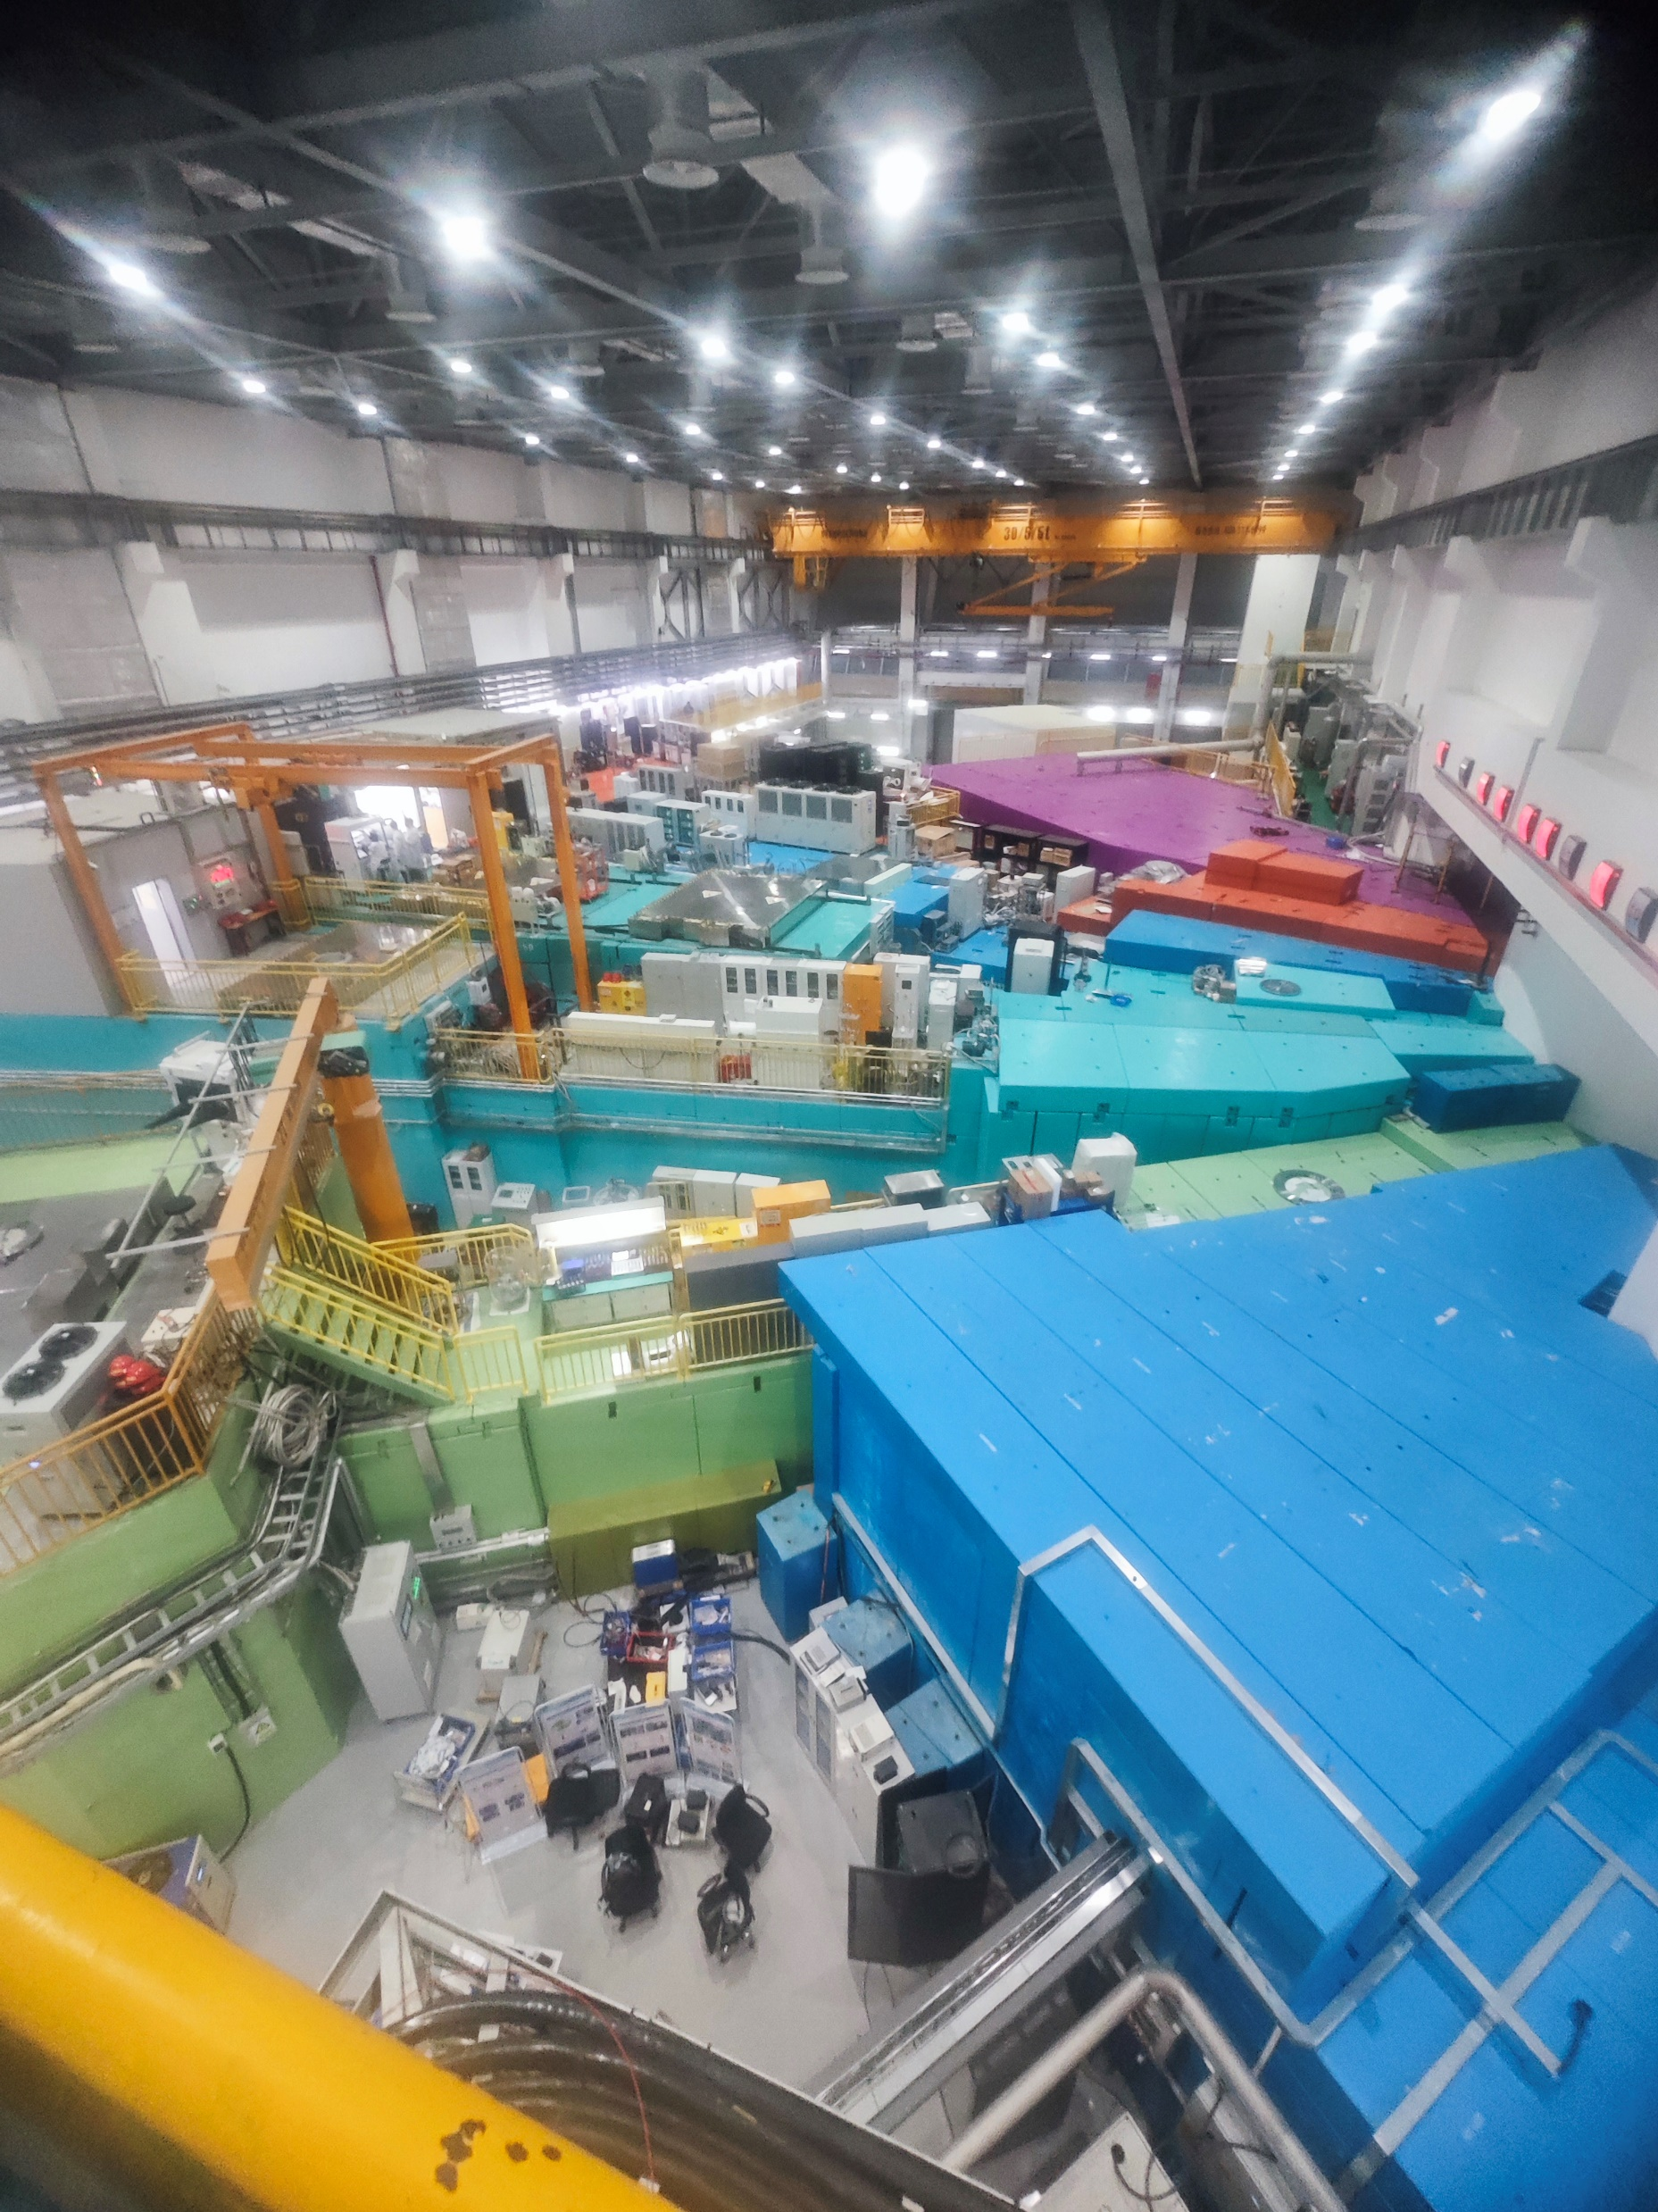
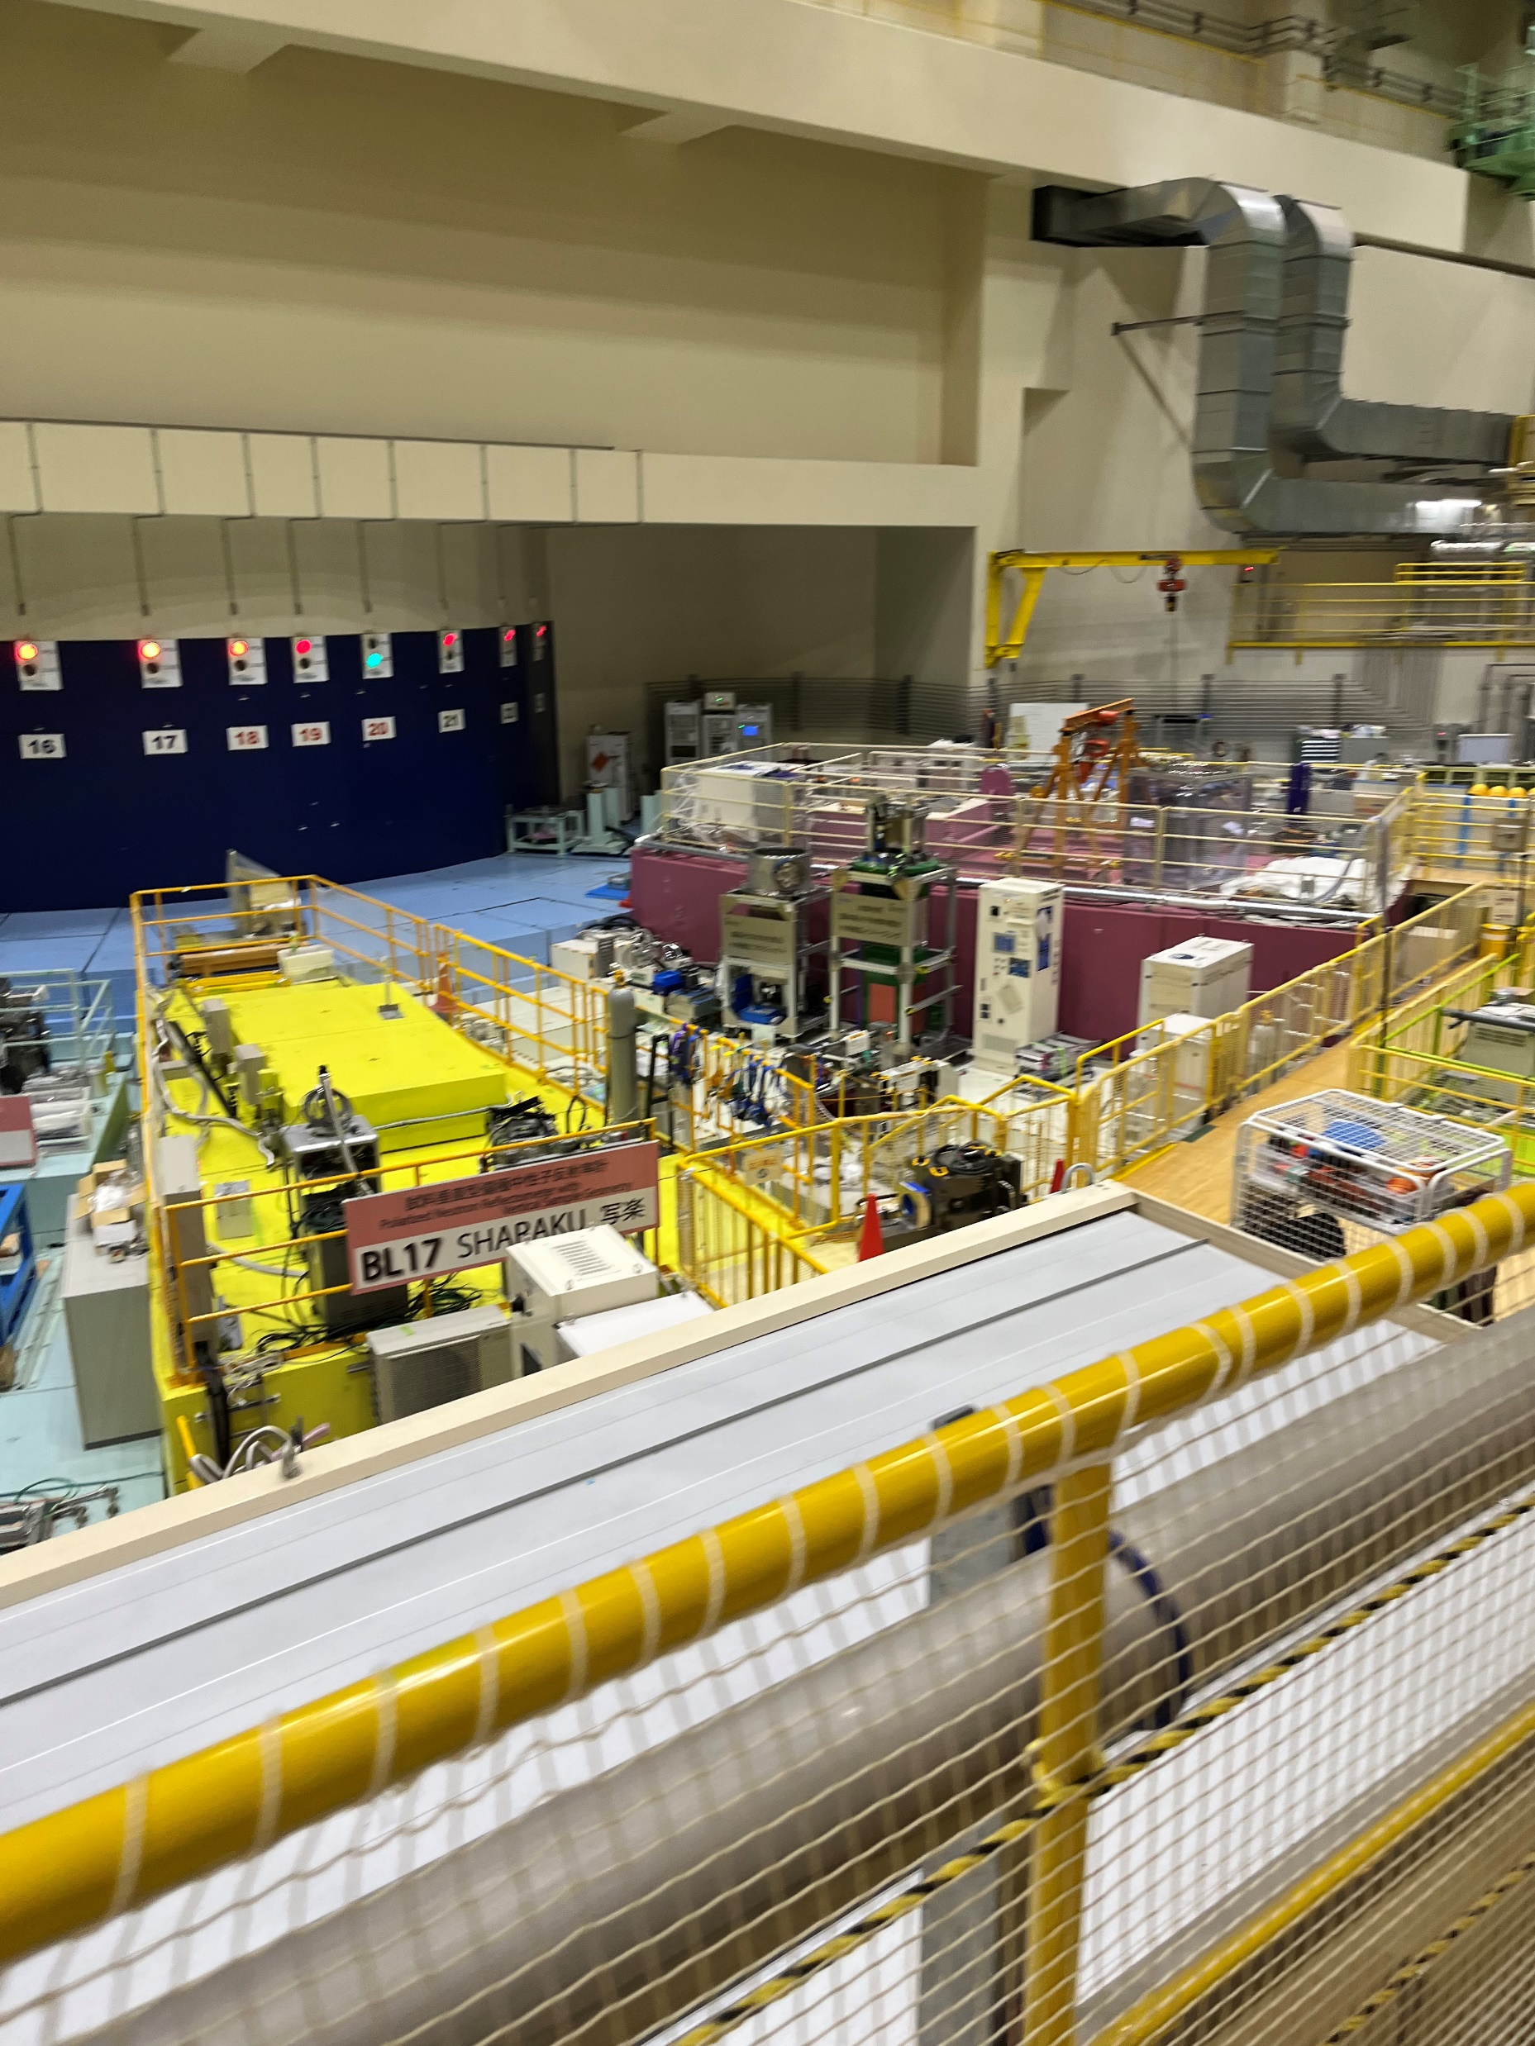
10
2. 实验研究
2.1 Muon Science Facility
Fig 2.3 Layout of the CSNS
Fig 2.4 Layout of the MLF

Slide 13
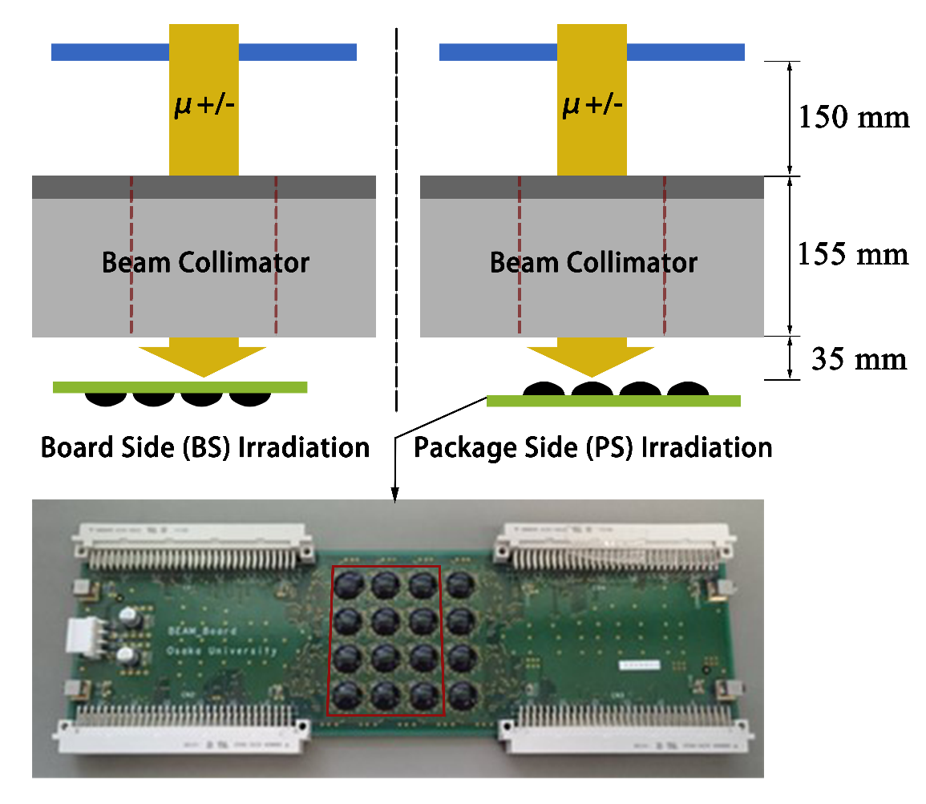
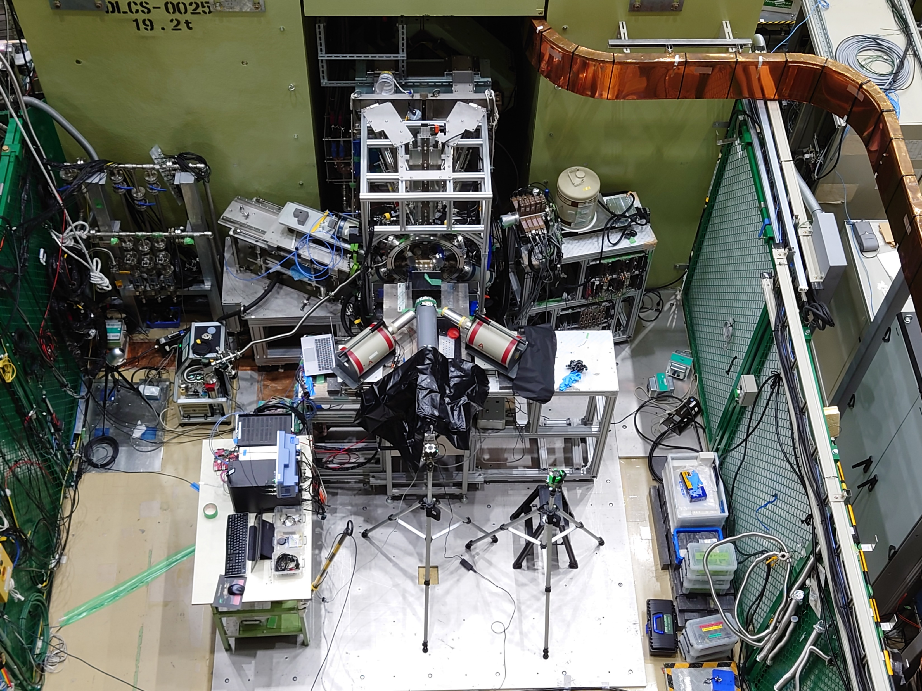
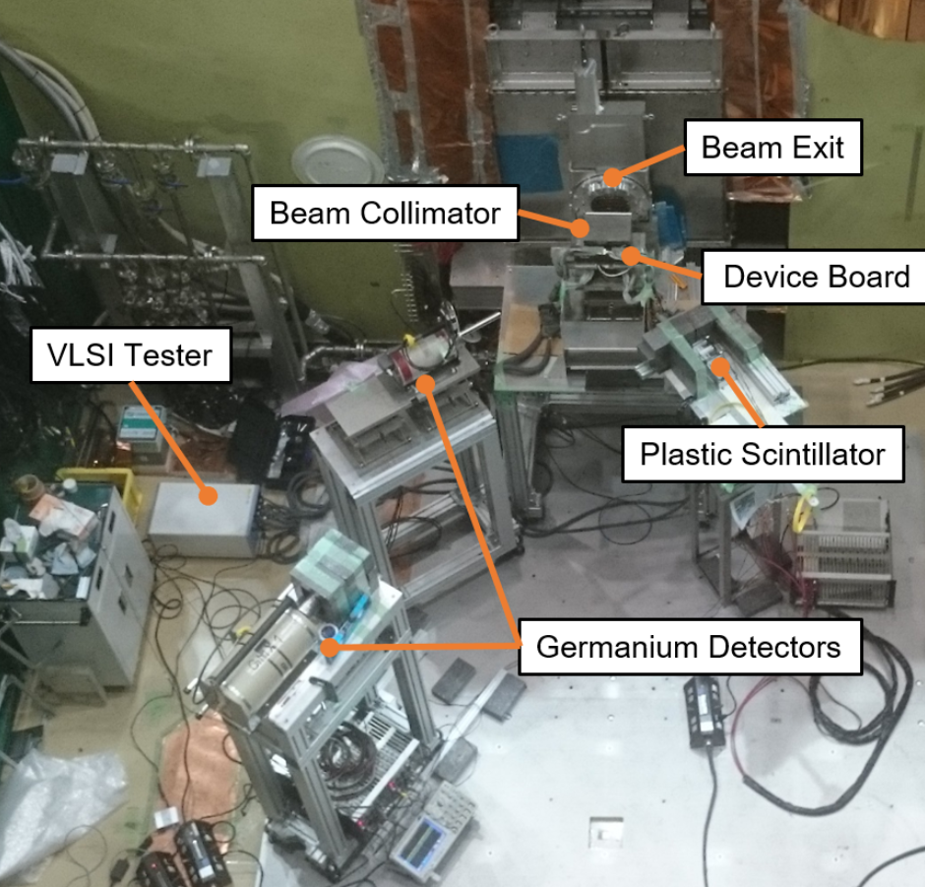
11
2. 实验研究
2.2 Experiment Setup
2.2.1 Experiment Layout in Different Irradiation Sides
Fig 2.5 Overall layout of the experimental setup in the irradiation tests.
Fig 2.6 Photograph of the experimental setup during irradiation tests.

Slide 14
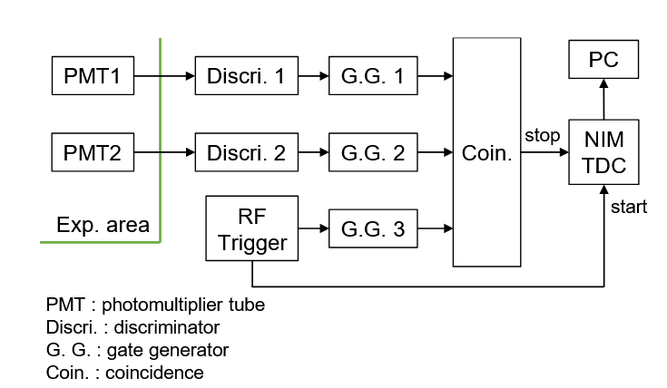
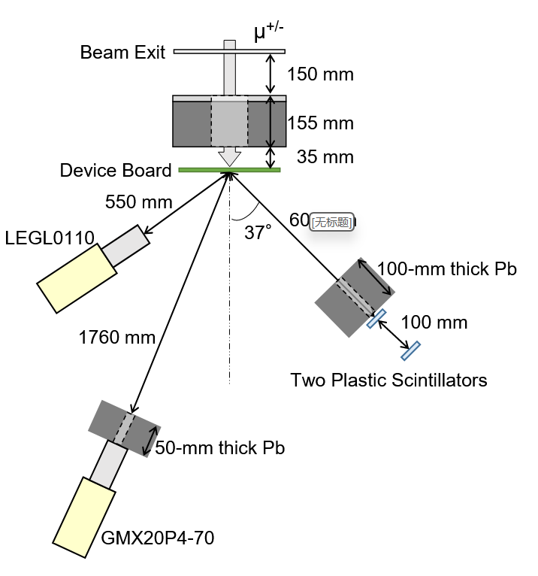
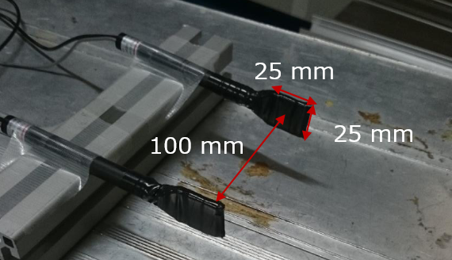
12
2. 实验研究
2.2 Experiment Setup
Fig 2.7 (a) Schematic diagram of the data acquisition circuit of the two plastic scintillators.
Fig 2.7 (b) Photograph of the two plastic scintillators used in the experiment.
Fig 2.8 Arrangement of the detectors during the experiment

Slide 15
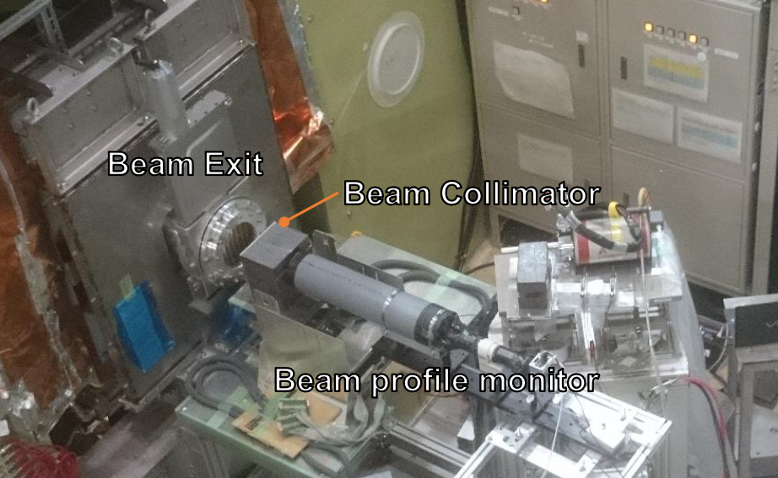
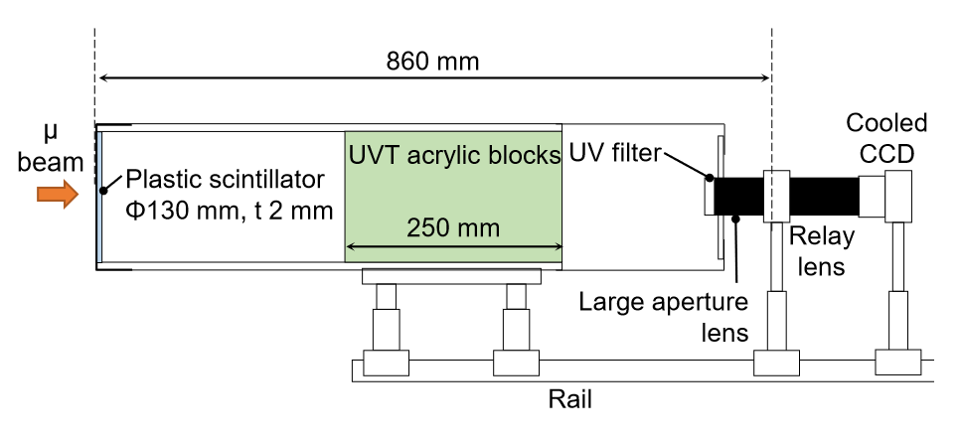
13
2. 实验研究
2.2 Experiment Setup
Flux Measure | Result | Steps | Applied Momentum Range
 |  |  | PS Irradiation | BS Irradiation
Counter Telescope | Absolute values | 1 MeV/c | None | 34 – 44 MeV/c
Beam Profile Monitor | Relative values | 2 MeV/c | 24 – 36 MeV/c | 32 – 44 MeV/c
2.3.1 Image Luminance of the Beam Profile Monitor Output
Fig 2.9 Layout of the relative muon flux measurement.
Fig 2.10 Schematic drawing of the beam profile monitor

Slide 16
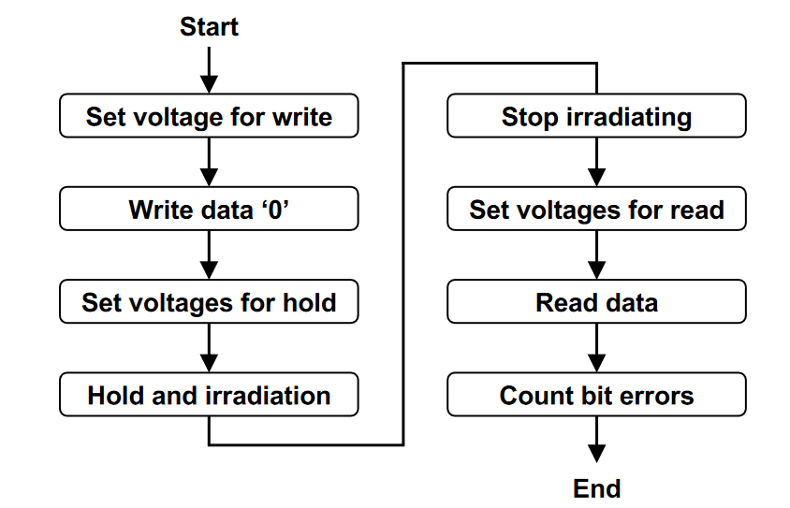
14
2. 实验研究
2.3 Measurement of SEU Cross Sections
PS irradiation | BS irradiation
24 - 36 MeV/c | 34 - 42 MeV/c
The SEU cross section σ_{<SEU>} was derived by:
N_{SEU} : the number of recorded SEUs in the tests
N_{bit} : the number of memory bits in the device
Φ : the total fluence of incident muons during the test
Fig. 2.11 Flow chart of the muon irradiation process.

Slide 17
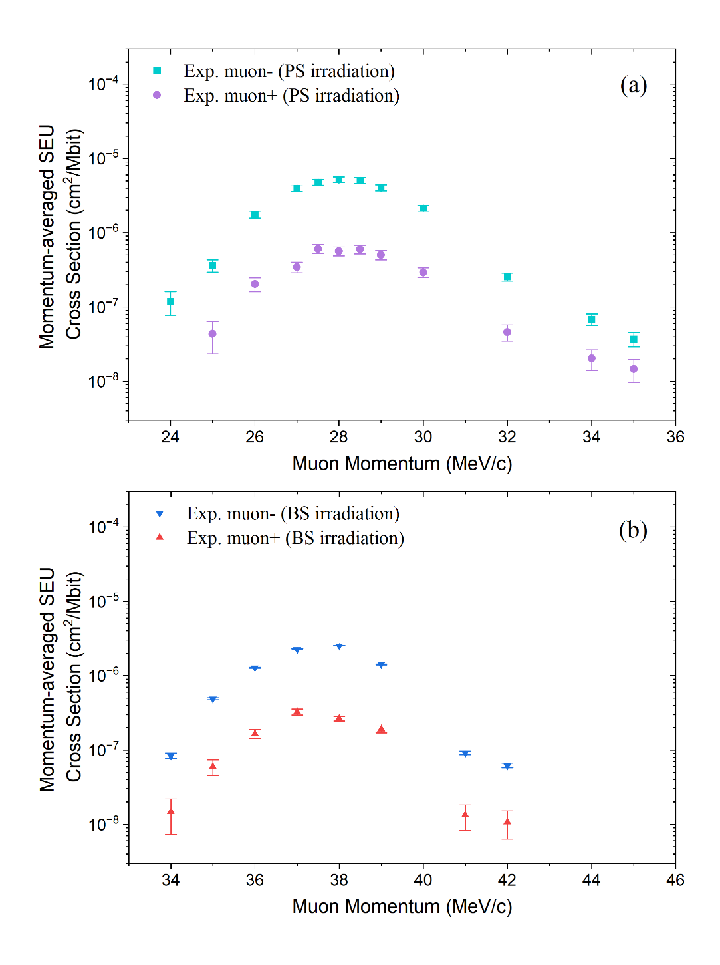
15
2. 实验研究
2.4 Results of the Irradiation Tests
The peak cross section for negative muons is about 9 times larger than that for positive muons in both the PS and BS irradiations.
The peak of the SEU cross-section in the BS irradiation tests appears at 38 MeV/c, which is much higher than that in the PS irradiation tests, i.e., 28 MeV/c.
The peak SEU cross-section of the PS irradiation is about twice larger than that of the BS irradiation for both positive and negative muons.
Fig 2.12 Panel (a) shows the measured and simulated positive and negative muon SEU cross sections of 65-nm bulk SRAM for the PS irradiation test, while panel (b) shows those for the BS irradiation test.

Slide 18
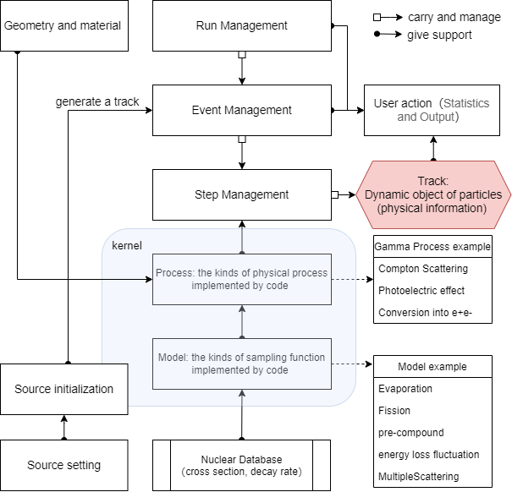
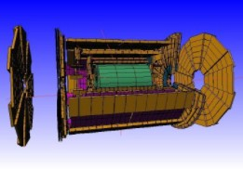
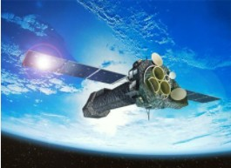
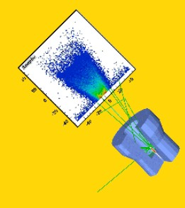
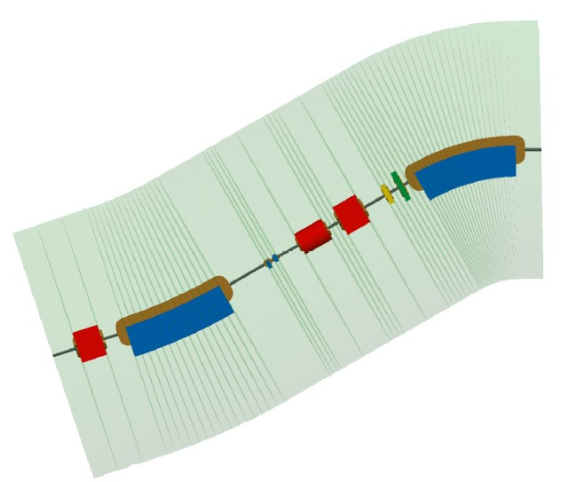
16
3. 蒙特卡罗模拟
模拟工具 | 开发维护 | 编写语言 | 输入 | 是否开源 | 特点
Geant4 | CERN | C++ | C++，mac | 是 | 统计，物理模型自由
Phits | JAEA | Fortran | 伪代码 | 否 | 缪子物理优化
Fluka | CERN | Fortran | 伪代码 | 否
Geant4 is a Monte Carlo simulation tools of particle transportation which is managed by CERN.
High Energy Physics | Space and Radiation | Medical Application | Accelerator design
Fig 3.1. A structure diagram of the Geant4 toolkit.

Slide 19
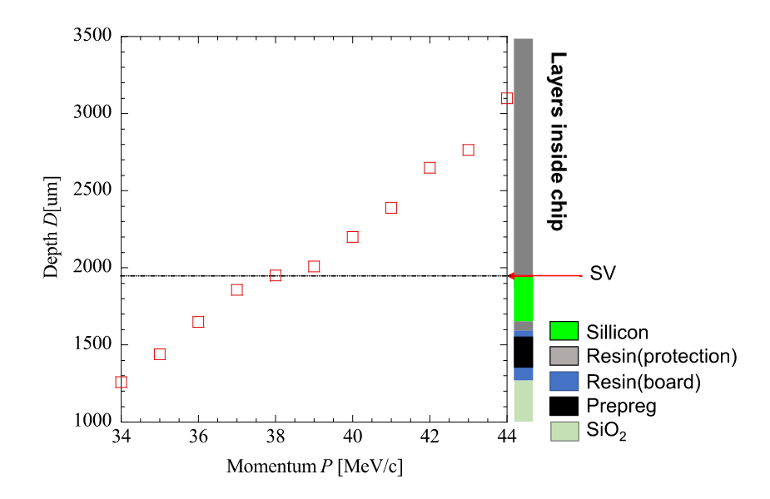
17
3. 蒙特卡罗模拟
3.1 Pre-Test Simulation
Determine the experimental momentum range
Estimated experimental time required
Pre-simulation of detector system efficiency
Fig 3.2. The stopping depth of muons with different momenta is used in the experiment. The depth of 38-MeV/c muon is the closest to SV compared with the other momenta.

Slide 20
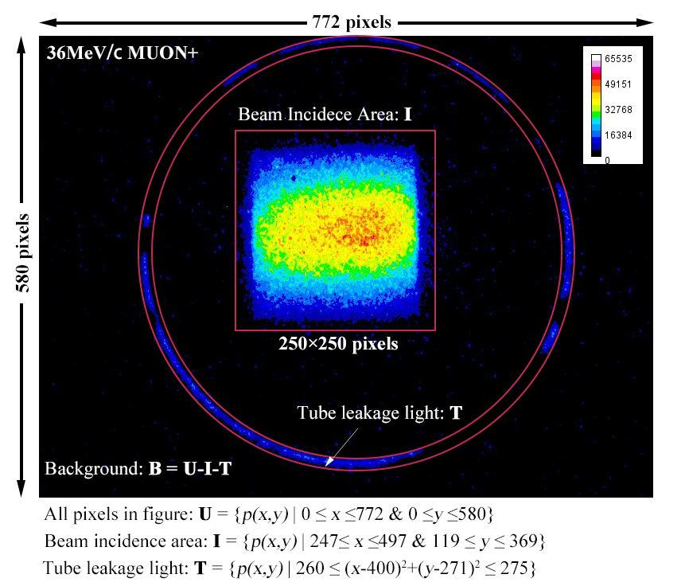
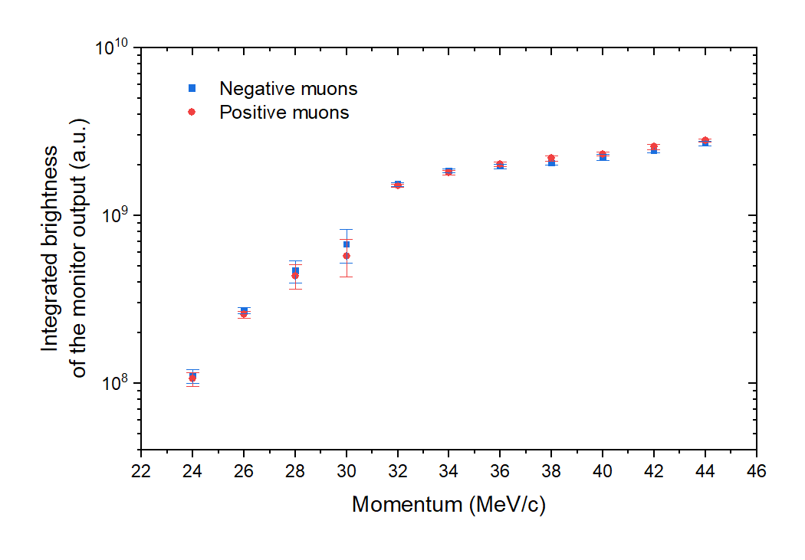
18
3. 蒙特卡罗模拟
3.2 Beam Intensity Analysis
Image Luminance of the Beam Profile Monitor Output
L_{p} : the brightness at pixel point p(i,j)
n_{I} : is the number of pixels in the integration area I
n_{B} : the pixel number in the background area
B : The background area is designated as B = U-I-T
Fig 3.4 Momentum dependence of the integrated brightness L of the beam profile images
Fig 3.3 A two-dimensional profile image of the beam intensity for a positive muon beam of 36 MeV/c

Slide 21
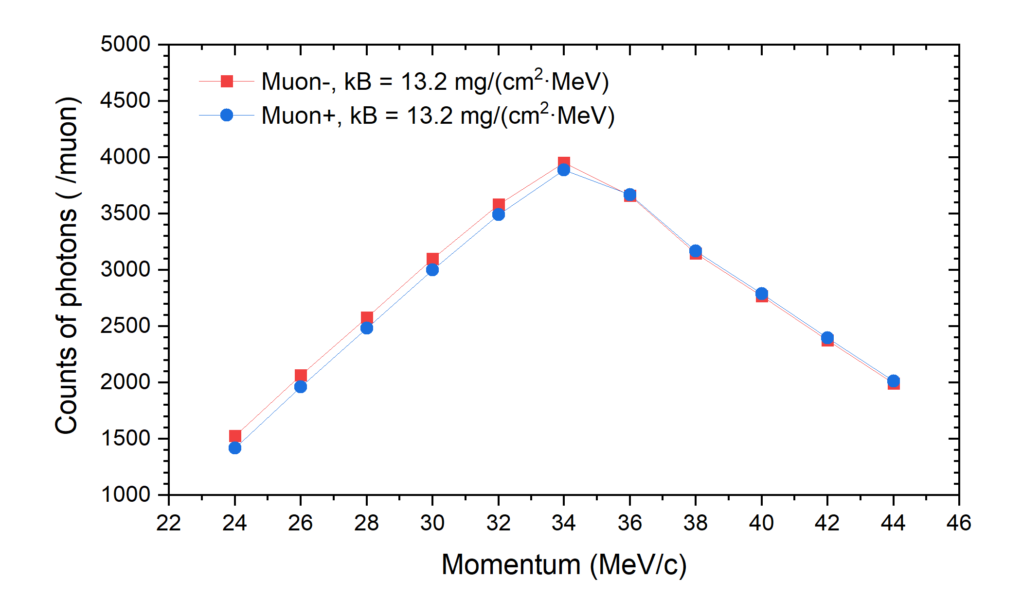
19
3. 蒙特卡罗模拟
3.2 Beam Intensity Analysis
To convert L to the relative beam intensity, the non-linear response of organic scintillators (Birks effect) should be considered:
Fig 3.5 A Geant4 Simulation of the beam profile monitor
N_{ph} : The number of generated photons in the scintillator per incident muon
kB : Birks constant
d : the scintillator thickness,
dE/dx : the ionization density
Y₀ : the absolute light yield
Fig 3.6 Simulated photon productions N_{ph} in the scintillator for incident muons with different momenta

Slide 22
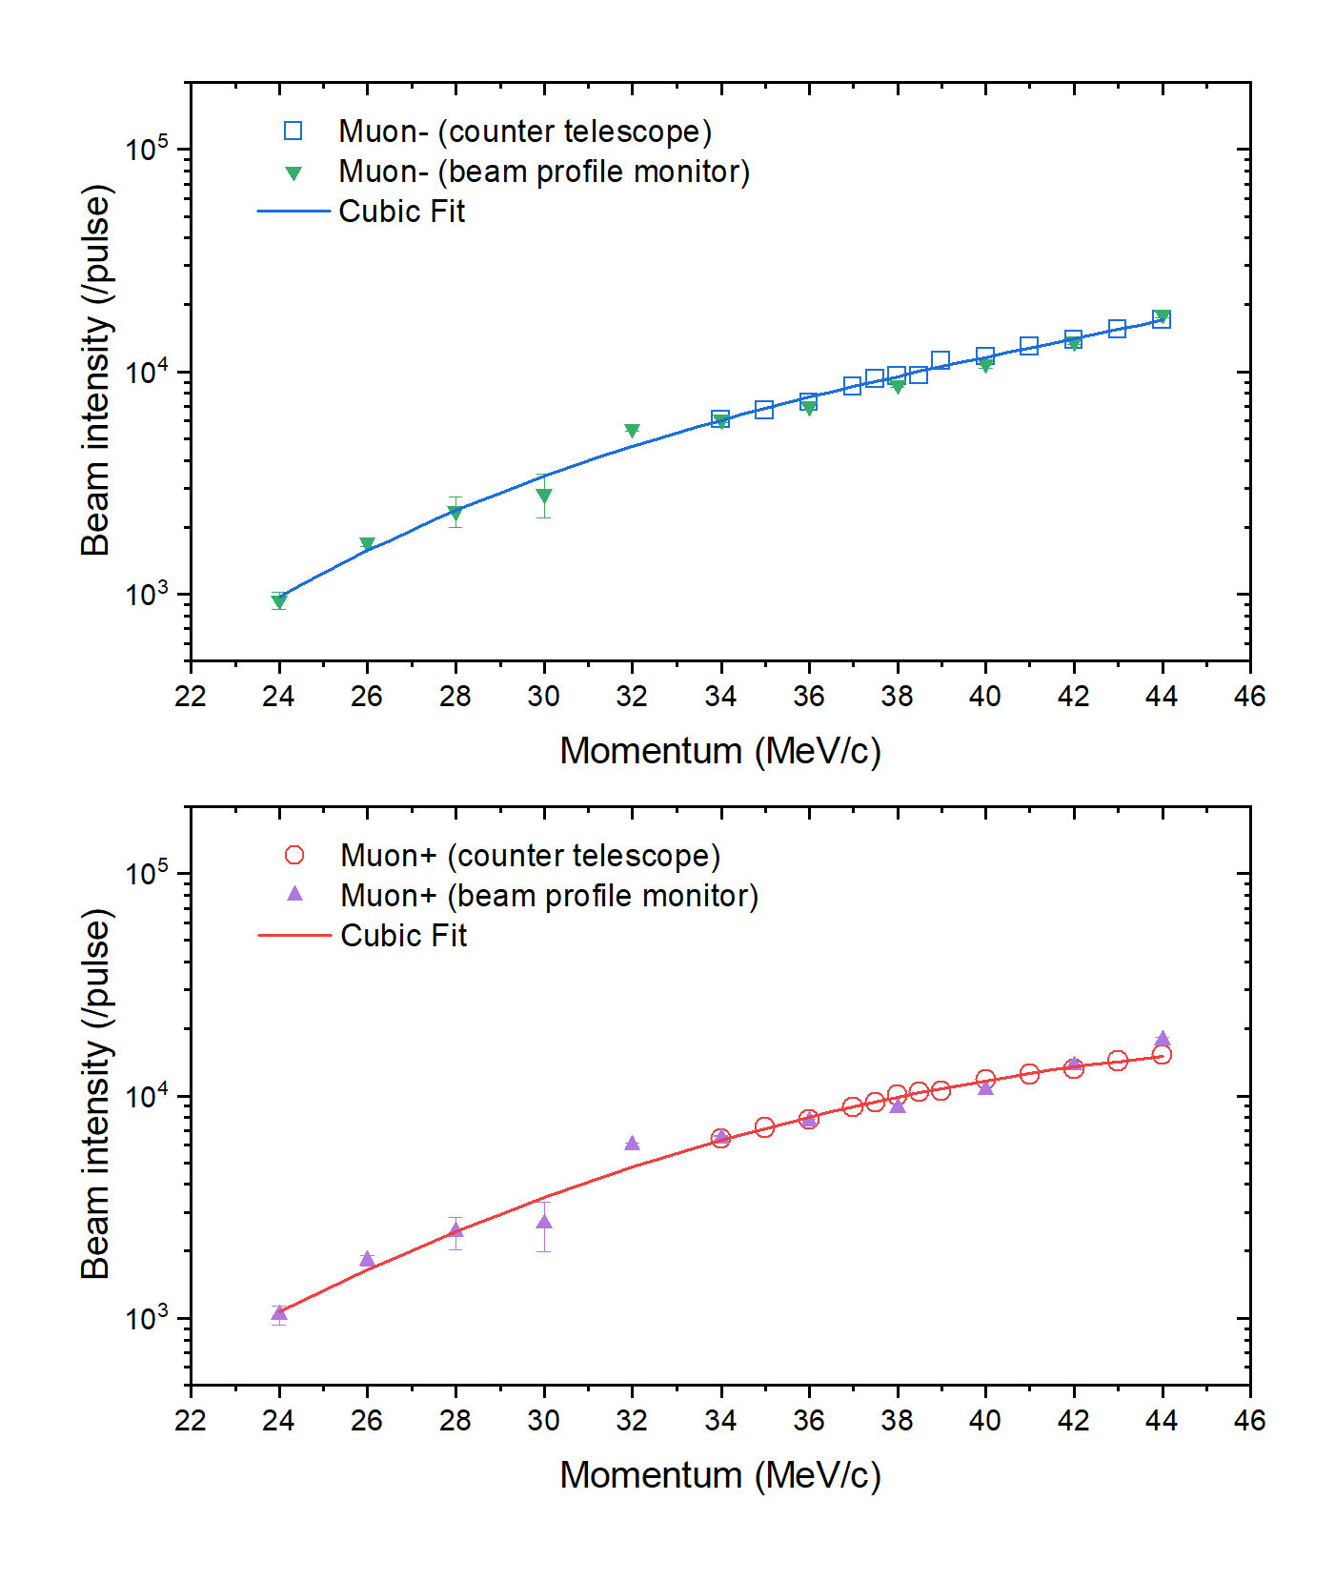
20
3. 蒙特卡罗模拟
3.2 Beam Intensity Analysis
Finally, the relative beam intensity was obtained using
The relative beam intensities measured by beam profile monitor are normalized to the absolute measurement by the counter telescope at 34 MeV/c for both positive and negative muon.
Fig 3.7 Measured intensities of the pulsed muon beams with the two different methods.

Slide 23
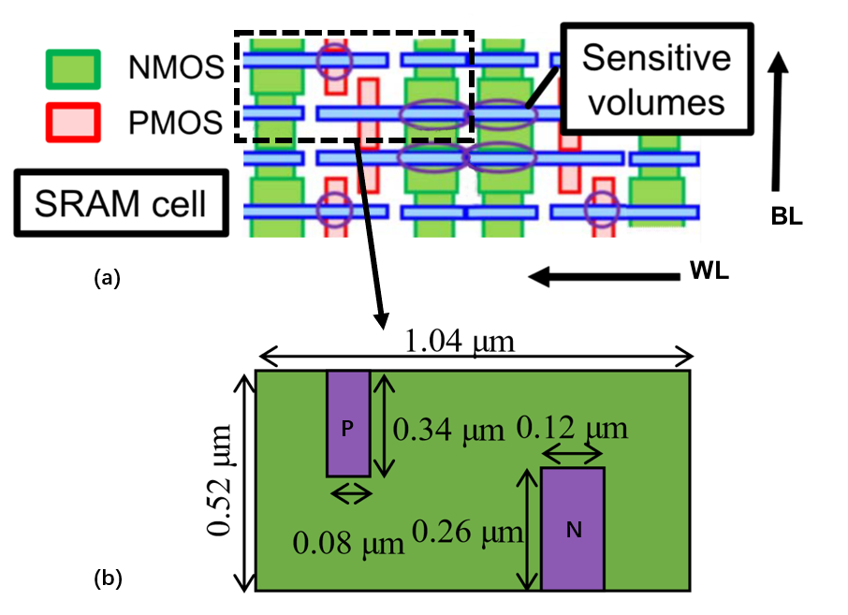
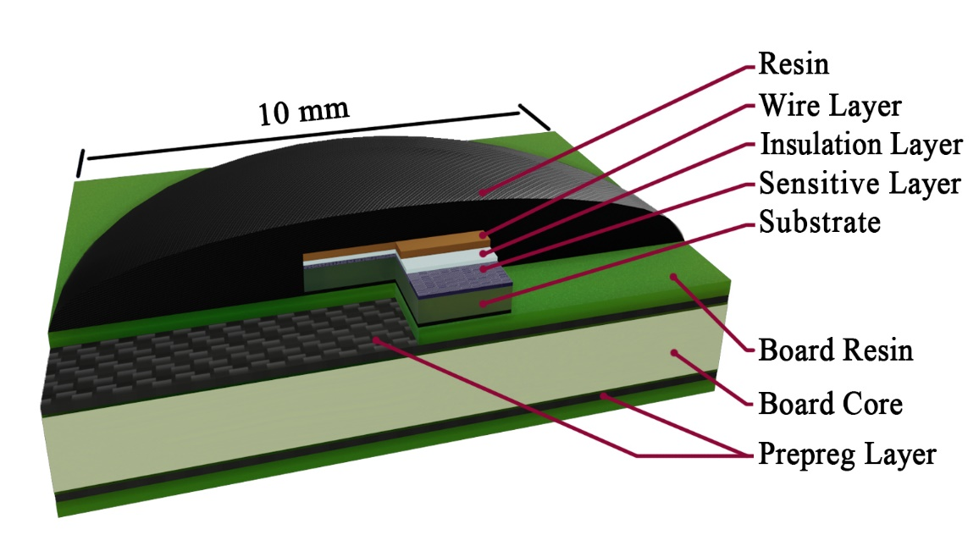
21
3. 蒙特卡罗模拟
3.3 Cross Section Simulation
3.3.1 Geometry Used in Simulation
Structure | Sub-layer | Composition | Density (g/cm³)
Chip | Metal Wire Layer | Cu & SiO₂ | 5.785
 | Insulation Layer | SiO₂ | 1.5
 | Sensitive Layer | Si | 2.329
 | Substrate Layer | Si | 2.329
Board | Board Resin | C₁₅H₁₆O₂ | 1.7
 | Board Core | SiO₂ | 1.5
 | Prepreg Layer | C₁₅H₁₆O₂ | 1.8
Package | Package Resin | C_{22.9}H_{26.1}O_{4.3} & C₉H₁₀O₃ & SiO₂ | 1.75
Fig 3.8 Geometric model of SRAM in simulation
Fig 3.9 (a) Schematic layout of a 2×2 SRAM cell and (b) SV structure configuration of a memory cell in the simulation.

Slide 24
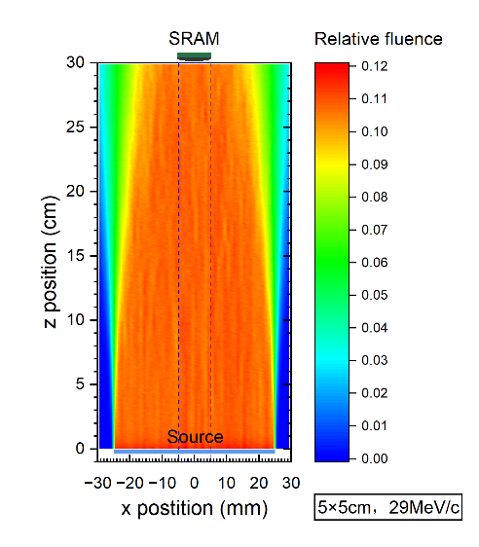
22
3. 蒙特卡罗模拟
3.3 Cross Section Simulation
3.3.2 Beam Source and SEU Determination
Beam source is a 340 mm air distance from the device. The size of the muon beam source is set to be 28 × 28 mm square. The standard deviation of the energy distribution is set to be 7.8% .
An SEU occurs when the deposition energy in SV greater than the threshold value E_{th}
e : the elementary charge
E_{pair} : to the minimum energy to create an electron-hole pair in silicon
Fig 3.10 Fluence distribution of 29MeV/c muons in case of 5×5 cm square source.

Slide 25
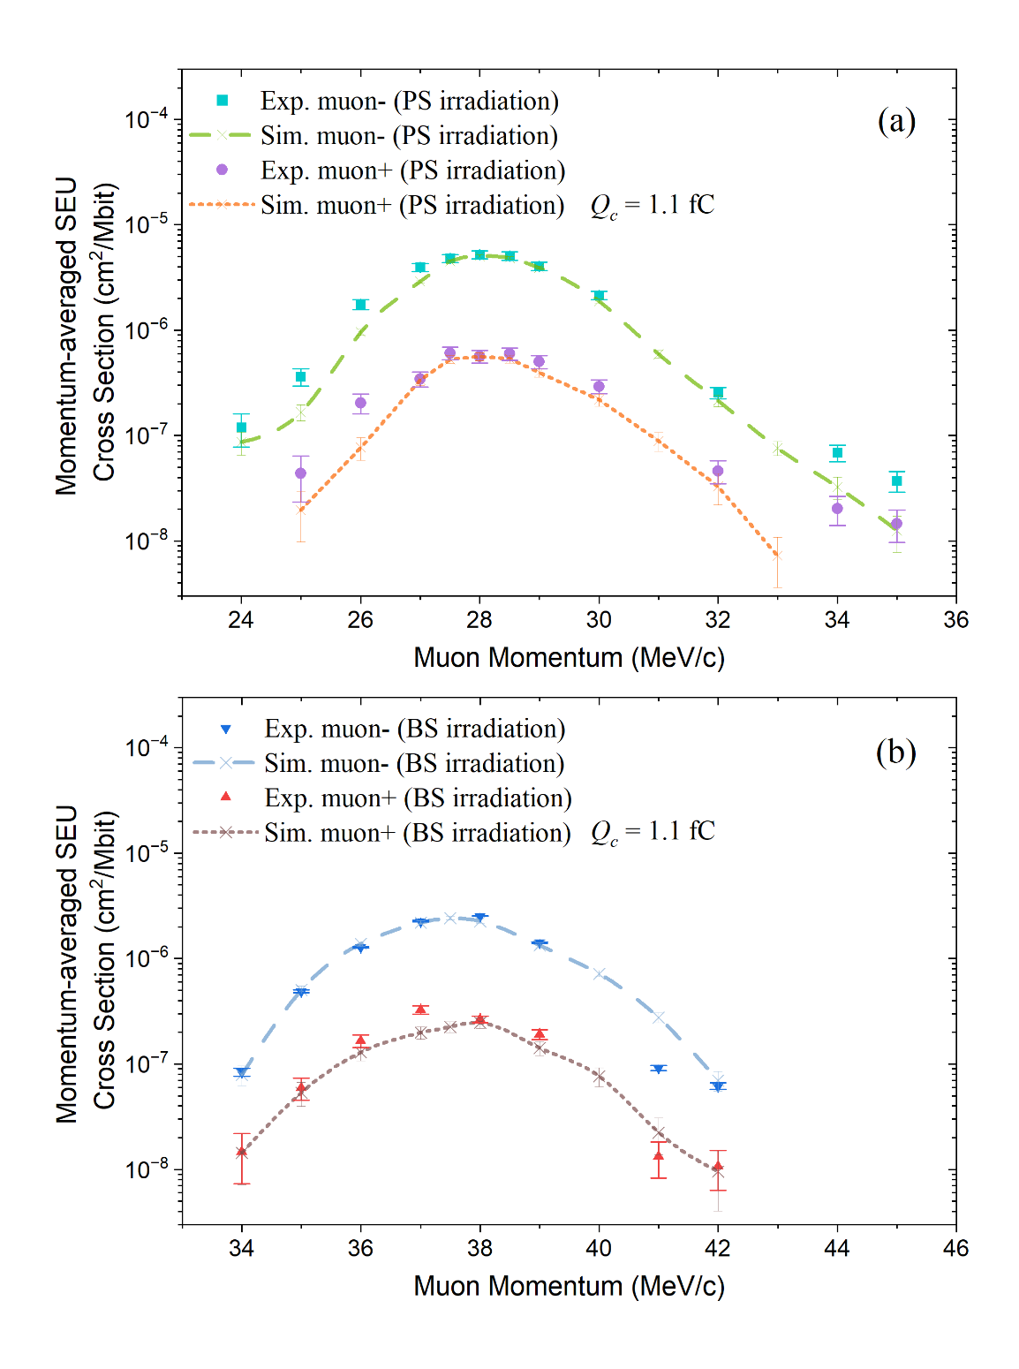
23
3. 蒙特卡罗模拟
3.3 Cross Section Simulation
3.3.3 Muon Momentum Dependence
The simulated peak positions and cross-sections under the BS irradiation agree well with the experimental results for both positive and negative muons.
The simulated results of the peak position and the cross sections near the peak region agree with the experimental results for PS irradiation.
the simulated cross-sections are smaller than the experimental ones in the non-peak area, This may because the standard deviation of the muon energy spectrum may vary with momentum.
Fig 3.11 The simulation results of momentum-dependent SEU cross sections induced by positive and negative muon for both PS and BS irradiation tests.

Slide 26
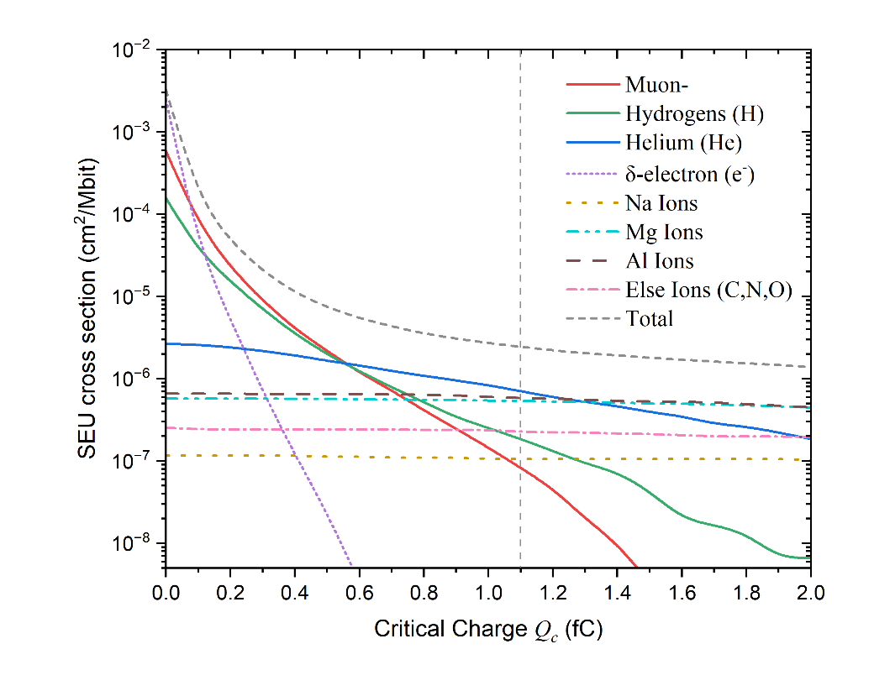
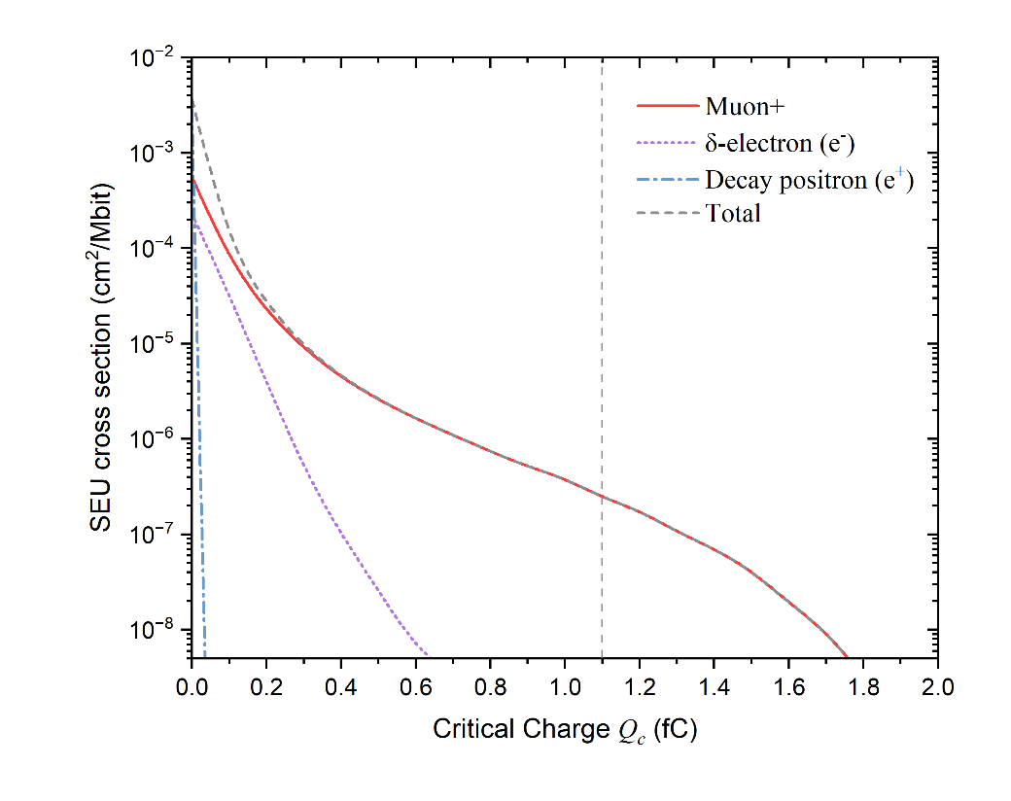
24
3. 蒙特卡罗模拟
3.4 Physical mechanism analysis
3.4.1 Critical Charge Dependence
Fig 3.12 Critical charge-dependent SEU cross sections induced by 38 MeV/c negative muons direct ionization and secondary ions from muon capture, in the case of BS irradiation.
Fig 3.13 Critical charge-dependent SEU cross sections induced by 38 MeV/c positive muons direct ionization in the case of BS irradiation.

Slide 27
25
3. 蒙特卡罗模拟
3.4 Physical mechanism analysis
3.4.1 Critical Charge Dependence
Helium (He) and the residual nucleus Magnesium (Mg) and Aluminum (Al) released from muon capture are the primary causes of the negative muon SEU
The Hydrogens (H) come in the second contribution of SEU, followed by direct ionization of negative muon.
Fig 3.14 Contribution of direct ionization and secondaries from muon capture to the SEU in the case of 38 MeV/c negative muon BS irradiation. The critical charge was set to 1.1 fC.

Slide 28
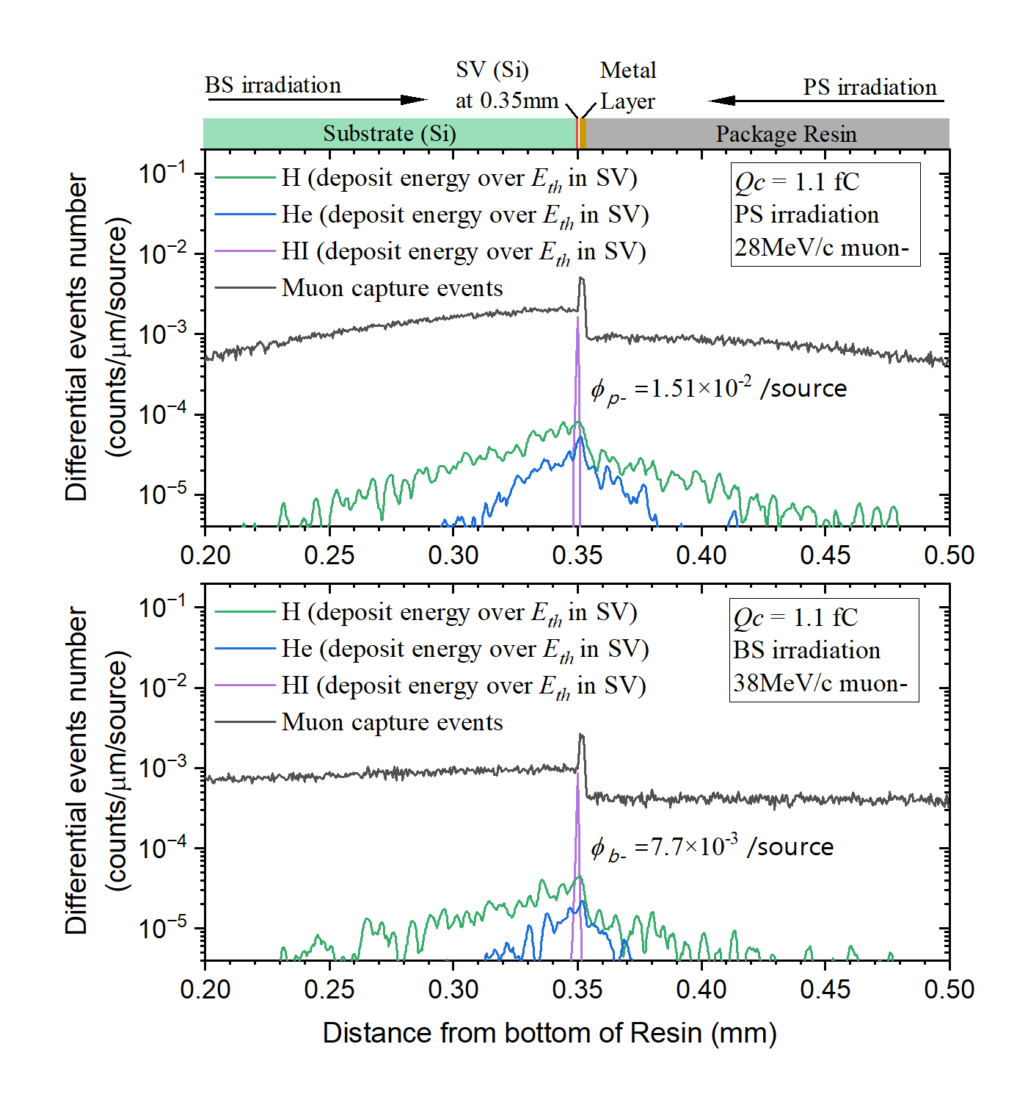
26
3. 蒙特卡罗模拟
3.4 Physical mechanism analysis
Quantitative Assessment of the Impact of Energy Straggling on SEU
The spatial distribution of the negative muon capture events is shown with the black curves
Once the secondary ions released from the muon capture reaction deposit the energy over E_{th} in the SV, the events are counted at their released (initial) position
the events of all the secondary ions, whose deposition energies in the SV exceed E_{th}, are added and defined as the effective SEU fluence of negative muons. Their ratio between PS and BS irradiation is :
Fig 3.15 Spatial distributions of muon capture events for PS and BS irradiation with negative muons.

Slide 29
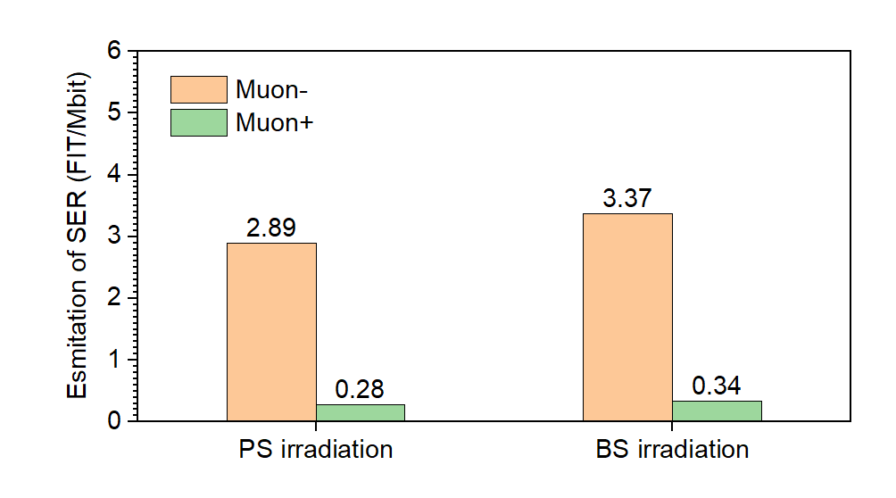
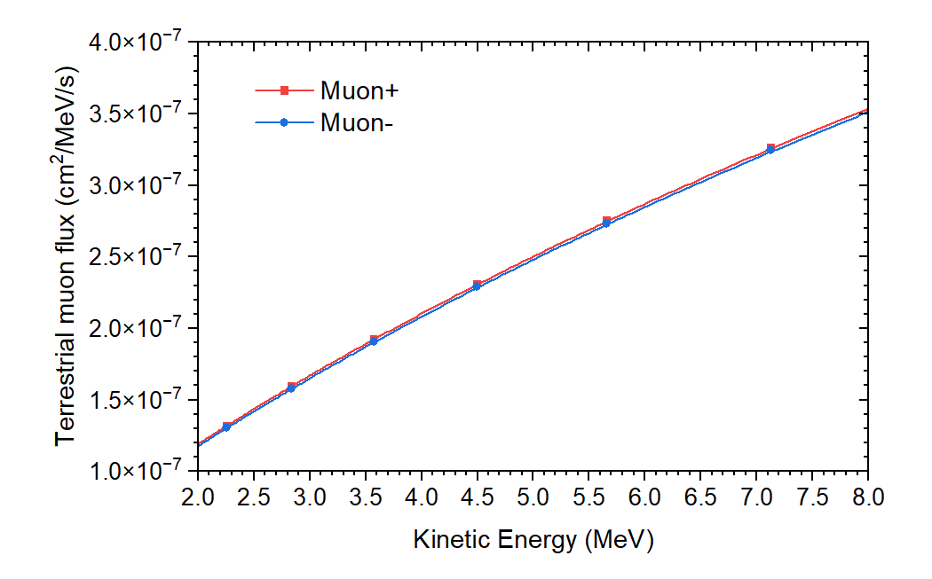
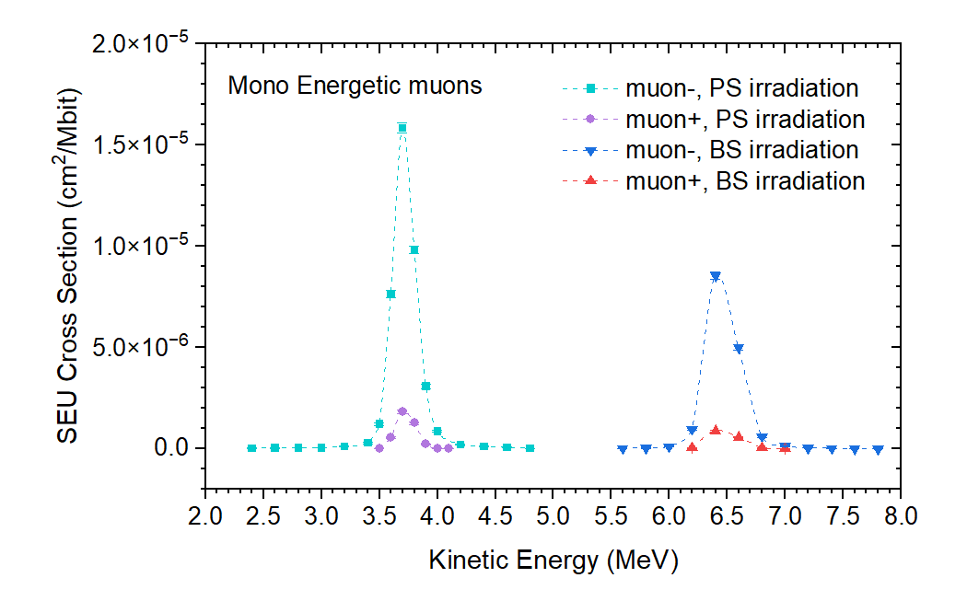
27
3. 蒙特卡罗模拟
3.5 SER prediction
The difference of estimation SERs between the BS and PS irradiation is at most 21%. The impact of the irradiation side on SER prediction is relatively weak.
Compared to PS irradiation, BS one has larger φ(E) but a smaller σ(E)
Fig 5.3 The estimated SERs of positive and negative muons for 65-nm bulk SRAM. The SEU cross-sections derived from the PS and BS irradiation tests are used in the estimation.
Fig 5.1 φ(E)
Fig 5.2 σ(E)

Slide 30
28
3. 蒙特卡罗模拟
3.5 SER prediction
the muon SERs for the 65-nm bulk SRAM are significantly less than the proton and neutron SERs
Cosmic ray | SER [FIT/Mbit]
neutron | ~1000
Proton | 44.23
Muon+ | 0.34
Muon- | 3.37
Fig 5.4 Kinetic energy-dependent SEU cross sections induced by mono-energetic protons and positive and negative muons in 65-nm bulk SRAM with BS irradiations.

Slide 31
29
4. Geant4 使用分享
4.1 Physical list and Step simulation
Proton：INCLXX，TENDL
Muon：G4MuMinusCapturePrecompound VS Bertini Cascade
Ion：QMD

Slide 32
30
4. Geant4 使用分享
4.1 Parameterised Volumes

Slide 33
31
4. Geant4 使用分享
4.2 Parameterised Volumes
class ChamberParameterisation : public G4VPVParameterisation {
...
voidComputeTransformation(const G4int copyNo, G4VPhysicalVolume *physVol) const;
voidComputeDimensions(G4Tubs& trackerLayer, const G4int copyNo,
const G4VPhysicalVolume *physVol) const;
... }
void ChamberParameterisation::ComputeTransformation(const G4int copyNo, G4VPhysicalVolume *physVol) const {
//Note:copyNowillstartwithzero!
G4int colNum = 100, rowNum = 50; fSpacingY = 20*um; fSpacingX= 10*um;
G4int row = floor(copyNo/colNum);
G4int col = copyNo%colNum;
G4double Xposition=fStartX+ col * fSpacingX;
G4double Yposition=fStartY+ row * fSpacingY;
G4ThreeVector origin(Xposition, Yposition,0); physVol->SetTranslation(origin); physVol->SetRotation(0);
}

Slide 34
32
4. Geant4 使用分享
4.3 并行统计输出
Track
Step
parallelism level
Run
Event

Slide 35
33
4. Geant4 使用分享
4.3 并行统计输出
RunAction
.hh
.cc

Slide 36
34
4. Geant4 使用分享
Data Structure
4.3 并行统计输出
EventAction
statistical function
.cc
.hh

Slide 37
35
4. Geant4 使用分享
4.3 并行统计输出
SteppingAction
ProcessGet
const G4VProcess* process = theTrack->GetCreatorProcess();
G4String procName = "Null";
if (process) procName = process->GetProcessName();
Conditional Trigger
.cc
.dat

Slide 38
感谢指导！
邓亦凡
2025年1月3日

Slide 39
5
1. 研究背景
1.3 Characteristics of Muons
Stopping Power
Fig 1.6 Stopping power of negative and positive muons for silicon, by Geant4
Fig. B1 Quasiclassical Approach to the Interpretation of the Barkas Effect

