Slide 1

第三届BESIII-Belle II-LHCb粲强子物理联合研讨会
Two-body nonleptonic decays
of charmed baryons
报告人： 王 迪
单 位：湖南师范大学

Slide 2
第三届BESIII-Belle II-LHCb粲强子物理联合研讨会
Contents
1
Motivation
2
Flavor symmetry
3
Topological amplitudes
4
Summary

Slide 3
第三届BESIII-Belle II-LHCb粲强子物理联合研讨会
Contents
1
Motivation
2
Flavor symmetry
3
Topological amplitudes
4
Summary

Slide 4
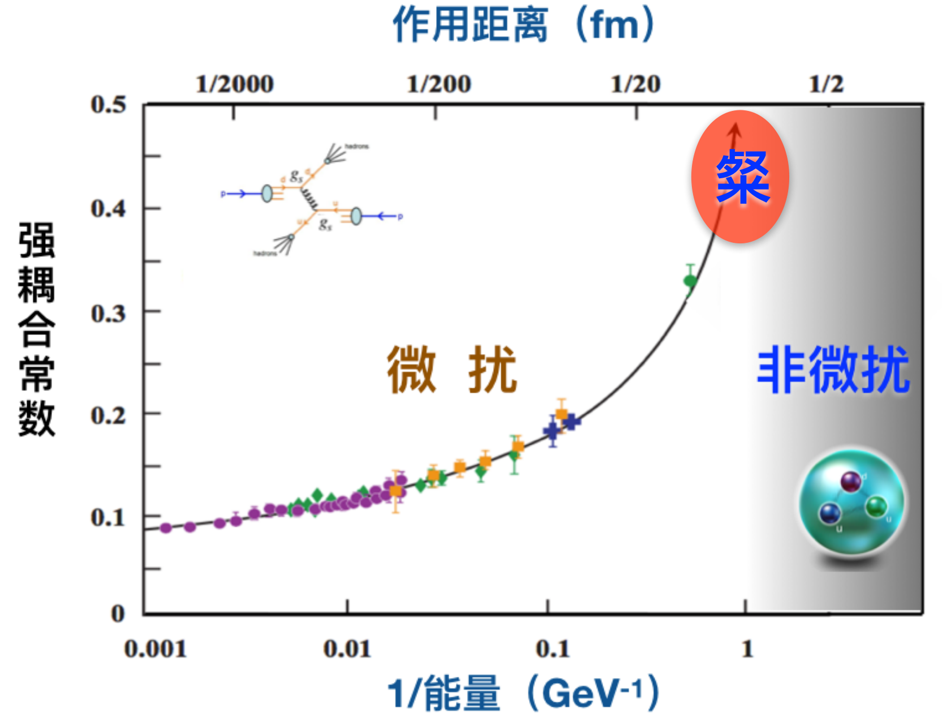
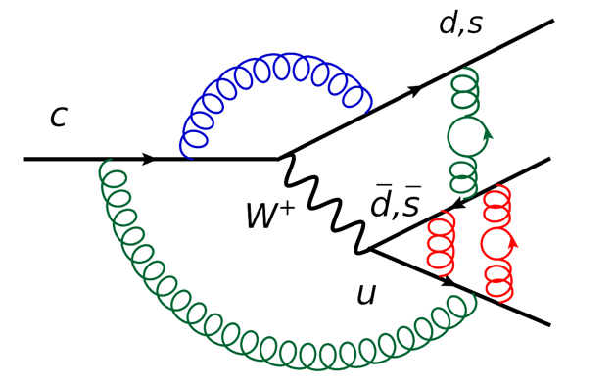
第三届BESIII-Belle II-LHCb粲强子物理联合研讨会
Charmed hadron decays
Non-perturbative
Up-type quark decay in hadron, search for new physics
Complementary to the decay of the down-type quarks d, s, b
CP violation in the SM is suppressed
4

Slide 5
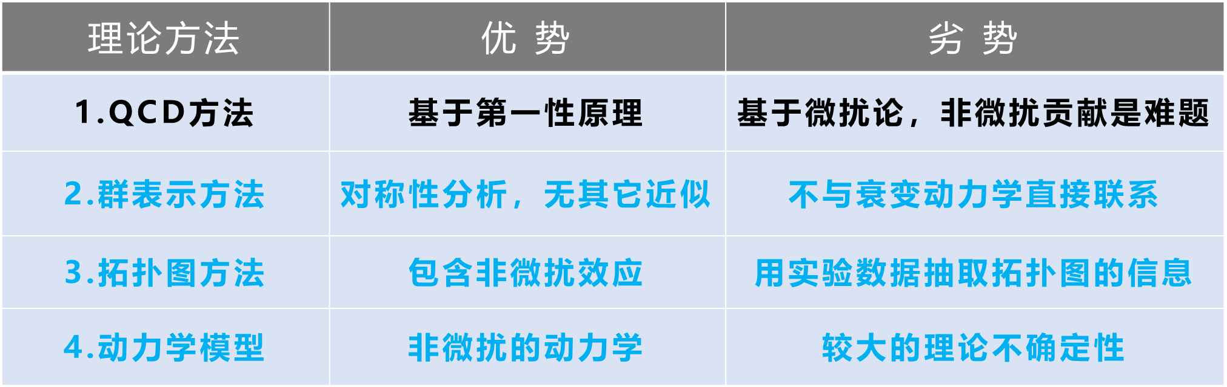
第三届BESIII-Belle II-LHCb粲强子物理联合研讨会
Charmed baryon decays
Cai-Ping Jia’ talk
Lu:2016ogy, Wang:2017azm, Shi:2017dto, Geng:2017esc, Geng:2017mxn, Wang:2017gxe, He:2018php, Wang:2018utj, He:2018joe, Geng:2018plk, Geng:2018bow, Jia:2019zxi, Geng:2019bfz, Wang:2020gmn, Li:2021rfj, He:2021qnc, Wang:2022wrb …
5

Slide 6
第三届BESIII-Belle II-LHCb粲强子物理联合研讨会
Contents
1
Motivation
2
Flavor symmetry
3
Topological amplitudes
4
Summary

Slide 7
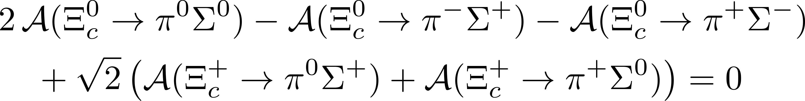
第三届BESIII-Belle II-LHCb粲强子物理联合研讨会
Flavor sum rules
Isospin sum rules
Test flavor symmetry
Estimate branching fraction
How to get the flavor sum rules?
7

Slide 8
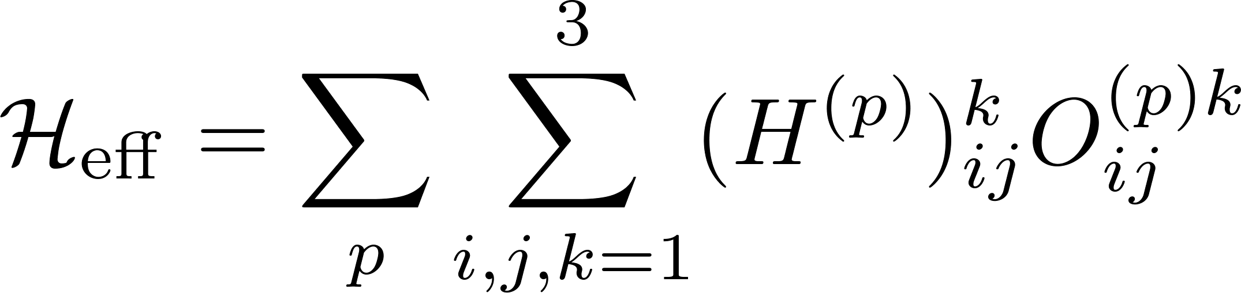
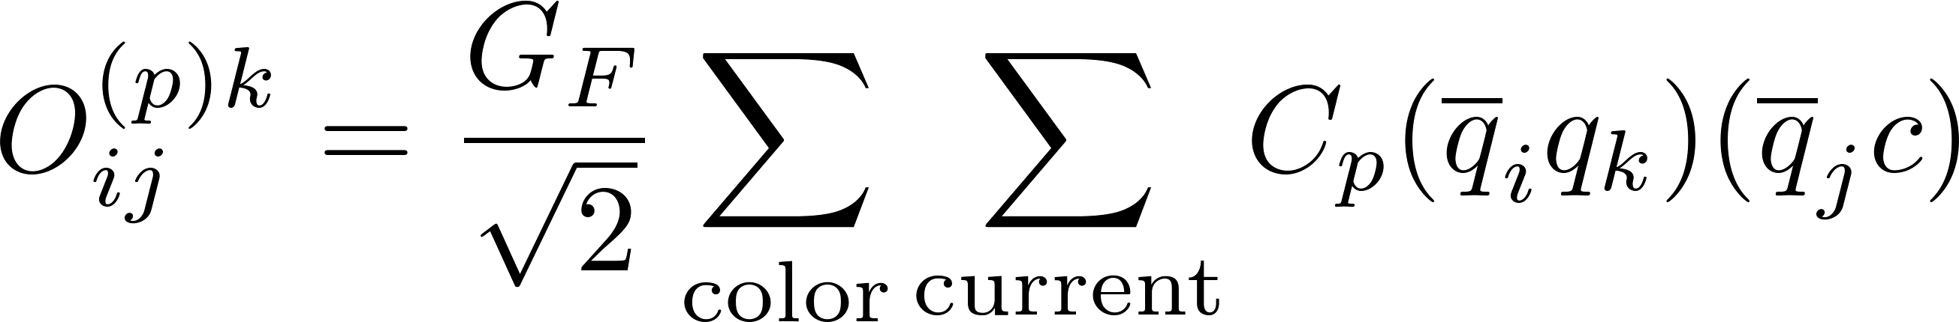
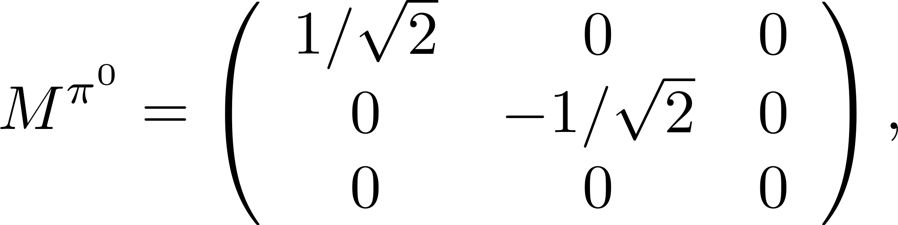
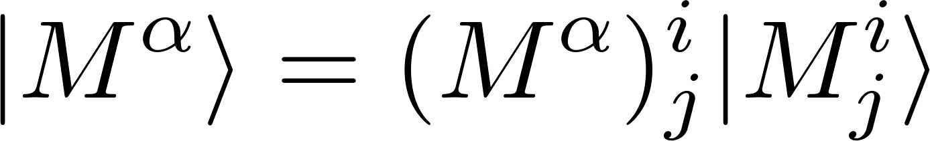
第三届BESIII-Belle II-LHCb粲强子物理联合研讨会
Charmed baryon decays
Effective Hamiltonian
CKM
Operator
Hadrons
…
D. Wang, C. P. Jia and F. S. Yu, JHEP 09, 126 (2021).
8

Slide 9
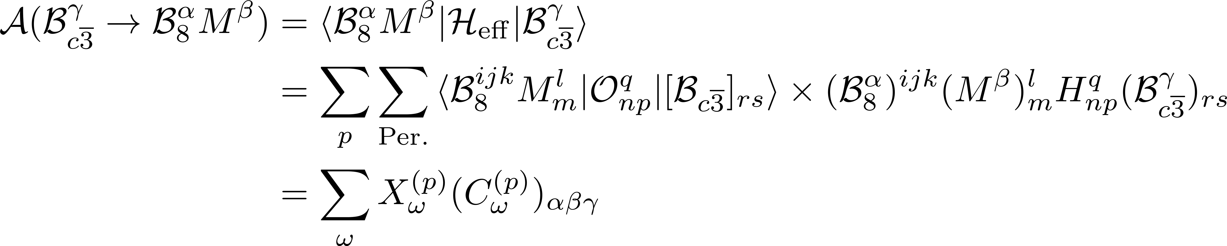
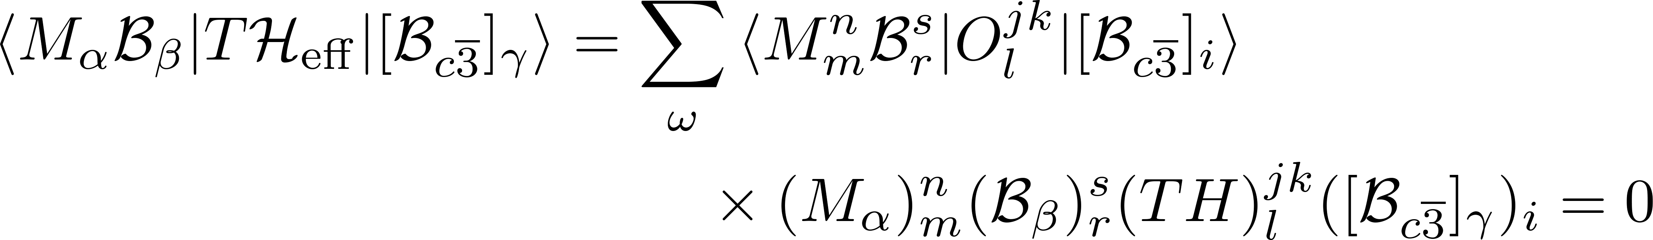
第三届BESIII-Belle II-LHCb粲强子物理联合研讨会
Decay amplitudes and Flavor relation
If there exists an operator T, under which the Hamiltonian is invariant, TH = 0. The invariance of Hamiltonian under T is related to the generation of sum rules.
9

Slide 10
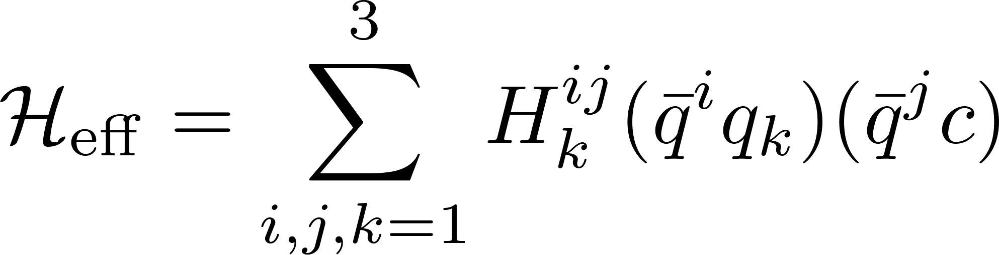
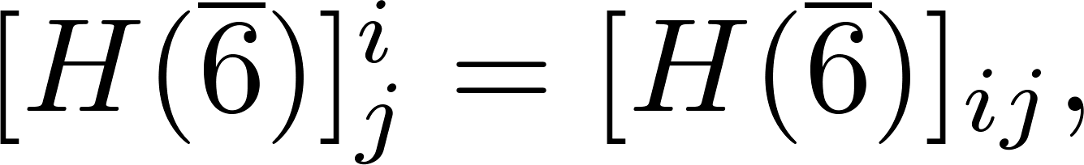
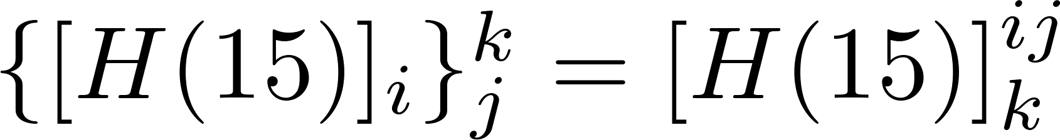
第三届BESIII-Belle II-LHCb粲强子物理联合研讨会
Isospin sum rule
No operator T constructed by I₃, I₋, I₊ which T H_{c}=0.
Isospin sum rule ?
10

Slide 11
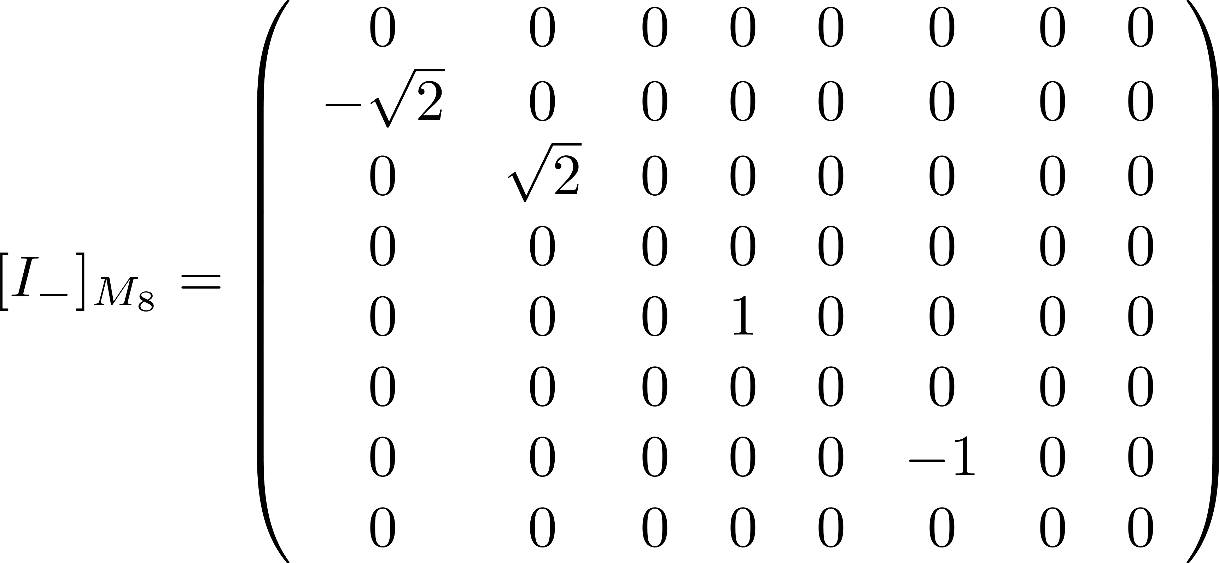
第三届BESIII-Belle II-LHCb粲强子物理联合研讨会
Isospin sum rule
To obtain isospin sum rules, we apply operator I₋ to the initial/final states and compute coefficients expanded by the initial/final states
Basis
Apply I₋ to the initial/final states
11

Slide 12
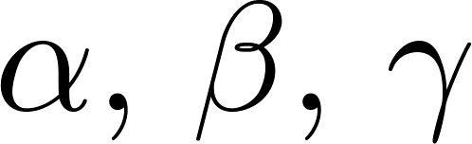
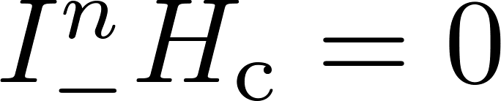
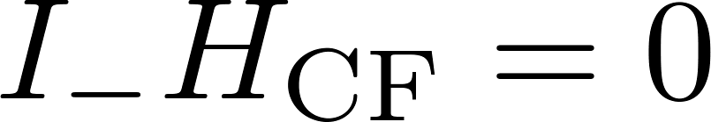
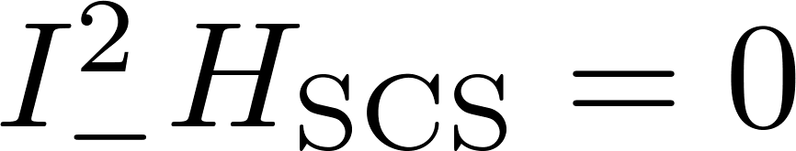
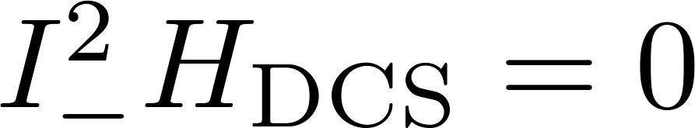

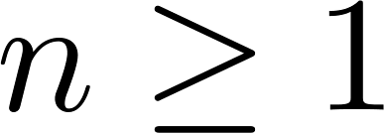
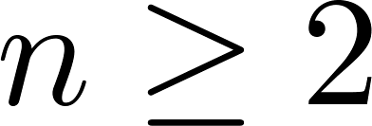





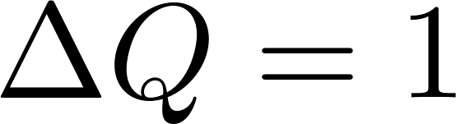
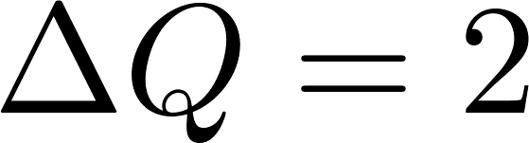
第三届BESIII-Belle II-LHCb粲强子物理联合研讨会
Isospin sum rule
An isospin sum rule is generated if appropriate are selected
Mode | CF | SCS | DCS
arXiv:2301.06104 [hep-ph]
12

Slide 13
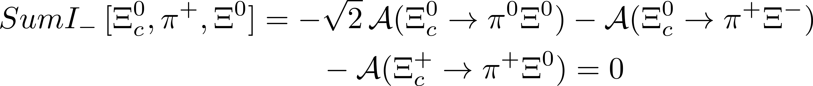
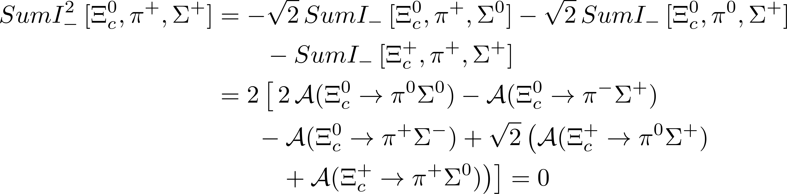
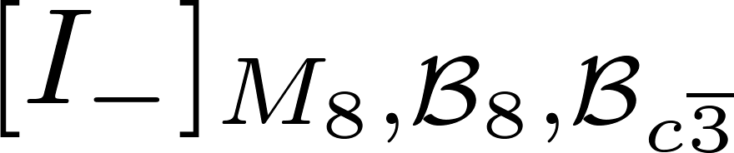
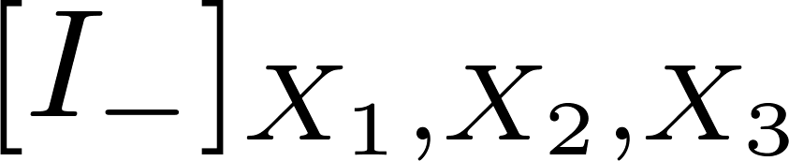
第三届BESIII-Belle II-LHCb粲强子物理联合研讨会
Isospin sum rules
CF mode
SCS/DCS mode
Other decay modes:
13

Slide 14
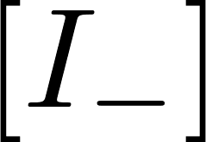

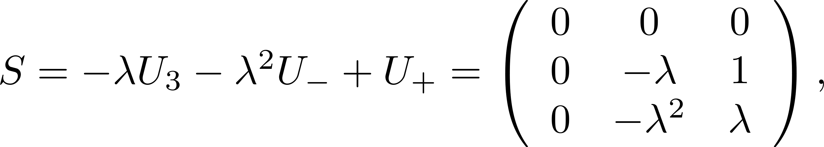

第三届BESIII-Belle II-LHCb粲强子物理联合研讨会
U-spin sum rules
U-spin sum rules:
The U-spin sum rules generated by U₋ involve only the CF, SCS, or DCS transition.
U-spin sum rules involve two or three decay types
14

Slide 15
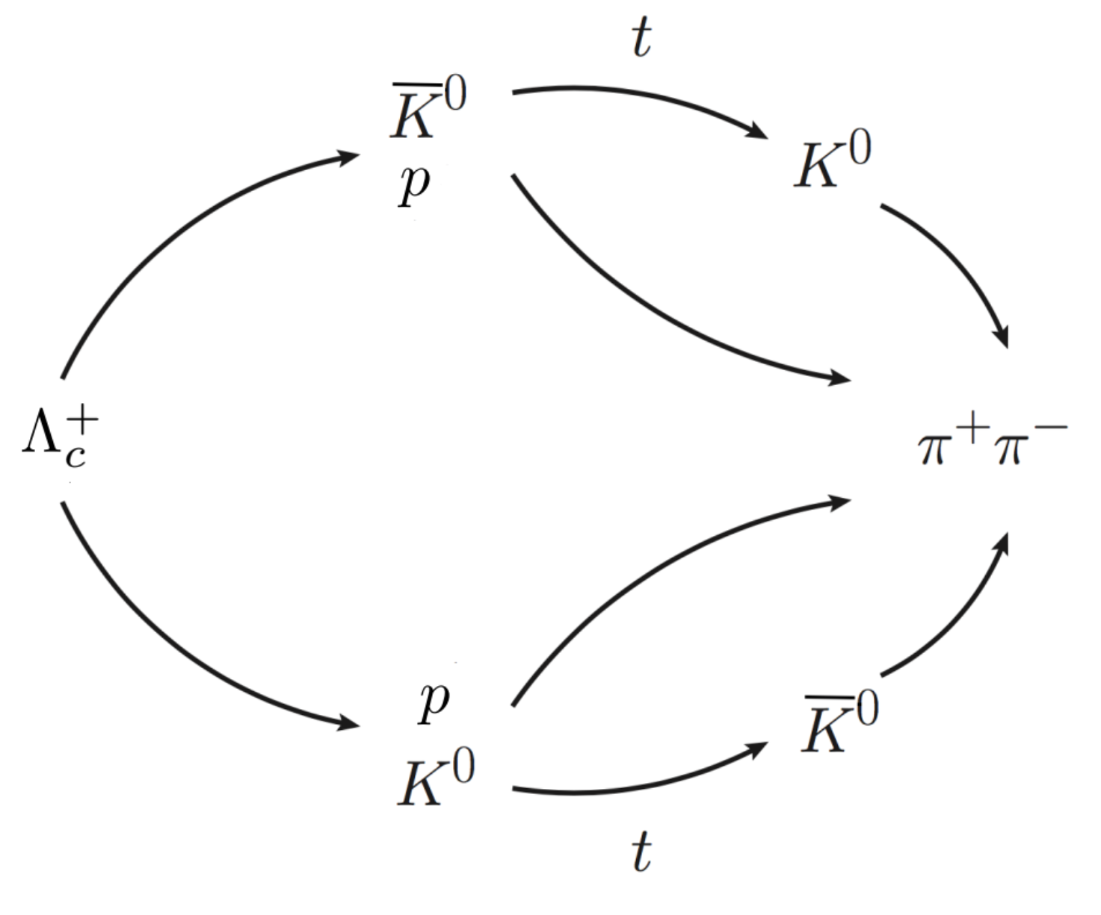
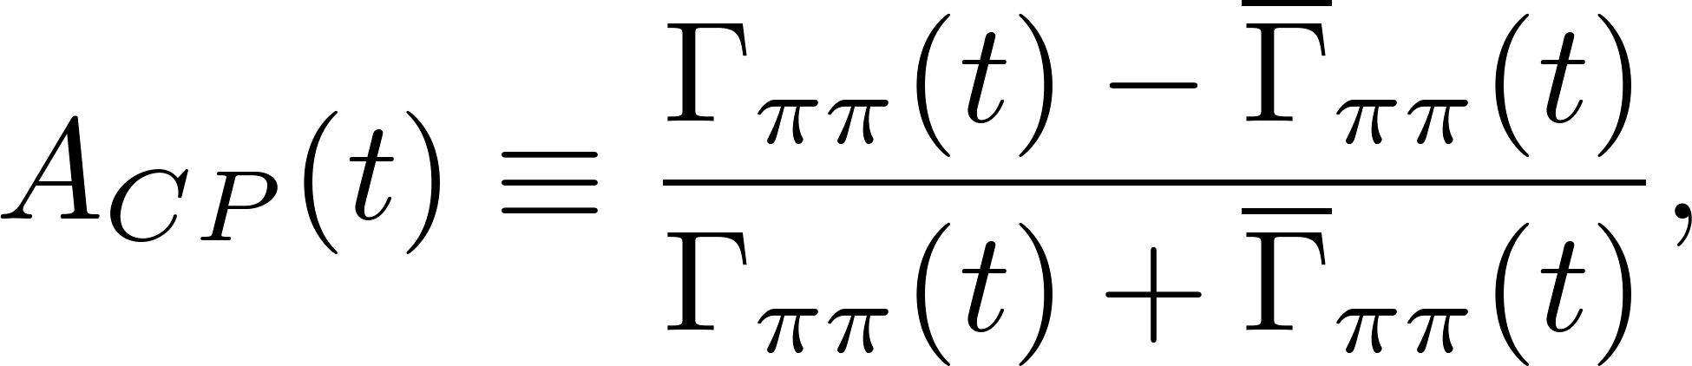
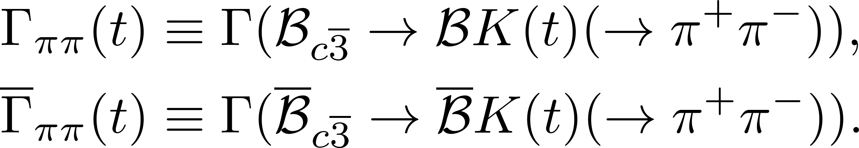
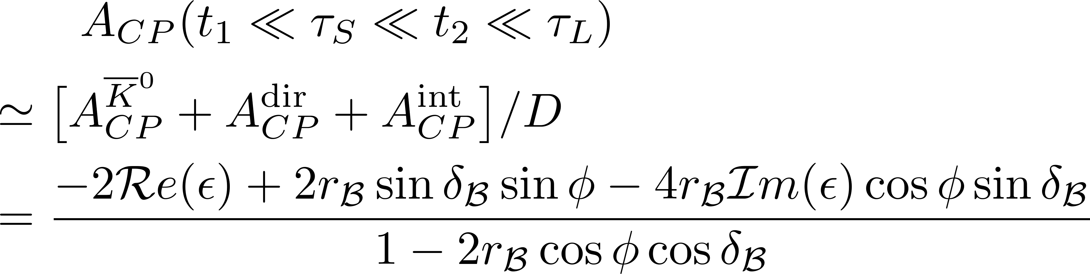
第三届BESIII-Belle II-LHCb粲强子物理联合研讨会
CPV in charm baryon decays into neutral kaons
[arXiv:1707.09297 [hep-ph]], [arXiv:1709.09873 [hep-ph]]
15

Slide 16
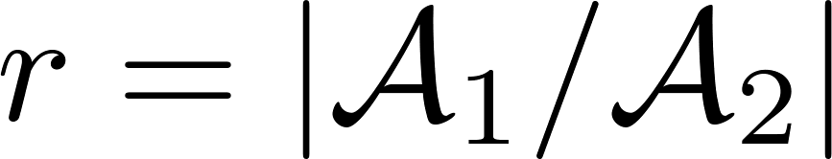
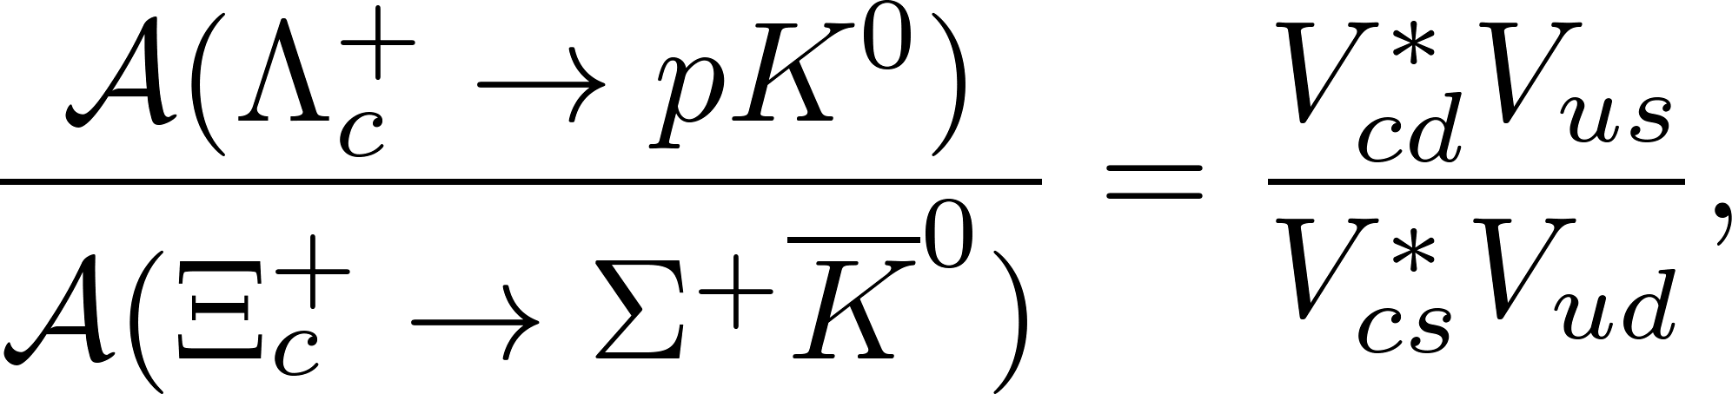
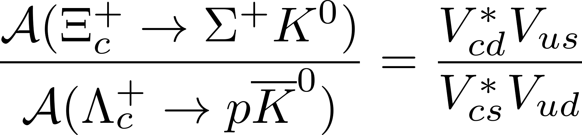
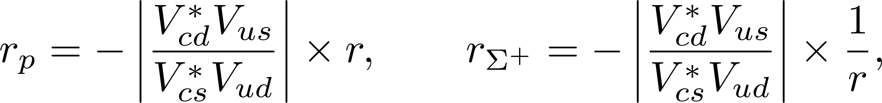
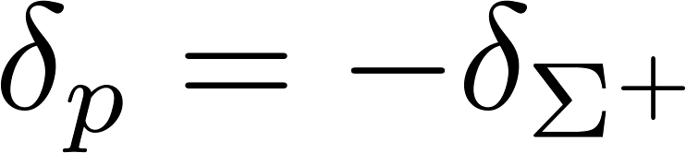
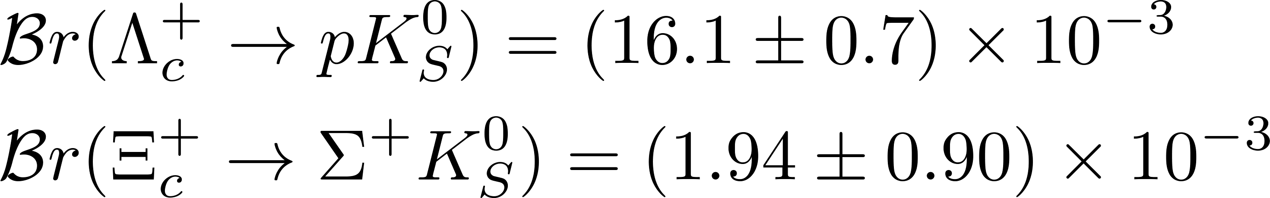
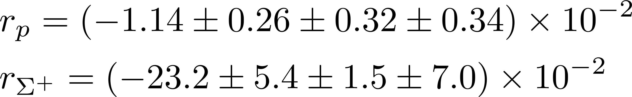
第三届BESIII-Belle II-LHCb粲强子物理联合研讨会
U-spin analysis
U-spin sum rules
I. Adachi et al. [Belle-II and Belle], [arXiv:2503.17643 [hep-ex]].
16

Slide 17
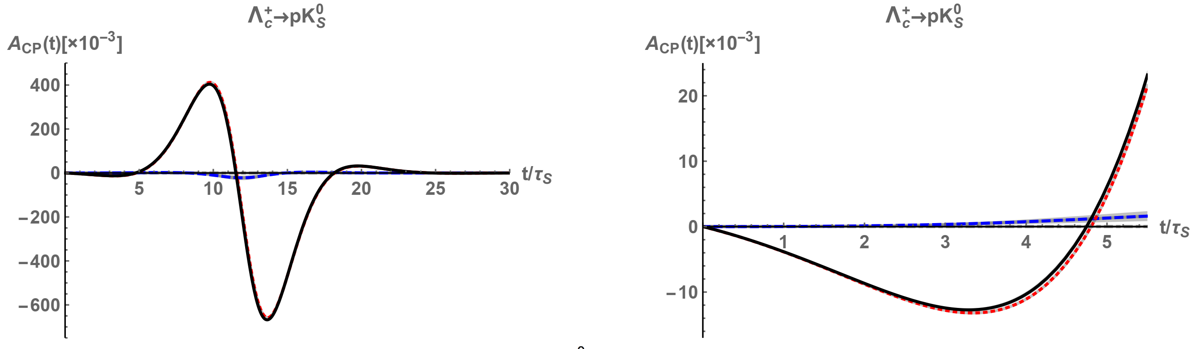
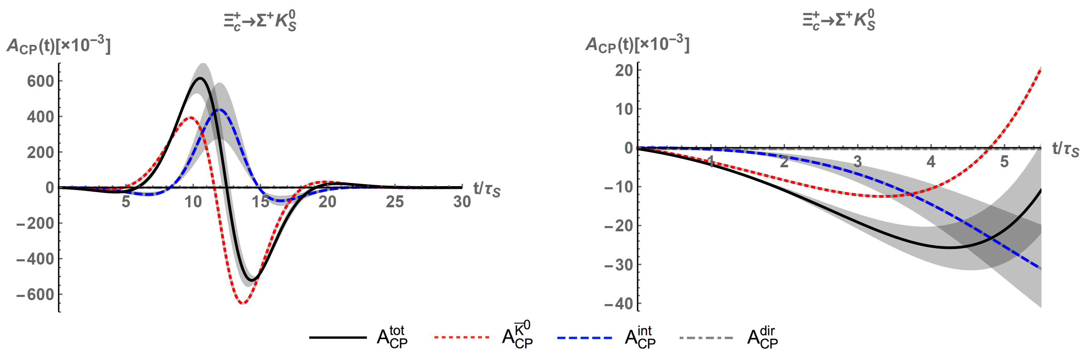
17

Slide 18
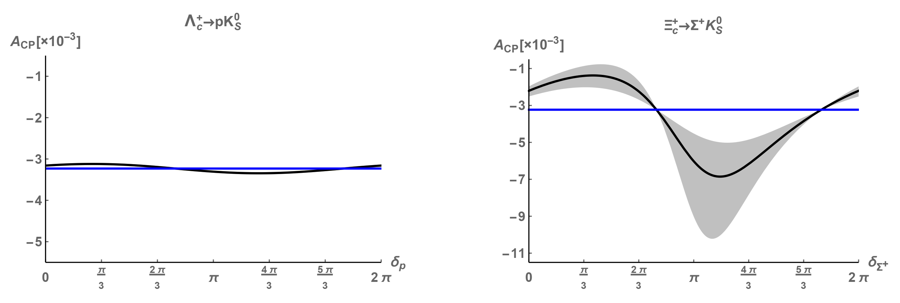
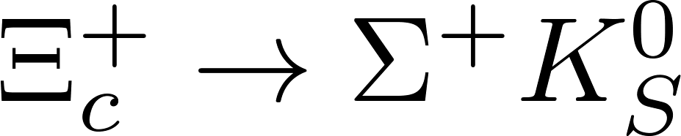
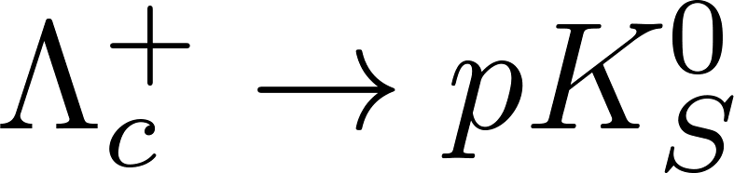
第三届BESIII-Belle II-LHCb粲强子物理联合研讨会
CPV
: verify interference between the hadron decay and neutral final-state kaon mixing
: search for new physics beyond the SM
18

Slide 19
第三届BESIII-Belle II-LHCb粲强子物理联合研讨会
Contents
1
Motivation
2
Flavor symmetry
3
Topological amplitudes
4
Summary

Slide 20
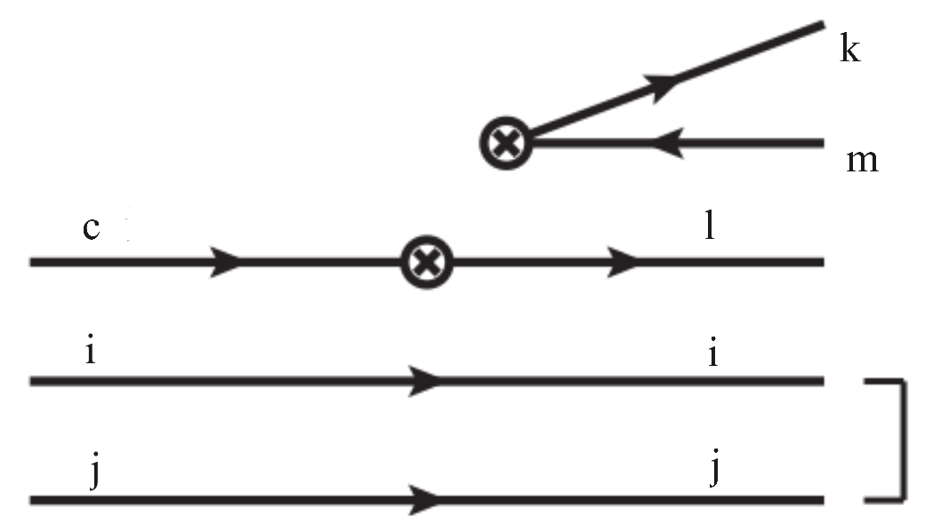
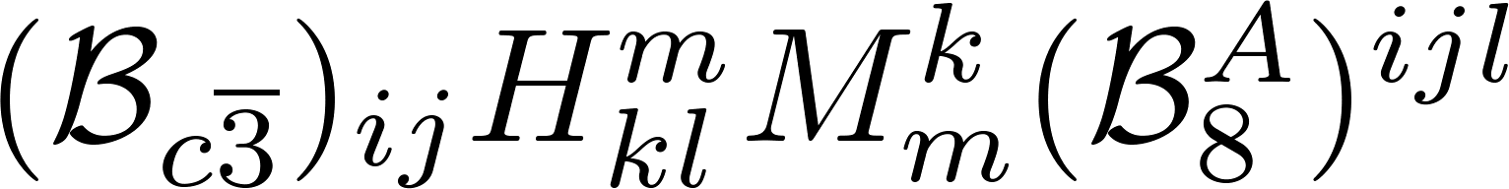
第三届BESIII-Belle II-LHCb粲强子物理联合研讨会
Topology Invariant Tensor
CG coefficient, mode-dependent
Reduced matrix element, mode-independent
Wigner-Eckart theorem
Index-contraction Quark flowing
arXiv:2406.14061
20

Slide 21
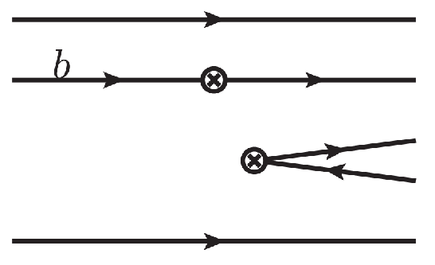
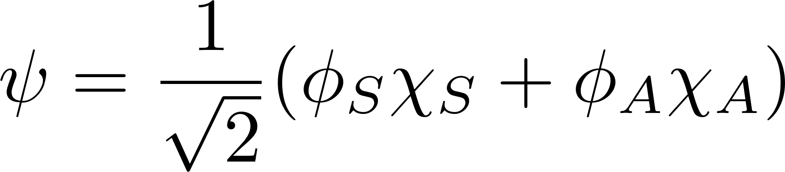
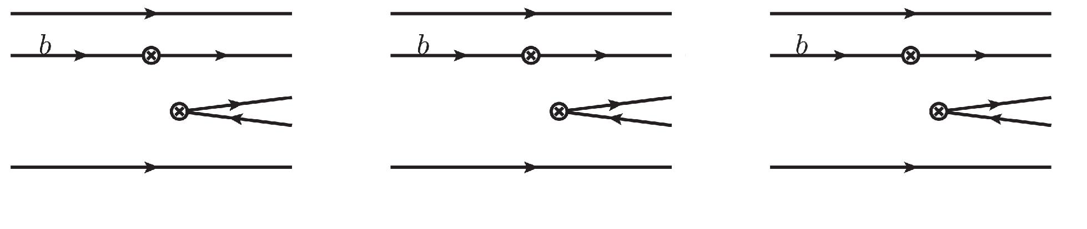
第三届BESIII-Belle II-LHCb粲强子物理联合研讨会
Meson .vs. Baryon
Wavefunction
Pauli Exclusion Principle
21

Slide 22


第三届BESIII-Belle II-LHCb粲强子物理联合研讨会
Completeness of topologies
Decay amplitude
Completeness of topologies
Invariant tensor: all indices are contracted
Computed by permutation!
22

Slide 23

第三届BESIII-Belle II-LHCb粲强子物理联合研讨会
Topologies in charmed baryon decays (A)
23

Slide 24

36 diagrams: without quark loop
24 diagrams: with quark loop
24

Slide 25







第三届BESIII-Belle II-LHCb粲强子物理联合研讨会
Three indices Two indices
Relation between topologies and SU(3) irreducible amplitudes
?
Reducing indices
arXiv:2406.14061
25

Slide 26

第三届BESIII-Belle II-LHCb粲强子物理联合研讨会
(1,1)-rank topological amplitudes
18 terms
26

Slide 27





第三届BESIII-Belle II-LHCb粲强子物理联合研讨会
Linear correlation of topologies
Relation between three- and (1,1)-rank octets
Example
27

Slide 28


第三届BESIII-Belle II-LHCb粲强子物理联合研讨会
SU(3) irreducible amplitude
2-rank TDA = IRA
3-rank TDA (1,1)-rank TDA (1,1)- rank IRA
28

Slide 29



第三届BESIII-Belle II-LHCb粲强子物理联合研讨会
Property of SU(3) group
29

Slide 30



第三届BESIII-Belle II-LHCb粲强子物理联合研讨会
Topologies in the Standard Model
Effective Hamiltonian of charm decay
Non-zero
Tree
Penguin
13 independent amplitudes in the SU(3)F limit: 9+4=13
30

Slide 31
第三届BESIII-Belle II-LHCb粲强子物理联合研讨会
Feynman diagram
Topological diagram
3-rank irreducible amplitude
(1,1)-rank topological amplitude
Irreducible amplitude
31

Slide 32




第三届BESIII-Belle II-LHCb粲强子物理联合研讨会
The K$\ddot{o}$rner-Pati-Woo theorem
Four decay amplitudes are very small due to small λb.
The K$\ddot{o}$rner-Pati-Woo theorem: If two quarks produced by weak operators enter one baryon, they are anti-symmetric in flavor.
J. G. Korner, Nucl. Phys. B 25, 282-290 (1971).
J. C. Pati and C. H. Woo, Phys. Rev. D 3, 2920-2922 (1971).
Decay amplitudes: 9 5
Parameters:
32

Slide 33


第三届BESIII-Belle II-LHCb粲强子物理联合研讨会
Test the K$\ddot{o}$rner-Pati-Woo theorem
SU(3) symmetry + KPW theorem
C. Q. Geng, X. G. He, X. N. Jin, C. W. Liu and C. Yang, Phys. Rev. D 109, no.7, L071302 (2024) .
刘佳伟’ talk
Isospin symmetry + KPW theorem
C. Q. Geng, C. W. Liu and T. H. Tsai, Phys. Lett. B 794, 19-28 (2019).
33

Slide 34




第三届BESIII-Belle II-LHCb粲强子物理联合研讨会
Final-state rescattering
Final-state rescattering
C. P. Jia, H. Y. Jiang, J. P. Wang and F. S. Yu, JHEP 11, 072 (2024).
H. Y. Cheng, F. Xu and H. Zhong, [arXiv:2505.07150 [hep-ph]].
M. W. Li, X. G. He, A. Cheek and X. Chu [arXiv:2506.05511 [hep-ph]]
34

Slide 35

第三届BESIII-Belle II-LHCb粲强子物理联合研讨会
Final-state rescattering
C. P. Jia, H. Y. Jiang, J. P. Wang and F. S. Yu, JHEP 11, 072 (2024).
35

Slide 36




第三届BESIII-Belle II-LHCb粲强子物理联合研讨会
Final-state rescattering
36

Slide 37




第三届BESIII-Belle II-LHCb粲强子物理联合研讨会
The K$\ddot{o}$rner-Pati-Woo theorem
Fierz transformation
symmetric
If two quarks enter baryon
antisymmetric
?
SU(3)C singlet
J. G. Korner, Nucl. Phys. B 25, 282-290 (1971).
J. C. Pati and C. H. Woo, Phys. Rev. D 3, 2920-2922 (1971).
antisymmetric
37

Slide 38




第三届BESIII-Belle II-LHCb粲强子物理联合研讨会
Test the K$\ddot{o}$rner-Pati-Woo theorem
Isospin symmetry + KPW theorem
?
M. Ablikim et al. [BESIII], Phys. Rev. D 106, no.5, 052003 (2022).
L. K. Li et al. [Belle] Sci. Bull. 68, 583-592 (2023).
Belle (II)
PDG
Isospin symmetry only
38

Slide 39

第三届BESIII-Belle II-LHCb粲强子物理联合研讨会
Test the K$\ddot{o}$rner-Pati-Woo theorem
Isospin symmetry + KPW theorem
39

Slide 40
第三届BESIII-Belle II-LHCb粲强子物理联合研讨会
Contents
1
Motivation
2
Flavor symmetry
3
Topological amplitudes
4
Summary

Slide 41
第三届BESIII-Belle II-LHCb粲强子物理联合研讨会
Summary
CP asymmetries in the and decays
Test the KPW theorem:
Thanks for your attention!
41

