Slide 1
粲强子衰变末态轻味强子态的理论研究
钟显辉
湖南师范大学
“第三届BESIII-Belle II-LHCb粲强子物理联合研讨会” 湖南长沙
2025年6月27-30日
1

Slide 2
CONTENTS
Background
Strange mesons
Strange baryons
Summary
2

Slide 3
Background
3

Slide 4
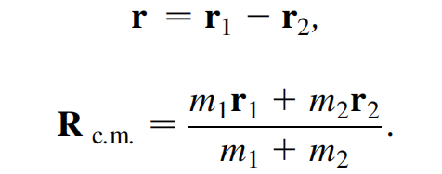
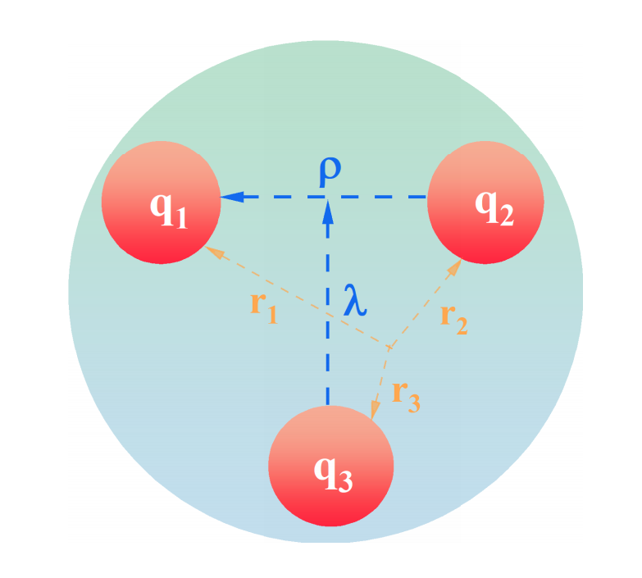
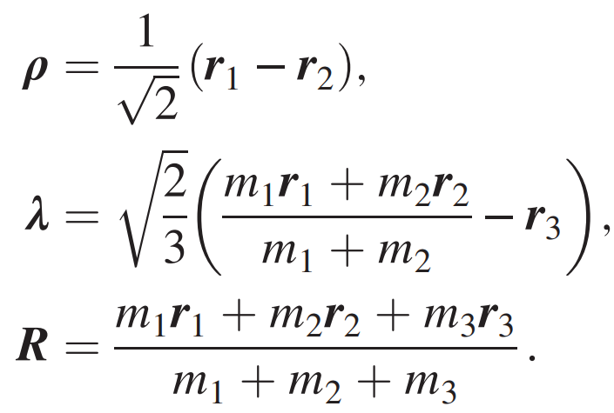


$$Quark model$$
Symmetry: SU(6)$⊗$O(3)
Meson
Baryon
4

Slide 5
Light meson spectrum observed from exp.
Poorly understanding for the excited isoscalar states
Tetraquark state?
Gluon ball?
How to understand the experimental findings
Why were the 0++, 1++, 1-- states not well established or still missing?
5

Slide 6
Light baryon spectrum observed from exp.
Poorly understanding for the excited hyperon states, especially for Ω and Ξ
Missing resonance problem
Low mass problem
How to looking for the missing states
Inner structure
Meson-baryon components
Dynamics
6

Slide 7
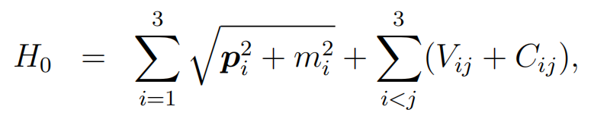
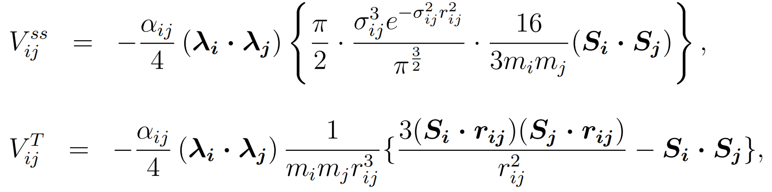
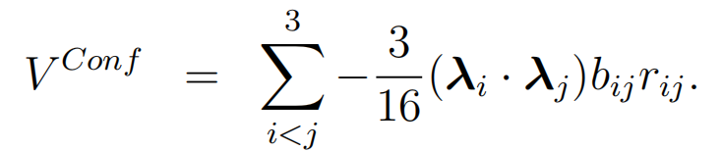
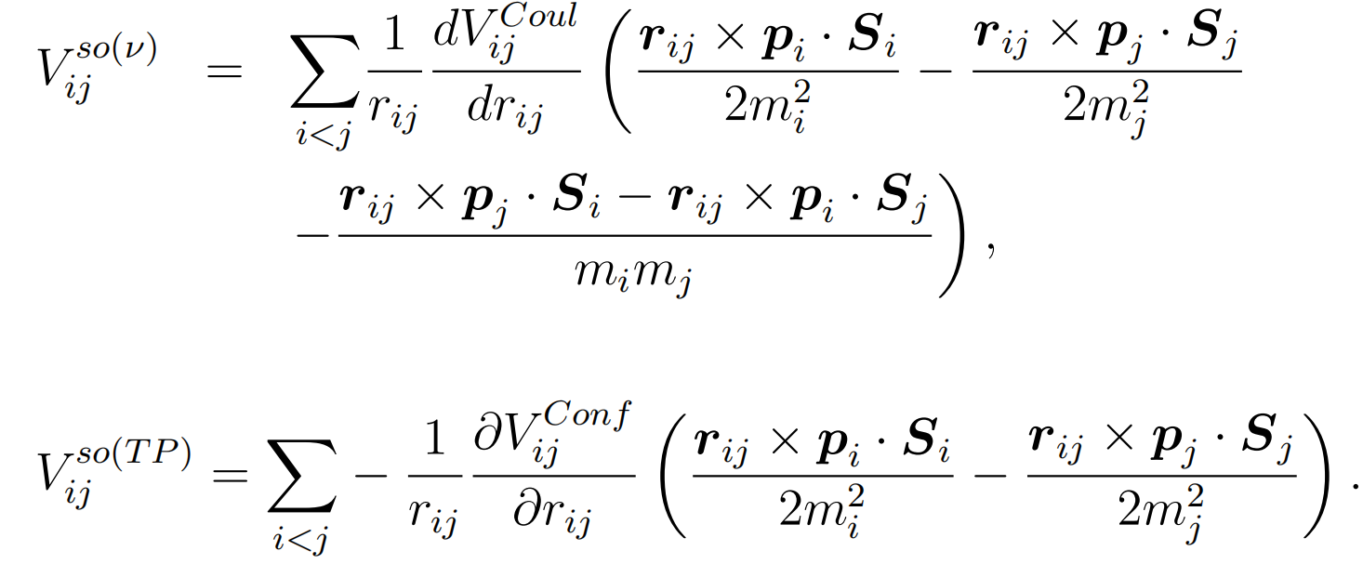
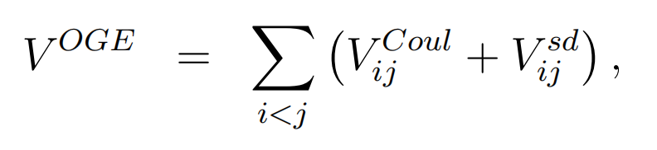
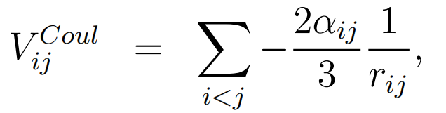

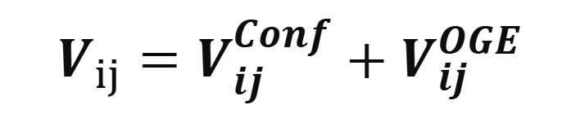
Model for spectrum——potential model
Spin-dependent potential of OGE:
$$Hamiltonian$$
$$V_{ij}=V_{ij}^{Conf}+V_{ij}^{OGE}$$
7

Slide 8
Strange mesons
Based on our works:
FX Liu, MS Liu, XH, Q Zhao, PRD 103, 016016 (2021);
Q Li, LC Gui, MS Liu, QF Lv, XH, Chin. Phys. C 45, 023116 (2021);
FX Liu et al, unpublished
8

Slide 9
Strangeonium spectrum
How to understand f₀(1500,1710)?
f₀(1370): 1250-1440, 200-500
1³P₀(ss): 1373, 338
Could X(2500) be evidence of the 4¹S₀ state? 【BESIII, PRD93,112011(2016)】
Exp: 2428-2586, 162-350, ϕϕ
Th: 2580, 409, KK*10% , ϕϕ1%
Could f₀(2410) be the 3³P₀ state? 【BESIII, PRD98,172003(2019)】
Exp: 2411, 348, KK
Th: 2434, 346, K*K* 10%,KK3%,
Could X(2062) be evidence of the 2¹P₁ state? 【BESIII, PRD99,112008(2019)】
Exp: 2062, 177, ϕη’
Th: 1991, 279, KK*18% , ϕη’ 2%
Many low-lying states are still missing!
9

Slide 10
Strangeonium spectrum
Could ϕ(2170) be the 3³S₁ state?
Exp: 2164, 88+26-21, not seen in K*K*,seen in ϕη,ϕη’,ϕππ
Th: 2198, 276, K*K*8% , ϕη 3%, ϕη’ 0.1%
Predicted width is too broad, the K*K* decay mode is not seen!
Could ϕ(2170) be the 2³D₁ state?
Exp: 2164, 88+26-21, not seen in K*K*,seen in ϕη,ϕη’,ϕππ
Th: 2272, 283, K*K*8% , ϕη 0.9%, ϕη’ 0.1%
Predicted mass and width are too large, the K*K* decay mode is not seen!
Could the newly observed state X(2300) be the 3¹P₁ state?
[BESIII, PRL134,191901(2025)]
Exp: 2316, 89+-41, seen in ϕη,ϕη’
Th: 2435, 269, KK*5% , K*K*7%, ϕη 2%, ϕη’ 0.6%
Predicted mass and width are too large!
Could ϕ(2170) and X(2300) be tetraquark states?
10

Slide 11
Towards establishing the 1D states
1¹D₂ state
Th: 1825, 80, KK*90% , K*K* 10%
Worth observing!
1³D₂ state
Th: 1840, 128, KK*70% , ϕη 20%
Worth observing!
1³D₁ state
Th: 1809, 707, KK1(1270)88% , KK4%, KK*6%, Too broad!
Towards establishing the 2P states
2¹P₁ state
Th: 1991, 179, KK*18%, K*K*17%,
ϕη 6%, ϕη’ 2%
Worth observing!
2³P₁ state
Th: 2027, 315, KK*13%, K*K*16%
Worth observing!
2³P₀ state
Th:1971, 849, KK₁(1270)50%,
KK(1460) 35%
Too broad!
2³P₂ state
Th: 2030, 147, KK3%, K*K*17%
Worth observing!
11

Slide 12
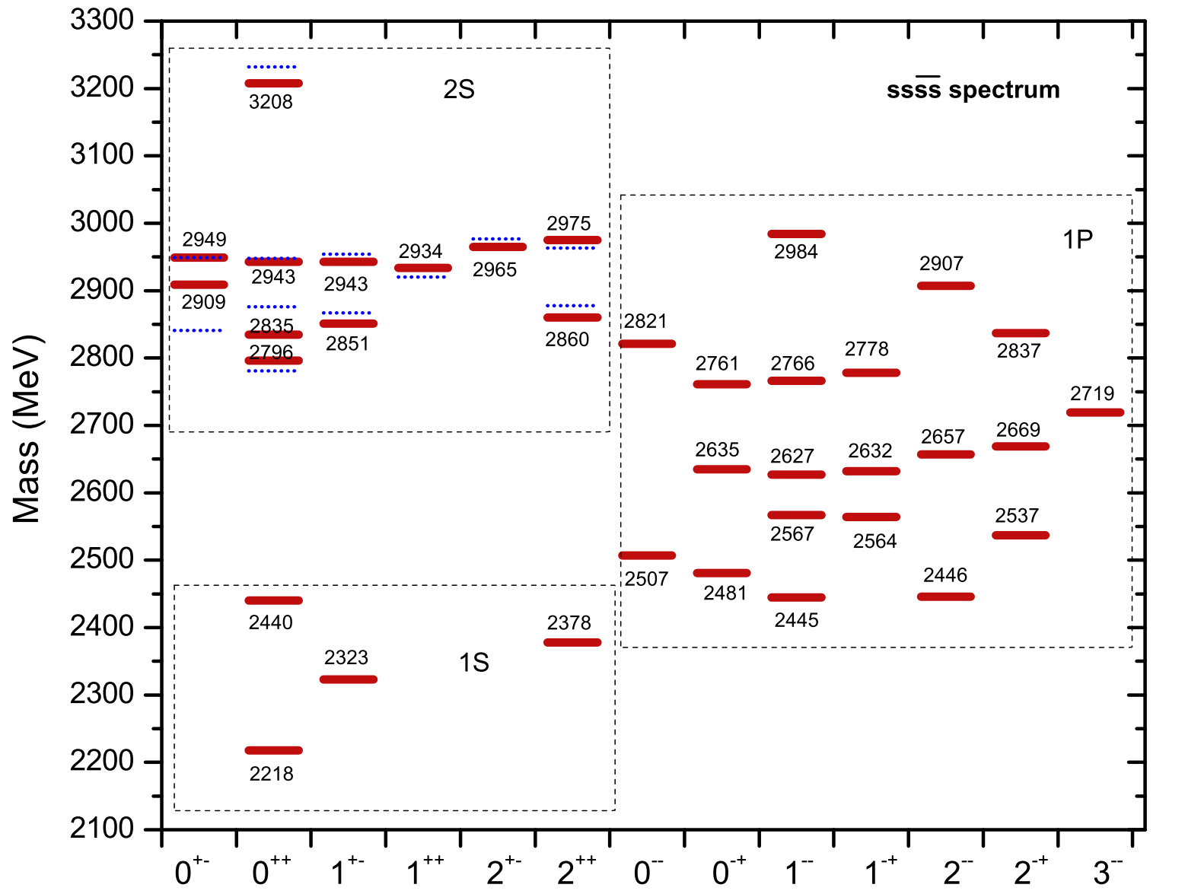
Fully strange tetraquarks
Could ϕ(2170) and X(2300) be tetraquark states?
The mass of the lowest tetraquark state is about 2.2 GeV.
The ϕ(2170) cannot be explained as a fully strange tetraquark state.
From the point of view of mass, the X(2300) is a good candidate of a fully strange tetraquark state with J^{PC}=1⁺⁻.
12

Slide 13
Fall-apart decays
Preliminary
13

Slide 14
Fall-apart decays
Preliminary
14

Slide 15
Some states may be found in experiments
Two 1S 0++ states (2218,2440) and one 2S 0++ state (2876) have large decay rates into ϕϕ.
The 2S 0++ states have large decay rates into the ϕϕ(1680) channel.
15

Slide 16
The newly observed X(2300) favors the 1+- T4s state
ψ(3686)→ϕηη’ @ BESIII [PRL 134,191901 (25)]
M_{exp}= 2316⁺³⁹₋₃₉ MeV, Γ_{exp}=89⁺⁴¹₋₄₁ MeV
Both the mass and decay properties predicted in theory are consistent with the observations.

Slide 17
Some hints of 1+- T_{4s}(2323) may be seen in J/ψ decays as well
J/ψ→ϕηη’ @ BESIII [PRD 99,112008 (19)],
More precise observations in ϕη, ϕη’ may is needed!
Can we observe the 1+- T4c (6500) state in J/ψη_{c} channel?

Slide 18
Experimental evidence for 0++ tetraquarks
J/ψ→γX→γϕϕ @ BESIII [PRD 93,112011 (16)]
Two 0++ resonances with masses around 2.2 GeV and 2.4 GeV were extracted from the data.
B_{s}⁰→J/ψϕϕ @ LHCb [JHEP1603,040 (16) ]
One 0++ resonance with mass around 2.2 GeV was extracted from the data.
A. A. Kozhevnikov, PRD99, 014019 (19);PRD 95, 014005 (17).

Slide 19
Strange baryons
Based on our works:
Hui-Hua Zhong et al, unpublished;
MS Liu, KL Wang, QF Lv, XH, PRD101, 016002(2020);
LY Xiao, XH, PRD98, 034004 (2018)
19

Slide 20
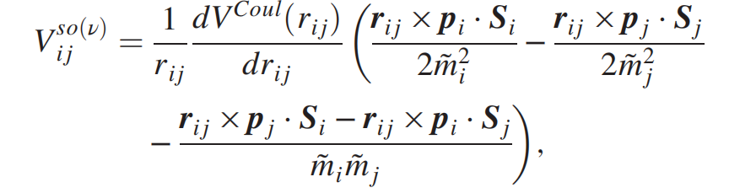
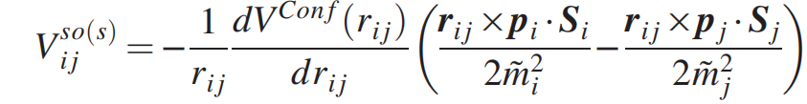
Ω(sss) spectrum
Old results labeled by Triangles（唯象）:
New results labeled by short lines (based on QCD):
Preliminary
Obvious differences of two models can be seen!
Confirm the mass gap between the two 1P states: ~60 MeV! The mass of the 1P ½- state should be ~1950 MeV!
20

Slide 21
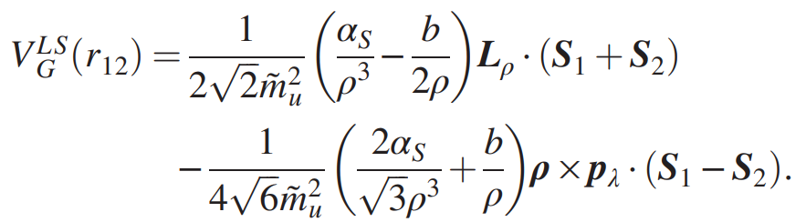
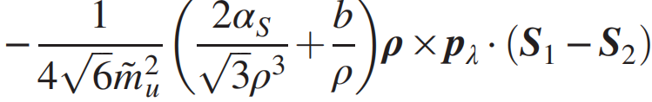



Three-body spin-orbit term $ρ×p_{λ}$
Complete form from OGE:
[Isgur]
A simple form with approximation
$$P_{i}=−P_{j}$$
[Hiyama]
However, for a baryon system
$$P_{i}≠−P_{j}$$
The complete form should be:
There is an additional three body spin-orbit （TBso）term!!!
» T.Yoshida, E.Hiyama, PRD.92.114029 (2015); S. Capstick and N. Isgur, PRD 34, 2809 (1986)
21

Slide 22







Three-body spin-orbit term $ρ×p_{λ}$is crucial !
Mass splitting : 𝚫(𝟏𝟔𝟐𝟎)1/2-−𝚫(𝟏𝟕𝟎𝟎)3/2-
Hui-Hua Zhong, MS Liu, RH Ni, MY Chen, XH, PRD 110 (2024) 11, 116034
No Tbso term:
$$V_{1}^{LS}∝$$
$$=0$$
Degenerate states
With Tbso term:
$$V_{2}^{LS}∝$$
$$≠0$$
Mass splitting : Ω(2012)(1P)1/2-−Ω(1950)(1P)3/2-
No Tbso term:
Degenerate states
With Tbso term:
22

Slide 23
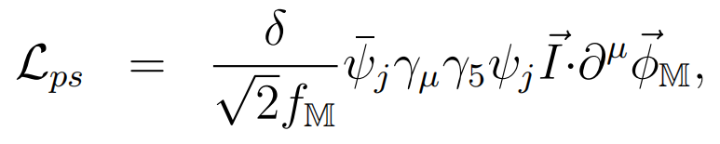
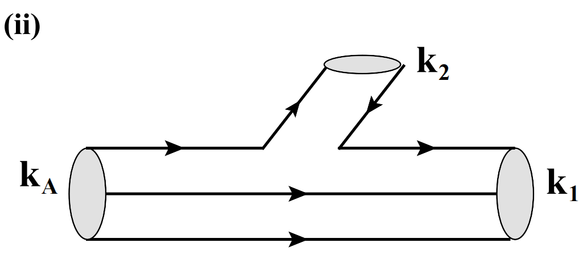
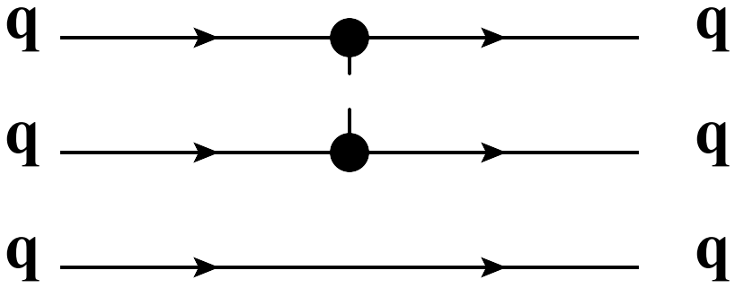

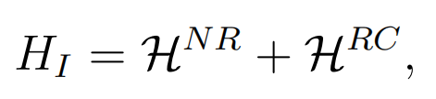
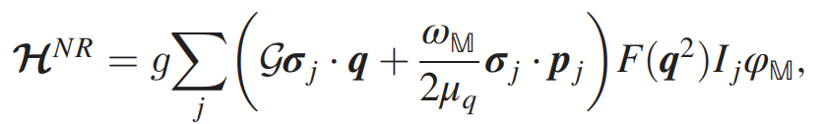
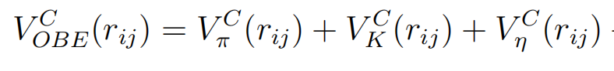
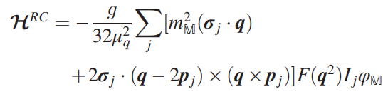
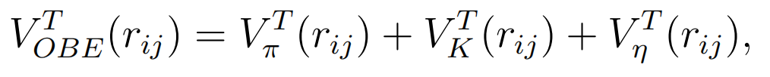
Strong decays-chiral quark model
Chiral Lagrangian:
$$π,K,η$$
mass spectrum:
strong decay:
$$π,K,η$$
23

Slide 24
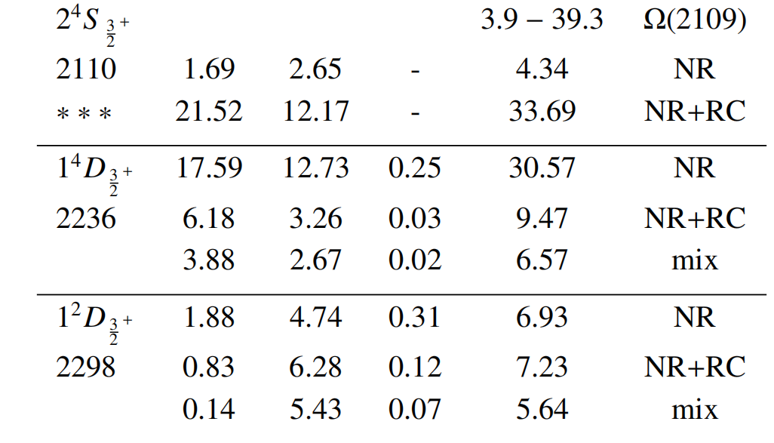
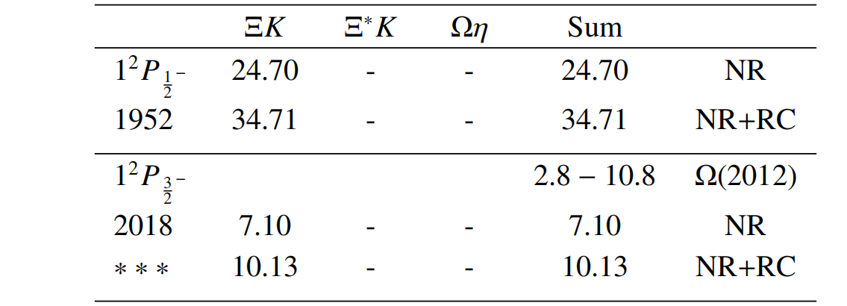
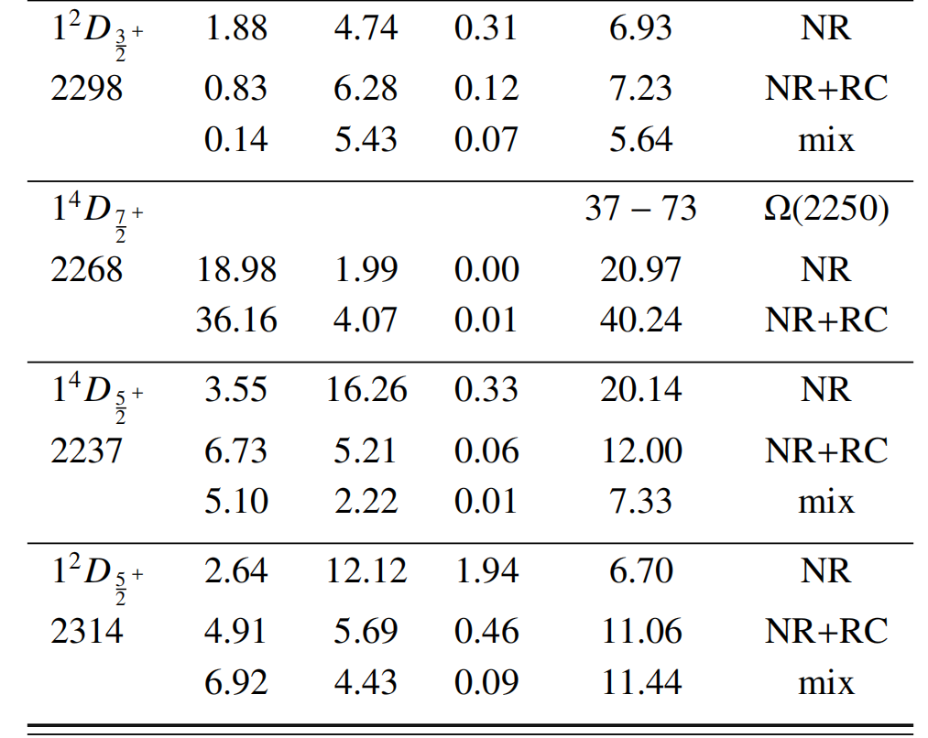
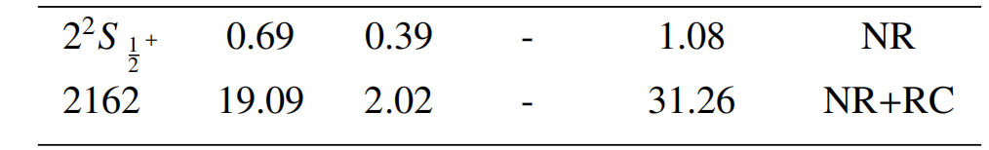
Strong decay properties
Preliminary
Preliminary
All of the excited states within N=2 shell have relatively narrow widths!
24

Slide 25
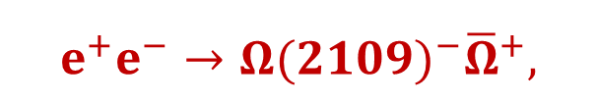
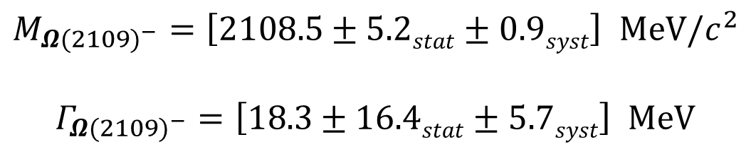
New Ω(2109) favors the 2S state with JP=3/2+
$$e^{+}e^{−}→{Ω(2109)}^{−}{\overline{Ω}}^{+},$$
@ BESIII [PRL 134,131903 (25)]
$$M_{{Ω(2109)}^{−}}=\left[2108.5±5.2stat±0.9syst\right] MeV/c^{2}$$
$$Γ_{{Ω(2109)}^{−}}=\left[18.3±16.4stat±5.7syst\right] MeV$$
Both the mass and decay properties predicted in theory are consistent with the observations.
also suggested by the Lanzhou group, [arXiv:2504.14648]

Slide 26
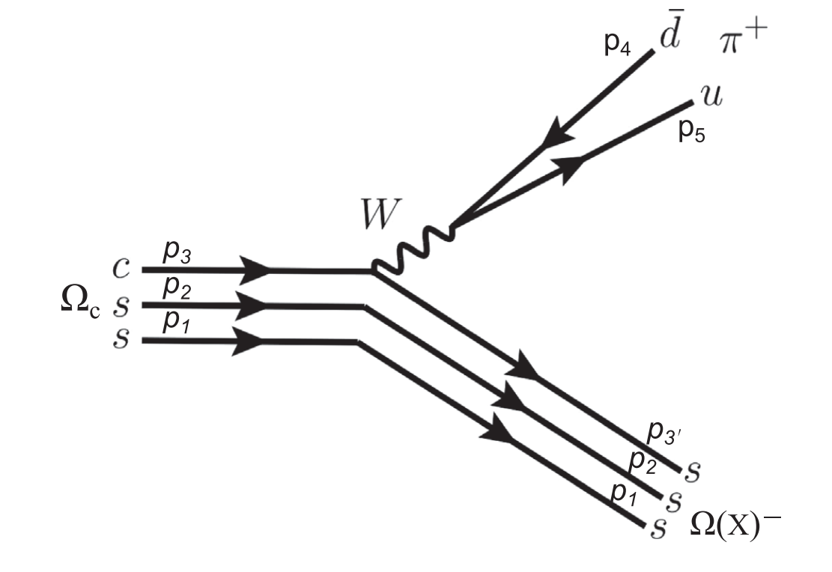
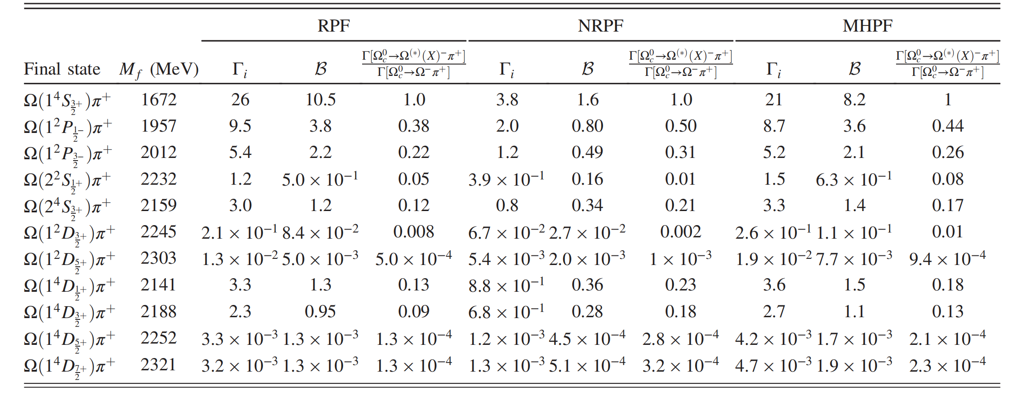
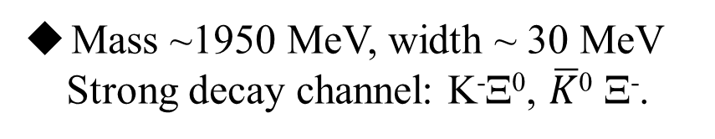
Towards establishing the low-lying 1P state with JP=½-
Mass ~1950 MeV, width ~ 30 MeV
Strong decay channel: K⁻Ξ⁰, $\overline{K}$⁰ Ξ⁻.
production
KL Wang, QF Lv, JJ Xie, XH, PRD107, 034015(2023)
26

Slide 27
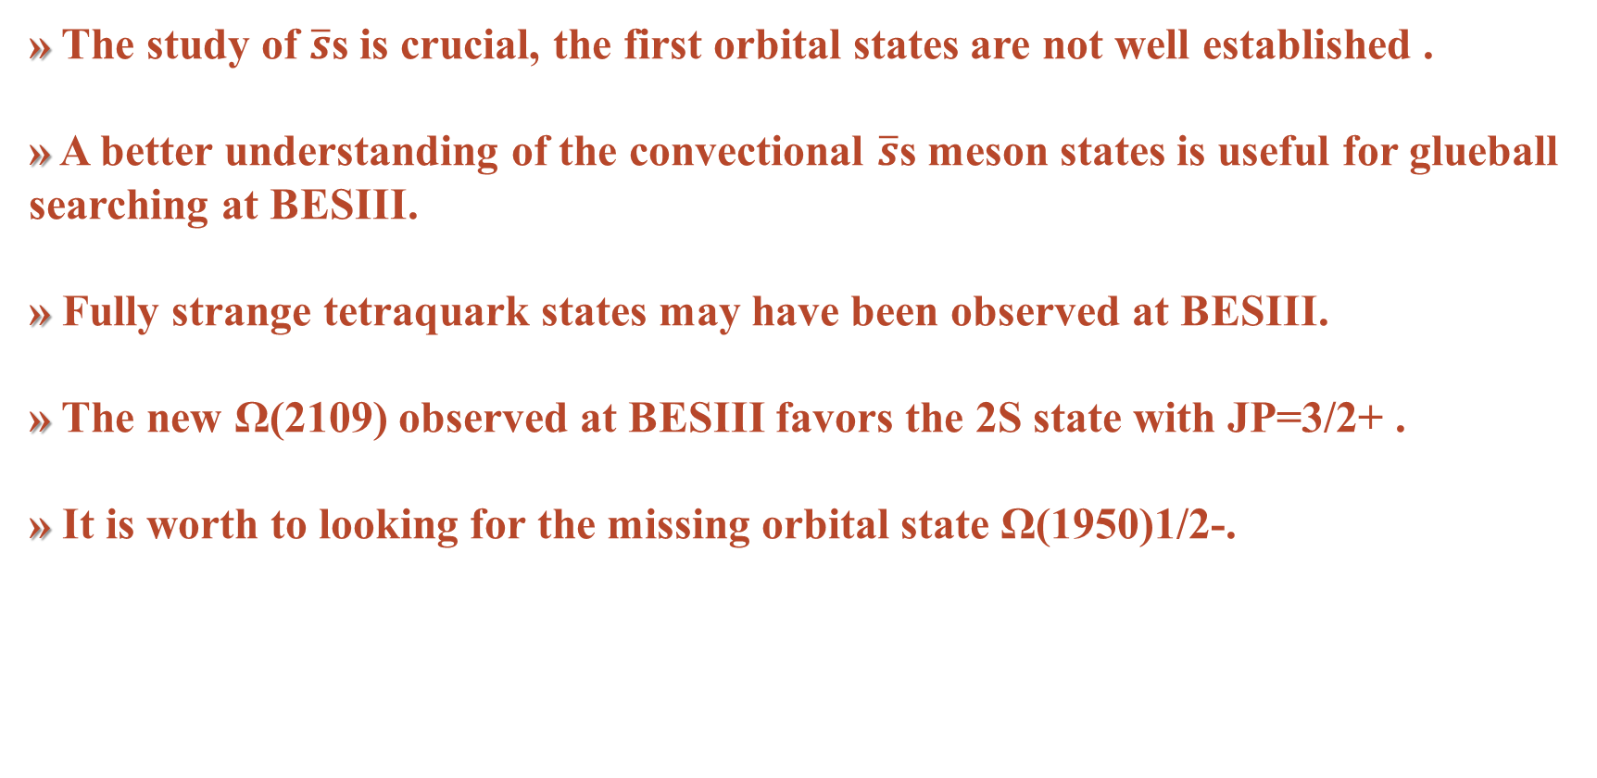
Summary
» The study of $\overline{s}$s is crucial, the first orbital states are not well established .
» A better understanding of the convectional $\overline{s}$s meson states is useful for glueball searching at BESIII.
» Fully strange tetraquark states may have been observed at BESIII.
» The new Ω(2109) observed at BESIII favors the 2S state with JP=3/2+ .
» It is worth to looking for the missing orbital state Ω(1950)1/2-.
27

Slide 28
Thanks
“第三届BESIII-Belle II-LHCb粲强子物理联合研讨会” 湖南长沙
2025年6月27-30日
28

