Slide 1
Status of Charmed Hadron Physics
Charmed Baryons
Hai-Yang Cheng (鄭海揚)
Academia Sinica, Taipei
3rd Joint Workshop of BESIII-Belle II-LHCb on Charmed Hadron Physics
Changsha, China
June 28, 2025

Slide 2
Dynamic approach based on effective Hamiltonian & factorization (generalized, 1/N_{c}). We don’t have QCD-inspired theory as in B physics
-- treat effective Wilson coefficients a₁ and a₂ as phenomenological parameters to account for nonfactorizable effects
-- cannot describe weak annihilation properly and tackle long-distance effects such as FSIs
Model-independent diagrammatical approach based on SU(3): strong-interaction effects included in topological amplitudes extracted from the data
They are complementary to each other for describing nonleptonic weak decays of heavy mesons
as sizable 1/m_{c} power corrections are expected in D decays
Bauer, Stech, Wirbel (’87)

Slide 3
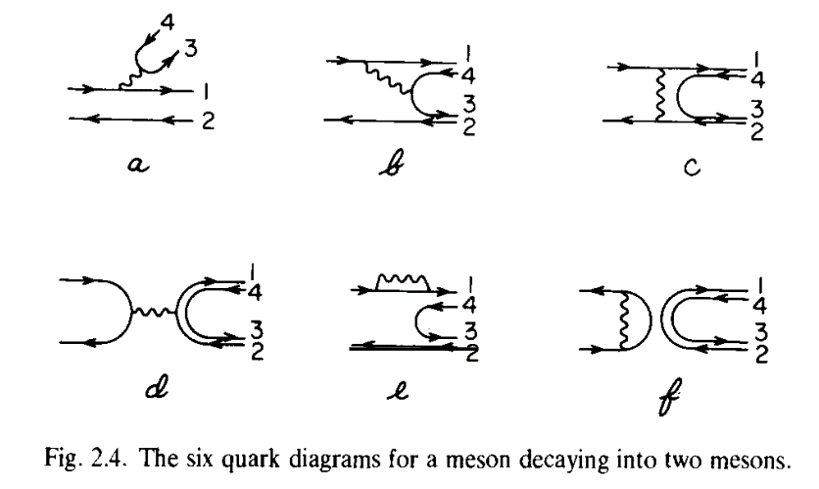
Topological Diagrammatic Approach
Ling-Lie Chau: Guangzhou Conference (1980); ICHEP (1980)
AIP Conference (1981)
Phys. Rep. 95, 1 (1983)

Slide 4
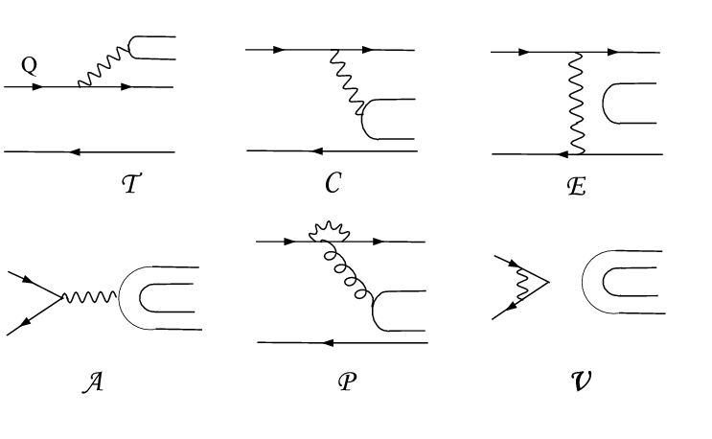
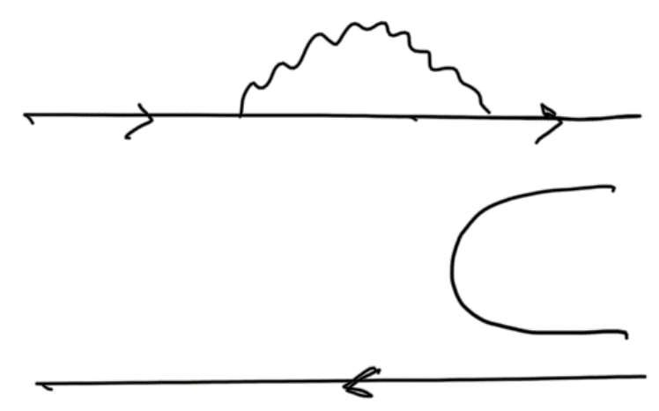
Topological Diagrammatic Approach
All two-body hadronic decays of heavy mesons can be expressed in
terms of six distinct topological diagrams [Chau (’80,’83); Chau, HYC (’86)]
(tree)
(color-suppressed)
(exchange)
(annihilation)
H (horizontal W-loop)
(vertical W-loop)
All quark graphs are topological, classified according to topologies of weak interactions and meant to have all strong interactions at all orders encoded and hence they are not Feynman graphs. That is, final-state interactions are included.

Slide 5
Topological tree amplitudes in D → PP decays
Data of D→PP decays dominated by CLEO with many being improved by BESIII
T = 3.134 ± 0.010 (taken to be real) (in units of 10⁻⁶ GeV)
C = (2.584 ± 0.014) exp[i (-151.9±0.3)º]
E = (1.472 ± 0.024) exp[i (121.7±0.4)º]
A = (0.394 ± 0.020) exp[i (14.1^{+11.0}-8.5)º]
Rosner (’99)
Wu, Zhong, Zhou (’04)
Bhattacharya, Rosner (’08,’10)
HYC, Chiang (’10, ’19, ‘23)
CF
Phase between C & T ~ 152º
W-exchange E is sizable with a large phase ⇒ importance of 1/m_{c} power corrections
W-annihilation A is smaller than E and nearly perpendicular to E
E
C
A
T
The great merit & strong point of this approach ⇒ magnitude and strong phase of each topological tree amplitude are determined
⇒ Direct CPV at tree level can be reliably estimated, e.g. $D_{s}^{+}→K^{+}η$
DCPV induced by penguin e.g. $D_{ }^{0}→π^{+}π^{−},K^{+}K^{−}$ can be estimated via $P^{LD}=E$
5

Slide 6
Caveat: discrete ambiguity in strong phases
Strong phases are subject to a simultaneous sign flip.
Our Rosner et al. FAT (Li, Lu, Yu)
C -151º -151º 148º
E 121º 120º -142º
A ~ 23º ~ 70º ?
P -150º 134º
FAT: factorization assisted topological amplitude approach
Discrete ambiguity can be removed by measuring CP violation in $D^{0}→K_{S}K_{S}$ !

Slide 7
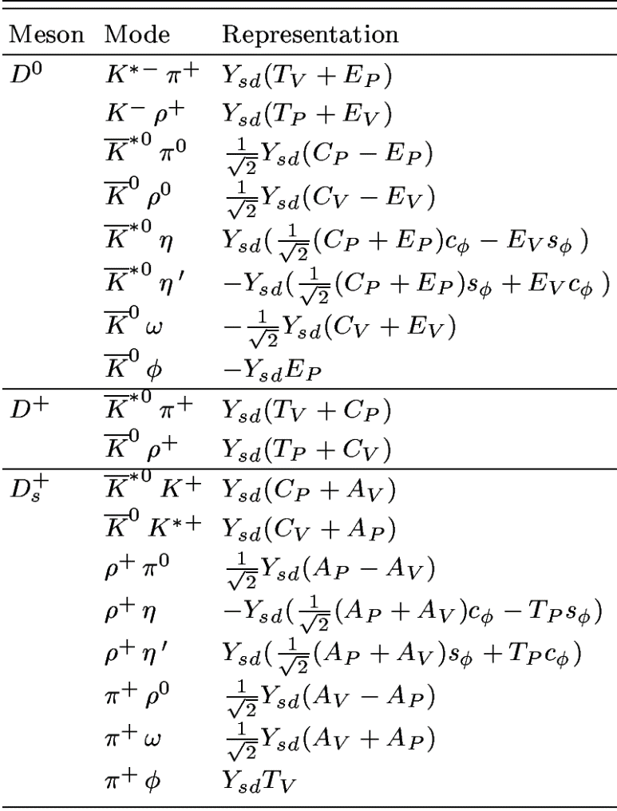
D→ VP decays
CF
T_{P}, C_{P}: P contains q of D meson
T_{V}, C_{V}: V contains q of D meson
E_{P}, A_{P}: P contains q₂ of q₁q₂
configuration
E_{V}, A_{V}: V contains q₂ of q₁q₂

Slide 8
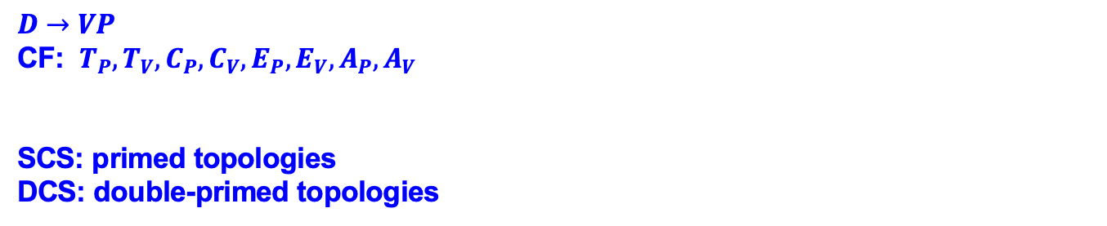
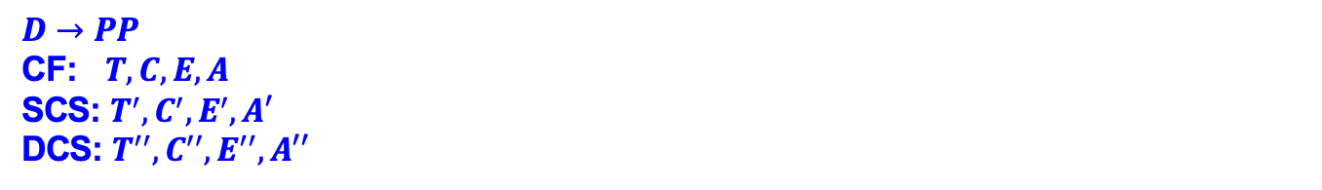
$D→PP$
CF: $T, C, E, A$
SCS: $T^{′}, C^{′}, E^{′}, A′$
DCS: $T^{′′}, C^{′′}, E^{′′}, A′′$
$D→VP$
CF: $T_{P}, T_{V}, C_{P}, C_{V}, E_{P}, E_{V}, A_{P}, A_{V}$
SCS: primed topologies
DCS: double-primed topologies
HYC, Cheng-Wei Chiang: Updated analysis of $D→PP,VP$ and $VV$
arXiv: 2401.06316, PRD 109, 073008 (2024)

Slide 9
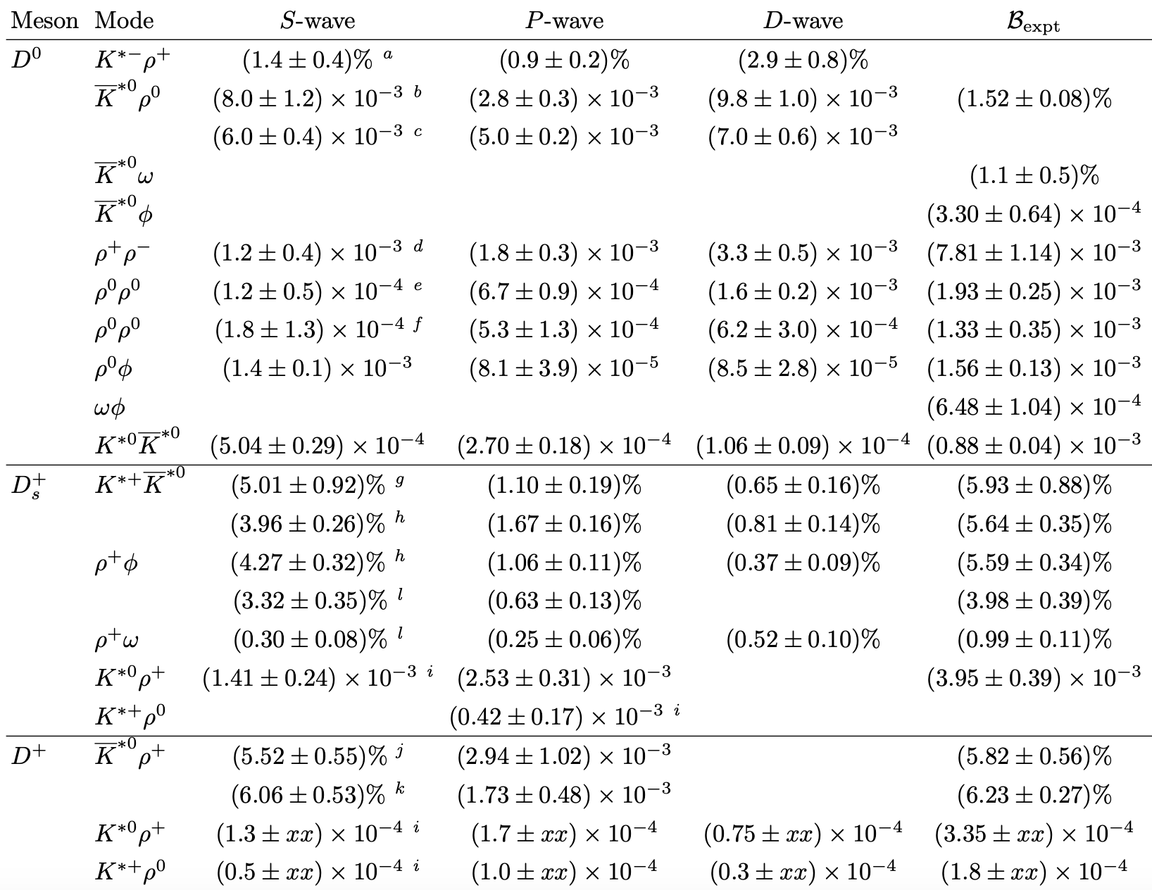
D → VV
D-wave dominated
BESIII (’19)
BESIII (’17)
LHCb (’18)
FOCUS (’03)
BESIII (’23)
BESIII (’23)
CLEO data reanalysis (’17)
BESIII (’21)
LHCb (’19)
BESIII (’21)
BESIII (’21)
BESIII (’21)
BESIII (’25)
BESIII (’25)
BESIII (’22)
BESIII (’22)
P-wave dominated
BESIII (’23)
BESIII (’24)
BESIII (’25)
BESIII (’25)

Slide 10
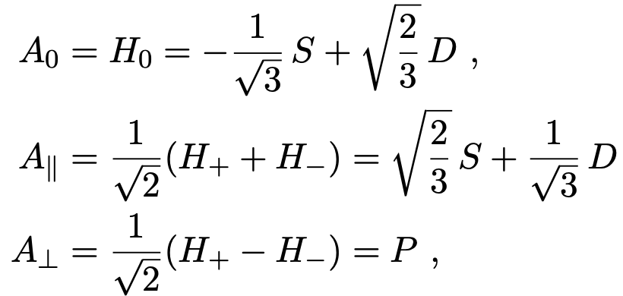
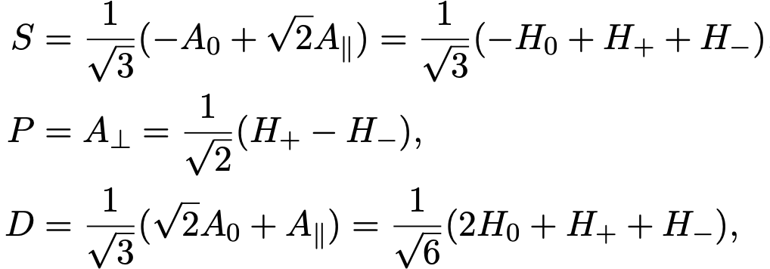
Decay amplitudes of $D→VV$ can be expressed in several different bases: helicity basis${ H}_{0, }$ $H_{+, }$ $H_{−, }$ transversity basis ($A_{0, }A_{||, }A_{⊥}) a$nd partial-wave basis (S, P, D)

Slide 11
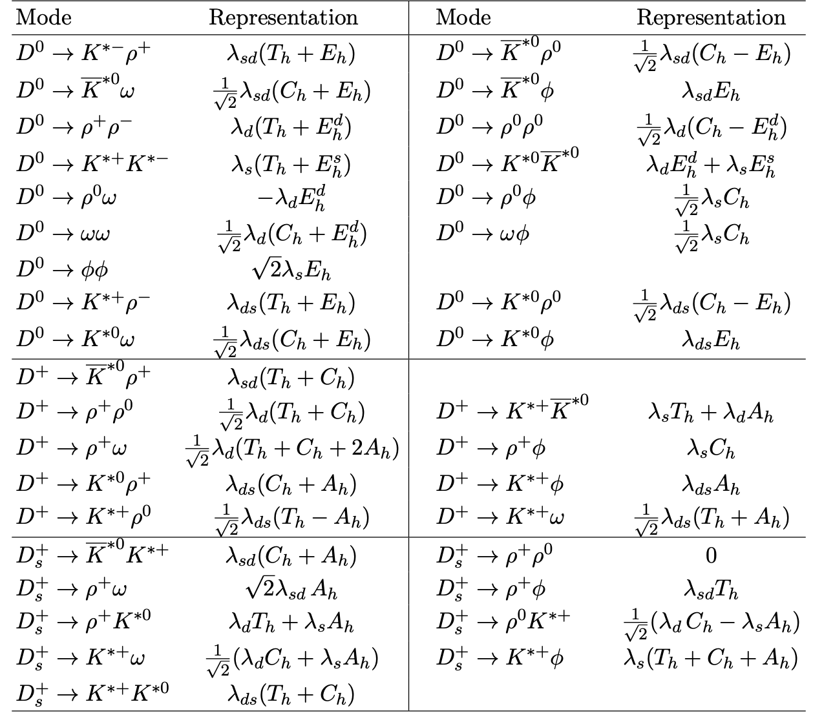




$λ_{sd}=V_{cs}^{∗}V_{ud}$(CF)
$λ_{d}=V_{cd}^{∗}V_{ud}$(SCS)
$λ_{s}=V_{cs}^{∗}V_{us }$ (SCS)
$λ_{ds}=V_{cd}^{∗}V_{us}$ (DCS)

Slide 12


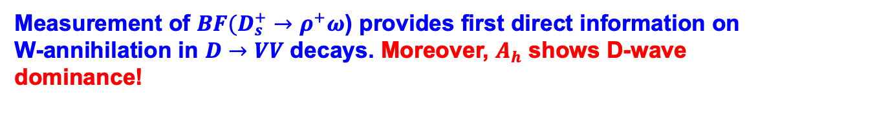

Factorizable D →VV amplitudes ⇒
$D^{0}→ρ^{0}φ,D^{+}→ρ^{+}φ$ proceed through C, while $D_{s}^{+}→ρ^{+}φ$ via T. Their measured polarizations are consistent with what are expected from factorization
$D^{0}→K^{∗−}ρ^{+},{\overline{K}}^{∗0}ρ^{0},ρ^{+}ρ^{−},ρ^{0}ρ^{0}$seem to be dominated by the D wave
${A(D}^{0}→K^{∗−}ρ^{+},ρ^{+}ρ^{−})∝$ $T_{h}+E_{h},$ ${A(D}^{0}→{\overline{K}}^{∗0}ρ^{0}, ρ^{0}ρ^{0})∝ C_{h}−E_{h}$
⟹ $E_{h}$ dominated by D wave!
$D_{s}^{+}→ρ^{+}φ, ρ^{+}ω$ have been measured by BESIII recently. 2501.04451
A($D_{s}^{+}→ρ^{+}φ$)$=V_{cs}V_{ud }T_{h}$
A($D_{s}^{+}→ρ^{+}ω$)$={\frac{1}{\sqrt{2}}V}_{cs}V_{ud }A_{h}$
Measurement of $BF(D_{s}^{+}→ρ^{+}ω$) provides first direct information on W-annihilation in $D→VV$ decays. Moreover, $A_{h}$ shows D-wave dominance!

Slide 13
If $D^{0}→ωφ$ and $D^{0}→ρ^{0}φ$ proceed only through internal W-emission, their branching fractions & polarizations are expected to be the same
$B(D^{0}→ρ^{0}φ\text{) = (1.56}\text{±0.13}\text{)}×{10}^{−3}, B(D^{0}→ωφ$) = (6.48±1.04)$×{10}^{−4},$
While $D^{0}→ρ^{0}φ$ behaves normally, $D^{0}→ωφ$ is transversely polarized
BESIII (’21) ⇒ transversely polarized in $D^{0}→ωφ$ with $f_{L}<0.24$
Q: How to understand the puzzles with rate and polarization for $D^{0}→ωφ, ρ^{0}φ?$
Consider FSI through $K^{∗+}K^{∗−}$ which contributes to $D^{0}→ωφ$ and $D^{0}→ρ^{0}φ$ from external W-emission, but only to the former from W-exchange
Cao, Cheng, Zhao (2303.00535)
LD contributions to topological internal W-emission $C$ could be different for both $D^{0}→ωφ$ and $D^{0}→ρ^{0}φ.$

Slide 14
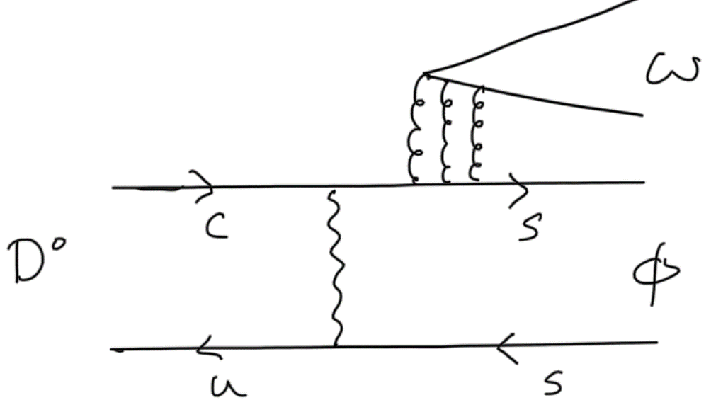
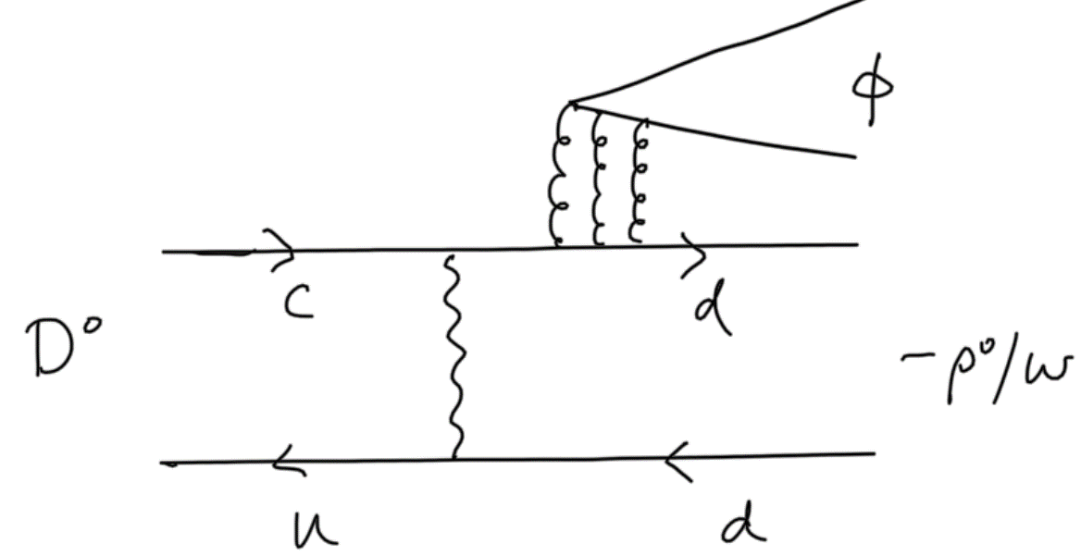


Another approach: $C$ topology is assumed to be the same for $D^{0}→ωφ, D^{0}→ρ^{0}φ$, but flavor-singlet contributions to them are different
$S_{h}^{φ}$:
$S_{h}^{ω}$:
Recall that flavor-singlet contribution is needed to explain $D_{s}^{+}→ρ^{+}η′$
To understand the polarization puzzle with D-wave or P-wave dominance, it is instructive to study W-exchange or W-annihilation induced D -> VV process manifested as a triangle diagram at hadron level.
V
D
V

Slide 15
CP violation in charmed meson decays

Slide 16

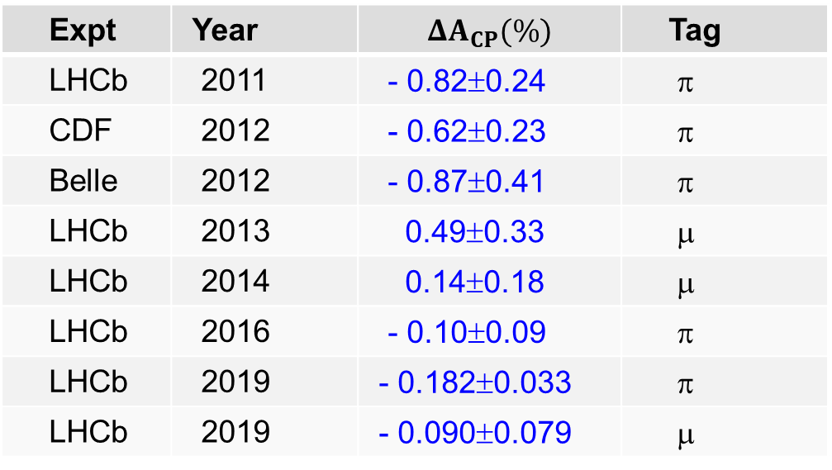

Experiment
LHCb: (11/14/2011) 0.92 fb⁻¹ based on 60% of 2011 data
ΔA_{CP} ≡ A_{CP}(D⁰→ K⁺K⁻) - A_{CP}(D⁰→ π⁺π⁻) = - (0.82±0.21±0.11)% 3.5σ effect
claimed to be the first evidence of CPV in charm sector
Expt | Year |  | Tag
LHCb | 2011 | - 0.82±0.24 | π
CDF | 2012 | - 0.62±0.23 | π
Belle | 2012 | - 0.87±0.41 | π
LHCb | 2013 | 0.49±0.33 | μ
LHCb | 2014 | 0.14±0.18 | μ
LHCb | 2016 | - 0.10±0.09 | π
LHCb | 2019 | - 0.182±0.033 | π
LHCb | 2019 | - 0.090±0.079 | μ
Fermilab Today, Dec 13, 2012:
“Another charm revolution?”
$$D^{∗+}→D^{0}π^{+}$$
Original evidence of CPV was gone in 2013 & 2014 after muon tag
$$B→D^{0}μ^{−}ν_{μ}X$$
LHCb (14’+16’+19’) ⇒ ΔA_{CP} = (- 0.154±0.029)% 5.3σ effect
First observation of CPV in charm sector

Slide 17
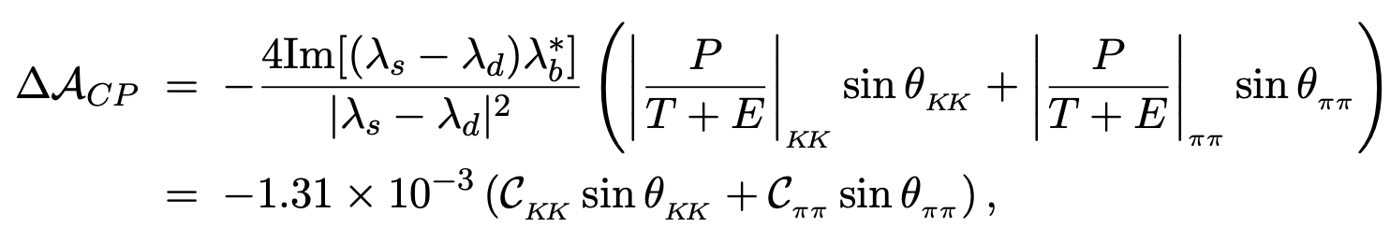



$$A\left(D^{0}→π^{+}π^{−}\right)=λ_{d}\left(T+E_{d}+P_{d}+PA_{d}\right)+λ_{s}(P_{s}+PA_{s})$$
$$A\left(D^{0}→K^{+}K^{−}\right)=λ_{d}\left(P_{d}+PA_{d}\right)+λ_{s}(T+E_{s}+P_{s}+PA_{s})$$
Naively, |P/T| = O($α_{s}(m_{c})/π$) ∼ 0.1 ⇒ CPV is of order ${10}^{−4}$ or even less
Perturbative $P/T$ has been estimated in several different manners:
pQCD + factorization-assisted topological amplitude (FAT) [ Li, Lu, Yu (’12)]
${\left(\frac{P}{T}\right)}_{ππ}≈0.30e^{i{110}^{∘}}$ ⇒ $C_{ππ}=0.66e^{i{134}^{∘}}$
ratios enhanced by a factor of 2
${\left(\frac{P}{T}\right)}_{KK}≈0.24e^{i{110}^{∘}}$ ⇒ $C_{KK}=0.45e^{i{131}^{∘}}$
⇒ $Δa_{CP}^{dir}≈−1.0×{10}^{−3}$

Slide 18
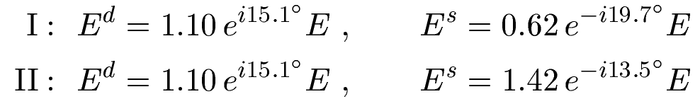
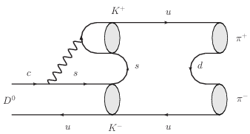
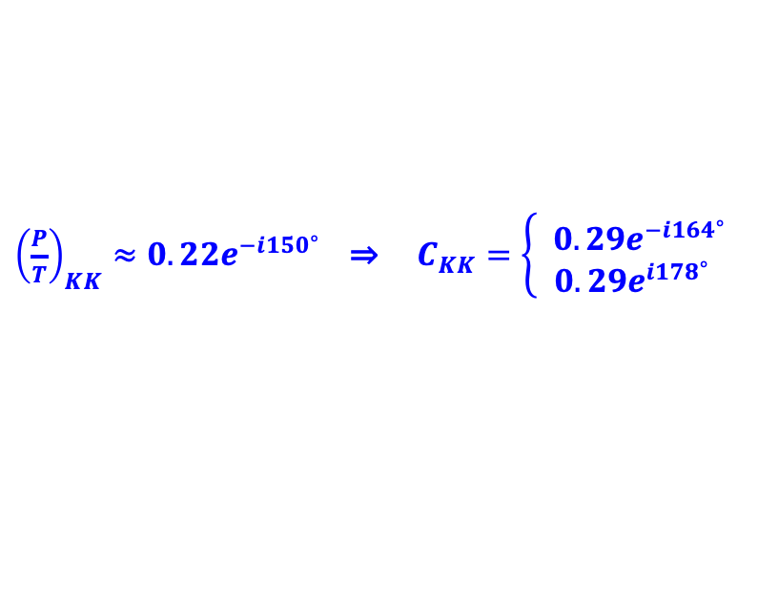


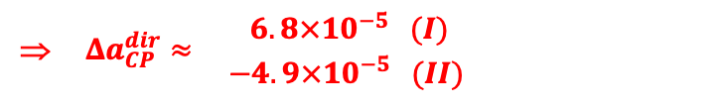

QCDF + topological approach [HYC & Chiang (’12)]
${\left(\frac{P}{T}\right)}_{ππ}≈0.23e^{−i{150}^{∘}}$ ⇒ $C_{ππ}=0.40e^{i{176}^{∘}}$
${\left(\frac{P}{T}\right)}_{KK}≈0.22e^{−i{150}^{∘}}$ ⇒ $C_{KK}=\left\{\begin{matrix} 0.29e^{−i{164}^{∘}} \\ 0.29e^{i{178}^{∘}}\end{matrix}\right.$
SU(3) violation in E amplitudes is fixed from $D^{0}→K^{+}K^{−},K^{0}{\overline{K}}^{0},π^{+}π^{−}. π^{0}π^{0}$
$$E^{q}:c\overline{u}→q\overline{q}$$
⇒ $Δa_{CP}^{dir}≈\begin{matrix} 6.8×{10}^{−5} (I) \\ −4.9×{10}^{−5} (II)\end{matrix}$
phases close to π !
Large LD contribution to P can arise from a resonantlike final-state rescattering
We made an ansatz that $P^{LD}∼E$

Slide 19
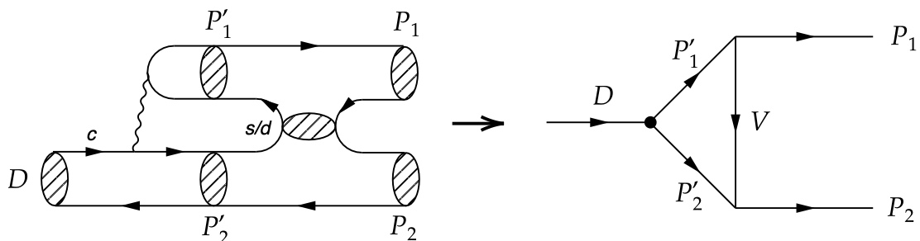
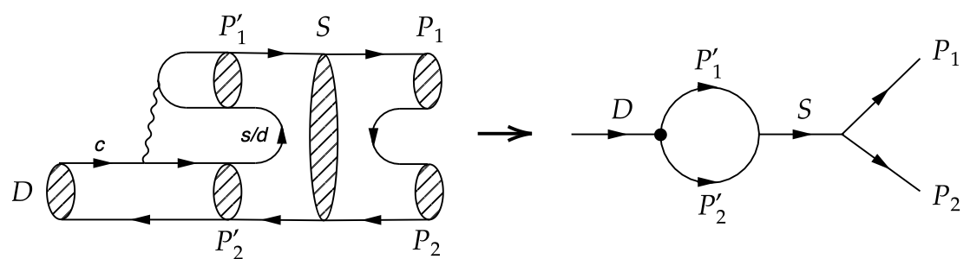
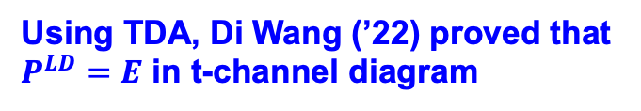
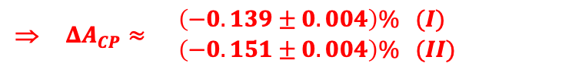
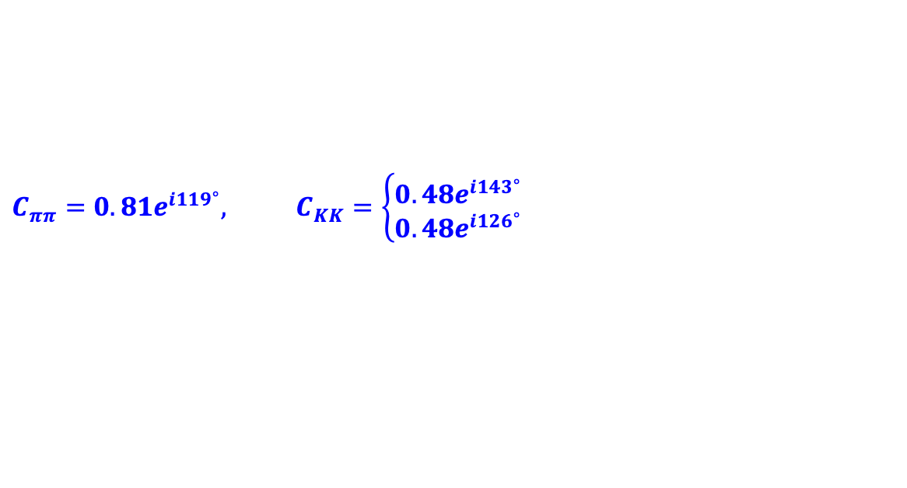

$C_{ππ}=0.81e^{i{119}^{∘}},$ $C_{KK}=\left\{\begin{matrix}0.48e^{i{143}^{∘}} \\ 0.48e^{i{126}^{∘}}\end{matrix}\right.$
⇒ $ΔA_{CP}^{ }≈\begin{matrix} \left(−0.139±0.004\right)\% (I) \\ \left(−0.151±0.004\right)\% (II)\end{matrix}$
(’12)
Predictions we made in 2012 agrees well with 2019 LHCb experiment
$$ΔA_{CP}^{ }=\left(−0.154±0.029\right)\%$$
Using TDA, Di Wang (’22) proved that $P^{LD}=E$ in t-channel diagram
We found it is also true in s channel

Slide 20
Other approaches
Based on LCSR, Khodjamirian and Petrov (’17) obtained
${|C}_{ππ}|={0.093±0.011}_{ }^{ },$ |$C_{KK}|=0.075±0.015$
while Lenz , Piscopo and Rusov (’24) got
${|C}_{ππ}|={0.089}_{−0.037 }^{+0.042},$ ${|C}_{KK}|={0.066}_{−0.029}^{+0.031}$
$$\left|Δa_{CP}\right|≤2.4×{10}^{−4}$$

Slide 21
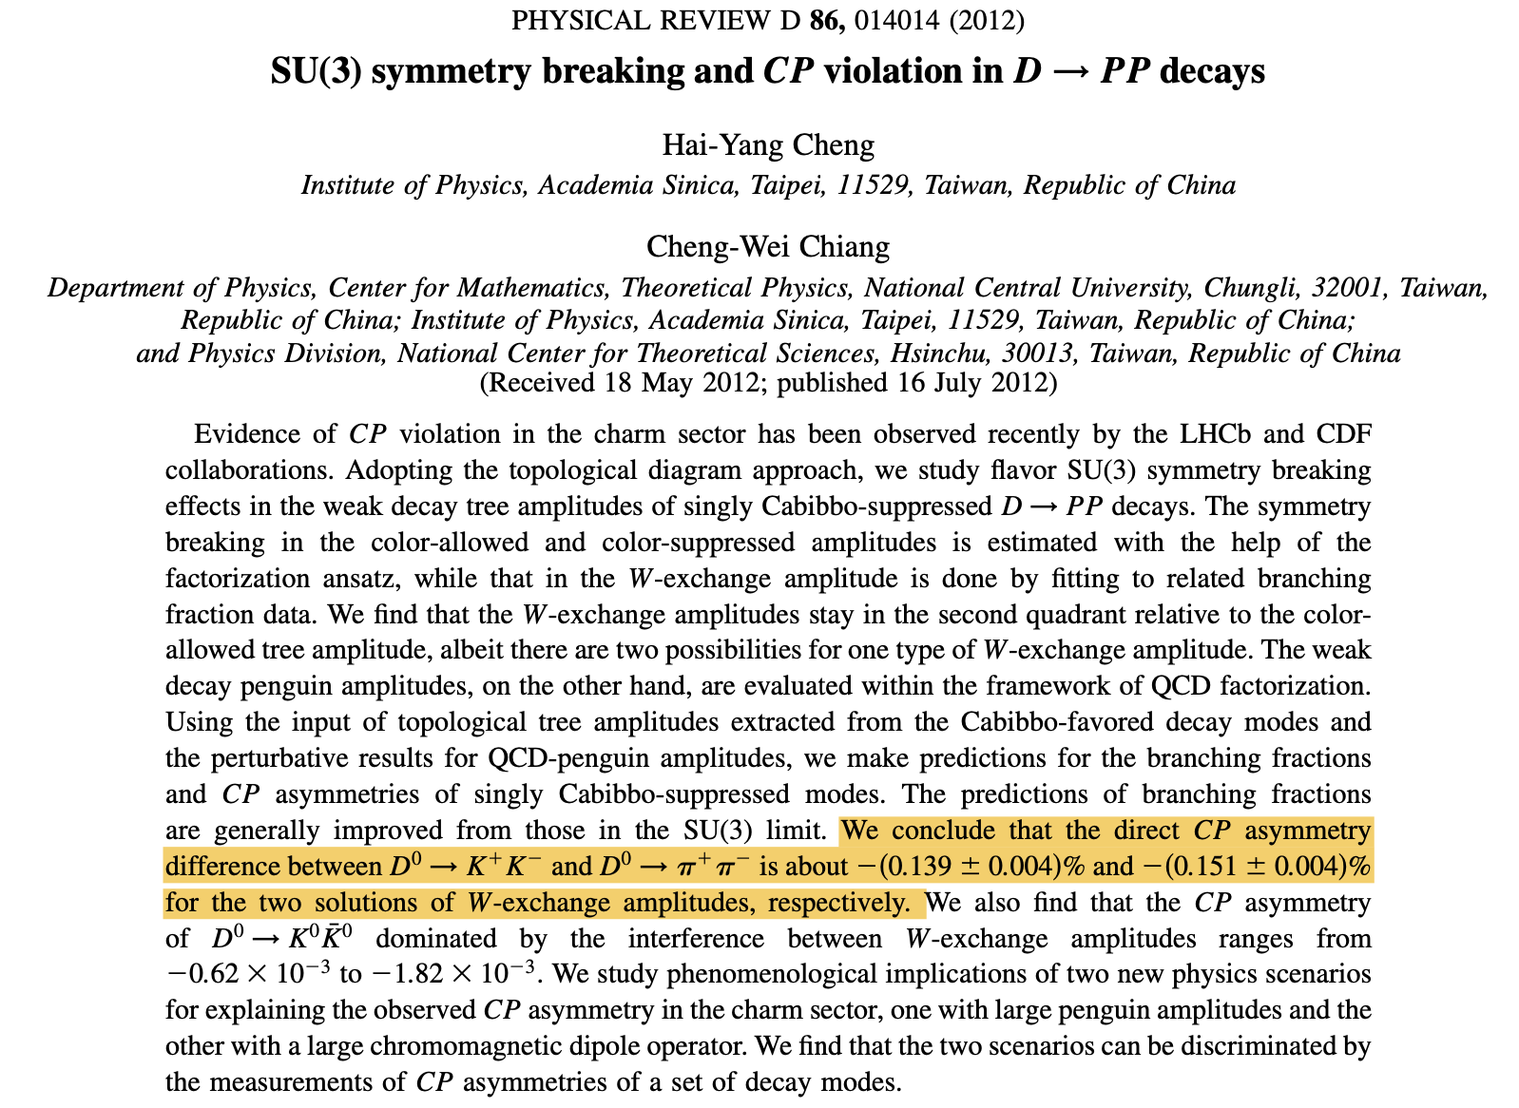
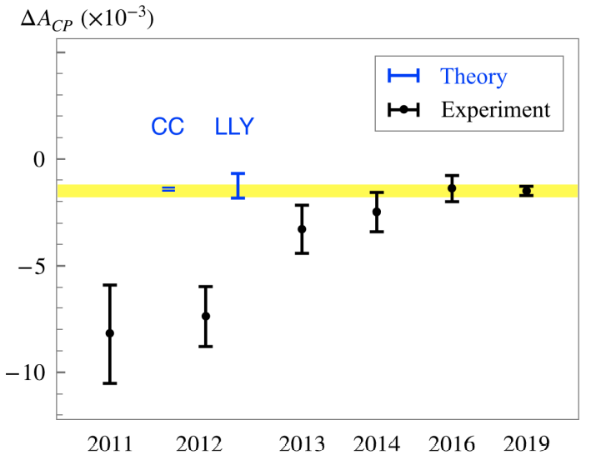
LLY: Li, Lu, Yu
CC: HYC, Chiang
M Saur & Fu-Sheng Yu
Sci. Bull. 65, 1428 (2020)

Slide 22
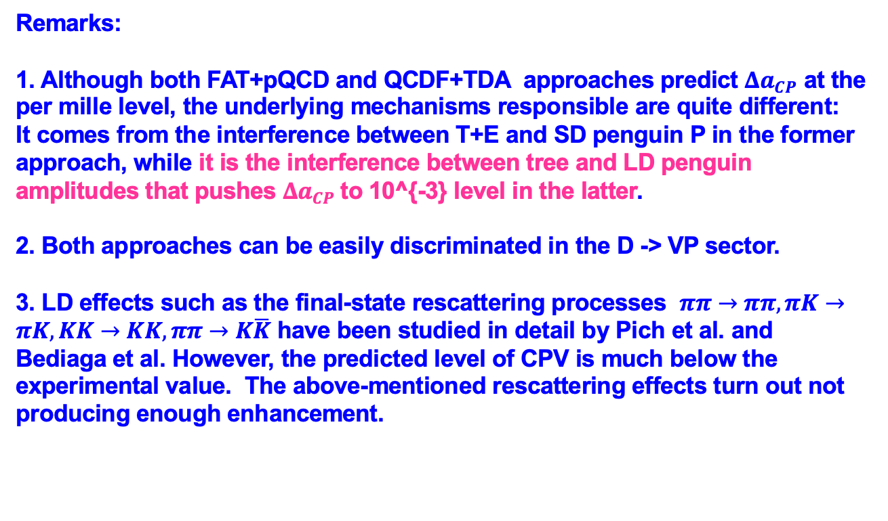
Remarks:
1. Although both FAT+pQCD and QCDF+TDA approaches predict $Δa_{CP}$ at the per mille level, the underlying mechanisms responsible are quite different:
It comes from the interference between T+E and SD penguin P in the former approach, while it is the interference between tree and LD penguin amplitudes that pushes $Δa_{CP}$to 10^{-3} level in the latter.
2. Both approaches can be easily discriminated in the D -> VP sector.
3. LD effects such as the final-state rescattering processes $ππ→ππ, πK→πK, KK→KK, ππ→K\overline{K}$ have been studied in detail by Pich et al. and Bediaga et al. However, the predicted level of CPV is much below the experimental value. The above-mentioned rescattering effects turn out not producing enough enhancement.

Slide 23

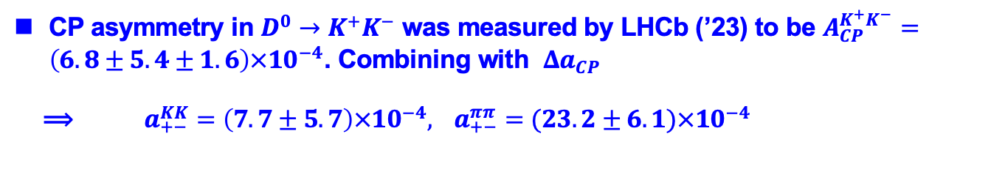
CP asymmetry in $D^{0}→K^{+}K^{−}$ was measured by LHCb (’23) to be $A_{CP}^{K^{+}K^{−}}=\left(6.8±5.4±1.6\right)×{10}^{−4}$. Combining with $Δa_{CP}$
⟹ $a_{+−}^{KK}=\left(7.7±5.7\right)×{10}^{−4},$ $a_{+−}^{ππ}=(23.2±6.1)×{10}^{−4}$
Rahul Sinha, Browder, Deshpande, D. Sahoo, Nita Sinha 2505.24338
Evidence of CPV in $D^{0}→π^{+}π^{−}$, $a_{+−}^{ππ}=(23.2±6.1)×{10}^{−4}$, provides an unambiguous evidence of New Physics at about 3$σ.$The central value of the fit for ${|C}_{+−}|$ is 4.80, indicating an unacceptably large penguin contribution.
In our case, $a_{+−}^{KK}=−\left(5.7±0.4\right)×{10}^{−4},$ $a_{+−}^{ππ}=(9.5±0.4)×{10}^{−4}$. Hence, we are able to reproduce CP-asymmetry difference $Δa_{CP}$, but not $a_{+−}^{KK}$ & $a_{+−}^{ππ}$.

Slide 24
Charmed baryon physics

Slide 25
H. Y. Cheng:
Charmed baryon production and decays, Int. J. Mod. Phys. A24, 593 (2009)
Charmed baryons circa 2015, Front. Phys. 10, 101406 (2015)
Charmed baryon physics circa 2021, Chin. J. Phys. 78 , 324 (2022)
H. B. Li and X. R. Lyu:
Study of the standard model with weak decays of charmed hadrons at
BESIII, Natl. Sci. Rev. 8 (2021) no.11, nwab181

Slide 26
Contents
Spectroscopy of excited charmed baryon states
Lifetimes
Hadronic weak decays
CP violation

Slide 27
Spectroscopy of charmed baryons

Slide 28
V Crede, J. Yelton
Review of charmed & bottom baryon spectroscopy
arXiv: 2502.08815
Hua-Xing Chen et al
An updated review of the new hadron states
Rep. Prog. Phys. 86 026201 (2023)

Slide 29
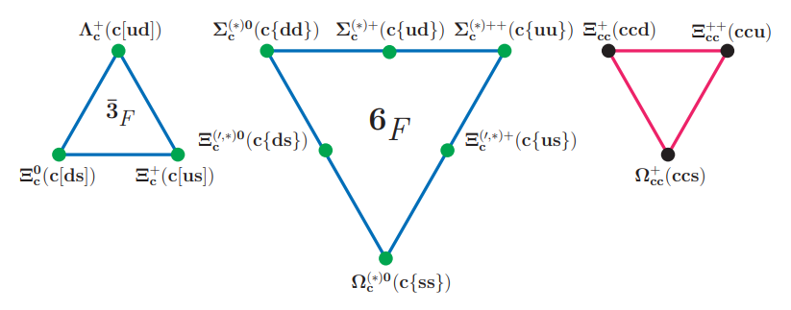


For singly charmed baryons, light diquark = 3×3 = 3+6 in SU(3) representation,
3: Λ_{c}⁺, Ξ_{c}⁺, Ξ_{c}⁰ all decay weakly
6: Ω_{c}⁰, Ξ’⁺_{c}, Ξ’⁰_{c}, Σ_{c}^{++,+,0} only Ω_{c}⁰ decays weakly
Ω_{c}^{*0}, Ξ^{*+}_{c}, Ξ^{*0}_{c}, Σ_{c}^{*++,+,0} (J^{P} = 3/2⁺)
spin [$q_{1}q_{2}]=0$
spin {$q_{1}q_{2}\}=1$

Slide 30
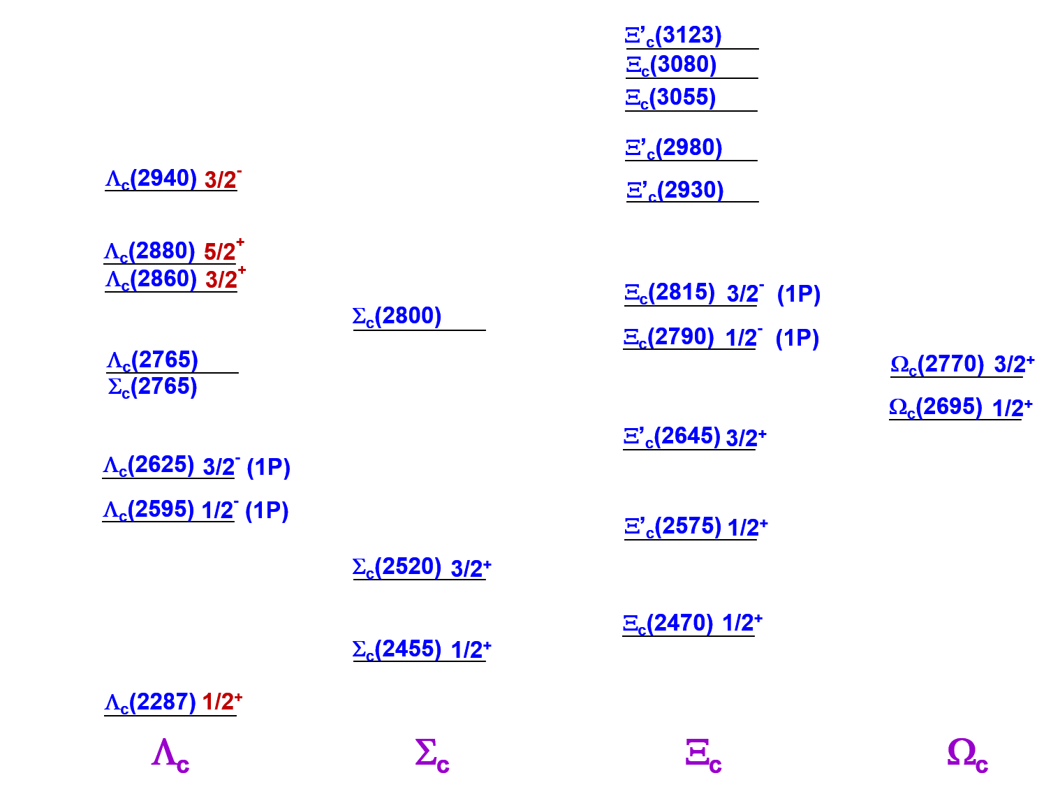

Slide 31
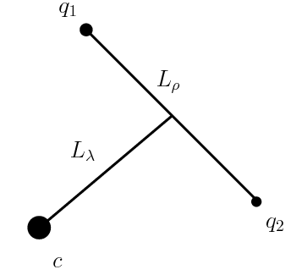
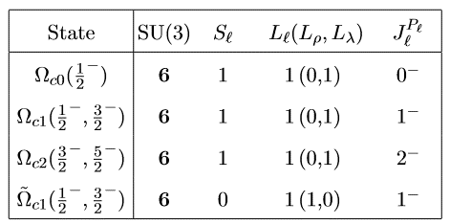

Orbitally excited charmed baryon states
$L_{ρ}+L_{λ}=L_{ℓ}$ (not $L_{ρ}+L_{λ}=L_{ℓ}$!): angular momentum of the diquark
Two possible p-wave states (L_{ρ}+L_{λ}=1):
ρ state L_{ρ} =1, L_{λ} =0; antisymmetric under q₁↔q₂
λ state L_{ρ} =0, L_{λ ¸}=1; symmetric under q₁↔q₂
$J_{ℓ}=S_{ℓ}+L_{ℓ}$, $J_{ }=S_{c}+J_{ℓ}$
In HQ limit, J_{l} & S_{c} are separately conserved
$$Ω_{c}^{0}:css$$
Assume S_{l}=1 (axial-vector diquark) for sextet, we have 5 P-wave Ω_{c} states.

Slide 32
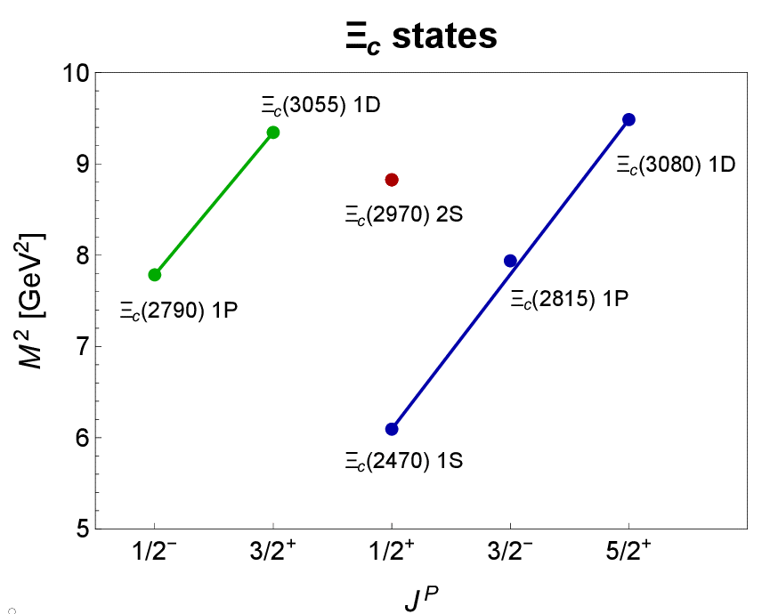
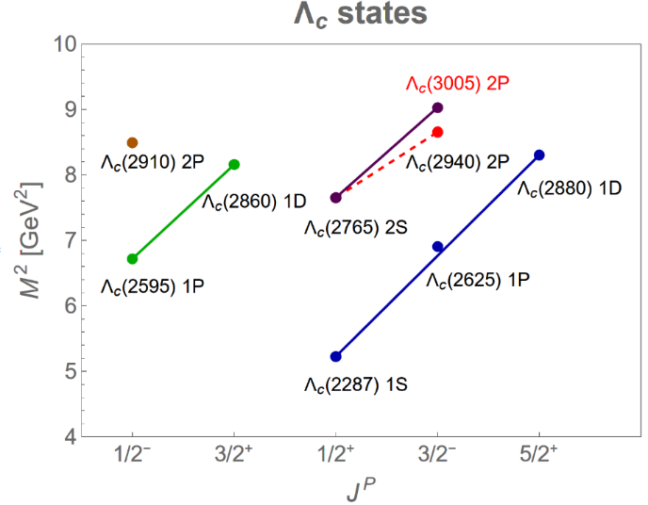
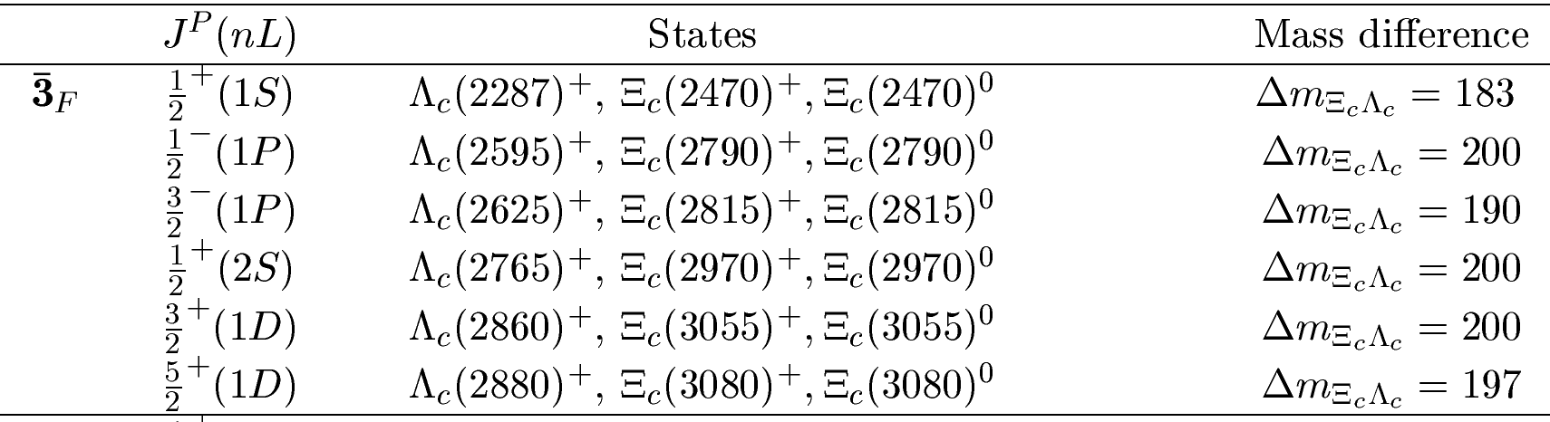


Antitriplet states
Regge trajectory:
$$J=αM^{2}+α_{0}$$
$$n_{r}=βM^{2}+β_{0}$$
Spin-parity of $Ξ_{c}^{+,0}\left(3055\right)$ measured by LHCb (’25) to be 3/2+

Slide 33
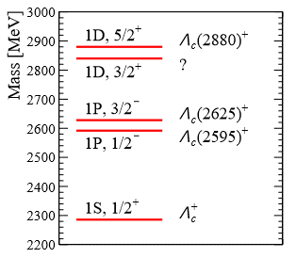
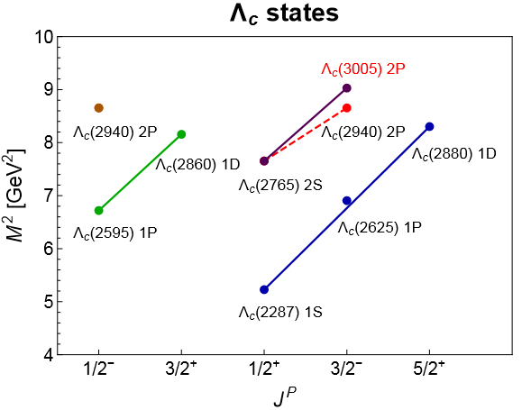
Λ_{c}(2860): another D-wave excited state
Existence of a new 3/2⁺ state was noticed even before LHCb experiment
B. Chen, Wei, Liu, Matsuki (’16)
Lu, Dong, Liu, Matsuki (’16)
B. Chen, Liu, Zhang (’17)
Λ_{c}(2860) observed by LHCb (’17) in D⁰p amplitude in Λ_{b}→ D⁰pπ⁻ decay. It has J^{P} = 3/2⁺.
M= 2856.1^{+2.3}_{-5.9} MeV
Γ = 67.6^{+11.8}_{-21.6} MeV

Slide 34
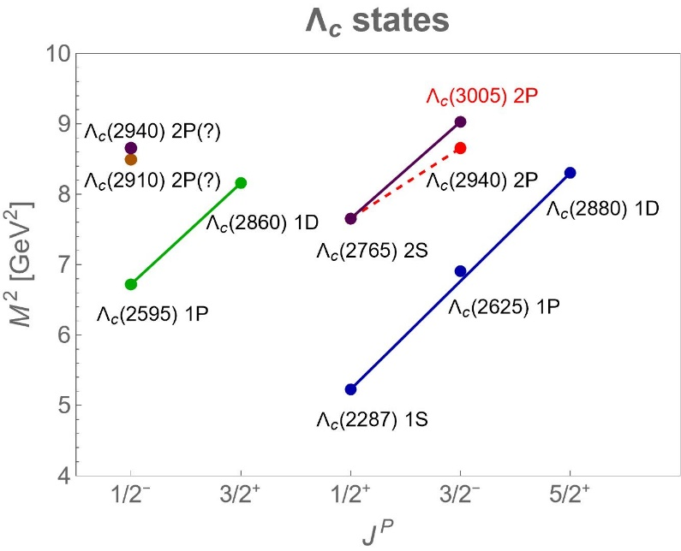
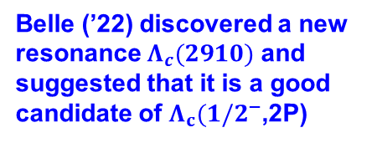
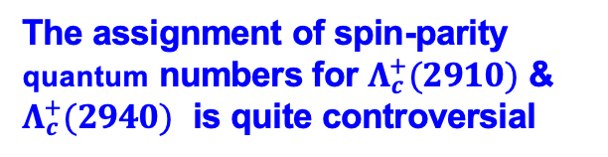
Λ_{c}(2940): J^{P} = 3/2- ?
LHCb (’17) studied spin & parity of Λ_{c}(2940) and found J^{P}= 3/2-. However, its Regge line is not parallel to other two Regge trajectories; Λ_{c}(3005) predicted by quark-diquark model fits better. Indeed, LHCb has commented that other solutions with spin 1/2 to 7/2 cannot be excluded
We suspcted if Λ_{c} (2940) is a 3/2⁻(2P) state. This needs to be checked.
HYC, Chiang (’17)
Belle (’22) discovered a new resonance $Λ_{c}(2910)$ and suggested that it is a good candidate of $Λ_{c}(1/2^{−}$,2P)
The assignment of spin-parity quantum numbers for $Λ_{c}^{+}(2910)$ & $Λ_{c}^{+}(2940)$ is quite controversial

Slide 35
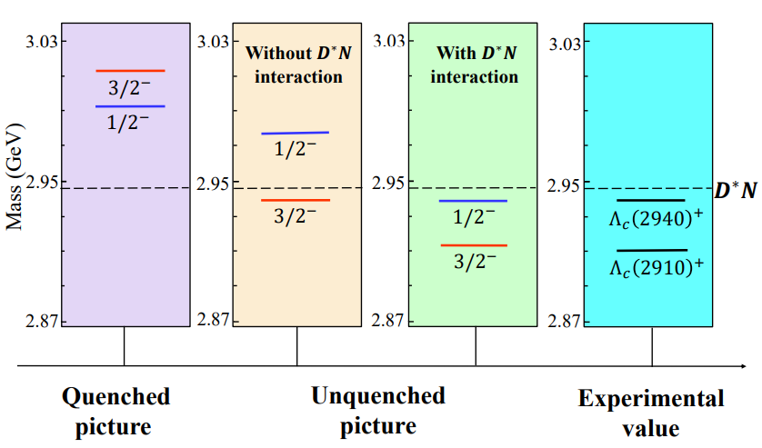
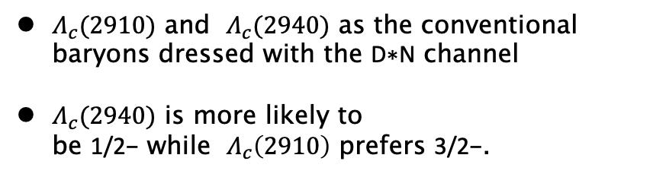

The mass of $Λ_{c}\left(2940\right)$ is expected to be 3012 MeV in QM, hence its mass is abnormally low, just like $Λ\left(1405\right), D_{s0}^{∗}\left(2317\right), X\left(3827\right).$ It could be a pentaquark or a $D^{∗}N$molecular$.$
S.Q. Luo, B Chen, Z.W. Liu, X. Liu (’20)
Zi-Le Zhang, Zhan-Wei Liu, Si-Qiang Luo, Fu-Lai Wang, Bo Wang, Hao Xu (`22)
$Λ_{c}(2910)$ and $Λ_{c}(2940)$ as the conventional baryons dressed with the D∗N channel
$Λ_{c}(2940)$ is more likely to be 1/2− while $Λ_{c}\left(2910\right)$ prefers 3/2−.
$Λ_{c}(2910)$: |3/2-, 2$⟩_{ρ}$, or |5/2-, 2$⟩_{ρ}$
2501.00268
$Λ_{c}(2940)$: |1/2-, 1$⟩_{λ}$, or |3/2-, 1$⟩_{λ,}$ the latter is more favorable

Slide 36
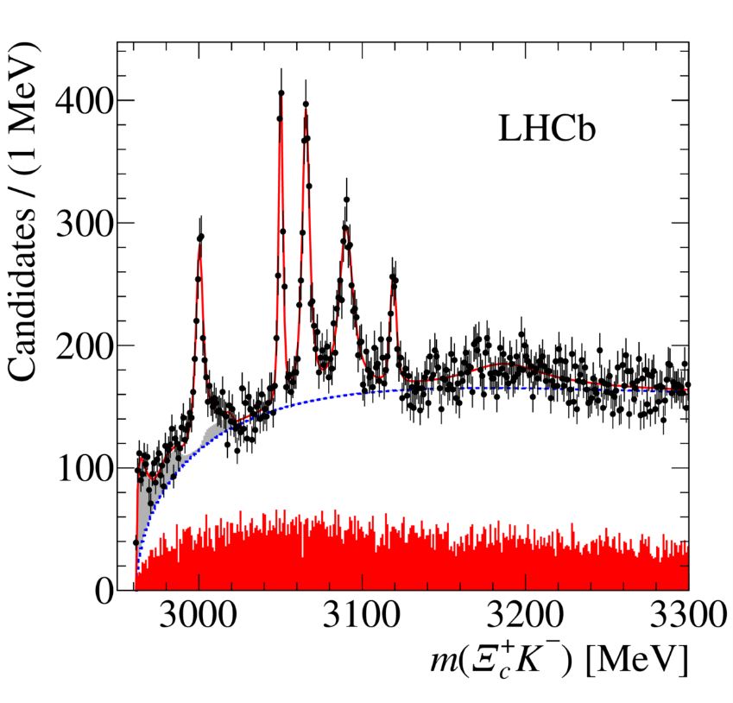
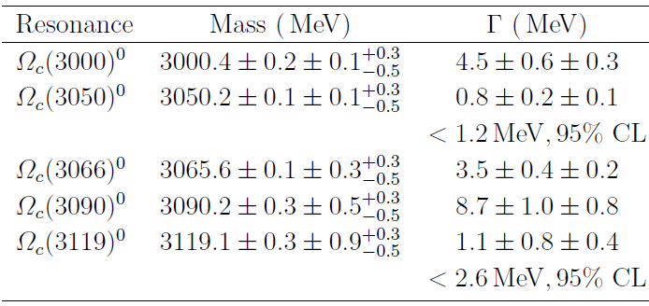
03/14/2017
5 narrow excited Ω_{c} states decaying into Ξ_{c}^{(’)}K
Confirmed by Belle except Ω_{c}(3119)

Slide 37
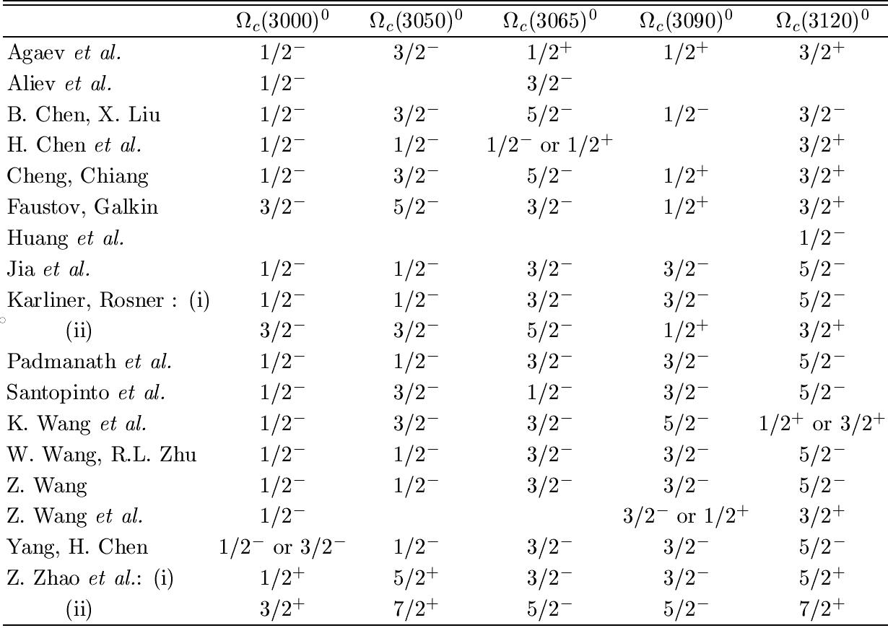
In 2017, 5 narrow excited Ω_{c} states decaying into Ξ_{c}^{(’)}K were observed by LHCb: Ω_{c}(3000), Ω_{c}(3050), Ω_{c}(3065), Ω_{c}(3090) and Ω_{c}(3120). Various spin-parity quantum numbers have been proposed in the literature
A popular spin-parity assignment: 1P(${1/2}^{−}$, ${1/2}^{−}$, ${3/2}^{−}$, ${3/2}^{−}$, ${5/2}^{−})$

Slide 38
A popular spin-parity assignment: 1P(${1/2}^{−}$, ${1/2}^{−}$, ${3/2}^{−}$, ${3/2}^{−}$, ${5/2}^{−})$
Assuming a mass 3000 MeV
Γ(Ω_{c0}) = 410 MeV for h₂ = 0.437 in HHChPT
HYC, Chiang (’17)
1400 MeV by Zhao, Ye, Zhang
420 MeV by H.X. Chen et al. using QCD sum rules
35 MeV by B. Chen, Liu using Eichten, Hill, Quigg decay formula
32 MeV by K.L. Wang et al. based on chiral quark model
With width of 410 MeV for Ω_{c0} and the data of 4.5± 0.7 MeV for Ω_{c}(3000), the mixing angle is constrained to be 96º or 84º. (111º by B. Chen & Liu, 24º or 47º by K. Wang et al.)
Ω_{c1}(1/2⁻) is prohibited to decay into Ξ_{c}K in HQ limit
The other state (1P,1/2-)_{h} must be too broad to be seen!

Slide 39
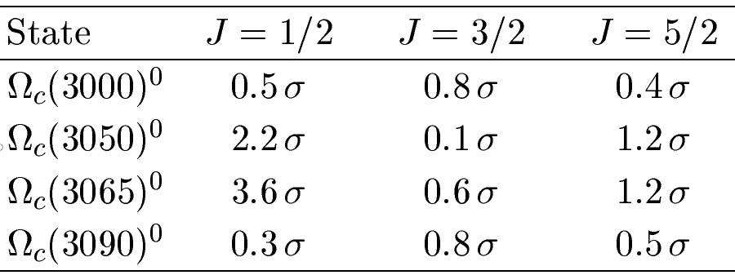
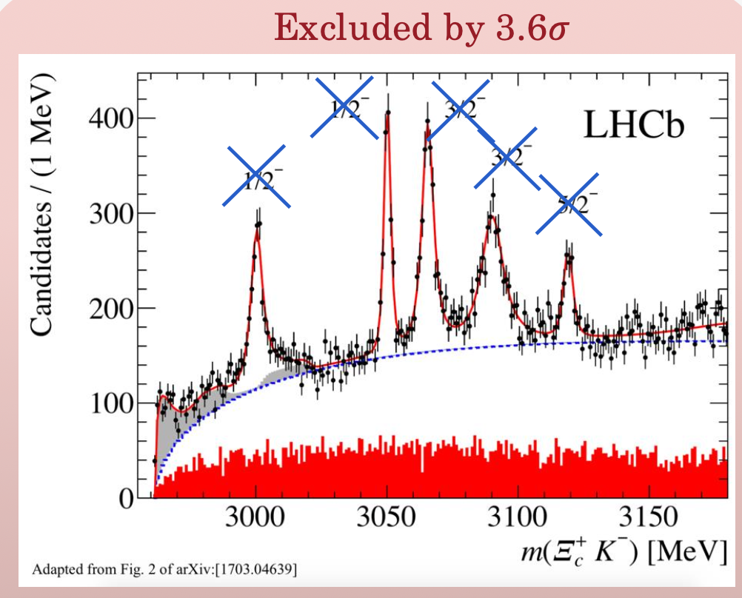
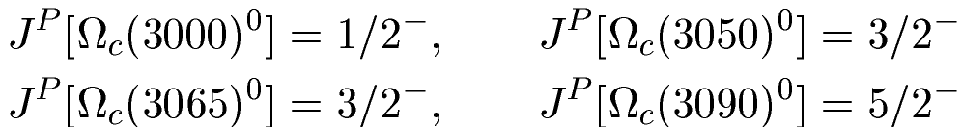
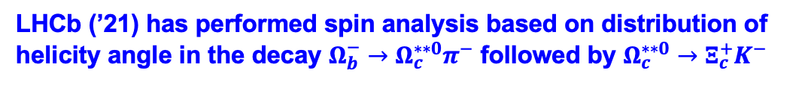
A test of spin-parity assignment: 1P(${1/2}^{−}$, ${1/2}^{−}$, ${3/2}^{−}$, ${3/2}^{−}$, ${5/2}^{−})$
LHCb (’21) has performed spin analysis based on distribution of helicity angle in the decay $Ω_{b}^{−}→Ω_{c}^{∗∗0}π^{−}$ followed by $Ω_{c}^{∗∗0}→Ξ_{c}^{+}K^{−}$
Significance values of excluding the J spin hypothesis
Hypothesis of J=1/2, 1/2, 3/2, 3/2 is rejected by 3.5σ
Spin assignment of four observed peaks is consistent with λ-mode excitations with J=1/2, 3/2, 3/2, 5/2
Non-observation of Ω_{c}(3120) is consistent with either a 2S doublet or a ρ-mode P-wave excitation

Slide 40
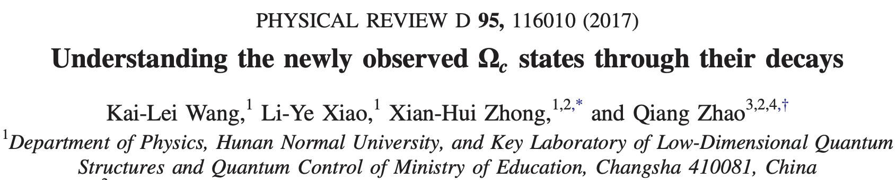

Slide 41



LHCb (2023) observed two new states $Ω_{c}^{0}\left(3185\right) \& Ω_{c}^{0}\left(3327\right).$
Both are broad. The state $Ω_{c}^{0}\left(3119\right)$ was confirmed.

Slide 42








$$×$$
$$J^{P}\left[Ω_{c}^{0}\left(3327\right)\right]={3/2}^{+}$$
Guo-Liang Yu, Yan Meng, Zhen-Yu Li, Zhi-Gang Wang, Lu Jie, 2302.11758
$${5/2}^{+}$$
Si-Qiang Luo, Xiang Liu, 2303.04022
${1/2}^{+},$ ${3/2}^{+},$ ${5/2}^{+}$
Zhi-Gang Wang, Fei Lu, Yang Liu 2303.13976
$${5/2}^{+},{7/2}^{+}$$
Hui-Hua Zhong, Ming-Sheng Liu, Li-Ye Xiao,
Kai-Lei Wang, Qi-Li, Xian-Hui Zhong, 2502.13741
Both 3/2+ & 5/2+ favored by Regge trajectory, but the former is ruled out by the predicted large width

Slide 43





LHCb (’20) observed three resonances $Ξ_{c}^{′}{\left(2923\right)}^{0}, Ξ_{c}^{′}{\left(2939\right)}^{0}, Ξ_{c}^{′}{\left(2965\right)}^{0}$
The broader resonance $Ξ_{c}^{′}{\left(2930\right)}^{0}$ seen by Babar (’08) and Belle (’18) resolves into two narrower peaks $Ξ_{c}^{′}{\left(2923\right)}^{0}, Ξ_{c}^{′}{\left(2939\right)}^{0}$
$Ξ_{c}^{′}{\left(2965\right)}^{0}$ was identified with $Ξ_{c}{\left(2970\right)}^{0}$ by PDG. They are actually two different states for two reasons:
$Ξ_{c}^{′}{\left(2965\right)}^{0}:$ M = 2964.88±0.33 MeV, Γ = 14.1±1.6 MeV
$Ξ_{c}{\left(2970\right)}^{0}:$ M = 2970.9±0.5 MeV, Γ =${ 28.1}_{−4.0}^{+3.4}$ MeV
2. $J^{P}\left[Ξ_{c}^{′}\left(2965\right)\right]=5/2^{−}$, $J^{P}\left[Ξ_{c}\left(2970\right)\right]=1/2^{+}$
Equal spacing rule:
3$/2^{+}(1S)$
see also Chen, Luo, Liu (’21)
for a justification
${ J}^{P}\left[Ξ_{c}^{′}\left(2923\right)\right]=3/2^{−}$, $J^{P}\left[Ξ_{c}^{′}\left(2939\right)\right]=3/2^{−}$, $J^{P}\left[Ξ_{c}^{′}\left(2965\right)\right]=5/2^{−}$

Slide 44


2020
2022
Just like $Ω_{c}\left(3000\right)1P, Ξ_{c}^{′}\left(2880\right)$ is an 1P 1/2- state.

Slide 45




Sextet states
$$×$$
$$×$$
The yet detected states labeled in red are obtained according to the equal spacing rule
${\frac{1}{2}}^{−}(1P)$ $Ω_{c}\left(3000\right), Ξ_{c}^{′}\left(2880\right), Σ_{c}\left(2740\right)$
While first three lines are established, the last three lines await for confirmation

Slide 46
Yu-Bin Zhang, Li-Ye Xiao, Xian-Hui Zhong 2501.00268
Possible explanations of the observed Λc resonances
Hui-Hua Zhong, Ming-Sheng Liu, Li-Ye Xiao, Kai-Lei Wang, Qi-Li, Xian-Hui Zhong
Ωc baryon spectrum and strong decays in a constituent quark model 2502.13741
Zhen-Yu Li, Guo-Liang Yu, Zhi-Gang Wang, Jian-Zhong Gu, and Hong-Tao Shen
Mass spectra of singly heavy baryons in the relativized quark model with heavy-quark dominance 2503.01237
Hua-Xing Chen, Wei Chen, Xiang Liu, Yan-Rui Liu and Shi-Lin Zhu
An updated review of the new hadron states 2204.02649
Xuan Luo, Yi-Jie Wang, and Hua-Xing Chen 2504.11219
P-wave single charmed baryons of the SU(3) flavor ̄3F

Slide 47
Lifetimes

Slide 48



 | $$τ(Ξ_{c}^{+})$$ | $$τ(Λ_{c}^{+})$$ | $$τ(Ξ_{c}^{0})$$ | $$τ(Ω_{c}^{0})$$
PDG (’04 ~ ’18) | 442 ± 26 | 200 ± 6 | ${112}_{−10}^{+13}$ | 69 ± 12
LHCb (’18) |  |  |  | 268 ± 26
LHCb (’19) | 457 ± 6 | 203.5 ± 2.2 | 154.5 ± 2.6
PDG (’20) | 456 ± 5 | 202.4 ± 3.1 | 153 ± 6 | 268 ± 26
LHCb (’21) |  |  | 148.0 ± 3.2 | 276.5 ± 14.1
PDG (’22,’23) | 453 ± 5 | 201.5 ± 2.7 | 151.9 ± 2.4 | 268 ± 26
Belle II (’22) |  | 203.20 ± 1.18 |  | 243 ± 49
PDG (’24) | 453 ± 5 | 202.6 ± 1.0 | 150.4 ± 2.8 | 273 ± 12
LHCb (’25) |  |  | 149.2 ± 2.7 | 276.3 ± 19.5
Average | 453 ± 5 | 202.6 ± 1.0 | 149.8 ± 1.9 | 274 ± 10
in units of fs (${10}^{−15}$ s)
2506.13334
$τ(Ω_{c}^{0})$ obtained by LHCb (’18) from semileptonic $Ω_{b}^{−}$ decays is nearly four times larger. It has been confirmed by LHCb (’21) using promptly produced $Ω_{c}^{0}$ baryons
and LHCb (’25) using hadronic b-hadron decays
$τ\left(Ξ_{c}^{+}\right)>τ\left(Λ_{c}^{+}\right)>τ\left(Ξ_{c}^{0}\right)>τ\left(Ω_{c}^{0}\right)$ before 2018
$τ\left(Ξ_{c}^{+}\right)>τ\left(Ω_{c}^{0}\right)>τ\left(Λ_{c}^{+}\right)>τ\left(Ξ_{c}^{0}\right)$ after 2018
$τ(Ξ_{c}^{0})$ becomes 3.3σ larger due to new measurements from LHCb (’19, ’21,’25)

Slide 49
Lifetimes of heavy baryons
Heavy quark expansion:
A₀ term from the decay of heavy quark Q
⇒ Lifetimes of all heavy hadrons H_{Q} are the same in m_{Q}→∞ limit
No linear 1/m_{Q} correction from A₁ term , known as Luke’s theorem
A₂ term arises from dim-5 kinetic & chromomagnetic operators $μ_{π}^{2}, { μ}_{G}^{2}$
A₃ term consists of dim-6 2-quark Darwin operator & 4-quark operators
which will induce the spectator effects responsible for lifetime differences
A₄ term includes dim-7 4-quark operators which will induce 1/m_{c}
corrections to spectator effects

Slide 50






Spectator effects described by dim-6 four-quark operators: dim-7 4-quark
W-exchange
destructive P.I. constructive
(Pauli interference)
constructive P.I. destructive
(only for charmed baryons)
Although spectator effects are 1/m_{Q}³ suppressed, they are
numerically important due to a p.s. enhancement factor of 16π²
relative to heavy quark decay

Slide 51




Effects of dim-7 4-quark operators were explored in 2017-2018. Preliminary results with the conjecture that $Ω_{c}^{0 }$ is no longer shortest-lived and that $τ\left(Ω_{c}^{0}\right)>τ\left(Λ_{c}^{+}\right)$ were first reported at 2018 HIEPA Workshop (March 19-21, 2018, Beijing).
An ad hoc parameter α was introduced to ensure the validity of HQE for $Ω_{c}^{0 }$
τ(Ω_{c}⁰) = 231 fs for α = 0.25
to dim-6 ⇒ $τ\left(Ξ_{c}^{+}\right)>τ\left(Λ_{c}^{+}\right)>τ\left(Ξ_{c}^{0}\right)>τ\left(Ω_{c}^{0}\right)$
to dim-7 ⇒ $τ\left(Ξ_{c}^{+}\right)>τ\left(Ω_{c}^{0}\right)>τ\left(Λ_{c}^{+}\right)>τ\left(Ξ_{c}^{0}\right)$

Slide 52

Less than three months later, LHCb’s new measurement of τ(Ω_{c}⁰) = (268±24±10±2) fs was first reported by Mariana Fontana on June 8th of 2018, which is nearly four-times larger than the world average of (69±12) fs obtained from fixed target experiments!
events
64
86
25
~ 1000 events

Slide 53


HYC, Chia-Wei Liu (’23) using improved bag model
$τ$ in units of ${10}^{−13}$ s
All predicted lifetimes are improved to NLO except for $Ξ_{c}^{+}$
To dim-6 ⇒ $τ\left(Ξ_{c}^{+}\right)>τ\left(Λ_{c}^{+}\right)>τ\left(Ξ_{c}^{0}\right)>τ\left(Ω_{c}^{0}\right)$
To dim-7 ⇒ $τ\left(Ξ_{c}^{+}\right)>τ\left(Ω_{c}^{0}\right)>τ\left(Λ_{c}^{+}\right)>τ\left(Ξ_{c}^{0}\right)$
Because of large destructive contributions from $Γ_{7}^{NL}$ and $Γ_{7}^{SL},$ $Ω_{c}^{0}$ could live
longer than $Λ_{c}^{+}$

Slide 54


($τ$ in units of ${10}^{−13}$ s )
 | BM | NRQM | Expt
$$Λ_{c}^{+}$$ | 1.92 ± 0.37 | ${ 3.04}_{−0.80}^{+1.06}$ | 2.026 ± 0.010
$$Ξ_{c}^{0}$$ | 1.66 ± 0.32 | ${ 2.31}_{−0.59}^{+0.84}$ | 1.504 ± 0.018
$$Ξ_{c}^{+}$$ | 3.27 ± 0.76 | ${ 4.25}_{−1.00}^{+1.22}$ | 4.53 ± 0.05
$$Ω_{c}^{0}$$ | 2.30 ± 0.58 | ${ 2.59}_{−0.70}^{+1.03}$ | 2.73 ± 0.12
NRQM: Gratrex, Melic, Nisandzic (’22) in the pole mass scheme
Improved bag model (BM): HYC, Chia-Wei Liu (’23)
Baryonic matrix elements
NLO dim-7
Heavy quark limit holds reasonably well in BM but is badly respected in NRQM.

Slide 55


Lifetimes of charmed mesons
in units of ${ps}^{−1}$
taken from Gratrex, Melic, Nisandzic (’22)
A negative $τ\left(D^{+}\right)$ due to a significant destructive contribution from Pauli interference

Slide 56
Hadronic weak decays of charmed baryons

Slide 57
Hadronic weak decays
Progress was relatively slow for a long time, both theoretically & experimentally. Several major breakthroughs in recent experiments:
Absolute branching fraction BF(Λ_{c}⁺→ pK⁻π⁺), a benchmark for other BFs of $Λ_{c}^{+}$, was measured by Belle (’14), BESIII (’16), LHCb (’18)
Absolute BFs of $Λ_{c}^{+}$ measured by BESIII (’16) for the first time
Absolute BFs of $Ξ_{c}^{+,0}$ reported by Belle (’19)
Observation of $Ξ_{cc}^{++}→Ξ_{c}^{+}π^{+}$ by LHCb in 2018 and $Ξ_{cc}^{++}→{Ξ′}_{c}^{+}π^{+}$ in 2022
Charm-flavor-conserving decay $Ξ_{c}^{0}→Λ_{c}^{+}π^{−}$ measured by LHCb (’20) and Belle (’22)
Absolute BFs for semileptonic decays of $Λ_{c}^{+}$ first measured by BESIII (’15)
Absolute BFs for semileptonic decays of $Ξ_{c}^{0}$ measured by Belle (’21) & ALICE (’21)
First measurement of partial wave phase shift in $Λ_{c}^{+}→ΛK^{+}$by BESIII (’24)
First precise measurements of Lee-Yang parameters $β$ and $γ$by LHCb (’24)
22

Slide 58



six new measurements of $Ξ_{c}^{+}$ decays
performed by Belle and Belle-II

Slide 59


Slide 60
$$M\left(ℬ_{i}→ℬ_{f}+P\right)=i\overline{u}(A−Bγ_{5})u_{i}$$
Dynamical model calculation
1. Pole model:
Kamal, HYC,…
Consider low-lying pole contributions:
s-wave is governed by ½⁻ resonances (very tedious, troublesome!)
p-wave is dominated by ½⁺ ground-state baryons
2. Relativistic QM: Korner, Kramer, Ivanov,…
overlap integrals
3. Current algebra: Kamal, HYC,…
s-wave is reduced to a commutator term in soft meson limit

Slide 61
Dynamic model calculations revived recently
NRQM
P.Y. Niu, J.M. Richard, Q. Wang and Q. Zhao (’20): $Λ_{c}^{+}$
P.Y. Niu, Q. Wang and Q. Zhao (’24): $Ξ_{c}^{0,+}$
Y.S. Li and X. Liu (’25)

Slide 62
Model-independent approach
1. Diagrammatic scheme
Chau, HYC, Tseng (’96); Kohara (’91); Zhao, Wang, Hsiao, Yu (’20); Hsiao, Wang, Zhao (’22)
Three different W- exchange diagrams
Need information of decay asymmetry to extract s-wave and p-wave amplitudes separately
2. SU(3) approach
Savage, Springer (’90); Sharma, Verma (’97); Lu, Wang, Yu (’16); Geng, Hsiao, Liu, Tsai (’17); Geng, Liu, Tsai (’19); Huang, Xing, He (’22); Zhong, Xu, Wen, Gu (‘23)
Parameters for s- and p-waves obtained by performing a global fit to the data of BFs and decay asymmetries

Slide 63
SU(3) or topological diagrammatic approach
Four-quark operator (${\overline{q}}_{1}q_{2})\left({\overline{q}}_{3}c\right)$ transforms as $\overline{3}×3×\overline{3 }$= $3+\overline{3′}+6+\overline{15}$
Sextet dominance over $\overline{15}$ was once assumed
⇒ $M\left(Λ_{c}^{+}→nπ^{+}\right)=\sqrt{2}M(Λ_{c}^{+}→pπ^{0})$ ruled out by experiment
S- and P-waves not distinguished
Savage, Springer (’90); Sharma, Verma (’97); Lu, Wang, Yu (’16); Geng, Hsiao, Liu, Tsai (’17).
S- and P-waves fitted separately to the data
Geng, Liu, Tsai (’19); Huang, Xing, He (’22); Zhong, Xu, Wen, Gu (‘23);
Xing, He, Huang, Yang (’23)
Relative phase between S- and P-waves taken into account
Geng, He, Jin, Liu, Yang (’23)

Slide 64








TDA @ Tree
Kohara (’91); Chau, HYC, Tseng (’96); Zhong, Xu, HYC (’24)
Independent diagrams are reduced to 7
Korner-Pati-Woo theorem
Further reduction from field redefinition: 7 to 5
weak interactions

Slide 65






TDA @ Penguin
HYC, Xu, Zhong (’25), D. Wang, J. F. Luo (`24)
five indep.
amplitudes

Slide 66

IRA (Irreducible SU(3) approach)
He, Shi, Wang (’20)
One of the first 5 terms is redundant. The next 5 terms are prohibited by KPW
(Korner-Pati-Woo) theorem except $a_{9}.$
Geng, He, Jin, Liu, Yang (’23), He, Liu (’24)

Slide 67


Slide 68


Strategy of global fit
Experimental input: 44 BFs and Lee-Yang parameters
5 independent TDA amplitudes @tree ⇒ 19 unknown parameters describing the magnitudes & phases of S- and P-waves
4 independent TDA penguin amplitudes ⇒ 15 unknown parameters describing the magnitudes & phases of S- and P-waves

Slide 69



Global fit to $Γ$and $α$ encounters a sign ambiguity for $β$ and $γ$
We propose to use the relation to avoid $±π$ ambiguity
$β$ and $γ$ parameters were measured for the first time in $Λ_{c}^{+}→Λπ^{+}$ and $Λ_{c}^{+}→ΛK^{+}$decays by LHCb (’24).

Slide 70




Before using LHCb’s $β$& $γ$
After using LHCb’s $β$& $γ$

Slide 71


For $Λ_{c}^{+}→ΛK^{+},$BESIII found
Our latest fits: $α=−0.07±0.12, β=−0.99±0.01$ and $δ_{P}−δ_{S}=−1.64±0.12$ are consistent with 1st phase-shift solution.
Without the phase-shift difference, the fit $α$ will be of order 0.95. It is the smallness
of $|\cos{{(δ}_{P}−δ_{S})|\sim 0.04}$ accounts for the nearly vanishing decay asymmetry

Slide 72



$Ξ_{c}^{0}→Ξ^{−}π^{+}$
$${10^{2}ℬ(Ξ}_{c}^{0}→Ξ^{−}π^{+})=\left\{\begin{matrix}1.43±0.32, PDG \\ 1.80±0.52, Belle\end{matrix}\right.$$
Our fit: ${ ℬ(Ξ}_{c}^{0}→Ξ^{−}π^{+})=\left(2.96±0.08\right)×{10}^{−2}$
Support from the sum rule
Geng, He, Jin, Liu, Yang (’23)
⟹ ${ ℬ(Ξ}_{c}^{0}→Ξ^{−}π^{+})=\left(2.85±0.30\right)×{10}^{−2}$

Slide 73
CP violation in charmed baryon decays

Slide 74
Recent studies of DCPV in charmed meson decays
Xiao-Gang He, Chia-Wei Liu 2404.19160
Zhi-Peng Xing, J Sun, Ruiling Zhu 2407.00426
Z.P. Xing, Y.J. Shi, J. Sun and Y. Xing 2407.09234
C.P. Jia, H.Y. Jiang, J.P. Wang and F.S. Yu 2408.14959-Peng Xing
HYC, Fanrong Xu, Huiling Zhong 2505.07150
C. Yang, Xiao-Gang He, Chia-Wei Liu 2506.19005

Slide 75




Penguin topologies are induced at quark level through FSR (final-state rescattering).
At hadron level, FSRs are manifested as triangle and bubble diagrams.
Our goal is to project out the amplitudes of these diagrams to penguin and tree topologies.
To render the loop integral finite, it is necessary to introduce form factors or cutoff to strong vertex to make the calculation meaningful
5. We follow Xiao-Gang He & Chia-Wei Liu to
sum over the intermediate states by
applying for the completeness relation
We have assumed tensor coupling dominance for $V𝓑′𝓑$ vertex

Slide 76




We have followed He & Liu to introduce overall unknown parameters $S^{−}, T^{−}, U^{−}$

Slide 77



TDA IRA

Slide 78


Slide 79






Slide 80
modes with CPV at per mille level:
to be compared with He & Liu
$𝓐_{CP}\left(Ξ_{c}^{0}→Σ^{+}π^{−}\right)=\left(0.71±0.16\right)×{10}^{−3}$, $𝓐_{CP}\left(Ξ_{c}^{0}→pK^{−}\right)=−\left(0.73±0.19\right)×{10}^{−3}$
SU(3) breaking effects are included in the new analysis of Yang, He & Liu
2506.19005
$𝓐_{CP}\left(Ξ_{c}^{0}→Σ^{+}π^{−}\right)=\left(1.77±0.29\right)×{10}^{−3}$, $𝓐_{CP}\left(Ξ_{c}^{0}→pK^{−}\right)=−\left(1.48±0.28\right)×{10}^{−3}$

Slide 81
Back-up slides

Slide 82
Some recent publications:
1. Ji-Hai Pan, Jisi Pan 2308.11769
Investigation of the mass spectra of singly heavy baryons ΣQ, Ξ ′ Q and ΩQ(Q = c, d) in Regge trajectory model
2. Emmanuel Ortiz-Pacheco, Roelof Bijker 2307.04939
Masses and radiative decay widths of S- and P-wave singly-, doubly- and triply-heavy charm and bottom baryons
3. Pooja Jakhad, Juhi Oudichhya, Keval Gandhi, Ajay Kumar Rai 2306.06439
Identification of newly observed singly charmed baryons using relativistic flux tube model
4. Guo-Liang Yu, Yan Meng, Zhen-Yu Li, Zhi-Gang Wang, Lu Jie 2306.06439
Strong decay properties of single heavy baryons ΛQ, ΣQ and ΩQ
Authors of first three papers assigned $J^{P}$ to be ${1/2}^{−}$, ${1/2}^{−}$, ${3/2}^{−}$, ${3/2}^{−}$, ${5/2}^{−}$,
not consistent with LHCb as they all failed to cite 2021 LHCb paper on $Ω_{c}!$

