Slide 1
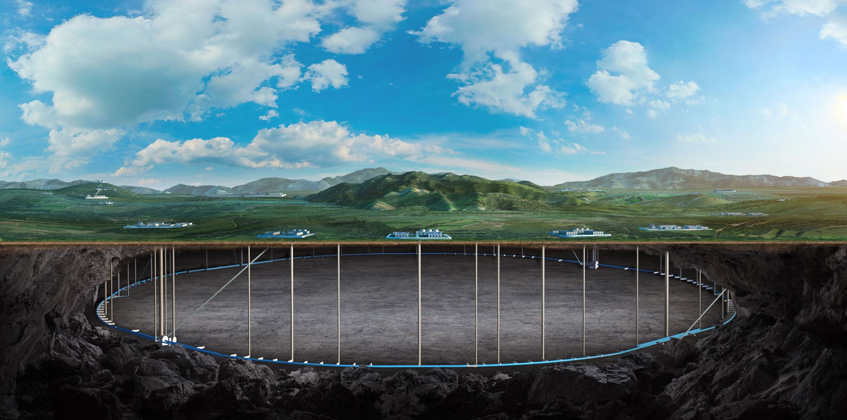

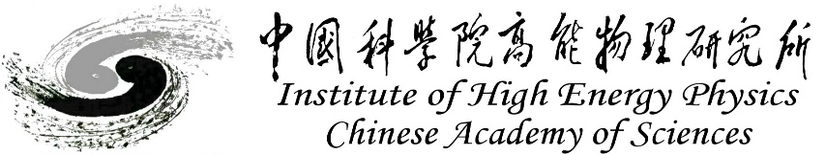
CEPC cryostat mechanical FEA, alignment and installation studies
Haijing Wang, Xiaolong Wang
On behalf of CEPC MDI group
CEPC DAY
2025.1.24

Slide 2
Content
Introduction
Cryostat mechanical FEA
Alignment and installation method
Conclusion

Slide 3
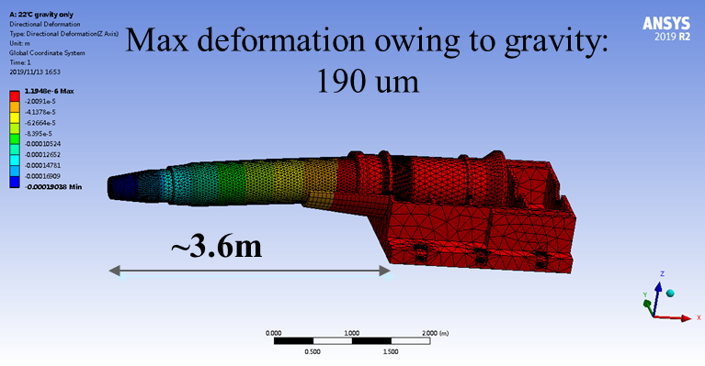
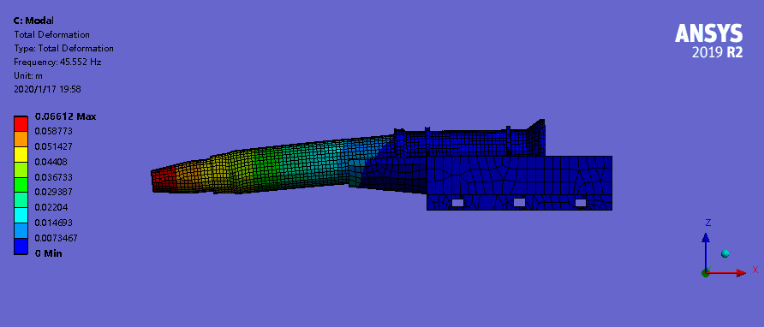
Introduction
The cryostat mechanical performance is one of the key points of MDI design.
  2019: based on CDR design, cantilever 3.6 m, Dmax=0.2 mm, F1=48 Hz.
  2021: based on CDR design, cantilever 5.5 m, Dmax=2 mm, F1=13 Hz.
  Preliminary material optimization, SS vacuum vessel was preferred.
  Auxiliary support was proposed.
  2022-2023: based on TDR design, cantilever 5.6 m, Dmax= 1.8 mm, F1=14 Hz
  * Dmax: the maximum deformation of the cryostat owing to gravity

Slide 4
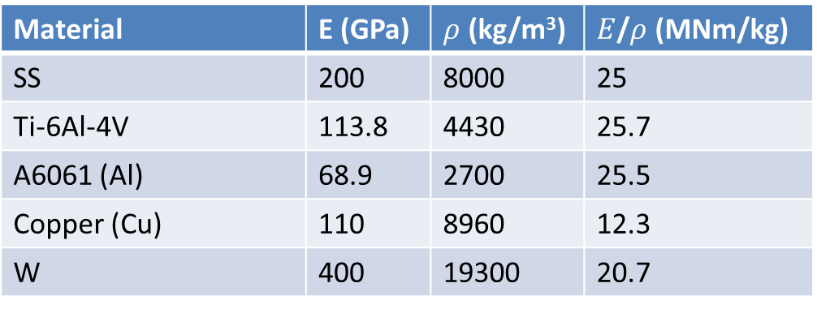
Introduction
Material | E (GPa) | $ρ$ (kg/m³) | $E$/$ρ$ (MNm/kg)
SS | 200 | 8000 | 25
Ti-6Al-4V | 113.8 | 4430 | 25.7
A6061 (Al) | 68.9 | 2700 | 25.5
Copper (Cu) | 110 | 8960 | 12.3
W | 400 | 19300 | 20.7
Preliminary material optimization based on CDR. SS vacuum vessel was preferred
Material | Uneven deformation in QD0 (um) | Uneven deformation in QF1 (um) | Max. vertical displacement of cryostat (mm) | Natural frequency (Hz)
All: A6061 | 45.4 | 1.1 | 3.77 | 10.9
All: Ti-6Al-4V | 34.4 | 0.8 | 3.01 | 12.3
All: SS | 27.6 | 0.61 | 2.62 | 13.1
Vessels: SS Others: Ti-6Al-4V | 26.9 | 0.7 | 2.43 | 13.7
Vessels: SS Others: A6061 | 26.8 | 0.72 | 2.33 | 14.0

Slide 5
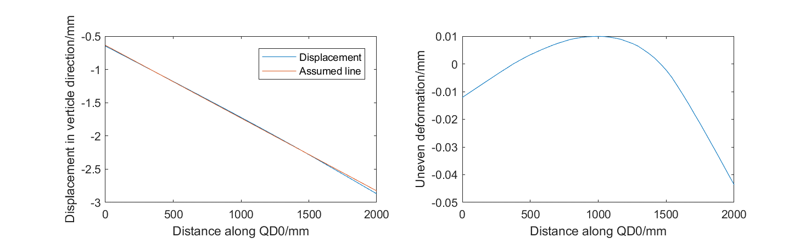
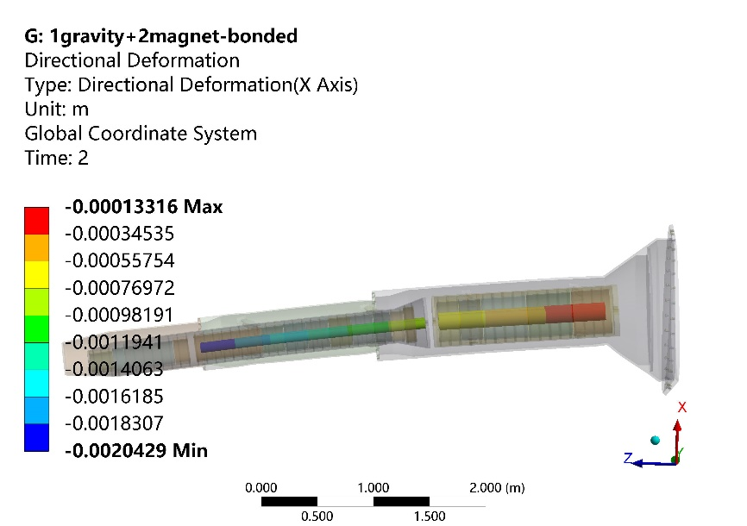
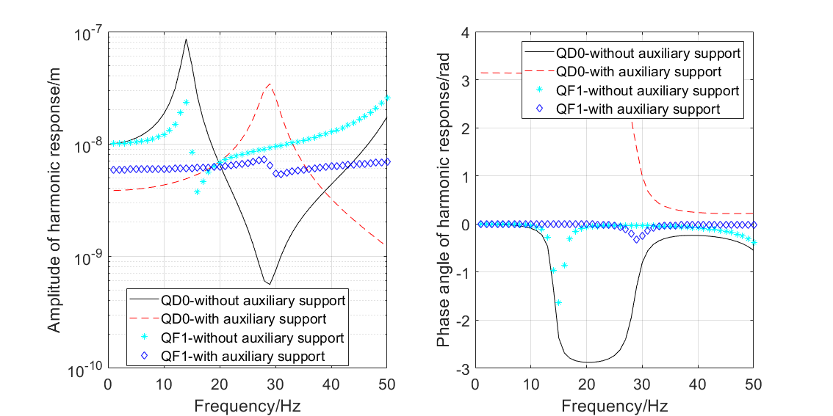
Introduction
Calculation of uneven deformation: the nonlinear deformation which can not be adjusted
Fixed constraint
Magnet displacement
Harmonic response, 0-50 Hz

Slide 6
Introduction
From TDR to EDR
  Iron SC magnets →iron-free, aiming at reducing the total weight
  SC magnet: 452→100 kg, anti-solenoid: almost the same
  Cryostat became thinner, and lighter Ti alloy is in consideration, aiming at reducing the total weight
  Total weight of cryostat: 2.1 ton →1.1 ton.
The cryostat installation and alignment method is one of the key points of MDI design
  SC magnet position accuracy: horizontal/vertical ≤ 100um
  Vibration as small as possible: 0-100Hz RMS ≤4nm, vibration test will be done with the geological exploration
  Leak rate requirement of RVC: ≤2.7 ×10^{–11} Pa·m³/s

Slide 7
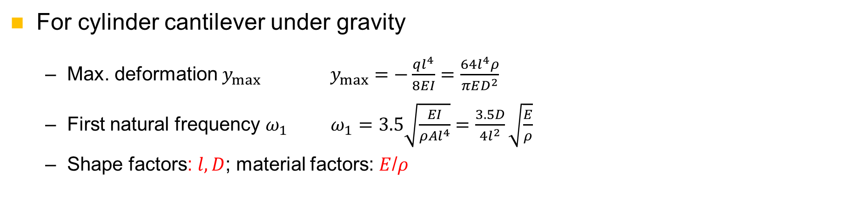
Cryostat mechanical FEA
Iron magnet vs iron-free magnet
Structure optimization (skeleton, vacuum vessel)
Material optimization
Auxiliary support
METHOD
KEY POINTS
Decrease deformation
Improve stability
For cylinder cantilever under gravity
  Max. deformation $y_{max}$ $y_{max}=−\frac{ql^{4}}{8EI}=\frac{64l^{4}ρ}{πED^{2}}$
  First natural frequency $ω_{1}$ $ω_{1}=3.5\sqrt{\frac{EI}{ρAl^{4}}}=\frac{3.5D}{4l^{2}}\sqrt{\frac{E}{ρ}}$
  Shape factors: $l, D$; material factors: $E$/$ρ$

Slide 8
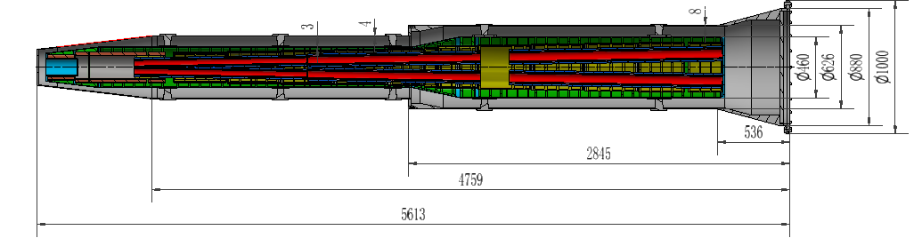
Cryostat mechanical FEA
Six models has been calculated these days, with a focus on comparing the effects of single variables.
  The TDR model (TDR)
  The IARC model: cryostat end same to TDR design (EDR1, EDR2)& enlarged cryostat end (EDR 3)
  The thinner cryostat (Thinner)
  The thicker cryostat (Thicker)

Slide 9
Cryostat mechanical FEA
Model | TDR | EDR 1/2 | EDR 3 | Thinner | Thicker
Cryostat length /mm | 5613 | 5716 | 5716 | 5599 | 5716
Vacuum vessel thickness /mm | 8/4 | 8/4 | 8/4 | 3/3 | 12/16
Helium vessel thickness/mm | 3 | 3 | 3 | 2 | 3
End diameter/mm | 1000 | 1000 | 1200 | 1000 | 1000

Slide 10
FEA：determine the analysis conditions
TDR model
  Loads: gravity, Lorenz Force (92000N+83000N+95000N)
  Constraint: cryostat end, screw fixed
  TDR A1: magnet material SS+copper
  TDR A2: magnet material copper, to simplify the magnet structure
  TDR A3: same to TDR A2 but coarse elements, to improve the analyses efficient
  TDR A4: material of K support 316→G10, compare the effect of the K support

Slide 11
FEA：determine the analysis conditions
TDR model
  TDR A1 vs TDR A2: four layers magnet can be simplified by one body with copper
  TDR A2 vs TDR A3: elements can be replaced by coarse ones
  TDR A3 vs TDR A4: results not sensitive to supports between helium vessel and vacuum vessel
Analyses | TDR A1 | TDR A2 | TDR A3 | TDR A4
Max. Y displacement of SC magnet/mm | 1.786 | 1.876 | 1.840 | 1.934↓
Max. Y displacement of cryostat /mm | 2.195 | 2.306 | 2.258 | 2.357
Max. Y uneven deformation of SC magnet/um | 35 (Q1b) | 37(Q1b) | 38(Q1b) | 36(Q1b)
Mode 1 /Hz |  |  | 13.1 (Y) | 12.7(Y)
Mode 2 /Hz |  |  | 13.4 (X) | 13.0(X)
Mode 2 /Hz |  |  | 49.7 (Y bend) | 44.6(Y bend)
Y: vertical translation
X: horizontal translation
Vertical bend

Slide 12
FEA：optimization
A1.1(model EDR 1) vs TDR A4, iron→ iron-free, good effect on displacement and frequency
A1.2 (model EDR 2)vs A1.1 , skeleton support optimized, good effect on displacement and frequency
Analyses | A1.1 | A1.2 | A2.1 | A2.2 | A3.1 | A3.2
Max. displacement of SC magnet/mm | 1.634 ↓ | 1.282 ↓ | 1.361 ↓ | 1.358 ↓ | 0.893 ↑ | 0.512 ↑
Max. displacement of cryostat/mm | 2.106 ↓ | 1.669 ↓ | 1.815 ↓ | 1.744 ↓ | 1.426 locally ~1 ↑ | 0.96 ↑
Max. uneven deformation of SC magnet/um | 41 (Q1b) | 29(Q1b) | 28(Q1b) | 32(Q1b) | 22(Q1b) | 25(Q1b)
F1 /Hz | 13.29 | 15.0 | 14.9 | 15.3 | 17.9 | 19.0
F2 /Hz | 13.65 | 15.3 | 15.2 | 15.3 | 21.0 | 21.2
F3 /Hz | 51.0 | 55.6 | 54.9 | 48.9 | 40.8 | 46.1

Slide 13
FEA：optimization
A2.1 vs A1.2, K support slide in Z direction, little effect
A2.1& A3.1 vs A2.2 &A3.2:enlarged cryostat end, little effect
A2.1 & A2.2 vs A3.1 & A3.2: Rake-shaped support, significant effect → can be optimized further
Analyses | A1.1 | A1.2 | A2.1 | A2.2 | A3.1 | A3.2
Max. displacement of SC magnet/mm | 1.634 ↓ | 1.282 ↓ | 1.361 ↓ | 1.358 ↓ | 0.893 ↑ | 0.512 ↑
Max. displacement of cryostat/mm | 2.106 ↓ | 1.669 ↓ | 1.815 ↓ | 1.744 ↓ | ~1 ↑ | 0.96 ↑
Max. uneven deformation of SC magnet/um | 41(Q1b) | 29(Q1b) | 28(Q1b) | 32(Q1b) | 22(Q1b) | 25(Q1b)
F1 /Hz | 13.29 | 15.0 | 14.9 | 15.3 | 17.9 | 19.0
F2 /Hz | 13.65 | 15.3 | 15.2 | 15.3 | 21.0 | 21.2
F3 /Hz | 51.0 | 55.6 | 54.9 | 48.9 | 40.8 | 46.1

Slide 14
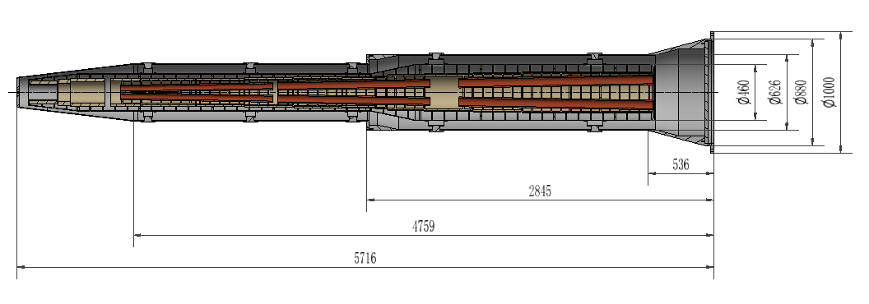
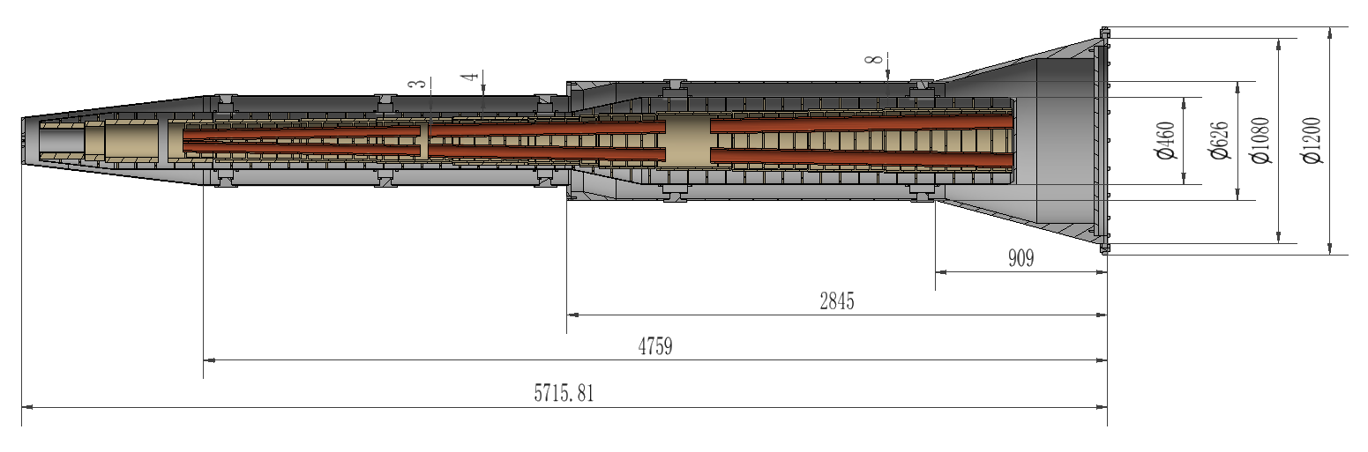
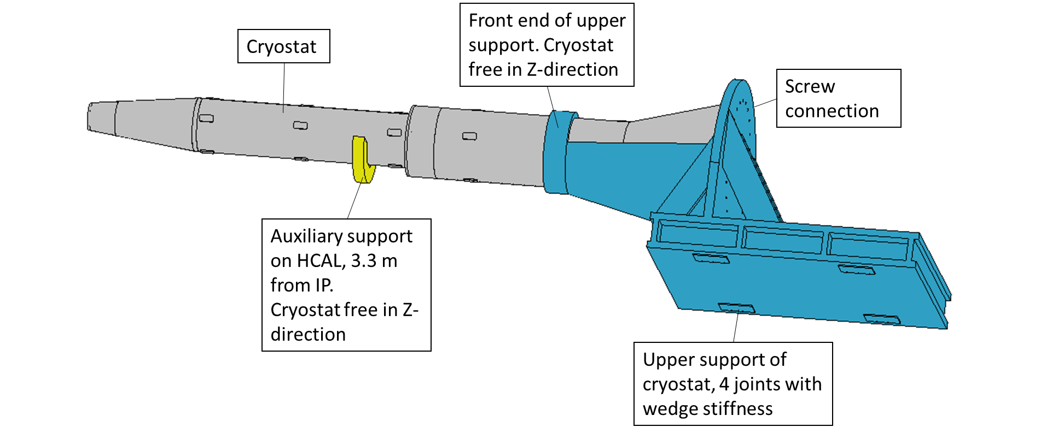
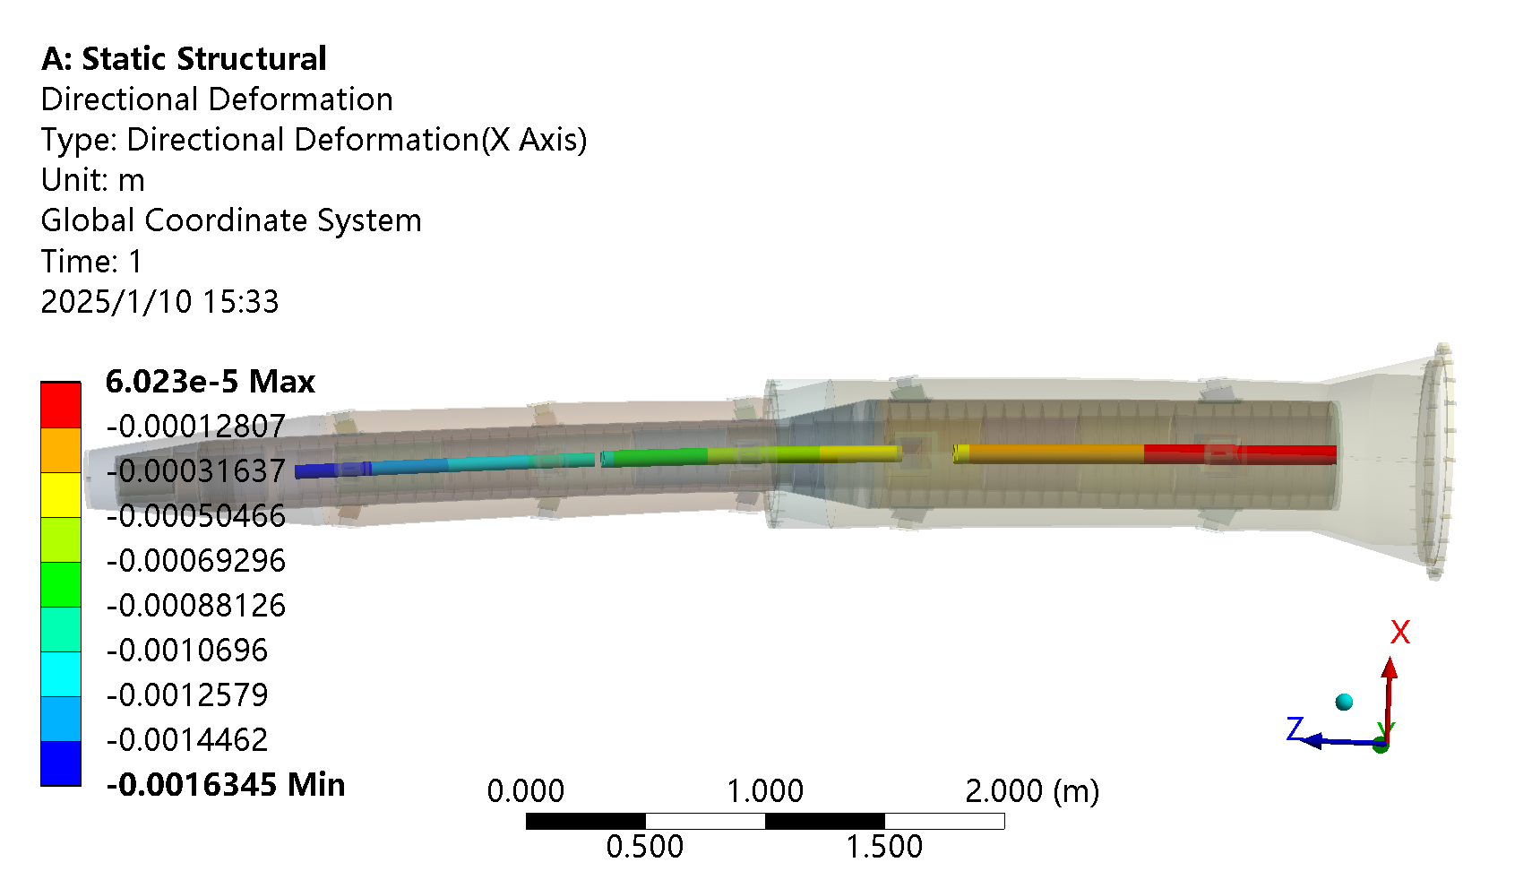
FEA：optimization
Model EDR 2, A1.2 & A2.1 & A3.1
Model EDR 3, enlarged cryostat end, A2.2 & A3.2
Raked-shaped support and auxiliary support
Fixed constraint
Magnet displacement, A1.1

Slide 15
FEA：optimization
All the analyses above, the loads include gravity and Lorenz force
For all the following analyses, Lumical (Al+Iron) is included, as well as the gravity of RVC and helium.
The naming rules:
Loads | With auxiliary support | Without auxiliary support
With Lorenz force | N.3 | N.1 | Compare the displacement before/after Lorenz force
Without Lorenz force | N.4 | N.2
 | Compare the effect of auxiliary support

Slide 16
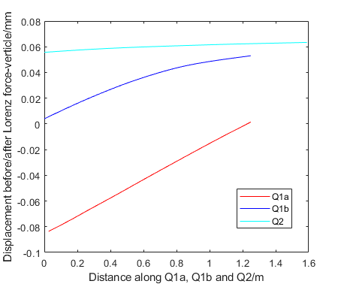
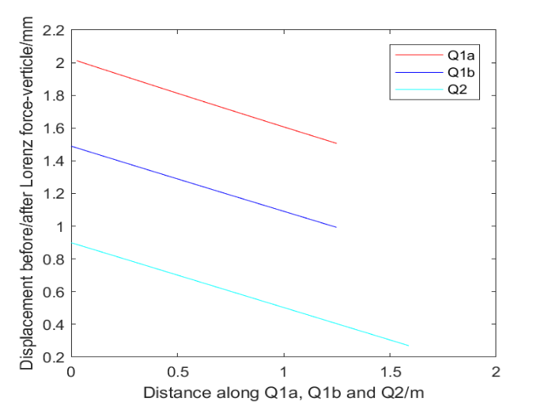
FEA：optimization
A4 (model EDR 2) as the control group for the optimization
  Auxiliary support has significant effect on improving the deformation and stability performance
  The displacement before and after Lorenz force is about 2mm without auxiliary support but 0.084mm with it
Analyses | A4.1 | A4.2 | A4.3 | A4.4
Max. displacement of SC magnet/mm | 0.805 ↑ | 1.220 ↓ | 0.117↓ | 0.043 (Q2) ↓
Max. displacement of cryostat/mm | ~1 ↑ | 1.545 ↓ | 0.166↓ | 0.016↓
Max. uneven deformation of SC magnet/um | 24(Q1b) | 25(Q1b) | 11(Q1b) | 6 (Q1a)
F1 /Hz | 17.7 | 17.8 | 49.2 (Z, magnet) | 47.0
F2 /Hz | 20.8 | 20.9 | 58.8 (bend, front) | 57.1
F3 /Hz | 40.3 | 40.3 | 60.2 (bend, front) | 58.4
Displacement change of magnets after applying Lorentz force, with auxiliary support
Displacement change of magnets after applying Lorentz force, without auxiliary support

Slide 17
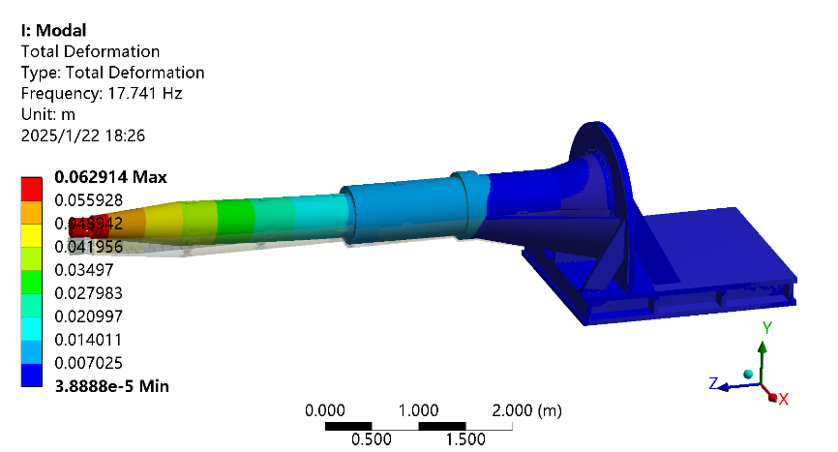
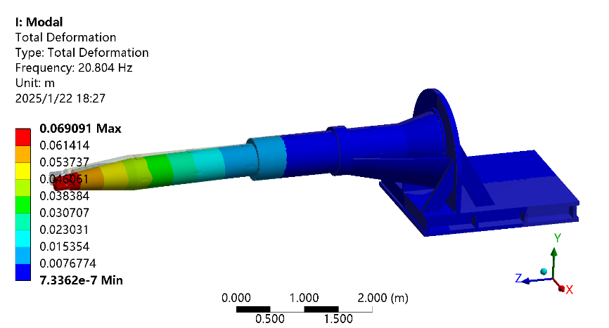
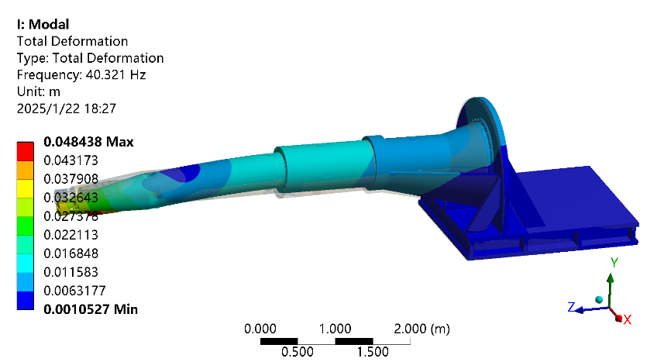
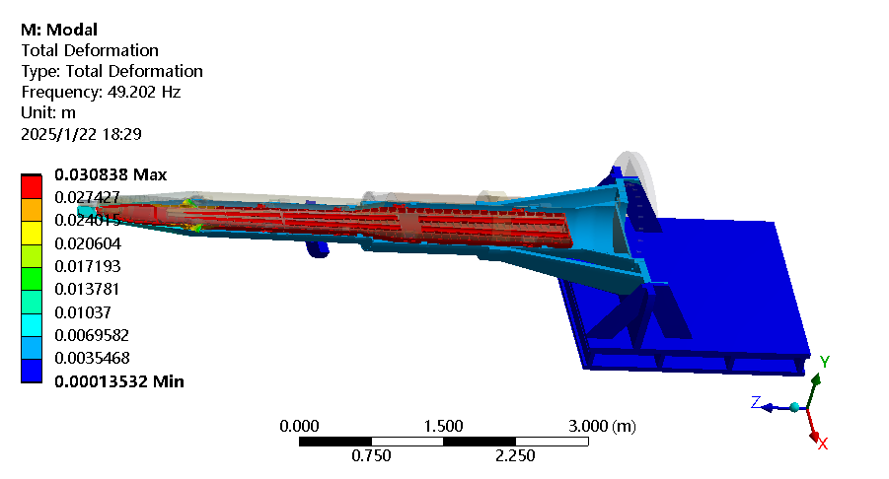
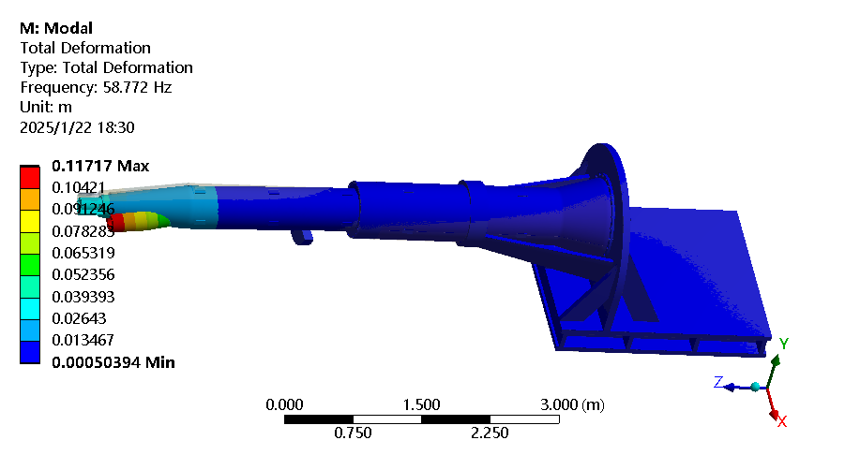
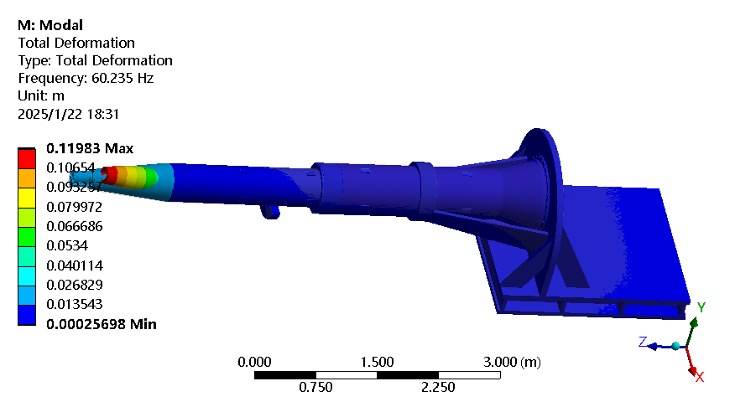
FEA：optimization
The first three modes of A 4.1, without auxiliary support (L: 1st, 17.7 Hz, Y; M:2nd,20.8Hz, X; R:3rd, 40.3Hz, Y bend)
The first three modes of A 4.3, without auxiliary support (L: 1st, 49.2 Hz, Z, magnet; M:2nd,58.7Hz, bend, front; R:3rd, 60.2Hz, bend, front)

Slide 18
FEA：optimization
Material optimization:
  Materials that can be optimized: vacuum vessel, helium vessel, skeleton supports
  A5, Ti-Ti-Ti; A6: Al-Al-Al; A7: Ti-SS-SS
  SS and Ti has similar performance, but it is better to have SS vacuum vessel
Analyses | A5.1 | A5.2 | A6.1 | A6.2 | A7.1 | A7.2
Max. displacement of SC magnet/mm | 0.821 ↑ | 1.236↓ | 0.792 ↑ | 1.401↓ | 0.755↑ | 1.299↓
Max. displacement of cryostat/mm | ~1↑ | 1.611↓ | ~1↑ | 1.873↓ | ~1↑ | 1.664↓
Max. uneven deformation of SC magnet/um | 34 | 36 | 49 | 51 | 32 | 33
F1 /Hz | 17.2 |  | 15.6 |  | 16.9
F2 /Hz | 19.2 |  | 16.9 |  | 19.2
F3 /Hz | 40.3 |  | 39.1 |  | 38.4

Slide 19
FEA：optimization
Material optimization:
  A8, W-SS-SS; A9: SS-Ti-Ti
  A4, A7 & A8: heavier vacuum vessel (even W) don’t bring bad performance
  A9: 1st modal has higher frequency but with a different mode shape (more sensitive of Q1a)
  The overall effect is not obvious for the material optimization
  SS is preferred for the similar thermal expansion coefficient as copper (magnet)
Analyses | A8.1 | A8.2 | A9.1 | A9.2 | A9.3 | A9.4
Max. displacement of SC magnet/mm | 0.674↑ | 1.357↓ | 0.881↑ | 1.148↓ | 0.120↓ | 0.038 (Q2)
Max. displacement of cryostat/mm | ~0.7↑ | 1.664↓ | ~1↑ | 1.453↓ | 0.167↓ | 0.016↓
Max. uneven deformation of SC magnet/um | 18 | 18 | 25 | 26 | 11 | 8 (Q1a)
F1 /Hz | 17.1 |  | 18.2 |  | 53.8(Y bend, front) | 51.0
F2 /Hz | 21.3 |  | 21.1 |  | 55.1(X bend, front) | 53.1
F3 /Hz | 41.8 |  | 41.9 |  | 56.2(Y bend, front) | 53.8

Slide 20
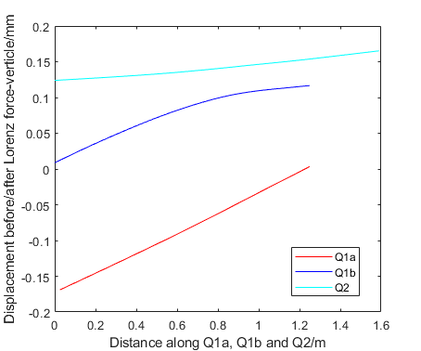

FEA：optimization
A4 (model EDR 2) vs B1 (model Thinner)
  Material: Ti-SS-SS
  The thinner Ti cryostat has worse deformation and stability performance
Displacement change of magnets after applying Lorentz force, with auxiliary support
Analyses | B 1.1 | B1.2 | B1.3 | B1.4
Max. displacement of SC magnet/mm | 0.790↑ | 1.408↓ | 0.210↓ | 0.053↓
Max. displacement of cryostat/mm | ~1↑ | 1.846↓ | 0.302↓ | 0.024↓
Max. uneven deformation of SC magnet/um | 52(Q1b) | 44(Q1b) | 25(Q1b) | 5(Q1a)
F1 /Hz | 16.0 |  | 54.8(bend, front)
F2 /Hz | 18.0 |  | 59.8(bend, front)
F3 /Hz | 43.6 |  | 65.1(Z+bend, front)
Displacement change of magnets after applying Lorentz force, without auxiliary support
  The displacement before and after Lorenz force is about 2mm without auxiliary support, and 0.169mm with it

Slide 21
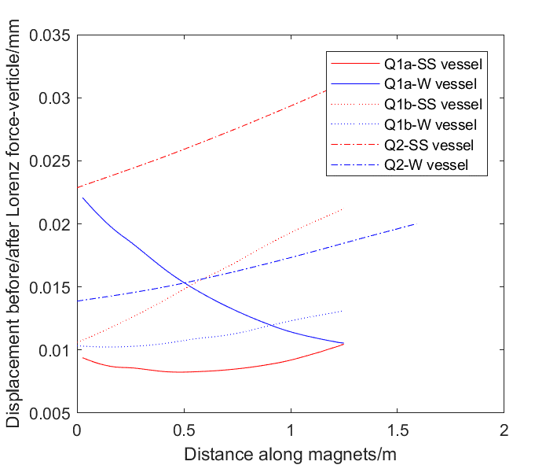
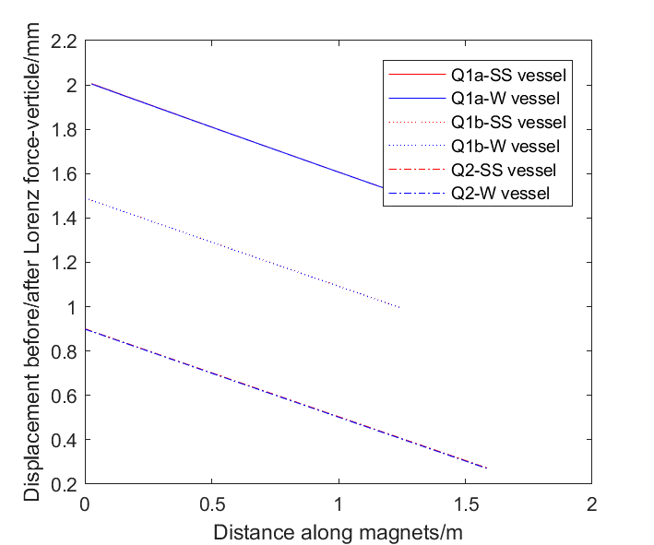
FEA：optimization
A4 (model EDR 2) vs C1 (model Thicker)
  Material: C1:SS-SS-SS; C2: W-SS-SS
  A sturdy vacuum vessel seems have benefit on displacement and stability performance
Displacement change of magnets after applying Lorentz force, with auxiliary support
Analyses | C 1.1 | C1.3 | C2.1 | C2.3
Max. displacement of SC magnet/mm | 0.756↑ | 0.268↑ (Q2) | 0.365↑ | 0.237↑ (Q2)
Max. displacement of cryostat/mm | 0.776↑ | 0.027↓ | 0.244↑ | 0.019↓
Max. uneven deformation of SC magnet/um | 12(Q1b) | 12(Q1b) | 11(Q2) | 13(Q1a)
F1 /Hz | 17.7 | 52.5 | 14.7 | 57.3
F2 /Hz | 22.2 | 60.9 | 19.4 | 59.8
F3 /Hz | 45.5 | 63.1 | 45.6 | 66.5
Displacement change of magnets after applying Lorentz force, without auxiliary support
Same mode shape as A4.3

Slide 22
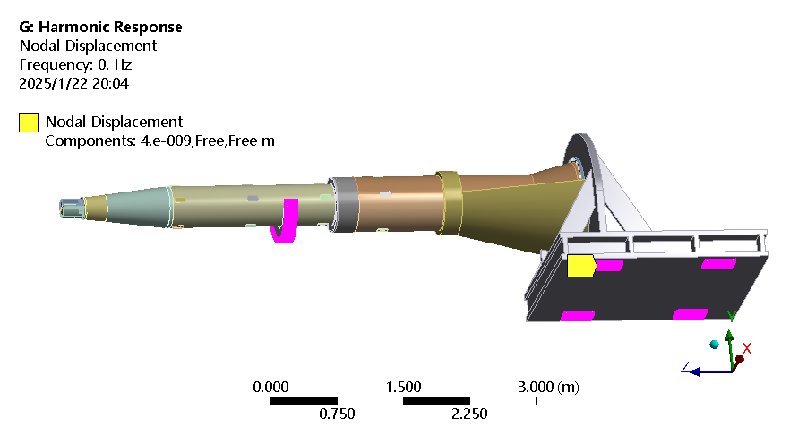
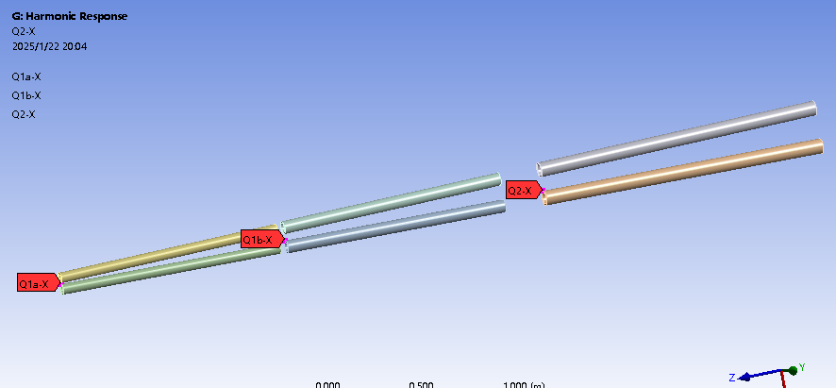

FEA：harmonic response
Input: $D_{input}=A∗\sin\left(2πft\right)$
  f: 0-100 Hz, with intervals of 2 Hz.
  A: 4 nm displacement, at the cantilever support and the auxiliary support, X, Y, and Z direction separately
  Response points recorded: end of Q1a, Q1b and Q2, near IP
Input locations
Response points recorded

Slide 23
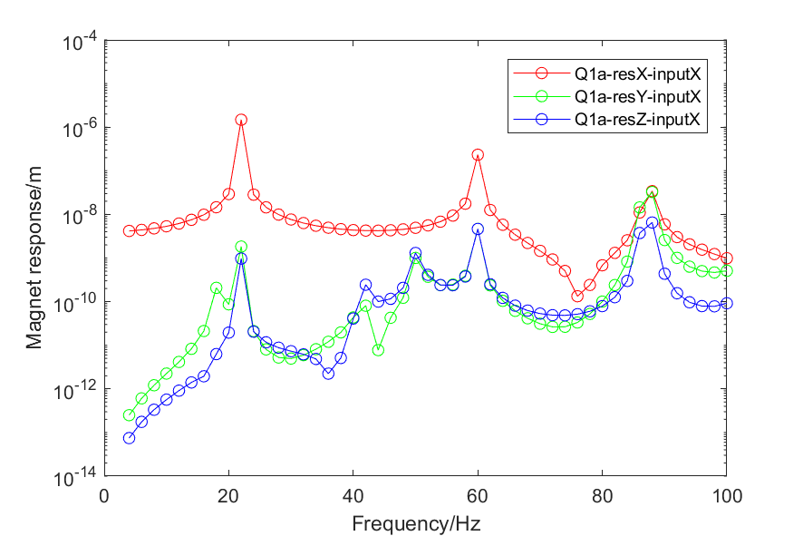
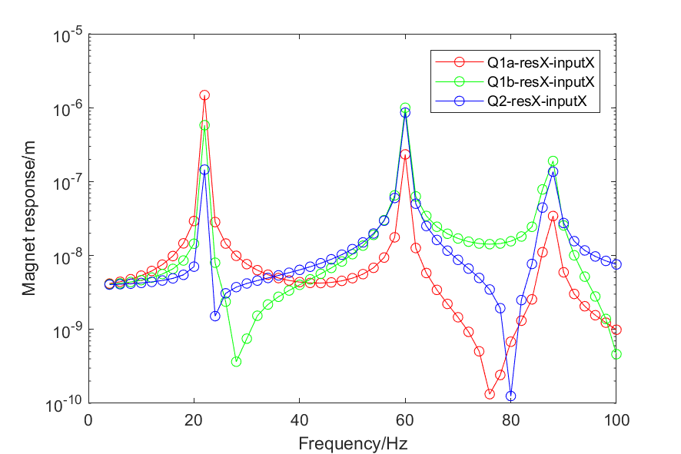
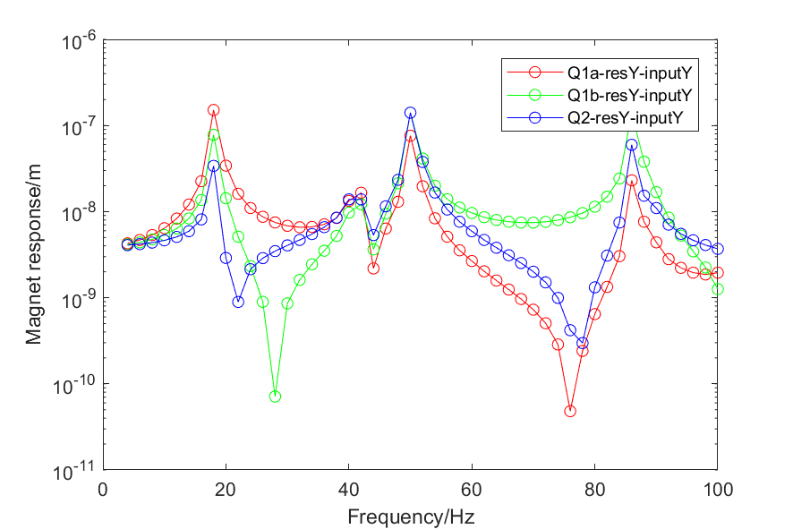
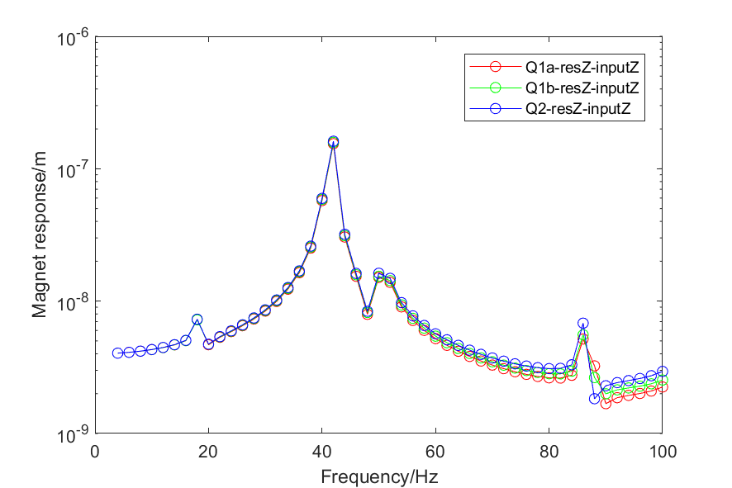
FEA：harmonic response
Harmonic response of A4.1
X, Y and Z response with input in X direction
Q1a, Q1b and Q2 response in X direction with input in X direction
Q1a, Q1b and Q2 response in Y direction with input in Y direction
Q1a, Q1b and Q2 response in Z direction with input in Z direction
(a)
(b)
(c)
(d)

Slide 24
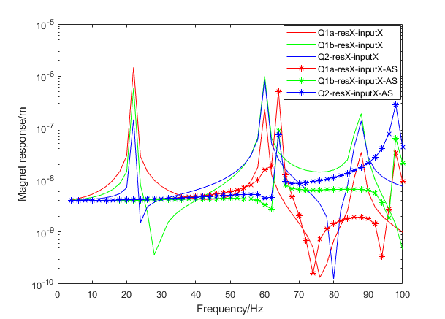
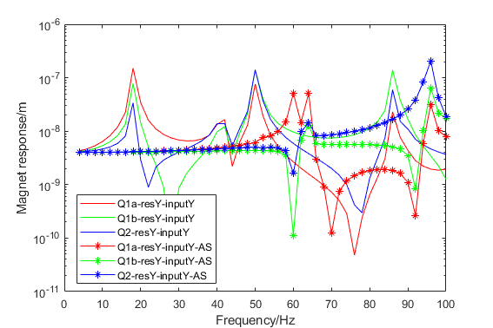
FEA：harmonic response
Harmonic response comparison with/without auxiliary support
L: Q1a, Q1b and Q2 response in X direction with input in X direction
R: Q1a, Q1b and Q2 response in Y direction with input in Y direction

Slide 25
Cryostat mechanical FEA
KEY POINTS
Decrease deformation
Improve stability
Conclusions on mechanical FEA
  Iron-free magnet has benefits
  Optimized skeleton support has benefits
  Rake-shaped support, significant effect →can be optimized further
  Auxiliary support has significant effect
  Material optimization has no obvious effect
  The thicker model with SS vacuum vessel is preferred
Fulfill alignment requirements, total 50 µm
    max. uneven deformation: 12 µm (Q1b)
    max. displacement change after applying Lorentz force: 33 µm (Q2)
    1st sensitive modal frequency: 60.9 Hz (The 1st natural frequency is 52.5 Hz, in Z direction). The modal analyses is related to the support connected to detector, but the trend should be unchanged, can be considered qualitative analysis
Errors cannot be corrected by correctors
No re-alignment is needed after applying Lorentz force
High natural frequency
Conforms to the direction of vibration reduction and shielding design

Slide 26
Cryostat mechanical FEA
Next plans
  Further FEA considering quench, cryogenic, updated Lorenz force, and more detailed optimization, including stress decreasing optimization
  More detailed vibration response analyses with more detailed inputs if possible
  Support design, connected to the ground of detector hall, and relative analyses

Slide 27
Cryostat mechanical FEA
Comments and recommendations of IARC 2024
Possible vibration of the detector may come from cryogenic system (we are planning to test the effect cryogenic system at HEPS as a reference in 2025), cooling system of detector (some requirements?)
It is better that the cantilever length is reduced. And we want to add auxiliary support and make a FEA comparison.
The increased wall thickness has benefits on the displacement and stability.

Slide 28
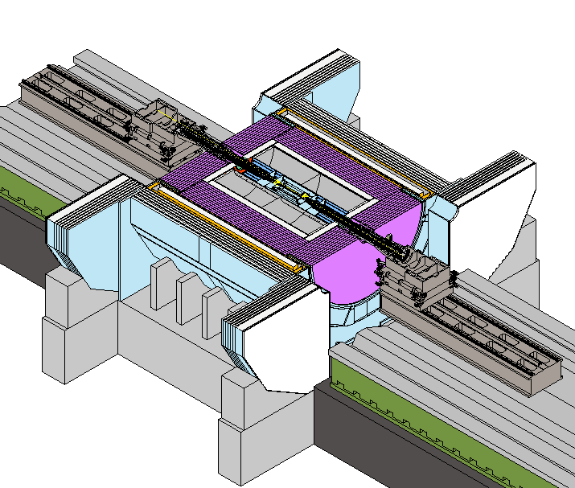
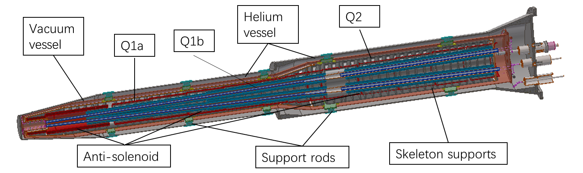
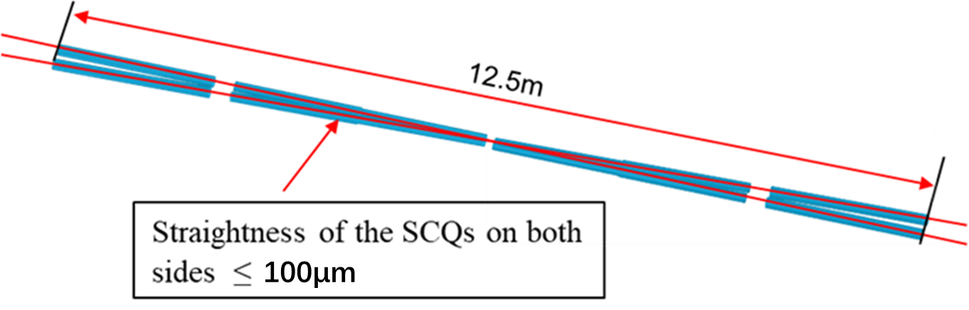
Alignment and installation method
Alignment scheme
  Helium vessel-magnet assembly fiducialization
  Cryostat pre-alignment
  Cryostat installation alignment
Alignment accuracy of SCQs on both sides ≤100 µm

Slide 29
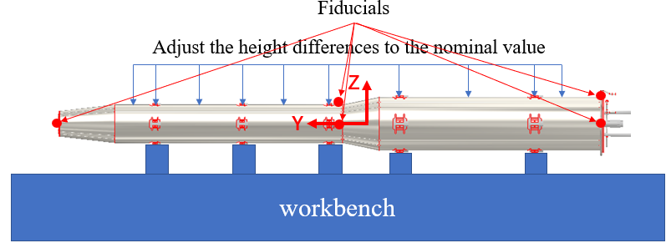
Alignment and installation method
  Helium vessel-magnet assembly fiducialization
    Q1a, Q1b, Q2, anti-solenoids are fixed together with the helium vessel by skeleton supports.
    The helium vessel-magnet assembly should be placed on a workbench and properly supported to prevent deformation.
    Making a fiducialization of the assembly to record the coordinates of the fiducials in this state.
Helium vessel-magnet assembly

Slide 30
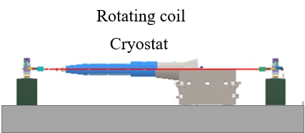
Alignment and installation method
  Cryostat pre-alignment
    After installed, adjust the helium vessel-magnet assembly according to the fiducialization of the fiducials by adjusting the support rods.
    Performing the SCQ magnetic center measurement by a rotating coil, and relating the magnetic center to the fiducials on the outside of the cryostat.

Slide 31
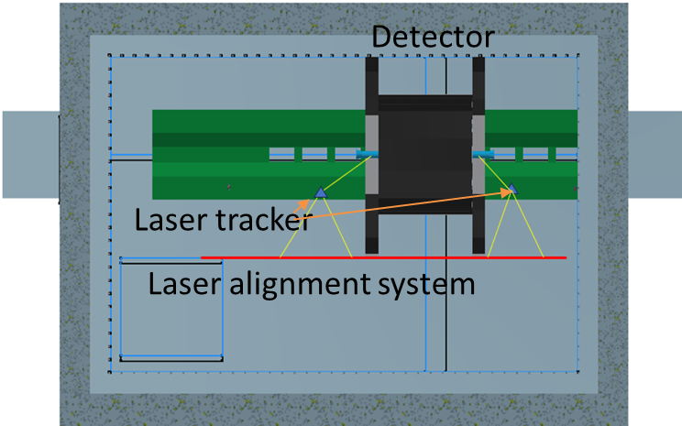
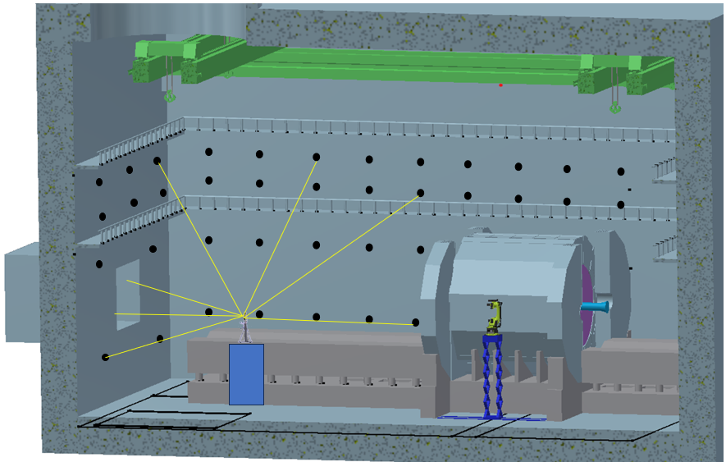
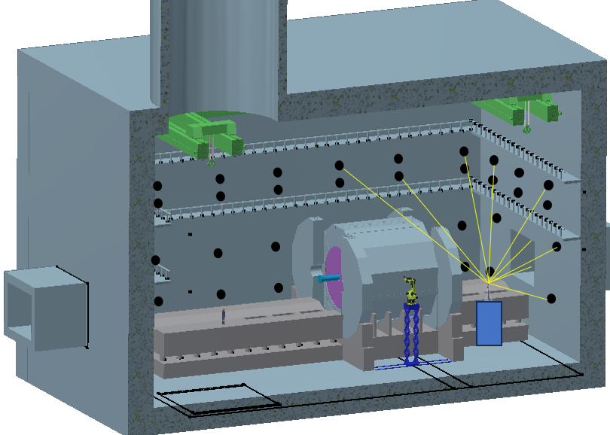
Alignment and installation method
  Cryostat installation alignment
    Install alignment control network at detector hall
    Connect the detector network and the tunnel network, calculate the coordinate of detector network in the CEPC coordinate system.
    Install the laser alignment system, adjust it parallel to beam center based on the detector network
Control points
Laser tracker
Alignment platform

Slide 32
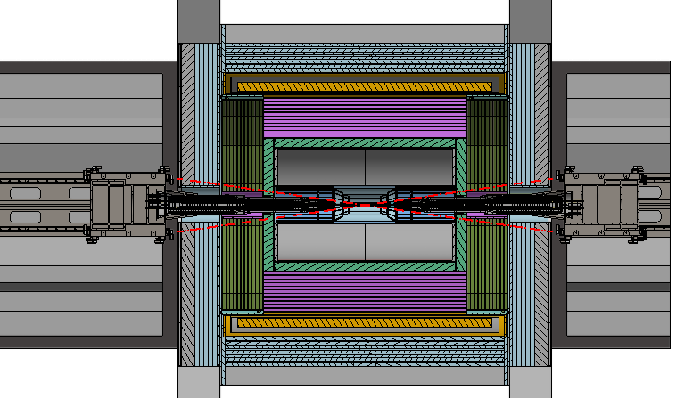
Alignment and installation method
  Cryostat installation alignment
    Using this laser alignment system as a reference, adjust the rails and cryostats to the designed position in vertical and transversal.
    Push the cryostats into the detector along the rail.
  Difficulty
    How to measure the cryostat front end position?

Slide 33
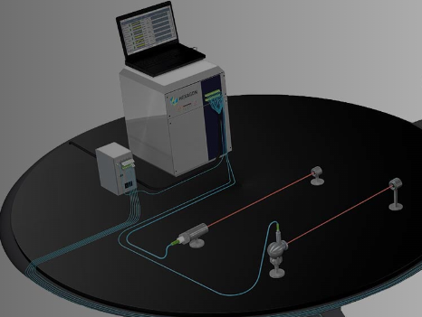
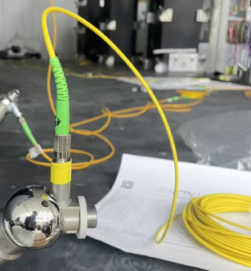
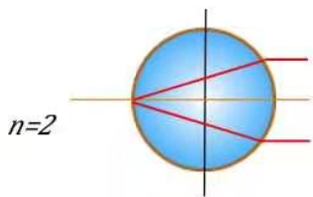
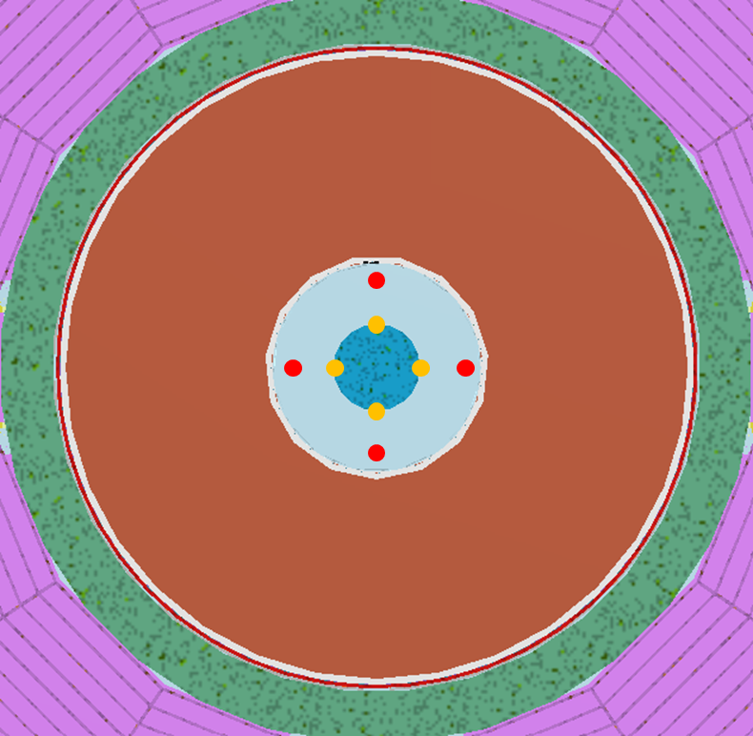
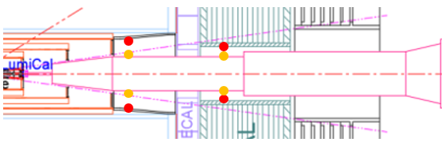
Alignment and installation method
  Possible method
    Multiline laser ranging system to monitor the cryostat front end position
Laser collimator
Laser collimator
High index glass target
High index glass target
Detector
Multiline laser ranging system
Cryostat

Slide 34
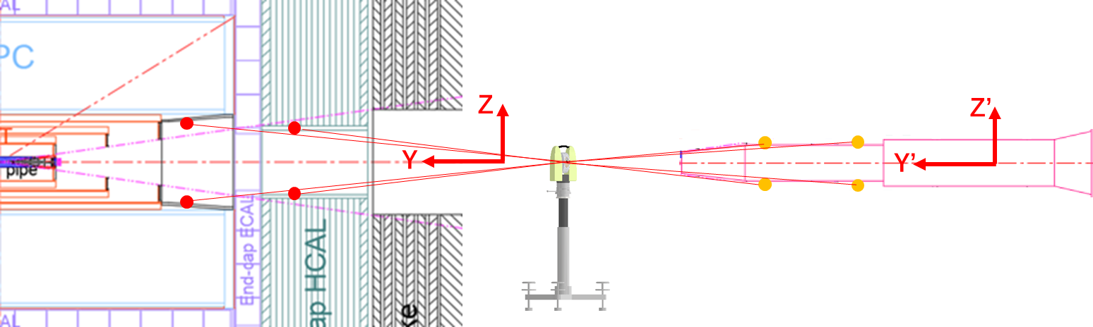
Alignment and installation method
  Before the cryostat is pushed into the detector, use a laser tracker measure the coordinates of these points.
  Calculate the nominal coordinates of these glass targets when the cryostat is pushed to the design position in the detector.
  Thus, we can obtain the nominal distance values between these laser collimators and the nominal coordinates of their corresponding targets.

Slide 35
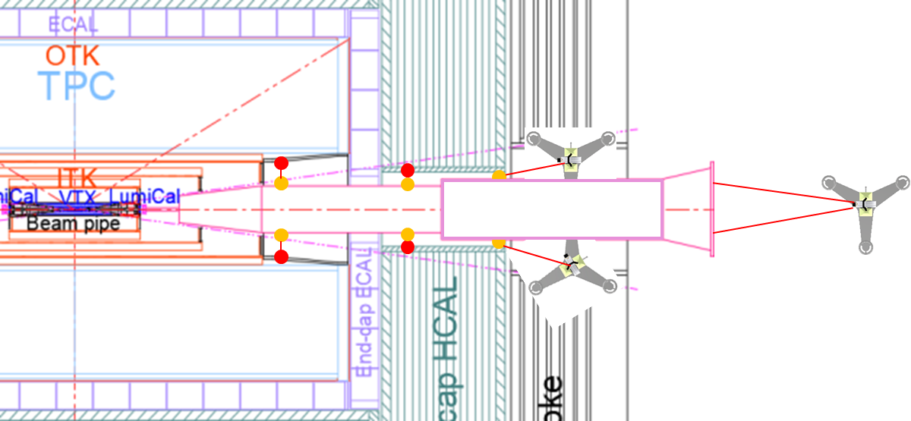
Alignment and installation method
  After the cryostat is pushed into the detector, jointly apply Multiline laser ranging system and laser trackers to measure its position and align it accurately.
  The offset of magnet can be adjusted about 0.5mm by correctors (translational) ←Yingshun Zhu
  The estimated alignment error is about 90 μm, fulfill the SC magnet position accuracy of 100 μm
Error analysis
Errors in P25
Error item | Error /μm
SCQs installation in helium vessel | 50
Helium vessel-magnet assembly fiducialization | 30
Cryostat pre-alignment | 50
Laser alignment system | 20
Multiline & Laser tracker measurement | 30
Cryostat adjustment | 30
Total | 90

Slide 36
Conclusion
The mechanical FEA and some optimizations has been done, the iron-free magnets and optimized skeleton support have benefits on displacement and stability, and the thicker SS vacuum vessel with auxiliary support is preferred.
A alignment and installation method has been designed, which is estimated possible to fulfill the alignment requirements.

Slide 37
Thanks for your attention!

