Slide 1



CEPC EDR mechanical detailed layout design progress
Haijing Wang, Yiwei Wang, Siyu Chen
CEPC DAY
2025.1.24

Slide 2
Content
Introduction
Partial layout in arc section (tunnel mockup)
2D/3D linkage design
Collider new survey (beam track) with hardware EDR layoutDiscussions

Slide 3
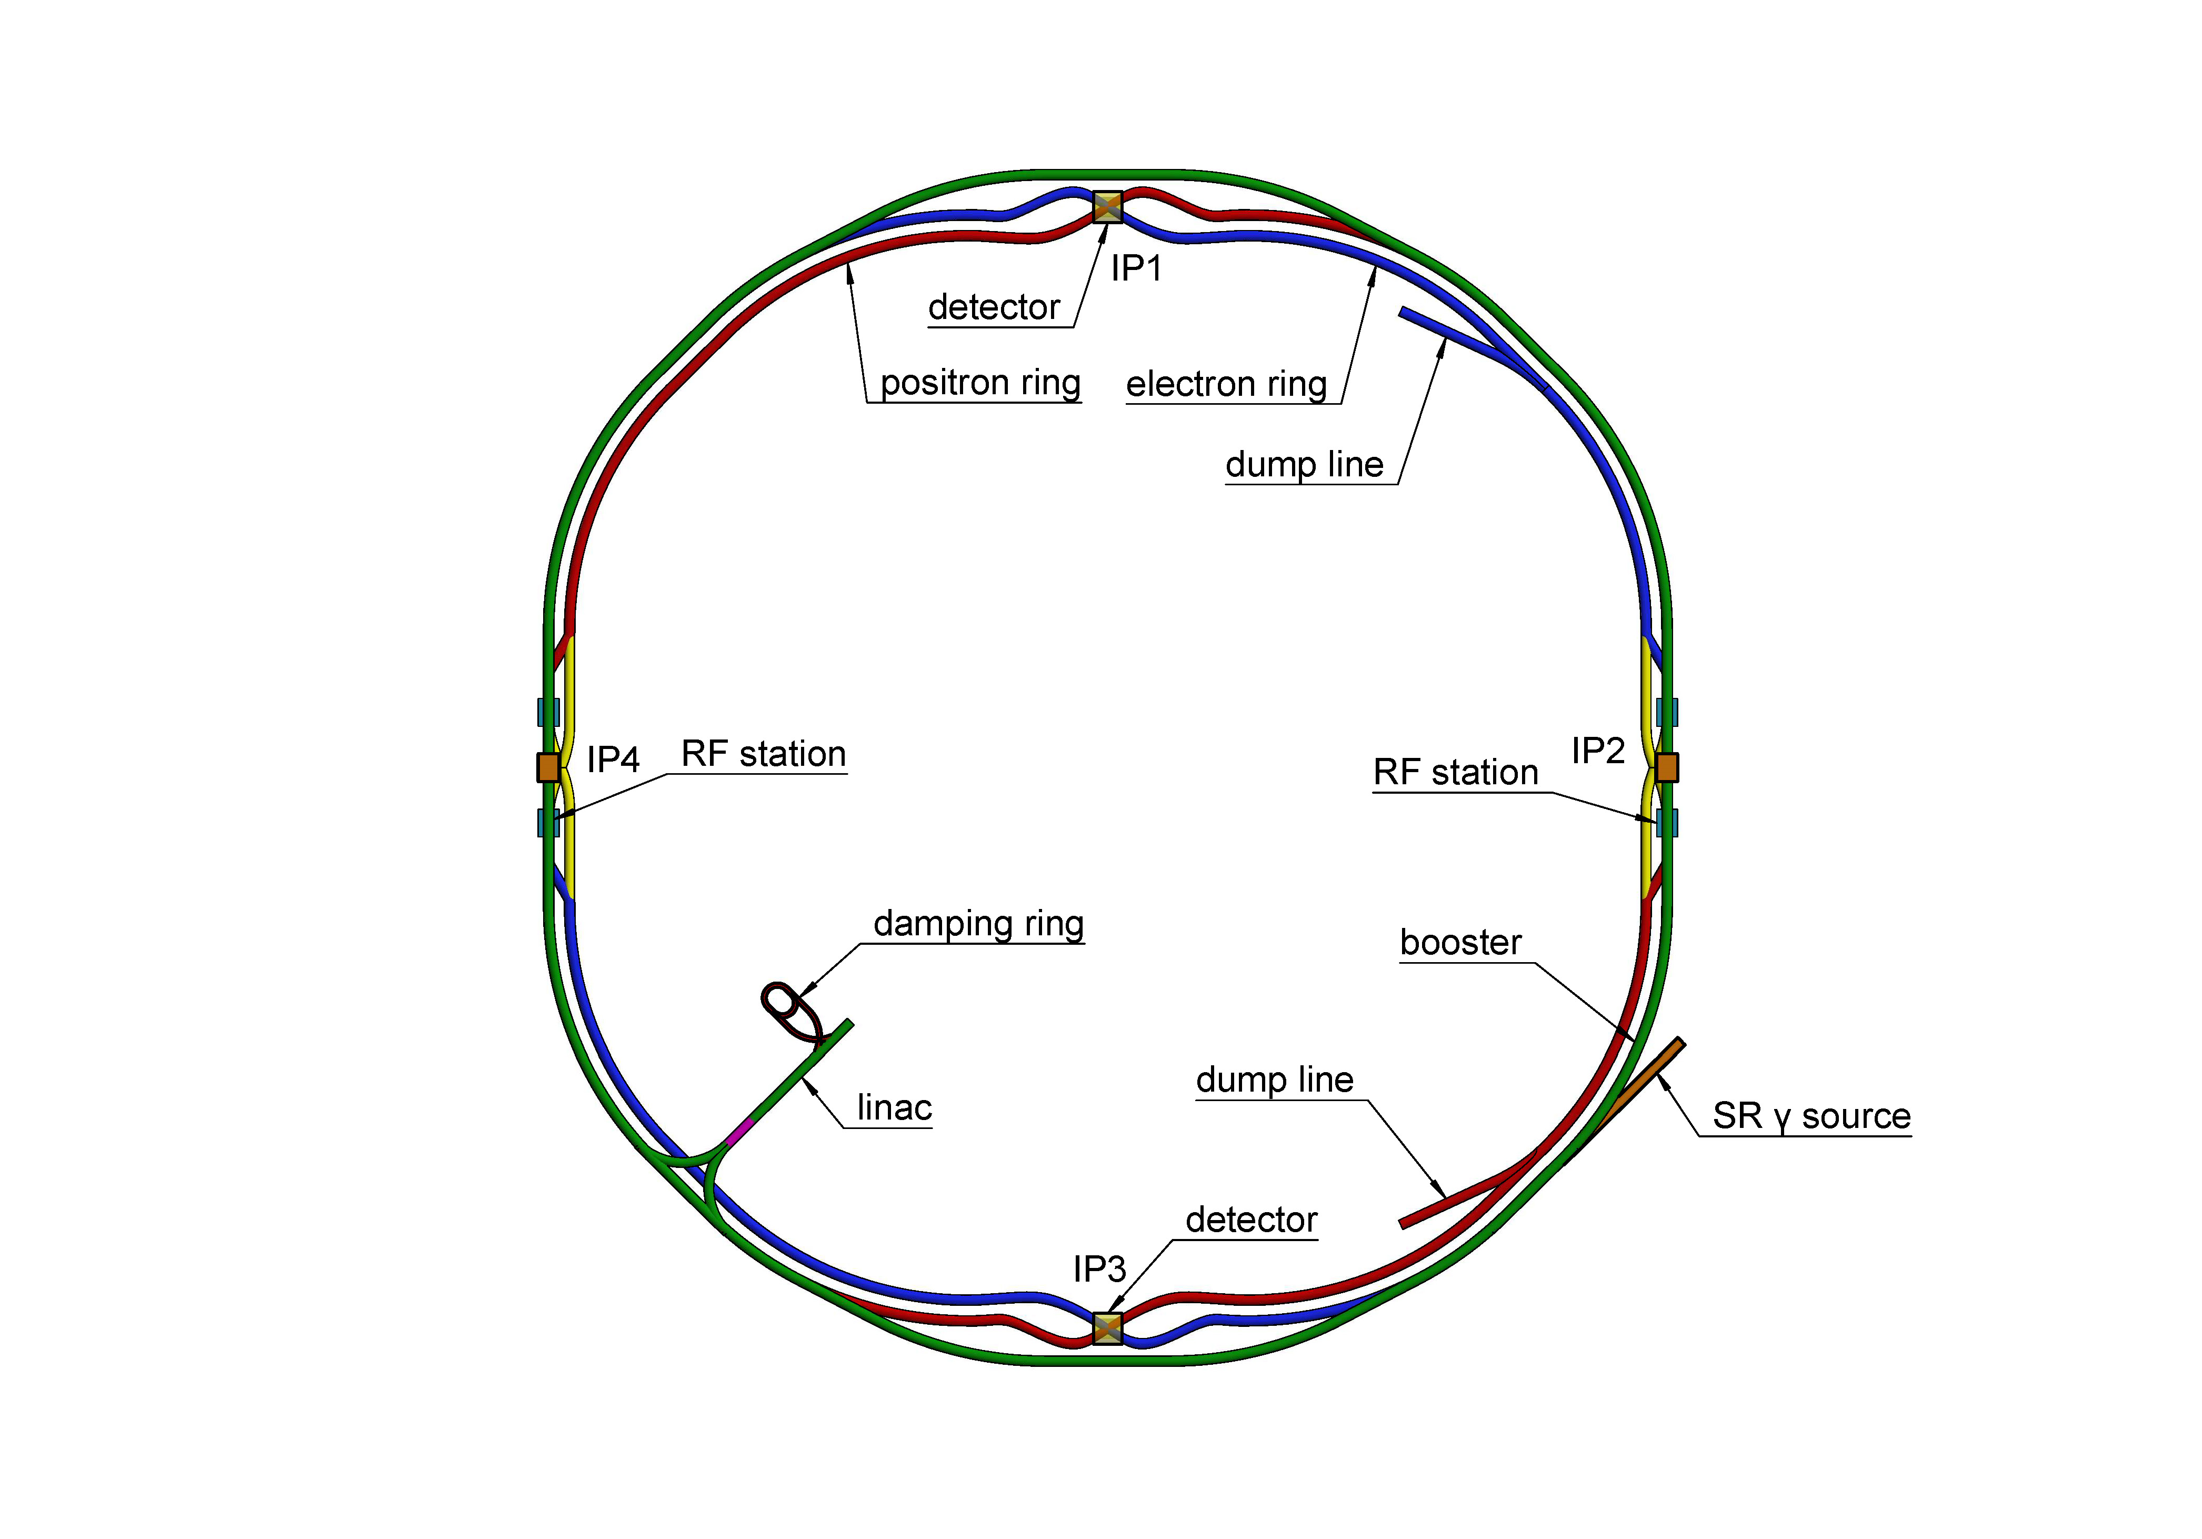
Introduction
The layout is the basis for the engineering design of each equipment.
The constraints for layout design
  Quadrupole locations are fixed according to TDR lattice.
  The pumping spacing is less than 12.5 meter to fulfill the vacuum requirements for different operating modes.
  BPMs are next to quadrupoles.
  Dipoles as long as possible to decrease SR power.
  Reasonable space for installation and replacement.
We begin here

Slide 4
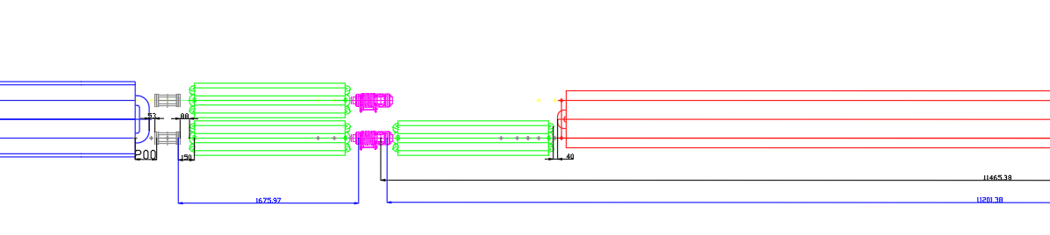
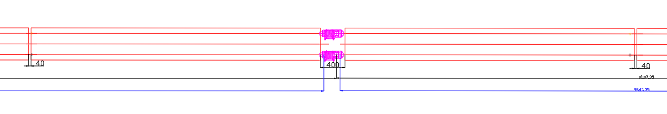
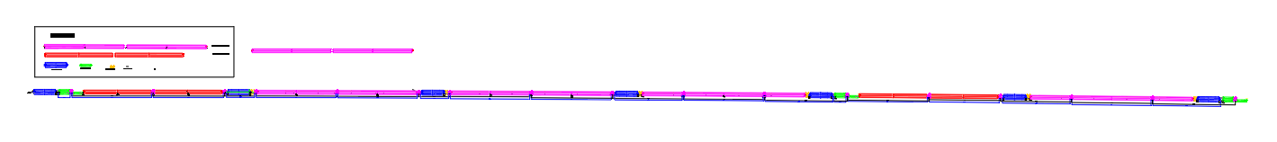
Introduction
Layout design from EDR beginning to 24.10
Quadrupole
BPM
sextupole
dipole
Vacuum connection part
dipole
Vacuum connection part
dipole
We are aiming to make a engineering layout with more details
  Quadrupoles fixed →A survey with all the magnets in/out coordinates
  Simplified device profiles → more detailed structure according to the EDR progress
  The layout of Booster, Linac, DR, transport lines…
  2D/3D linkage design is under studying

Slide 5
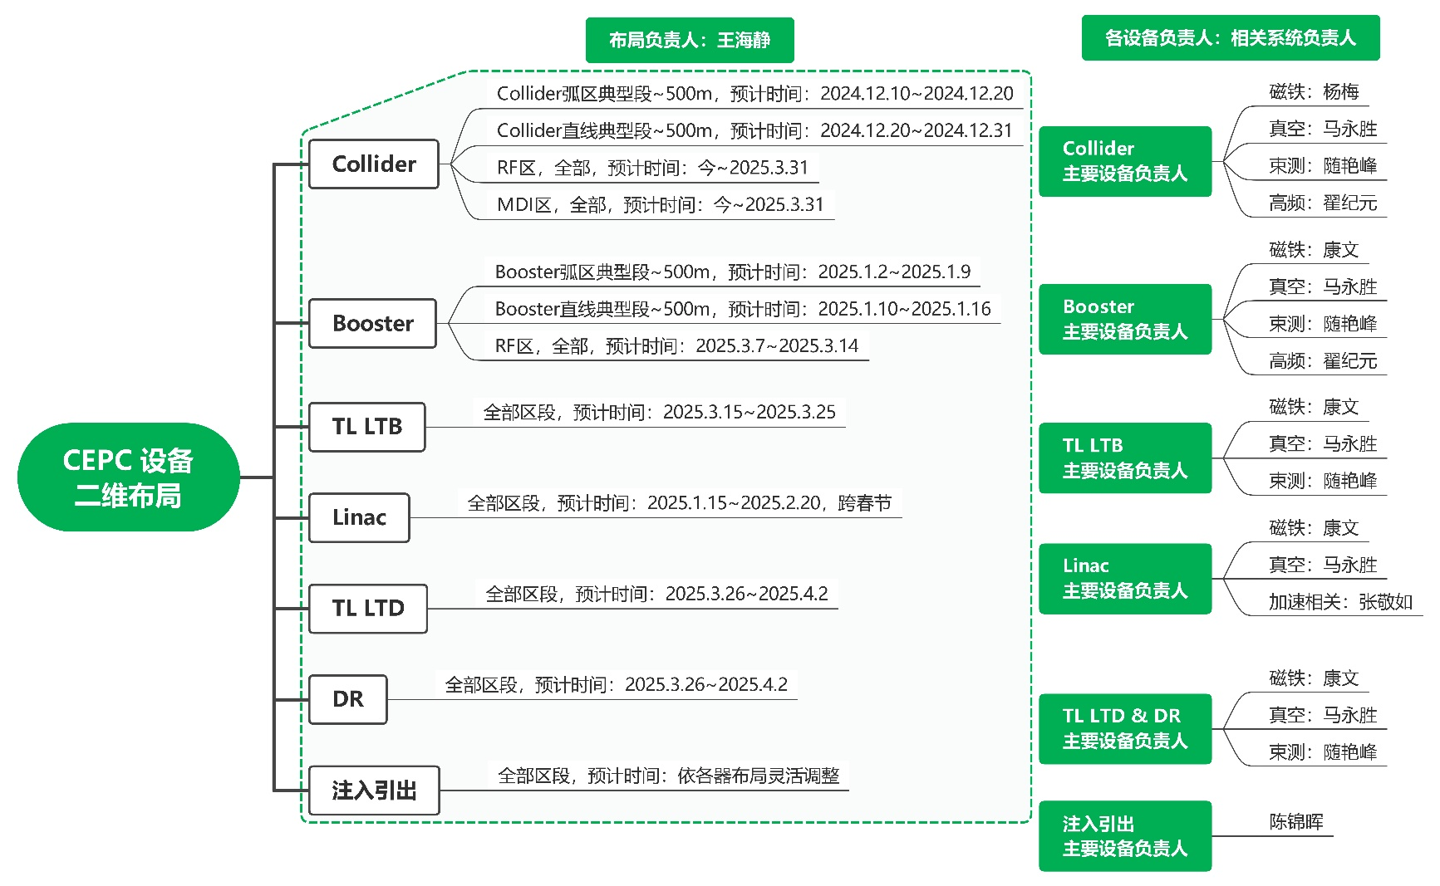
Introduction

Slide 6
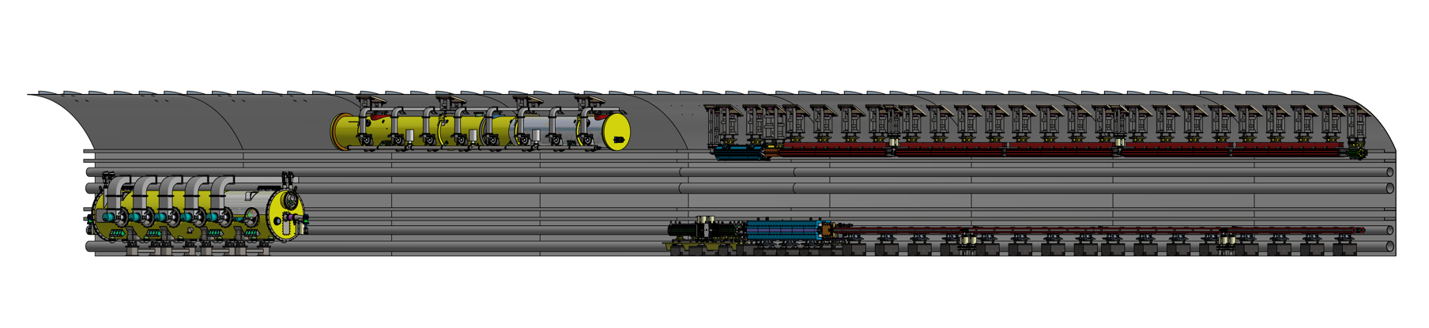
Partial layout in arc section (tunnel mockup)
A 60-meter tunnel with typical arc section and RF section
  Arc section：one FODO cell in both Collider and Booster（including dipole, quadrupole, sextupole, corrector and BPM）
  RF section：one RF module in both Collider and Booster
  Technical verification of installation and alignment for the above-mentioned equipment.

Slide 7
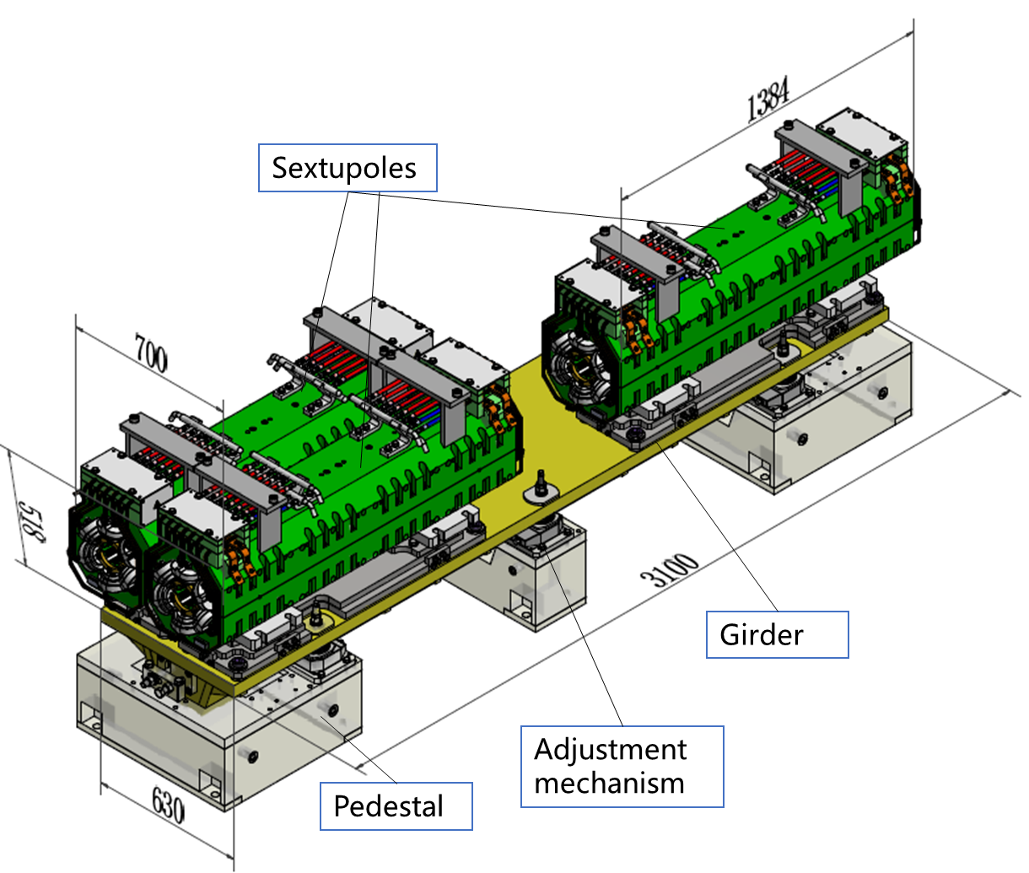
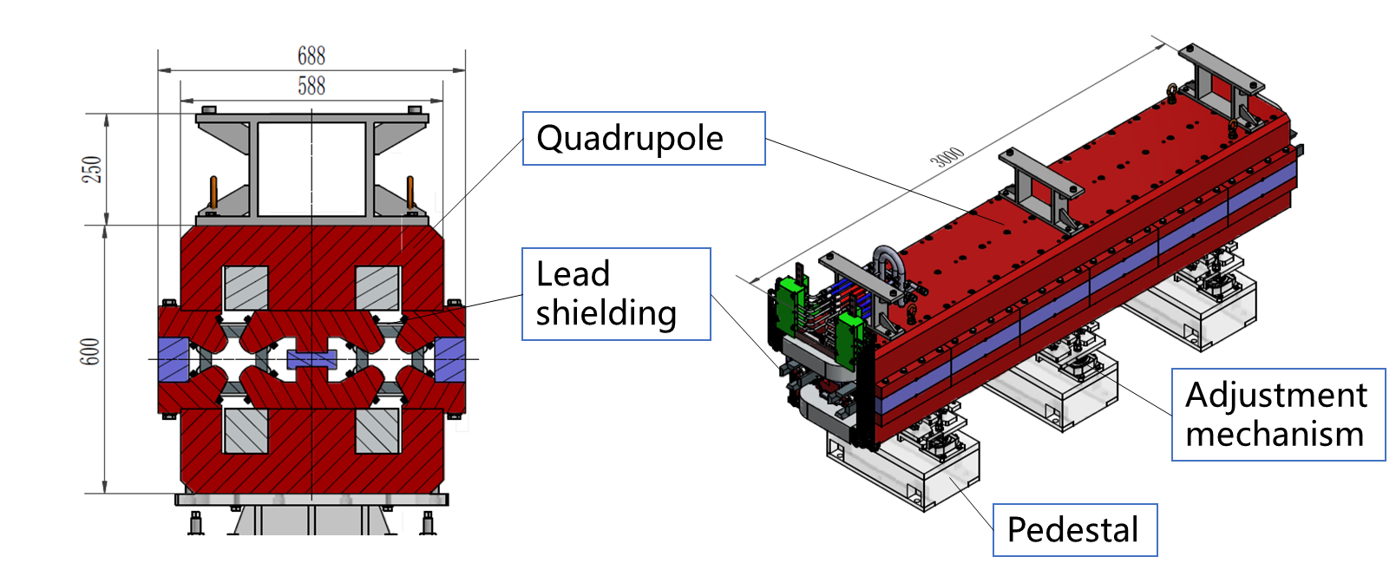
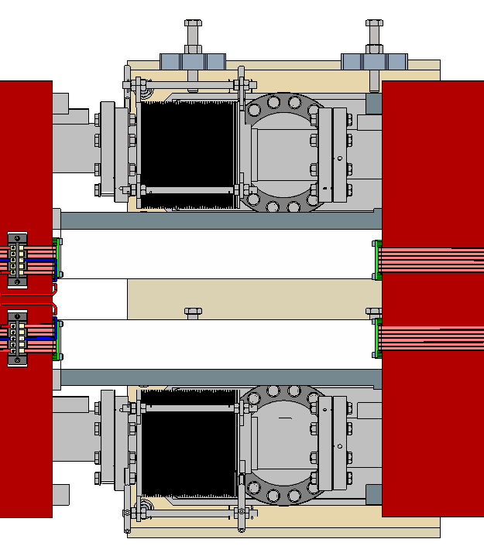
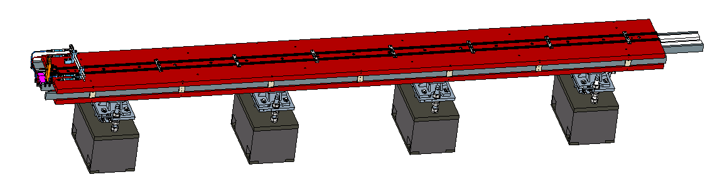
Partial layout in arc section (tunnel mockup)
Width of quadrupole and sextupole assembly: ≤700mm √
All magnets in collider add lead shielding of 25 mm √
Dipole
Thinned tungsten shielding at bellow locations
Lead shielding
Adjustment mechanism
Pedestal

Slide 8
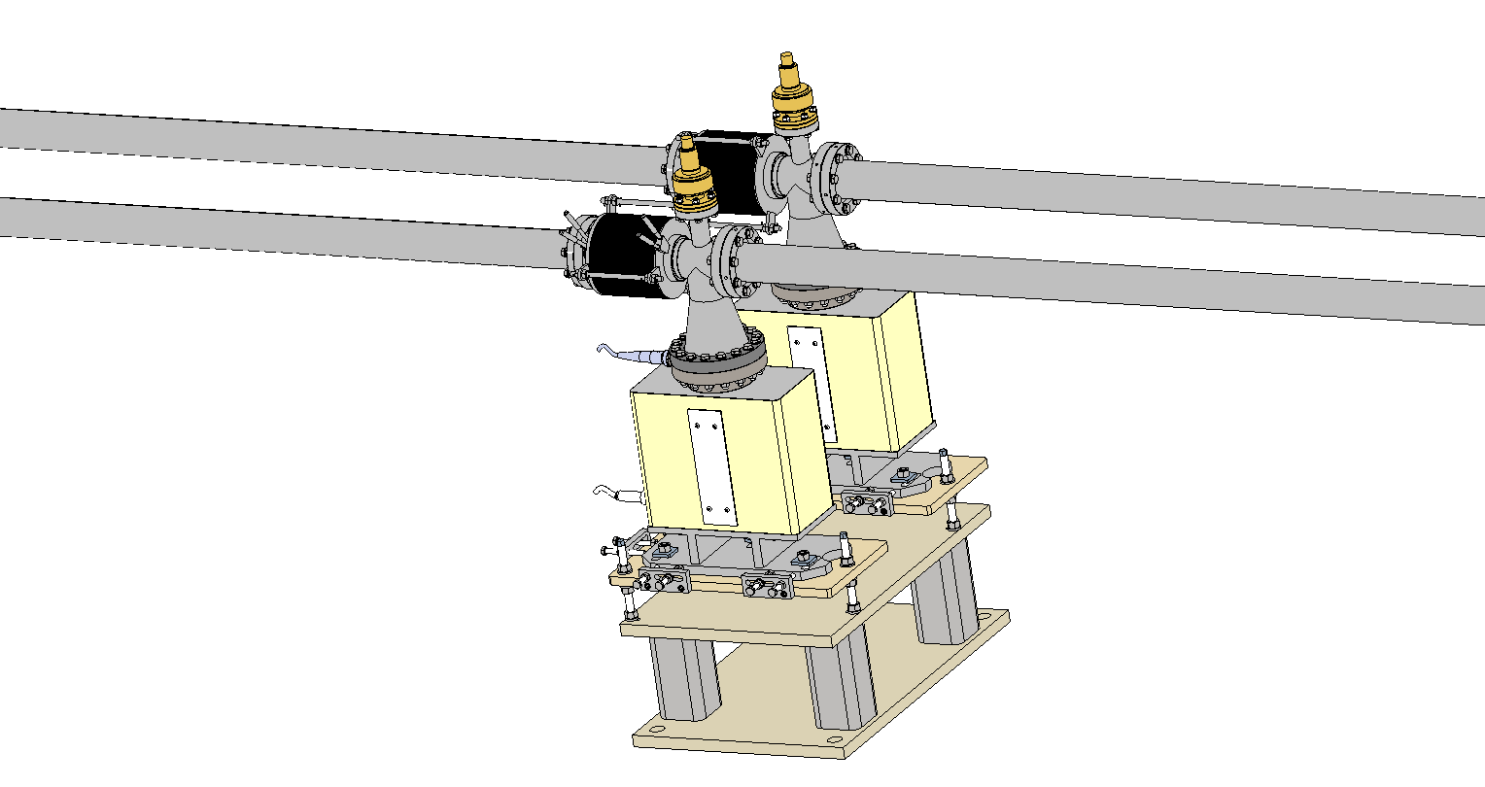
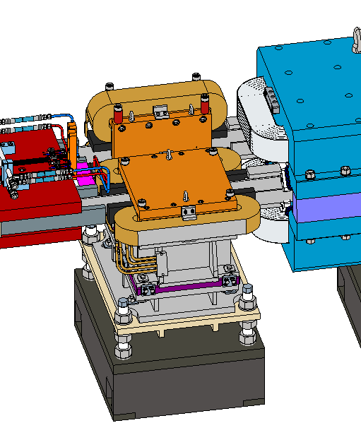
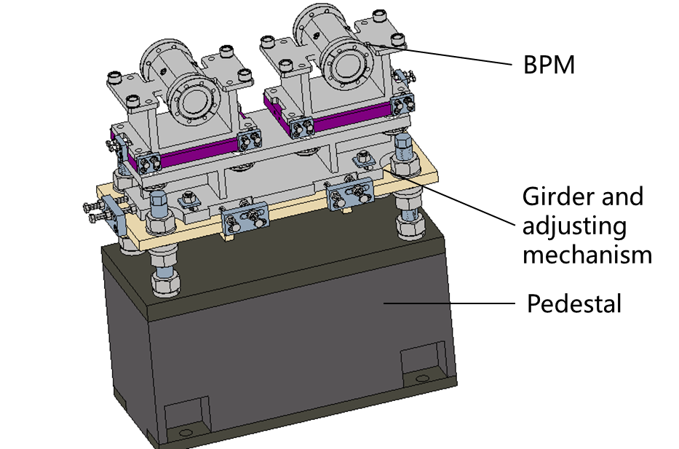
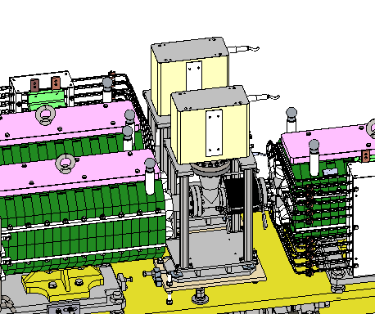
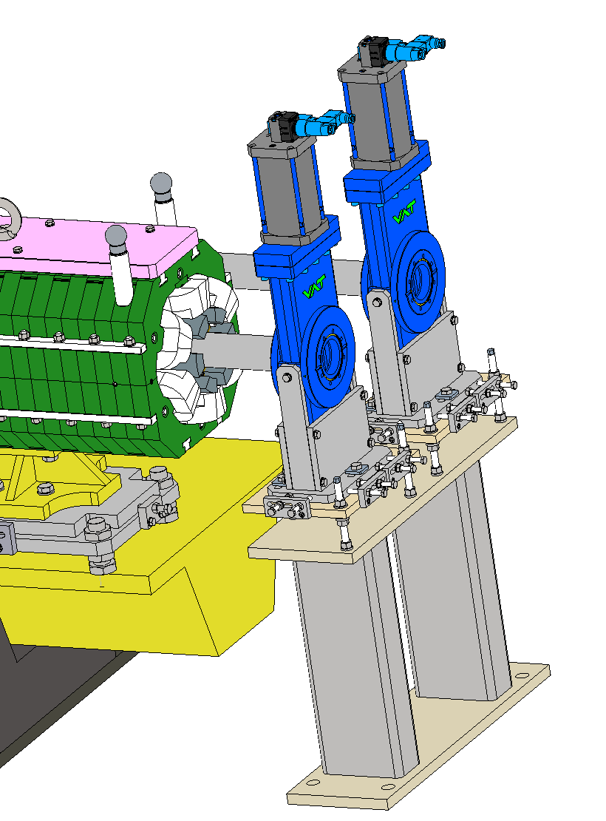
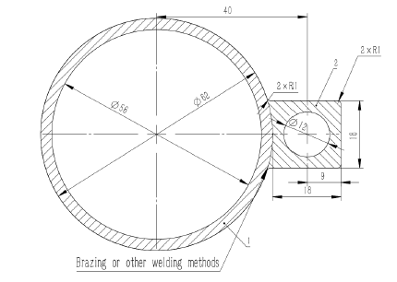
Partial layout in arc section (tunnel mockup)
Other tunnel mockup elements in Collider arc section
Girder and adjustment mechanism
CV
CH
Pedestal
Cooling channels in sextupoles will be smaller

Slide 9
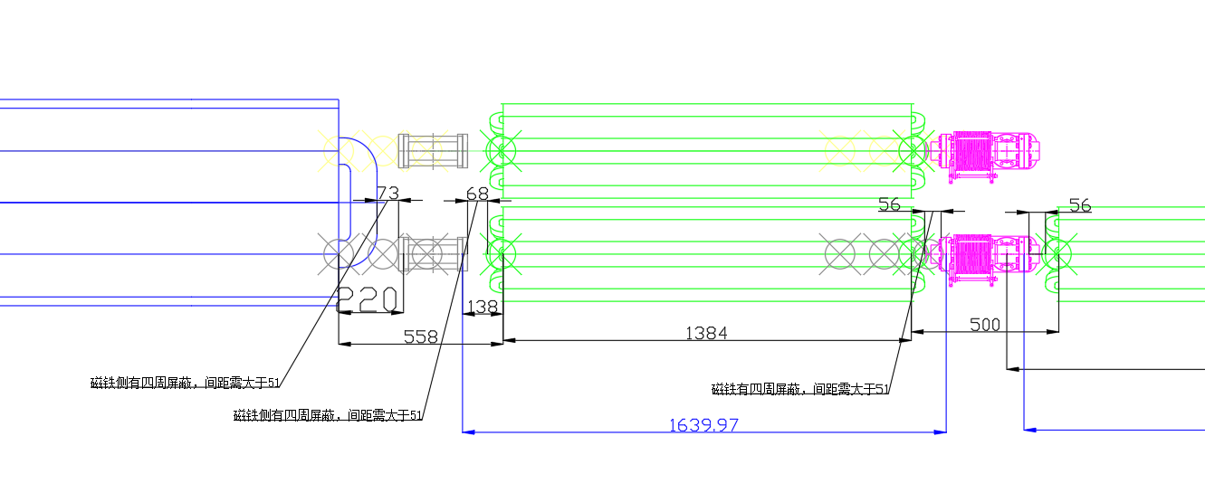
Partial layout in arc section (tunnel mockup)
The layout of arc section of Collider has been updated according to mockup design.
  All the vacuum connection locations should consider the lead shielding
  Considering the possible locations for valves
  Longitudinal adjustment of each device under constraints
  → length of BOB yoke reduced from 5485 mm to 5450 mm
Quadrupole
BPM
Sextupole
Connect space should be longer than a screw

Slide 10
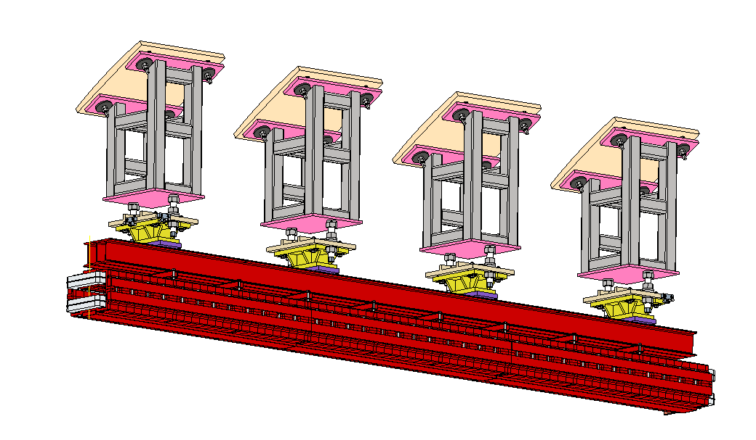
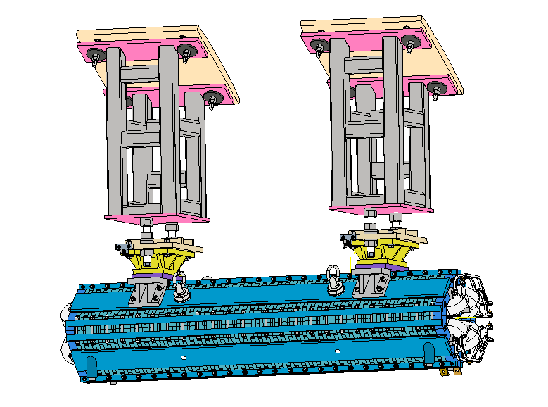
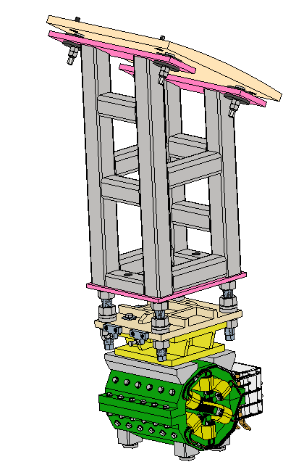
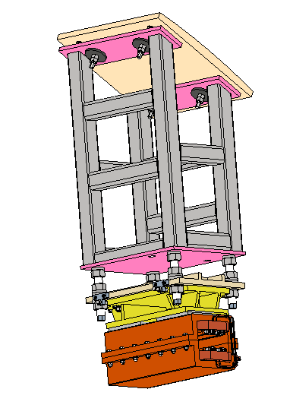
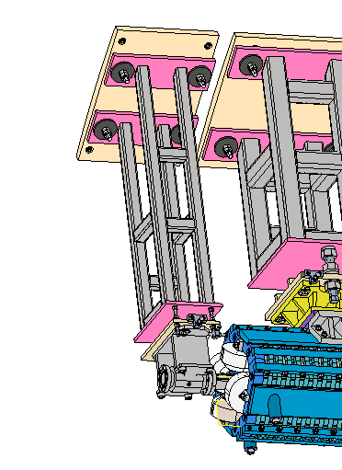
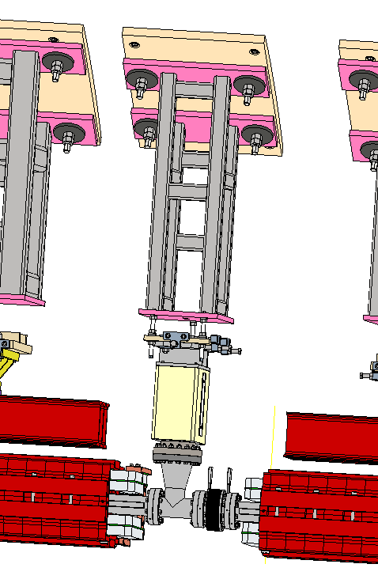
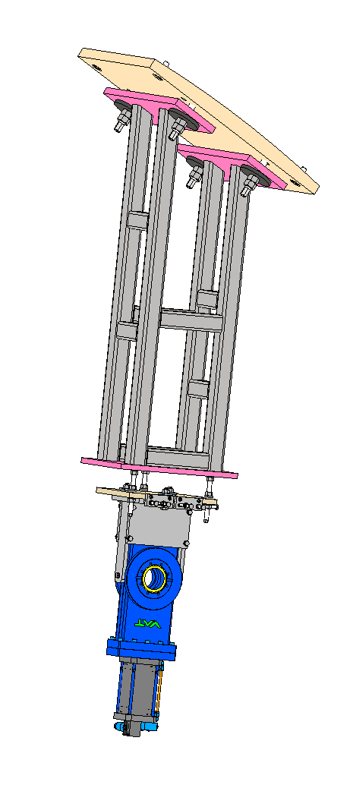
Partial layout in arc section (tunnel mockup)
Tunnel mockup elements in Booster arc section
Steel frame
Adjustment mechanism
Coil
Yoke

Slide 11
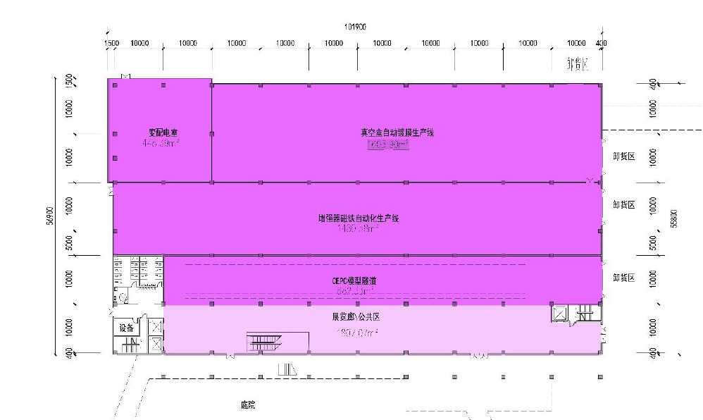
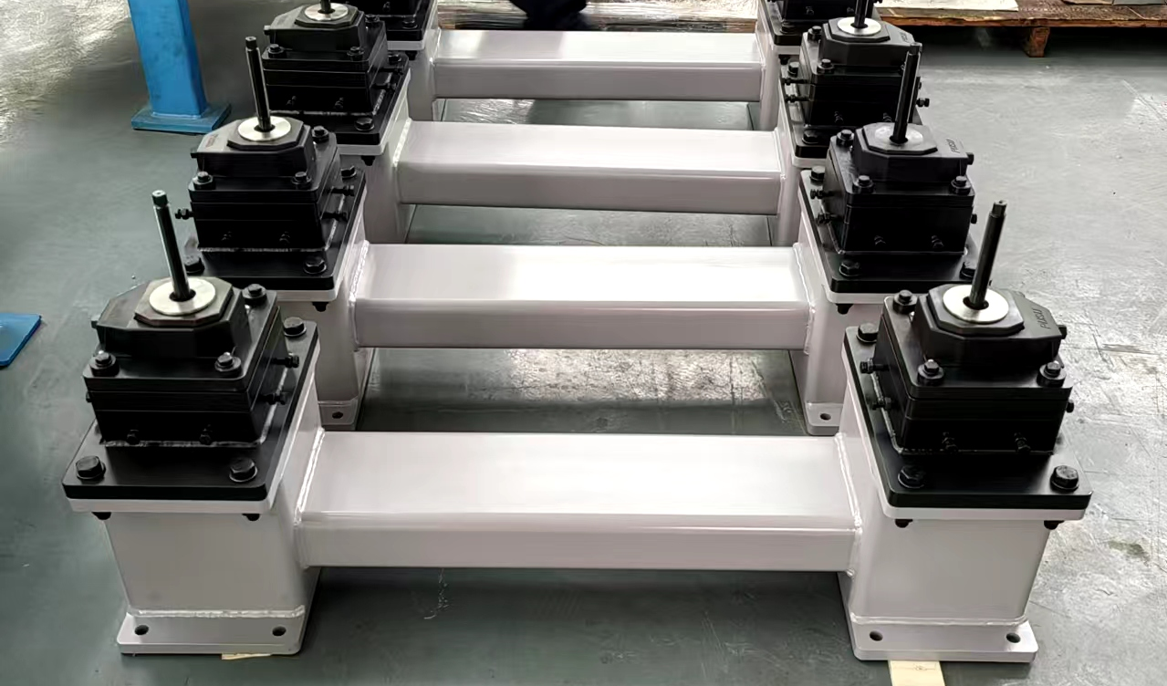
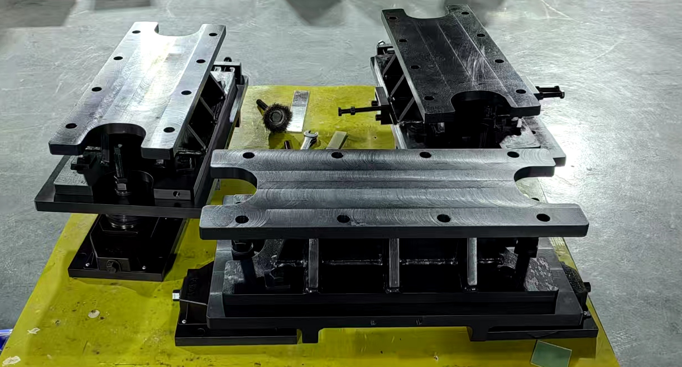
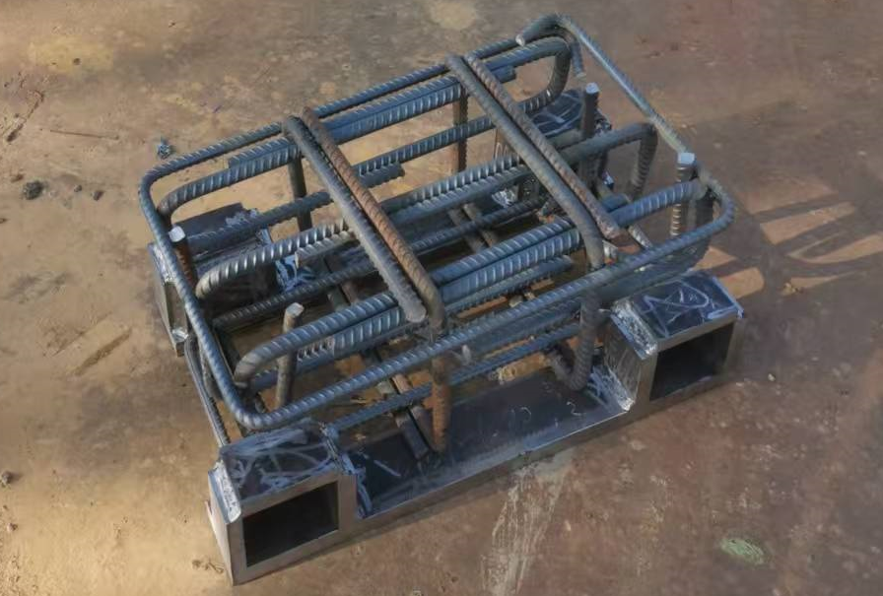
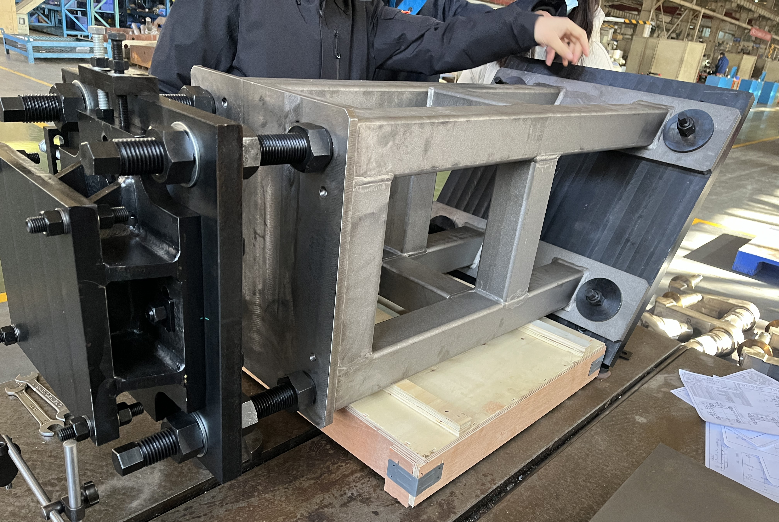
Partial layout in arc section (tunnel mockup)
The site construction design of the tunnel mockup is under-going.
The devices of the mockup is under developing.

Slide 12
2D/3D linkage design
The accelerator layouts before CEPC (HEPS\BEPC\CSNS…), the 2D and 3D layouts are designed separately and has no direct linkage
  More workloads
  Easily to have inconsistencies between 2D and 3D layout
We want to make a 2D/3D linkage design for CEPC
  Autodesk soft wares: AutoCAD Mechanical, Autodesk Inventor Professional, Factory Design Utilities, the three should have the same version and language. We use V2025
  We also investigated “中望CAD”. It doesn’t have this usage
  Other soft wares: we haven’t investigated.

Slide 13
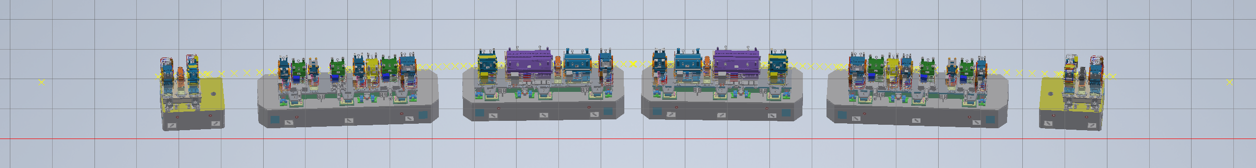
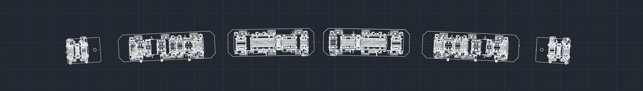
2D/3D linkage design
Take the 7BA cell of HEPS as an example
Autodesk Inventor Professional
AutoCAD Mechanical

Slide 14
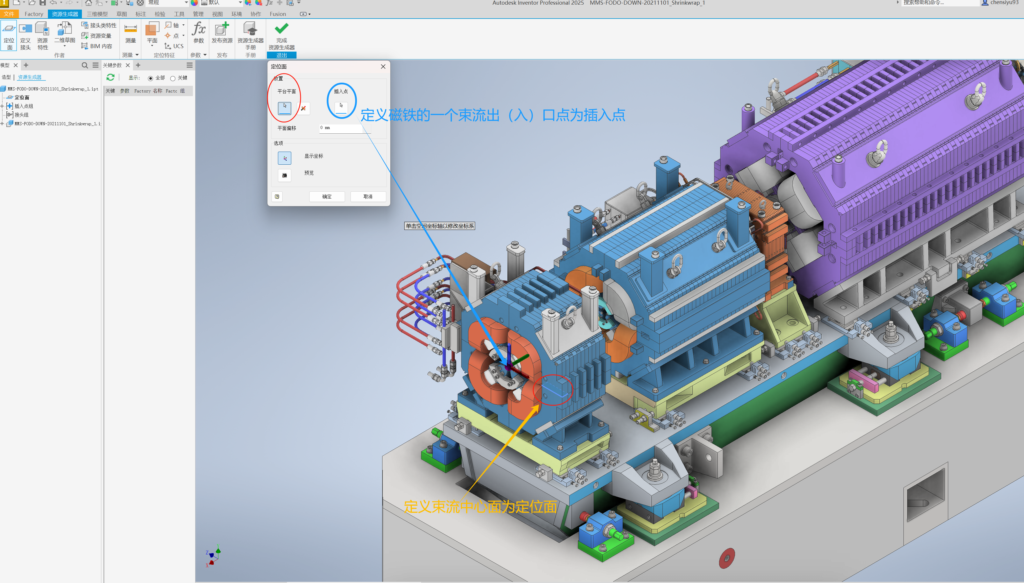
2D/3D linkage design
Take 7BA cell of HEPS as an example
  Pre-processing: define a work plane and a plug-in point in 3D environment
  Publish the top view resource → a new model in the resource library
  Publish the resources one by one
  Create survey coordinates in 2D environment
  The models in resource library can be loaded in resource browser. Place the models on the corresponding survey points.

Slide 15
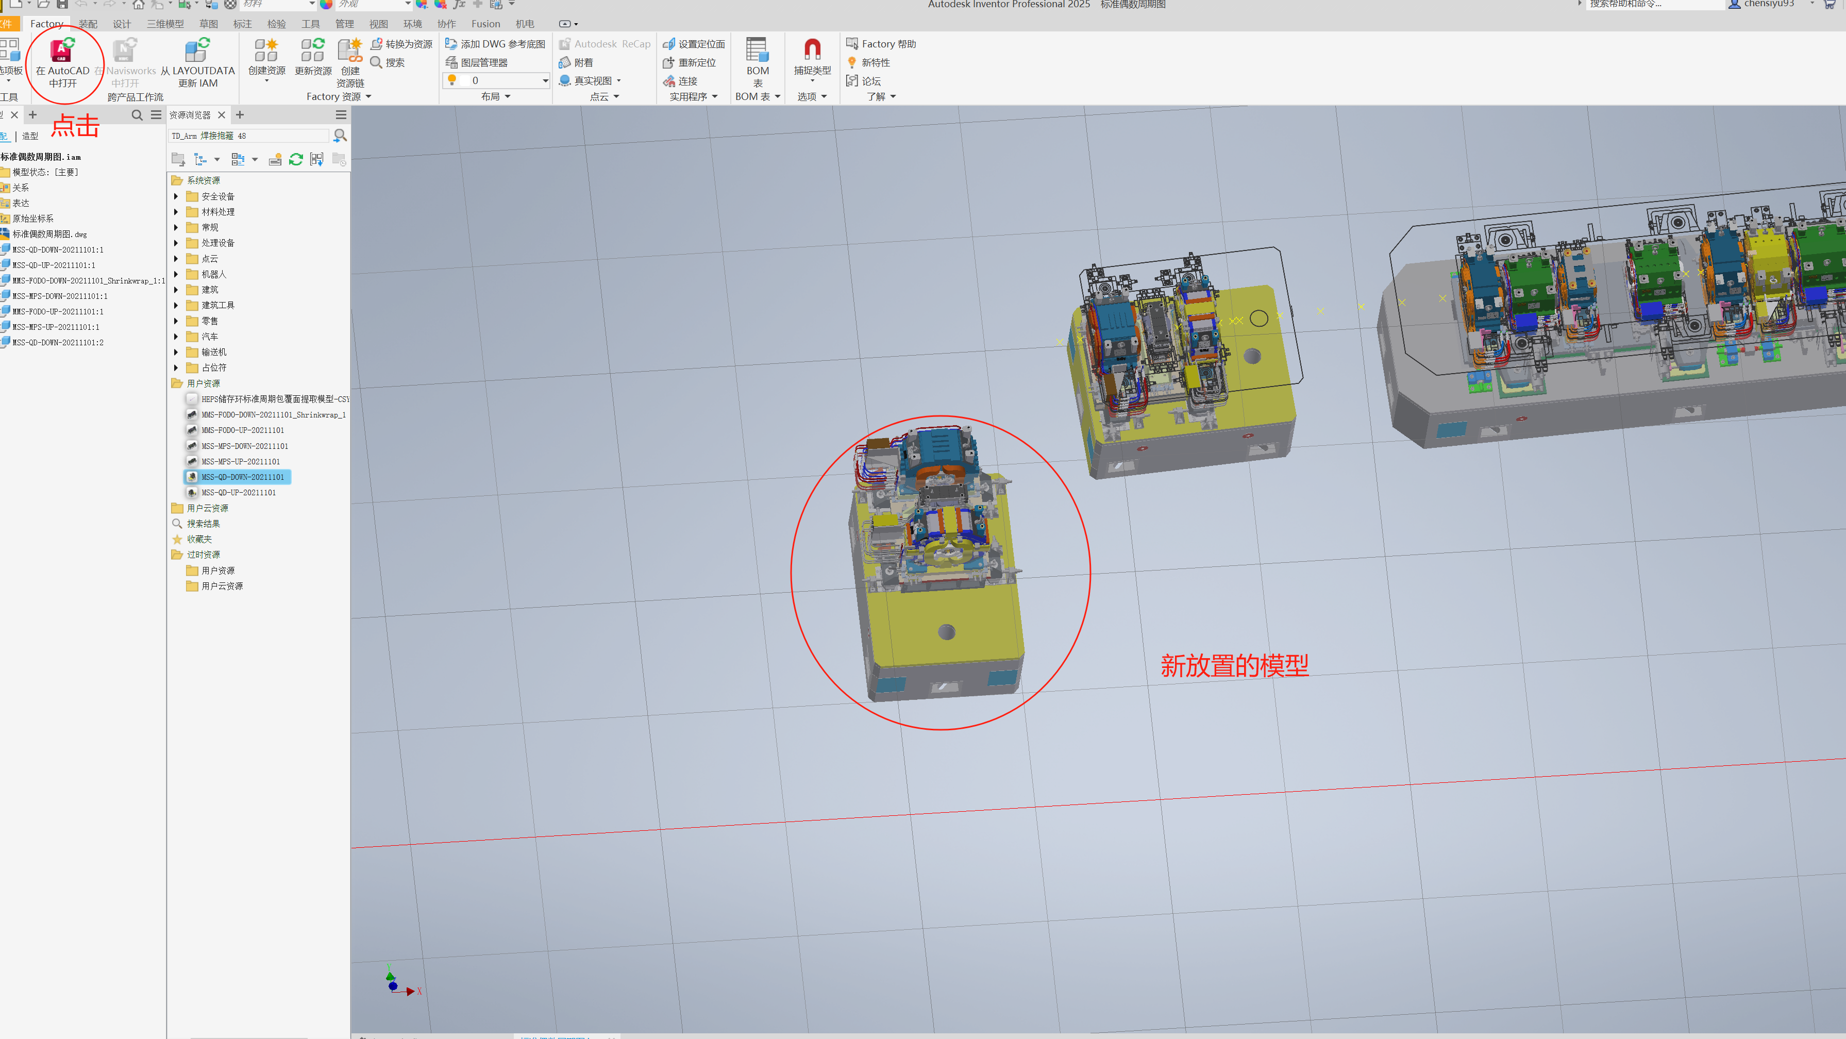
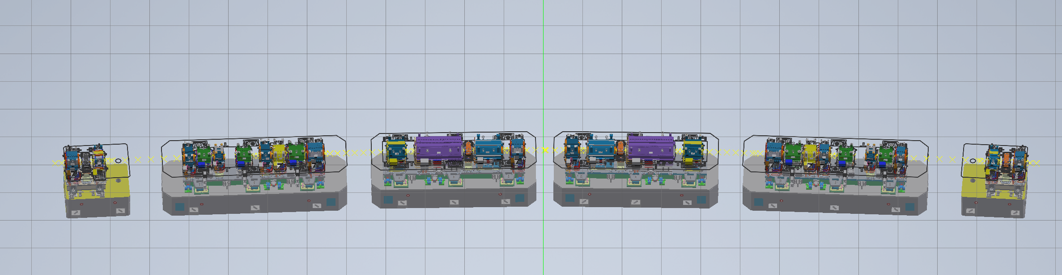
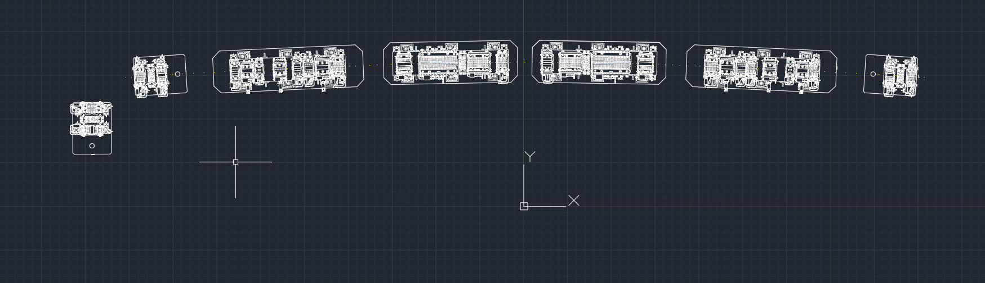
2D/3D linkage design
Take 7BA cell of HEPS as an example
  Factory-open in inventor, the 3D assembly of the cell is built automatically.
  If the 3D model is changed or replaced, the 2D model will be updated.
  If the 2D model is replaced or its location is changed, the 3D model will be updated.

Slide 16
2D/3D linkage design
Next plan
  Accessible by others
  2D layer settings and association with 3D models
  Refine the details
  Make a CEPC example

Slide 17
Collider new survey (beam track) with hardware EDR layout
Constraint on new survey：
  Least change compare with TDR: from the view point of the civil engineering continuity and the SPPC dipole feasibility (new survey may also work, but need more check)
  The machine parameters: emittance and synchrotron radiation power should not change significant

Slide 18
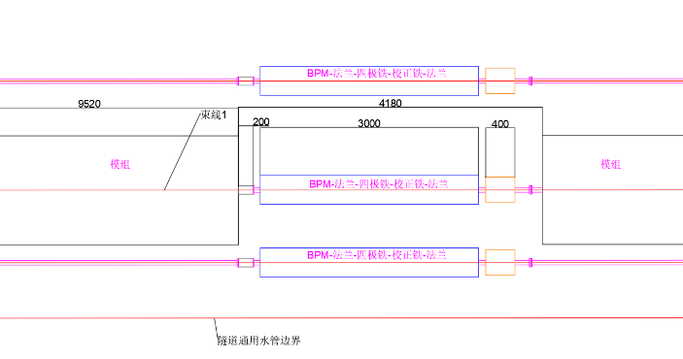
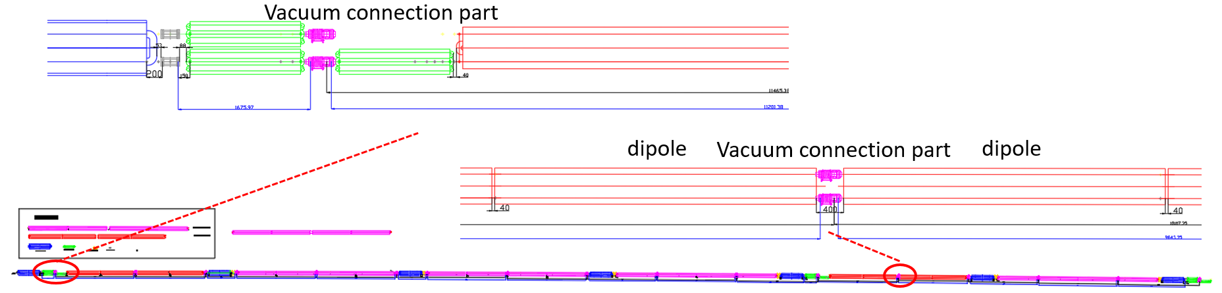
Collider new survey (beam track) with hardware EDR layout
New lattice design in order to get the new survey and check the machine performance
  New ARC, dispersion suppressor: in order to get self-consistency of hardware dimensions
  New RF: in order to get self-consistency of hardware dimensions and new circumference 99955.418 m requirement from time lock
  IR: remains temporarily
Line 2
Line 1
Line 3

Slide 19
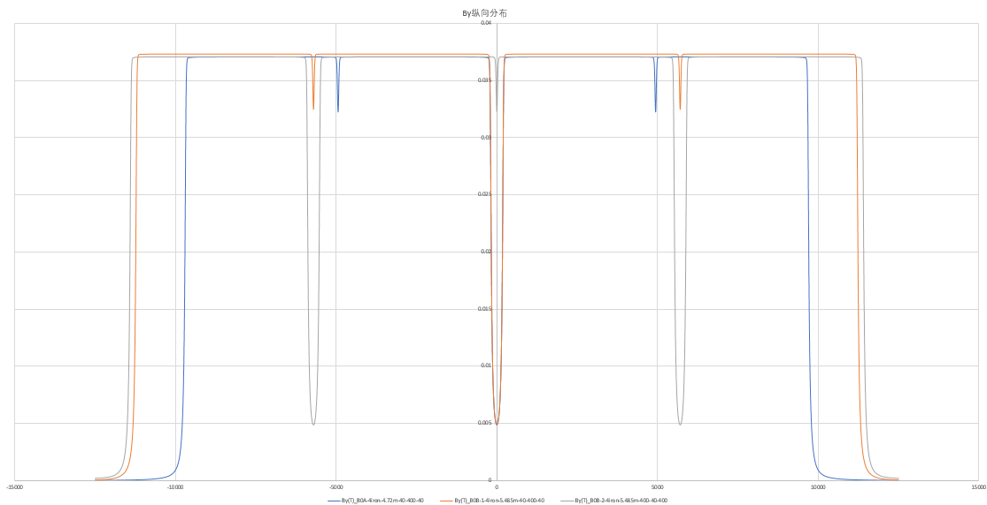
Collider new survey (beam track) with hardware EDR layout
A new Lattice design in on the way
  More realistic model of the arc dipoles for beam dynamics: 6 models of dipole coil with different effect length, distances, bend angles and fringe fields (3 kinds of dipoles)
  New RF region, new circumference have been done; ARC, dispersion suppressor is on the way
  Models have been constructed, but need adjustment and iteration between lattice and magnet design
主环弧区二极铁纵向场分布
弧区设备分布

Slide 20
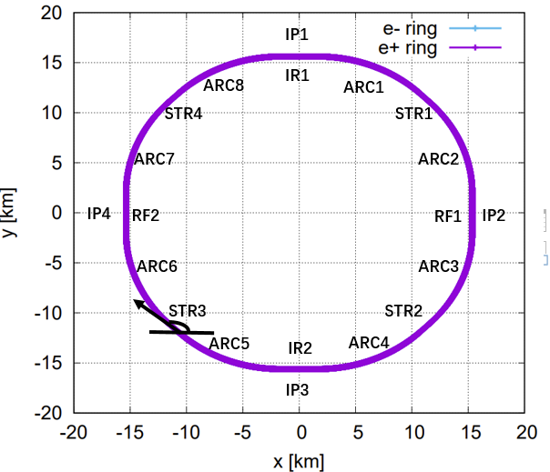
Collider new survey (beam track) with hardware EDR layout
Difficulties:
  Complicate longitudinal distribution of the arc hard wares (magnets, vacuum devices, beam instruments) : TDR period 1/2 cell, EDR status 6 cells.
  Mainly driven by 12.5 m limit of vacuum chamber and long yoke length
  Need to check the effects and then confirm this version layout: non regular arc optics, dispersion surppresor scheme, long sextupoles effects (1.4m+0.5m valve+1.4m)
  Check the aperture longitudinal position consistence of two beams
  Temporarily survey with simplified ARC, the perimeter is 99955.418 meters

Slide 21
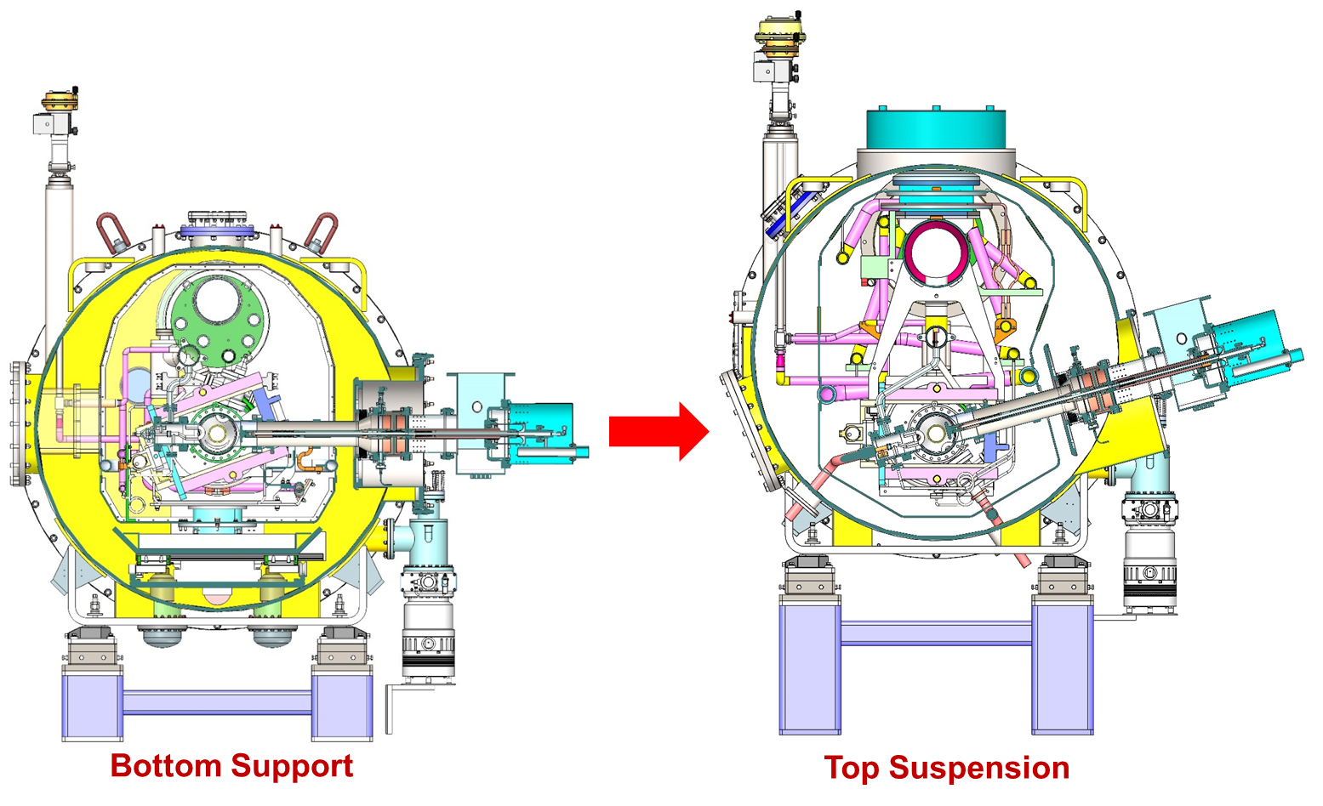
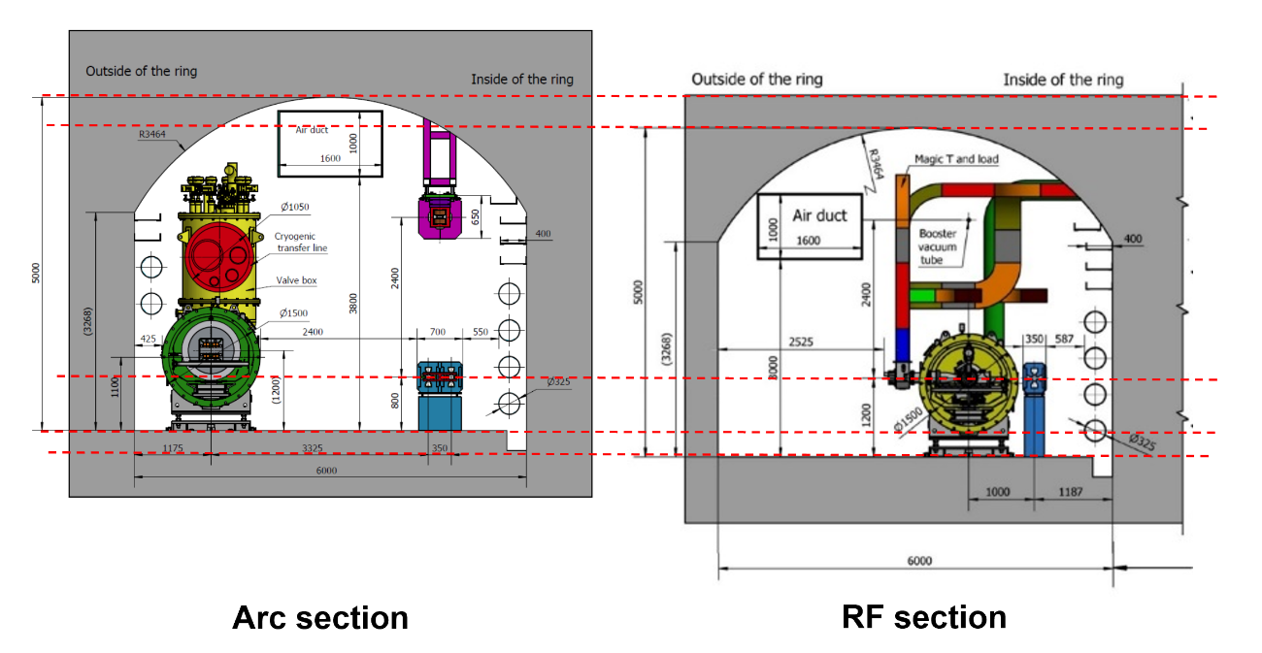
Discussions
There had a 400 mm difference of the Arc section ground and RF section ground in the CDR and TDR.
The RF design updated, the ground can be at the same level now!√
From Jiyuan Zhai, IAS 2025

Slide 22
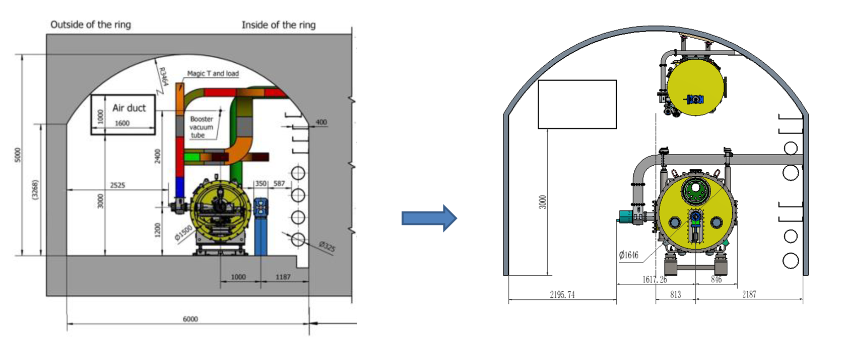
Discussions
The horizontal dimensions is about 300 mm larger from beam center to coupler end.
The tunnel section needs detailed design further.
Line 2
Line 1
Line 3

Slide 23
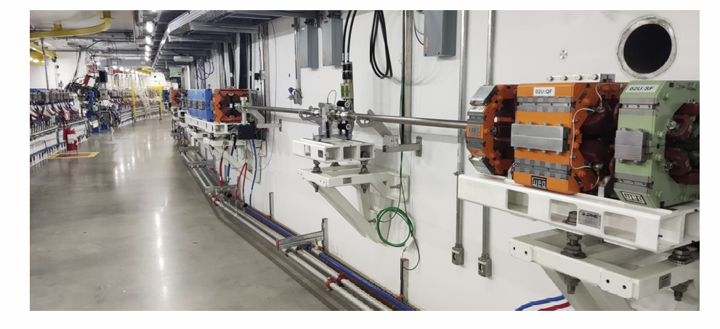
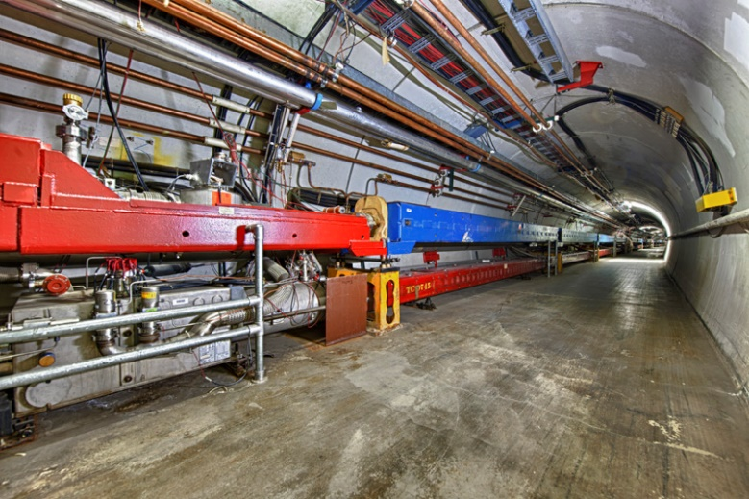
Discussions
Booster support locations
  Baseline: hanged on the ceiling. The tunnel is not lined
  Waterproof, stability, installation and maintenance convenience, multi-point support, alignment…
Sirius tunnel
Tevetron tunnel
Euro-XFEL tunnel
Three support schemes of Booster elements

Slide 24
Thanks for your attention!

