Slide 1
Progress in the overall mechanical design of CEPC detectors
Ji Quan
(On behalf of the CEPC Mechanics Working Group)
Jan 24, 2025

Slide 2
Outline
1. General Drawing
2. Connection of the detectors
3. Installation of the detectors
4. Experimental Hall
5. Summary

Slide 3
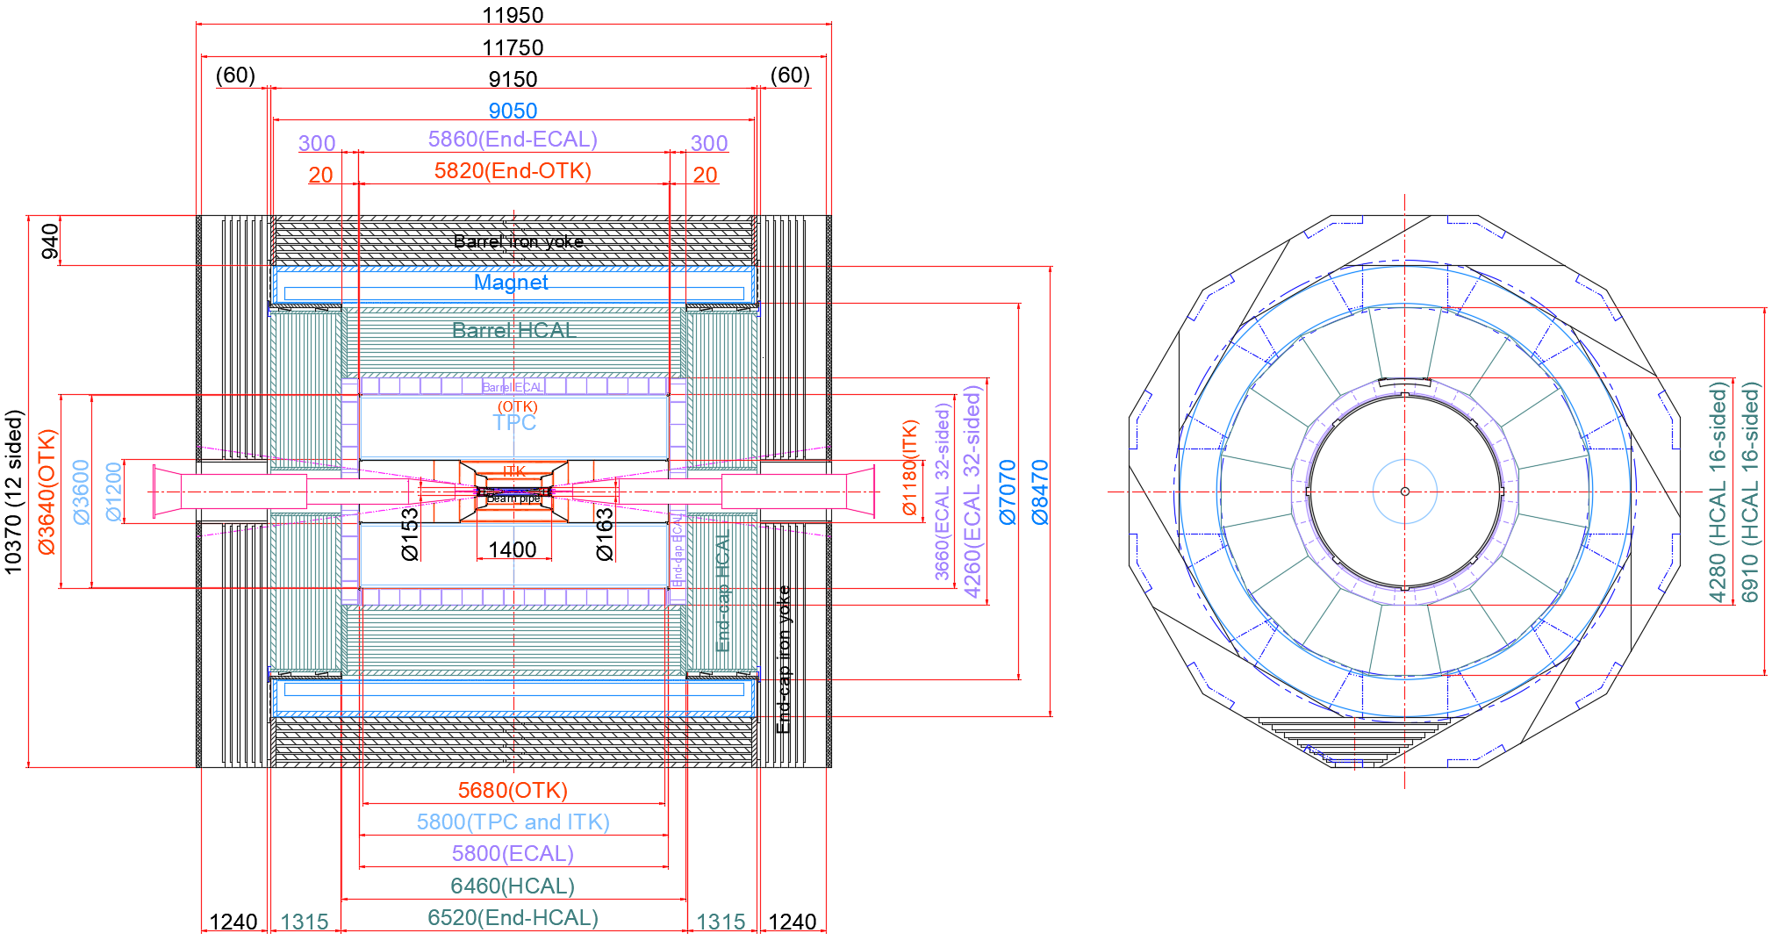
1. General Drawing --- Size distribution of Overall Detectors
Continue to optimize :
Pipeline arrangement
TDR Version

Slide 4
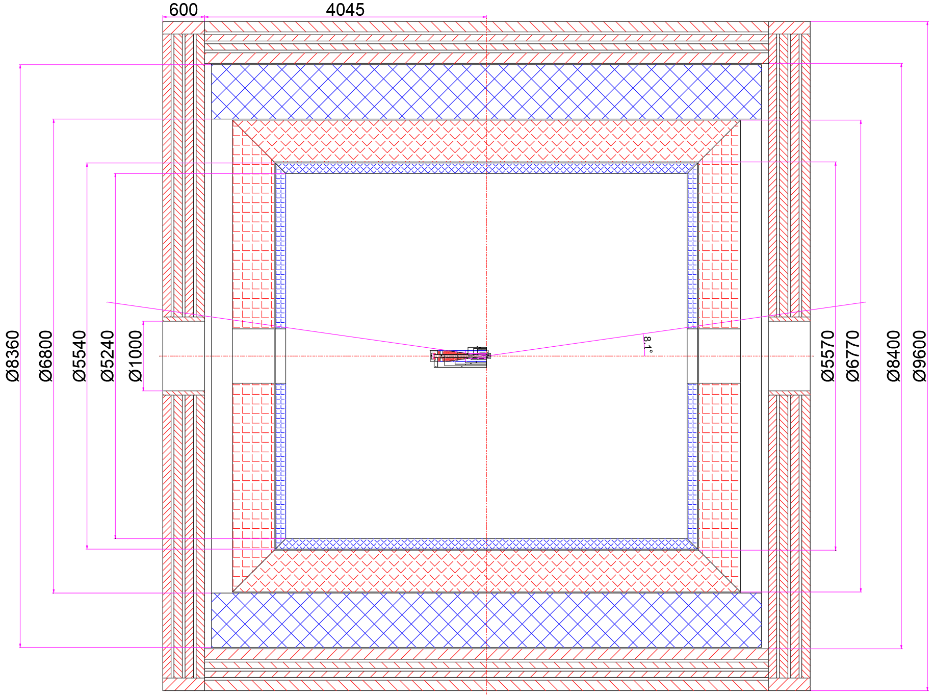
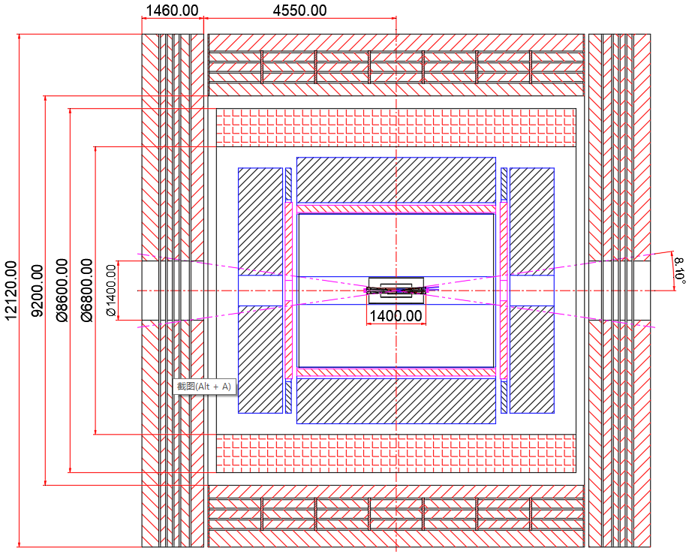
1. General Drawing --- Retrospect the Journey of the General drawing
2019年6月29日
2020年3月31日

Slide 5
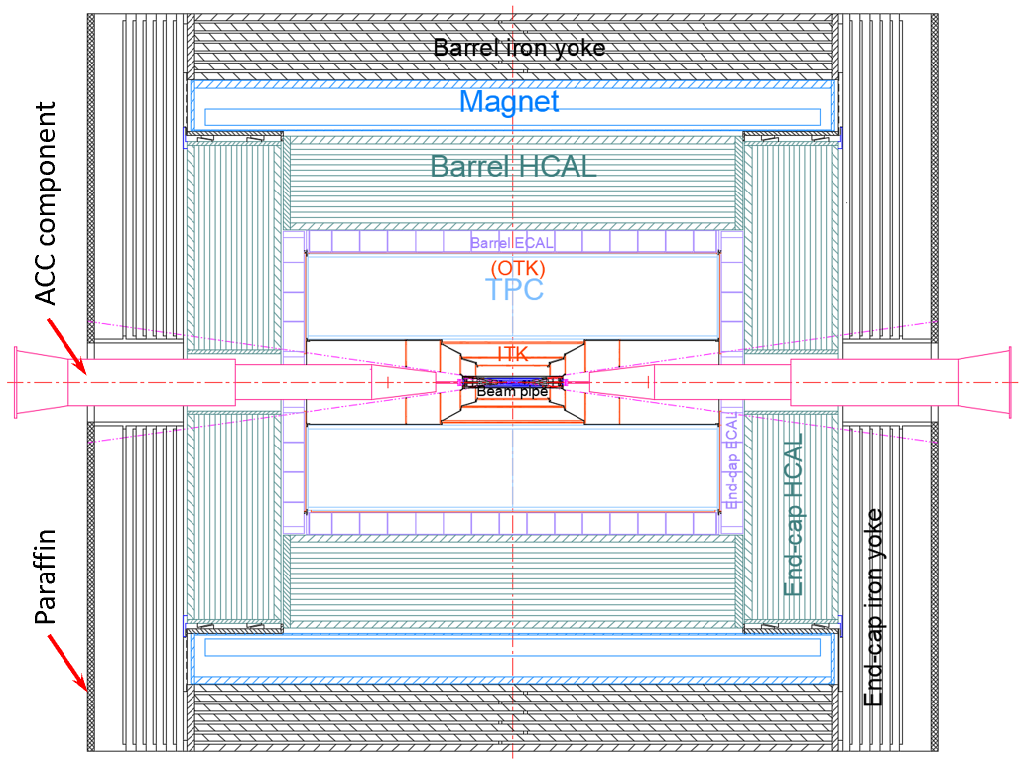
1. General Drawing --- Detectors Mechanical Layout
From outmost to innermost
Barrel(7)
Endcap(3)
MDI(1)
Yoke
(Muon)
Magnet
HCAL
ECAL
TPC
(OTK)
ITK
Beam pipe
(VTX LumiCal)
Yoke
(Muon)
HCAL
ECAL
(OTK)
ACC component
Total weight :
≈ 5,120 t

Slide 6
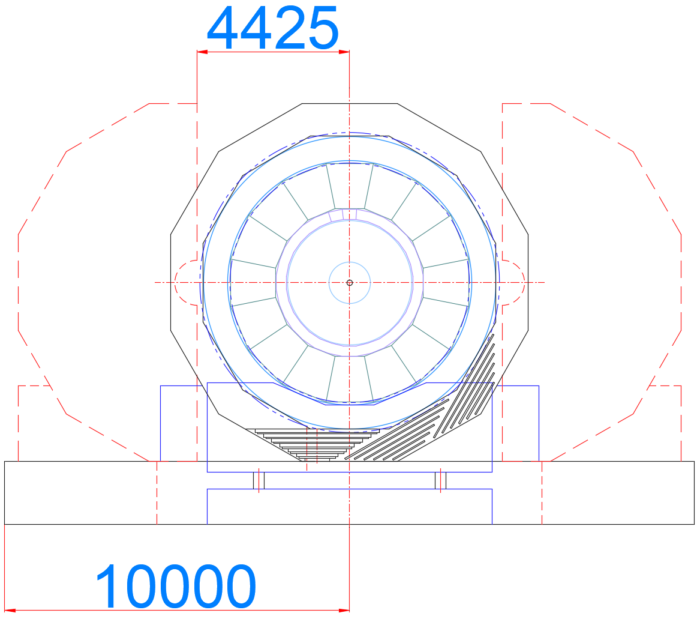
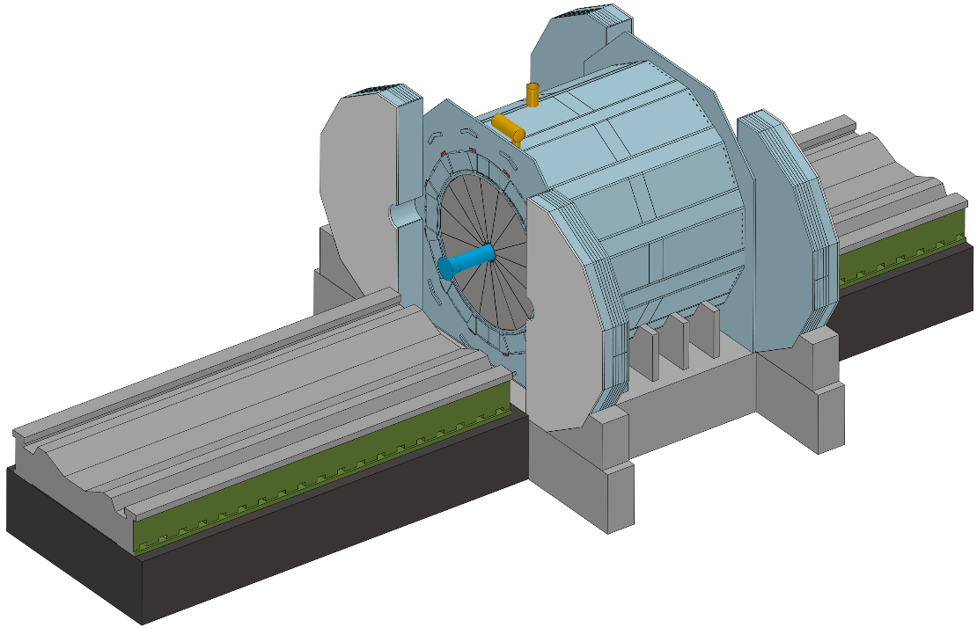
1. General Drawing --- Open Range of the End Yokes
Main
maintenance path
Muon
Side Maintenance
Factors considered :
1. Maintenance and replacement
2. Saving floor space

Slide 7
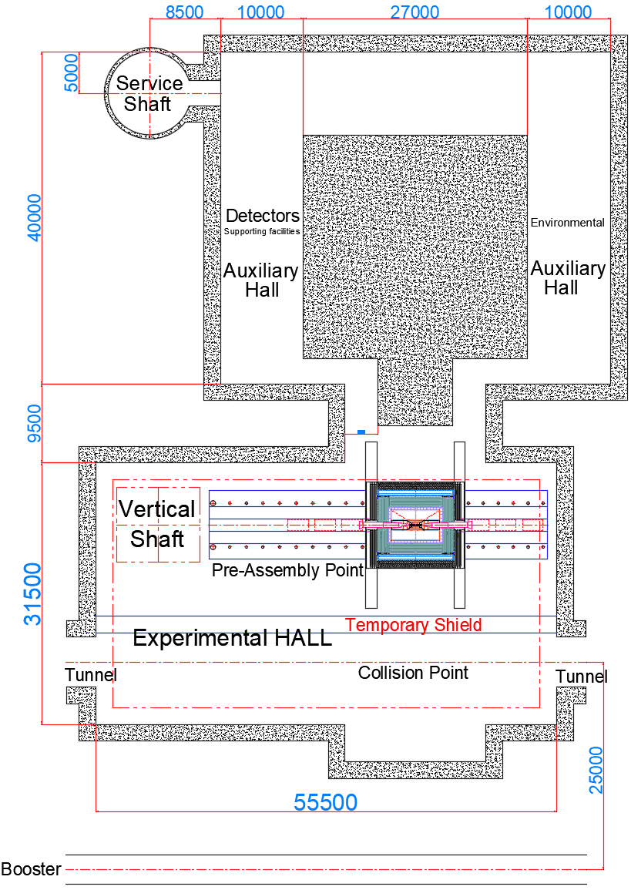
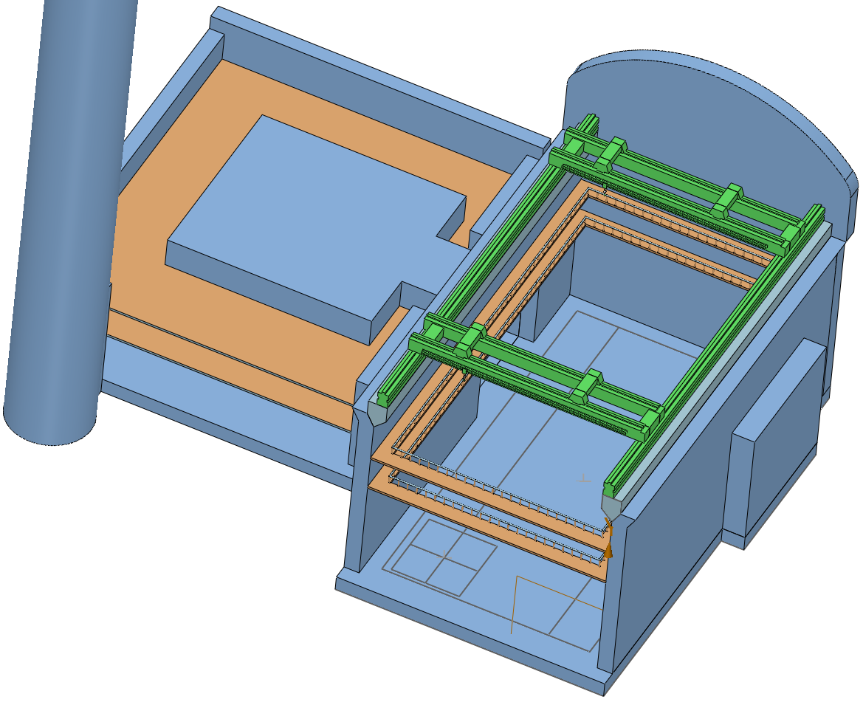
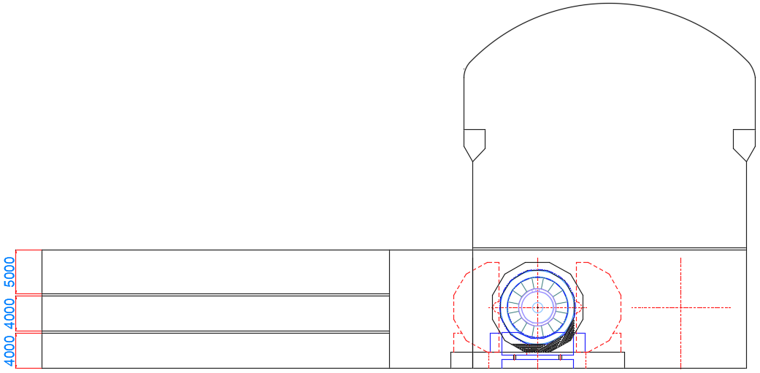
1. General Drawing --- Pre-assembly Installation
TDR Version

Slide 8
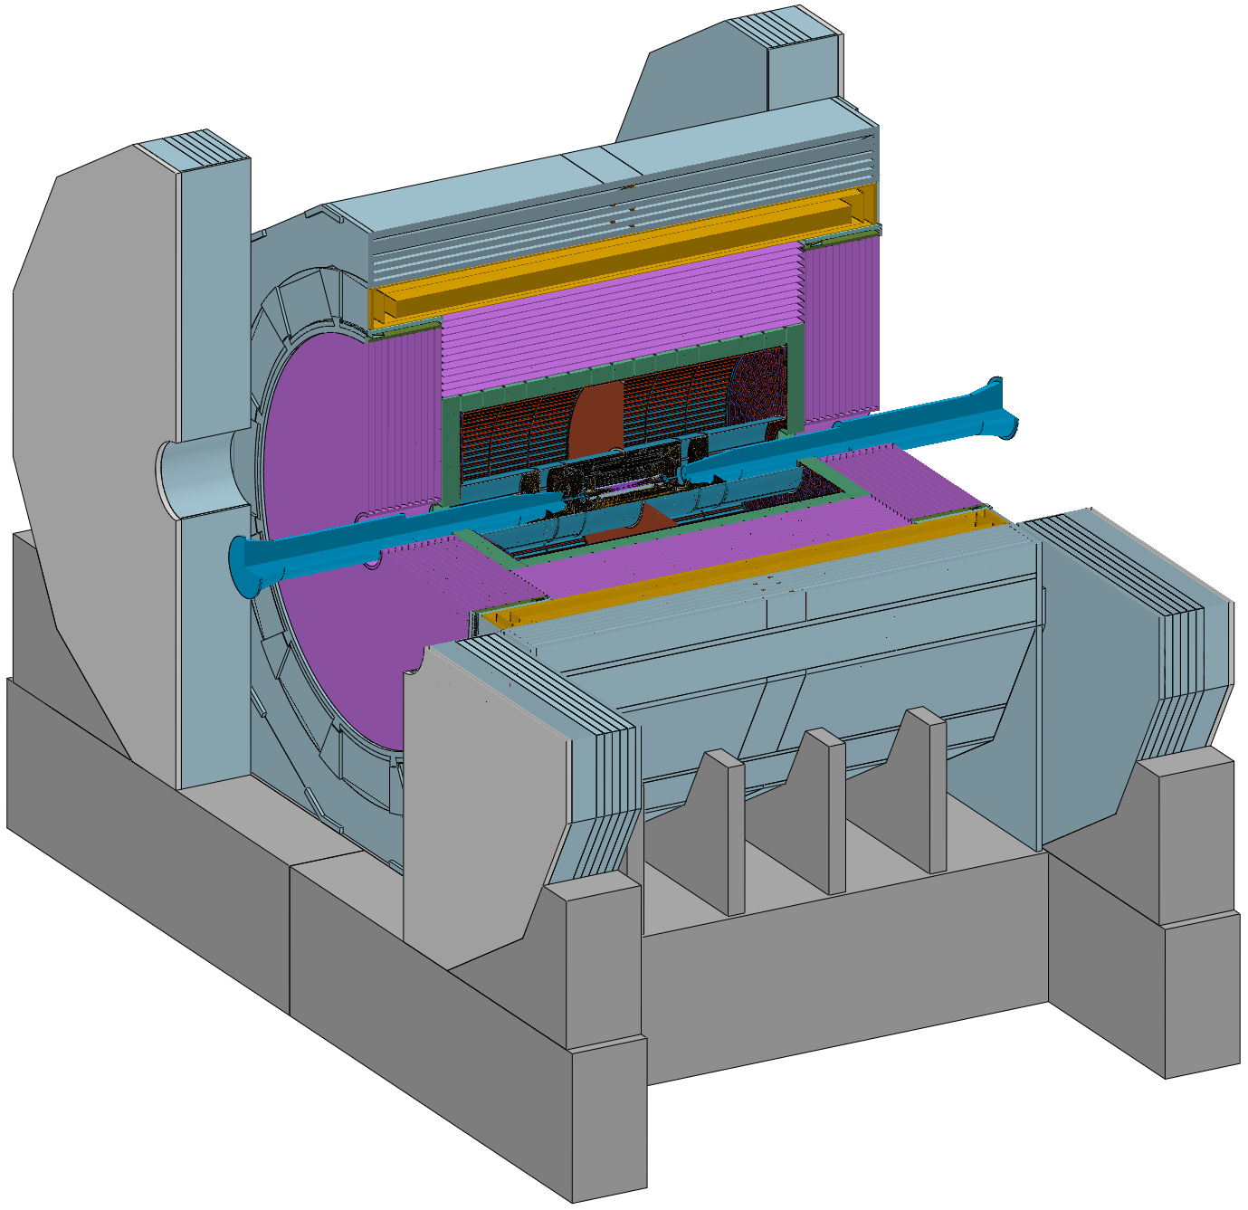
2. Connection of sub detectors
Continue to optimize :
Connection Structure
Design Requirements
1. The connection structure should be proximity
2. The connection structure should be adjustable (Remote automatic)
Barrel Yoke : Fixed on the ground Base
Magnet : Fixed on the Barrel Yoke
Barrel HCAL : Fixed on the Barrel Yoke
Barrel ECAL : Fixed on the Barrel HCAL
TPC+OTK : Fixed on the Barrel ECAL
ITK : Fixed on the TPC
Beampipe(Vertex and LumiCal) : Fixed on the ITK
End-cap ECAL+OTK : Fixed on the Barrel HCAL
End-cap HCAL : Fixed on the Barrel HCAL
(Auxiliary ring or Flange)
End Yoke : Fixed on the ground Base
Base

Slide 9
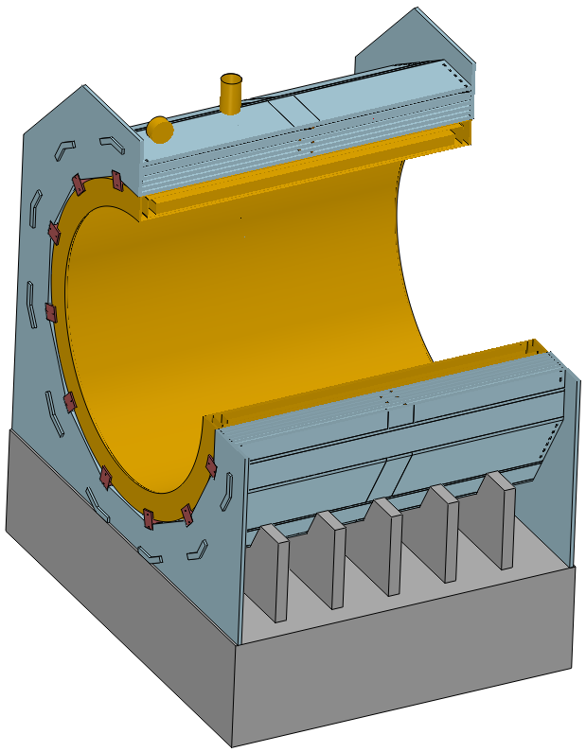
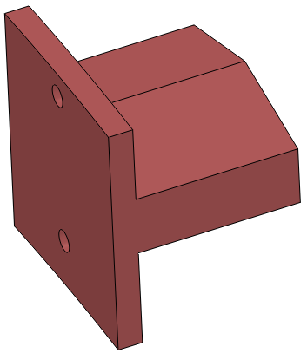
2. Connection of sub detectors --- Magnet
Weight :
≈ 1560(Yoke) + 290(Magnet) t
“T” Shape Connection Structure

Slide 10
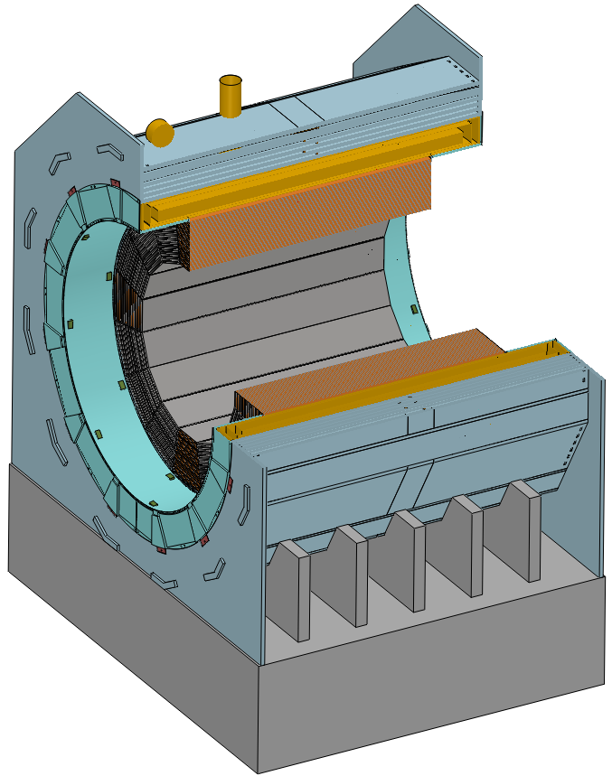
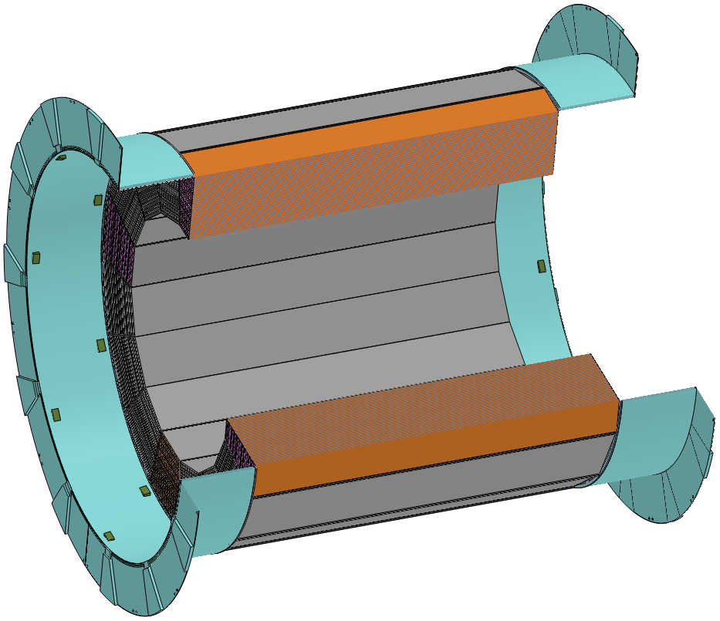
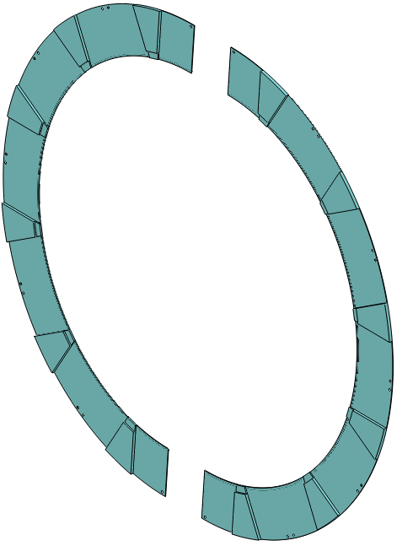
2. Connection of sub detectors --- Barrel HCAL
Weight :
≈ 960 t
Half connection rings Structure

Slide 11
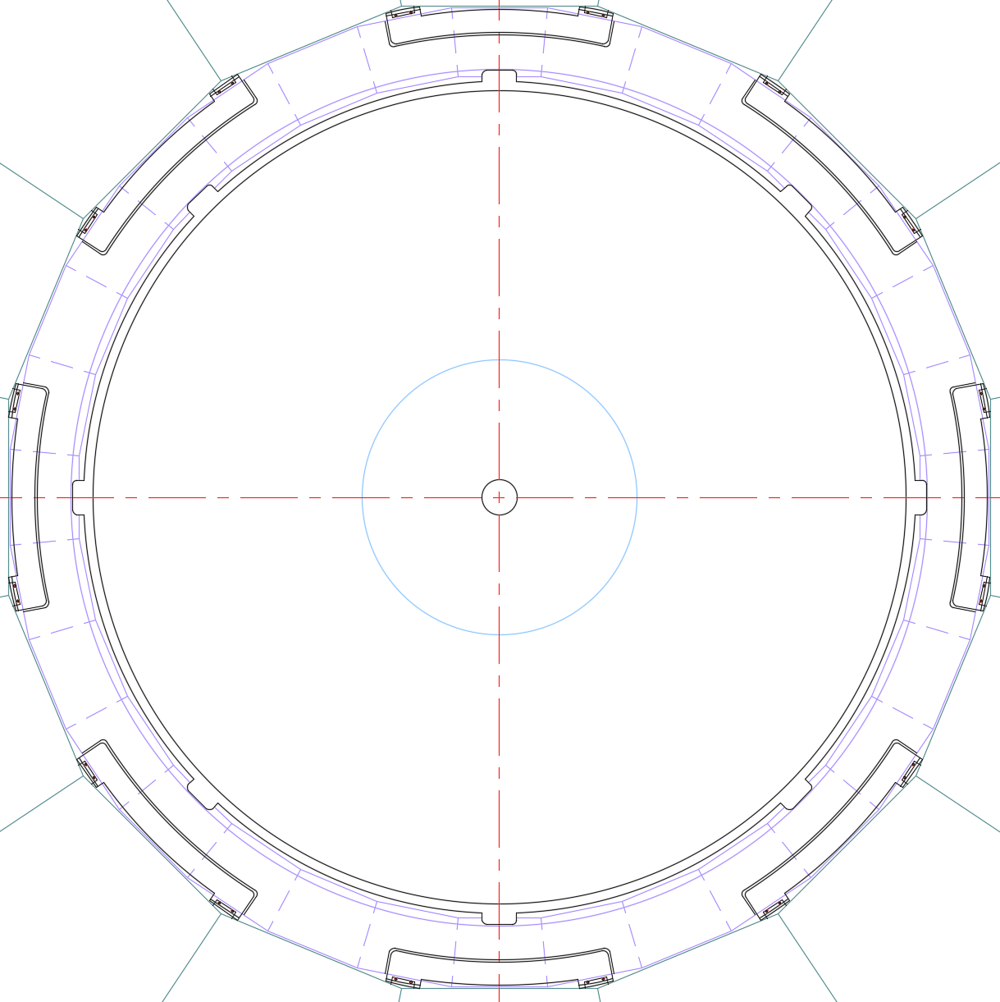
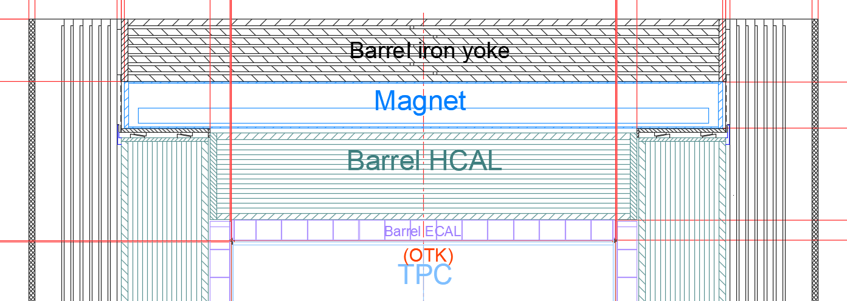
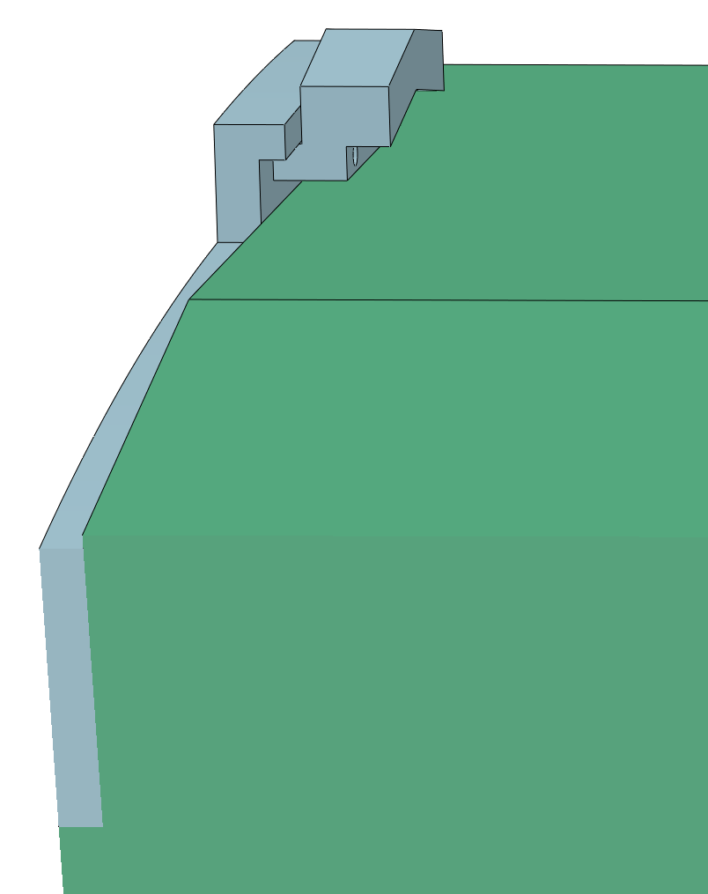
2. Connection of sub detectors --- Barrel ECAL
Weight :
≈ 150 t
“Z” Shape Suspended Structure

Slide 12
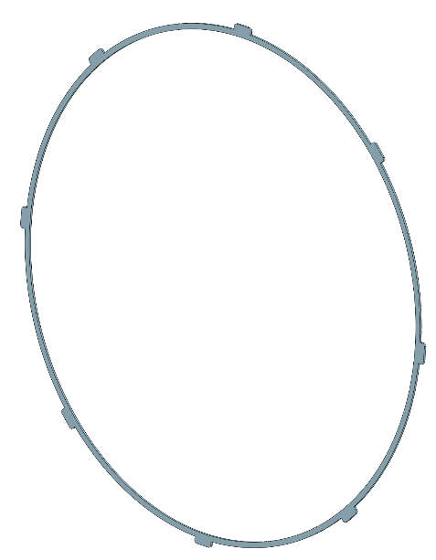
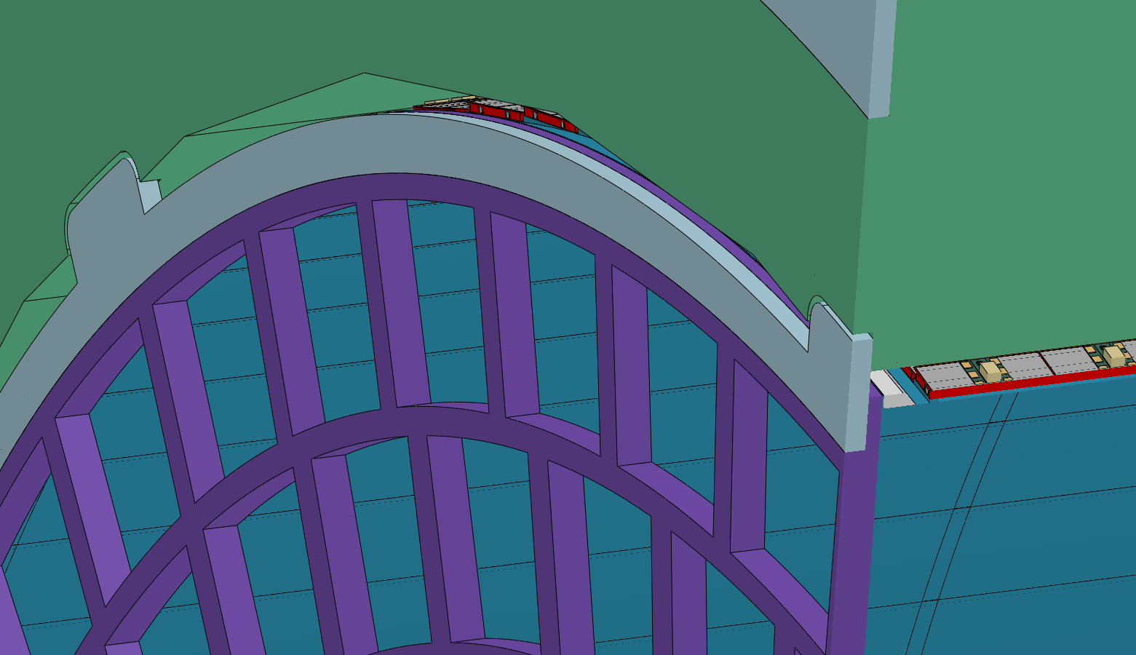
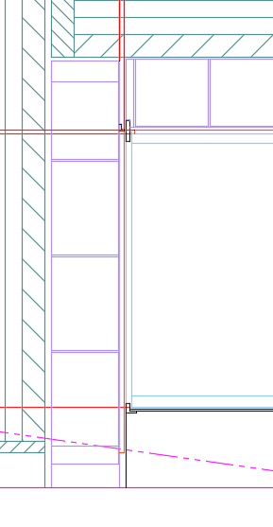
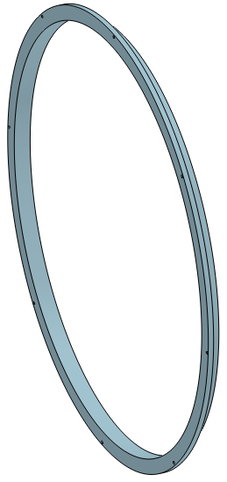
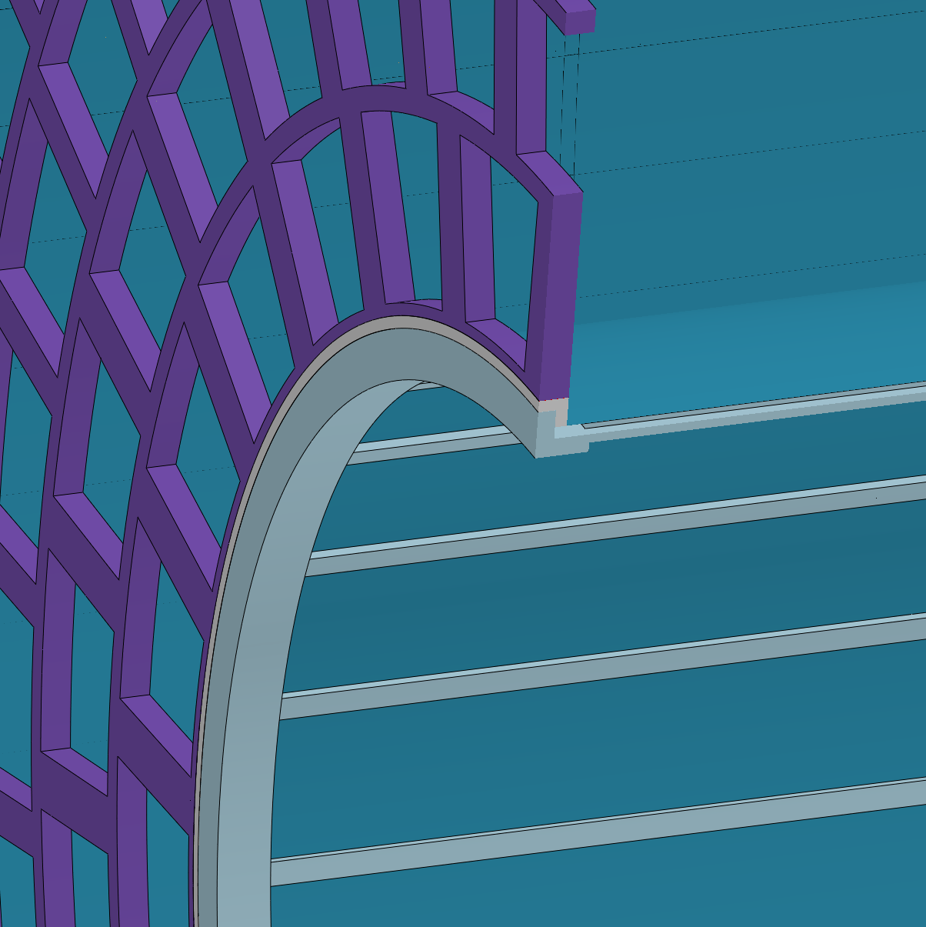
2. Connection of sub detectors --- TPC
Eight-point
suspension structure
ECAL
OTK
TPC
Weight :
≈ 2 t
ITK

Slide 13
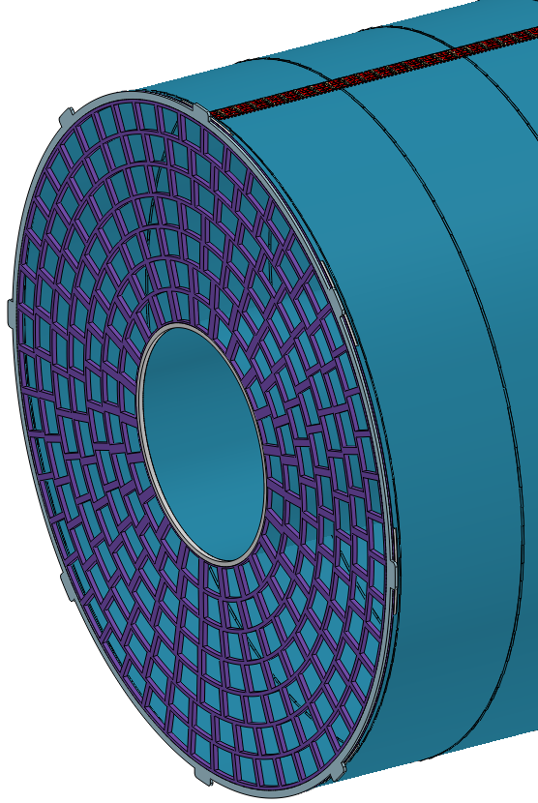
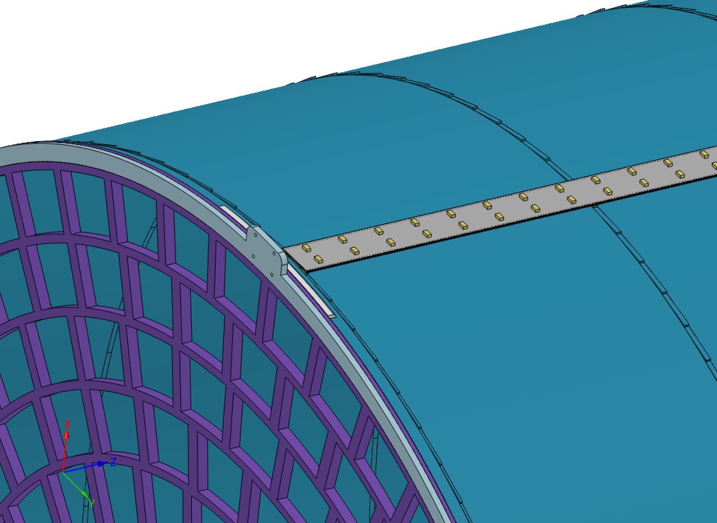
2. Connection of sub detectors --- TPC + OTK
Weight :
≈ 1.5 t
OTK

Slide 14
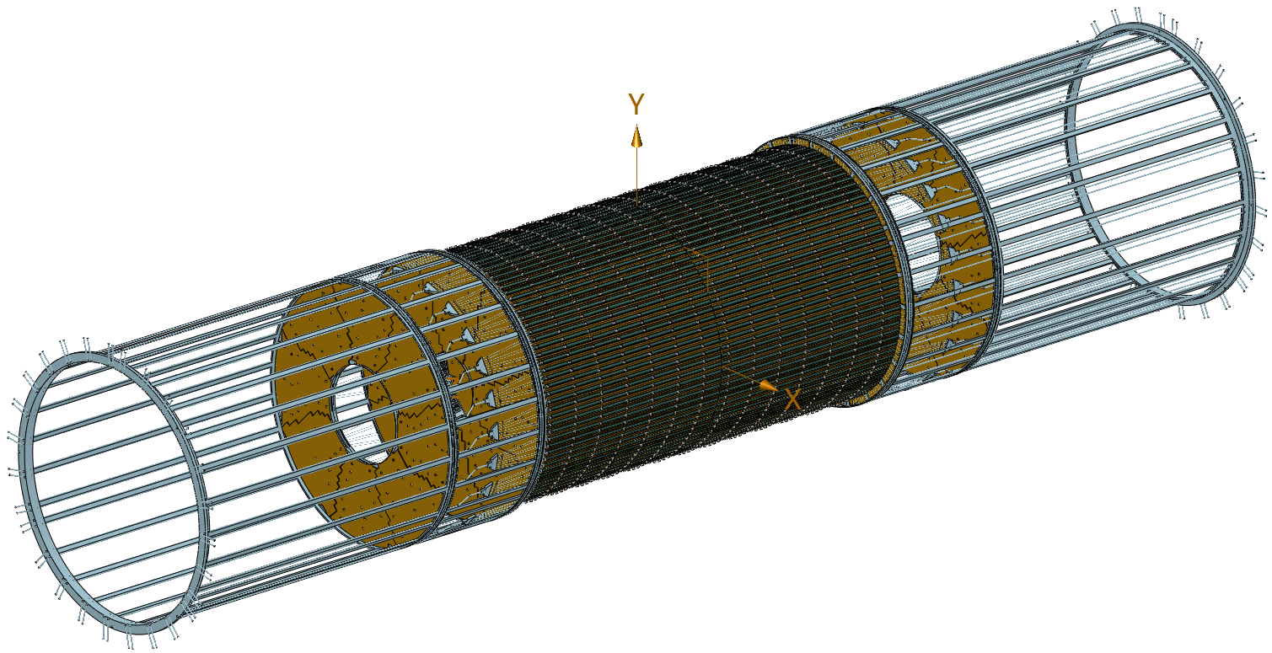
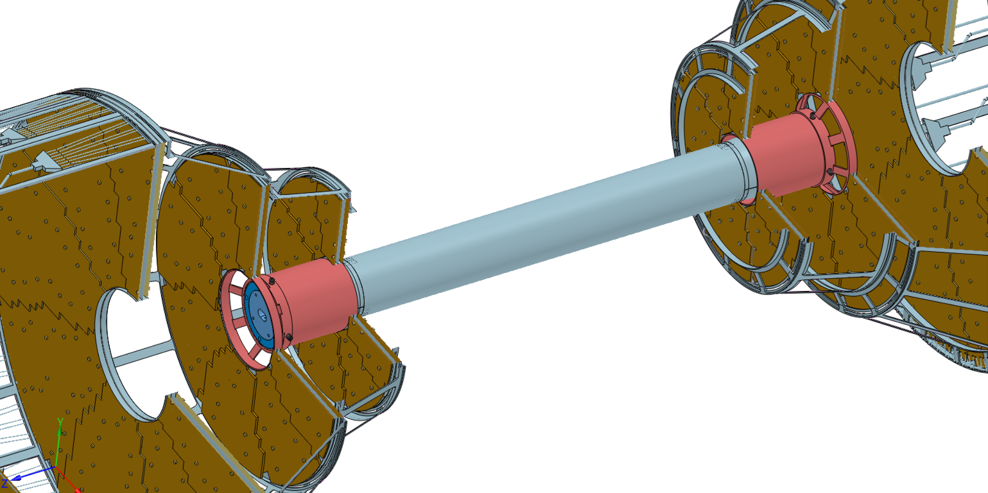
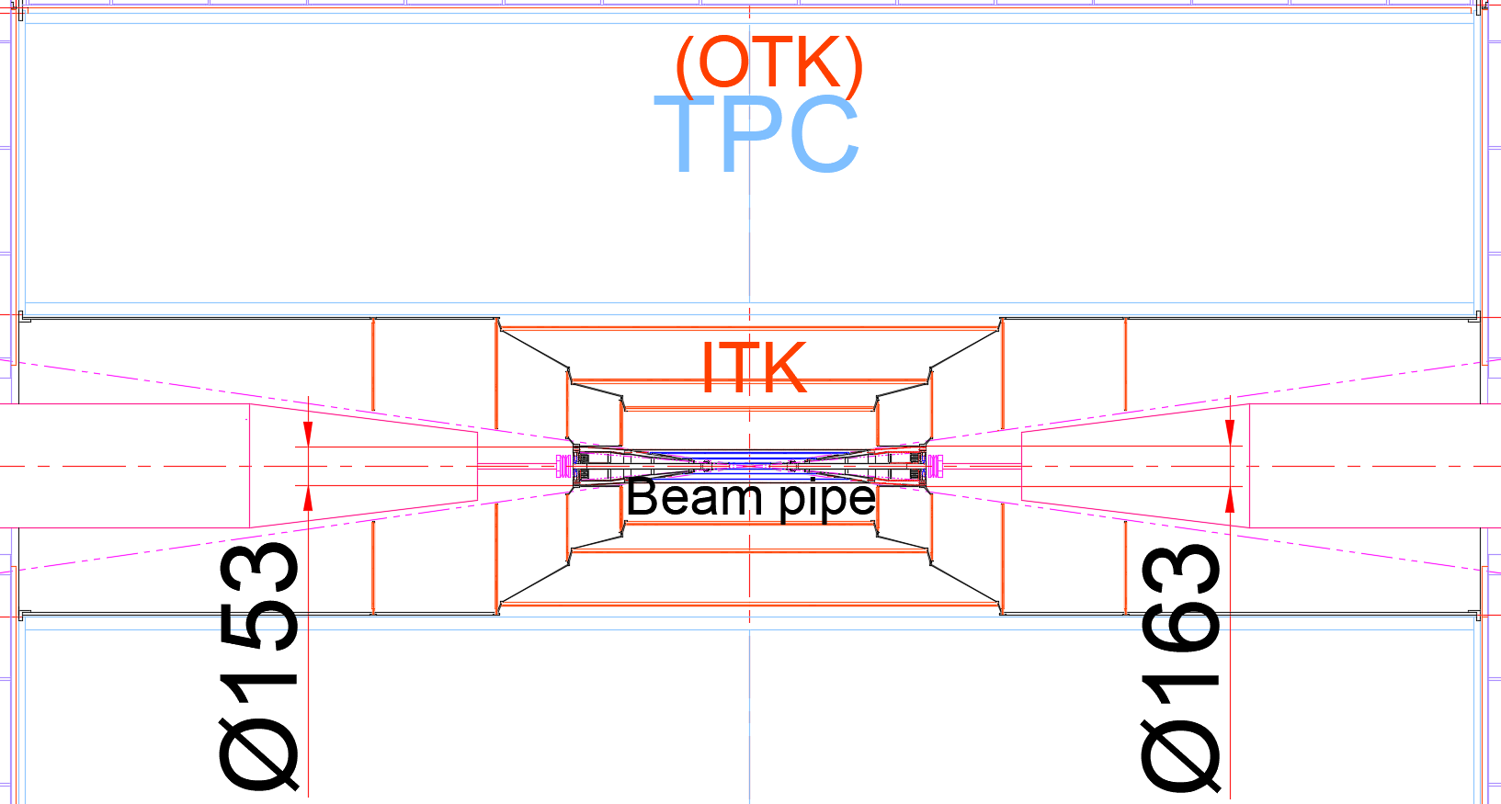
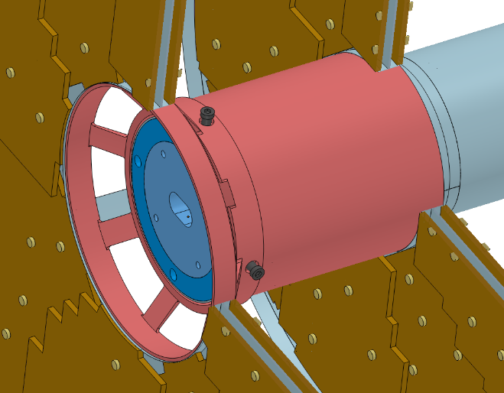
2. Connection of sub detectors --- ITK
Beampipe
Weight :
≈ 80 kg

Slide 15
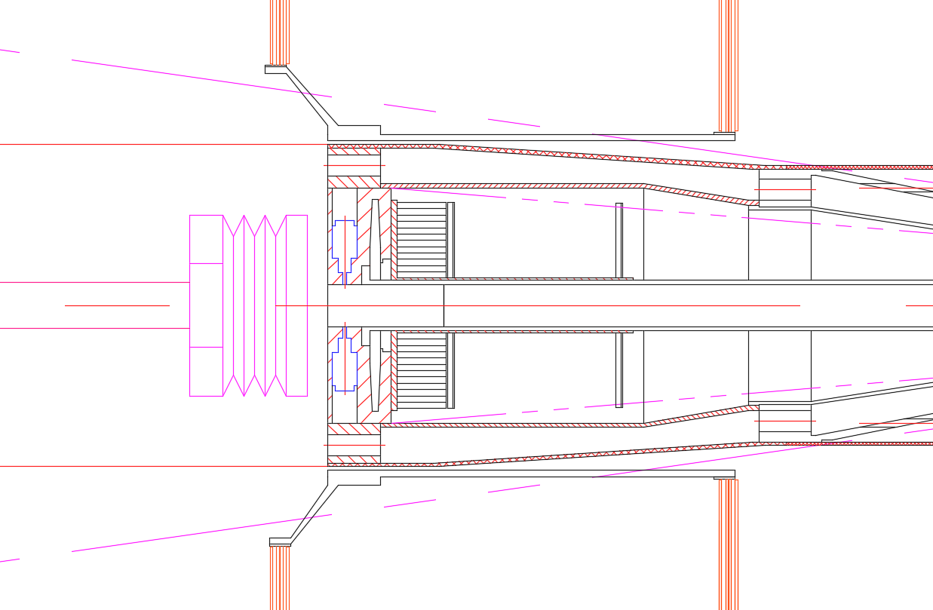
2. Connection of sub detectors --- Beampipe
Weight :
≈ 10 kg
Vertex
LumiCAL
BPM
Pillow Seal

Slide 16
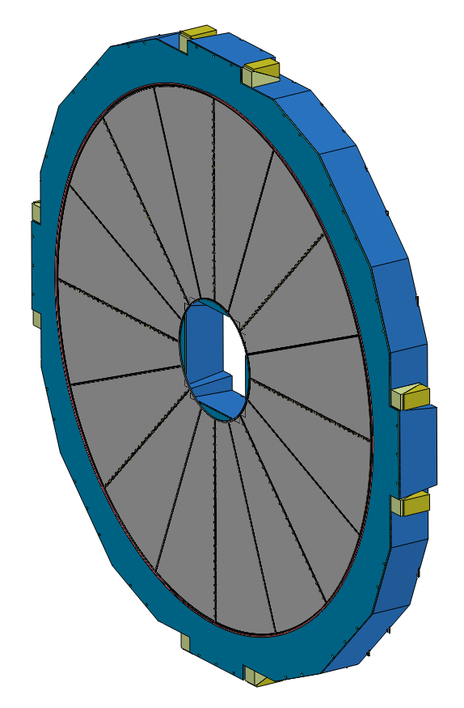
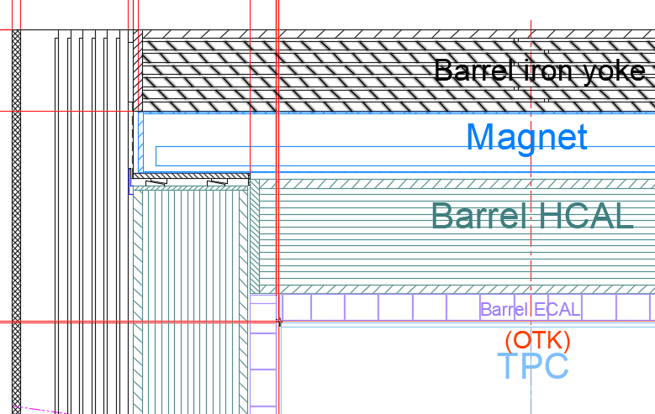
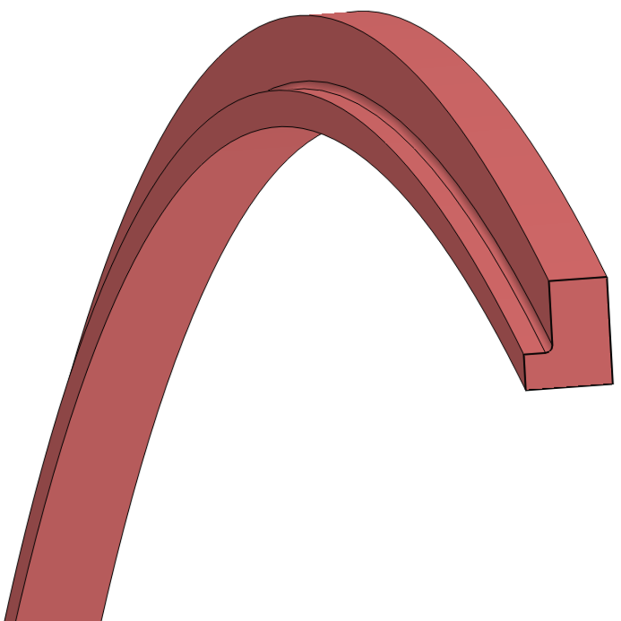
2. Connection of sub detectors --- End ECAL + End OTK
L Connection Ring
End ECAL
Weight :
≈ 25X2 t

Slide 17
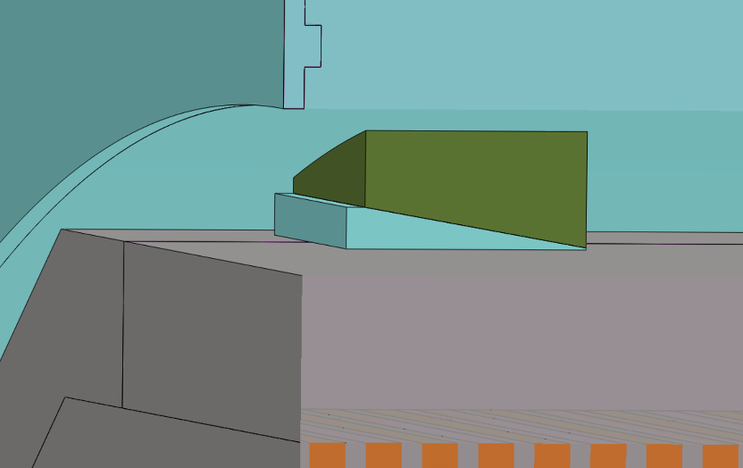
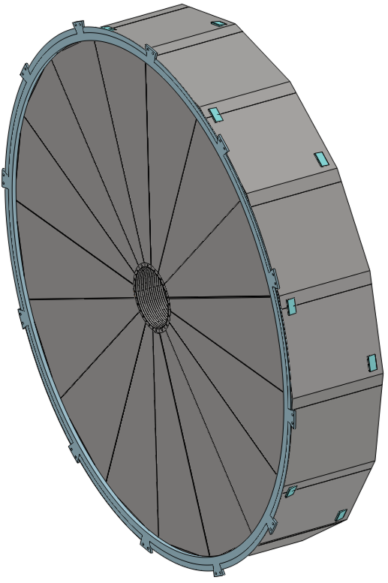
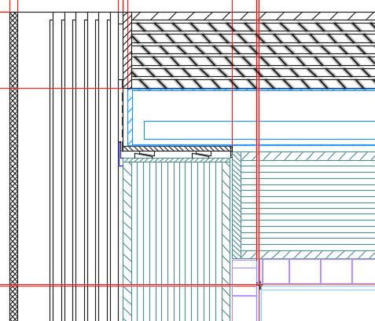
2. Connection of sub detectors --- End HCAL
Eight pairs Adjustable Pad Irons
Weight :
≈ 350X2 t
End HCAL

Slide 18
3. Installation of the Detectors
Step 1 Alternating installation : Yoke and Magnet (3) --- Barrel and End Yoke, Magnet
Step 2 Core shaft installation : Barrel HCAL and Barrel ECAL (2) --- Barrel Detectors
Step 3 Cantilever installation : TPC(OTK) ITK + Beampipe(Vertex + LumiCal) (3) --- Barrel Detectors
End HCAL and End ECAL (2) --- End Detectors
Step 4 Move the detectors from the Pre-assembly point to the Collision point
Push the accelerator vacuum component into the center of the detector and connect it with the Be beampipe

Slide 19
3. Installation of the Detectors
Step 1 Alternating installation : Yoke and Magnet (3) --- Barrel and End Yoke, Magnet

Slide 20
3. Installation of the Detectors
Step 2 Core shaft method installation : HCAL and ECAL (2) --- Barrel Detectors
Continue to optimize :
Merge Animation

Slide 21
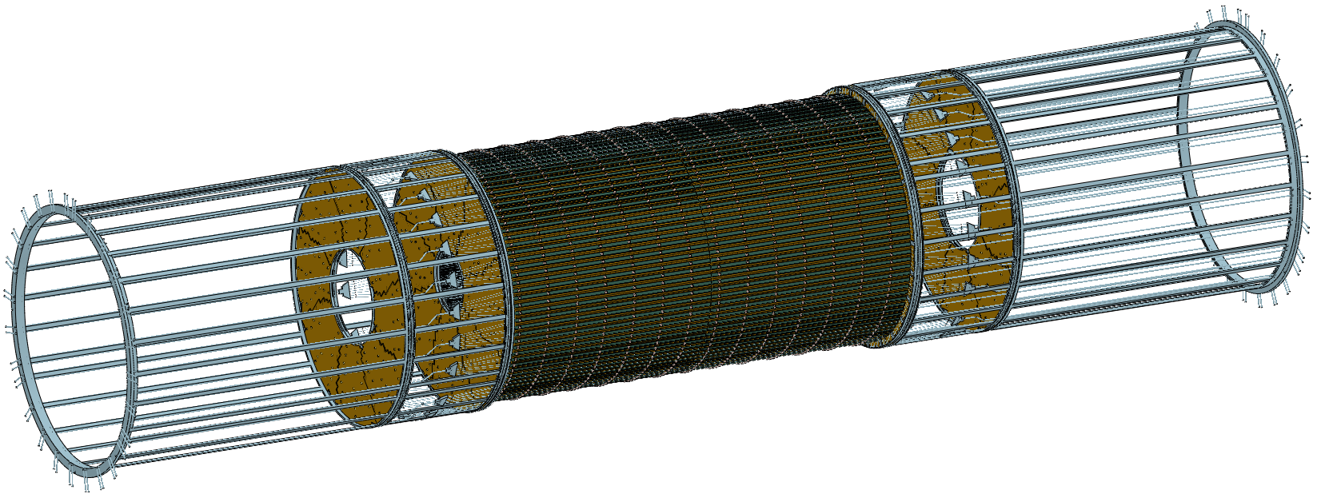
3. Installation of the Detectors
Step 3 Cantilever installation : TPC(OTK) ITK + Beampipe(Vertex + LumiCal) (3) --- Barrel Detectors
End HCAL and End ECAL (2) --- End Detectors
Pre-assembly between of the ITK and Beampipe
TPC
ITK
Beampipe
Installing
End ECAL
End HCAL
Optimize : Display the installation process in animation

Slide 22
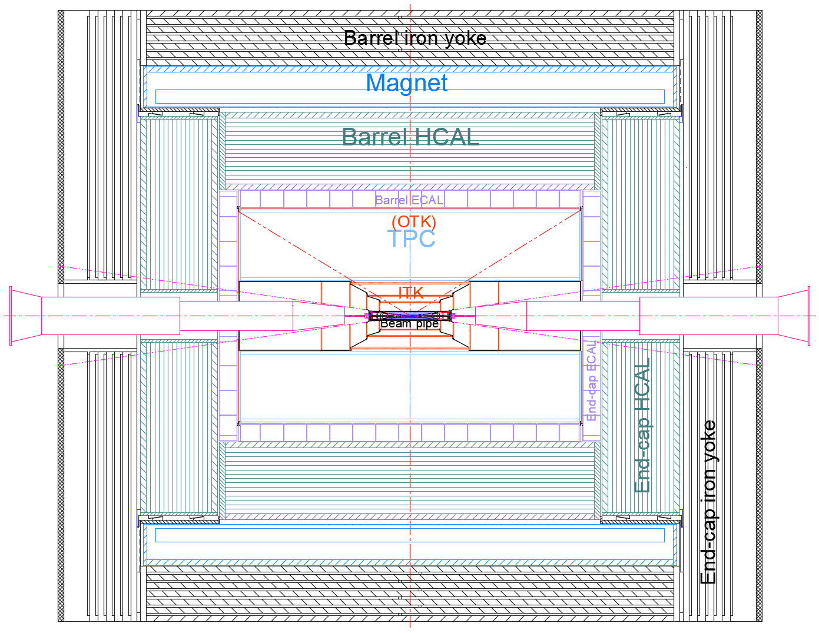
3. Installation of the Detectors
Step 3 Cantilever installation : TPC(OTK) ITK + Beampipe(Vertex + LumiCal) (3) --- Barrel Detectors
End HCAL and End ECAL (2) --- End Detectors
Pipeline path

Slide 23
3. Installation of the Detectors
Step 4 Move the detectors from the Pre-assembly point to the Collision point

Slide 24
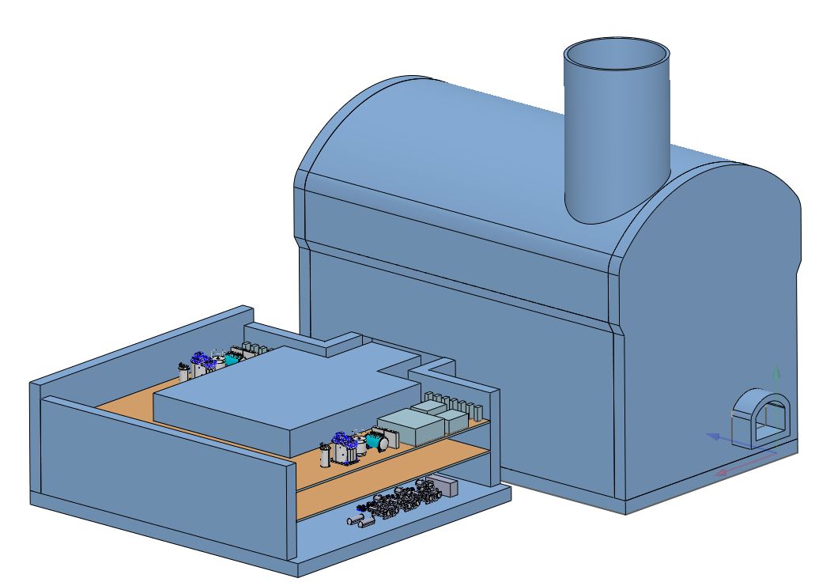
4. Experimental Hall
ambient temperature : 25 ℃
ambient humidity : ＜60%
Overall layout
Auxiliary facilities
Overall layout
1. Water-cooling system
Inlet temperature
ECAL
HCAL
TPC
Beampipe
15℃
ITK
OTK
5℃
2. Air-cooling system
Vertex
5℃
3. Gas System
4. Cryogenic system
5. Electronics Cabinet
Power Cabinet
TPC (Ground)
Magnet(Det. and ACC.)

Slide 25
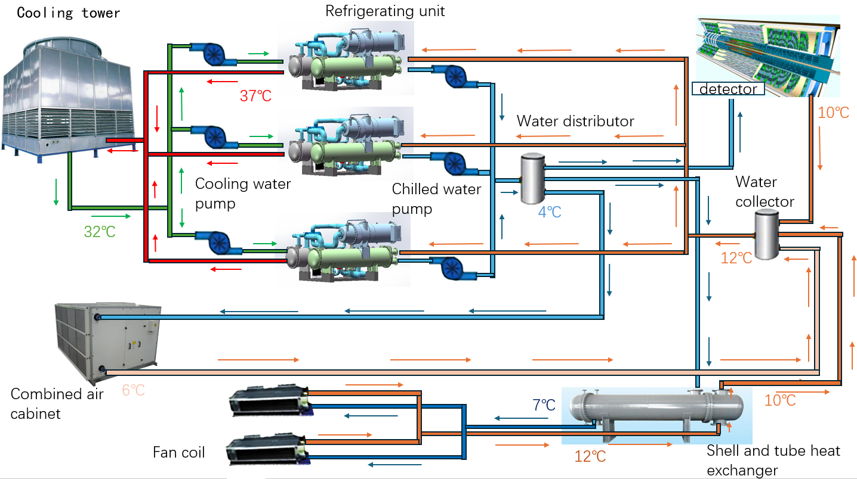
4. Experimental Hall --- Water cooling and Air cooling system
Hall
Design Features :
1. Two for use and one for backup
2. Energy conservation
3. integrated design

Slide 26
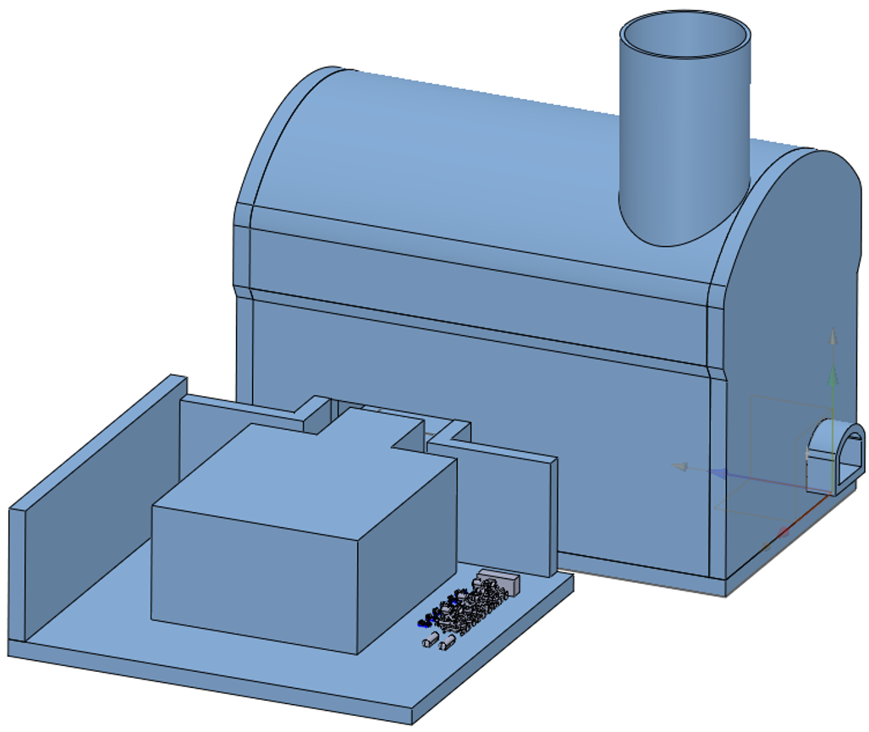
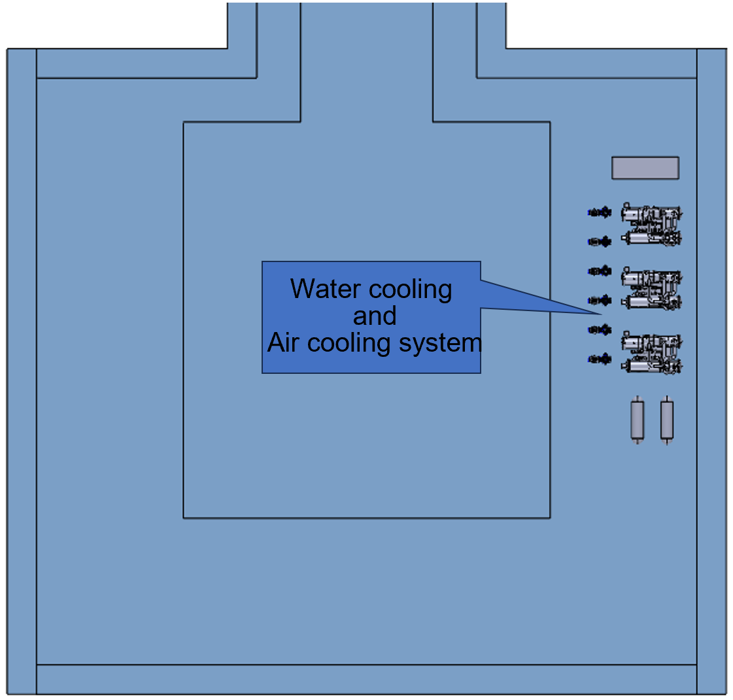
4. Experimental Hall --- Water cooling and Air cooling system
郑州轻工业大学 吴学红(热能与动力学院 院长)
严琪, 李刚, 祁辉荣, ……

Slide 27
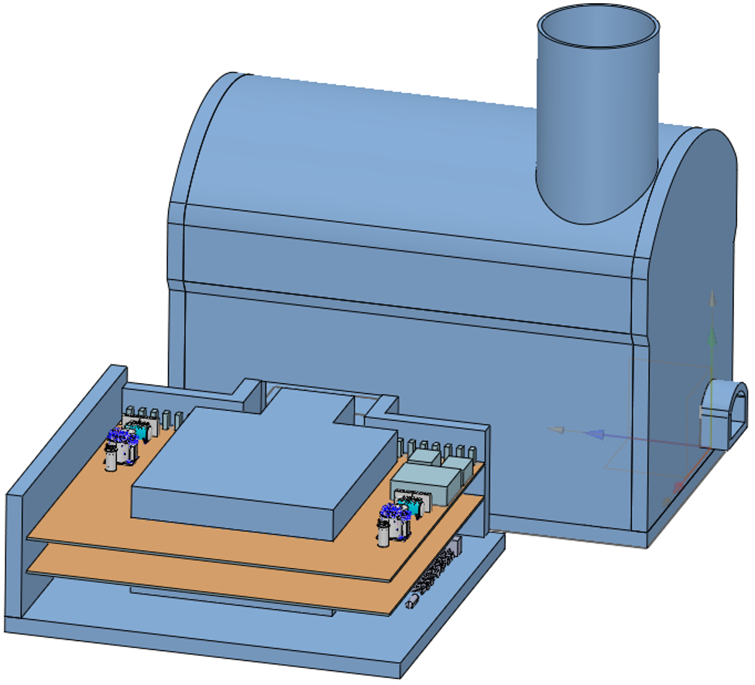
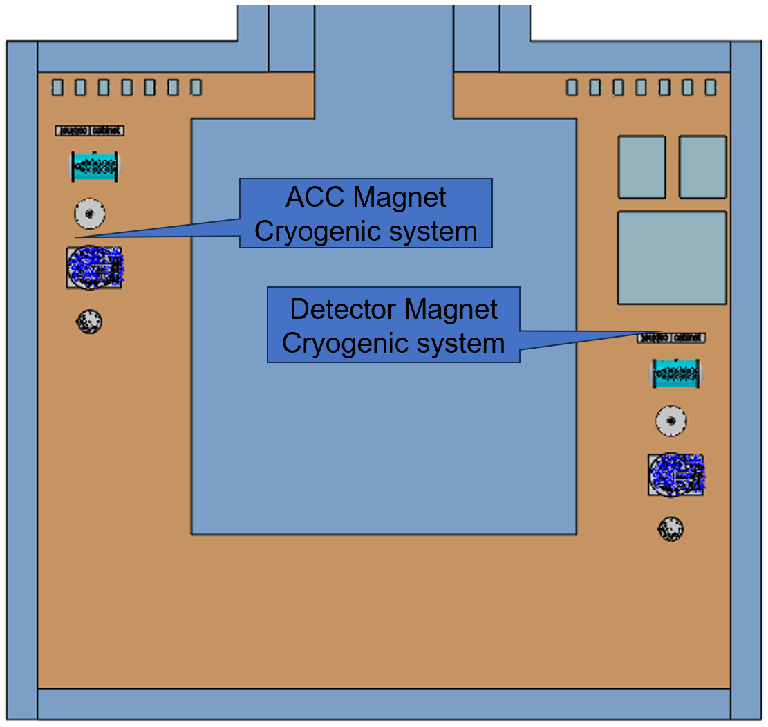
4. Experimental Hall --- Cryogenic system
宁飞鹏, 朱应顺, 杨啸辰, 张祥镇, 陈兵, 王海静, 石澔玙, ……
Total power : Collecting and confirming

Slide 28
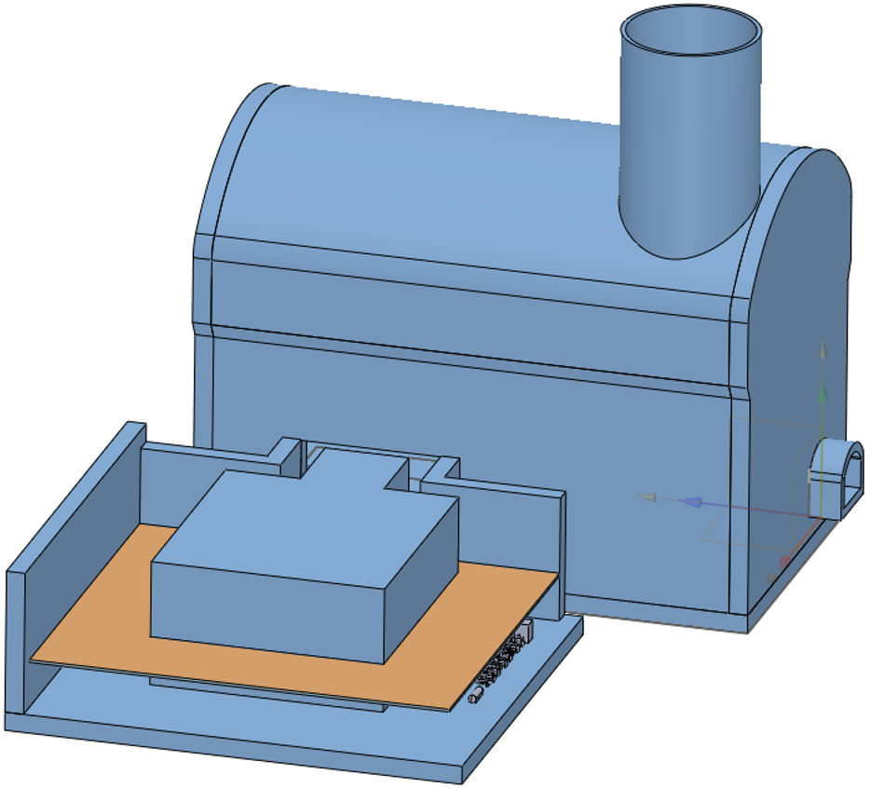
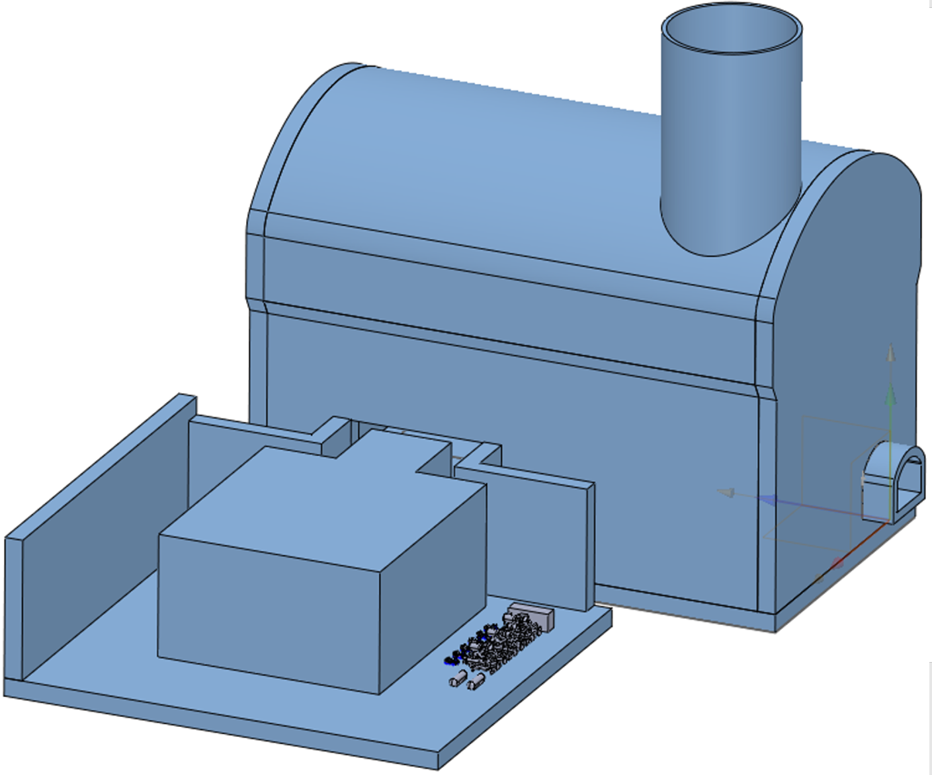
4. Experimental Hall --- Electronics Cabinet and Power Cabinet
Minimum crates from current MDI
110 data crates, 237 power crates, 91 Det-HV crates, 20 Trigger crates
Minimum racks from current MDI
37 data racks, 24 power racks, 23 Det-HV racks, 10 trigger racks (94 in total)
More 2 racks for AC-DC power for all the above racks
96 racks in total
王铮, 魏微, 黄金书, ……

Slide 29
5. Summary
The design content of the Ref TDR report is basically completed
Suggestion :
Mechanical design must undergo in-depth research and provide feasible solutions
If there are modification requirements, I hope all sub detectors can be modified together

Slide 30
Thank you for your attention!

