Slide 1
Update

Slide 2
Summarization of data
Mode | Shield | Ave.True(MHz/cm2) | Max.True(MHz/cm2) | Ave.Cluster(MHz/cm2) | Max.Cluster(MHz/cm2)
Higgs | No | 1.05 | 1.22 | 5.76 | 6.96
Higgs | More | 1.08 | 1.52 | 6.14 | 9.09
LowZ | No | 12.51 | 18.96 | 92.97 | 141.52
LowZ | More | 12.47 | 18.40 | 90.71 | 137.10
HighZ | No | 43.51 | 60.88 | 291.54 | 430.23
HighZ | More | 50.86 | 75.47 | 370.06 | 562.63
Higgs | More | 1.03 | 1.19 | 5.84 | 7.07
LowZ | More | 25.82 | 34.44 | 196.53 | 267.83
HighZ | More | 101.20 | 136.31 | 767.82 | 1037.33
All the data is from first layer

Slide 3
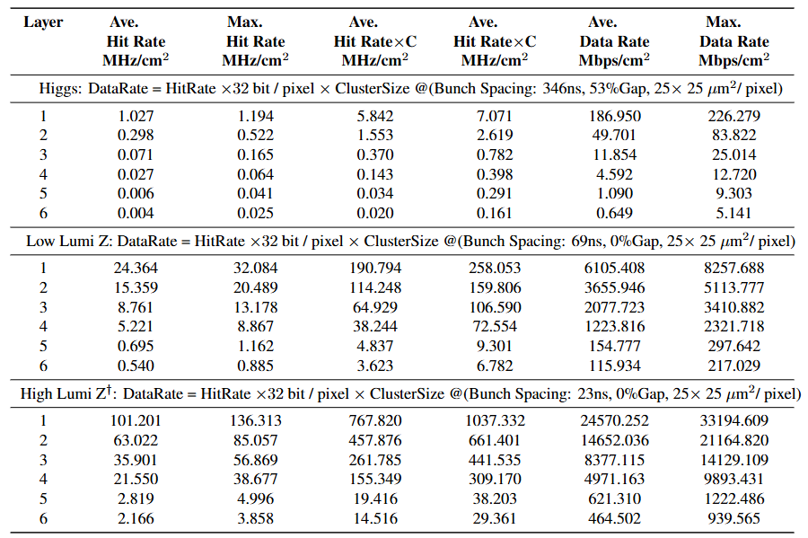
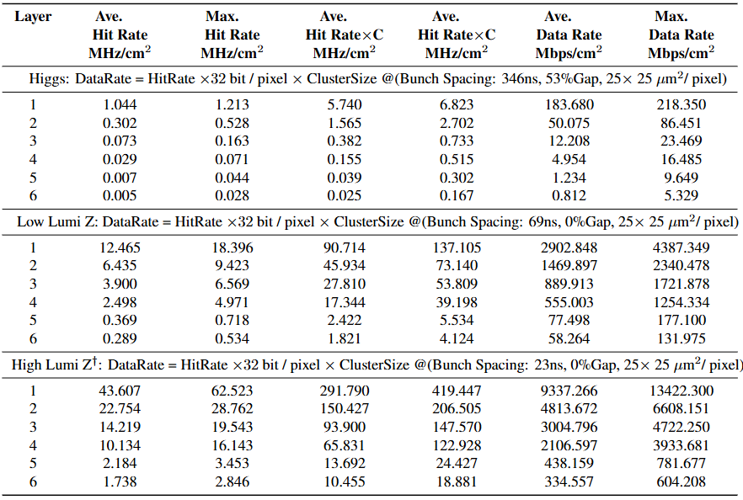
Summarization of data

