Slide 1
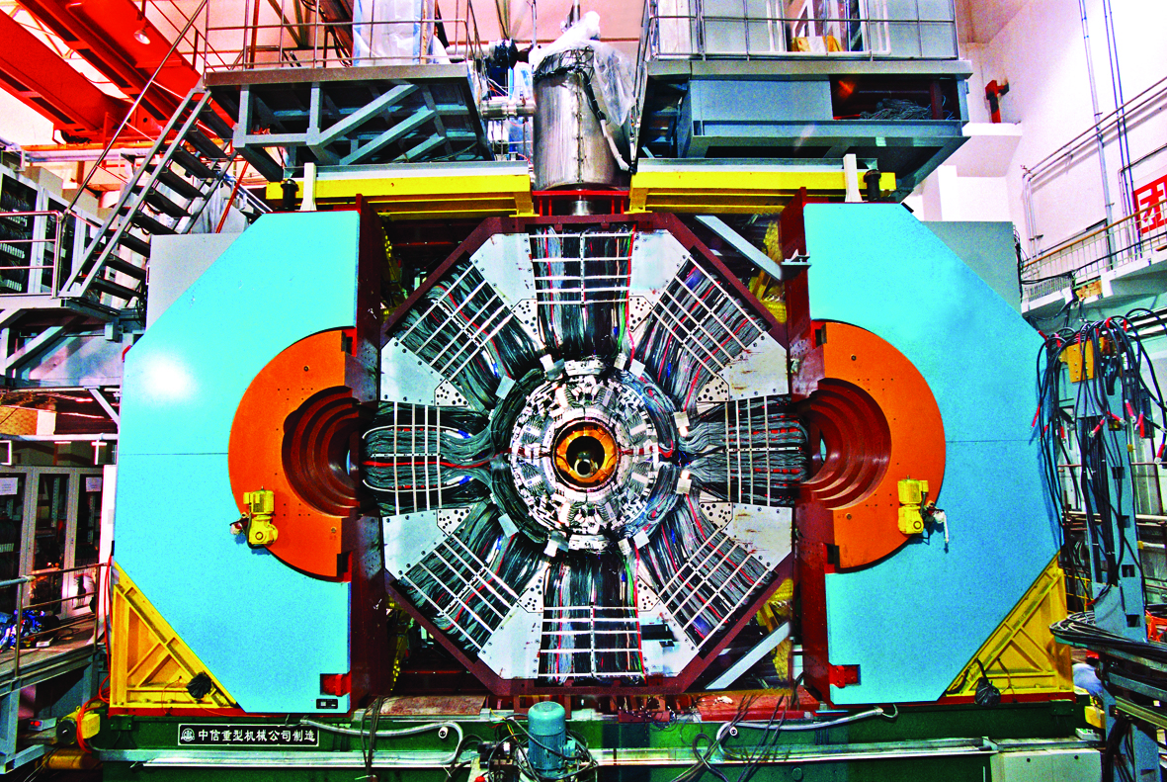
BESIII highlights and prospects
Hai-Bo Li
(on behalf of the BESIII Collaboration)
Institute of High Energy Physics, CAS, Beijing
第五届LHCb前沿物理研讨会，
华中师范大学，2025年4月26日

Slide 2
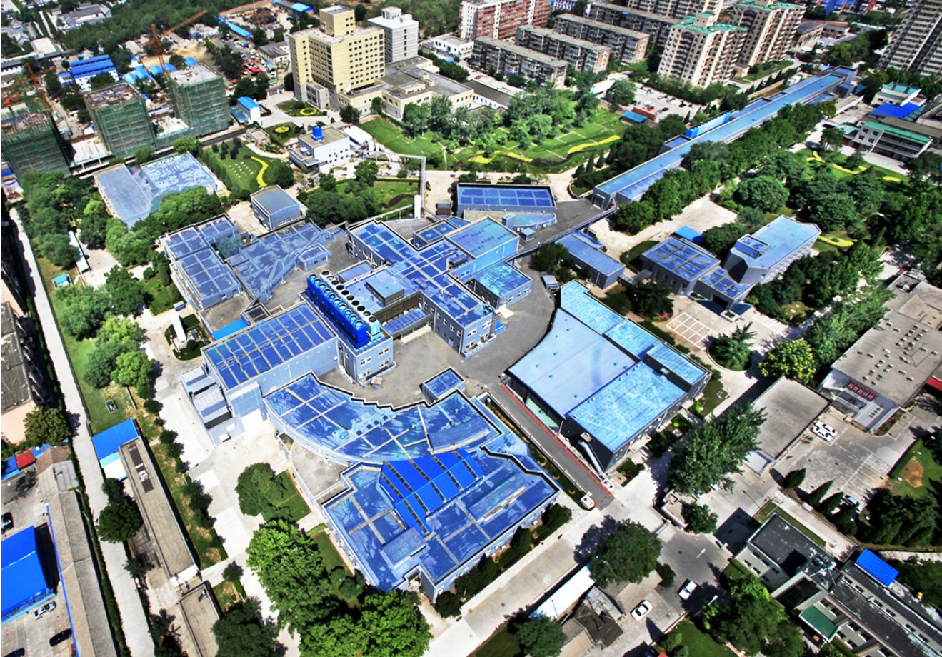
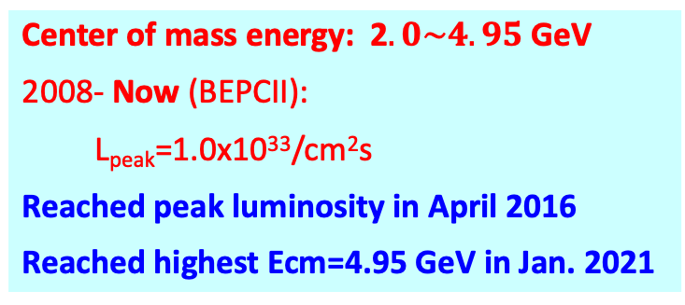
Beijing Electron-Positron Collider II (BEPCII)
Center of mass energy: 2$.0\sim 4.95$ GeV
2008- Now (BEPCII):
L_{peak}=1.0x10³³/cm²s
Reached peak luminosity in April 2016
Reached highest Ecm=4.95 GeV in Jan. 2021
Linear part
BEPCII
(Circular part)
BESIII detector
Notes:
Circumference : 240 meters, Linac part: 200 meters

Slide 3
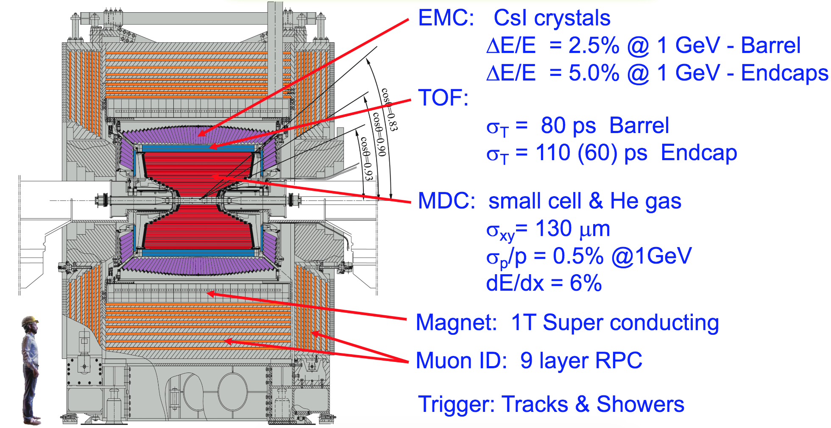
BESIII detector
The detector is designed for neutral and charged particle with excellent resolution, PID, and large coverage.
Total weight 730 ton, ~40,000 readout channels, Data rate: 5kHz, 50Mb/s
Has been in full operation since 2008, all subdetectors are in very good status!

Slide 4
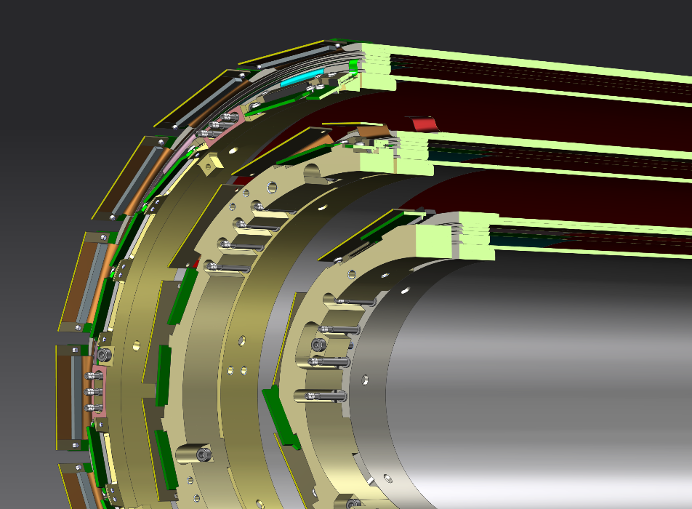
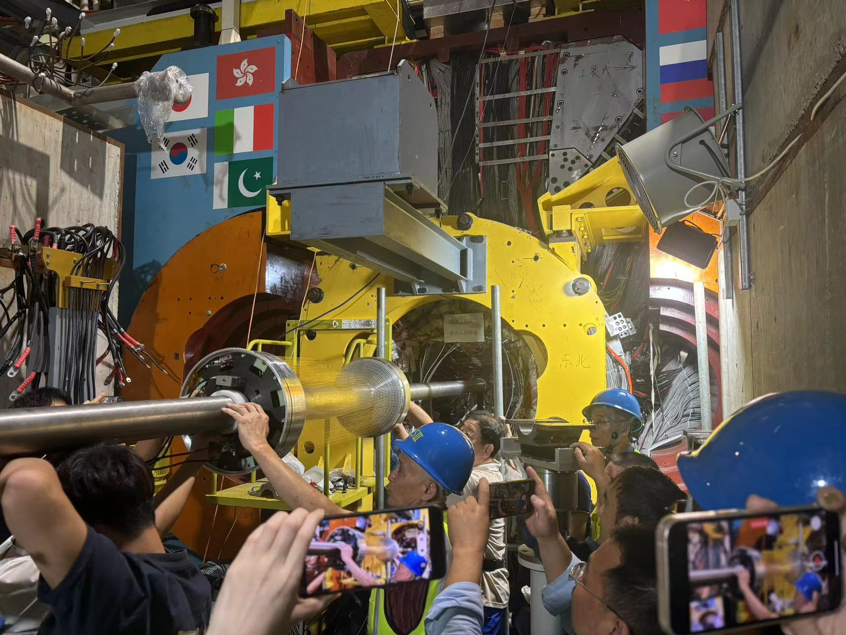
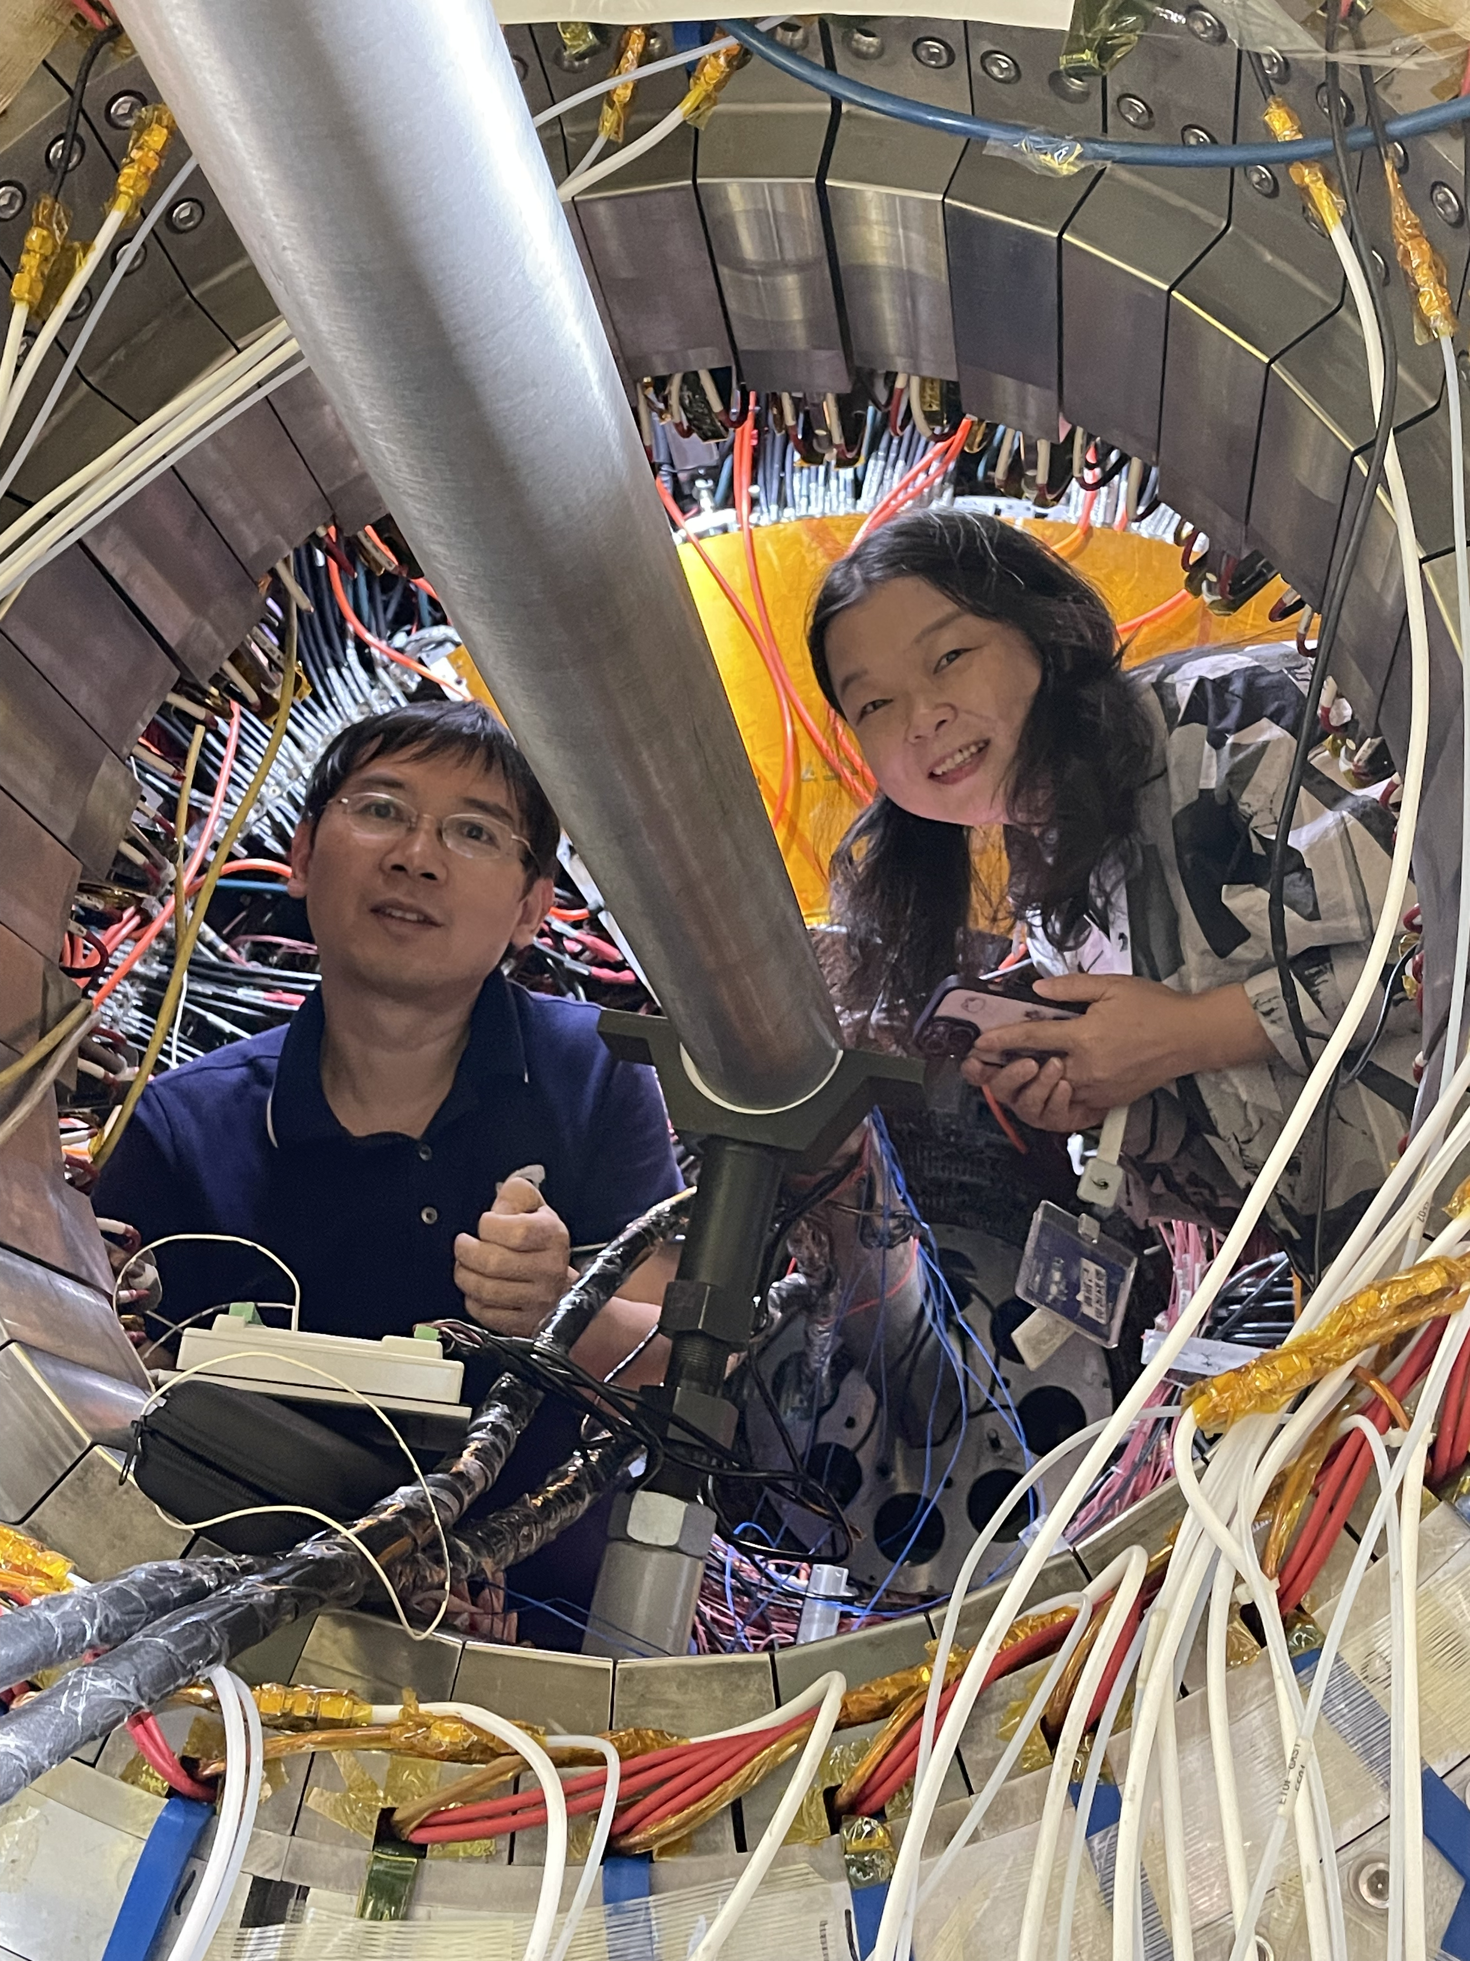
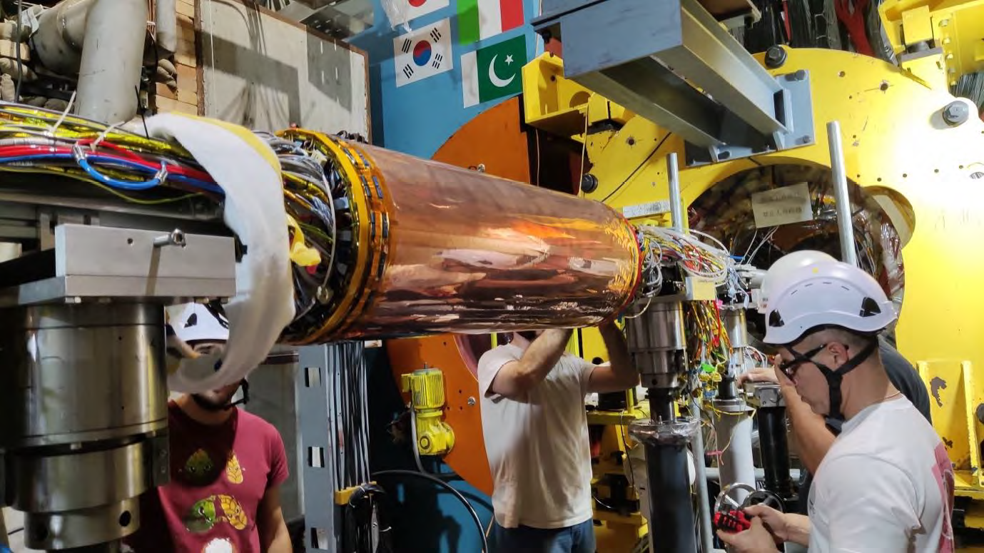
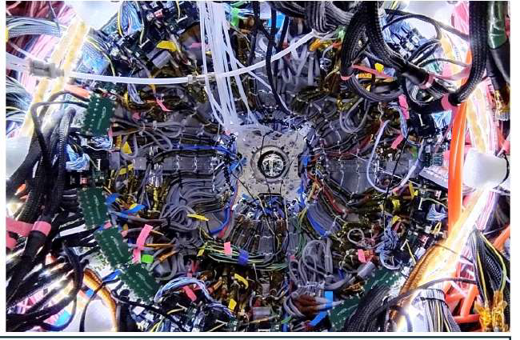
Cylindrical Gas Electron Multiplier Inner Tracker (CGEM-IT)
Three layers of cylindrical triple GEM to replace the inner MDC
Improve spatial resolution along the beam axis (< 300 μm), rate capability, and radiation hardness
Status and timeline
Software review on Dec. 1st, 2023
Performance review on Feb. 20th 2024
Overall assessments of Installation (March, 2024)
Installation in October 2024 during the BEPCII-upgrade
Extraction of inner draft chamber on Sep. 14th
Ready for installation on Oct. 2nd
Completed on Oct 18th!
Notes:
In sync with the upgrade of BEPCII(from July-December 2024), an innovative Cylindrical Gas Electron Multiplier Inner
Tracker (CGEM-IT) is under construction to replace the inner tracker, which is suffering from aging problems. CGEM-IT
was designed to restore efficiency and enhance the reconstruction of the secondary vertex. The project costs ~1.5 million Euros
and is strongly supported by the Joint Laboratory IHEP-INFN and the Institutes from Indiana, Mainz and Uppsala Universities.

Slide 5

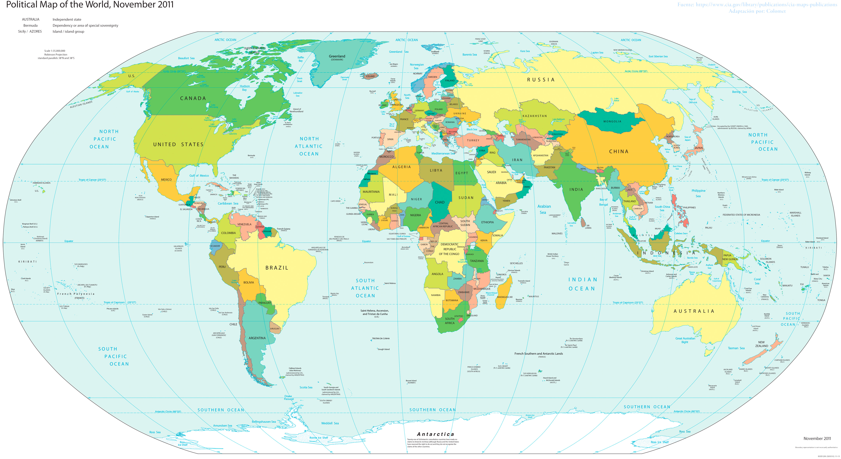

BESIII Collaboration
Europe (17/115)
Germany (6): Bochum University,
GSI Darmstadt, Helmholtz Institute Mainz, Johannes Gutenberg University of Mainz, Universitaet Giessen,University of Münster
Italy (3): Ferrara University, INFN, University of Torino
Netherlands (1):KVI/University of Groningen
Russia (2): Budker Institute of Nuclear Physics, Dubna JINR
Sweden (1):Uppsala University
Turkey (1):Turkish Accelerator Center Particle Factory Group
UK (2): University of Manchester, University of Oxford
Poland (1)National Centre for Nuclear Research
Asia (6/10)
Pakistan (2): COMSATS Institute of Information Technology
University of the Punjab, University of Lahore
Mongolia (1): Institute of Physics and Technology
Korea (1): Chung-Ang University
India (1): Indian Institute of Technology madras
Thailand (1): Suranaree University of Technology
USA(4/8)
Carnegie Mellon University
Indiana University
University of Hawaii
University of Minnesota
China (58/367)
Institute of High Energy Physics (146), other units(221): Beijing Institute of Petro-chemical Technology, Beihang University,
China Center of Advanced Science and Technology, Fudan University,
Guangxi Normal University, Guangxi University,
Hangzhou Normal University, Henan Normal University,
Henan University of Science and Technology,
Huazhong Normal University, Huangshan College, Hunan University,
Hunan Normal University, Henan University of Technology
Institute of modern physics, Jilin University, Lanzhou University, Liaoning Normal University, Liaoning University, Nanjing Normal University, Nanjing University, Nankai University, North China Electric Power University,
Peking University, Qufu normal university, Shanxi University,
Shanxi Normal University, Sichuan University, Shandong Normal University,
Shandong University, Shanghai Jiaotong Univeristy, Soochow University,
South China Normal University, Southeast University, Sun Yat-sen University,
Tsinghua University, University of Chinese Academy of Sciences, University of Jinan, University of Science and Technology of China,
University of Science and Technology Liaoning,
University of South China, Wuhan University, Xinyang Normal University,
Zhejiang University, Zhengzhou University,YunNan University , China University of Geosciences
South America (1/1)
Chile: University of Tarapaca
~700 members
From 86 institutions in 16 countries

Slide 6

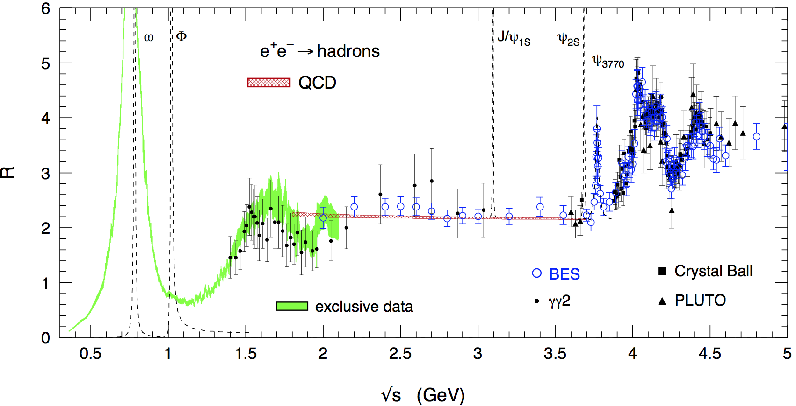
Rich Physics at τ-charm Energy Region
Other talks will cover these physics
Hadron form factors
R values and QCD
Light hadron spectroscopy
Gluonic and exotic states
Physics with τ lepton
XYZ particles
Charm mesons
Charm baryons

Slide 7
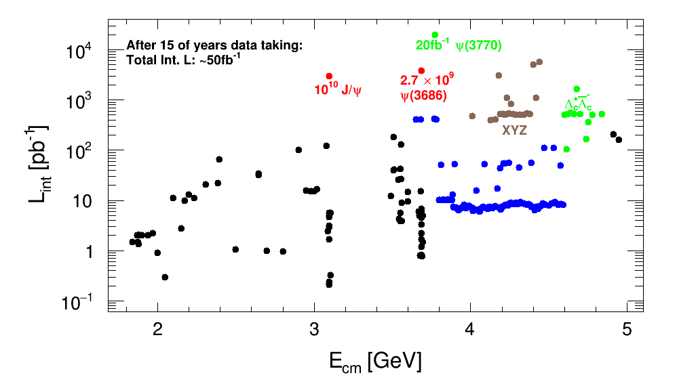
BESIII data samples: integrated luminosity

Slide 8
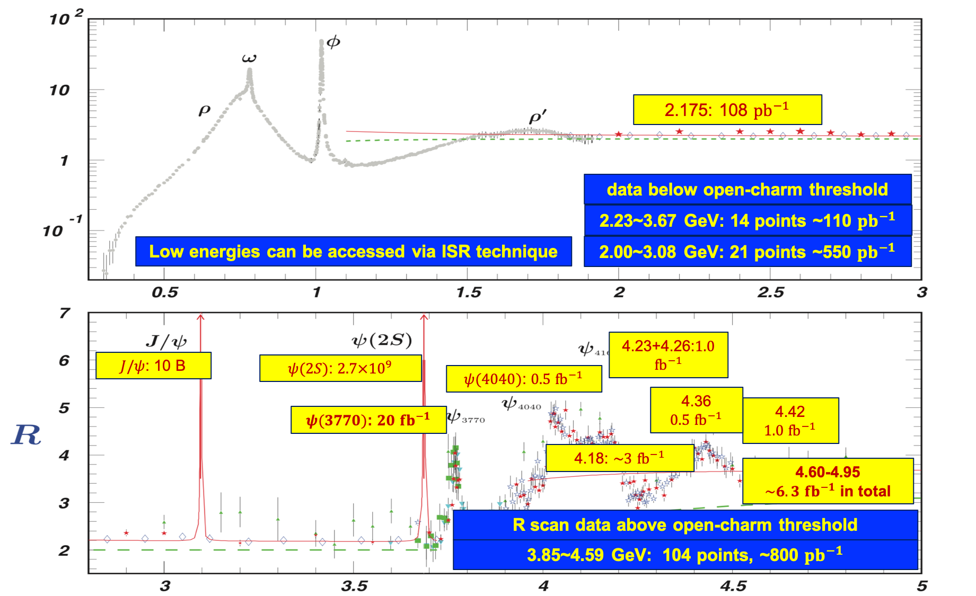
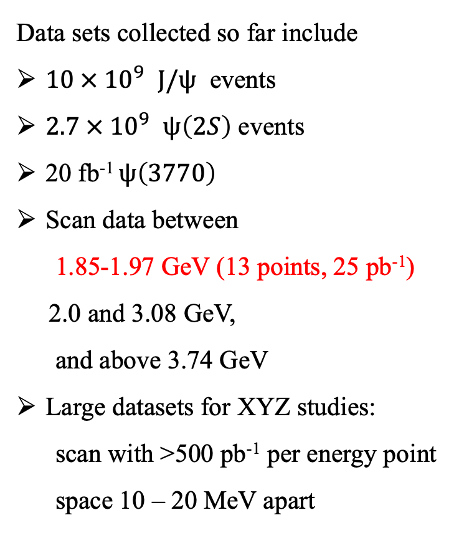
BESIII data samples: rich physics
Data sets collected so far include
$10 × {10}^{9}$ $J/ψ$ events
$2.7 × {10}^{9}$ $ψ\left(2S\right)$ events
20 fb⁻¹ $ψ\left(3770\right)$
Scan data between
1.85-1.97 GeV (13 points, 25 pb⁻¹)
2.0 and 3.08 GeV,
and above 3.74 GeV
Large datasets for XYZ studies:
scan with >500 pb⁻¹ per energy point
space 10 – 20 MeV apart
Totally about 50 fb⁻¹ integrated luminosity from 1.84-4.95 GeV
Entangled hadron pair-productions
near thresholds: form-factors,
relative phase, polarization and CP violation.
Hadron structure & dynamics in the non-perturbative QCD regime
About 20 fb⁻¹ on the $ψ\left(3770\right)$ had been collected

Slide 9
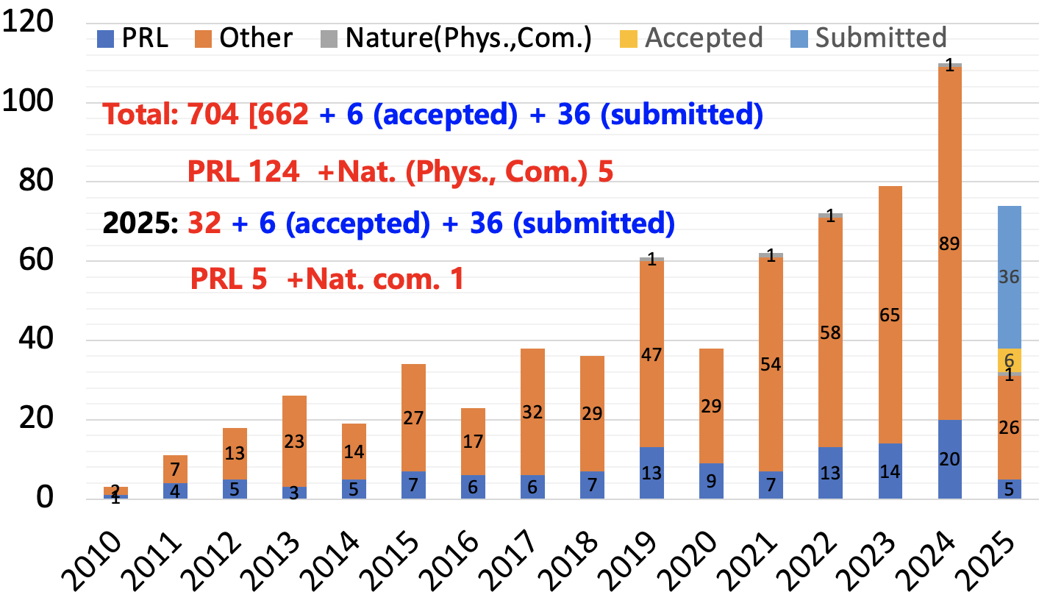
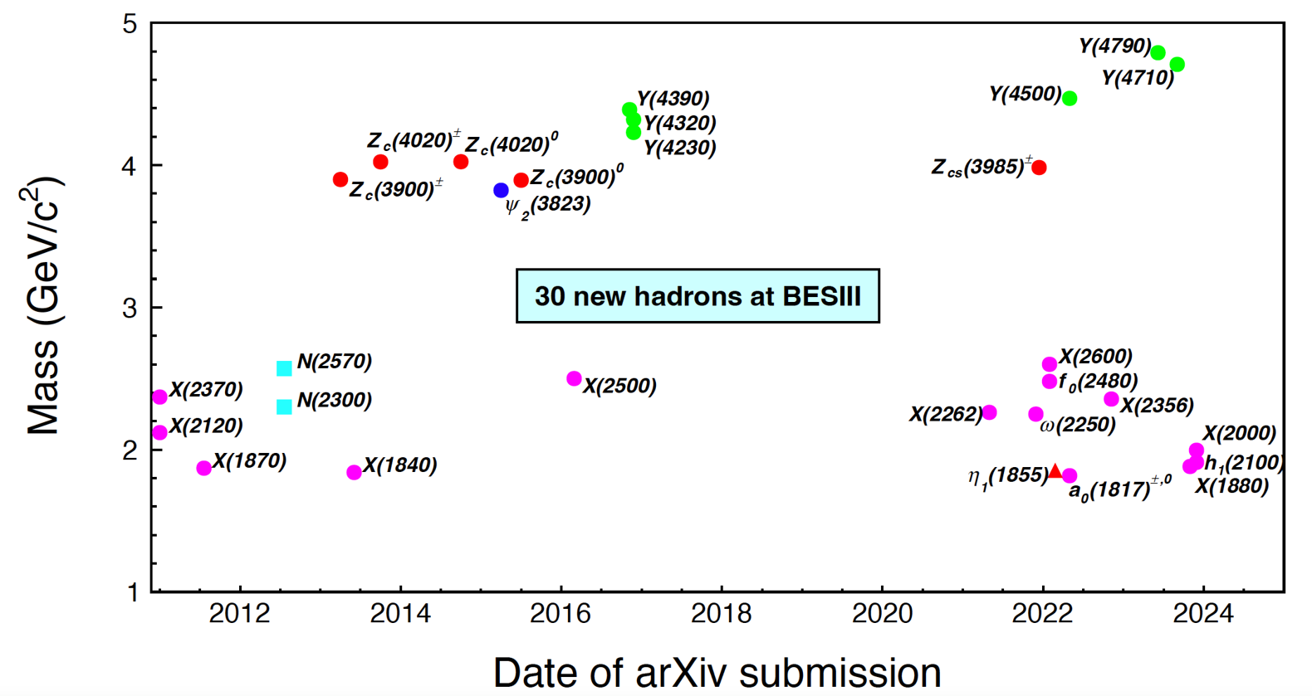
BESIII publications and achievements
110 papers published by BESIII in 2024
74 papers submitted by BESIII as of April 14, 2025
BESIII累计投稿680余篇论文，130篇PRL。
2024年发表110余篇，25余篇PRL。

Slide 10
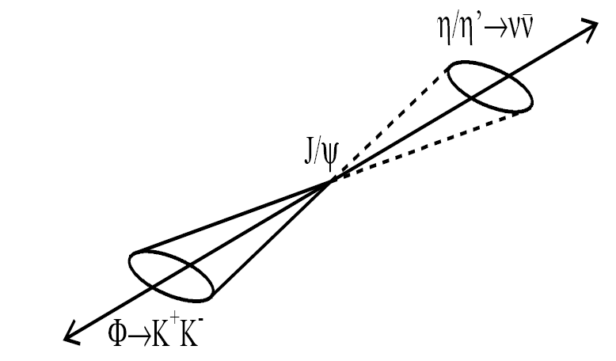
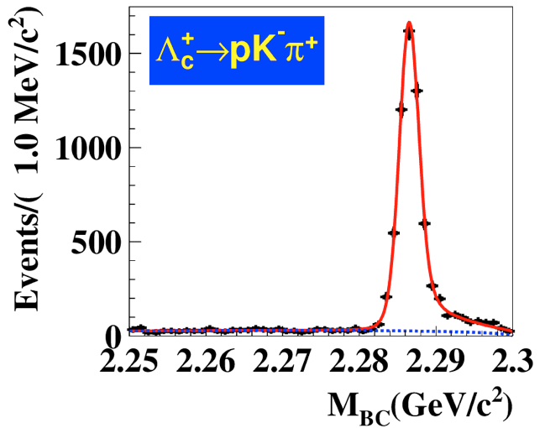
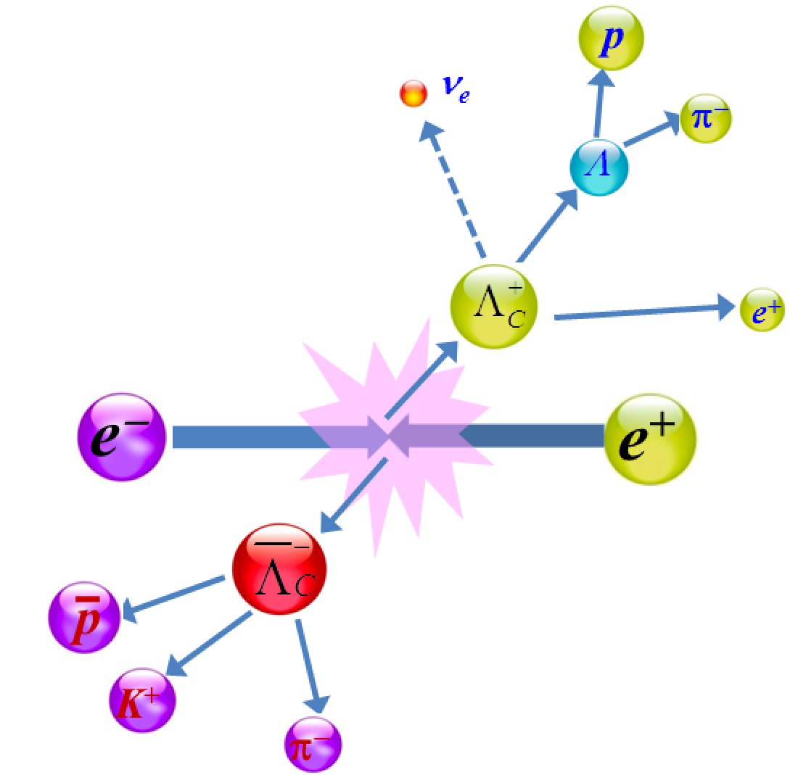
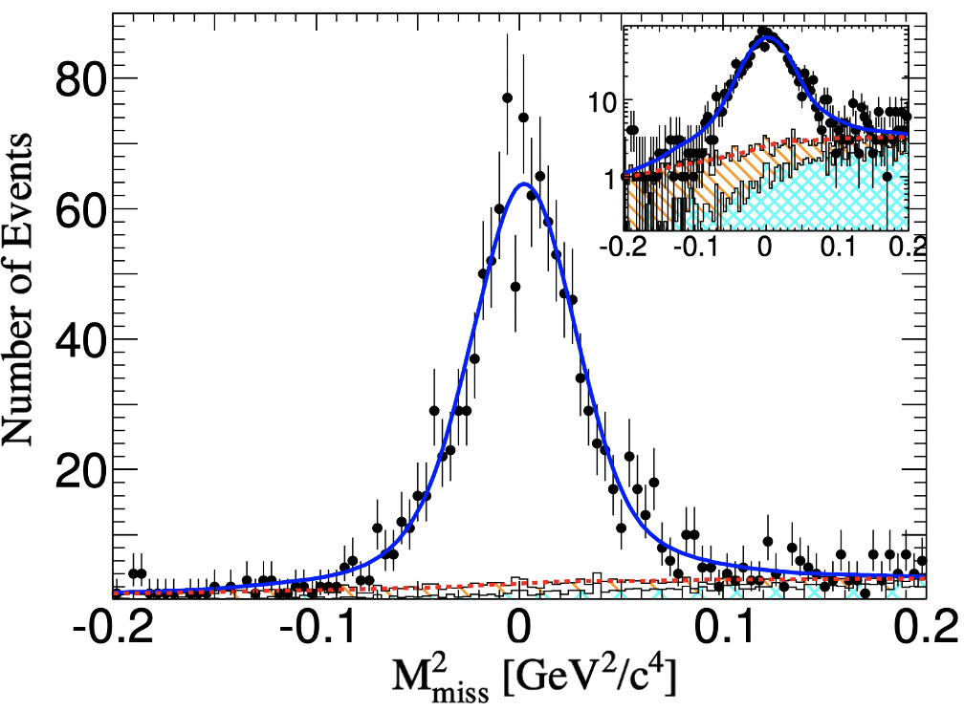
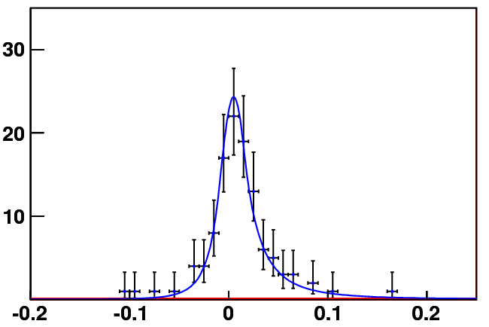
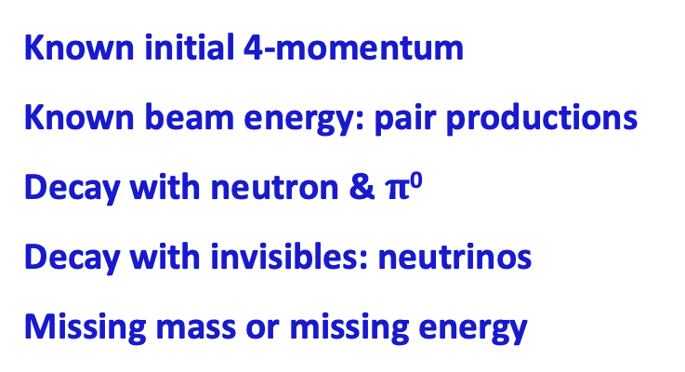

BESIII advantage: unique data near to the thresholds
Known initial 4-momentum
Known beam energy: pair productions
Decay with neutron & $π$⁰
Decay with invisibles: neutrinos
Missing mass or missing energy
Double tag
Excellent resolution
Beam-constraint Λ_{c} mass
e+
e-
Single tag
$$Σ^{+}→pπ^{0}$$
Missing mass
Neutrino reconstruction
Events /0.010 (GeV)
U_{miss} (GeV)

Slide 11
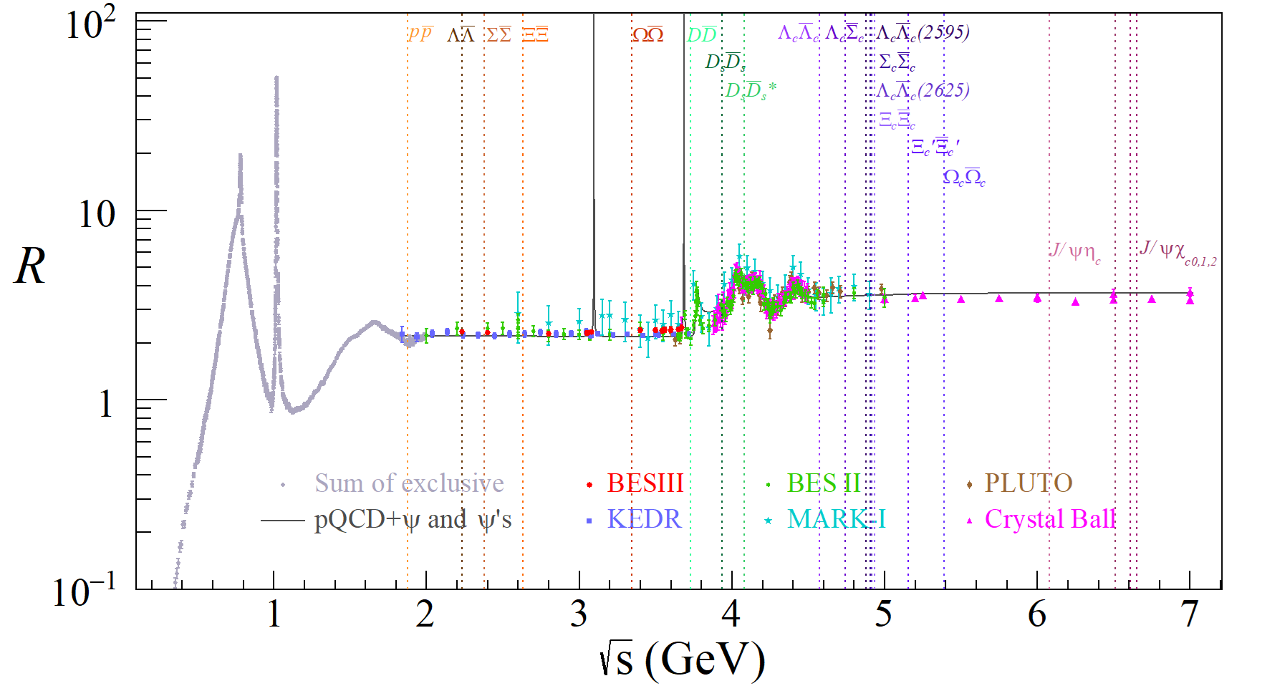
Advantage: data near to the thresholds
Meson and Baryon pairs productions near
thresholds: form-factors, relative phase;
Hyperon and charmed baryon entangled
Spin polarization;
CP violation with quantum-entangled
hadron pairs.

Slide 12
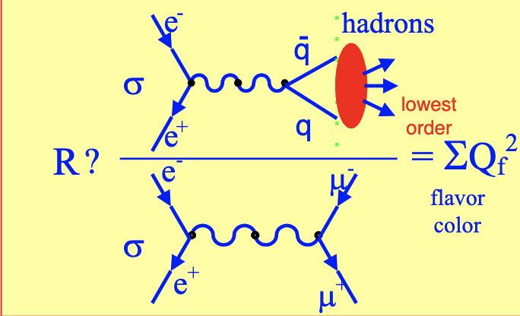
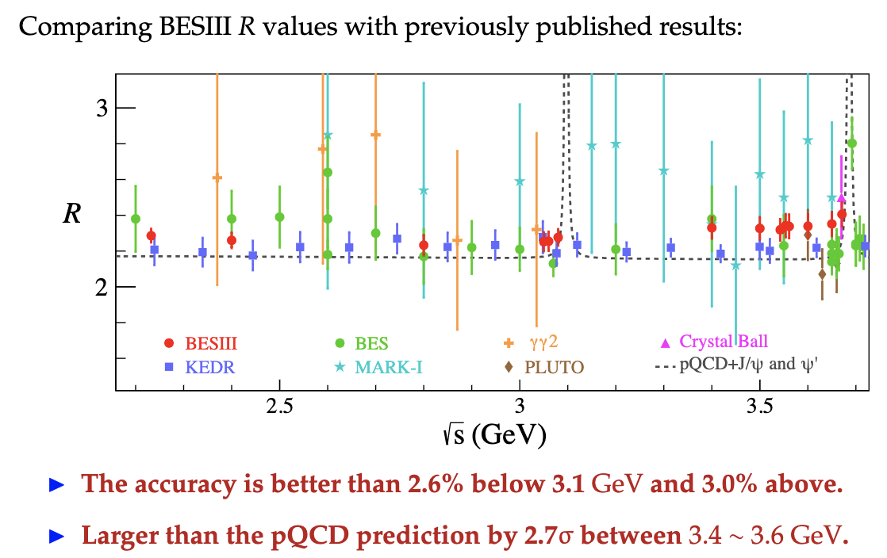
Updated R values at BESIII
14 fine-scan data points from 2.23-3.67 GeV
Important inputs for SM-prediction of g-2
BESIII PRL128, 062004 (2022)

Slide 13
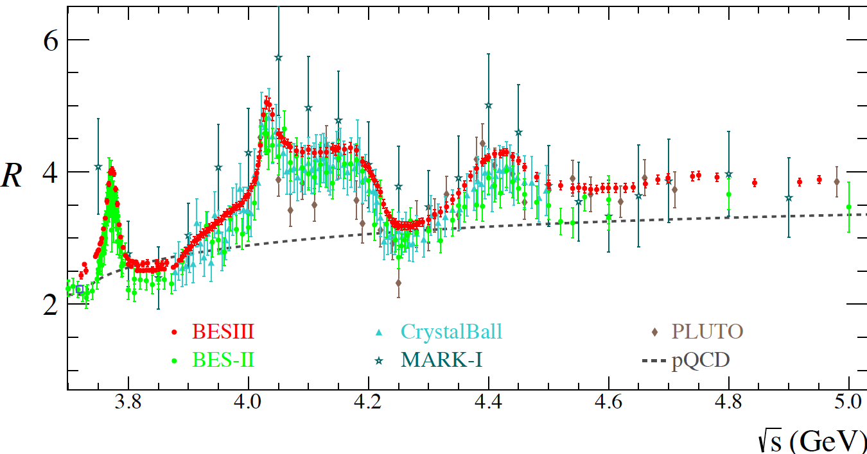
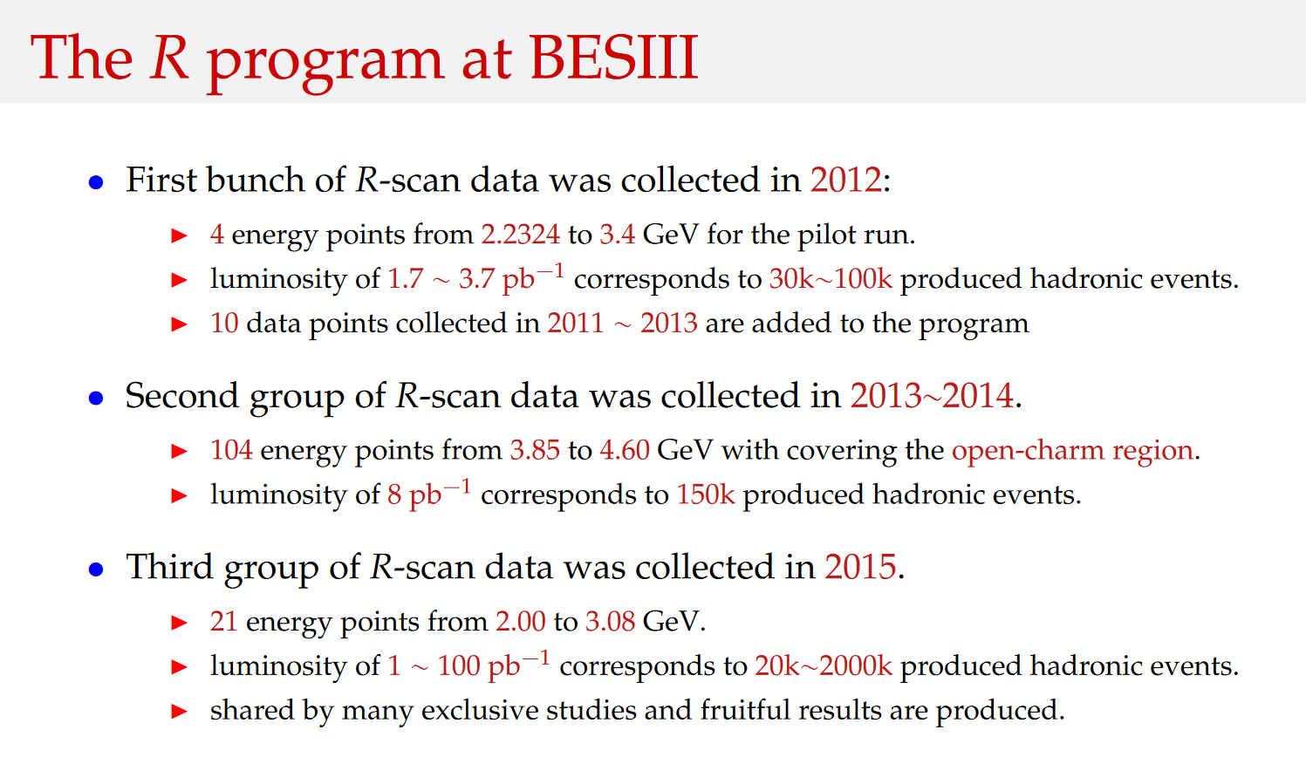
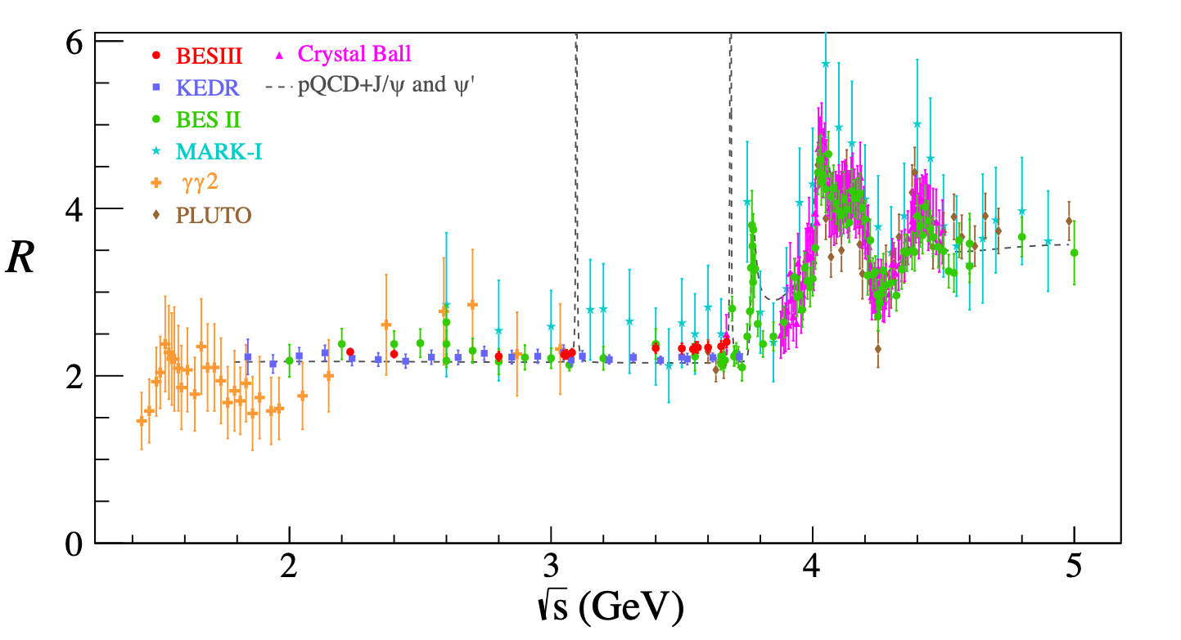
Done
The uncertainty will be reduced to 2% -3 %
(by a factor of 2-3)
R values were done at 14 scan data points from 2.23-3.67 GeV
Notes:
These future measurements can be used not only to test SM, but also to understand the complicated structures above 4 GeV.

Slide 14
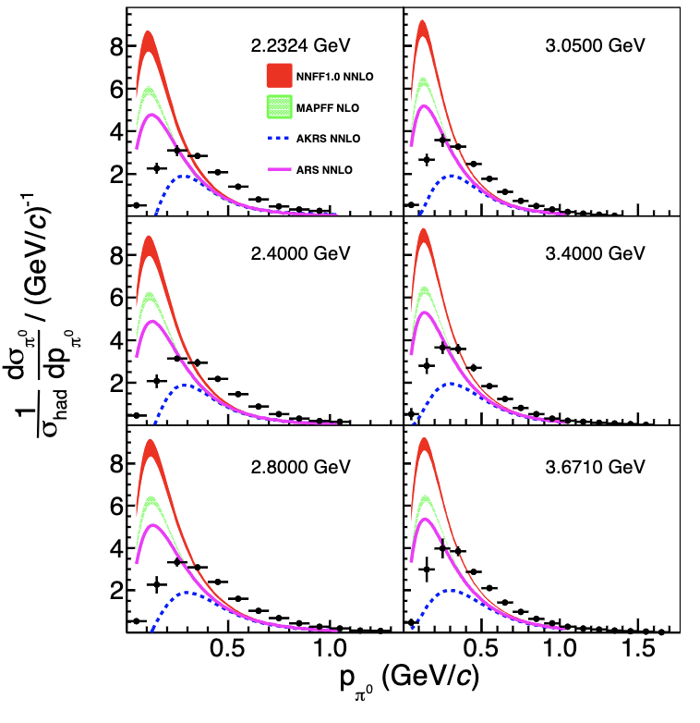
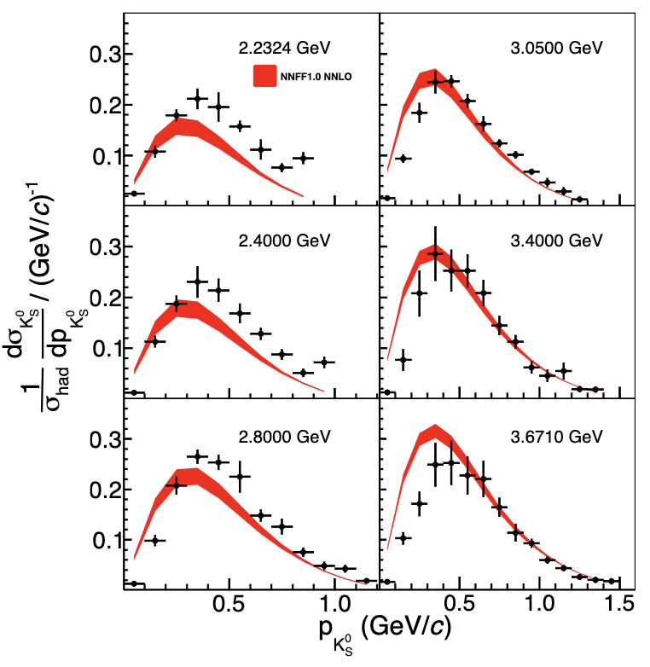
Inclusive $π^{0}$ and $K_{S}$ productions in $e^{+}e^{−}$ annihilations
PRL 130 (2023) 231901
Broad relative hadron energy range z_{h} from 0.1 to 0.9 with precision of around 3% at z_{h} ∼ 0.4.
Results significantly deviate from several theoretical calculations based on the existing FFs
Provide brand new inputs in low-energy region to global fits of fragmentation function
Notes:
Based on the electron-positron collision data collected by BESIII at the center-of-mass energies from 2.2324 to 3.6710 GeV, the differential cross sections of inclusive $π^{0}$ and $K_{S}^{0}$ production as a function of hadron momentum and normalized by the total cross section of the inclusive hadronic process are measured. Our results significantly deviate from several theoretical calculations based on the existing FFs, as shown in following figure. These results provide new ingredients for the global data fits of the FFs, in which almost no single inclusive annihilation data measured in this special energy region has been included.

Slide 15
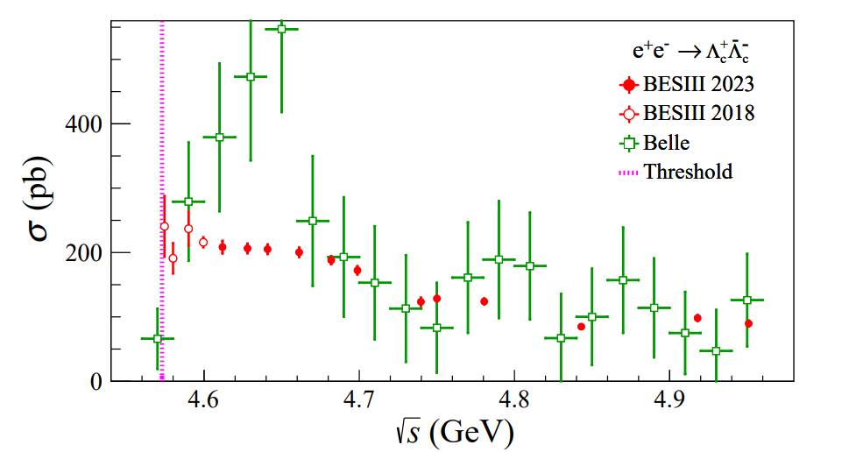
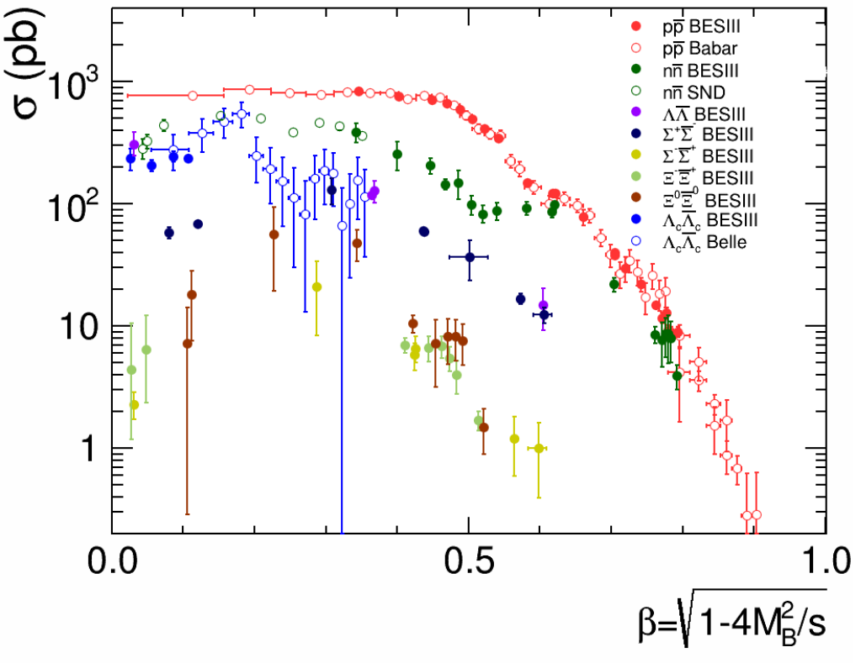
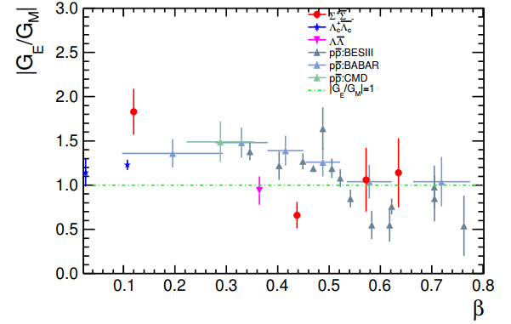
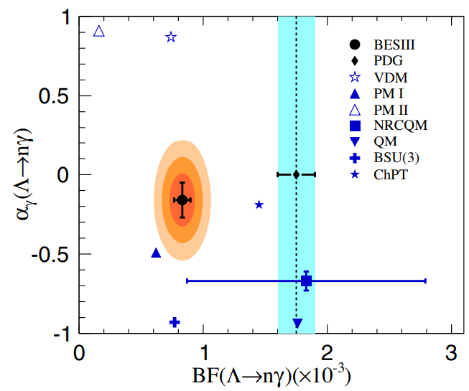
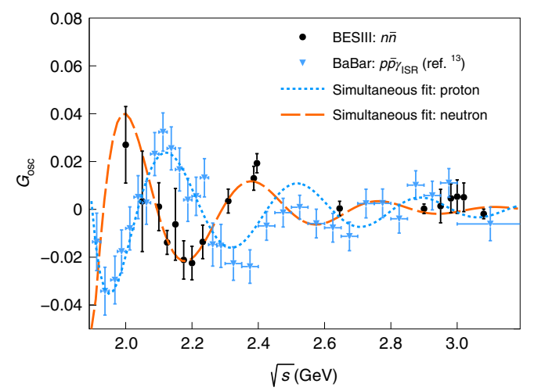
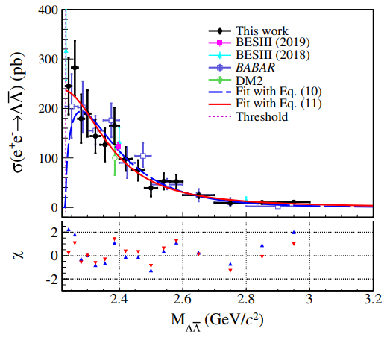
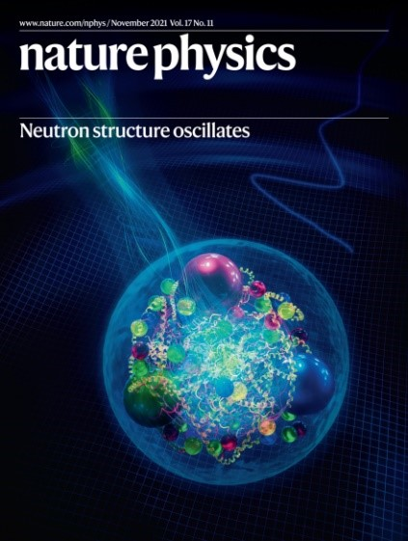
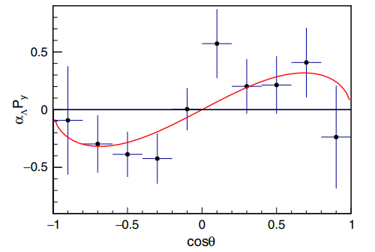
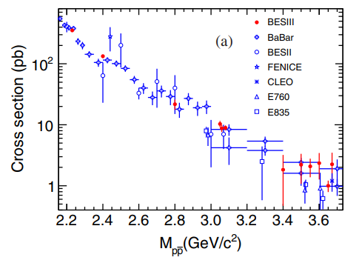
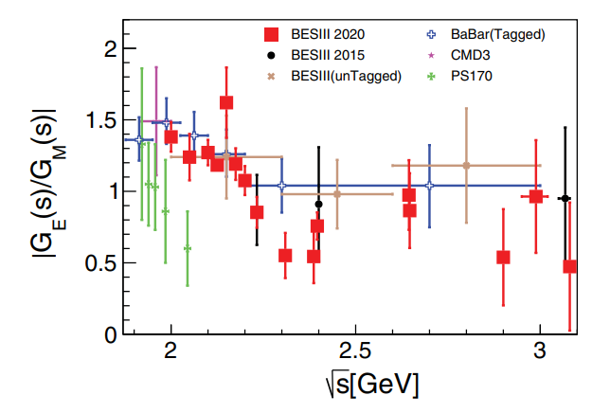
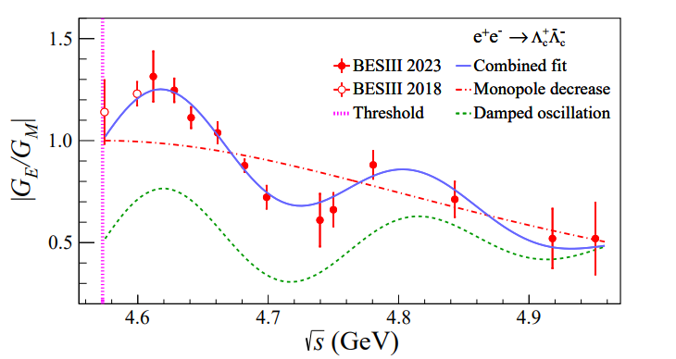
Baryon Electromagnetic form factors (EMFF)
PRL 131,191901 (2023)
Baryon EMFFs
Threshold effect
Complete EMFF
CP measurement
Weak radiative baryon decay
Nat.Sci.Rev. 8 (2021) 11, nwab187
More precise results input to non-pQCD and SM!
Nat. Phys. 17, 1200 (2021)
PRL 123, 122003 (2019)
PRD 91, 112004 (2015)
15
PRL 124, 042001 (2020)
PRL 131,191901 (2023)
Notes:
Anomaly threshold enhancements are observed, and E & M formfactor can be measured for nucleon, hyperon, and charmed baryons.

Slide 16
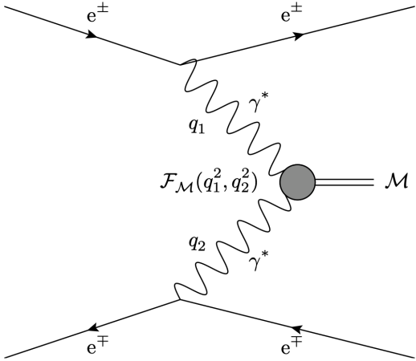
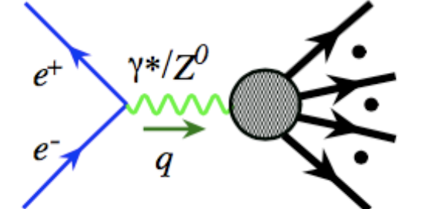
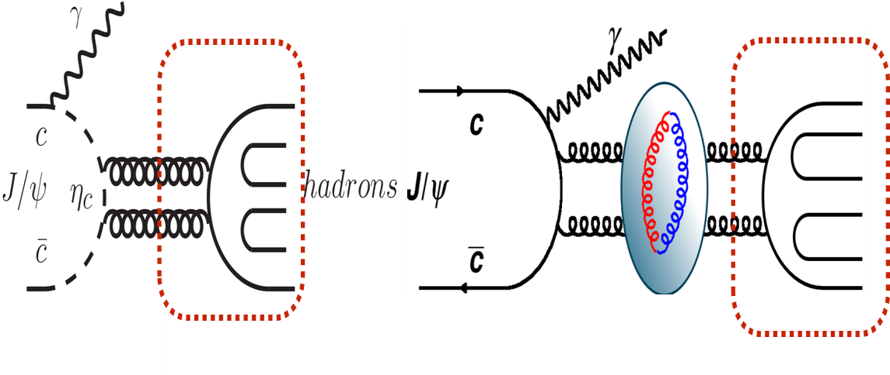
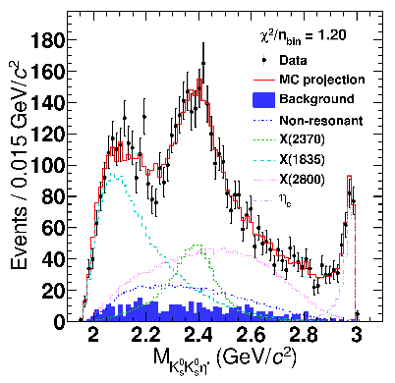
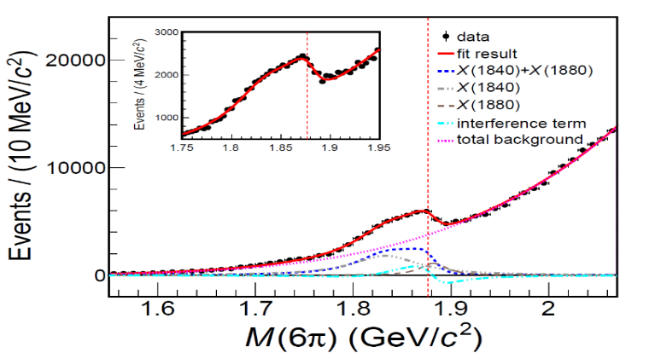



Highlight: light spectroscopy
Light hadrons via Electron-positron annihilations, charmonium decays, charmed hadron decays,
two-photon processes …
It is crucial to search for light exotic states: glueball, hybrid, multi-quark states …
Rich light scalars, missed excited baryons …
Evidence for Two Excited $Ω^{−}$ Hyperons
BESIII, Phys. Rev. Lett. 134, 131903 (2025)
Discovered a Glueball-like Particle – X(2370)
BESIII, Phys. Rev. Lett. 132, 181901 (2024)
Discovery of fine structure near proton-
anti-proton threshold:: X(1840) and X(1880),
BESIII, PRL132 (2024) 151901
${Ω(2109)}^{−}$
${Ω(2012)}^{−}$

Slide 17
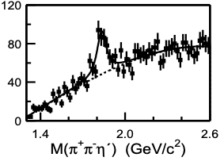
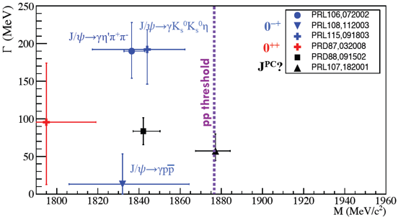
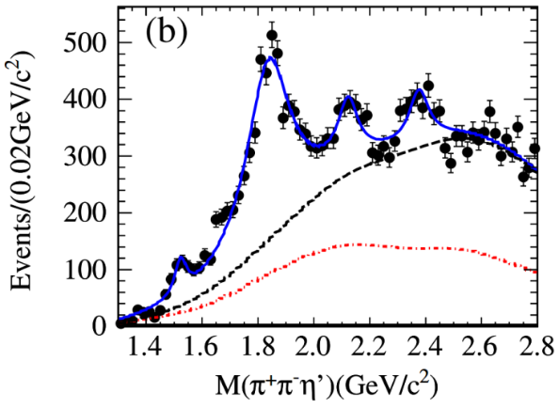
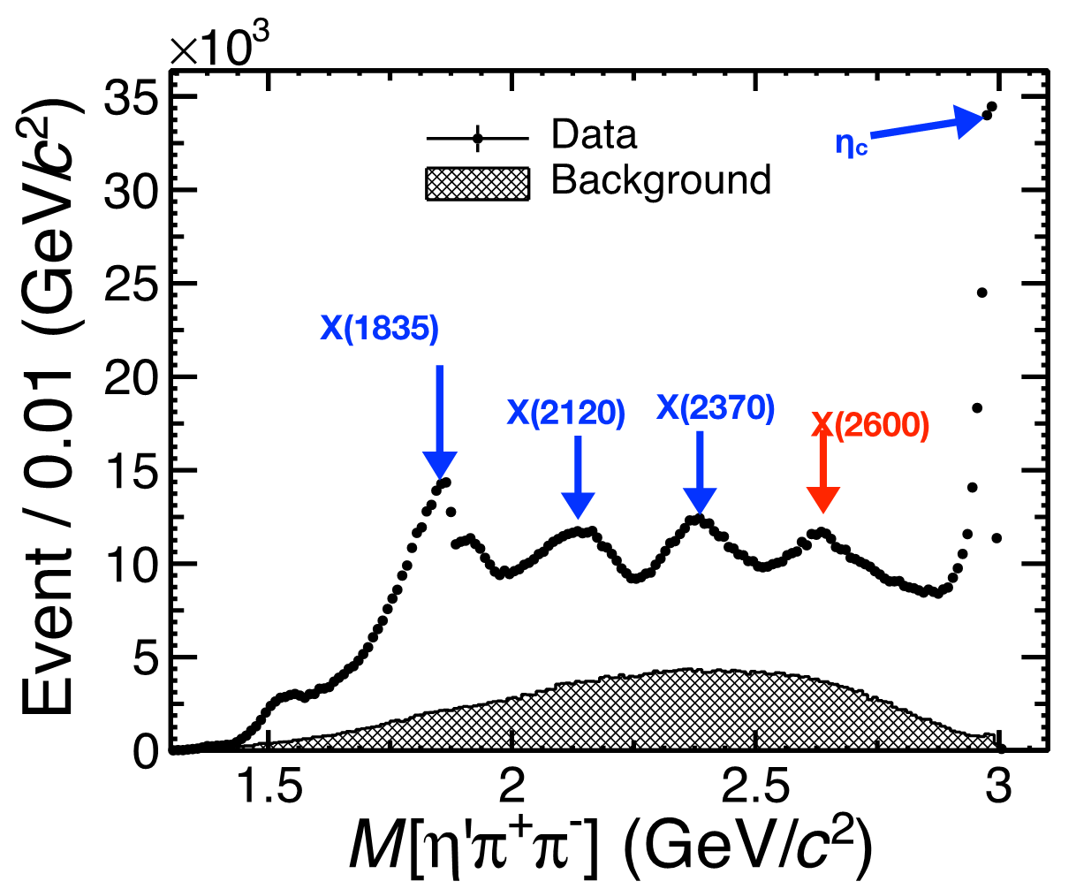

Hadron spectroscopy: high-statistics data
X(1835)
J/ψ→γ$η^{′}π^{+}π^{−}$
Structure
58 million
PRL 95(2005) 262001
Rich spectra
More structures
225 million
PRL106(2011)072002
Fine structures
10 billion
PRL129 (2022) 042001

Slide 18






Highlight: light hadron from charmed hadron decays
Phys. Rev. Lett. 123, 112001 (2019)
Phys. Rev. D 110, L111102 (2024)
W-Annihilation
W-Emission & W-Exchange
Phys. Rev. Lett. 132, 131903 (2024)
Phys. Rev. Lett. 134, 021901 (2025)
W-Emission
W-Emission & W-Exchange

Slide 19





Highlight: light hadron from charmed hadron decays
Phys. Rev. Lett. 132, 141901 (2024)
Phys. Rev. Lett. 122, 062001 (2019)
Phys. Rev. Lett. 134, 011904 (2025)
Still being controversial!

Slide 20










Highlight: light hadron from charmed hadron decays
Phys. Rev. D 104, 012016 (2021)
Phys. Rev. D 105, L051103 (2022)
One order of magnitude larger than the expectation!
Phys. Rev. Lett. 129, 182001 (2022)

Slide 21








Highlight: Puzzle of φ decays in charm
In $D_{s}^{+}→π^{+}π^{+}π^{−}π^{0}$, $D_{s}^{+}→π^{+}π^{+}π^{−}π^{0}π^{0}$ and $K_{S}^{0}K_{L}^{0}π^{+}$decays, Relative Branching Fraction of φ meson deviate from PDG;
More results are coming. New mechanism?
Phys. Rev. Lett. 134, 011904 (2025)
arXiv:2503.11383
arXiv:2501.04451

Slide 22







Highlight: Production and decay properties of $h_{c}$
$P$-wave singlet charmonium state, first observed by CLEO
First measurement of $B[ψ^{′}→π^{0}h_{c}]$ by BESIII
2M $h_{c}$ particle in 2.7B $ψ′$ events, possible to explore $h_{c}$ decay mode with $Br\sim {10}^{−4}$; 0.7M $h_{c}$ particle from XYZ scan sample
Decay of $h_{c}$:
  pQCD prediction: $h_{c}→γgg\sim 5.5\%$
  pQCD and NRQCD predictions of $h_{c}→$light hadrons: 48% and 8%
$$L_{\text{int}}\sim 15.7 \text{1/}\text{fb}$$
PRL95, 102003 (2005)
PRL104, 132002 (2010)
$$ππ,η$$
$$σ\left[ππh_{c}\right]\sim 50 pb$$
$$σ\left[ηh_{c}\right]\sim 10 pb$$
PRD 66, 014012 (2002)
PRD 65, 094024 (2002)
2.7Billion
$$π^{0}$$
$$Br:7.4×{10}^{−4}$$
arXiv: 2501.15447

Slide 23









Highlight: Production and decay properties of $h_{c}$
Observation of $h_{c}$radiative decays and $h_{c}→γf_{2}(1270)$
arXiv: 2501.15447
$$h_{c}→γf_{2}(1270)$$
5.4$σ$
7.5$σ$
5.1$σ$
11.8$σ$
6.4$σ$
$h_{c}$ sideband region

Slide 24








Highlight: measurements of $η_{c}→γγ$
arXiv: 2412.12998
Accepted by PRL
As the simplest decay of $η_{c}$，$η_{c}→γγ$ serves as a benchmark for QCD calculation.
Most measurements come from the time reversal process $γγ^{(∗)}→η_{c}$
BESIII has the unique opportunity to directly measure $η_{c}→γγ$ via $J/ψ→γη_{c}$ (first observation) or $h_{c}→γη_{c}$ (absolute branching fraction, most precise).
Measured $B(J/ψ→γη_{c})×B(η_{c}→γγ)$ is consistent with theoretical predictions, while the individual $Γ(η_{c}→γγ)$ deviates from the most recent LQCD prediction by more than $3σ$.
$$Γ(η_{c}→γγ)=(11.30±{0.56}_{stat.}±{0.66}_{syst.}±{1.14}_{ref.}) keV$$
Preliminary
evidence
most precise
observation !
$$h_{c}→γη_{c}(→γγ)$$
The first measurement of absolute branching fraction
via $h_{c}→γη_{c}$ will provide a brand new reference
Phys. Rev. D 87 (2013) 3, 032003
arXiv: 2412.12998
$$J/ψ→γη_{c}(→γγ)$$
in preparation
Precise test of LQCD: hyperfine mass splitting

Slide 25






Highlights: The most precise measurement of $D^{+}→μ^{+}ν_{μ}$
The most precise measurement of $D^{+}→μ^{+}ν_{μ}$ with 20.3 fb⁻¹@3.773 GeV
arXiv:2410.07626
2890±57
The most precise to date
$$B[D^{+}→μ^{+}v]=(3.98±0.08±0.04)×10^{−4}$$
The decay constant
The value of Vcd
$$f_{D^{+}}\left|V_{cd}\right|= 47.53±0.48±0.\text{27} \text{MeV}$$
Precision~1.2%

Slide 26






Highlights： observation of $Λ_{c}^{+}→ne^{+}ν_{e}$
BESIII, Nature Commun. 16, 681 (2025)
A novel Deep Learning is utilized to separate signals from dominant background.
First observation of $Λ_{c}^{+}→ne^{+}ν_{e}$
This measurement demonstrates a level of precision comparable to the LQCD prediction.
The absence of HCAL restricted us to extract the form factors.
Still, the BF provides significant insights, shedding light on the di-quark structure within the $Λ_{c}^{+}$ core and the 𝜋 − 𝑁 clouds in the low $Q^{2}$

Slide 27

CPV in hyperon decays, # events we need?
CPV in SM is small ： # events Experiments
B meson : O(1) discovered (2001） 10³$B factory$
K meson : O(10⁻³) discovered (1964） 10⁶ $Fix targets$
D meson : O(10⁻⁴) discovered(2019） 10⁸ LHCb
Hyperon : O(10⁻⁴) no evidence (10⁻²) O(10⁸) $Fix targets$
→ BESIII ?
Flavor-SU(3) Octet of spin ½
Flavor-SU(3) Decuplet of spin 3/2
Ω⁻ was predicted by quark model
Discovered in 1964 at BNL.

Slide 28

BESIII: A hyperon factory
10 billion $J/ψ$ and 2.7 billion $ψ($2S)events collected
Large BRs in $J/ψ$ decays : ${10}^{7}$ entangled hyperon pairs
Quantum entangled pair productions
Background free
Hai-Bo Li, arXiv:1612.01775
e+
e-
Single tag
$$Σ^{+}→pπ^{0}$$

Slide 29












CPV in hyperon decay
CP observables in hyperon decays
Phys. Rev. 108, 1645 (1957)
The amplitude of spin ½ baryon $B_{i}$ decay to a spin ½ baryon $B_{f}$ and $π$:
$$𝓐\sim Sσ_{0}+Pσ⋅\hat{n}$$
The decay parameters are defined as:
Two complex amplitudes:
$$S=Σ^{i}S_{i}e^{i(φ_{i}^{S}+δ_{i}^{S})}, P=Σ^{i}P_{i}e^{i(φ_{i}^{P}+δ_{i}^{P})}$$
Under CP transformation:
$$\overline{S}={−Σ}^{i}S_{i}e^{i(−φ_{i}^{S}+δ_{i}^{S})}, \overline{P}=Σ^{i}P_{i}e^{i({−φ}_{i}^{P}+δ_{i}^{P})}$$
If CP conserved: $S \underset{⇒}{ CP }−S$
PRD 34,833 1986
hep-ph/991023
hep-ph/0002210
$φ$ weak phase, $δ$ strong phase
$Δ=\frac{Γ−\overline{Γ}}{Γ+\overline{Γ}}$
$CPV$ observables
$$A=\frac{Γα+\overline{Γ}\overline{α}}{Γα−\overline{Γ}\overline{α}}≈\frac{α+\overline{α}}{α−\overline{α}}+Δ$$
$$α \underset{⇒}{ CP } \overline{α}=−α$$
$$β \underset{⇒}{ CP }\overline{β}= −β$$
$$B=\frac{Γβ+\overline{Γ}\overline{β}}{Γβ−\overline{Γ}\overline{β}}≈\frac{β+\overline{β}}{β−\overline{β}}+Δ$$
$P \underset{⇒}{ CP } P$
Notes:
These decays are described by the usual decay parameters given by Lee
and Yang' with the convention used here of
The experimental observables are the total rate \Gamma, and
the decay parameters \alpha, beta, and gamma which govern the
decay-angular distribution and the polarization of the final
baryon. Among alpha, beta, and gamma, only two are independent
as they are related by
The angular distribution of the pion from a completely polarized hyperon at rest.
The three parameters are related through this relation ?

Slide 30













CP observables in hyperon decays
PRD 34,833 1986
hep-ph/991023
hep-ph/0002210
PRD 34,833 1986
John F. Donoghue
Xiao-Gang He
Sandip Pakvasa
SM Prediction of
$Λ$ decay
$Δ=\frac{Γ−\overline{Γ}}{Γ+\overline{Γ}}≈\sqrt{2}\frac{T_{\frac{3}{2}}}{T_{\frac{1}{2}}}\sin{Δ_{s}\sin{φ_{CP}}}$
$$−5.4×{10}^{−7}$$
Not sensitive to $CPV$
Decay width difference
$$A=\frac{Γα+\overline{Γ}\overline{α}}{Γα−\overline{Γ}\overline{α}}≈\tan{Δ_{s}}\tan{φ_{CP}}$$
Easiest to measure
Decay parameter difference
$$−0.5×{10}^{−4}$$
Polarization of decayed baryon needs to be measured
$$B=\frac{Γβ+\overline{Γ}\overline{β}}{Γα−\overline{Γ}\overline{α}}≈\tan{φ_{CP}}$$
Decay parameter difference
$$3.0×{10}^{−3}$$
$Ξ^{−}, Ξ^{0}, Ω^{−}$ cascade decay
Notes:
Sandip from Hawai, who was one of early researchers of CPV in hyperons.

Slide 31

Entangled and Polarized hyperon pairs produced in $e^{+}e^{−}$ collisions
m=±1
m=±1
A_{½ -½}
θ,φ
A_{½ ½}
θ,φ
J/ψ
J/ψ
A_{-½ ½}
m=±1
A_{-½ -½}
m=±1
θ,φ
θ,φ
J/ψ
J/ψ
From Steve Olsen
Parity conservation : A_{½ ½} =A_{-½ -½}
parity conservation : A_{½} _{-½} =A_{-½ ½}
Δ$Φ$= complex phase between A_{½} _{½} and A_{½ -½}
Notes:
According to parity conservation,

Slide 32


Correlated 5-dim. angular distribution
If Δ$Φ$ ≠ 0, Λ and Λ are transversely polarized
Unpolarized part
Entangled part
Polarized part
Polarization-term can be used to determine a₋ and a₊ simultaneously
Λ
Notes:
the joint angular distribution is [

Slide 33






The most precise$CP test in Λ$ and $\overline{Λ}$ decay
10 billion J/$ψ$ (Phys. Rev. Lett. 129, 131801 (2022)
Nat. Phys. 15, 631 (2019)
10 billion $J/ψ$
Paras. | This Work (10 billion $J/ψ$) | Previous Results (1.3 billion $J/ψ$)
$$α_{J/ψ}$$ | $$0.4748±0.0022±0.0024$$ | $$0.461±0.006±0.007$$
$$ΔΦ$$ | $$0.7521±0.0042±0.0080$$ | $$0.740±0.010±0.009$$
$$α_{−}$$ | $$0.7519±0.0036±0.0019$$ | $$0.750±0.009±0.004$$
$$α_{+}$$ | $$−0.7559±0.0036±0.0029$$ | $$−0.758±0.010±0.007$$
$$A_{CP}$$ | $$−0.0025±0.0046±0.0011$$ | $$−0.006±0.012±0.007$$
$$α_{avg}$$ | $$0.7542±0.0010±0.0020$$ | −−−
Polarization: max 25%
More than 10
standard deviation
shift from all
previous
measurements
Sensitivity of A_{CP} ：
below 0.5%
unprecedented
precision
Standard model prediction : A_{CP}~ 10⁻⁴ (PRD 34, 833 (1986))

Slide 34











Search for CPV in $Ξ$ decay
Phys. Rev. D 99, 056008 (2019)
Phys. Lett. B 772, 16 (2017)
$$pπ^{−}$$
$$Λ$$
↱
spin-aligned
quantum entangled
$$Λπ$$
↱
$$e^{+}e^{−}→J/ψ→Ξ\overline{Ξ}$$
↳
$$\overline{Λ}π$$
↳
$$\overline{p}π^{+}$$
$$\overline{Λ}$$
Through the sequential decays of $Ξ$, the CPV phase can be directly measured!
The perfect reaction for hyperon $CPV$ searches!
Notes:
Next is the Search for CPV in Xi decays. The whole process is e+e→jpsi->Xi Xibar, Xi->Lambda pi, Lambda ->ppi. This figure shows how a XiXibar event looks like in the BESIII detector. The joint angular distribution of this process can be described by this formula. This process has a relatively high branching fraction and comparable S/P waves, plus the sequential Xi decay, it’s the perfect reaction for hyperon CPV searches.

Slide 35











Search for CPV in $Ξ$ decay
The precision of our analysis (73K $Ξ^{−}{\overline{Ξ}}^{+}$) is comparable with the measurement from HyperCP (144M events), which means that the accuracy of a single event is more than 1000 times higher than HyperCP!
320K $Ξ^{0}{\overline{Ξ}}^{0}$ pairs
$$Ξ^{−}$$
1.3 billion $J/ψ$
10 billion $J/ψ$
$$Ξ^{0}$$
Phys. Rev. D 108, L031106 (2023)
First measurements of the weak (CPV) phase difference in $Ξ^{−}/Ξ^{0}$decays
Three CP tests in $Ξ^{−}/Ξ^{0}$ decays
The results of 10B $J/ψ$ is on the way!
PRD(L) Editor’s Suggestion
Notes:
Here are the results of the searches for CPV in Xi decays. The left table is the Xi- results, in this analysis, we used part of the jpsi data, and reconstructed 73K Xi-Xibar+ pairs. For the decay parameter phi_Xi, our precision is comparable with the previous hyperCP result, which has 144M Xi hyperons. That means the single-event sensitivity of our data is 1000 times higher than the hyperCP experiment.
For the first time, we measured the CPV phase in the baryon weak decays, and it’s consistent with zero at a few percent level.

Slide 36







Polarization and CP test in $Σ^{+}{\overline{Σ}}^{−}$ J/$ψ and ψ\left(2S\right)→Σ^{+}{\overline{Σ}}^{−}$
$e^{+}e^{−}→J/ψ,ψ(3686)→Σ^{+}{\overline{Σ}}^{−}$, $Σ^{+}→pπ^{0}, \overline{Λ}→\overline{p}π^{0}$
arXiv:2503.17165, submitted to PRL
Polarizations of $Σ^{+}$
10B $J/ψ$ and 2.7B $ψ(3686)$
1.12 M $Σ^{+}{\overline{Σ}}^{−}$ pairs reconstructed
Phys. Rev. Lett. 131, 191802 (2023)
Opposite directions of the $Σ^{+}$ polarization in $J/ψ$ and $ψ\left(3686\right)$ decays
Most precise measurements of the $Σ^{+}$ decay parameters
Most precise CP test in the decays of $Σ^{+}$
Polarization ratio of $Σ^{+}$ between $J/ψ$ and $ψ(3686)$ decays

Slide 37











Search for Strong CPV in $Σ^{0}(→Λγ)$ decay
Phys. Rev. Lett. 133 (2024) 10, 101902
Phys. Lett. B 788, 535 (2019)
The CPV sources in SM:
  Weak interaction, CKM (observed, but too small)
  Strong interaction, $θ$-term (Not yet observed)
The Transition EDM of $Σ^{0}(→Λγ)$
SU(3) symmetry
Neutron EDM
10 B $J/ψ$ and 2.7 B $ψ(3686)$
Polarizations of $Σ^{0}$
$$e^{+}e^{−}→J/ψ,ψ(3686)→Σ^{0}\left(→Λγ\right){\overline{Σ}}^{0}\left(→\overline{Λ}γ\right), Λ→pπ^{−}, \overline{Λ}→\overline{p}π^{+}$$
Phys. Rev. Lett. 133 (2024) 10, 101902
Similar behavior is observed in $Σ^{+}$, but not in $Λ or Ξ$!
Opposite directions of the $Σ^{0}$ polarization
The first attempt to measure the P-violating decay parameter of $Σ→Λγ$.
The first strong-CP test in hyperon decays.
Notes:
The $θ$-term is

Slide 38







More and more $J/ψ$ needed
BESIII collected
10 billion $J/ψ$
(4 million hyperons)
Current technology “Topup” $×2$ +
improved technology “monochromatic collision” $×10$ +
Someday with new facility ($J/ψ$ factory) $×10$0
X.G. He et al. Sci.Bull. 67 (2022) 1840-1843:
${10}^{13}J/ψ$ per year
何小刚
10 Billions of hyperon pairs produced
Billion of hyperon pairs reconstructed
CPV： ${10}^{−4} −{10}^{−5}$
Challenge the Standard Model

Slide 39




















Radiative decay: $Σ^{+}→pγ$ in $J/ψ→Σ^{+}{\overline{Σ}}^{−}$
$$p$$
BESIII: PRL130, 211901(2023)
$$Σ^{+}→pπ^{0}$$
data
$${\overline{Σ}}^{−}→\overline{p}π^{0}$$
data
$$e^{+}$$
  $$γ$$
$$J/ψ$$
$$Σ^{+}$$
$$\overline{p}$$
$${\overline{Σ}}^{−}$$
$$π^{0}$$
$$e^{−}$$
  $$γ$$
  $$γ$$
Signal side: momentum distributions of proton in the rest frame of $Σ$:
The decay rate deviates from
previous value by 4.2 σ
4$.2 σ$
The CP asymmetry is calculated to be
  The decay rate ($0.996±{0.022}_{stat}±{0.017}_{syst}$) $×{10}^{−3}$
  The decay parameter: $−0.651±{0.056}_{stat}±{0.020}_{syst}$

Slide 40









Radiative decay: 𝚲→𝒏𝜸 in
BESIII: PRL 129, 212002 (2022)
$$Λ→nγ$$
$$\overline{Λ}→\overline{n}γ$$
Variables | Λ→γn | $\overline{\text{Λ}}$→γ$\overline{n}$
BF $(×{10}^{3})$ | 0.834±0.046±0.064 | 0.876±0.071±0.082
$$α_{γ}$$ | -0.13±0.13±0.02 | 0.21±0.15±0.06
$$Δ_{CP}$$ | $$−0.025±0.049±0.060$$
$$A_{CP}$$ | $$−0.25±0.61±0.15$$ | -0.249±0.608±0.147
$$5.5 σ$$
Theoretical attentions: Li-sheng Geng, Qiang Zhao, R. M Wang et al.
BF of $Λ→nγ,$with improved precision, smaller than PDG value by 5.5$σ$

Slide 41


Semileptonic decays: |V_{us}|
arXiv:1909.12524
HFLAV group 2018
$$Λ$$
usu
dss
$$Ξ^{−}$$
|V_{us}| measurements are inconsistent:
between Kl3 and Kl2 decays and tau decays.
N. Cabibbo, E. Swallon, R. Winston
Ann.Rev.Nucl.Part.Sci. 53:39-75,2003

Slide 42





Absolute BF measurement of $Λ→pμ^{−}{\overline{ν}}_{μ}$
The results for 𝚲→𝒑e⁻𝝂e
will come soon.
Phys. Rev. Lett. 127, 121802 (2021)
$$N_{ST}=14, 609, 800±7, 117$$
$N_{DT}=64±9$
First absolute BF measurement
Test lepton flavor universality
$$R^{μe}=\frac{ℬ(Λ→pμ^{−}{\overline{ν}}_{μ})}{{ℬ(Λ→pe^{−}{\overline{ν}}_{e})}_{PDG}}=0.178±0.028$$
Consistent
with LFU
$$ℬ\left(Λ→pμ^{−}{\overline{ν}}_{μ}\right)=(1.48±0.21±0.08)×{10}^{−4}$$
$$0.153±0.008$$
Update measurement after a 50-year hiatus
The first study of its absolute BF
The most precise result to date
Search for CP violation
$$Δ_{CP}=\frac{ℬ_{Λ→pμ^{−}{\overline{ν}}_{μ}}−ℬ_{\overline{Λ}→\overline{p}μ^{+}ν_{μ}}}{ℬ_{Λ→pμ^{−}{\overline{ν}}_{μ}}+ℬ_{\overline{Λ}→\overline{p}μ^{+}ν_{μ}}}=0.02±0.14±0.02$$
Consistent
with CP symmetry

Slide 43







Searching for hyperon EDM at BESIII
何小刚
马建平
Detailed dynamics in $J/ψ$ decay to hyperon pair, have been studied:
X.G.He, J.P. Ma, Phys.Lett.B 839(2023)137834
$$𝒜=ε_{μ}\left(λ\right)\overline{u}\left(λ_{1}\right)\left(F_{V}γ^{μ}+\frac{i}{2M_{Λ}}σ^{μν}q_{ν}H_{σ}+γ^{μ}γ^{5}F_{A}+σ^{μν}γ^{5}q_{ν}H_{T}\right)ν(λ_{2})$$
Dominant contribution
Psionic form factor
$F_{V}$ and $H_{σ}$
can also be represented as $G_{1}$ and $G_{2}$
$P$violation term
Complex form factor, $F_{A}≠0$ indicate $P$ violation
$H_{T}$ is included in this term
$$H_{T}(q^{2})=\frac{2e}{3m_{Jψ}^{2}}g_{V}d_{B}(q^{2})$$
Assuming $d_{B}(q^{2})≡d_{B}(0)$
$d_{B}(q^{2})$: electric dipole form factor
$d_{B}\left(0\right)$: electric dipole moment
Physics Letters B 551 (2003) 16–26
arXiv:hep-ph/0412158

Slide 44

Sensitivities of hyperon EDM at BESIII
Jinlin Fu, Hai-Bo Li, Jianpeng Wang, Fusheng Yu, and Jianyu Zhang, arxiv: 2307.04364

Slide 45


Overpopulated charmonium spectrum
arXiv:1511.01589, arXiv:1812.10947
BEPCII energy
Overpopulated observed charmonium-like states, i.e. “XYZ”:
Most of them are close to the mass thresholds of charmed meson pairs
Some are not accommodated as conventional meson
==> candidate of exotic hadron states
More efforts are needed to pin down their nature

Slide 46




The vector Y states from scan data near open-charm thresholds
$e^{+}e^{−}→$ $^{+}π^{−}\text{J}\text{/}\text{ψ}$
BESIII Resolution: 1 - 2 MeV
Belle Resolution: about 5-10 MeV
PRL 110 (2013) 252002
Y(4260) ➔ Y(4230)
Phys.Rev.D 102 (2020) Phys.Rev.Lett. 118 (2017)
Fine structures of Charmonium-like states are seen at BESIII with scan data!
Y(4230)
Y(4660)
Y(4360)
Notes:
A lot of theoretical studies ate inspired form besiii measuremnts.

Slide 47








More Y states: Y(4500) ,Y(4710) and Y(4790)
PRL130, 121901 (2023)
e⁺e⁻→ $D^{∗0}D^{∗−}π^{+}$
PRD107, 092005 (2023)
e⁺e⁻ → K_{S}K_{S}J/ψ
Y(4230)
Y(4500)
Y(4660)
Y(4230)
PRL, 131.151903 （2023）
PRL131, 211902 (2023) e⁺e⁻→K⁺K⁻J/ψ
$ψ\left(4160\right)$ or $ψ\left(4230\right)$
e⁺e⁻→$D_{s}^{∗+}D_{s}^{∗−}$
$ψ\left(4415\right)$?
Y(4790)

Slide 48


How many vectors in charmonium energy region?
Between 3 and 5 GeV:
6 ψ + 8 new charmonium-like states
Besides vector charmonium ($c\overline{c}$) states, we also expect $c\overline{c}g$ hybrids, and $c\overline{c}q\overline{q}$ tetraquark states. Have they already been observed?
➔ More theoretical/experimental efforts necessary!
Y(4230), Y(4320),
Y(4360), Y(4390)
Y(4660), Y(4710), Y(4790)
Y(4500)

Slide 49
BESIII white paper: Future Physics Programme
arXiv:1912.05983 : Chin.Phys. C44 (2020) no.4, 040001
Another 6 years running to collect >60 fb⁻¹ data at different energies .

Slide 50



BEPCII upgrades in 2024
BEPCII upgrade (installation: 2024. 7- 2024. 12)
Highest beam energy: 2.8 GeV
Luminosity: 1.2$×{10}^{33}$ cm⁻²s⁻¹ （ 4.0 ~ 5.0 GeV）
(0.4-0.7) $×{10}^{33}$ cm⁻²s⁻¹ （ 5.0 ~ 5.6 GeV）
BESIII will collect about 60 fb⁻¹ between 4.0 – 5.6 GeV, and to study potential physics:
Cover energy up to 5.6 GeV
Deeper studies of the XYZ states
Study the ground-state charmed baryons
Provide information on charm-quark fragmentation function
Notes:
The fragmentation functions of the light quarks have been measured with a reasonable precision, while the information on the c-quark fragmentation function (CFF) is scarce. There is virtually no experimental data on CFF below the energy of the B-factories. Such information is vital. It is proposed to perform a first measurement of the inclusive D-meson production in e⁺e⁻ collisions in the energy domain between charmonium and bottomonium using a unique data sample of about 5 fb⁻¹ integrated luminosity at energies from 4.60 to 4.95 GeV.

Slide 51


Summary
BESIII is running smoothly, and very productive now;
BEPCII upgrades have been finished in 2024, more data taking above 4.0 GeV, up to 5.6 GeV to study: excited charmonium, charmonium-like states, XYZ particles, charmed baryon …
Advantages at BECPII/BESIII: scan data near thresholds, quantum-entangled meson and baryon pairs
BESIII plays leading role in hadron physics, flavor physics(charmed hadron and strange hadron).
Charm is still needed for precise test of the SM!
2021
2035
Strong phase in
neutral D decay

Slide 52
Thank you for your attentions!

Slide 53
Entangled hyperon pairs
Kang, Li, Lu, Phys.Rev. D81 (2010) 051901
To determine parameters:

Slide 54




Σ⁻ at BESIII
40∼50 year-old measurements,
probably wrong for the same reason
the Λ measurements were wrong
α$−$≈0 ➔ 1 partial wave dominates
interference is small not
well suited for α₋+α₊/α₋− α₊
measurements
no measurements of α₊ for $\overline{Σ}+$
_
single dominant decay mode
no suitable for ΔΓ measurements
BESIII analysis is underway, will appear soon.

Slide 55


BESIII achievements on hyperon physics
PRL 129, 131801(2022)
PRL 125,052004(2020)
Nature 606,64(2022)
arXiv:2305.09218v1
Parameters | $$Λ\overline{Λ}$$ | $$Σ^{+}{\overline{Σ}}^{−}$$ | $$Ξ^{−}{\overline{Ξ}}^{+}$$ | $$Ξ^{0}{\overline{Ξ}}^{0}$$
$$α_{Ξ^{−}/Ξ^{0}}$$ | - | - | $$−0.376±0.007±0.003$$ | $$−0.3750±0.0034±0.0016$$
$$α_{{\overline{Ξ}}^{+}/{\overline{Ξ}}^{0}}$$ | - | - | $$0.371±0.007±0.002$$ | $$0.3790±0.0034±0.0021$$
$$φ_{Ξ^{−}/Ξ^{0}}$$ | - | - | $$0.011±0.019±0.009$$ | $$0.0051±0.0096±0.0018$$
$$φ_{{\overline{Ξ}}^{+}/{\overline{Ξ}}^{0}}$$ | - | - | $$−0.021±0.019±0.007$$ | $$−0.0053±0.0097±0.0019$$
$$A_{CP}(Ξ^{−}/Ξ^{0})$$ | - | - | $$0.006±0.013±0.006$$ | $$−0.0054±0.0065±0.0031$$
$$Δφ_{CP}(Ξ^{−}/Ξ^{0})$$ | - | - | $$−0.005±0.014±0.003$$ | $$−0.0001±0.0069±0.0009$$
$$α_{Λ/Σ^{+}}$$ | $$\text{0.7519}±\text{0.0036}±\text{0.0024}$$ | $$−0.998±0.037±0.009$$ | $$0.757±0.011±0.008$$ | $$0.7551±0.0052±0.0023$$
$$α_{\overline{Λ}/{\overline{Σ}}^{−}}$$ | $$\text{−0.7559}±\text{0.0036}±\text{0.0030}$$ | $$0.990±0.037±0.011$$ | $$−0.763±0.011±0.007$$ | $$−0.7448±0.0052±0.0023$$
$$A_{CP}(Λ/Σ^{+})$$ | $$−0.0025±0.0046±0.0012$$ | $$−0.004±0.037±0.010$$ | $$−0.004±0.012±0.009$$ | $$0.0069±0.0058±0.0018$$
BESIII best measurements: $A_{CP}^{Λ}=−0.0025±0.0046±0.0012$
Systematic uncertainties are well controlled!
  Excellent performance of BESIII detectors.
  Data-driven method to study data-MC inconsistency.

Slide 56

Searching for hyperon EDM at BESIII
Systematic measurements of the EDMs of the hyperon family!
Only the EDM of Λ in the hyperon had been measured. Based on massive quantum-correlated hyperon pairs, BESIII is expected to improve the measurement precision of the Λ EDM by a factor of 1000, and provides the first measurement results of the EDMs of Σ, Ξ, Ω, and other hyperons
X.G. He, J.P. Ma PLB 839 (2023) 137834
J.Phys.G 47 (2020) 1, 010501
Jinlin Fu, Hai-Bo Li, Jianpeng Wang, Fusheng Yu, and Jianyu Zhang, arxiv: 2307.04364

Slide 57


${\text{sensitivity} to sin}^{2}{θ_{w}^{eff}}$ at STCF
Jinlin Fu, Hai-Bo Li, Jianpeng Wang, Fusheng Yu, and Jianyu Zhang, arxiv: 2307.04364

