Slide 1
开味四夸克态$T_{c\overline{s}0}$(2900)及其自旋伴随态的研究
王恩（郑州大学）
第五届LHCb前沿物理研讨会
2025年4月25-28日@武汉
Notes:
Good afternoon, I am En Wang from Zhengzhou University, and I am glad to give a talk about our recent work about DD bar bound state.

Slide 2
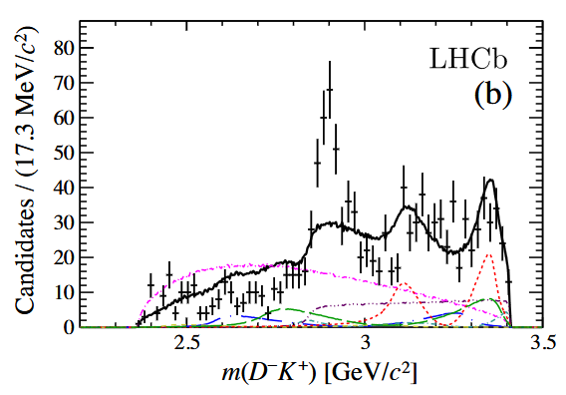
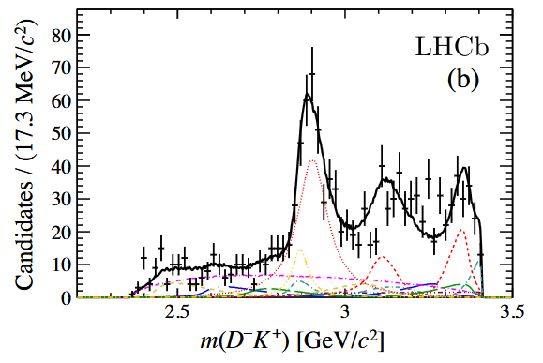
$X_{0,1}(2900)$ at LHCb
PRL125(2020)242001
PRD102(2020)112003

Slide 3
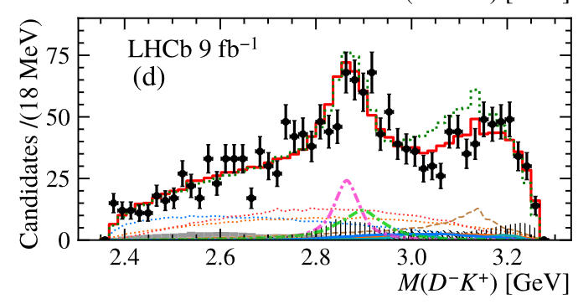
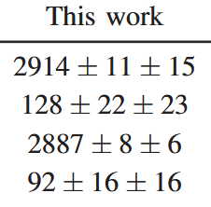
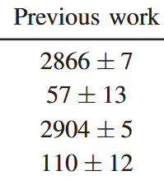
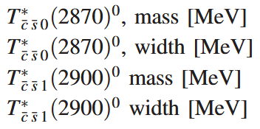
$X_{0,1}(2900)$ ($T_{cs}$) at LHCb
2411.19781
PRL133(2024)131902

Slide 4
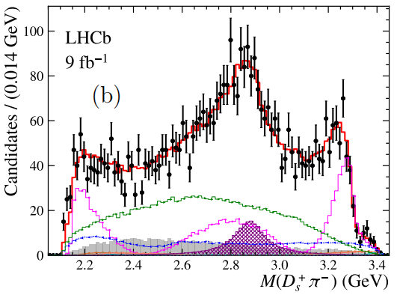
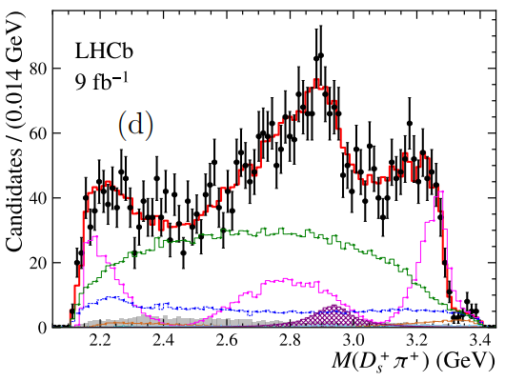
$T_{c\overline{s}0}(2900)$ at LHCb
PRL131(2023)041902
PRD108(2023)012017
4

Slide 5
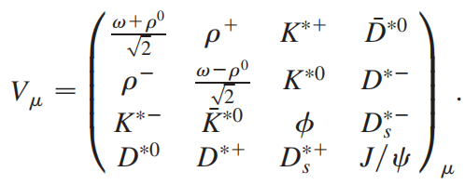
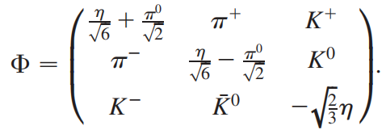
V-V interaction
Hidden-gauge formalism Molina-Branz-Oset, PRD82(2010)014010
V/P mesons in SU(4) flavor space

Slide 6
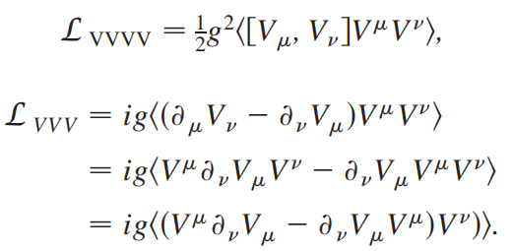
V-V interaction
The Lagrangian of four-vector and three-vector contact terms

Slide 7
V-V interaction
spin-projection operators

Slide 8
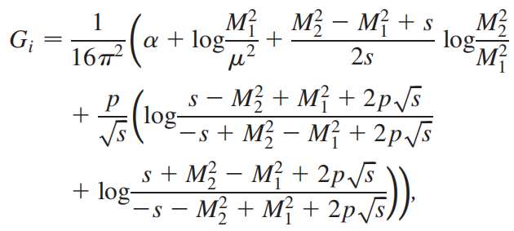
Bethe-Salpeter equation
Bethe-Salpeter equation

Slide 9
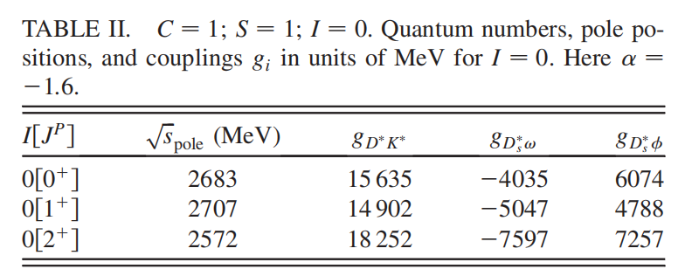
Pole and coupling
Molina-Branz-Oset, PRD82(2010)014010

Slide 10
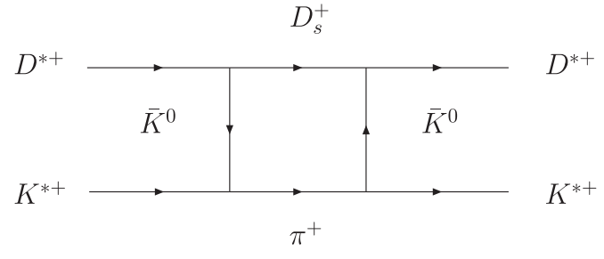
Spin partner $T_{c\overline{s}2}$
Du-Guo-Chen-Wang, PRD108(2023)074006
Molina-Oset, PRD107(2023)056015
Spin partner $T_{c\overline{s}2}$ with mass around 2.8GeV was predicted!

Slide 11
Interpretation of $T_{c\overline{s}0}$(2900)
Virtual state or cusp
PRD107(2023)056015, PRD108(2023)074006
Compact tetraquark
IJMPA38(2023)2350056, PRD108(2023)114016
EPJC84(2024)1
Symmetry 2023, 15, 695
Searching for the $T_{c\overline{s}0}(2900)$
$Λ_{b}→ΛD^{0}K^{0}$，2310.11139, EPJC85(2025)123
${\overline{B}}_{s}→K^{0}D^{0}π^{0}$, 2408.11454, EPJC85(2025)90
$B→D_{s}^{+}π^{−}K^{−}$, PRD109(2024)014008
$B^{+}→K^{+}D^{+}D^{−}$ EPJC84(2024)681

Slide 12
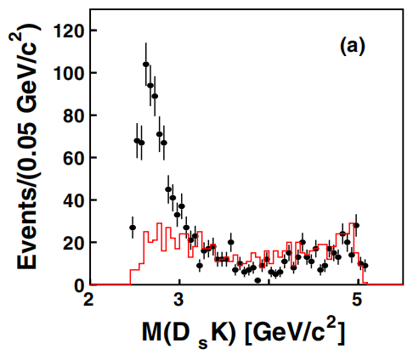
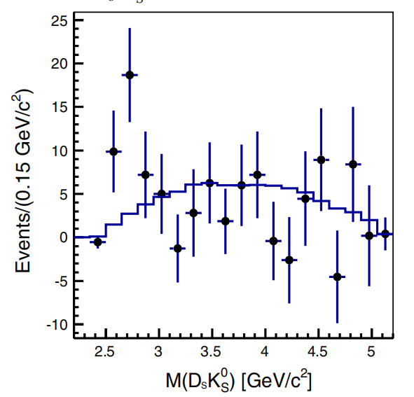
$$B^{−}→D_{s}^{+}K^{−}π^{−}$$
Belle data
PRD80, 052005 (2009)
PRD91, 032008 (2015)

Slide 13
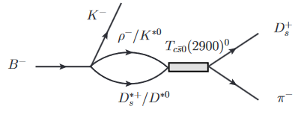
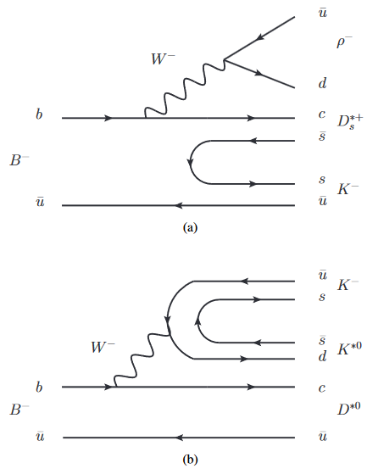
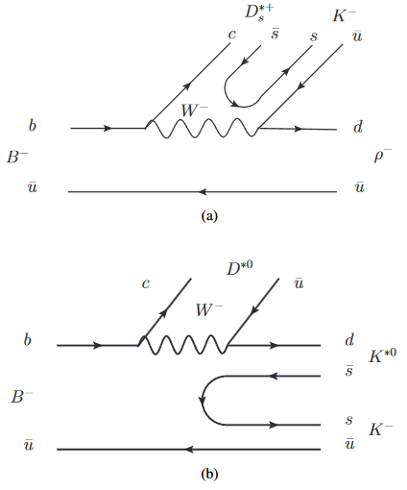
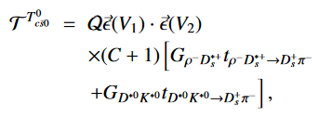
$$B^{−}→D_{s}^{+}K^{−}π^{−}$$
PRD109(2024)014008
Mechanisms

Slide 14
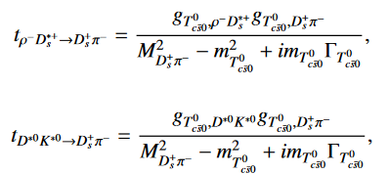
coupling constants
Transition amplitudes
$λ=1$ gives the probability to find the molecular component in the physical states
DYChen, PRD107, 034018 (2023)
S. Weinberg, PR137, B672 (1965)
Baru, PLB 586, 53-61 (2004)

Slide 15
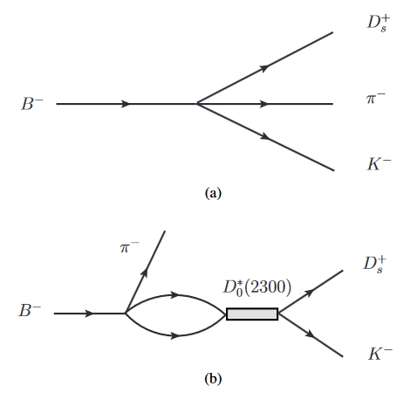
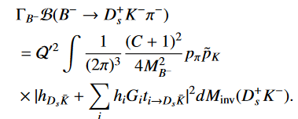
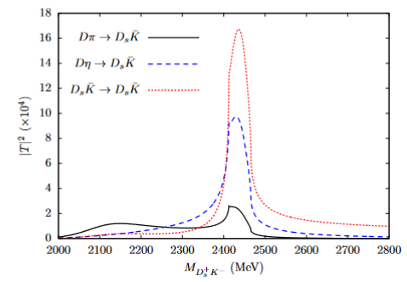
D(2300)-$D_{s}K$ interaction
Mechanisms
Phys. Rev. D 102, 096020 (2020)
Phys. Rev. D 87, 014508 (2013)

Slide 16
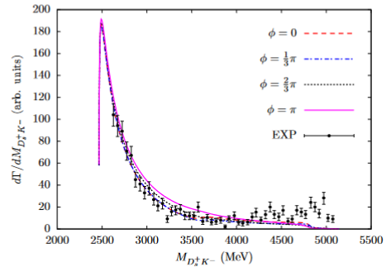
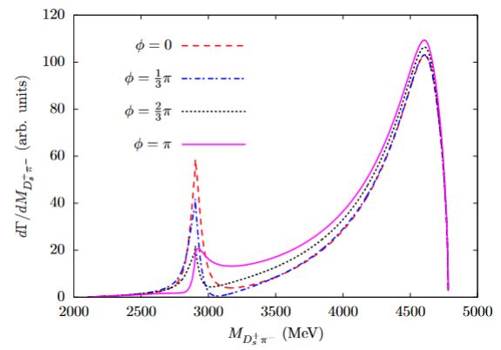
Results for $B^{−}→D_{s}^{+}K^{−}π^{−}$
Mass distributions
Belle: PRD80 (2009)052005

Slide 17
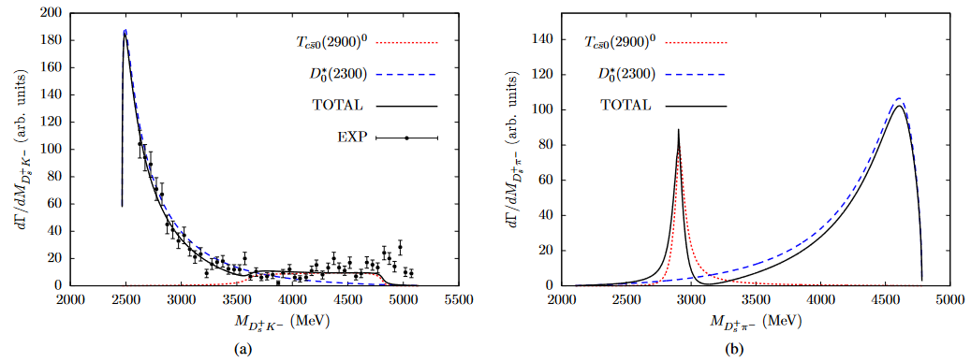
Results with fitted parameters
Fitted results

Slide 18
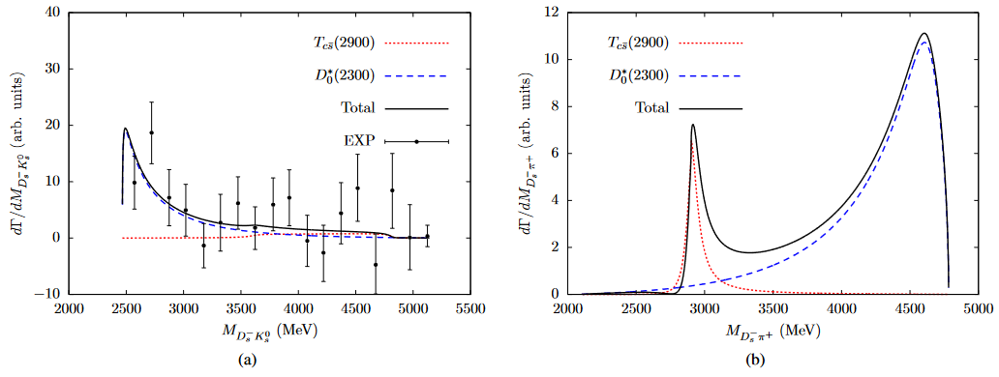
Results-Fitted parameters
Belle: $B^{0}→D_{s}^{−}K_{s}^{0}π^{+}$, PRD91, 032008(2015)

Slide 19
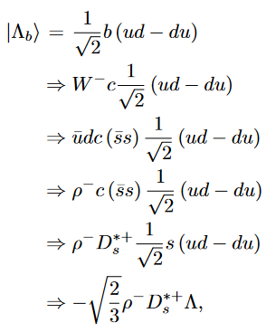
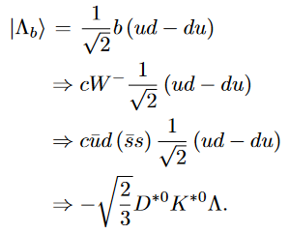
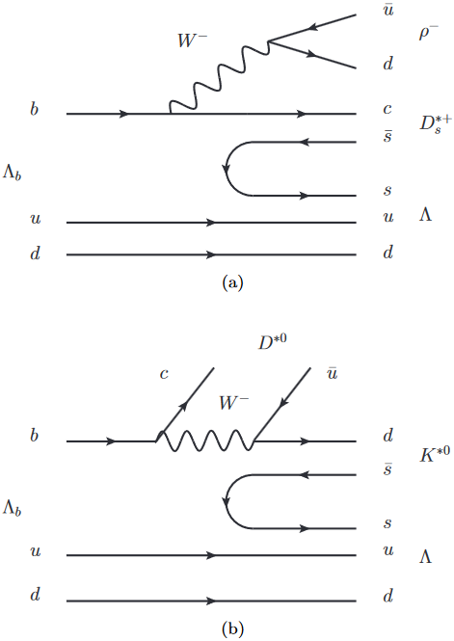
$$Λ_{b}→K^{0}D^{0}Λ$$
EPJC85(2025)123
Mechanisms

Slide 20
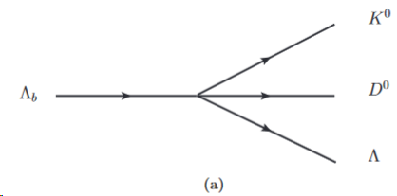
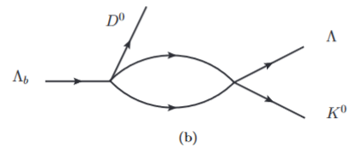
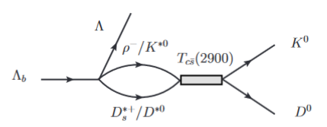
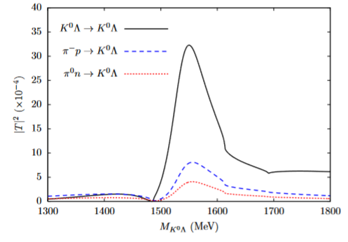
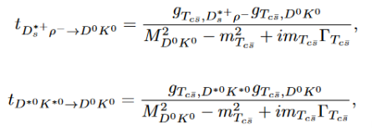
Formalism
Final state interaction
Inone Oset, PRC65, 035204 (2002)

Slide 21
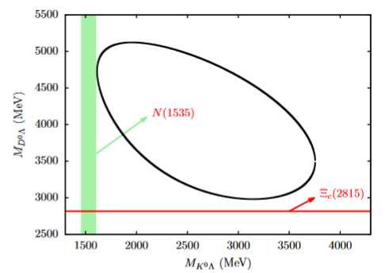
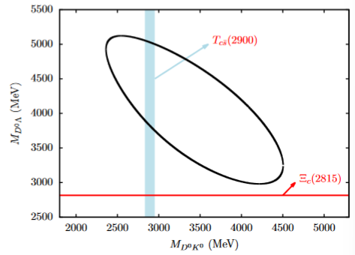
$ΛD$ interaction
Dalitz plots
Contribution from $ΛD$ interaction is neglected!
PRD 85 (2012), 114032

Slide 22
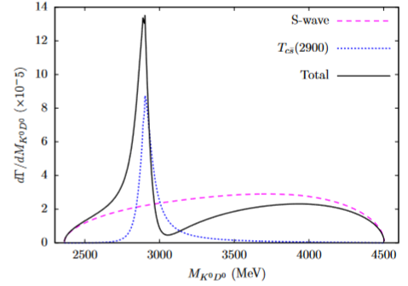
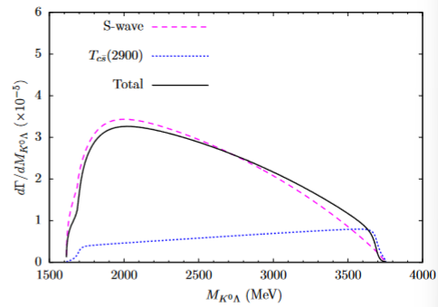
Results for $Λ_{b}→K^{0}D^{0}Λ$
Mass distributions

Slide 23
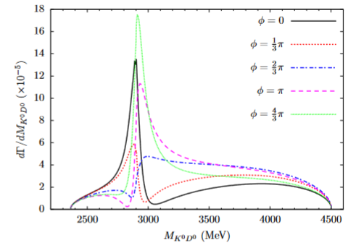
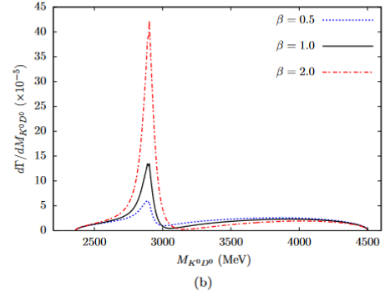
Results
Interference

Slide 24
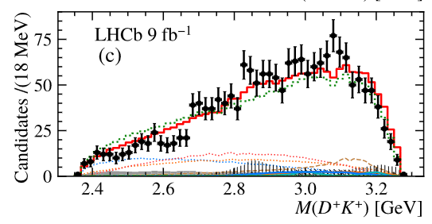
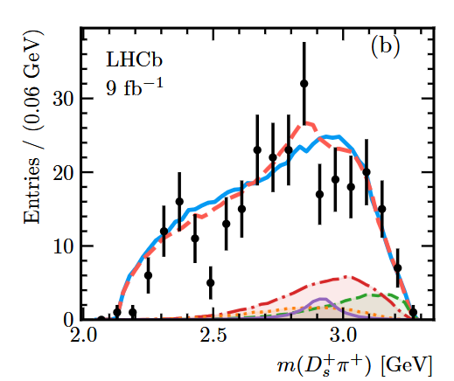
Some hints of $T_{c\overline{s}2}$
PRL133(2024)131902
JHEP08(2024)165

Slide 25
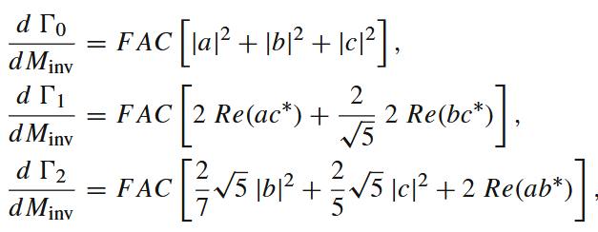
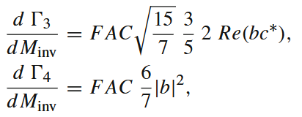
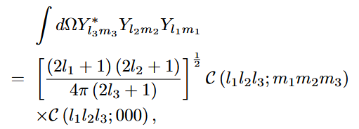
$$B^{+}→D^{∗−}D^{+}K^{+}$$
EPJC84 (2024) 12, 1302
Formalism
Angular moments

Slide 26
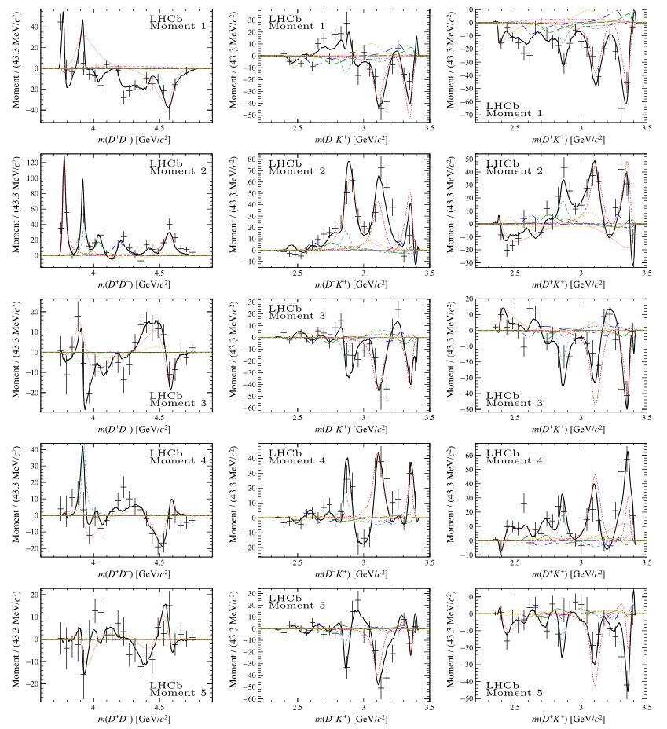
Angular moments
LHCb: PRD102(2020)112003
BESIII: PRD104(2021)012016
BABAR: PRD83(2011)052001
EW-DMLi, PLB821(2021)136617

Slide 27
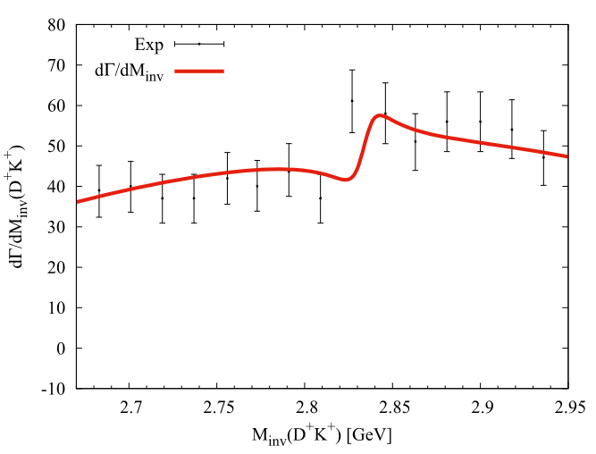
Results for J=0

Slide 28
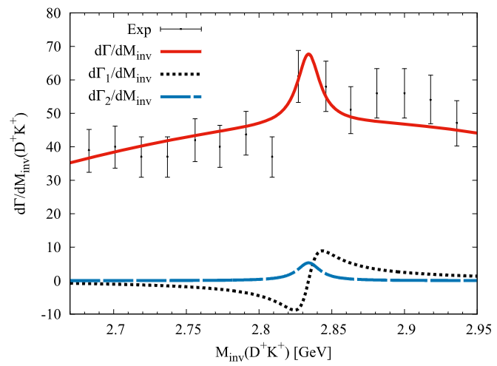
Results for J=1

Slide 29
Results for J=2

Slide 30
$B^{+}→D^{∗−}D_{s}^{+}π^{+}$
2501.02839

Slide 31
Summary
$T_{c\overline{s}0}(2900)$ could be explained as the virtual state within the hidden-gauge formalism.
Spin partner $T_{c\overline{s}2}$ is expected be more bound than $T_{c\overline{s}0}(2900)$.
The measurements of $B^{+}→D^{∗−}D^{+}K^{+}$ and $B^{+}→D^{∗−}D_{s}^{+}π^{+}$ show some hints for the predicted $T_{c\overline{s}2}$.
The angular mass distributions are very different for each of the spin assumptions $J=0,1,2.$
Thanks for your attention!

Slide 32
招聘-有编制，不是“非升即走”
感谢国内实验和理论同行的支持，郑州大学物理学院领导对粒子物理理论和实验的发展给予大力支持，包括进人指标
方向：粒子物理实验（BESIII，Belle II，ATLAS，JUNO，LHAASO，也包括LHCb等其他合作组），粒子物理理论
联系邮箱：
ipp@zzu.edu.cn

