Slide 1
Practical parametrization of two-pole structure
周智勇
东南大学
e-Print: 2502.15139
in collaboration with Junxi Cui and Zhiguang Xiao
2025年4月26日，华中师范大学，武汉东湖

Slide 2
Background
How to describe a resonance
The simplest Breit-Wigner
$$T=\frac{1}{M^{2}−s−i M Γ}$$
Or Breit-Wigner distribution with energy-dependent width
Blatt-Weisskopf Barrier Factors
$$T_{l}\left(s\right)=\frac{B_{l}^{2}\left(q\right)Γ}{M^{2}−m^{2}−i ρB_{l}^{2}\left(q\right)m_{0}Γ}$$
$$F_{0}\left(x\right)=1$$
$$F_{1}\left(x\right)=\sqrt{\frac{x}{x+1}}$$
$$F_{2}\left(x\right)=\sqrt{\frac{13x^{2}}{{\left(x−3\right)}^{2}+9x}}$$
$$⋯⋯$$
$B_{l}\left(q,q_{R}\right)=\frac{F_{l}(q)}{F_{l}(q_{R}) }$, $ρ_{i}=\frac{2q_{i}}{m}$
by Hippel and Quigg (1972)

Slide 3
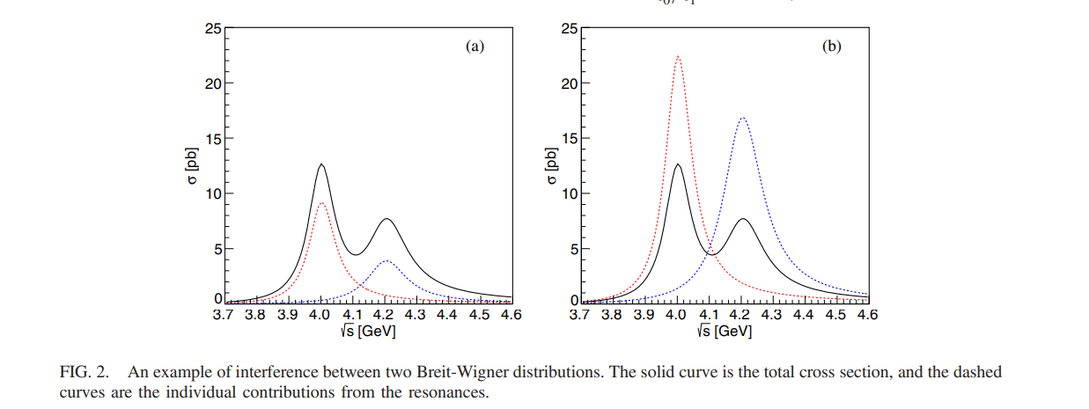
Motivation
What we should know about Breit-Wigner distribution in the experimental analysis
Only distribution, no correct analyticity structure
Multi-solution ambiguity
$n+1$ Breit-Wigner with $2^{n}$ solutions
of similar fit quality
K. Zhu et. al., IJMPA 26, 4511 (2011)
A. D. Bukin, arXiv:0710.5627
X. Han and C. P. Shen, CPC 42, 043001 (2018)
Y. Bai and D.Chen, PRD 99, 072007
PRD 99, 072007

Slide 4
Motivation
What we should know about Breit-Wigner distribution in the experimental analysis
Only distribution, no correct analyticity structure
Multi-solution ambiguity
No constraints from unitrarity

Slide 5
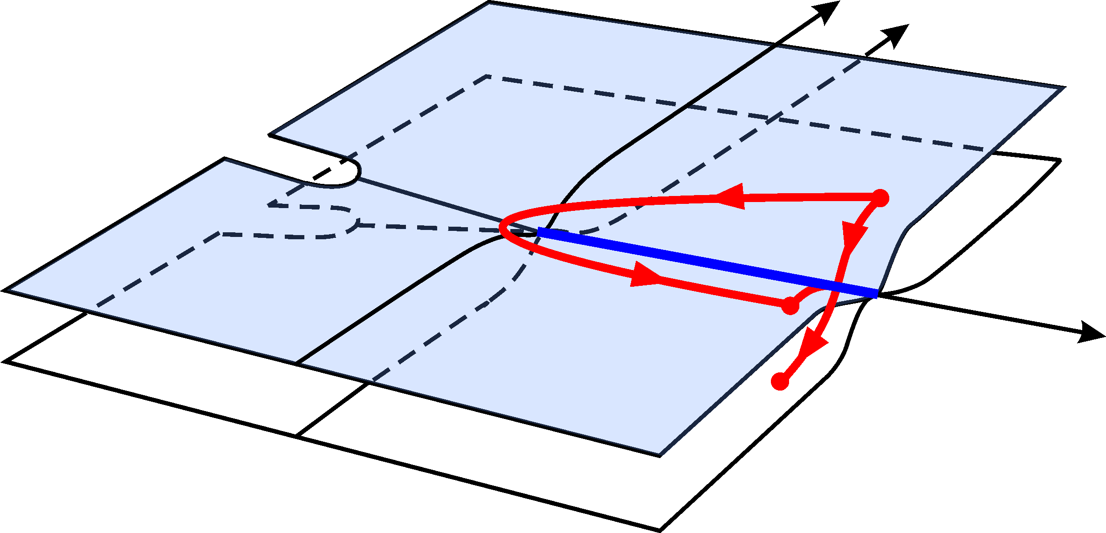
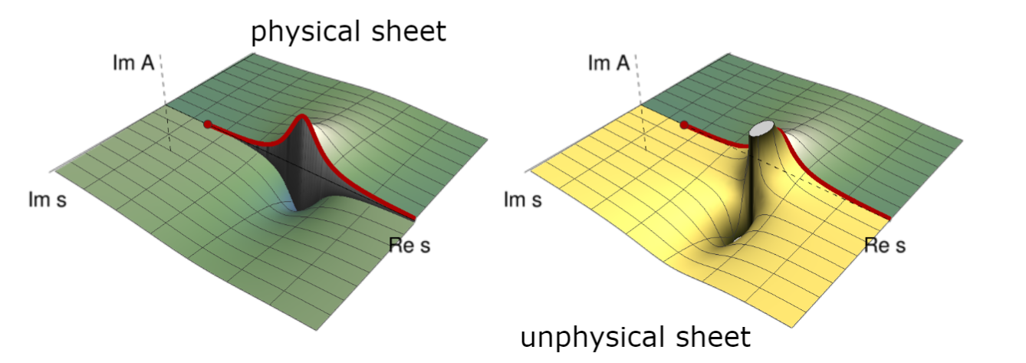
Background
How to describe a resonance
黎曼面结构
$${\left\langle p_{1}^{′}p_{2}^{′},b | iT|p_{1}p_{2},a\right\rangle }_{}=i{\left(2π\right)}^{4}δ^{4}\left(p_{1}+p_{2}−p_{1}^{′}−p_{2}^{′}\right)ℳ{\left(p_{1},p_{2};p_{1}^{′},p_{2}^{′}\right)}_{ba}$$
Disc $ℳ_{ba}=ℳ_{ba}−ℳ_{ab}^{∗}=i{\left(2π\right)}^{4}\sum_{c}{∫dΦ_{c}ℳ_{cb}^{∗}ℳ_{ca}}$
$$Imℳ_{ba}=\sum_{c}{ℳ_{cb}^{∗}ρ_{c}ℳ_{ca}}$$
Unitarity and analyticity
PDG review

Slide 6
Lee-Friedrichs model
Background
Gamow态的数学基础
Energy eigenfunction with a complex eigenvalue, proposed by G.Gamow to understand alpha decay.
However, in Hilbert space, a self-adjoint operator can only admit real eigenvalues. A rigorous treatment to Gamow state require an extension of Hilbert space to Rigged Hilbert space(RHS).
Lee-Friedrichs 模型
A solvable model to demonstrate the properties of Gamow state.
Several variants:
Lee model
Fano model
Anderson model
G.Gamow , Z.Phys. 51 (1928) 204-212
A.Bohm, M.Gadella, Dirac kets, Gamow vectors, and Gelfund Triplets, Springer Lectures Notes in Physics Vol.348, Springer, Berlin
K. O. Friedrichs, Communications on Pure and Applied Mathematics 1, 361 (1948).
T. D. Lee, Phys. Rev. 95, 1329 (1954),
U. Fano, Phys. Rev. 124, 1866 (1961).
P. W. Anderson, Phys. Rev. 124, 41 (1961).

Slide 7
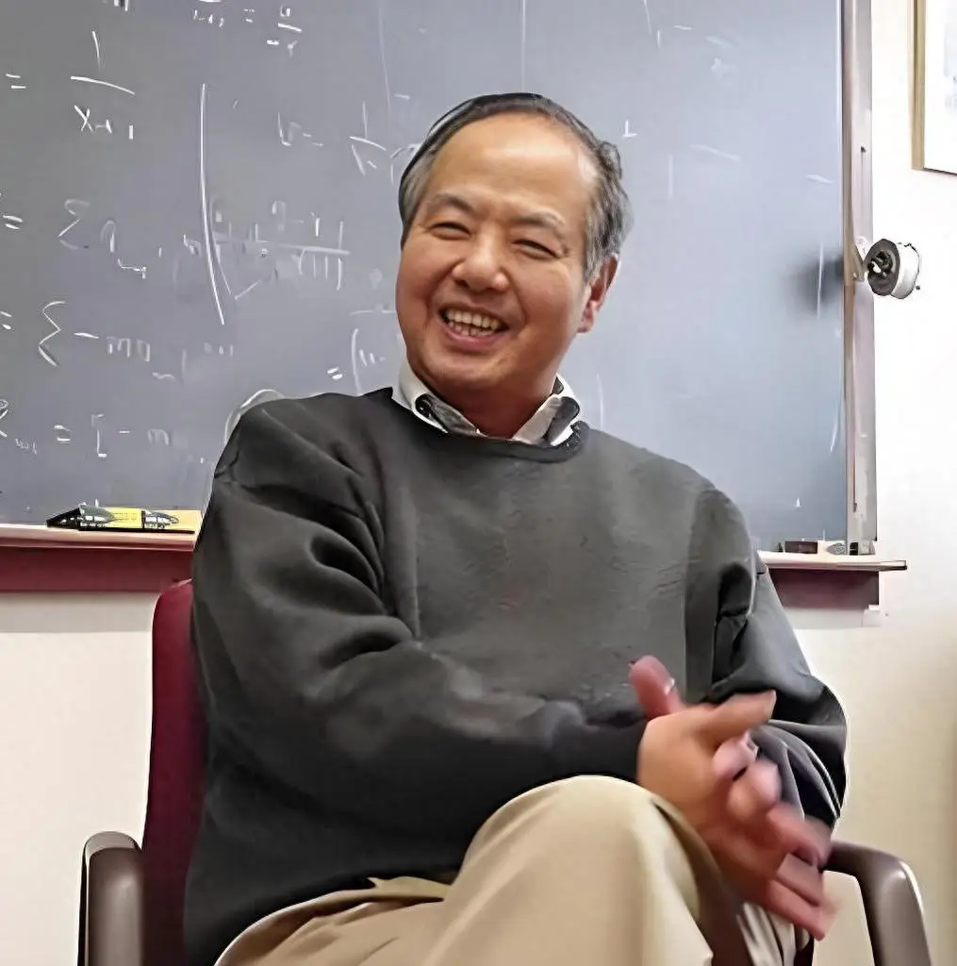
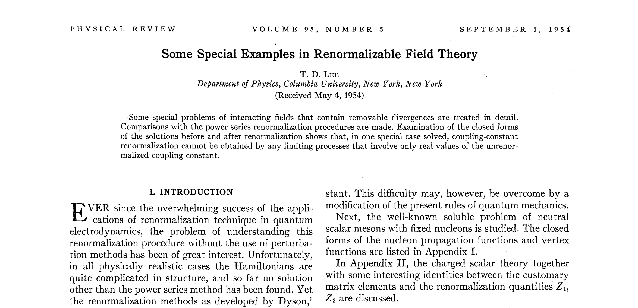
Lee-Friedrichs model
T. D. Lee, Phys. Rev. 95, 1329 (1954),

Slide 8
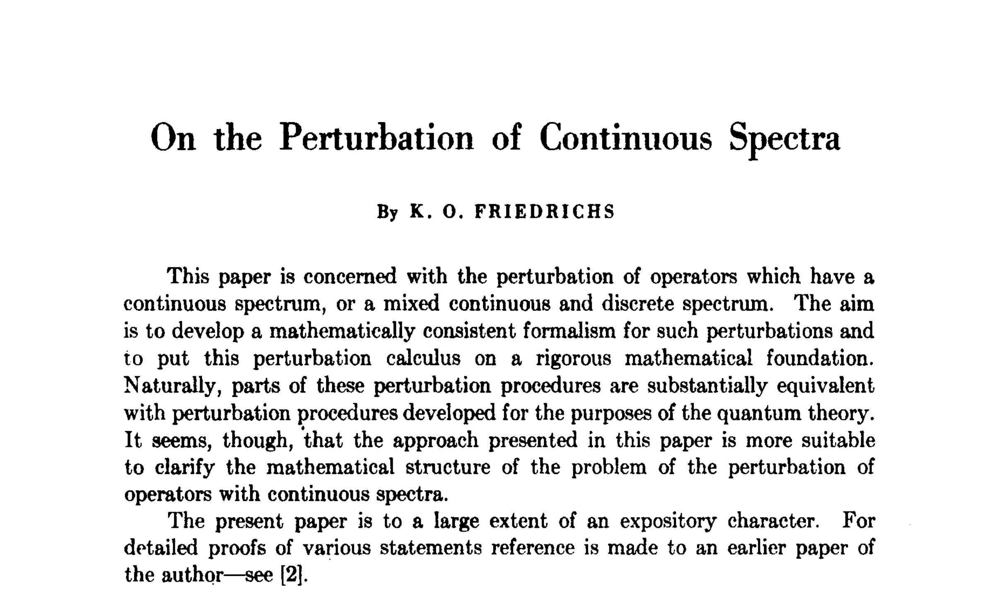
Lee-Friedrichs model
K. O. Friedrichs, Communications on Pure and Applied Mathematics 1, 361 (1948).

Slide 9
Extended Lee-Friedrichs scheme with multi discrete and continuous states
多粒子多道的Lee-Friedrichs框架
Arxiv: 2310.14937
Arxiv: 2304.07052
Hamiltonian
Scattering matrix
Cross section of $e^{+}e^{−}→hadron pairs$

Slide 10
Lee-Friedrichs parametrization
可以在实验分析中尝试，与Breit-Wigner参数化进行比较

Slide 11
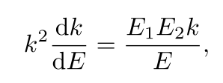
parametrization : (1,1) case Relativistic scenario
The (1,1) case 最简单情形，类比单道Breit-Wigner
Scattering matrix
Distribution function
Spectrum density function?
Phase space
Threshold constraints
Exponential suppression
Principlevalue integral
Numerically integrated

Slide 12
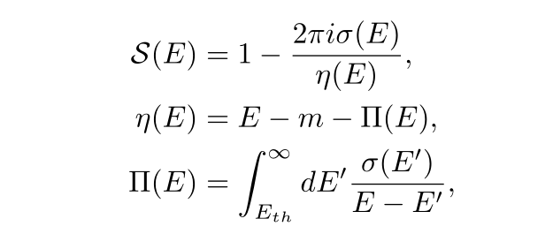
New parametrization : (1,1) case non-relativistic scienario
非相对论近似下，公式类似
Similar equations:

Slide 13
New parametrization : (1,1) case non-relativistic scienario
但是，色散积分可以解析积出来，并且具有正确解析结构
大大节省计算时间！！！

Slide 14
The（1,2)-case LF parametrization V.S. Flatté parametrization
The (1,2) case
类似于Flatté参数化
Dressed propagator
Scattering matrix
satisfy
Comparing with Flatté parametrization

Slide 15
(2,2)-case and general case
The (2,2) case 更一般的多道多共振情形
S-matrix element
Observables: as

Slide 16
Poles’ structure
共振极点结构

Slide 17
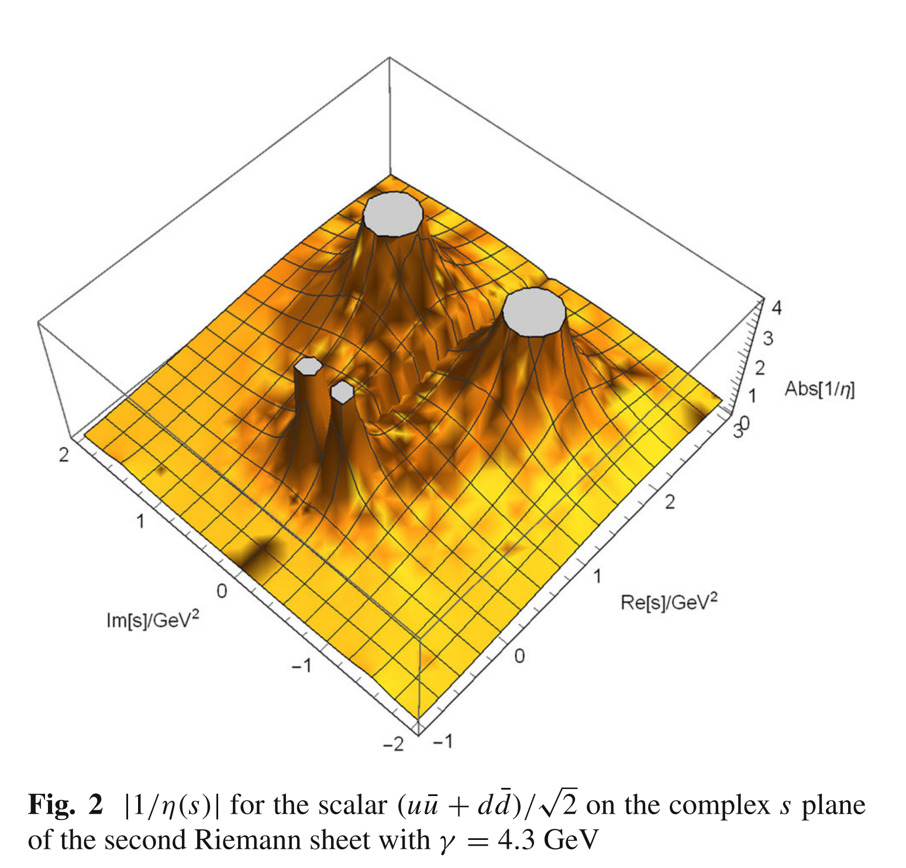
Relativistic Lee-Friedrichs-QPC scheme
Two-pole structure(双极点结构)
resolvent function
$$η\left(s\right)=s−ω_{0}^{2}−\int_{sth}{ds′\frac{ρ(s′)}{s−s^{′}+iε}}$$
$$ρ\left(s\right)≡2ω_{0}\frac{kE_{1}E_{2}}{\sqrt{s}}α{\left(k\right)}^{2}$$
双极点结构：一个裸态产生两个共振极点.
Phys.Rev.D 83 (2011) 014010
Eur.Phys.J.C 80 (2020) 12, 1191
Eur.Phys.J.C 81 (2021) 6, 551

Slide 18
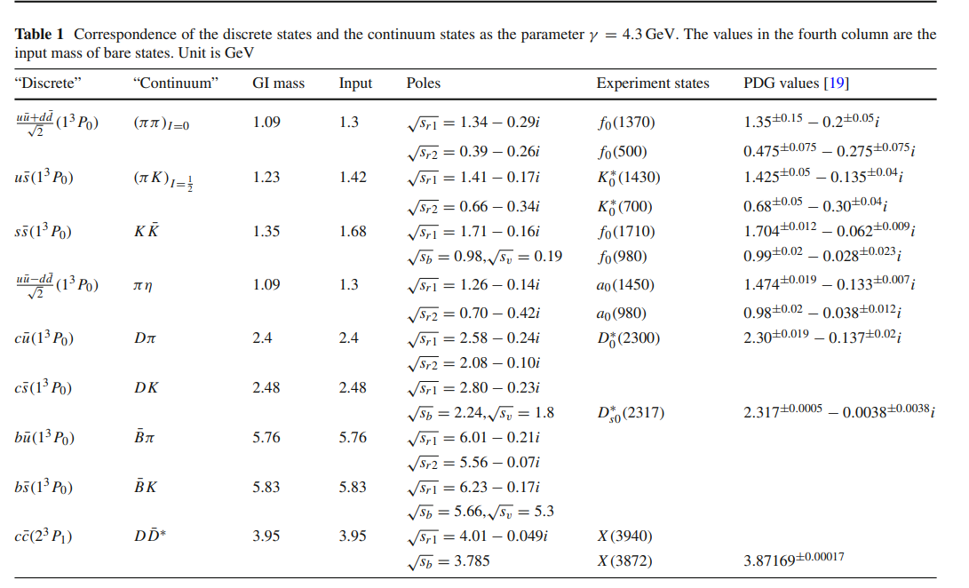
Two pole structure
猜测：双极点结构的普遍性（预言）
Eur.Phys.J.C 80 (2020) 12, 1191
Eur.Phys.J.C 81 (2021) 6, 551
An ambitious prediciton with only a few parameters in this scheme
(1) Some Bare Masses (2) a global coupling $γ$
强烈建议LHCb进行寻找，特别是最后一个，类似于$D_{s0}^{∗}(2317)$,窄共振
$χ_{c1}(4010)$ $4.012±0.031 GeV$
$$D_{b0}^{∗}(5720)$$

Slide 19
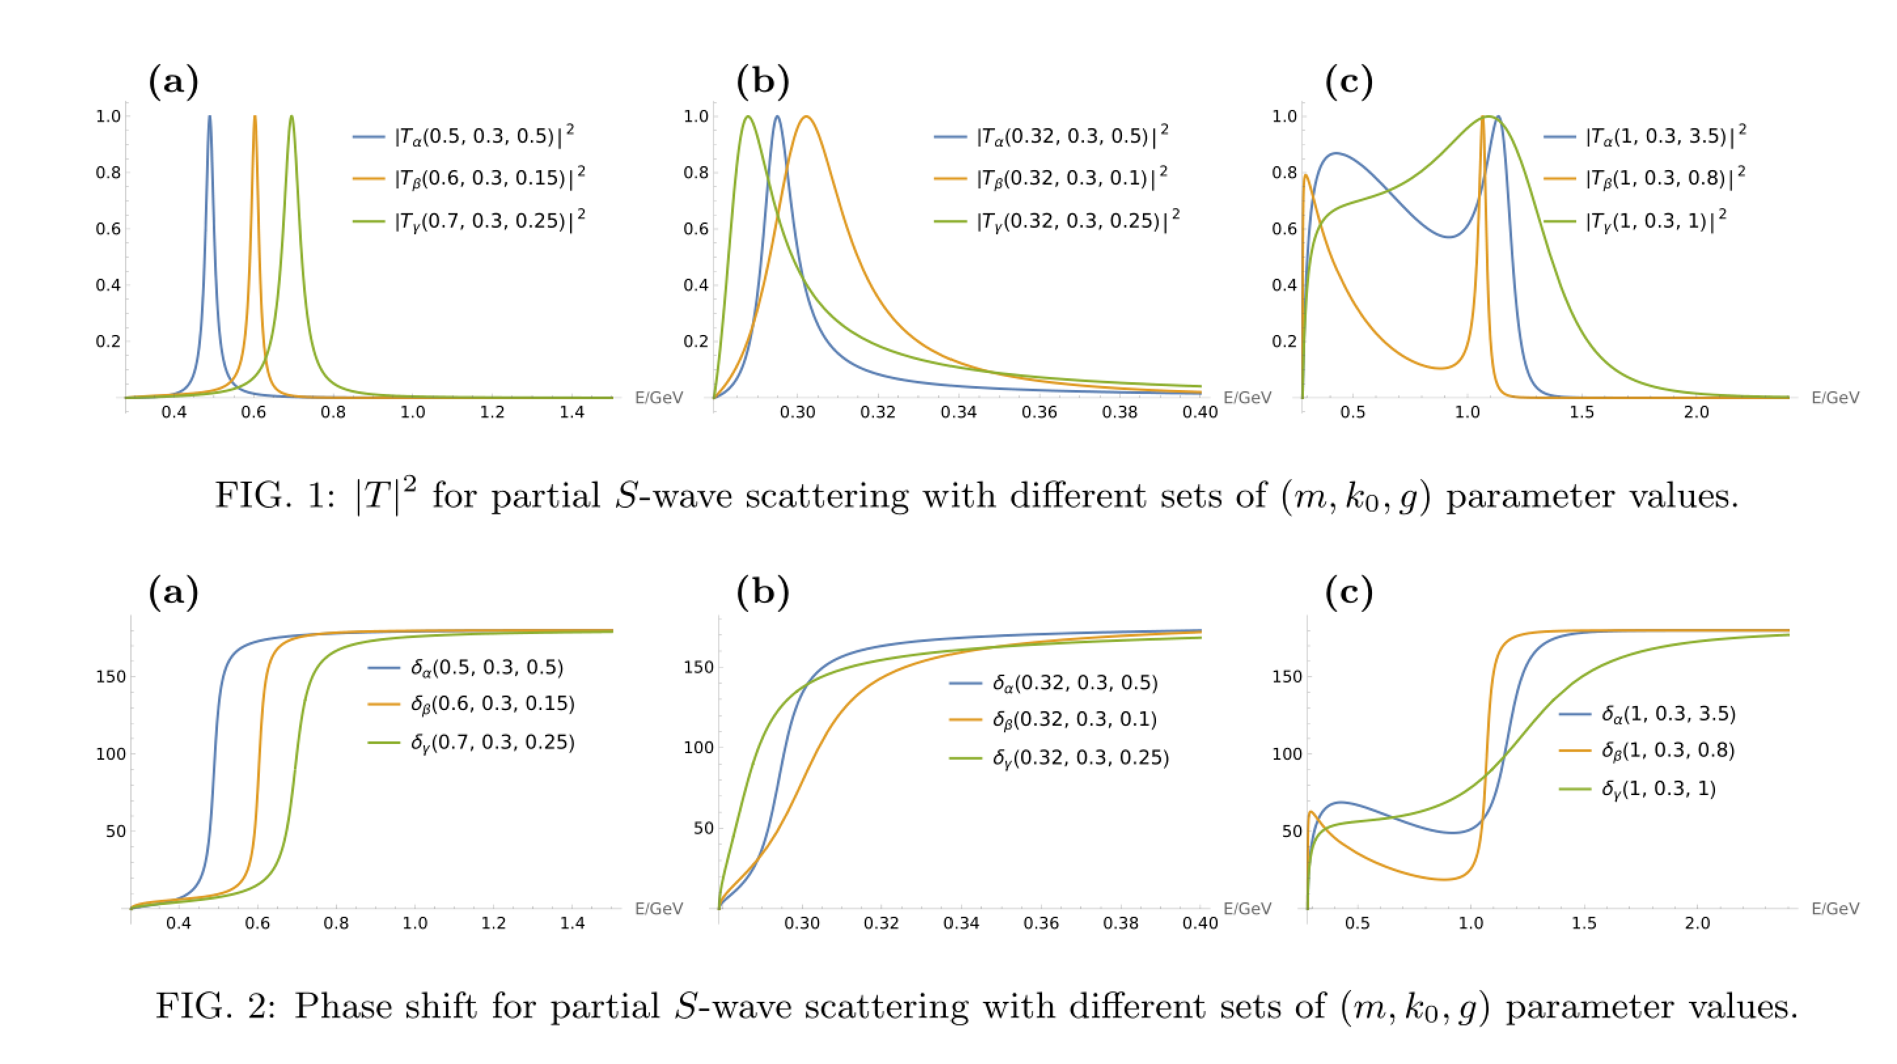
Sum rule of Phase shift for two-pole structure
线型（lineshape）和相位（phaseshift）会受到附近极点的影响

Slide 20
Several examples

Slide 21
$ρ(770)$: fit $ππ$ phase shift data

Slide 22
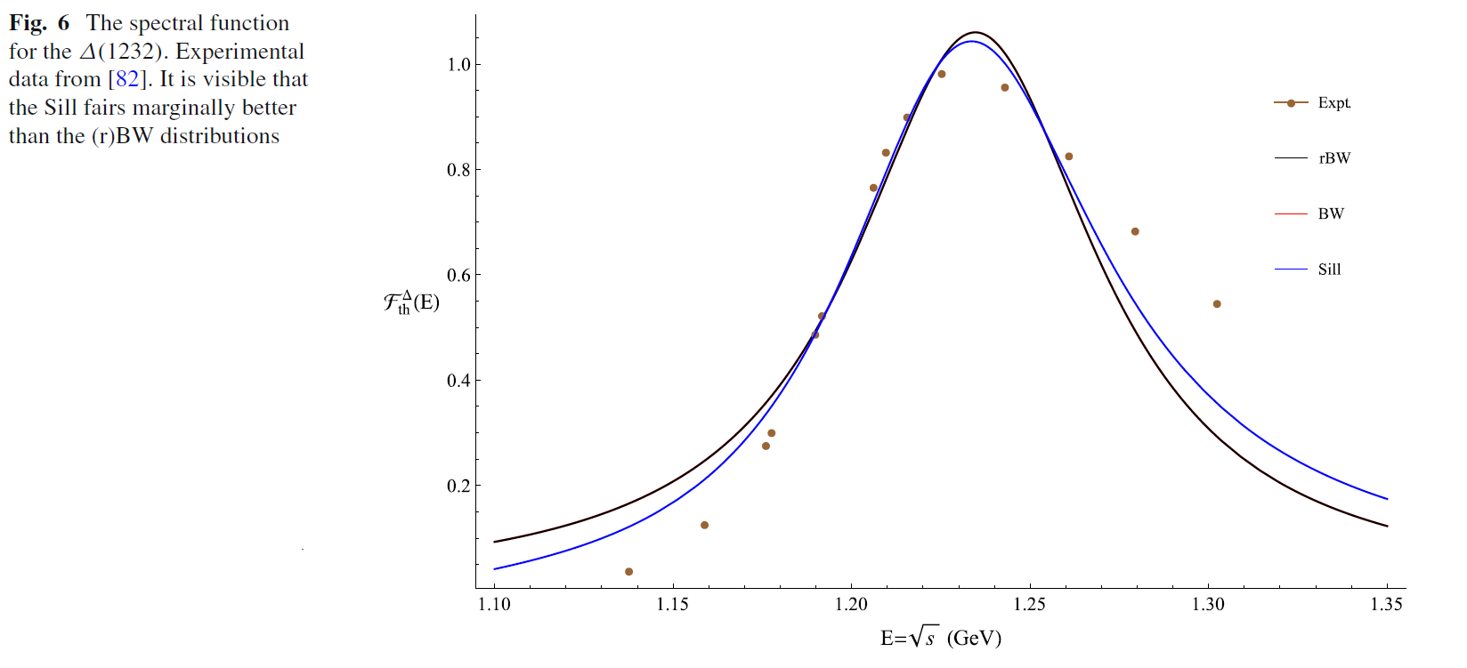
$Δ\left(1232\right)$ : fit $πp$ phase shift and cross section data
Asymmetric Lineshapes of $Δ(1232)$
Fit of traditional BW distribution and Sill distribution
Eur. Phys. J. A (2021) 57:336

Slide 23
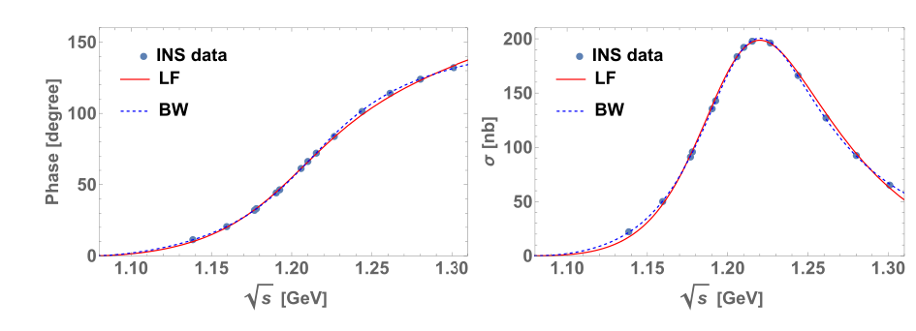
$Δ\left(1232\right)$ : fit $πp$ phase shift and cross section data
Asymmetric Lineshapes of $Δ(1232)$
Fit of LF distribution and improved BW distribution

Slide 24
$Δ\left(1232\right)$ : fit $πp$ phase shift and cross section data
Asymmetric Lineshapes of $Δ(1232)$
Fit of LF distribution and improved BW distribution
$1202−\frac{i}{2}88MeV$ $1370−\frac{i}{2}378MeV$
$Δ(1232)$ $Δ\left(1600\right)???$
这只是单道情形的结果，更严格应该是多道形式，存在$Nππ$阈

Slide 25
$K_{0}^{∗}\left(700\right)and K_{0}^{∗}(1430)$: fit $πK$ scattering phase and magnitude in $IJ=\frac{1}{2}0$
Only three parameters

Slide 26
$K_{0}^{∗}\left(700\right)and K_{0}^{∗}(1430)$: fit $πK$ scattering phase and magnitude in $IJ=\frac{1}{2}0$
RchPT fit result
M. Jamin, J. A. Oller, and A. Pich, Nucl. Phys. B 587, 331 (2000)

Slide 27
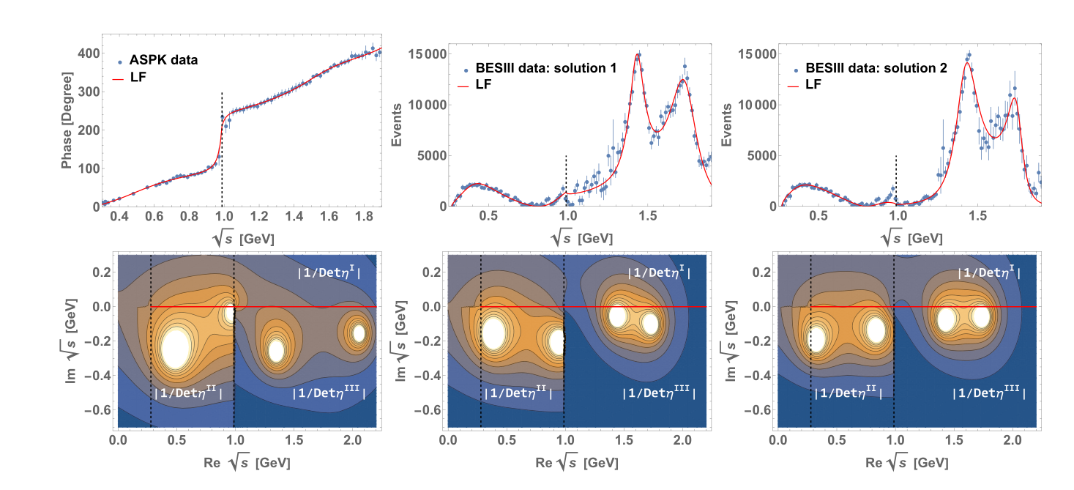
$f_{0}$: fit the BESIII data of $J/ψ$ $→γππ$

Slide 28
Some proposals about X(3872) and X(4012)
LHCb, Phys. Rev. Lett. 133(2024)131902

Slide 29
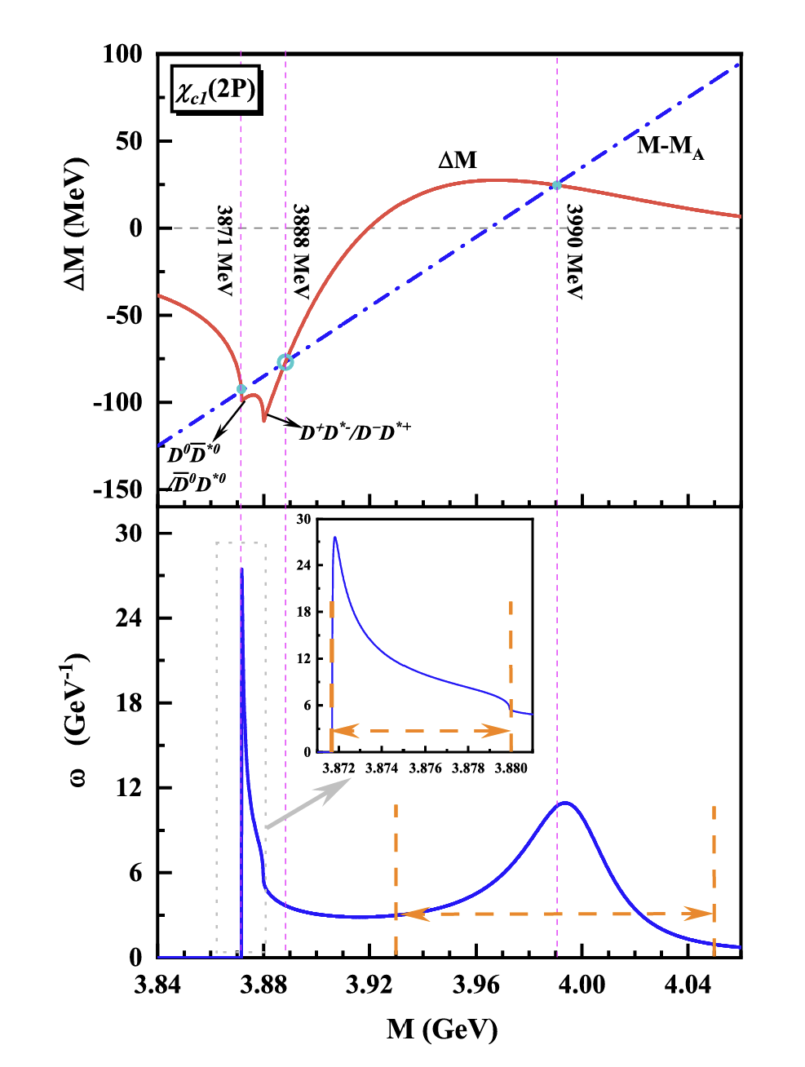
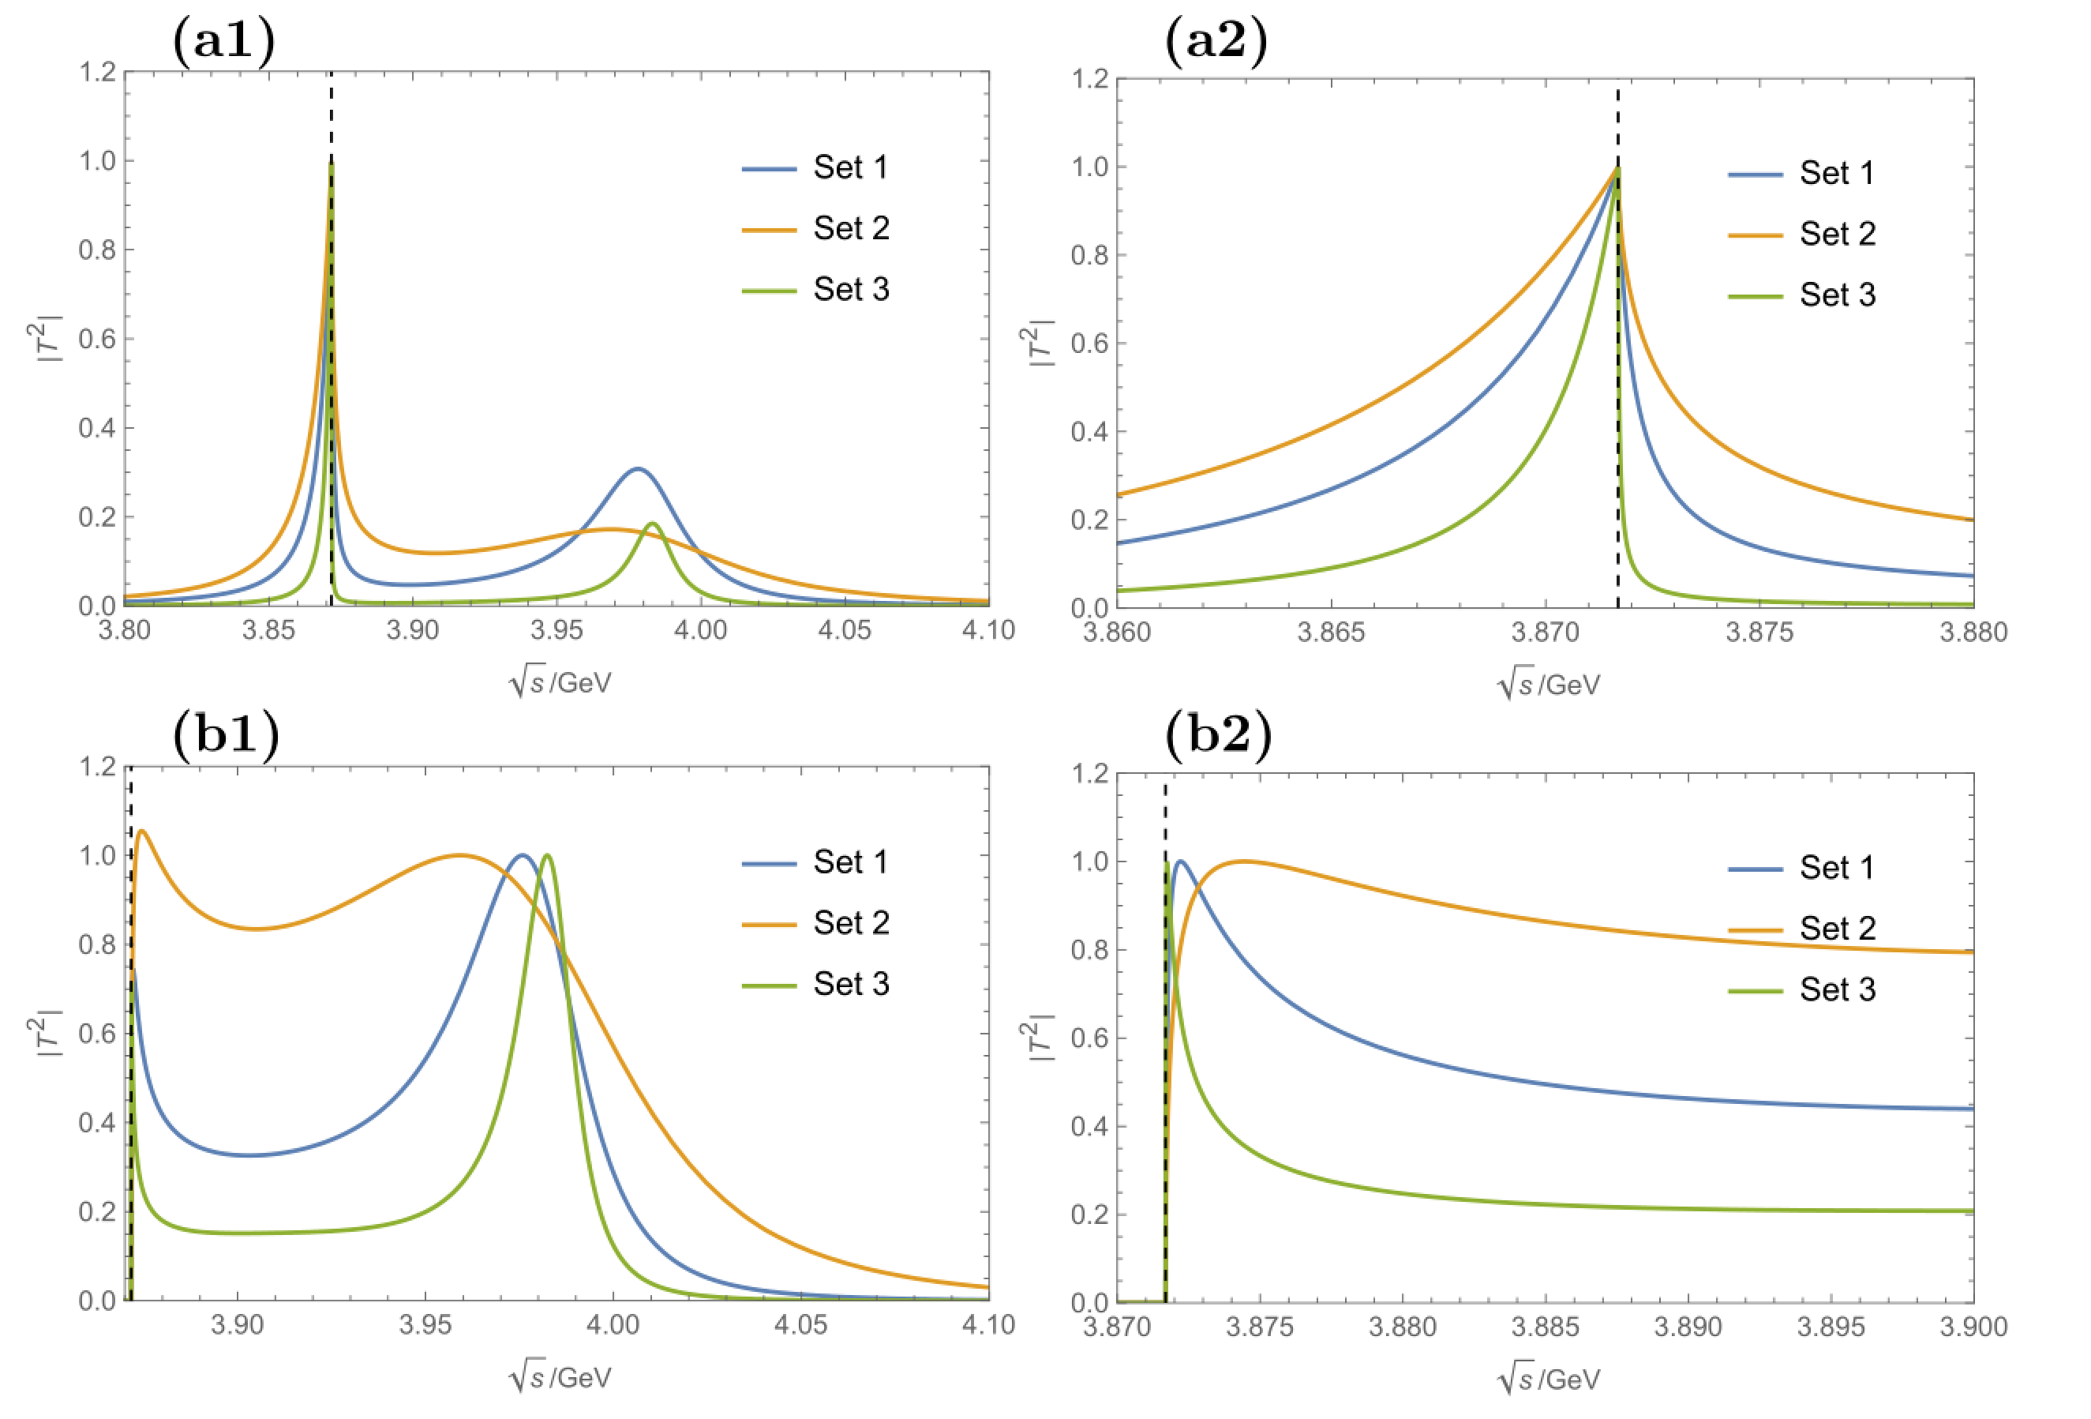
Some proposals about X(3872) and X(4012)
Conjecture: $χ_{c1}\left(2P\right)$ coupled to ${\overline{D}D}^{∗}$ generate $X(3872)$ and a higher state
Lee-Friedrichs parametrization:
Some lineshapes of $J/ψππ$ and$\overline{D}D^{∗}$with different parameter sets put by hand
ZYZ, Zhiguang Xiao, Phys.Rev.D 96 (2017) 5, 054031
$$J/ψππ$$
$$J/ψππ$$
$$\overline{D}D^{∗}$$
$$\overline{D}D^{∗}$$
Qian Deng, Ru-Hui Ni, Qi Li,Xian-Hui Zhong,
Phys.Rev.D 110 (2024) 5, 056034

Slide 30
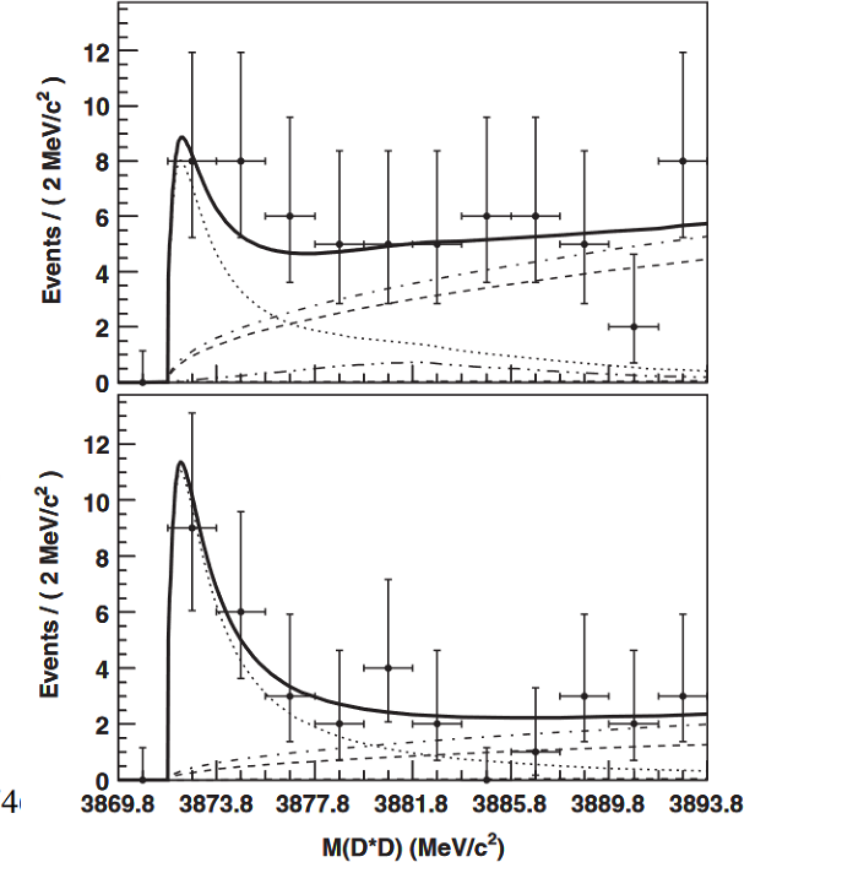
Some proposals about X(3872) and X(4012)
$$\overline{D}D^{∗}$$
$$J/ψππ$$
$$J/ψππ$$
$$\overline{D}D^{∗}$$
$$\overline{D}D^{∗}$$
$$\overline{D}D^{∗}$$

Slide 31
Some proposals about X(3872) and X(4012)
$$J/ψππ$$
$$J/ψππ$$
$$\overline{D}D^{∗}$$
$$\overline{D}D^{∗}$$
Use Lee-Friedrichs parametrization with fewer parameters

Slide 32
Summary
A simple parametrization based on Lee-Friedrichs model.
Parametrizing Two resonances (elementary one and dynamical one) might be economic and necessary.
Effectiveness of LF parametrization form need to be verified.
Suggestion of refitting $X(3872)$ and $X(4012)$ in such a form.
Strong suggestion of searching for $D_{b0}^{∗}(5720)$and other states by LHCb.

Slide 33
Thanks for your patience！
zhouzhy@seu.edu.cn

