Slide 1
Progress Report for CEPC FLM detector with SiC

Slide 2
OUTLINE
Description about CEPC FLM
Position 1
Incident Particle Selection
Geometric Design
10-bunch-crossing Simulation
Precision Calculation
Position 3
Conclusion and Next to do

Slide 3
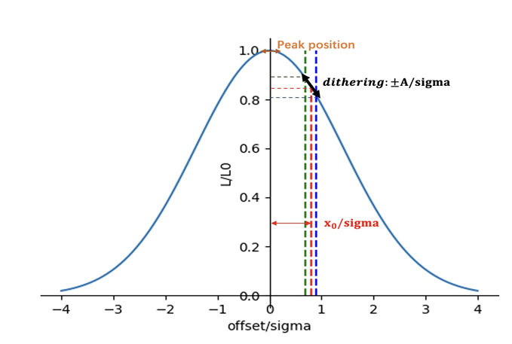
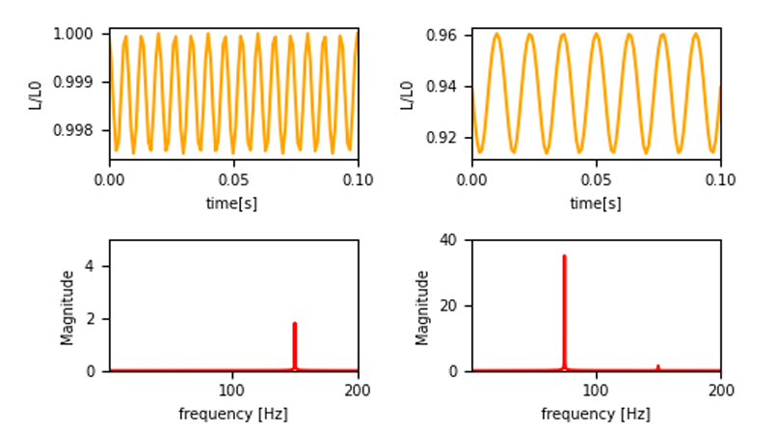
CEPC Fast Luminosity Feedback System

Slide 4
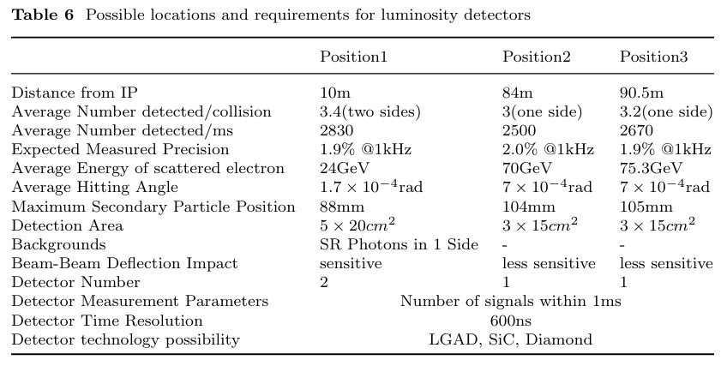
CEPC Fast Luminosity Feedback System

Slide 5
Position 1
Incident Particle Selection
10m≤S≤10.2m
Select Condition
|x| ≥28*cos(51°)

Slide 6
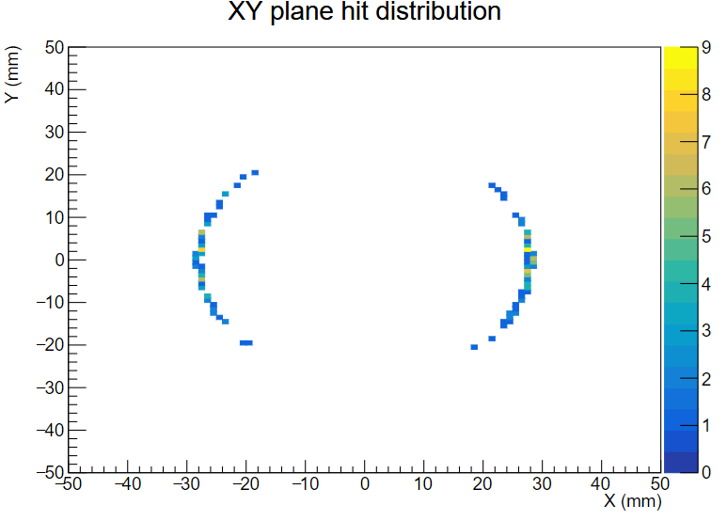
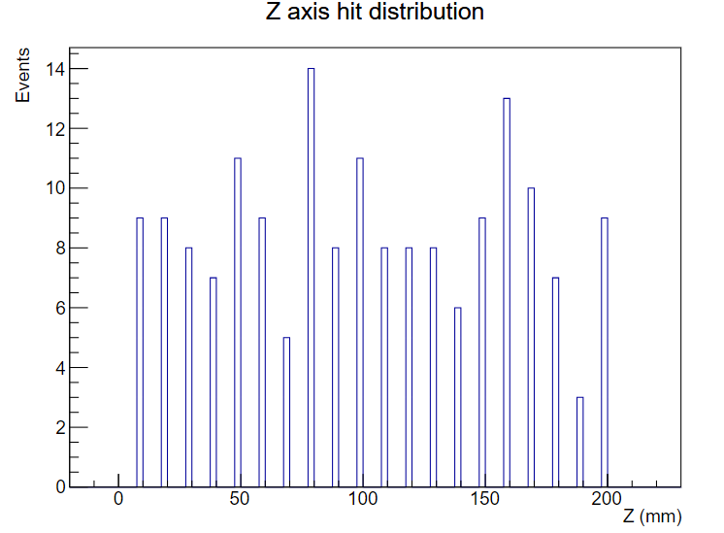
Position 1
Incident Particle Selection
z=(s-10)*1000mm

Slide 7
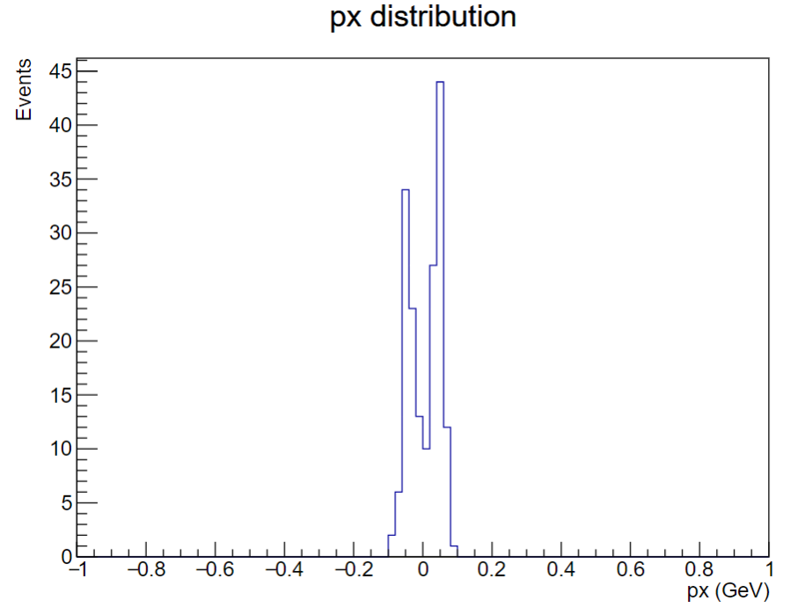
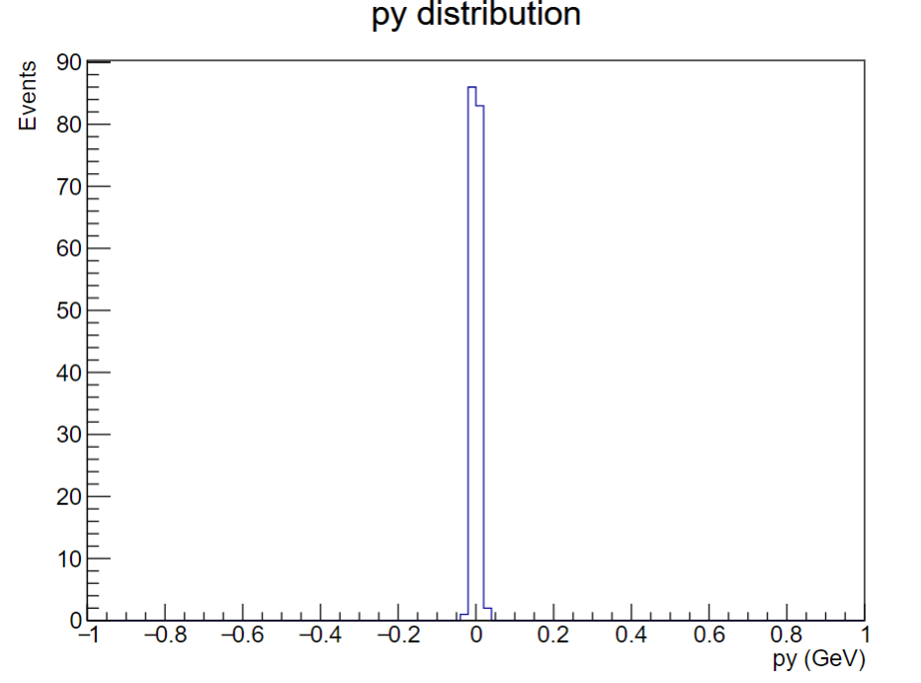
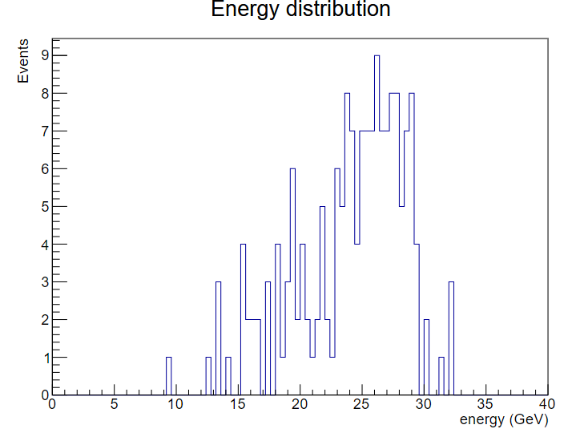
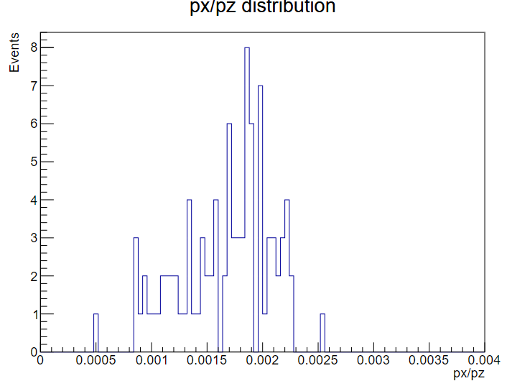
Position 1
Incident Particle Selection

Slide 8
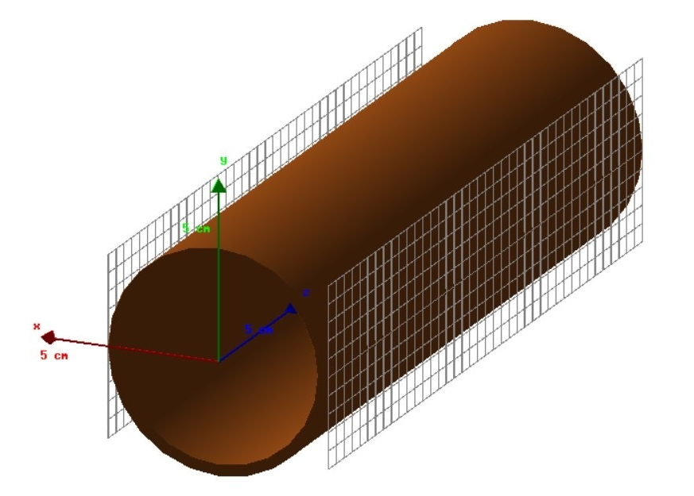
Position 1
Geometric Design
Geometric Dimensions: 5mm*5mm*100um
Y direction: 10, Z direction: 40 (total 400)
Double sides

Slide 9
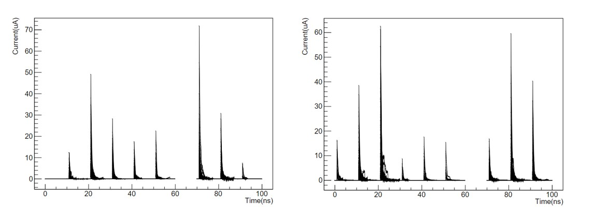
Position 1
10-bunch-crossing Simulation
Detector negative X-axis
Detector positive X-axis
In 10 bunch crossings, a response was generated in the detector 9 times
At t=60ns, no electrons hit the detection area, the detector did not respond, so the signal was interrupted at t=60ns
In the simulation, the time interval for each bunch crossing is set to 10ns, while the bunch crossing interval for CEPC is 600ns. Therefore, a 10-bunch-crossing can represent the response of the detector within 6us.

Slide 10
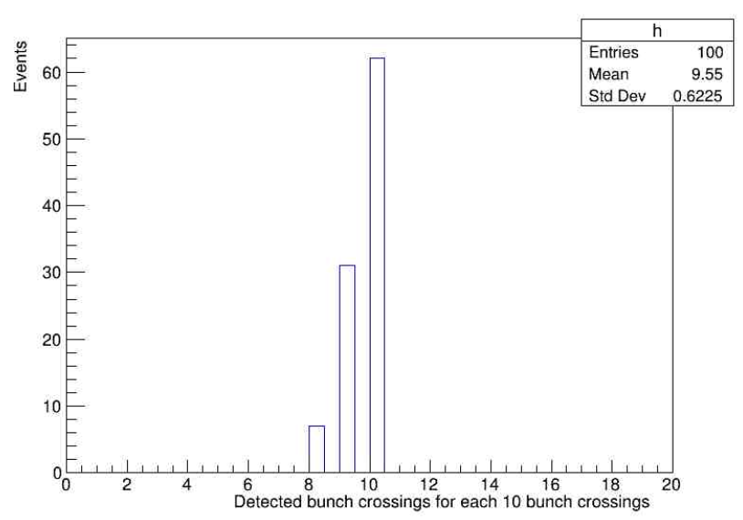
Position 1
10-bunch-crossing Simulation
To obtain statistical results, 100 sets of 10-bunch-crossings were simulated

Slide 11
Position 1
Precision Calculation
Time of signal generation within 1ms
Time required for a beam bunch to complete one round: $T_{round}=\frac{100km}{3∗{10}^{5}km/s}=333$us
For Higgs mode, the bunch only exists in half of the ring, $N_{bunch}=268$
Assuming the interval between beam bunches is $t_{interval}$=600ns
Total signal time for one round: $t_{sig}=N_{bunch}$* $t_{interval}=160us$, and total signal time in 1ms: $t_{sig}^{′}=\frac{1ms}{T_{round}}∗t_{sig}=480us$

Slide 12
Position 1
Precision Calculation
the number of bunch crossings we detect within 1ms
On average, 9.55 bunch crossings are detected in one 10-bunch-crossing, so the average number of bunches detected in 1ms is$N_{bc}$:
$$N_{bc}= \frac{t_{sig}^{′}}{t_{tw}}∗9.55=\frac{480us}{6us}=764$$

Slide 13
Position 1
Precision Calculation
the number of total Bhabha electrons we detect in 1ms and precision
Average Number detected/collision: $N_{0}$=3.4, and we can get the number of total Bhabha electrons we detect in 1ms and precision:
$N_{Bhabha}=$ $N_{bc}$* $N_{0}$ = 2598 (double sides, 1ms)
$v=\frac{1}{\sqrt{N_{Bhabha}}}= \frac{1}{\sqrt{1088}}$*100% = 1.96%±0.06% （double sides, 1ms）

Slide 14
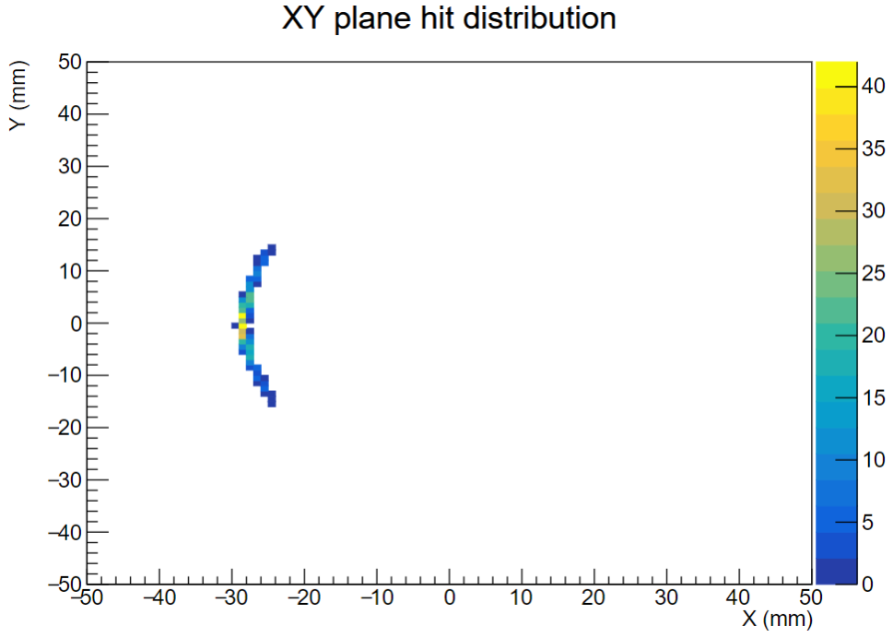
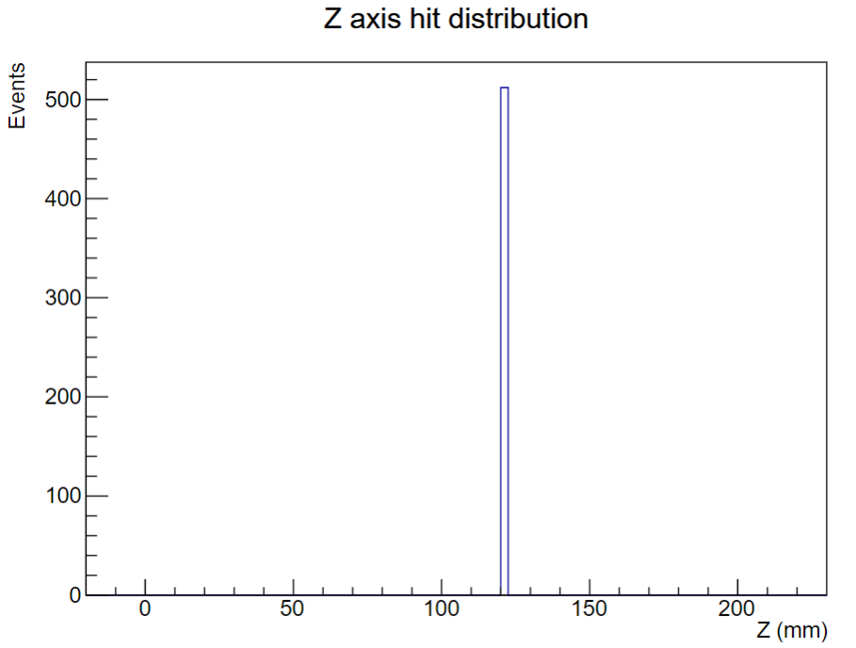
Position 3
Incident Particle Selection
90.35m≤S≤90.5m
Select Condition
X ≤-28*cos($\frac{61}{2}$°)

Slide 15
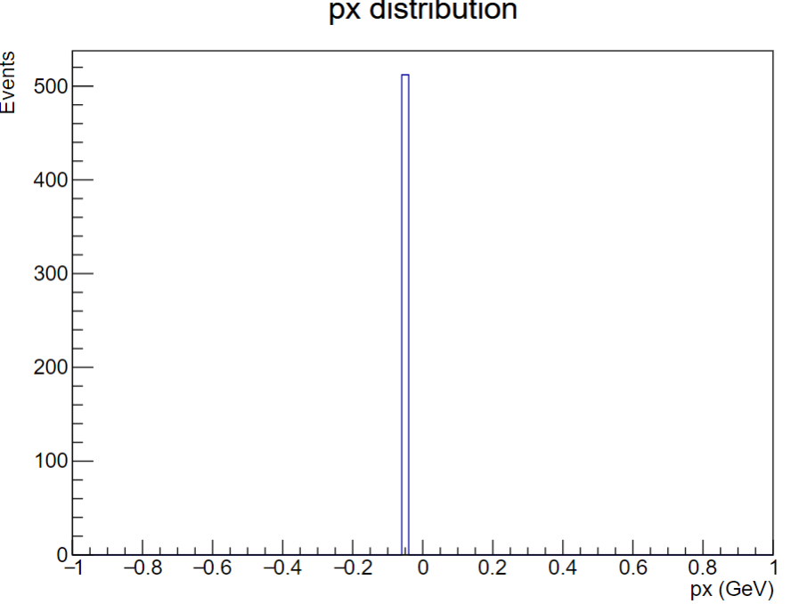
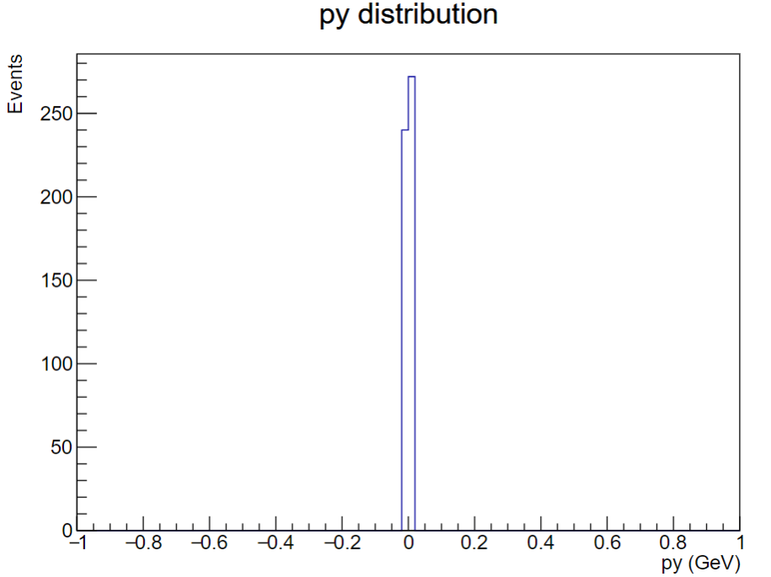
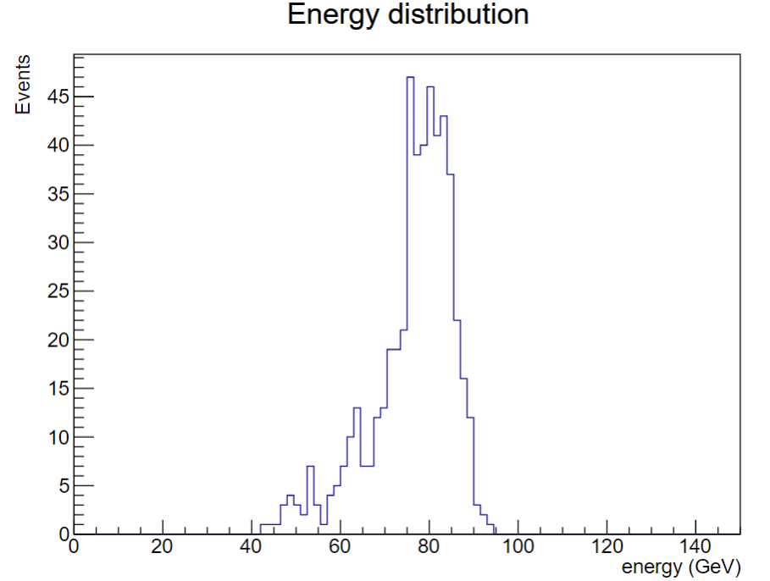
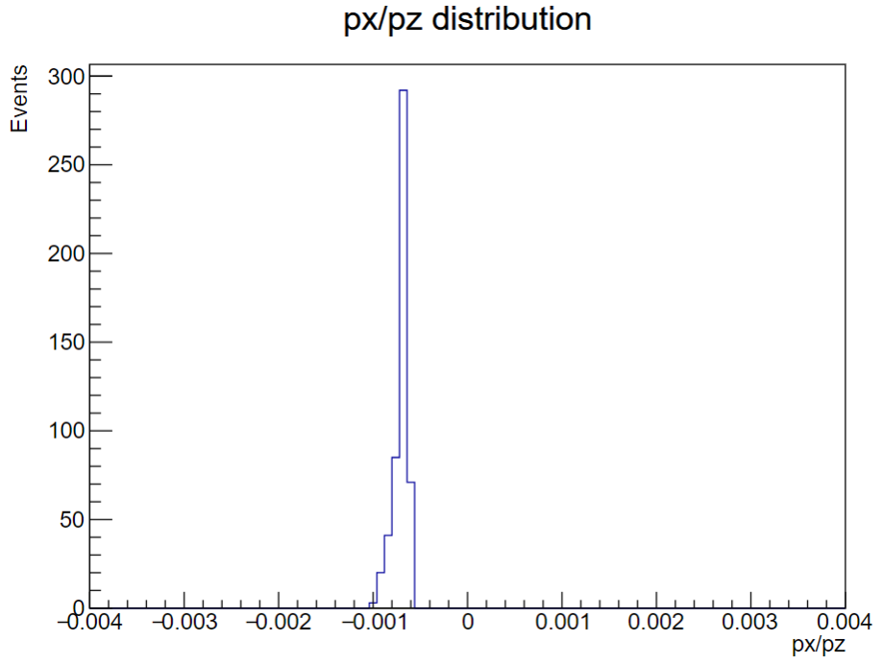
Position 3
Incident Particle Selection

Slide 16
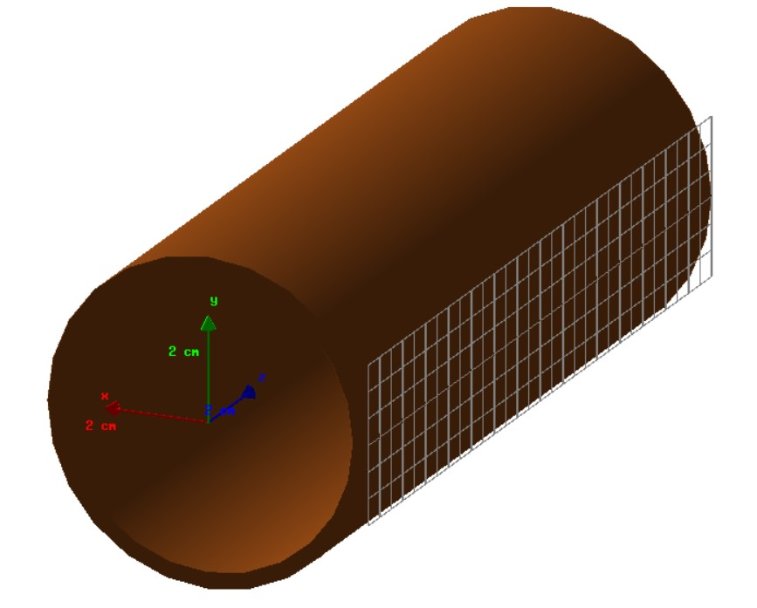
Position 3
Geometric Design
Geometric Dimensions: 5mm*5mm*100um
Y direction: 6, Z direction: 30 (total 180)
One side

Slide 17
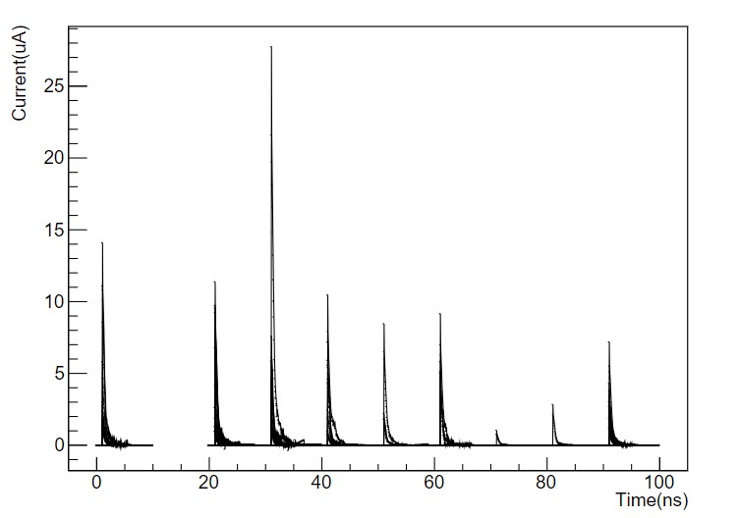
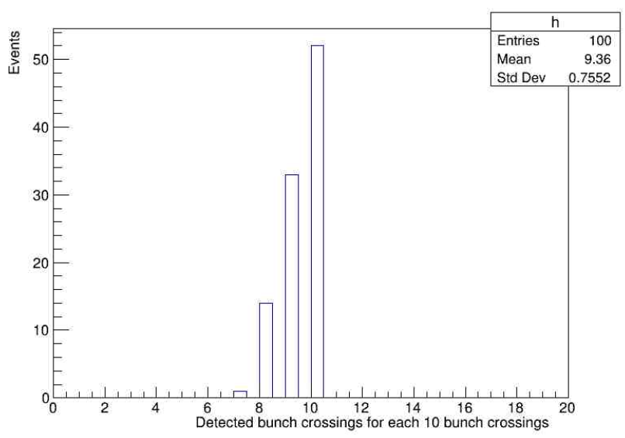
Position 3
10-bunch-crossing Simulation

Slide 18
Position 3
Precision Calculation
the number of bunch crossings we detect within 1ms
On average, 9.36 bunch crossings are detected in one 10-bunch-crossing, so the average number of bunches detected in 1ms is$N_{bc}$:
$$N_{bc}= \frac{t_{sig}^{′}}{t_{tw}}∗9.36=\frac{480us}{6us}=749$$

Slide 19
Position 3
Precision Calculation
the number of total Bhabha electrons we detect in 1ms and precision
Average Number detected/collision: $N_{0}$=3.2, and we can get the number of total Bhabha electrons we detect in 1ms and precision:
$N_{Bhabha}=$ $N_{bc}$* $N_{0}$ = 2396 (one side, 1ms)
$v=\frac{1}{\sqrt{N_{Bhabha}}}= \frac{1}{\sqrt{1088}}$*100% = 2.04%±0.08% （one side, 1ms）

Slide 20
Conclusion and Next to do
Conclusion
Without considering the trigger, under normal beam alignment conditions, the precision of the luminosity monitoring detectors at positions 1 and 3 are 1.96%±0.06% and 2.04%±0.08%, respectively.
Next to do
Explore the relationship between $N_{0}$ and the integrated signal amplitude/Identify the number of particles corresponding to each bunch crossing(BDT….)
Fabrication of devices

