Slide 1
Progress Report for CEPC FLM detector with SiC
Reporter： Yanpeng Li
2025.02.11

Slide 2
OUTLINE
Detect precision @50MW Higgs mode
The relationship between the integral of the current and N0 at Position 1
Conclusion and Next to do
About the reply

Slide 3
Detect precision @50MW Higgs mode
$N_{bunch}=268∗\frac{5}{3}$= 447 @50MW
The interval between beam bunches is $t_{interval}$=600ns
$N_{Bhabha}=$ $N_{bc}$ * $N_{0}$ = 4330 (double sides, 1ms)
$v=\frac{1}{\sqrt{N_{Bhabha}}}= \frac{1}{\sqrt{4330}}$*100% = 1.52%±0.01% （double sides, 1ms）
(Position 1)
$N_{Bhabha}=$ $N_{bc}$* $N_{0}$ = 3993 (one side, 1ms)
$v=\frac{1}{\sqrt{N_{Bhabha}}}= \frac{1}{\sqrt{3993}}$*100% = 1.58%±0.02% （one side, 1ms）
(Position 3)

Slide 4
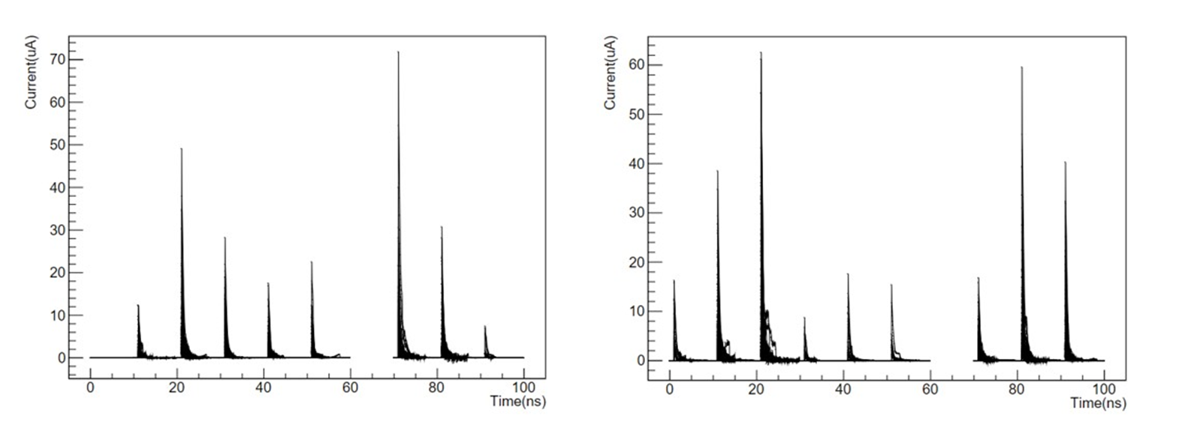
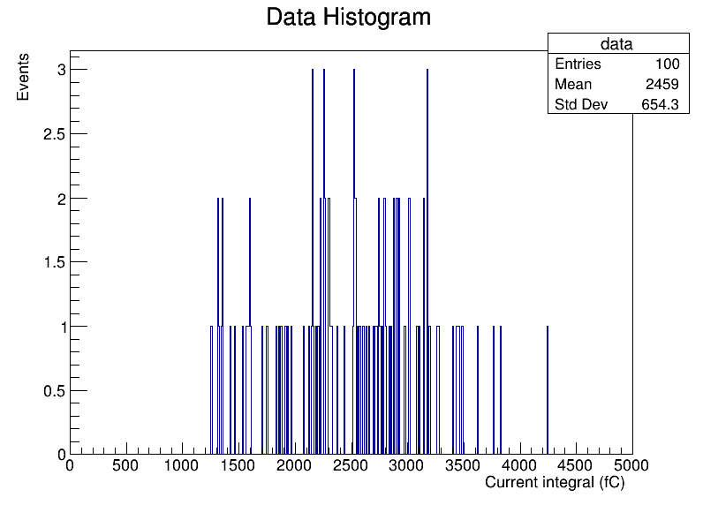
The integral of the current versus N0 at Position 1
Detector negative X-axis
Detector positive X-axis
Integrate over each 10-bunch-crossing (100ns, simulation ~ 6μs, reality)
all pixels with response on both sides of the detect area.
Integration step: 1ps, Simpson’s integration method.
Record the integration results of 100 sets of 10-bunch-crossings to obtain statistical results.

Slide 5
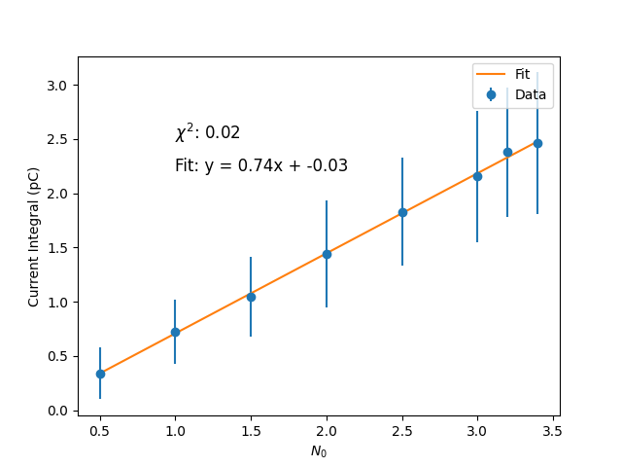
The integral of the current versus N0 at Position 1
$^{2}$ fit:
y=0.74x-0.03

Slide 6
Conclusion and Next to do
Conclusion
Detect precision @50MW Higgs mode is 1.52%±0.01% (Position 1) and 1.58%±0.02% (Position 3), respectively.
The current integral has a linear relationship with N0, therefore N0 can be inferred based on the current integral.
Next to do
The relationship between the integral of the current and N0 at Position 3 (Data file calibration)
study the impact of photons

Slide 7
About the reply

