Slide 1
CEPC探测器超导磁体
2025-01

Slide 2
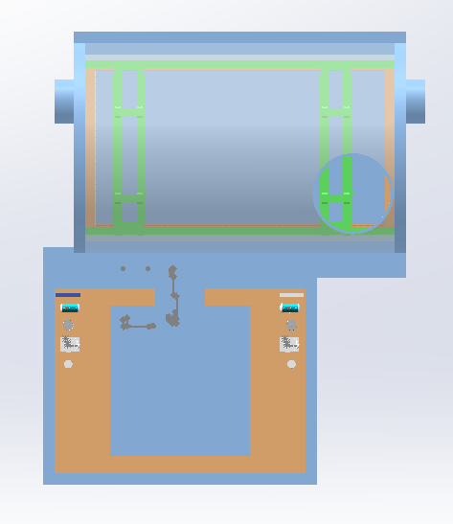
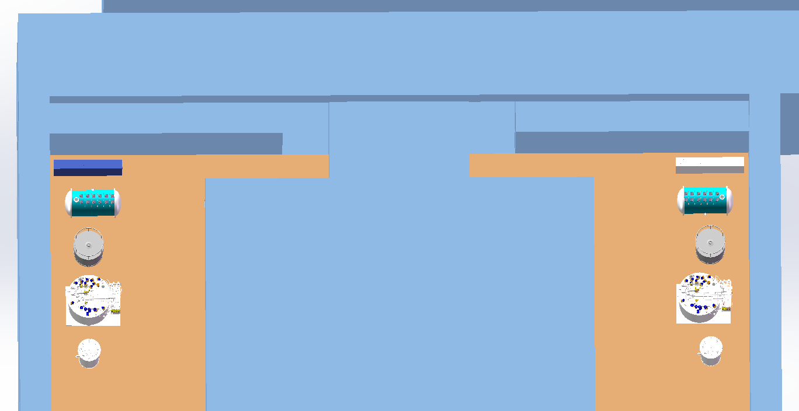
4.7m
5.3m
磁铁恒温器侧
探测器恒温器侧
14.2m

Slide 3
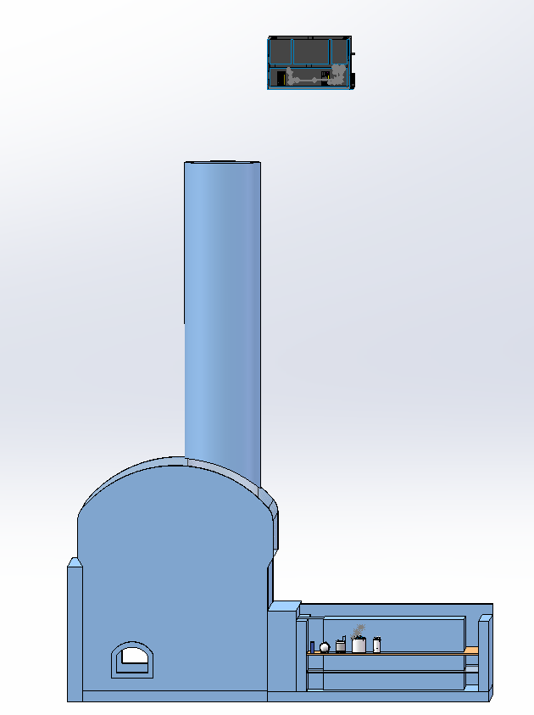
4m

Slide 4
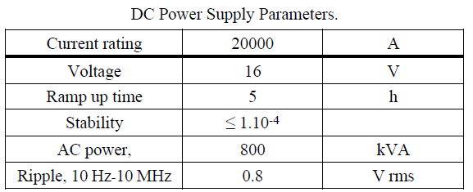
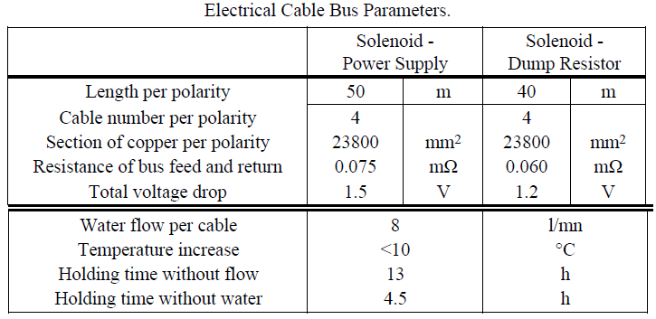
Solenoid Magnet
DC Power Supply: 20kA power supply: 3 m x 4 m with a height of 2.5 m and a weight of about 7 tones.
Breakers CP: The two 20 kA breakers are air cooled and must support an opening voltage of 1000 V. They are housed in a cabinet attached to the power supply in the cryogenic cavern of about 3 m x 4 m, height 2 m and weight about 5 tones.
Dump Resistor And Breakers CR: The estimated volume of the dump resistor housing and its electrical lines is about 100 m³.
Electrical lines: The 20 kA electrical buses between the power supply, the solenoid and the dump resistor are made of water-cooled copper cables. The space occupied in section by each cable bus is of 450 x 450 or 900 x 200 mm², depending whether the cables are disposed in a flat or square arrangement.
22
4

Slide 5
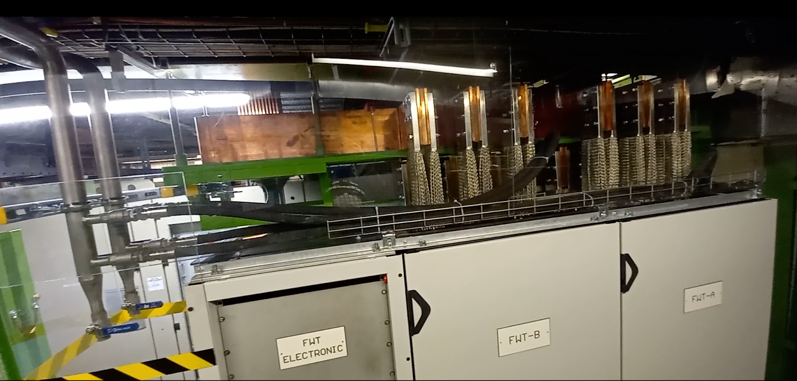
DC Power Supply

Slide 6
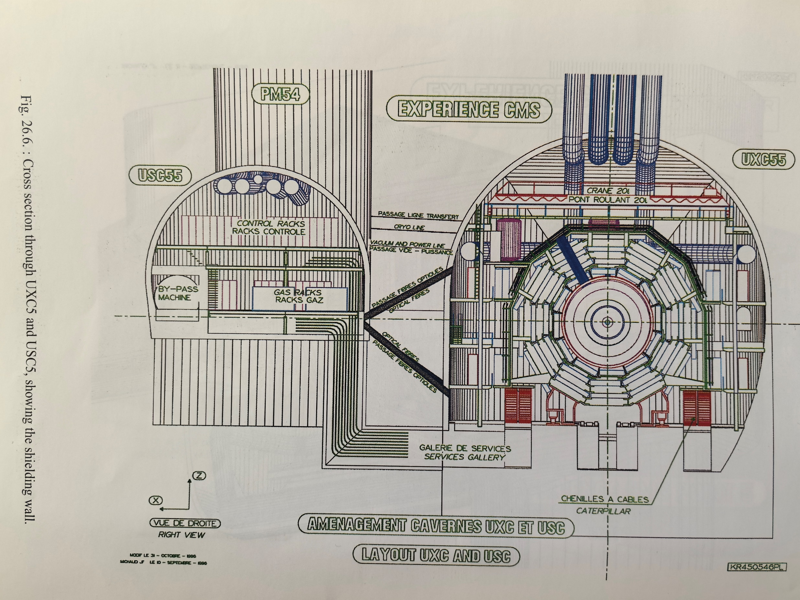

Slide 7
电源间布局
 | 长（米） | 宽（米） | 高（米）
DC Power supply | 4 | 3 | 2.5
Breakers CP | 4 | 3 | 2
Dump Resister | 7 | 6 | 2.5
DC Power Supply
Breakers CP
Dump Resistor

Slide 8
机械结构

Slide 9
机械结构

Slide 10
低温系统
The cold box will be connected to the magnet via an intermediate cryostat (see Fig. 21.2), which will house all the cryogenic valves needed to pre-cool the magnet and its heat shield. The intermediate cryostat includes a 5000 l reserve of liquid helium to allow the magnet slow discharge in the event of failure of the cryogenic system or other facilities.
根据超导磁体系统的热负荷和运行条件（LHC技术停机期间的热序列、冷却时间和失超恢复），决定使用功率为1.5千瓦@4.5K（等熵等效）的制冷机。冷盒的上部包含一组液氮/液氦换热器，用于将磁体冷却至100K。此外，液氮预冷应允许在必要时增加工厂的液氦液化。冷盒将通过一个中间低温容器（见图21.2）连接到磁体，该容器将容纳所有预冷磁体及其热屏所需的低温阀门。中间低温容器包括一个5000升的液氦储备，以便在低温系统或其他设施发生故障时允许磁体缓慢放电。

