Slide 1
Acceleration of CGEM Digitizer

Slide 2
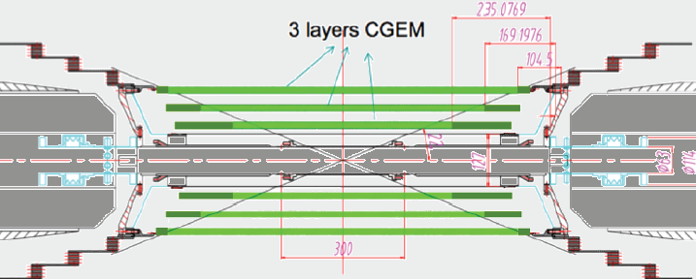
Introduction
3 layer Cylindrical GEM
Simulation procedure
Each layer composed by 3 gem foils, a cathode and an anode
CGEM cluster
Geant4
Index of fired strips, T & Q
Electronics Measurement
Anode
Induction
Time Consuming
GEM3
Particle type, charge,
momentum,
trajectory
GEM2
Drift and Avalanche
GEM1
Digitization
Ionization
Cathode

Slide 3
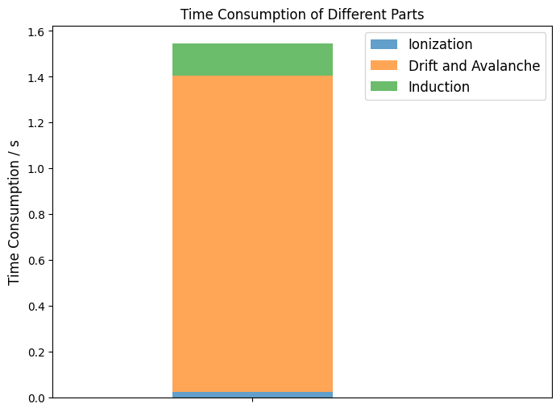
Drift and Avalanche
Induction
Problem:
Too many electrons! → Too many sampling!
Problem:
Many time bins in induction
Solution:
Pre-generate random numbers in memory in initialing, using them rather than generating random numbers in real time
Modify the code to improve code spatial locality to fully utilize CPU cache
Take advantage of compiler
Solution:
Reduce the numbers of time bins from 2000 to 1200

Slide 4
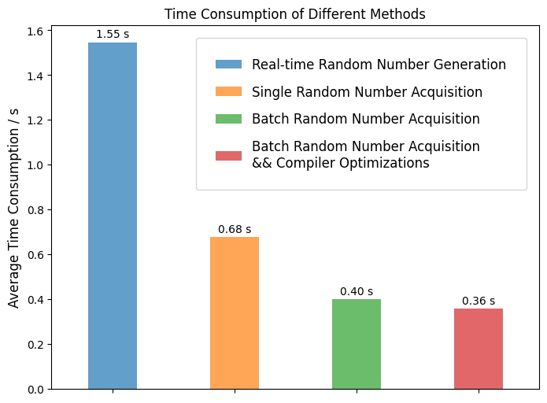
Per CGEM cluster
$π^{+}:$ p (0.02 ~ 1.4) GeV/c, $cosθ$ (-1,1), $φ$ (0,$2π$)
Real-time: using G4Gassian() to generate one random number when needed in real time
Single Acquisition: Pre-generated random numbers in memory in initialing, get one random number when needed & time bins reduction
Batch Acquisition: Pre-generated random numbers in memory in initialing , get a batch of random numbers when needed & time bins reduction
Batch Acquisition & Compiler Optimizations: Batch Acquisition with (g++ -ffast-math -mavx2)
(-ffast-math: complier flag for floating-point number
-mavx2: hardware-related, avaliable after 2013 for Intel and after 2017 for AMD)
4 times faster!

Slide 5
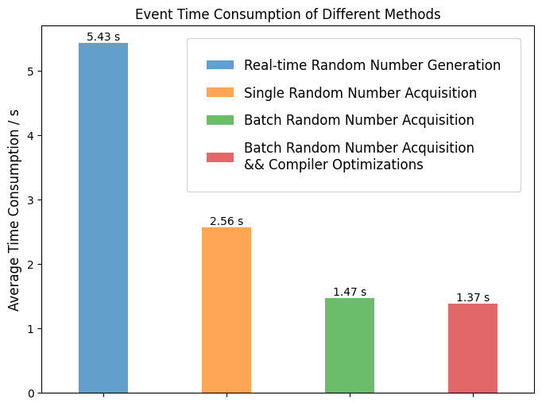
Per Track (Only CGEM)
$π^{+}:$ p (0.02 ~ 1.4) GeV/c, $cosθ$ (-1,1), $φ$ (0,$2π$)

Slide 6
T, Q distribution comparison
consistent

Slide 7
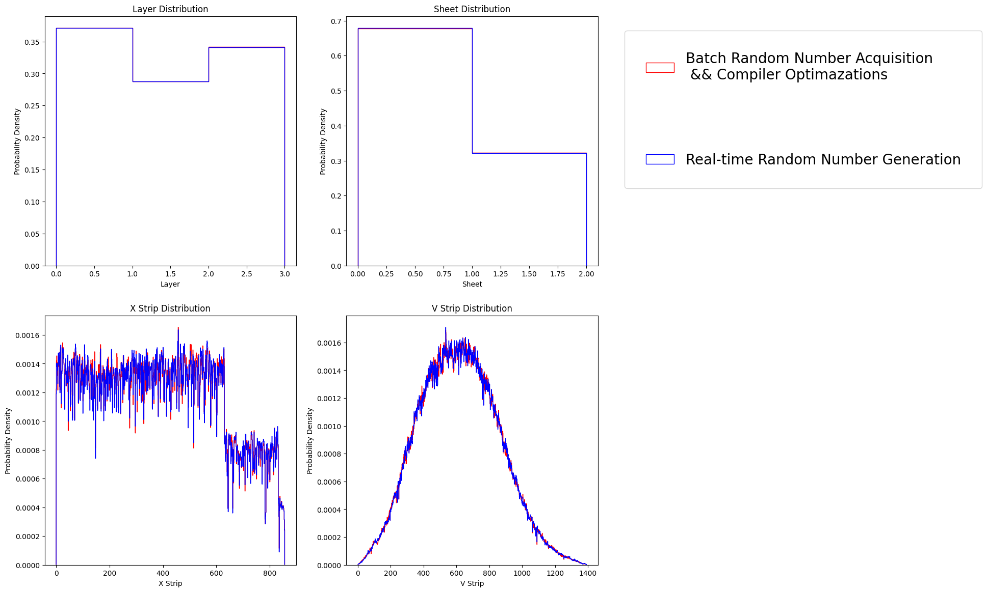
consistent

Slide 8
Summary
Acceleration of CGEM digitizer has been primarily completed
4 times faster
consistent results of CGEM digits with original digitization

Slide 9
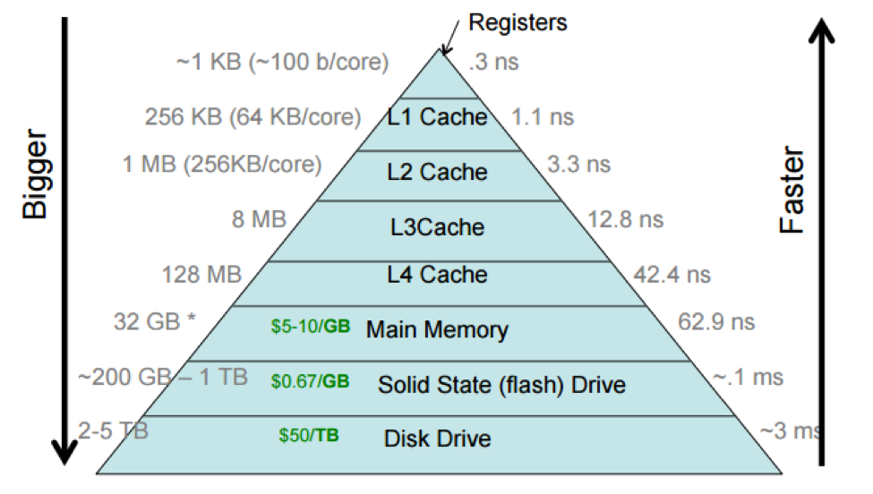
Improving cache hit rate can enhance the execution speed of the code.

Slide 10
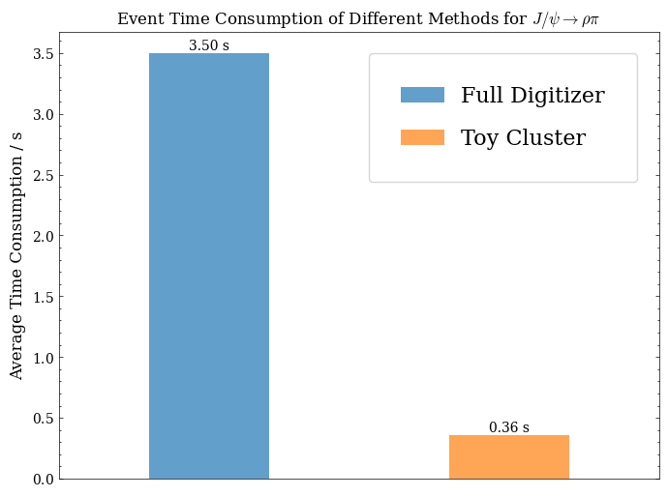
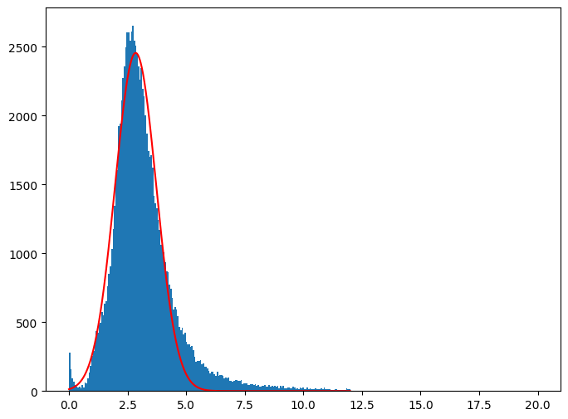
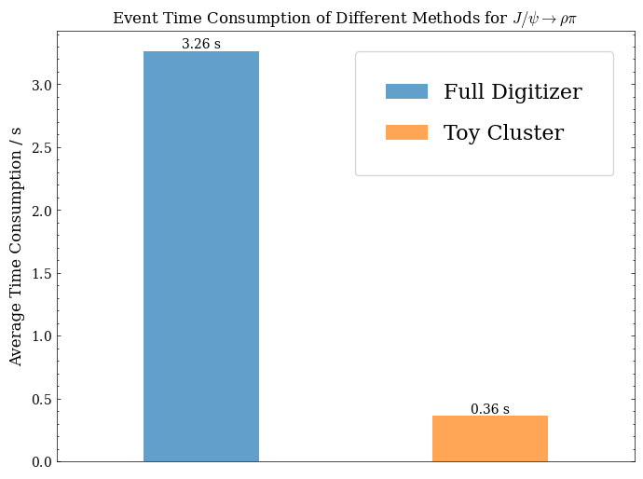
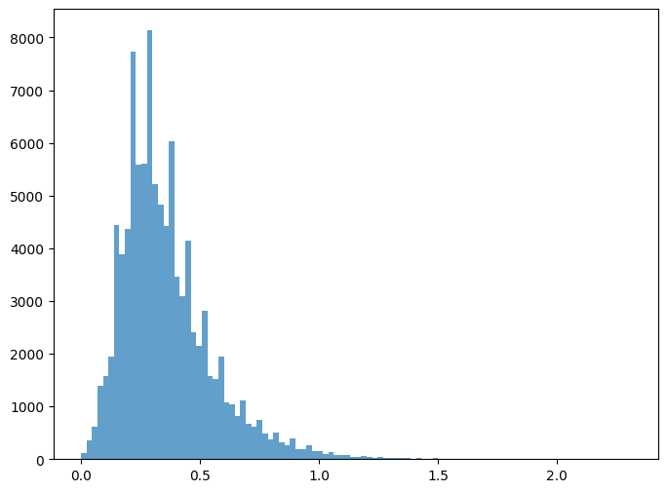
All events
Fitted parameters: Amplitude = 2456.3387436007806,
Mean = 2.8461761092549596, Stddev = 0.8799734127274031
~10倍
Time distribution of full sim
~10倍
Exclude events whose time > 20s
2.85/0.36 = 8倍
9倍
Time distribution of Toy cluster

