Slide 1
Further speed up of CGEM digitization
Xinnan Wang, Liangliang Wang

Slide 2
CGEM cluster
Electronics Measurement
Anode
Induction
GEM3
GEM2
Drift and Avalanche
GEM1
Ionization
Cathode
Drift and Avalanche
Induction
Gain*scale (scale ~ 1.6)
→ Gain*scale2 (scale2 < 1)
Signal-current
→Signal-current*(scale/scale2)³ (3 GEM foils)
Tests with single π⁻

Slide 3
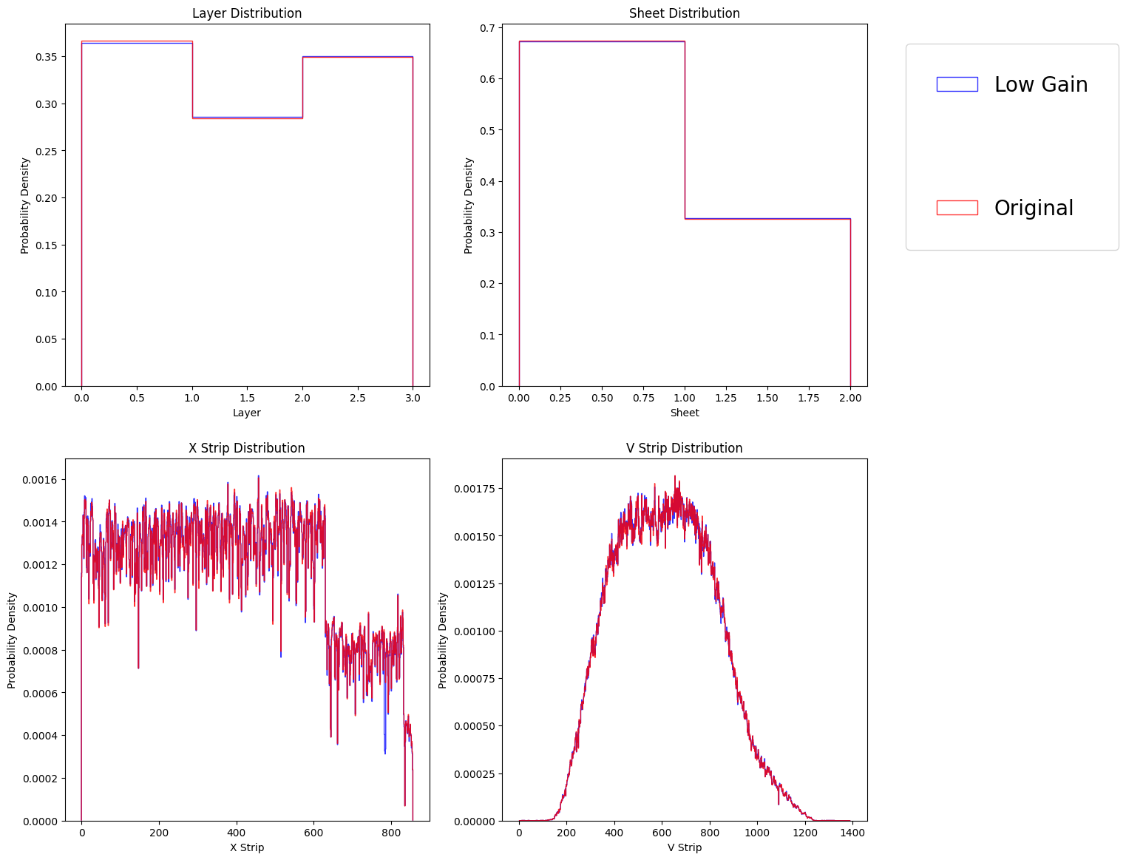
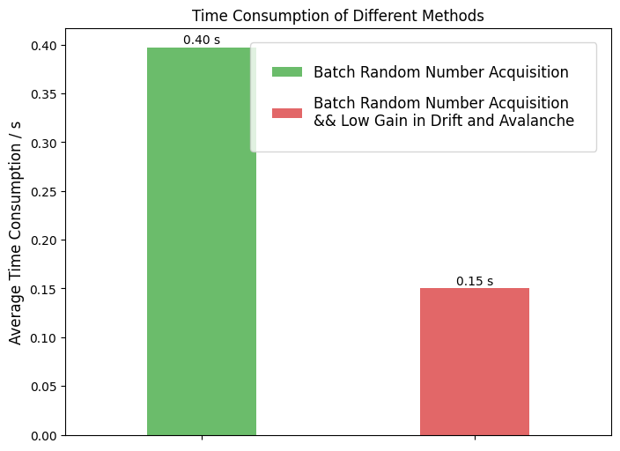
scale2=1

Slide 4
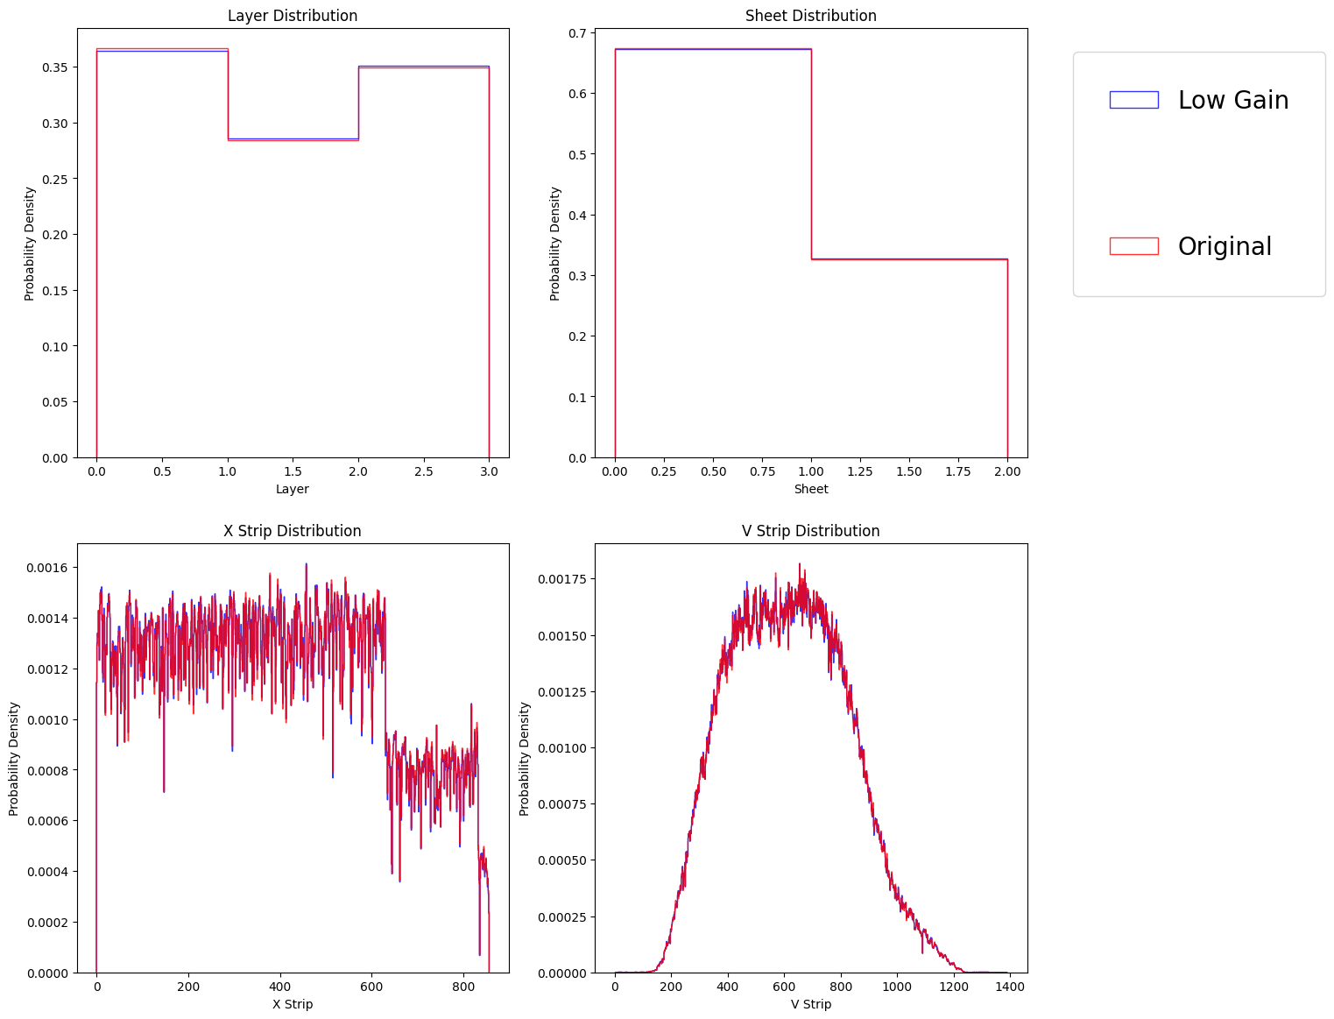
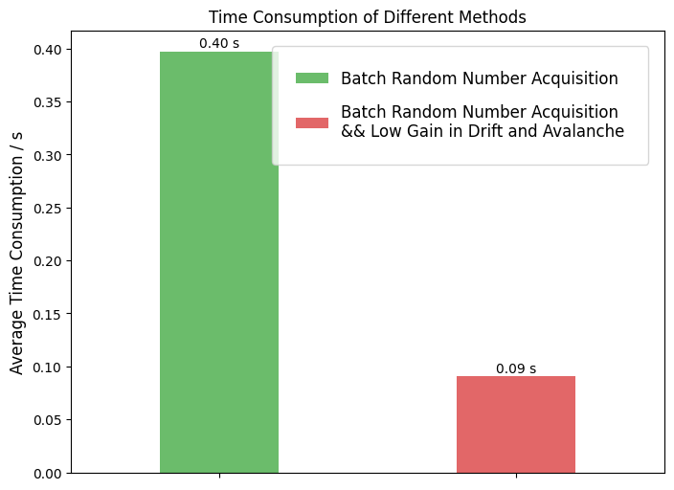
scale2=0.5

Slide 5
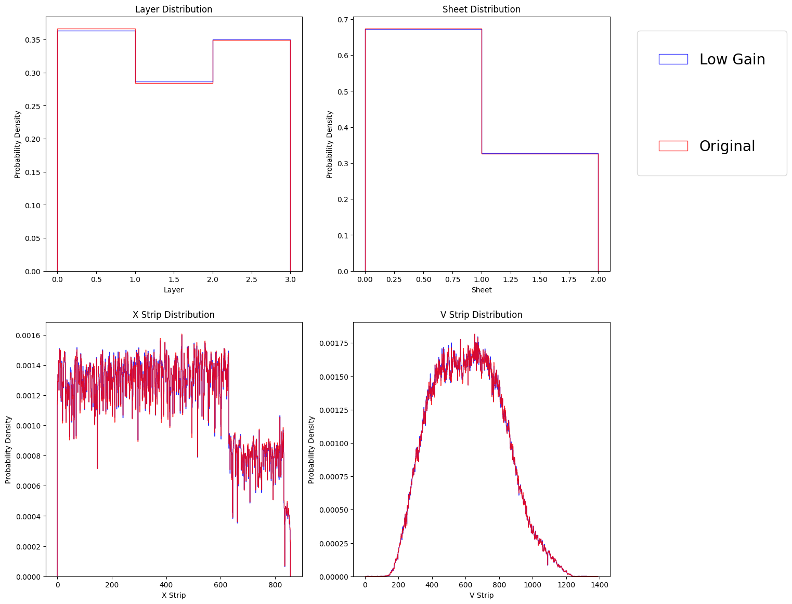
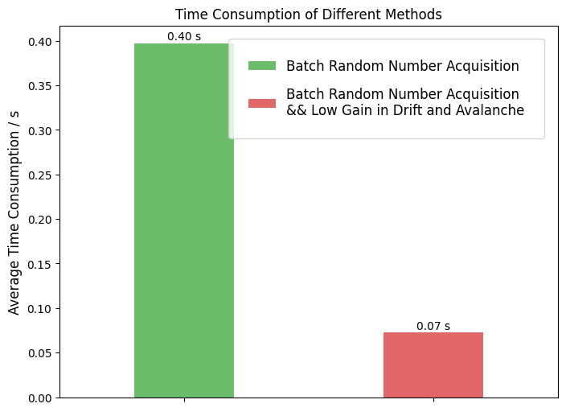
scale2=0.25

Slide 6
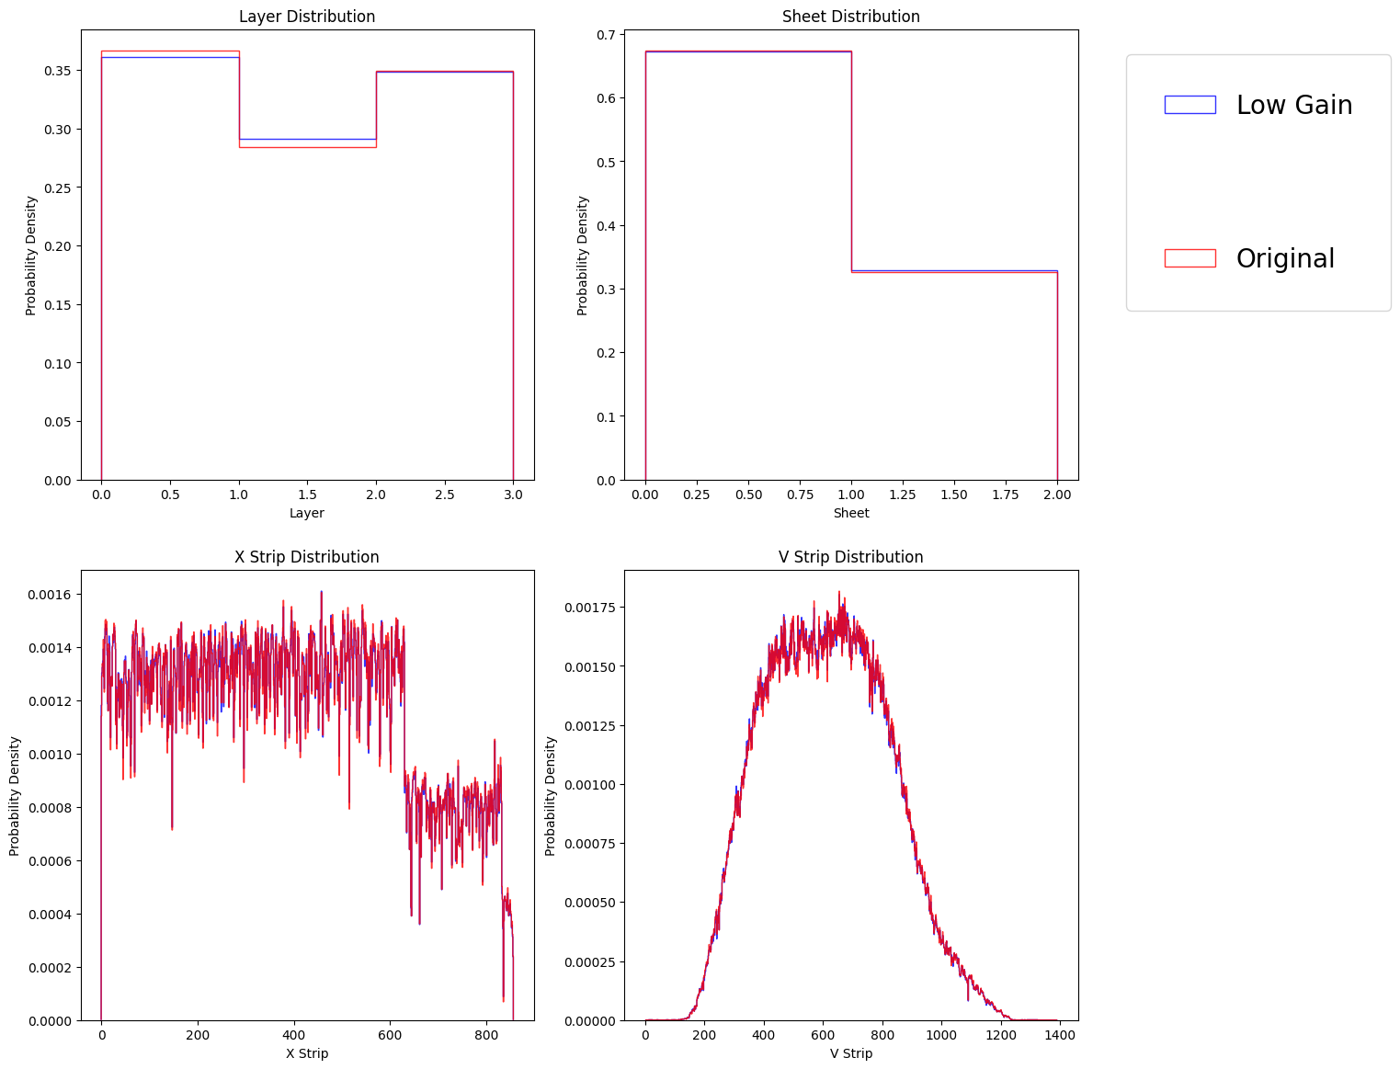
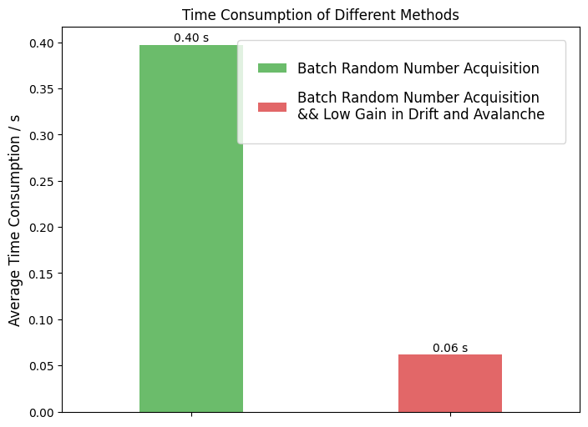
scale2=0.1

Slide 7
Summary
The gain in sampling can be reduced and then the induced current can be scaled back
A proper reduction can keep consistent digitization result, and get a further speed up by a factor of 5 to 6 for single pions
Need more tests with different momentum, particle type, w/ and w/o magnetic field to get a proper reduction factor

