Slide 1
Last week work
给出了inclusive MC的初步结果
$η′$的背景分析
系统误差只做了$η$的，还有$η′$没做（$J/ψ$衰变分支比，$χ^{2}$和信号窗口两个不一样）
使用TRolke包来计算分支比，需要系统误差的数据（预计会大一个数量级）

Slide 2
Search for lepton flavor violation decay from $$η/η′ →μ^{+}μ^{+}e^{−}e^{−} +c.c.$$
Yunhe Yang¹, Jianping Dai², Zhiyong Wang³, Chunxu Yu¹
¹Nankai university
²Yunnan university
³Institute of High Energy Physics

Slide 3
Outline
Motivation
Data and MC sample
Event selection
$η→e^{+}e^{+}μ^{−}μ^{−}+c.c.$
$η^{′}→e^{+}e^{+}μ^{−}μ^{−}+c.c.$
Systematic uncertainty
Summary

Slide 4
Motivation
The observation of neutrino oscillations indicates the violation of charged lepton flavor.
The probability of charged lepton flavor violation predicted by the minimally extended Standard Model is ${10}^{−54}$.
CLFV is a evidence of new physics beyond the Standard Model.
Collaboration | Upper limit of decay branching ratio
MEG | $$B\left(µ^{+}→e^{+}γ\right)<4.2×{10}^{−13}$$
Barbara | $$B\left(τ^{+}→e^{+}γ\right)<3.3×{10}^{−8}$$
KTeV | $$B\left(π^{0}→eµ\right)<3.6×{10}^{−10}$$
BNL E871 | $$B\left(K_{L}^{0}→eµ\right)<4.7×{10}^{−12}$$
SND | $$B\left(φ→eµ\right)<2.0×{10}^{−6}$$
CLEO | $$B\left(Υ\left(1S,2S,3S\right)→µτ\right)<O\left({10}^{−6}\right)$$
BESII | $$B\left(J/ψ→eµ\right)<1.1×{10}^{−6}$$
BESII | $$B\left(J/ψ→eτ\right)<8.3×{10}^{−6}$$
BESII | $$B\left(J/ψ→µτ\right)<2.0×{10}^{−6}$$
BESIII | $$B\left(J/ψ→eµ\right)<1.6×{10}^{−7}$$
BESIII | $$B\left(J/ψ→eτ\right)<7.1×{10}^{−8}$$

Slide 5
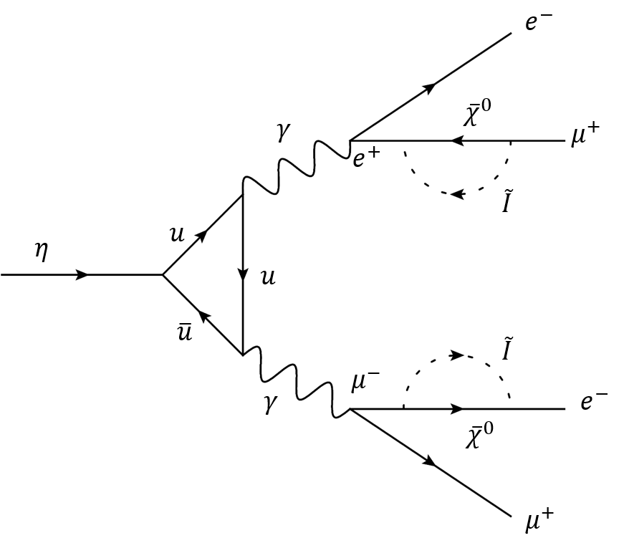
Motivation
10 billion $J/ψ$ events
During the analysis of $η/η′ →μ^{+}μ^{+}e^{−}e^{−} +c.c.$ can find charge lepton flavor violation.
$J/ψ→ηγ$
$η→e^{+}e^{+}μ^{−}μ^{−}+c.c.$
$J/ψ→η^{′}γ$
$η^{′}→e^{+}e^{+}μ^{−}μ^{−}+c.c.$

Slide 6
Data and Simulation
BOSS version: 7.0.8.
Data: (10086±45.1)$×{10}^{6}$@ $\sqrt{s}$=3.097 GeV
Inclusive MC: round02, 05, 11, 12
Signal MC: $1×{10}^{6}$
Decay channel | Generator
$$J/ψ→γη$$ | 𝑉𝑆𝑃_𝑃𝑊𝐴𝑉𝐸
$$η→e^{+}e^{+}μ^{−}μ^{−}+c.c.$$ | 𝑃𝐻𝑆𝑃
$$J/ψ→γη′$$ | 𝑉𝑆𝑃_𝑃𝑊𝐴𝑉𝐸
$$η′→e^{+}e^{+}μ^{−}μ^{−}+c.c.$$ | 𝑃𝐻𝑆𝑃

Slide 7
Event selection
Good Charged Choose
$\left|V_{r}\right|<1.0cm, \left|V_{Z}\right|<10cm, \left|cosθ\right|≤0.93, N_{total}=4, Q_{total}=0$
Photon Choose
$N_{γ} ≥1, dang≥{10}^{◦}, 0≤TDC≤700ns$
$Barrel EMC: \left|cosθ\right|≤0.8, E_{γ}≥25MeV$
$Endcap EMC: 0.86≤\left|cosθ\right|≤0.92, E_{γ}≥50MeV$
PID
$For μ: C_{μ}>0.001, C_{μ}>C_{e}, C_{μ}>C_{K}$
$For e: C_{e}>0.001, C_{e}>C_{K}, C_{e}>C_{π}, C_{e}/(C_{e}+C_{K}+C_{π} )>0.8$
Vertex fit and 4C kinematic fit

Slide 8
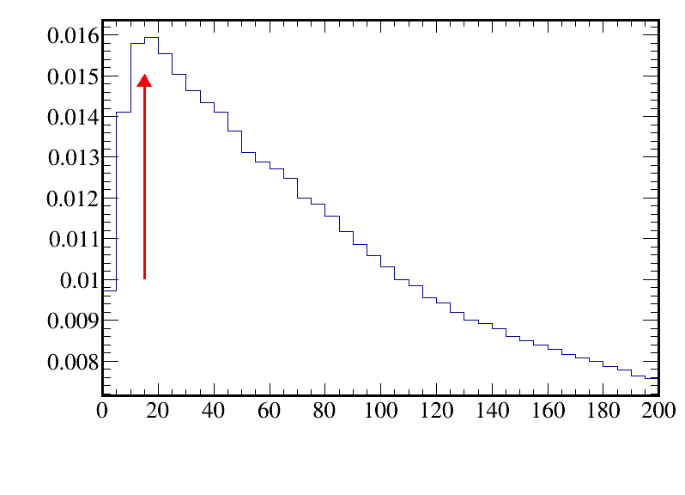
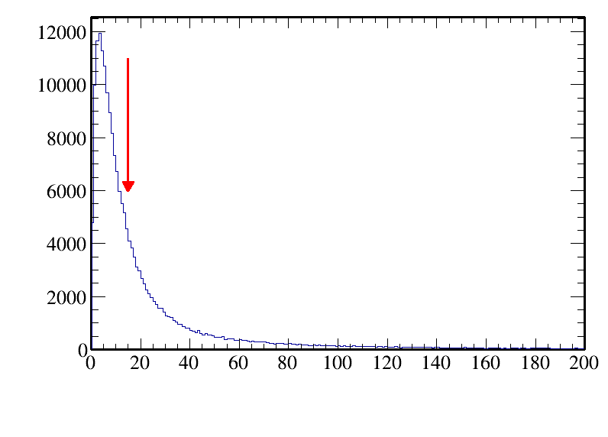
$$η→e^{+}e^{+}μ^{−}μ^{−}+c.c.$$ Further Selection
Use chi-square to cut background:
$FOM=ε/{1.5+\sqrt{B}}$
$χ^{2}<15$

Slide 9
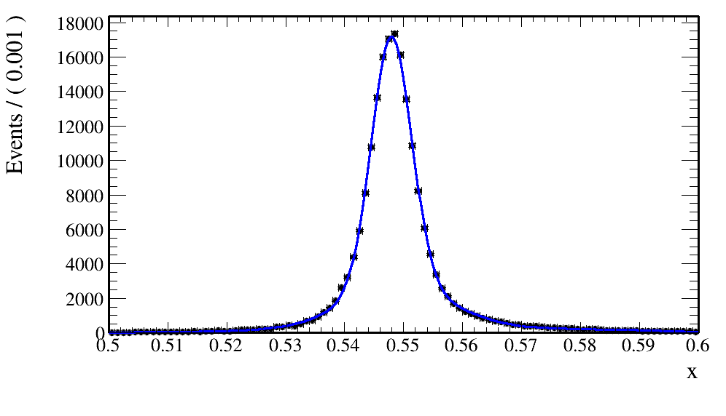
Signal window
The signal shape is modeled by a double Gaussian function.
$μ=0.54823, σ=0.00574$
$\left[μ−3σ,μ+3σ\right]=[0.53101,0.56545]$
$$μ1=0.5490$$
$$μ2=0.5479$$
$$σ1=0.0090$$
$$σ2=0.0034$$
$$f=0.30347$$

Slide 10
Cut flow
Events selection | Signal MC | Inclusive MC
Total number | 1000000 (100.0%) | $1.0011×{10}^{10}$ (100.0%)
Charge choose | 415314 (41.53%, 41.53%) | $2.2056×{10}^{9}$
Photon choose | 400661 (40.07%, 96.47%) | $2.0822×{10}^{9}$
PID | 313848 (31.38%, 78.33%) | 210699
Vertex fit | 310066 (31.07%, 98.79%) | 198239
4C fit | 196271 (19.63%, 63.29%) | 598
$$χ^{2}<15$$ | 122356 (12.24%, 62.34%) | 39
$$0.5310<M_{eeμμ}<0.5655$$ | 118896 (11.89%, 97.17%) | 0
Final Efficiency | 11.89%

Slide 11
Background analysis
Through topology analysis, the number of backgrounds has been suppressed sufficiently low.

Slide 12
Background analysis
We can see that there are no event in the signal window!

Slide 13
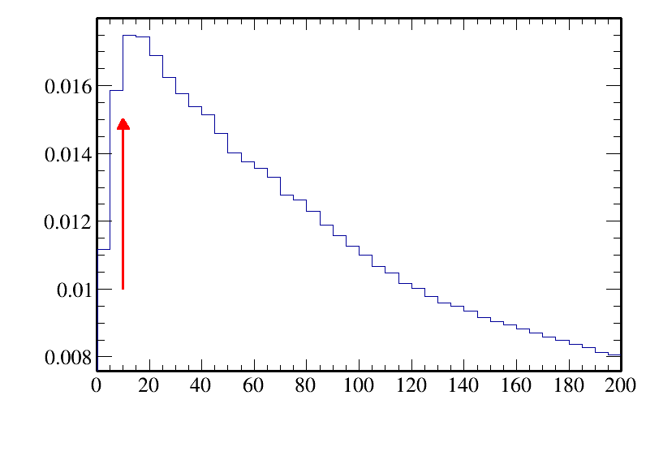
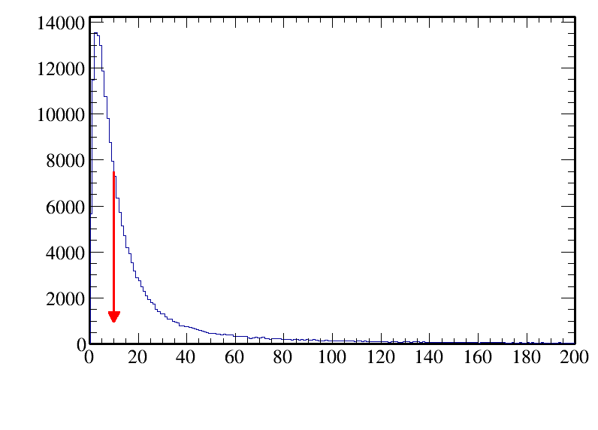
$$η′→μ^{+}μ^{+}e^{−}e^{−} +c.c.$$ Further Selection
Use chi-square to cut background:
$FOM=ε/{1.5+\sqrt{B}}$
$χ^{2}<10$

Slide 14
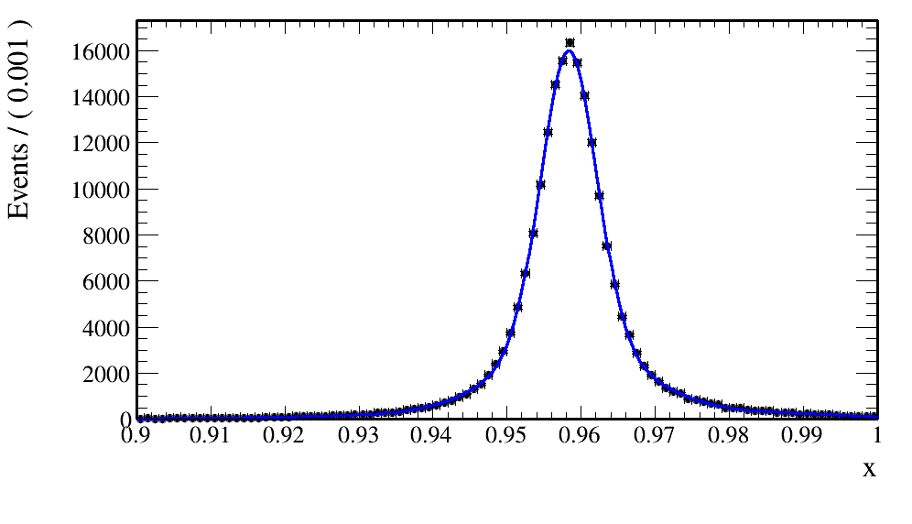
Signal window
The signal shape is modeled by a double Gaussian function.
$μ=0.9584, σ=0.0062$
$\left[μ−3σ,μ+3σ\right]=[0.9398,0.9770]$
$$μ1=0.9584$$
$$μ2=0.9585$$
$$σ2=0.0090$$
$$σ1=0.0037$$
$$f=0.6368$$

Slide 15
Cut flow
Events selection | Signal MC | Inclusive MC
Total number | 1000000 (100.0%) | $1.0011×{10}^{10}$ (100.0%)
Charge choose | 470213 (47.02%, 47.02%) | $2.2056×{10}^{9}$
Photon choose | 441584 (44.16%, 93.91%) | $2.0822×{10}^{9}$
PID | 339209 (33.92%, 76.82%) | 210699
Vertex fit | 335797 (33.57%, 98.99%) | 198239
4C fit | 208891 (20.89%, 62.21%) | 598
$$χ^{2}<10$$ | 106253 (10.63%, 50.87%) | 27
$$0.9398<M_{eeμμ}<0.9770$$ | 102897 (10.30%, 96.84%) | 0
Final Efficiency | 10.29%

Slide 16
Background analysis
We can see that there are no event in the signal window!

Slide 17
Systematic uncertainty
The Branch fraction
The branching fraction of the $J/ψ→γη$decay is cited from the PDG, which is $(1.090±0.013)×{10}^{−3}$.
The systematic uncertainties from the cited branching fraction is 1.19%.
The branching fraction of the $J/ψ→γη′$decay is cited from the PDG, which is $(5.28±0.06)×{10}^{−3}$.
The systematic uncertainties from the cited branching fraction is 1.14%.

Slide 18
Systematic uncertainty
MC statistics
The error of systematic eﬃciency can be calculated by:
$$∆_{sys}^{MC statistics} =\frac{∆ε}{ε}=\sqrt{\frac{1}{N_{total}^{MC}}}∙\sqrt{\frac{1−ε}{ε}}$$
The MC statistics uncertainty is 0.27%.

Slide 19
Systematic uncertainty
Event selection
For good charge track choose
Data-MC difference of MDC tracking eﬀiciencies is assigned as 1% per charged particle in analysis.
For good photon choose
Data-MC difference of photon selection eﬀiciencies is assigned as 1% per photon.
For PID
Data-MC difference of MDC tracking eﬀiciencies is assigned as 1% per charged particle in analysis.

Slide 20
Systematic uncertainty
Vertex fit and 4C kinematic fit
Fit is studied by correcting the track helix parameters to reduce the difference between data and MC simulation.
The systematic uncertainty can be calculated by: ${ε_{1}−ε_{2}}/{2ε_{1}}$, where $ε_{1}$ is the efficiency with correction and $ε_{2}$ is the efficiency without correction.
The systematic uncertainty of 4C kinematic fit and vertex fit are calculated as 0.28%.
Signal window | Use calibration | No calibration
Final events | 196271 | 195176
Selection efficiency(%) | 19.63% | 19.52%
Uncertainty(%) | 0.28%

Slide 21
Systematic uncertainty
Cut $χ^{2}$ of 4C fit
We estimate the systematic uncertainty from stability checks and take the maximum difference of the selection efficiencies as systematic uncertainty.
Finally, we take 3.8% as the uncertainty for $χ^{2}$ cut.
Finally, we take 5.9% as the uncertainty for $χ^{2}$ cut.
Cut $χ^{2}$ of 4C fit | Detection eﬀiciency
$$χ^{2}<14$$ | 11.78%
$$χ^{2}<14.5$$ | 12.01%
$$χ^{2}<15$$ | 12.24%
$$χ^{2}<15.5$$ | 12.44%
$$χ^{2}<16$$ | 12.65%
Cut $χ^{2}$ of 4C fit | Detection eﬀiciency
$$χ^{2}<9.2$$ | 10.00%
$$χ^{2}<9.6$$ | 10.33%
$$χ^{2}<10$$ | 10.63%
$$χ^{2}<10.4$$ | 10.93%
$$χ^{2}<10.8$$ | 11.22%

Slide 22
Systematic uncertainty
Signal window
The detection eﬀiciencies after varying the signal windows to be $±3.0σ, ±3.2σ, ±2.8σ$.
The systematic uncertainty from signal window is 0.34%.
The systematic uncertainty from signal window is 0.49%.
Signal window | Detection eﬀiciency
$$[μ−2.8σ，μ+2.8σ]$$ | 11.84%
$$[μ−2.8σ，μ+3.0σ]$$ | 11.87%
$$[μ−2.8σ，μ+3.2σ]$$ | 11.90%
$$[μ−3.0σ，μ+2.8σ]$$ | 11.85%
$$[μ−3.0σ，μ+3.0σ]$$ | 11.88%
$$[μ−3.0σ，μ+3.2σ]$$ | 11.91%
$$[μ−3.2σ，μ+2.8σ]$$ | 11.85%
$$[μ−3.2σ，μ+3.0σ]$$ | 11.89%
$$[μ−3.2σ，μ+3.2σ]$$ | 11.92%
Signal window | Detection eﬀiciency
$$[μ−2.8σ，μ+2.8σ]$$ | 10.25%
$$[μ−2.8σ，μ+3.0σ]$$ | 10.28%
$$[μ−2.8σ，μ+3.2σ]$$ | 10.31%
$$[μ−3.0σ，μ+2.8σ]$$ | 10.26%
$$[μ−3.0σ，μ+3.0σ]$$ | 10.30%
$$[μ−3.0σ，μ+3.2σ]$$ | 10.32%
$$[μ−3.2σ，μ+2.8σ]$$ | 10.27%
$$[μ−3.2σ，μ+3.0σ]$$ | 10.30%
$$[μ−3.2σ，μ+3.2σ]$$ | 10.33%

Slide 23
Systematic uncertainty
$η→e^{+}e^{+}μ^{−}μ^{−}+c.c.$
Summary of the systematic uncertainties is presented in Table.
The total systematic uncertainty is 7.01%.
Source | Uncertainty | Comment
$$J/ψ→γη$$ | 1.19% | from PDG
MC statistics | 0.27%
MDC tracking | 4% | cited
Photon detection | 1% | cited
PID | 4% | cited
Vertex fit and 4C kinematic fit | 0.28%
$$χ^{2}<15$$ | 3.8%
Signal window | 0.34%

Slide 24
Systematic uncertainty
$η′→e^{+}e^{+}μ^{−}μ^{−}+c.c.$
Summary of the systematic uncertainties is presented in Table.
The total systematic uncertainty is 8.34%.
Source | Uncertainty | Comment
$$J/ψ→γη′$$ | 1.14% | from PDG
MC statistics | 0.27%
MDC tracking | 4% | cited
Photon detection | 1% | cited
PID | 4% | cited
Vertex fit and 4C kinematic fit | 0.28%
$$χ^{2}<10$$ | 5.9%
Signal window | 0.49%

Slide 25
Result from inclusive MC
$N_{sig}=0$
$N_{bkg}=39$
$S_{sig}=L_{sig max}−L_{sig min}=0.03444$
$S_{bkg}=\left(L_{bkg max}−L_{bkg min}\right)−S_{sig}=2.96556$
$τ=S_{bkg}/S_{sig} =86.10801$
$em=0.1189$
$sde=em×ε_{sys}=0.00833489$
$α=90\%$
$ℬ\left(η→e^{+}e^{+}μ^{−}μ^{−}+c.c.\right)<\frac{N_{equ}}{N_{tot}×ℬ(J/ψ→γη)×ε}=\frac{12.9491}{10011×{10}^{6}×1.090×{10}^{−3}×0.1189}=9.98×{10}^{−6}$

Slide 26
Result from inclusive MC
$N_{sig}=0$
$N_{bkg}=27$
$S_{sig}=L_{sig max}−L_{sig min}=0.0372$
$S_{bkg}=\left(L_{bkg max}−L_{bkg min}\right)−S_{sig}=2.3628$
$τ=S_{bkg}/S_{sig} =63.5161$
$em=0.1029$
$sde=em×ε_{sys}=0.00858186$
$α=90\%$
$ℬ\left(η′→e^{+}e^{+}μ^{−}μ^{−}+c.c.\right)<\frac{N_{equ}}{N_{tot}×ℬ(J/ψ→γη′)×ε}=\frac{15.2425}{10011×{10}^{6}×5.28×{10}^{−3}×0.1029}=2.80×{10}^{−6}$

Slide 27
Summery and Next work
给出了inclusive MC的结果
去新物理组会上报告，申请半盲数据！

